Slide 2
Cryolab measurement capabilities and R&D – related to MSC
Torsten Koettig on behalf of the whole Cryolab team

Slide 3
Outline
Introduction
Standard experimental infrastructure in the Cryolab
R&D projects performed together with MSC
Ongoing developments and new experimental systems
Future topics
Summary

Slide 4
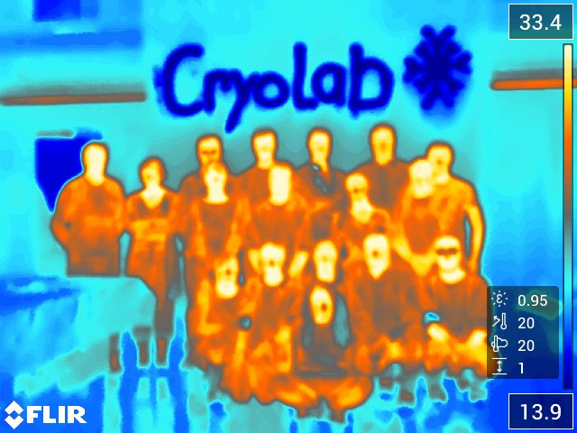
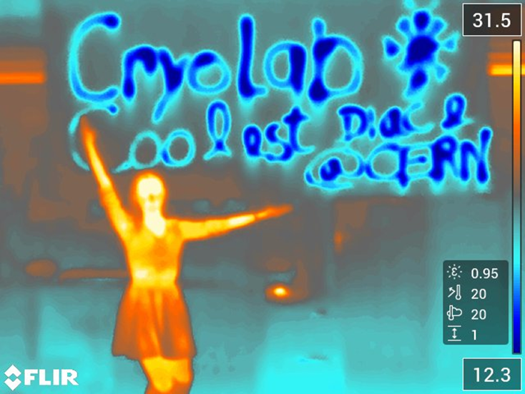
The Cryolab team TE/CRG-CI
2.5 scientists
1 technical engineer
1 mechanical engineer
2 Fellows
2 PhD students
2-3 technical students
2 FSU

Slide 5
Cryolab projects 2019/20 35-40 short and long term projects
Technology development
RF cavity diagnostics BCCCA upgrade Cryo - Beam Loss Monitor RRR thin films, strips and bulk samples Thermal conductivity test stand Thermal dilatation test stand HFM λ-plate seal heat inleak Helios refill LKr purity monitor NA62 CAST Compass cooldown Rades 2 K - cavity validation Gas permeability LHC beam screen heaters RF surface impedance
Project driven
HL-LHC beam screen: non-standard conditions HL-LHC inner triplet current feeders Thermal cycling of 11 T coil He II heat transport in Nb₃Sn cable geometries He II cooling simulations of Nb₃Sn coils LAr calorimeters high-density feedthroughs BPM thermal link Near Tc wire characterization Nb₃Sn FCC MLI test stand EASITrain - SC thin film on substrate DarkSide FCC transparent cryostat thermal performance LAr robot, CryFish Shape Memory Alloys ALPHA - Current leads test
Generic R&D
Thermal mapping of SRF cavities Cryocooler remote cooling study Cryogenic force calibrator Sub-Kelvin cryogenic cooling study
Training and Outreach
Cryogenic Safety courses: Fundamentals, LHe transfer, TSO Safety course: Self-Rescue mask Visits/Demonstration LN₂ Open Days 2019 HSSIP
projects directly linked with MSC

Slide 6
Standardized test stations and R&D projects
MSC related topics
Material properties
Heat transfer
Simulations
Standardized test stands
Materials e.g. composites
Interfaces at low temperature
Transient conditions
& application
Remote cooling options
He II in confined geometries
New setups
Metal/epoxy to He
Custom design
& installation
Thermodynamics of Quench
Novel concepts and R&D
HEX num. model to adapt to applic.

Slide 7
Standardized test stations

Slide 8
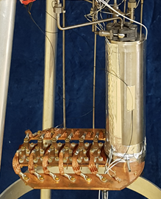
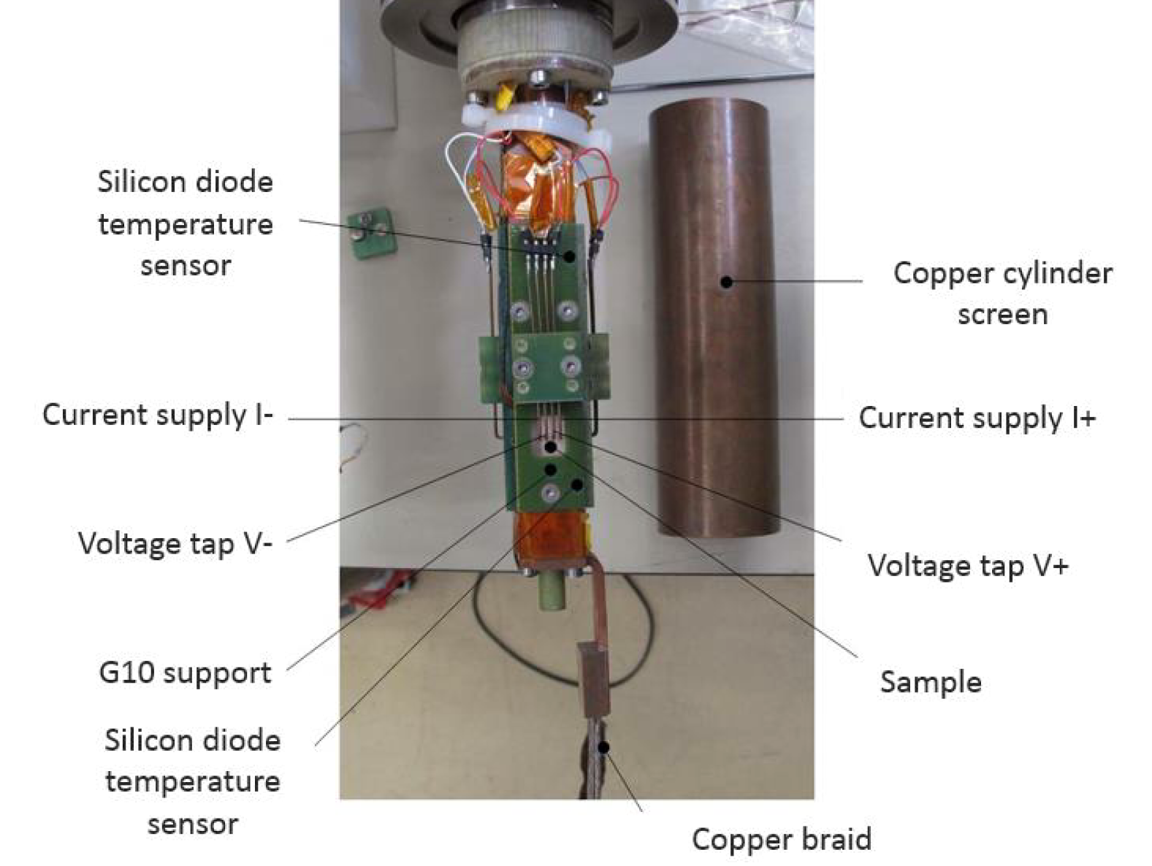
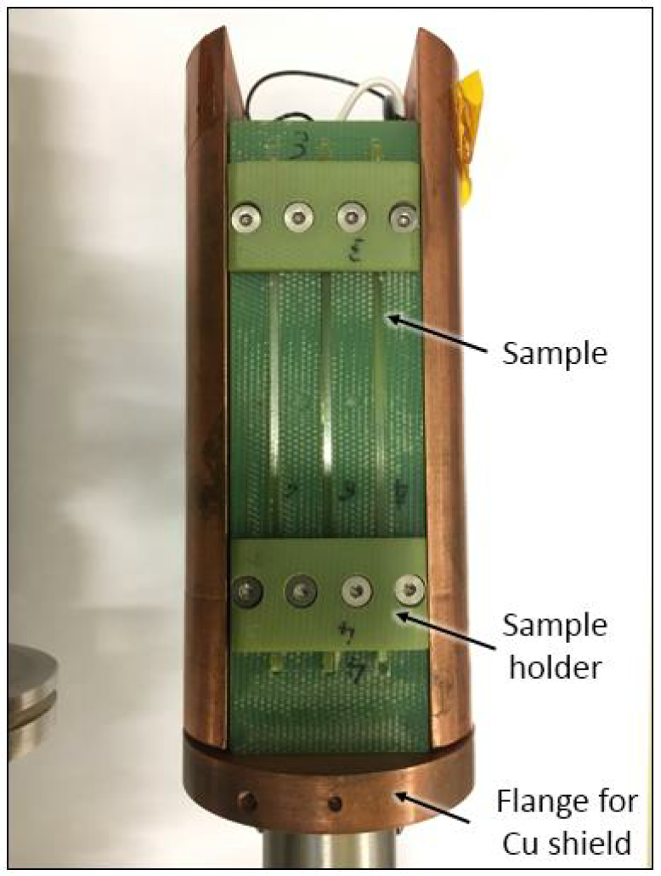
Cryolab test capabilities
Bulk e.g. metals, SC like Nb
Cryolab infrastructure for tests of:
  RRR for films, foils and bulk samples
Films on substrate
Foils e.g. Quench heaters
6 bulk samples
2 x 2 x 120 mm³
He phase separator
2 x 100 mm²
10 x 35 mm²

Slide 9
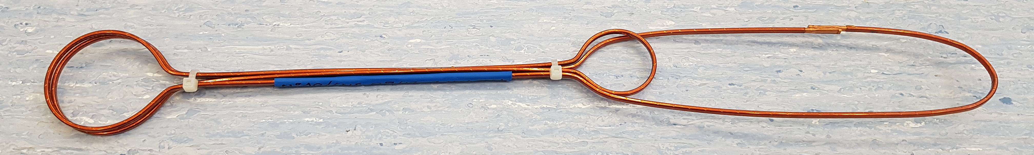
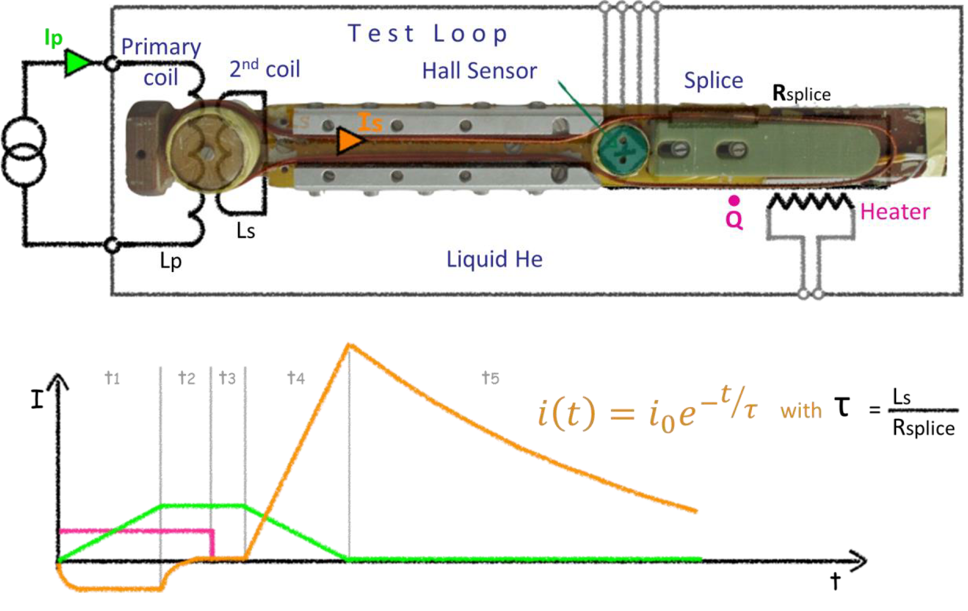
Cryolab test capabilities
Cryolab infrastructure for tests of:
  RRR for films, foils and bulk samples
  SC splice resistance
Example of a SC cable with joint
Schematic of the setup Induced current in a SC loop with a resistive connection => R ~ 1-2 nΩ

Slide 10
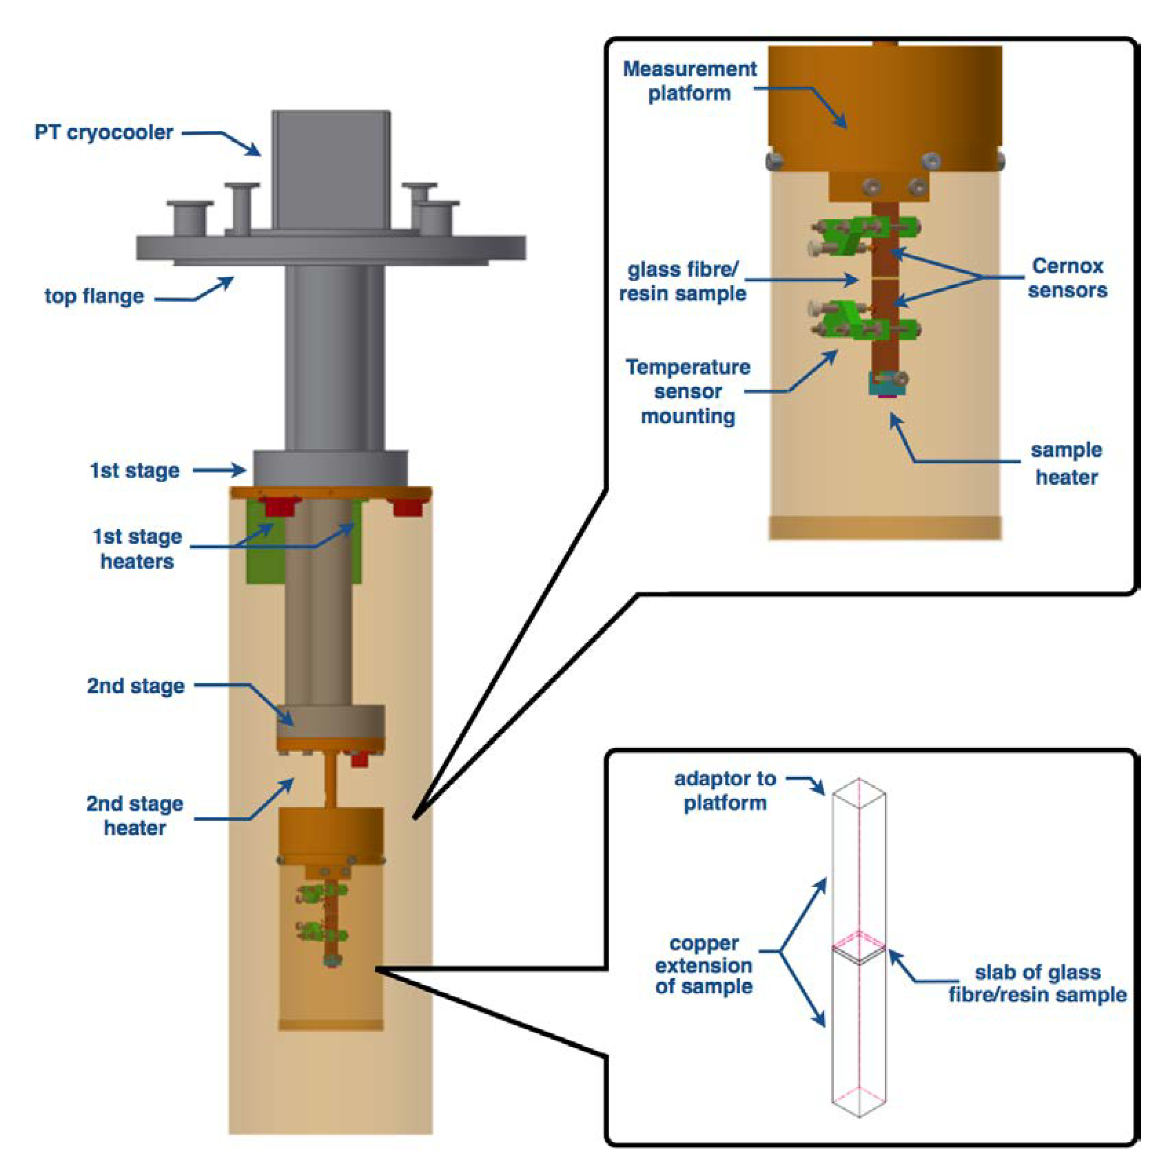
Cryolab test capabilities
Cryolab infrastructure for tests of:
  RRR for films, foils and bulk samples
  SC splice resistance
  Thermal conductivity test stand
  Thermal diffusivity test option
Courtesy: Patricia Borges de Sousa

Slide 11
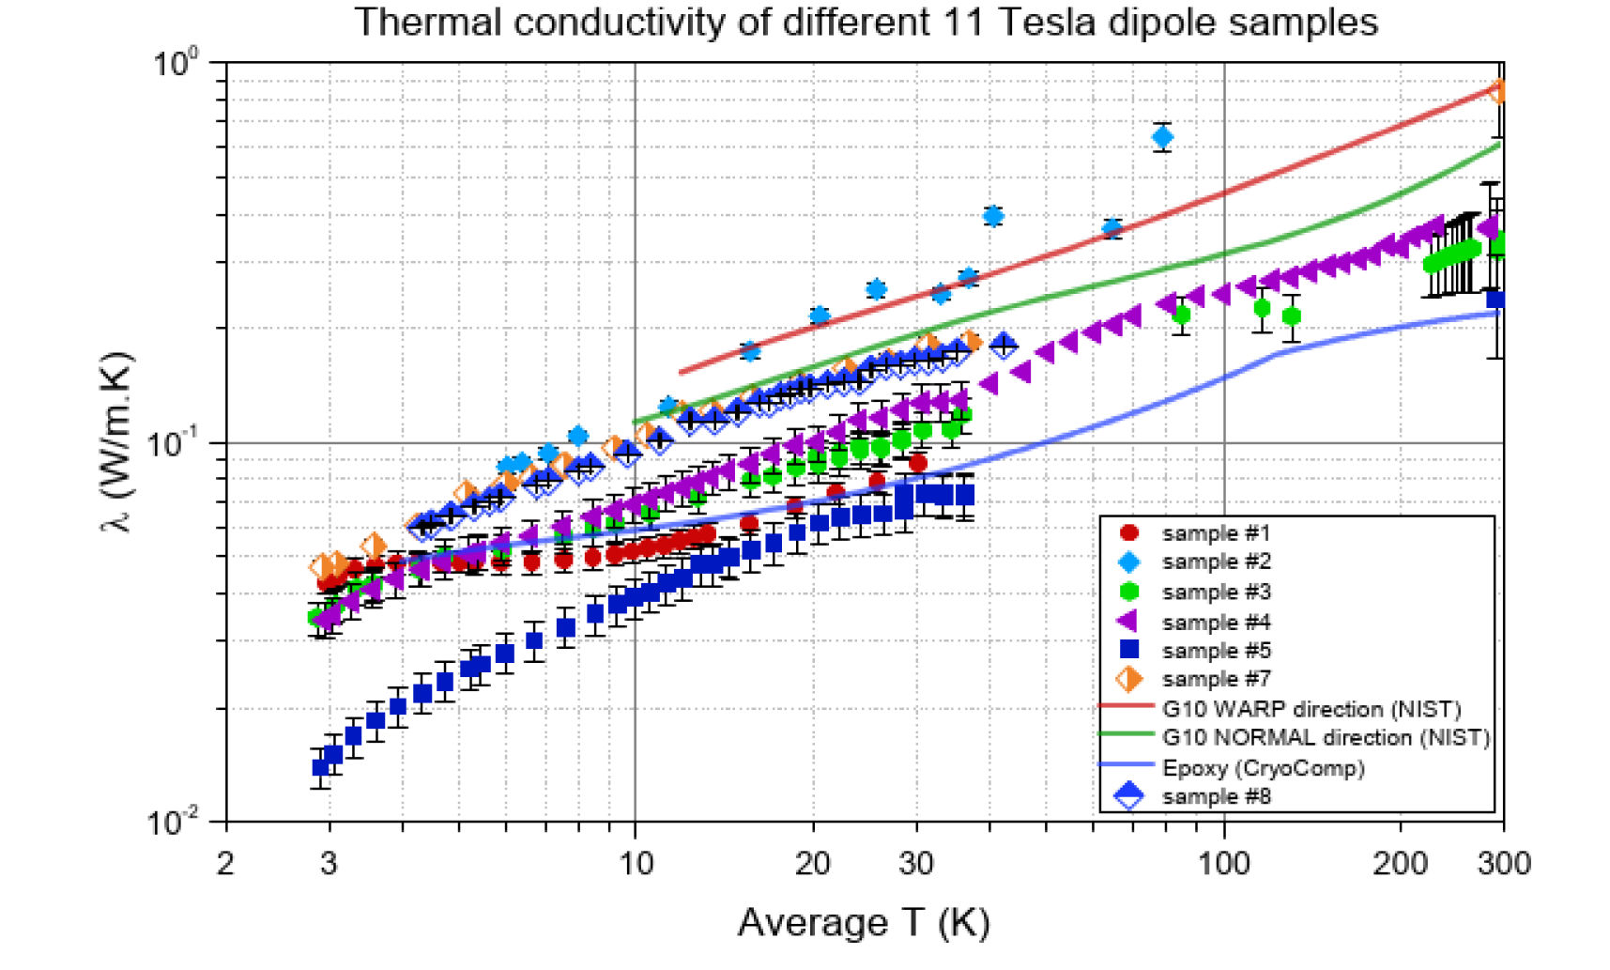
Cryolab test capabilities
Cryolab infrastructure for tests of:
  RRR for films, foils and bulk samples
  SC splice resistance
  Thermal conductivity test stand
  Thermal diffusivity test option
Thermal conductivity of different 11 T dipole impregnation samples
Courtesy: Patricia Borges de Sousa

Slide 12
Cryolab test capabilities
Cryolab infrastructure for tests of:
  RRR for films, foils and bulk samples
  SC splice resistance
  Thermal conductivity test stand
  Thermal diffusivity option
  Thermal cycling (small and large scale)
next 2 slides

Slide 13
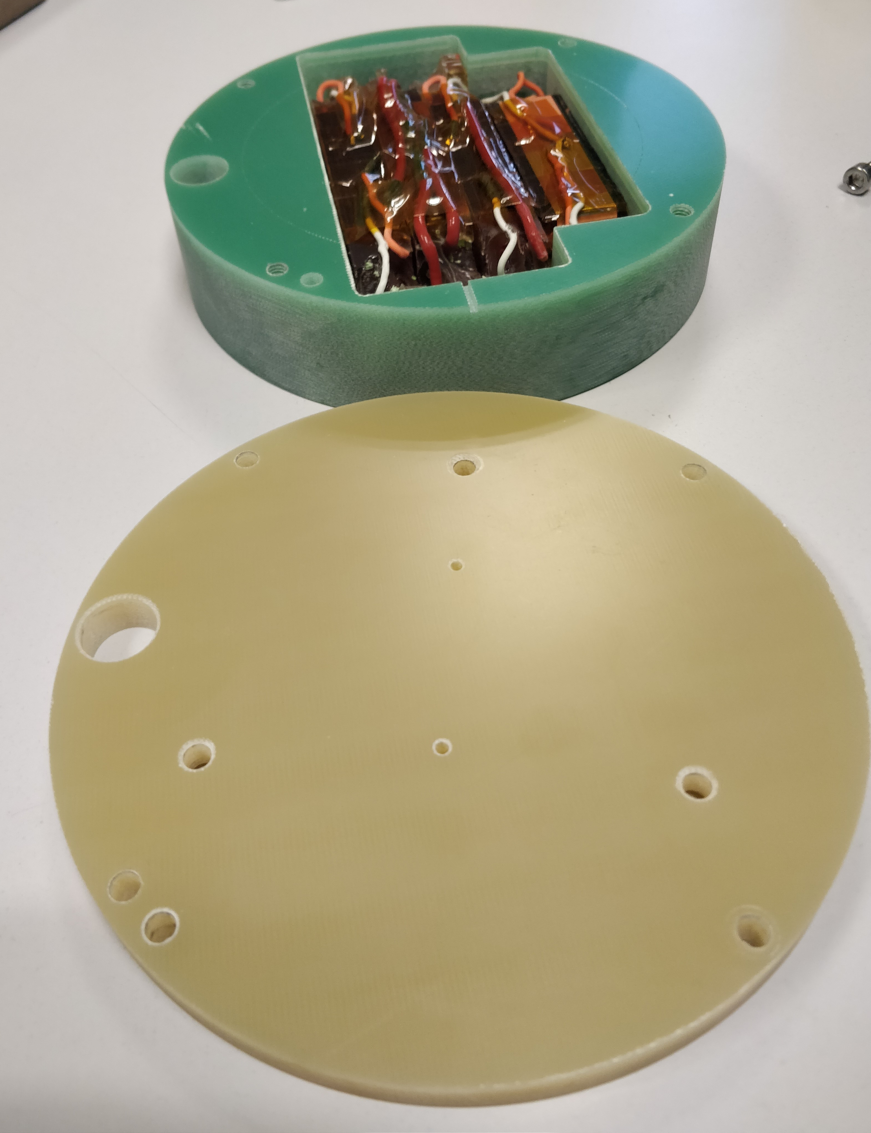
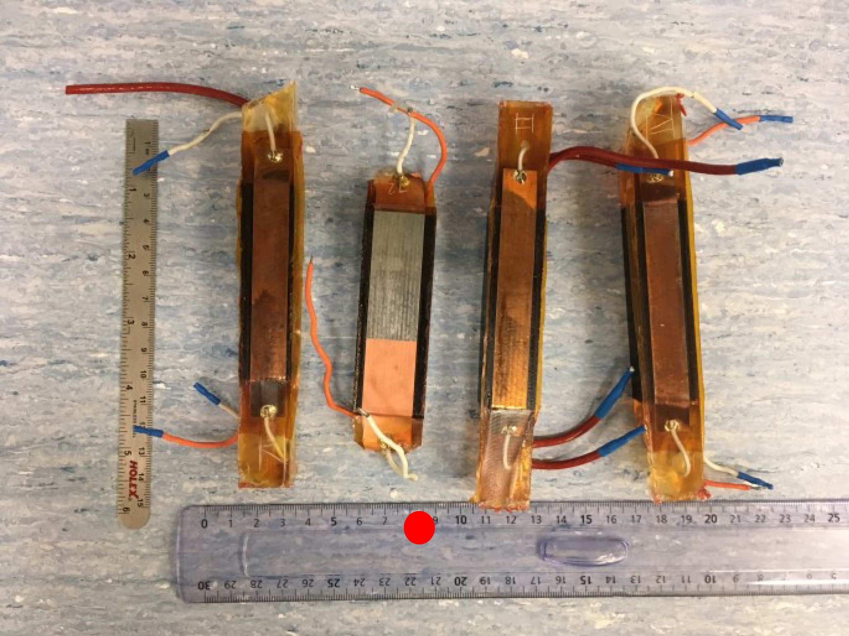
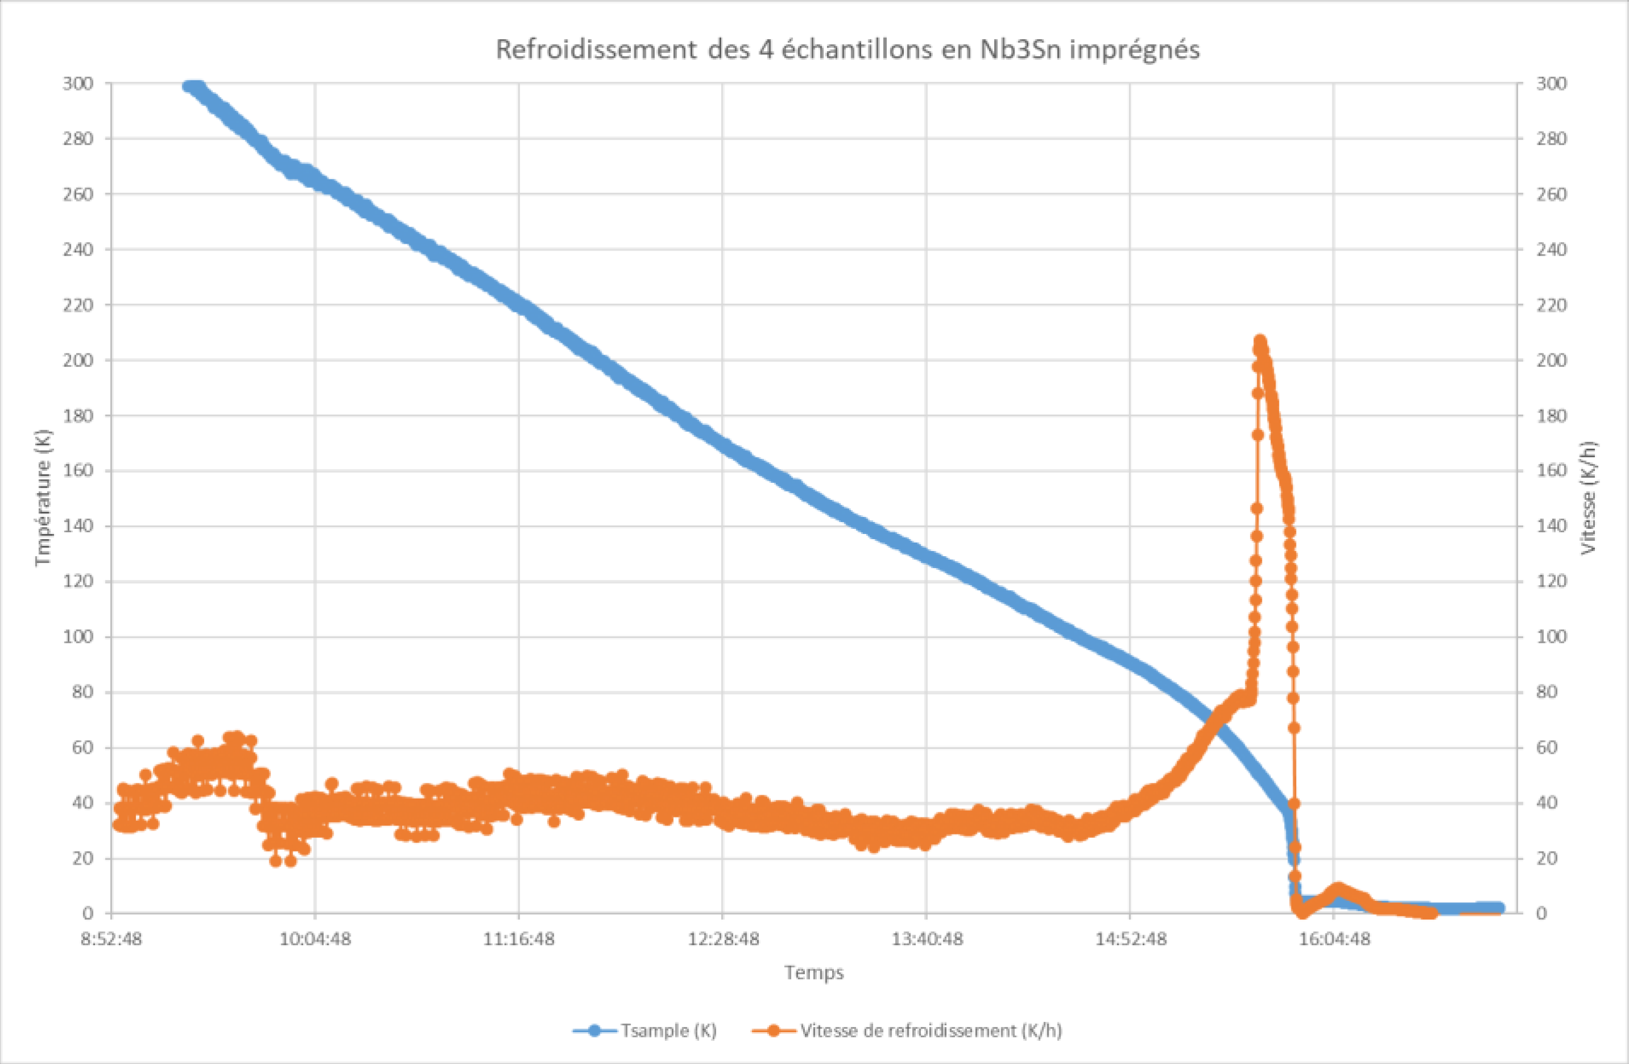
Nb₃Sn small scale samples thermal cycling to 2 K
Felix Wolf
4 samples to be cooled down
Immersion in He II
Warm up to 4.2 K => 293 K
Sample box in G10
TT in sample space
Cover to protect from
He gas stream
80 K/h for T> 50 K
faster to reach 2 K

Slide 14
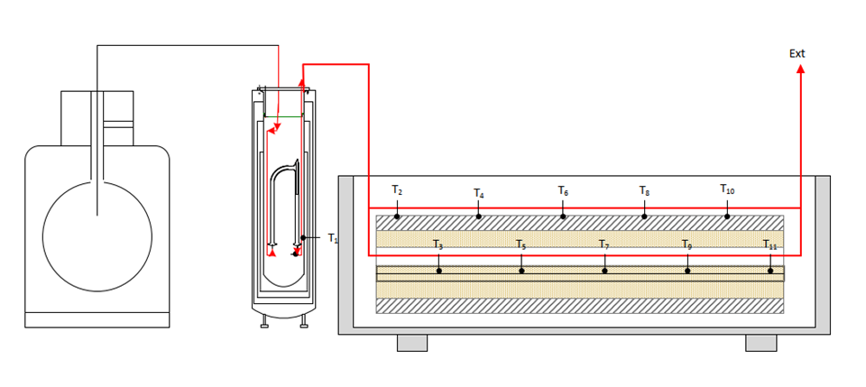
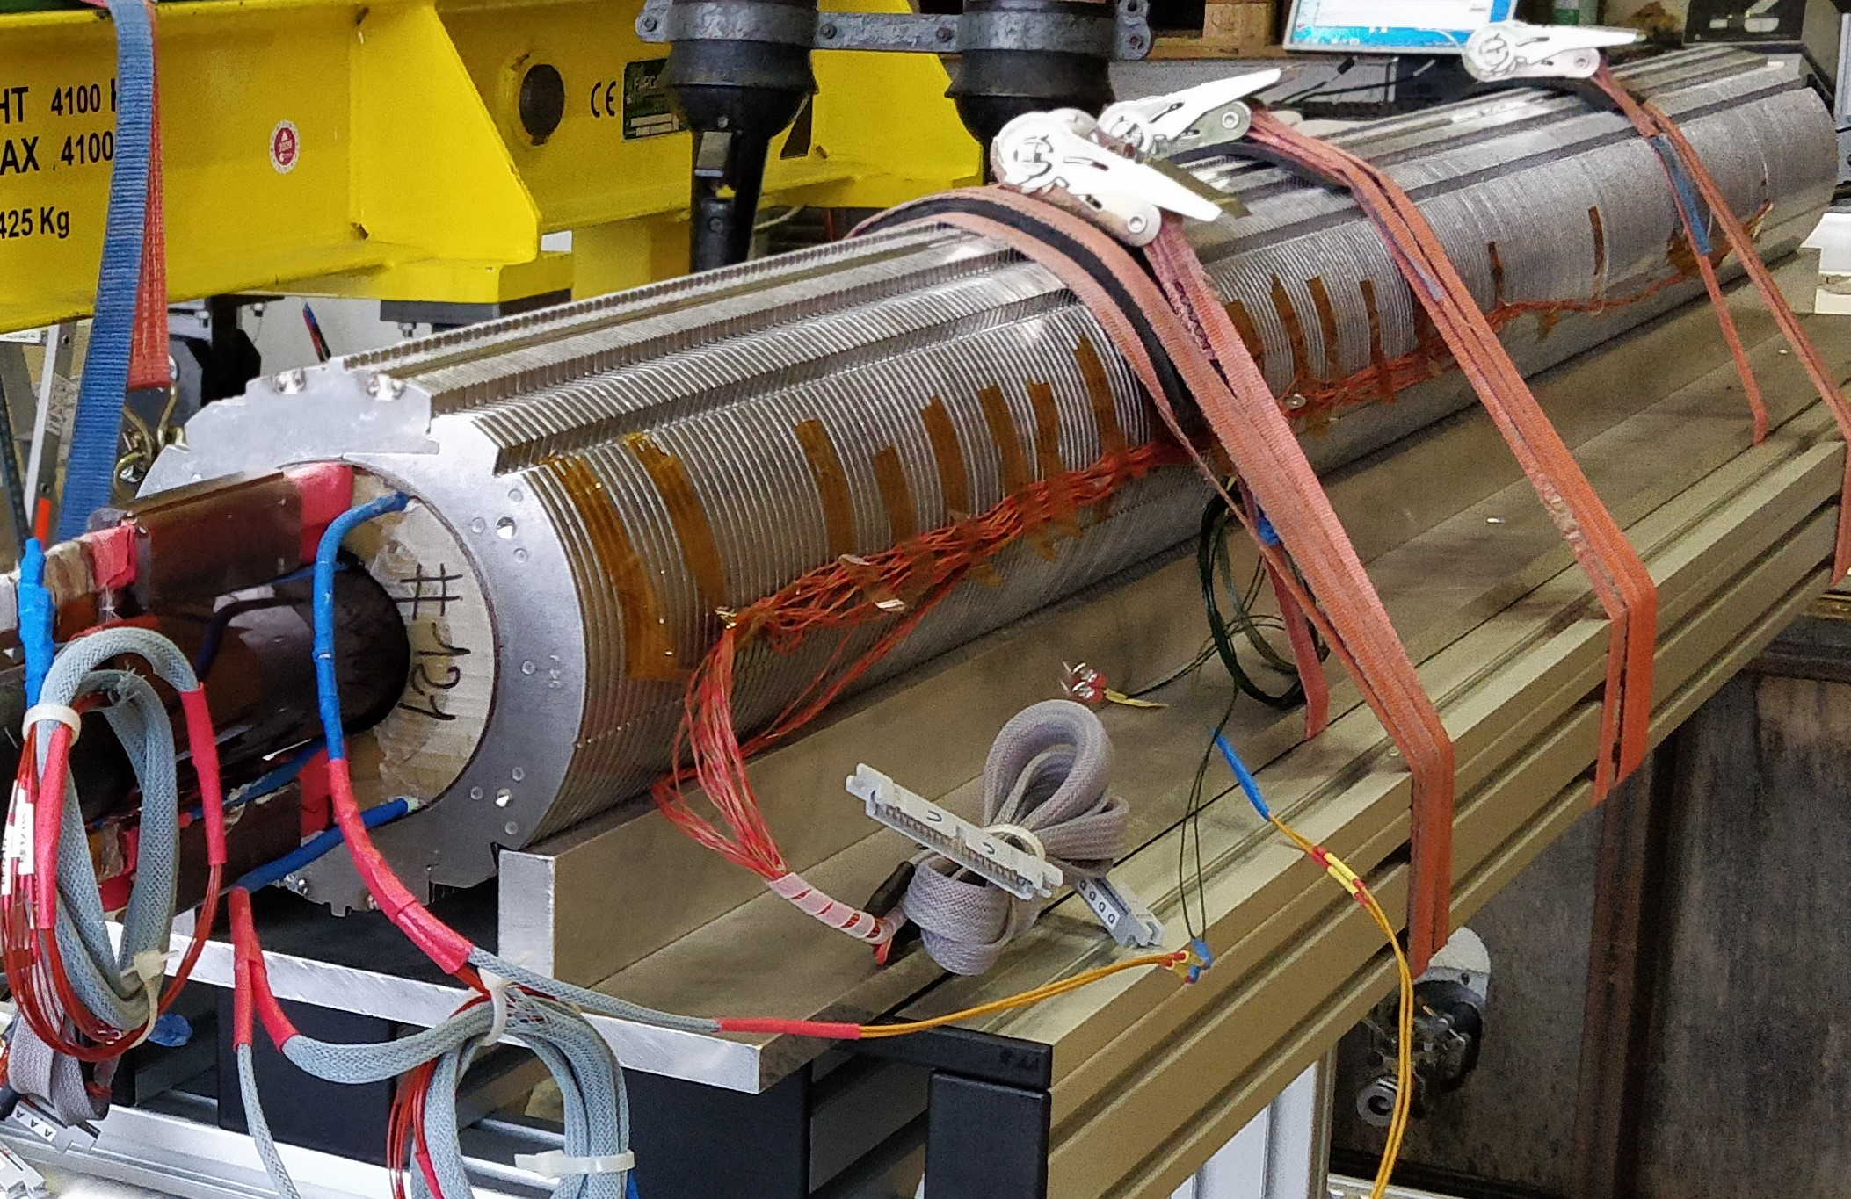
Thermal cycling 11 T coil thermal cycling 10 x to 80 K in GN₂
Evaluation of the effect of thermal cycling on impregnated Quench heater insulation to the coil and the respective resistance (SP07)
  10 thermal cycles to 80 K in GN₂ atmosphere
  Controlled ΔT during magnet cooldown
  Insulation resistance measurement after each cycle 660 V, 2 min
Setup of a gas distribution system, guaranteeing the max. thermal gradient across the magnet of 50 K (100 K) and cooldown in 24 h.
10 thermal cycles have been performed while staying within the maximum allowed temperature gradients.
No thermal degradation has been identified by MSC.
Humidity and temperature influence during the insulation tests => MSC
EDMS: 2150812 /2332230

Slide 15
Cryolab test capabilities
Cryolab infrastructure for tests of:
  RRR for films, foils and bulk samples
  SC splice resistance
  Thermal conductivity test stand
  Thermal diffusivity option
  Thermal cycling (small and large scale)
R&D:
  A) Thermal dilatation, classic and laser based system
  B) Near T_{c} test stand for SC wires
  C) T_{c} of SC films on Cu substrate (cavities)

Slide 16
Dilatation test stands in the Cryolab
Number | Setup | Sample dimensions | Temperature in K | Remarks
1 | Pyrex cryostat insert | 50 mm x 8 mm x 8 mm | 293 K reference, 78 K and 4.2 K | Requires LN₂ or LHe
2 | Laser based cryostat insert | 80 mm x 15 mm x 15 mm | 5 K to 293 K continuous | Requires LHe 5 samples measured for MSC
3 | Laser based interferometer R&D | All dimensions up to: 200 mm x 70 mm x 50 mm Max. 18 mm dx from edge | 8 K to 293 K continuous | Sample in vacuum Cryocooler based Laser beam distance 21 mm
The Laser dilatometer #3 (based on a cryocooler) is a completely new developed dry experimental station, and is under commissioning in the Cryolab right now.
The goal is to have a versatile measurement setup esp. in terms of sample dimension and composition.

Slide 17
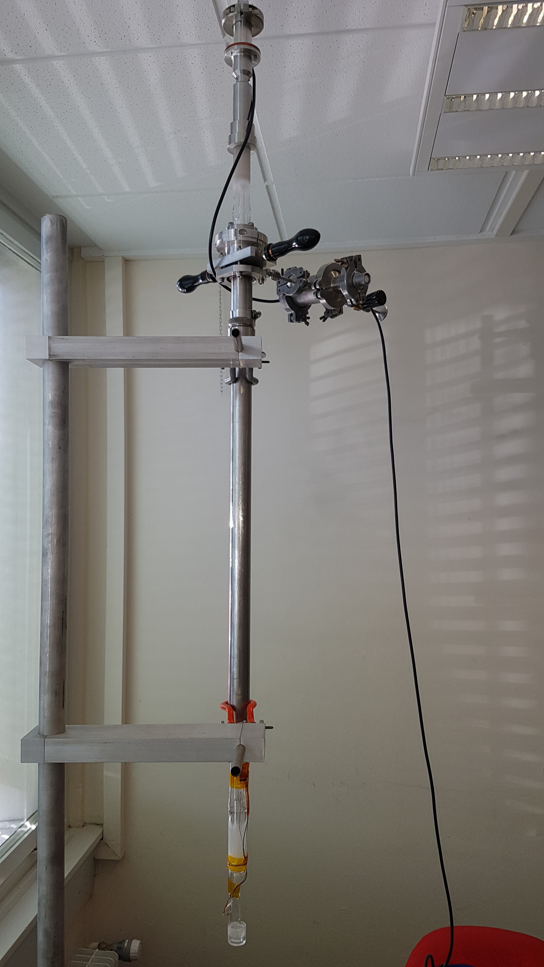
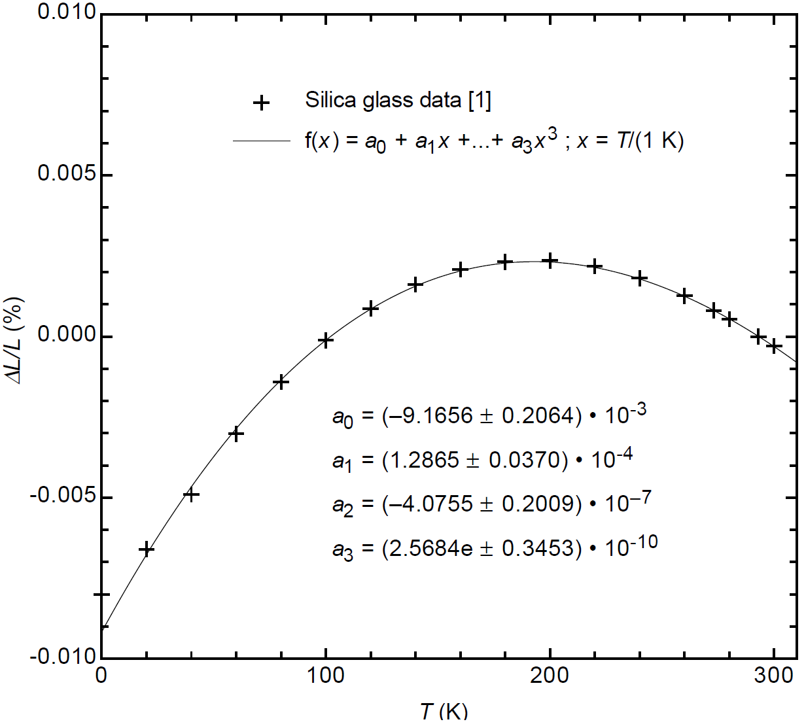
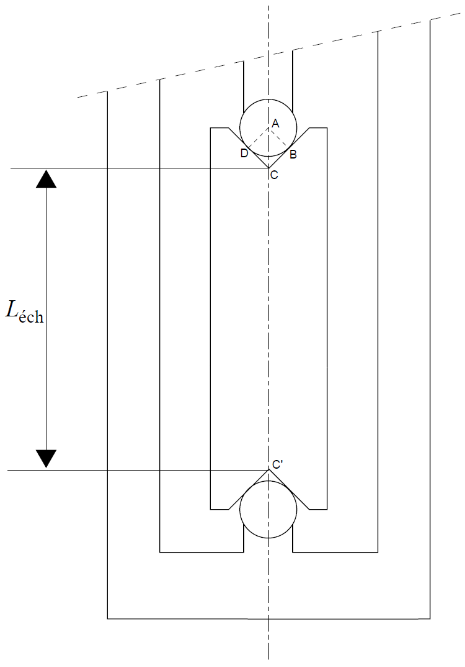
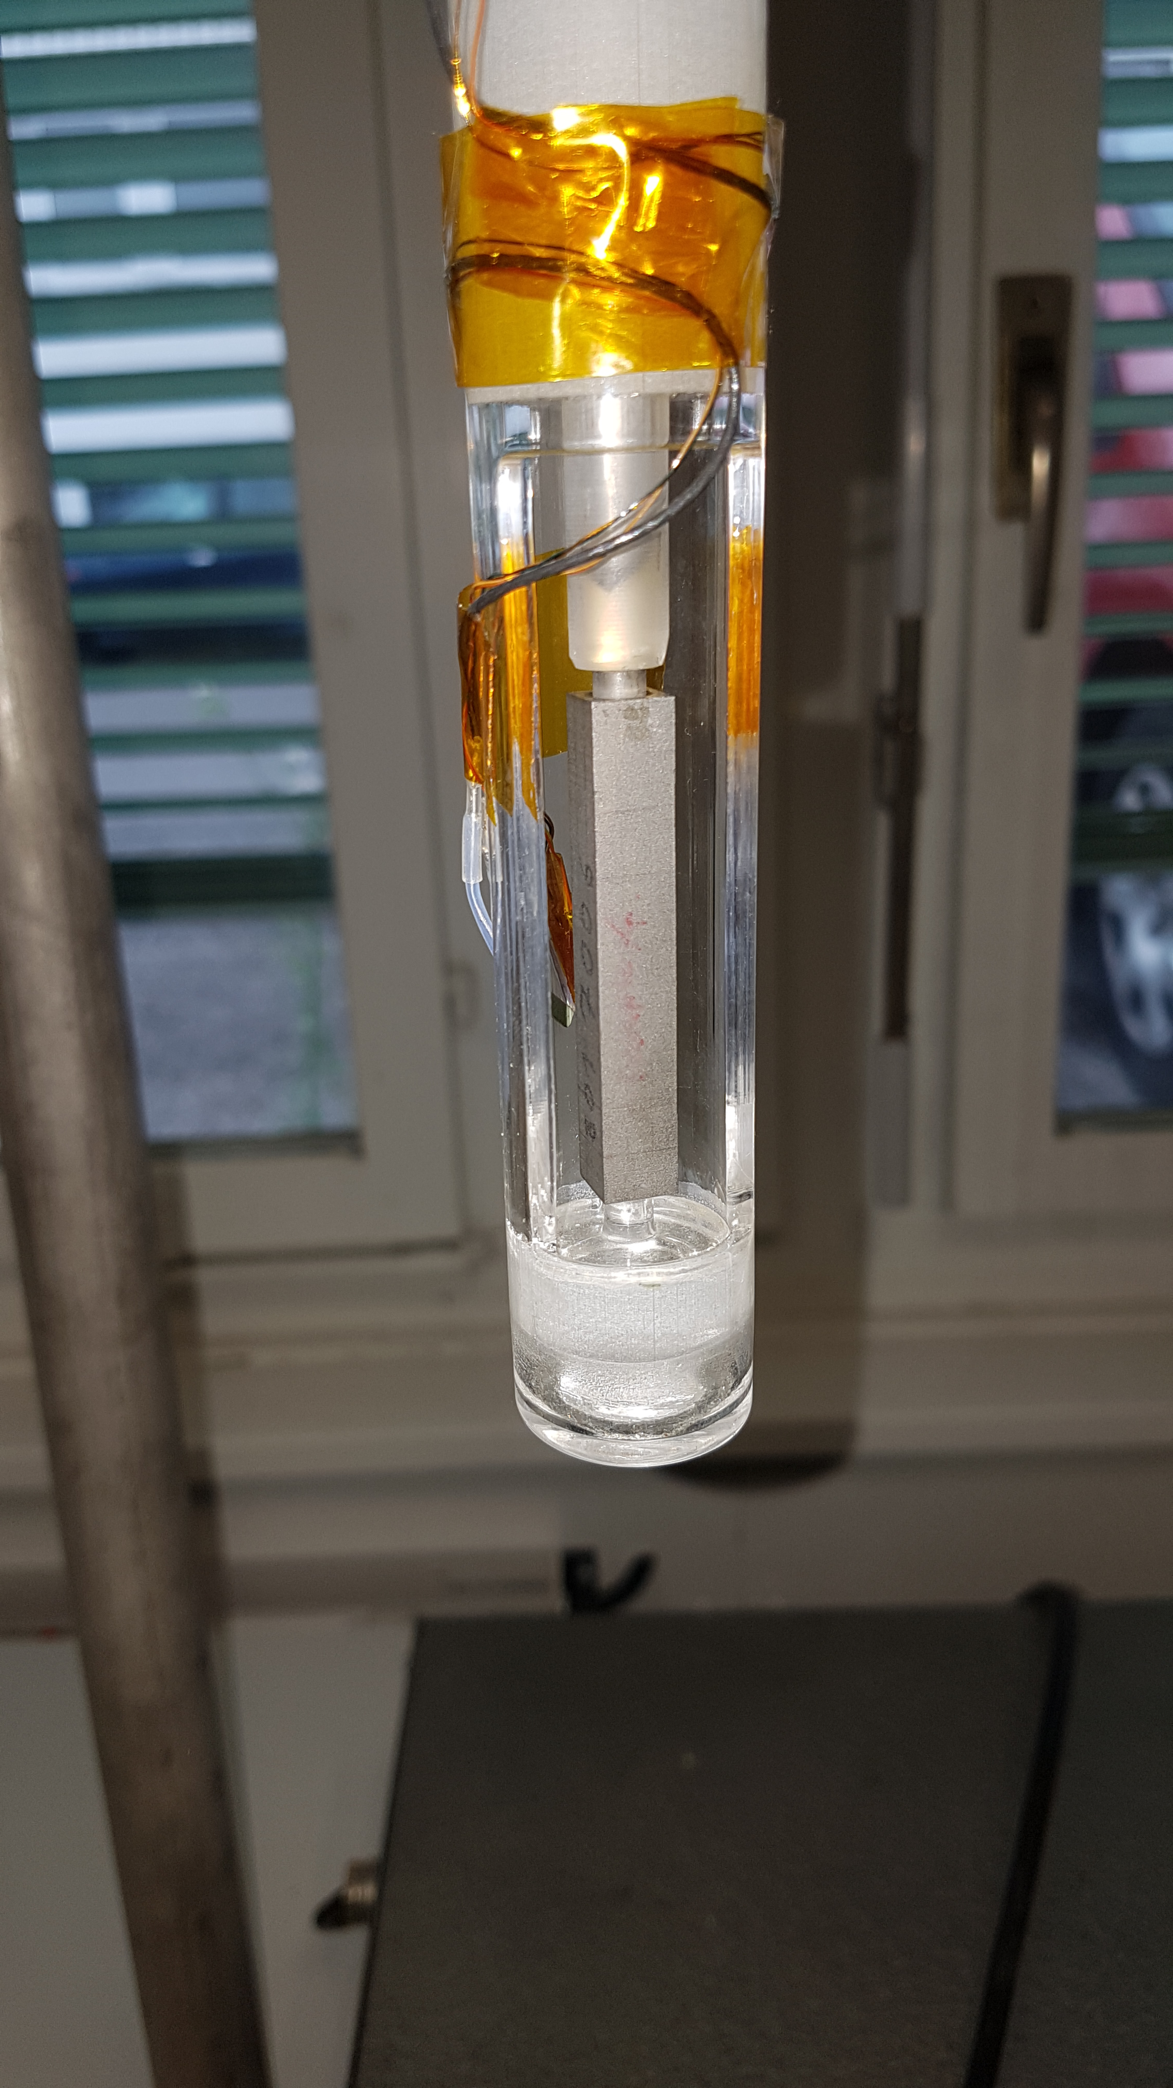
Dilatation test stand – Pyrex insert
Measurement points: 293 K reference, 78 K LN₂ and 4.2 K LHe
Sensor at RT
Liquid level
Inermet
Reference material used for calibration of the glass insert (NIST)
50 mm sample length with special interfaces
0.8 m
Measurements: Inermet, Ultem 1000, G10 II and
Ͱ
Old system => cryostat insert

Slide 18
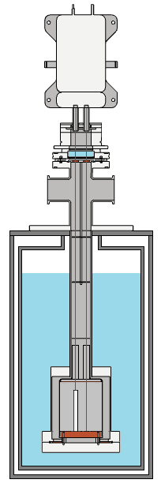
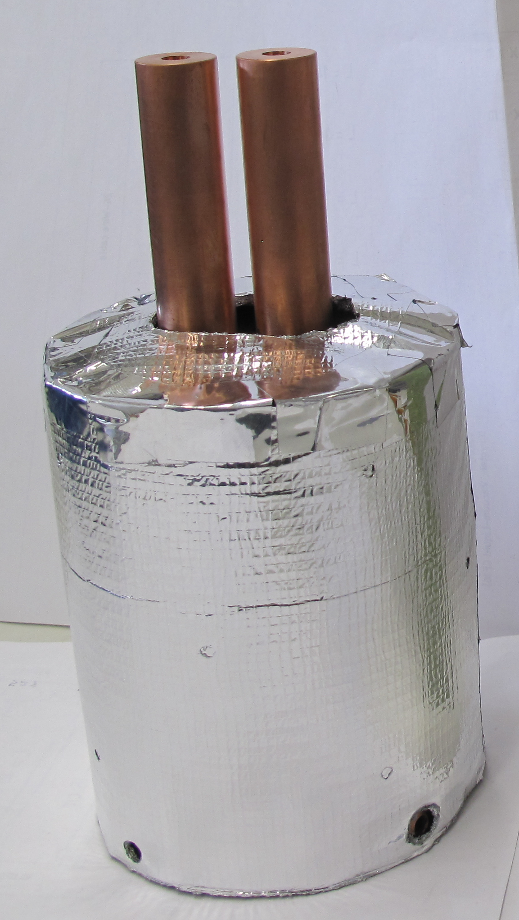
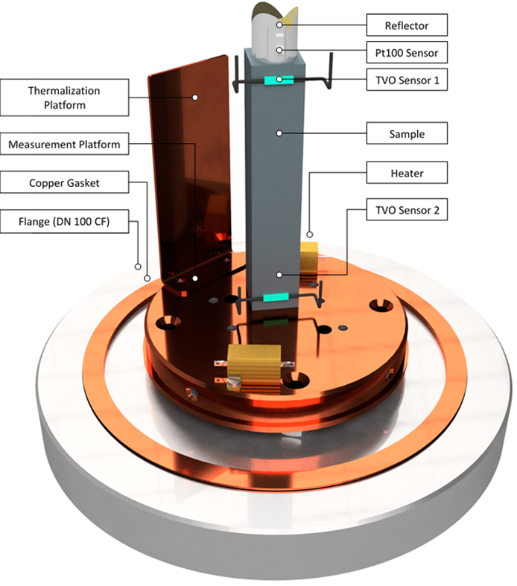
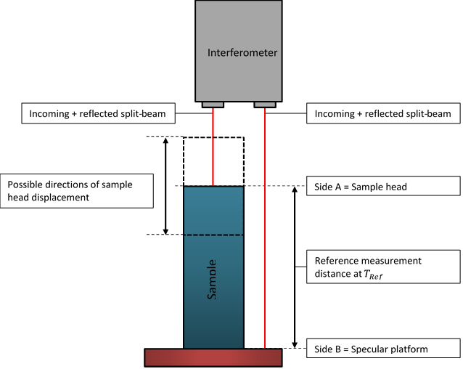
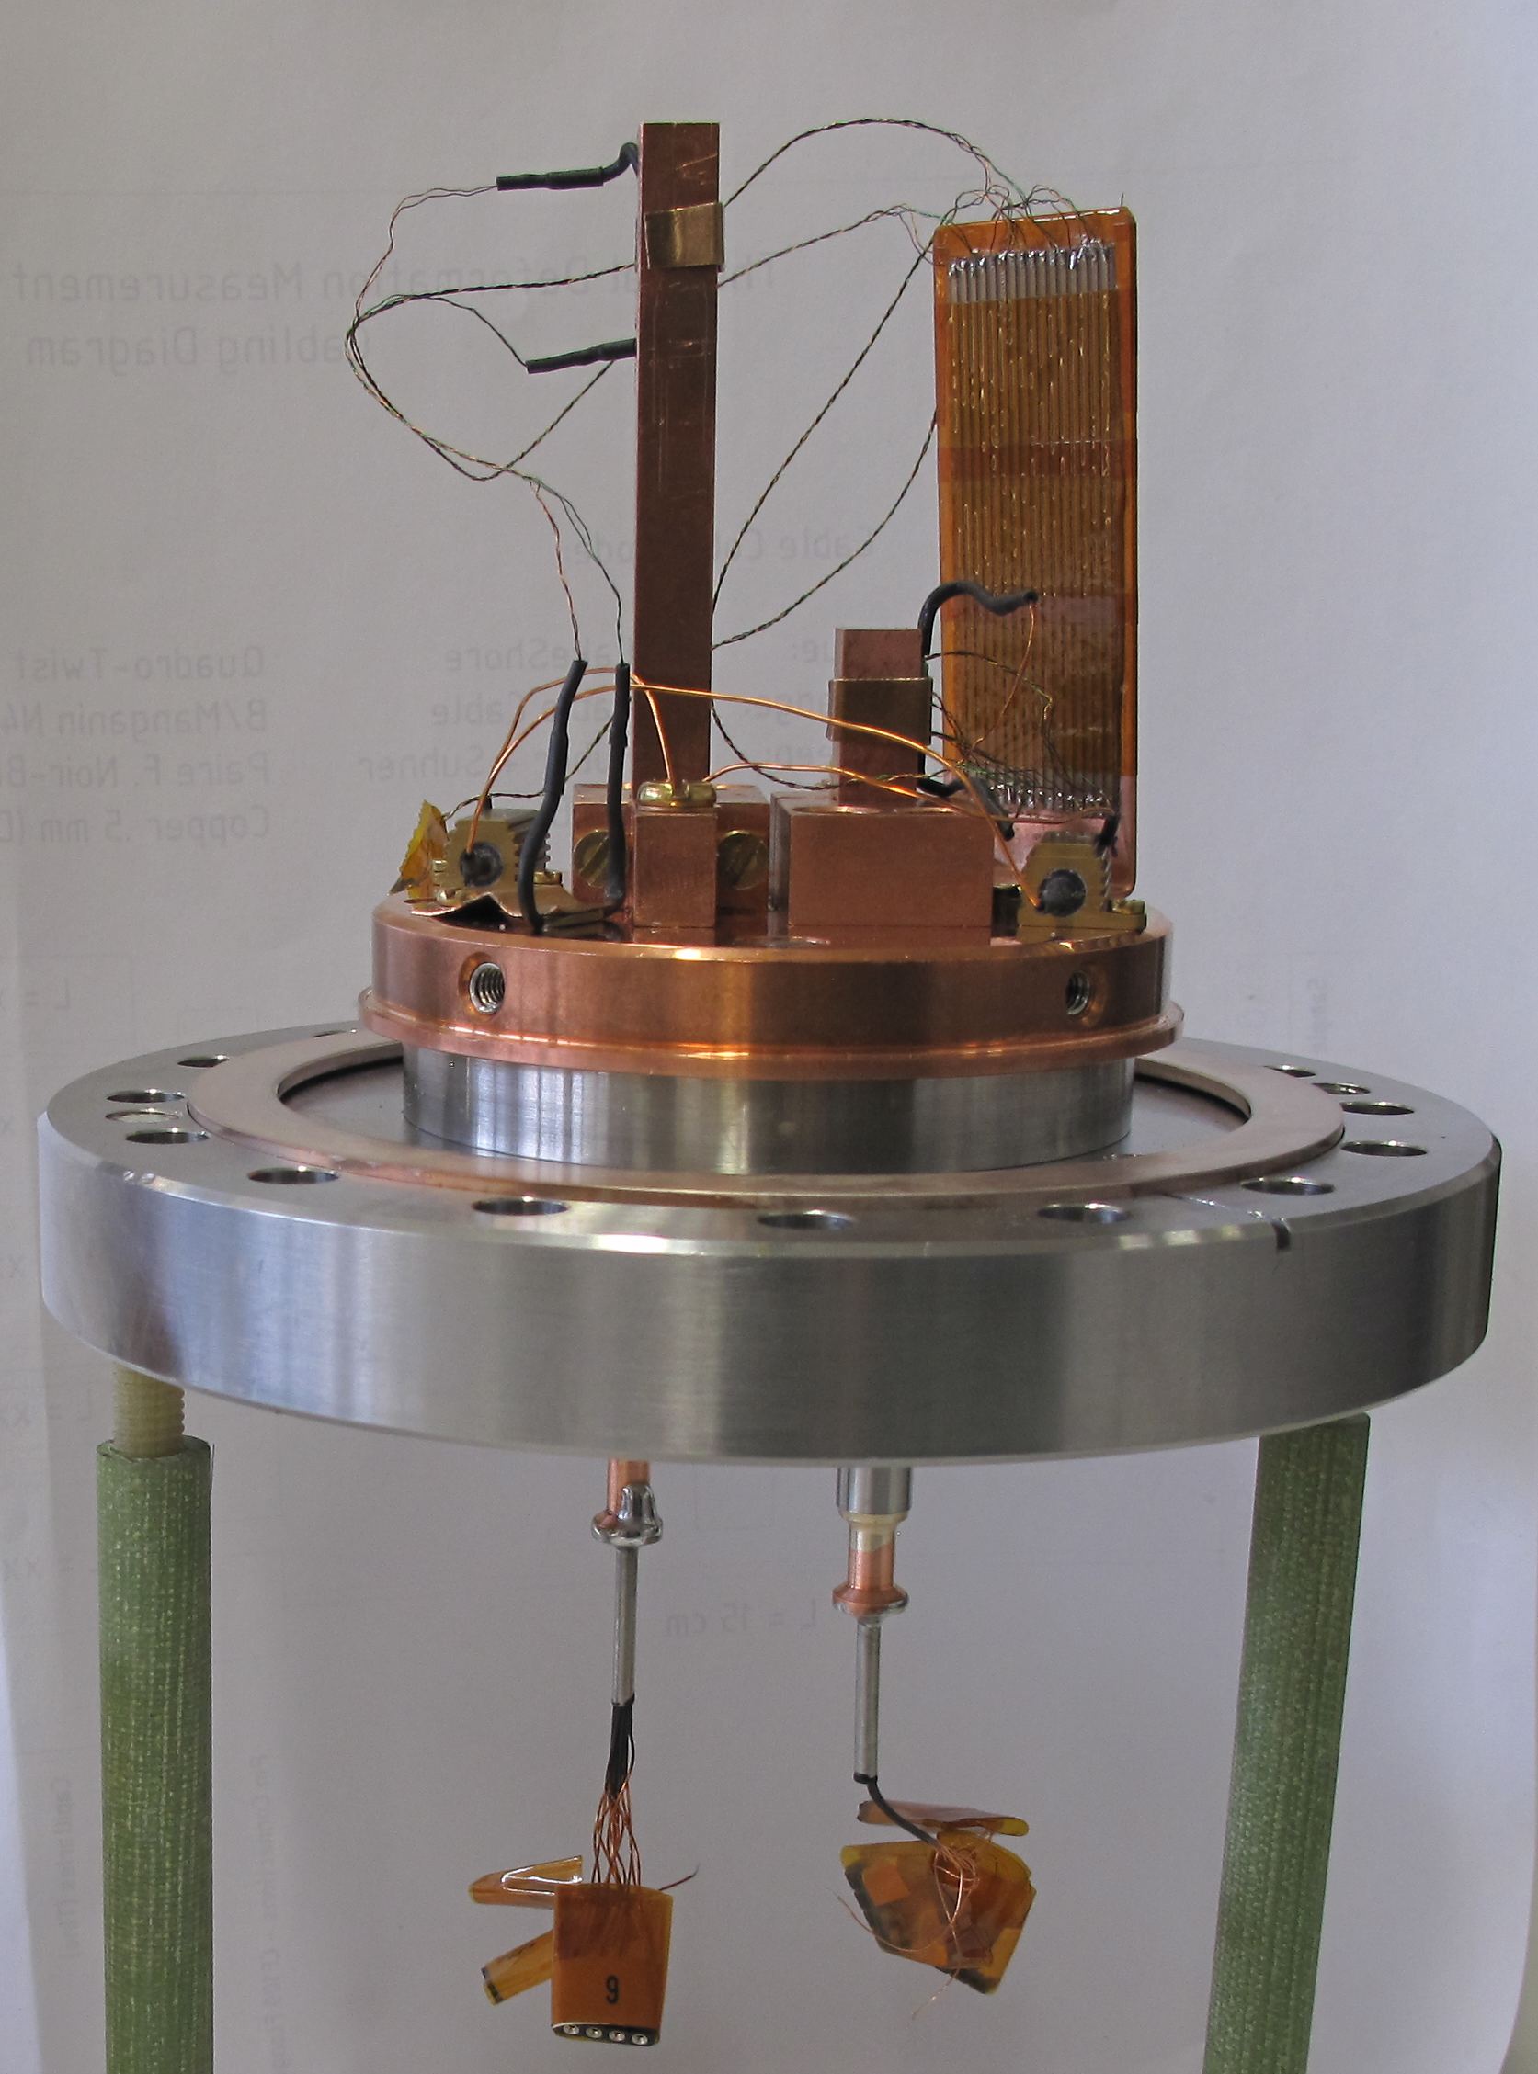
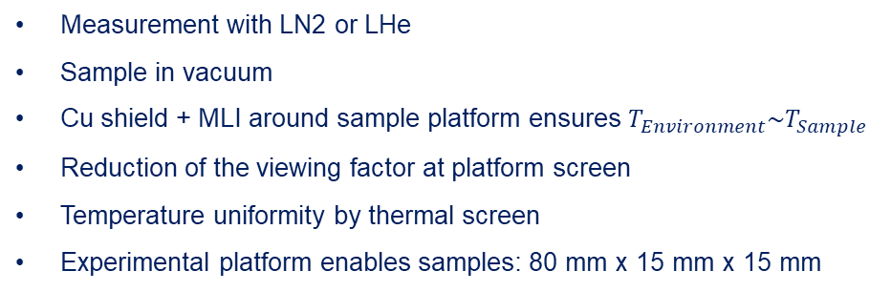
Dilatation test stand laser interferometer cryostat
Measurement with LN2 or LHe
Sample in vacuum
Cu shield + MLI around sample platform ensures $T_{Environment}\sim T_{Sample}$
Reduction of the viewing factor at platform screen
Temperature uniformity by thermal screen
Experimental platform enables samples: 80 mm x 15 mm x 15 mm
Laser head
Thermal
screen
Instrumentation feedthrough

Slide 19
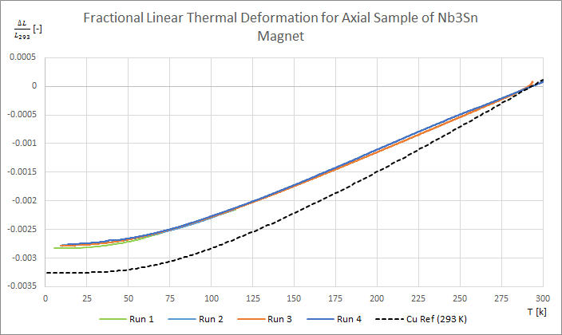
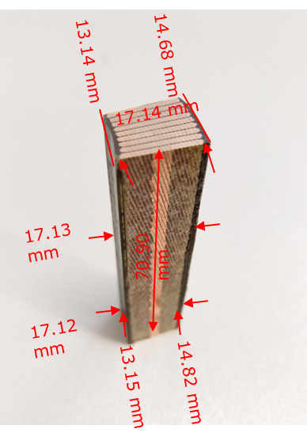
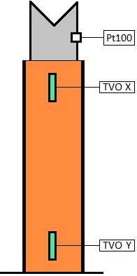
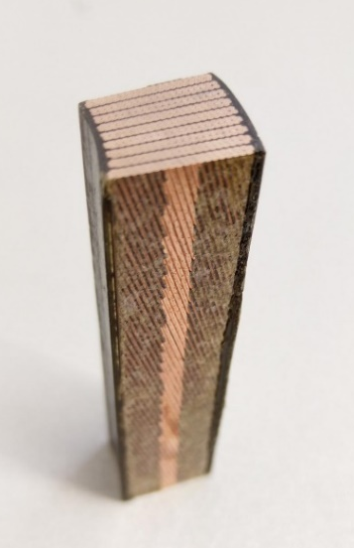
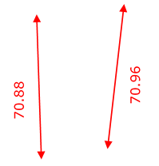
Dilatation test stand – results Nb₃Sn samples
Matthias Michels
Axial direction
Courtesy: Remy Kriboo, Flory ten Broeke

Slide 20
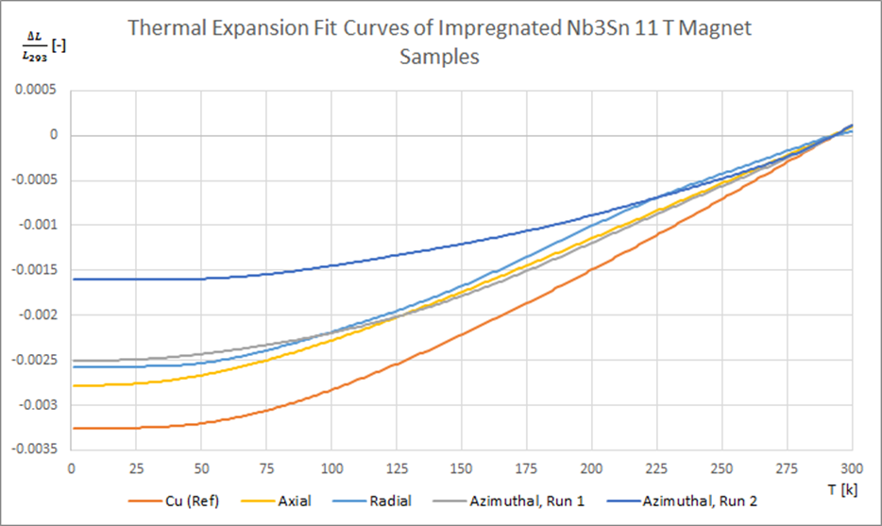
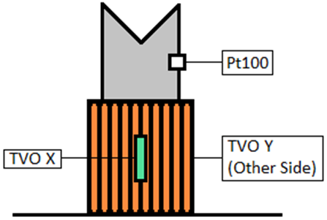
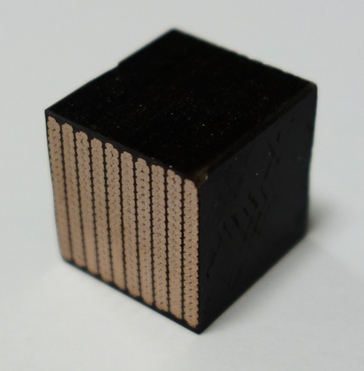
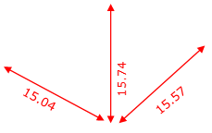
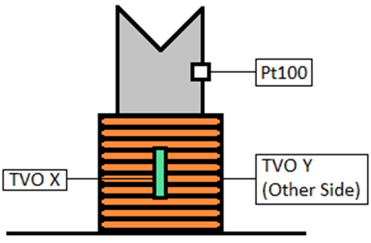
Dilatation test stand – results Nb₃Sn samples
Matthias Michels
Axial direction
Courtesy: Remy Kriboo, Flory ten Broeke
10 stack Radial
10 stack Azimuthal

Slide 21
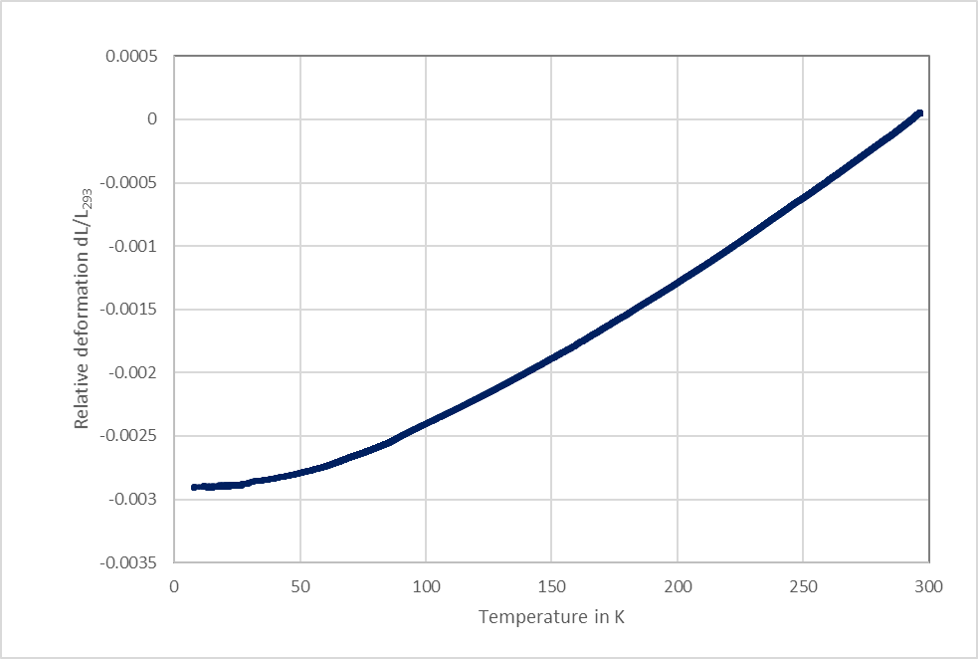
Dilatation test stand – results Nb₃Sn samples
Matthias Michels
Axial direction
Courtesy: Remy Kriboo, Flory ten Broeke
10 stack Radial
Additional test with azimuthal
straight 18 stack sample
10 stack Azimuthal

Slide 22
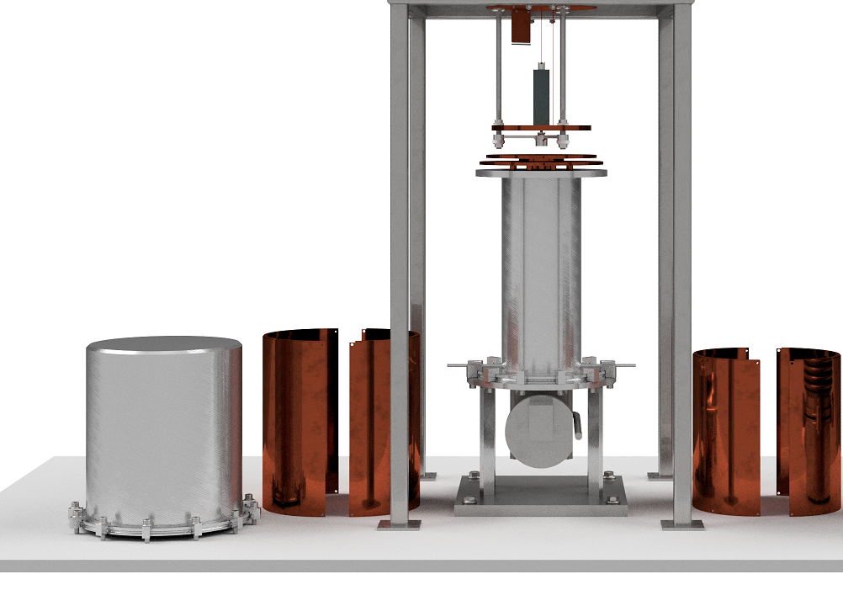
Upgrade dilatation test stand to cryocooler and laser
Laser interferometer
Features:
LHe free system
Vacuum environment
Variable temperature 8 K to 293 K
Long term stable temperature
Controlled ramp rates
Easy to mount sample
Sample: 200 x 70 x 50 mm³
Open points:
Decoupling and alignment
Parasitic heat leaks
Thermal Shield
Cryocooler First Stage
Vacuum enclosure
Courtesy: Remy Kriboo, Flory ten Broeke
Thermal shield of
sample environment

Slide 23
Finished R&D topics:
- Near T_{c} characterization of Nb₃Sn wire
(mechanical stress applied at room temperature)
Patrick Ebermann

Slide 24
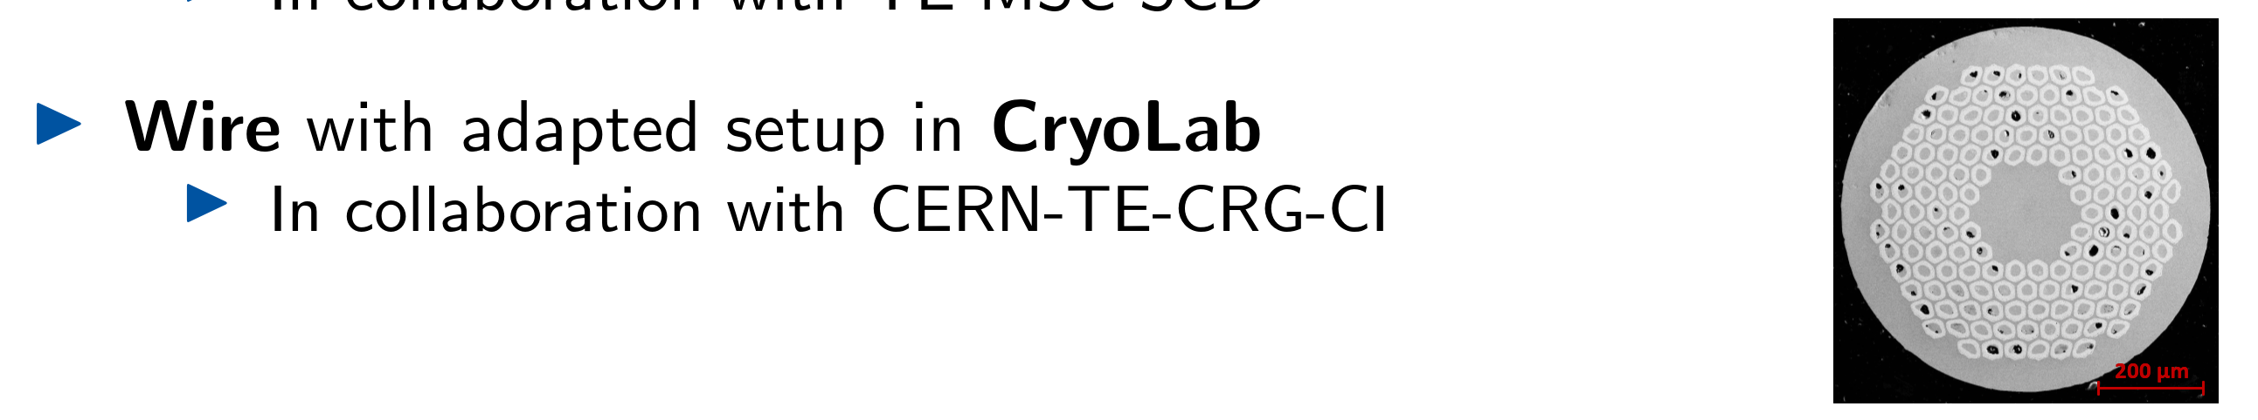
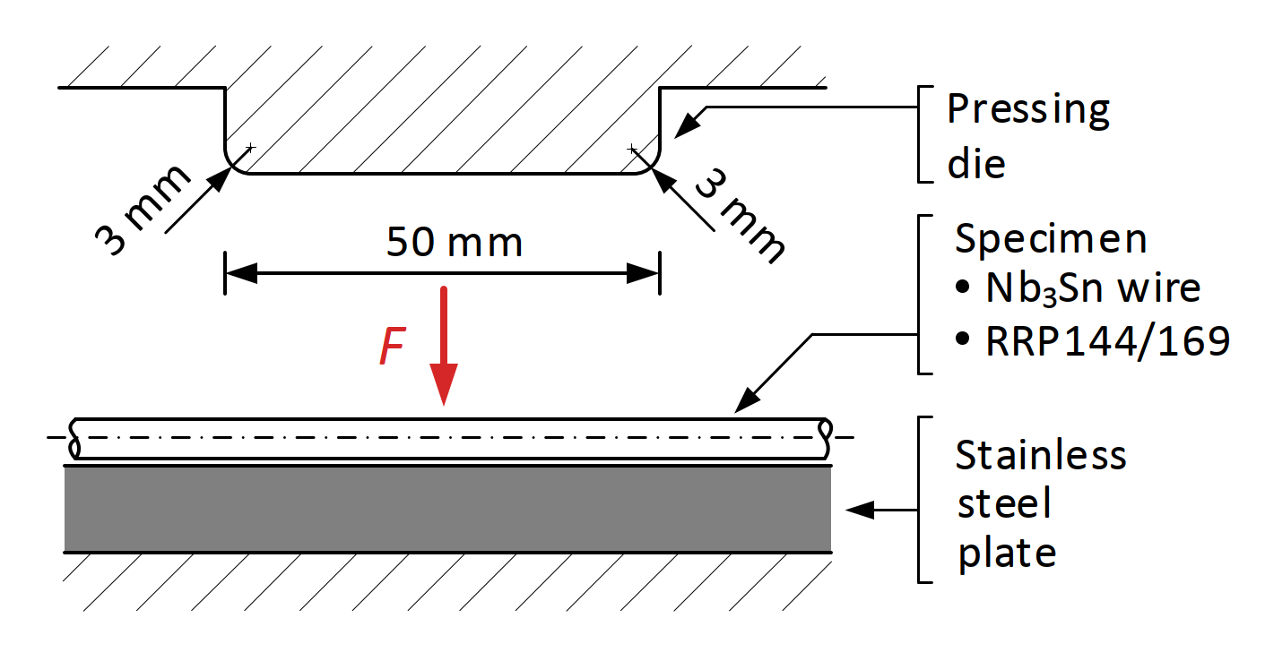
A) Near Tc test stand for I_{c} measurement of reacted Nb₃Sn wire
PhD topic of Patrick Ebermann: “Analysis of electrical degradation by measuring I_{c} as a function of transversal stress applied at room temperature:
Cryogenic test 1 =>
=> Cryogenic test 2 =>
1st compression force applied at room temperature
2nd compression force applied at room temperature

Slide 25
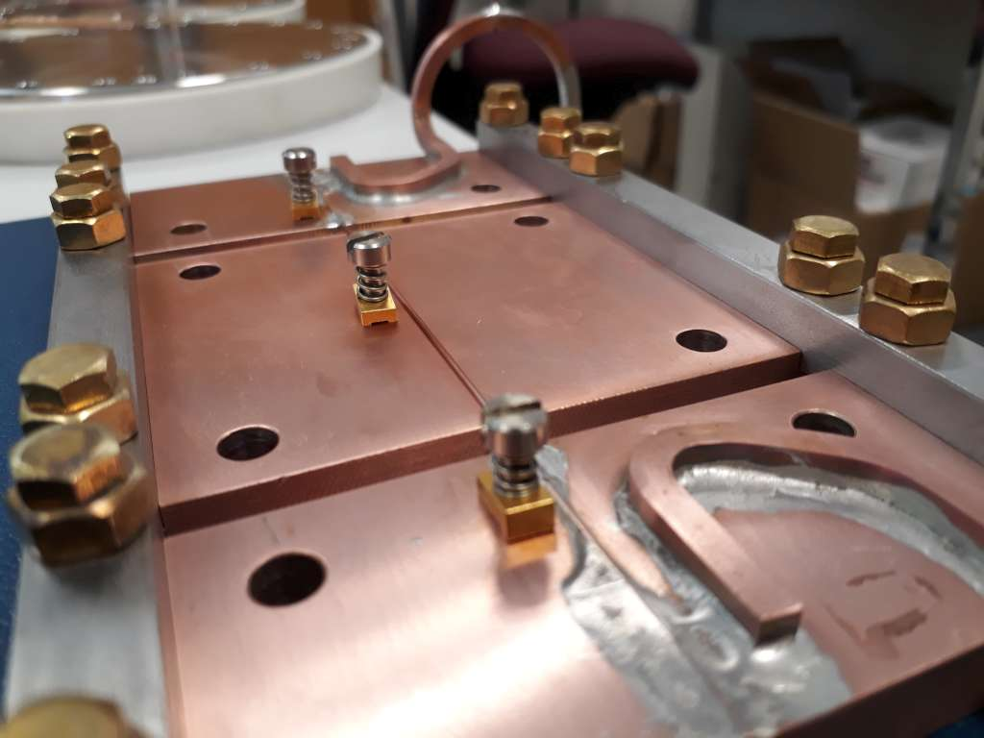
A) Near Tc test stand for I_{c} measurement of reacted Nb₃Sn wire
PID of the Near Tc test stand, P. Ebermann
Demountable sample holder
thermalized at 16 -18 K with dT=0.1 K
Purge
45/3
FC
001
FC
001
FC
002
45/2
FC
002
Bypass
Bypass
150 A current leads
180/2 ^{Safety}
outlet
FT
001
FT
001
FT
002
He recovery
system
FT
002
(30 mbarg)
Shield
Cooling plate
flow controller
flow controller
LT
LT
001
001
ET
032
ET
031
ET
032
ET
031
Outlet
vapor
Outlet
liquid
PT
003
Turbo
Temp.
sensors
PT
003
molecular
pump
Vacuum
pump
Nb₃Sn wire
Bypass
Dewar
pressure
PC
003
PC
003
TT
081
Thermalisation of
current leads
TT
TT
082
081
TT
TT
091
082
TT
TT
092
091
TT
controller
TT
101
092
on shield
TT
TT
102
101
TT
102
PI
PI
001
001
Vacuum gauge
TT
007
< 10⁻⁶ mbar (HV)
TT
007
155 mbarg
4.3 K LHe
Thermal shield
with heat
exchanger
Dewar
Phase Separator
GHe ^{LHe}
TT
050
Transportable platform
T_{test}=16-18 K
TT
EH 011 EH 012
200 bar
050
Portable
sample holder
with sample
500 ltr
TT ET
011
TT
030
ET
011
ET
012
ET TT
012
ET
021
TT
020
ET
021
ET
022
030
020
ET
022
TT
040
TT
Cooling support
plate
040
TT
060
TT
060
Cooling plate
with heat exchanger
(experimental platform)

Slide 26
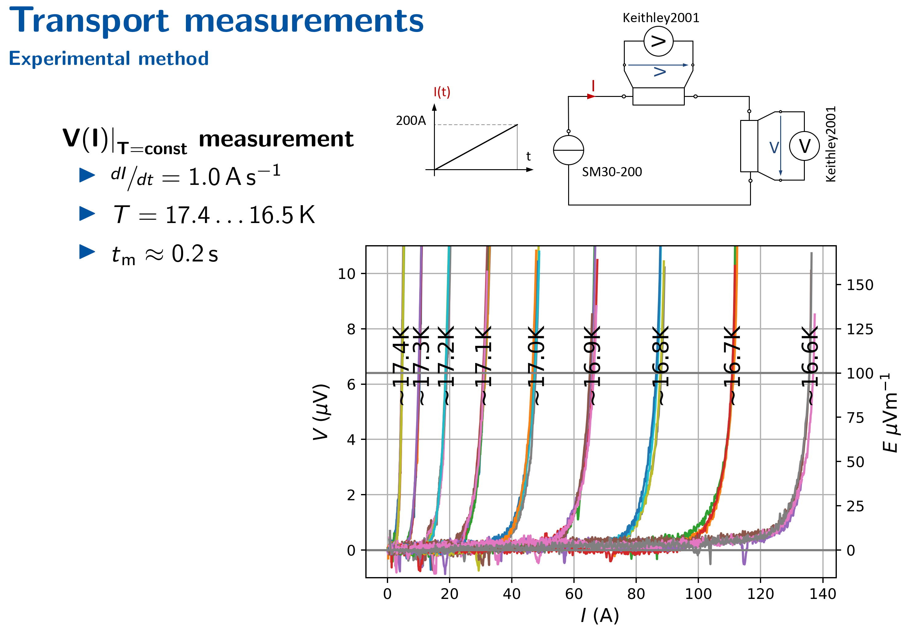
A) Near Tc test stand for I_{c} measurement of reacted Nb₃Sn wire
Keep T_{sample} constant
Courtesy: Patrick Ebermann, Irreversible degradation of superconducting Nb₃Sn wires and cables caused by transverse stress at room temperature.

Slide 27
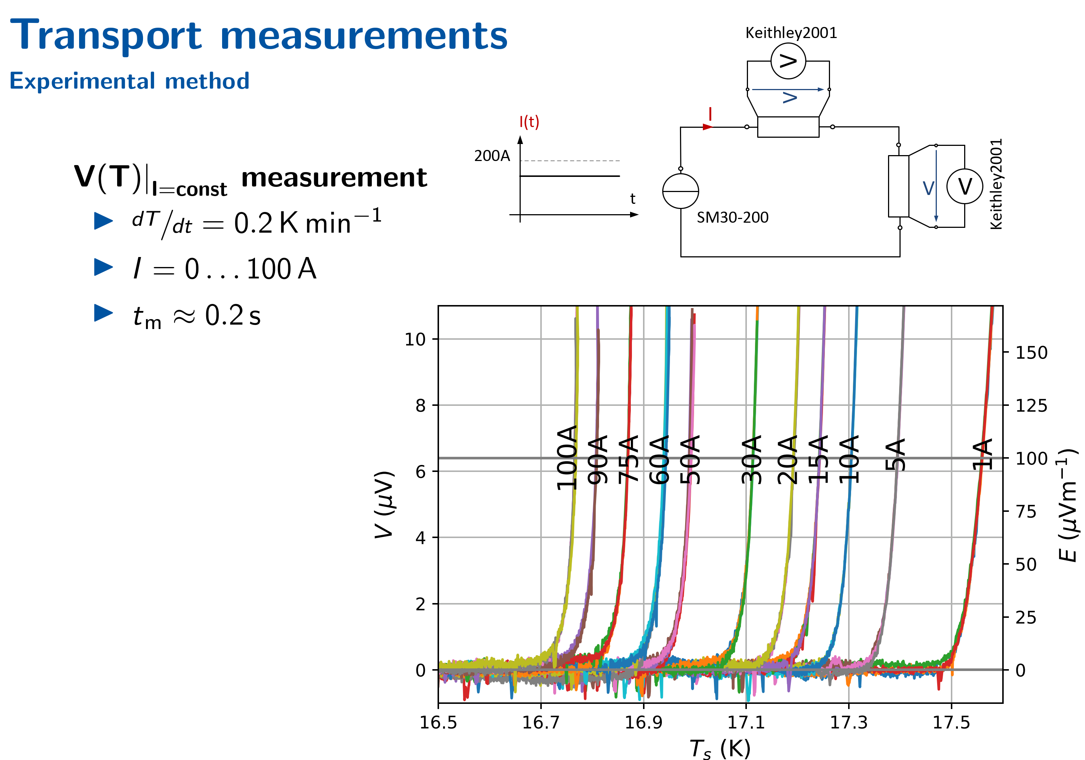
A) Near Tc test stand for I_{c} measurement of reacted Nb₃Sn wire
Keep T_{sample} constant
Controlled ramping T_{sample}
Courtesy: Patrick Ebermann, Irreversible degradation of superconducting Nb₃Sn wires and cables caused by transverse stress at room temperature.

Slide 28
A) Near Tc test stand for I_{c} measurement of reacted Nb₃Sn wire
Feasibility shown:
  Test near Tc (16 K-18 K) possible
  Dismountable support allowing for room temperature stress application
  Heat loads are reasonable (CL 150 A) at 50 K and 15 K
  Possible to test with a cryocooler system

Slide 29
Finished R&D topics:
- Near T_{c} characterization of Nb₃Sn wire
- HIE ISOLDE thermalisation of RF cable and coupler

Slide 30
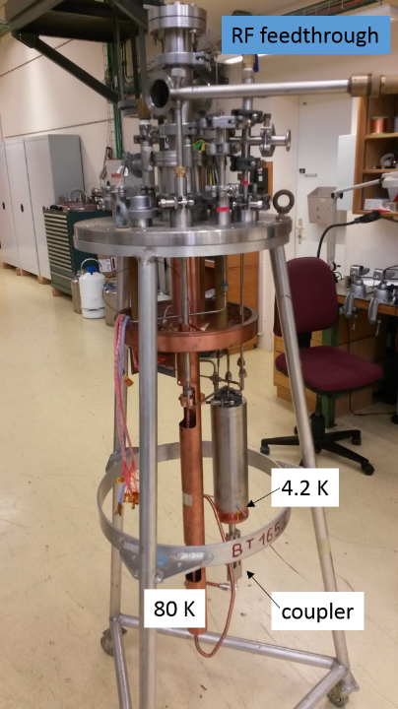
HIE-ISOLDE RF cable temperature distribution
Established thermal mockup of HIE-ISOLDE semi rigid RF cable thermalisation from 293 K to 4.2 K incl. RF coupler and its antenna
Actively stabilized thermal shield
4.2 K coupler interface
13 Pt100 sensors at screen and RF cable
4 TVO at coupler and LHe reservoir
Heat meter at the cavity interface to calibrate after RF power tests
Results:
No thermal run-away observed in the tested set-up with RF power up to 95 W for 24 h => heat load to cavity in that case 0.8 W
Heat intercept of RF coax cable at thermal shield temperature effective, see TT8 at 1.38 m

Slide 31
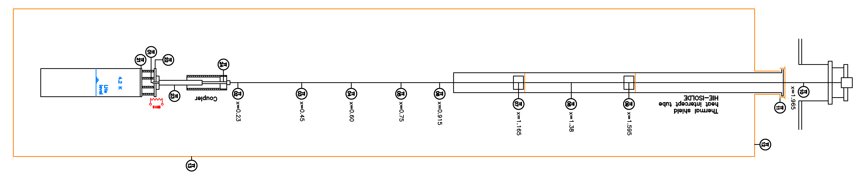
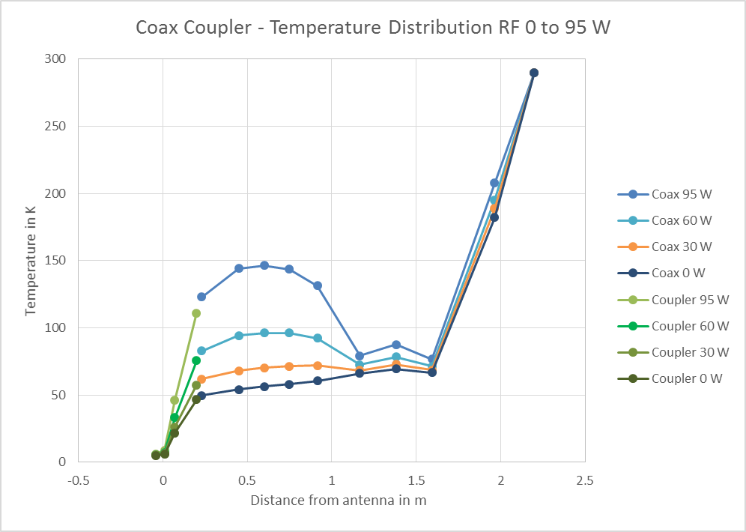
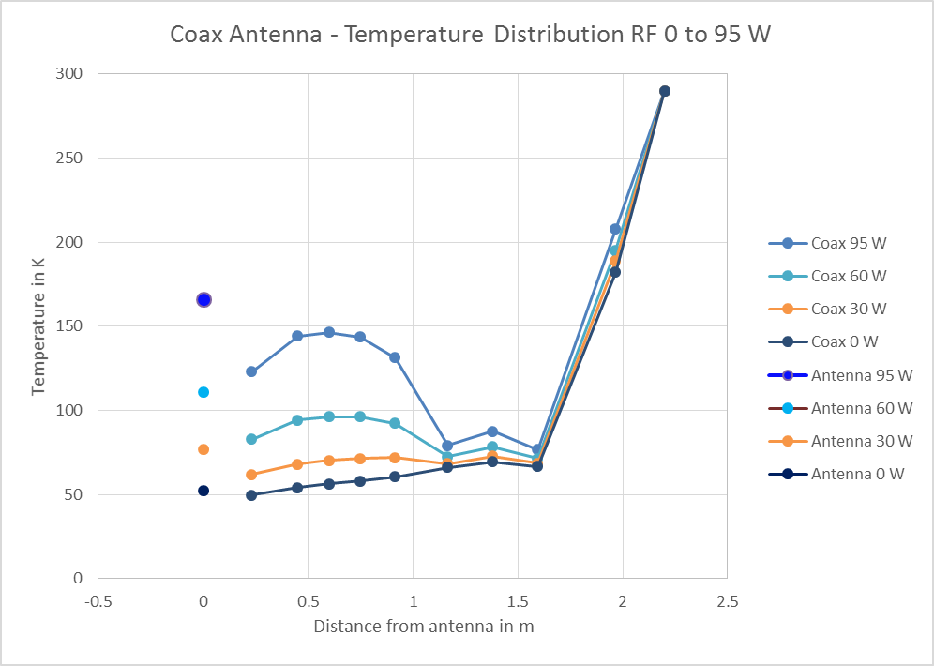
HIE-ISOLDE RF cable temperature distribution

Slide 32
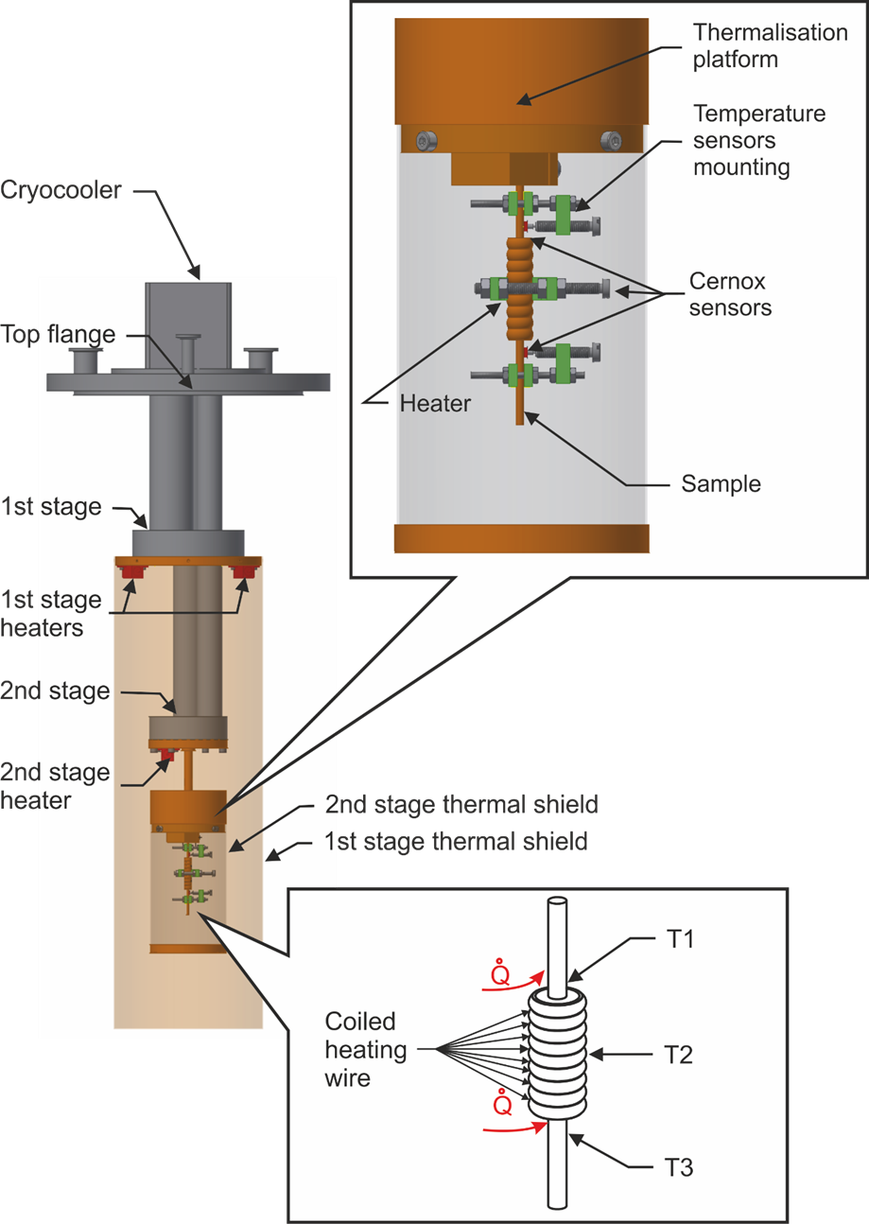
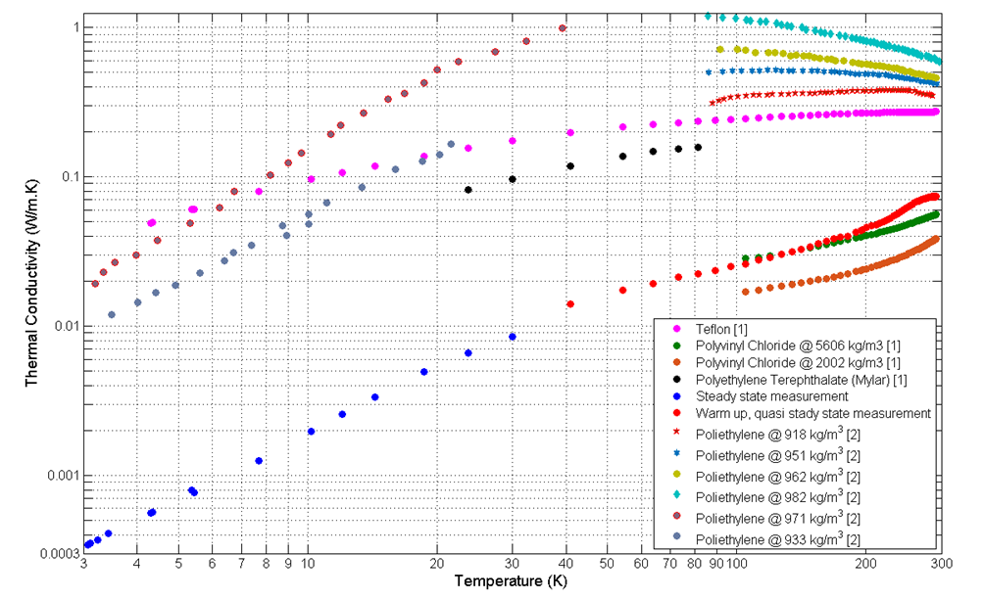
HIE-ISOLDE RF cable transverse thermal conductivity
[1] http://cryogenics.nist.gov/MPropsMAY/materialproperties.htm
[2] Perepechko, Low temperature Properties of Polymers

Slide 33
Finished R&D topics:
- Near T_{c} characterization of Nb₃Sn wire
- HIE ISOLDE thermalisation of RF cable and coupler
- MLI thermal performance as fct. (T_{warm} and p_{vac})

Slide 34
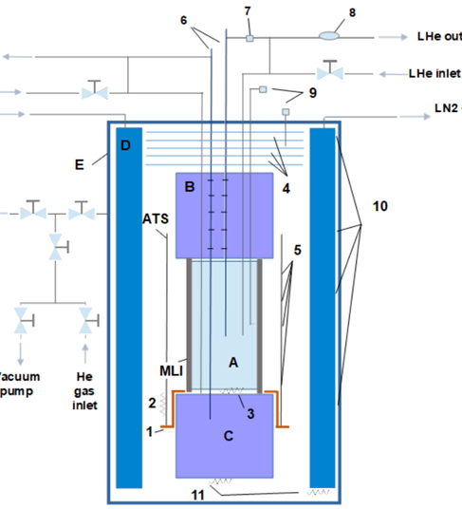
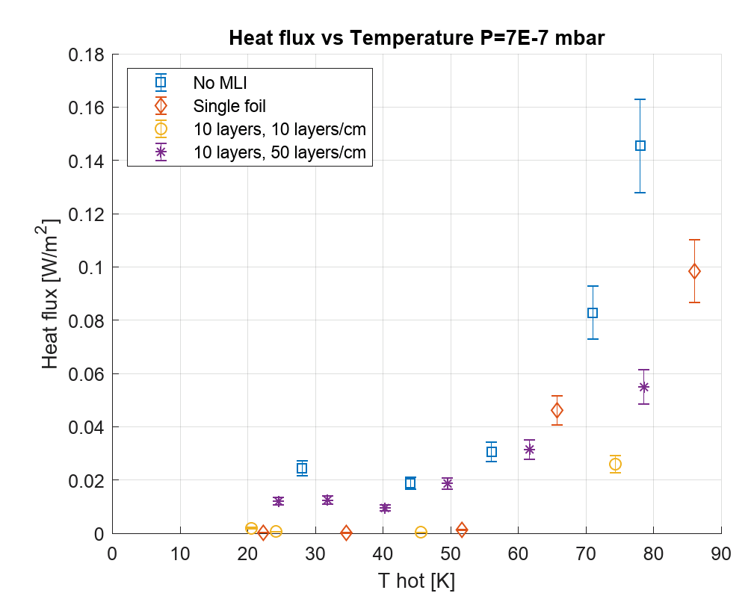
MLI performance test stand => host and support
Vacuum and He degraded vacuum conditions
Different MLI configurations
7x10⁻⁷ mbar
Courtesy: Valentina Venturi

Slide 35
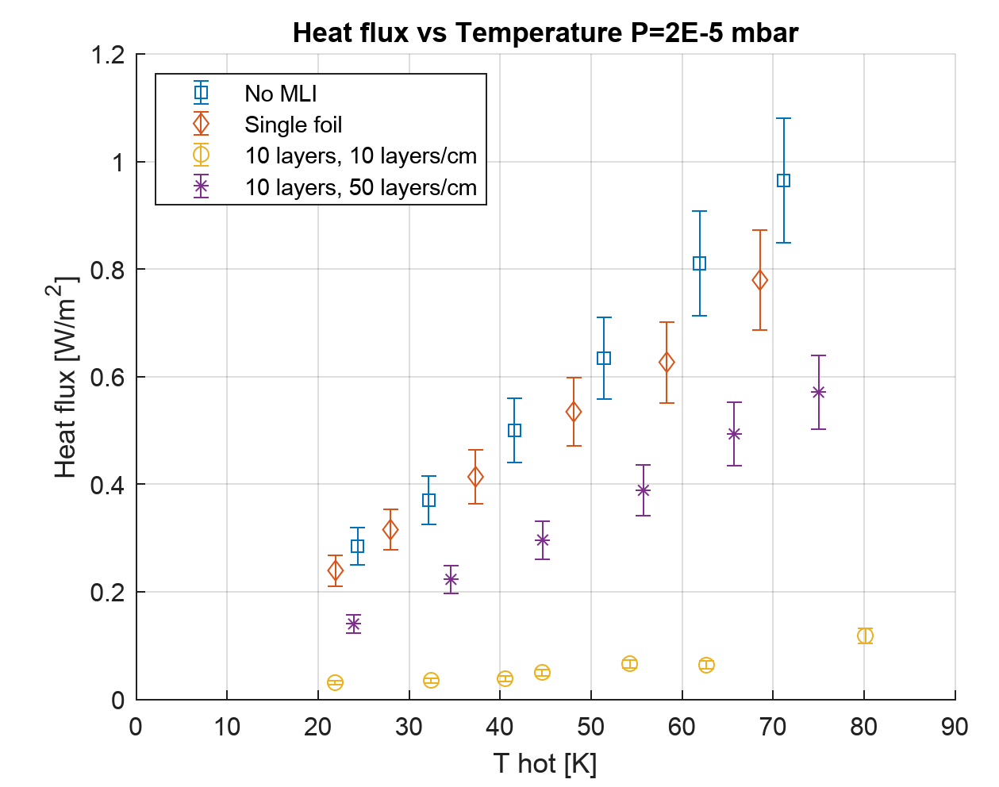
MLI performance test stand => host and support
Vacuum and He degraded vacuum conditions
Different MLI configurations
2x10⁻⁵ mbar
Courtesy: Valentina Venturi

Slide 36
Finished R&D topics:
- Near T_{c} characterization of Nb₃Sn wire
- HIE ISOLDE thermalisation of RF cable and coupler
- MLI thermal performance as fct. (T_{warm} and p_{vac})
- HFM Lambda plate seal – thermal heat leak

Slide 37



HFM lambda plate seal test - heat load He I to He II
D-shape profile silicone based
choice tested
EDMS: 1845733 v.1

Slide 38

HFM lambda plate seal test - heat load He I to He II
Arnaud van de Craen
Heat meter calibration with Indium seal
EDMS: 1845733 v.1
Silicone seal showed similar results of 2 W like In

Slide 39
R&D topics
- Thermal performance of He II cooled magnet coil samples

Slide 40




Thermal performance of He II cooled NbTi & Nb₃Sn coil samples
SC coil samples from prototype magnets are tested in pressurized He II
NbTi cable
Steady state temperature difference
Step function heating
time constant response
Courtesy: Rob van Weelderen, Tiemo Winkler, Mario Grosso, Kirtana Puthran, Lise Eder Murberg
Evaluation of the step heating response:
Steady state => R_{th}
Transient => R_{th}∙C = τ
Num. simulations
Sample: LARP 007, tested in MQXFS3 conductor type RRP108/127 => MQXF coil

Slide 41


Thermal performance of He II cooled NbTi coil-pack samples
Original machine wrapped cable
Instrumentation in removed strand
Courtesy: Tiemo Winkler, Jens Schundelmeier Rob van Weelderen
Mechanical compression of 50 and 75 MPa

Slide 42





Thermal performance of He II cooled Nb₃Sn coil samples
Steady state temp. D11 T sample
Steady state temp. MQXF sample
_{He II}
Predicted He porosity 0.35-0.65% in the sample
Sample preparation for new D11T in progress (latest design)
To approach predicted operational heat loads on the magnets.
  Exploring thermal behaviour at higher heat loads by using an external heater and/or
  Variable frequency current source ν< 50 Hz
Courtesy: Rob van Weelderen, Tiemo Winkler, Mario Grosso, Kirtana Puthran, Lise Eder Murberg
Volumetric heat input in mW/cm³
Volumetric heat input in mW/cm³
Time constant D11 T sample
Time constant MQXF sample
0.65%
0.6%
0.4%
0.35%

Slide 43


Thermal performance of He II cooled Nb₃Sn coil samples
Effect of magnetic field penetration and frequency dependency of the AC magnetic field.
Courtesy: Rob van Weelderen, Kirtana Puthran, Lise Eder Murberg

Slide 44


Thermal performance of He II cooled Nb₃Sn coil samples
Effect of magnetic field penetration and frequency dependency of the AC magnetic field.
Courtesy: Rob van Weelderen, Kirtana Puthran, Lise Eder Murberg

Slide 45

Thermal performance of He II cooled Nb₃Sn coil samples
Effect of magnetic field penetration and frequency dependency of the AC magnetic field.
20 V_{AC} peak, bipolar PS
Courtesy: Rob van Weelderen, Kirtana Puthran, Lise Eder Murberg

Slide 46
R&D topics
- Thermal performance of He II cooled magnet coil samples
- Thermal performance of HL-LHC Inner Triplet Current Feeders

Slide 47
Thermal validation: HL-LHC Inner Triplet Current Feeders
Mock-up measurement setup
K-mod configuration
2 x 10mm² Cu cable (Kapton insulated in stainless steel tubes)
Equivalent thermal path like in HL-LHC
Thermal performance validation
  Temperature feedthroughs to outside
  Heat load to 1.9 K pressurized bath
  Cooldown behavior and thermal stability

Slide 48

Thermal validation: HL-LHC Inner Triplet Current Feeders
Mockup of electric current feeders 35 A_{AC}
Equivalent thermal path like in the application => K-mod
Feeder connection from room temperature flange directly to He II bath.
Goals:
  Feedthrough temperature
  Temperature profile
  Thermal stability
  Heat inleak into 1.9 K LHe
  Electrical tests with CERN colleagues
Courtesy: Joanna Liberadzka

Slide 49


Thermal validation: HL-LHC Inner Triplet Current Feeders
Results
Warm end temperatures with and w/o HX and electrical current 25 A DC:
dT is important for dew point in the LHC tunnel air
Courtesy: Joanna Liberadzka
Heat input to the He II system (2 leads):
Simulation expected Q=1.9 W

Slide 50

Thermal validation: HL-LHC Inner Triplet Current Feeders
Simulations tube
Simulations cable
Courtesy: Joanna Liberadzka
TE/MPE-EE: Electrical tests with pulses up to 7 kA were successful in the Cryolab setup, see EDMS: 2332911 v.1

Slide 51
R&D topics
- Thermal performance of He II cooled magnet coil samples
- Thermal performance of HL-LHC Inner Triplet Current Feeders
- HTS small coil test

Slide 52


Variable temperature cryostat setup for HTS small test coils
Test stand to determine the performance of novel HTS solenoids
Non-metallic cryostat insert
Operating temperatures at 4.2 K, 20 K … 80 K => LN₂ or LHe or He vapor
Long ramp duration (stable for up to 6 h)
2 kA current leads => in-house build to fit the gas cooling insulated loop
Vehicle for MSC to test new technologies (like partial or non-insulated coils)
Drawings courtesy: D. Schoerling

Slide 53

Vapor cooled non-magnetic cryostat setup, 2 kA current leads
Test of small HTS coils
Controlled inter-turn resistance
Temperature steps 4.2 K < T< 80 K
Adapted current leads for max. 2 kA
Fully non magnetic insert (Quench)
Glass epoxy chamber with temperature stabilization for several hours
Cryo system is commissioned
Courtesy: Joanna Liberadzka

Slide 54
R&D - possibly interesting for MSC
- Remote cooling with He fluid circuits

Slide 55


LHe zero boil off cryostat for the Antimatter Factory (BCCCA)
Detector with SC shield and SQUID sensor measuring the antiproton beam current.
LHe
Courtesy: Miguel Abreu Fernandez, Jocelyn Tan, Andrew Lees
Detector
Inner vessel

Slide 56
LHe zero boil off cryostat for the Antimatter Factory (BCCCA)
Stand alone cryo system
Complex design with ceramic breaks
Q<1.2 W available cooling power
Courtesy: Miguel Abreu Fernandez, Jocelyn Tan, Andrew Lees
Warm bore cryostat for Antiproton beam pipe
Low values of: vibration, dT and magnetic field variations are crucial
=> paved the way to remote cooling circuit R&D

Slide 57

Helium remote cooling circuit R&D
Research goal: Protect the experiment from cryocooler influences (vibration/mag. disturbance) or
separate the cryocooler from harsh environment (radiation/mag. field).
2 stage cryocooler
High pressure
hot flow
Novel HEX design
Enhanced tube in tube geometry
Highly compact geometry
High effectiveness of the HEXs is key for system performance
Design code
Adaptable to various applications
Courtesy: Aleksandra Onufrena
Low press.
cold flow
Low press.
cold flow
Results:
Performance is tested in between 293 K to 50 K,
CFHEX 1 achieved 94.6 % overall effectiveness, which will enable an increased cooling performance of the circulation loop compared to the cryocooler alone.

Slide 58

New / further topics
Thermal conductivity of coil impregnation and a double Rutherford cable with one impregnation layer axial direction:
Emissivity of materials at T ≤ 4 K
Vacuum break at non-standard geometries and higher than 4 K temperatures
MQXF impregnation and a double cable structure

Slide 59
Summary
Capabilities of the Cryolab and its personnel for tests and projects,
R&D in the range between 25 mK to 1.5 K to room temperature,
Staff is guiding the young generation of scientist and engineers in their projects
Our work is free of charge
We are interested to participate in the R&D of MSC
Goal is to further improve our testing capabilities and perform R&D together with you
Cryolab capabilities document: https://edms.cern.ch/document/2384399/1

