Slide 1

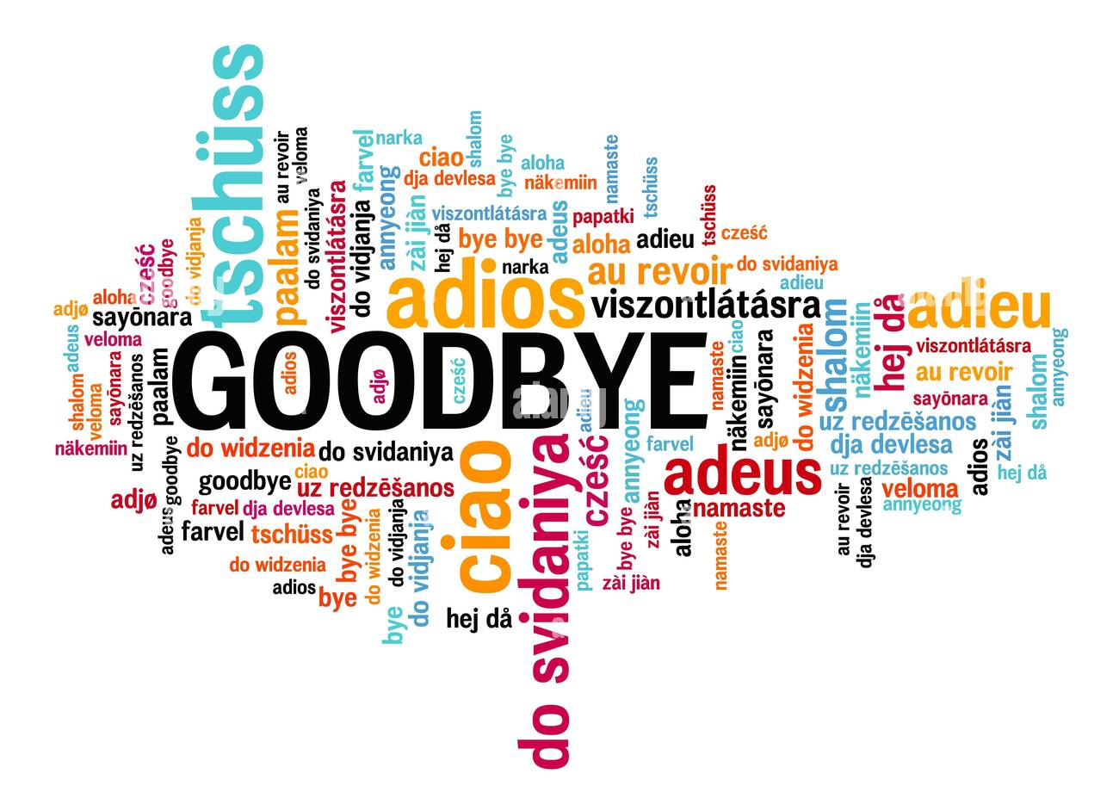
ALMOST TIME
to say…

Slide 2
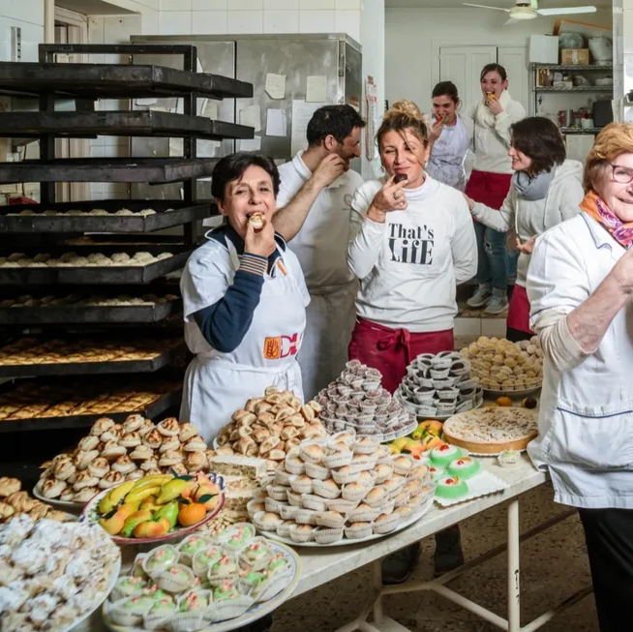
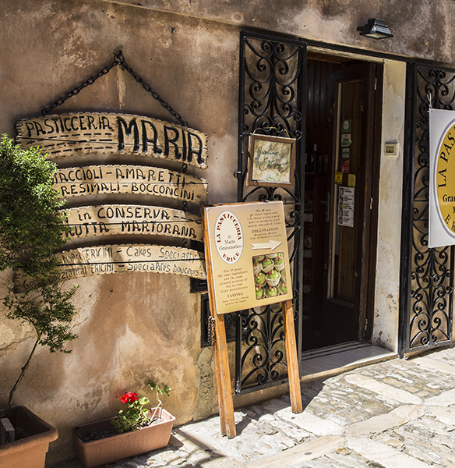
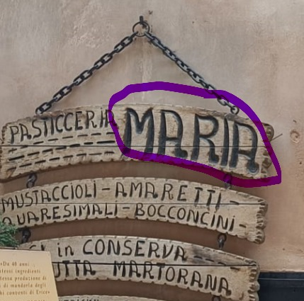


FIRST THINGs First

Slide 3
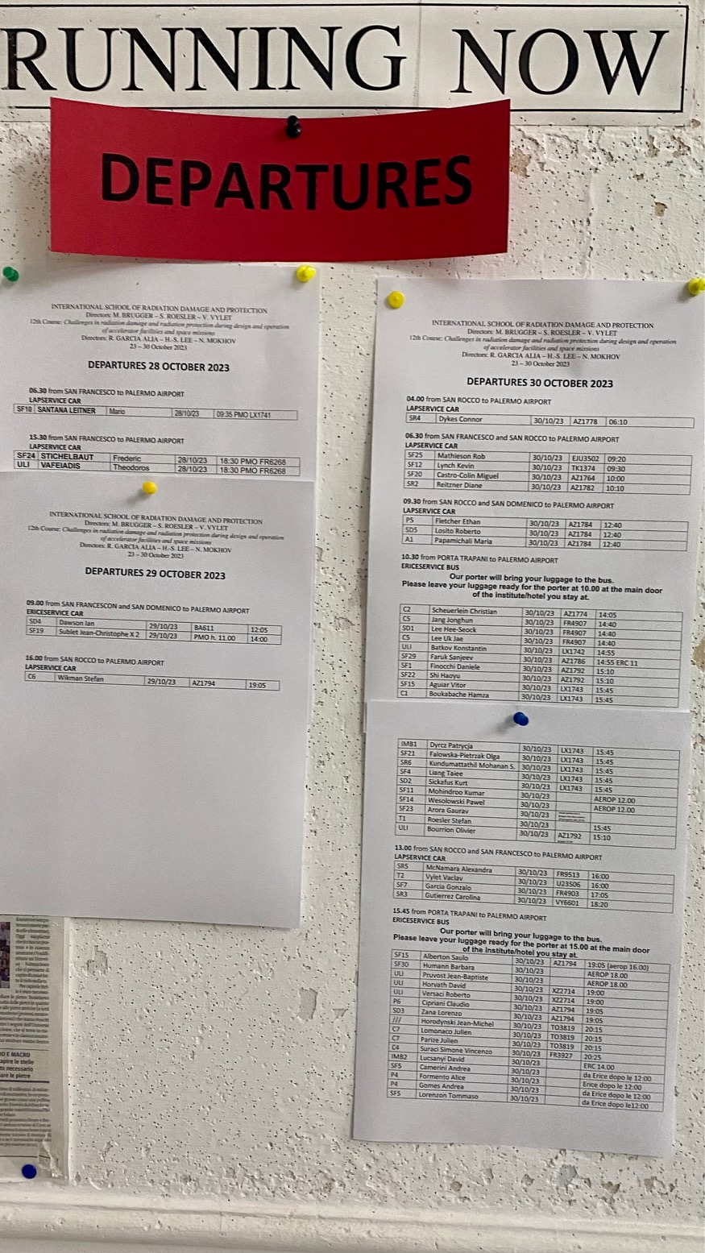
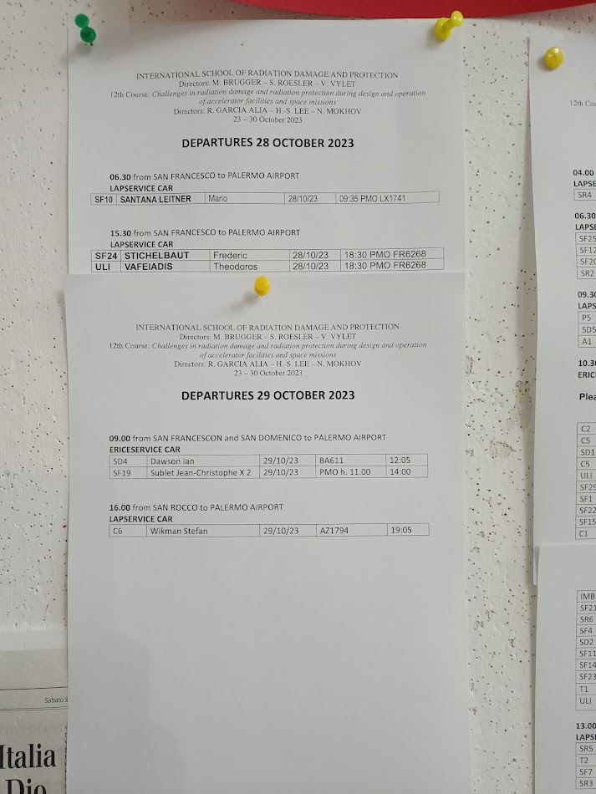
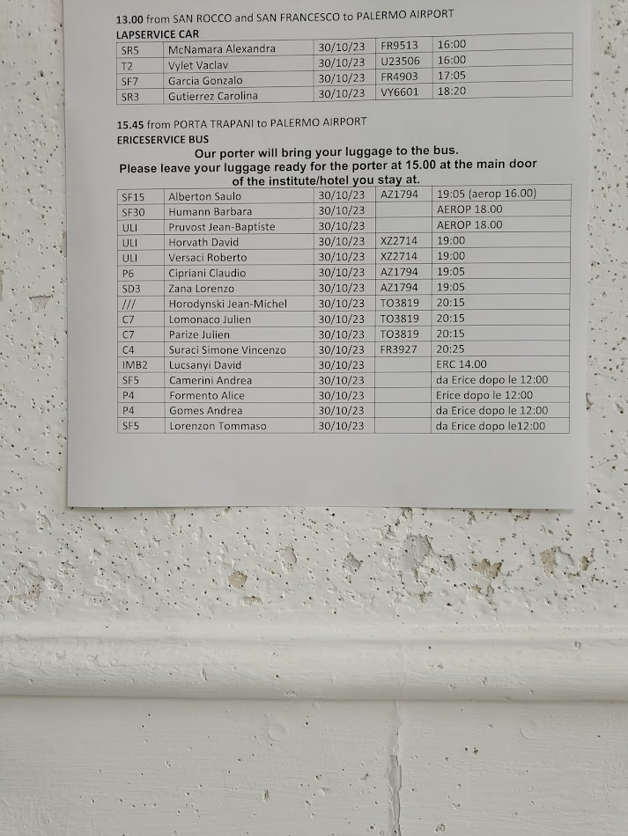
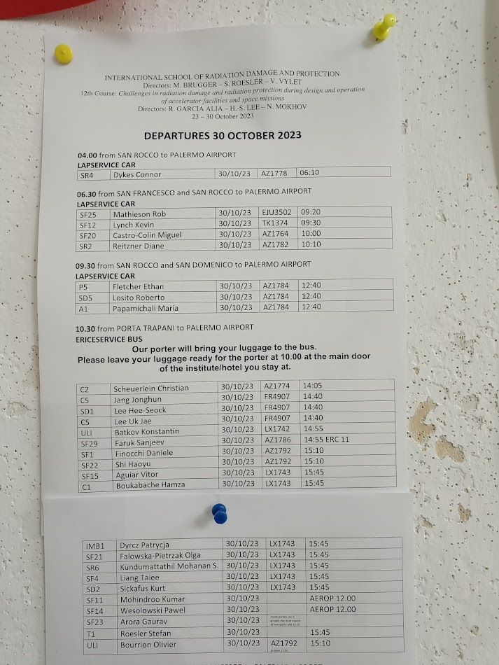
SOME LAST Admin-Related
Departures – please check the list @San Rocco

Slide 4
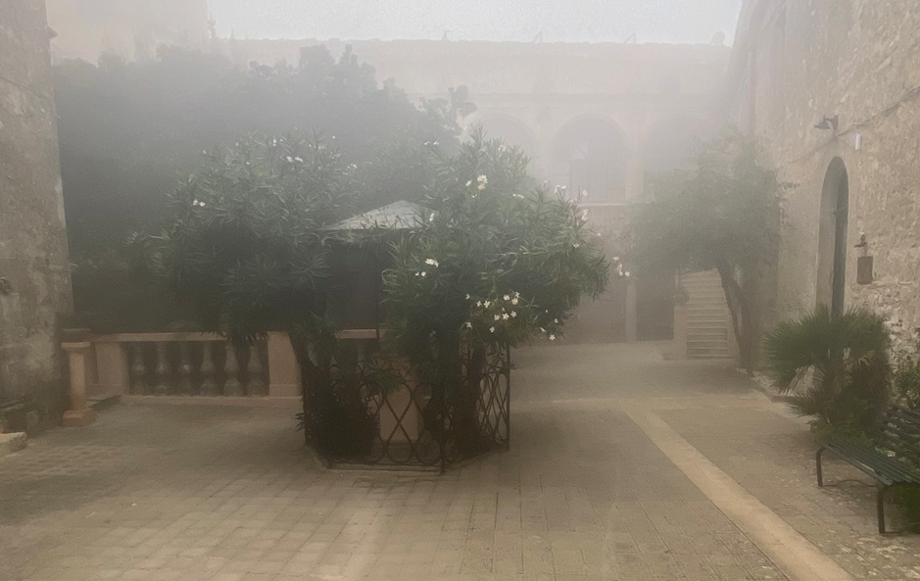

SOME LAST Admin-Related
(2) Breakfast tomorrow: together @ San Rocco

Slide 5
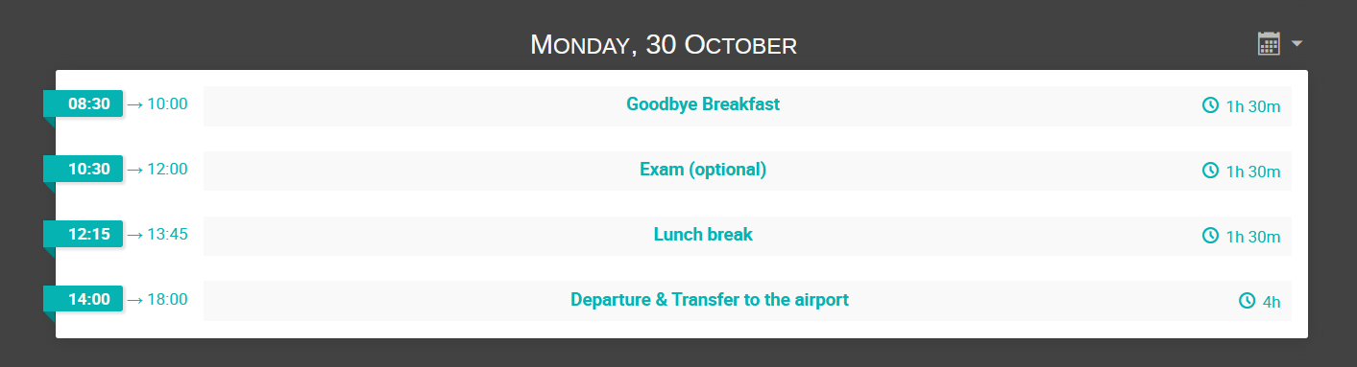
SOME LAST Admin-Related
(3) No lectures/attendance required @ San Domenico

Slide 6
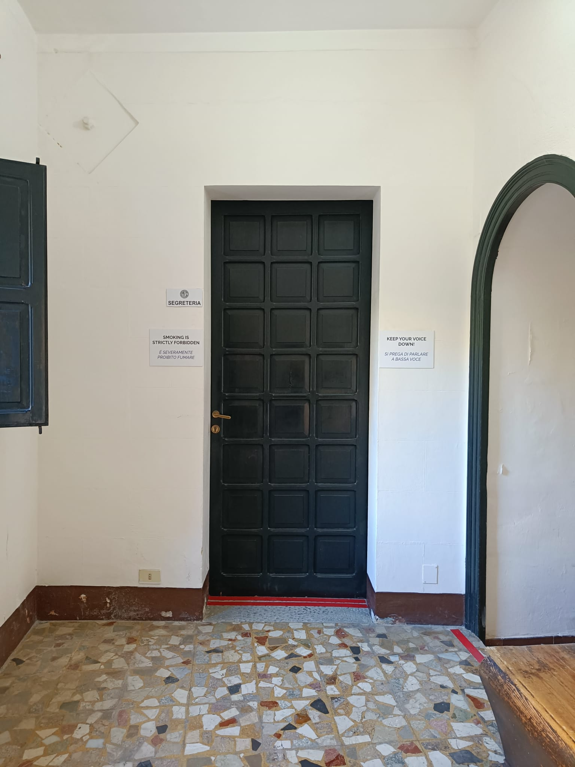
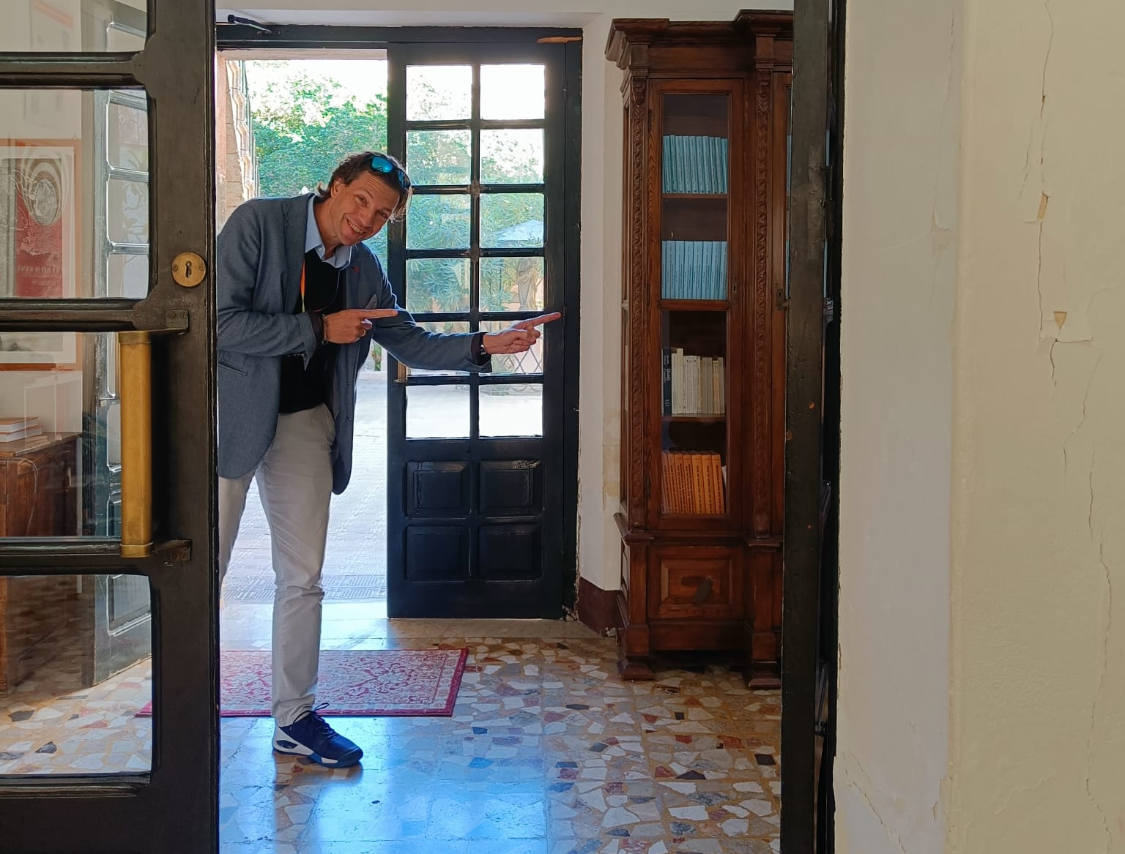
SOME LAST Admin-Related
(4) Payments for last night(s)
& pending respective receipts
-> go to see Alessandro

Slide 7
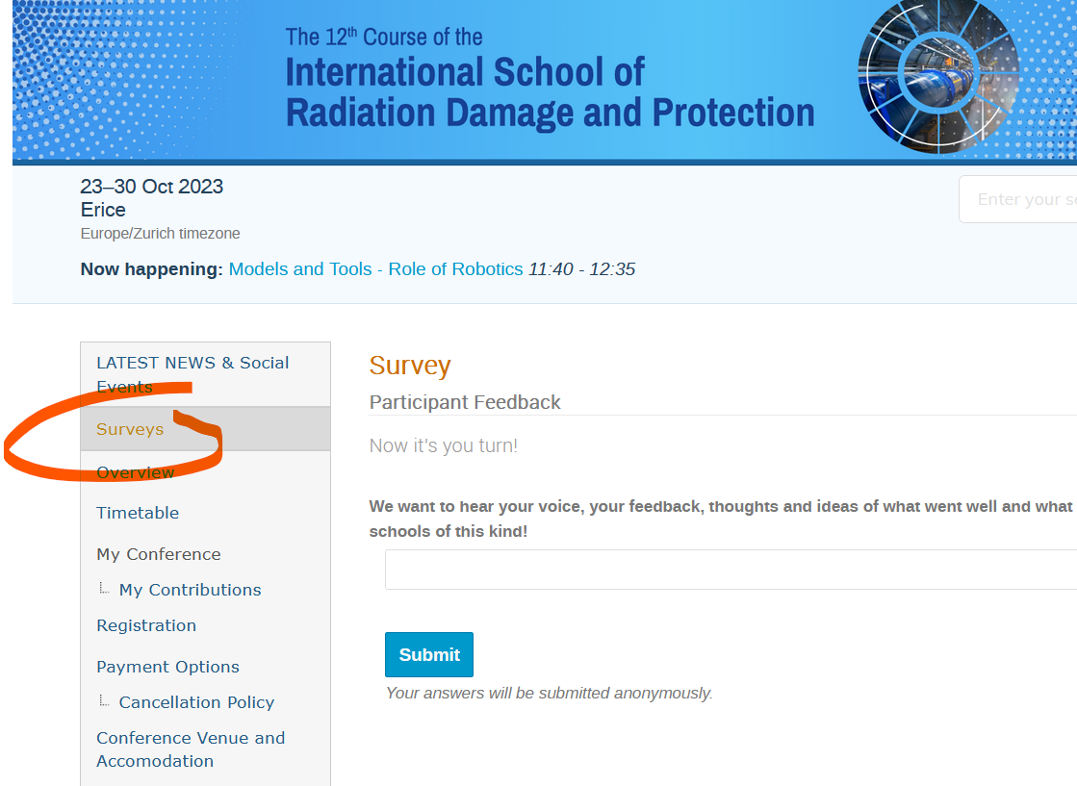
SOME LAST Admin-Related
School
Feedback
Form

Slide 8

SOME LAST Admin-Related
(6) School Attendance Certificate

Slide 9
SOME LAST Admin-Related
(7) Knowledge Evaluation
  Interesting/Useful for all of us (review some slides)
  Counting as Exam for students needing credits
  -> You will receive a respective link by email
  & it will be visible as well on the website

Slide 10
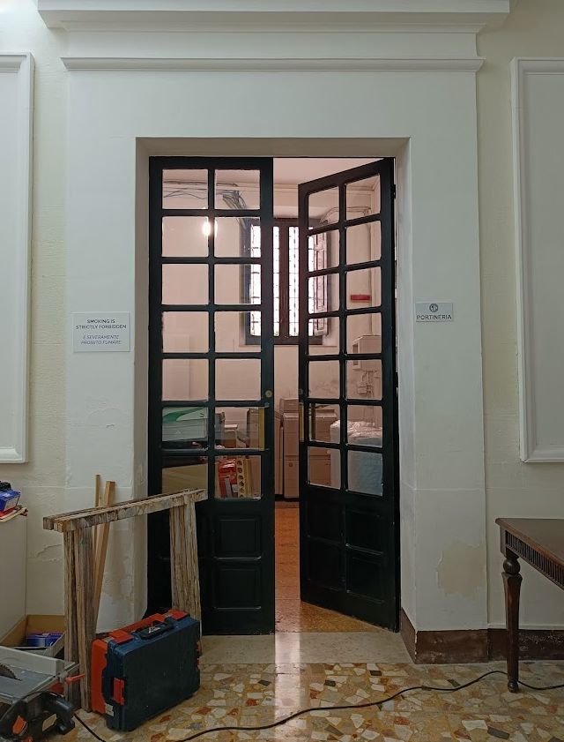
SOME LAST Admin-Related
(8) Giving back your keys
-> PLEASE
  You can drop them off
  at San Rocco

Slide 11

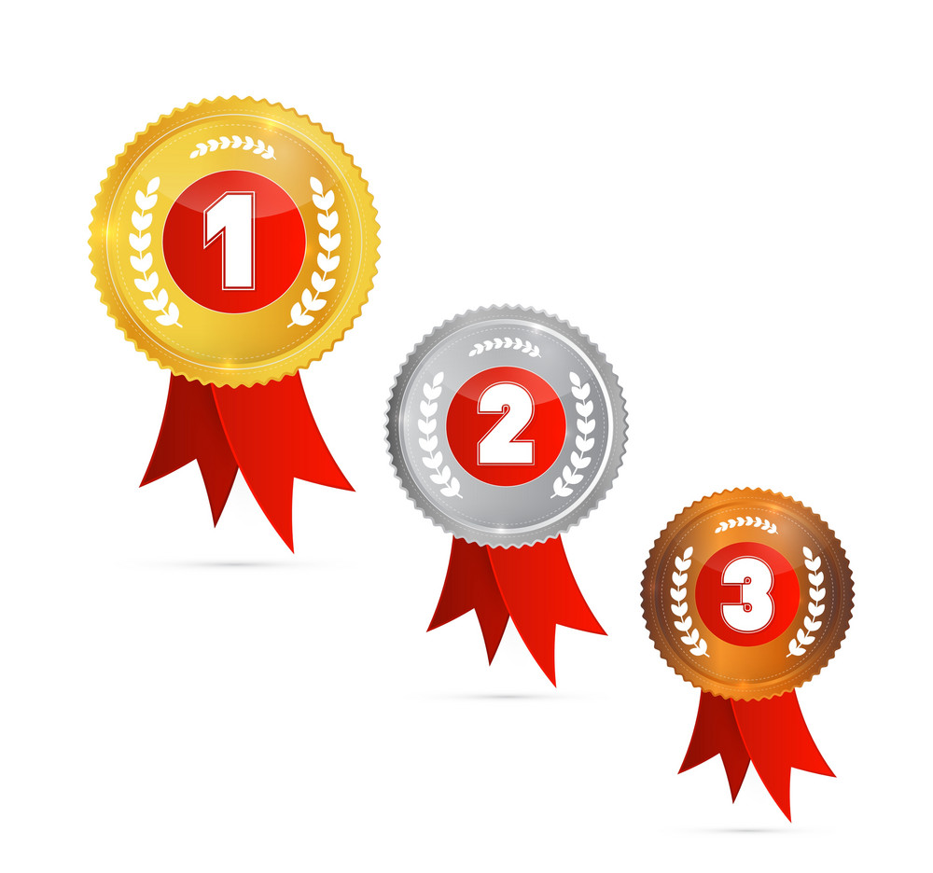

A Course Looking
@ Radiation Damage
& Protection
through…
Theory, Methodology,
Examples & Tools
… as they appear ..
In Multiple
Application Fields
BRINGING YOU/US
ALL TOGETHER

Slide 12




MANY THANKS
LECTURERS
SCHOOL &
COURSE

Slide 13
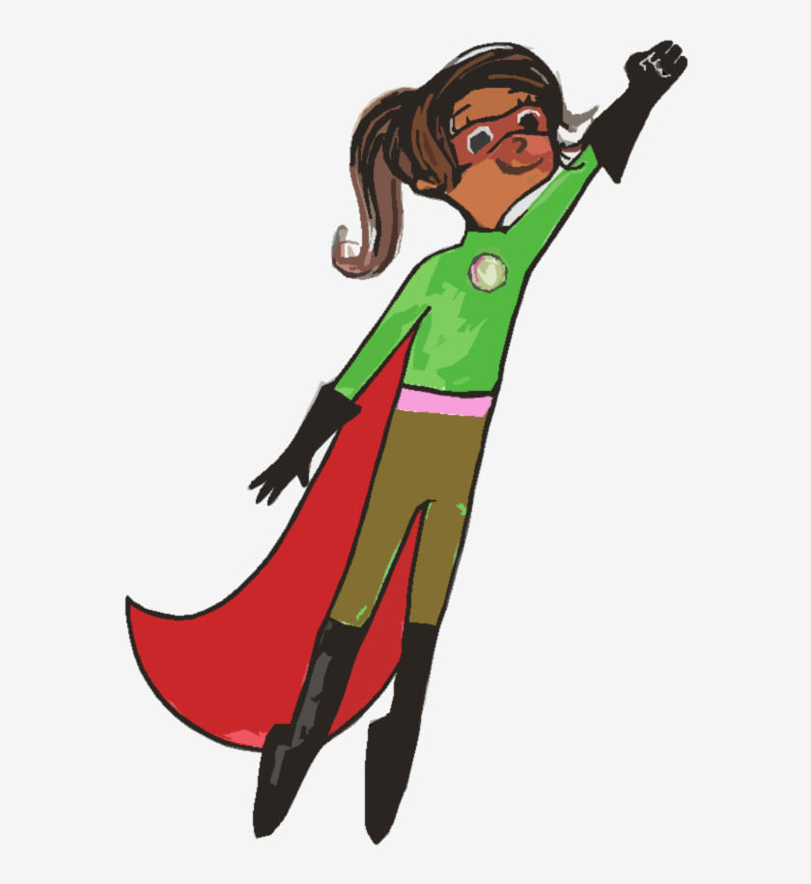


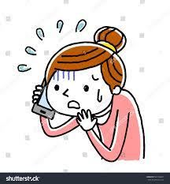





Slide 14

MANY THANKS

Slide 15
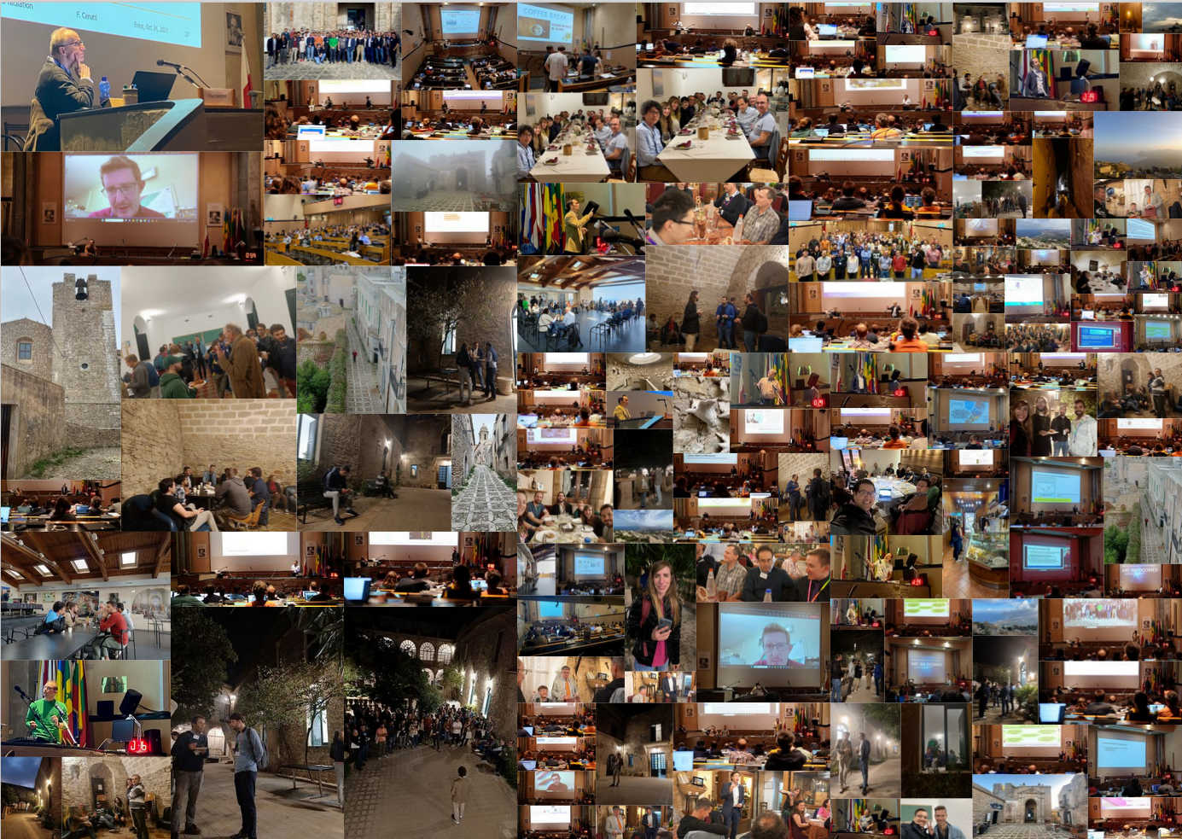
MANY THANKS

Slide 16
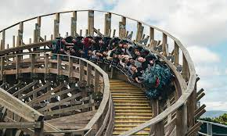
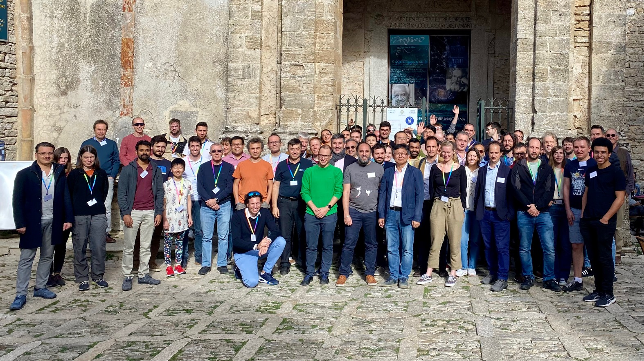

IT IS/WAS a GREAT RIDE
PICTURES (CERNbox, Dropbox-like)
(https://cernbox.cern.ch/s/1nm6oEM9NcGfx6p)

Slide 17

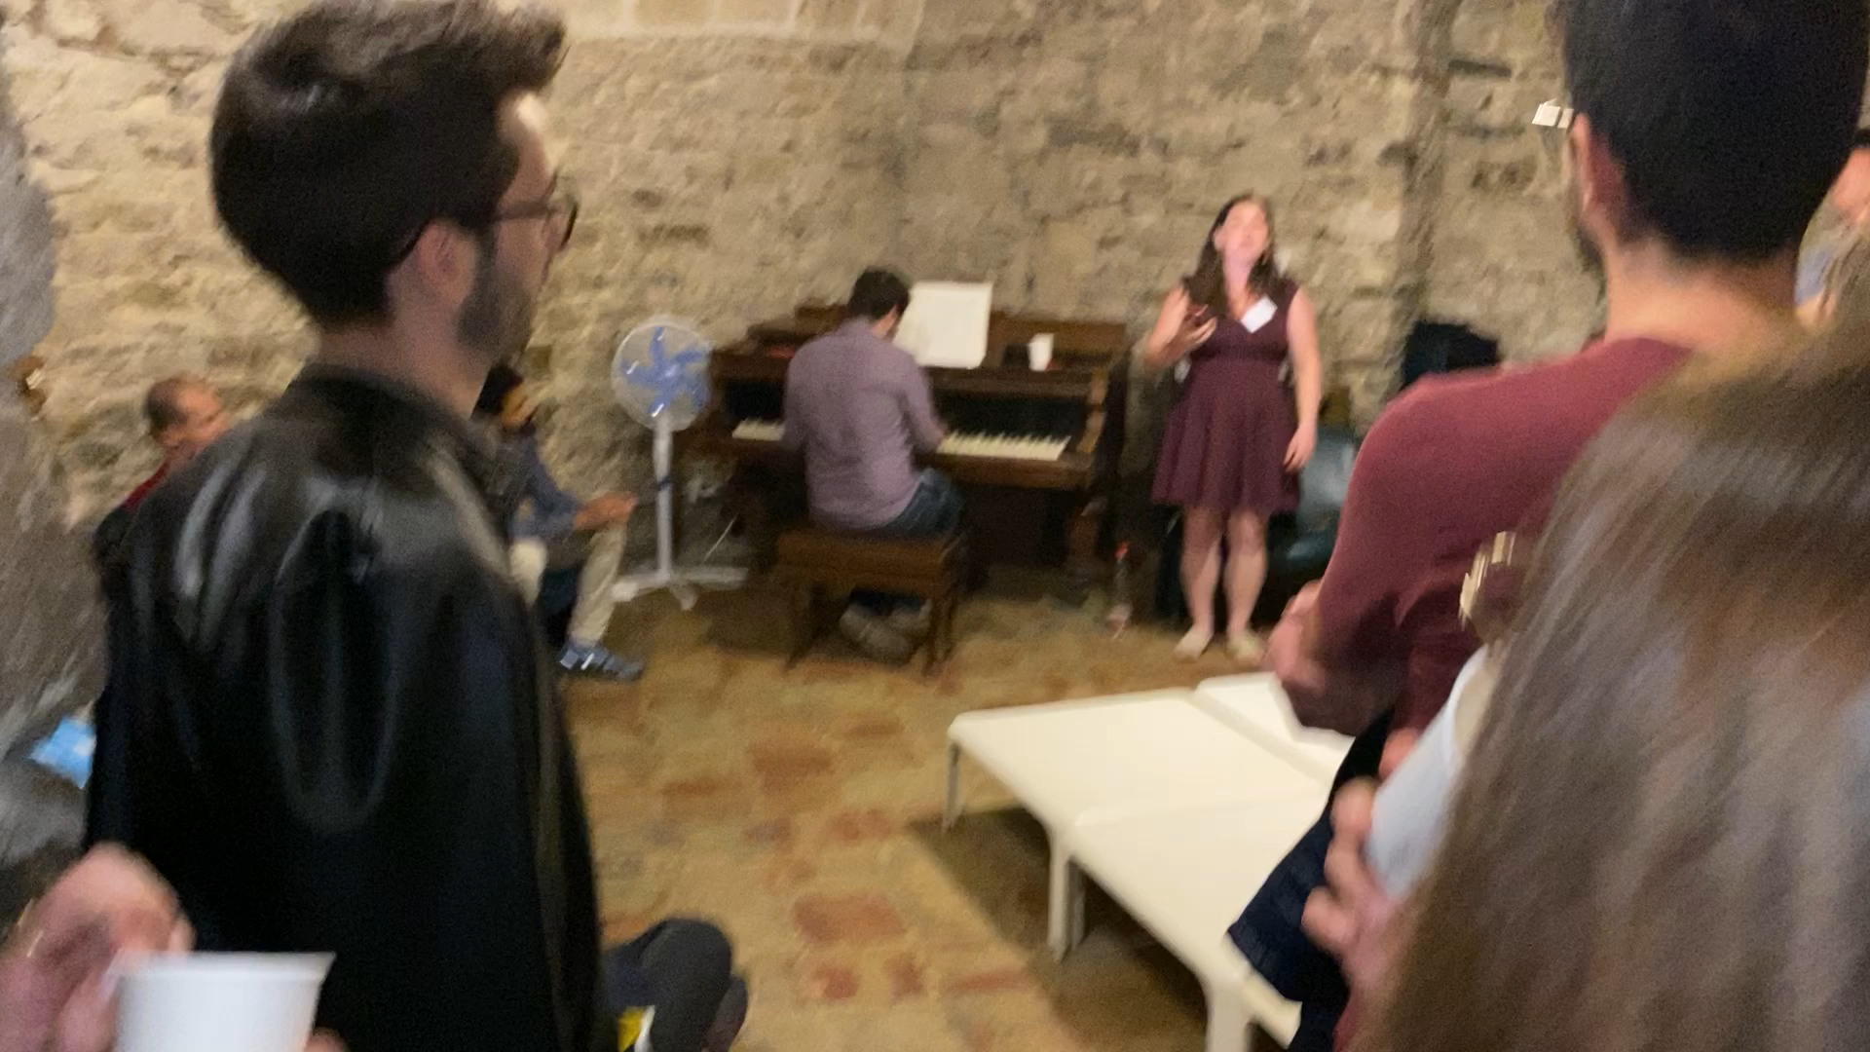
Marsala Room
…again this evening

