Slide 1





Perturbed angular correlation and x-ray diffraction studies on the α-β phase transition in multiferroic bismuth ferrite
DI Georg Marschick

Slide 2
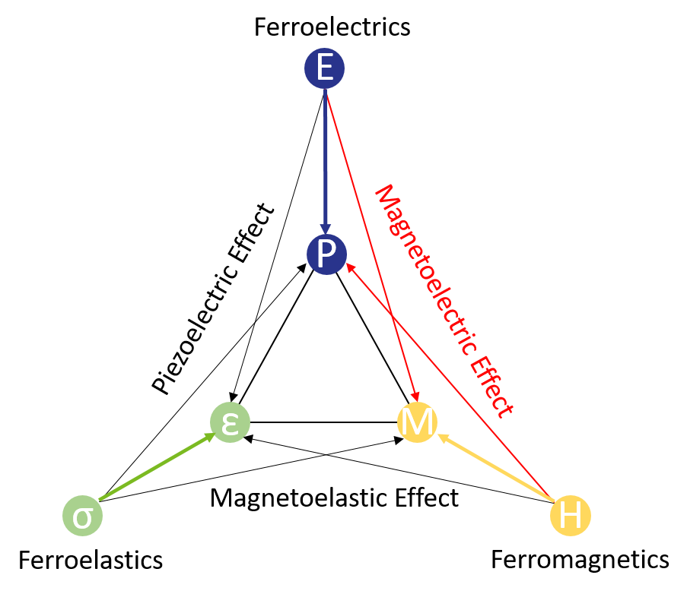
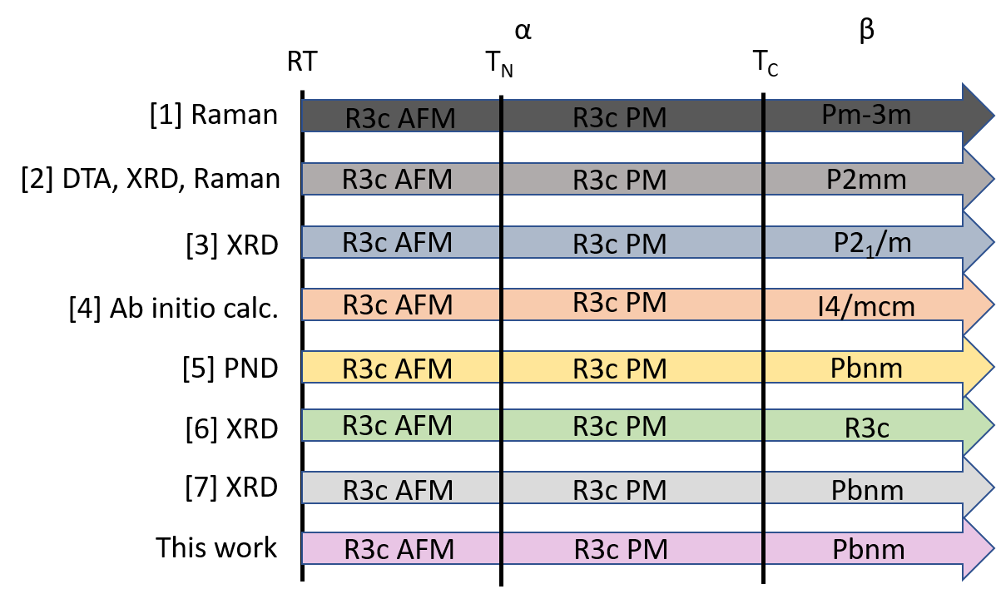
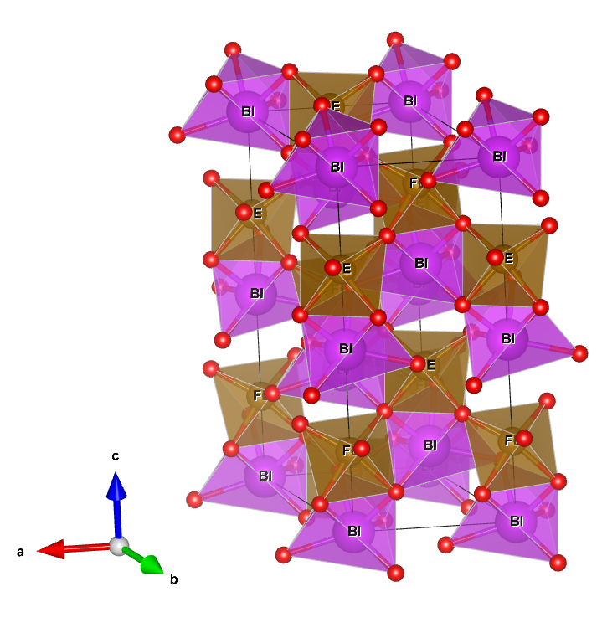
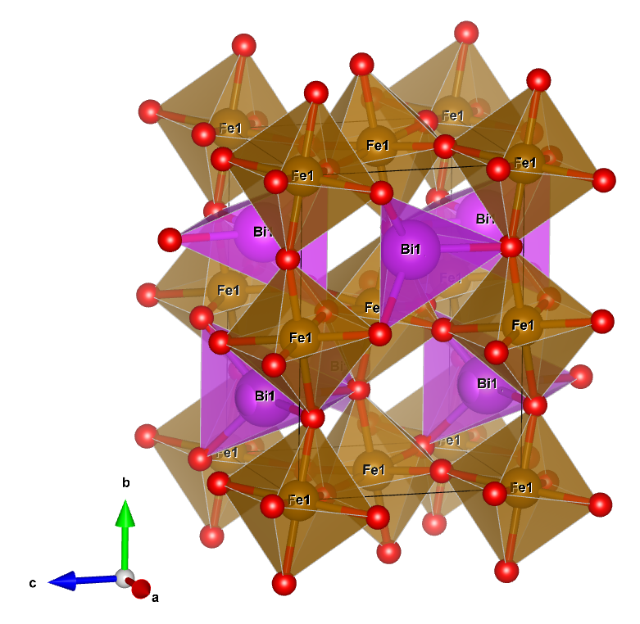
Bismuth Ferrite – BiFeO₃
Quasi-cubic canted perovskite of LiNbO₃ type
Curie Temperature: 820°C
Néel Temperature: 370°C
  Thus magnetoelectric at room temperature
Rhombohedral α-phase
Orthorhombic β-phase
α
β

Slide 3
Structural studies – lattice and local properties
Perturbed angular correlation (local properties)
  Asymmetry and strength of Electric field gradient
  How are local properties influenced by the phase transition?
  Is the phase transition visible?
X-ray diffraction (lattice properties)
  Description of unit cell, lattice parameters and space group
  Atomic positions, bond lengths and angles
  Well known and understood method
Notes:
PAC: determining the limits of pac, can we perform a structural analysis?
Xrd: validate the results of pac

Slide 4
Perturbed Angular Correlation (PAC)
Naive theory
Observable
Actor / Consequence
Reason
We measure a frequency ω of angular γ-γ coincidences…
…due to force acting on the nucleus and thus „turning“ it…
…caused by electric or magnetic fields in the nucleus´ vicinity.

Slide 5
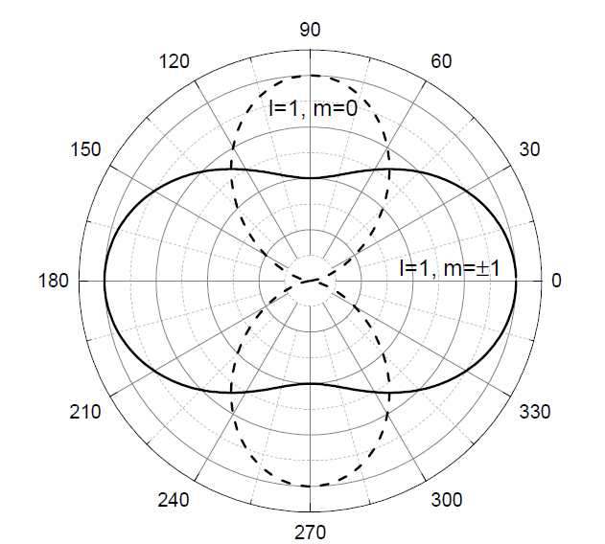


Perturbed Angular Correlation (PAC)
Naive theory
Emission characteristic of γ-radiation – orientation of nuclei
Conservation of angular momentum and selection rules
Anisotropic emission of a γ- γ cascade
+
=
# of γ-γ coincidences
Channel
z

Slide 6
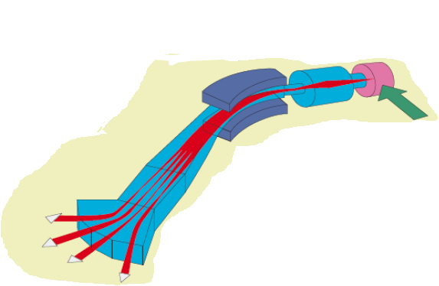
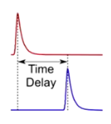
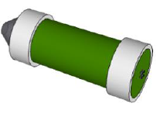

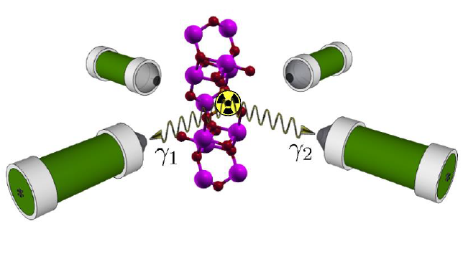
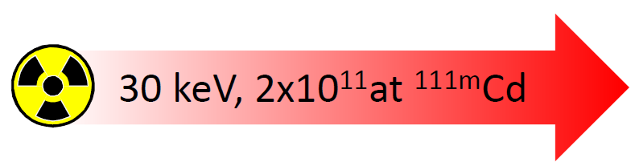
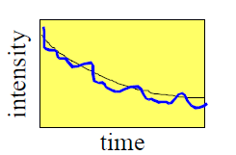
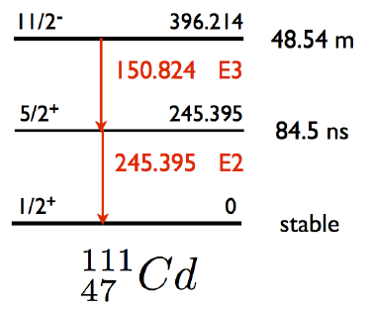
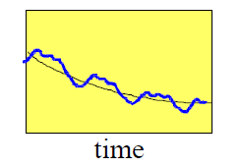



Perturbed Angular Correlation (PAC)
A method to probe hyperfine interactions in matter
Target
Molten Sn
Acceleration
$$\vec{E}$$
Mass separation
$$\vec{B}$$
γ₁
Primary 1.4 GeV
proton beam
γ₂
z
intensity

Slide 7
Perturbed Angular Correlation (PAC)
A method to probe hyperfine interactions in matter
Target
Molten Sn
Acceleration
$$\vec{E}$$
Cd @ Bi-site
Mass separation
$$\vec{B}$$
γ₁
Primary 1.4 GeV
proton beam
γ₂
90°
z
90°
intensity

Slide 8
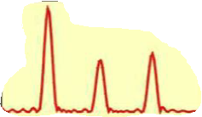

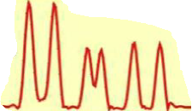

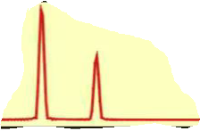




Perturbed Angular Correlation (PAC)
A method to probe hyperfine interactions in matter
Transition frequencies
Nuclear level splitting
ω₁
ω₂
ω₃
Electric Field Gradient (EFG)
ω₂
ω₃
$$\left(\begin{matrix}V_{xx} & 0 & 0 \\ 0 & V_{yy} & 0 \\ 0 & 0 & V_{zz}\end{matrix}\right)$$
ω₁
ω$∝$
5/2⁺
245.395keV
84.5ns
+ combined interactions
ω_{n}
Magnetic Hyperfine field
$$\left(0,0,B_{z}\right)$$
ω_{L}
2ω_{L}
ω$∝$
ω_{L}
2ω_{L}
Nuclear probing state in matter
Consequence
Observable

Slide 9
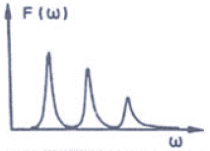
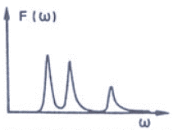
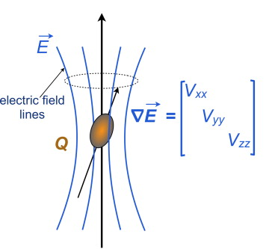
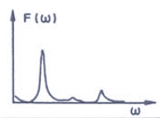

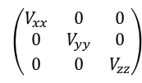


Perturbed Angular Correlation (PAC)
A method to probe hyperfine interactions in matter
Transition frequencies
η=0
symmetric
Electric quadrupole interaction
Electric Field Gradient (EFG)
ω₁
ω₂
ω₃
ω₂
ω₃
$$\left(\begin{matrix}V_{xx} & 0 & 0 \\ 0 & V_{yy} & 0 \\ 0 & 0 & V_{zz}\end{matrix}\right)$$
ω₁
η
η≠0
5/2⁺
245.395keV
84.5ns
ω$∝$
interacts with core quadrupole moment Q
$$η=\frac{V_{xx}−V_{yy}}{V_{zz}}$$
ω₁
ω₂
ω₃
η=1
unsymmetric
$η$ and V_{zz} (ω₀)
describe the EFG
ω₁=
ω₂
ω₃
Nuclear probing state in matter
Consequence
Observable

Slide 10
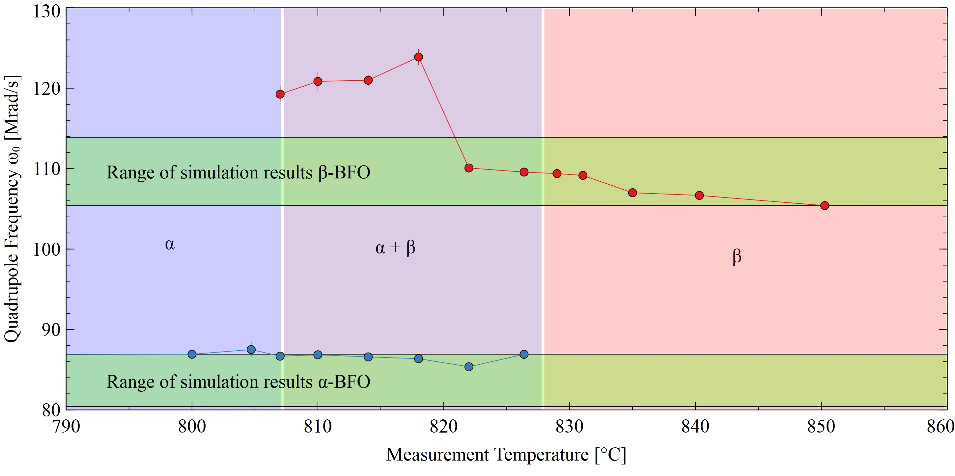
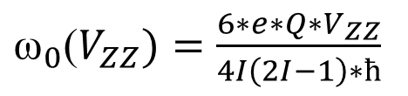
DFT Simulations at University of Aveiro (PT)
Density functional theory simulations to calculate Vzz and η done for Cd @ Bi
Range of values follows the error
of the Q values of Cd of Q=0.641(25) b
${\text{ω}}_{0}$($V_{ZZ})=\frac{6∗e∗Q∗V_{ZZ}}{4I\left(2I−1\right)∗ħ}$

Slide 11
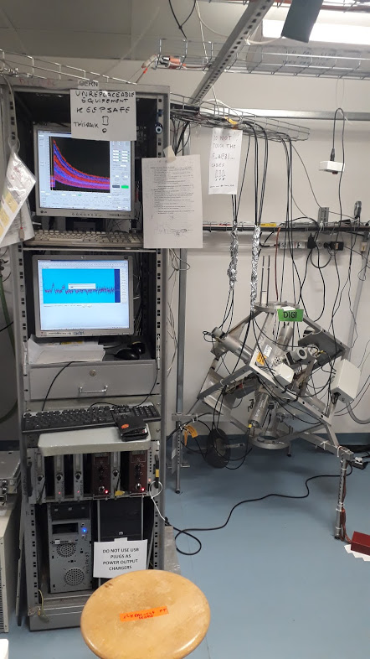
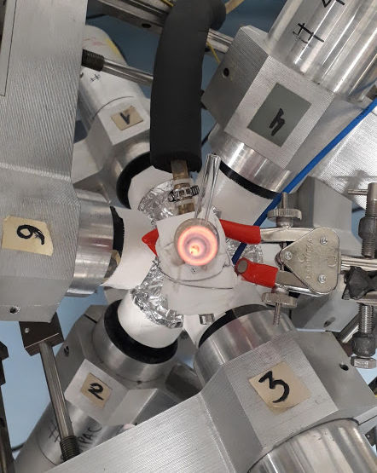
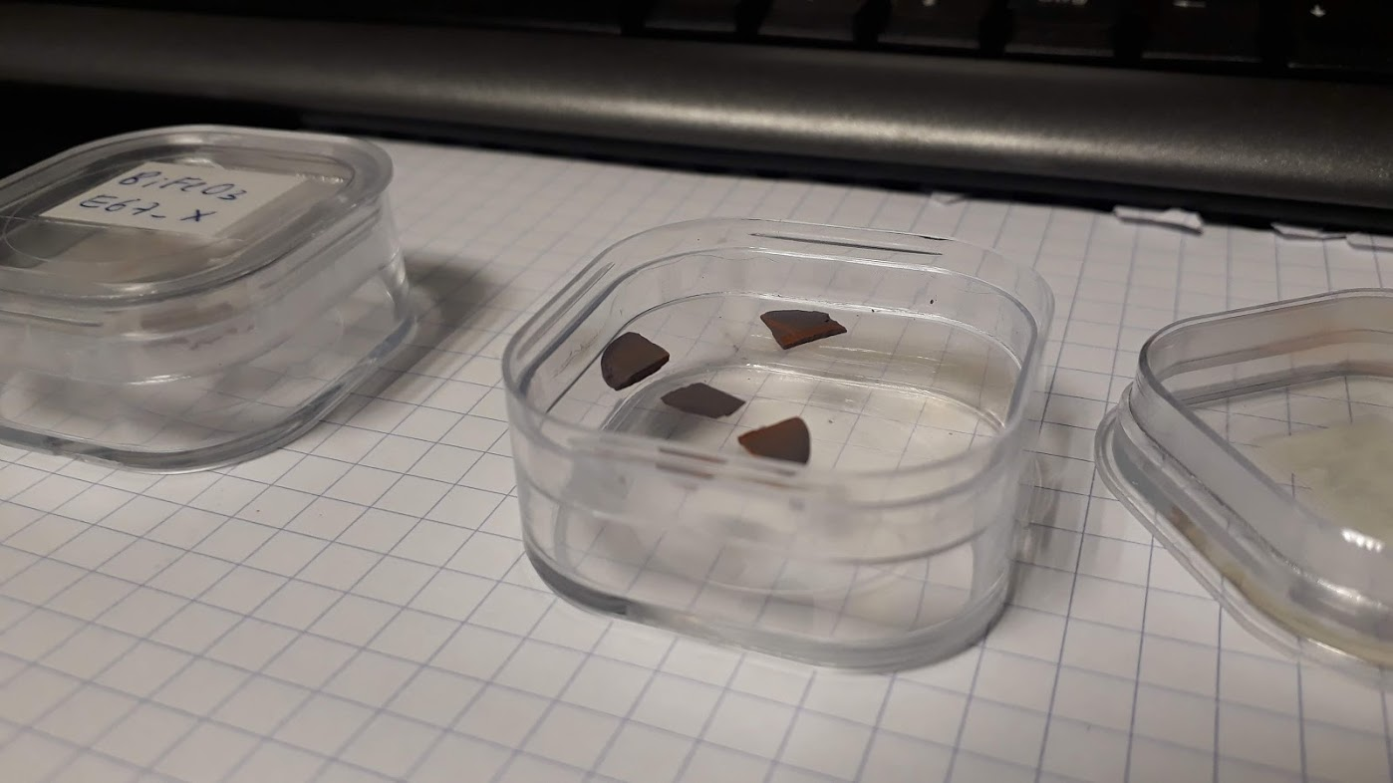
PAC Studies at CERN - ISOLDE (CH)
BiFeO₃ samples were cut and ^{111m}Cd implanted at GLM
beamline at 30keV
6 detector fully digital spectrometer
High temperature measurements directly after implanting
One temperature per sample

Slide 12
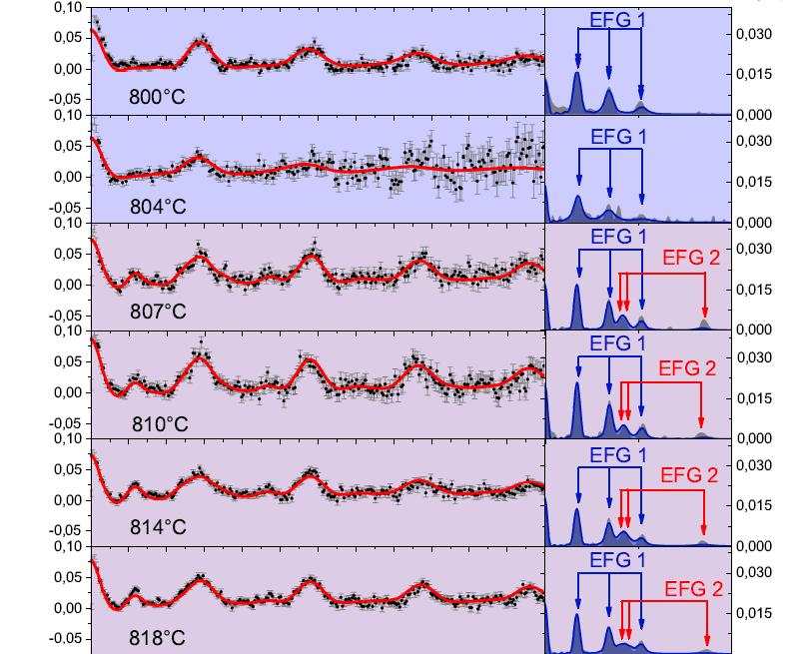
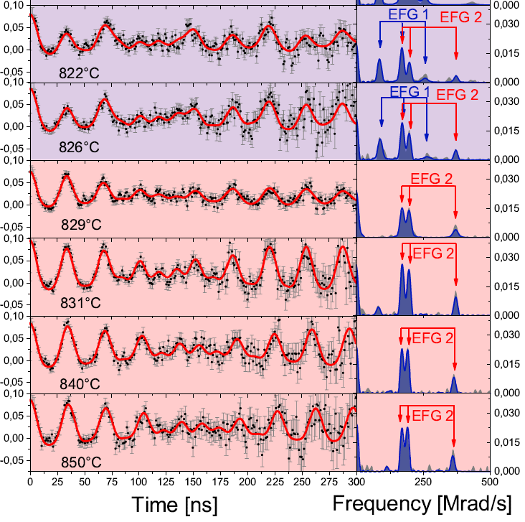
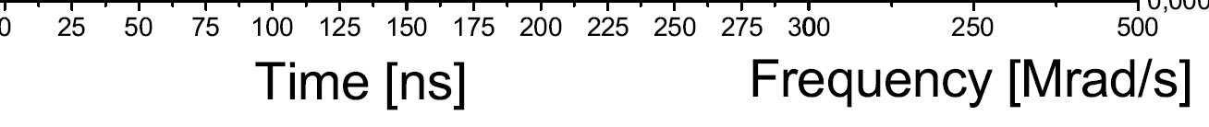


Temperature dependence of perturbation function R(t)

Slide 13
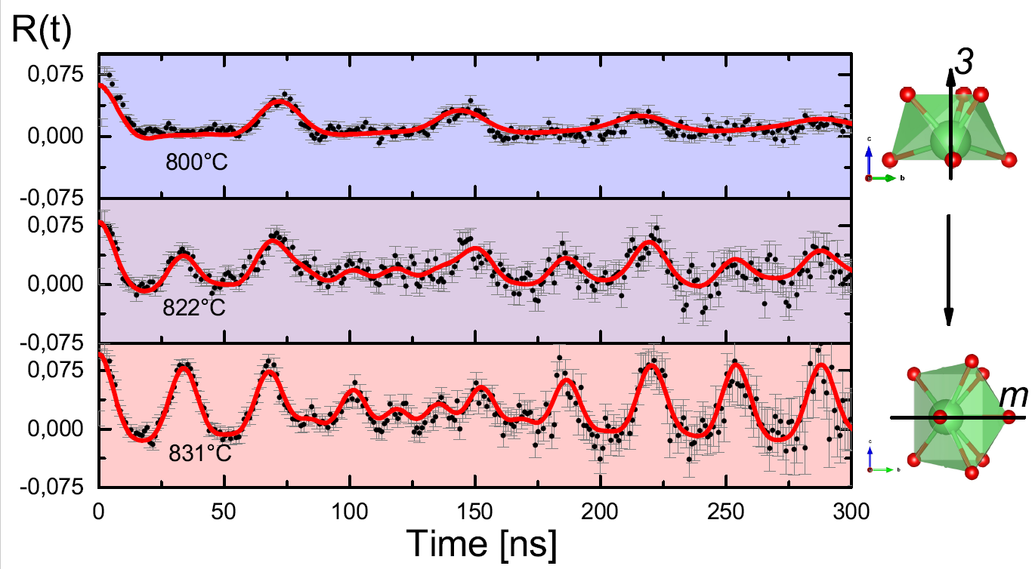
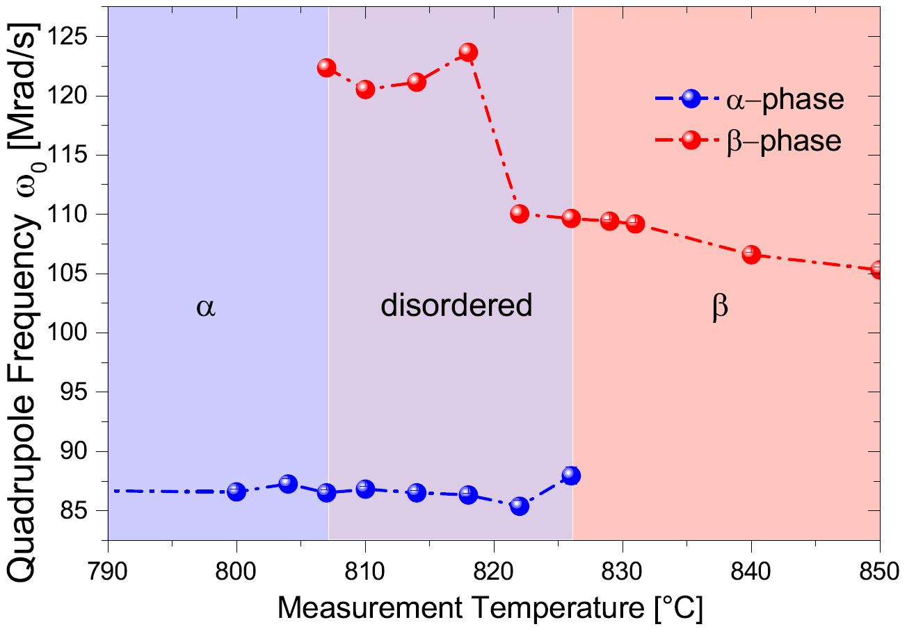
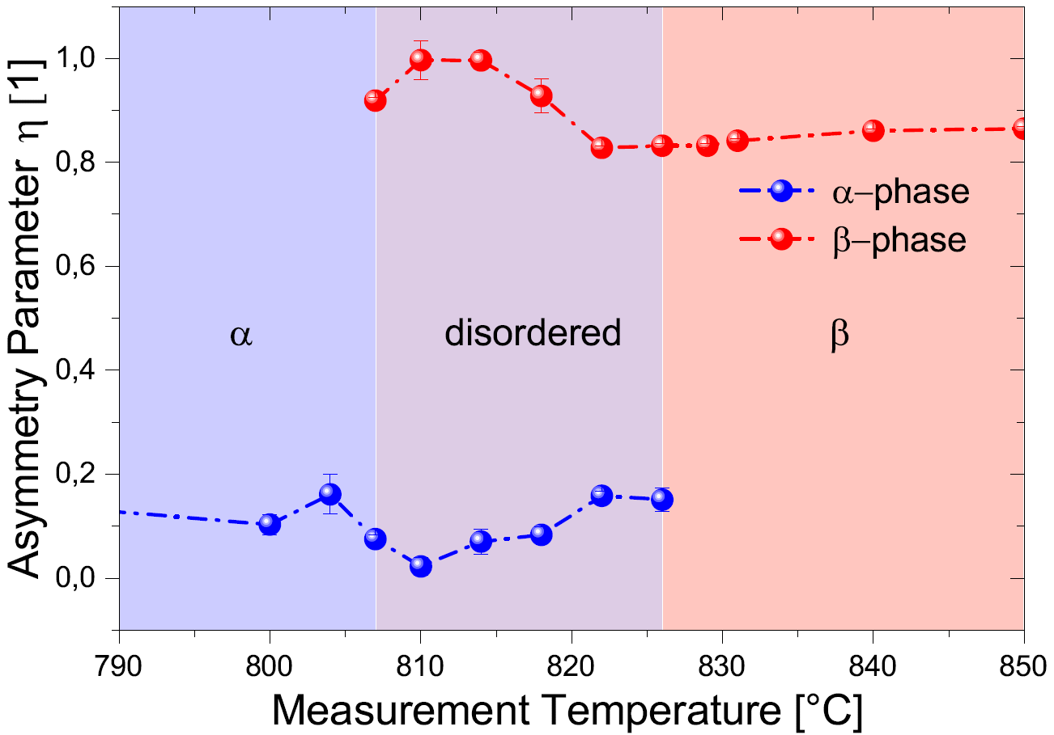
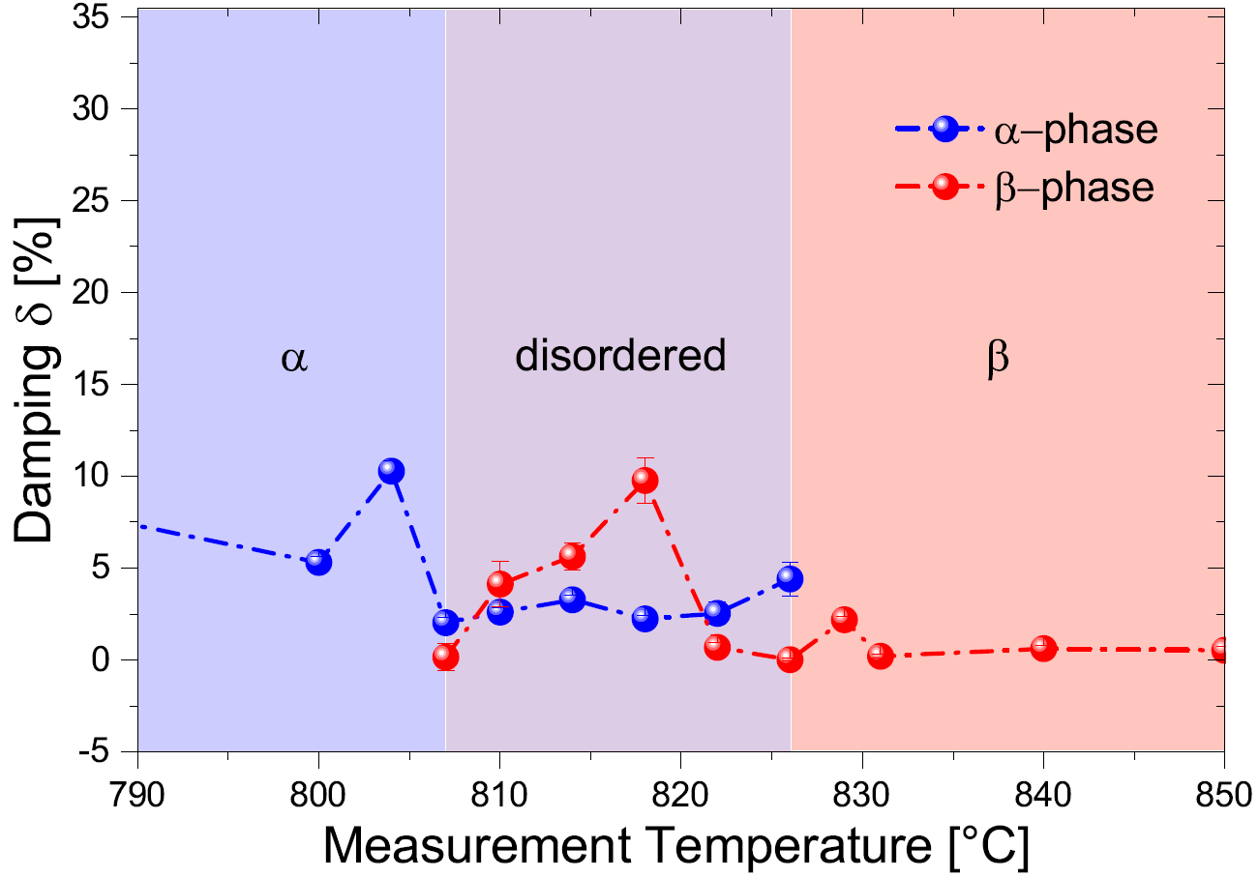
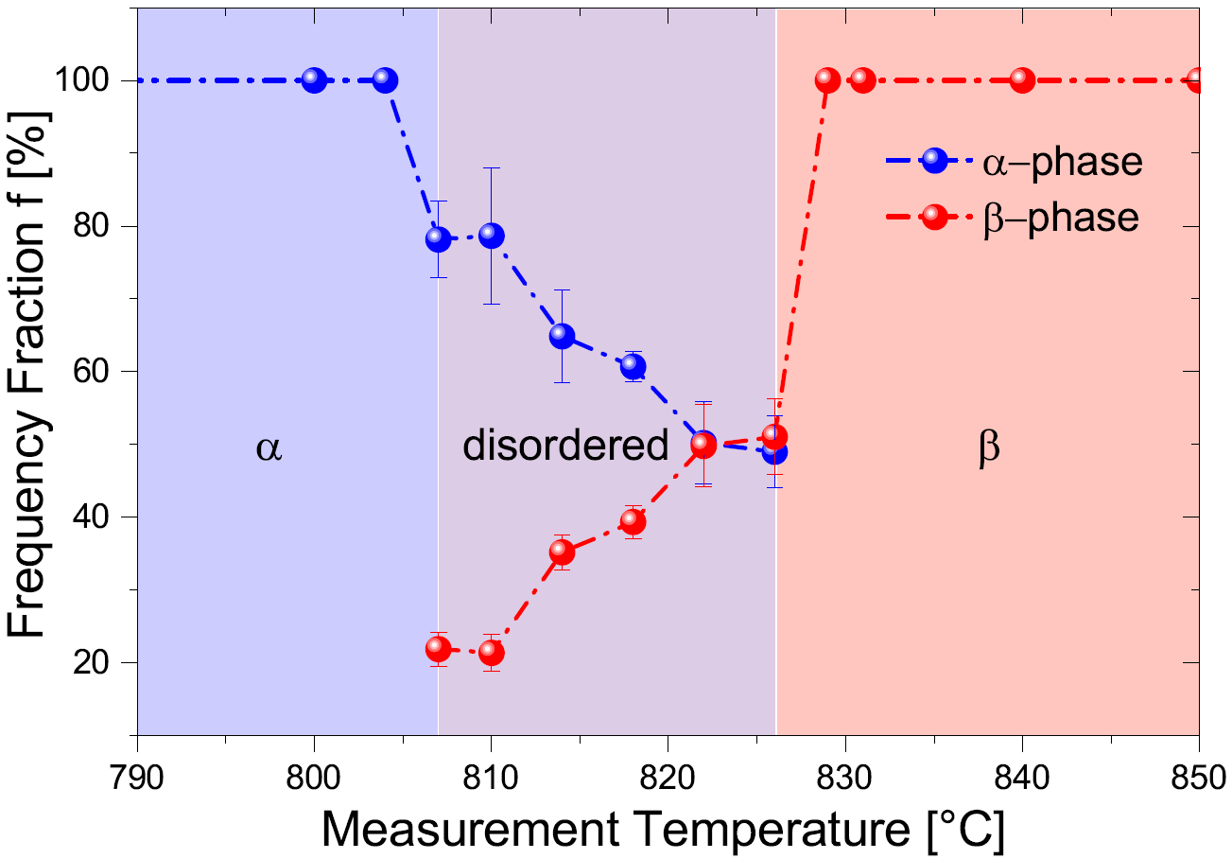
Temperature dependence of error function R(t)
α
β

Slide 14
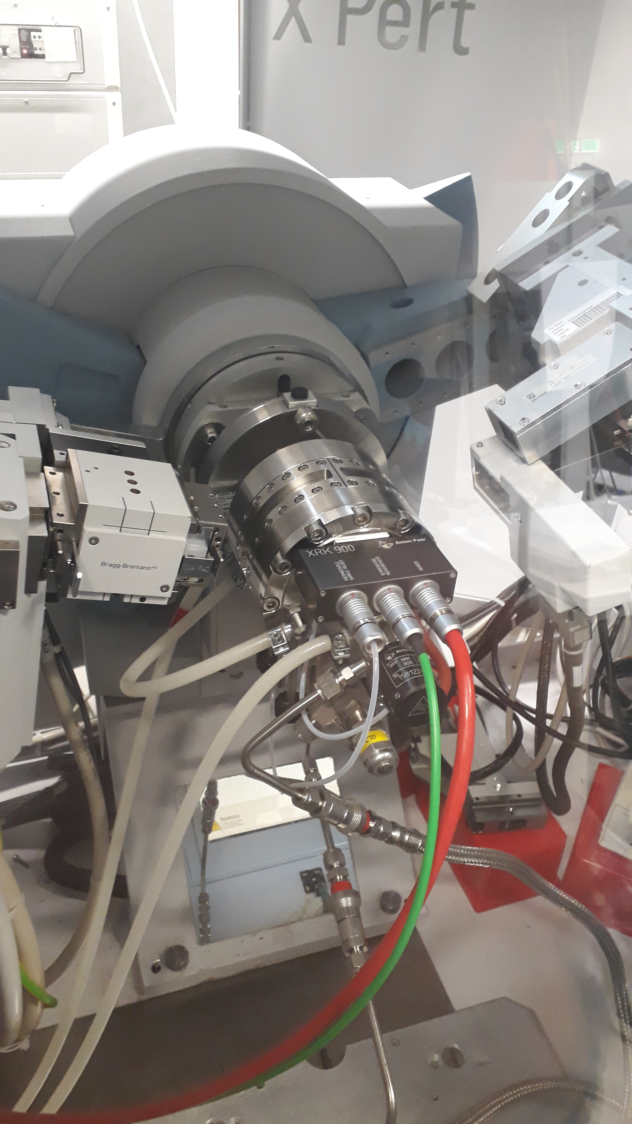
X-ray diffraction studies at TU Wien (AT)
Samples were ground and placed on Pt-sample holder
Single temperature Bragg Brentano measurement (20°-70°)
Sweep measurements 30-33° (800-840-800°C)

Slide 15
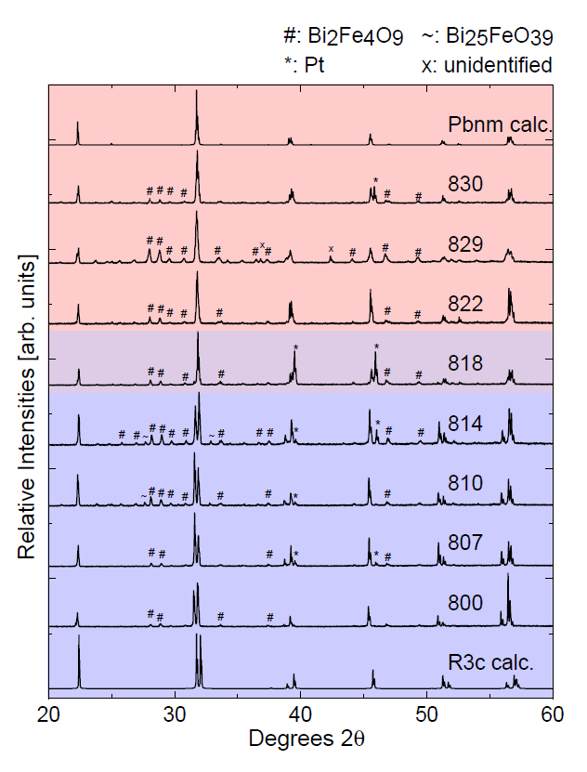
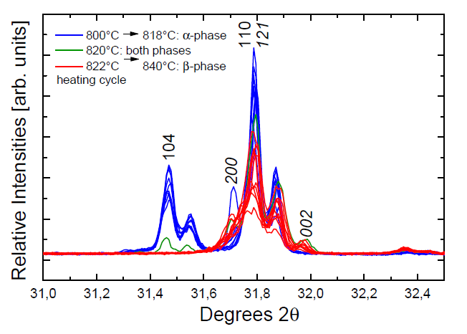
X-ray diffraction studies at TU Wien
Single temperature measurements
Both measurements show a phase transition at 818-820°C
Sweep measurement 30°-33°

Slide 16
Results
The results of both experimental methods agree with a phase transition from rhombohedral α-BFO in R3c setting to orthorhombic β-BFO with its Pbnm space group at 820°C
PAC results suggest a forecast of the first order phase transition by the Cd probe ion as it senses the preceding symmetry change of the Bi(Cd) coordination environment
Phase transition is visible through a drop in quadrupole interaction frequency ω₀
DFT results support the PAC results
XRD single temperature measurements suggest a phase transition temperature of 818°C, sweep measurements indicate a transition temperature of 820°C
The XRD results support the results gained with PAC

Slide 17
Thank you!
J. Schell^{2, 3}, B. Stöger¹, J. N. Gonçalves⁴, M. O. Karabasov³, D. Zyabkin⁵, A. Welker², M. Escobar C.³, D. Gärtner⁶, I. Efe⁷, R. A. Santos⁸, J. E. M. Laulainen⁹ and D. C. Lupascu³
1 X-Ray Center, Vienna University of Technology, 1040 Vienna, Austria
2 European Organization for Nuclear Research CERN, CH-1211 Geneva, Switzerland
3 Institute for Materials Science and Center for Nanointegration Duisburg-Essen (CENIDE), University of Duisburg-Essen, 45141 Essen, Germany
4 Departmento de Física and CICECO, Universidade de Aveiro, 3810-193 Aveiro, Portugal
5 Chair Materials for Electronics, Institute of Materials Science and Engineering and Institute of Micro and Nanotechnologies MacroNano, TU Ilmenau, 98693 Ilmenau, Germany
6 Institut für Materialphysik, AG Wilde, Universität Münster, 48149 Münster, Germany
7 Department of Materials, ETH Zürich, 8092 Zürich, Switzerland
8 Hyperfine Interactions Group - IPEN University of São Paulo, São Paulo, SP, Brazil
9 Department of Materials Science and Metallurgy, University of Cambridge, Cambridge, United Kingdom
Federal Ministry of Education and Research (BMBF) through grants 05K16PGA and 05K16SI1
European Union’s Horizon 2020 Framework research and innovation program 654002 (ENSAR2)
Thanks to the whole team of ISOLDE for the support and the high-quality beams

Slide 19
DFT Details
VASP Code (Vienna Ab-Initio Simulation Package)
projector augmented wave method with a general gradient approximation
  5d¹⁰6s²6p³ for Bi
  2s²2p⁴ for Fe
  3p⁶3d⁶4s² for O
  4d¹⁰5s² for Cd
Alpha phase: 2x2x1 supercell with 4x4x3 k-point grid
Beta phase: 2x2x1 supercell with 5x5x4 k-point grid
Bi2Fe4O9: 2x1x2 supercell with 3x2x4 k-point grid
Energy cut-off 450eV
Self consistent stop @ values < 10e-5 eV

Slide 20
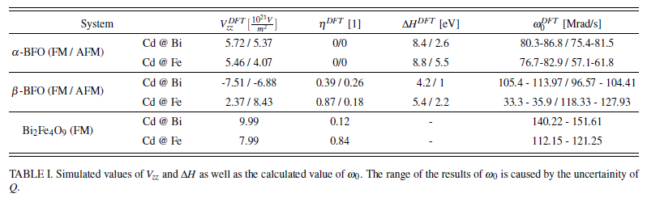
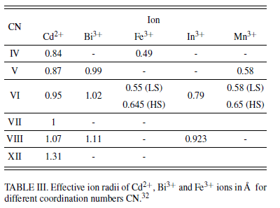
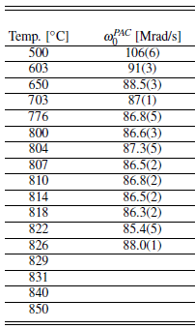
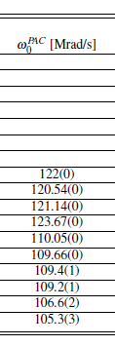
DFT Results
Ion radii
PAC Results

