Slide 1
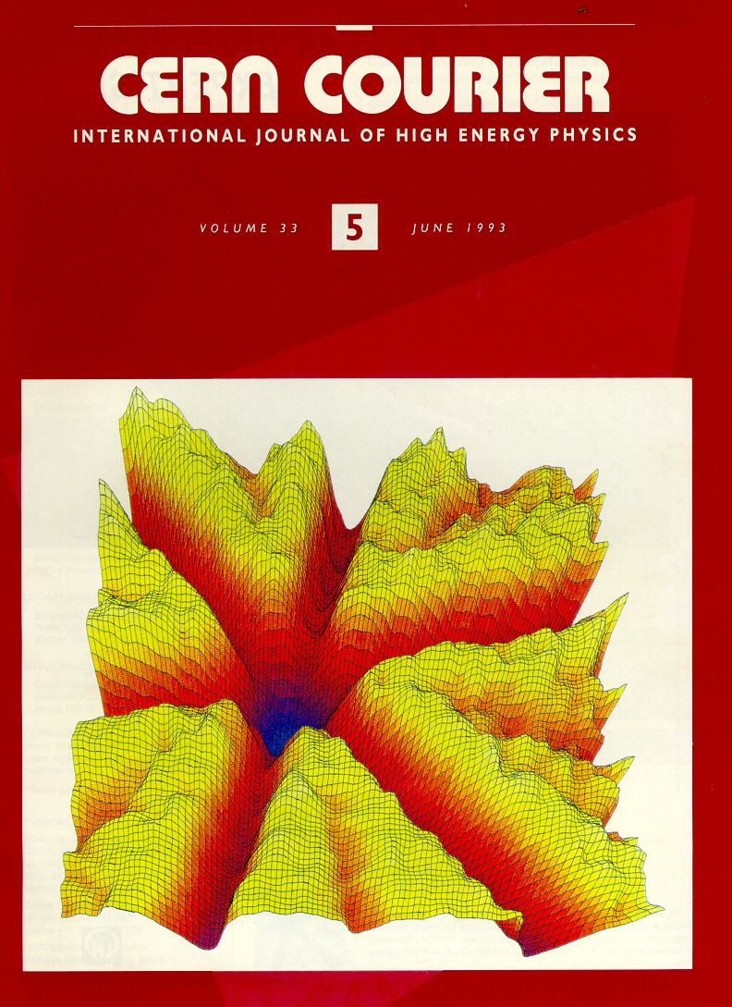
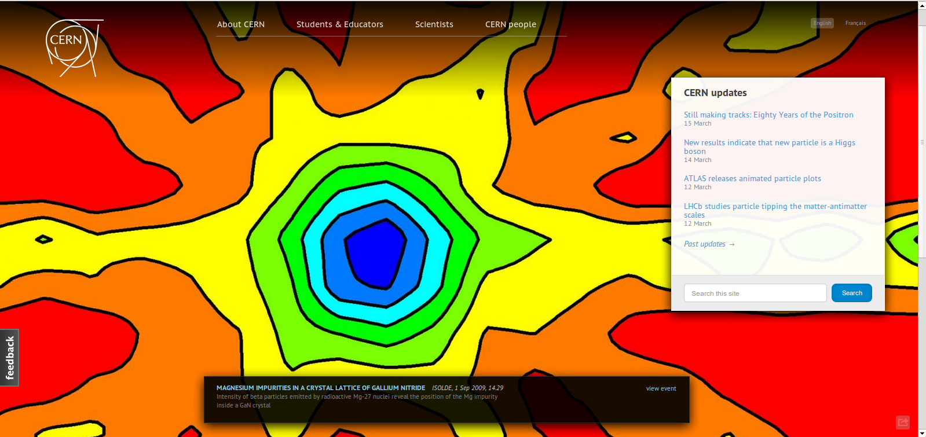
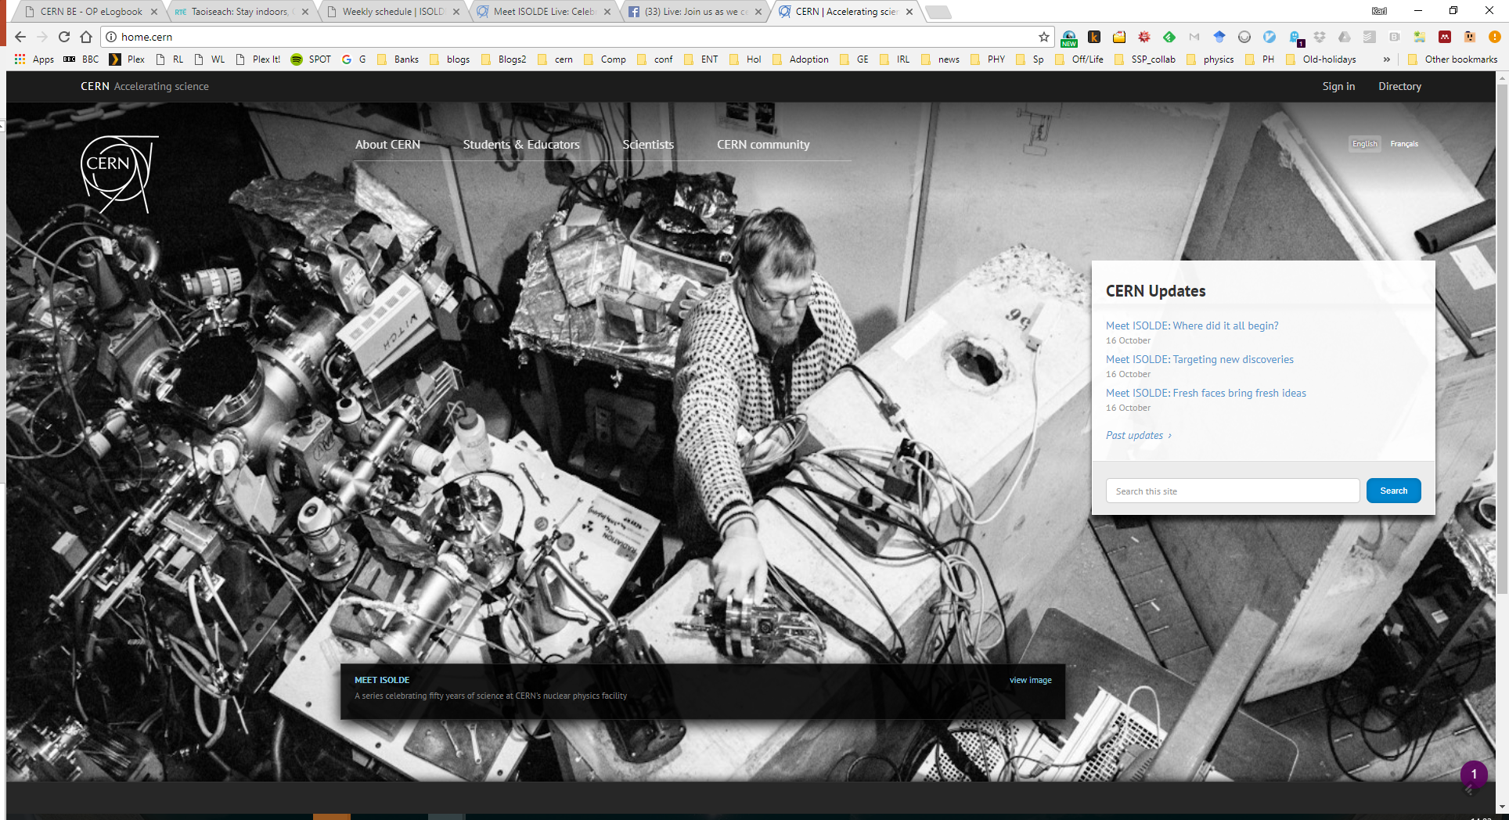
A history of Solid State physics at ISOLDE, where it fits within EPIC, and overview of the current biophysics activities
Overview of how the solid state and biophysics programmes have developed at ISOLDE
Advantages and challenges of applying radioactivity
Support needed for visiting teams
Forthcoming requests for more space, new techniques
Where EPIC could help
Biophysics considerations
Karl Johnston, and on behalf of Lars Hemmingsen and Magda Kowalska
Thanks to Juliana Schell, Guilherme Correia, Manfred Deicher and all groups in SSP@ISOLDE
Karl Johnston et al 2017 J. Phys. G: Nucl. Part. Phys. 44 104001
M Kowalska et al 2017 J. Phys. G: Nucl. Part. Phys. 44 084005
Attila Jancso et al 2017 J. Phys. G: Nucl. Part. Phys. 44 064003
K Potzger et al 2017 J. Phys. G: Nucl. Part. Phys. 44 064001

Slide 2
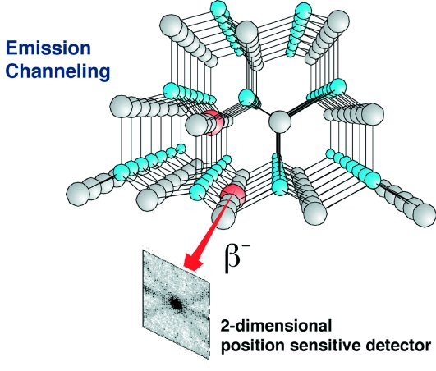
Unique features of radioactive probe atoms
for Solid State Physics/biology applications
c
Chemically selective and isotope specific
Extremely good detection limit
  among the most sensitive methods,
  no reaction cross section limitation
    10¹⁵ - 10¹⁸ probes/cm³
    10¹¹ - 10¹² probe atoms
Depth distribution and concentration control
  Ion energy and ion fluence control
  Circumventing solubility and diffusion limits
Highly local Information
  Nucleus-size sensors for local magnetic and electric fields
  Electric Field Gradient ~ r ⁻³
  Emission channeling: ~ 0.02 nm position resolution
z
Why radioactive probes ? Sensitive – Selective - Controllable – Local
Often relatively easy isotopes for (some) RIB facilities to produce (can be difficult to justify…)

Slide 3
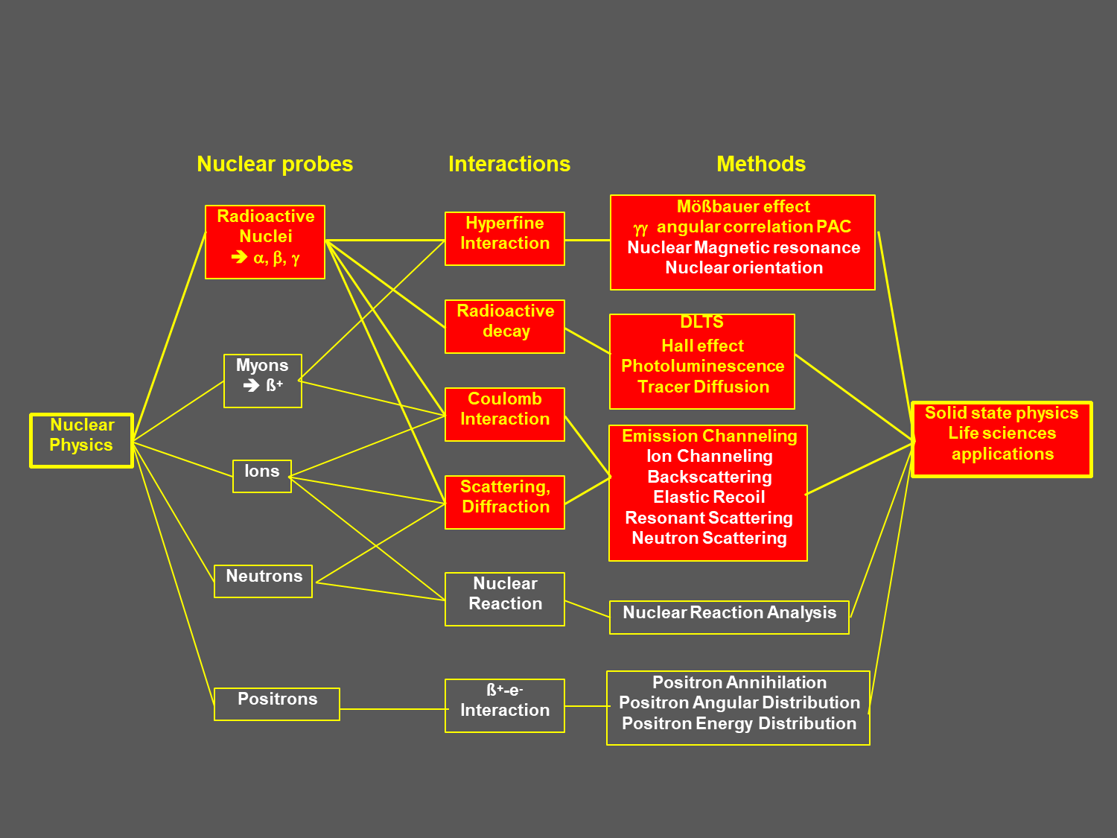
Applying radioactivity to solid state physics/biophysics

Slide 4
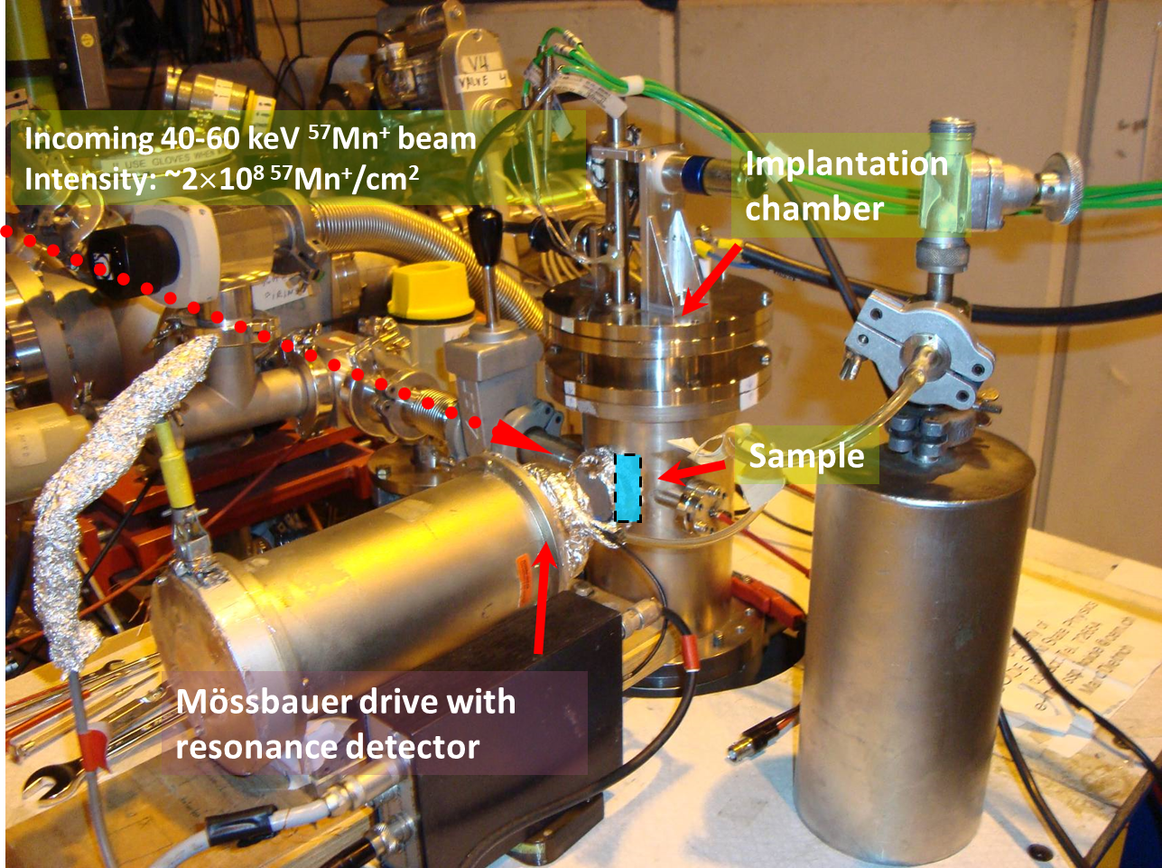
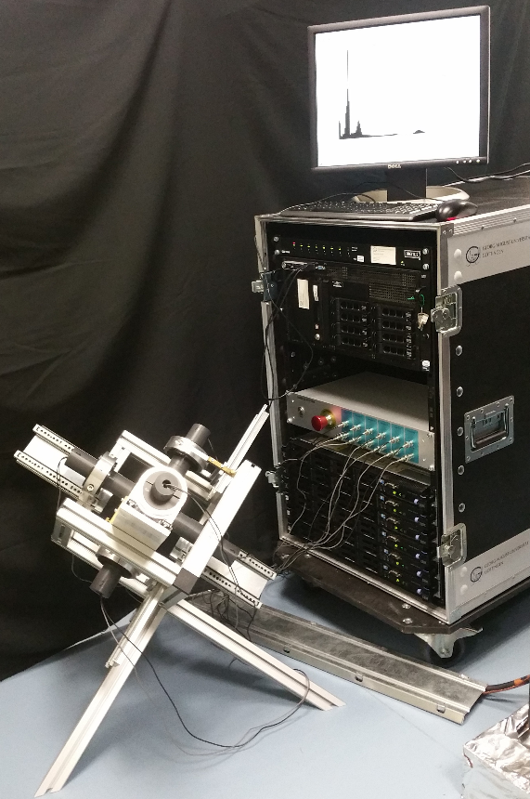
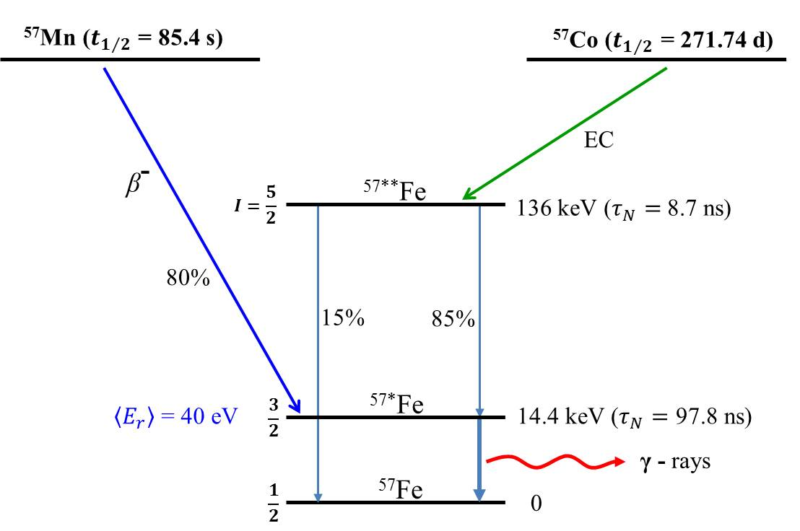
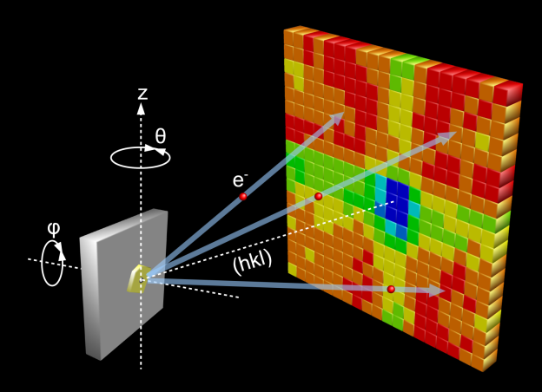
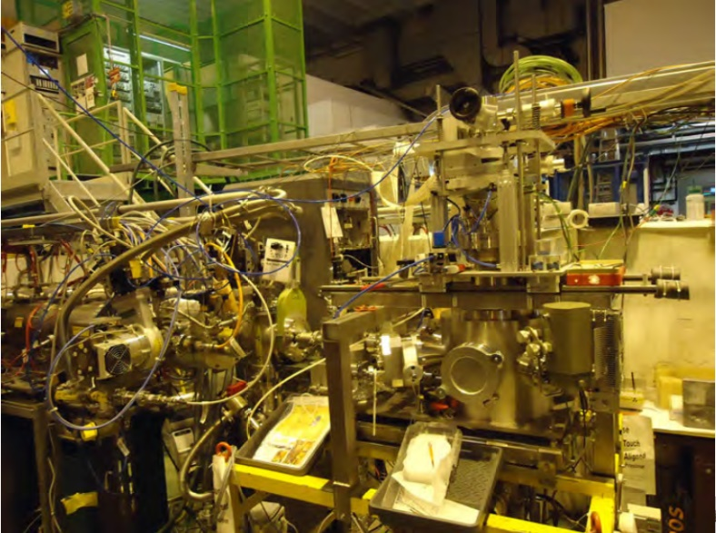
Overview of techniques for «applied» nuclear physics I: local probes/channelling
Perturbed angular correlation
Mossbauer effect
Beta-NMR
Very sensitive probes to the local environment of a material/protein etc, magnetic interactions, dynamical processes. Very intense (and often unique) beams available at ISOLDE
Emission channelling:
Almost unique to ISOLDE. 4 orders of magnitude more sensitive than RBS.
Ability to utilise low concentrations to determine position…
single crystal
position-sensitive detector

Slide 5
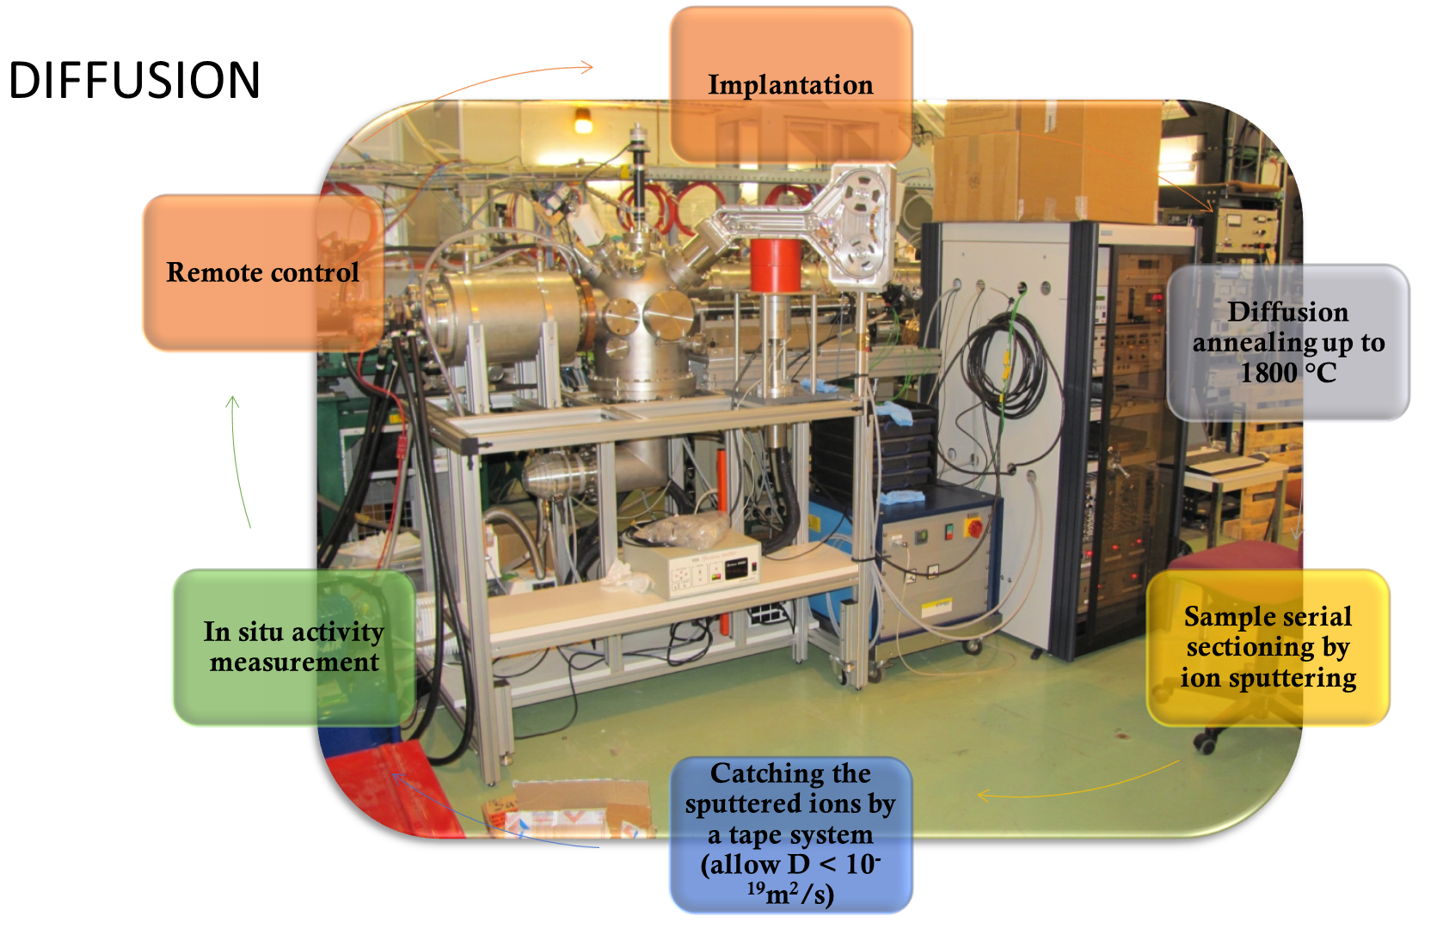
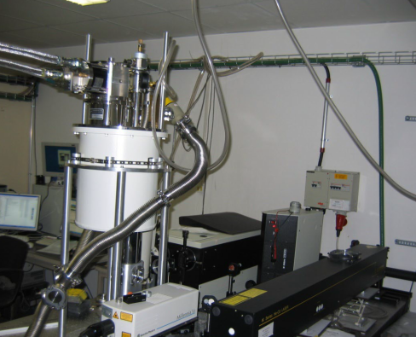
Overview of techniques for «applied» nuclear physics II: Tracer methods
Photoluminescence spectroscopy
Most general approach….tracking half-life of implanted isotopes or their daughters
Can be applied to almost any «typical» laboratory technique: offers unique sensitivity

Slide 6
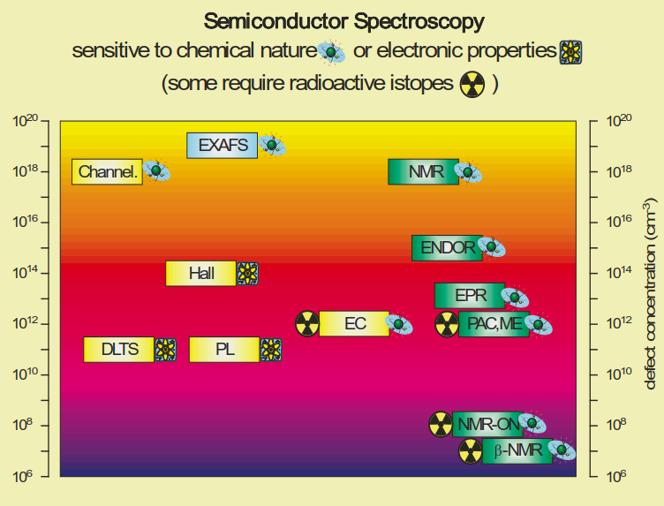

Slide 7
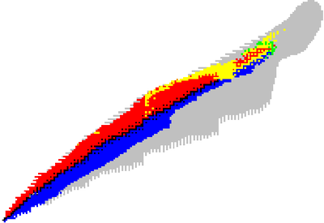
Research with radioactive beams at ISOLDE
Astrophysics
Search for beyond Standard model physics
Nuclear physics
and
atomic physics
Material science
Life sciences and biophysics
Radioisotopes for medical applications

Slide 8
«Applied» methods at ISOLDE: between 15-20% of the programme

Slide 9
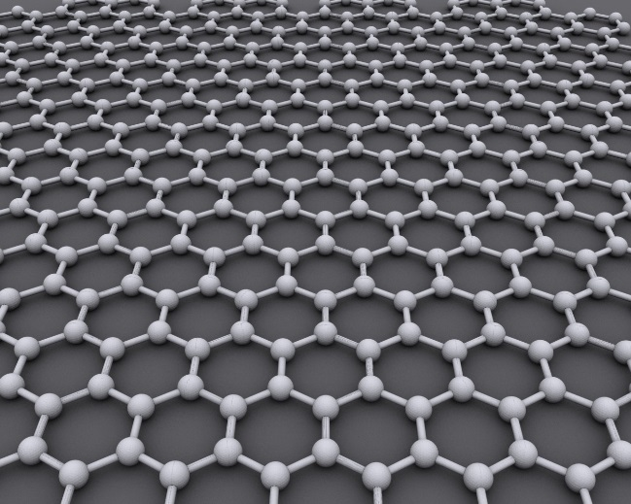
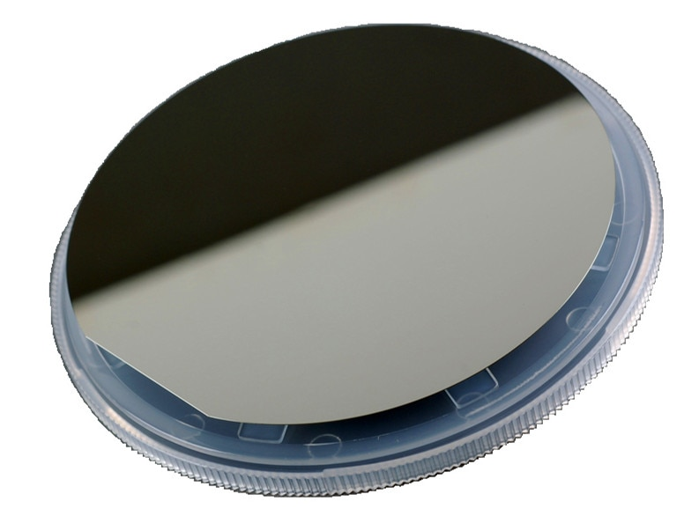
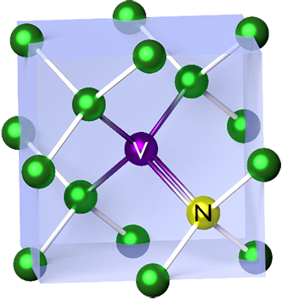
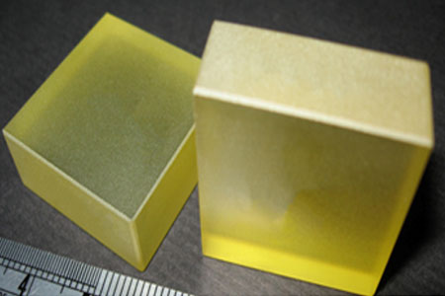
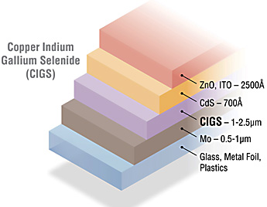
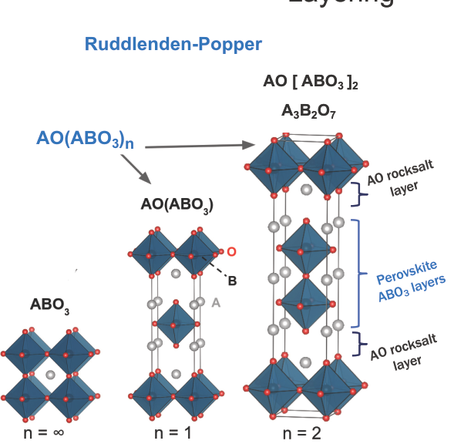
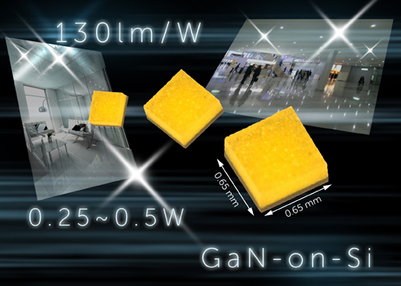
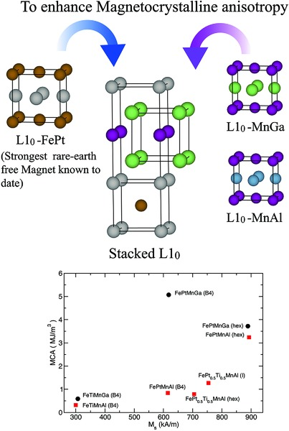
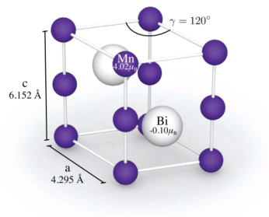
2D materials
Materials studied at ISOLDE
Quantum bits
Solar cells
Semiconductors
Multiferroics
Future magnetic materials
hex.- MnBi
L1₀- MnAl

Slide 10
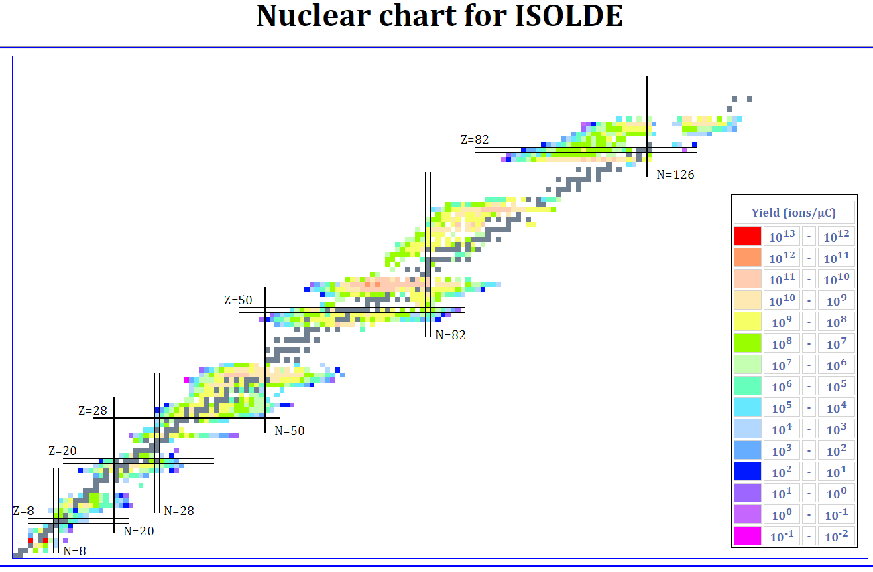
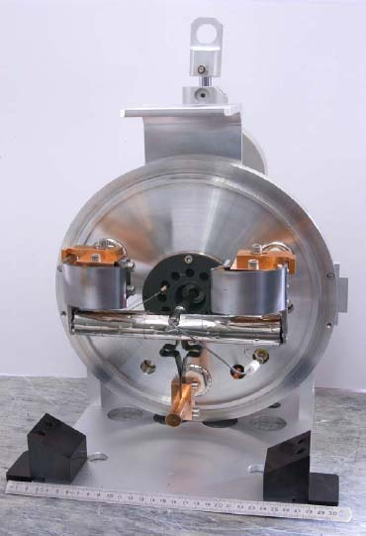
ISOLDE today offers the largest range of available isotopes of any ISOL facility worldwide.
1000 isotopes of >70 elements
NOTE:
  For materials science/medicine…yields typically >1e7 s-1

Slide 11
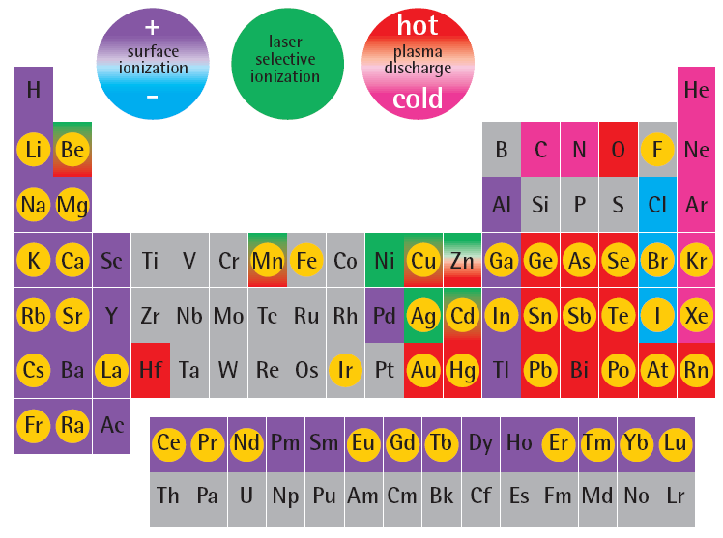
ISOLDE table of elements
Workhorse probes:
¹¹¹Cd, ¹⁹⁹Hg, ¹¹⁷Cd, ⁵⁷Mn, ⁷³As
New promising probes:
⁶⁸Cu, ¹⁴⁹Gd, ¹⁷²Lu, ¹⁵¹Gd, ¹⁹⁷Hg
Cr
Co
Ni
Isotopes of this element
used for solid state physics
or life science
Pt

Slide 12
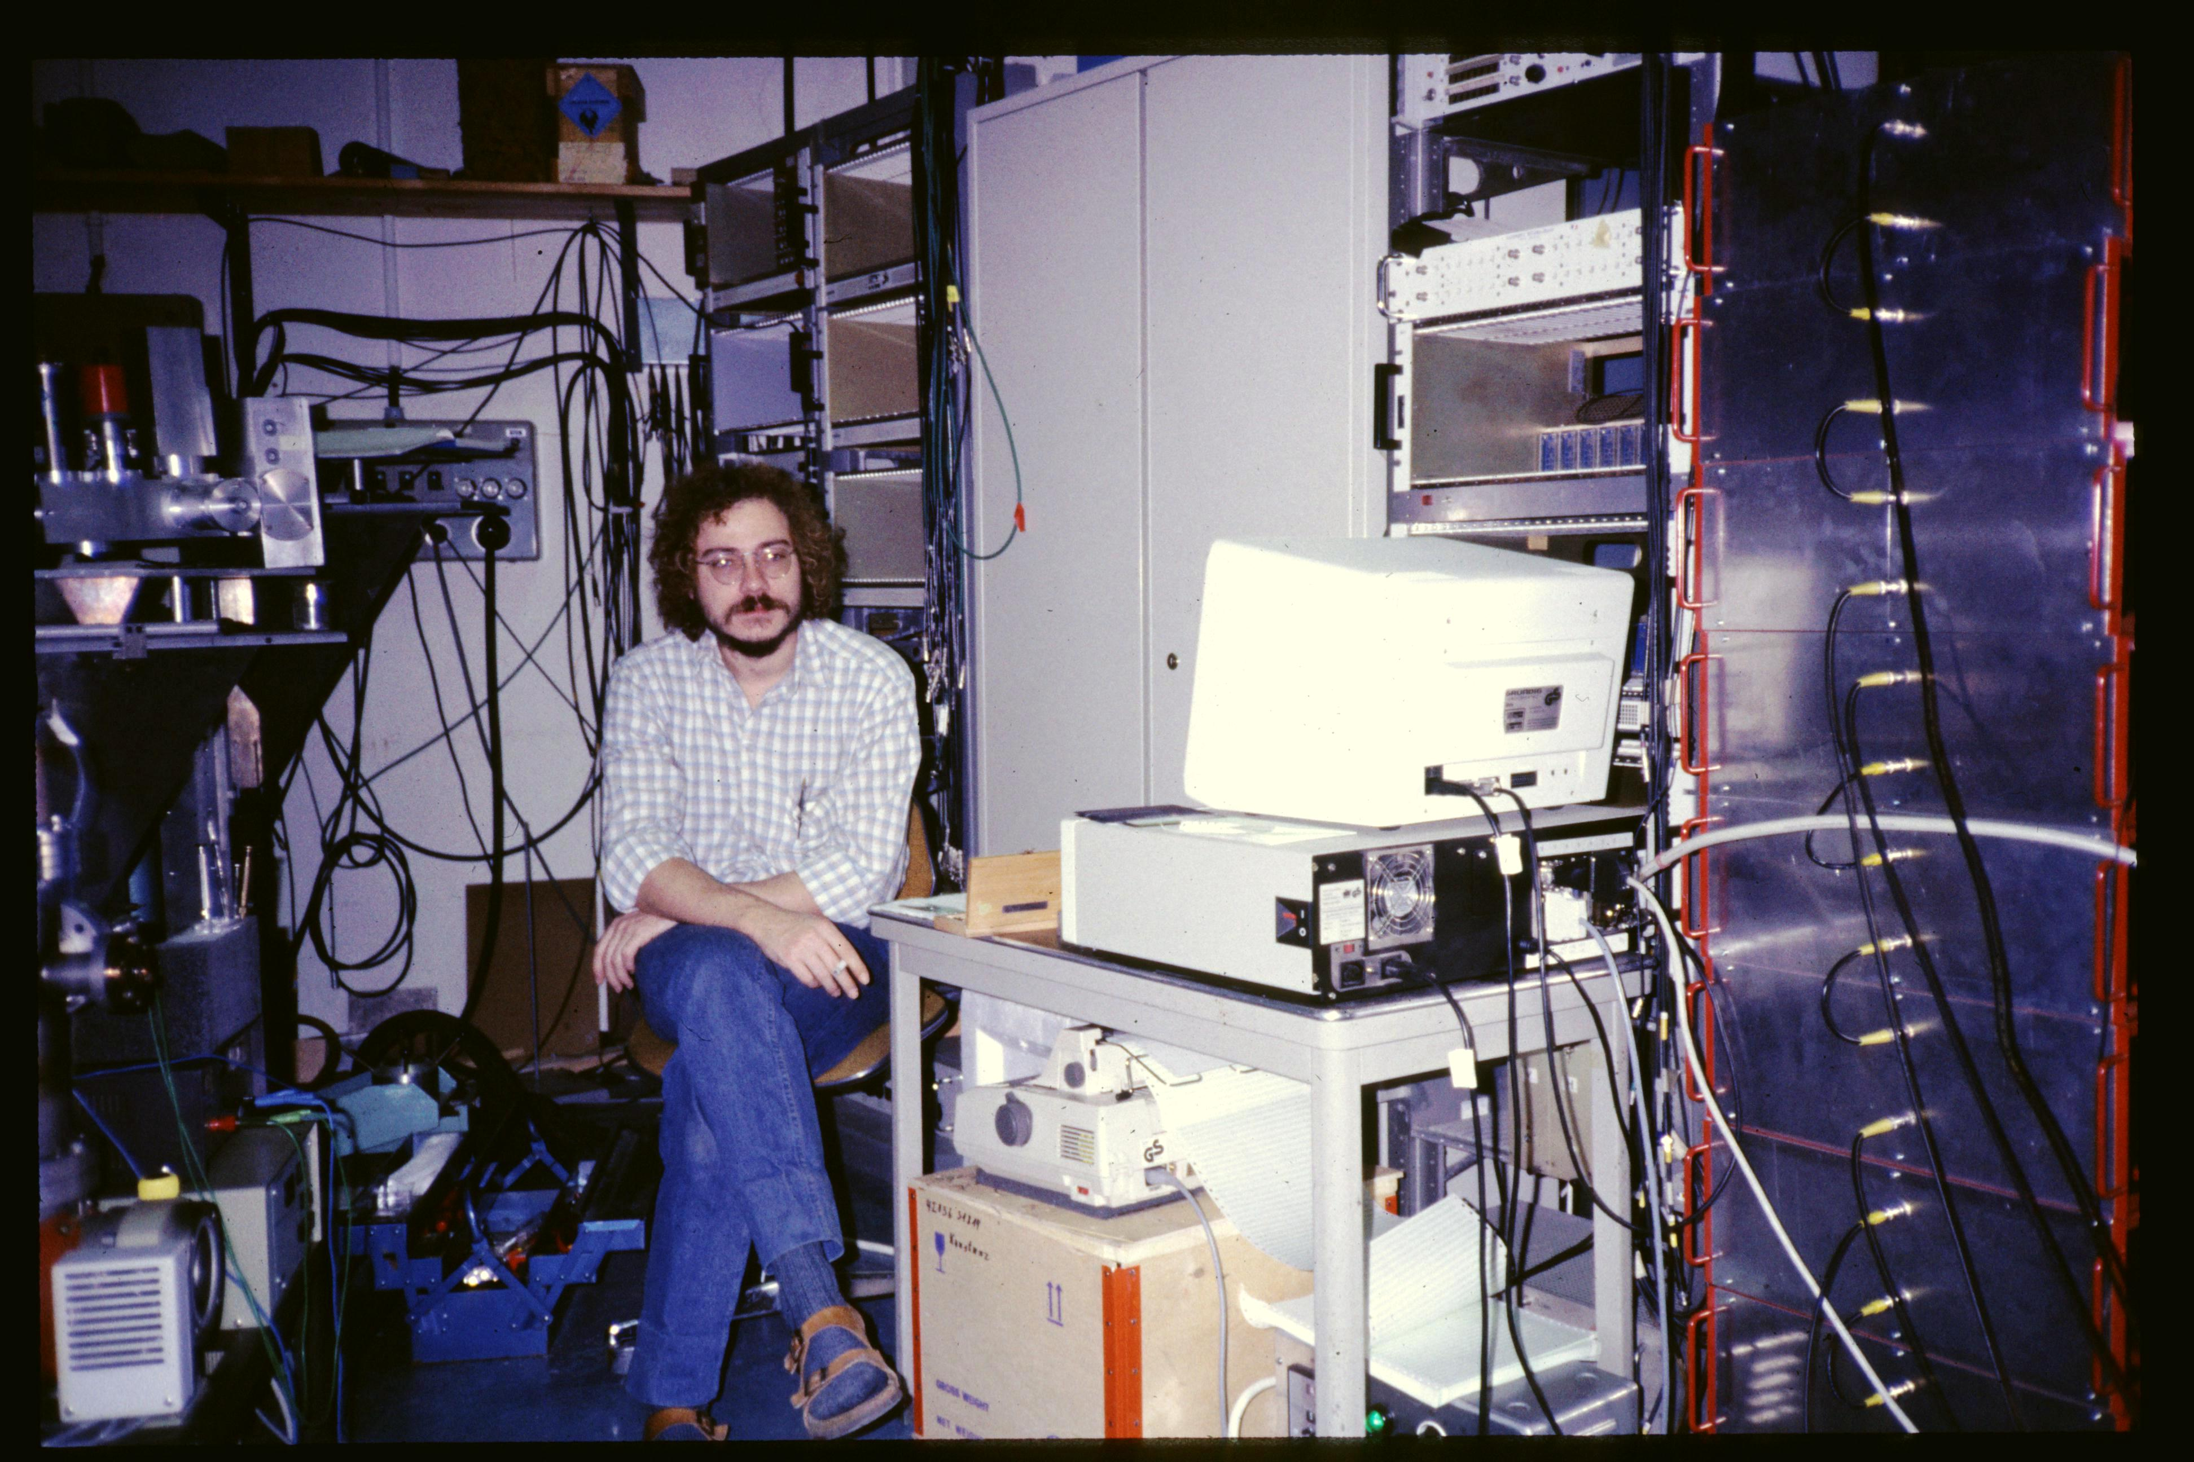
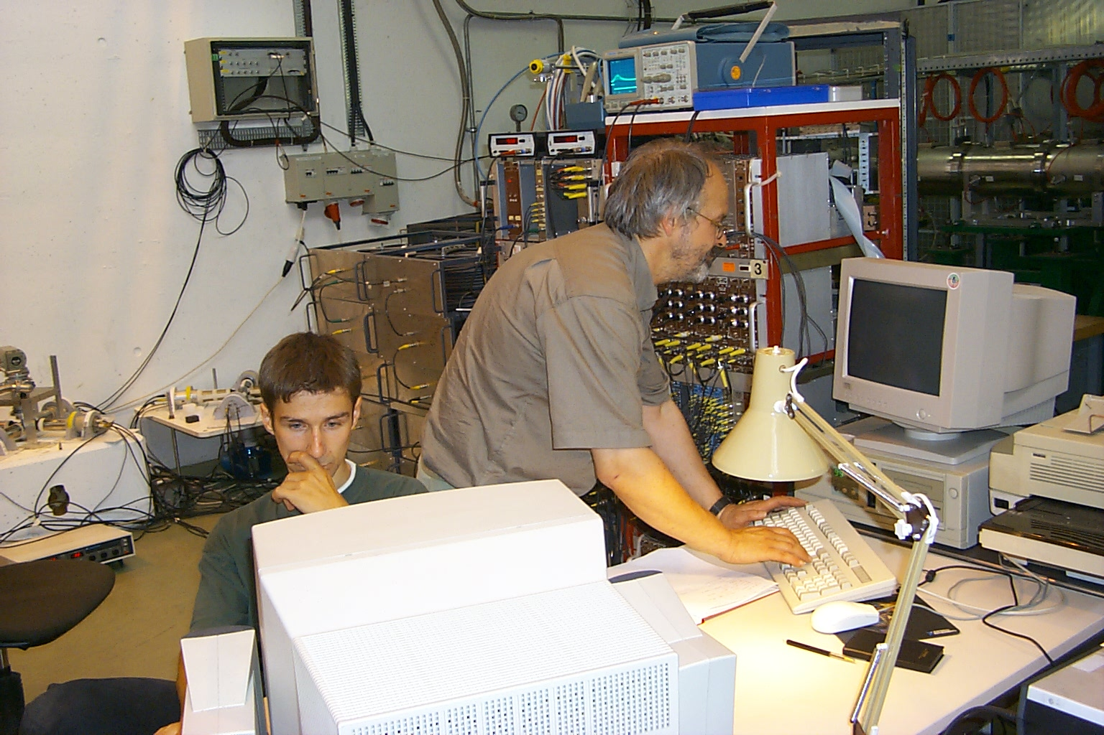
The importance of offline laboratories
To properly perform solid state and biophysics, fully equipped offline labs are essential e.g characterisation, thermal and chemical treatments.
For many years equipment was brought back and forth from e.g. Germany
Over time infrastructure was built up in various labs.
Demand and resources from SSP community has been a driver for ISOLDE expansions e.g. B. 170 extension (now HIE ISOLDE) and B. 508.
Temporary setup in proton hall
Temporary setup in ISOLDE hall

Slide 13
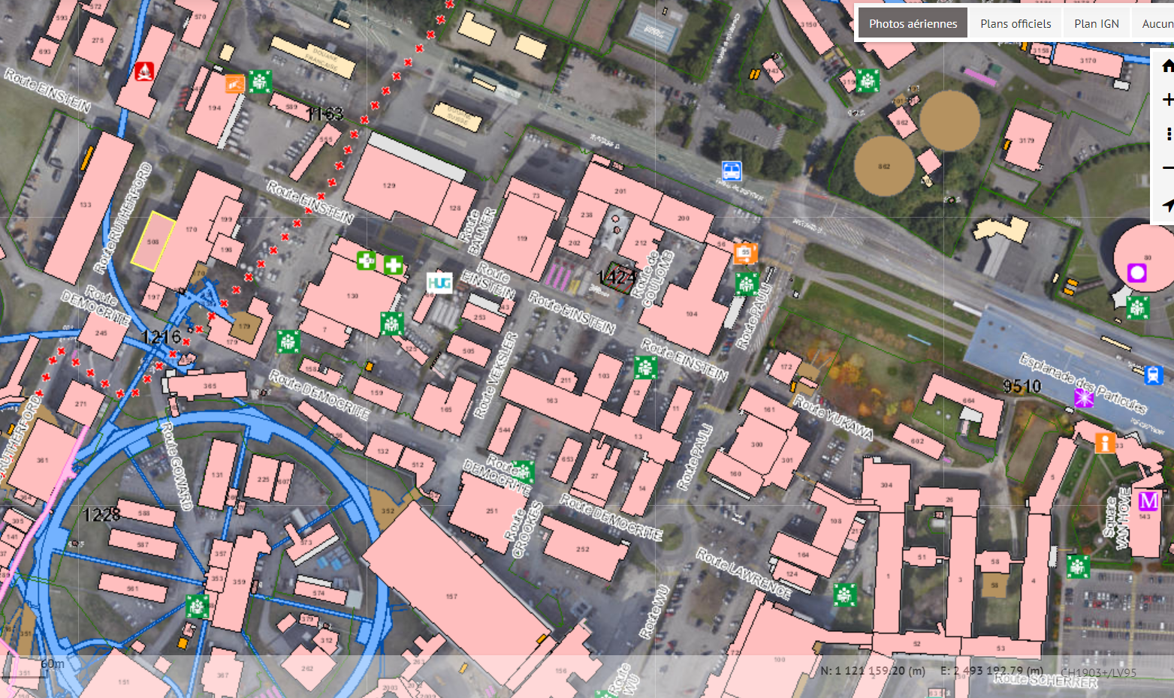
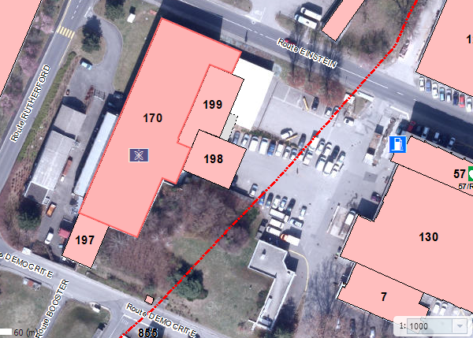
275
Offline labs for SSP/bio over the years
507
115b
115a
161
3

Slide 14
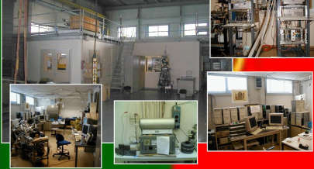
2002: offline laboratory setup in building 275

Slide 15
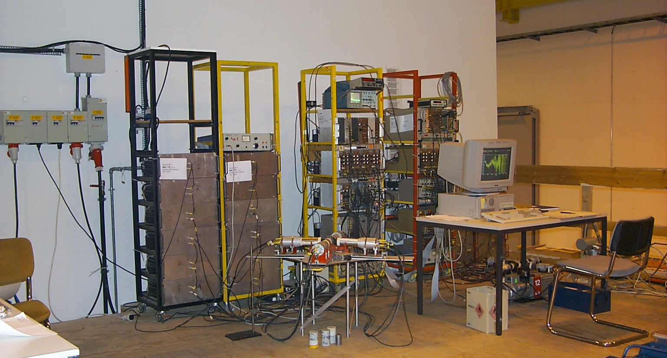
PAC setup on the «NICOLE» platform in the ISOLDE hall

Slide 16
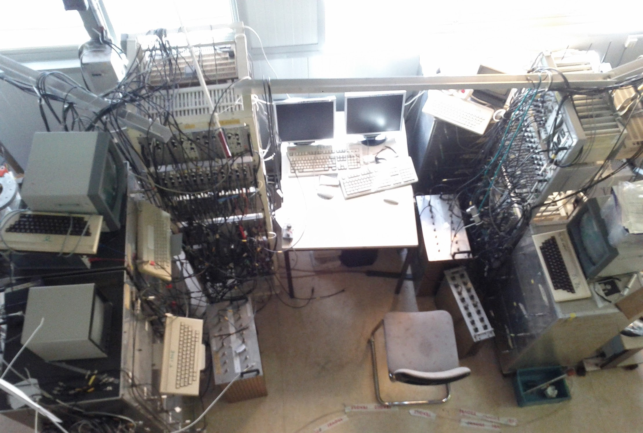
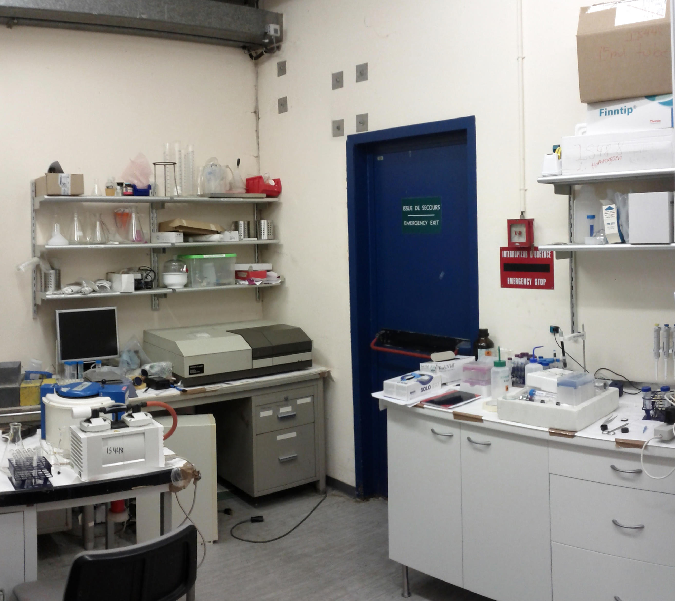
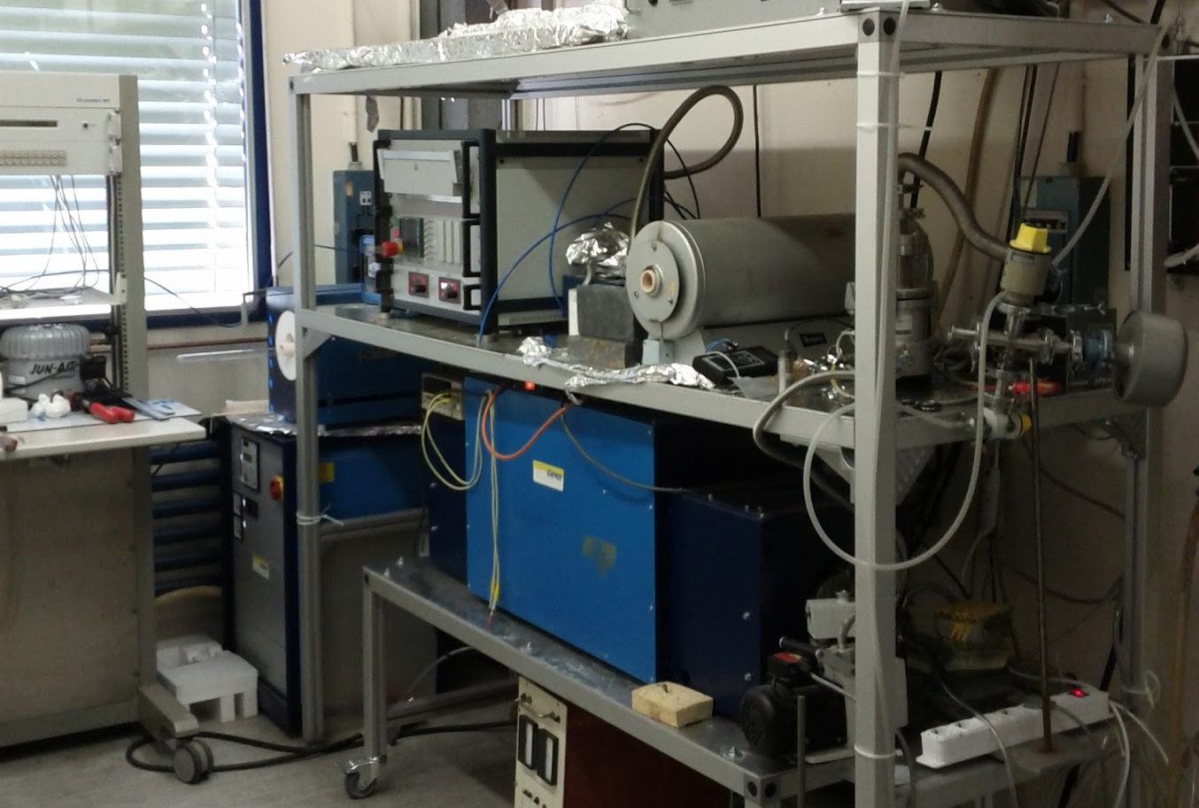
B. 115 behind ISOLDE became the central lab for PAC and thermal treatment …but still spread around

Slide 17
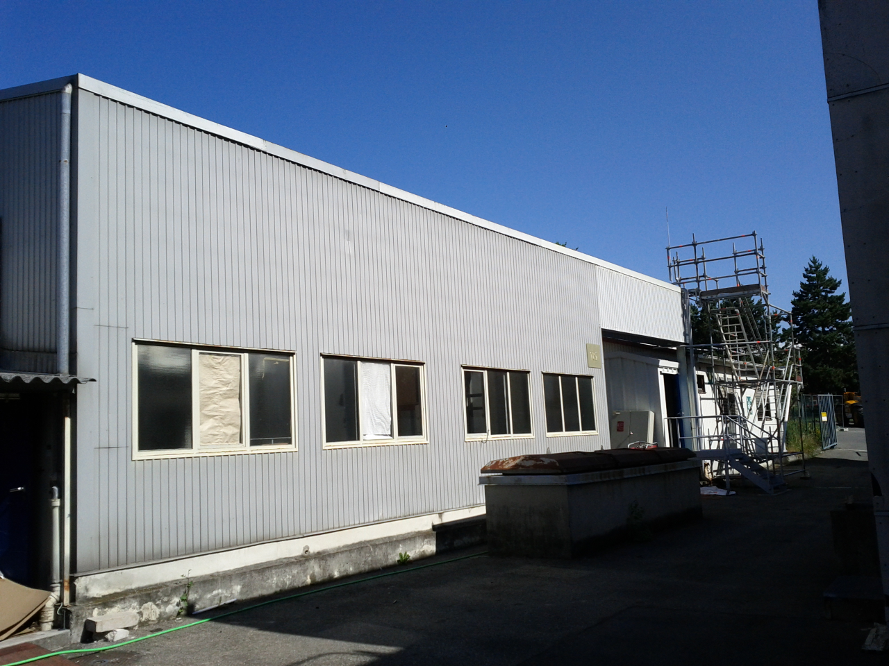
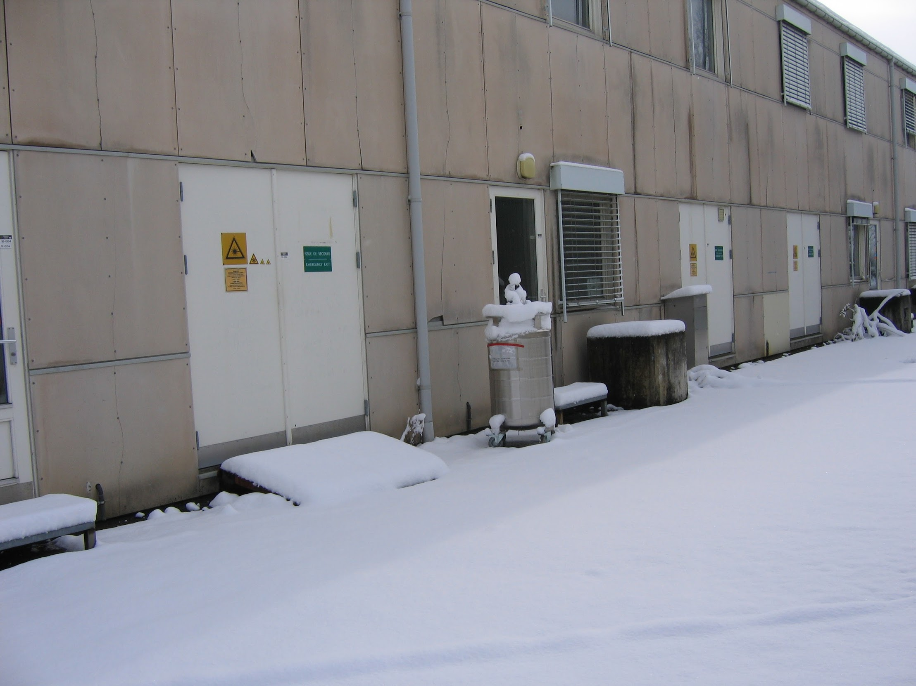
Eventually B. 115 and B. 507 could no longer satisfy the needs of the various user communities neither in terms of capabilties nor in terms of safety.

Slide 18
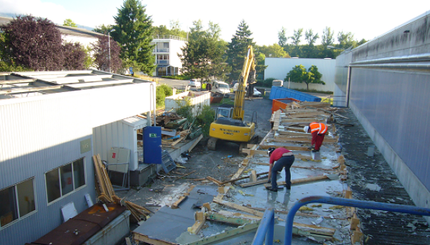
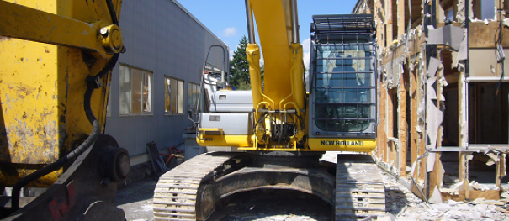
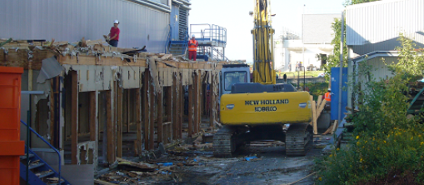
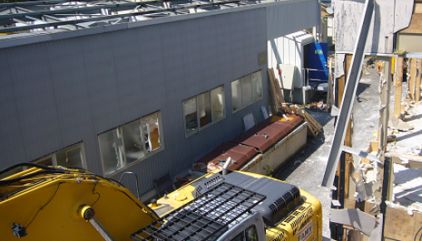

Slide 19
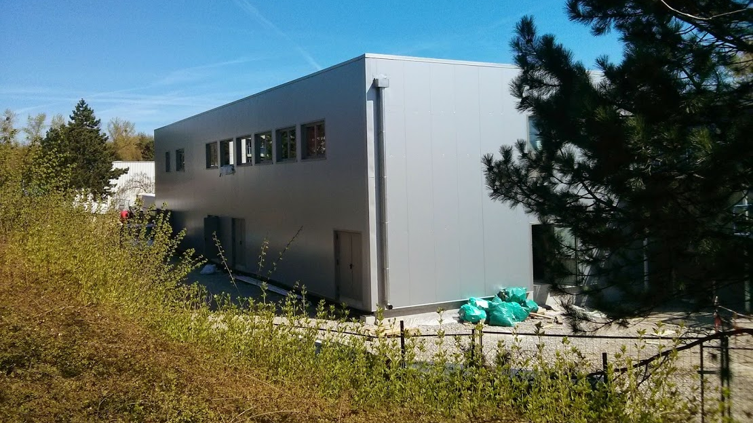

Slide 20
508

Slide 21
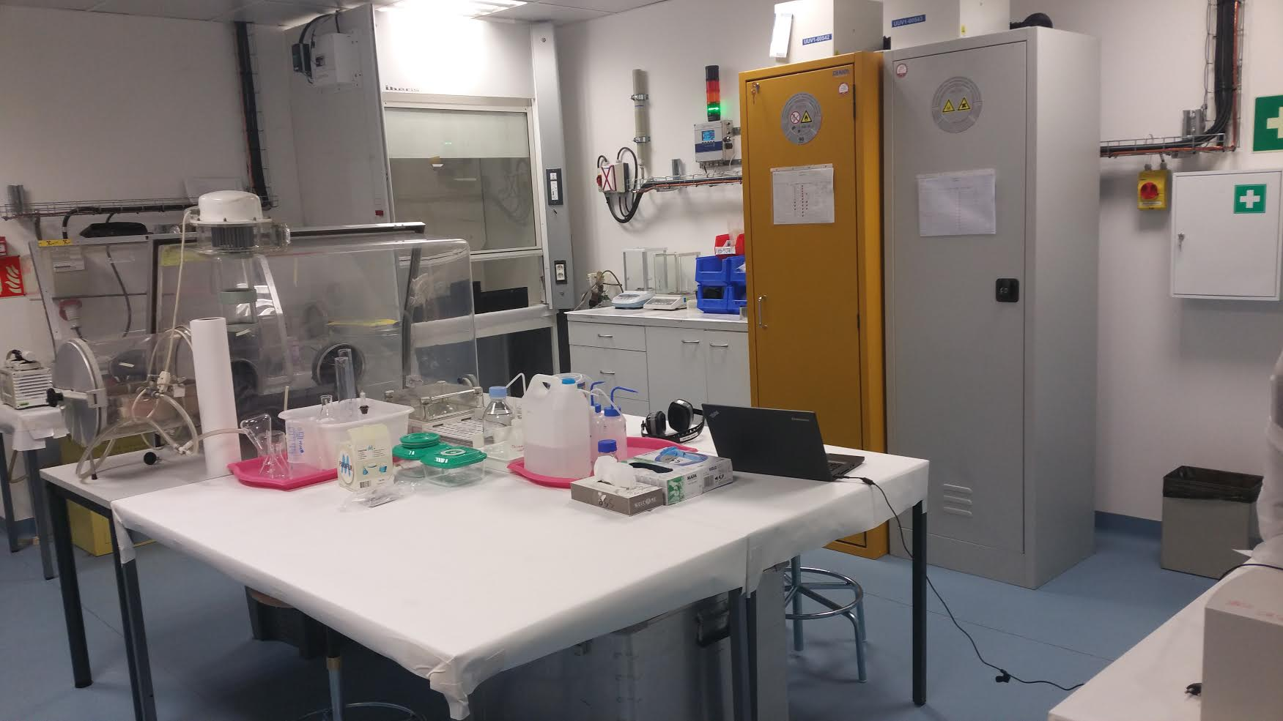
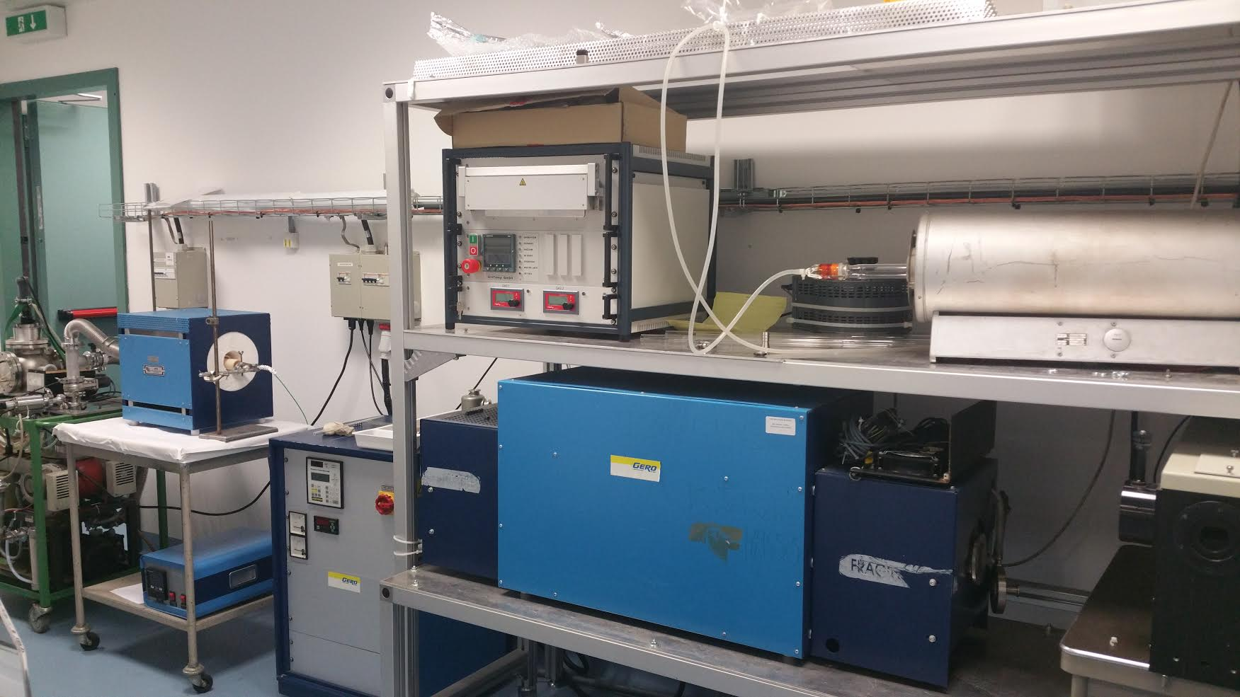
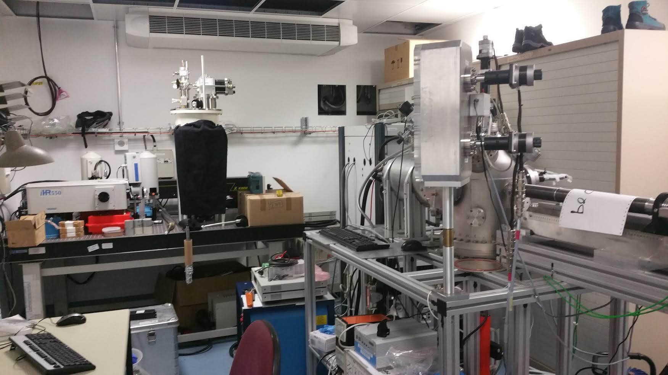
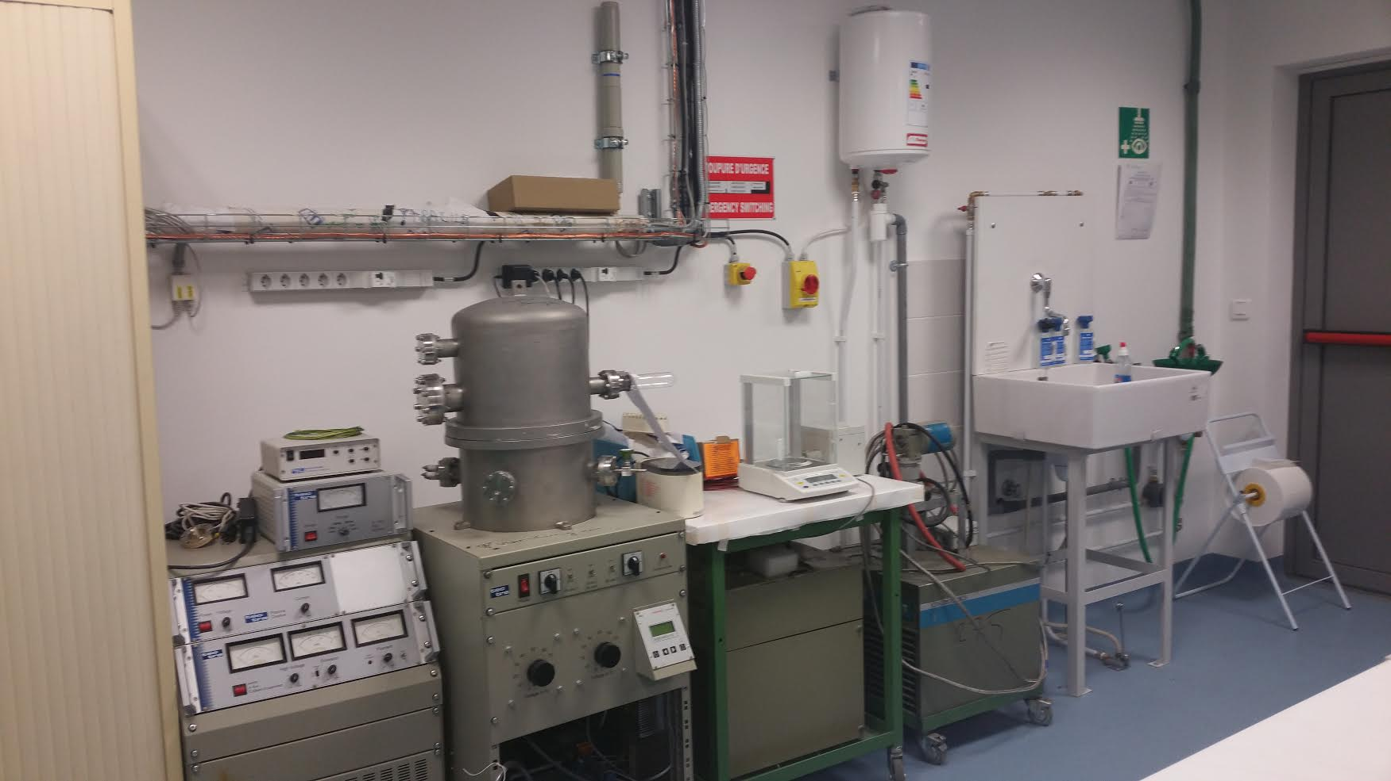
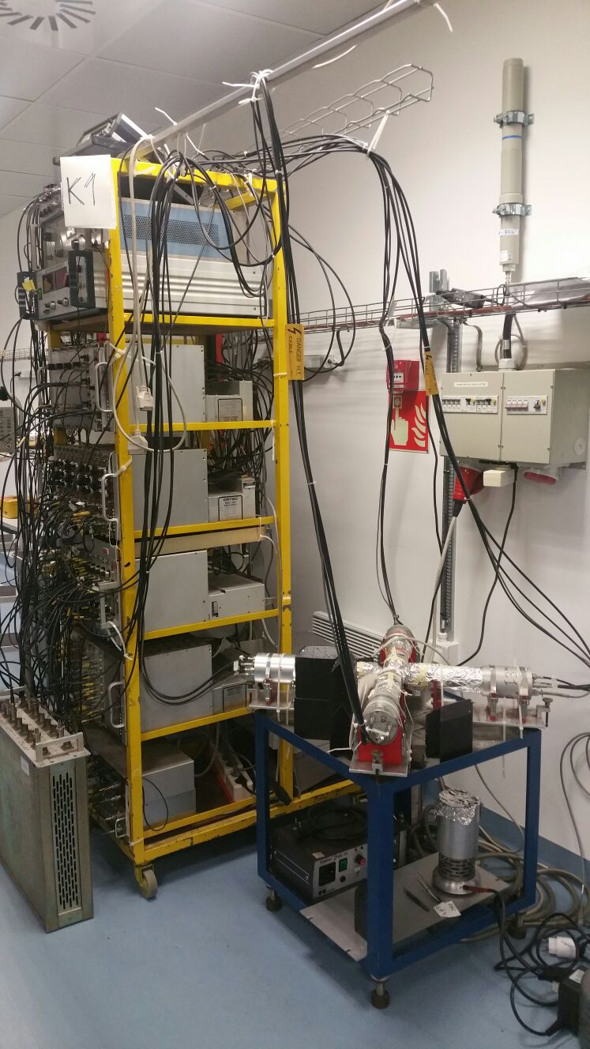
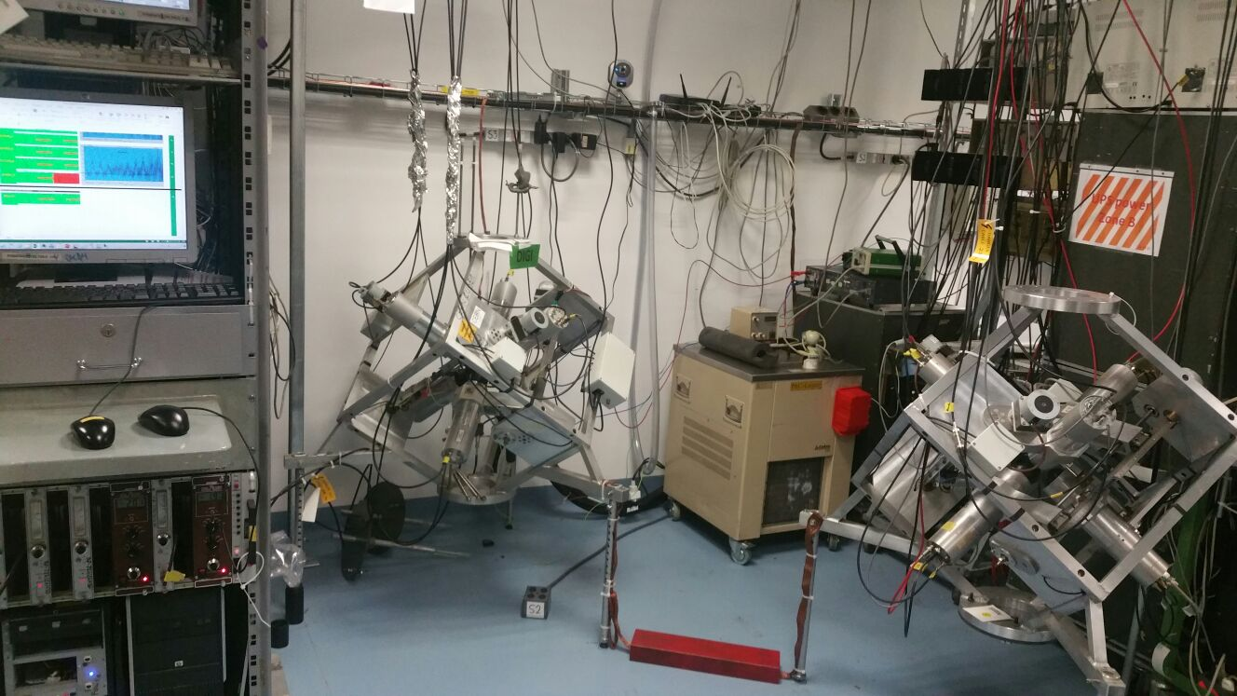
Offline labs at ISOLDE: B. 508 all setups now housed in dedicated labs

Slide 22
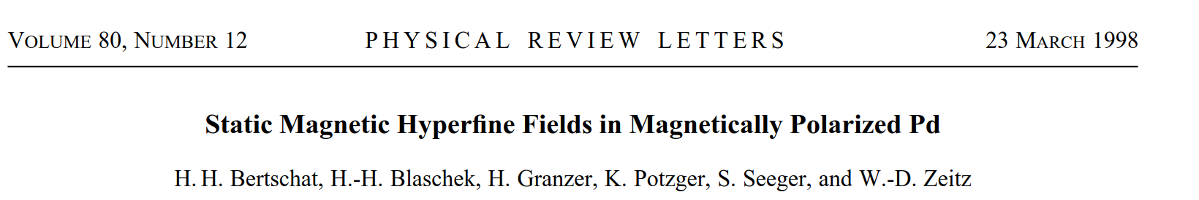
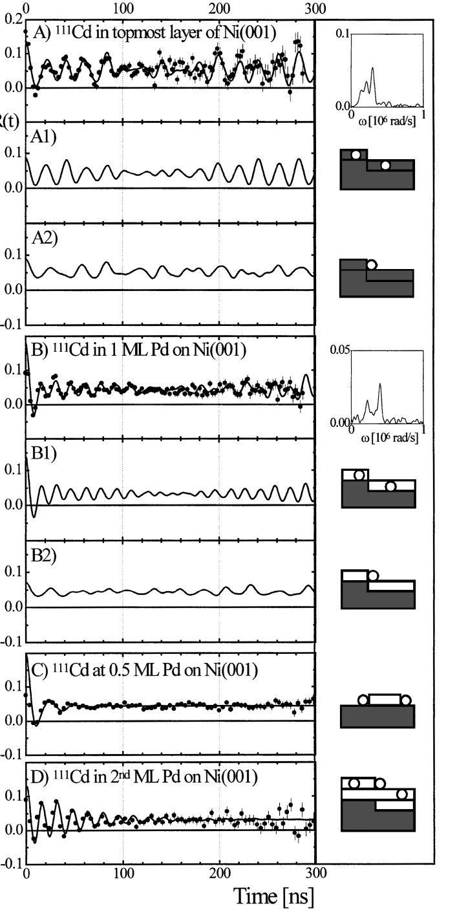




Selected highlights through the years
PAC
Diffusion
Emission channelling

Slide 23


Mossbauer spectroscopy
Radiotracer Photoluminescence
Disentangling the nature of magnetism in ZnO: paramagnetic not ferromagnetic
J Cullen et al Appl. Phys. Lett. 102 192110 (2013)
Emission channelling
Gunnlaugsson et al (APL 97 142501 2010)
Gunnlaugsson et al APL 100 042109 (2012)
Phys. Rev. Lett. 118, 095501(2017)

Slide 24





Need for on-site expertise
Many groups only visit CERN once a year. Without on-site presence experiments are impossible
Since mid-1990s a coordinator dedicated for solid state physics has been based at ISOLDE:
Coordinates and supports SSP / Life science experiments
Manages financial aspects of SSP / Life science infrastructure
User support for the visiting groups
Contact person between ISOLDE and CERN administration
Management and maintenance of the infrastructure
Local representative for implementing CERN’s safety rules.
Dr Juliana Schell (Essen)
In addition, coordinating Portuguese activities (with strong interactions with Belgian groups), Dr Guilherme Correia has been at ISOLDE since 1990.
Responsible for many of the upgrades of emission channelling, ice-collection chambers, and maintenance of PAC spectrometers

Slide 25
Current challenges…
Still a niche field, unfamiliar beyond the core community: e.g. need to explain, and justify, techniques which is not the case with other spectroscopy methods in materials science…
…or (currently) necessarily small: e.g. emission channelling needs to be attached to an ISOLDE (or equivalent beam-equipped facility)…
Not a user facility: ISOLDE is not like a synchrotron….steep learning curve to carry out experiment
Limitations with beamtime → shift requests can be comparatively modest compared to nuclear physics. → often only one run a year….can take 1-2 years to complete data set
Core community e.g. in Germany in danger of not being renewed, nuclear solid state physics can be unpopular at home labs:
  Leads to problems with training.
  Reduced number of labs to carry out experiments….growing pressure on large scale facilities to host these techniques
Pace of materials science is very fast… difficult to react to new developments/materials…. experiments which don’t get beam within one year can lose relevance….
Safety considerations restrict what can be carried out. Need to rezone and improve handling while still retaining flexibility which is attractive to users.

Slide 26

Reconfiguration of GLM/GHM area following recommendations from OFSP

Slide 27
…….and opportunities
The sensitivity and chemical selectivity are attractive for resolving problems which other facilities/methods prove problematic
Ability to probe magnetic properties in dilute and sensitive way is essentially unique to hyperfine techniques such as PAC and Mossbauer.
Ability to probe in such dilute quantities is extremely attractive: devices are not getting any bigger…
The interface of materials can be impossible to study reliably…radioactive probes are the ideal tool
Flexibility of PAC techniques allows for temperature, surface, magnetic and other perturbative studies in materials
Chemical information which can be addressed with radiotracer methods could reveal hidden aspects of quantum materials
Many areas of biophysics which could be addressed e.g. chemical dynamics and overcoming chemically blind techniques (beta-NMR)
Support from INTC to the community
Where EPIC can help
Increase in capacity i.e. multiple target stations:
Greater access to beamtime
  Faster response to topical areas of Materials science: 6-9 months can be a long time …
  Allow more systematic runs so that a complete data set could be collected within one calendar year.
More «reliable» access would allow groups to invest in training.
Increase in capability
E.g. purification of beams to allow greater control of isotopes…especially important for precise implantation into e.g. interfaces

Slide 28


Exploit STAGISO and NORMHRS Parallel running
Exploit STAGISO and NORMHRS Parallel running
Exploit STAGISO and NORMHRS Parallel running
(but beginning to to reach the limit of what is possible)

Slide 29
















Endorsed science but note that space needs to be found for this setup.
New setups on the horizon
Endorsed science CASE but note that space needs to be found for this setup.
Endorse
Endorse the science case although feasibility needs to be demonstrated due to space constraints
Endorse
Potentially interesting science: requires clarification of science cases
Endorse
Endorse

Slide 30




Biophysical applications of PAC spectroscopy
Function and toxicity of metal ions in biology
Lars Hemmingsen (lhe@chem.ku.dk), Department of Chemistry, University of Copenhagen
  De novo designed proteins – a Lego approach to elucidate protein metal sites
  Function of a bacterial Cu(I) sensor – discrimination against divalent metal ions
Balogh et al. Chem. Eur. J., 2019, 25, 15030; Chakraborty et al. Acc. Chem. Res., 2017, 50, 2225; Jancso et al., J. Phys. G, 2017, 44, 064003; Szunyogh et al., Dalton Trans., 2015, 44, 12576; Garcia Ruiz et al. Eur. Phys. J. WOC, 2015, 93, 07004; Luczkowski et al., Metallomics, 2015, 7, 478; Gottberg et al., ChemPhysChem, 2014,15, 3929; Luczkowski et al., Chem. Eur. J. 2013,19, 9042; Sezer et al., Inorg. Chem. 2012, 51, 11339;

Slide 31







Challenges, needs and funding
Main challenge: Running and maintaining to chemistry and two spectroscopic labs - one at the home institution and one at ISOLDE
Needs: Local staff at ISOLDE to support users – my group (Lars Hemmingsen) would not have been successful without the excellent local support.
Recent funding (2016-2020):
  National Instrument Centre for CERN Experiments, Danish Agency for Science, Technology and Innovation, co-applicant, local share ca. 330.000 Euro
  Danish Council for independent research, PI, 286.000 Euro

Slide 32





Biological β-NMR studies at VITO
M. Kowalska,
on behalf of
betaDropNMR team
Status:
²⁶⁻²⁸Na liquid β-NMR studies at 1.2T with ppm homogeneity and stability
In-situ ¹H NMR probe for referencing
Support by conventional NMR + theory
Recent achievements:
Interpretation ongoing of relaxation-time studies of ²⁶Na:
different liquid hosts and DNA solutions
comparison with conventional ²³Na NMR
comparison with ab initio calculations
1st ppm-level magnetic moment of a short-lived nucleus *:
μ(²⁶Na)= 2.851(2) μ_{N} => 2.849390(20) μ_{N}
Universal β-NMR referencing scheme based on ¹H *:
no ad-hoc references
increase in beamtime efficiency
direct link to conventional NMR
direct comparison with absolute shielding from theory
26Na in
$$σ=1−\frac{2ν}{ν1H}\frac{|μ1H|}{|μ|}\frac{1+\left(\frac{1}{3}−α1H\right)κ1H}{1+\left(\frac{1}{3}−α\right)κ}(1−σ1H)$$
* Harding, Pallada, Croese, et al. Magnetic moments of short-lived nuclei with part-per-million accuracy: Paving the way for applications of β-detected NMR in chemistry and biology, accepted by PRX, 2020; ArXiv: 2004.02820

Slide 33


Biological β-NMR at VITO and ISOLDE: present and future
Expertise built in-house:
Experiments:
  Chemistry and bio-chemistry
  Conventional NMR
Theory:
  Molecular Dynamics
  Density Functional Theory (DFT)
Collaborations with experts in relevant fields:
Experiments:
UNIGE – conventional NMR platform
Ljubljana – NMR of Na/K interaction with DNA
Poznan – NMR, x-ray scattering, pure solvents
Theory:
UNIGE - DFT
Bratislava – coupled cluster theory, DFT
Plans until LS3:
Priority on studying Na and K interaction with DNA G-quadruplex structures
Exploring other interesting biological topics relevant to biochemistry collaborators
Implementing 4.7 T superconducting magnet: better field homogeneity and higher resolution
More automatisation in liquid sample handling
Going towards 10 mbar required by aqueous samples
Wish-list:
More space → possibility of several permanent end-stations devoted to different projects with different collaborators (biology, material science, nuclear physics, fundamental studies)

Slide 34
EPIC_applied:
Increased capacity and capability leading to new communities, new scientific directions
Training to seed new generation of researchers
Higher impact for nuclear physics research within society
Biophysics:
More access to beam allows for more topical problems to be addressed.
Unique availability of isotopes overcomes chemical blindness with “typical” biophysics methods
Increased offline characterisation
Support staff
Quantum technologies:
Rapid turn-around on requested isotopes (~6 months)
Combine conventional spectroscopies with radioactive aspects, development of new field
New user communities
Multiferroics/local probes:
Regular access to beam
Avail of new developments in techniques
Fully exploit the hyperfine properties to address otherwise inaccessible problems. E.g. phase transitions, interfaces…

