Slide 2

ISOLDE as a
Multi-User Facility
Jose Alberto Rodriguez (BE-OP-ISO)
Erwin Siesling (BE-OP-ISO)

Slide 3
Outline:
Introduction / Motivation
Capabilities of the New Facility
Facility Layout
Example of an Operational Scenario
Summary
J.A. Rodriguez, E. Siesling – EPIC Workshop – 2020/11/25

Slide 4
Introduction / Motivation:
This presentation will address only a few of these points
From 2019 EPIC Workshop and the first day of the 2020 Workshop:
Increase of the capacity of the facility:
Any new facility should be able to profit from proton beam energy and intensity increases
Increase of proton beam intensity (linear increase in RIB production)
Option to profit from increased proton beam energy 2 GeV (up to a x10 for the production of some RIBs)
Space for additional experimental stations
Additional target stations
Parallel operation (i.e. simultaneous beam delivery to several experimental stations)
Physics with pre-irradiated targets during technical stops
…
Compatible with winter physics programs
Increase of the capabilities of the facility:
Only the reserved space
Improve the beam purification (high-resolution separator, MR-ToF (M. Vilen’s presentation), molecular beams, RILIS…)
Development of new beams
Higher energy beams out of the post-accelerator (10 MeV/u for A/q=4.5)
Increase the A/q “acceptance” of the post-accelerator (2.0 < A/q < 5.5)
Pulsed accelerated beams for ToF measurements (harmonic pre-buncher + chopper)
High-energy compact storage ring
Recoil separator (I. Martel’s presentation)
…
Additional requirements/constrains:
Construction compatible with parallel physics program
Operational costs should remain low
Improved reliability
Beam production monitoring (i.e. feedback loops, automatic notifications…)
…
J.A. Rodriguez, E. Siesling – EPIC Workshop – 2020/11/25

Slide 5
Outline:
Introduction / Motivation
Capabilities of the New Facility
Facility Layout
Example of an Operational Scenario
Summary
J.A. Rodriguez, E. Siesling – EPIC Workshop – 2020/11/25

Slide 6
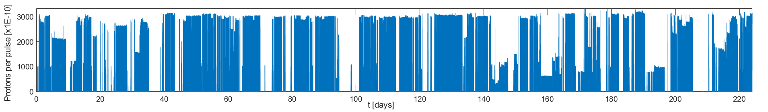
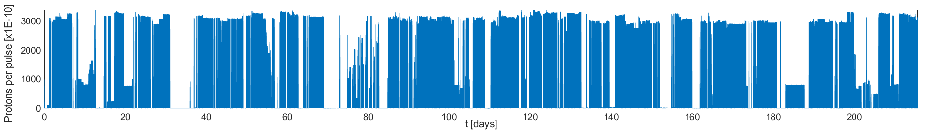
Optimal Use of Available Protons:
Around 50-60% of the protons accelerated by the PSB are used in ISOLDE
ISOLDE typically receives around 1E20 protons during Physics campaign
The typical average proton current during a Physics campaign is ~ 0.8 uA
Once scheduled stops, downtime from the whole accelerator chain, machine studies… are factored in, the effective average proton current is still ~ 0.9 uA
 | 2018 | 2017
Start date | April 10th | April 24th
End date | Nov. 12th | Dec. 4th
Number of days | 215.6 | 224
Protons at ISOLDE | 9.6E19 | 9.0E19
I_{AVG} [uA] | 0.83 | 0.74
Effective I_{AVG} [uA] | ~ 0.95 | ~ 0.85
The MoU between CERN and the ISOLDE collaboration:
“CERN shall provide proton beam from the PS Booster to the ISOLDE target stations according to the schedule approved by the CERN Research Board. The intensity of the proton beam will be typically 3×10¹³ protons per pulse and on average an intensity of 1.5 uA will be delivered to the ISOLDE target”
The gap between the the available ~ 1.5 uA and the actual ~ 0.9 uA is mostly explained by the time needed in between experiments to set-up the machine. Other contributors include: beam characterization and optimization, user requirements on the proton structure and occasional machine/target development studies. ← Listen to the Beam Switching presentation by S. Rothe
A new facility should maximize the use of the available protons
Proton beam current delivered to the ISOLDE facility
2017
2018
J.A. Rodriguez, E. Siesling – EPIC Workshop – 2020/11/25

Slide 7
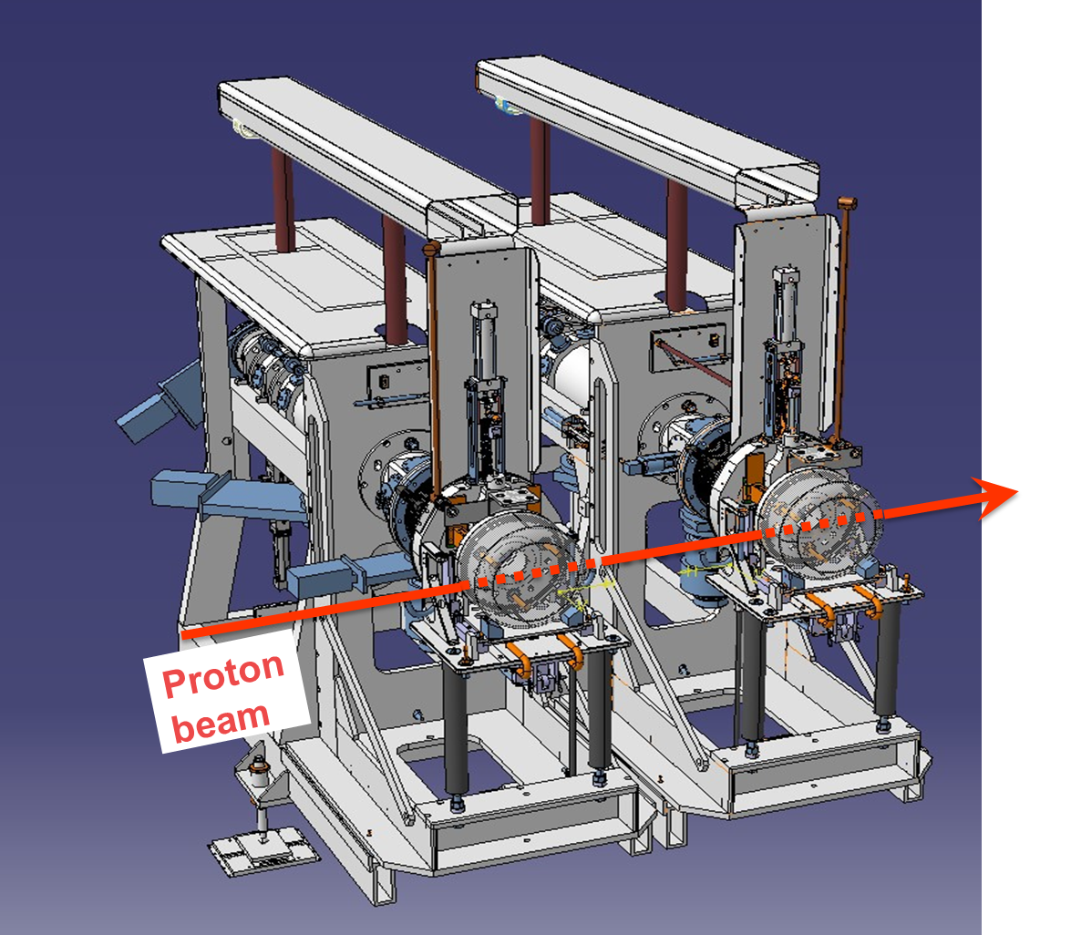
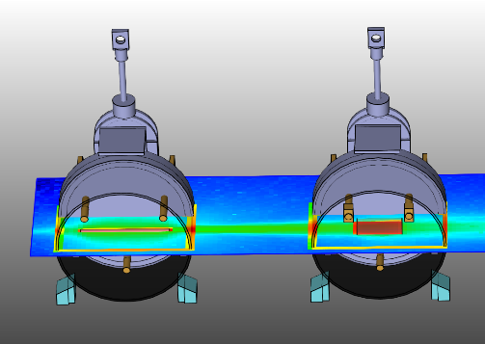
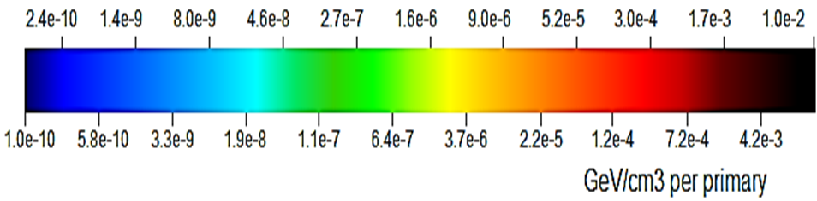
Double Target Front-ends:
Concept presented by M. Lozano during the previous EPIC workshop (https://indico.cern.ch/event/838820/contributions/3634430)
Two target units in series in a given target area profiting from the full proton current simultaneously
Each target unit is followed by a full on-line separator
The two different RIBs can be delivered simultaneously to two separated experimental stations ← Multi-user facility
Initial FLUKA calculations to asses the feasibility of the concept by C. Duchemin
Better results when the targets are closer to each other, with 2 GeV protons, light first targets and larger diameter second targets
Summary of FLUKA simulations (C. Duchemin)
 | Energy deposited in target [W/uA]
 | Δ = 5 cm |  | Δ = 25 cm |  | Δ = 100 cm
Target type#1 (radius) – Target type#2 (radius) | 1.4 GeV | 2.0 GeV | 1.4 GeV | 2.0 GeV | 1.4 GeV | 2.0 GeV
UC₂(0.7) - Ta(2.5) | 106 - 88 | 117 - 108 | 109 - 69 | 117 - 96 | 105 - 32 | 118 - 50
UC₂(0.7) - UC₂(2.5) | 107 - 153 | 116 - 186 | 107 - 121 | 117 - 165 | 106 - 57 | 118 - 85
UC₂(0.7) - UC₂(0.7) | 107 - 16 | 118 - 26 | 107 - 7 | 117 - 13 | 107 – 1.5 | 117 – 2.5
UC₂₋nano(0.7) - UC₂(2.5) | 32 - 203 | 33 - 244 | 31 - 197 | 33 - 235 | 32 - 130 | 32 - 186
UC₂₋nano(0.7) - UC₂(0.7) | 31 - 51 | 32 - 70 | 31 - 30 | 33 - 46 | 32 - 7 | 32 - 13
Δ
✅
❌
✅
Constrains:
Not all combinations of targets are possible
Proton beam energy and time structure identical for both targets
RIBs energy (most likely) identical to be able to keep the targets not too far apart
Question for the community: Are these constrains acceptable? If they are, a new facility with double target front-ends could potentially double the RIBs available for physics
J.A. Rodriguez, E. Siesling – EPIC Workshop – 2020/11/25
1.4 GeV
Δ [cm] | 5 |  | 25 |  | 100
Target type#1 (radius) – Target type#2 (radius) | W₁ – W₂ [W/µA] | W₁ / W₂ | W₁ – W₂ [W/µA] | W₁ / W₂ | W₁ – W₂ [W/µA] | W₁ / W₂
UC₂(0.7) - Ta(2.5) | 106 – 88 | 1.20 | 109 – 69 | 1.58 | 105 – 32 | 3.28
UC₂(0.7) - UC₂(2.5) | 107 – 153 | 0.70 | 107 – 121 | 0.88 | 106 – 57 | 1.86
UC₂(0.7) - UC₂(0.7) | 107 – 16 | 6.69 | 107 – 7 | 15.29 | 107 – 1.5 | 71.33
UC₂₋nano(0.7) - UC₂(2.5) | 32 – 203 | 0.16 | 31 – 197 | 0.16 | 32 – 130 | 0.25
UC₂₋nano(0.7) - UC₂(0.7) | 31 – 51 | 0.61 | 31 – 30 | 1.03 | 32 – 7 | 4.57
1.4 GeV
Δ [cm] | 5 |  | 25 |  | 100
Target type#1 (radius) – Target type#2 (radius) | W₁ – W₂ [W/µA] | W₁ / W₂ | W₁ – W₂ [W/µA] | W₁ / W₂ | W₁ – W₂ [W/µA] | W₁ / W₂
UC₂(0.7) - Ta(2.5) | 106 – 88 | 1.20 | 109 – 69 | 1.58 | 105 – 32 | 3.28
UC₂(0.7) - UC₂(2.5) | 107 – 153 | 0.70 | 107 – 121 | 0.88 | 106 – 57 | 1.86
UC₂(0.7) - UC₂(0.7) | 107 – 16 | 6.69 | 107 – 7 | 15.29 | 107 – 1.5 | 71.33
UC₂₋nano(0.7) - UC₂(2.5) | 32 – 203 | 0.16 | 31 – 197 | 0.16 | 32 – 130 | 0.25
UC₂₋nano(0.7) - UC₂(0.7) | 31 – 51 | 0.61 | 31 – 30 | 1.03 | 32 – 7 | 4.57
1.4 GeV
Δ [cm] | 5 |  | 25 |  | 100
Target type#1 (radius) – Target type#2 (radius) | W₁ – W₂ [W/µA] | W₁ / W₂ | W₁ – W₂ [W/µA] | W₁ / W₂ | W₁ – W₂ [W/µA] | W₁ / W₂
UC₂(0.7) - Ta(2.5) | 106 – 88 | 1.20 | 109 – 69 | 1.58 | 105 – 32 | 3.28
UC₂(0.7) - UC₂(2.5) | 107 – 153 | 0.70 | 107 – 121 | 0.88 | 106 – 57 | 1.86
UC₂(0.7) - UC₂(0.7) | 107 – 16 | 6.69 | 107 – 7 | 15.29 | 107 – 1.5 | 71.33
UC₂₋nano(0.7) - UC₂(2.5) | 32 – 203 | 0.16 | 31 – 197 | 0.16 | 32 – 130 | 0.25
UC₂₋nano(0.7) - UC₂(0.7) | 31 – 51 | 0.61 | 31 – 30 | 1.03 | 32 – 7 | 4.57
1.4 GeV
Δ [cm] | 5 |  | 25 |  | 100
Target type#1 (radius) – Target type#2 (radius) | W₁ – W₂ [W/µA] | W₁ / W₂ | W₁ – W₂ [W/µA] | W₁ / W₂ | W₁ – W₂ [W/µA] | W₁ / W₂
UC₂(0.7) - Ta(2.5) | 106 – 88 | 1.20 | 109 – 69 | 1.58 | 105 – 32 | 3.28
UC₂(0.7) - UC₂(2.5) | 107 – 153 | 0.70 | 107 – 121 | 0.88 | 106 – 57 | 1.86
UC₂(0.7) - UC₂(0.7) | 107 – 16 | 6.69 | 107 – 7 | 15.29 | 107 – 1.5 | 71.33
UC₂₋nano(0.7) - UC₂(2.5) | 32 – 203 | 0.16 | 31 – 197 | 0.16 | 32 – 130 | 0.25
UC₂₋nano(0.7) - UC₂(0.7) | 31 – 51 | 0.61 | 31 – 30 | 1.03 | 32 – 7 | 4.57

Slide 8
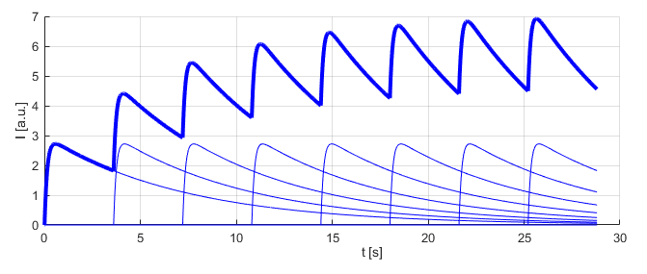
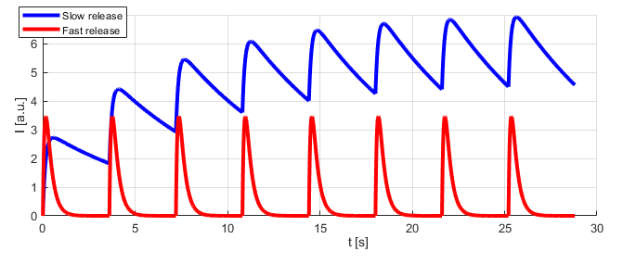
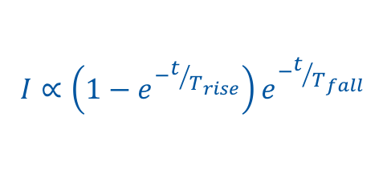
Time Separation Kickers:
Beam dump
Mass separator dipoles
Experimental stations
An electrostatic kicker is used to separate fast and slow release RIBs into two different beam lines
Each beamline is equipped with its own mass separator dipole
The two RIBs can be delivered simultaneously to two different experimental stations ← Multi-user facility
Time separator kicker
Slow released isotopes
Target
Fast released isotopes
Proton beam
Period
Fast release
Slow release
$$I∝\left(1−e^{−t/{T_{rise}}}\right)e^{−t/{T_{fall}}}$$
 | Fast release | Slow release
T_{rise} / ln(2) [ms] | 100 | 100
T_{fall} / ln(2) [ms] | 200 | 5000
RIBs – 0.78 s window | 90 % | 75 %
RIBs – 0.99 s window | 95 % | 69 %
RIBs – 1.45 s window | 99 % | 55 %
Constrains:
Proton beam energy and time structure identical for both beams
RIBs energy identical since they are both extracted from the same target
There will be time gaps in the beam structure
Question for the community: Are these constrains acceptable? If they are, a new facility equipped with time separation kickers could increase significantly the RIBs available for physics
J.A. Rodriguez, E. Siesling – EPIC Workshop – 2020/11/25

Slide 9
Outline:
Introduction / Motivation
Capabilities of the New Facility
Facility Layout
Example of an Operational Scenario
Summary
J.A. Rodriguez, E. Siesling – EPIC Workshop – 2020/11/25

Slide 10
Facility Layout:
Beam dump
Slow released isotopes
Mass separator dipoles
Time separator kickers
Experimental stations
Target
01
Fast released isotopes
Beam
switchyard
High-resolution separator
Target
02
Experimental stations
Beam dump
Time separator kickers
Target
03
High-resolution separator
Proton beam
Beam characterization lines
Fast released isotopes
Target
04
Slow released isotopes
Experimental stations
Mass separator dipoles
Proton beam
J.A. Rodriguez, E. Siesling – EPIC Workshop – 2020/11/25

Slide 11
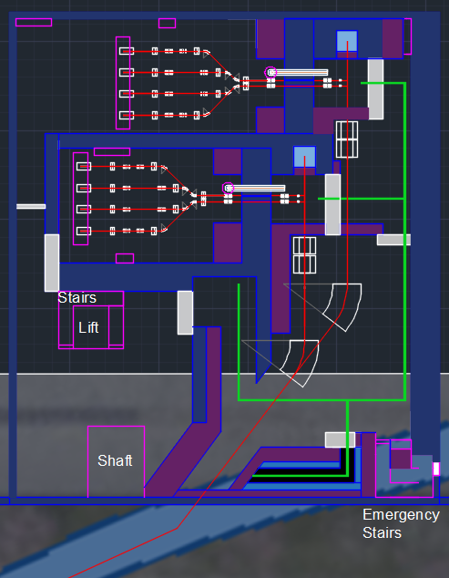
Facility Layout: Target and Separator Zones
Space reserved for future upgrades
Time separation kickers
Faraday cage of Target area 1
Separator area 1
Double target front-ends
90 deg. separator magnets
Space reserved for future upgrades
Faraday cage of Target area 2
Laser injection points
Separator area 2
Underground Level -3:
Target/Separator
2 GeV proton beamline
TT70 tunnel
J.A. Rodriguez, E. Siesling – EPIC Workshop – 2020/11/25

Slide 12
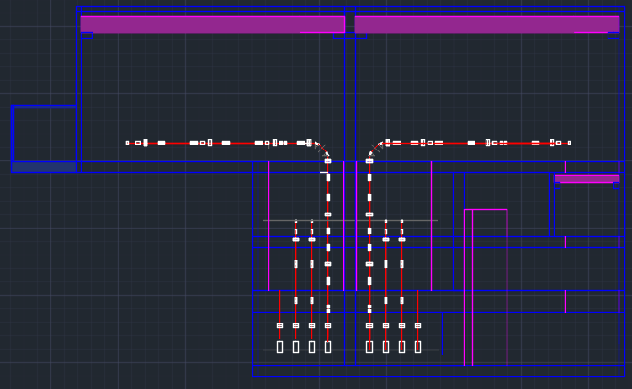
Facility Layout: Vertical Beamlines
Vertical beamlines
Surface Level 0:
Experimental Hall
Underground Level -1:
Beam distribution and purification
Underground Level -2:
HT/RILIS/CV
Space reserved for future upgrades
Underground Level -3:
Target/Separator
Space reserved for future upgrades
90 deg. separator magnets
Separator areas
J.A. Rodriguez, E. Siesling – EPIC Workshop – 2020/11/25

Slide 13
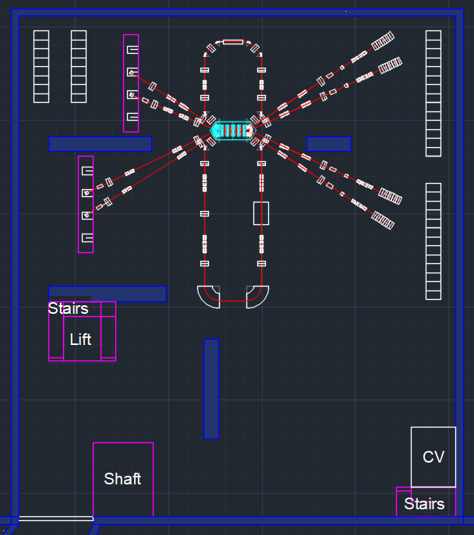
Facility Layout: Beam Distribution and Purification Zones
Vertical beamlines to experimental hall
MR-ToF purification area
Electronic racks for equipment
Vertical beamlines shaft
Beam characterization lines (triplet + BI + tape station)
Compact beam switchyard
Cooler/buncher
HRS purification area
(- 60 kV floating platform)
Underground Level -1:
Beam distribution and purification
J.A. Rodriguez, E. Siesling – EPIC Workshop – 2020/11/25

Slide 14
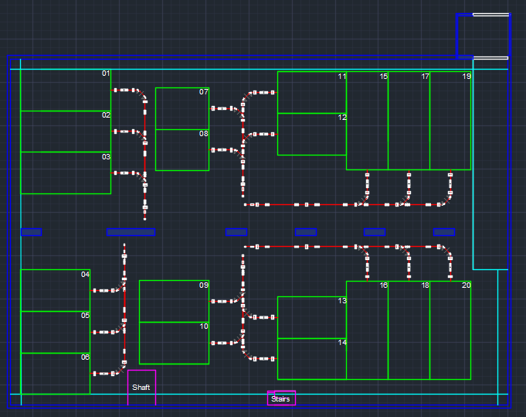
Facility Layout: Experimental Hall
Beam distribution lines
Vertical beamlines from lower levels
Experimental stations (6 with standard separation)
Surface Level 0:
Experimental Hall
Experimental stations (14 with possible high-resolution separation)
J.A. Rodriguez, E. Siesling – EPIC Workshop – 2020/11/25

Slide 15
Outline:
Introduction / Motivation
Capabilities of the New Facility
Facility Layout
Example of an Operational Scenario
Summary
J.A. Rodriguez, E. Siesling – EPIC Workshop – 2020/11/25

Slide 16
Example of an Operational Scenario:
Separator # |  | 1.5 uA for Target 1 & 2 | 1.3 uA for Target 1 & 2 0.2 uA for Target 3 & 4 | 1.3 uA for Target 1 & 2 0.2 uA for Target 3 & 4 | 1.5 uA for Target 3 & 4
1 | Target 1 - slow release | Collections 1 | Collections 1 | Collections 1 | Preparation accelerator (heating of targets, set-up of beamlines with stable beams…)
2 | Target 1 - fast release | Experiment 1 | Experiment 1 | Experiment 1
3 | Target 2 | Experiment 2 with HRS | Experiment 2 with HRS | Experiment 2 with HRS
4 | Target 3 - slow release | Preparation accelerator (heating of targets, set-up of beamlines with stable beams…) | Preparation of experiment (set-up with RIBs) | Experiment 3 | Experiment 3
5 | Target 3 - fast release |  | Beam characterization and optimization | Preparation of experiment (set-up with RIBs) | Experiment 4 with HRS
6 | Target 4 |  | Collections 2 | Collections 2 | Collections 2
Separator # |  | 1.5 uA for Target 1 & 2 | 1.3 uA for Target 1 & 2 0.2 uA for Target 3 & 4 | 1.3 uA for Target 1 & 2 0.2 uA for Target 3 & 4
1 | Target 1 - slow release | Collections 1 | Collections 1 | Collections 1
2 | Target 1 - fast release | Experiment 1 | Experiment 1 | Experiment 1
3 | Target 2 | Experiment 2 with HRS | Experiment 2 with HRS | Experiment 2 with HRS
4 | Target 3 - slow release | Preparation accelerator (heating of targets, set-up of beamlines with stable beams…) | Preparation of experiment (set-up with RIBs) | Experiment 3
5 | Target 3 - fast release |  | Beam characterization and optimization | Preparation of experiment (set-up with RIBs)
6 | Target 4 |  | Collections 2 | Collections 2
Separator # |  | 1.5 uA for Target 1 & 2 | 1.3 uA for Target 1 & 2 0.2 uA for Target 3 & 4
1 | Target 1 - slow release | Collections 1 | Collections 1
2 | Target 1 - fast release | Experiment 1 | Experiment 1
3 | Target 2 | Experiment 2 with HRS | Experiment 2 with HRS
4 | Target 3 - slow release | Preparation accelerator (heating of targets, set-up of beamlines with stable beams…) | Preparation of experiment (set-up with RIBs)
5 | Target 3 - fast release |  | Beam characterization and optimization
6 | Target 4 |  | Collections 2
Separator # |  | 1.5 uA for Target 1 & 2
1 | Target 1 - slow release | Collections 1
2 | Target 1 - fast release | Experiment 1
3 | Target 2 | Experiment 2 with HRS
4 | Target 3 | Preparation accelerator (heating of targets, set-up of beamlines with stable beams…)
5 | Target 4 - fast release
6 | Target 4 - slow release
J.A. Rodriguez, E. Siesling – EPIC Workshop – 2020/11/25

Slide 17
Outline:
Introduction / Motivation
Capabilities of the New Facility
Facility Layout
Example of an Operational Scenario
Summary
J.A. Rodriguez, E. Siesling – EPIC Workshop – 2020/11/25

Slide 18
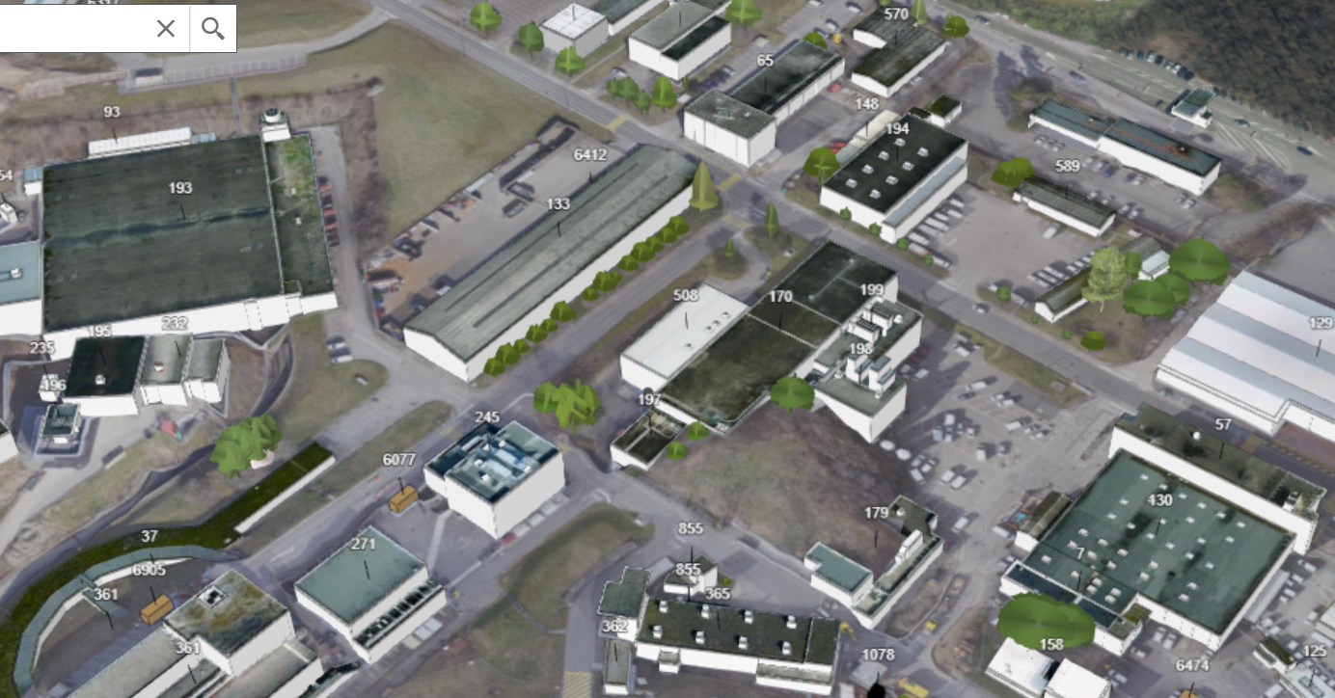
Summary:
This presentation introduces a concept for a new ISOLDE hall for low-energy experiments
It is meant to be a starting point and to trigger discussions that could help refining the concept
The goal is to converge to a feasible concept that could serve better the current and future community of users
The initial proposal:
  Makes use of all the protons that the PSB could deliver (up to x1.5 more RIBs)
  Makes use of double target front-ends (up to x2 more RIBs)
  Makes use of time separation kickers in two of the targets (up to x1.3 more RIBs)
  Has six separators that can be used simultaneously to deliver beam to six different experimental stations
  The experimental hall can host up to 20 experimental stations (6 of them with standard separation, 14 of them with high-resolution separation, 2 of them simultaneously)
Thank you for your attention!
J.A. Rodriguez, E. Siesling – EPIC Workshop – 2020/11/25

