Slide 1
ISOLDE@CERN: near and long-term future
S. Gilardoni (EN/STI)
In collaboration with:
J.A. Rodriguez, E. Siesling (BE/OP)
G. Neyens, K. Johnston (EP/SME)
R. Heinke (EP/UIS)
M. Calviani, R. Catherall, S. Rothe, A. P. Bernardes, J. Vollaire (EN/STI)

Slide 2
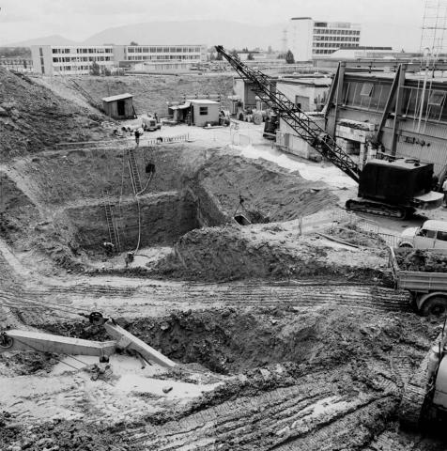
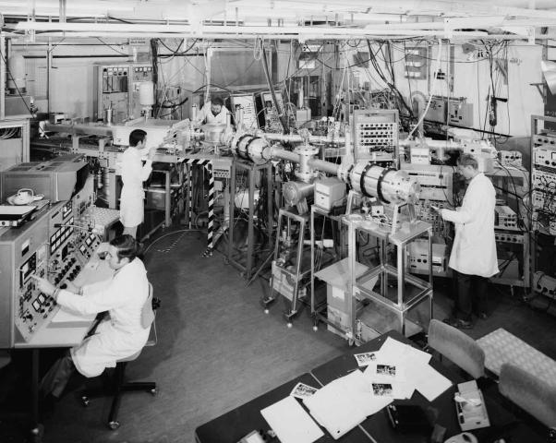
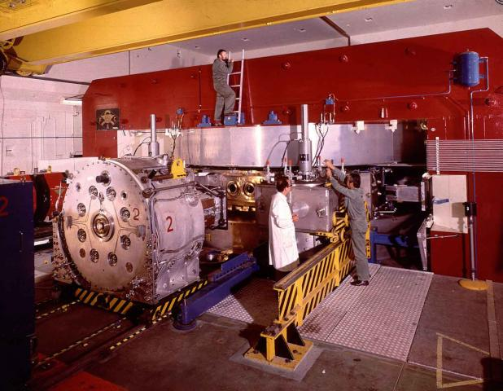
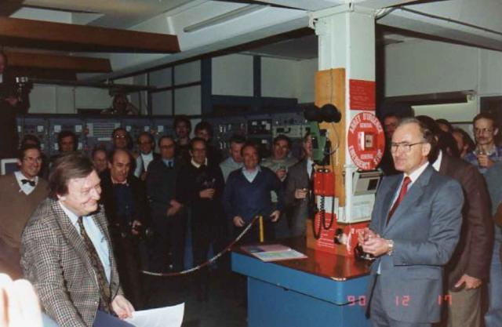
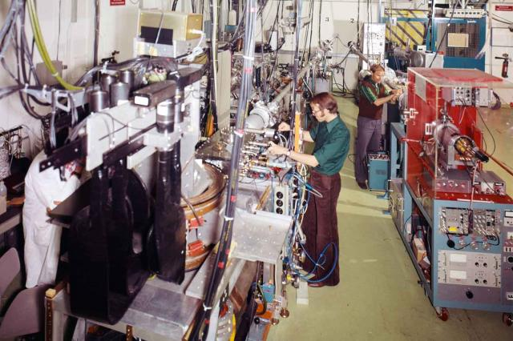
ISOLDE : a successful long history
From CERN Convention: 1953
The Organization shall, […], confine
its activities to the following:
May 1966: Synchro-Cyclotron
shuts down for ISOLDE construction
Oct 1967: First proton
beams at ISOLDE
Dec 1964: CERN approves
the online separator project
June 1983: ISOLDE III approved –
two-stage high resolution separation
using two magnets
Dec 1990: The Synchrocyclotron beam ends
New ISOLDE facility → Online in 1992@PSB
1972:
SC Improvement Program – doubles the intensity

Slide 3
Future of ISOLDE : a proposed roadmap
Goal: secure the future of ISOLDE leadership as flagship facility for nuclear physics:
  Combined effort between different programs: CONS, Operation, EPIC
  Different horizons : up to LS4 for EPIC, starting now for all the others
Staged approach:
  Intermediate upgrade/consolidation steps bringing improvement to the operability of the facility together with new physics potentials
  Each step studied to be potentially compatible with financial situation
  Mayor interventions can happen only during LS or extended
Strategy since the beginning for EPIC:
  Consider global optimization of resources with other programs
  Avoid same path as for TSR, discussion within ATS sector since first EPIC days.
Opening synergies with other experimental programs (AD, n_TOF)
→ See Doser’s and Mengoni’s presentations

Slide 4

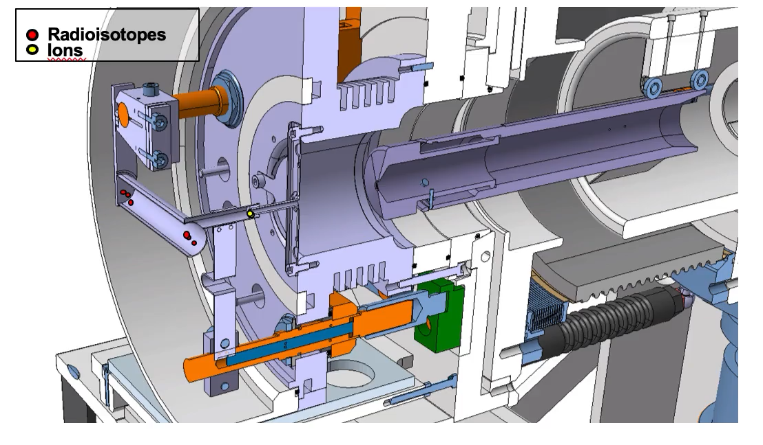
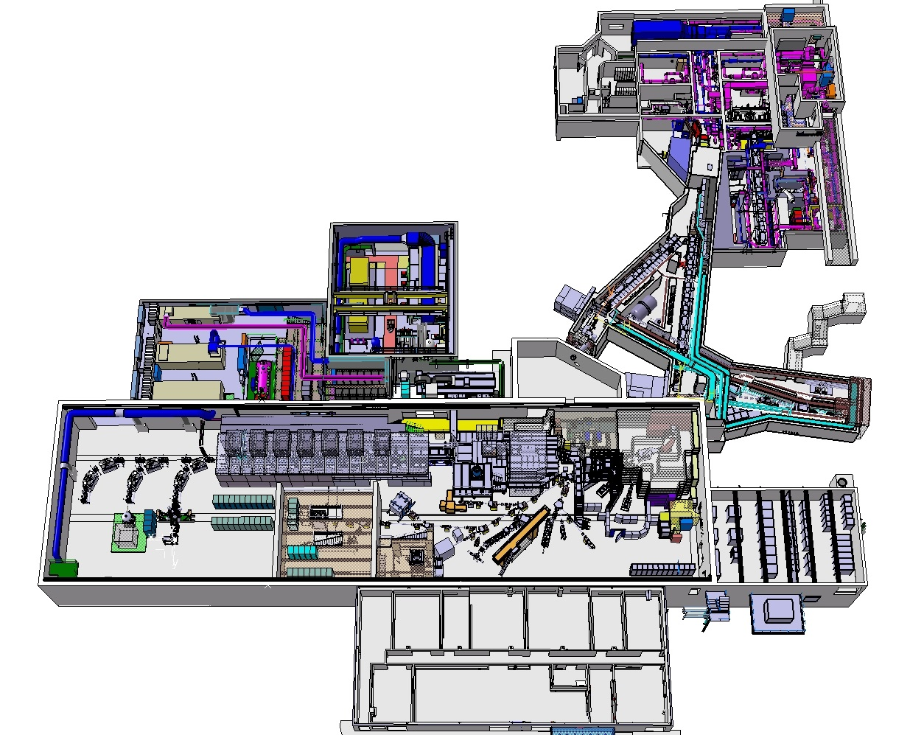
ISOLDE
Front-ends
Targets
Class A labs
MEDICIS
Target area
ISOLDE Control Room
1° Floor

Slide 5
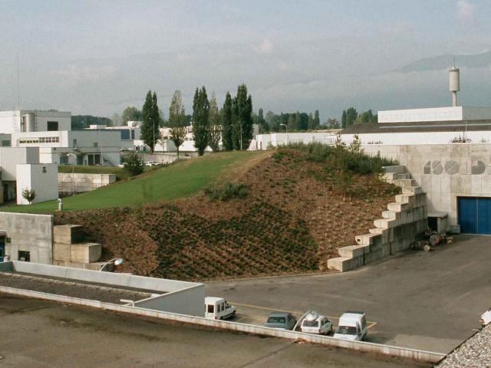
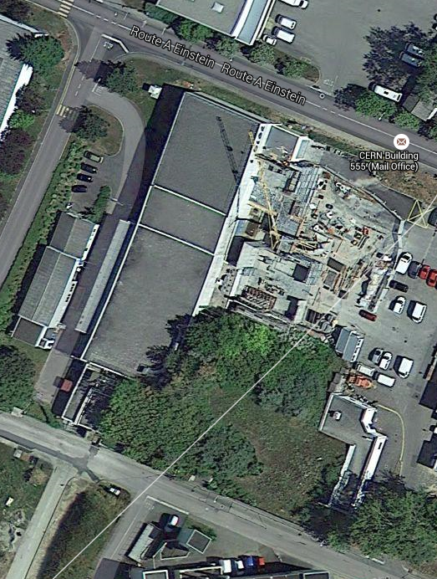
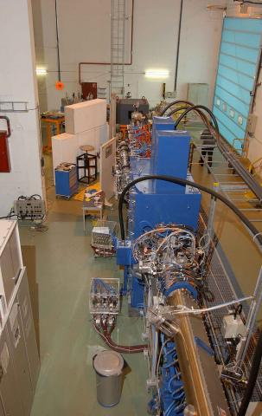
Isolde evolution - expansion
1992
1999
2001
REX-ISOLDE
1992

Slide 6
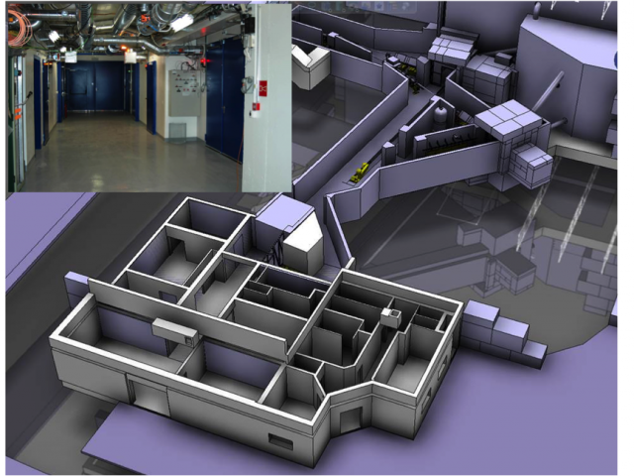
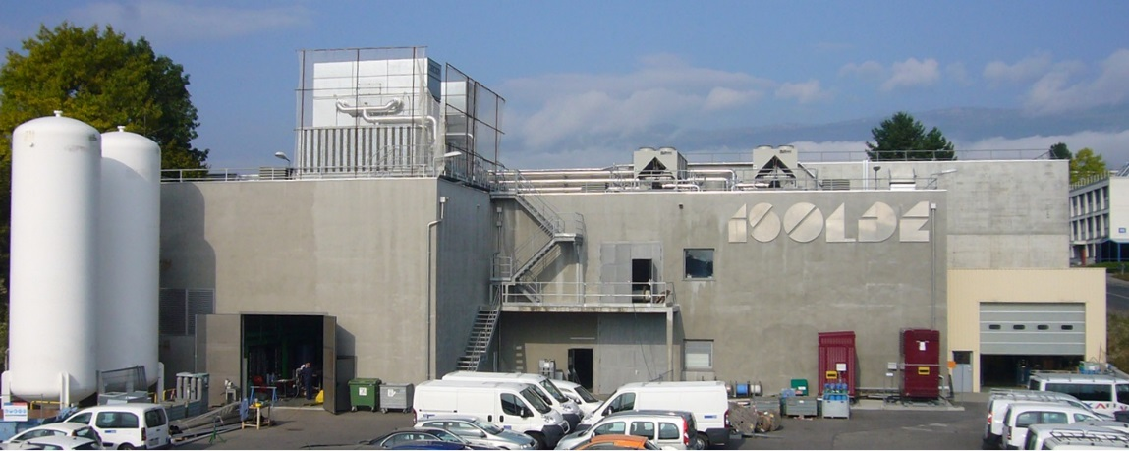
Isolde evolution - expansion
2004
2007
1999
2012
Class A radioactive laboratory
2015
1992
2004
HIE ISOLDE on line 2015

Slide 7
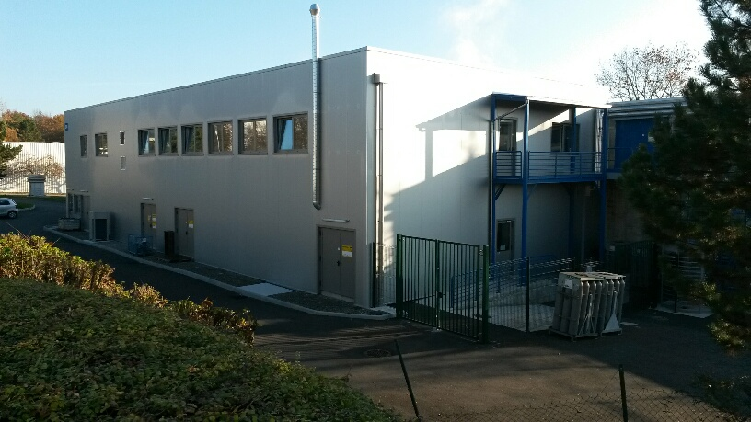
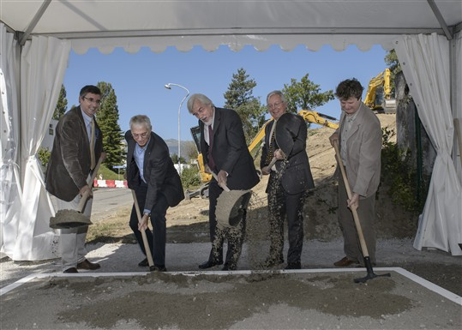
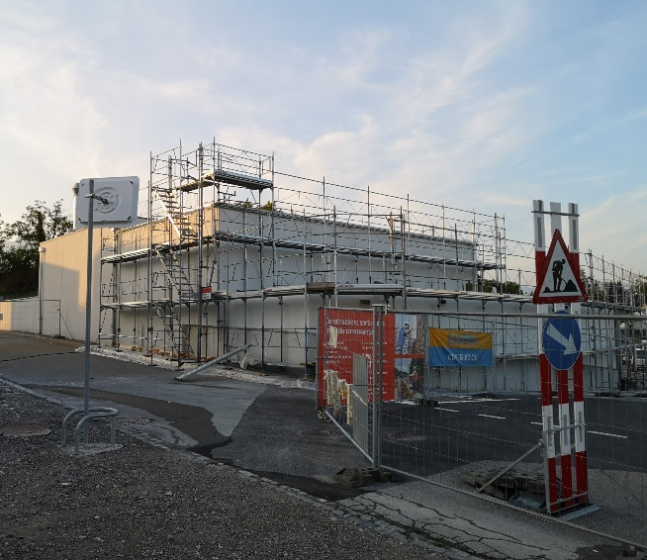
Isolde evolution - expansion
2014
2007
1999
2014
User and Operations facility building
2012
2013
2020
1992
2004
2020
2014
Groundbreaking MEDICIS
building
NANO-lab building

Slide 8
PSB evolution
ISOLDE matching proton beam evolution
following PSB performance improvements
With LIU (LHC INJECTOR UPGRADE)
post LS2 for PSB:
2 GeV beams → all users except ISOLDE
Potentially higher intensity
ISOLDE consolidation/upgrade considering
potential offered by L4+PSB@2GeV
M. Chanel

Slide 9
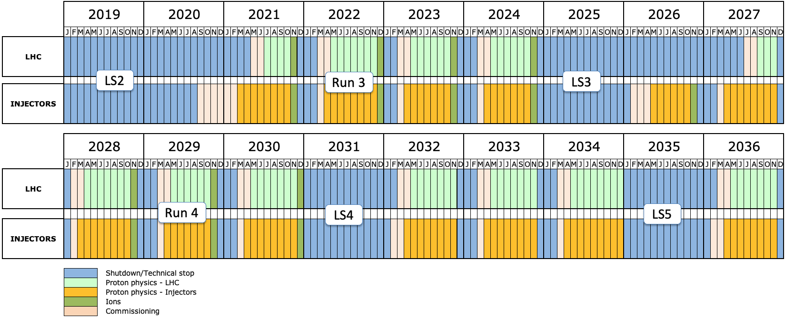
Draft of future CERN accelerator plan
By M. Lamont, https://lhc-commissioning.web.cern.ch/schedule/images/LHC-and-injectors-to-2036.png

Slide 10
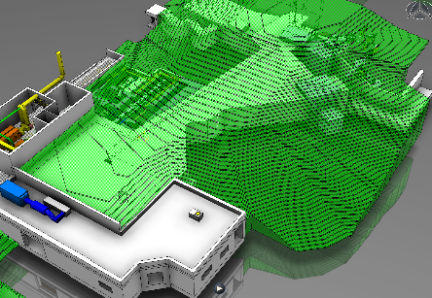
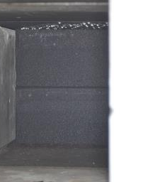
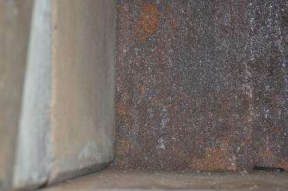
ISOLDE target areas consolidation : up to LS3
High priority consolidation items:
Renovation of beam-dumps at end of life-time (signs of rust)
Replacement of Front-end after
few years of operation
  FE lifetime given by integrated dose.
ISOLDE RILIS Lasers regular replacement

Slide 11

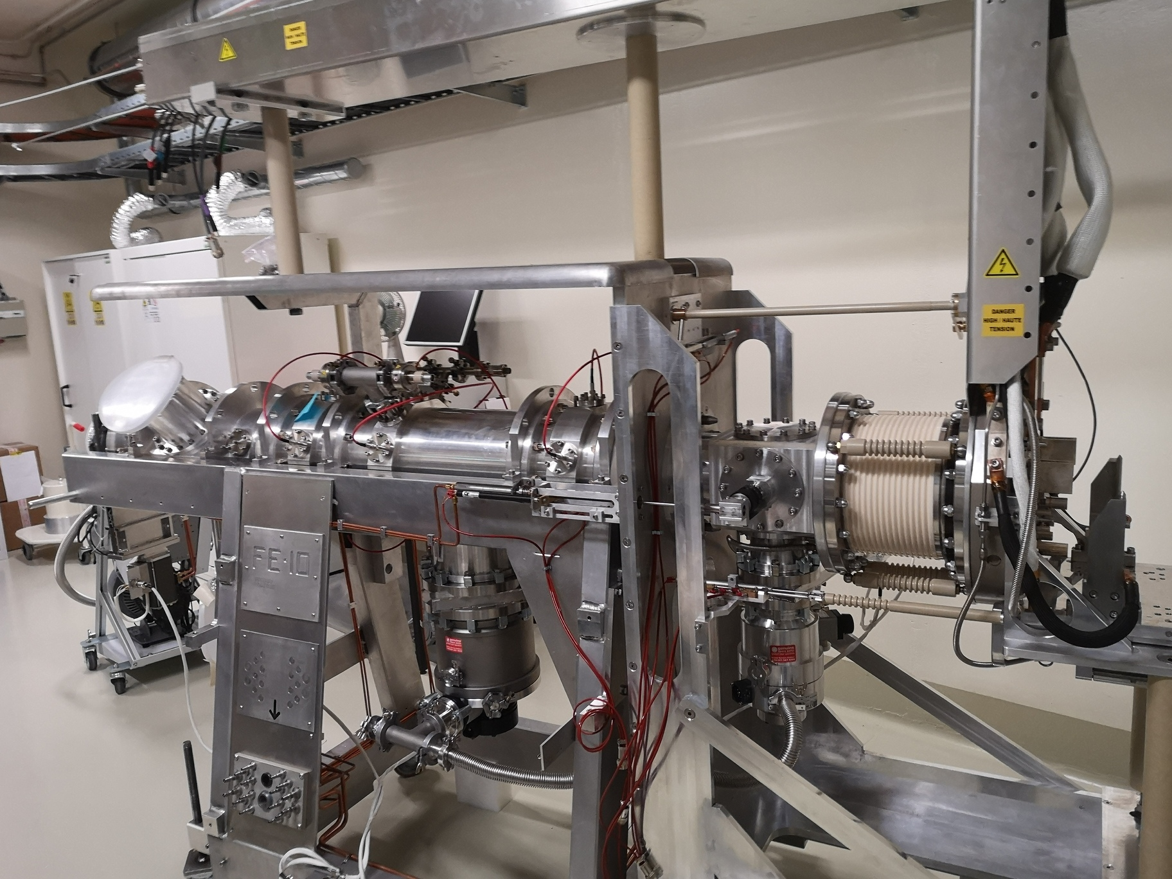
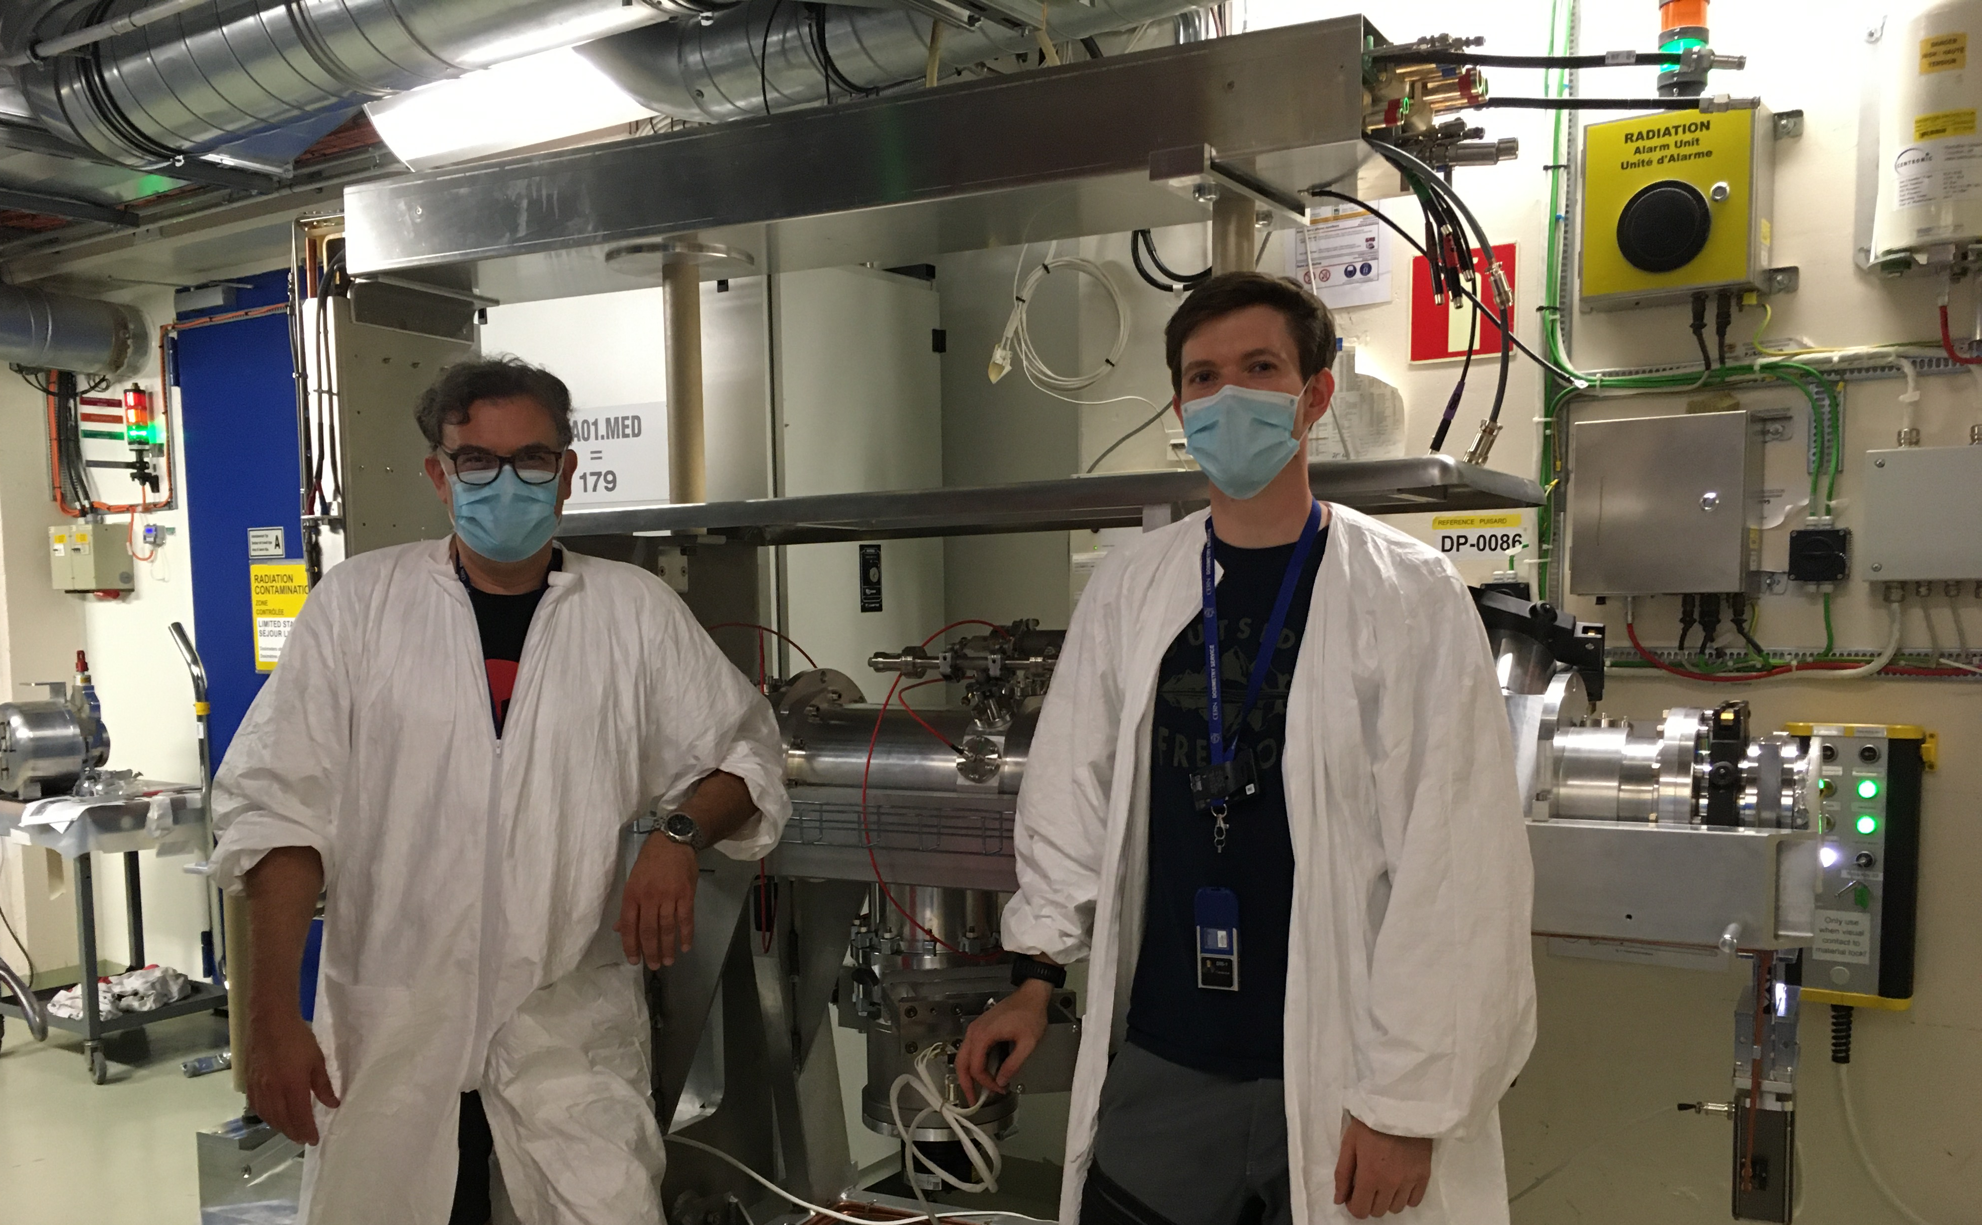
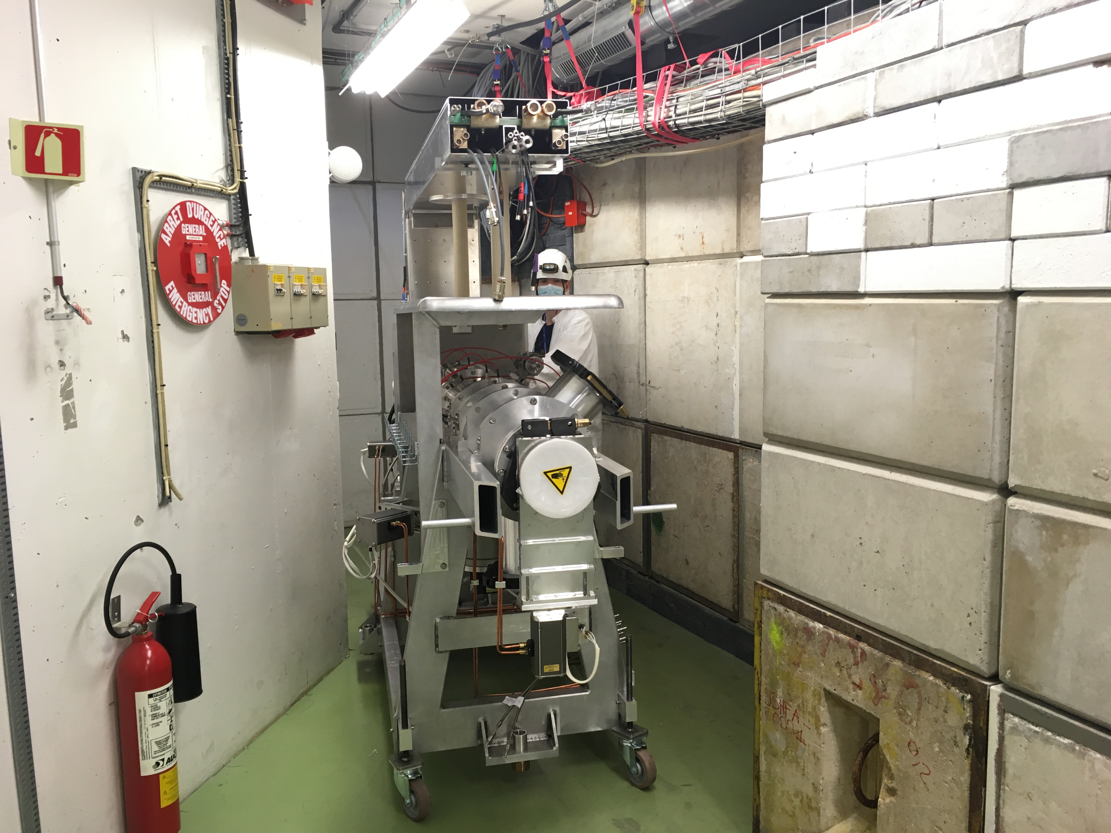
Frontend exchange
Front-end exchange is a major work requiring an LS both for cooldown as for installation
Design of new generation starting after beginning of operation
Typical FE lifetime is 4 – 8 years depending on dose cumulated (seal, HV, etc…) → Next LS3
Identified need for larger Faraday cage to easy interventions/maintenance (ALARA)
FE10 completion in Build. 179
Frontend delivery team (with masks)
Passing the chicane

Slide 12
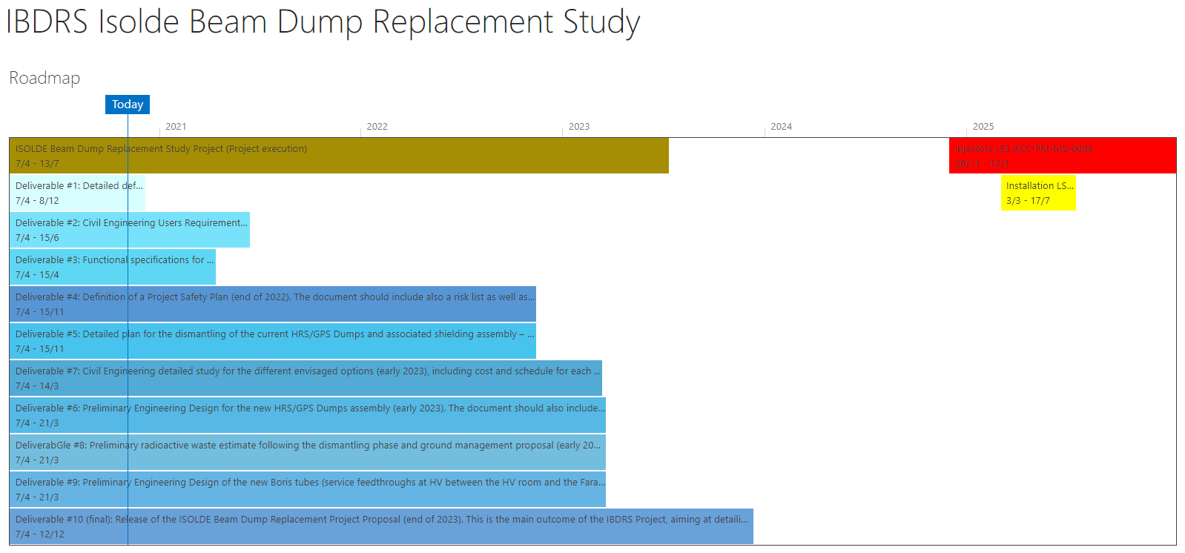
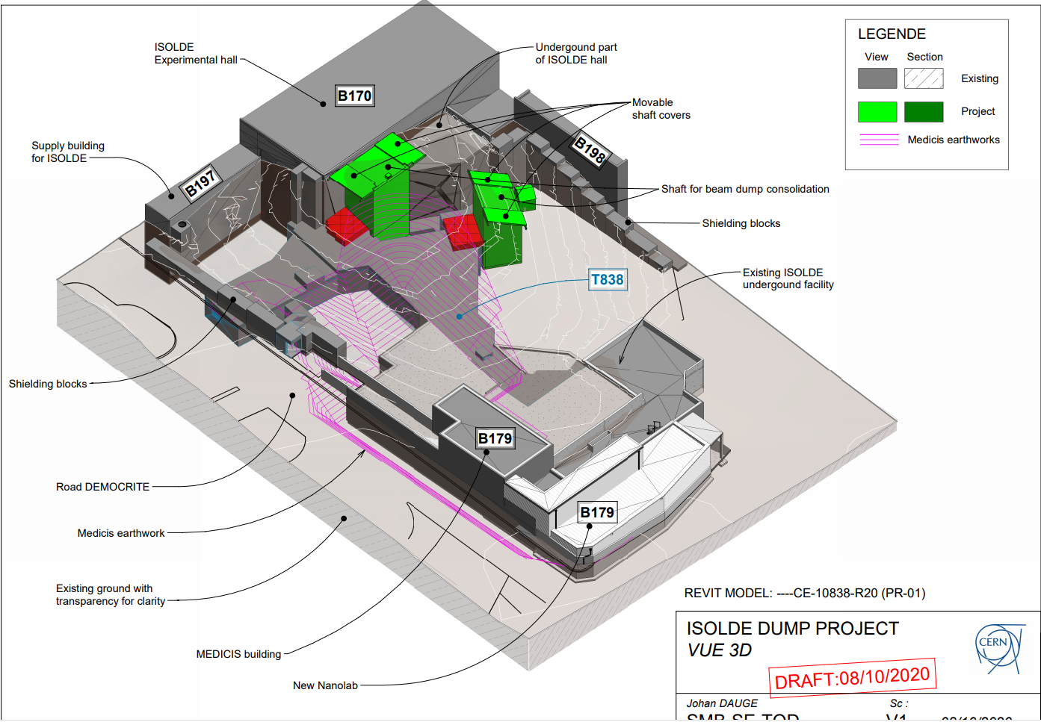
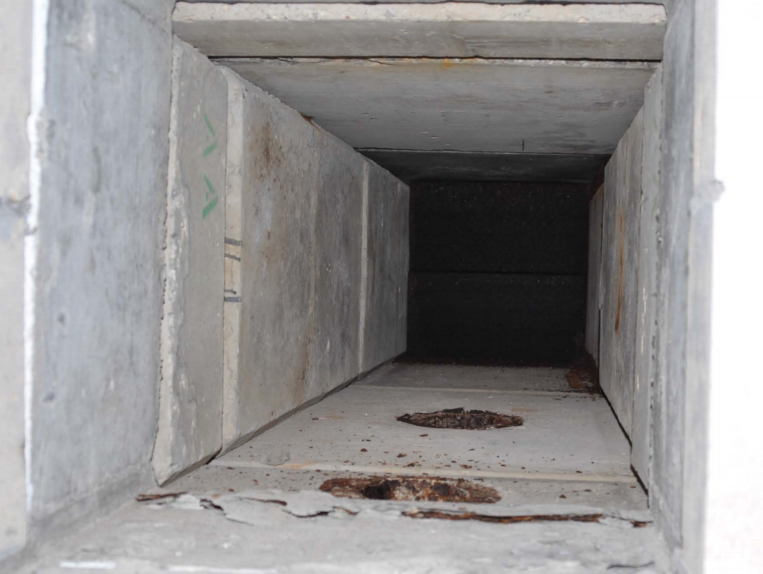
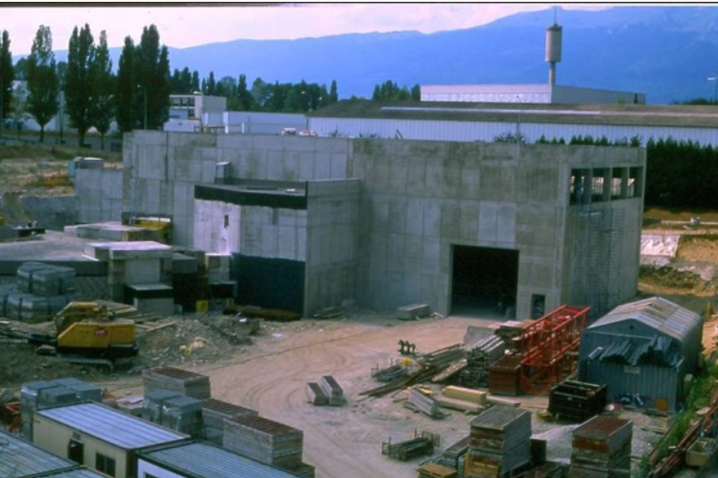
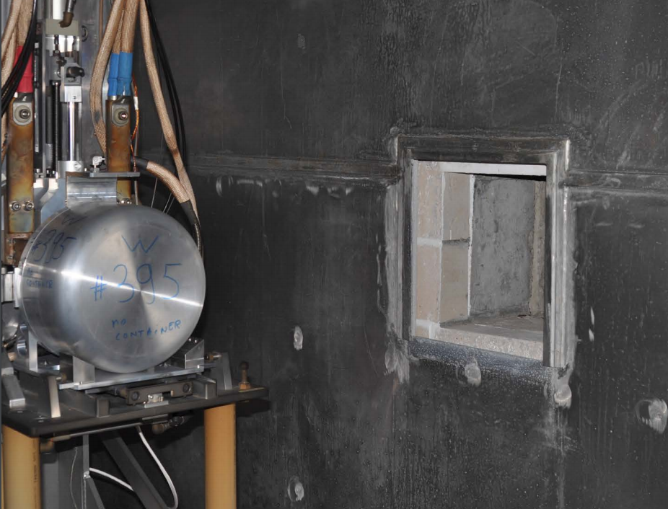
ISOLDE Beam Dump Replacement Study
Ana-Paula Bernardes nominated Project Leader
  See her presentation
New beam dump system compliant with modern standard for operation and RP
Opportunity to implement solutions to overcome some current limitations (space, accessibility, intensity, energy...)

Slide 13
ISOLDE operability: more time to users
 | Sum of Shifts remaining for Run3 | Number of experiments
Number of shifts remaining after status report review | 485 | 34
Grand Total of shifts now on books at ISOLDE | 1015,5 | 66
Parallel operation of the two front-ends (see Rothe’s presentation):
  Setting up of one experiment on one FE while a second is running on the other
  Consider real alternating operation running HRS and GPS at later stage
Nano-material based targets potential gains:
  Improve target lifetime → reduce target exchange and number of targets
  Improve yields
  Offer new short-live isotopes

Slide 14
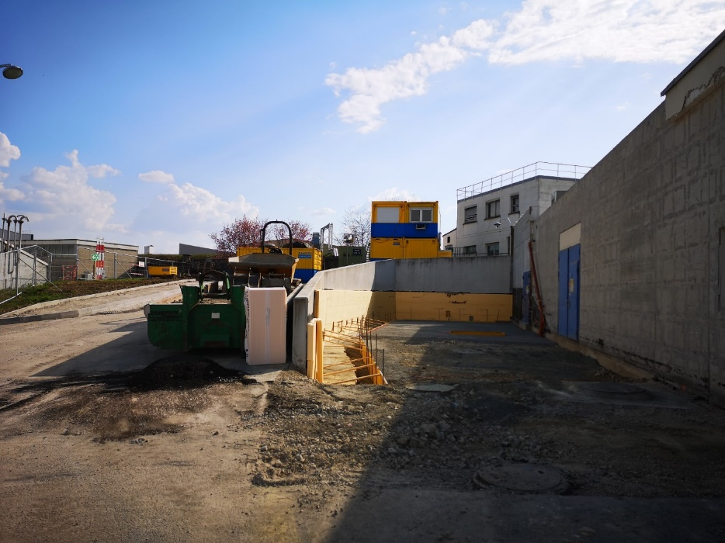
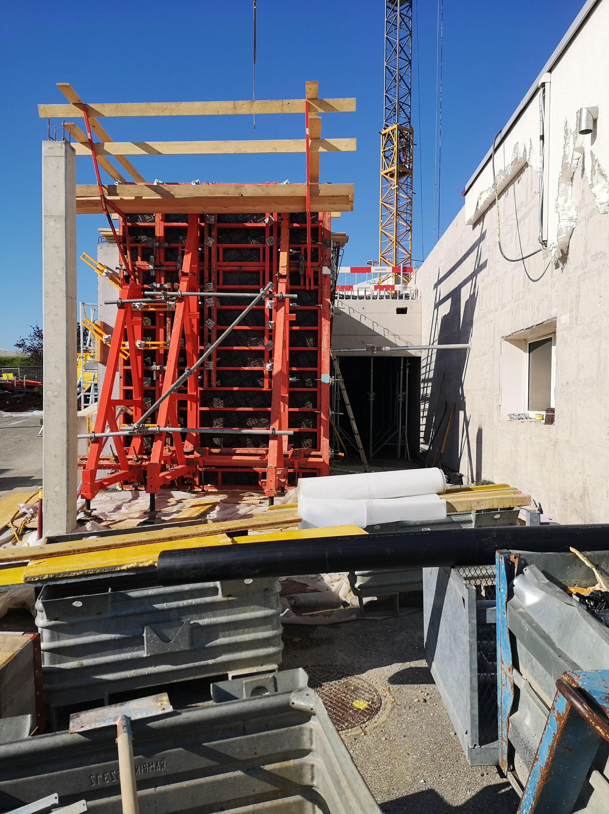
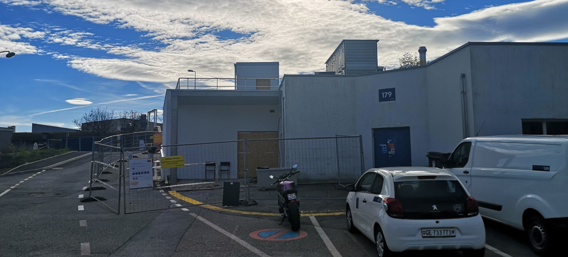
Nano-Laboratory Construction
March
June
November
Existing Building 179
New laboratory will offer more space and a modern infrastructure (fully enclosed process requiring less transfer of radioactive powder) for production of UCx pills (including pills from nano-material powders)
Storage area for radioactive material (hot cell for ISOLDE and MEDICIS targets dismantling)
Operation will start in 2021

Slide 15
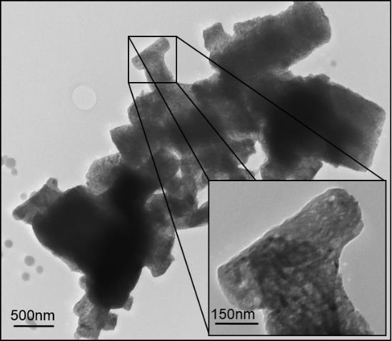
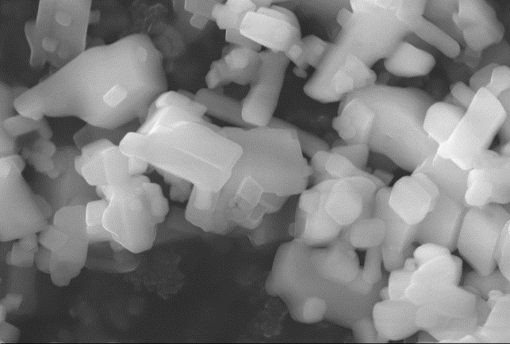
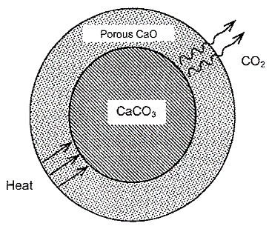

Nano-target: Calcium Oxide example
CaCO₃
CaO
800ºC – 2 h
Vacuum (base P=10⁻³ mbar)
650 nm
Grain size ~1 μm
35Ar
Grain size ~40 nm
Operation temperature reduced to keep nanostructure
Pseudomorphous reaction
J.P. Ramos, et. al., Ceramics International 41 (6) (2015), 8093-8099.
J.P. Ramos, et al., NIMB 320 (2014), 83-88
J.P. Ramos, Master Thesis, Univ. Aveiro/CERN (2012)
J. P Ramos

Slide 16
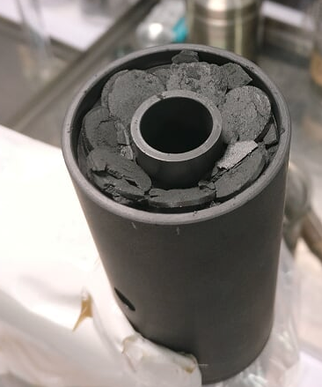
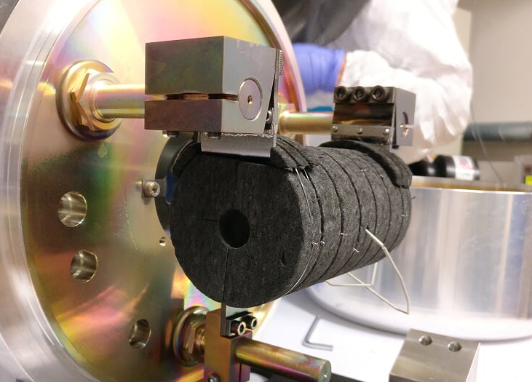
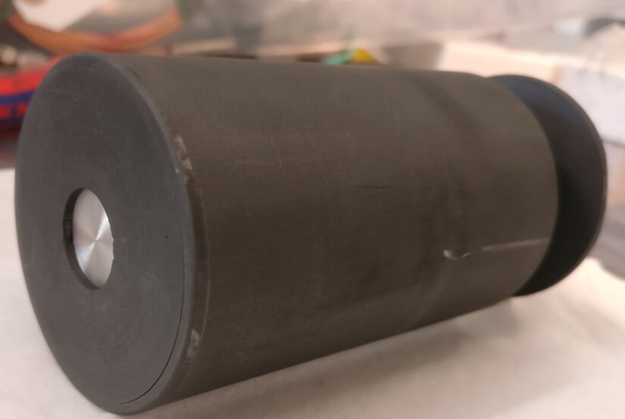
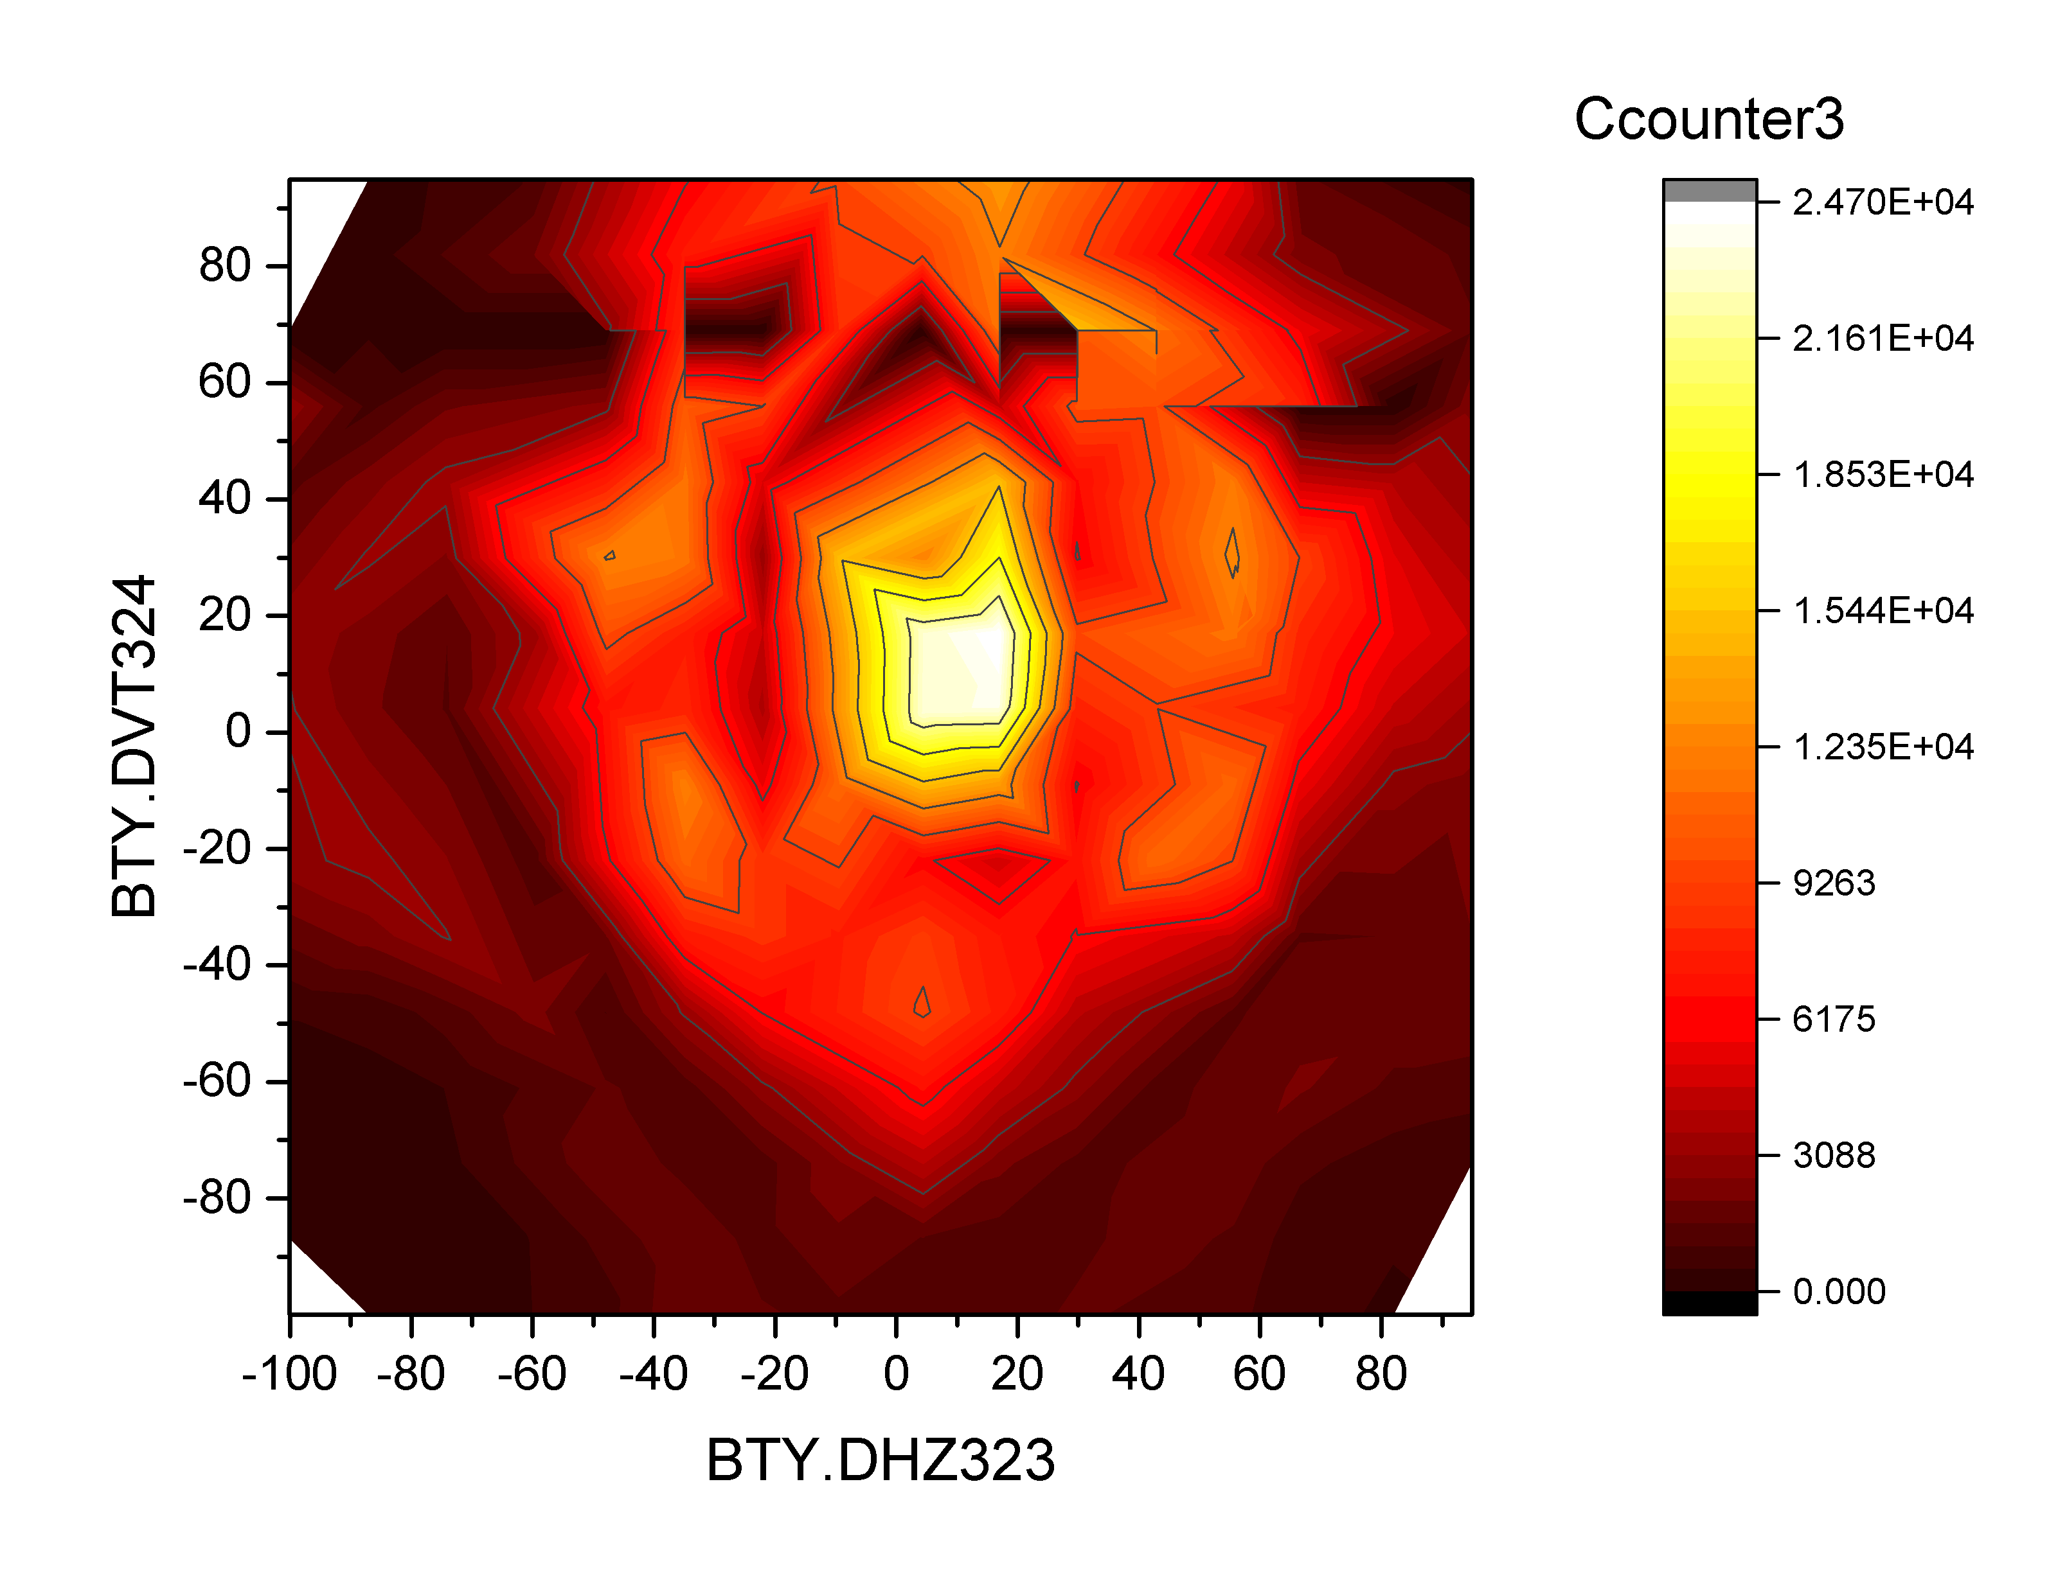
ISOLDE target development:
Proton-to-neutron converter
Succesfully tested at ISOLDE
Rb and Cs isotopes have been measured –
T1/2 down to 30 ms seen at the tapestation
(>101Rb, >150Cs)
2nd half of beam time:
Laser beams (Ga, Zn, Ni, In, Te)
Proton scan with 145Cs

Slide 17
Physics → what we do with that
Run more / longer experiments per year
  Fulfil high demand for beam time
Better quality beams, e.g. around ¹³²Sn (intensity/purity)
  Region of interest for astrophysics r-process path (link to origin of elements, neutron-star mergers, gravitational waves)
Faster release
  Shorter lived (thus more exotic) isotopes
  Those are typically of highest interest (astrophysics, nuclear modelling, …)

Slide 18
Improving beam purity
Some exotic beams are produced only a few isotopes/second in a background of more than 1.000.000/s isobars.
  Current isobar selection using HRS is about 1/2000
  Separation of isotopes with same number of nucleons is impossible
  Purification of 1/20000 is needed
Development of a fast MR-TOF mass spectrometer
(talk by M. Vilen)
Improving purification is essential in case of upgrade to 2 GeV

Slide 19
ISOLDE upgrade : EPIC – Medium term
Medium-term facility upgrade (possible horizon LS3)
to fully profit from LIU-PSB improvements:
ISOLDE @ 2 GeV
Increased POT
Upgrade needed :
Rebuilding of PSB-ISOLDE transfer line
Rebuilding of ISOLDE beam dumps
Validate new targets and future FEs

Slide 20
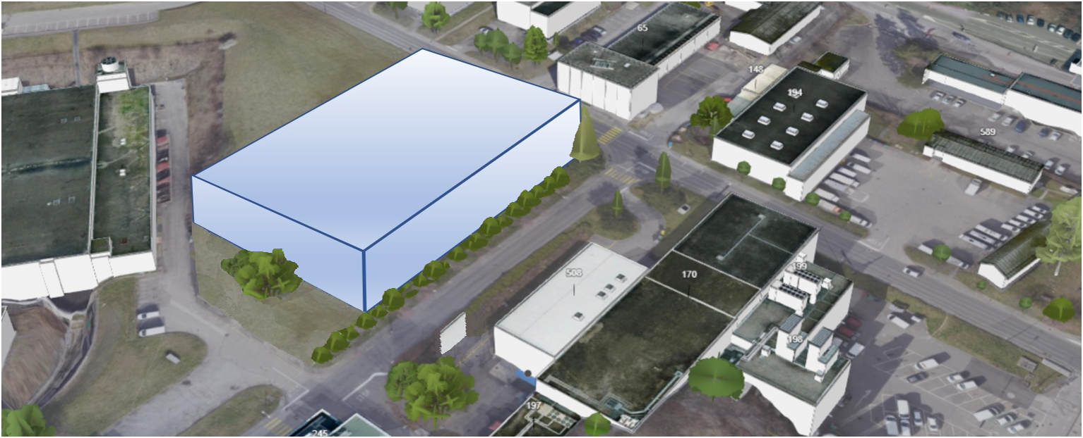
ISOLDE upgrade : EPIC – long-term (>LS3)
Goal:
increase integrated intensity to final users
→ 1-2 new Front-Ends with RILIS systems
increase possible experiments
→ New experimental hall
New physics opportunities
→ Isotope storage ring

Slide 21
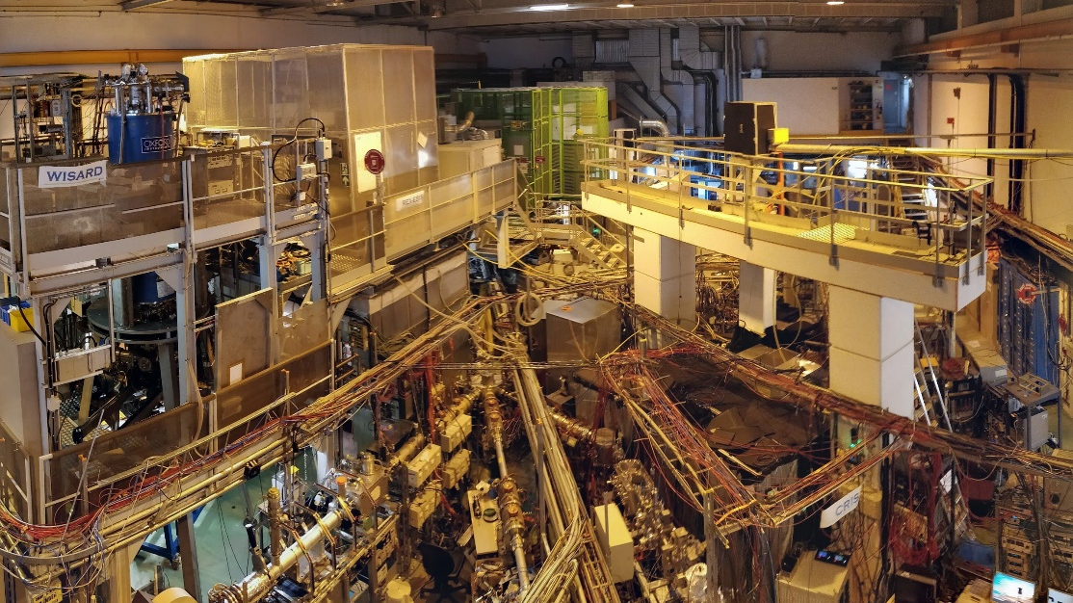
Reasons for a new ISOLDE hall and target stations
Space in the existing ISOLDE hall
No-more expansion of the existing ISOLDE experimental hall possible
An overfull existing ISOLDE experimental hall and growing demand for new
experimental stations: 2 out of 5 new by the RB endorsed experiments
will have difficulties to be housed in the existing hall
Need for higher efficiency and higher quality beams:
parallel physics from new target stations and infrastructure with high-resolution separation
Proposed solution
A new Low Energy Nuclear Physics experimental hall with its own underground
target stations at CERN making use of existing tunnel structures (TT70) to transport the proton beam from PSB
Present experimental hall 170 and target-zone fully available for HIE ISOLDE post-acceleration experiments, MEDICIS as well as Class A and nano-lab target and ion source development
Opens the possibility to add a future storage ring in the existing Low Energy hall after the existing Low E experiments have been moved to the new hall and the space becomes available
Opens the possibility to connect to the AD (and n_ToF), enabling promising future physics
Construction and installation of the new hall and target stations can be carried out in parallel with physics at the existing ISOLDE facility securing nuclear physics at CERN.
(See Erwin’s talk)

Slide 22
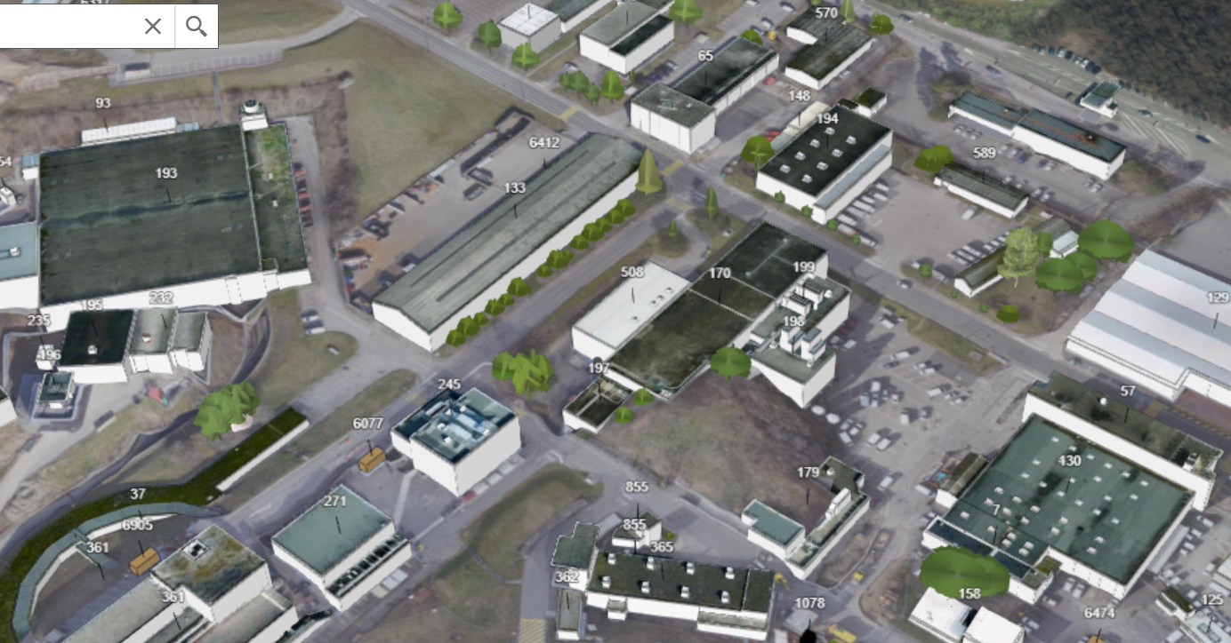
Present/future situation of the ISOLDE area
Fire Brigade
CERN goods reception
Recuperation site building 133
Potential for a new ISOLDE Low Energy Nuclear Physics facility at CERN
AD pbar facility
ISOLDE experimental hall 170,
control & user building 508 and cryo buildings 198, 199
ISOLDE target area, Class A lab,
MEDICIS and nano-lab
PS Booster
BTY proton line from PSB to ISOLDE target area

Slide 23
A New ISOLDE experimental hall and target stations
a new ISOLDE Low Energy Nuclear Physics experimental hall (50x72m)
With underground target stations making use of existing tunnel structures (TT70)for the proton beam from PSB
AD pbar facility
ISOLDE experimental hall 170,
control & user building 508 and cryo buildings 198, 199
Access to the underground areas

Slide 24
Concept for a new ISOLDE Hall

Slide 25
Conclusion
Rich possible improvement program following the long-term tradition of the ISOLDE community/facility
Clear need for physics community to keep/improve ISOLDE capabilities in producing a large variety of isotopes, but also need in increase integrated time to users
Staged proposed approach with clear improvements in facility operability and physics potentials
  Secure long term facility operation without forgetting potential given by post LIU PSB
  (FEs, dumps, new faraday cages, targets, etc..)
  Explore possible funding schemes for each upgrade step outside CERN
Explore synergies with other CERN physics programs
  n_TOF, AD for example
To be done:
  Continue working on technical proposals with horizon LS3 and LS4
  evaluate impact on facility future operational costs wrt to proposed upgrades

Slide 26
Thank you for your attention!

