Slide 1
Summary from the
2nd ISOLDE-EPIC Workshop
Exploiting the Potential of ISOLDE @ CERN
Kieran Flanagan

Slide 2

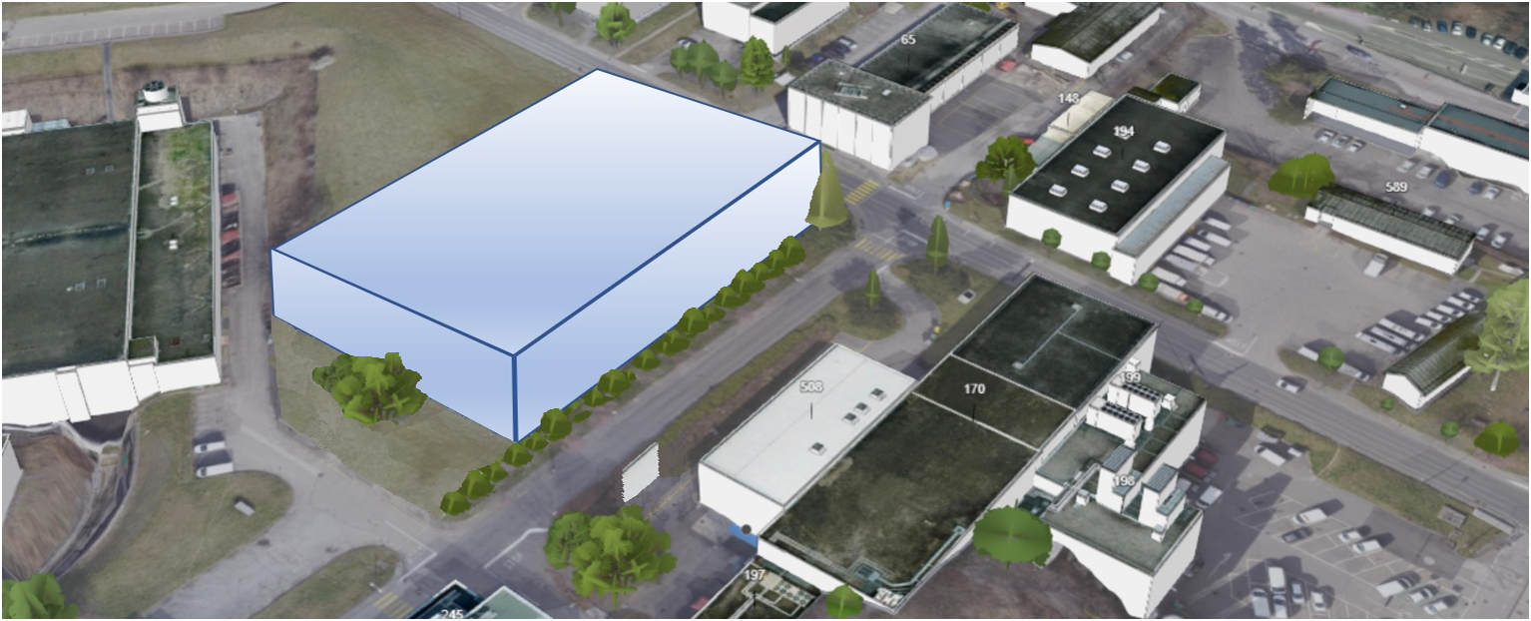
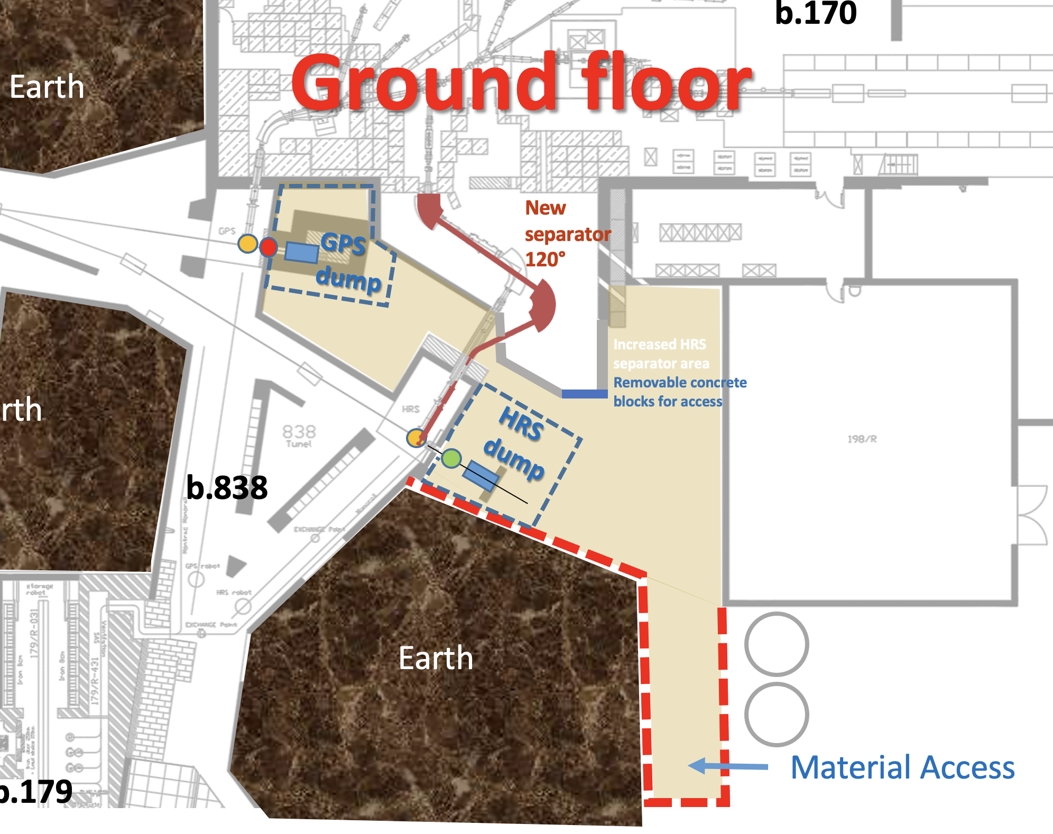
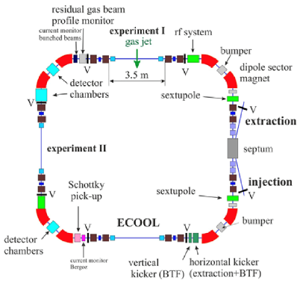
A New ISOLDE experimental hall and target stations
A possible option to build a new ISOLDE experimental hall and target stations at the present recuperation site B133 to make use of the existing TT70 tunnel and underground structures.
Construction and installation work of a new hall and target stations can be carried out in parallel with physics at the existing ISOLDE facility, securing nuclear physics at CERN
Possibility to connect AD and n-TOF, enabling promising future physics.
Existing facility dedicated to HIE physics, MEDICIS and a possible future compact storage ring
n-TOF – ISOLDE physics
New Low E experiments
AD – ISOLDE physics
Existing Low E experiments
ISOLDE control room and DAQ rooms in 508:
Commissioning of the New facility while running the existing facility
Enhanced capability within building 170
E. Siesling, J.A. Rodriguez - 2020 EPIC Workshop
Compact storage ring
A.P. Bernardes

Slide 3
Opportunities
Many exciting and unique potential experiments with anti-protons and intense neutron beams.
Provide time and required laboratory space to study the fundamental properties of quantum materials.
New building will provide space and capability for the next generation of high precision experiments with the required clean areas.
Creating space in 170 will enable new experiments with reaccelerated beams (recoil separation, storage ring)
Intense Muon production at CERN should be closely monitored and any synergy explored.

Slide 4
Components of EPIC
Construction and commissioning of the new low energy building would not interrupt measurements at ISOLDE.
Target areas designed for higher proton beam currents.
New building has space to expand in the future.
Consolidation of building 170 is just as important and first priority ! The beam dump replacement will open the ability to make future changes to the HRS magnet area – options need to be considered with the Collaboration (better beam purification)
Opportunity to strengthen collaboration with TRIUMF and exchange experience, designs and procedures.

Slide 5
Lesson learned this year
Remote operation and participation to experiments is possible – explore this further, and consider it when designing new experiments and facility
  pros/cons

Slide 6
Next Steps
Preliminary feasibility of a new building from the point of view of civil engineering look promising – more detailed study is in progress.
Current designs present in this workshop are meant to be a starting point and to trigger discussions that could help refining the concept – send us your comments !
The goal is to converge to a feasible concept that could serve better the current and future community of users (considering 10-30 years time scale)
We need to define what we want in a conceptual design report of the project, covering:
  The key physics cases and new scientific opportunities.
  The technical conceptual details of the project with input from the CERN and ISOLDE collaboration communities.

Slide 7
Proceedings to the EPIC workshop
The “proceedings” to these workshops has to be seen as a first quick step towards preparing the CDR document.
Editorial board will be setup in the coming weeks
Present the physics and technical opportunities of EPIC.
The aim is to create a document like the TDR for the Storage Ring at ISOLDE.
Opportunity for the community to provide input into the document (not limited to participants of the workshops).

