Slide 1

Welcome to CERN

Slide 2

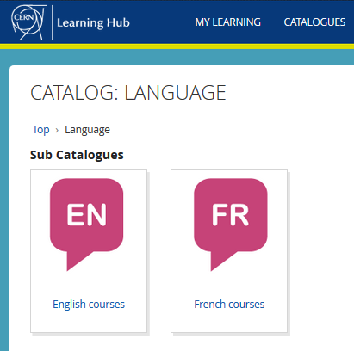

Language Training
Virtual Classroom courses
https://learninghub.cern.ch
Tandem
link
Find a partner
to practice speaking
each other’s language
Notes:
ROCIO
About language trainings…we have created virtual classrooms courses in both languages english and french, and these courses are also available for spouses.
You can find more information under the Learning Hub link.
And we alro offer the tandem sistem, where you can find a partner to practice each other language, and this is not limited to french and english. You can take this opportunity to grow your network!

Slide 3
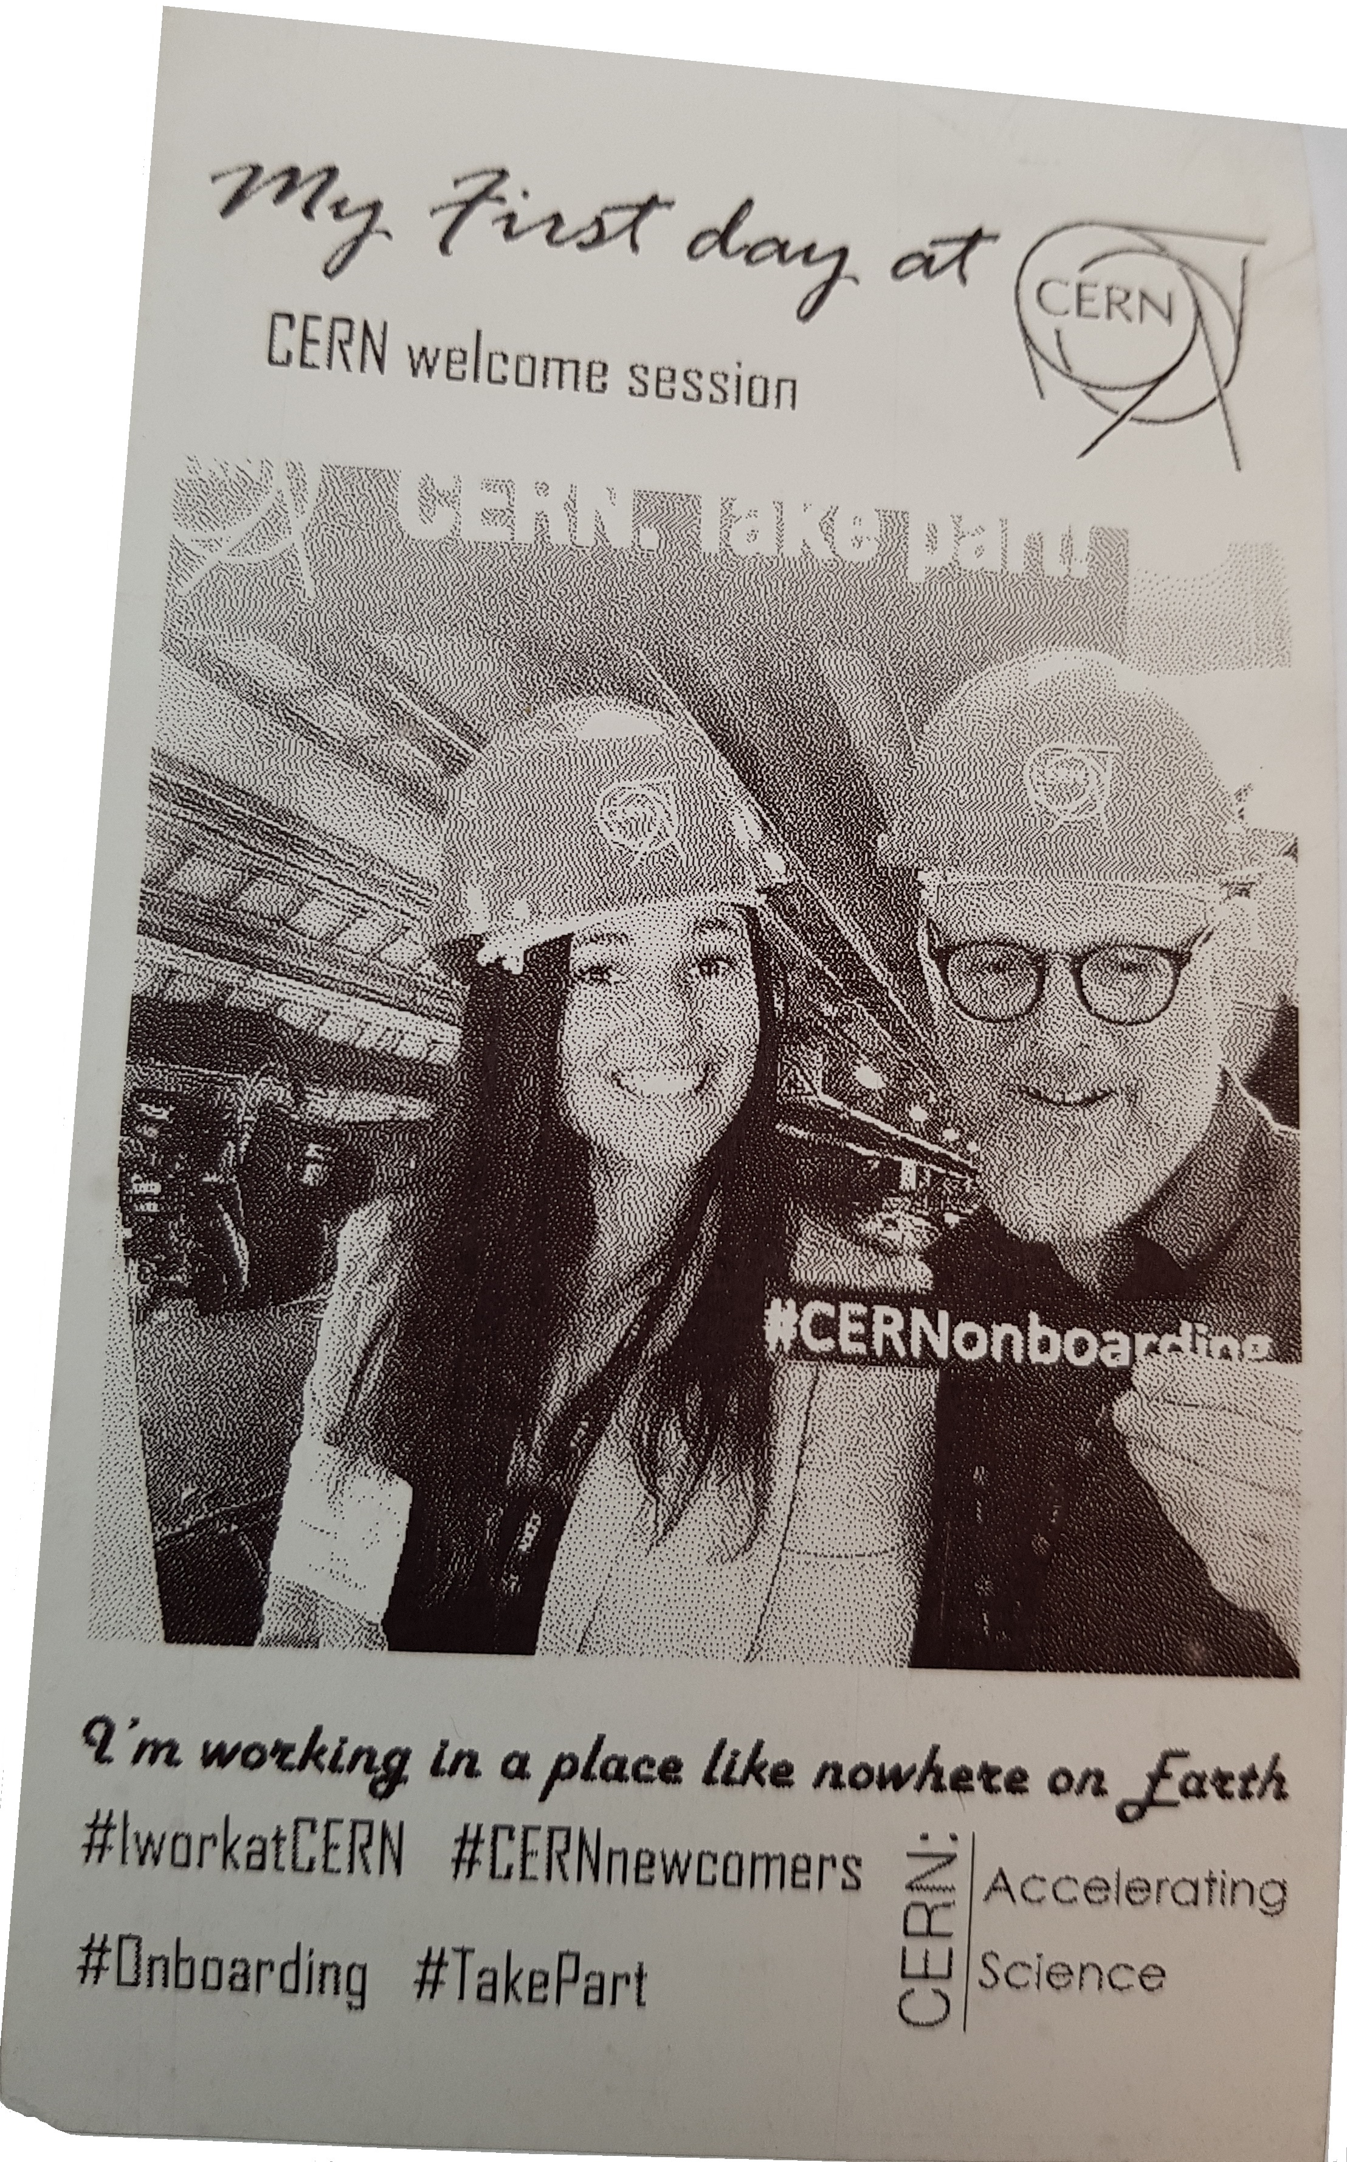
Welcome Bienvenue
Rocio
ALOT
HR Department,
Recruitment and
Sourcing Specialist
Erwin
MOSSELMANS
HR Department,
Learning Specialist
Notes:
(Rocio)

Slide 4
Welcome programme
Today
10.05 – 10.50 Presentation
Short break
11.00 – 11.30 Question & Answer session
Tomorrow
10.00 – 10.30 Coffee break
Notes:
Rocio :
This is the programme, as you also can find it on the Indico page.
We will start with a presentation, where Erwin and me will be alternating. We will have also a few polls for you to answer.
During the presentation, which we will record, please stay muted in order to avoid noise or echos. Note your questions for the question and answer session which starts at 11.00.
You can use the chat.
And tomorrow, we will have a more informal coffee break to learn more about your colleagues who started at the same time as you.
Let start immediately with a first poll.

Slide 5

Notes:
(Erwin to launch poll, read question, stop poll, present results, stop presenting results, return to powerpoint)

Slide 6
Presentation : overview of topics
CERN and COVID19
Teleworking
On site
CERN as an organisation
Notes:
Erwin
These are the topics we will cover in our presentation

Slide 7

CERN and COVID19
3 stages for rundown (21 January – 18 May)
3 phases for gradual restart (18 May – September)
Notes:
Rocio

Slide 8

CERN plan - 3 stages
Stage 1
21 Jan – 8 March
Stage 2
9 March – 15 March
Stage 3
16 March – 18 May
Self-isolation of those coming from "risk zones"
Telework for all CERN employees
Cancellation guided tours
Meetings 100+ people cancelled
Encourage remote meetings in all cases
Suspension CERN Clubs activities, Exhibitions.
Suspension of all official travel
Access CERN site restricted to those whose activities are essential.
CERN enters safe mode
“Safe mode”
Notes:
Rocio
Cern is located in the Franco-Swiss border, and FR and Switzerland are what we call CERN Host members. This is an overview of the evolution of the 3 phases of the Coronavirus spread in this area.
This is an overview of the Coronaviros situation
Stage 1: WHO alerts for the spreading
Stage 2: Host-State declares part of its territory, distant from CERN as affected.
Stage 3: Virus circulates widely in the Geneva area, including at CERN itself.
Stage 3 meant that CERN was in «safe mode» and access onsite is restricted.

Slide 9
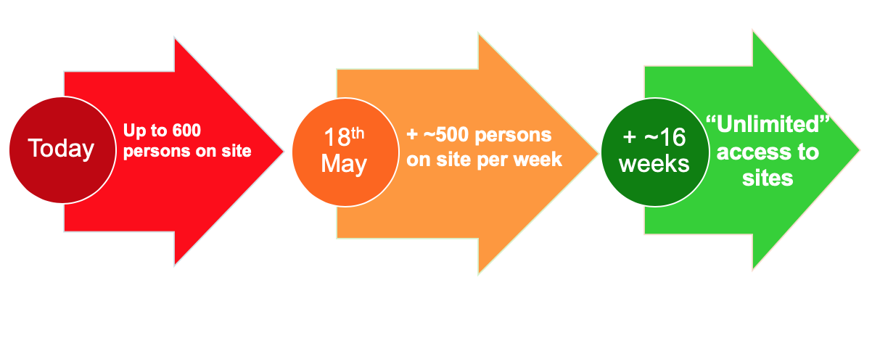
A gradual and cautious re-start plan
Phase 0
to
Phase 1
Phase 2
Safe-mode and other
urgent activities
Resume gradually, starting
with LS2, accelerator and
detector upgrades, urgent
site and building work
Ramp-up to “unlimited”
access may be completed
by mid-September
Number of people on sites includes CERN’s personnel as well as contractors
Personnel involved in LS2, accelerator and detector upgrades, urgent site and building work will come back to site gradually as of 18 May
The rest of personnel will come back gradually as of 2nd week of June.
Personnel will be called back by supervisors.

Slide 10
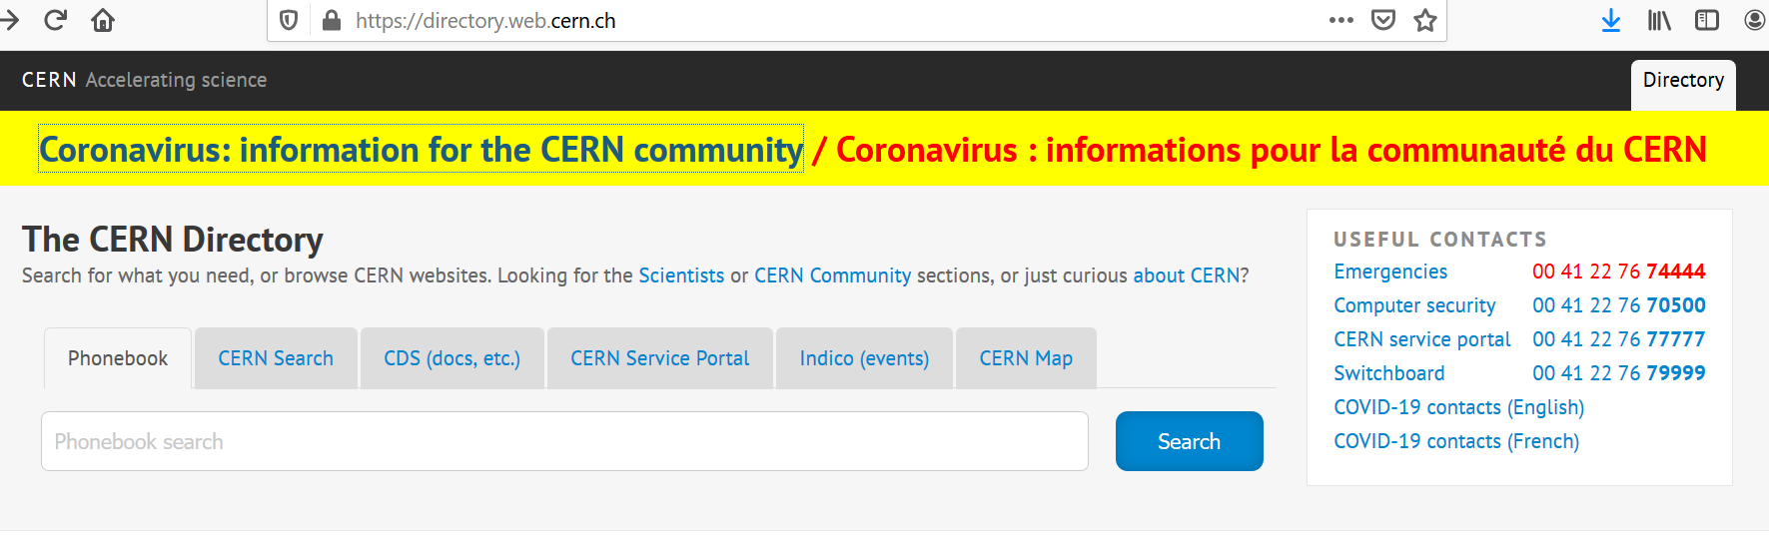
Stay informed about the situation
One central place : CERN directory
emails from the Directorate
English version
En français
Notes:
Erwin
It is important to stay informed about what is going on at CERN.
There is one central place to find the information about the impact of the Coronavirus for CERN : on the directory page. The information is available in English and in French.
Check also your emails. Our Directorate informs us at regular intervals about the decisions which are taken.

Slide 11

Teleworking
Notes:
Erwin

Slide 12
Overview
Computing account
Single Sign-On
Setting up your own devices for teleworking
Getting support
Notes:
Erwin
In our presentation, we’ll cover mainly 2 main areas :
- A first part on setting up your environment at home to be able to work remotely, and where you can get IT support
- A second part on how to remain informed about how CERN manages this pandemic, and where you can find support

Slide 13
Computing account
Your login and password are your keys to get into virtual CERN !
You must sign that you comply with CERN computer security rules.
What does that mean ? (link)
  Recommendations to keep your PC/Mac safe
Need assistance to create your account ? Service Desk
Notes:
Rocio
You most probably have already created a CERN computing account, when entering the HR website, along with other things to do under the tab «before I arrive».
This login and pasword is ESSENTIAL, you will need it at work everyday. So please, keep your password safe and comply wit CERN computer security rules, you can find more information under the link along with some recommendations to keep your devices safe
If you need assistance to create an account, or have problems with the login, sen an email to service desk.

Slide 14

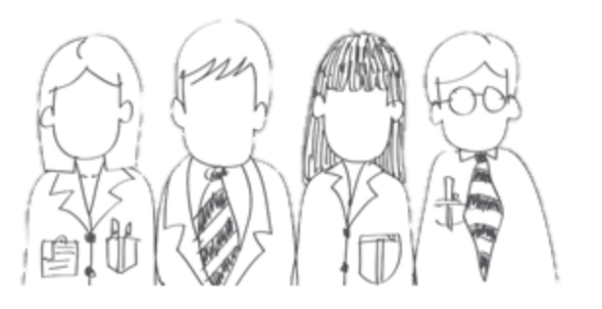




CERN Service Desk
Phone: +41 22 76 77777
Email: service-desk@cern.ch
Monday to Friday
from 7.30 to 18:30
( Geneva time )
CERN Service Portal
Services
Service overview in a glance
Online forms
Report an incident, submit a request
Knowledge articles
Find your answer!
Feedback
Your feedback matters!
https://cern.ch/service-portal
Notes:
Rocio
The CERN service desk will help you with any request, and especially if you do not know which service to contact. They will make sure that your question gets to the right person, and that you get a reply.
Your request will generate a ticket for an efficient follow-up, and you will be informed by mail.
You can contact the service by phone or by sending an e-mail.
The CERN service portal, accessible from the directory or from the link below, allows you to search for a service, find out what they offer and make an online request. There are also Knowledge Base articles where you find answers to the most frequent questions.

Slide 15

SSO: Single Sign-On
One login and password to access to all CERN files, applications, webpages, …
Login once and get immediate access to all
  does not work on all webpages
Moving gradually to a new portal in 2020
  old and new co-exist at the moment (more info)
Notes:
Rocio
Do you know what SSO means? Single Sign On, is a single login that grants you access to all CERN files, applications and websites.
If you are logged into your cern computing account, you will have access to most of the cern pages. Please note that we are gradually moving to a new portal this year, and the new and the old co-exist at the moment, you will see the two lay-outs in the foollowing page

Slide 16
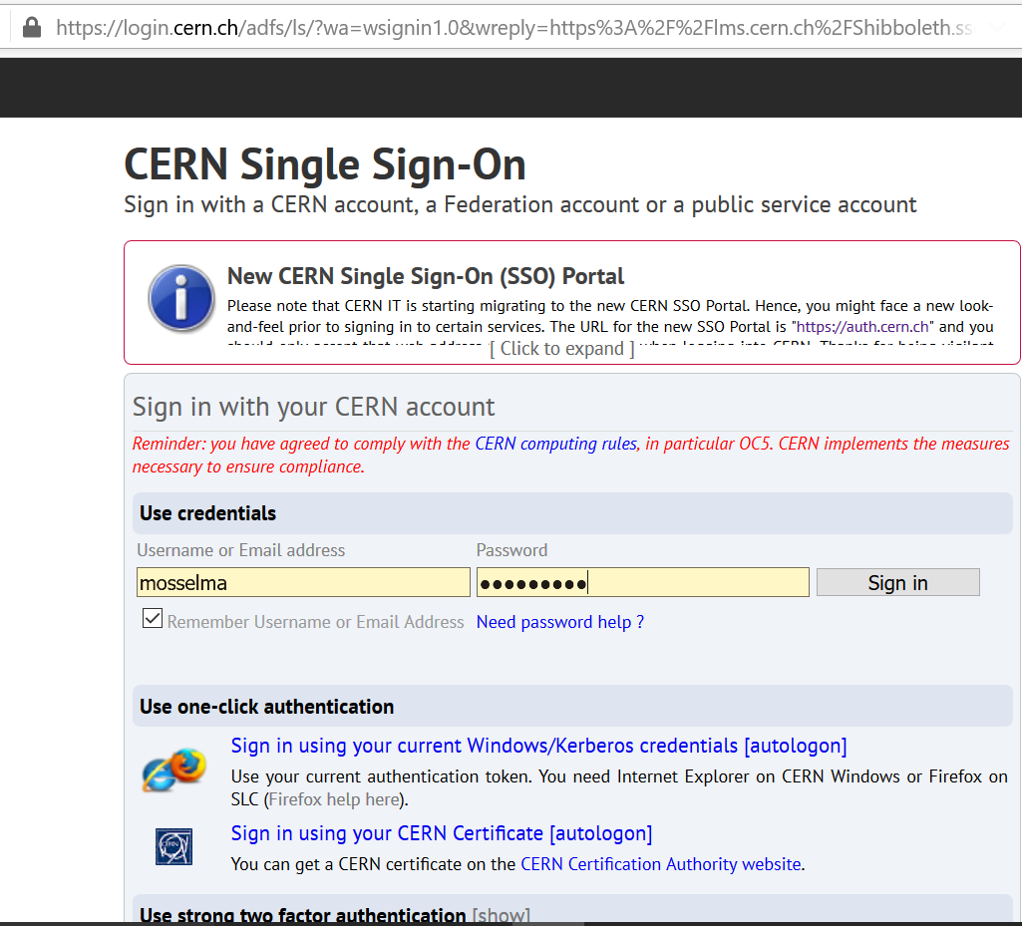
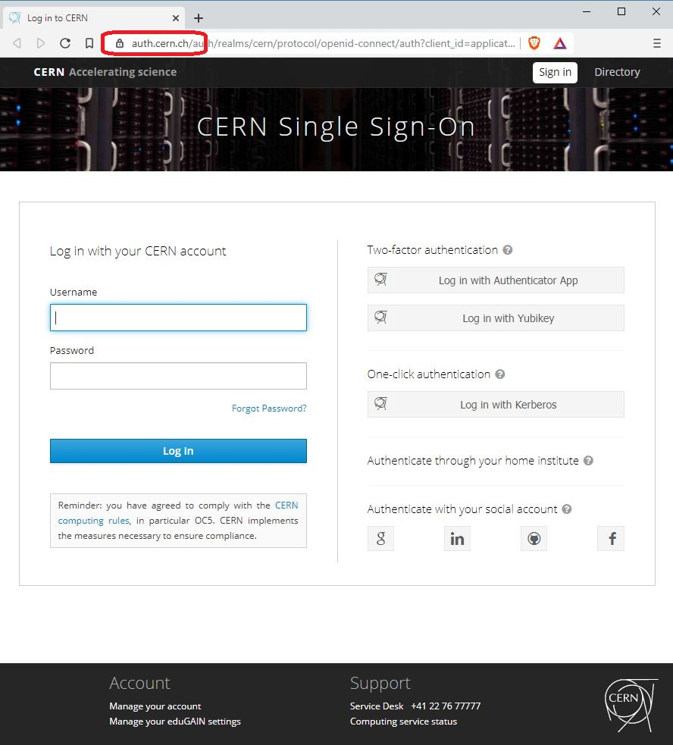
Old SSO New SSO
Notes:
Rocio
Here we have the two SSO portals we use at the moment, the old on the left and the new on your right.
Pay attention to the website address, and ensure its correspond to the ones shown in the images, to avoid fake sites trying to steal your password
Pay attention to fake sites, phishing, trying to steal your password !
Old site = URL starts with https://login.cern.ch
New site = URL starts with “auth.cern.ch” or, ideally, “https://auth.cern.ch” and
In both cases, the URL should be accompanied with a small lock icon (= showing that your communication is encrypted and that the corresponding certificate is valid).

Slide 17
Notes:
Erwin

Slide 18
Poll : Which link brings you to the CERN directory ?
https://cern.home (-> public homepage)
https://home.cern.ch (-> does not work)
https://directory.web.cern.ch/ (-> OK)
https://cern.ch/directory (-> OK)
Notes:
Erwin

Slide 19
Equipment
Laptop/desktop with microphone, speaker, (and camera)
Network connection at home
Notes:
Rocio
In terms of equipment, we will ask you to have your Laptop or desktop, a microphone, speaker and camera. And, of course, internet connection

Slide 20

Setting up your devices
Remote desktop (terminal services)
Web applications
Installing software and apps on your device
VPN access to CERN prohibited
Notes:
Erwin
Now you will have to set up your equipment so that you can access files, applications who are on CERN servers.
There are several possibilities :
You can use remote desktop and connect as if your device is physically at CERN
Certain applications can be accessed through a webbrowser, like your CERN mail
There are also applications which you can download and install on your computer, or phone, like for example Skype for Business
Please note that due to severe security risks it is prohibited to access CERN through a Virtual Private Network connection.

Slide 21
IT Support
IT blog (useful tools for teleworking)
CERN Computer Security website
Service Portal (Knowledge Base articles)
Service Desk (Tickets)
Supervisor/colleagues – job-specific tools
Notes:
Rocio
Here you will find useful resources for getting started with your new contract
IT blog (useful tools for teleworking)
CERN Computer Security website
Service Portal (Knowledge Base articles)
Service Desk (Tickets)
Supervisor/colleagues – job-specific tools

Slide 22
Read your CERN mail
Web application
  Outlook Web Access (OWA)
  Kopano WebApp
Configure your email client to use IMAPS or POPS (IMAP/POP over SSL).
Notes:
Erwin
You can read your mail on a Web application.
We have been using Outlook Web Access for many years, and as we are gradually moving away from Microsoft products, we have introduced recently Kopano, which has also a web application.
If you want you can also configure your email client to receive your CERN mail, via secure channels.

Slide 23

Phone and videoconferencing
Skype for Business
  installation or Web application
CERN Phone book
Videoconferencing tools
  Vidyo
  Zoom (pilot)
    Information on how to first login here
Notes:
Rocio
A call is usually more efficient than an email,
So we encourage you to reach out to colleagues, programme cordinators or supervisor, and we give you different options to do so:
If you go for a classic voice call, we use skype for business
You can access the CERN phone book to find any employyee working at cern, and dial her or his number.
For video conference, we use vidyo and Zoom, feel free to check what tool your closest colleagues use in their regular meeting and use these links to join them

Slide 24

Absence Request in
Working from home (teleworking)
Normally only for Employed members of Personnel
In this exceptional period :
also for Associated members of Personnel
Notes:
Erwin
If you are absent from CERN, you have to make an absence request in EDH.
Such a request needs also be made when you are working from home instead of from CERN.
Working from home is normally possible only for Employed members of Personnel, but during the CORONA crisis it has been extended exceptionally to Associated members of Personnel.
EDH is CERNs electronic routing and approval system, which is used for a variety of requests and documents.
How do get to EDH ?
From your browser, type edh.cern.ch, and you will be landing on the SingleSignOn page.
Note that many CERN applications can be accessed by typing the name of the application, followed by dot cern cot ch.
You arrive at the EDH menu page, which can be customised in the Settings page so that the documents you use most are immediately accessible from here.
Under Tasks, you will find all documents that EDH handles, grouped in families.
The absence request is under the Header Absences.
The first part BALANCE shows your present and future leave entitlements.
The second part is for your making your request.
First you have to select the Absence type. A short list of absences is proposed, but Teleworking is not part of it. Select Other to find a more complete list. Select now Teleworking (occasional).
Then complete the period using, the calendar icon.
Finally, in the Remarks you have to indicate “Exceptional Circumstances – COVID 19”.
You then submit the document, and enter your EDH password, which is different from your CERN login.

Slide 25
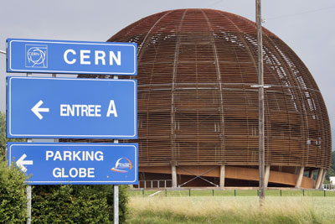
Coming on site
Notes:
Rocio

Slide 26

Acces to CERN ?
Only on request of supervisor
Limited in time : presence
required to carry out the activity
Notes:
Rocio

Slide 27

Acces to CERN
Person with vulnerabilities
  inform supervisor
  2 options : work remotely or leave
You or household members have COVID symptoms :
  stay home and
  inform CERN medical service
Notes:
Rocio

Slide 28

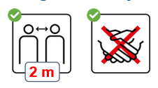
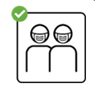
Acces to CERN
Physical distance of 2 meters
Masks :
  indoors in public or shared workspaces
  outdoors if 2m can not be respected
Hygiene measures (handwashing, etc.)
+ specific PPE if needed
Notes:
Erwin
Masks (distribution by department, first time ask security guard at gate)

Slide 29
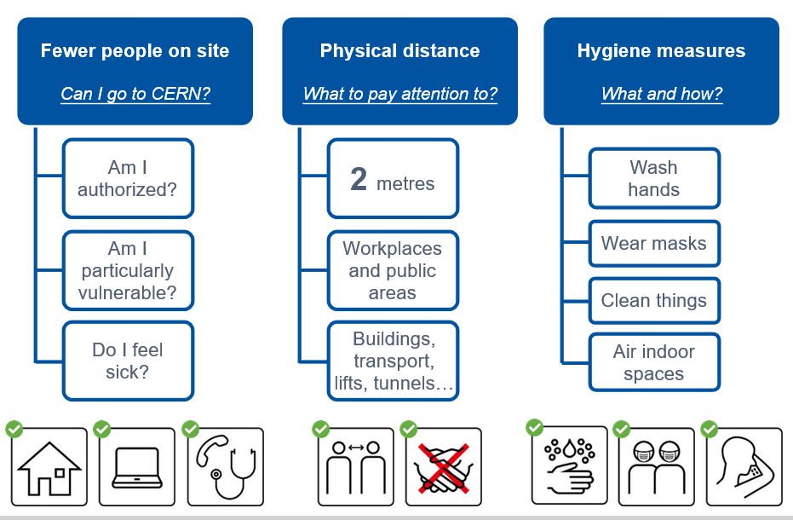

Slide 30
Additional requirements
(To be done once)
Declaration
COVID19 health and safety measures elearning + exam
Notes:
Rocio

Slide 31
Limited services on site
Restaurants
Transportation
…
Overview (link from COVID19 homepage)
Notes:
Rocio

Slide 32



Support
Supervisor
Departmental Administrative Officer (DAO)
HR Advisor or programme coordinator
Links/FAQ from COVID-19 page
Service Portal
Mattermost group for newcomers
Notes:
Rocio

Slide 33

CERN as an international organization
Quiz – part 1
Notes:
Rocio
************************
Ready to start with the real quiz ?
We first have a few questions about CERN as an international organisation.

Slide 35
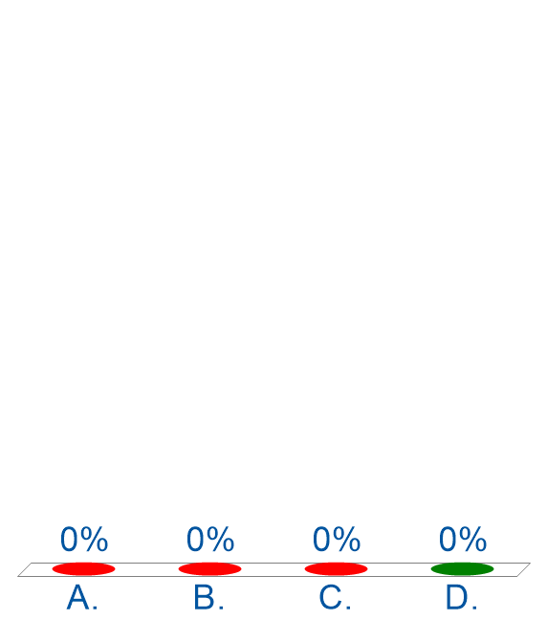
CERN members of personnel
How many ?
~ 2500
~ 3500
~ 9000
~ 17500
Only 1 answer is correct
Notes:
Rocio
************************
How many members of personnel ?

Slide 36






CERN MoP
~17 600
Contractors
> 4 500
Employed MPE
~ 3 500
Associated MPA
~ 14 200
Staff
~ 2 650
Fellows
~ 800
Users
~ 13 000
Associates
~ 700
Students
~ 500
Notes:
Erwin
************************
If you answered 2500, then you probably only took into account the staff members (click).
But on top of the staff, we also have more than 800 fellows (click).
The staff members and fellows together are the employed members of the personnel or MPE (click): CERN is their employer.
But besides these more than 3300 people, there are also many people who have a contract with CERN, although it is not an employment contract :
First of all, we have more than 12500 users (click) who are working in scientific collaborations
And also more than 700 associates
And more than 700 students
All together 14000 people who have a contract of association with CERN.
Both MPE and MPA are considered MoP, and you are a member of that big family of more than 17000 people.
Not all users are present at CERN every day. Note also that there is also personnel from contractors which can be working on the CERN site : there are more than 4500 such people with an active registration, and some of them come here every day while others come only for the duration of a specific intervention.

Slide 37
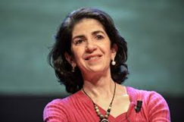
Unit
Directorate Services
Health, Safety and Environment
Sector
Accelerator and Technology
Beams
Technology
Finance and Human Resources
International Relations
Research and Computing
Engineering
Finance and Administrative Processes
Industry, Procurement and Knowledge Transfer
Human Resources
Site Management and Buildings
Experimental Physics
Theoretical Physics
Information Technology
Department
Notes:
Erwin
At the head of the organisation, there is the Director General, Fabiola Gianotti.
She is assisted by 4 directors, which each are responsible for a sector :
Accelerators and technology
Finance and Human Resources
International Relations
Research and Computing
Within each sector, except for International relations, there are departments.
Some units are directly attached to the DG : Directorate services and Health, Safety and Environment.

Slide 38
DG
HSE
ATS
BE
TE
FHR
IR
RCS
EN
FAP
IPT
HR
SMB
EP
TH
IT
Notes:
Erwin
The Sectors, Departments and Units have acronyms, which are used more often than the full names.
Here they are.

Slide 39
Unit
Department
Sector
Group
Group
Group
Section
Section
Section
Notes:
Erwin
The size of a Department can be from less than 100 people to several hundreds of people.
A Department has usually several groups.
And groups can in turn be composed of several sections.

Slide 41
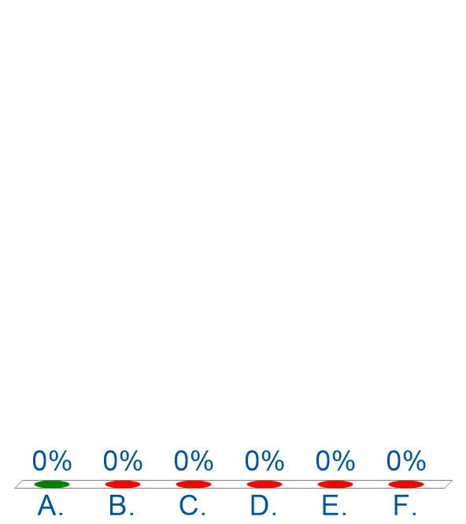
Physics Nobel prizes for CERN
How many ?
0
3
4
5
6
8
Only 1 answer is correct
Notes:
Rocio
************************
The correct answer is 0 : CERN is not eligible for a Nobel prize in Physics.
A Nobel prize for Physics can be awarded only to a person and on top, that person must still be alive.
However, CERN can be associated very easily with a number of Nobel prize winners.

Slide 42
Working at CERN when Nobel prize
1992 : Georges Charpak
1988 : Carlo Rubbia & Simon van der Meer
1984 : Jack Steinberger (with Lederman and Schwartz)
Working at CERN after Nobel prize
1952 : Felix Bloch
1976 : Sam Ting
Nobel prize thanks to discoveries at CERN
2013 : Peter Higgs & Francois Englert
Notes:
Erwin
************************
https://public-archive.web.cern.ch/public-archive/en/About/Nobels-en.html
https://www.nobelprize.org/nobel_prizes/facts/
3 prizes for people who were working at CERN when they received the Nobel prize
1992 : Georges Charpak
1988 : Carlo Rubbia & Simon van der Meer
1984 : Jack Steinberger (with Lederman and Schwartz)
+ 2 Nobel prize winners who worked at CERN
1952 : Felix Bloch, became CERN DG in 1954
1976 : Sam Ting, still works here at CERN on AMS (alpha magnetic spectrometer which is installed on ISS, the International Space Station)
+ 2 Nobel prize winners thanks to discoveries at CERN
2013 : Higgs and Englert

Slide 43
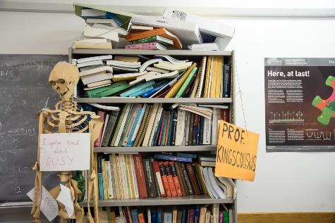
Daily life at CERN
Quiz part 2
Notes:
Rocio
************************
We have some questions for you, which will be helpful for your daily life at CERN.
Your daily life can be exciting – here you have a picture of an 96 hour contest in which students from different disciplines and countries worked in teams to prototype a robot showing human emotions. It is one of the activities organised by Ideasquare.

Slide 44
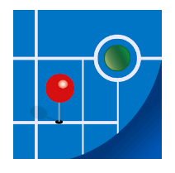
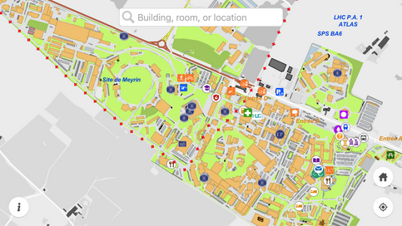
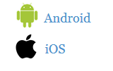
MapCERN
Notes:
Rocio
************************
The app is called MapCERN and is available for Android and iOS.
You can do a quick search, it covers all places at CERN and works offline.

Slide 45
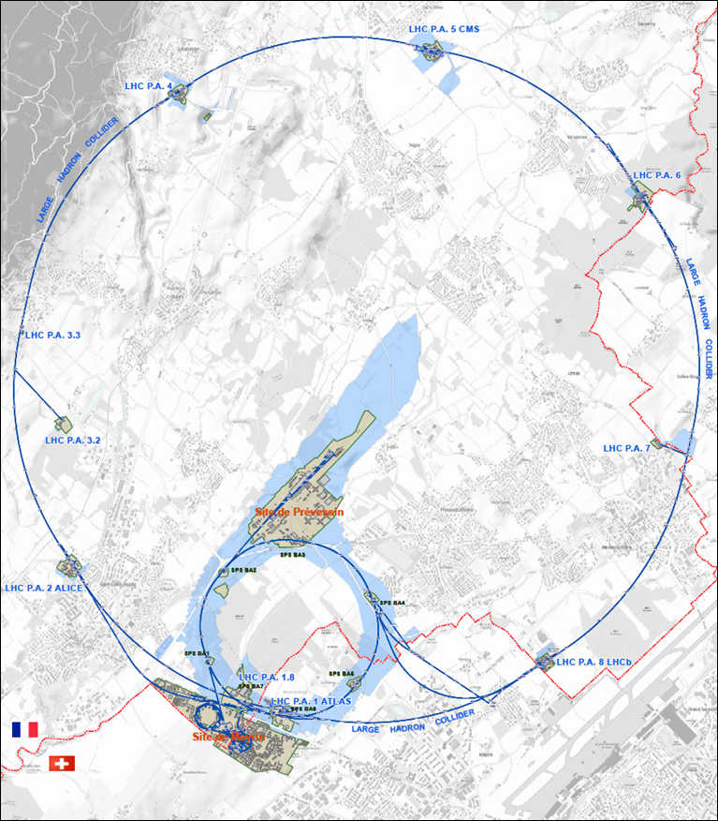




625 ha
515 ha
fenced : 220
110 ha
… 700+ buildings
accounting for
500.000 m²
6 180 parking spots
101 ha
green
spaces
30 km roads
Notes:
Erwin
************************
Source : https://indico.cern.ch/event/669690/contributions/2740056/attachments/1553507/2441980/Mobility_IoT.pptx
CERN is indeed composed of 2 major sites : Meyrin in Switzerland and Prevessin in France. But there are many more smaller CERN sites, especially in France.
CERN has all in all 625 hectares of land, of which 1/3 is fenced. The majority is on the French territory.
There are more than 700 buildings, for a variety of purposes and built in different periods in a variety of styles. Office space as well as parking space are sometimes difficult to find !
There are also 30 km of roads, and normal traffic rules applies. And there is control and sanctions : if you park your car on the footpath, the sidewalk, your car might be towed away.
There also green spaces, especially on the Prevessin site. Some people have the luck to see through their window deers coming out of the wood or a flock of sheep grazing in the prairie next to their office.

Slide 47
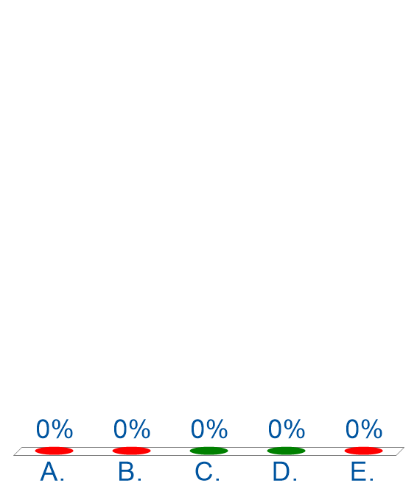
In case of a road accident on the CERN site, I call …
Geneva police
CERN Service desk 77777
CERN Emergency 74444
My supervisor
My mother
Several correct answers → Click OK
Notes:
Rocio
************************
Answer A is not correct : the Geneva police can not enter on any of the CERN sites without the explicit authorisation of CERN, which is given by the Host State Relation Service.
Answer B, the CERN help desk, will not help you any further either. They will create a ticket and assign it to the right people.
Can someone tell me what do you expect as a result from calling your mother ?

Slide 48
Accident on site – different cases
In all cases
Inform supervisor
In case of
Injury
Environmental hazard
Disruption traffic
3rd party involved
CERN Fire & Rescue 74444
(+ 41 22 767 44 44)
+
Internal accident report (EDH)
+
European Union Car Accident form
Notes:
Erwin
************************
The correct answer in all cases is to call your supervisor (D) and in some cases (C), the CERN Fire and rescue service, through the number 74444.
Why always your supervisor ?
Internal accident report :
- needs to be signed by your supervisor, so for that reason he must be informed immediately.
- also used to report near-misses -> can be used to avoid further accidents
In certain cases, the CERN Fire and rescue need to be called.
We recommend to add the full number in your mobile phone
+41 22 767 44 44, so you can also call them if you are not connected to the CERN telephone network.
https://admin-eguide.web.cern.ch/node/352
2.2.1 Accident on the CERN site
In the event of injury, disruption to the flow of traffic or involvement of a third party:
The CERN Fire Brigade will go to the scene of the accident, take the appropriate measures required by the circumstances and draw up a call-out report.
The local Gendarmerie/Police will intervene only if so requested by CERN (Relations with the Host States Service or CERN Fire Brigade).
The driver(s) of the vehicle(s) (or, if not possible, the Fire Brigade) must complete a European car accident form (a blue form known as the "Constat européen d'accident automobile"), which must be signed by the parties involved. A copy of page 1 of the form must be sent to the Legal Service and to the CERN's Insurance Manager. If the injured party is a member of the personnel or a family member who is a member of the CERN Health Insurance Scheme, the procedure set out in paragraph 3 must also be followed.
In all other cases, and if the vehicle suffers material damage:
The member of the personnel must draw up a report to which he must attach, where possible, a statement by a witness (the European car accident form may be used). This report (or a copy of the European car accident form) must be sent to the CERN's Insurance Manager together with a statement by the Head of Department or his designated representative, certifying that the journey was made on official duty, or a copy of the official travel form if applicable.

Slide 49
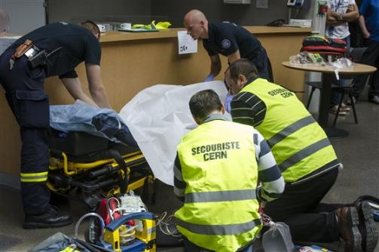
CERN Fire and Rescue Service
assisted by local First Aiders
Find out who
are closest to
your office / usual work places
© CERN Photo
Notes:
Rocio
************************
CERN’s Fire and Rescue Service is a team of more than 50 qualified fire-fighters and paramedics. They are available 24h/day, all year long.
They are assisted by more than 800 First Aiders, who are trained volunteers.

Slide 50
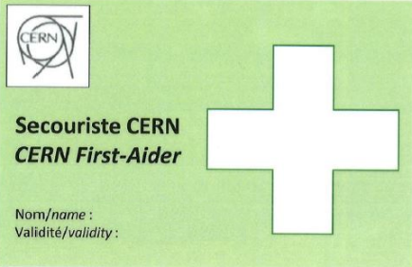
First Aider door sticker
Your safety contacts : http://safety.cern.ch/FirstAid.html
Notes:
Rocio
************************
You can find the first aiders in your building in this link.
And you also spot the green stickers on the doors, indicating that there is a qualified CERN first-aider in that office

Slide 51
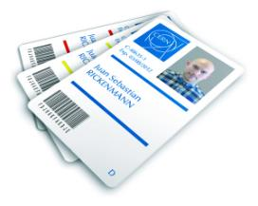
CERN access card
Visitors badge
Validity :
2 working days
CERN access card
Building 55
Working days
from 7:30 to 17:30, non stop
Also
vehicle registration
biometrics registration
Notes:
Rocio
If you hurry to get your CERN access card, you might find yourself queuing.
Avoid
Mondays
1st working day of the month
7:30 to 9

Slide 53
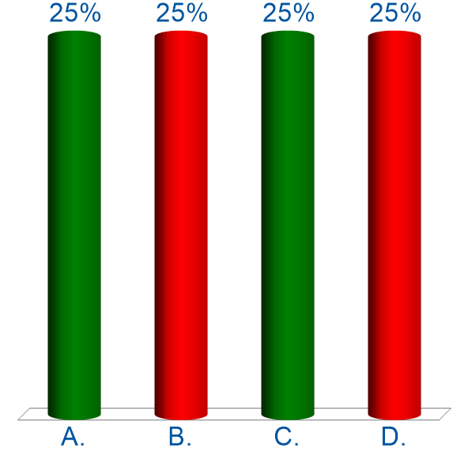
Access to the CERN site
Is strictly controlled at all entrance gates
Sporadic controls at gates – only proof identity needed
Badge visible all time when on site
Everyone has the right to enter CERN
Several correct answers → Click OK
Notes:
Erwin
************************

Slide 54




Gates | Days
Meyrin A | Mon-Fri | 6-22 |  | 7-19
Porte Jura Bldg 33 |  | 24/24
Meyrin B (Main entrance) |  | 24/24
Meyrin C | Mon-Fri | 6-22 |  | 7-19
Meyrin D (goods only) | Mon-Fri |  |  |  | 08-12 13-16
Meyrin E | Mon-Fri | In : 7-9.30 Out : 16.30-20
Intersites tunnel (restrictions) | Mon-Fri |  |  | 7-18
Prevessin Main entrance |  | 24/24
Prevessin Route du Maroc |  | 24/24
Prevessin Moulin des Ponts |  | 24/24
Notes:
Erwin
************************
There are 7 gates at the Meyrin site, and 3 gates at the Prevessin site.
The Main gates in Meyrin and Prevessin are open 24 hours a day, for pedestrians, bikes and motorized vehicles.
In Meyrin, on top of the main gate, there are 4 other gates for pedestrians, with are open only on workdays and for certain periods. 3 of them are also open for bycicles. With a car, you can get in on workdays during certain hours through 3 other gates.
Meyrin 2 gates with restrictions : entrance D is for goods only, and the intersites tunnel can only be used with a car and being on duty. It can not be used to get to your workplace nor to go home.

Slide 55
Welcome programme
Today
10.00 – 10.40 Presentation
Break
11.00 – 11.30 Question & Answer session
Tomorrow
10.00 – 10.30 Coffee break
Notes:
Rocio :
This is the programme, as you also can find it on the Indico page.
We will start with a presentation, where Erwin and me will be alternating. We will have also a few polls for you to answer.
During the presentation, which we will record, please stay muted in order to avoid noise or echos. Note your questions for the question and answer session which starts at 11.00.
You can use the chat.
And tomorrow, we will have a more informal coffee break to learn more about your colleagues who started at the same time as you.
Let start immediately with a first poll.

Slide 56

Quarterly onboarding session
Also virtual
Wednesday 16 September
You will receive an invitation
Programme on Indico

Slide 57


