Slide 1

Muon Collider Collaboration
Interest from the University of Oslo
Erik Adli,
Kyrre N. Sjøbæk
Department of Physics
University of Oslo, Norway
Muon Collider Collaboration Meeting
July 3, 2020

Slide 2
General interest
Understand the potential of the muon collider option
Apply experience from CLIC to this study
Investigate overlap with plasma acceleration/focusing research
Current resources: 1 PhD student (from end 2020) + fraction of researcher + supervision
  Master students
  More funding may be sought
Preferred collaboration model: light-weigth MoU (a la CLIC), with contributions pending funding, easy access to CERN

Slide 3
Study/design of μ-linacs
Study muon linacs, from the cooling to the accelerator ring
  Detailed numerical studies (level of CLIC). Conceptual design (not technical design)
  Tool development for integrated simulations. One possible path upgrade working tools from CLIC with muon functionality.
    Muon decay and production of secondaries needs to be implemented
    PLACET2? (structure for multi-pass and time-tagging), Elegant?
Investigate whether plasma acceleration may improve μ-collider performance
  Higher gradient -> higher muon survival
  Could parts/all of the μ accelerator be done with plasma?
    Can the AWAKE scheme be used for a CERN-based μ−collider
    For MAP scheme?
    For LEMMA scheme?
Relevant experience at Oslo
  CLIC linac studies/integrated simulations
  Operational experience with linacs: CLEAR, FACET (tuning and correction of the 2 km SLAC linac)
  ESS high power proton beam (Norwegian in-kind contributions)

Slide 4
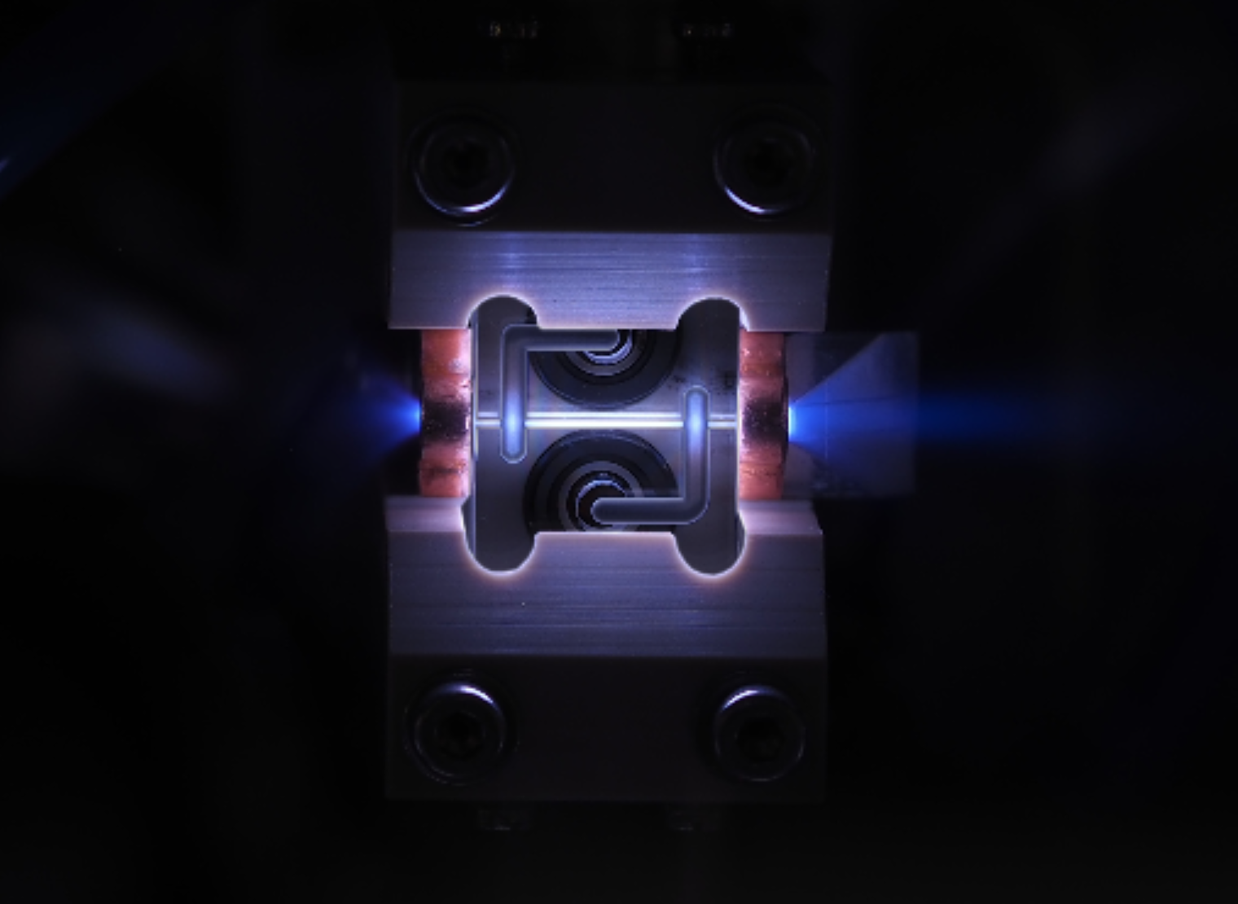
Other topics
Plasma lensing for capture?
Could muon capture or positron capture profit from the strong, radial focusing of plasma lenses?
Exploratory topic. Need to understand better the current concepts for muon capture
Relevant experience at Oslo
  Numerical and experimental studies of active plasma lenses
Potential synergies with ESSnuSB interests at Oslo?
Potential interest from theory at Oslo?
(photo(s) of the our plasma lens)

