Slide 1
Integrated Power Conversion
MUX 2010

Slide 2
Power electronics?
Analog Electronics: the ensemble of techniques and circuit solution to project systems to elaborate the information in analog way
Digital Electronics: the ensemble of techniques and circuit solution to project systems for the logical and numeric elaboration of the information
Power Electronics : the ensemble of techniques and circuit solution to project systems to control the energy transfer from a source to a load

Slide 3
Targets
The principles that defines the quality of product are
  Small dimension
  High performance
  Small power consumption otherwise high battery life for portable systems
  Low cost
Compact and efficient power distribution system
High consumption
High efficiency
Small component and high efficiency
Normally a good product design requires a good power management system
Notes:
The power management in many product or system design isn’t ancillary but can be stratecgic

Slide 4
Figures of merit
Analog electronics: precision (low offset and high signal noise ratio), high speed (bandwidth), low consumption and low area
Digital electronics: high elaboration frequency, low energy for operation and low area
Power electronics: high conversion efficiency that implies high power density (ratio between the circuit volume and the power utilized).

Slide 5
Chip technologies Figures of merit
Analog electronics : low offset for area unit, high devices cut off frequency
Digital electronics : high number of gates for area unit
Power electronics : low resistance for area unit, low charge to drive the switch and low reverse recovery charge

Slide 6
Outline
Conversion topologies design strategies
  Linear conversion
  Switched capacitor conversion
  Magnetic conversion
Integrated power devices and parasitcs effects
  Power mosfet
  Parasitic effetcs

Slide 7
Power flux control
Energy
Information
Processing
Input Signals
Output Signals
Control Signal
Source
Load
Power
Processing
Input Energy
Output Energy

Slide 8
Power source
Specification:
  VI characteristic and type of source (AC/DC)
  Energy available (limited or unlimited)
Rules to utilize the source
  Safe operating area
  Rules on the type of load connected to the source ex:
    Maximum power point tracking requirement
    Power factor correction requirement
  Limit on the Instant power requirement
  EMI Rules

Slide 9
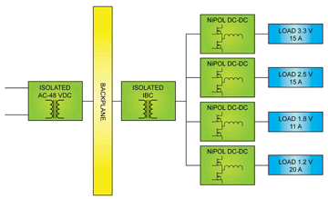
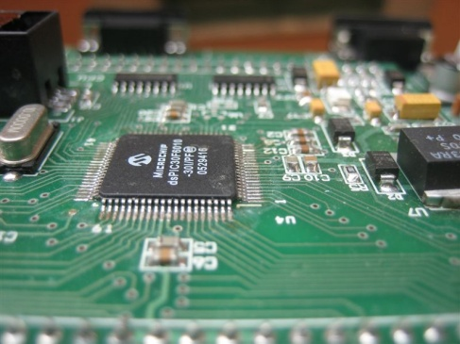
Power source example: Power distribution system
VI characteristic
EMI rules
V
Voltage reference
Over current protection
I

Slide 10
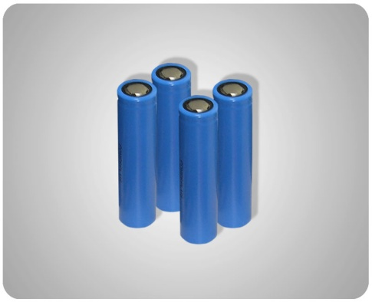
Power source examples: Batteries
Vbat
Vbat
R_{B}
Q dependent
[mAh]
Q
The characteristic depends on charge level
The quality of a battery on the ratio between the charge stored and the volume
For the rechargiable batteries another important figure of merit is the number time cycles

Slide 11
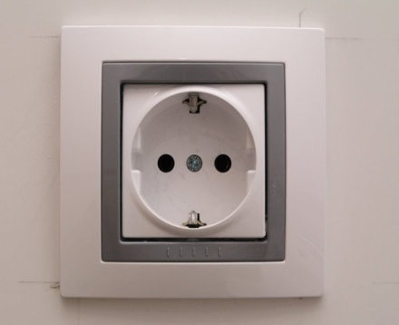
Power source examples: AC line power source
Vac, Iac
R_{B}
t
The ac line power source requires a high power factor in order to have only current that gives a mean output power:
  No high order harmonics
  Current waveform proportional to the voltage waveform

Slide 12
Power Load
Specification:
  Load specification
  Characteristic (Model)
    Static
    Dynamic
Rules to utilize the load
  Safe operating area
  Precision on current/voltage regulation
  EMI Rules: Maximum ripple

Slide 13
Power load examble: Battery charger
Vbat
R_{B}
Model
Q dependent
The charge current is equal to I_{pre-ch} when the battery is below 3V.
The battery is charged with I_{ch} when the battery voltage is 4.1V > V_{batt} >3 V.
After the charge goes in a control voltage charge phase in which the charge current depend on the error voltage I_{ch}=K(4.2 – V_{batt})
Charge Profile for a Li-Ion battery
V
Battery Voltage
Battery Current
t

Slide 14
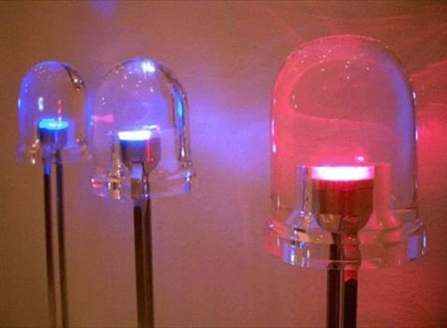
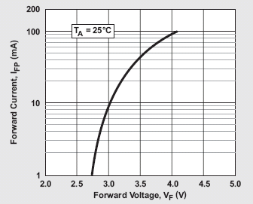
Power load examble: WLED
Optical power of a LED is proportional to the current present on the device
The voltage in approximately constant
For the driving is used a pulsed current
I_{d}=I_{fixed} P_{(t)}
P_{(t)} :
Vd
Model
Rd

Slide 15
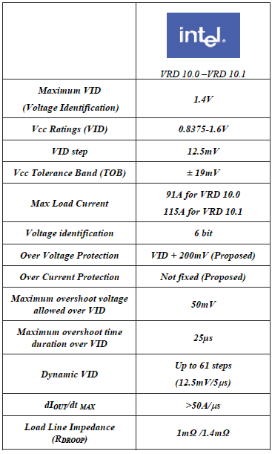
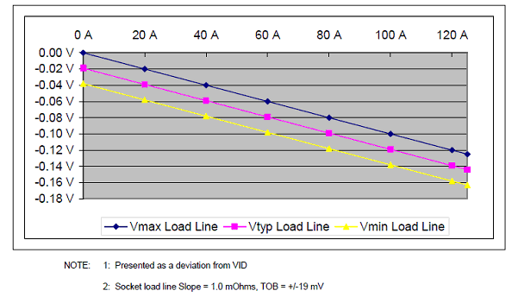
Power Load examples: uP power supply
Specication VRD 10.x per Intel P4 Prescott
Small voltage variation
Model
V_{core}
High current
High slew rate
Output impedance resistive required
“Droop Function” or “Adaptive Voltage Positioning”

Slide 16
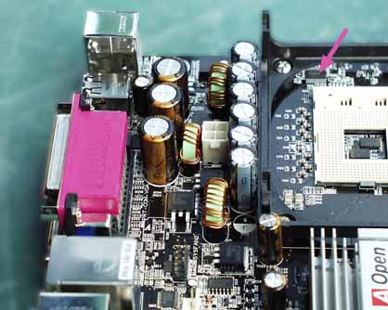
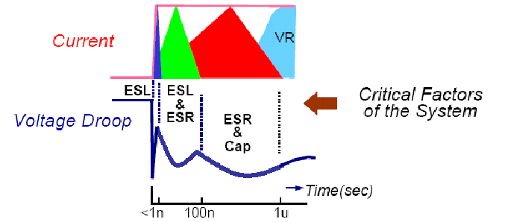
Transient
Synchronous buck converters
Processor
i_{VRM}
i_{C}
i_{A}
i_{B}
DC/DC
Converter
Bulk
Decoupling
Packaging
C
die
i_{A}
i_{VRM}
i_{B}
i_{C}
Max CPU Voltage
Min CPU Voltage

Slide 17
Power Load examples: uP power supply
Load current step variation
Output voltage response:
Without Droop Function
With Droop Function
ΔV = ESR · ΔI_{OUT}
ΔV = ESR · ΔI_{OUT}
Tolerance Band NOT respected
Tolerance Band respected

Slide 18
The Power System
The total power system composed by the power circuits and the control circuits
meets the specifications of the power source and the power load
maximizes the power transfer.
Power system
Control Signal
Load
Source
Power
Processing
Output Energy
Input Energy

Slide 19
Choose of the correct architecture
In a integrated the power architecture selection is driven by
  Type of conversion (non isolated)
    Step down (voltage of the source in all codition is major than the voltage of the load)
    Step up (voltage of the source in all condition is the same of the load)
    Step down and up (when the voltage of the source and the load can have a common interval of values).
  Maximum power utilized
    Low power
    Medium power
    High power
  Complexty of the architecture

Slide 20
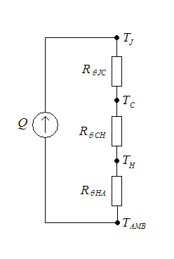
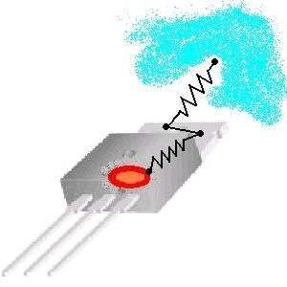
Determinate the maximum power
The maximum power consumed by the system is limited by:
The package
The cooling system
Junction case resistace
Dissipated power
Case Heater resistace
Heater Ambient resistace

Slide 21
Choose the correct architecture
Dependely on the architecture the power related to the converter can be plotted as reported
Solution 1
η
Solution 2
Ploss
Ploss max
Solution 1
Solution 2
Pload
Pload

Slide 22
Linear conversion
This scheme, commonly used to stabilize low power supply, is designed to meet the load specification by using the analog strategies but it doesn’t maximizes the power transfer
  High power loss ⇒ low efficiency ⇒ low power density

Slide 23
Linear conversion efficienty
Bias consumption
η
Pload

Slide 24
Switched-mode conversion
To maximizes the energy transfer the power systems must be designed using energy storage elements (inductor and capacitor) and switches :
Capacitive (Charge Pump)
Magnetic
Control & Sensing Signals
Input
Energy
Output
Energy
T h e r m a l E n e r g y

Slide 25
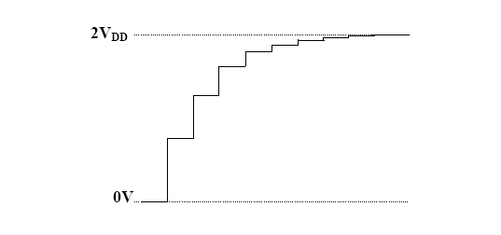

Capacitive Switch- mode conversion : Charge Pump
The energy is periodically stored into and released from the E filed of the Pump or Flying capacitors. They are typically used in applications requiring relatively small amounts of current.
Reduced components
Integration
Example Voltage Step-Up
This scheme is the simpler Charge pump structure and its dynamic output voltage is
Without output current we have

Slide 26


Capacitive Switch- mode conversion : Charge Pump
In case of load
The voltage is reduced
The variable available to control the converter in the frequency
With Ideal components the efficiency is

Slide 27
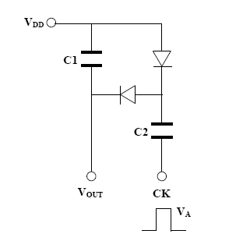
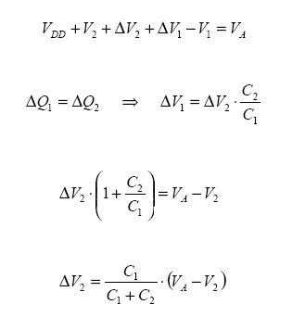

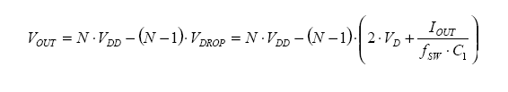
Capacitive Switch- mode conversion : Charge Pump (discrete)

Slide 28
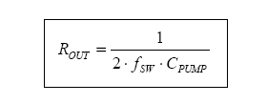
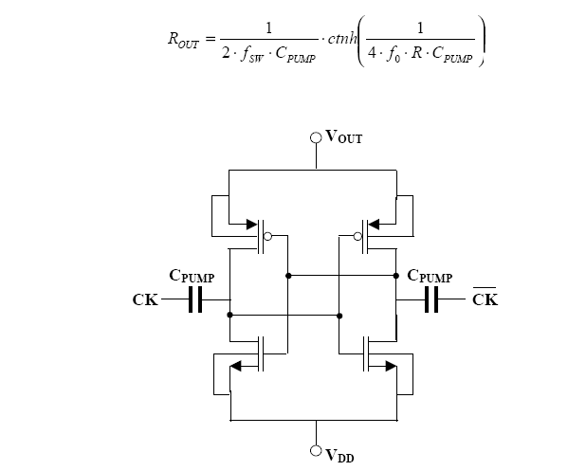
Switched capacitor with MOS
Two phase charge Pump
If the RdsON is big the equivalent resistance is higher because during the turn on time the pump capacitor it isn’t completely charged.

Slide 29
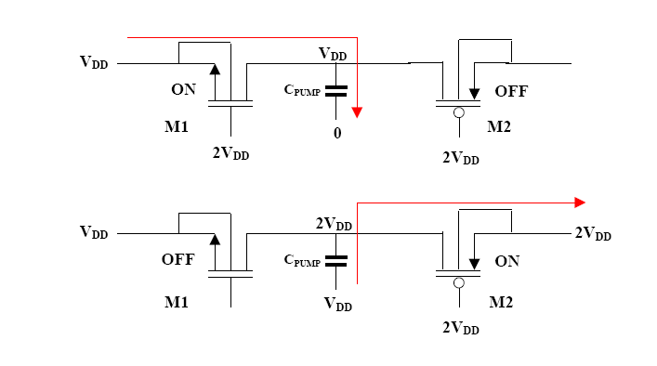
Detailed description

Slide 30
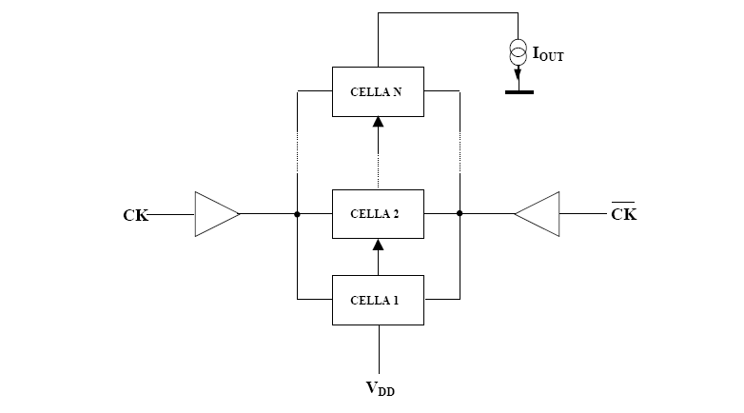
Big Step Up function
For an higher output voltage the cell can be connected

Slide 31
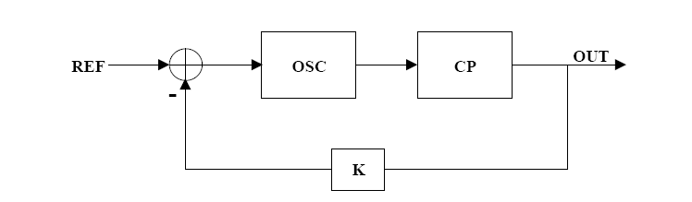
Charge pump control system
If the Charge pump is controlled it modulates its equivalent resistance in order to achieve the output voltage level. From an efficienty point of view it is equivalent to a LDO

Slide 32
Switch cap conversion efficienty
Bias consumption and turn on charge
η
Pload

Slide 33
Magnetic power conversion
This type of circuits are based on using the magnetic field to store the energy of inductor or transformer other than the electric field of the capacitors.
It’s possible classifying the converter on the basis of
type source and load
  AC-AC
  AC-DC Rectifier
  DC-AC Inverter
  DC-DC
presence or not of a transformer
  Non isolated
  Isolated
mode of operation
  DCM
  CCM
switching condition
  Hard switching
  Resonant

Slide 34
Type of converter
In general application IC integrated the different soultion utilized are
Step down
With the same voltage rate
Step up

Slide 35
Switched-mode control
To meet the load and source specification is needed a control system :
Voltage mode if the sensing signal is only the voltage
Current mode if in the sensed signal there is the current
Control & Sensing Signals
Input
Energy
Output
Energy
T h e r m a l E n e r g y

Slide 36
Modulation
Each switch has two possible level so the control system can only modulate the duration of each state:
Frequency modulation
  Ton constant
  Toff constant
  Duty constant
Fixed frequency
  Pulse width modulation

Slide 37
Pulse width modulation at constant frequency
w
w_{max}
m = Constant
m
w
-
x
t
+
m
x
t_{on}
t_{off}
t
T_{S}

Slide 38
Control loop

Slide 39
Switched-mode control
To meet the load and source specification is needed a control system :
Voltage mode if the sensing signal is only the voltage
Current mode if in the sensed signal there is the current
Control & Sensing Signals
Input
Energy
Output
Energy
T h e r m a l E n e r g y

Slide 40
Power Switch: Power MOS
Power switch requirements for MOSFET:
  Low Rdson ⇒ Low L and high W
  High breakdown ⇒ Body region low doped
Punch through when the channel is fully depleted

Slide 41
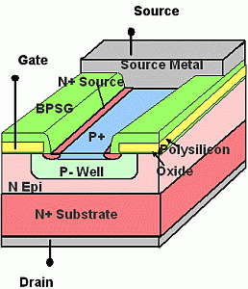
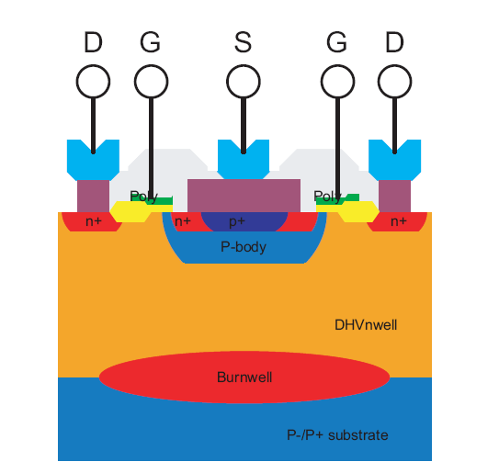
Power MOSFET
Vertical power MOS
This structure has the high breakdown voltage and low Rdson:
  During the off state the depletion region is present in the Nepi
  The Rds on decreases by reducing the channel length

Slide 42
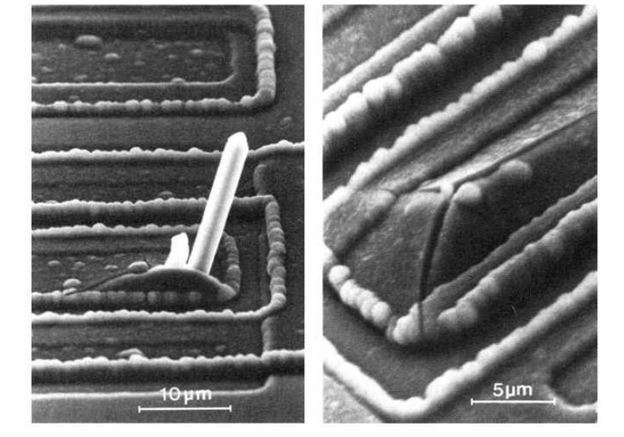
Electromigration problem

Slide 43
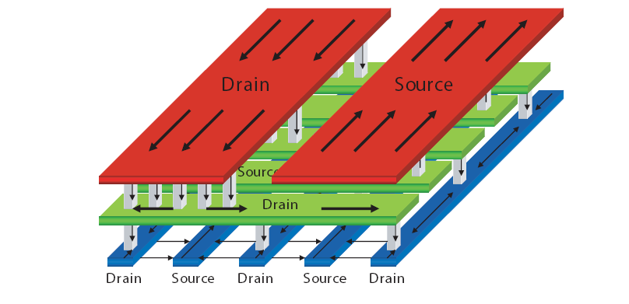
Layout power MOSFET

Slide 44
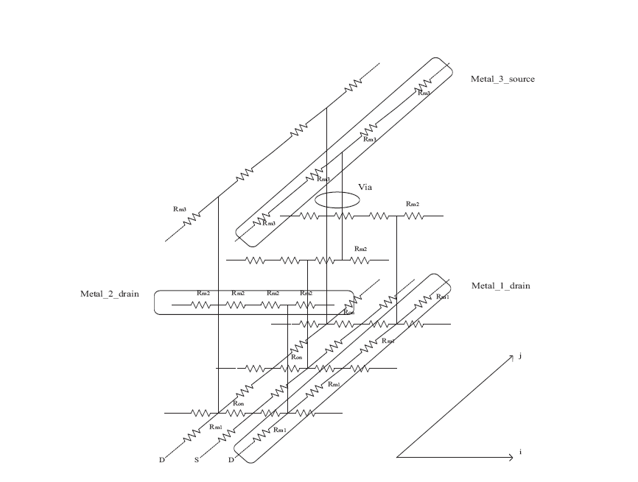
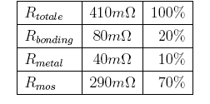
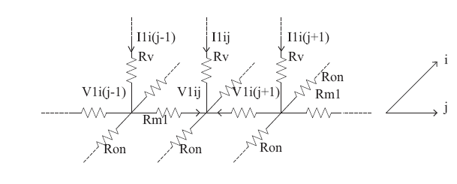
Rdson contributions

Slide 45
POWER MOS commutations: Gate charge curves
The MOS commutation characteristic with an inductive load is described by the gate charge curves
This curves is a charge controlled representation of the power MOS. They report the relation between the Vgs voltage and the charge injected in the gate to drive the device in relation with the switching condition (Ids, Vds)
V_{d}
V_{gsth}
Q_{g}

Slide 46
POWER MOS commutations: Gate charge curves
The importance of the gate charge curves is related to the driving circuit design because they represent the relation between the driving mode and the switching losses.
The gate charge curves depends on the switching condition (Il ,Vds) and on the parasitic present on the application but almost they don’t depend on the driving circuit.

Slide 47
POWER MOS commutations: Gate charge curves
V_{G}
V_{GE}
The ideal inductive commutation
With a fixed inductor current level and voltage level
Considering an ideal diode
V_{GEth}
I_{C}
tdon
V_{CE}
E
loss
ton

Slide 48
Gate charge in real condition
The parasitcs elements presents on the applications change the gate charge of the turn on and the turn off
  The capacitor of the Vds
  The diode reverse recovery
  The parasitc inductor Ls and Ld

Slide 49
Driving specification depending on gate charge
The driver ideal commutation can be calculated in the application considering the condition of maximum current but is a rare approssimation.
  The driver current depends on the impedance
The real commutation depend on the voltage hence the impedance present on the application that depend on many parameters:
  Ls that is vary important because it effects is amplified by
  Lgate and Rgate limits the driving capabiity

Slide 50
Choose the correct architecture
Dependely on the architecture the power related to the converter can be plotted as reported
Switching losses
Bias and driving losses
Conduction losses
η
Increase the FOM= Qg Rdson
Pload

Slide 51
Power MOS limitations
The limitations of the power MOS is for the High current and voltage application:
  To increase the operating voltage (during turn off) it is necessary increase the width of the n-epi region
  The R_{ds on} depends also by the R_{epi} resistance
  Trade off between max turn off V_{ds} and R_{ds on}

Slide 52
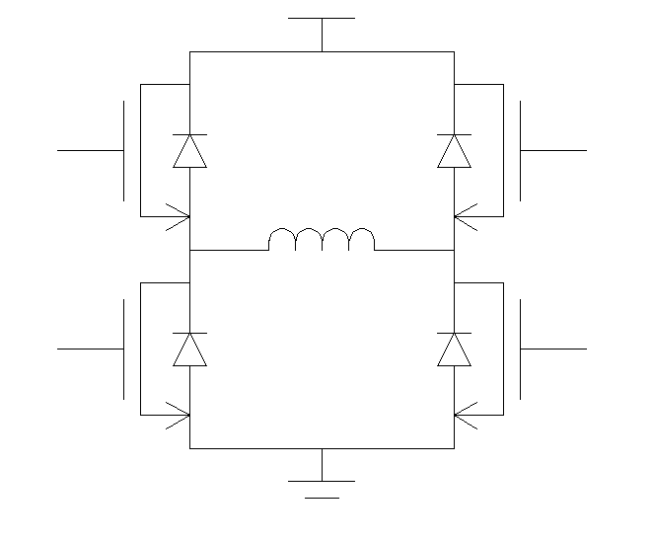
When does NPN turn on?
VM
VM
VM
OFF
OFF
OFF
ON
OFF
OFF
I
P sub
Ic
A
B
A
B
A
B
Nwell
ON
I
ON
OFF
ON
OFF
I
ON
2
3
1
Fly-BACK PHASE
During phase 2 (high to low transition of A) both HSD and LSD are OFF due to the cross conduction control.
In this phase the inductor current flows through the intrinsic diode turning on the parasitic NPN.
A
B
1
2
3

Slide 53
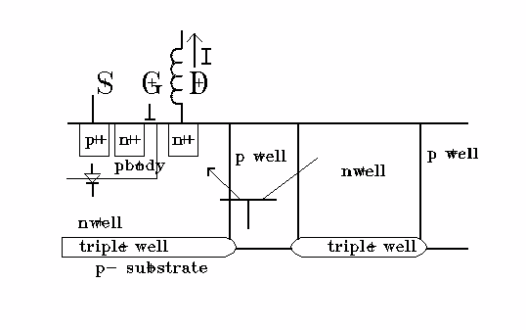
Parasitic NPN negative fly back phase
I npn
Id
The Collector current flows from other pockets close to the Power.

Slide 54
When does PNP turn on?
VM
VM
VM
ON
OFF
ON
OFF
ON
ON
I
I
Id
I
P sub
A
B
A
B
OFF
ON
OFF
A
B
OFF
OFF
OFF
2
3
1
Positive Fly-BACK PHASE
During phase 2 (low to high transition of B) both HSD and LSD are OFF due to the cross conduction control.
In this phase the inductor current flows through the intrinsic diode ”Id” turning on the intrinsic parasitic PNP.
A
B
1
2
3

Slide 55
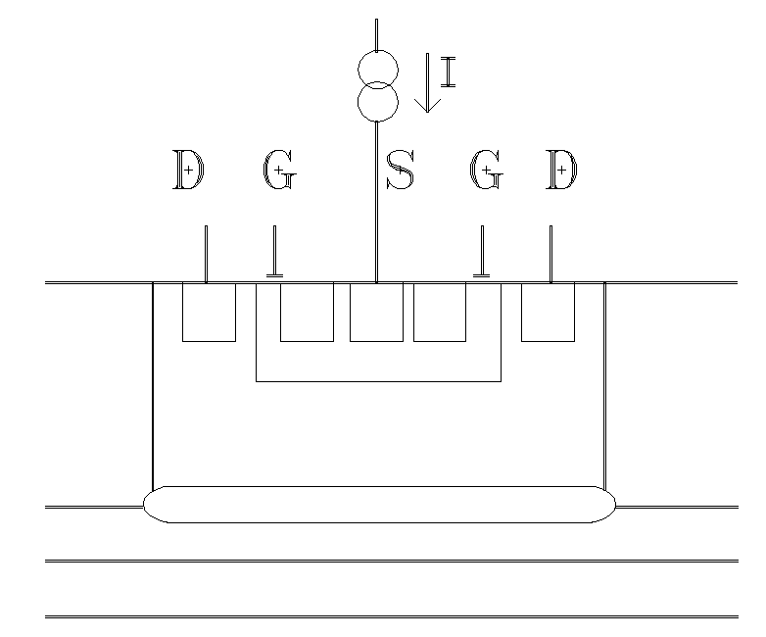
Parasitic PNP positive fly back phase
Parasitic PNP
N+
N+
P+
N+
N+
Id
pbody
nwell
Pwell
Ipnp
Triple well
The PNP Collector current flows into the substrate rising its voltage

Slide 56
“Bootstrap” Supply for High-Side Power

Slide 57
Bootstrap Cap Charges When Lo-Side ON

Slide 58
Cap Supplies Power When Hi-Side ON

Slide 59
High Voltage IC Level-Shifting Driver

Slide 60
HVIC Block Diagram for Half-Bridge Driver

Slide 61
Junction Isolated CMOS HVIC Driver
Boot
Phase

Slide 62
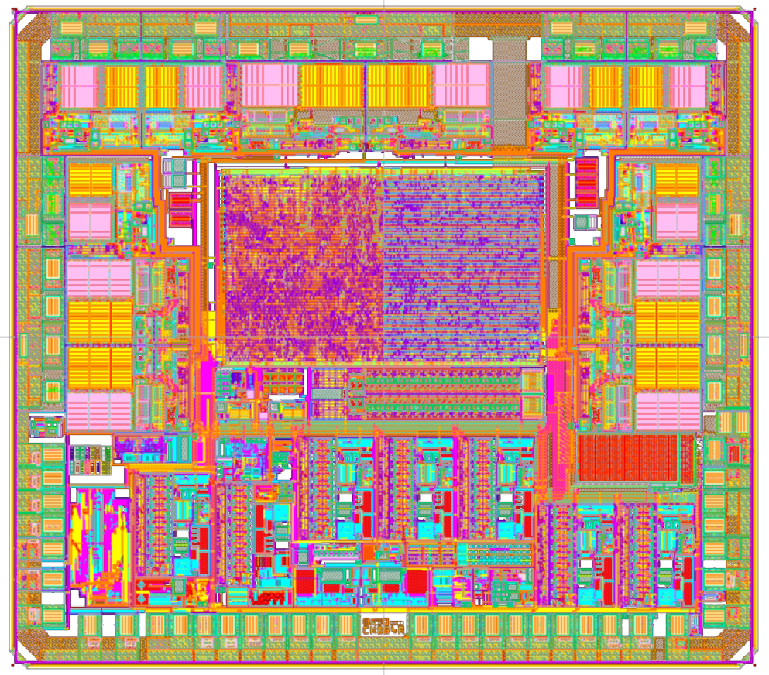
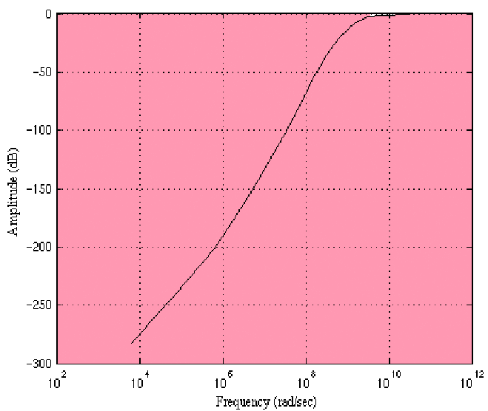
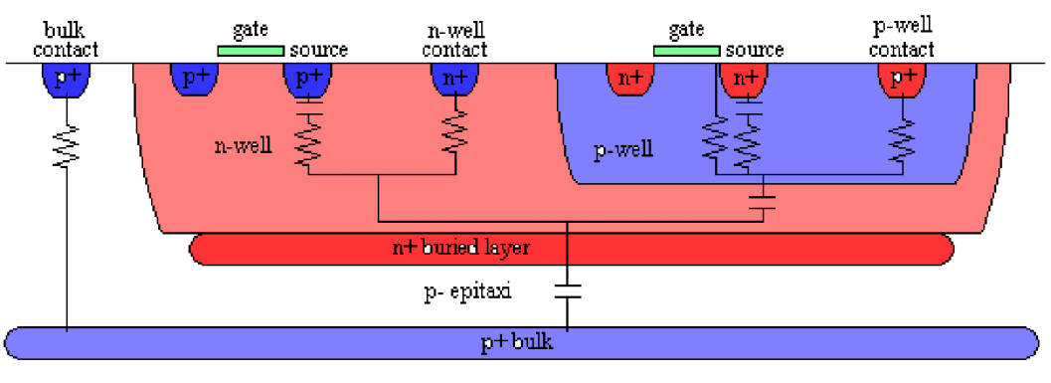
Substrate coupling
Transfer functions of the substrate coupling

Slide 63
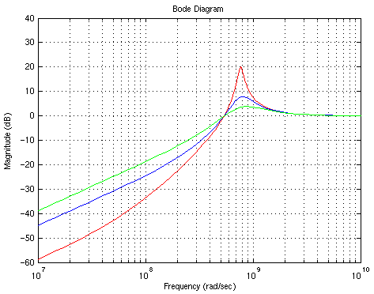
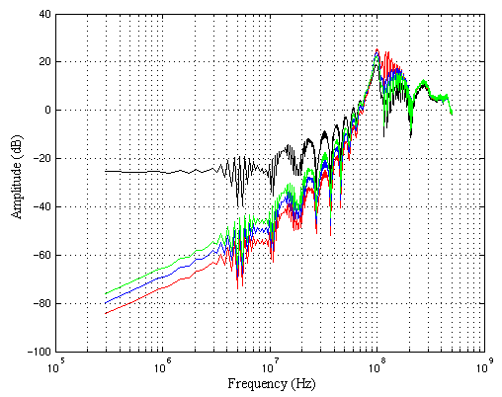
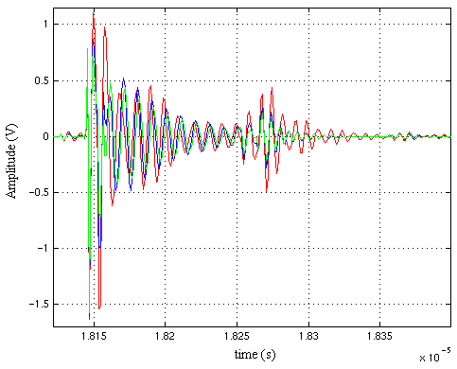
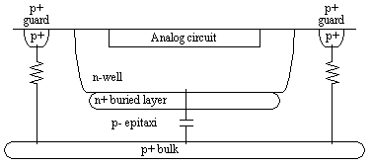
Substrate coupling
R₂=0.1Ω
R₂=1Ω
R₂=0.5Ω

Slide 64
Conclusions
Voltage Conversion topologies (LDO, Switched cap,SMPS)
Power devices
Design problems

