Slide 1
Gamma rays as tracer for cosmic rays
Xin Wu
Department of Nuclear and Particle Physics (DPNC)
University of Geneva
Swiss CTA day, 24 November 2020, Geneva

Slide 2
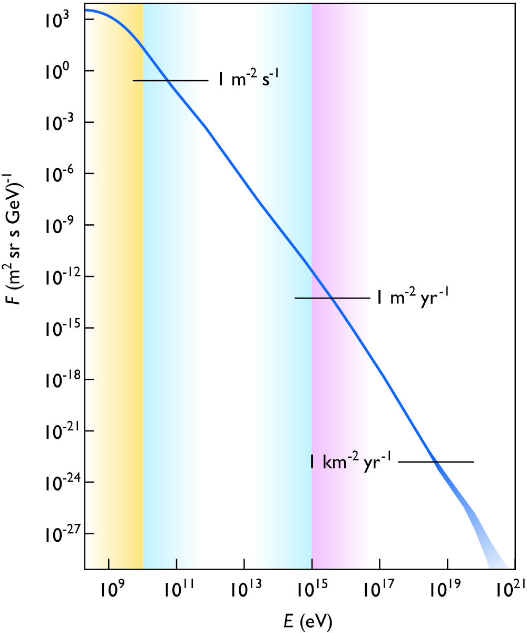
Introduction
Cosmic rays in general refers to high energy charged particles originated outside the Solar system
  p, He, and heavier nuclei, antiproton
  But also electron and positron!
Wikipedia
Observed spectrum covers 12 orders of magnitude in energy and 30 orders in flux
  UHECR: > 100 TeV (0.1 PeV)
  VHECR: 100 GeV - 100 TeV
  Multiple sources and processes
  Modulated by propagation effects
All particle spectrum
The origins of cosmic rays can only be truly resolved by a multi-messenger and global approach
  Precise spectral and elemental measurements of cosmic rays
  Gamma rays (CTA, …)
  Neutrino
  Gravitational wave
GeV
PeV

Slide 3
Cosmic rays: around and above the knee (UHECR)
Because of the Earth atmosphere only particles above ~100 TeV (the “knee” region) can be precisely measured by ground detectors
  Extended Air Shower detectors: AUGER, TA, HAWC, …
  Composition measurement difficult, but mass groups possible/improving
What is behind the observed spectral features?
  Transition between galactic and extragalactic sources
    acceleration - confinement - interaction
  Composition change?
Gamma rays as tracers of cosmic rays
  CR + p/γ -> π⁰ + X -> γγ + X
  Typically E_{γ} ~ 0.1 E_{CR}
  Need spectral features to identify “hadronic” gamma-rays
    w.r.t “leptonic” gamma-rays, e.g. IC, SR, BR
  Observed gamma ray spectrum is a convolution of the CR spectrum and π⁰ production/decay, as well as injection and cooling effects
PeV
EeV

Slide 4
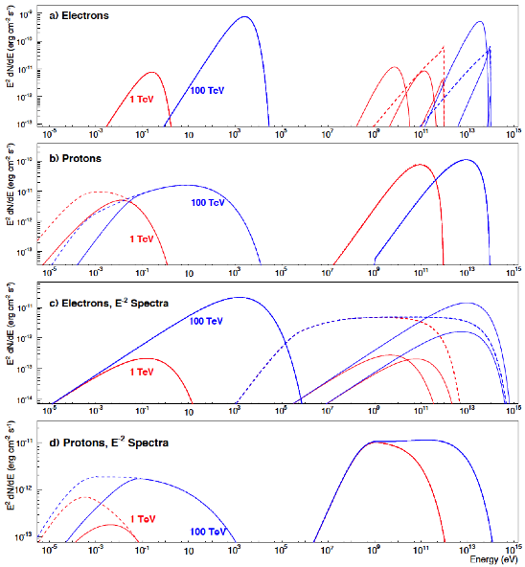
“Leptonic” vs “Hadronic” gamma rays
Hinton & Hofmann, Annu. Rev. Astron. Astrophys. 47, 523 (2009).
  ⎯ IC: CMB, IR, SL
  SR, 3 μG
Mono-E electron: 1 TeV/100 TeV
  …. BR
  SR, 30 μG
Mono-E proton: 1 TeV/100 TeV
  ⎯ 10⁴ y
  …. 10⁵ y
E⁻² electron with cut-off: 1 TeV/100 TeV
  π⁰ bump
E⁻² proton with cut-off: 1 TeV/100 TeV
  Hard spec.
  Complex picture, need
Wide energy range
Good energy resolution
Good imaging
meV
keV
MeV
GeV
TeV
100 TeV

Slide 5
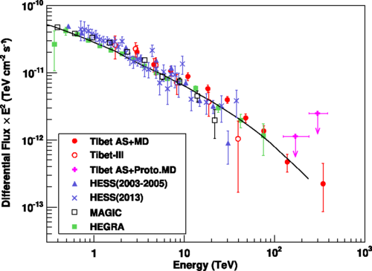
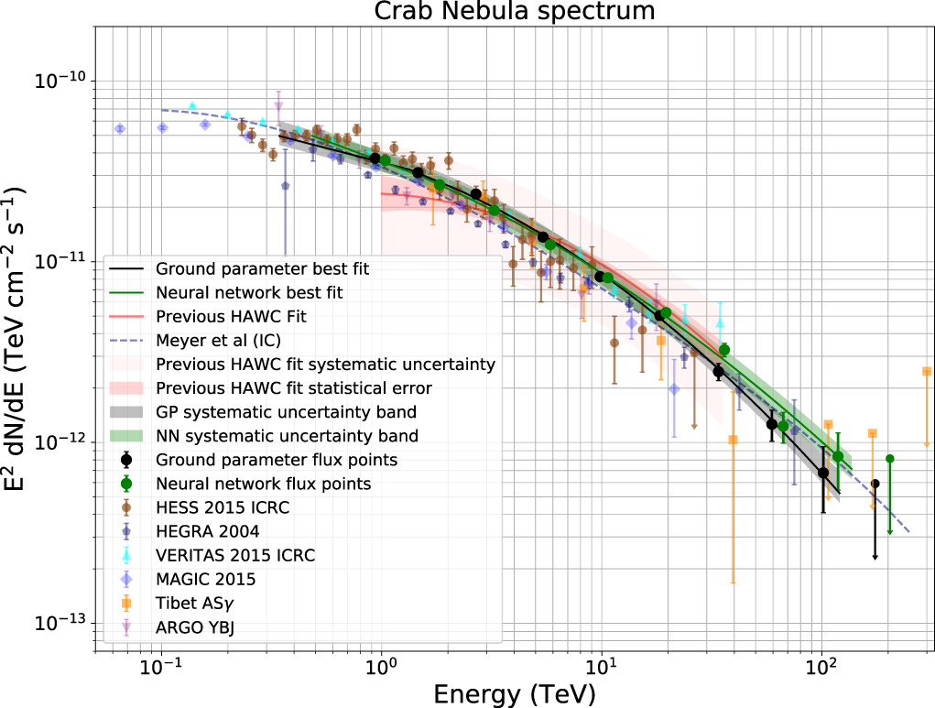
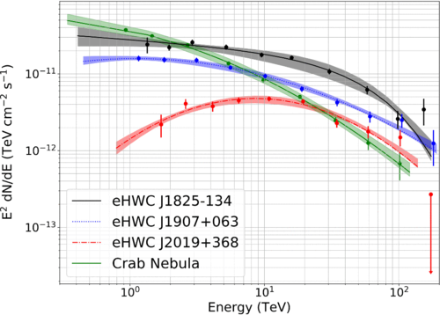
Multi-TeV gamma-ray sources: hunting ground for PeVatrons
A few >100 TeV gamma-ray sources reported recently
Crab Nebula
Tiber ASγ, July 2019
Crab Nebula
HAWC, August 2019
HAWC, January 2020
HAWC: 8 >56 TeV sources (excluding Crab)
  Extended; Close to the galactic plane (<1°)
  Consistent with known TeV sources
  Have nearby pulsar (<0.5°)
  Pure leptonic cannot be excluded, neither hadronic contribution
3 >100 TeV sources (excluding Crab)

Slide 6
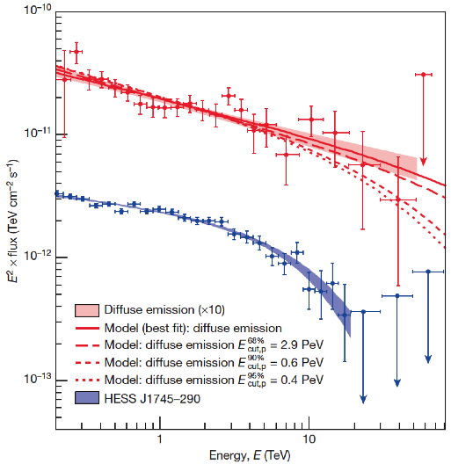
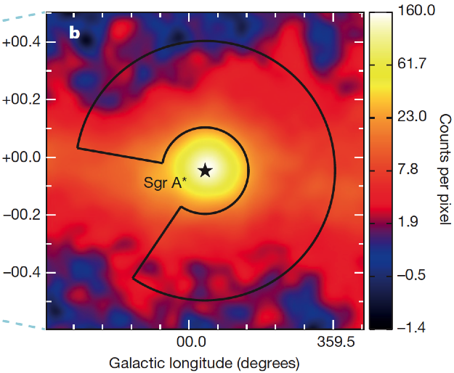
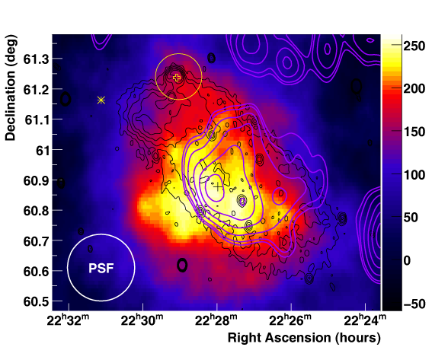
Multi-TeV gamma-ray sources: potential PeVatron candidates
A PeVatron at the Galactic Center (Sagittarius A*)?
HESS J1745− 290
SNR G106.3+2.7: VER J2227+608/HAWC 2227+610
HAWC, Astrophys.J.Lett. 896 (2020)
Not yet possible to differentiate hadronic and leptonic origins

Slide 7
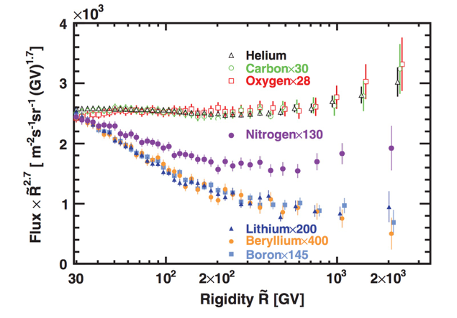
VHECR: many breaks from direct detections below the knee
Precision measurements below the knee become possible with balloons and satellites
  Many interesting spectral features of individual species are being unveiled between ~0.1 – 100 TeV, and soon to PeV
Key questions
  Are the UHE and VHE cosmic rays from the same population? What is the effect of propagation? What is the effect of secondary production?
proton
AMS
Primary vs secondary
DAMPE
2 groups of primary
Helium
DAMPE
https://doi.org/10.1016/j.physrep.2020.09.003
https://doi.org/10.1103/PhysRevLett.124.211102
Parallel to PeVatron hunting, it is a fundamental task for CTA/gamma-ray astronomy to help to resolve these questions
  Resolve point sources of the dense galactic plane
  Constraint parameters of propagation models

Slide 8
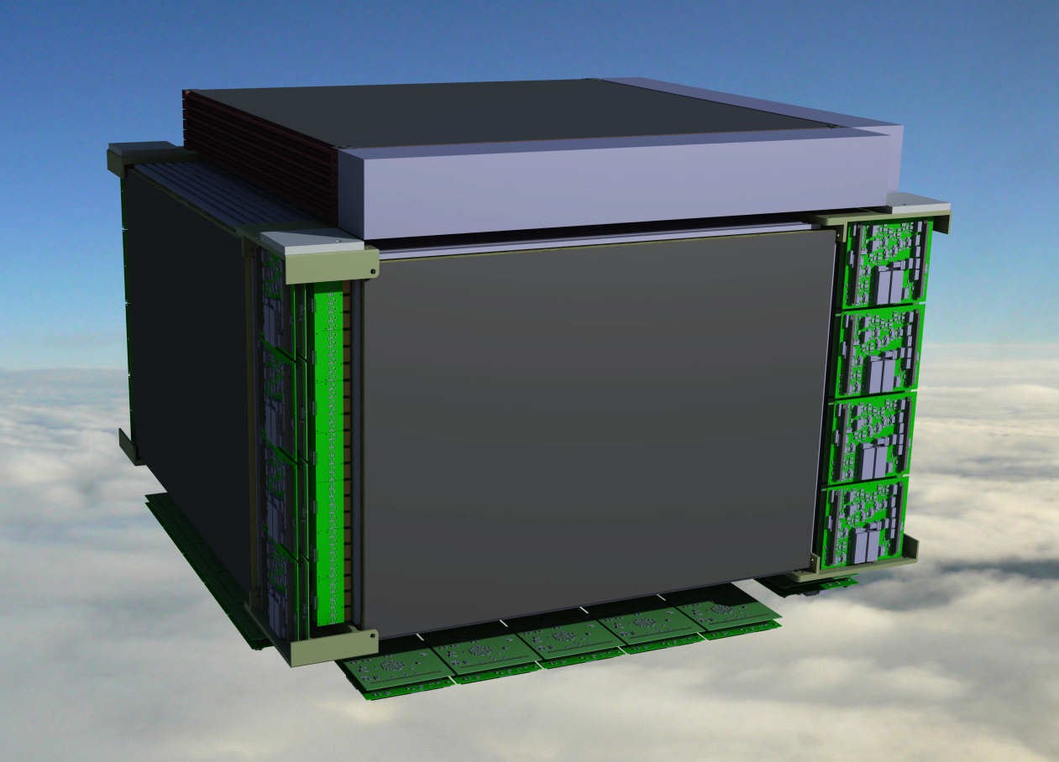
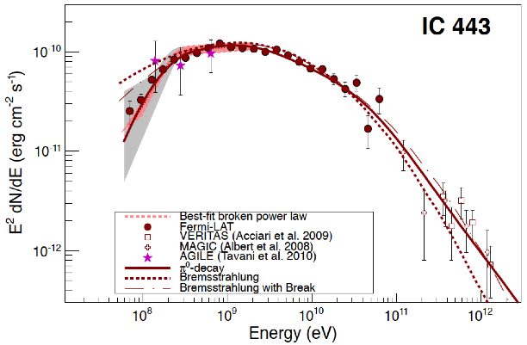
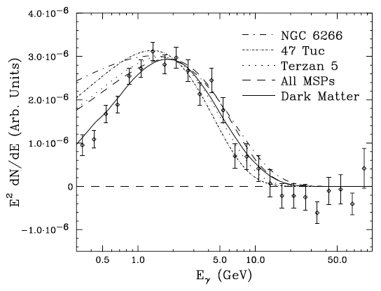
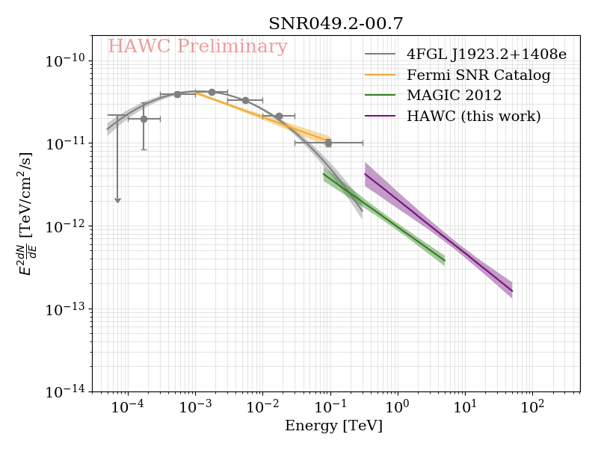
Cosmic ray and GeV gamma-ray astronomy with HERD
HERD with 5-side fiber tracker (FIT, developed by DPNC)
  ~3x better angular resolution than Fermi in the 0.1 - 1 GeV range, large FOV
Fermi, >100 MeV
HERD will resolve large number of sub-GeV sources and measure diffuse flux in the galactic plane
  Millisecond pulsars (MSP) peaked at ~GeV
The sub-GeV part of the spectrum is essential to distinguish hadronic and leptonic emission
SNR IC 433
Primary vs secondary
Fermi, >2GeV/>100 MeV
HERD is complementary to CTA
… and to elucidate the origin of the Galactic Center GeV Excess (GCE)
SNR W51
Daylan et al. (2014)

Slide 9
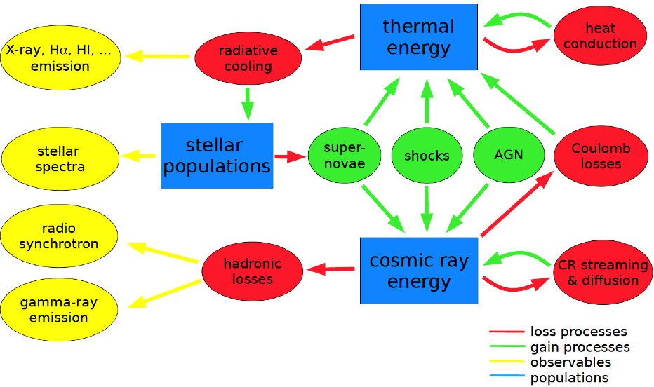
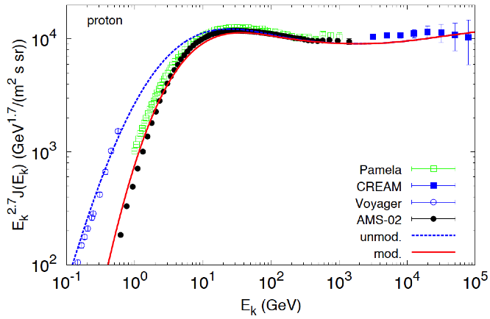
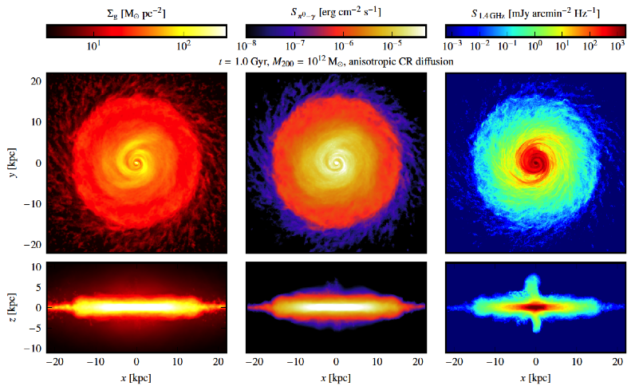
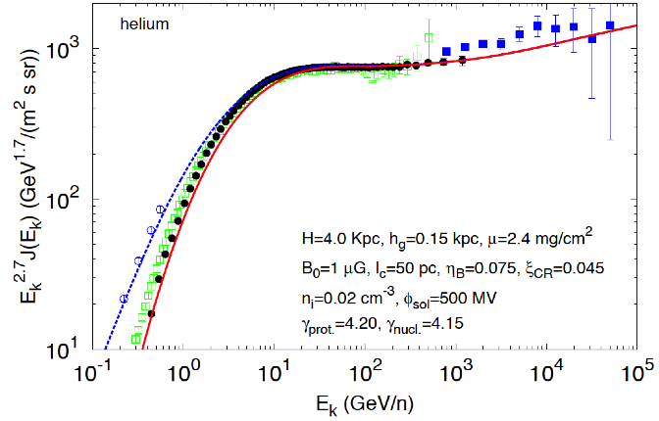
Galactic wind, cosmic ray feedback, non-linear transport
Strong phenomenological and theoretical arguments support that Galactic winds can be launched by accelerated cosmic rays
  CR can play a critical role in galaxy formation
M82
proton
  Pfrommer et. al. AIP Conf. Proc., V 1792, 1
  Alisio et. al. A&A 583, A95 (2015)
Helium
Gas
π⁰ →γγ
radio
γ-ray > 100 MeV (HERD!)

Slide 10
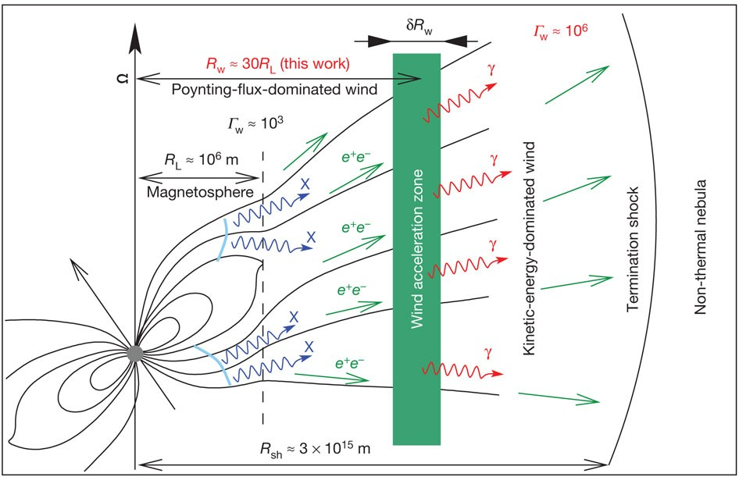
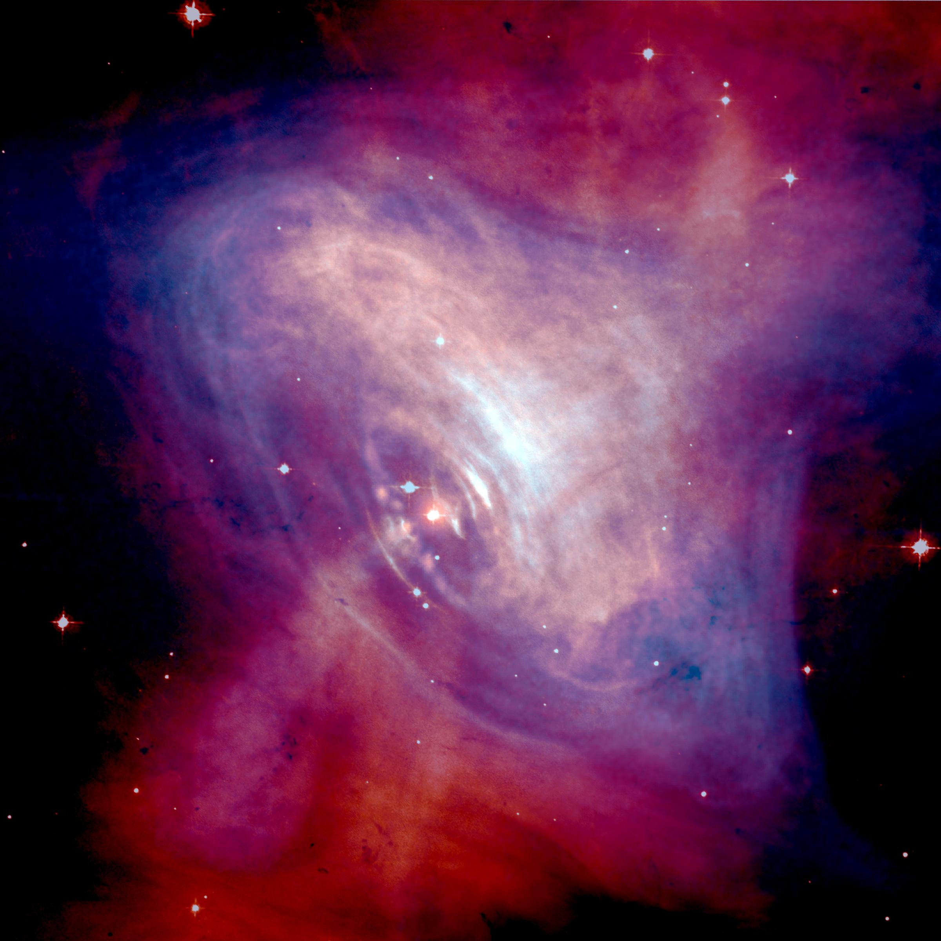
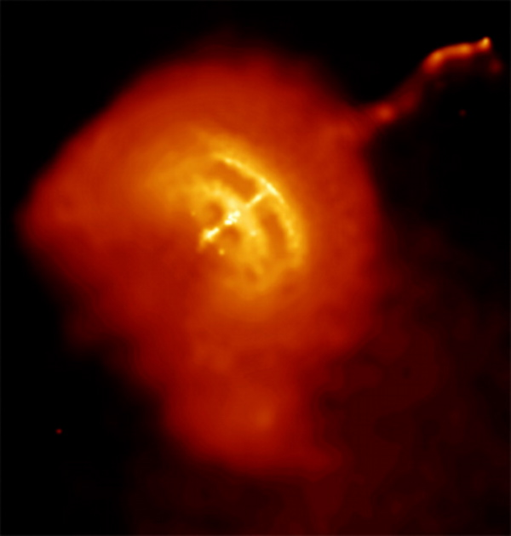
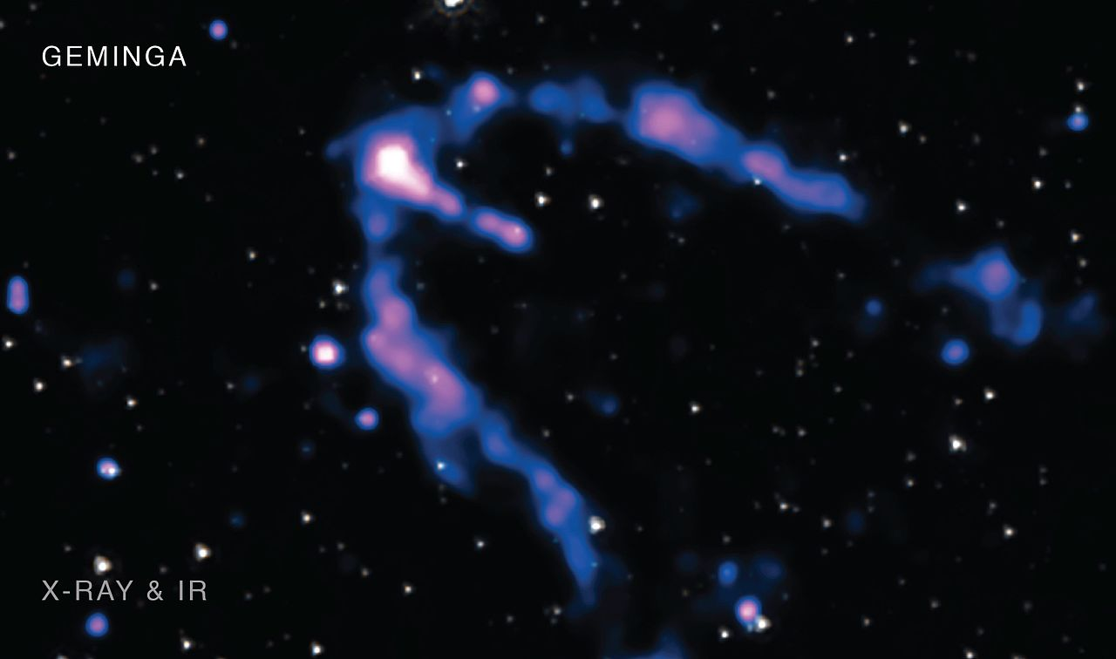
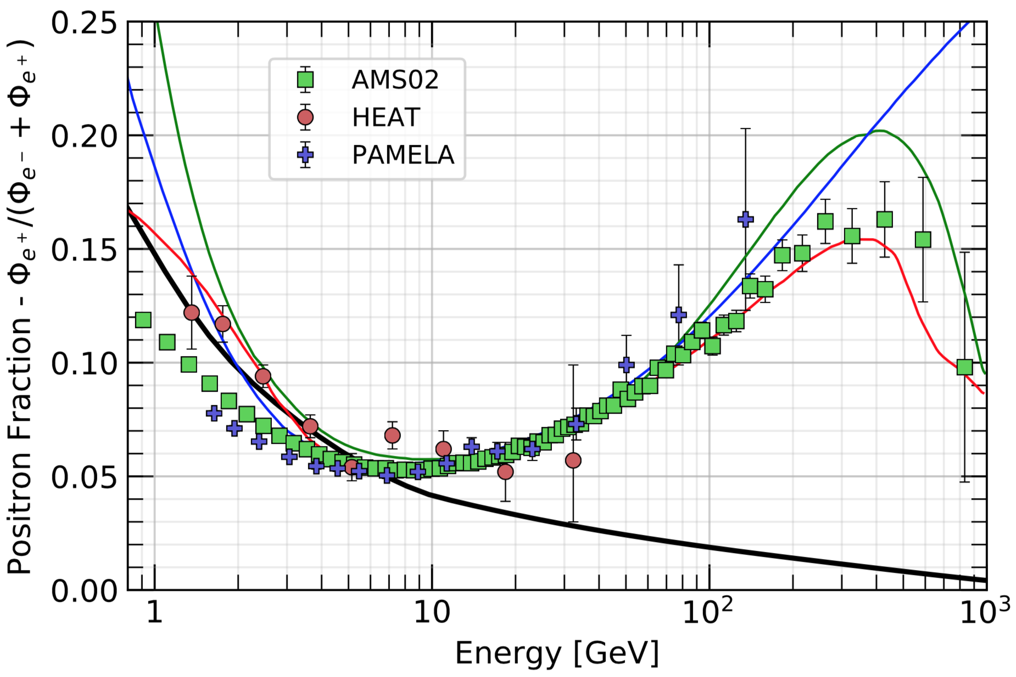
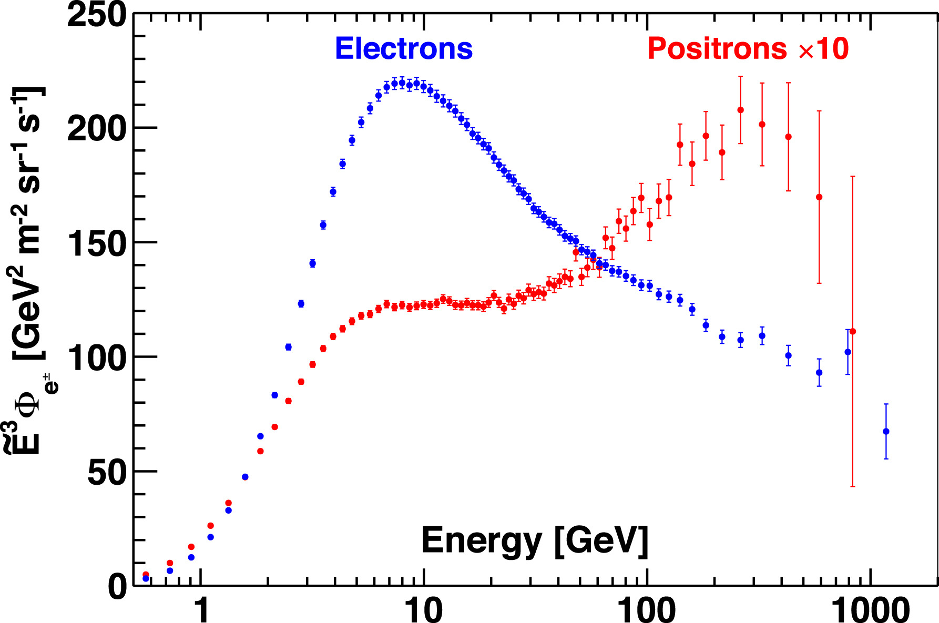
Pulsars and Pulsar Wind Nebulae as particle accelerators
Relativistic outflows can be efficient and extreme accelerators, and lepton factories!
  γ → e⁺+e–
  Could nearby pulsars be sources of high energy electron and positron observed?
Crab
Vela
Geminga
Aharonian Nature 482, 507(2012)
PAMELA and AMS observed a rising e⁺ fraction
DAMPE observed a TeV break of e⁺+e– flux
Particle Data Group 2020 Review
  Upcoming DAMPE paper and future HERD

Slide 11
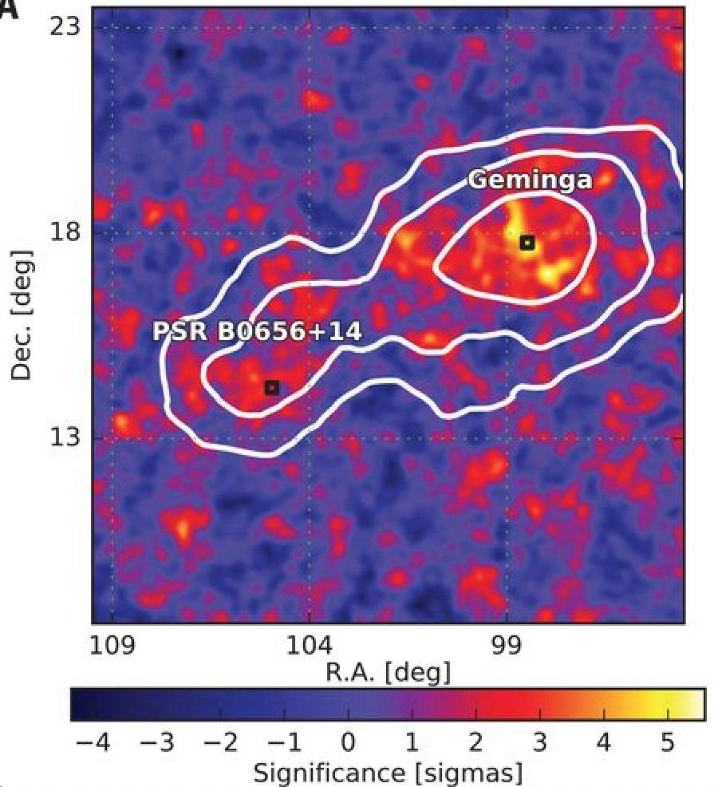
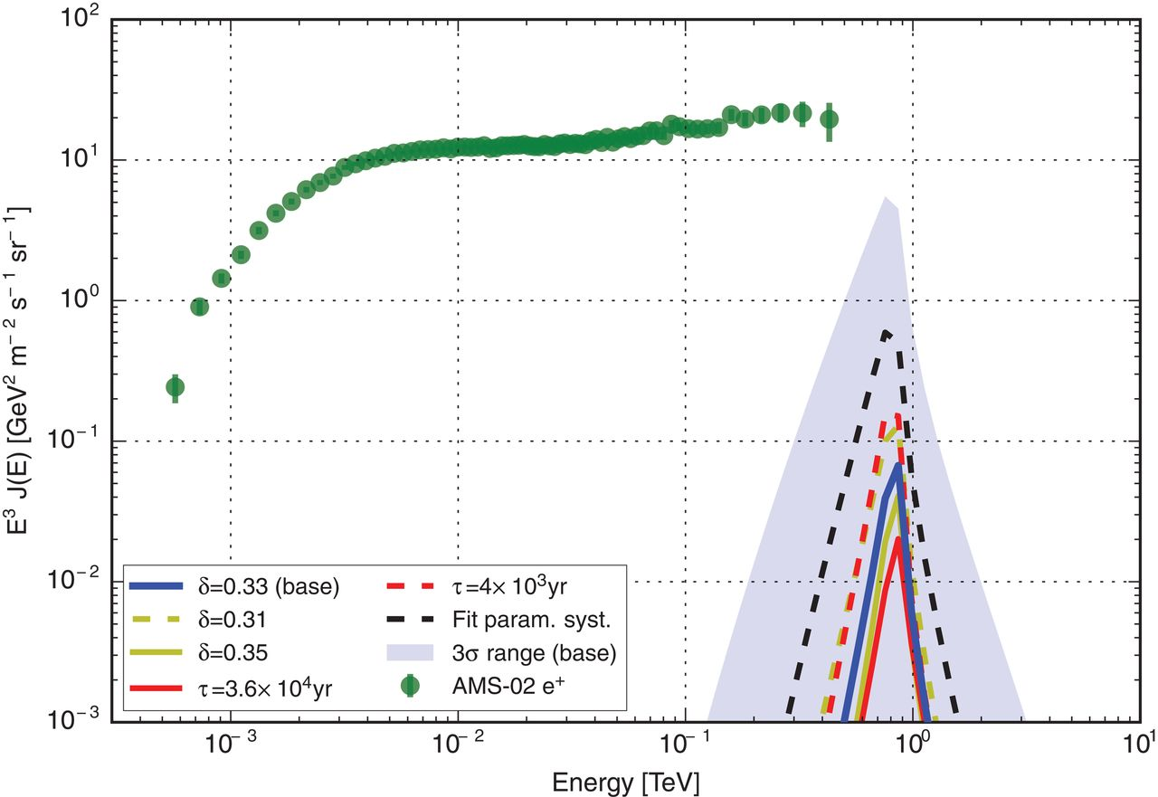
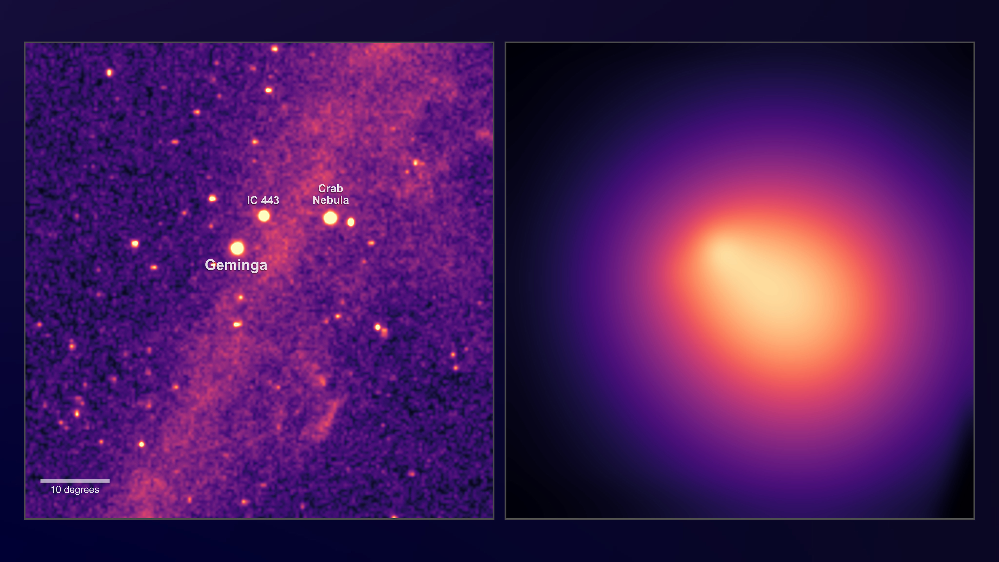
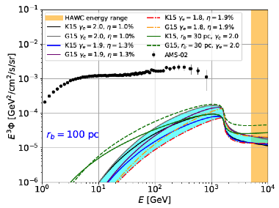
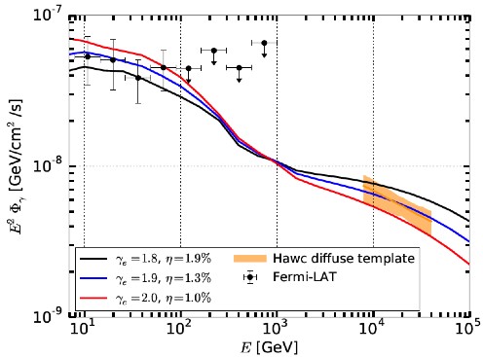
Is the positron excess due to nearby pulsars?
10°
  Gamma-ray observations provide very interesting constraints
HAWC, Science 358, 911–914 (2017)
  Small zone of TeV γ-ray flux near Geminga and Monogem
→ small lepton diffusion coefficient → constraint on positron flux at Earth
  Leptons from these pulsars are “unlikely to be the origin of the excess positrons, …”
But it is also possible diffusion is less efficient around the source!
10°
Fermi, Phys. Rev. D 100, 123015 (2019)
  Large sub-TeV γ-ray bubble around Geminga
100 pc
Use 2-zone diffusion model
the cumulative positron emission from Galactic PWNe remains a viable interpretation for the positron excess

Slide 12
Conclusion
Gamma ray, as tracer for cosmic ray, is a powerful tool to map the cosmic ray acceleration and propagation sites in the Galaxy, and beyond
  There are recent major progress, and near future major observational capability extension, in cosmic ray observations and gamma ray observations
  Multi-messenger cosmic ray acceleration and propagation models are fast evolving
Switzerland is a key player in this global effort through its major hardware contributions and leading roles in data analysis, covering x-ray, gamma ray, cosmic ray, neutrino, and gravitational wave
University of Geneva is a center of excellency in multi-messenger astrophysics
  Space: AMS, DAMPE, HERD, POLAR-2, …
  Ground: MAGIC, IceCube, LAHSSO, CTA, …
  HERD and CTA concurrently cover gamma-ray sky from 0.1 GeV to ~300 TeV
    Strong complementary/synergy in observation and science

