Slide 1
The
Particle World: Q&A
@tarashears

Slide 2
Questions
Particles
Forces
Higgs
Standard Model
CP violation
Supersymmetry
Future colliders
Applications

Slide 3
Particles
Why is a particle a resonance in a field? (Afnan)
Could our fundamental particles be composite? (Sarah) *
What’s the difference between a neutrino and an antineutrino (Laura) *
Is the neutrino oscillation same as quark mixing? Should we use same technique for the neutrino oscillation? (Erdenebalgan) *
Do the masses of virtual particles from vacuum fluctuations also contribute to the mass of the universe? (Maximillian)
Can "nothing"/an empty universe be stable or does it need to change due to creation and annihilation of virtual particles/other circumstances? (Maximillian)

Slide 4
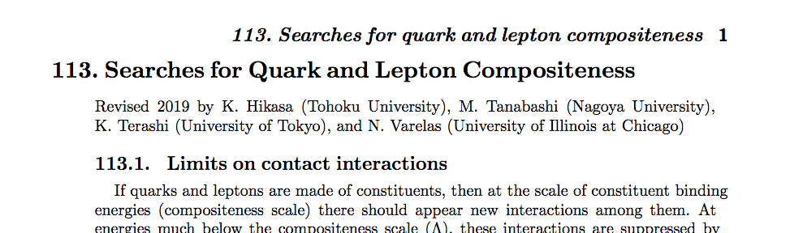
(particle data group)

Slide 5
Particles
Why is a particle a resonance in a field? (Afnan)
Could our fundamental particles be composite? (Sarah) *
What’s the difference between a neutrino and an antineutrino (Laura) *
Is the neutrino oscillation same as quark mixing? Should we use same technique for the neutrino oscillation? (Erdenebalgan) *
Do the masses of virtual particles from vacuum fluctuations also contribute to the mass of the universe? (Maximillian)
Can "nothing"/an empty universe be stable or does it need to change due to creation and annihilation of virtual particles/other circumstances? (Maximillian)

Slide 6
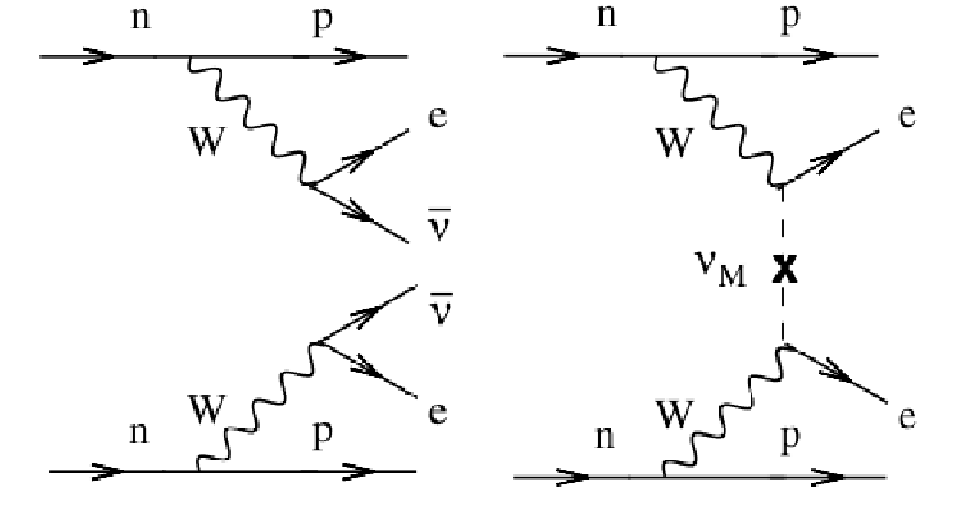
Neutrinoless double beta decay
Neutrino/antineutrino different
Neutrino/antineutrino identical

Slide 7
Particles
Why is a particle a resonance in a field? (Afnan)
Could our fundamental particles be composite? (Sarah) *
What’s the difference between a neutrino and an antineutrino (Laura) *
Is the neutrino oscillation same as quark mixing? Should we use same technique for the neutrino oscillation? (Erdenebalgan) *
Do the masses of virtual particles from vacuum fluctuations also contribute to the mass of the universe? (Maximillian)
Can "nothing"/an empty universe be stable or does it need to change due to creation and annihilation of virtual particles/other circumstances? (Maximillian)

Slide 8
Parametrisation to describe quark mixing (CKM matrix). Weak eigenstates related to mass eigenstates:
d_{W}
s_{W}
b_{W}
d
s
b
Weak eigenstates
Mass eigenstates
=
Mixing matrix is 3x3.
Unitarity constraints ⇒ 4 independent parameters
3 angles quantify mixing between (1,3) (2,3) (1,2) generations, 1 complex phase (mechanism for introducing CP)

Slide 9
Similar framework adopted for neutrinos (PMNS matrix). Flavour (e, μ, τ) related to mass eigenstates:
v_{e}
v_{μ}
v_{τ}
v₁
v₂
v₃
Weak eigenstates
=
Mass eigenstates
Mixing matrix is 3x3.
Unitarity constraints ⇒ 4 independent parameters
3 angles quantify mixing between (1,3) (2,3) (1,2) generations, 1 complex phase (mechanism for introducing CP)

Slide 10
Particles
Why is a particle a resonance in a field? (Afnan)
Could our fundamental particles be composite? (Sarah) *
What’s the difference between a neutrino and an antineutrino (Laura) *
Is the neutrino oscillation same as quark mixing? Should we use same technique for the neutrino oscillation? (Erdenebalgan) *
Do the masses of virtual particles from vacuum fluctuations also contribute to the mass of the universe? (Maximillian)
Can "nothing"/an empty universe be stable or does it need to change due to creation and annihilation of virtual particles/other circumstances? (Maximillian)

Slide 11
Forces
What is the difference between a charge and a colour charge and why the name "colour charge" ? (Jonathan)
Does the weak force show confinement? (Carolina)
The weak force has two charges, are these the weak hypercharge and weak isospin? (Willem)
Are these charges independent like the colour charges? (Willem)
If the weak interaction is non-Abelian, then why do the electroweak bosons have 0 hypercharge and hence not form vertices with only gauge bosons as we see in the strong force? (Willem) *
Do forces change strength in extreme situations (eg in a black hole) (Sarah)
What does a unified force appear like? (Laura) *

Slide 12
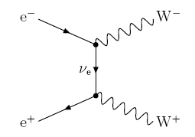
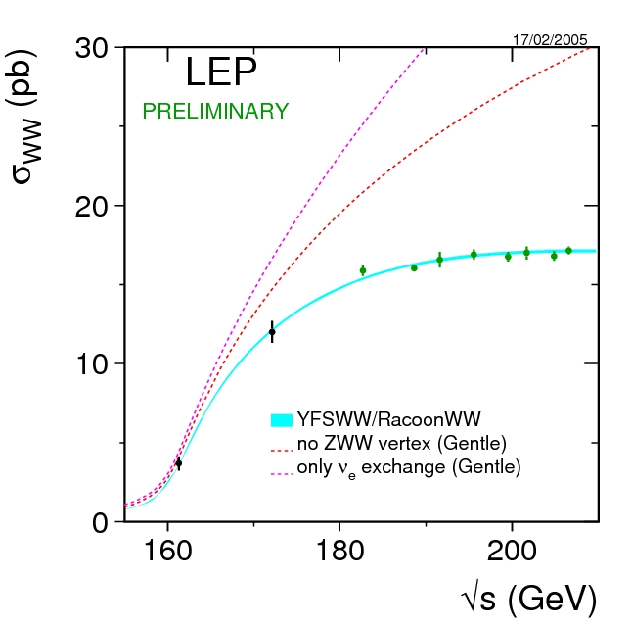
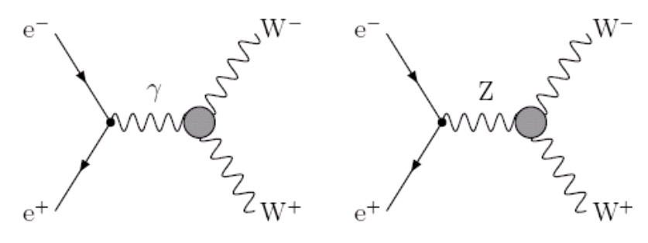
Proof: weak force non-Abelian
1
1
1
2
1
2
3
2
3
Check rate of e⁺e⁻ → WW production at LEP
LEP 4fermion working group

Slide 13
Forces
What is the difference between a charge and a colour charge and why the name "colour charge" ? (Jonathan)
Does the weak force show confinement? (Carolina)
The weak force has two charges, are these the weak hypercharge and weak isospin? (Willem)
Are these charges independent like the colour charges? (Willem)
If the weak interaction is non-Abelian, then why do the electroweak bosons have 0 hypercharge and hence not form vertices with only gauge bosons as we see in the strong force? (Willem) *
Do forces change strength in extreme situations (eg in a black hole) (Sarah)
What does a unified force appear like? (Laura) *

Slide 14
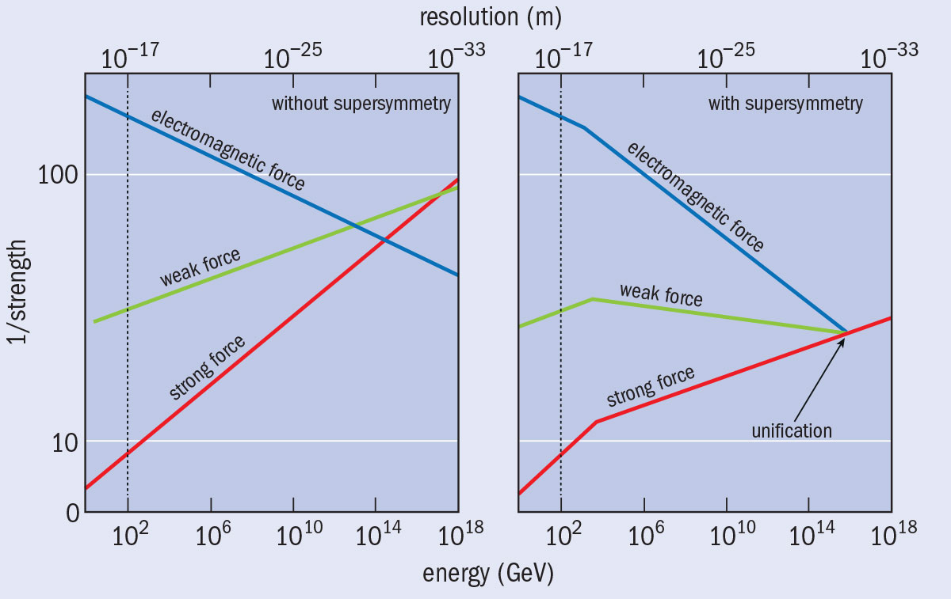

Slide 15
Higgs
Does the Higgs mechanism explain why M(Z) is so close to M(H)? (Artem)
How do we know the temperature when symmetry breaking occurred? (Artem)
Is the Higgs field consistent with mass bending space-time in general relativity? (Sarah)
What if we are in a local minima of the Higgs field; could the universe flip to another configuration? (Artem) *

Slide 16
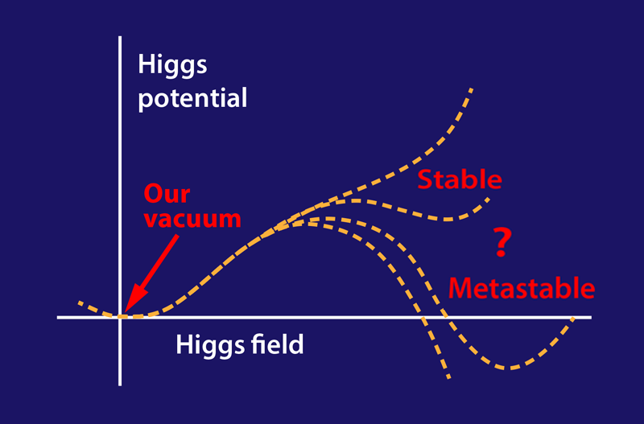
https://physics.aps.org/articles/v8/108

Slide 17
Standard Model
Is it possible to describe the Standard Model using a Hamiltonian rather than a Lagrangian? (Dauke)
How do we know the Standard Model applies everywhere? Could it be local? (Sarah)
In total, what is the minimum number of free parameters required to fully form the Standard Model? (Joshua) *
Are there any theories which try to reduce this by connecting two parameters, or is that essentially what electroweak unification/Higgs attempts to do? (Joshua) *

Slide 18
Standard Model free parameters: 25
12 fermion masses
3 coupling constants for the forces
4 parameters for the CKM matrix (quark mixing, CP violation)
4 parameters for the PMNS matrix (neutrino mixing, CP violation)
2 parameters for the Higgs (boson mass, vacuum expectation value)
But the Standard Model predicts relationships between the quantities,
eg. between the Z and W masses and the Weinberg angle (and hence the force couplings)
  Tan θ_{W} = g’ / g
  M_{W} = M_{Z}/cos θ_{W}

Slide 19
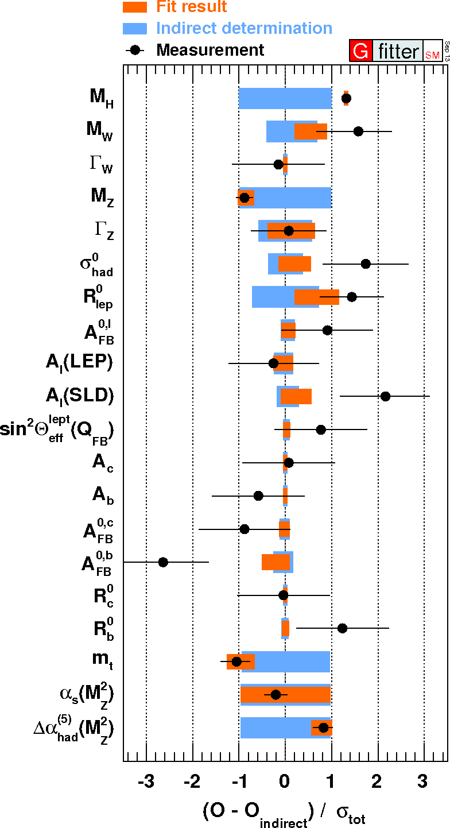
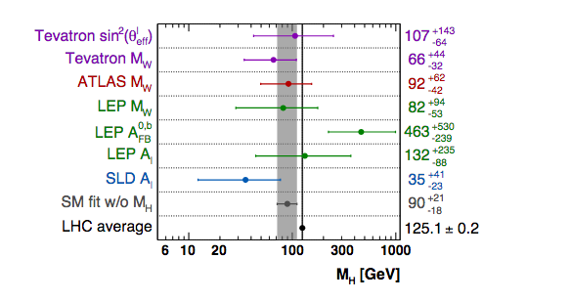
Test relationships in fit to data
Many SM parameters are sensitive to the Higgs mass

Slide 20
CP violation
  How do you detect and measure it? (Sarah) *
  Can Beyond Standard Model theories explain it? (Felix)

Slide 21
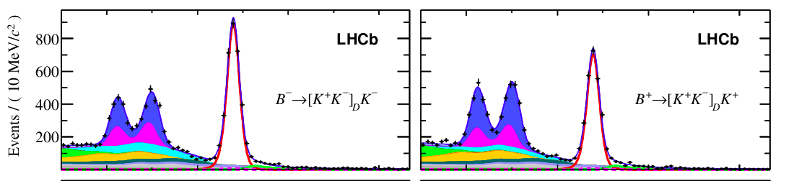
matter
antimatter

Slide 22
Supersymmetry
  What is it? (Robert) *
  How are supersymmetric particles different to normal particles? (Robert)

Slide 23
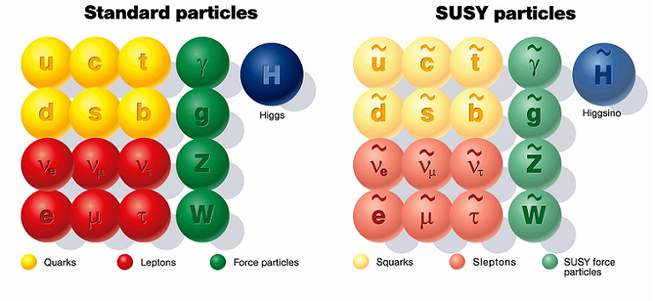
squarks and sleptons – integer spin
SUSY force particles – half integer spin
SUSY masses – unknown.

Slide 24
Future Colliders
  What are the latest developments since 2019? (Felix)
  Which are most promising? (Sarah) *

Slide 25

Full exploitation of the LHC and HL-LHC
Long baseline neutrino experiments (DUNE, Hyper-K)
Electron-positron Higgs factory (circular and/or linear)
100TeV proton-proton collider
+ diversity of small experiments
Development of new accelerator technologies
Development of new detector technologies

Slide 26
Applications
  Does applied physics research use the fundamental particle physics that CERN discovers to develop new tools and technologies? (Benjamin)

