Slide 1
Inspections on larger coil size of 7-m long practice coil for D1
Michinaka SUGANO (KEK)
KEK
On behalf of CERN-KEK Collaboration for D1 Development for HL-LHC

Slide 2
Outline
Coil size of 7 m-long practice coil
Results of inspections
  Wedge size
  Visual inspection of cables
  Bare cable thickness
  Insulation tape thickness
  10 stack measurement

Slide 3
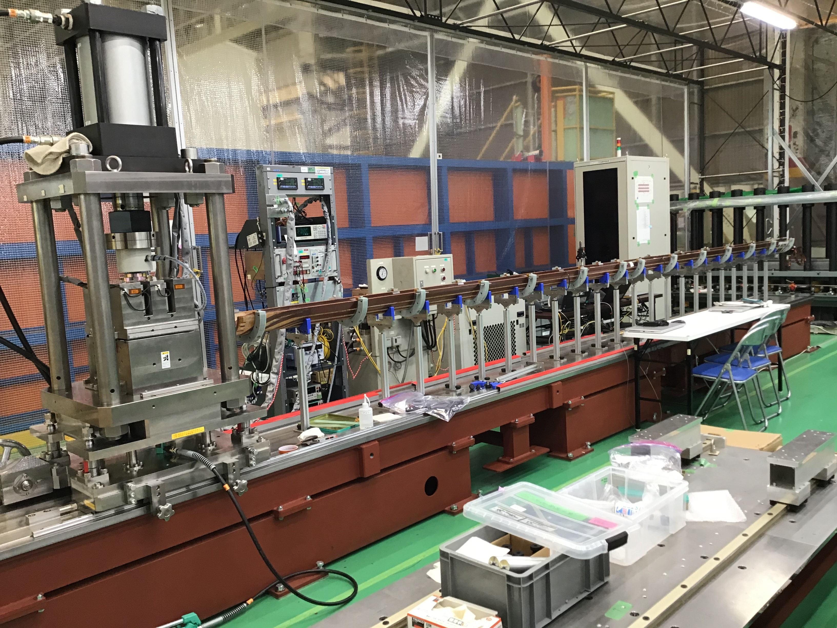
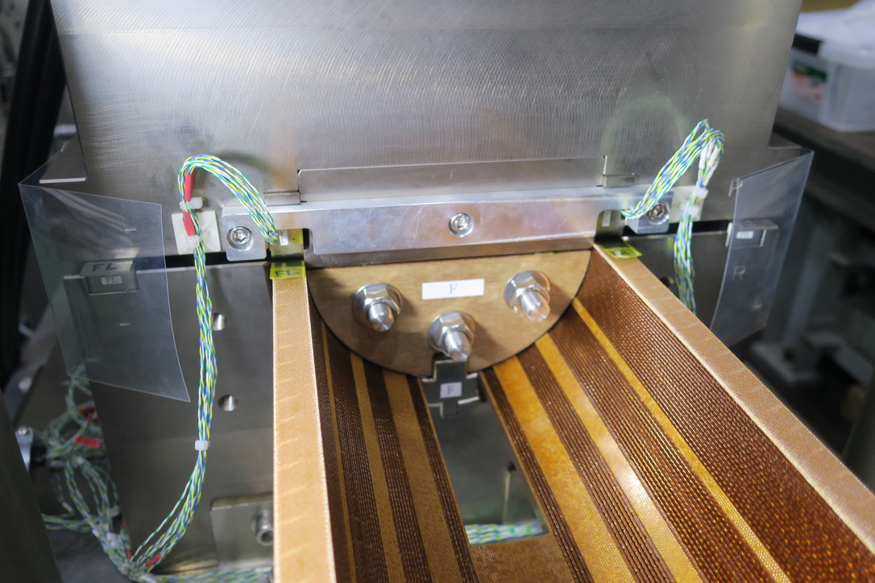
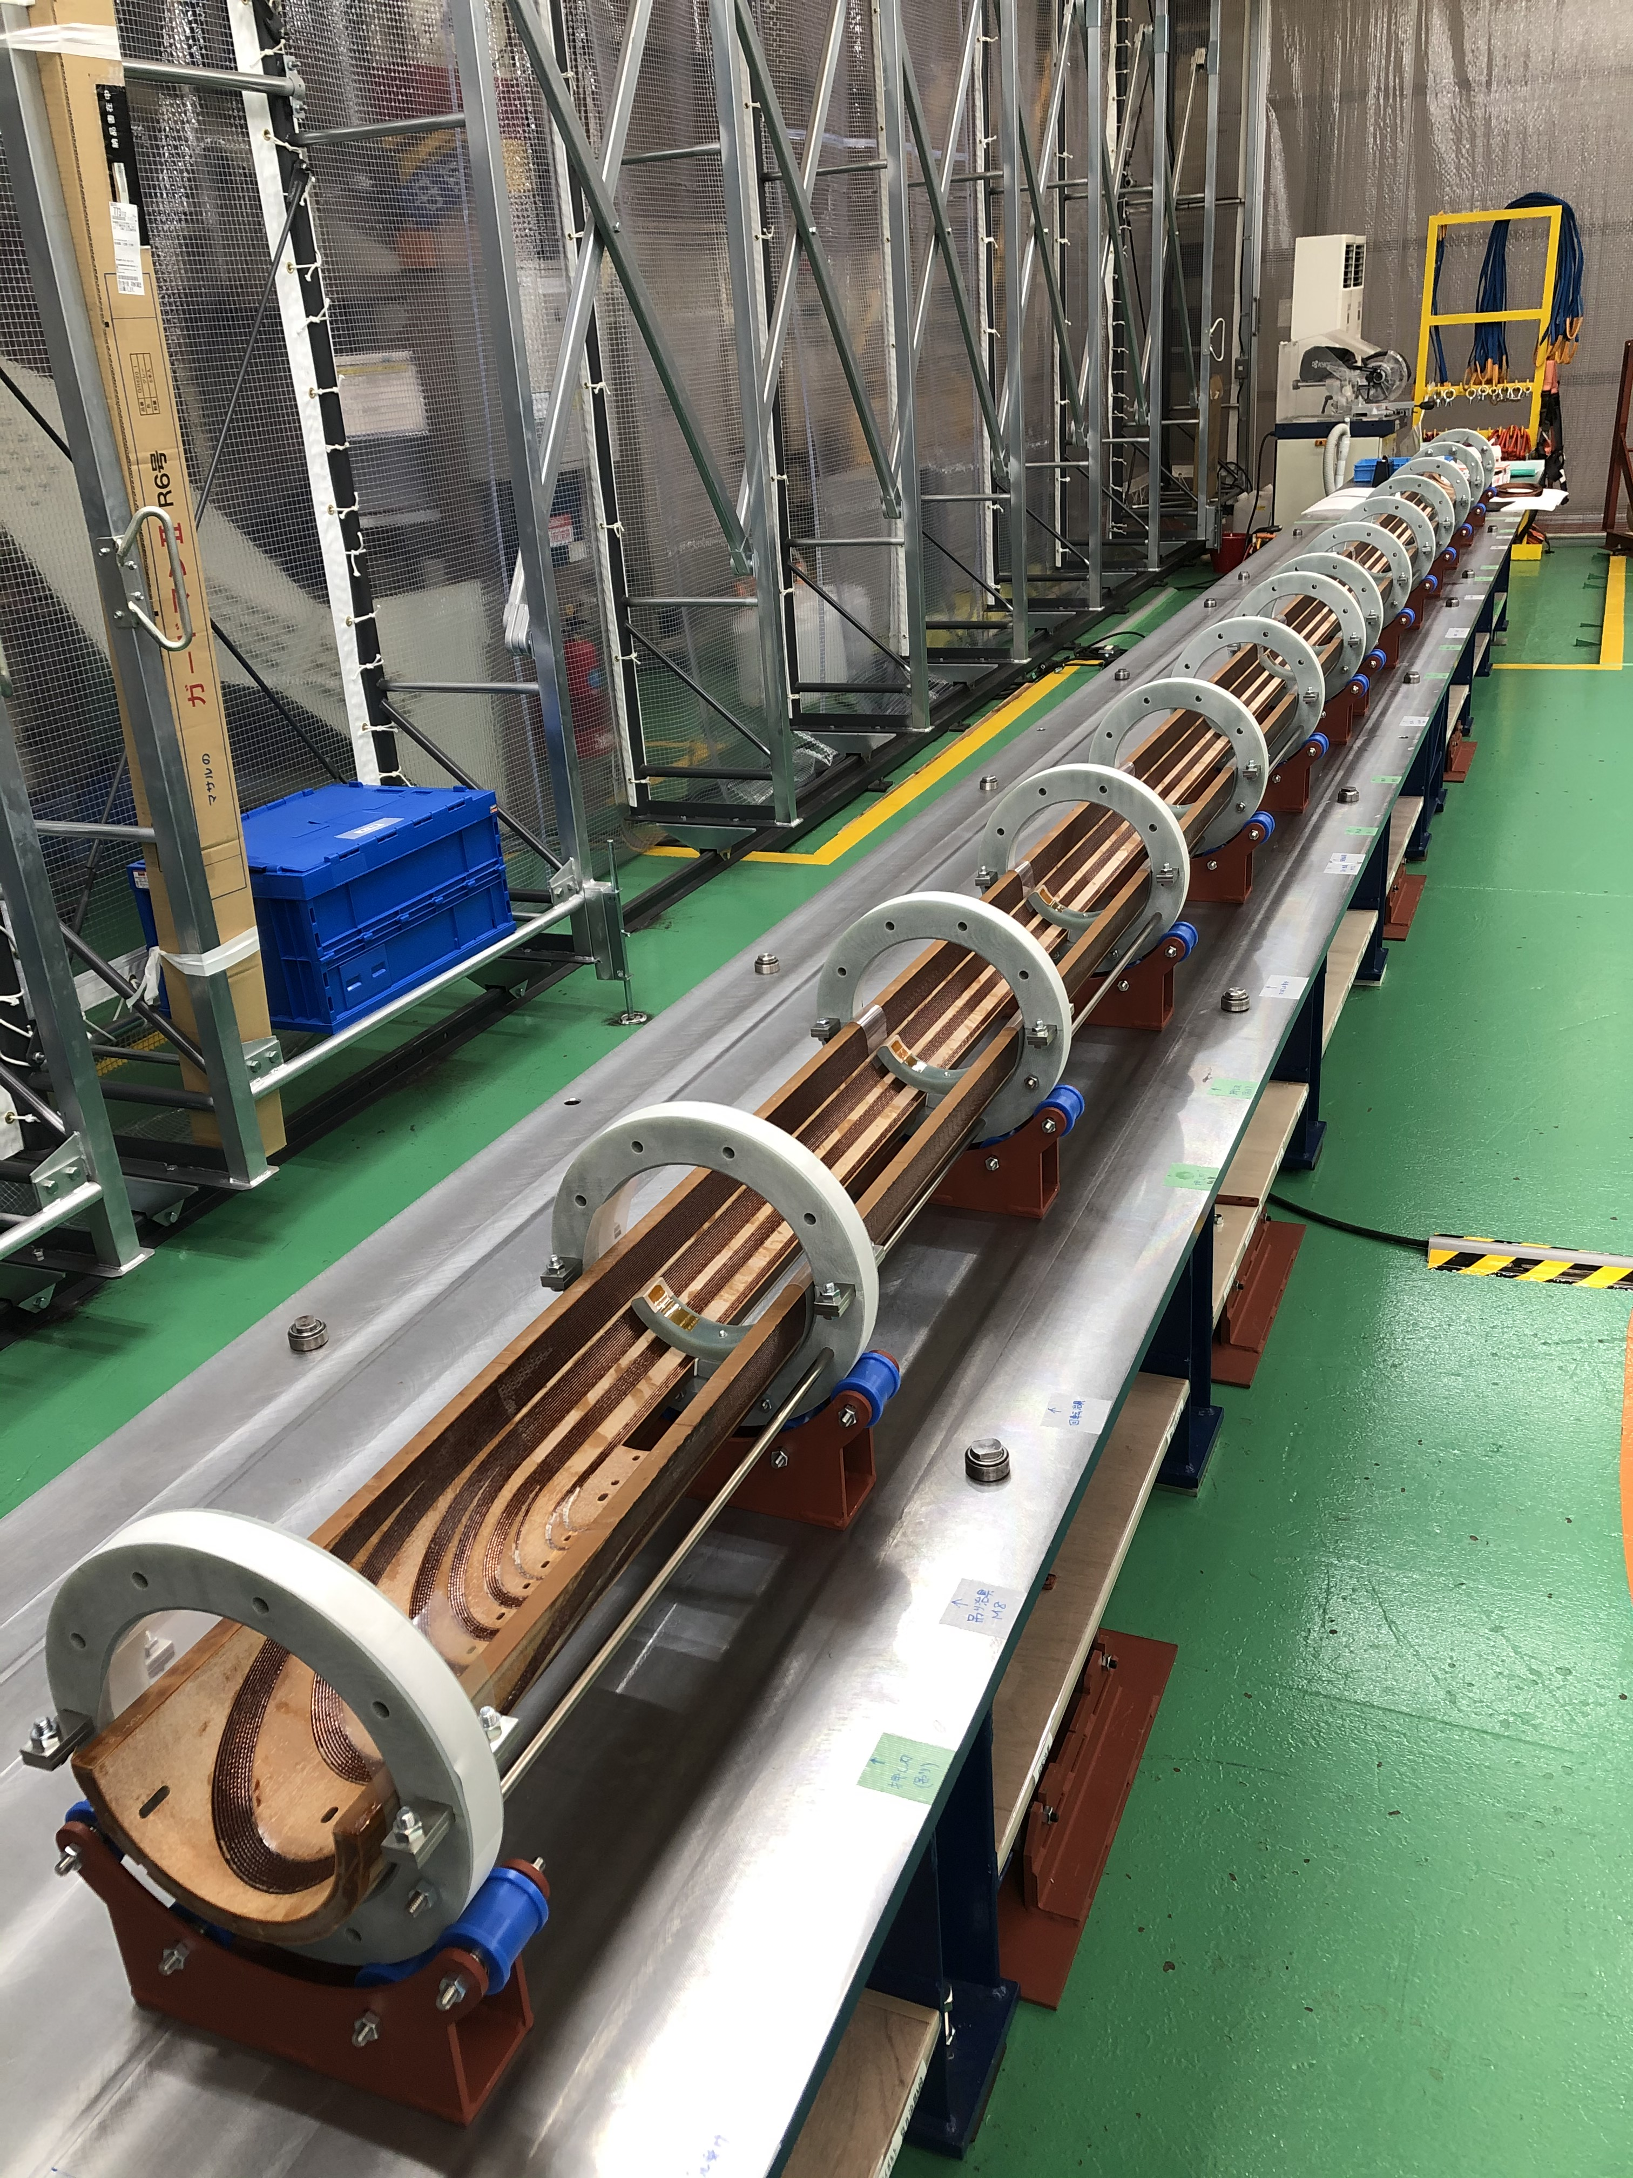
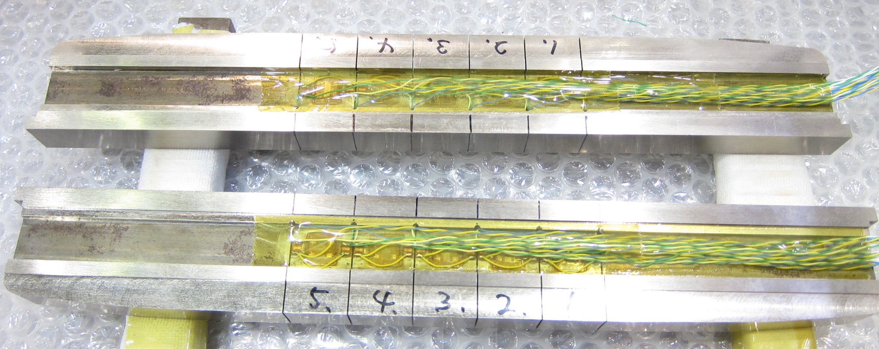
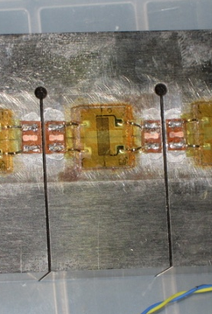
Coil size measurement of D1
L-side
(Ramp-side)
R-side
20 mm
100 mm
Pushing bars
7 m-long practice coil (Coil LP-0) was cured in May, 2020 in Hitachi.
Coil size measurement was performed at Hitachi using the equipment prepared by KEK.
Coil size was evaluated for a quadrant coil (R-side, L-side).
Every 20 mm-long section was measured by using pushing bars instrumented by strain gauges. 100 mm-long section can be measured at the same time.
Coil size in the straight section of LP-0 was compared with those of 2 m-long coils fabricated by KEK during model magnet development.

Slide 4
Coil size of LP-0 and 2 m-long coils
R-side (Ramp-side)
0.5 mm
LP-0
S2-1
S2-4
0.1 mm
L-side (Non-ramp-side)
Larger coil size
100 mm
With respect to coil S2-4
LP-0 is 0.5 mm larger
S2-1 is 0.1 mm larger
per quadrant coil
Scatter of coil size over SS in LP-0 = ±0.05 mm
Relative coil size per quadrant (mm)
Coil ID | Length | Remarks | Measurer | Relative coil size at 100 MPa wrt S2-4
 |  |  |  | L-side | R-side
LP-0 | 7 m | Practice coil | Hitachi | +0.48 | +0.51
S2-1 | 2 m | Same design as MBXFS2 coil Not used for magnet assembly due to cable detachment | Hitachi | +0.07 | +0.09
S2-4 | 2 m | Assembled into MBXFS3 | KEK | – | –

Slide 5
Possible reasons of larger coil size
Wedge size → Checking measured wedge size
Cable
  Insulation wrapping → Visual inspection
  Bare cable thickness → Document check
  Insulation tape thickness → Measured in this campaign
  10 stack measurement → Measured in this campaign

Slide 6
Inspection of wedge size
Pole shim
Deviation
Wedge D
Wedge A
Wedge E
Wedge B
Wedge F
Wedge C
MP shim
  All wedges used for S2-4 and LP-0 have been measured by CMM or optical method.
  Deviation from the design size in the azimuthal direction of each wedge was evaluated and summed up per quadrant coil.

Slide 7
Difference of azimuthal wedge size
Deviation of the azimuthal wedge size (μm)
Pole shim
Coil ID | LP-0 |  | S2-4
 | L-side | R-side | L-side | R-side
Pole shim | +16.6 | +15.5 | +6.3 | +18.8
Wedge A or D | +11.2, +3.6 | +11.7 | +11.8 | +8.9
Wedge B or E | +27, +5 | +1.5 | -8.4 | -22.7
Wedge C or F | +31, +9.3 | +17.7 | -7.8 | -15.8
MP shim | -11.3 | -8 | -6.3 | -8.3
Total (average) | 45.3 | 38.4 | -4.4 | -19.1
Wedge D
Wedge A
Wedge E
Wedge B
Wedge F
Wedge C
MP shim
Measured size error wrt the design thickness per quadrant coil
  LP-0: L-side = +38 μm, R-side = +45 μm
  S2-4: L-side = -4 μm, R-side = -19 μm
Total wedge size of LP-0 is 60 μm larger by design than that of S2-4
Total wedge size of LP-0 is 0.10 – 0.12 mm larger than that of S2-4
LP-0 > S2-4 by 0.04 – 0.06 mm

Slide 8
Cable ID
Coil ID | Bare cable | Insulated cable | Coils wound using the same cable (Magnet ID)
Coil LP-0 | 02B50866B | HCMB_AI473T50866B | –
Coil S2-1 | 02G00346A | HCMB-AO47CM001622 | S1-1, S1-2 (MBXFS1)
Coil S2-4 | 02B81232A | HCMB_AI47CR001623 | Coil S2-5 (MBXFS3)

Slide 9
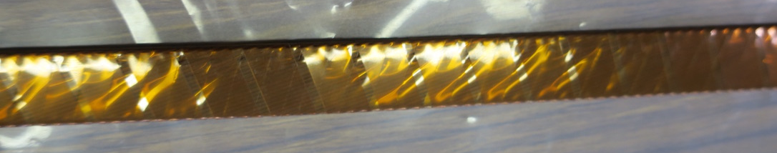
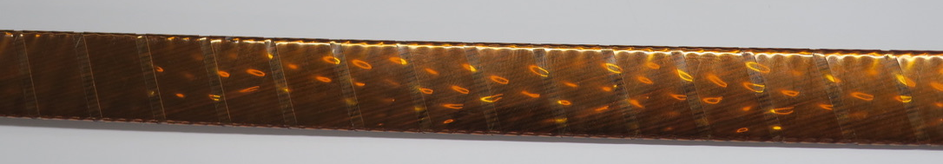
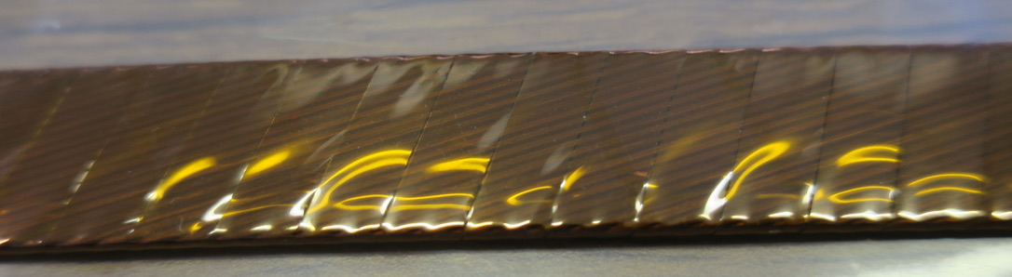
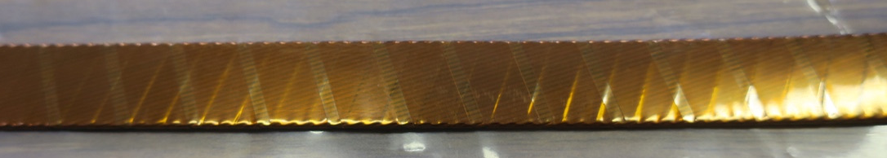
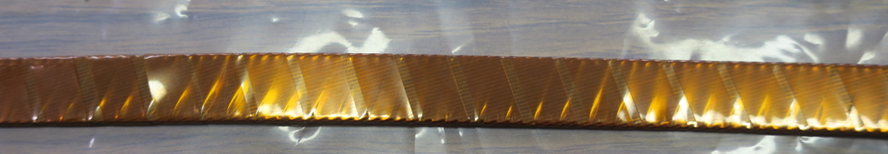
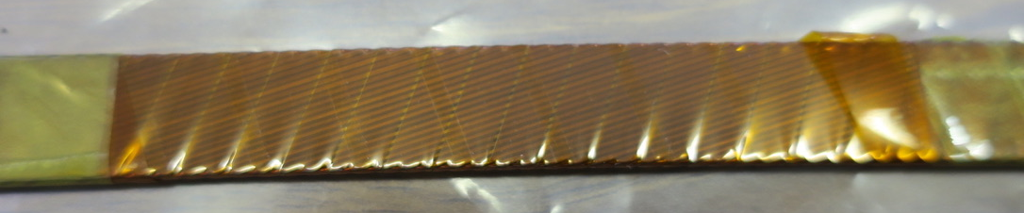
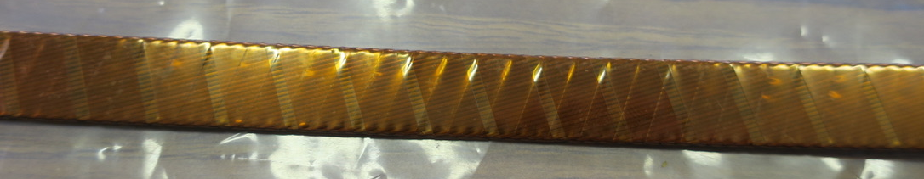
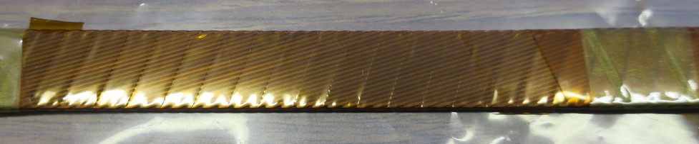
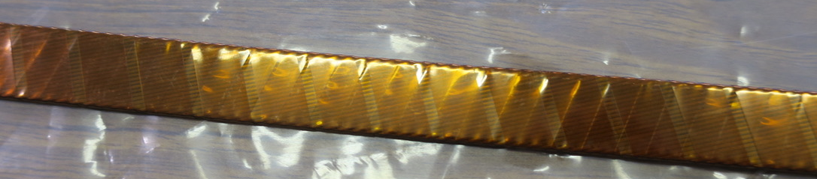
Visual inspection
with 1st, 2nd and 3rd insulations
after removing 3rd layer
LP-0
S2-1
S2-4
Insulation tapes of LP-0 cable seems to be loosely wound.

Slide 10
Bare cable thickness
Coil LP-0
Coil S2-1
Coil S2-4
02B50866B
(HCMB_AI47-3T50866B)
02G00346A
(HCMB-AO47-CM001622)
02B81232A
(HCMB_AI47-CR001623)
No difference in bare cable thickness between Coil S2-1 and LP-0 cables.
3 μm thinner in S2-4 cable → 0.13 mm thinner for 44 turns

Slide 11
Insulation tape thickness
Thickness of insulation tapes unwrapped from each cable was measured
using a micrometer.
Coil ID | Cable ID Bare cable Insulated cable | Layer of insulation | #1 | #2 | #3 | #4 | #5 | Ave.
Coil LP-0 | 02B50866B HCMB_AI47-3T50866B | 1st | 0.051 | 0.051 | 0.051 | 0.050 | 0.050 | 0.051
 |  | 2nd | 0.051 | 0.051 | 0.050 | 0.051 | 0.049 | 0.050
 |  | 3rd | 0.067 | 0.067 | 0.067 | 0.067 | 0.066 | 0.067
Coil S2-1 | 02G00346A HCMB-AO47-CM001622 | 1st | 0.050 | 0.051 | 0.049 | 0.050 | 0.049 | 0.050
 |  | 2nd | 0.049 | 0.051 | 0.051 | 0.052 | 0.051 | 0.051
 |  | 3rd | 0.066 | 0.067 | 0.067 | 0.067 | 0.066 | 0.067
Coil S2-4 | 02B81232A HCMB_AI47-CR001623 | 1st | 0.051 | 0.051 | 0.051 | 0.051 | 0.051 | 0.051
 |  | 2nd | 0.051 | 0.051 | 0.051 | 0.051 | 0.051 | 0.051
 |  | 3rd | 0.069 | 0.068 | 0.068 | 0.068 | 0.068 | 0.068
No difference in insulation tape thickness

Slide 12
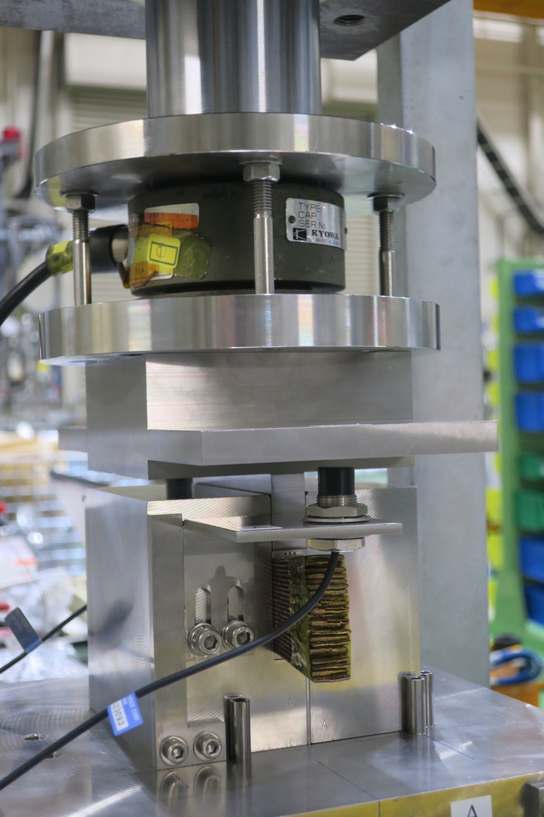
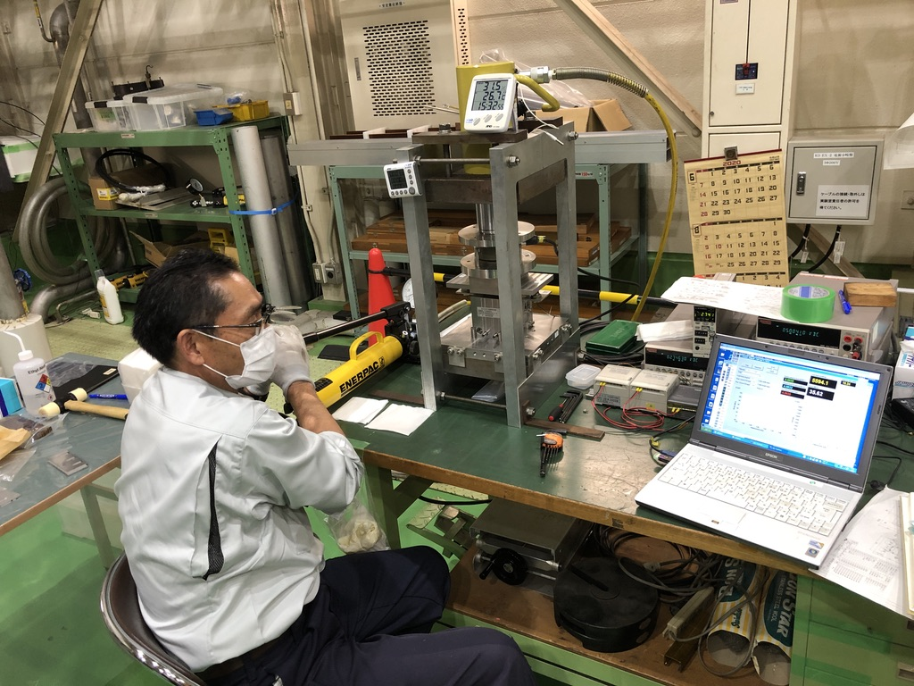
10 stack measurement
Load cell
Top block
Displacement
sensor
22 cable stack
Bottom block
Measurement setup: 50 ton hydraulic press, manual pump, 20 ton load cell, eddy current displacement sensor
Curing
  22 cable stack (a half number of turns of D1 coil) was cured at 190ºC for 0.5 h with the pressure of 50 MPa.
Compressive test
  Reference specimen(SS400 block), cable stack
  Loading and unloading up to 100 MPa
  Measured data of the second cycle among three cycles were used.

Slide 13
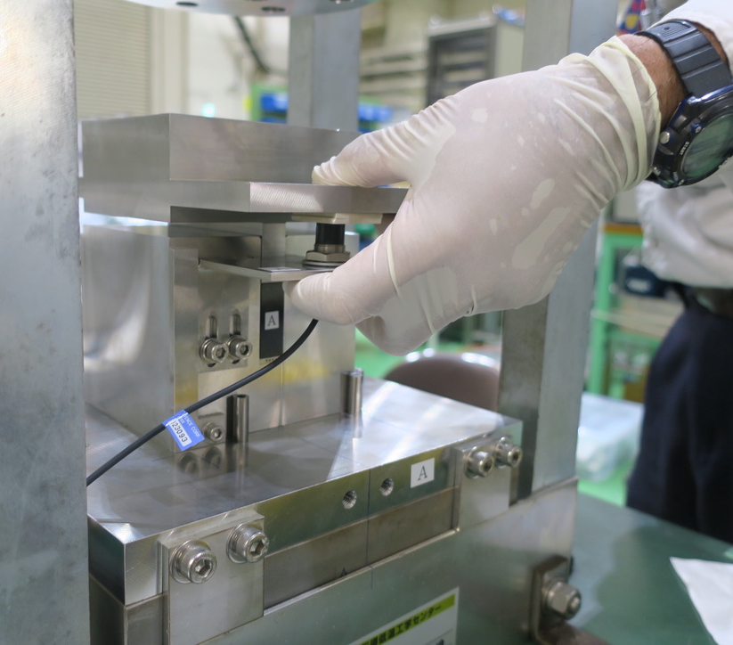
Measured stress-displacement curve of Fe block
(only 2nd loading/unloading curve, raw data)
30 μm
5 mm-thick refence plate
Displacement
sensor
Bolts to fix the disp. sensor
Offset of 30 μm at maximum among the measured Fe-block data was found. This comes from mispositioning of the displacement sensors.
This offset was corrected during data analysis.
Measured data of Fe block were used to subtract deformation of the measuring jig.

Slide 14
Measured stress-displacement curve of cable stack
(raw data)
2nd loading/unloading
Thicker cable stack
1st loading
Unloading
2nd, 3rd
loading
The curves of the 2nd and 3rd run are more reproducible, while the 1st run exhibits larger hysteresis.
→ 2nd loading curve was used for the following analysis

Slide 15


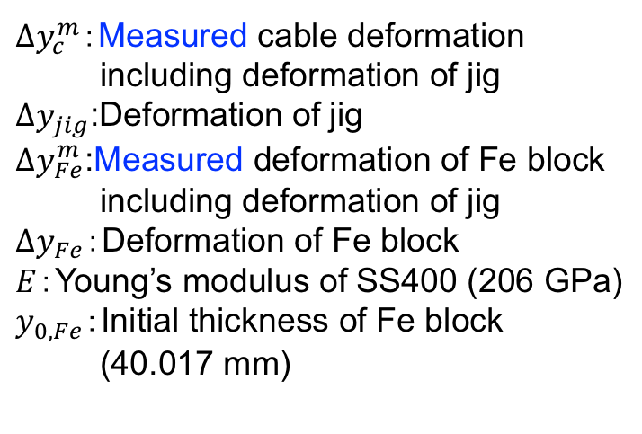

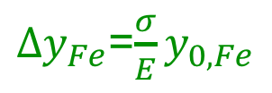
Data analysis: Deformation of cable stack
Cable stack thickness was compared at 100 MPa
Cable stack thickness at the stress of σ (y_{c}(σ))
= Initial thickness (y_{0,c}) + Deformation of cable stack (Δy_{c}(σ))
Deformation of cable stack (Δy_{c}(σ)) was derived as follows.
$Δy_{c}^{m}$：Measured cable deformation
including deformation of jig
$∆y_{jig}$:Deformation of jig
$Δy_{Fe}^{m}$:Measured deformation of Fe block
including deformation of jig
$Δy_{Fe}$：Deformation of Fe block
$E$：Young’s modulus of SS400 (206 GPa)
$y_{0, Fe}$：Initial thickness of Fe block
(40.017 mm)
Cable stack
$$Δy_{c}^{m}=Δy_{c}+∆y_{jig}$$
Fe block
$$Δy_{Fe}^{m}=Δy_{Fe}+∆y_{jig}$$
Hooke’s law
$Δy_{Fe}$=${\frac{σ}{E}y}_{0, Fe}$
$Δy_{c}=Δy_{c}^{m}−Δy_{Fe}^{m}+$ $\frac{σ}{E}y_{0, Fe}$
Measured values in Page 6
Calculated value

Slide 16
Data analysis: Initial thickness
Initial thickness (y_{0,c}) was determined in the following way.
2nd loading curve of the cable of
coil LP-0
Linear fit
from 30 to 50 MPa
y_{0,c}
Non-linear initial part of the stress-displacement curve leads to ambiguity of y_{0,c}.
In this analysis, y_{0,c} was determined by extrapolating the linear fit of the curve from 30 to 50 MPa.

Slide 17
Thickness difference among LP-0, S2-1, S2-4 cable stack
22 cable stack thickness under 100 MPa (mm)
Coil ID | #1 | #2 | #3 | Average | Stand. dev.
LP-0 | 38.573 | 38.523 | 38.538 | 38.544 | 0.026
S2-1 | 38.414 | 38.429 | 38.443 | 38.428 | 0.015
S2-4 | 38.394 | 38.397 | 38.422 | 38.404 | 0.015
Difference in cable stack thickness with respect to S2-4 cable (mm)
Coil ID | 22 cable stack | 44 cable stack
LP-0 | +0.140 | +0.280
S2-1 | +0.024 | +0.048
The maximum scatter among three samples was ~ 50 μm for 22 cables,
which is the limitation of the resolution in our measurement using the current setup.
For 44 cables, LP-0 cable stack is 0.28 mm thicker than S2-4 cable stack.

Slide 18
Contribution of each factor to coil size difference
Magnet |  | MBXFS2 | MBXFS3 | MBXFP1 | Remarks
Coil |  | S2-1 | S2-4 | LP-0
Remark |  | Unused, remaining. Cable detachment after curing. | Assembled into MBXFS3 | 7 m long practice coil.
Producer |  | KEK | KEK | Hitachi
Coil stress at curing |  | ~50 MPa | ~50 MPa | 80 MPa (?) | Fuji-paper measurement and expectation by hydrauric pressure.
Cross section |  | Type Model #2 | Type Model #2 | Type Prototype | Design by KEK
Relative coil size wrt S2-4. (in quad. coil) |  | +0.1 mm mm | 0 mm | +0.5 mm | Both coils were measured at Hitachi in June 2020. Wrt S2-4 coil in MBXFS3, the difference for LP-0 coil is +0.5 mm. Difference between S2-1 and S2-4 can be explained by thickness of the bare cables (0.003 x 44=0.132 mm).
Difference wrt S2-4 coil or cable (in quad. coil) | 1. Difference in design for all wedges (Page 6) | 0 mm | 0 mm | +0.06 mm | Drawing prepared by KEK.
 | 2. Actual size from design for all wedges by measurement (Page 6) | NA | 0 mm | +0.06 mm at max | Report from Hitachi
 | 3. Difference in 44 cables with insulation (10-stack measurement) (Page16) | +0.05 mm | 0 mm | +0.28 mm | Difference of 0.14 mm in stack measurement with 22 cables at KEK, June 2020.
1+2+3 | Wedge size error + diff. of cable stack thickness | – | 0 mm | +0.4 mm | Difference btw LP-0 and S2-4 = 0.4 mm
 | Annex A. Difference in 44 cables w/o insulation. (Page 9) | +0.13 mm | 0 mm | +0.13 mm | Data from CERN.
 | Annex B. Difference in insulation tape thickness (Page 10) | 0 mm | 0 mm | 0 mm | Measured by KEK

Slide 19
Contribution of each factor to coil size difference
Magnet |  | MBXFS2 | MBXFS3 | MBXFP1 | Remarks
Coil |  | S2-1 | S2-4 | LP-0
Remark |  | Unused, remaining. Cable detachment after curing. | Assembled into MBXFS3 | 7 m long practice coil.
Producer |  | KEK | KEK | Hitachi
Coil stress at curing |  | ~50 MPa | ~50 MPa | 80 MPa (?) | Fuji-paper measurement and expectation by hydrauric pressure.
Cross section |  | Type Model #2 | Type Model #2 | Type Prototype | Design by KEK
Relative coil size wrt S2-4. (in quad. coil) |  | +0.1 mm mm | 0 mm | +0.5 mm | Both coils were measured at Hitachi in June 2020. Wrt S2-4 coil in MBXFS3, the difference for LP-0 coil is +0.5 mm. Difference between S2-1 and S2-4 can be explained by thickness of the bare cables (0.003 x 44=0.132 mm).
Difference wrt S2-4 coil or cable (in quad. coil) | 1. Difference in design for all wedges (Page 6) | 0 mm | 0 mm | +0.06 mm | Drawing prepared by KEK.
 | 2. Actual size from design for all wedges by measurement (Page 6) | NA | 0 mm | +0.06 mm at max | Report from Hitachi
 | 3. Difference in 44 cables with insulation (10-stack measurement) (Page16) | +0.05 mm | 0 mm | +0.28 mm | Difference of 0.14 mm in stack measurement with 22 cables at KEK, June 2020.
1+2+3 | Wedge size error + diff. of cable stack thickness | – | 0 mm | +0.4 mm | Difference btw LP-0 and S2-4 = 0.4 mm
 | Annex A. Difference in 44 cables w/o insulation. (Page 9) | +0.13 mm | 0 mm | +0.13 mm | Data from CERN.
 | Annex B. Difference in insulation tape thickness (Page 10) | 0 mm | 0 mm | 0 mm | Measured by KEK
• Coil size difference by 0.4 mm between LP-0 and S2-4 can be explained by
difference in wedge size and cable stack thickness.
• Remaining 0.1 mm can be due to uncertainty of 10 stack measurement.

Slide 20
Further plan
KEK has received 19 Rutherford cables for D1 prototype and series. One of them has been used for the 7 m-long practice coil. KEK will perform 10 stack measurement for all the remaining cables.
For mutual comparison, KEK will send the LP-0, S2-1, S2-4 cables to CERN for 10 stack measurement at CERN.
KEK asked to CERN to send the newly insulated cable with a certain length to KEK for 10 stack measurement.

Slide 21
Supply of cables for prototype and series
KEK needs at least 3 insulated cables to wind coils for a prototype. Coil winding will start in the middle of Aug. 2020. KEK prefers to receive the cables at the beginning of Aug. , so that KEK can conduct 10 stack measurement before sending the cables to Hitachi.
KEK requests to CERN for re-insulating the remaining 18 cables.

Slide 22
Appendix

Slide 23
Influence of additional coil size on coil pre-stress
Azimuthal coil stress at the final size (MPa)
Coil LP-0
Magnet or Coil ID | Coil size meas. (extrapolated) | SG meas. at collar pole
MBXFS1 | 92 | 65
MBXFS1b | 137 | 100
MBXFS3 (Coil S2-4) | 165 | 114
Coil LP-0 | 208 | 147 (estimated)
MBXFS3
MBXFS1b
MBXFS1
In the coil size measurement, coil stress is measured at MP, while strain gauge measurement shows the stress at collar pole.
Linear relation between these two stresses was confirmed in the model magnets.
Estimated stress at collar pole for coil LP-0 is 147 MPa. Pre-stress increase by additional coil size of 0.5 mm per quadrant is 33 MPa.
Additional coil size of 0.1 mm → pre-stress increase of 7 MPa

