Slide 1
CCT Magnet Aperture Deflection Measurements
O. Sacristán
EN MME Mechanical Measurement Lab

Slide 2
Outline
MME Laboratory
Measurement Principle
Experimental Set-Up
Results
Discussion and next steps

Slide 3





MME Laboratory mandate
Stress / strain analysis
Dynamic strain measurements
Residual stress measurements
Experimental stress analysis
Experimental modal analysis
Vibration monitoring
Operating deflection shape
Vibration analysis
Transfer function analysis
Transfer path analysis
Coherence length measurements
Seismic measurements
CERN-wide Support
EDMS – TEST REPORTS
Sensors development
Load cell based on strain gauges
Displacement sensors
Capacitive gauges
Thermo-physical analysis
Thermal Conductivity and Diffusivity
Specific Heat
Density and CTE
Mechanical testing
Impact testing method
Tensile and Flexural tests
Compression tests

Slide 4
Lab mandate
Stress / strain analysis
Dynamic strain measurements
Residual stress measurements
Experimental stress analysis
Experimental modal analysis
Vibration monitoring
Operating deflection shape
Vibration analysis
Traditional domain of expertise of the laboratory
Main application: Superconducting Magnets measurements down to 1.9K
Strain measurements based on optical fibers
Displacement sensors
As a measurement lab, we must perform a metrology qualification of new systems before field implementation
Transfer function analysis
Transfer path analysis
Coherence length measurements
Seismic measurements
CERN-wide Support
EDMS – TEST REPORTS
Sensors development
Load cell based on strain gauges
Displacement sensors
Capacitive gauges
Thermo-physical analysis
Thermal Conductivity and Diffusivity
Specific Heat
Density and CTE
Mechanical testing
Impact testing method
Tensile and Flexural tests
Compression tests

Slide 5
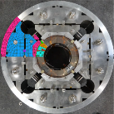
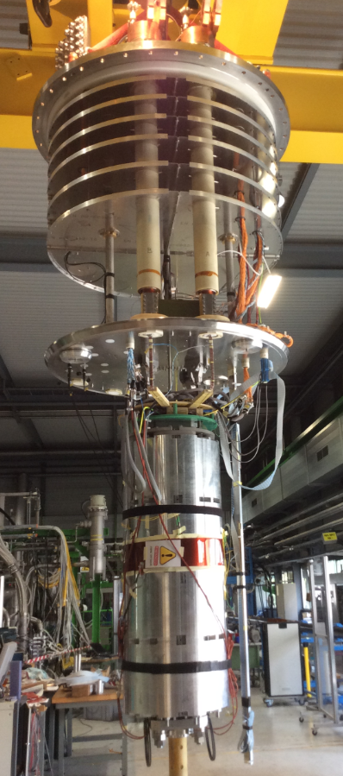
Experimental Stress Analysis in MME Lab
Strain measurements in superconducting magnets to:
  Improve the mechanical design during prototyping
  Check the integrity of the structure real time during the magnet lifecycle
  Validate Finite Element Analysis during assembly phases, thermal cycles down to 1.9 K and powering tests
Measurement challenges:
  Absolute strain measurement is requested over the full lifetime, also during thermal cycles
Thermal compensation to counterbalance the apparent strain!
Magnetic field compensation

Slide 6
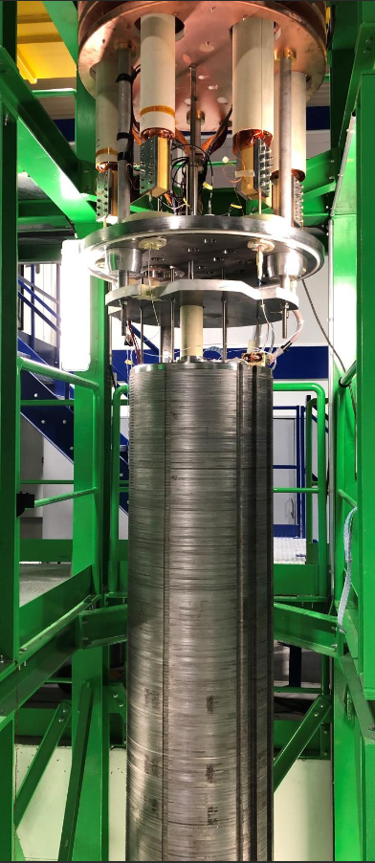
Measurement Request
MCBRDP1 Testing Campaign
Determination of the current-induced aperture shape changes during the powering of the magnet
Displacement measurements:
  At 4K
  Under intense magnetic fields
  Accuracy of 10 µm
  Limited space

Slide 7
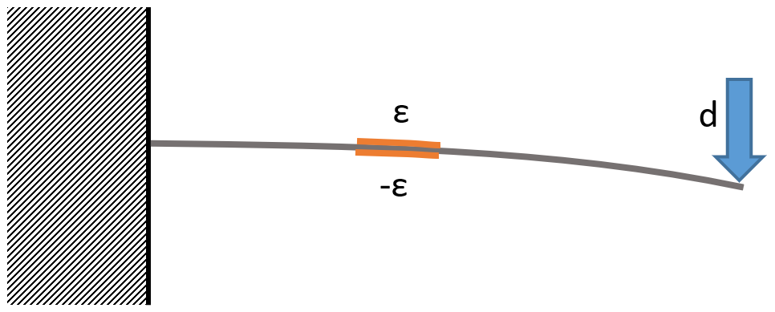

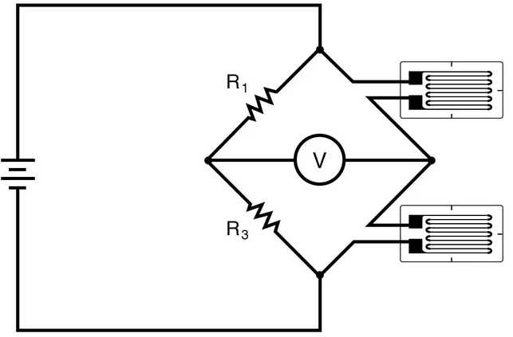
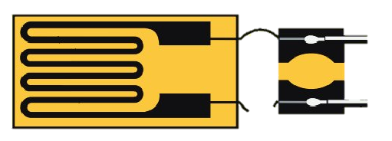
Displacement Measurements Principle
No commercial solution for displacement measurements at 4 K in the presence of magnetic fields
Strain gage based technique developed in the laboratory
Simple yet robust and accurate (few µm accuracy for 1 mm stroke)
Instrumentation is temperature and magnetic field compensated
Lorentz forces effect not compensated, but quantified (free-free sensors)
Studies in order to optimize the performance of the sensor (adequate stroke, maximize sensitivity, minimize magnetic effect)

Slide 8
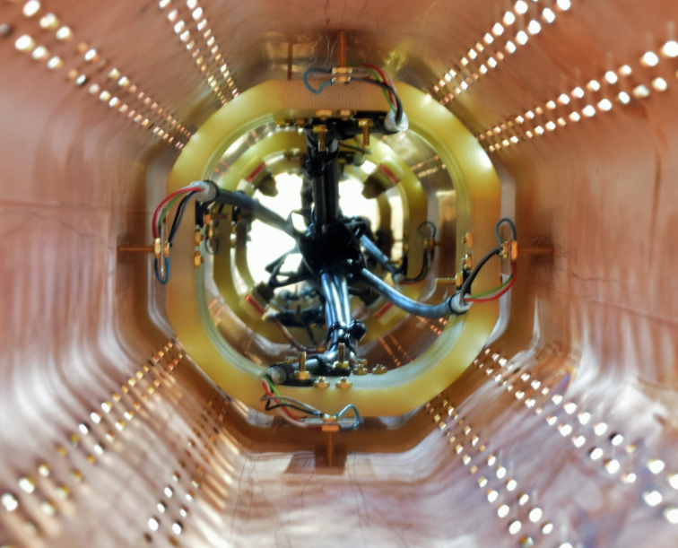
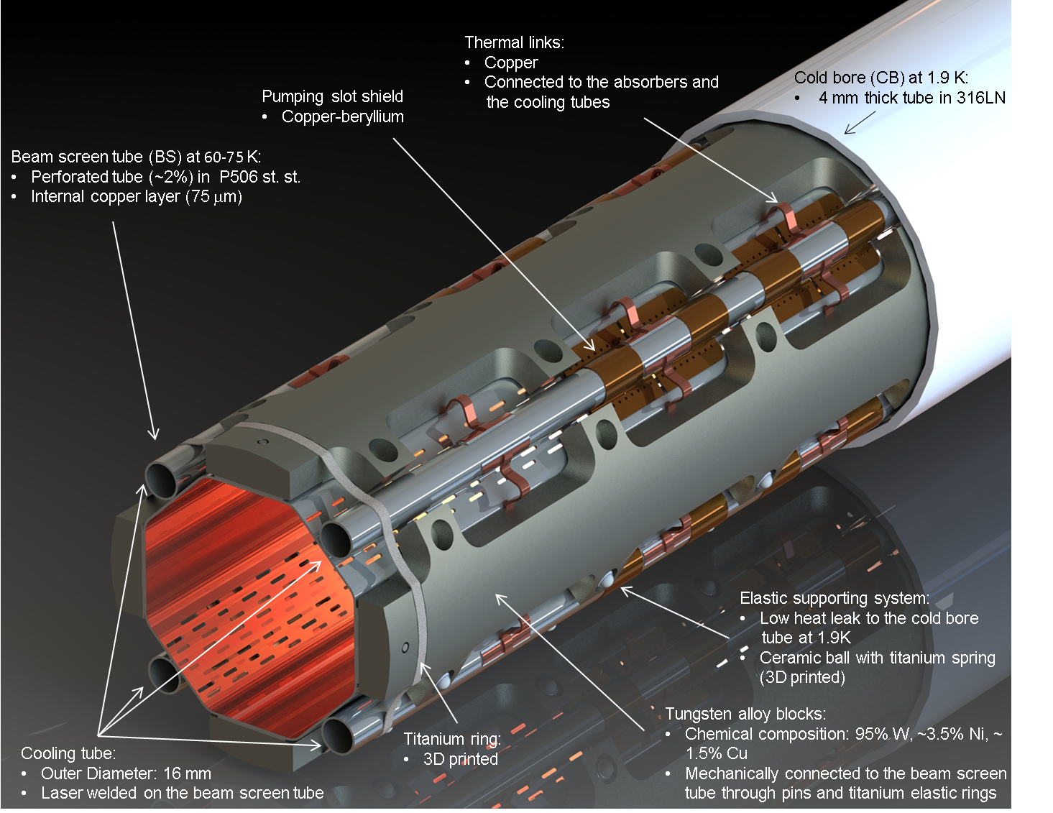
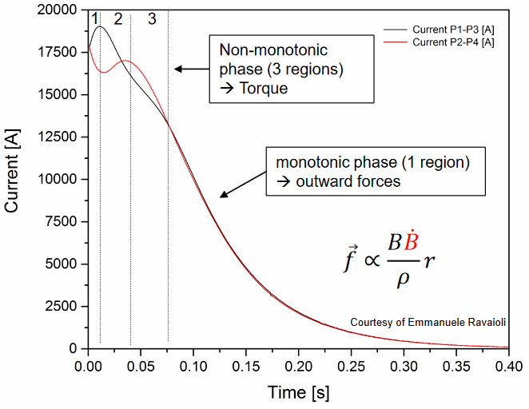
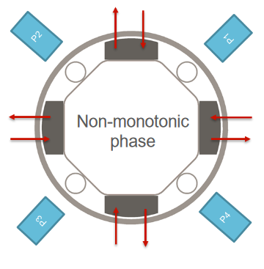
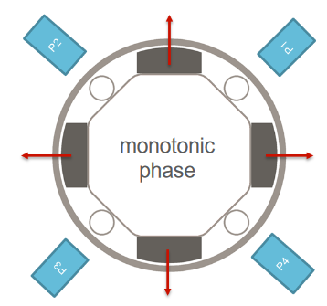
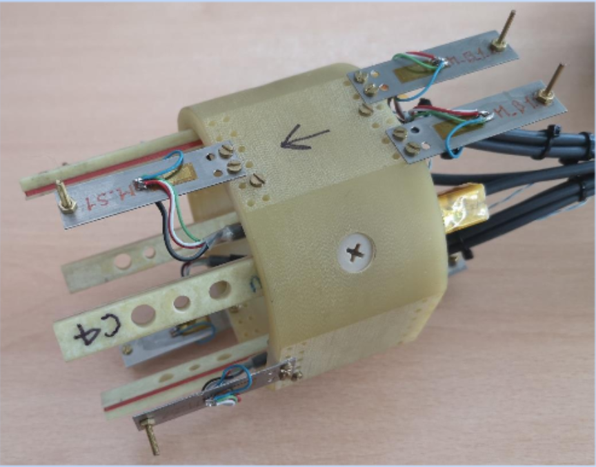
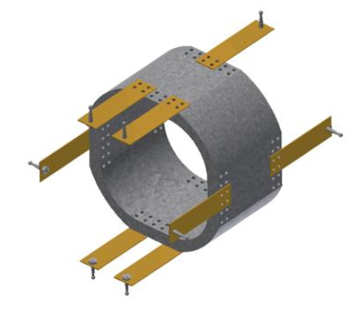
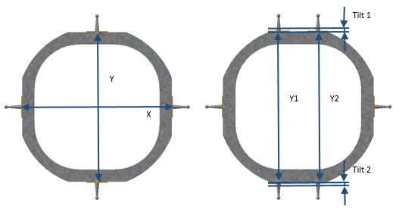
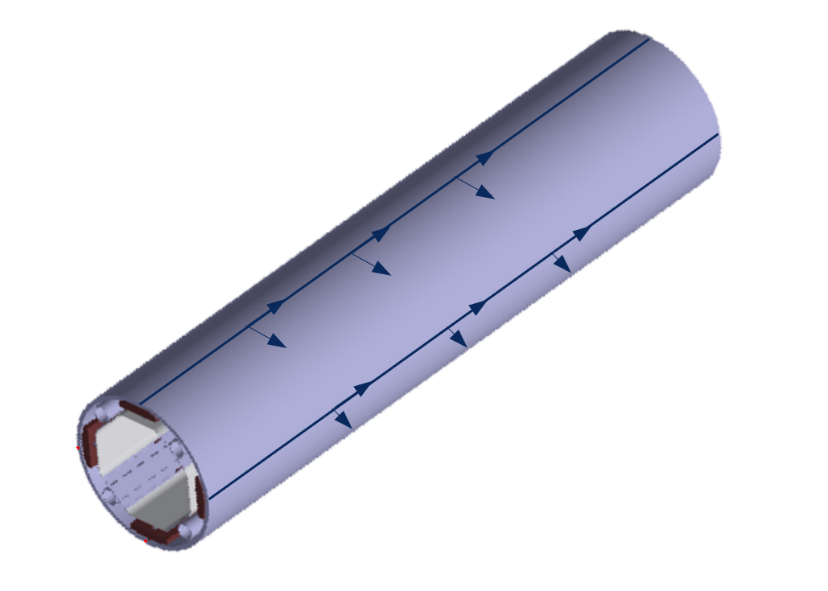
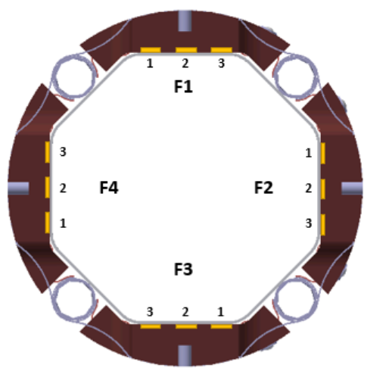
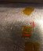
Previous Experiences
MQXFS4b quench tests campaign
Effect of CLIQ on the beam screen
Tungsten Blocks Tilt
Beam Screen Expansion
Extensive instrumentation
42 Strain gages in the external side of the beam-screen
3 custom made displacement probes
4 optical fibers in the cold bore outer face

Slide 9
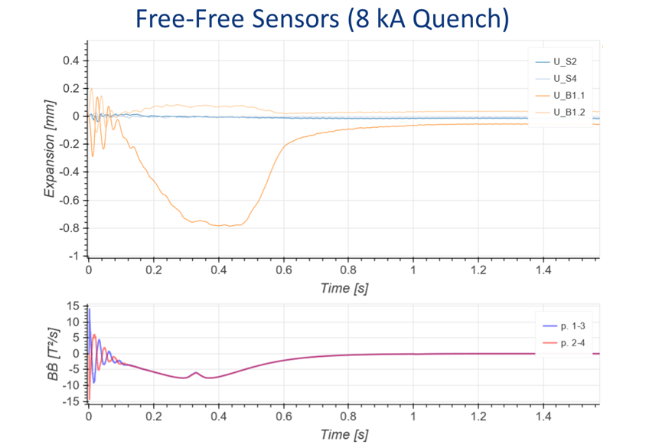
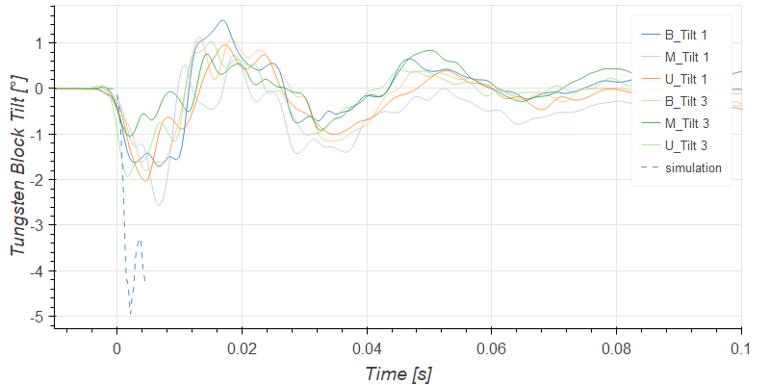
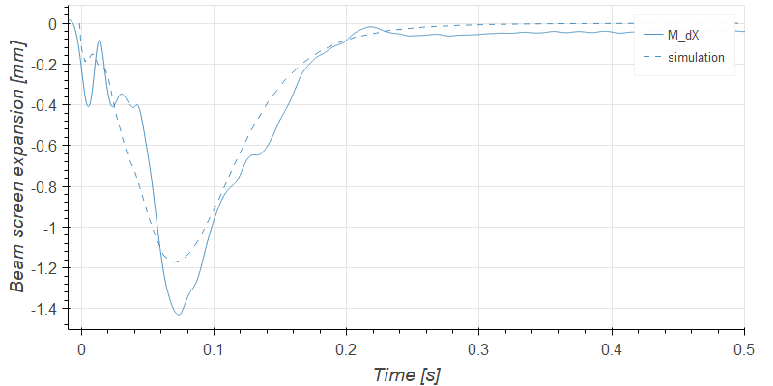
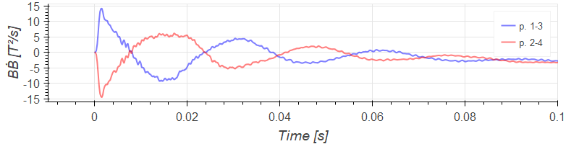
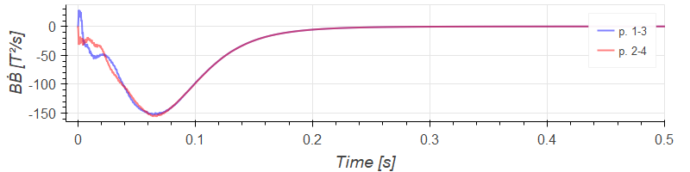
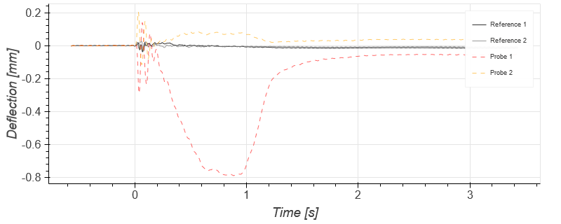
MQXFS4b Quench Tests Campaign Results
Tungsten Blocks Tilt (8 kA)
Beam-Screen Expansion (18 kA)
Ref 1
Ref 2
Free-Free Sensors (8kA)
Great help in the understanding of the mechanical behaviour of the beam-screen
Mature technique in the lab
Proven performance in very stringent conditions

Slide 10
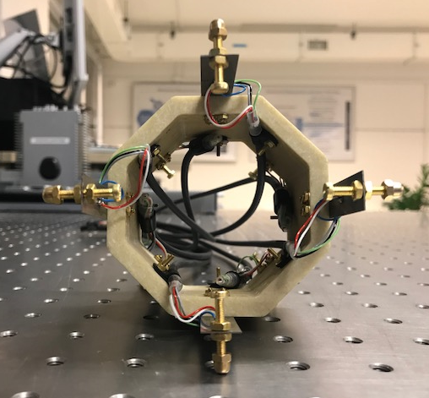
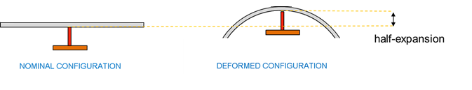
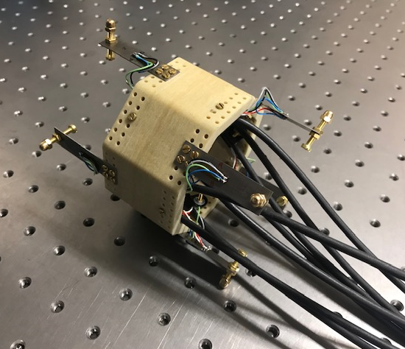
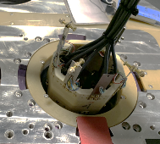
CCT Aperture Measurements Set-Up
G10 octagonal support holding 8 pairs of sensors in all the desired diameters + 2 free-free sensors
Ti grade 5 instrumented strips
Brass screws and tips
The tips are in contact with the inner side of the aperture
The diametrical deformation is calculated as the sum of the deflections of diametrically opposed sensors
0 degrees radius points to the current leads of the aperture

Slide 11
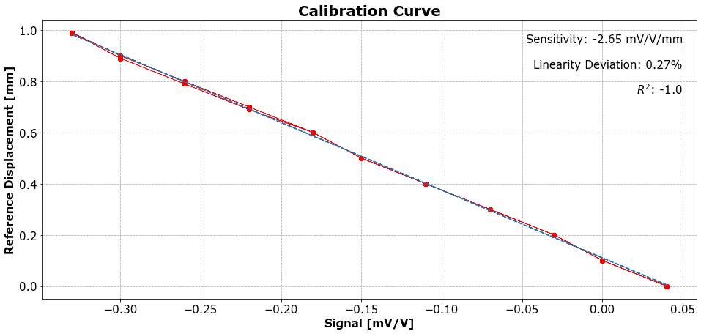
Sensors Calibration
Sensors calibrated at RT according to ASTM F2537 in a ZWICK Z400 universal testing machine
Strain gages k-factor consequently adapted at 4 K
Sensor | Calibration Factor [mm.V/mV] | R-squared | Max. lin error [%] | Max. STD Voltage [mV/V]
0_d | -2.644 | 1 | 0.27 | 0.000129
45_d | -2.616 | 0.9999 | 0.39 | 0.0000916
90_d | -2.772 | 1 | 0.31 | 0.000146
135_d | -2.644 | 1 | 0.28 | 0.000105
180_d | -2.652 | 1 | 0.28 | 0.000127836
225_d | -2.505 | 1 | 0.26 | 1.77E-05
270_d | -2.644 | 0.9999 | 0.29 | 5.17E-05
315_d | -2.634 | 0.9999 | 0.23 | 0.000102156
0_d_dummy | -2.644 | 1 | 0.3 | 5.80E-05
90_d_dummy | -2.412 | 2 | 0.24 | -7.85E-05

Slide 12
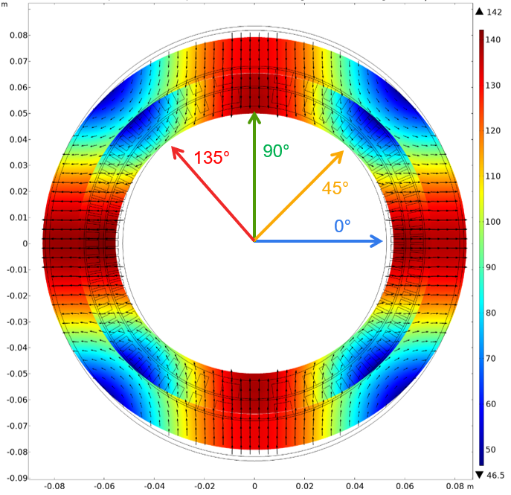
Results
Reference direction (0°) is at 90° from of the dipole field
FEM simulations predict “expansion” at 0° and “contraction” at 90°
Predicted maximum diametrical deformations of 600 µm (non bonded contact)
The deformations depicted are diametrical at 0°, 45°, 90°, and 135°
Total Displacement with Respect to the Center of the Magnet at 400 A driving current (µm) (G. Kirby)

Slide 13
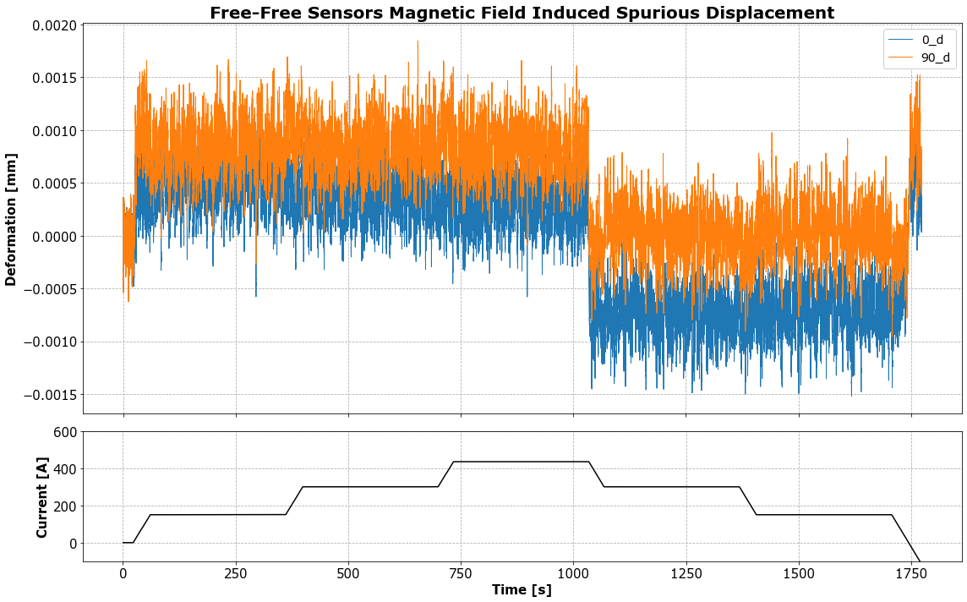
Free-Free Sensors
≈3 µm peak to peak (400 A ramp)

Slide 14
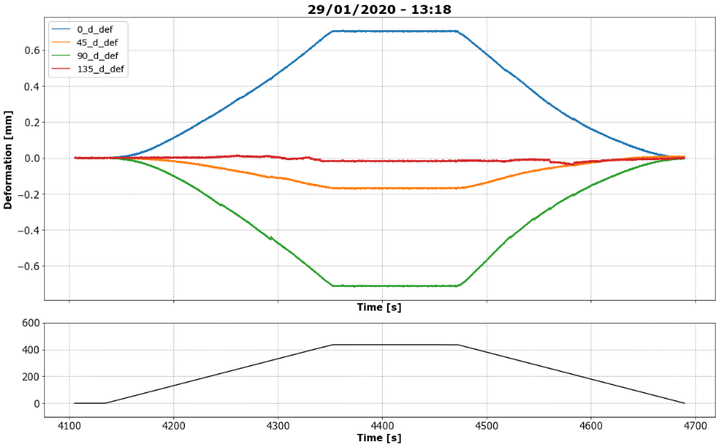
Violet Aperture

Slide 15
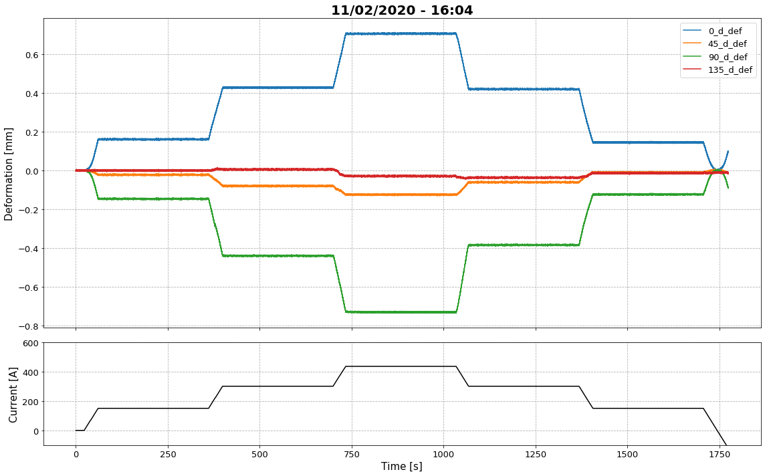
Red Aperture

Slide 16
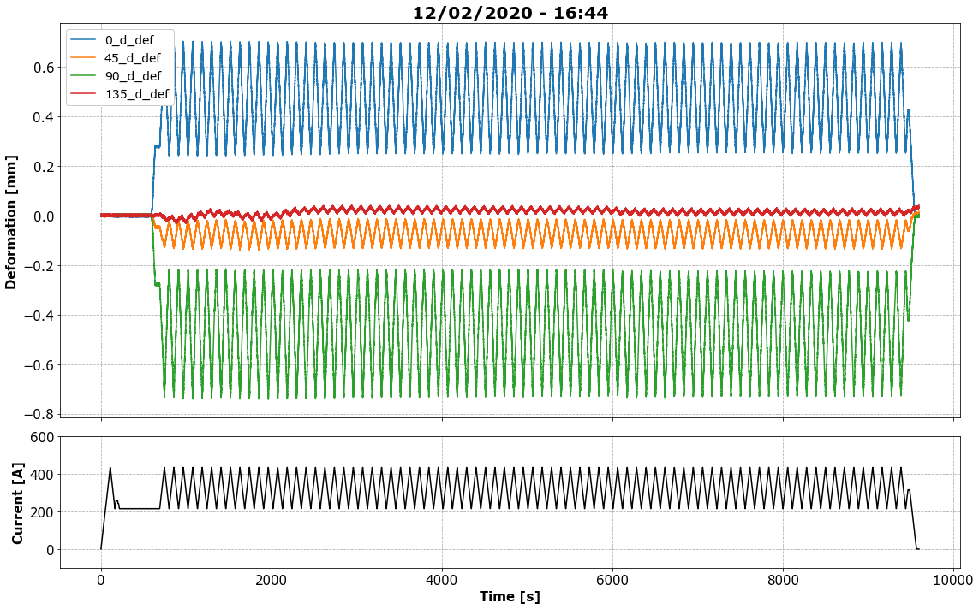
Red Aperture

Slide 17
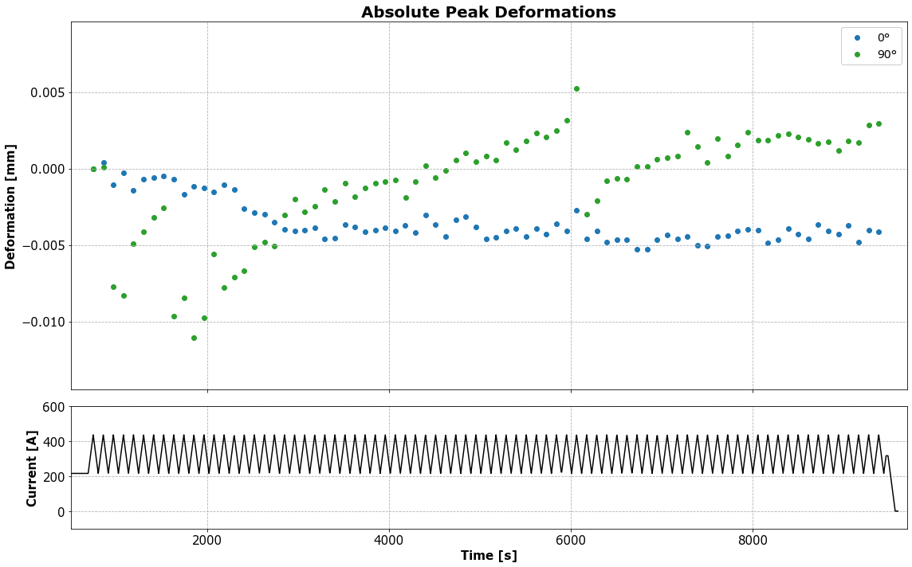
Red Aperture

Slide 18
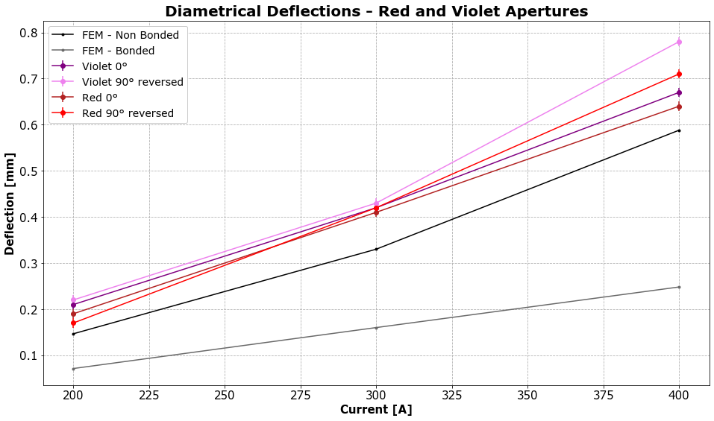
Deflections Summary

Slide 19
Discussion
Measurements were performed according to the planning
Sensors demonstrated their reliability and insensitivity to magnetic fields
Both apertures show a similar behaviour in terms of deformations
The measured displacements match closely the FEM predictions for a non bonded scenario
Cyclic powering showed no effect so far. Higher cycles number?
Probe is still fully functional and ready for further measurements if needed
Next steps??

Slide 20
Thank you for your attention

Slide 21
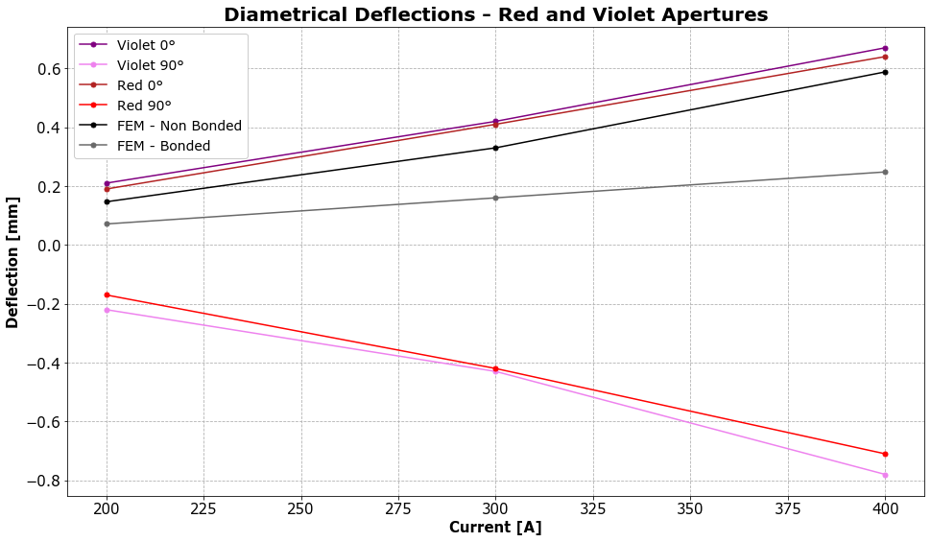
Deflections Summary

Slide 22
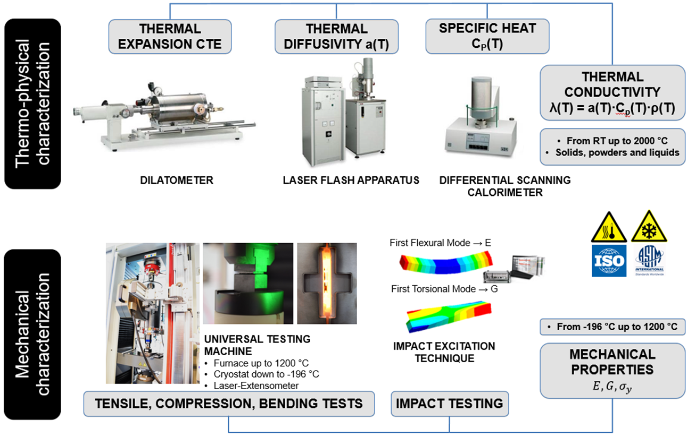
Thermo-Mechanical Analysis Capabilities

Slide 23
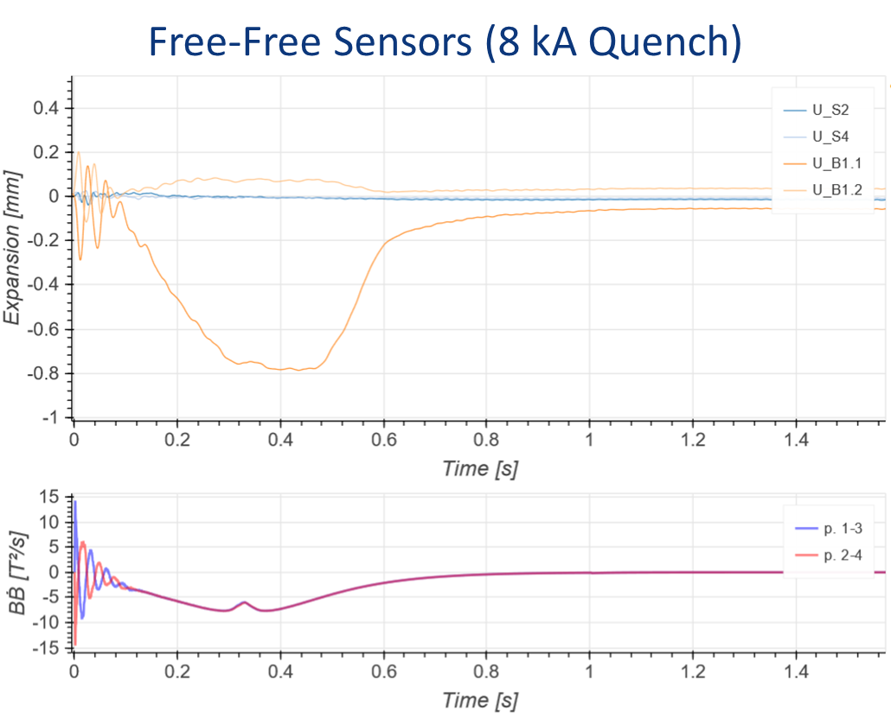
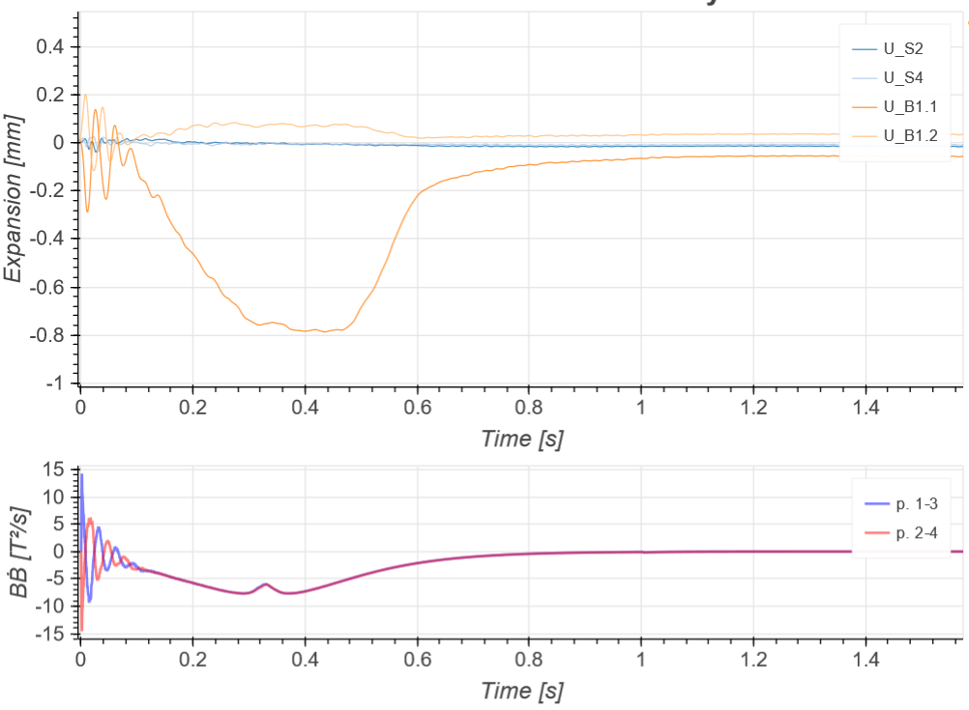
Free-Free Sensors (8 kA Quench)

Slide 24
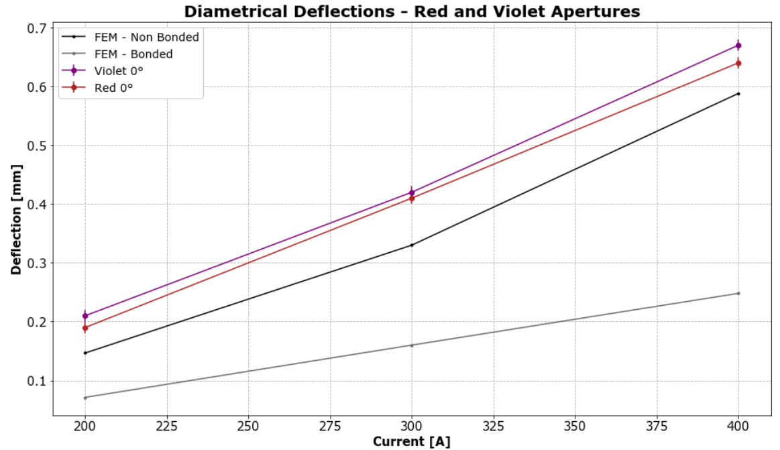
Deflections Summary

