Slide 1
LHCONE L3VPN status update
COVID-19 edition!
Enzo Capone
Head of Research Engagement and Support
LHCONE-OPN Virtual Meeting
16th Sep 2020

Slide 2
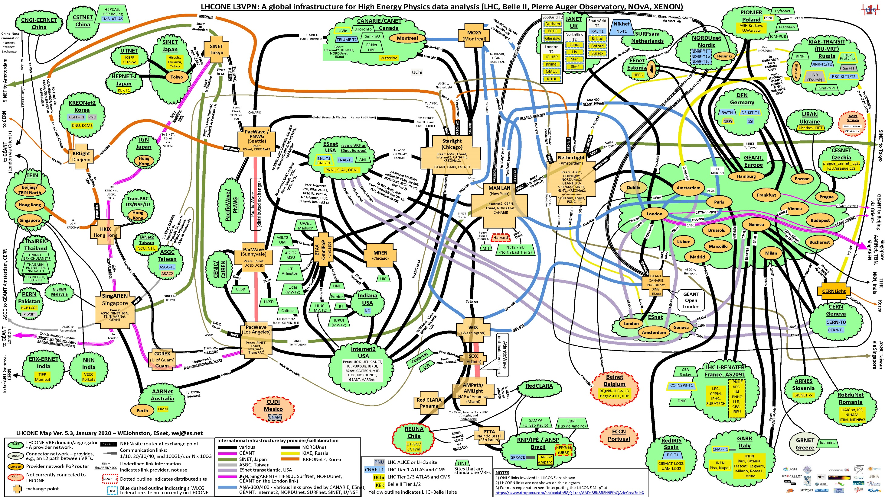

Slide 3
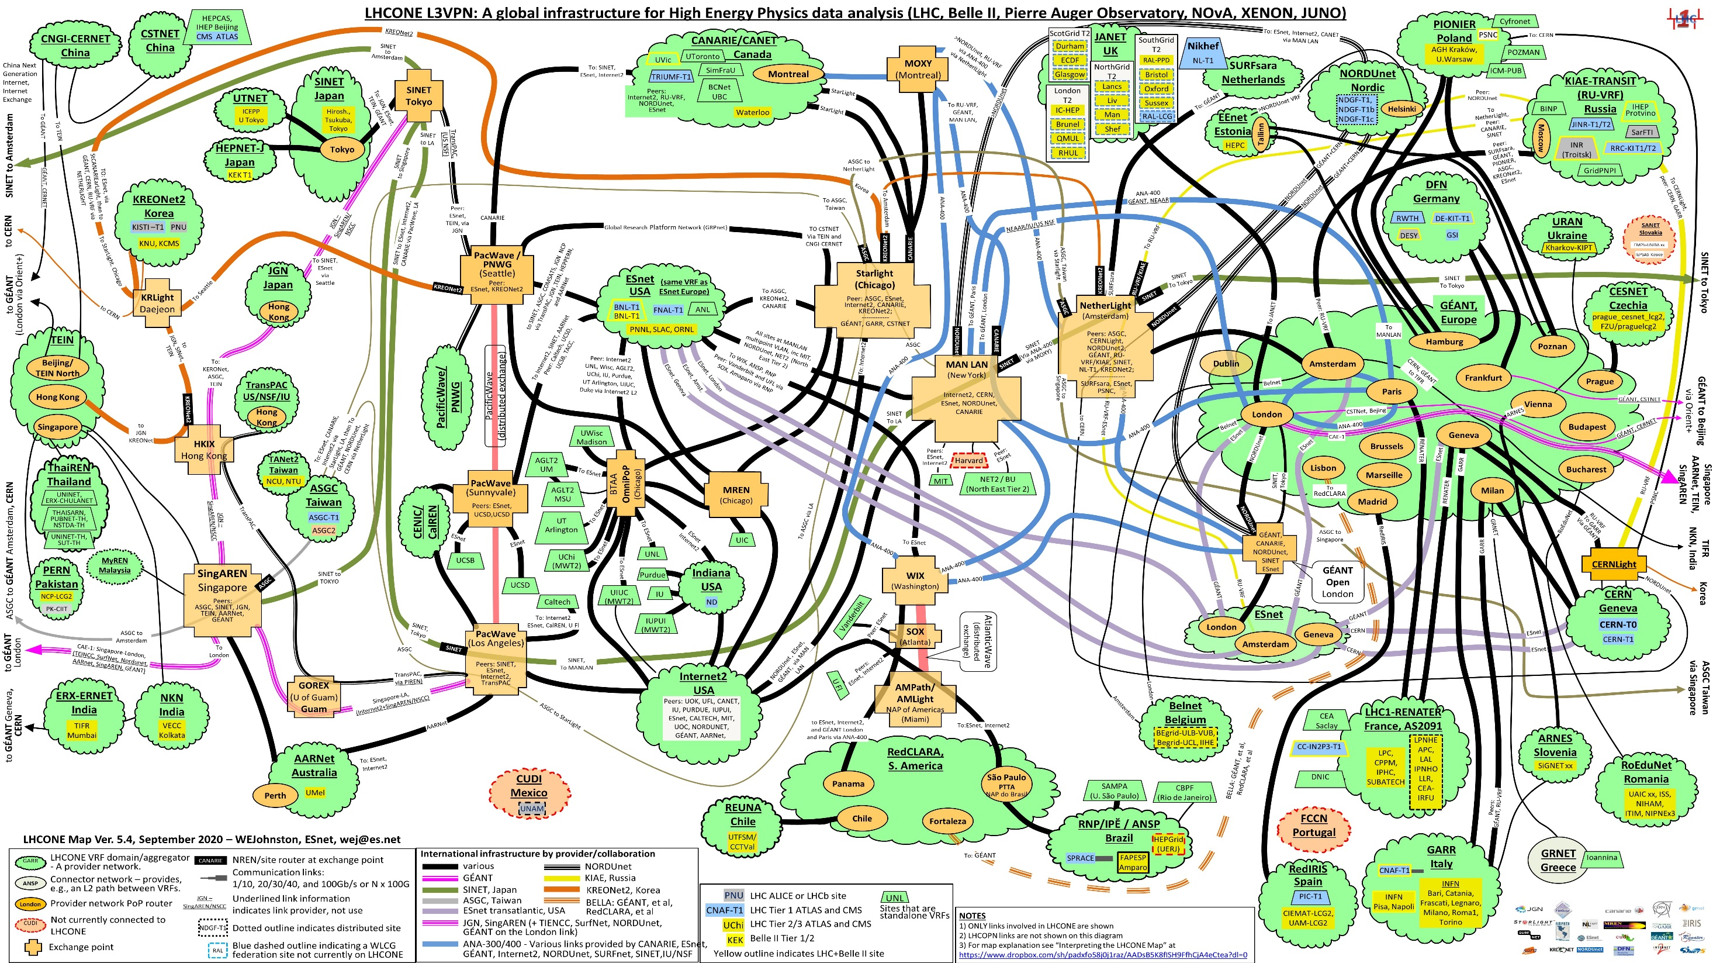

Slide 4

























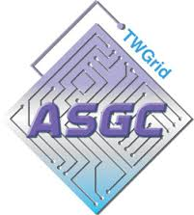










LHCONE around the world

Slide 5
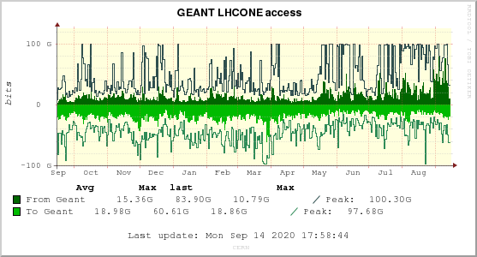
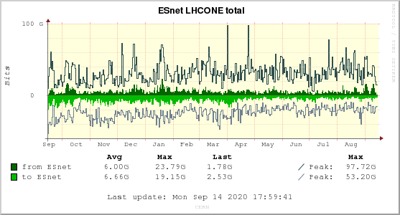

CERN
Notes:
CERN hitting the capacity limit for incoming traffic from GEANT. Currently in the process of ordering a second 100G port.
Rates to/from Esnet seems constant in the last year.

Slide 6
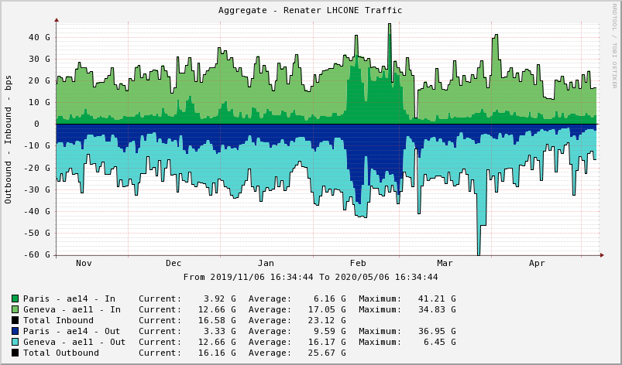
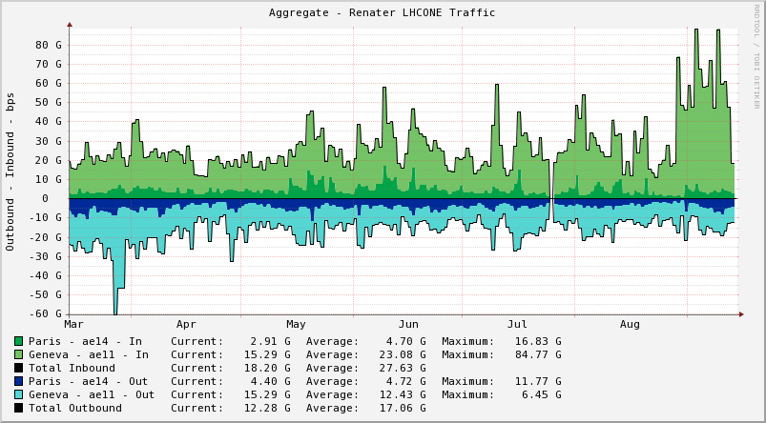
RENATER
Notes:
Substantial increase

Slide 7
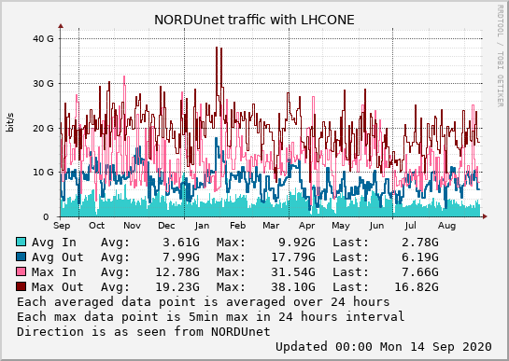
NORDUNet
Notes:
http://stats.nordu.net/connections.html
The graph shows total LHCONE traffic in NORDUnet which include links to CERN, GÉANT, Esnet and other connectors.
Only a slightly visible reduction in the last part of the year.

Slide 8
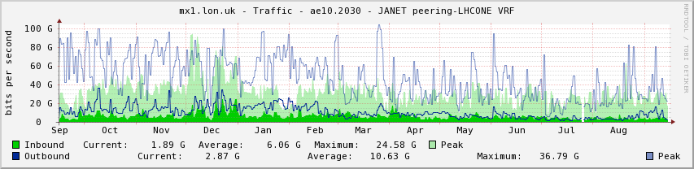
JISC
Notes:
Slight decrease

Slide 9
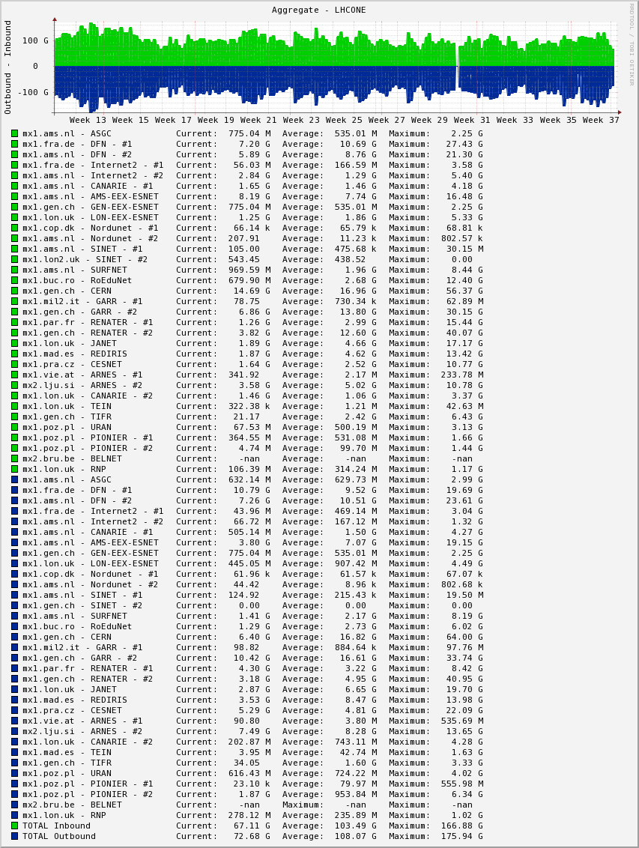
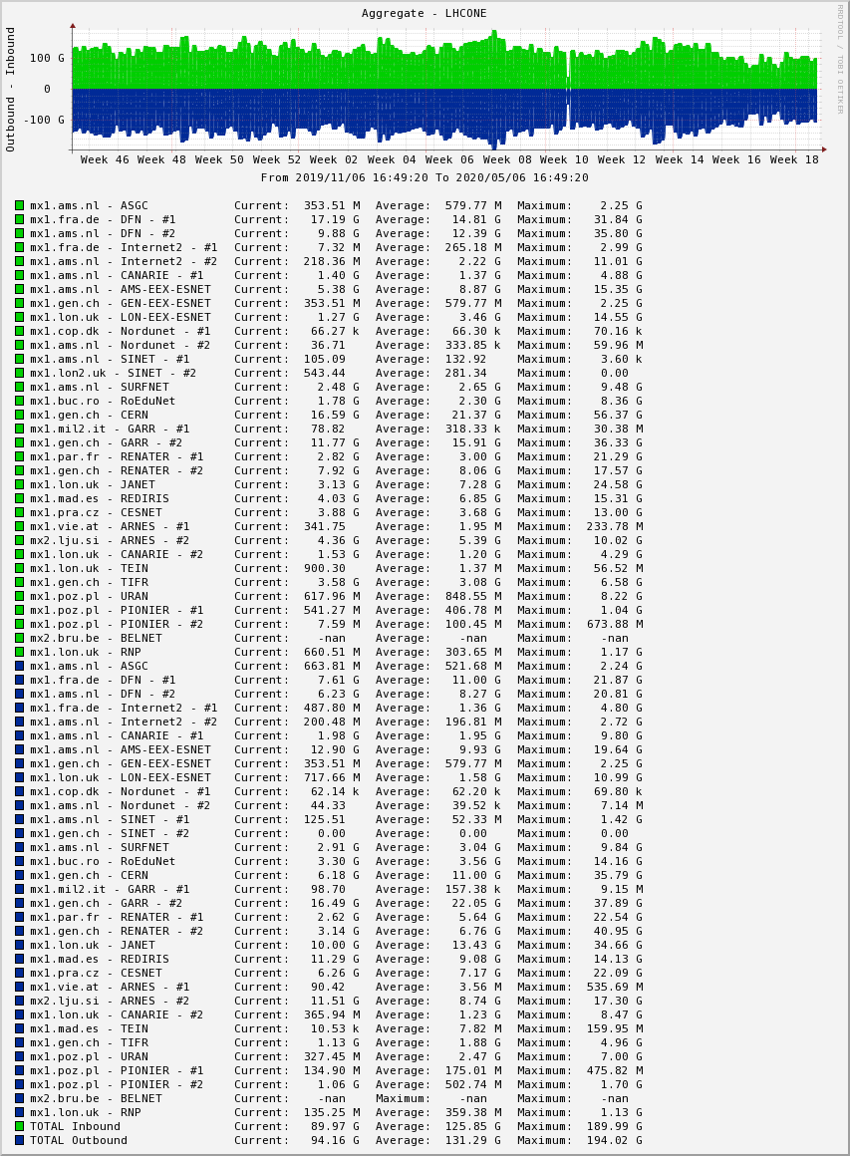
GÉANT overall
Notes:
The last 6 months compared to the previous 6 months have seen a decrease, overall,

Slide 10
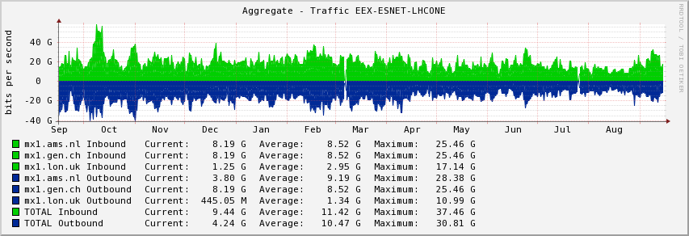

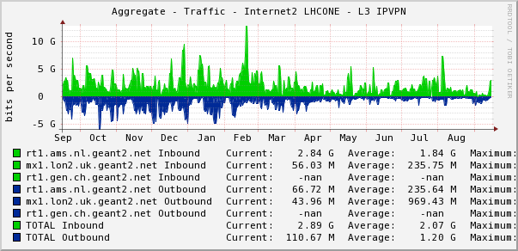

GÉANT<->US
Notes:
Decrease

Slide 11

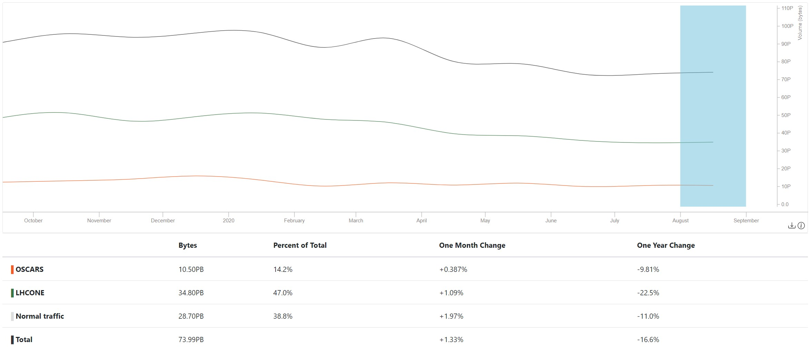
ESnet
Notes:
Some decrease in the latest 4 months.

Slide 12

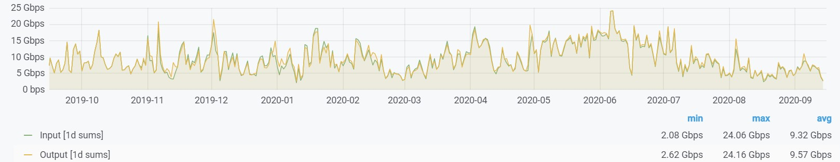
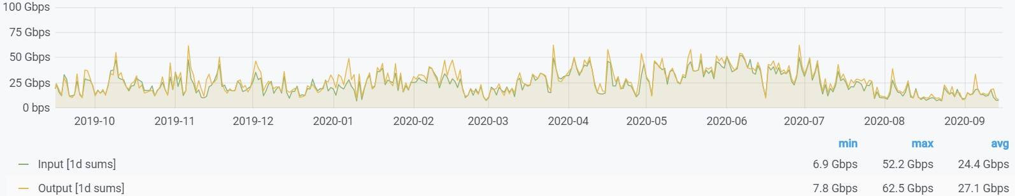
Internet2
Average
95th percentile
Notes:
https://snapp-portal.net.internet2.edu/grafana/d/86accab5aab6402a726547024df93fbf2/browse-interfaces?orgId=2&from=now-6M&to=now&var-POP=All&var-Node=All&var-Search=lhcone&var-identifier=All&var-Metrics=input&var-Metrics=output&var-Aggregation=average
1 year

Slide 13


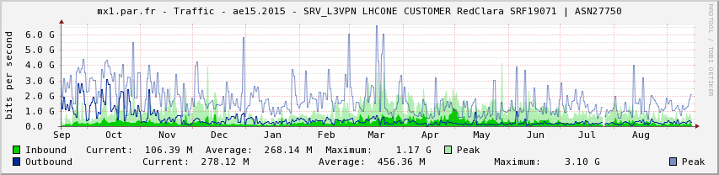
Latin America
Notes:
Removed the direct peering between RNP and GÉANT, now RedCLARA has created its own VRF.

Slide 14
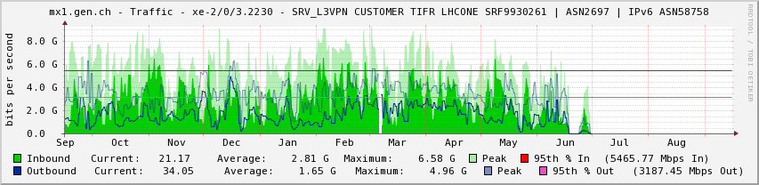


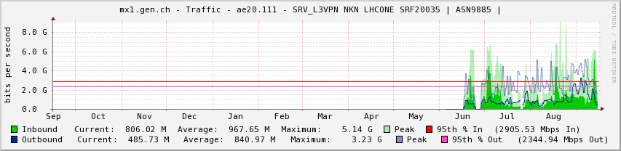

NKN-TIFR <-> GÉANT
Notes:
10G peering in GVA. Including all Indian sites, not just TIFR.

Slide 15
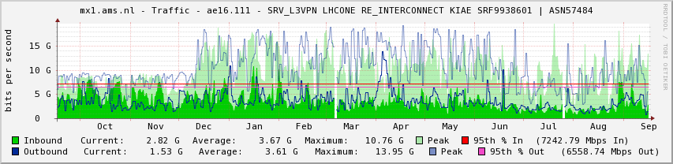

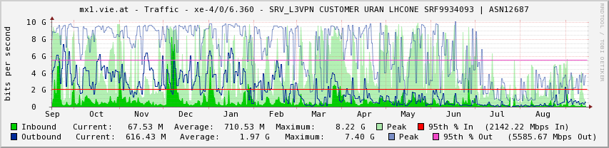
Latest upgrades
Notes:
Upgrading the AMS peering 20G>30G
Upgraded Kyev-Vienna 10G>20G

Slide 16
A few facts
12 Tier 1s
94 Tier 2/3
29 R&E operators
No major news in the last 6 months
Some slight reduction in overall traffic
  COVID lockdown doesn’t seem to have affected the data movement
  LS2 is in “full swing”

Slide 17

Thank you!
vincenzo.capone@geant.org
@EnzinoCapone
www.geant.org
@GEANTnews
© GÉANT Association
As part of the GÉANT 2020 Framework Partnership Agreement (FPA), the project receives funding from the European Union's Horizon 2020 research and innovation programme under Grant Agreement No. 856726 (GN4-3).

