Slide 1
FACT First GAPD Cherenkov Telescope
CHIPP Plenary meeting
23-24 August 2010, Gersau, Switzerland
W. Lustermann, ETH Zurich
TU Dortmund, Dortmund, Germany
EPFL, Lausanne, Switzerland
University of Würzburg, Würzburg, Germany
ETH, Zurich, Switzerland
Collaboration
Content
Introduction
FACT 1440 Camera
Mechanics / Electronics
Summary / Outlook
ISDC, Geneva, Switzerland

Slide 2
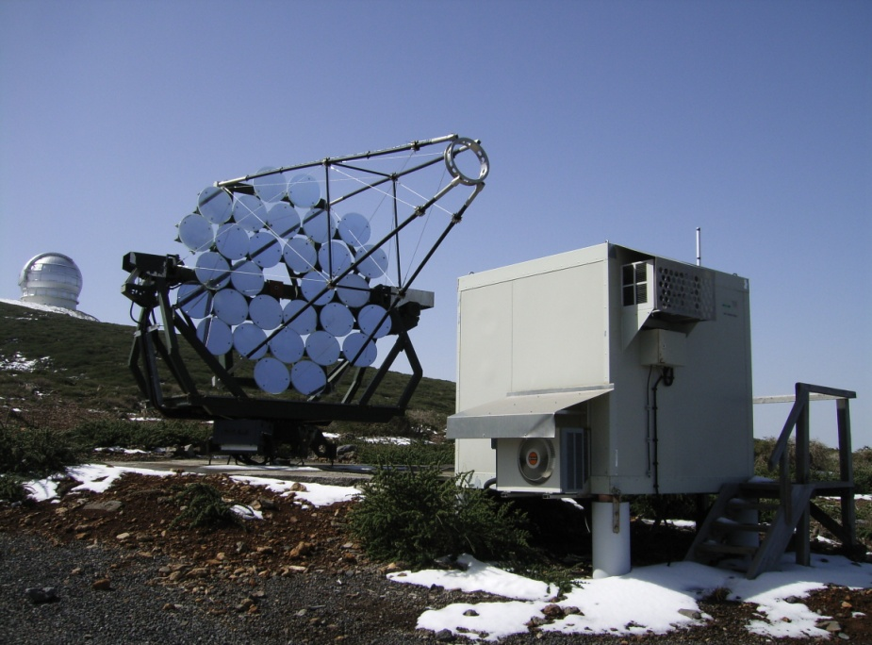
Introduction
FACT project objectives
Construction of the first imaging air -shower Cherenkov telescope using G-APDs (Geiger mode avalanche photo diodes) as photo-detectors
gain operation experience and observe the Crab-nebula
Mirror Dish
Number of mirrors: 30
MoU with MAGIC collaboration is existing
Agreement with IAC on creating of infrastructure existing
FACT instrument: Hegra CT3 Telescope, La Palma
Owner: MPI for Physics, Munich
Close to the MAGIC telescopes
Diameter: 3.885 m
Surface coverage: 82.9 % (not counting the missing central mirror)
Location: European Northern Observatory, Roque de los Muchachos, Canary Island La Palma
Mirror arrangement: 1 ring of 6 and two rings of 12 mirrors, no central mirror
total mirror surface: 9.51 m²
altitude: 2199.4 m
longitude: -17deg 53m 26s
Operation stopped in 2003
Administrative arrangements
latitude: 28deg 45m 42s
Former HEGRA CT3 telescope
La Palma, Canary Islands

Slide 3
FACT Camera
Camera
PMMA 7M entrance window, transmission > 82% for > 300 nm
FOV: 0.11 deg / pixel (4.5 deg total)
Dynamic range: 333 photons / pixel
Resolution: 0.5 photons (for less than 10 photons)
Timing resolution: 300 ps
Double hit resolution: 5 ns
Solid light concentrators (Winston-cones)
1440 pixels (G-APDs)
Design requirements
Operation also under twilight/moon (background rate up to 1 GHz / pixel)
Telescope Drive system
Drive calibration system
Temperature and Humidity monitoring
Trigger system
Infrastructure (power, Ethernet, counting hut, …)
Money, optimism and very good people
LV power supplies
Cooling system
Internal light pulser
External light pulser (bias supply feedback)
GAPD bias supplies
Camera mechanics including shutter
Signal conditioning & DAQ system
Online monitoring and control software
Simulation and analysis software

Slide 4
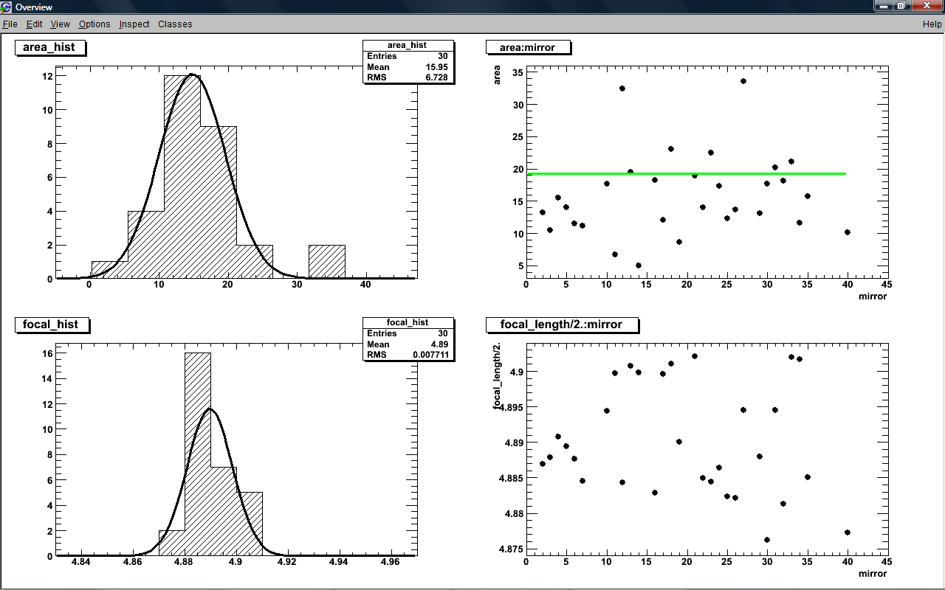
Mirrors
Mirrors (re-use existing Hegra CT1 mirrors)
Spherical mirrors with hexagonal shape
Sandwich construction:
Diameter (inner circle): 60.5 cm
Al base plate, 1 mm thick
Al honeycomb (hexcell)
Al alloy (AlMgSi 0.5) front plate, 5 mm thick
Surfaces were re-machined
Surface finish
Sputtering of Silicon in a Methan-atmosphere followed by oxidation
Fraunhofer-Institut für Fertigungstechnik und Angewandte Materialforschung – IFAM (Bremen)
thickness: ~120 nm
reflectivity maximum around 450 nm, average reflectivity of ~90% between (300 and 500) nm
area: 0.317 m²
Weight: ~6 kg
Mean focal length: (4.890 ± 0.008) m
diamond milling by LT ultra Precision Technology GmbH
Average spot size at 2f: 16.0 mm²

Slide 5
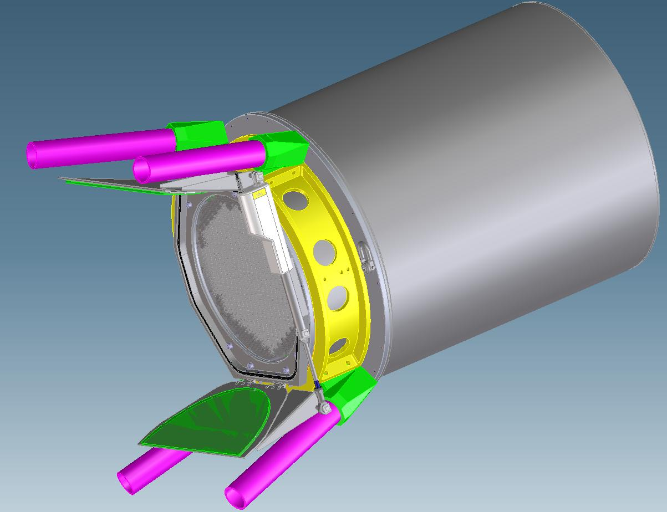
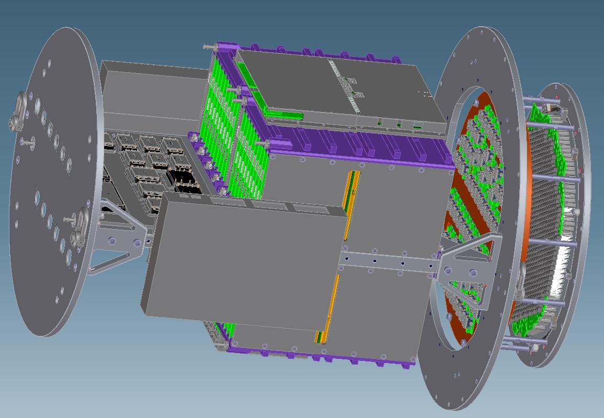
Camera Mechanics
Length 812 mm, diameter 532 mm, weight approx. 100 kg
4 water cooled electronic crates
Sensor and electronics compartment thermally separated
Window
Mount to telescope
shutter
Crates
The construction must be water tight (following IP67) specifications:
This concerns the housing as well as connectors on the patch panel
Ethernet switches
Connectors
Sensor
compartment

Slide 6
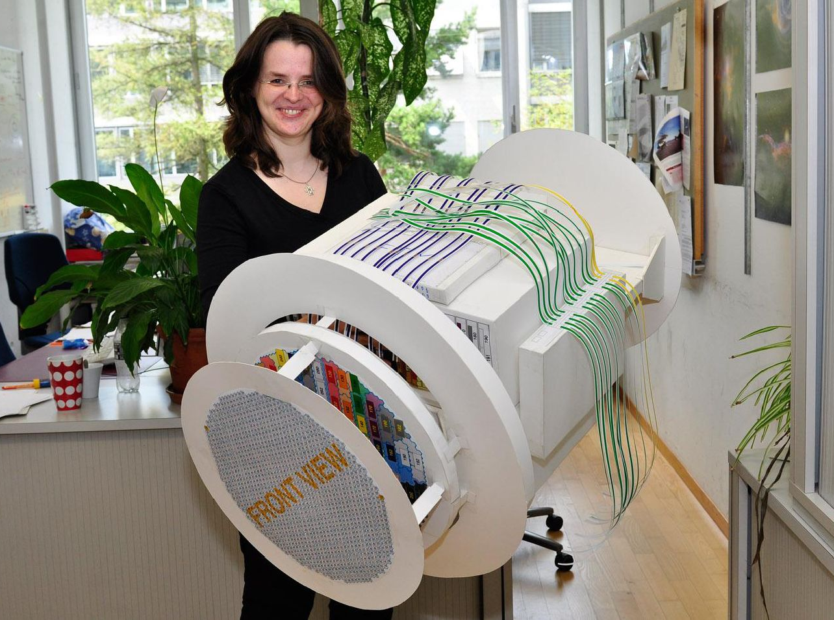
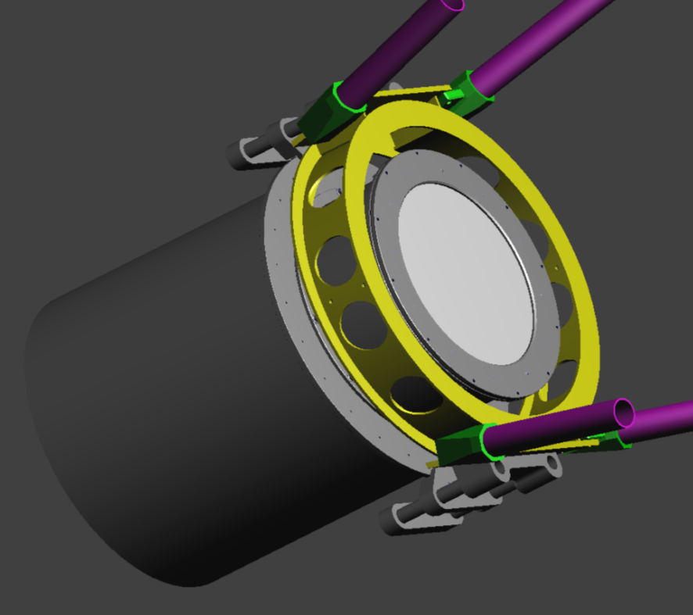
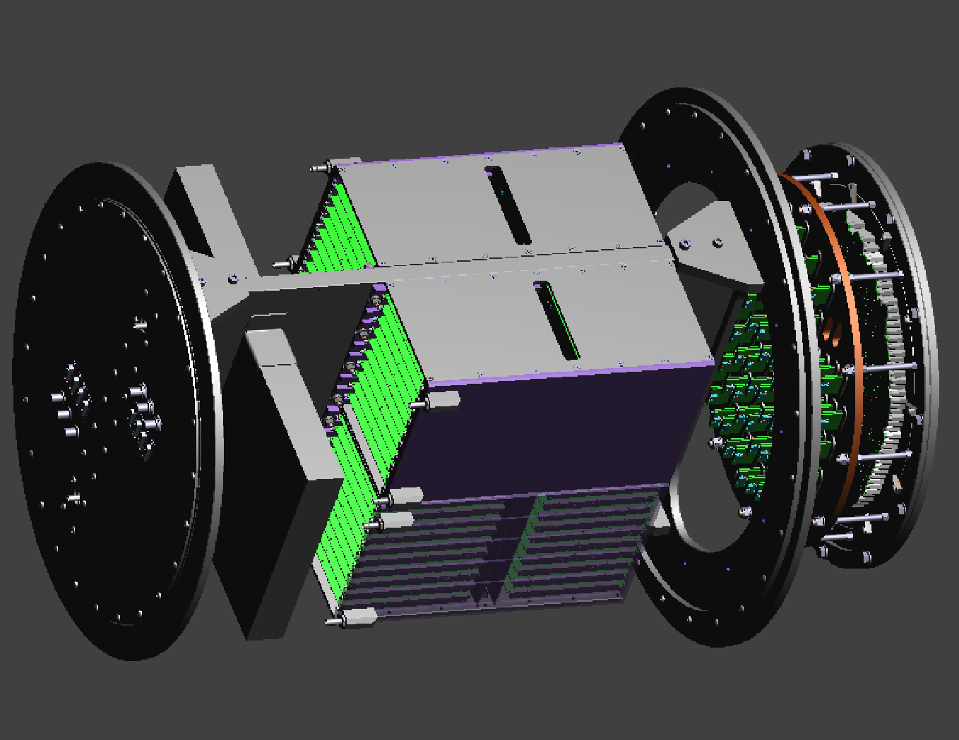
Camera Mechanics
Mount to telescope
Length 812 mm, diameter 532 mm, weight approx. 120 kg
4 water cooled electronic crates
Sensor and electronics compartment thermally separated
Window
Sensor
compartment
Crates
The construction must be water tight (following IP67) specifications:
This concerns the housing as well as connectors on the patch panel
Connectors

Slide 7
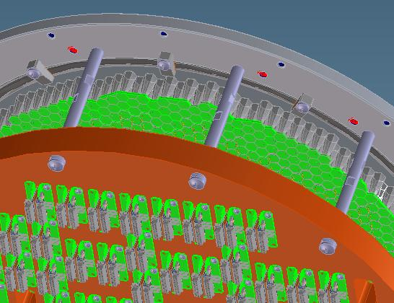
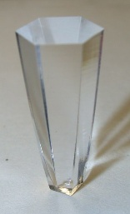
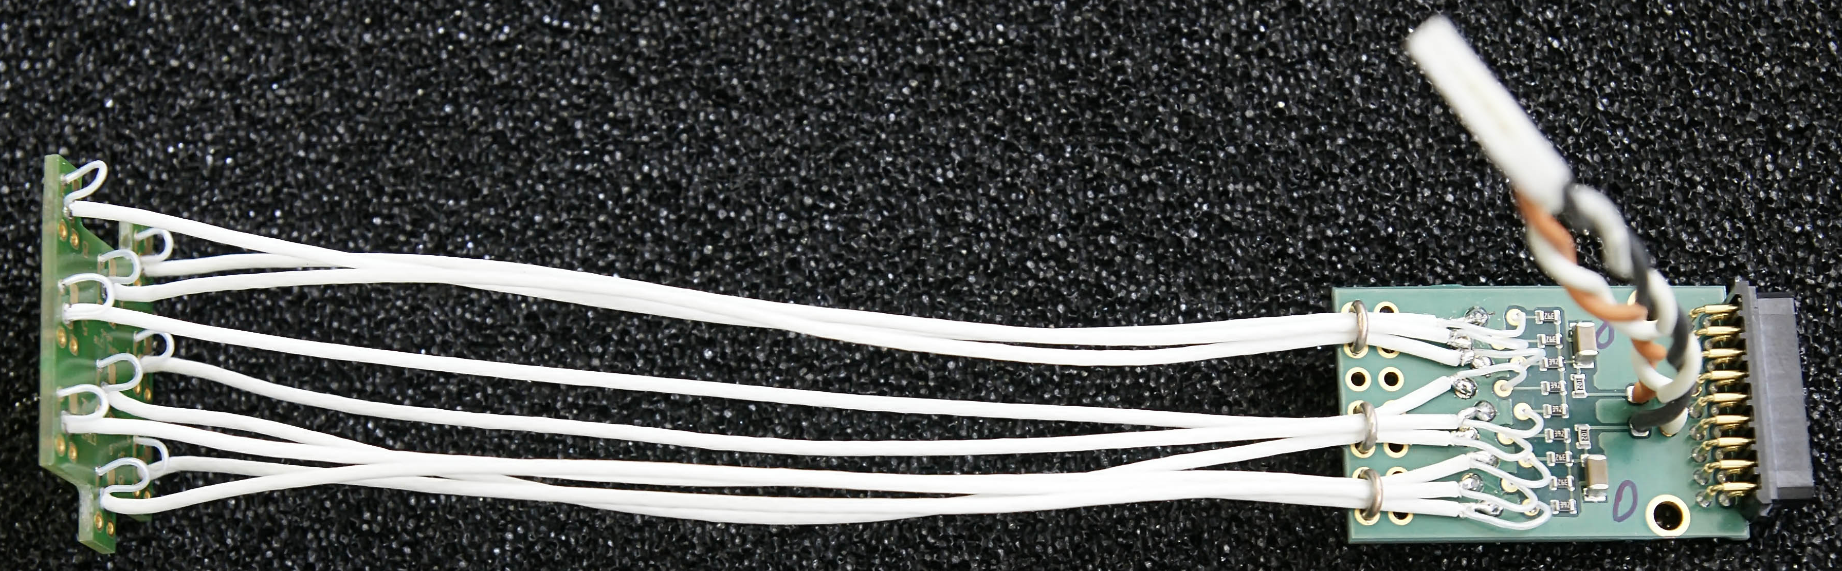
Camera Details
G-APDs with
Winston cones
Height: 19.939 mm
IN: Hexagon:
9.5 mm
OUT Square:
2.8 mm
Front baffle plate
Light Concentrating Cones
Cones and window from
UV transparent PMMA
Fabricated by injection moulding (IMOS Gubela GmbH)
Presently prototypes are tested
normal parabolas shape
Cable adapters /
bias feed
Co-axial signal cables, 50 ohm, ~35 cm
Thanks for the support of University of Zurich.

Slide 8
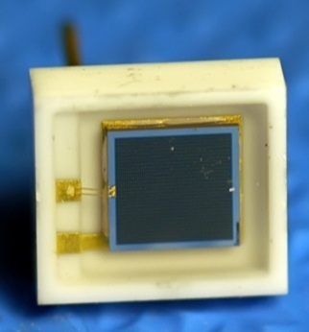
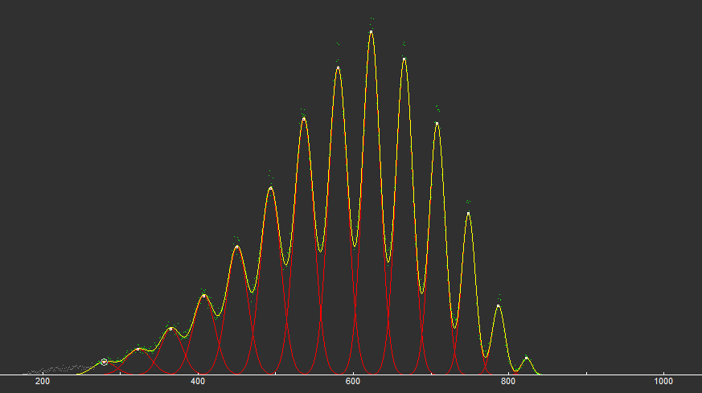
G-APD and single photon spectrum
Photo detectors: MPPC
Manufacturer: Hamamatsu
Type: S10362-33-50-C
active area: 3 x 3 mm²
3600 pixels of (50 μm)²
Ceramic package 5.9 x 6.6 mm²
Operation voltage: ~70 V
Gain (nominal): 7.5 x 10⁵
Photon detection efficiency: ~35%
Optical cross talk and after pulsing: ~25%

Slide 9
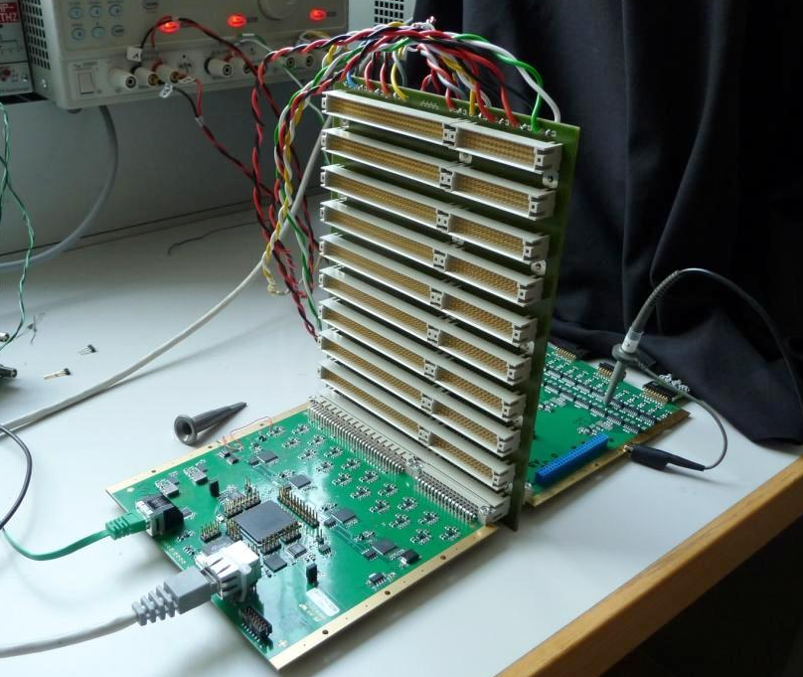
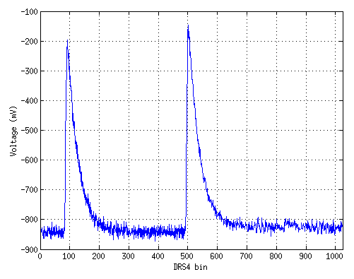
FACT DAQ – LED pulses
Pre-amplifier board (FPA) and analog pipeline (DRS4) & digitization board (FAD) connected via the mid plane (FMP) distributing power and slow control signals
LED flashes registered by an MPPC connected to the FACT readout system

Slide 10
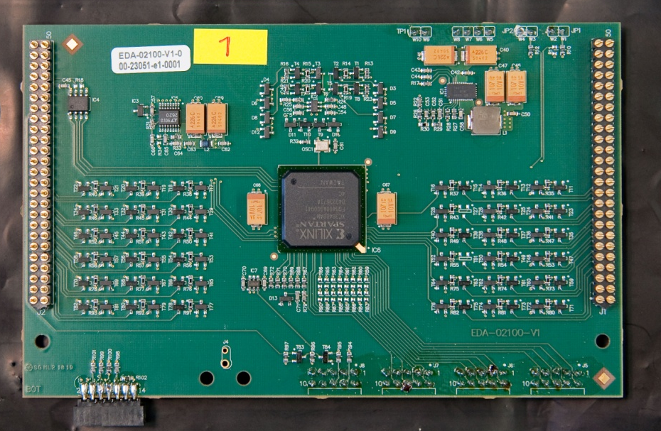
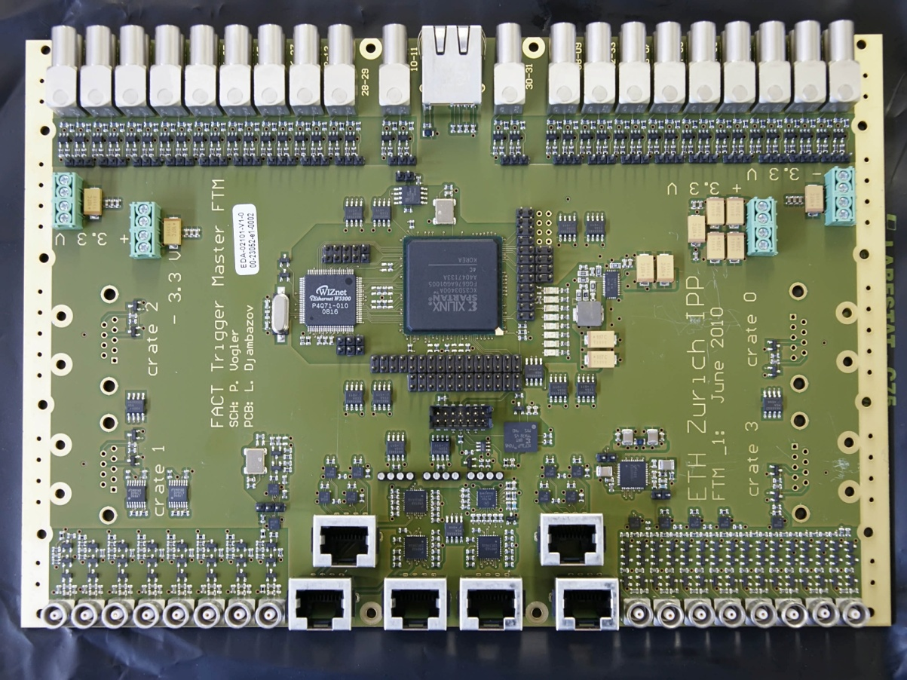
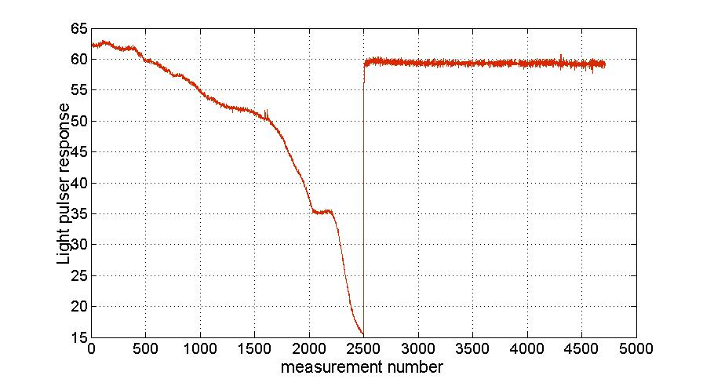
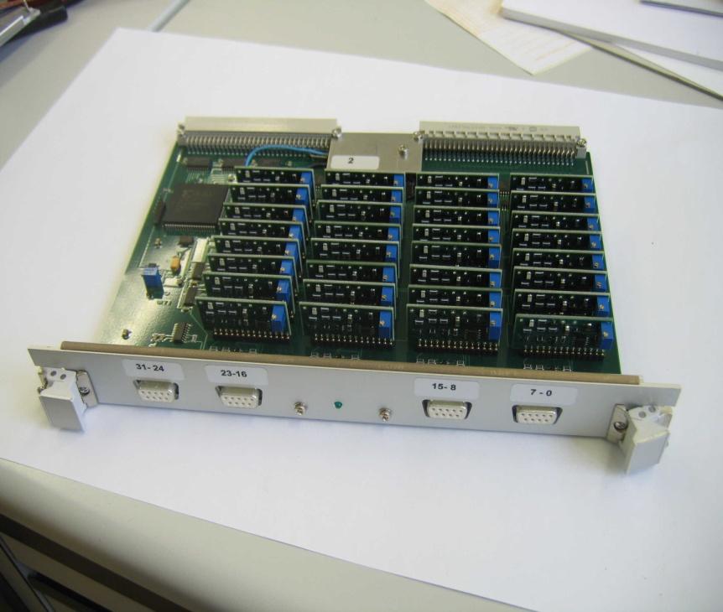
Trigger system & HV Feedback
Trigger unit (FTU) – 40 pieces
Uses 4 sums of 9 pixels for a majority decision
Mezzanine card on the FPA
Trigger master (FTM) – 1 piece
Provides trigger decision upon 40 FTU inputs
Provides CLOCK, TRIGGER and RESET signals
32 channel GAPD bias card
Computer controlled (USB)
Counting hut
Active bias supply feedback
Light pulses of 9 LEDs (FLP) are triggered by the FTM and read out
Deviations from nominal values are converted into GAPD bias corrections and applied.

Slide 11
Summary / Outlook
Telescope
Mechanics
Objektives
Mirrors and drive system ready for installation
Observation of Crab-nebula beginning 2011
Design including cooling finalized
Fabrication of components started
Electronics
Fully integrated into the camera
Prototypes of all PCBs fabricated, tests ongoing
Necessary agreements signed
Fabrication of all components in 2010
Photo Detection
all G-APDs available
Winston cone fabrication ongoing

Slide 12
Electronics Systems Overview
FTM x 1
1
FFC x 1
G-APD x 1440
40
40
160 x 9
FTU x 40
FAD x 40
FEI x 2
FCB x 160
FPA x 40
40 x 36
160 x 2
FHV x 320
FLV
PC
USB
FSC
PC

Slide 13
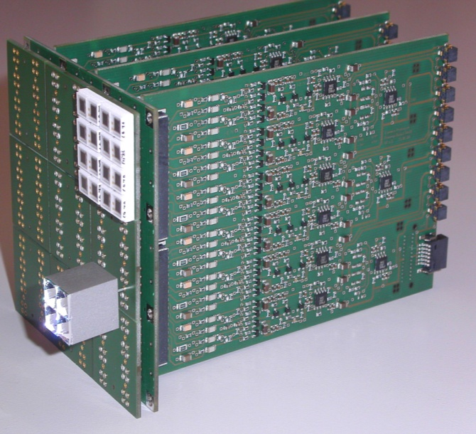
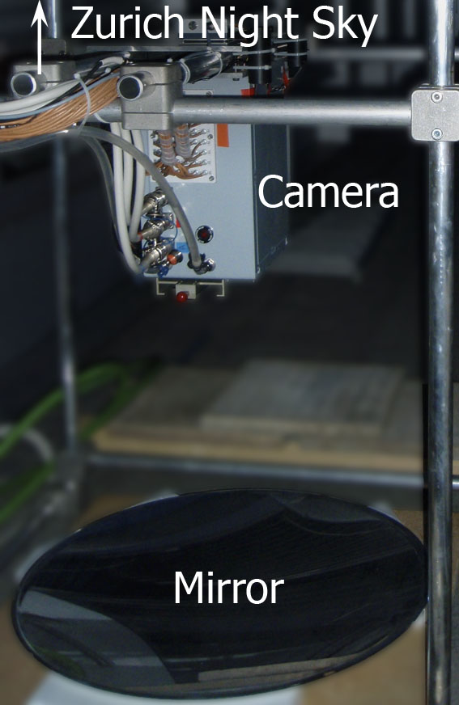
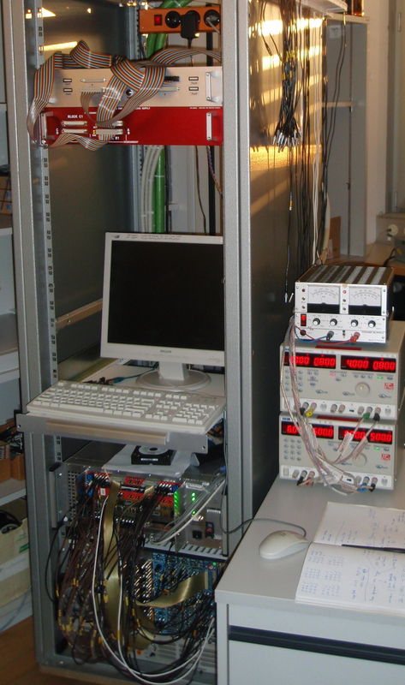
First Measurements
Night of 2.-3. June on the roof of our ETH physics building
PA48
SP16
CP144
Mirror
80 cm focal length
NSB
from buildings and moonlight:
1.2 GHz / pixel
FOV: 1 deg /pixel

Slide 14
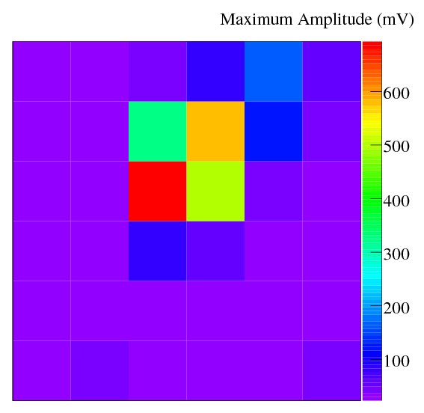
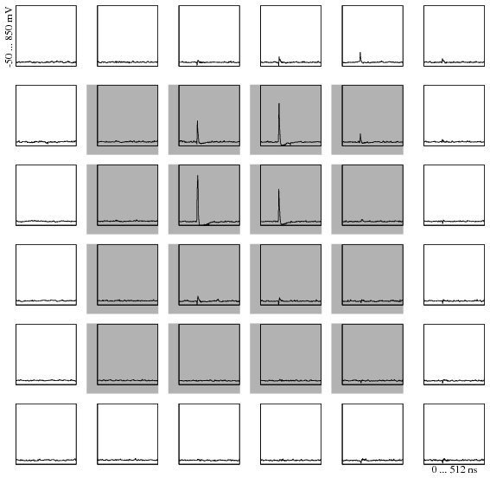
Event 21 Run 201
25mV single pixel threshold (4 p.e.)
Majority 4 out of 16
100 kHz trigger rate per pixel
0.1 Hz total rate
2 GHz sampl. freq.
Horizontal: 0 ... 512 ns, Vertical: -50 ... 850mV

