Slide 1
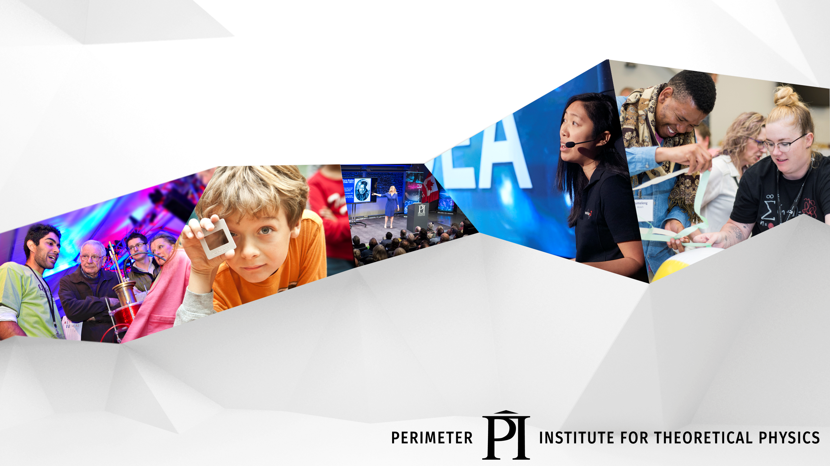
The Process of Science
How Do Scientists Think?
CERN HST 2022
Notes:
DONE

Slide 2
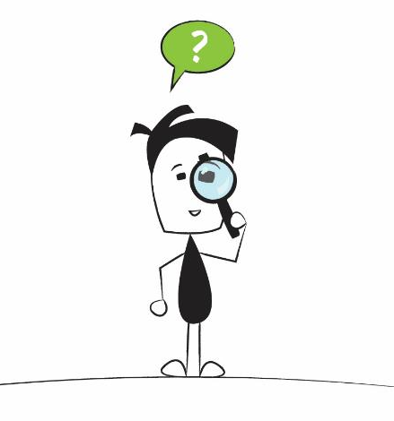
How Do Scientists Think?
Scientists Are Curious

Slide 3
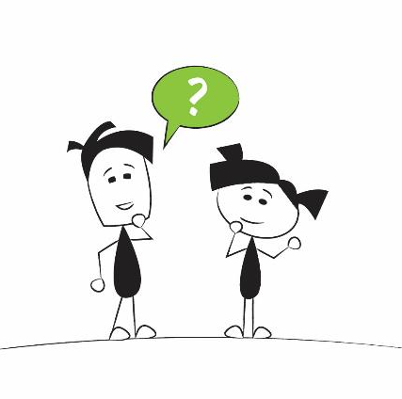
How Do Scientists Think?
Scientists Ask Questions
Notes:
The natural response to curiosity is questions.
Scientists are just big toddlers that are good at asking questions.

Slide 4
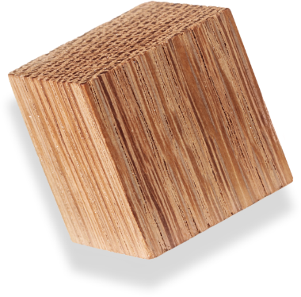
How Do Scientists Think?
Scientists Build and Revise Models
Notes:
(About 10-15 min) Using the Black Box:
-Demonstrate the box by pulling several strings
-Ask the participants to draw what they think is happening using their whiteboards
-Ask 3-4 people with different ideas to come up at the same time. Test their models, if they work, give their boards a checkmark
-Explain how nature can be described using models. We test these model/theories until they are proven wrong. At that point, they need to be thrown out or revised. Several, different models are capable of describing the same thing.
-Shake the Black Box. Show how some of the drawn models fail, while others survive.
-It is important to build vocabulary such as “predict, observe, model, etc.”

Slide 5
Why is it Like That?
Notes:
The next three slides are samples of an upcoming activity. Using the “Why is it like that” pictures from the resource, stations can be setup where groups look at a picture and attempt to add to a Freyer graphic organizer. After a defined amount of time, the groups can change stations. It should be pointed out that the questions and observations become more detailed and descriptive over time.

Slide 6
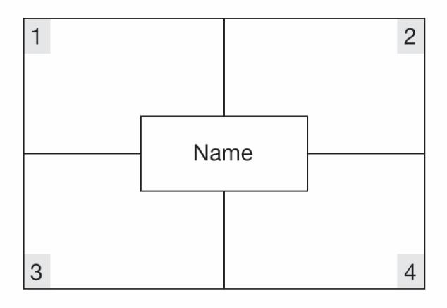
Frayer Models
Describing words
Characteristics
Inferences
Questions

Slide 7

How Do Scientists Think?
Scientists Are Creative

Slide 8
What happened?
Notes:
Challenge the participants to describe what is happening. How do you know? Which story is right? Can we find additional evidence?

Slide 9
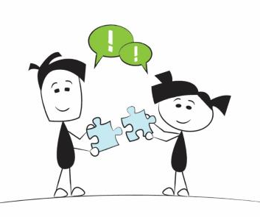
How Do Scientists Think?
Scientists Collaborate
Notes:
ASHLEY
[The next section describes the Science in the News activities from the resource. ]
Scientists do work individually, but they also work collaboratively to push theories forward.
It is just the same for students in the classroom. It’s important for students to work together as co-learners and co-teachers.
This is another important skill that kids need to learn that will be vital to their success in all aspects of their life.

Slide 10
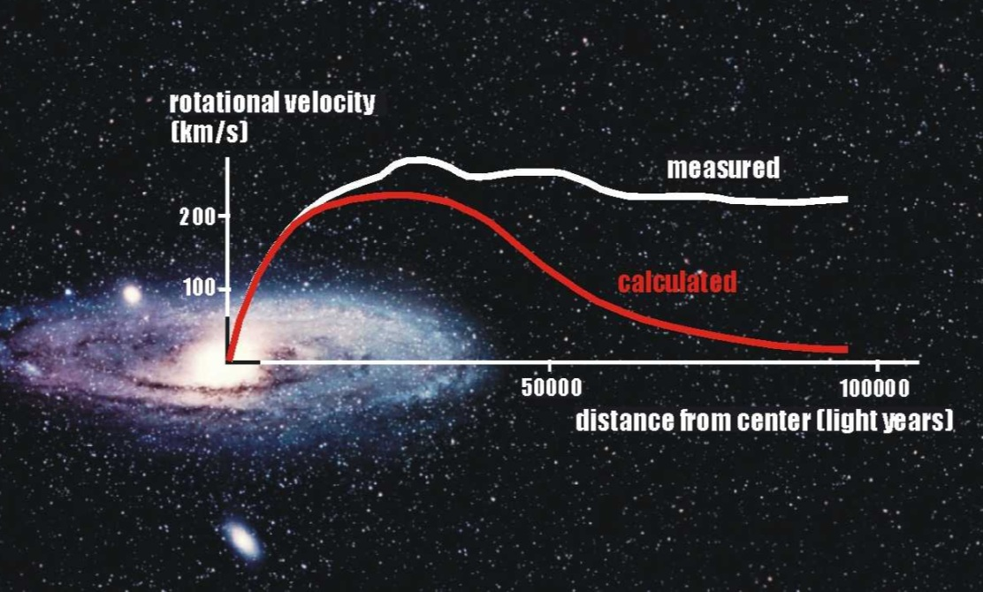
Science in the News
The stars in the Andromeda galaxy are moving much faster than they should. Why?

Slide 11
Distant planets and moons are hard to see.
The mass of all the gas and
stars in a galaxy can be
determined.
Black holes are heavy objects
that do not emit light so they
cannot be observed directly.
There is no reason to expect
that all matter that has mass
would also be visible to
astronomers.
Most of the mass in our solar
system is in the Sun. Planets are very light in comparison.
Our theory for gravity is well
established and supported by
many observations.
The objects in outer space
include: planets and moons,
stars, and black holes.
Black holes are heavy objects
that can be observed by
astronomers indirectly.
Astronomers can tell how much mass is in a region of space by how much it bends light.
The speed of an orbiting star
depends on the force acting on the star.

Slide 12
How Do Scientists Think?
Scientists Look for Patterns
Notes:
Humans are innately skilled at finding patterns. Scientists make observations and then sort their data to look for patterns.
This is similar to how Mendeleev created the periodic table.
Murray Gell-Mann predicted the existence of the omega minus particle after listening to a presentation from CERN scientists on the most recent discoveries. Gell-Mann was selected to comment first since he was the senior physicists in the audience. There was another person at the same workshop who was prepared to make the same prediction (Yuval Ne’eman).

Slide 13
Looking for patterns
spin
electric charge (Q)
strangeness (S)
mass
date

Slide 14
Finding patterns

Slide 15
Finding patterns
Column:
Same Charge
Increasing Mass
Row:
Same Strangeness

Slide 16
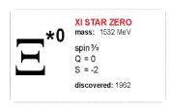
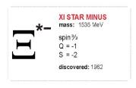
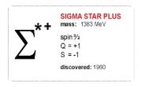
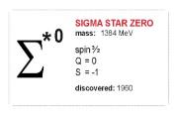
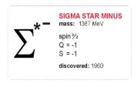
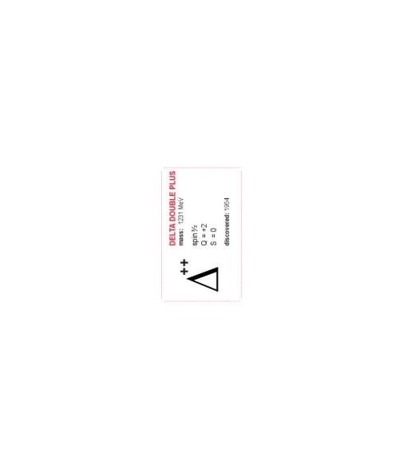
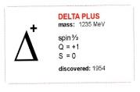
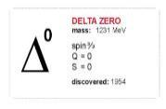
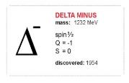
Finding patterns
?
Column:
Same Charge
Increasing Mass
Row:
Same Strangeness

Slide 17

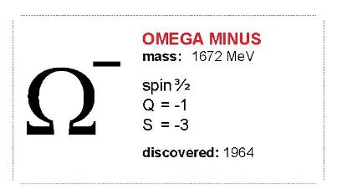
Particle Prediction
spin 3/2
charge = -1
strangeness = -3
mass ≈ 1680 MeV
Notes:
Predicting particles

Slide 18
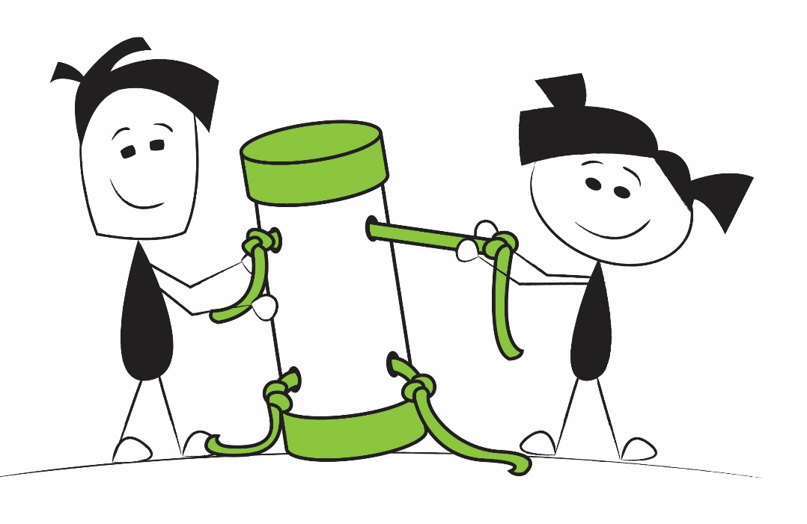
Thinking Like A Scientist
Let’s work together to build and revise our model for a simple question.

Slide 19
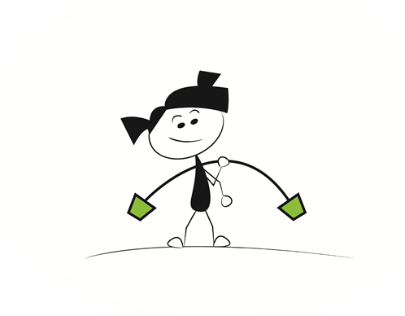
Why does this rod bend?
Notes:
Use a sizable rod that is flexible. Hold the middle and challenge the audience to describe why it bends. Focus on a “force” model or explanation. Gravity pulls down the two ends, but your hand “counter-acts” gravity by holding it up in the middle.

Slide 20
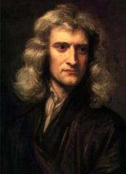
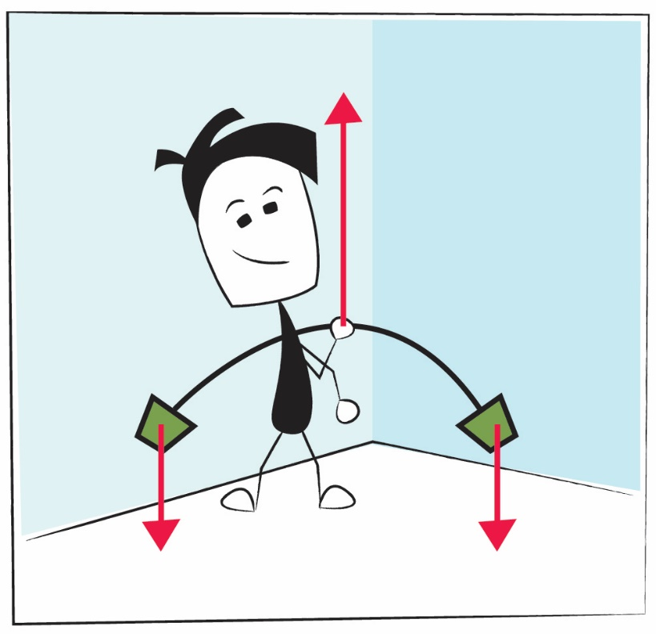
One force pulls down another pushes up

Slide 21
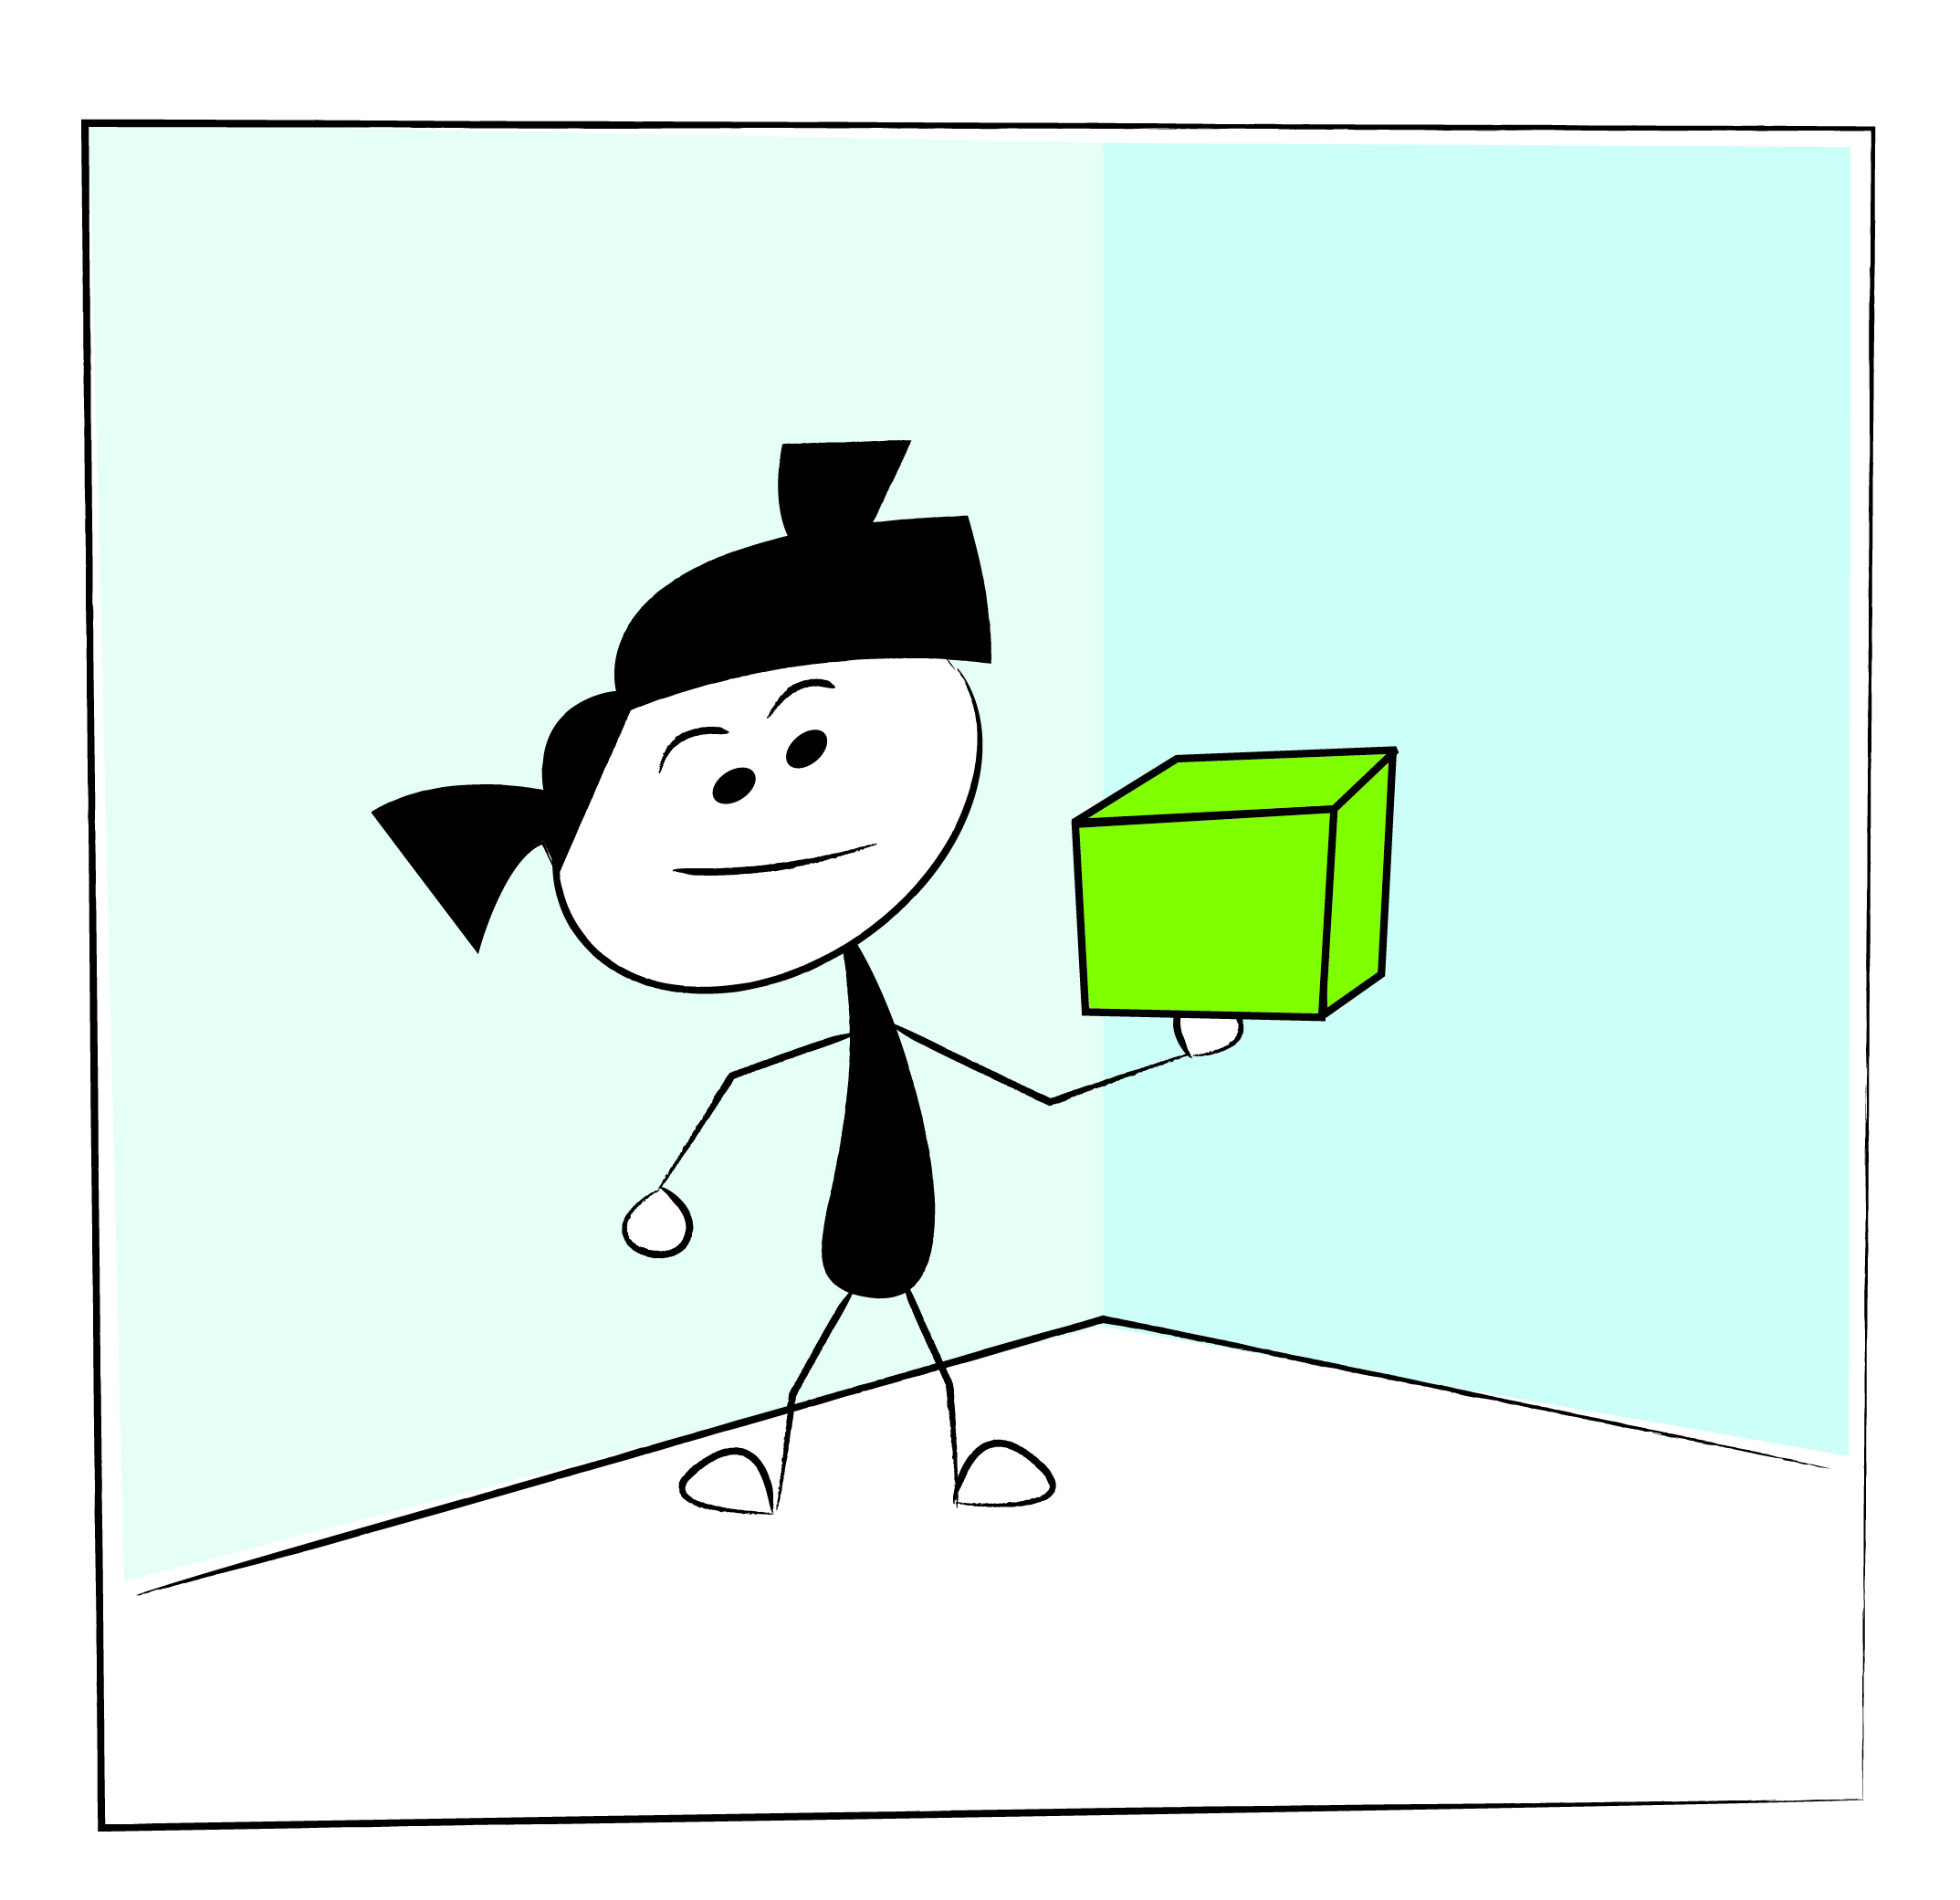
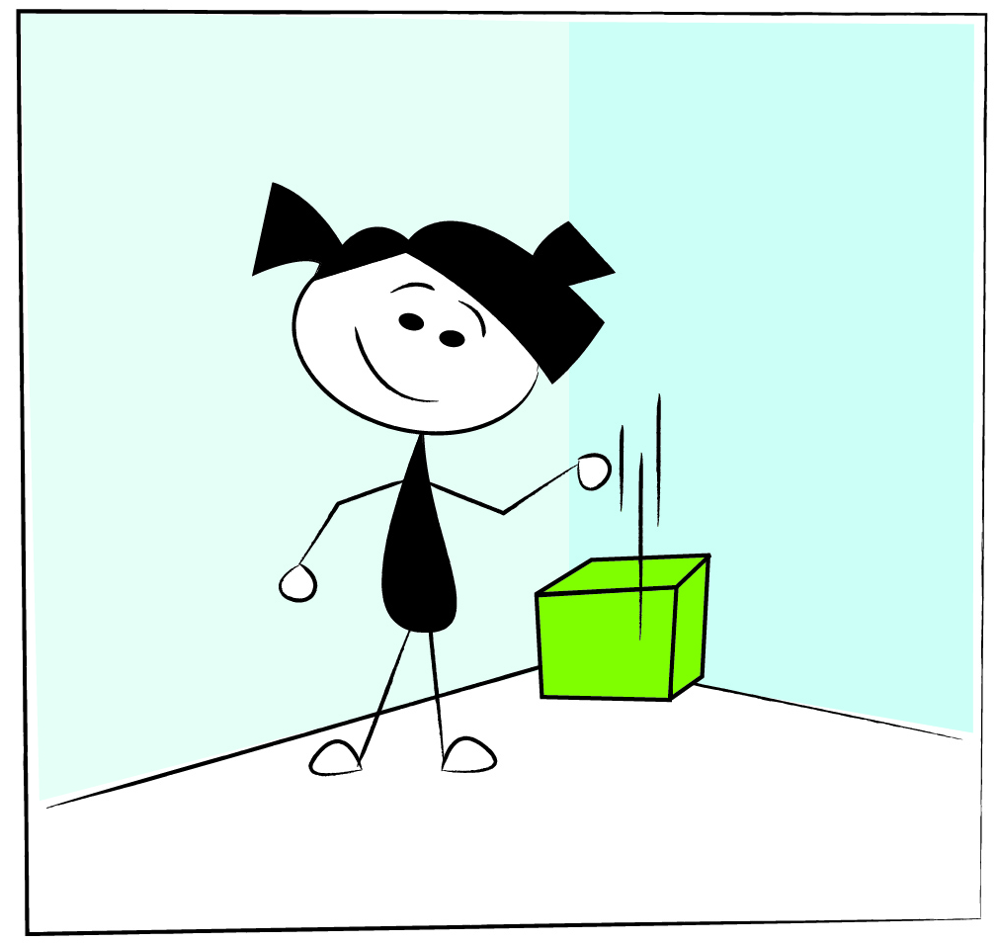
Force Model
Why do objects feel heavy?
Why do objects fall?

Slide 22
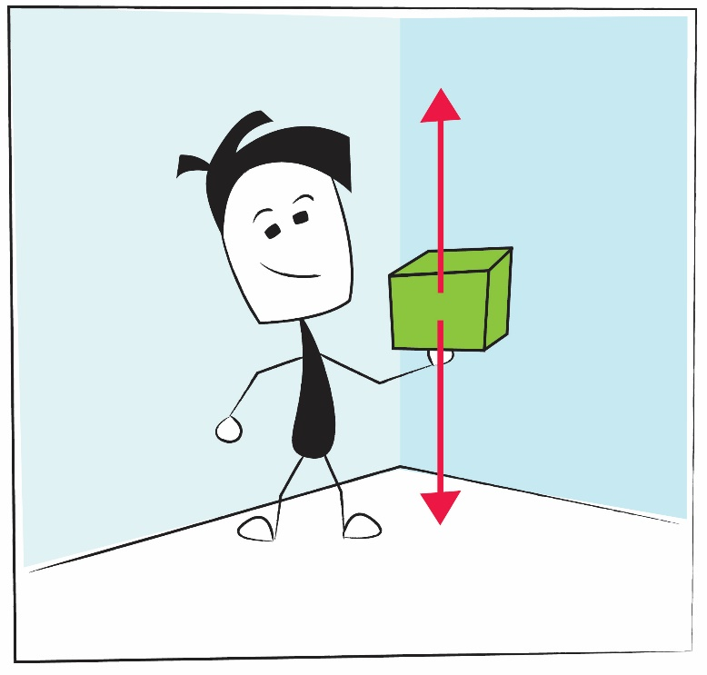
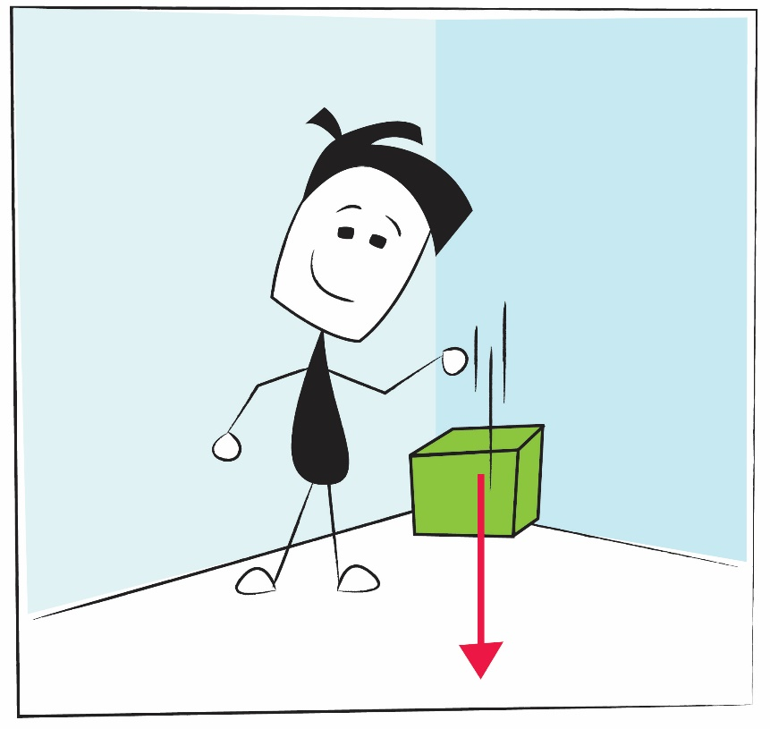
Force Model
Why do objects feel heavy?
Why do objects fall?
You push up to oppose the force of gravity
The force of gravity pulls them down

Slide 23
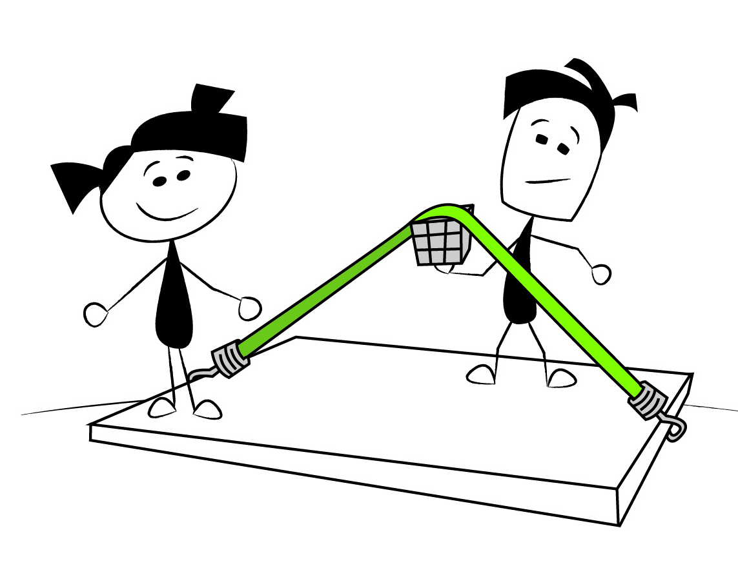
Force Model of Gravity
Gravity is like an Invisible Bungee Cord
Notes:
This shows that gravity is like a “bungee cord” that keeps you anchored to the Earth. This can be demonstrated by putting an object below a bungee cord (which is attached to a board), as shown in the image. This demonstration gives a good visualization of this mysterious, invisible force known as gravity.

Slide 24
“That gravity should be innate, inherent, and essential to matter so that one body may act upon another, at a distance through vacuum, without the mediation of anything else…is to me so great an absurdity, that I believe no man who has in philosophical matters a competent faculty of thinking, can ever fall into it.”
- Isaac Newton
Notes:
This is a famous quote from around the time of Newton. Read the quote and ask the audience to guess its author.
Newton could describe the strength of gravity to great precision, but had no idea how gravity actually worked.

Slide 25
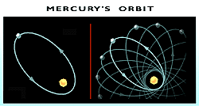
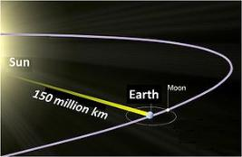
Newtonian gravity works…right?
Observations (1859)
Force model predicts the wrong orbits
Theory (1905)
Force model violates speed of light limit
Notes:
There are two observations that cannot be explained with gravity being a force:
Mercury. Mercury’s orbit is not a perfect ellipse (as predicted with Newton’s and Kepler’s Laws).
In order for Newton’s model to work, the force of gravity must act instantly between two objects. If the sun were to disappear, this model predicts Earth would feel this effect instantly, thus knowing this information instantly. Einstein said nothing can move faster than the speed of light, so how could the Earth know this (before the 8min passed for the absence of the Sun’s light would finally reach Earth).

Slide 26
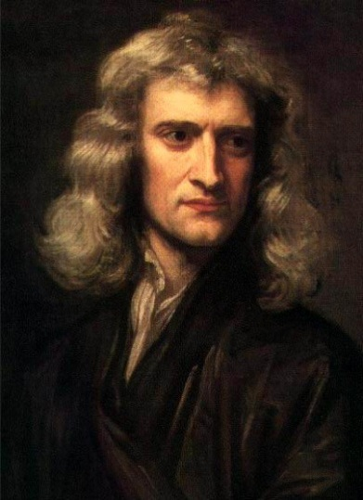
Newton: Gravity is a force
FEELS RIGHT, but doesn’t survive experimental tests
Notes:
Summary

Slide 27
so….
something is wrong with our force model for GRAVITY
Notes:
Summary. We need something new.

Slide 28
How else can I make this rod bend?
Notes:
Ask the audience for a new model. Hopefully somebody suggests acceleration. Ask them how this rod could bend if it were accelerated. Inertia would be resisting the acceleration, thus making the rod bend.

Slide 29
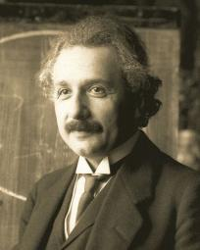
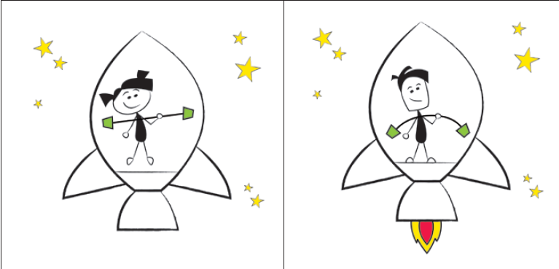
Acceleration Model

Slide 30
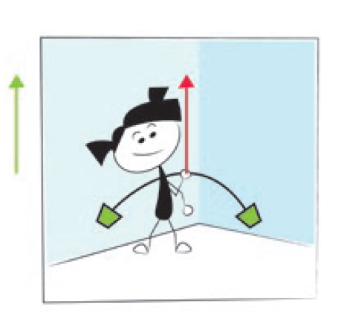
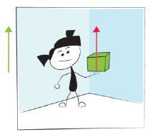
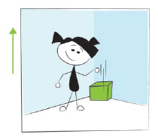
Acceleration Model
Bendy Rod
Weight
Freefall

Slide 31
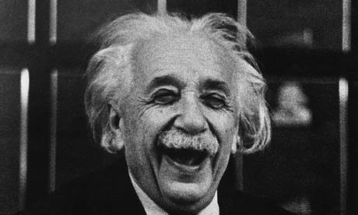
Acceleration Model of Gravity
Acceleration in one direction is identical to a force in the other direction!
Einstein’s “happiest thought”
Gravity isn’t a force pulling us down.
We are accelerating UP!
Notes:
Einstein championed the acceleration model.

Slide 32

The BIG Question
How can the ground be accelerating up without moving up?
Notes:
Hopefully somebody may have suggested this problem with the acceleration model. Is there any way to get around this?

Slide 33
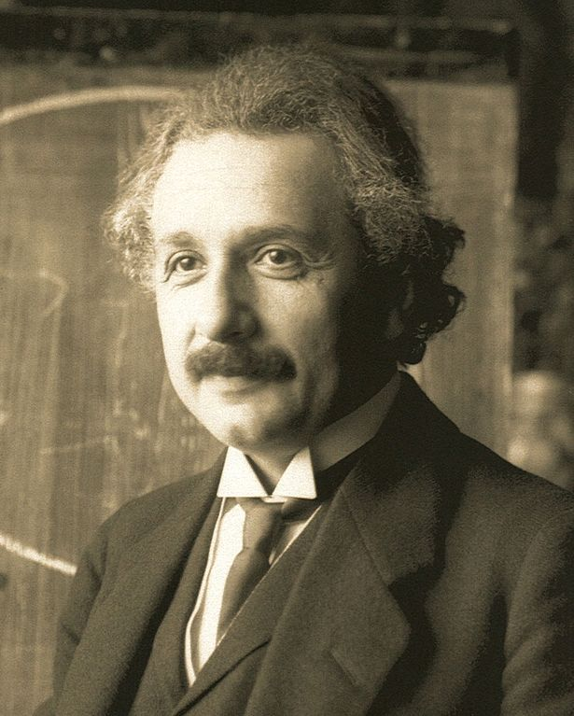
Two Models
Newton: Gravity is a force
FEELS RIGHT, but doesn’t survive experimental tests.
Einstein: Acceleration Model
FEELS WEIRD but could work...
... But earth isn’t expanding!
Notes:
So, we have two models that can describe gravity. One that uses force and another that uses acceleration.

Slide 34
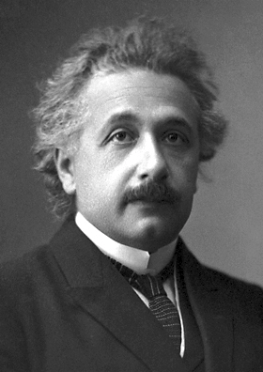
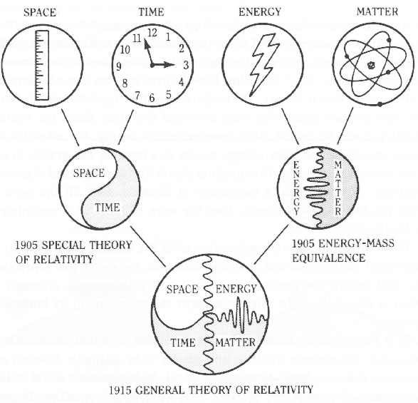
Special Relativity

Slide 35
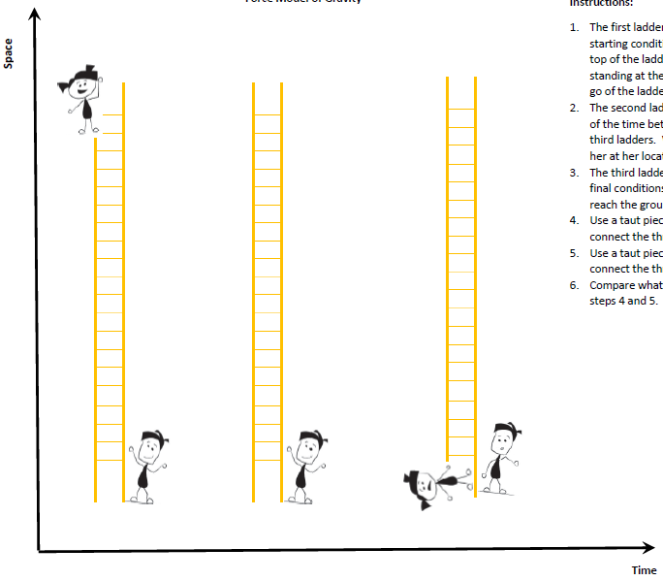
Force Model: Falling Off a Ladder
Space
Curved lines on spacetime diagram mean the object accelerated.
Time
Notes:
Let’s perform a thought experiment using the two models. First, we will use the force model to describe what happens. Ask the participants to plot the positions of Alice and Bob in each frame:
In frame one, Alice will start at the top of the ladder, while her brother, Bob, is holding the ladder below. Alice lets go of the ladder at time = 0 seconds and begins to fall.
In the second frame, Alice has fallen some distance, but Bob is still holding the bottom of the ladder. Challenge the participants to guess if Alice will be exactly half way down or will she be at some other point on the ladder?
In the third frame, Alice hits the ground, and Bob is still holding the ladder.
When the positions of each have been plotted, ask the participants to “connect the dots” by using a piece of tape or a length of string held taut. Have them do both Alice’s path through space-time as well as Bob’s.

Slide 36
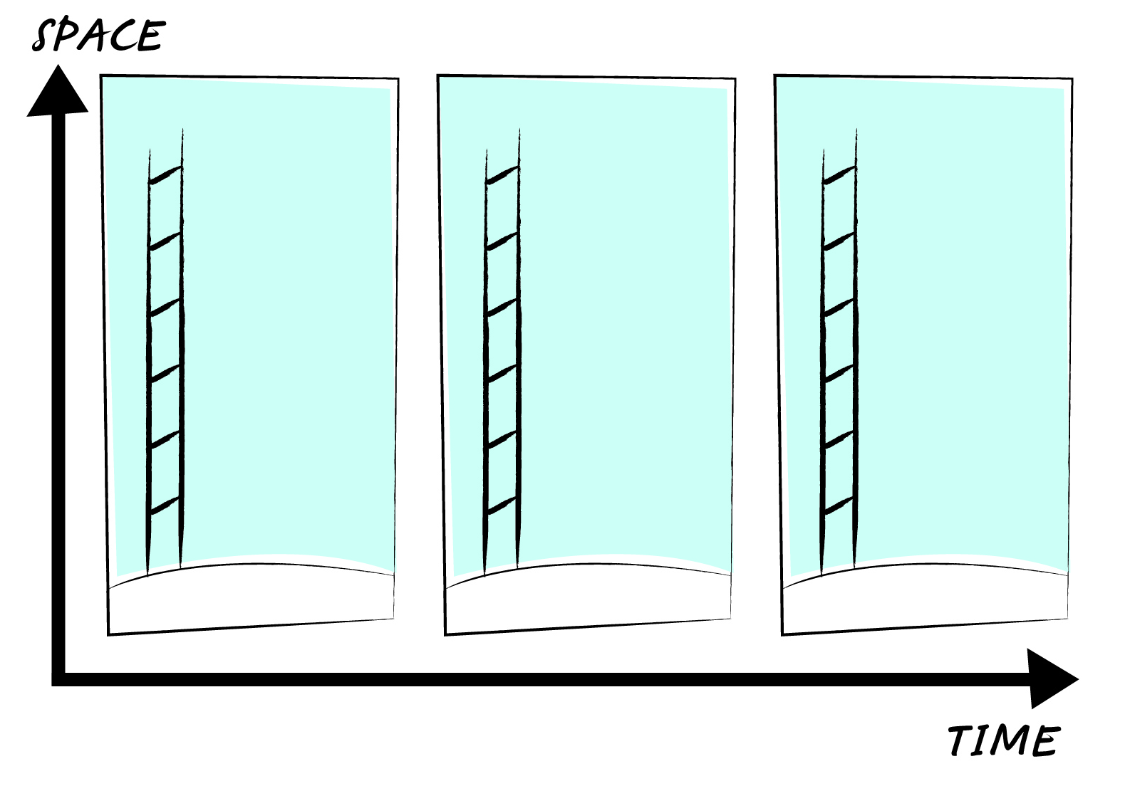
Curved lines on a spacetime diagram mean the object accelerated.
Spacetime Diagram
Create three ‘snapshots’ of Alice as she falls.
Notes:
Let’s perform a thought experiment using the two models. First, we will use the force model to describe what happens. Ask the participants to plot the positions of Alice and Bob in each frame:
In frame one, Alice will start at the top of the ladder, while her brother, Bob, is holding the ladder below. Alice lets go of the ladder at time = 0 seconds and begins to fall.
In the second frame, Alice has fallen some distance, but Bob is still holding the bottom of the ladder. Challenge the participants to guess if Alice will be exactly half way down or will she be at some other point on the ladder?
In the third frame, Alice hits the ground, and Bob is still holding the ladder.
When the positions of each have been plotted, ask the participants to “connect the dots” by connecting Alice’s path through space-time as well as Bob’s.

Slide 37
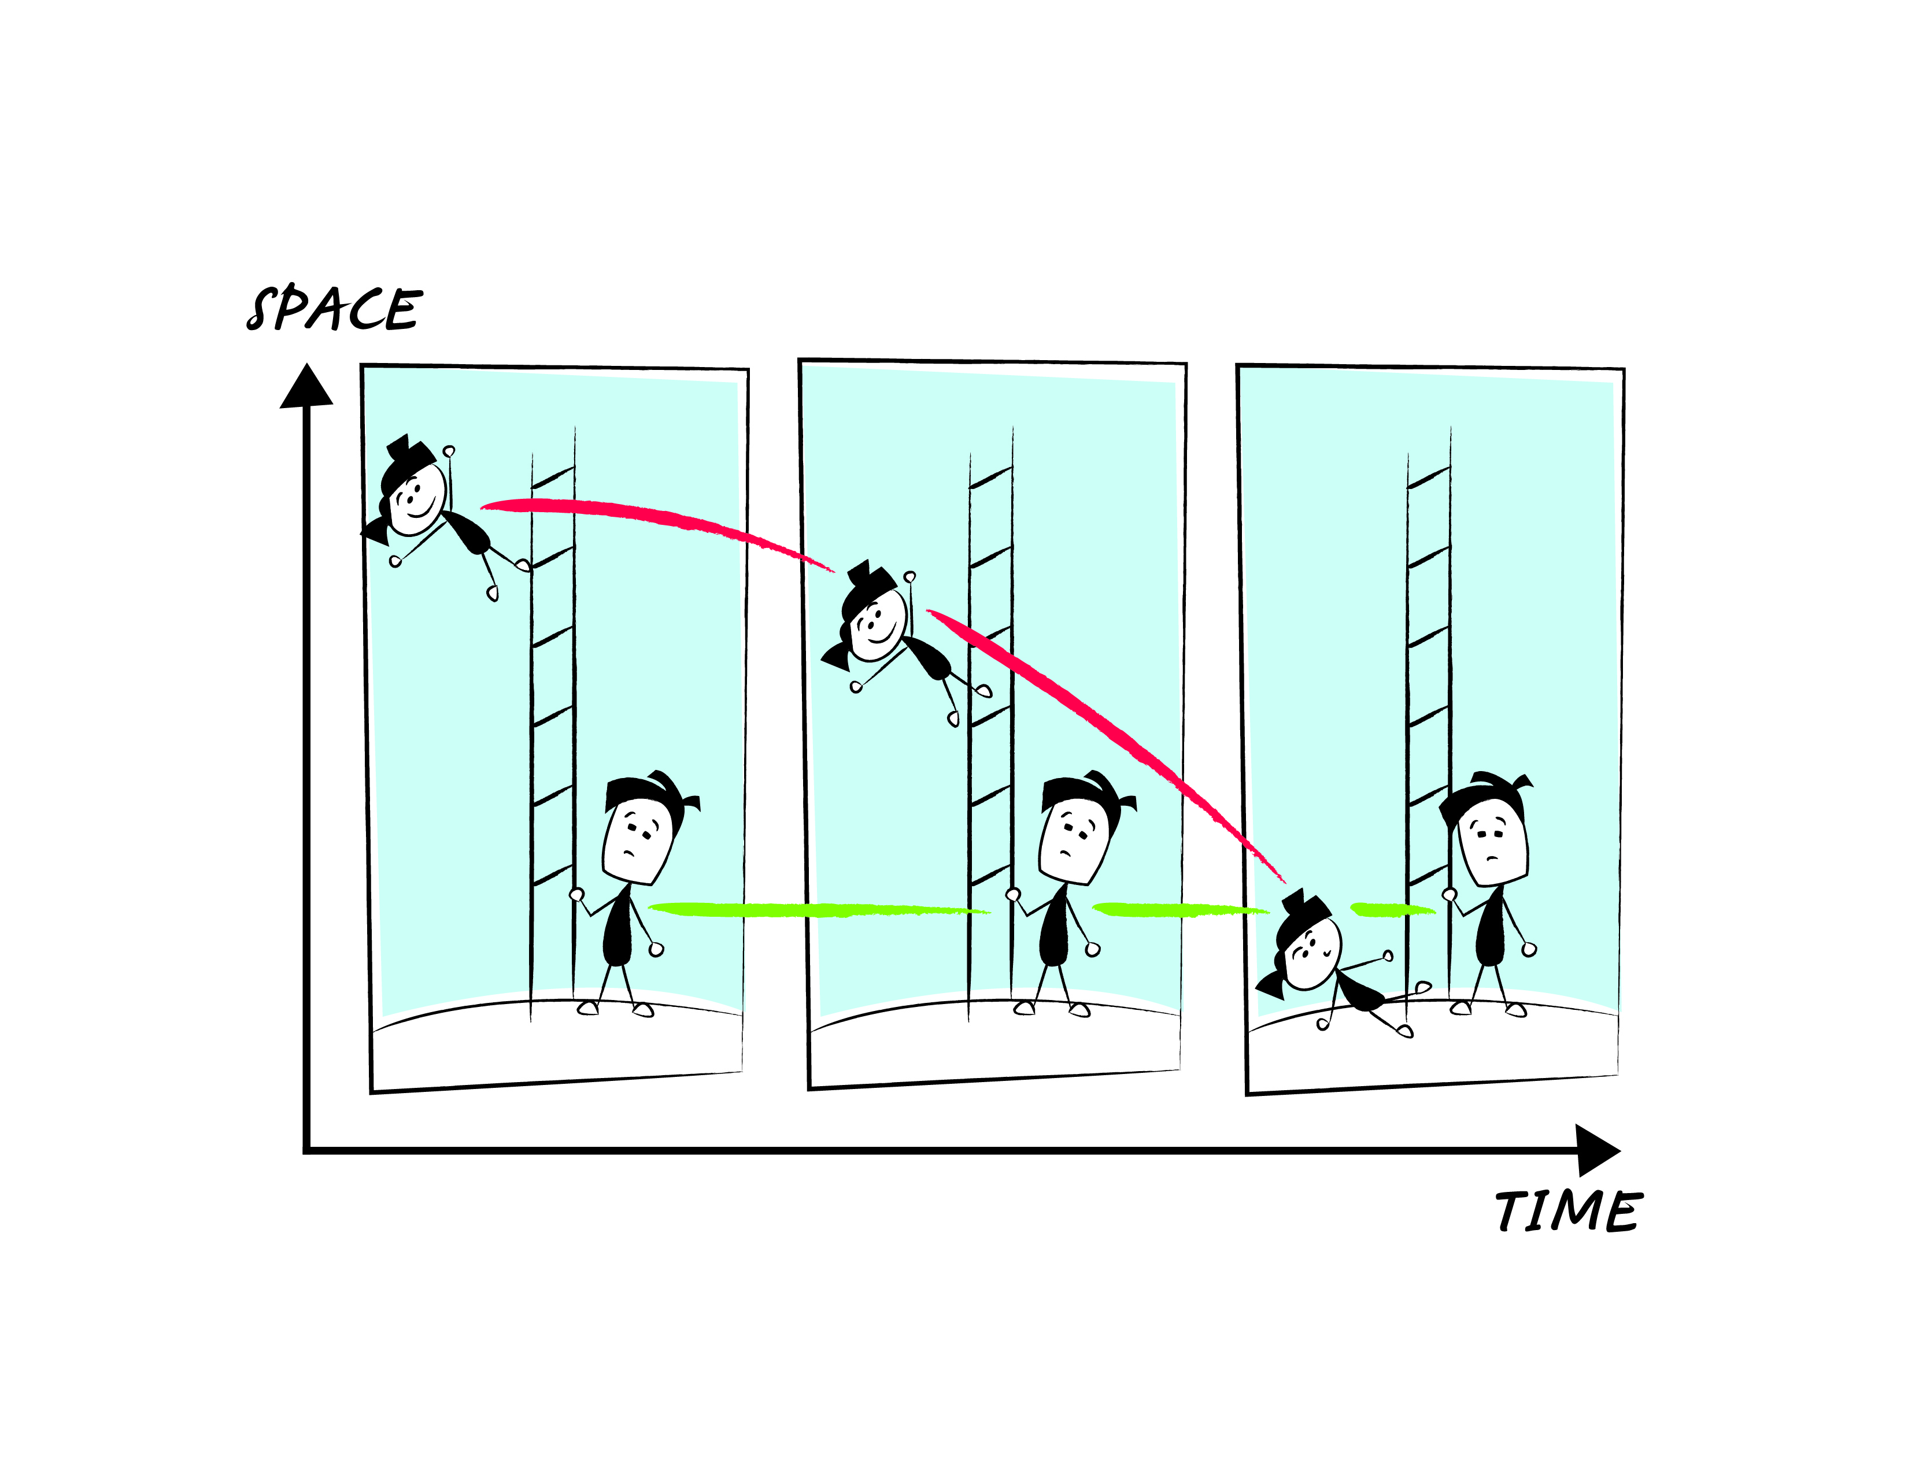
Spacetime Diagram
Notes:
Summarize the meaning of a curved line (acceleration) vs the meaning of a straight line (constant velocity/rest).
Looking at this problem through Einstein’s eyes, he had to think of a way to draw this diagram while making Alice’s line straight and Bob’s curved (but prevent Bob from moving relative to the x-axis, the surface of Earth).
Create this on the table top using masking tape.
New definition for ACCELERATION = crinkly tape, NO ACCELERATION = flat tape.

Slide 38
Spacetime Diagram
Curved lines on spacetime diagram mean the object accelerated.
Einstein’s acceleration model needs to have Alice’s line flat and Bob’s curved, while Bob remains the same distance from the x-axis…
Notes:
Summarize the meaning of a curved line (acceleration), vs the meaning of a straight line (constant velocity/rest).
Looking at this problem through Einstein’s eyes, he had to think of a way to draw this diagram while making Alice’s line straight and Bob’s curved (but prevent Bob from moving relative to the x-axis, the surface of Earth).

Slide 39
How can Bob be made to accelerate?
Notes:
Summarize the meaning of a curved line (acceleration), vs the meaning of a straight line (constant velocity/rest).
Looking at this problem through Einstein’s eyes, he had to think of a way to draw this diagram while making Alice’s line straight and Bob’s curved (but prevent Bob from moving relative to the x-axis, the surface of Earth).

Slide 40
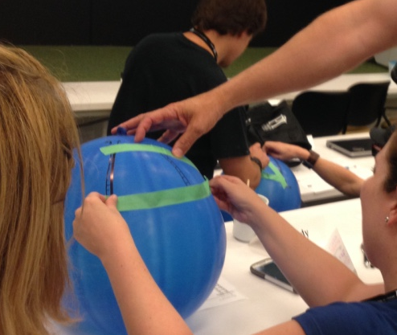
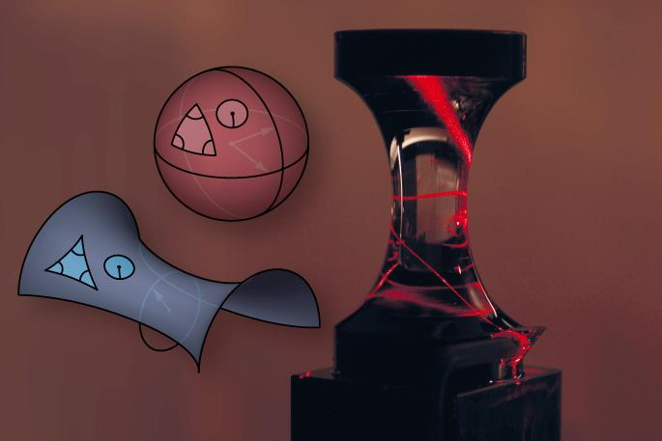
Einstein’s Solution: Spacetime is not flat!

Slide 41
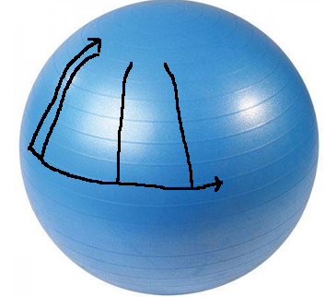
Repeat the same steps on the balloon
Curved lines on spacetime diagram mean the object accelerated.

Slide 42
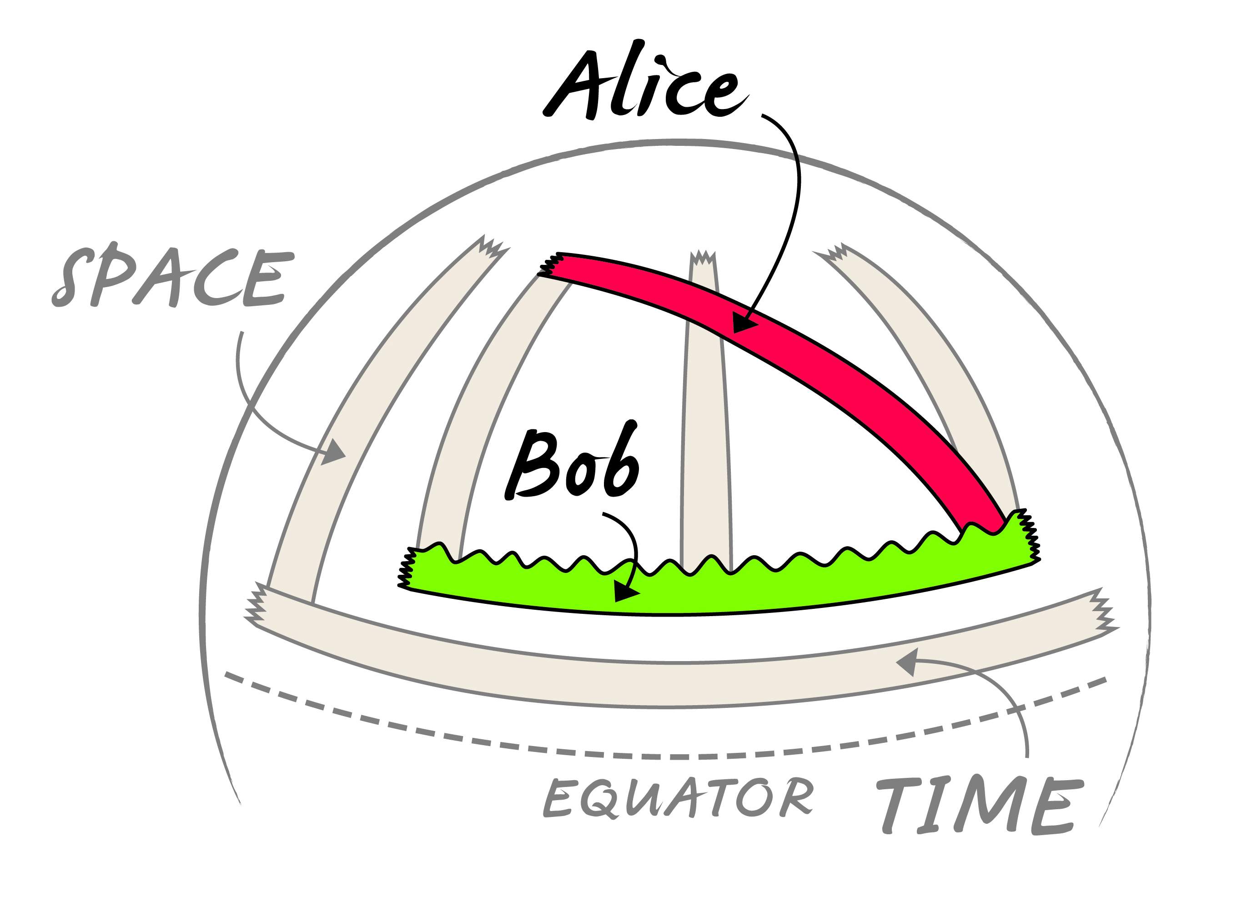
Curved Spacetime
Notes:
Einstein’s solution to this was to transfer this diagram to a curved surface.
A curve in flat space turns into a flat line in curved space.
Using large balloons, have the participants use markers and green painters tape to recreate the diagram. As part of the preparation beforehand, make sure the balloons are pumped up and the x- and y-axes have been drawn on them (make sure they follow lines of latitude (above the equator) and longitude, respectively). Have the participants draw on the ladders (along lines of longitude) and mark the positions of Alice and Bob with a marker. Use the green painters tape to “connect the dots.” Have the participants realize the qualities of a straight piece of tape vs one that is curved.

Slide 43
Curved Spacetime
Notes:
Einstein’s solution to this was to transfer this diagram to a curved surface.
Using large balloons, have the participants use markers and green painters tape to recreate the diagram. As part of the preparation beforehand, make sure the balloons are pumped up and the x- and y-axes have been drawn on them (make sure they follow lines of latitude (above the equator) and longitude, respectively). Have the participants draw on the ladders (along lines of longitude) and mark the positions of Alice and Bob with a marker. Use the green painters tape to “connect the dots.” Have the participants realize the qualities of a straight piece of tape vs one that is curved.

Slide 44
Alice’s path stays straight (no force, no acceleration)
…and yet she is falling from the top of the ladder to the bottom!
Notes:
Alice’s piece of tape will be completely flat (meaning it is straight). Using curved space-time, Einstein could describe Alice’s motion to be uniform motion (no acceleration).
ALSO, on this straight line, notice where Alice passes the ladder in the second frame (above the centre of the ladder). This reaffirms the description of acceleration, and the ground accelerating up.

Slide 45
Bob’s path curves up (he feels upward force and acceleration)
…and yet he is not moving up!
Notes:
Bob’s piece of tape is curved on the balloon. This shows that he is accelerating with the ground, but never changes his position along the y-axis on the graph (showing that he is not moving). He is ACCELERATING without MOVING.
This is a special type of acceleration, similar to acceleration experienced in circular motion. As an object moves around a circle, it experiences acceleration, but never gets closer to the centre of the circle. Bob experiences acceleration, but does not move in any recognizable direction.

Slide 46
Two Models
Newton: Gravity is a force
FEELS RIGHT, but doesn’t survive experimental tests
Einstein: Spacetime is curved
FEELS WEIRD but explains what we see (so far)
Notes:
So far, the acceleration model has survived our tests. It is able to explain gravity, and we have been able to show how something like the Earth can accelerate without getting larger.

Slide 47
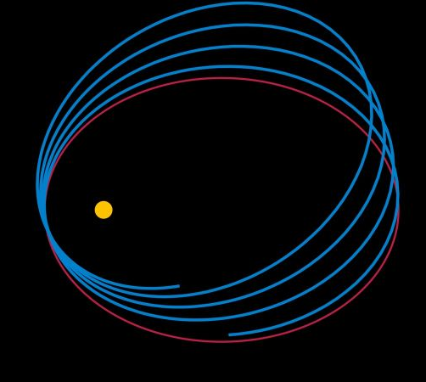
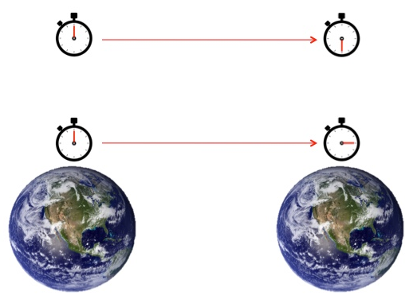

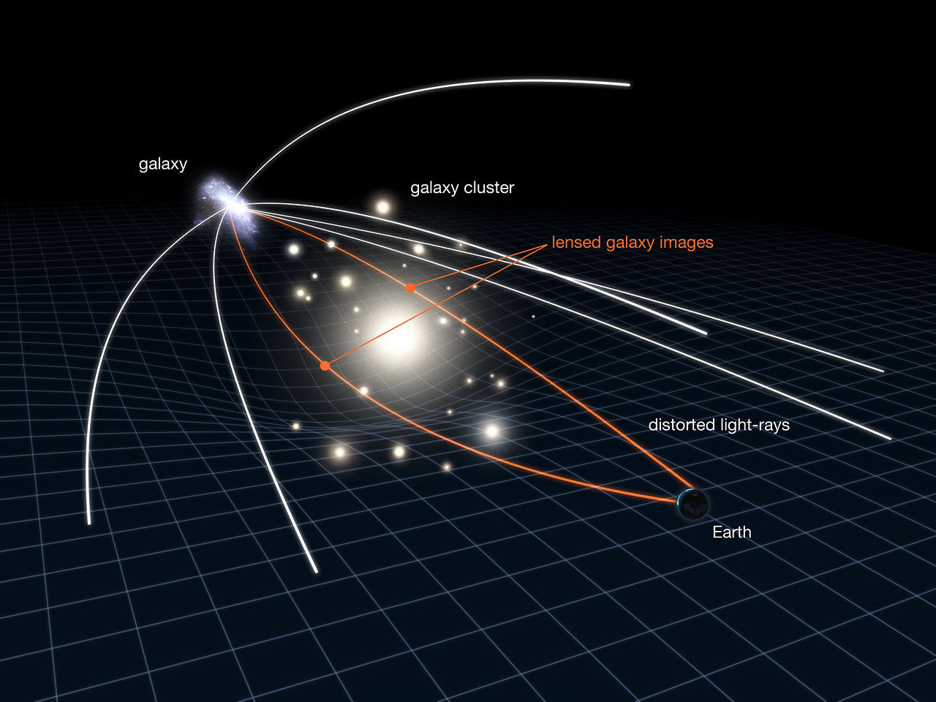
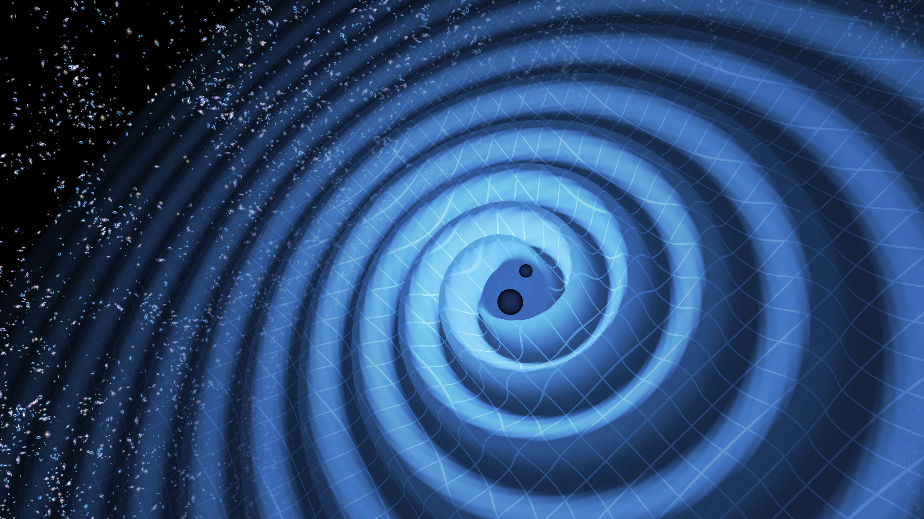
Mercury’s Orbit
Time Dilation
Lensing
Gravitational Waves

Slide 48

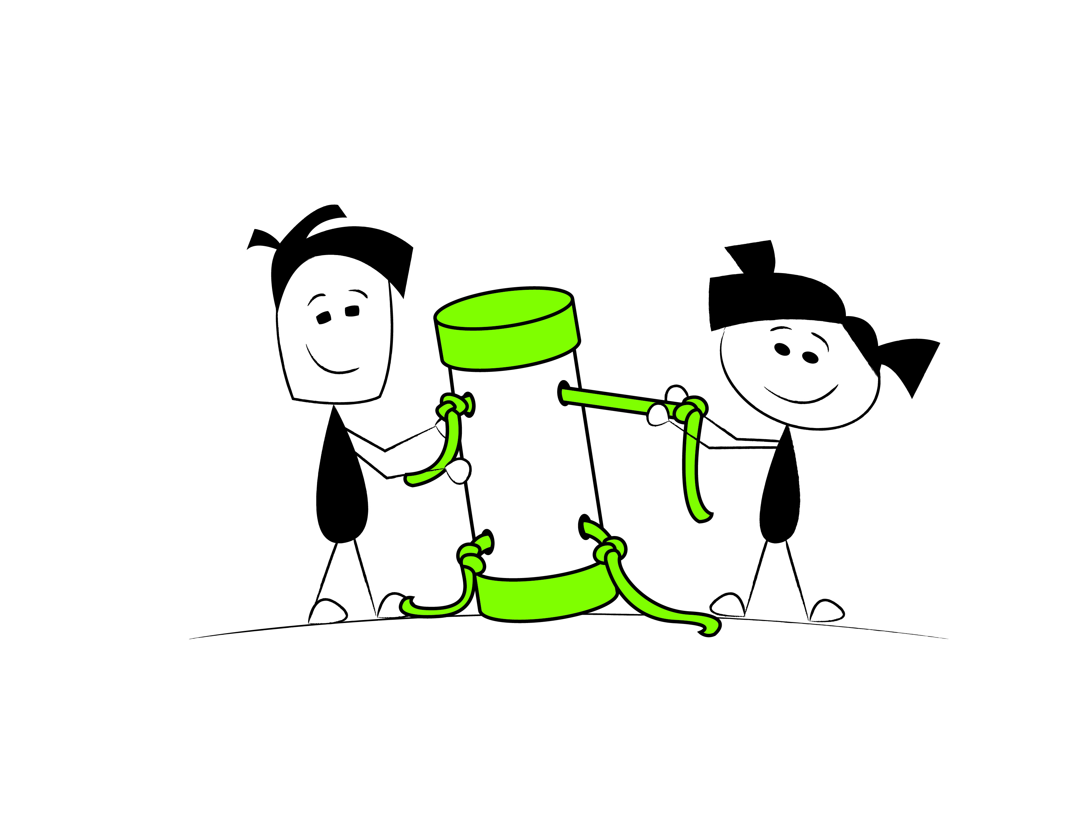
Science is a powerful way of thinking
Curiousity
Creativity
Collaboration
Notes:
The model nature of science.

Slide 49

Notes:
13 short years later, PI is now the largest theoretical physics institute in the world.
We recently double the size of the facility, tripling capacity with the addition of the Stephen Hawking Centre at PI.
Stephen is a DVRC and a huge supporter, this is the first time he has ever lent his name to a facility

Slide 50

Notes:
Research strategy

Slide 51



Teacher Programs
www.perimeterinstitute.ca/outreach/teachers
Notes:
Perimeter Institute offers a range of programming for high school physics and science teachers. Visit our website or email outreach@perimeterinstitute.ca for current programs.

Slide 52



IN-CLASS RESOURCES
Experienced teachers
Perimeter researchers
Pedagogy and teaching strategies
https://resources.perimeterinstitute.ca/
Notes:
We produce about two resources per year, each with a suite of lessons and often with a short video. Our resource centre has 21 compilations and over 100 individual resources.
The resources are written by a team of teachers and outreach scientists. All lessons are reviewed and tested by our teacher network. All science content is carefully vetted by one of our researchers to ensure not just correctness, but insight and depth.
One of our goals is to equip teachers with excellent material that they can use in their classroom.Face to face just can’t scale; how do we reach as many youth as possible in an extremely impactful way … we choose to reach them through their teachers … we know where they are, we know what they are trying to do, and we know how we can help…
Raising the research culture throughout the Region, across Ontario and Canada – joint hires, exchanges, joint-workshops, etc.
96% report “increase value of scientific skills of creativity, critical thinking, communication”
Teachers
Researchers
Professional Editorial and Design
Classroom tested;
Challenge: Finding the core concepts, must relevant to the subject, the teachers, the students.

Slide 53


High School Student Programs
www.perimeterinstitute.ca/outreach/students
1-day workshops (online)
ISSYP
Notes:
Perimeter Institute offers a range of programming for high school students. Visit our website or email outreach@perimeterinstitute.ca for current programs.

Slide 54


Slide 55







INSPIRING THE NEXT GENERATION
10 MILLION/year
In-class resources
20,000⁺
teachers trained
100⁺ countries
100,000⁺ on site
MILLIONS online views

Slide 56

https://resources.perimeterinstitute.ca/

Slide 57
Thank You!!
www.perimeterinstitute.ca
Dave Fish
Perimeter Institute dfish@pitp.ca
@DaveFishPI
Kelly Foyle
Perimeter Institute
kfoyle@pitp.ca

