Slide 1
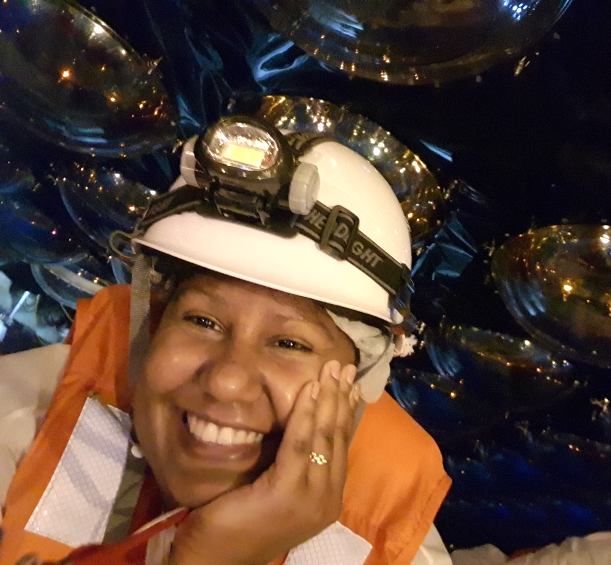
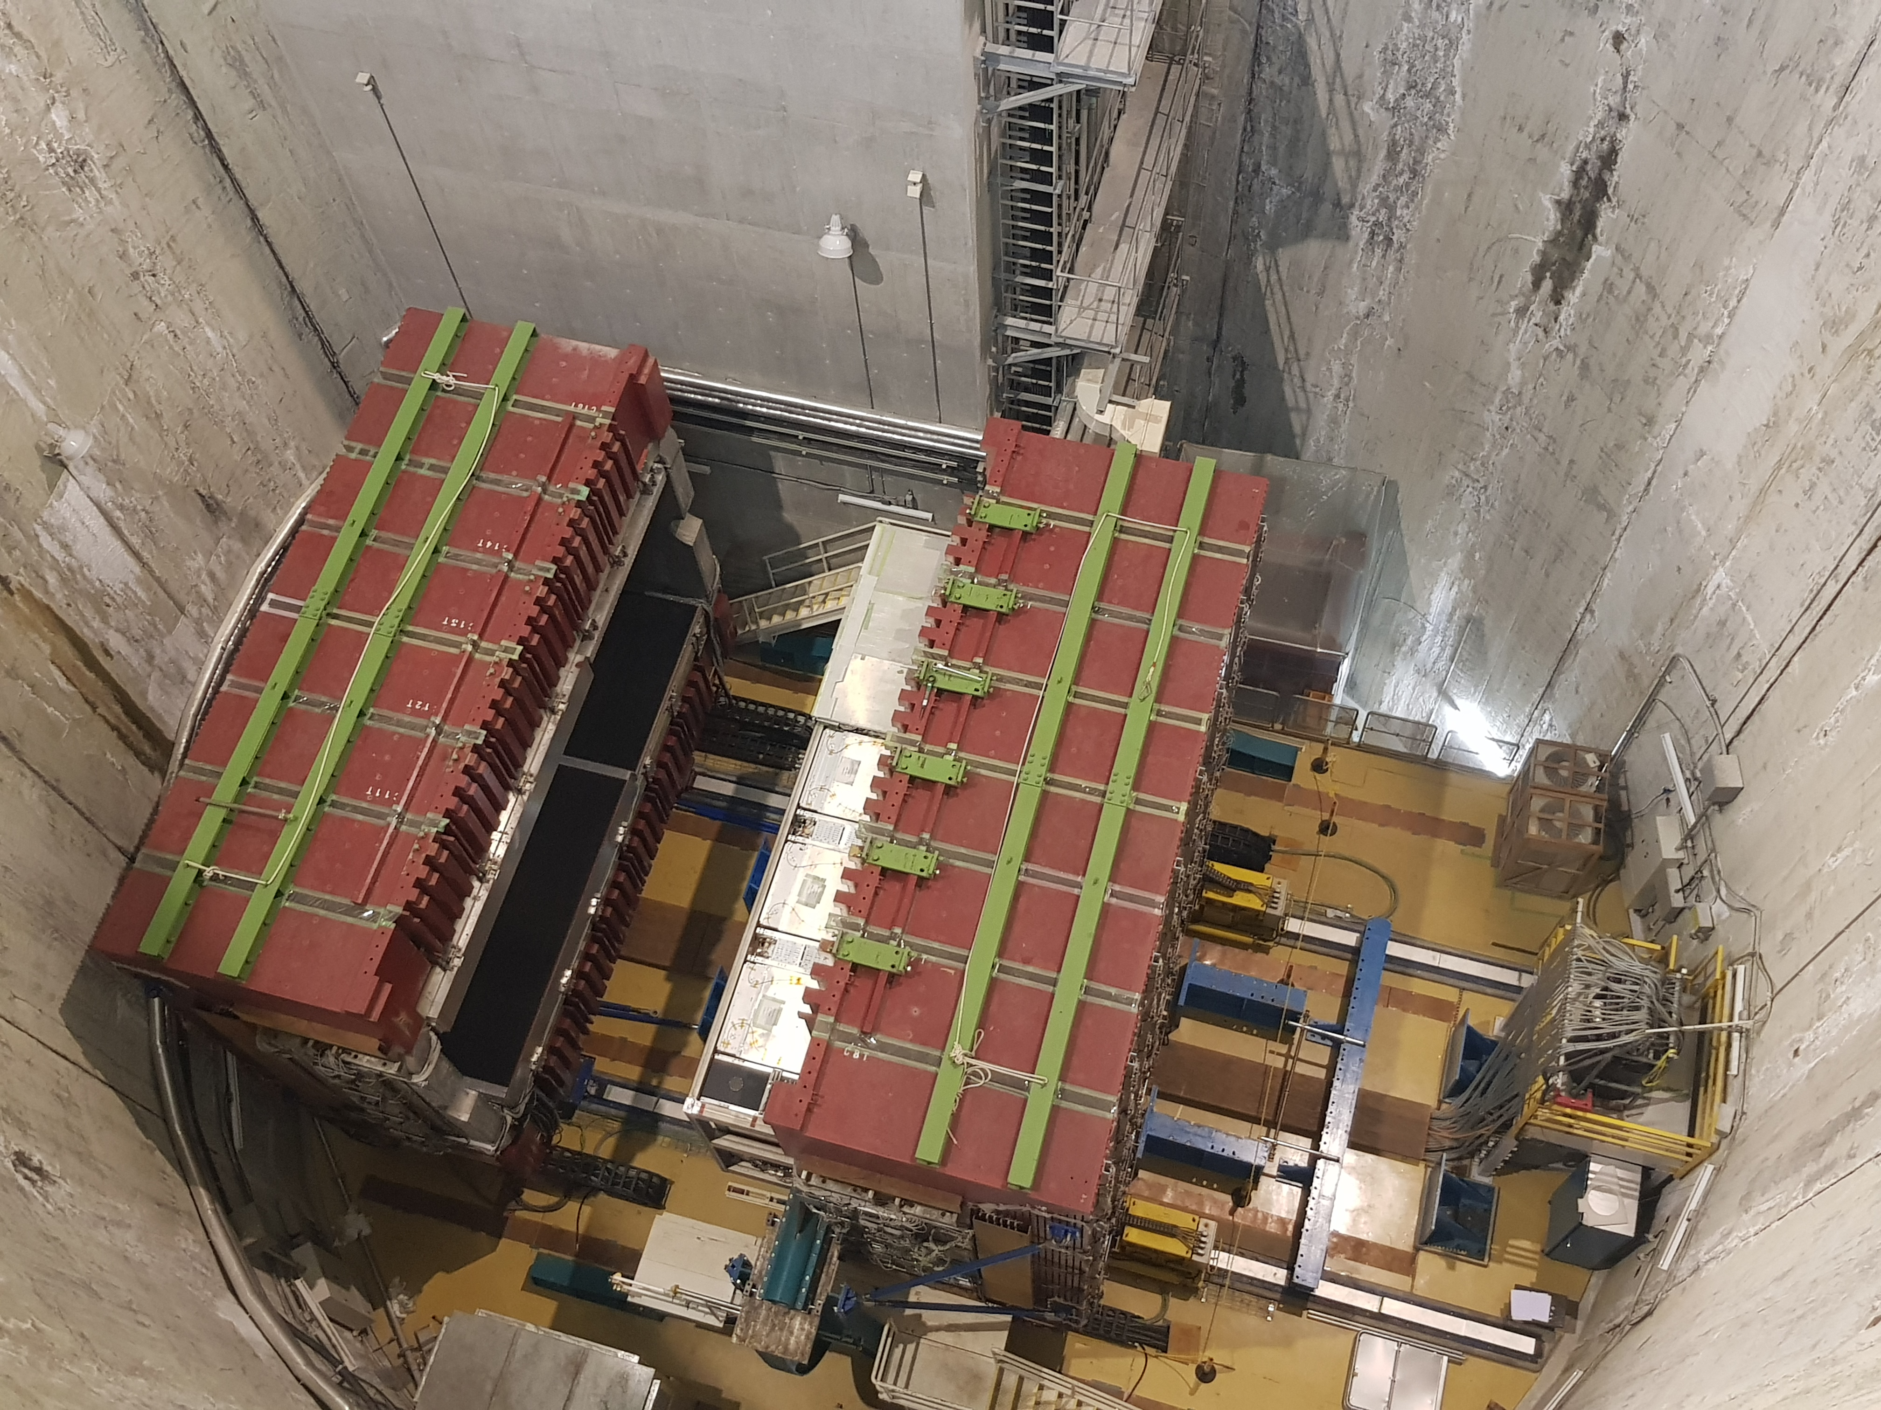


Neutrino Physicist or Ghost Hunter?
International High School Teacher Programme
Danaisis Vargas Oliva
danaisis.vargas@cern.ch
University of Toronto
July ${13}^{th}$, 2022
Inside Proto-DUNE
Inside Super-Kamiokande
On top of ND280

Slide 2
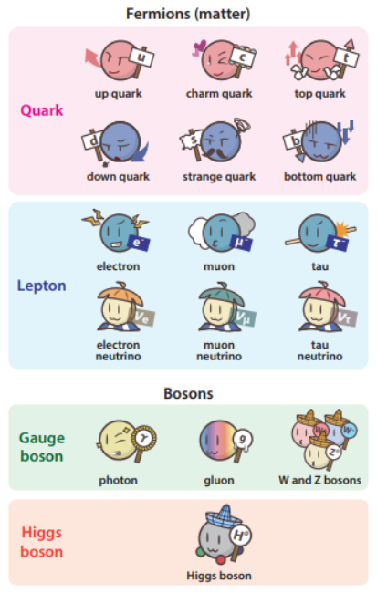
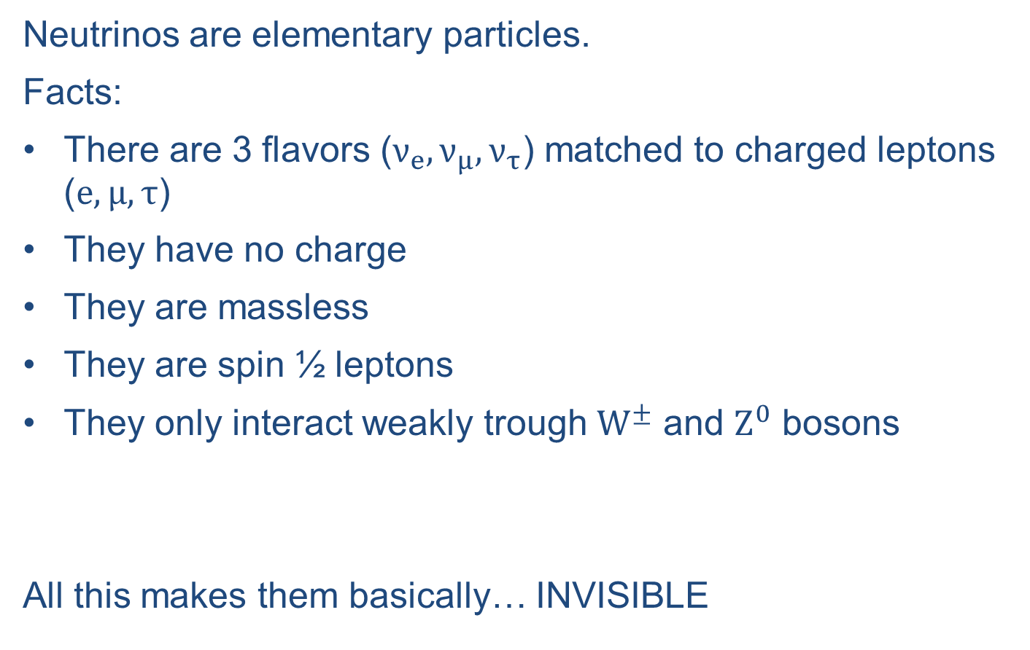
Neutrinos in the Standard Model
Neutrinos are elementary particles.
Facts:
There are 3 flavors ($ν_{e}, ν_{μ}, ν_{τ}$) matched to charged leptons ($e, μ, τ$)
They have no charge
They are massless
They are spin ½ leptons
They only interact weakly trough $W^{±}$ and $Z^{0}$ bosons
All this makes them basically… INVISIBLE
nearly massless
https://www-he.scphys.kyoto-u.ac.jp/nucosmos/en/
Notes:
The fundamental constituents of matter are the quarks, the charged leptons, and the neutrinos.
The standard model is the theory of fundamental particles and how they interact.

Slide 3
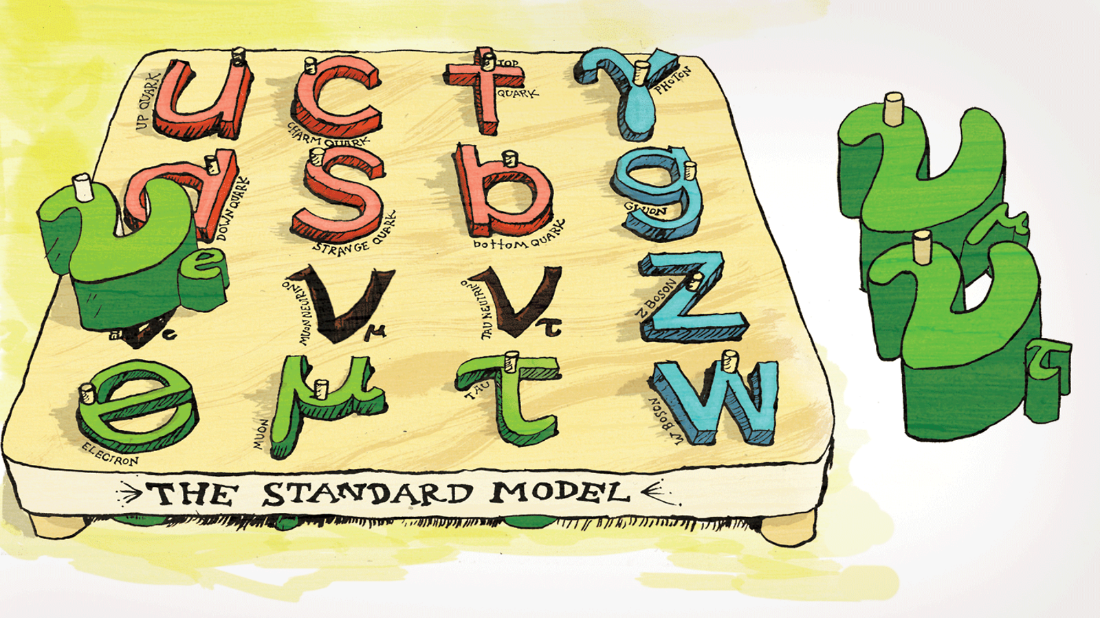
Neutrinos in the Standard Model
Notes:
Massive neutrinos do not fit with the SM prediction.

Slide 4
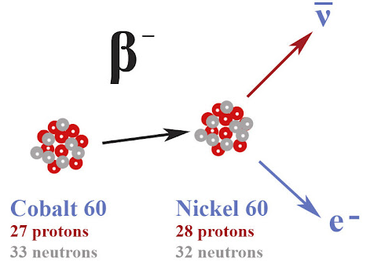
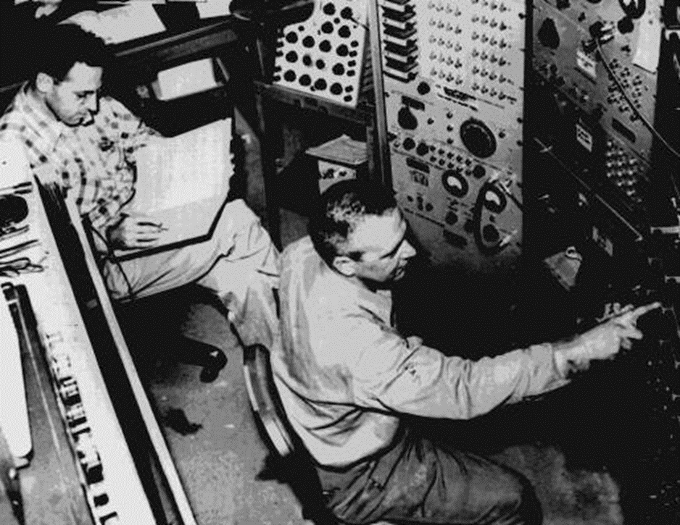

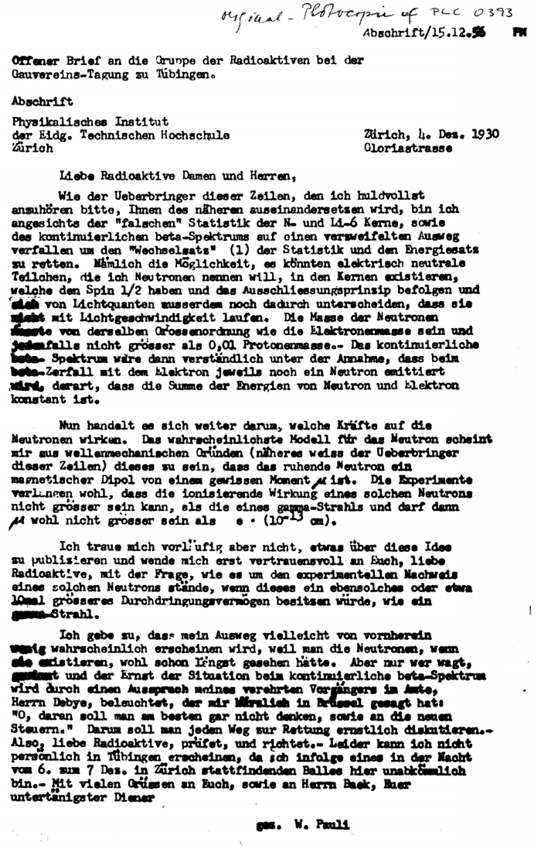
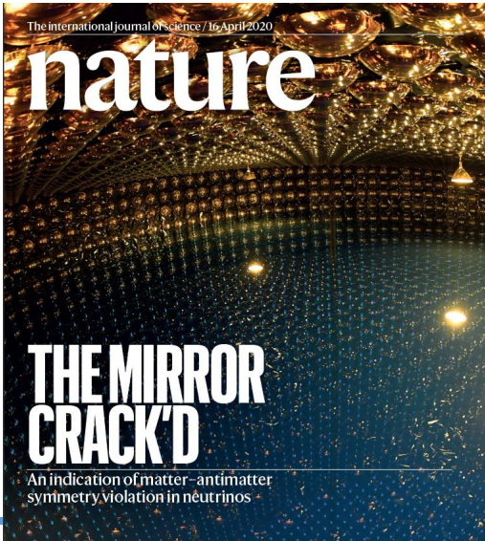
Neutrino physics history
2020
2015
Constraint on the Matter-Antimatter Symmetry-Violating Phase in Neutrino Oscillations
2000
Nobel Prize in Physics to Takaaki Kajita and Arthur B. McDonald "for the discovery of neutrino oscillations, which shows that neutrinos have mass.“
1962
1956
The DONUT collaboration at Fermilab announced the discovery of the tauonic neutrino
1932
Leon Max Lederman, Melvin Schwartz, and Jack Steinberger showed that more than one type of neutrino existed when the muon neutrino was first detected
1930
Clyde Cowman and Federick Reines detected the neutrino experimentally from a reactor source
The Pauli neutron was renamed "neutrino" by Fermi when the real neutron was discovered by Chadwick
Wolfgang Pauli postulated the “neutron” to compensate for the apparent loss of energy and conserve the momentum of decay 𝛽−

Slide 5
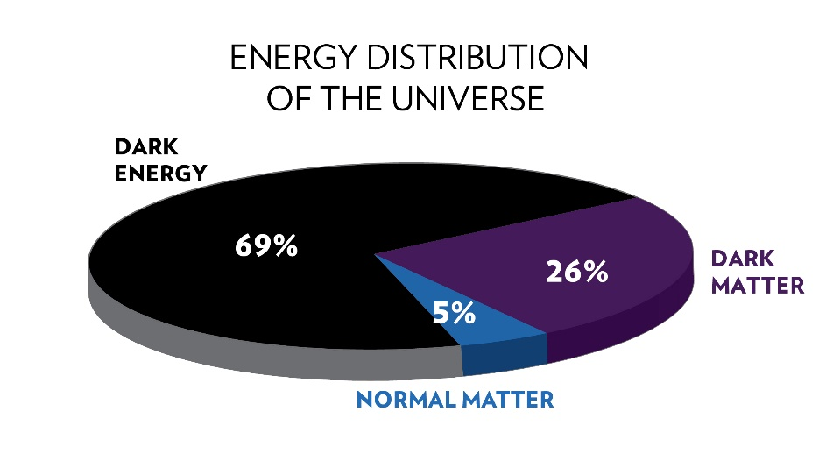
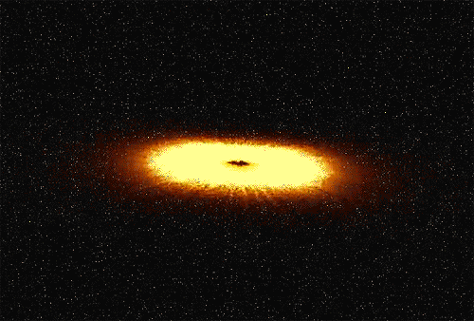
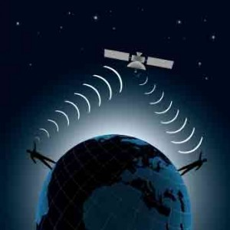

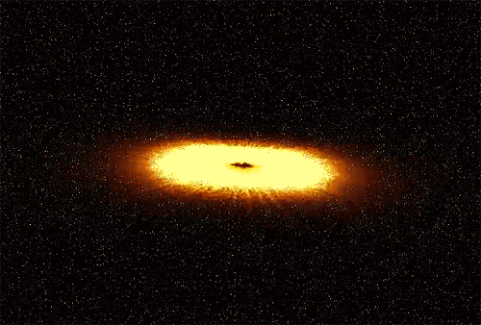
What's so interesting about neutrinos?
Discover supernovae and other astrophysical events.
We could explain the matter/antimatter asymmetry.
They could help explain dark matter.
Geologically study the interior of the earth.
Monitor nuclear weapons on earth.
Method of transmitting information (in the distant future).
$$ν$$

Slide 6
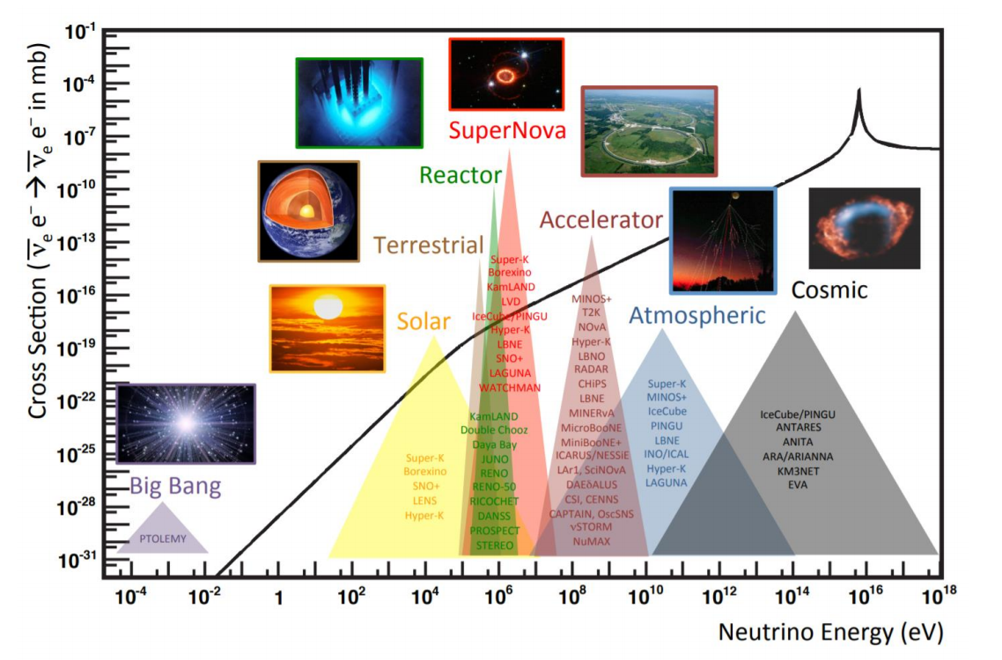
Neutrino sources
Neutrino sources
There are two types of neutrino sources:
Natural:
  Sun (solar neutrinos)
  Big Bang (relic neutrinos)
  Supernova explosions (supernova neutrinos)
  Cosmic rays interacting in the atmosphere (atmospheric neutrinos)
Artificial:
  Nuclear reactors (reactor neutrinos)
  Particle accelerators (accelerator neutrinos)
Neutrinos cover a wide spectrum of energy and detecting them involves using different techniques and detectors.

Slide 7
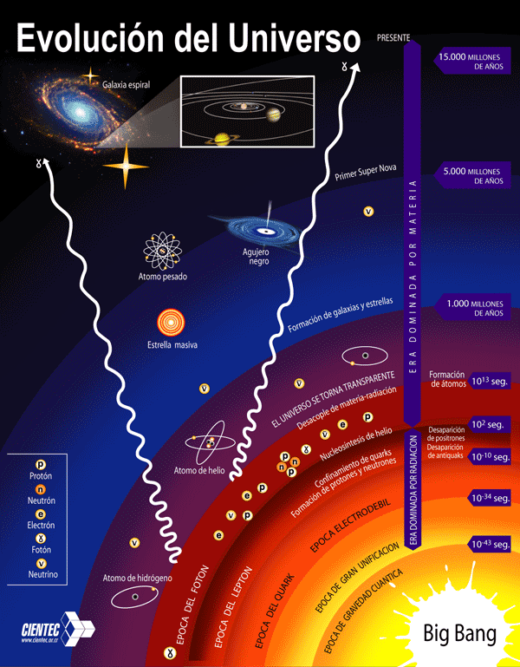
Relic neutrinos
Relic neutrinos from the cosmic neutrino background (CNB) originating in the early Universe let us know:
  The conditions of the early Universe (neutrino decoupling ~1 s after the Big Bang)
Could answer basic questions like:
What is the absolute scale of the neutrino mass?
Are neutrinos their own antiparticle?…
But they haven't been detected yet!!!

Slide 8
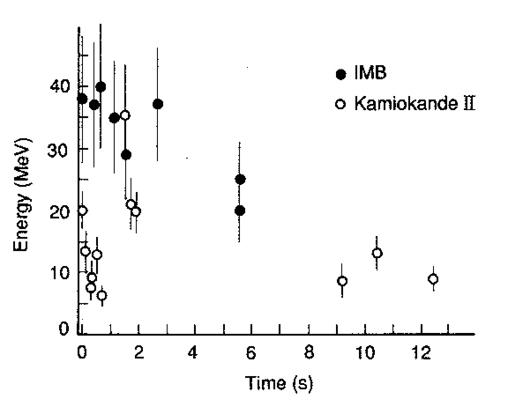
Supernova neutrinos (SN)
Supernovae bursts are a huge source of neutrinos of all flavors within ~12 sec.
Measurement of SN neutrinos will provide information about:
  Supernova physics: Core collapse mechanism, SN evolution in time, black hole formation, etc.
  Neutrino physics: neutrino oscillation, neutrino absolute mass, etc.
~20 supernova neutrino events were measured in Kamiokande and IMB from SN1987A.
  Beginning of using neutrinos for multi-messenger astronomy.

Slide 9
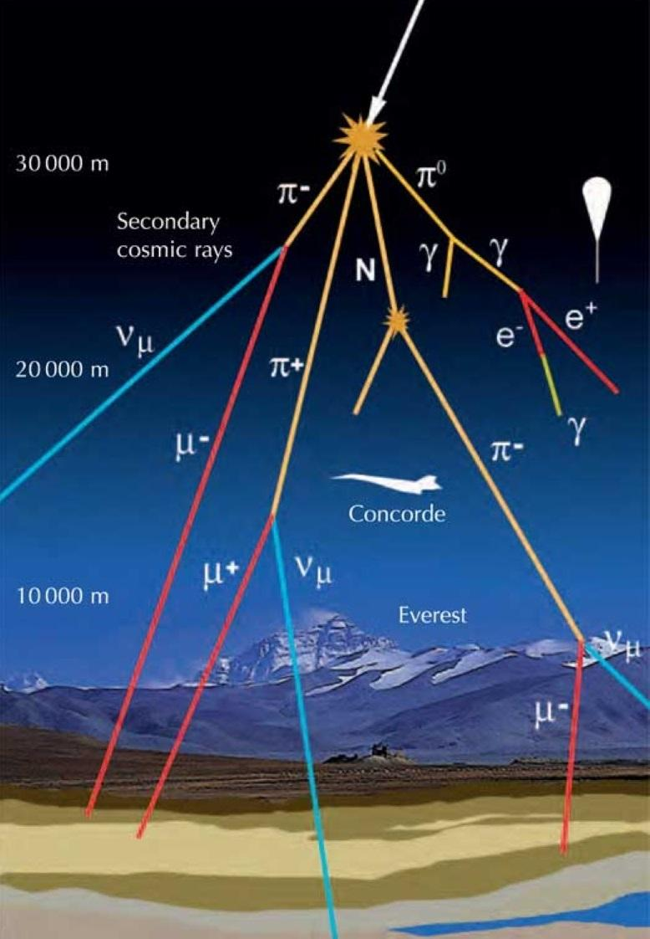






Atmospherics neutrinos
$$p+{}_{}^{A}X→π^{±}+{}_{}^{A}{X^{′}}$$
$π^{±} → μ^{±}+ν_{μ}\left({\overline{ν}}_{μ}\right)$
$μ^{±} → e^{±}+ν_{e}\left({\overline{ν}}_{e}\right)+{\overline{ν}}_{μ}\left(ν_{μ}\right)$
$$p+{}_{}^{A}X→K^{±}+{}_{}^{A}{X^{′}}$$
$K^{±} → μ^{±}+ν_{μ}\left({\overline{ν}}_{μ}\right)$
$μ^{±} → e^{±}+ν_{e}\left({\overline{ν}}_{e}\right)+{\overline{ν}}_{μ}\left(ν_{μ}\right)$
Experiments to observe atmospheric neutrinos are built underground:
  To diminish the effects of cosmic rays and other sources of stellar noise.

Slide 10
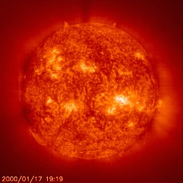

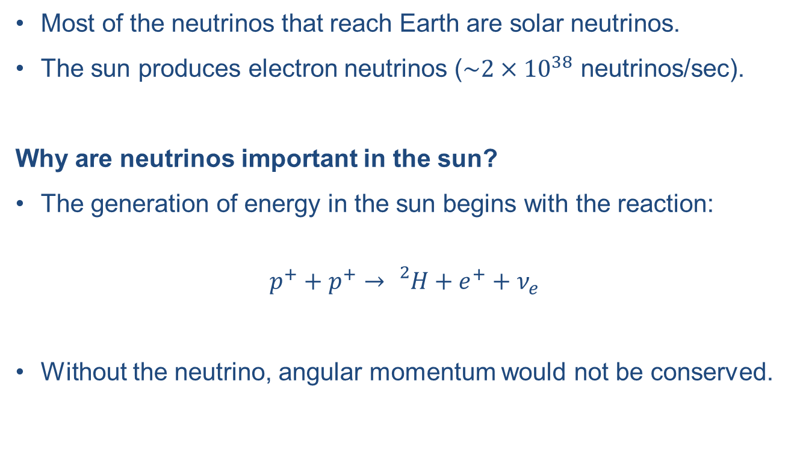

Solar neutrinos
Most of the neutrinos that reach Earth are solar neutrinos.
The sun produces electron neutrinos ($\sim 2×{10}^{38}$ neutrinos/sec).
Why are neutrinos important in the sun?
The generation of energy in the sun begins with the reaction:
$$p^{+}+p^{+}→{}_{}^{2}H+e^{+}+ν_{e}$$
Without the neutrino, angular momentum would not be conserved.

Slide 11
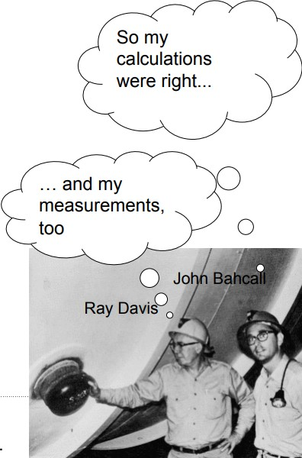
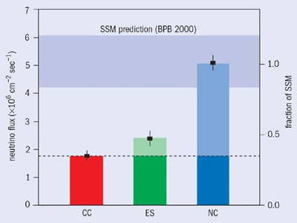
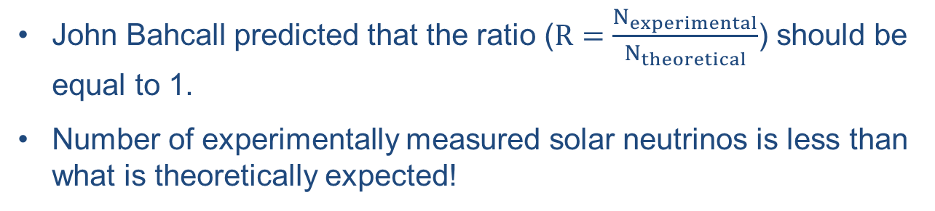
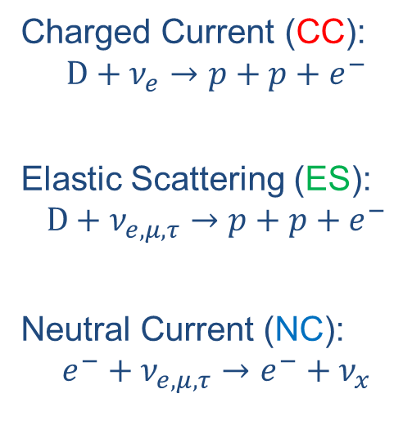
Solar neutrinos
John Bahcall predicted that the ratio ($R=\frac{N_{experimental}}{N_{theoretical}}$) should be equal to 1.
Number of experimentally measured solar neutrinos is less than what is theoretically expected!
Charged Current (CC):
$$D+ν_{e}→p+p+e^{−}$$
Elastic Scattering (ES):
$$D+ν_{e,μ,τ}→p+p+e^{−}$$
Neutral Current (NC):
$$e^{−}+ν_{e,μ,τ}→e^{−}+ν_{x}$$

Slide 12








Neutrino oscillation
Neutrinos interact with matter and produce a lepton of the same flavor as the neutrino.
$$e^{−}$$
$$μ^{−}$$
$$τ^{−}$$
$$e^{−}$$
$$ν_{e}$$
$$ν_{μ}$$
$$ν_{τ}$$
$$ν_{μ}$$
Detector
Detector
Detector
Detector
Never
Notes:
Neutrinos can change their flavors and this flavor change is known as neutrino oscillation.

Slide 13


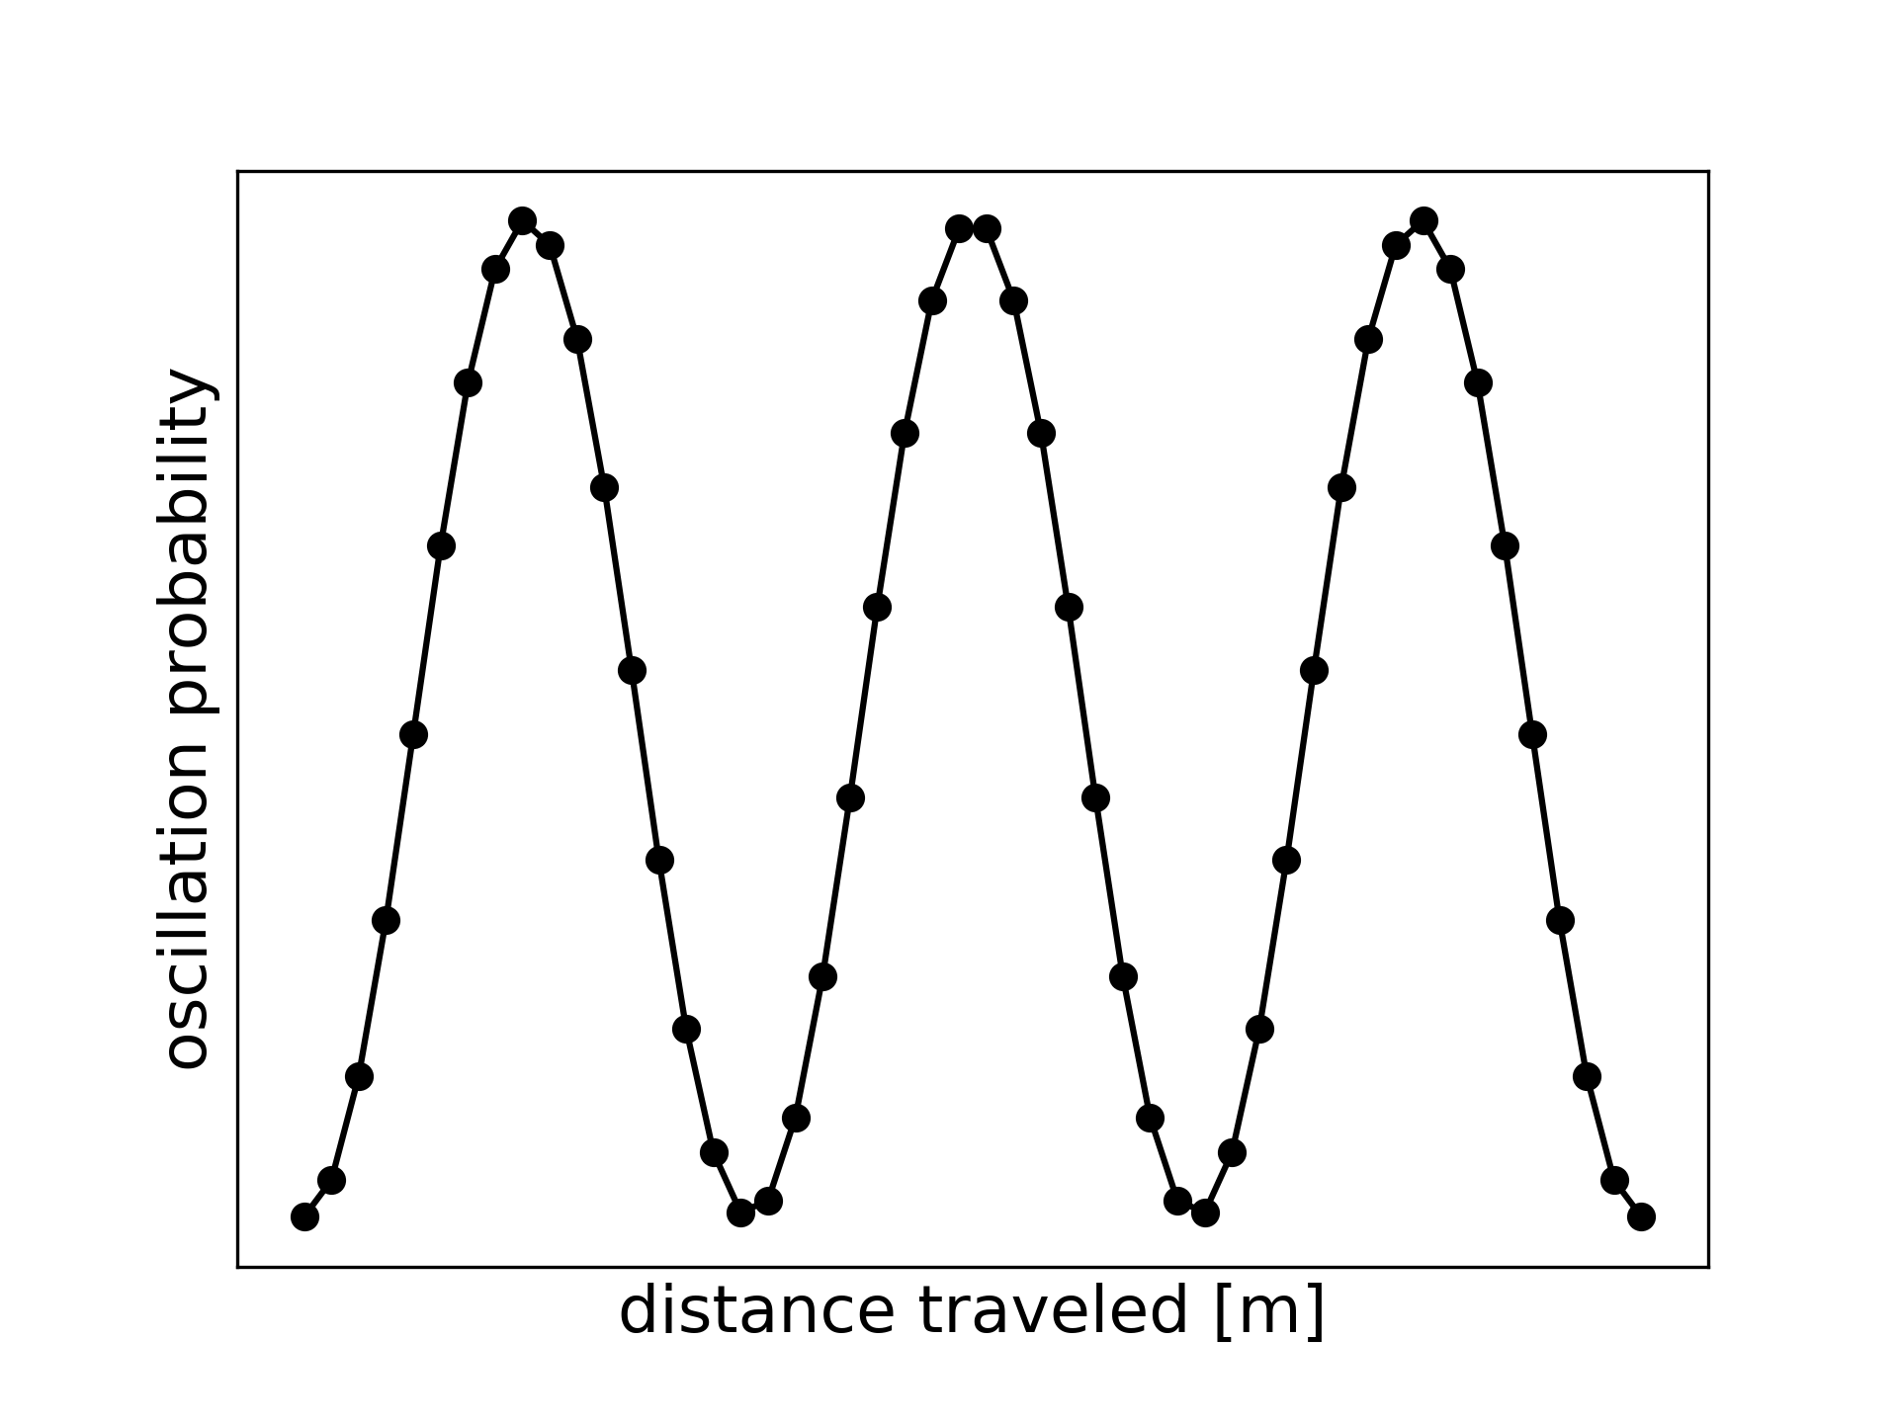




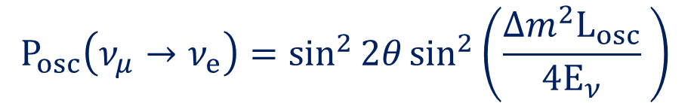




Neutrino two flavor oscillation
$$e^{−}$$
$$μ^{+}$$
$$ν_{μ}$$
$$ν_{e}$$
All oscillation experiments live in the 0.1-10 GeV transition region.
$$W^{+}$$
Long trip ($L_{osc}$)
Far detector
The oscillation is described by this equation:
We extract:
Rotation angle
$$P_{osc}\left(ν_{μ}→ν_{e}\right)=\sin^{2}{2θ}\sin^{2}\left(\frac{Δm^{2}L_{osc}}{4E_{ν}} \right)$$
We know:
length of the neutrino's long journey
$$\sin^{2}{2θ}$$
$$L_{osc}$$
We calculate:
Probability of the oscillation
We calculate:
Neutrino flux energy
Note: Which means that at least one of them has to have mass for the oscillation to occur.
Notes:
Changing the mass parameter changes the position of the minimum.
Changing the angle parameter changes the depth of the minimum.

Slide 14
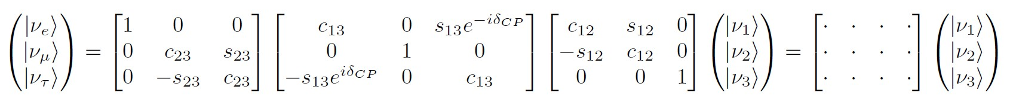
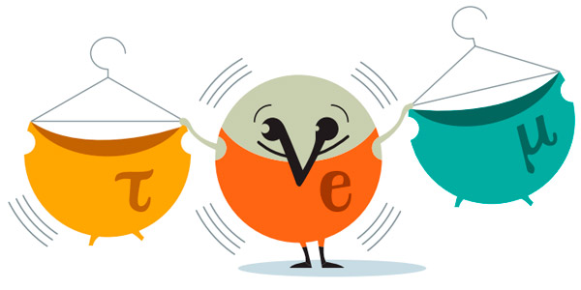
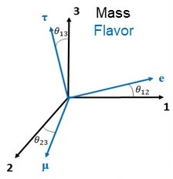

Neutrino three flavor oscillation
PNMS (Pontecorvo–Maki–Nakagawa–Sakata) rotation matrix.
Where $c_{ij}=\cos{θ_{ij}}$, $s_{ij}=\sin{θ_{ij}}$ and ${∆m}_{ij}^{2}=m_{i}^{2}−m_{j}^{2}$
The oscillation depends of:
3 mixing angles: $θ_{12}, θ_{13}, θ_{23}$
1 CP violating phase: $δ_{CP}$
2 mass differences: $Δm_{21}^{2}, Δm_{32}^{2}$
Atmospheric Reactor Solar
Value still unknown
Sign still unknown
Notes:
PMNS is analogous to the Cabibbo-Kobayashi-Maskawa (CKM) matrix which mixes the weak and strong quarks
Neutrino flavors eigenstates are related through the rotation PNMS matrix to the neutrino mass eigenstates;
Of them the value of the CP violation phase and the sign of one of the mass differences are still unknown.
There are two possible arrangements of neutrino masses.
The mass difference values have been measured using atmospheric and solar neutrinos.

Slide 15
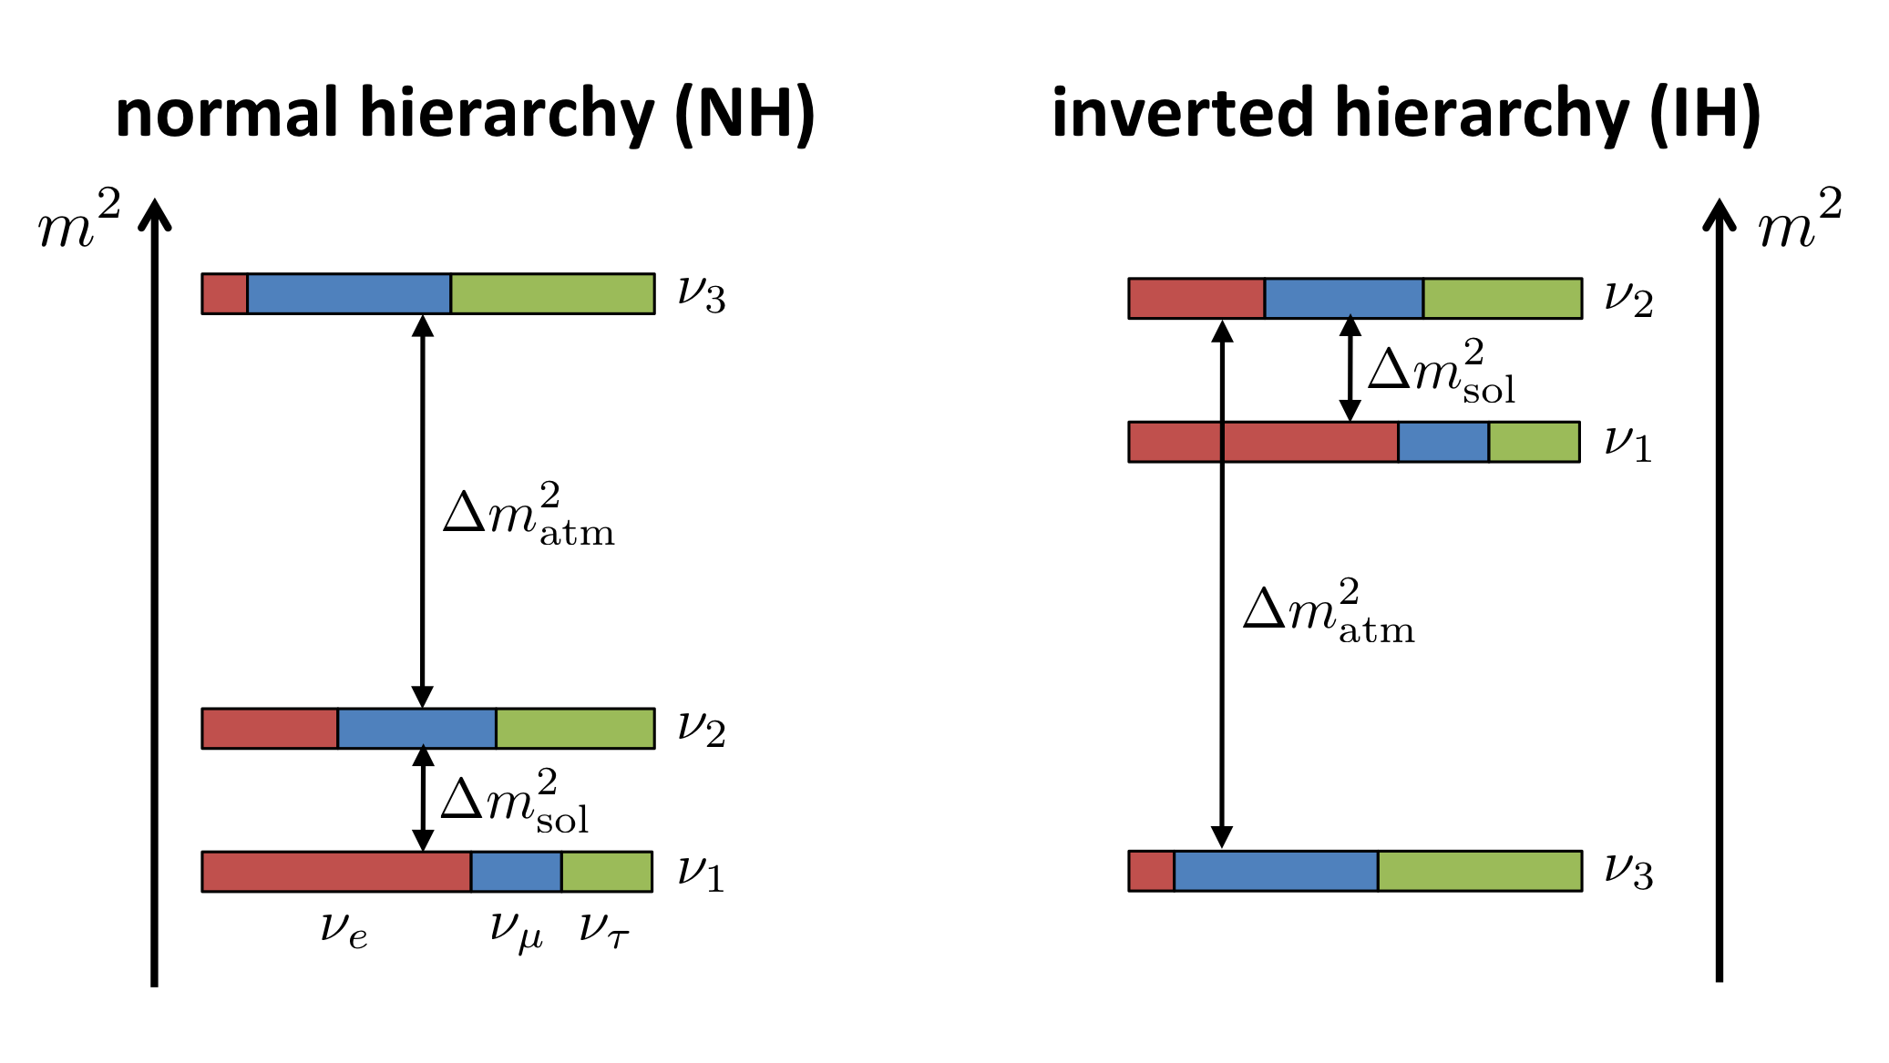
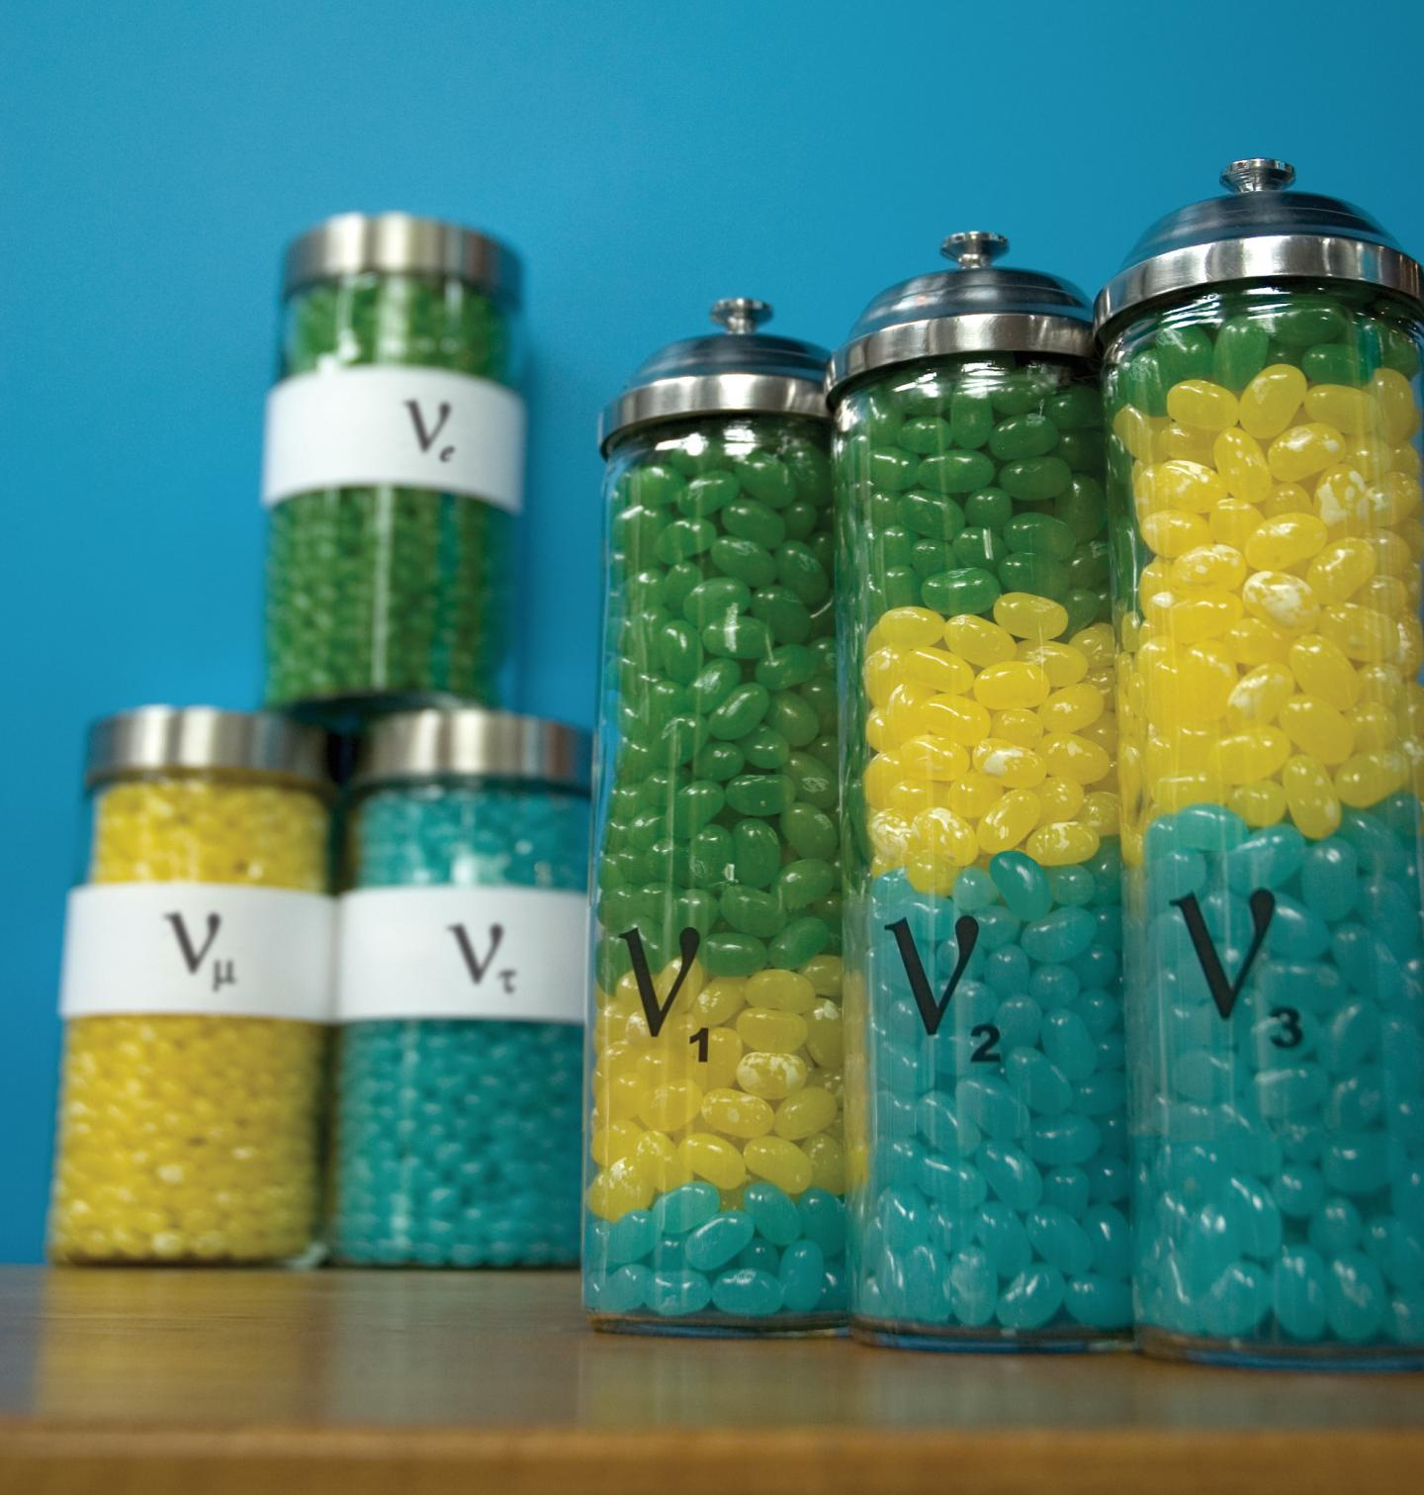
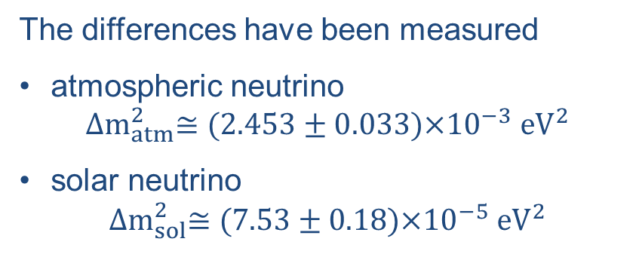
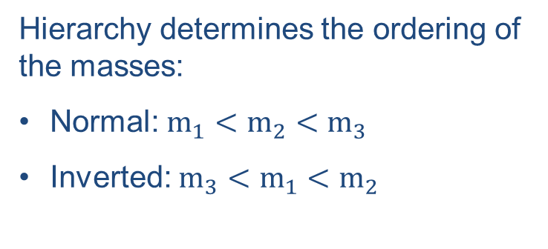
Mass hierarchy
A neutrino with a specific mass has no specific flavor … a neutrino with a specific flavor has no specific mass
Absolute scale of neutrino masses unknown
Hierarchy determines the ordering of the masses:
Normal: $m_{1}<m_{2}<m_{3}$
Inverted: $m_{3}<m_{1}<m_{2}$
The differences have been measured
atmospheric neutrino
$${∆m}_{atm}^{2}≅\text{(}\text{2}\text{.}453±0.033\text{)}\text{×}{10}^{−3} {eV}^{2}$$
solar neutrino
$${∆m}_{sol}^{2}≅\text{(7.53}±0.18\text{)}\text{×}{10}^{−5} {eV}^{2}$$
https://pdg.lbl.gov/2022/tables/contents_tables.html
Notes:
Neutrino can change their flavors and these flavor change is known as neutrino oscillation.
Neutrino flavors eigenstates are related through the rotation PNMS matrix to the neutrino mass eigenstates;

Slide 16
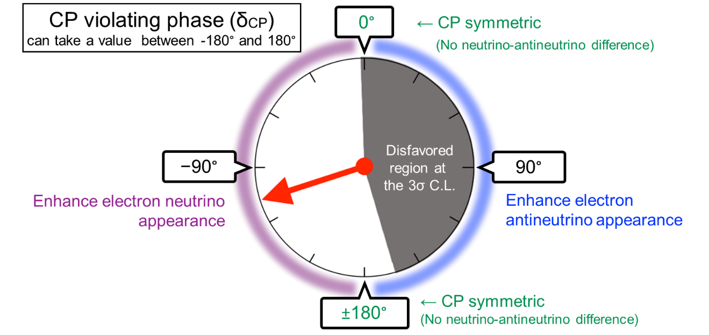
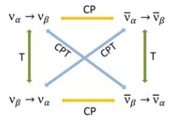
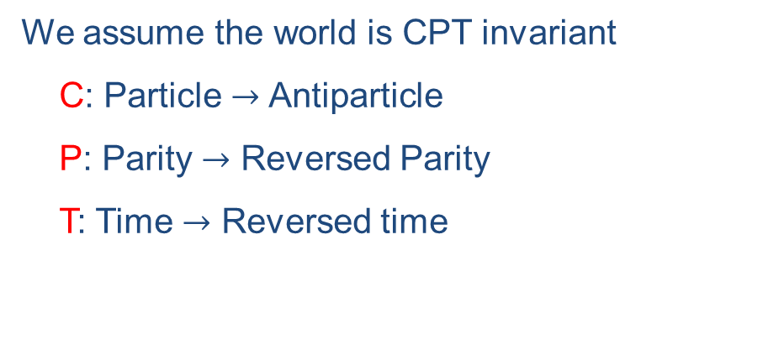
CP violation
We assume the world is CPT invariant
  C: Particle $→$ Antiparticle
  P: Parity $→$ Reversed Parity
  T: Time $→$ Reversed time
Best fit
https://www.nature.com/articles/s41586-020-2177-0
T2K result excludes most of the $δ_{CP}$ >0 values a 99.7% Confidence Level
Notes:
Best fit $\sim 108°$

Slide 17
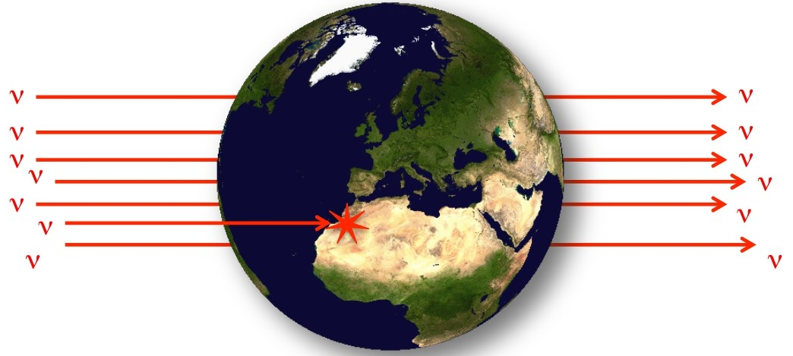
Why is it so hard to detect them?
With $E_{ν}=11 MeV$ the mean free path in lead is 350 billion kilometer
In earth ~3 out of 1 billion neutrinos would interact

Slide 18
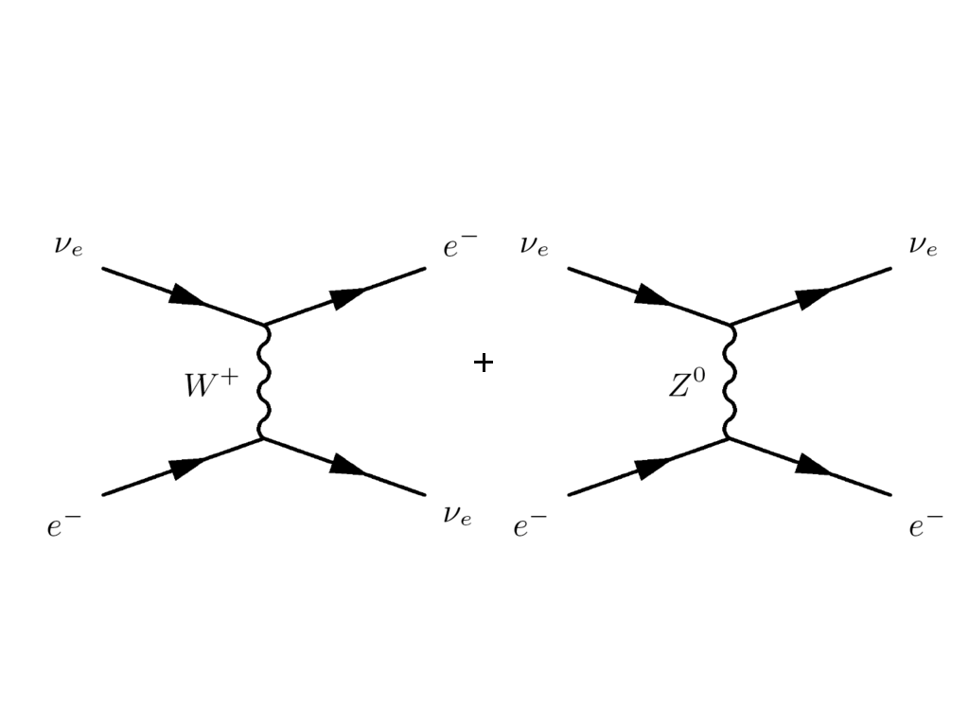
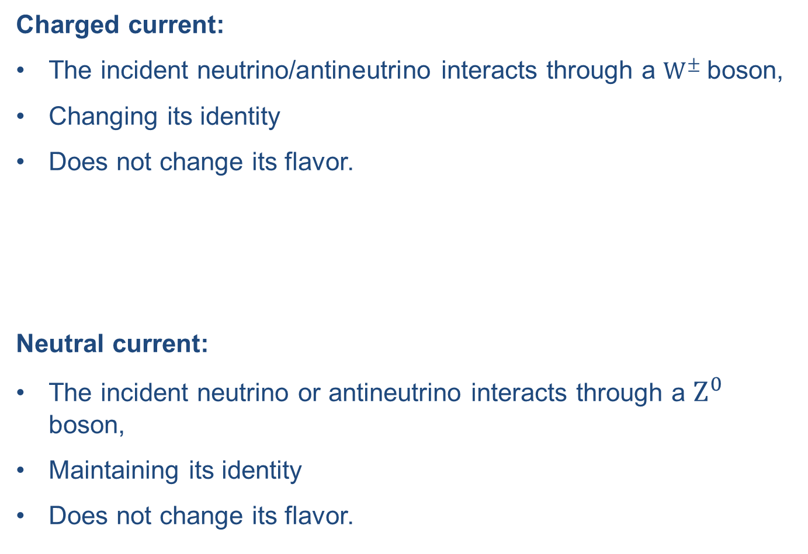
Neutrino interactions
Charged current:
The incident neutrino/antineutrino interacts through a $W^{±}$ boson,
Changing its identity
Does not change its flavor.
Neutral current:
The incident neutrino or antineutrino interacts through a $Z^{0}$ boson,
Maintaining its identity
Does not change its flavor.

Slide 19
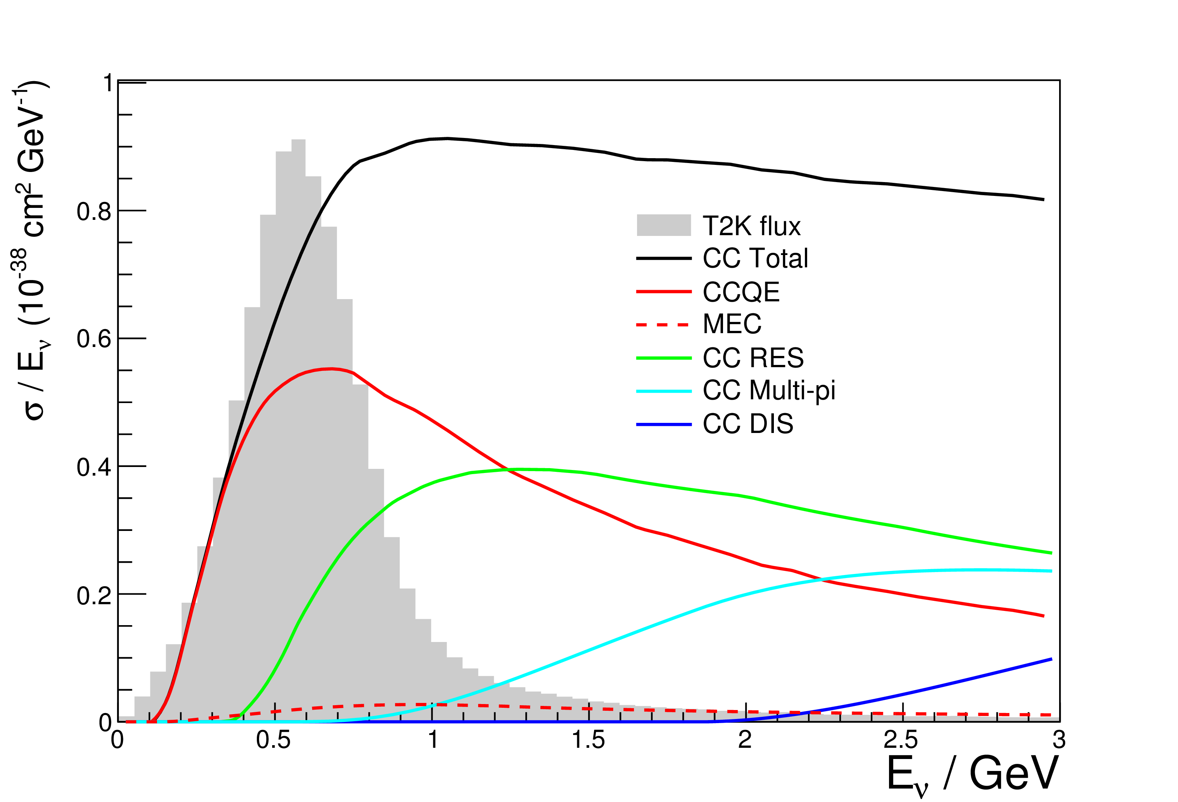
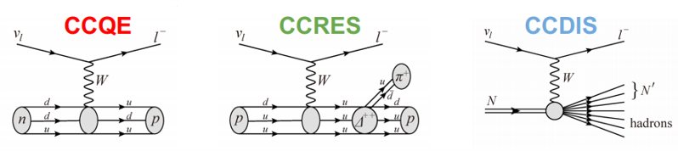
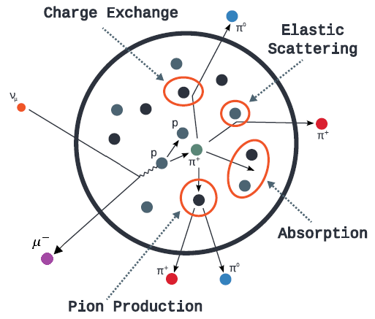
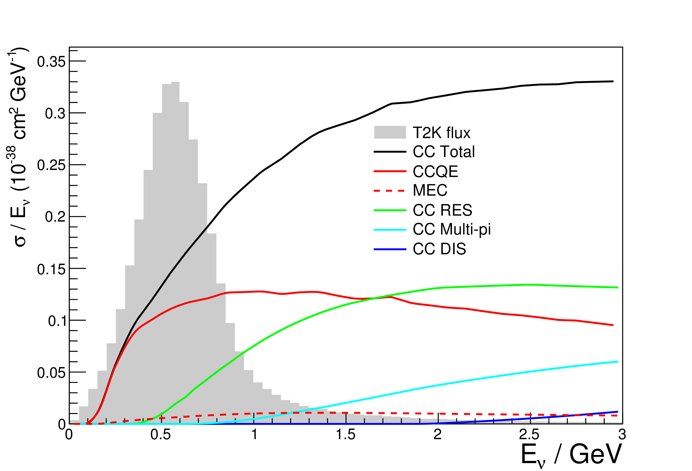
Neutrino interactions
Interaction modes (nucleon level)
Neutrino
Three dominant scattering processes:
Quasi Elastic,
Resonant Pion Production,
Deep Inelastic Scattering
Antineutrino
As a consequence of this, the kinematics and/or interaction topology can be altered.
Notes:
What it take us to neutrino interactions
Current status:
quasi-elastic scattering is well study.
We now need to accurately model interactions occurring at higher energies such as single pion production.
Current and future measurements can be performed only on nuclei.

Slide 20
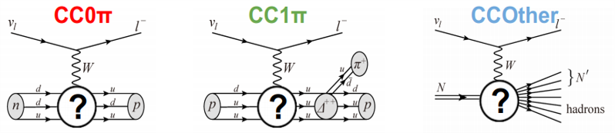







Neutrino interactions
Interaction modes (nucleon level)
Nuclear Effects
and Final State Interactions
$${CCQE: ν}_{μ}+n → μ^{−}+p$$
$${CCQE: ν}_{μ}+n → μ^{−}+p$$
$${+ π}^{+}$$
$${CCRES: ν}_{μ}+p → μ^{−}+ π^{+}+p$$
$${CCRES: ν}_{μ}+p → μ^{−}+ π^{+}+p$$
$$ν_{μ}+n → μ^{−}+ π^{+}+n$$
$$ν_{μ}+n → μ^{−}+ π^{+}+n$$
Interaction topologies (nucleus level)

Slide 21
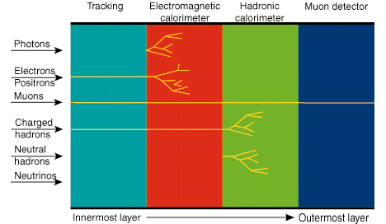
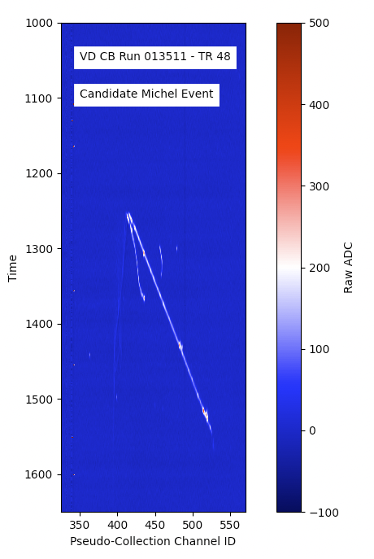

What do we see in the detector?
$$μ^{−}$$
Notes:
We have 2 types of experiments:
The ones that are like a trap and the others that are like a fram.

Slide 22
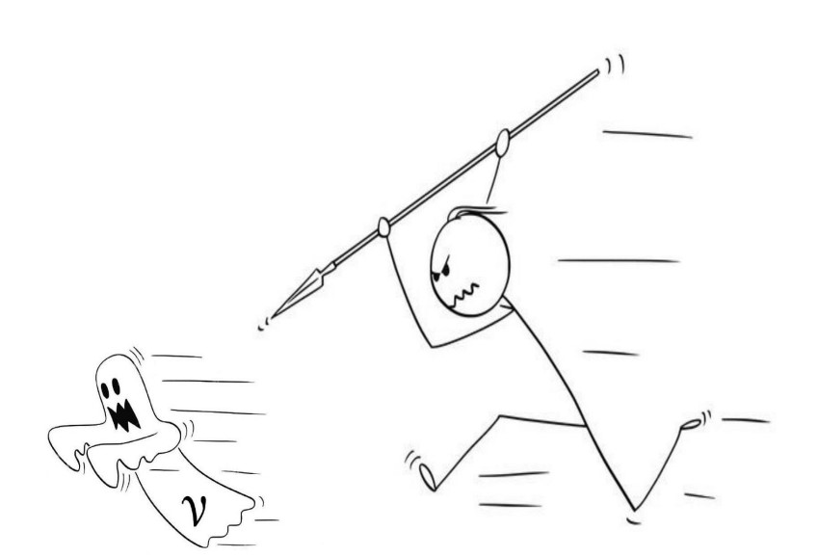
How do we hunt the neutrinos?
detect
Notes:
Since what we are looking for is to study the change of flavor of neutrinos, we usually need near and far detectors.

Slide 23
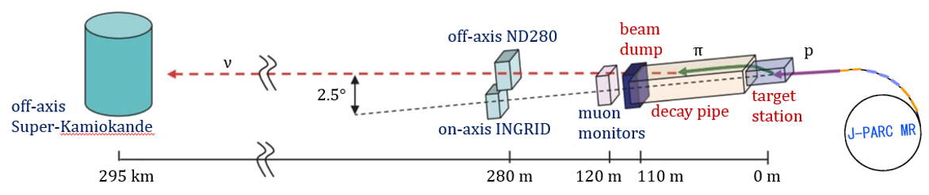
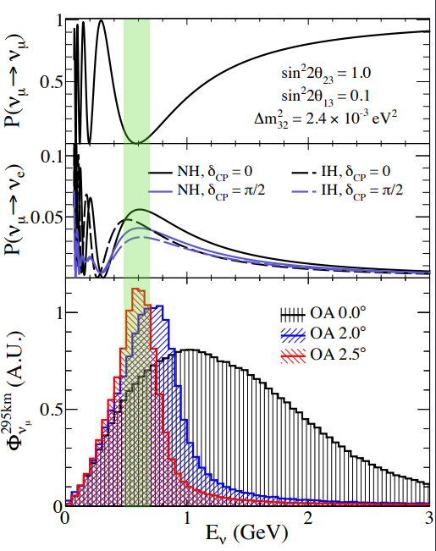
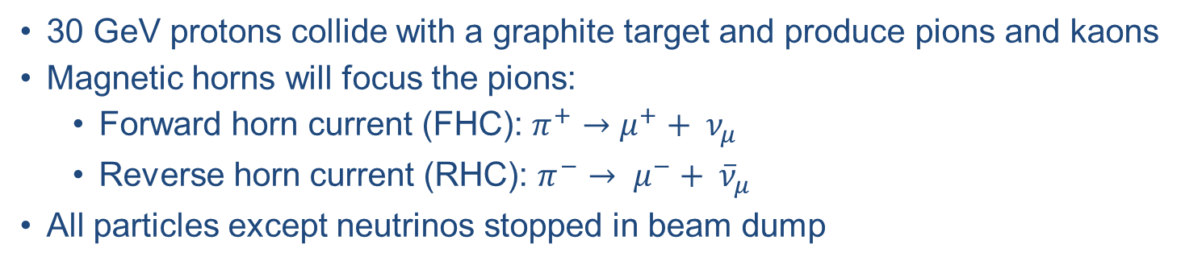
How do we produce the neutrino beam?
30 GeV protons collide with a graphite target and produce pions and kaons
Magnetic horns will focus the pions:
  Forward horn current (FHC): $π^{+}→μ^{+}+ ν_{μ}$
  Reverse horn current (RHC): $π^{−}→ μ^{−}+ {\overline{ν}}_{μ}$
All particles except neutrinos stopped in beam dump
Use off-axis beam for narrower energy spectrum.
Off-axis angle flux peaked at 0.6 GeV, which is at an oscillation maximum.
Only one oscillation maximum can be measured at a fixed distance.

Slide 24

What do we measure?
Number of neutrino-matter interactions
Detector efficiency
Near detector
Oscillation probability
$$N_{x}\left(E_{ν}\right)=φ\left(E_{ν}\right) σ\left(E_{ν}\right) ε\left(E_{ν}\right) P\left(ν_{μ}→ν_{x}\right)$$
The neutrino energy is reconstructed:
using leptonic and hadronic kinematics,
assuming stationary target (a nucleon)
massless neutrino.
This introduces some biases:
Due to initial state interactions (Fermi motion),
The detector misses neutral particles,
Far detector
Neutrino flux
Cross-section
depends on the source
It is very small and depends on the energy
very energetic sources
go to higher energies

Slide 25








T2K experiment
Measure neutrino oscillations: ${{\overline{ν}}_{μ}}/{ν_{μ}}$ disappearance and ${{\overline{ν}}_{e}}/{ν_{e}}$ appearance.
Measure the oscillation parameters ${θ_{13},θ}_{23}, δ_{CP}$ and ${∆m}_{32}^{2}$
Notes:
It is sensitive to the mass hierarchy through matter effect.
We have different flux, target and acceptance for near and far detectors.

Slide 26


T2K experiment: near detector
ND280 is used to:
constrain the flux and cross section parameters.
measure background processes to oscillation.
ND280 is formed by:
Pion zero detector (P∅D): neutral pion detector, optimized for NC interactions.
Time Projection Chambers (TPCs): energy, angle and identification
Fine grained detectors (FGDs): active target
  FGD1: Hydrocarbon
  FGD2: Hydrocarbon + Water
Electromagnetic Calorimeters (ECals): separate tracks from showers and used as veto.
Side Muon Range Detector (SMRD): energy of muons based on the range and as veto.
Magnet: charge of the particles and momentum.
Neutrino
beam
y
x
z
TPC3 FGD2 TPC2 FGD1 TPC1

Slide 27



T2K experiment: far detector
Off-axis (2.5 degrees) Super-Kamiokande
Water Cherenkov detector
50 kton of ultra-pure water
22.5 kt fiducial volume
40 m diameter and ~50 m deep
~11000 20 inch PMTs
1 km underground
Operational since May 31,1996
https://www.nature.com/articles/s41586-020-2177-0
Notes:
The electron rings are fuzzier and therefore we can distinguish them from muons.

Slide 28


T2K experiment: far detector
Particle identification
Particle range
Interaction vertex reconstruction
Electromagnetic energy reconstruction
Track Multiplicity
Notes:
The electron rings are fuzzier and therefore we can distinguish them from muons.

Slide 29

DUNE experiment
Notes:
1-6 GeV muon neutrinos/antineutrinos obtained from high-power proton beam (1.2 MW – upgradable to 2.4 MW)
Near detector will characterize the beam (100s of millions of neutrino interactions)
Far Detector is >40 kton fiducial mass Liquid Argon Time Projection Chambers (LAr TPC) – fine granularity

Slide 30


LAr TPC working principle
Liquid Argon Time Projection Chamber: technology capable of measuring with sub-centimeter precision ionization tracks and is sensitive to energies in the range 5MeV – 100GeV.
detectors with large fiducial volumes,
high imaging capabilities → excellent kinematic reconstruction with a mm-scale spatial resolution.
Notes:
An Event:
Incoming neutrino interacts with Argon nucleons
Charged particles from interaction generate ionization electrons and photons
Ionized electrons drift towards the anode wires planes (~ms) for YZ-coordinate
Signals generated in wires are reconstructed as 2D projections called views
High-resolution 3D track reconstruction is obtained by combining different 2D views
Argon scintillation light (~ns) is detected by photon detectors (SiPM), providing event start time t0

Slide 31

DUNE experiment: far detector
10kt
10kt
10kt
10kt
Notes:
4 chambers,
10kt fiducial mass each

Slide 32


DUNE experiment: far detector
First 10 kt module will be Single Phase (SP) design with Horizontal Drift (HD), LArTPC divided into 4 drift volumes.

Slide 33

DUNE experiment: far detector
Second 10 kt module will be Single Phase (SP) design with Vertical Drift (VD), LArTPC divided into 2 drift volumes.

Slide 34










Tau neutrinos
DUNE will be able to constrain the three-massive-neutrino paradigm by providing complementary measurements to:
  $ν_{e}$-appearance channel
  $ν_{μ}$-disappearance channel.
Almost all knowledge of $ν_{τ}$comes from:
  Lepton universality for cross-sections
  PMNS unitarity for oscillations
The 𝜏 production by $ν_{τ}CC$-nucleus scattering requires neutrino energies $E_{ν}≥3.5 GeV$.
Very heavy and immediately decays
$$ν_{τ}$$
$$π^{−}/e^{−}{/μ}^{−}$$
$$τ^{−}$$
$$ν_{τ}$$
$$π^{0}/{\overline{ν}}_{e}{/\overline{ν}}_{μ}$$
These assumptions need to be tested!!!
$${}_{}^{40}{Ar}$$
Very high energy
$$Δ^{++}$$
$$p$$
$$π^{+}$$

Slide 35

Physics Beyond the Standard Model (BSM)
Neutrinos are the first experimental observation of physics beyond the standard model.
Most theories, explaining neutrino masses, need extra neutrinos and/or non-standard neutrino interactions (NSI)

Slide 36

What are you going to see at the neutrino platform at CERN?
SF-VD
SF-VD Control room
SF-HD Control room
Computing room
DAQ barracks
SF-HD
Slow control racks
Cryogenics

Slide 37

Summary
Neutrino physics is entering the precision era.
  Most of the parameters measured with <10% precision
  $θ_{23}$ mixing angle is known with 15% precision
  Remaining parameters are $δ_{CP}$ and mass hierarchy
  T2K result excludes most of the $δ_{CP}$ >0 values a 99.7% Confidence Level
Beyond the Standard Model Physics is being studied in our experiments
  PMNS non-unitarity
What are neutrinos?
How do we detect them?
Why are they important?

Slide 38

Notes:
We are a small community but crowing.

Slide 39



Solar neutrinos
LS: Borexino, SNO+, …
Water Cerenkov: Kamiokdande, SNO, SuperK
Ga: Gallex & SAGE
Cl Homestake

Slide 40

Neutrino interactions

Slide 41


Icecube
Detect Cherenkov light from charged particles.
Incoming neutrino produces the associated charged lepton through charged current.
  Muon neutrinos leave a track + a hadronic shower
  Electron and (low energy) tau neutrinos produce only a shower
Neutral currents produces only the hadronic shower

Slide 42




ProtoDUNE
ProtoDUNE-I (Sept 2018 to July 2020)
Single Phase detector collected hadron data and cosmic ray data
Dual Phase detector
ProtoDUNE- II (will start Aug or Sept 2022)
Single Phase with Horizontal Drift
Single Phase with Vertical Drift
  Central Cathode Plane Assembly (CPA) hanging at mid-height
  Field cage ensures E-field uniformity, 500 V/cm
  Electrons drift vertically over 6.5m
  Perforated PCB Anode Plane Assemblies (APAs) on the top and bottom of the detector
  Photon sensors on cathode (provide the trigger and timestamp of the events)

Slide 43



Anomalies in oscillations
Gallium anomaly: GALLEX and SAGE collaborations place detectors besides artificial radioactive sources producing high fluxes of electron neutrinos ($ν_{e}$) - 2.9 σ deficit of the $ν_{e}$.
https://oglez.web.cern.ch/oglez/public/EPPSU-CMS-Week-v0.pdf
https://www.sciencedirect.com/science/article/pii/S0370269310000729
https://arxiv.org/abs/nucl-ex/0512041

Slide 44

https://www.innovationnewsnetwork.com/dune-experiment-unlock-mysteries-neutrino/21061/

