Slide 1










PPT模板下载：WWW.HOMEPPT.COM/moban/ 行业PPT模板：WWW.HOMEPPT.COM/hangye/
节日PPT模板：WWW.HOMEPPT.COM/jieri/ PPT素材下载：WWW.HOMEPPT.COM/sucai/
PPT背景图片：WWW.HOMEPPT.COM/beijing/ PPT图表下载：WWW.HOMEPPT.COM/tubiao/
优秀PPT下载：WWW.HOMEPPT.COM/xiazai/ PPT教程： WWW.HOMEPPT.COM/powerpoint/
Word教程： WWW.HOMEPPT.COM/word/ Excel教程：WWW.HOMEPPT.COM/excel/
资料下载：WWW.HOMEPPT.COM/ziliao/ PPT课件下载：WWW.HOMEPPT.COM/kejian/
范文下载：WWW.HOMEPPT.COM/fanwen/ 试卷下载：WWW.HOMEPPT.COM/shiti/
教案下载：WWW.HOMEPPT.COM/jiaoan/ PPT论坛：www.homeppt.cn
Particle Accelerators
Group 1
THE MIGHTY TEACHERS
Iron Man
Tracie Schroeder
Black Widow
Dana Eliyahu
Iron Patriot
Zokir Abdurakhmanov
Vision
Marlena Ćukteraš
Black Panther
Omid Shamsara

Slide 2

Curriculums
NGSS
AP
IB
ANAS
None of these curricula explicitly mention particle physics or particle accelerators

Slide 3
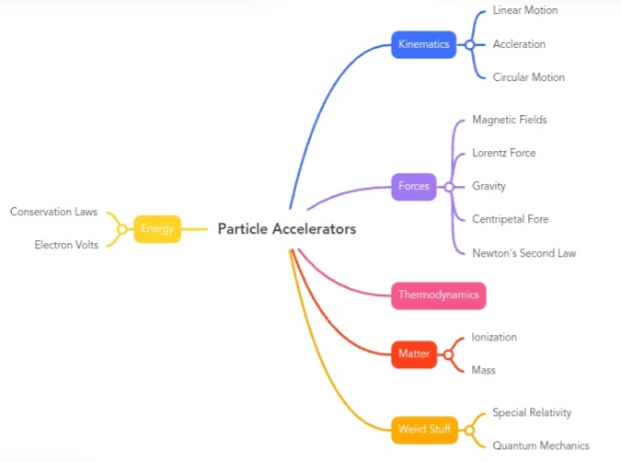
Classroom Connections

Slide 4
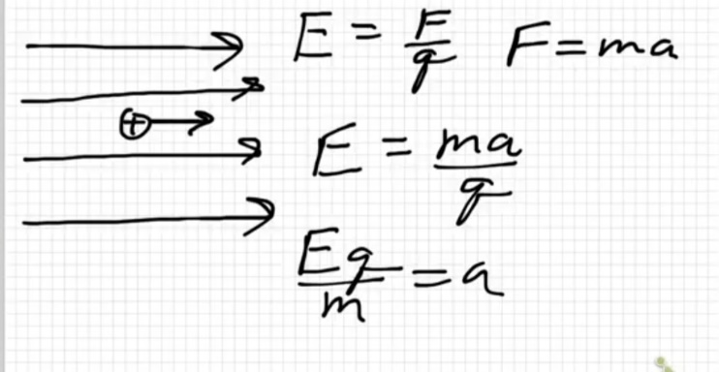
Key Ideas
Ionization of an atom enables the acceleration of the ion
Electric fields cause the acceleration of the ion

Slide 5
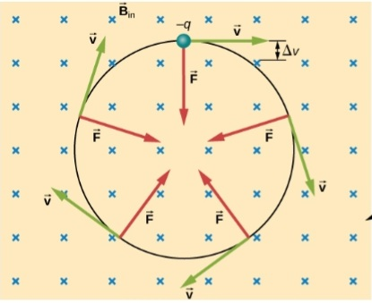
Magnetic fields cause the circular motion of the ion

Slide 6
Pedagogical point of views:
Scale of mass and energy units
Introduce particle physics while teaching these topics
Bonus topics for advenced classes

Slide 7
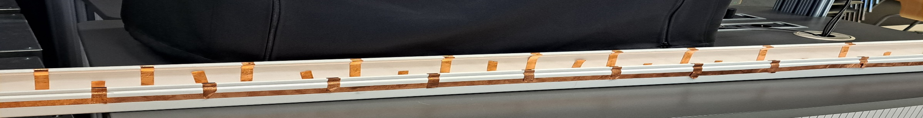
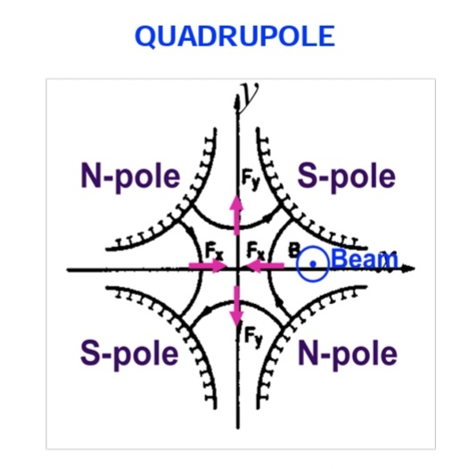
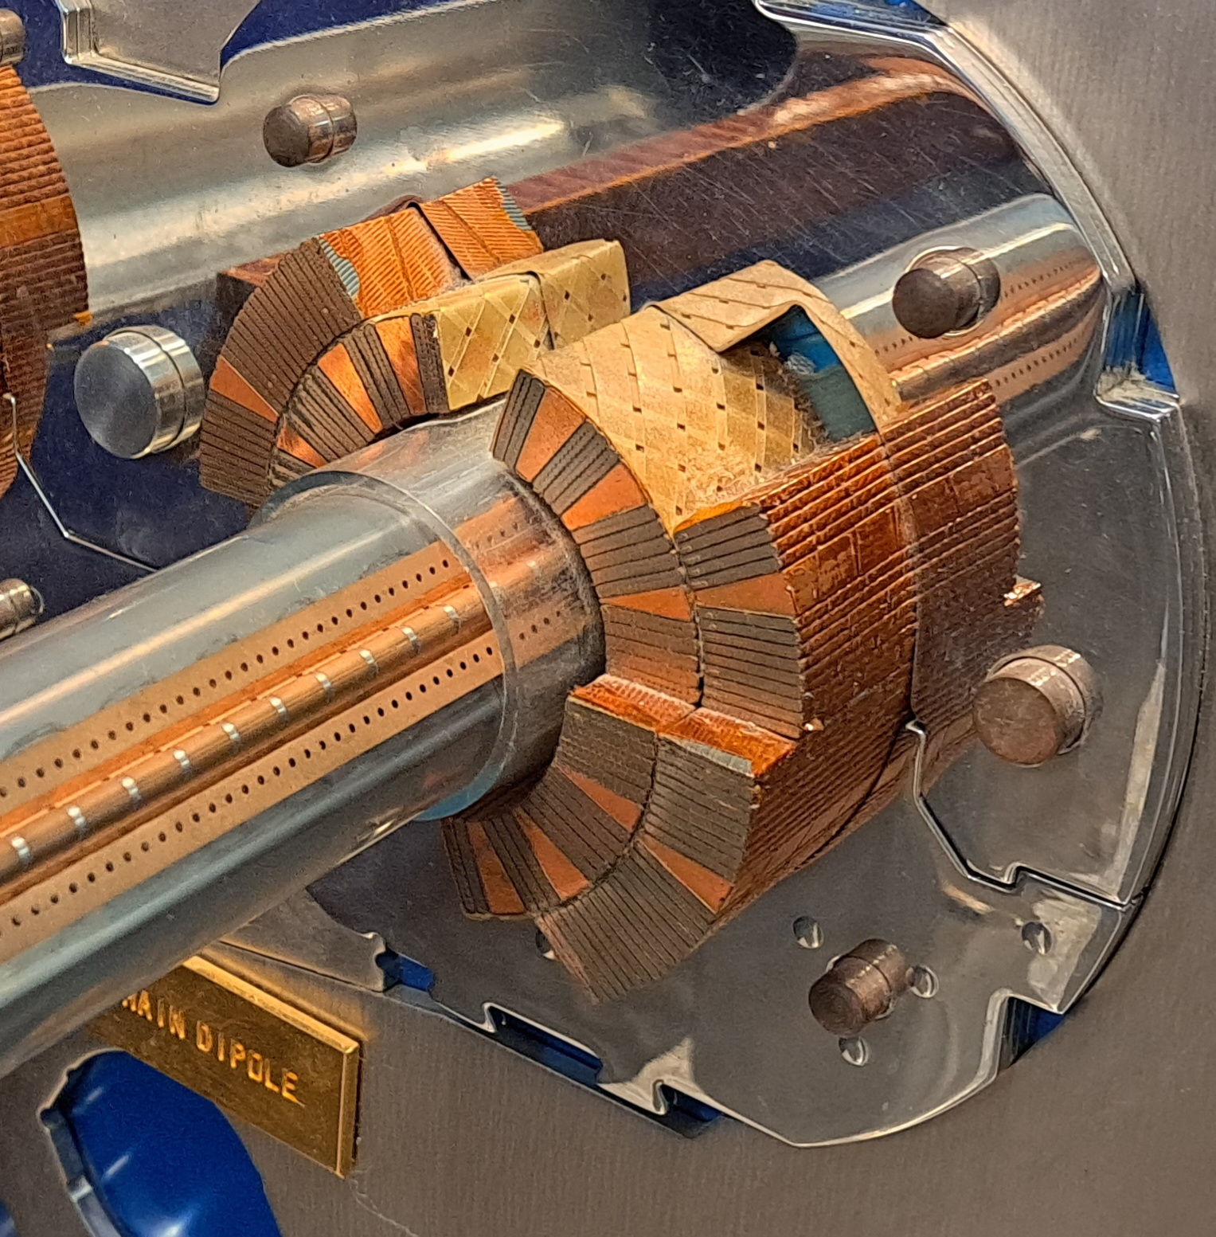
Bonus Topics
RF acceleration
Quadrupole field
(with optional reference of gravity)

Slide 8
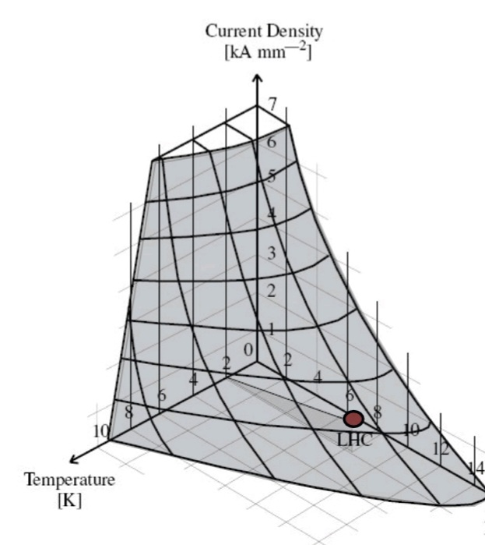
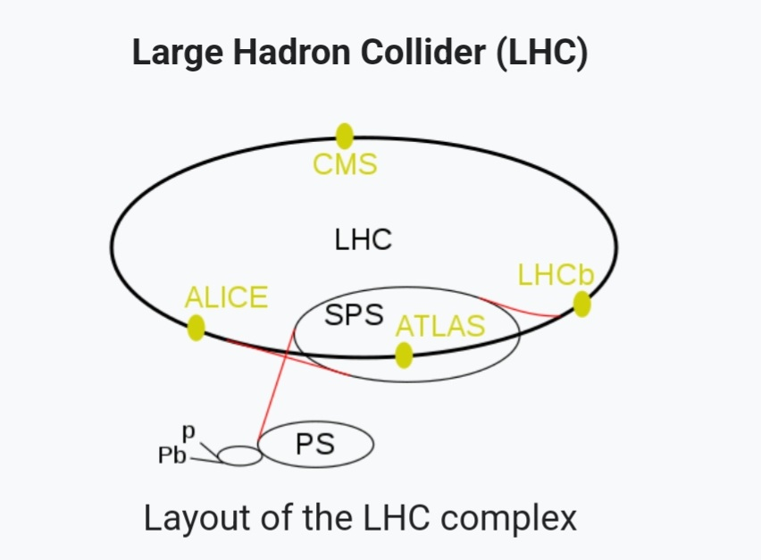
Superconductivity
Series of accelerators

Slide 9

Potential students’ misconceptions and challenges when introducing particle accelerators
Picture from https://www.searchenginejournal.com/blogging-challenges/321109/

Slide 10
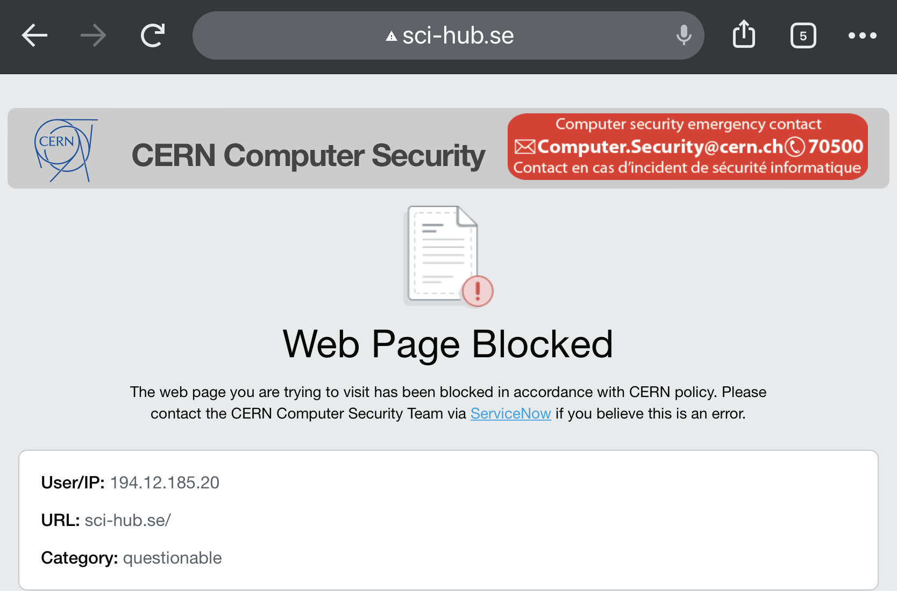
The following misconceptions and challenges are listed based on observations
and experience because…
Challenges
Students’ misconceptions about technical/physical principles of particle accelerators
Not knowing the aims from building particle accelerators

Slide 11
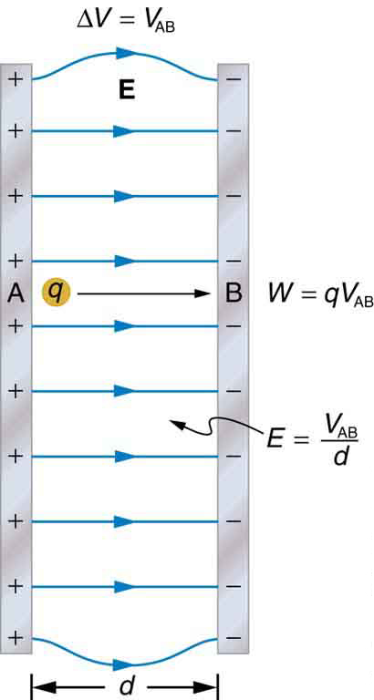
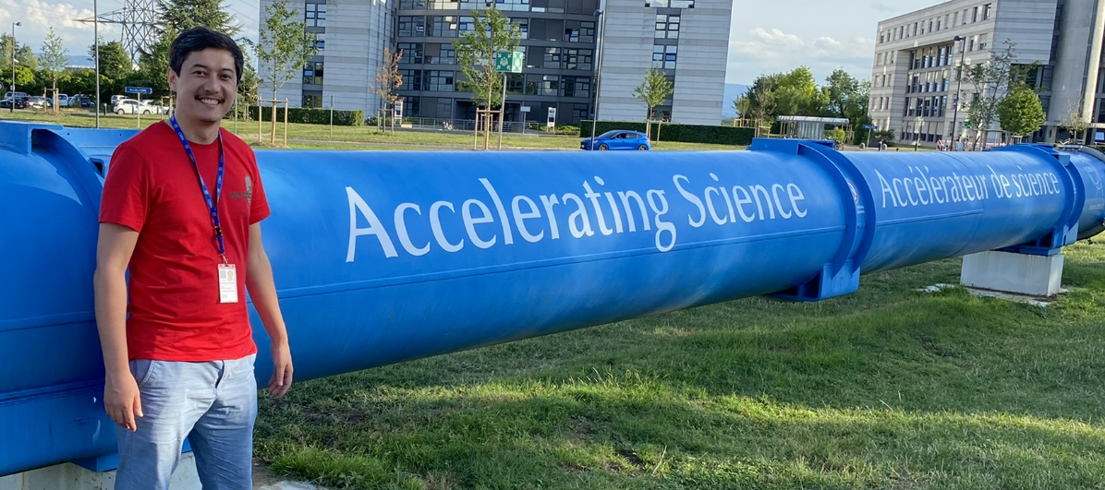
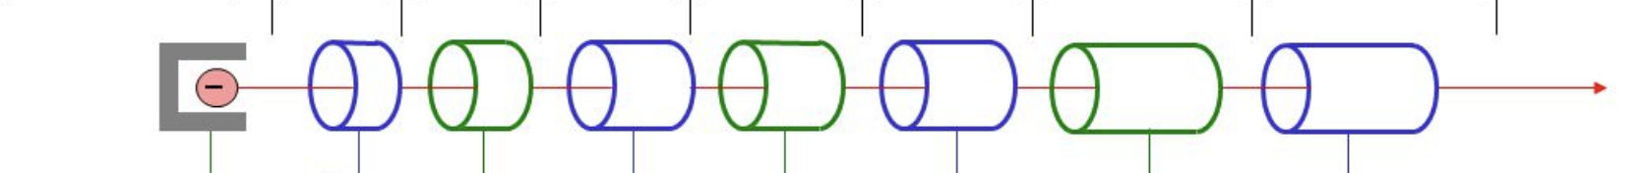
1.Misconceptions about technical/physical principles a. How can you continuously accelerate a particle???
Figures are from
http://pressbooks-dev.oer.hawaii.edu/collegephysics/chapter/19-2-electric-potential-in-a-uniform-electric-field/
https://slideplayer.com/slide/5682354/18/images/7/Linear+accelerator+%28LINAC%29.jpg

Slide 12
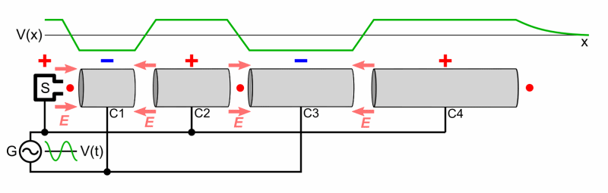
A possible solution
Use visual materials(ex: animation) to demonstrate how it happens.
Figure from https://en.m.wikipedia.org/wiki/Particle_accelerator

Slide 13
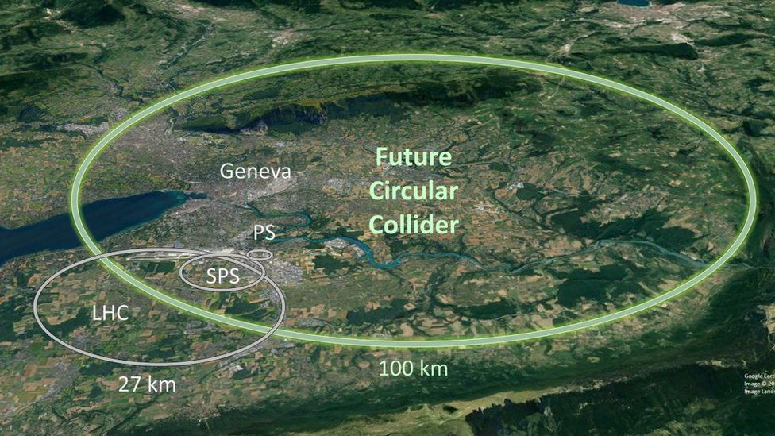
b. Why are some accelerators circular and how charges move in them?
Why circle???
Figure from https://www.bbc.com/news/science-environment-61149387

Slide 14
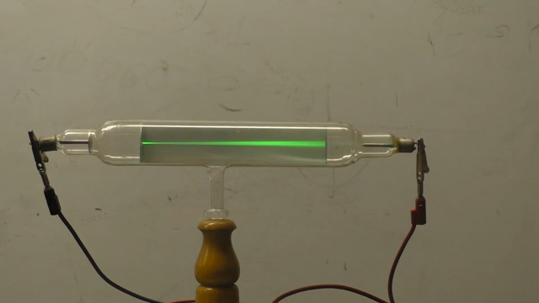
How circle???
https://m.youtube.com/watch?v=TVeEJsfD-2k

Slide 15
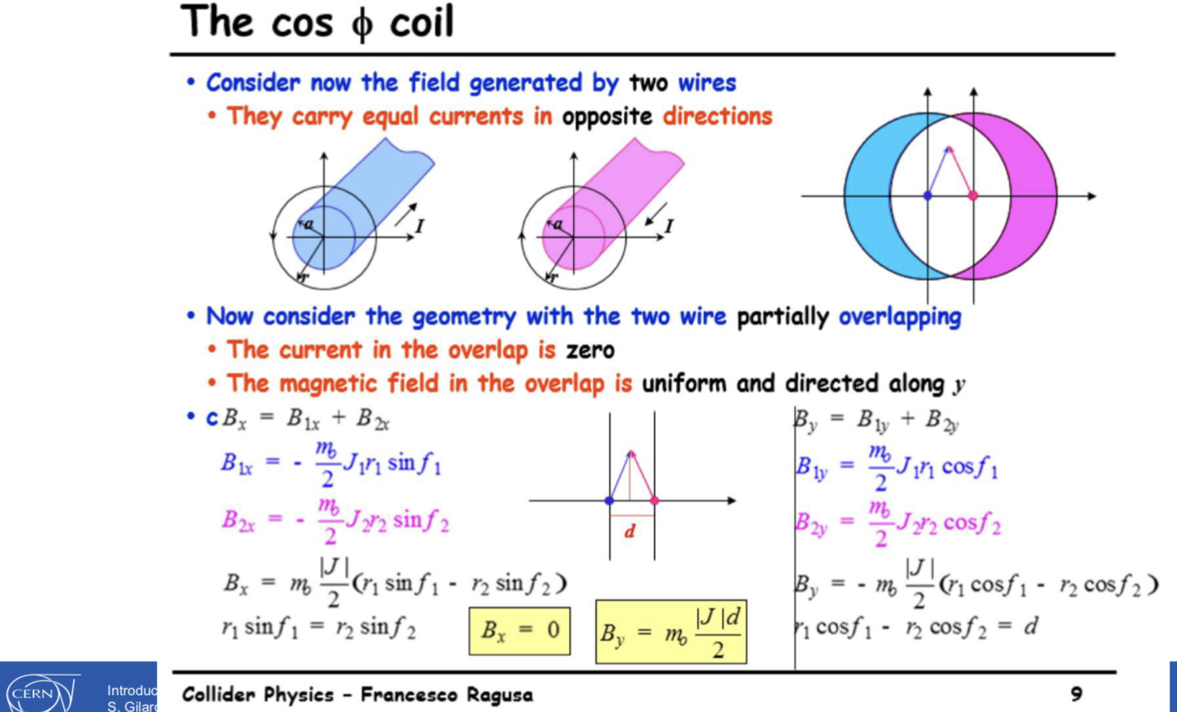
c. Math involved
From https://indico.cern.ch/event/932906/contributions/4889583/attachments/2476115/4249589/2022-intro-to-acc-second-general.pdf

Slide 16

The best solution:
Ignore math!!!
Picture from
https://gfycat.com/discover/ignore-gifs

Slide 17
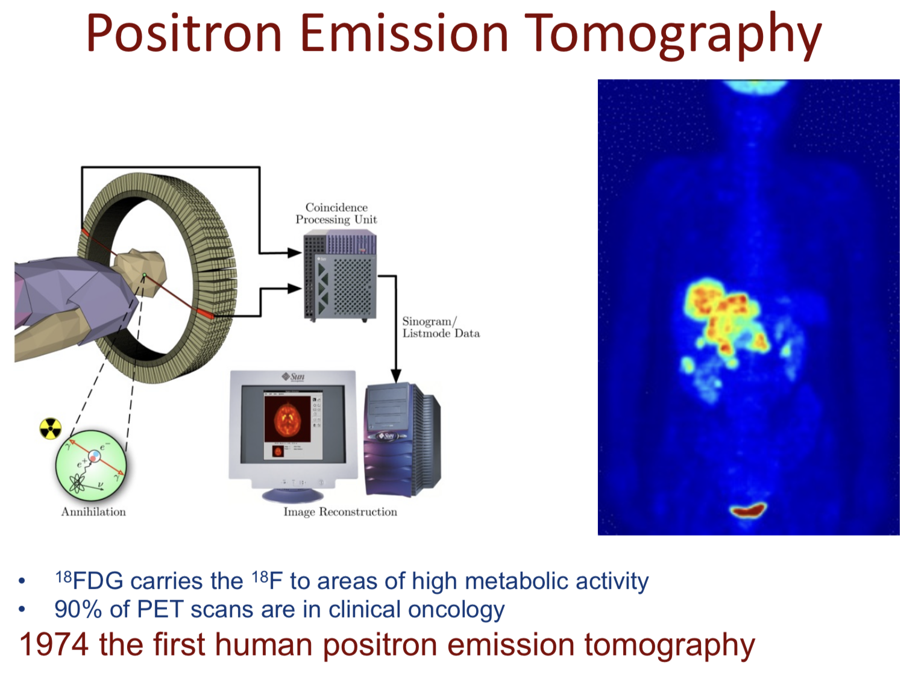
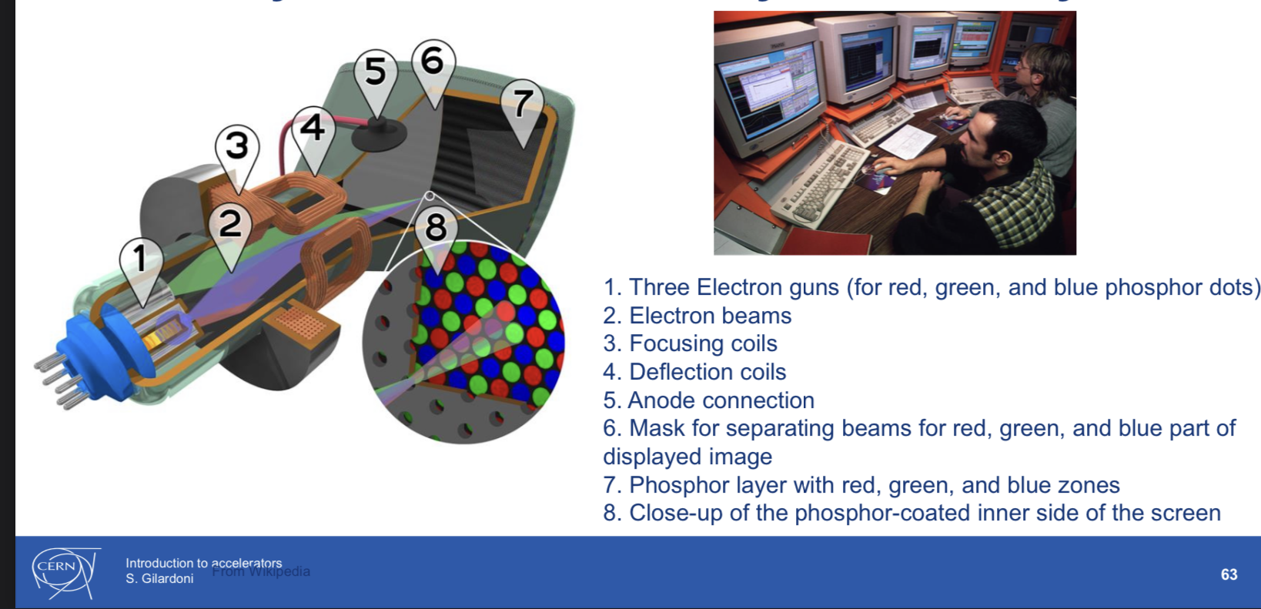
2. Not comprehending the aim from building particle accelerators
Why do we build accelerators???
At school do not stress about fundamental research, stress on applications.
Like, Tube monitors or medical applications
https://indico.cern.ch/event/932906/contributions/4889583/attachments/2476115/4249589/2022-intro-to-acc-second-general.pdf
https://indico.cern.ch/event/932906/contributions/4928501/attachments/2476662/4250567/Teachers%20Programme%20-%20From%20Physics%20to%20Medical%20Applications-6%20July%202022.pdf

Slide 18
Comic Sans
OFC
Best practise

Slide 19


Super school
Particle accelerators
CERN

Slide 20
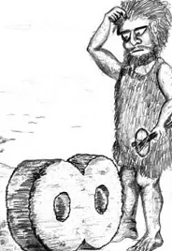
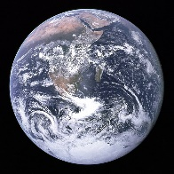
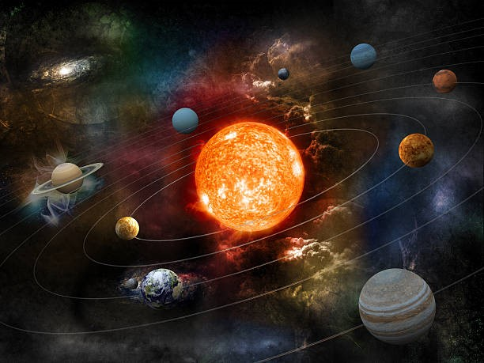


Slide 21





Slide 22


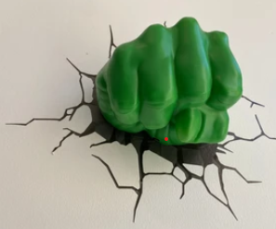

Slide 23
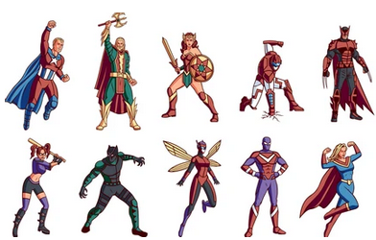
FROM NERD TEACHER
TO
SUPER HERO

Slide 24
PPT模板下载：WWW.HOMEPPT.COM/moban/ 行业PPT模板：WWW.HOMEPPT.COM/hangye/
节日PPT模板：WWW.HOMEPPT.COM/jieri/ PPT素材下载：WWW.HOMEPPT.COM/sucai/
PPT背景图片：WWW.HOMEPPT.COM/beijing/ PPT图表下载：WWW.HOMEPPT.COM/tubiao/
优秀PPT下载：WWW.HOMEPPT.COM/xiazai/ PPT教程： WWW.HOMEPPT.COM/powerpoint/
Word教程： WWW.HOMEPPT.COM/word/ Excel教程：WWW.HOMEPPT.COM/excel/
资料下载：WWW.HOMEPPT.COM/ziliao/ PPT课件下载：WWW.HOMEPPT.COM/kejian/
范文下载：WWW.HOMEPPT.COM/fanwen/ 试卷下载：WWW.HOMEPPT.COM/shiti/
教案下载：WWW.HOMEPPT.COM/jiaoan/ PPT论坛：www.homeppt.cn
THE MIGHTY TEACHERS
Iron Man
Super Tracie
Black Widow
Super Dana
Iron Patriot
Super Zokir
Vision
Super Marlena
Black Panther
Super Omid

Slide 25


Slide 26
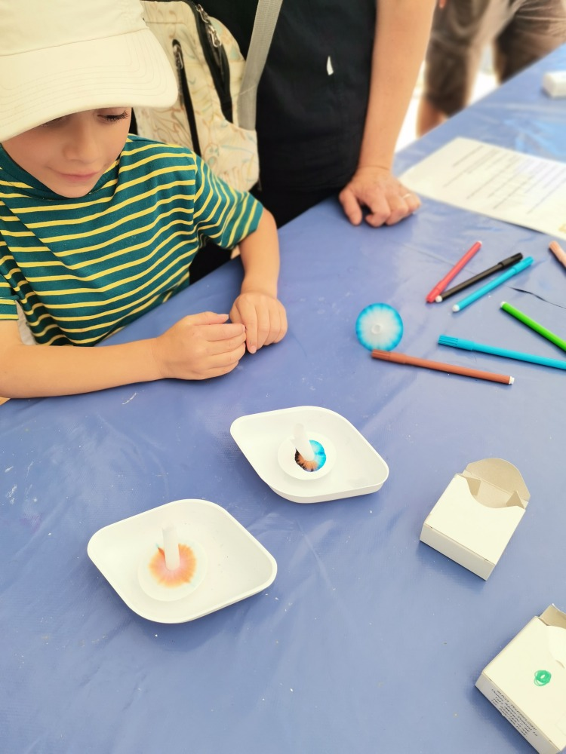
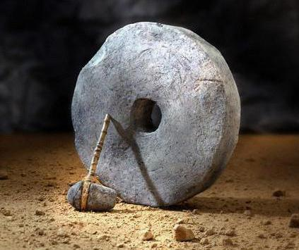
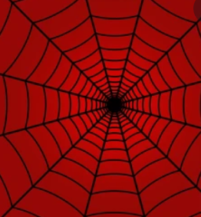
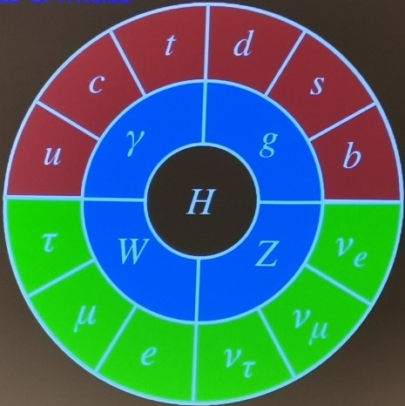
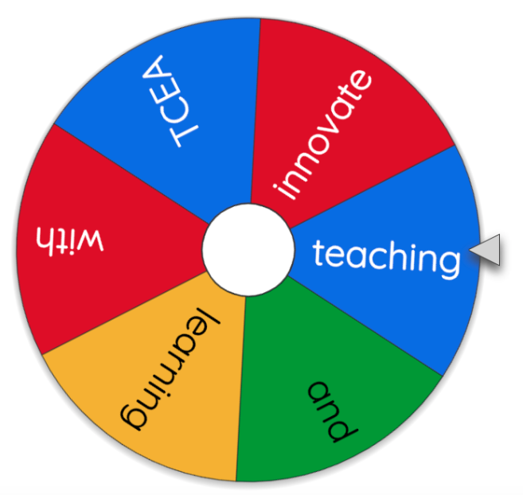

Slide 27

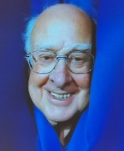
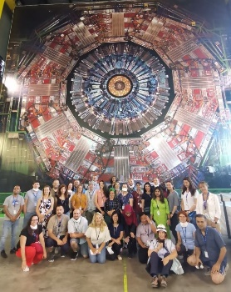


CERNTINI

Slide 28
Acknowledgement!!!

Slide 29
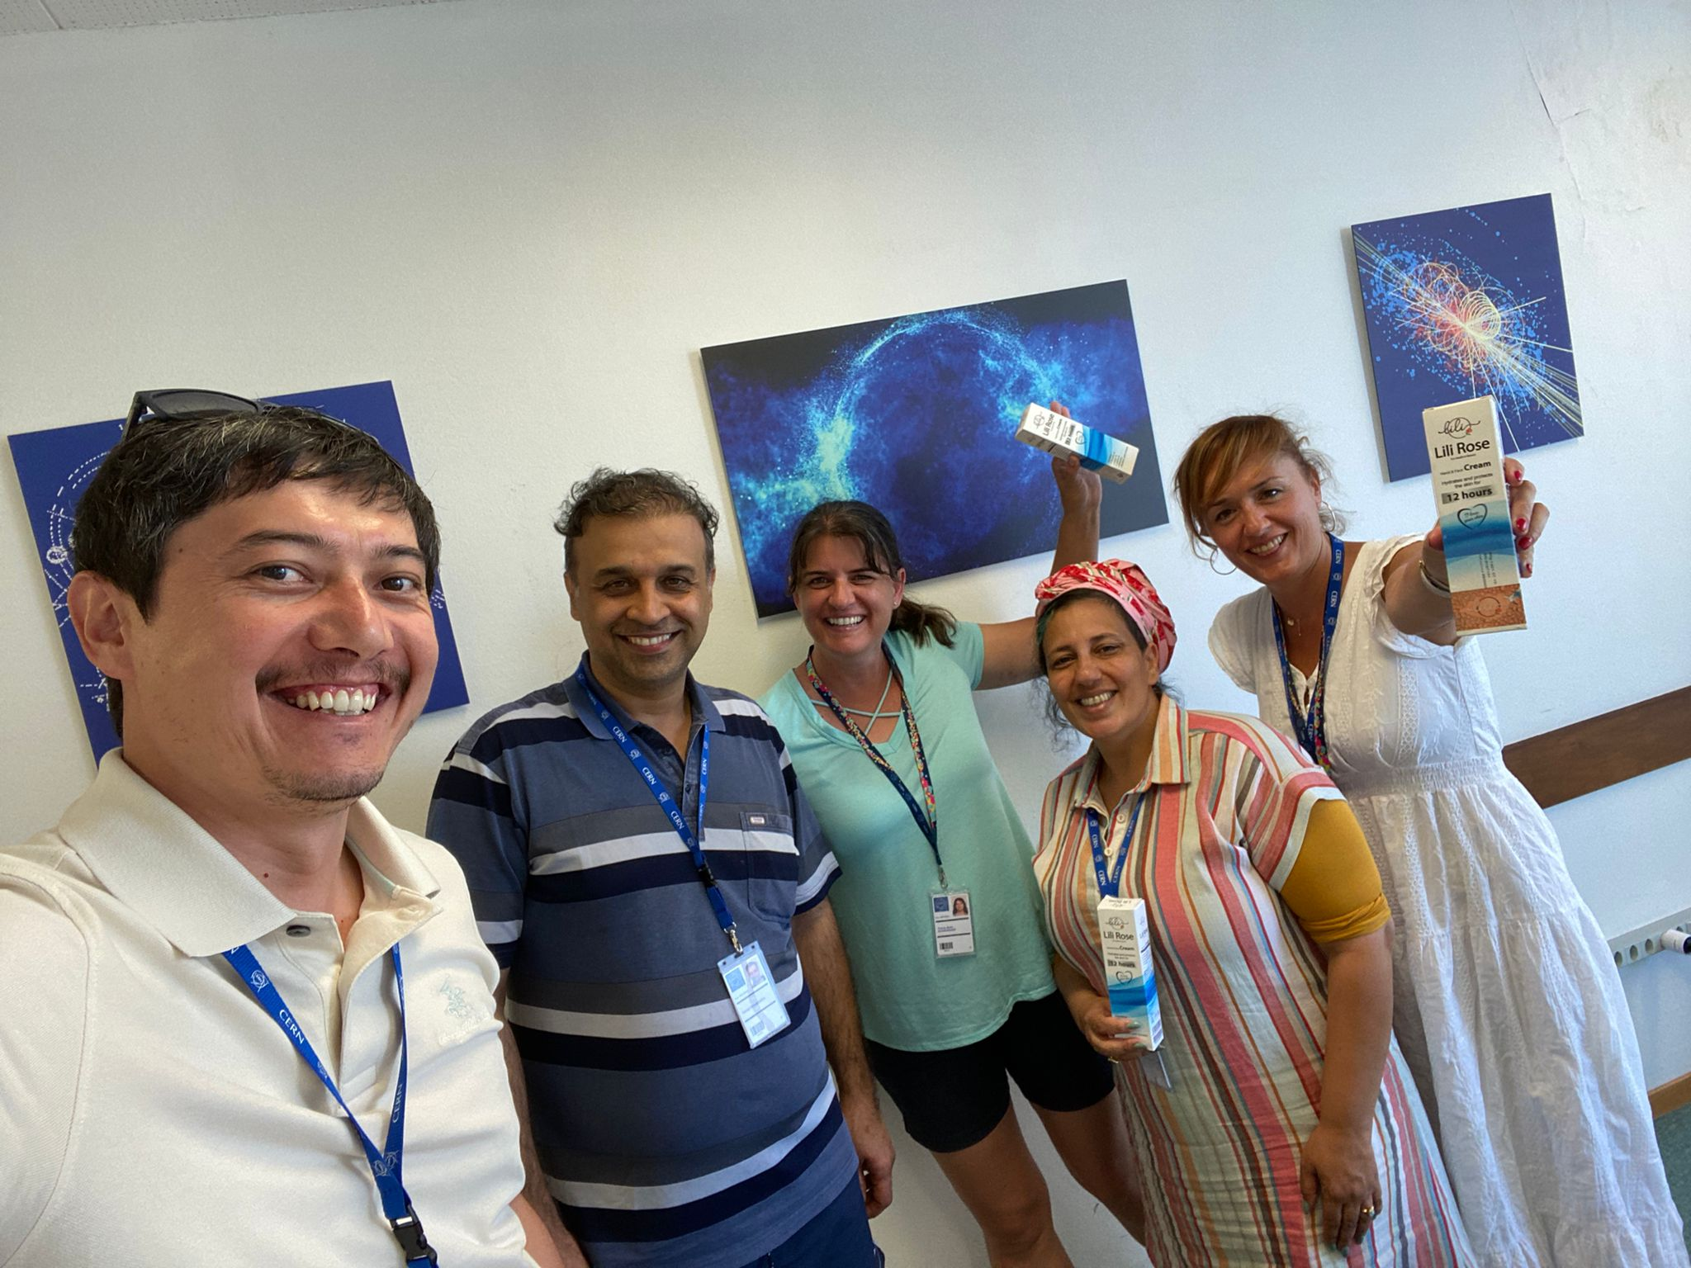
Our sponsor – Lili Rose Cream…

Slide 30
http://pressbooks-dev.oer.hawaii.edu/collegephysics/chapter/19-2-electric-potential-in-a-uniform-electric-field/
https://slideplayer.com/slide/5682354/18/images/7/Linear+accelerator+%28LINAC%29.jpg
https://en.m.wikipedia.org/wiki/Particle_accelerator
https://www.bbc.com/news/science-environment-61149387
https://indico.cern.ch/event/932906/contributions/4889583/attachments/2476115/4249589/2022-intro-to-acc-second-general.pdf
https://indico.cern.ch/event/932906/contributions/4928501/attachments/2476662/4250567/Teachers%20Programme%20-%20From%20Physics%20to%20Medical%20Applications-6%20July%202022.pdf
https://indico.cern.ch/event/932906/contributions/4928501/attachments/2476662/4250567/Teachers%20Programme%20-%20From%20Physics%20to%20Medical%20Applications-6%20July%202022.pdf

