Slide 1
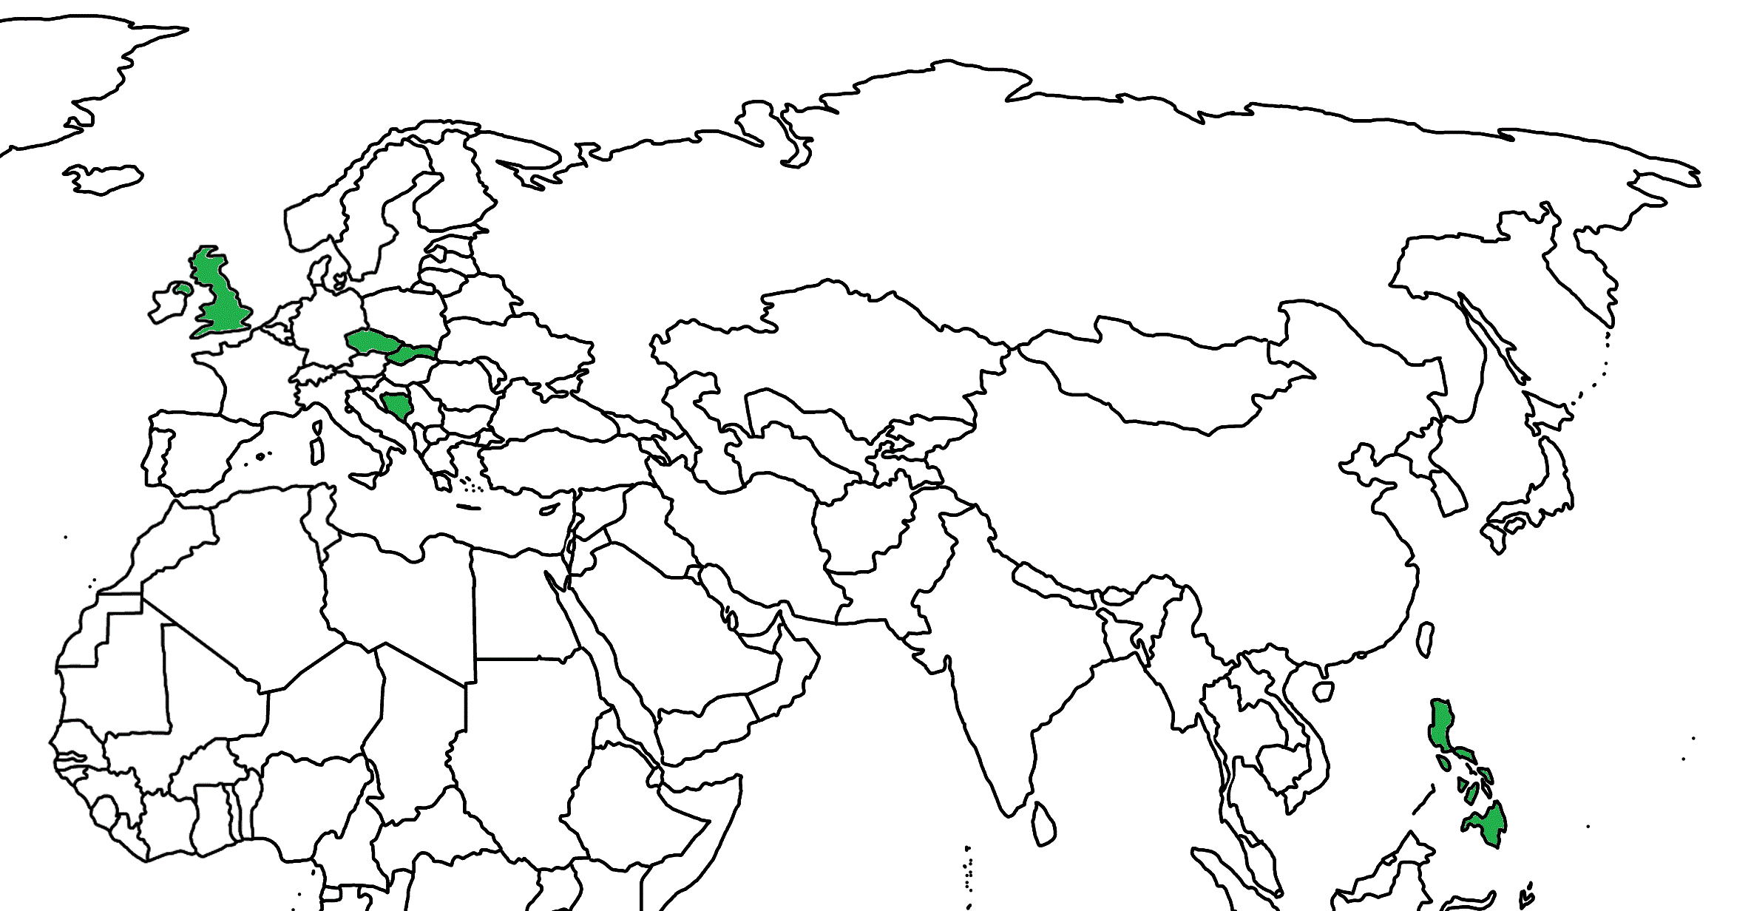
Theoretical Physics and Higgs Physics
Dana Jančinová
Joseph Hortezuela
Martina Obdržálková
Mary Fisher
Miljan Rupar

Slide 2
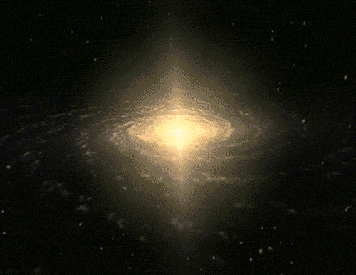
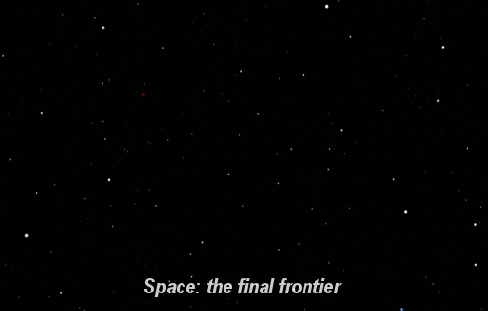
Notes:
Space,the final frontier of human kind, exploring new boundaries of our apparently infinite universe.
--- CLICK
But how small can we go? What about the world of micro universe?
--- CLICK
An atom?

Slide 3




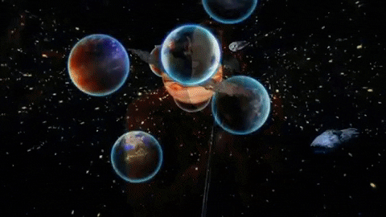
Notes:
Space,the final frontier of human kind, exploring new boundaries of our apparently infinite universe.
--- CLICK
But how small can we go? What about the world of micro universe?
--- CLICK
An atom?

Slide 4
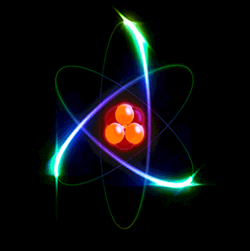

Notes:
Space,the final frontier of human kind, exploring new boundaries of our apparently infinite universe.
--- CLICK
But how small can we go? What about the world of micro universe?
--- CLICK
An atom?

Slide 5
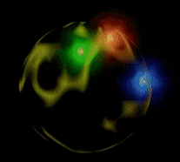
Notes:
We can go even deeper:
Quarks, photons, gluons, leptons.
--- CLICK
Scientists have discovered a galore of particles, and they keep discovering new ones.

Slide 6
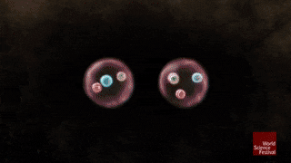
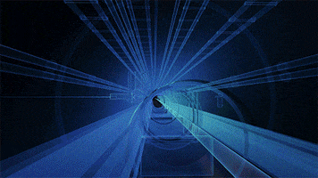
Notes:
We can go even deeper:
Quarks, photons, gluons, leptons.
--- CLICK
Scientists have discovered a galore of particles, and they keep discovering new ones.

Slide 7
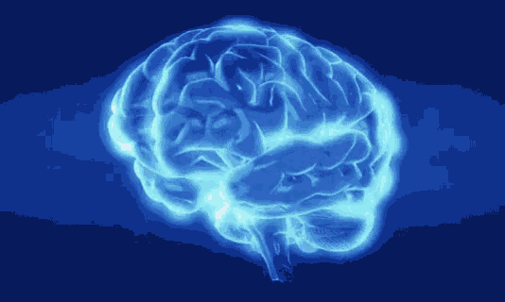

Notes:
However, advancements in this field require a continuous supply of dedicated young minds.
How to make modern physics more accessible and understandable to students?
--- CLICK
How to make students interested but not afraid of modern and particle physics?
That is the topic of our working group within HST 2022 program.
—-----CLICK
(We come from 5 countries: UK, Chech, Slovakia, Bih, Philippines)

Slide 8

Theoretical Physics and Higgs Physics
Dana Jančinová
Joseph Hortezuela
Martina Obdržálková
Mary Fisher
Miljan Rupar
Notes:
However, advancements in this field require a continuous supply of dedicated young minds.
How to make modern physics more accessible and understandable to students?
--- CLICK
How to make students interested but not afraid of modern and particle physics?
That is the topic of our working group within HST 2022 program.
—-----CLICK
(We come from 5 countries: UK, Chech republic, Slovakia, Bih, Philippines)

Slide 9
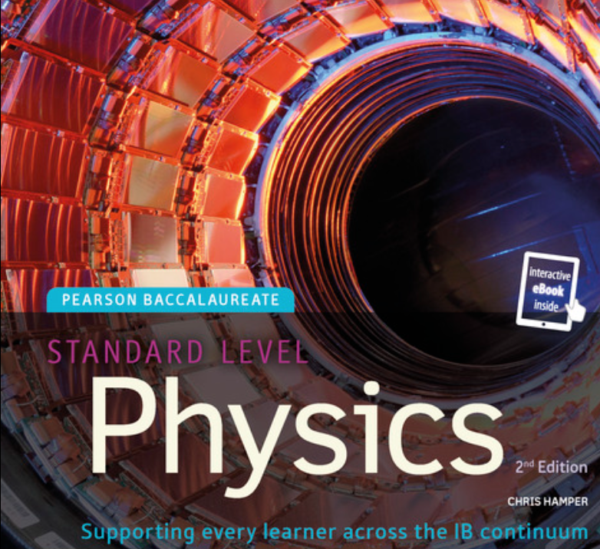
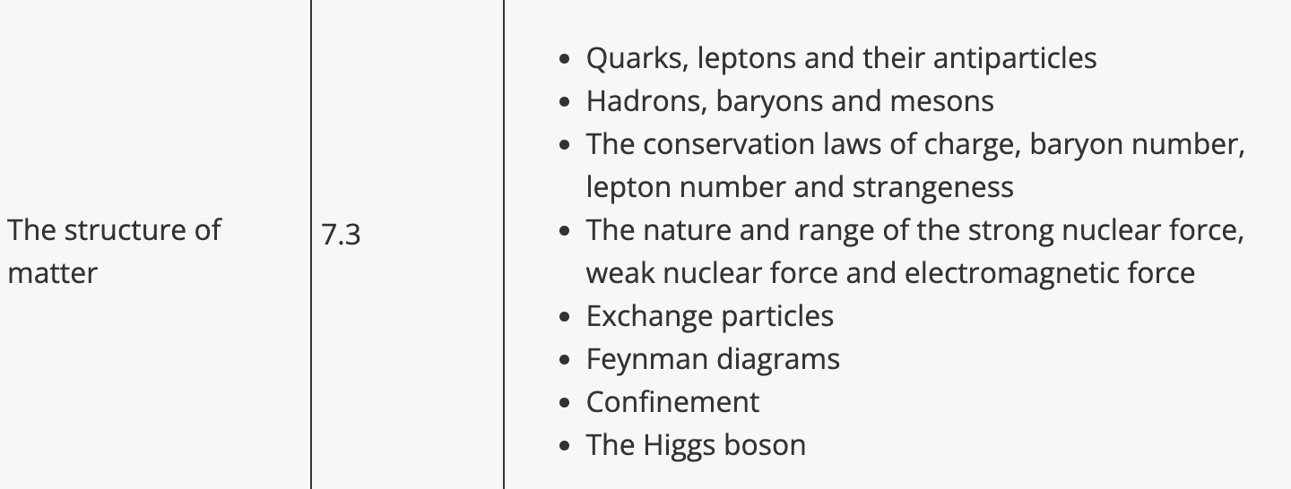
Curriculum and Classroom Connections
Concept of Energy in Classical Physics Framework
  Mass: result of a dynamic effect of the interaction with a scalar field.
Next Generation Science Standards (NGSS)
  HS-PS3: Design, build, and refine a device to convert one form of energy into another form.
IB Physics SL and HL
  Topic 7.3: Structure of Matter

Slide 10
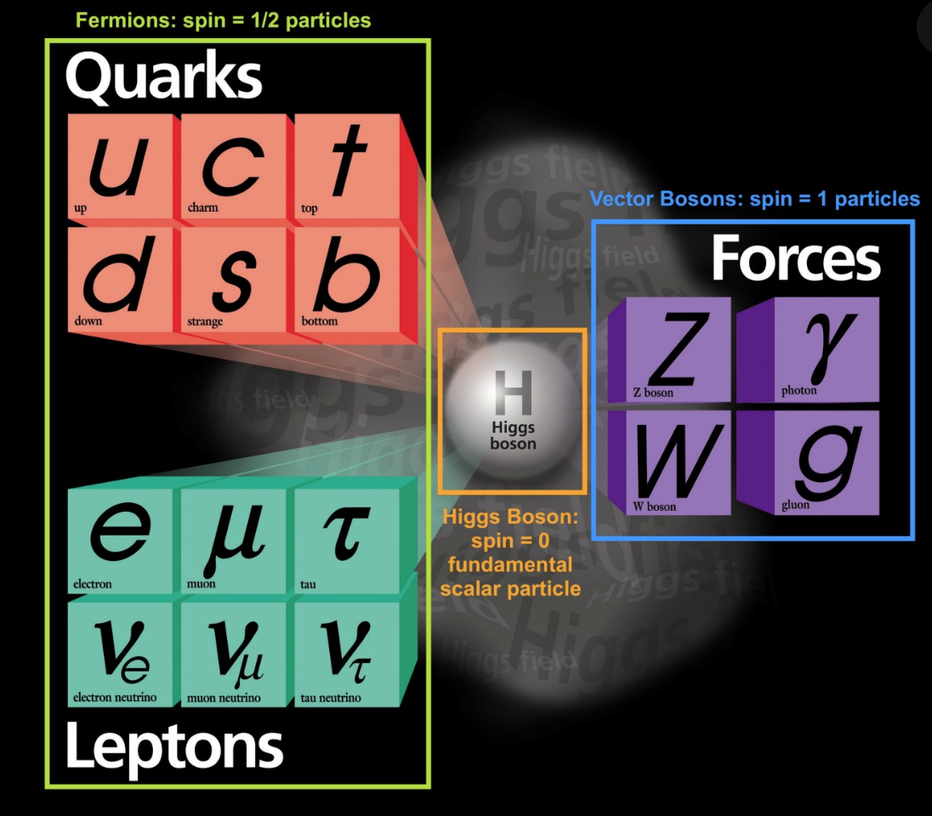

Slide 11
Key ideas
1964 - THEORY - Peter Higgs suggested an existence of a new field
2012 - EXPERIMENT - the Higgs boson associated with the Higgs field has been detected at Cern and announced to general public
2013 - NOBEL PRIZE - for Peter Higgs and Francois Englert

Slide 12
First question:
Why there has been so much excitement and delight about Higgs boson?

Slide 13


Slide 14
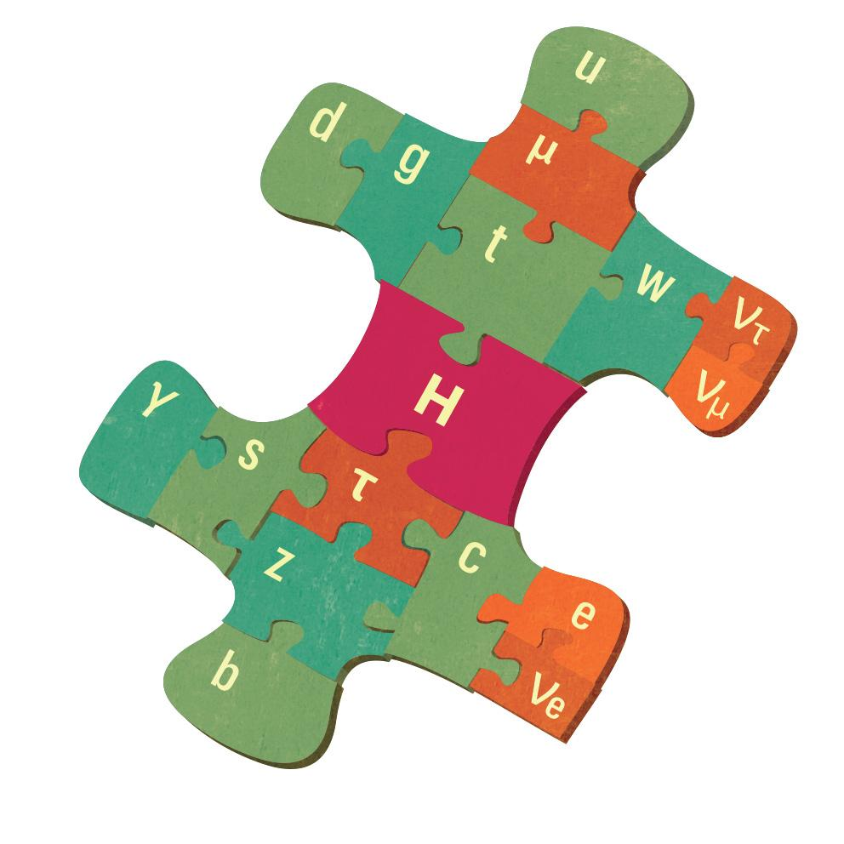
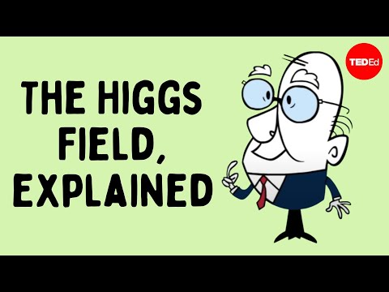
Higgs field and Higgs particle/boson
Last piece of puzzle to standard model
Answer to the very basic question
  What gives the particles their mass
On the cutting-edge of Physics research
Best analogy so far - room filled with people
Texas A&M University

Slide 15
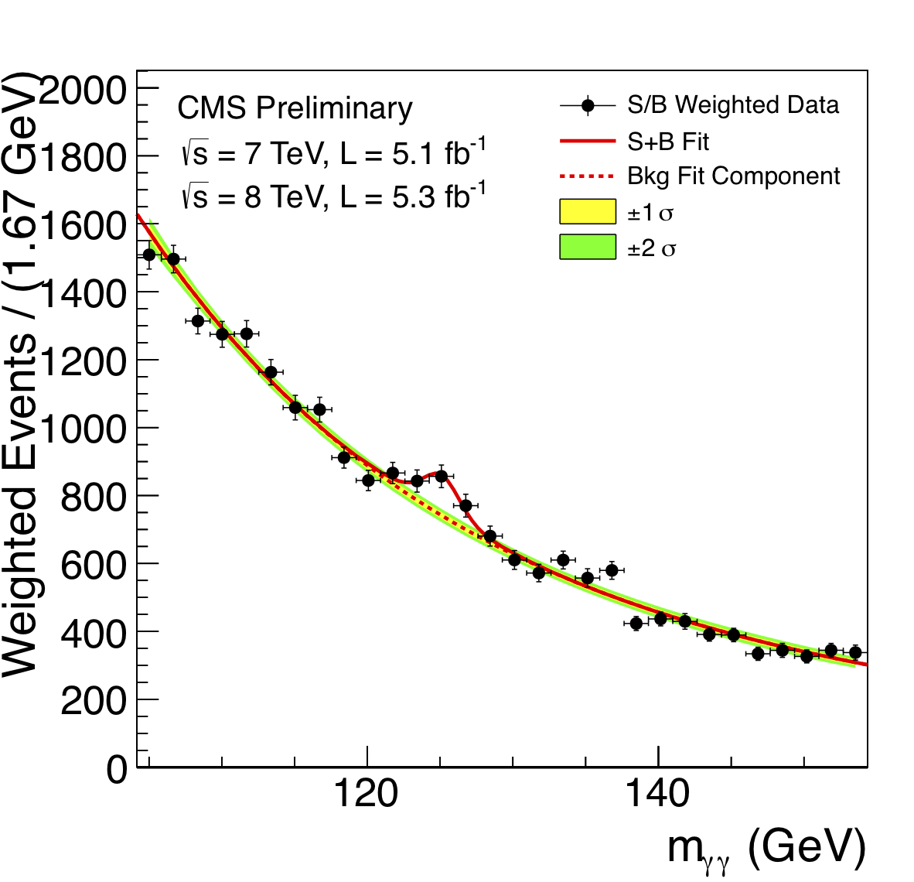
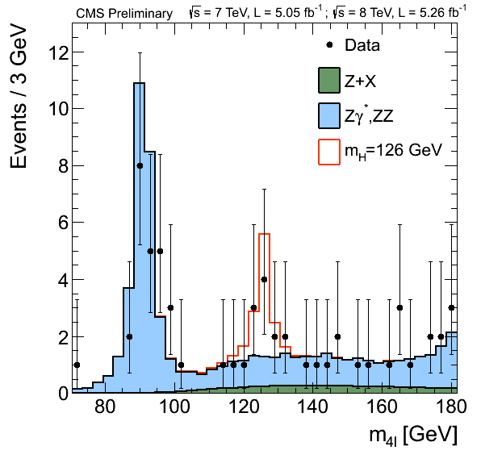
How does the research work:
Theory - expectations
Experiment - real data
Do the experimental data correspond with theoretical expectations?

Slide 16
An Alternative approach
Experiment(s) which does not match with current theory
Theory explaining it
Predictions
Can the predictions of the theory be proven by an experiment?

Slide 17


Potential students’ conceptions & challenges
Notes:
The topics of relativistic physics, nuclear physics and especially particle physics often seem very confusing, far and non-understandable to students.
Here are some of the concepts that a lot of students have a hard time accepting:

Slide 18

Potential students’ conceptions & challenges
Relativistic physics - time dilation.
Nuclear physics - mass defect
Particle physics - annihilation, creation oscillation
Notes:
In relativistic physics, suddenly time does not flow equally for every observer.
--- CLICK
- In nuclear physics mass is suddenly not conserved and can be energy.
--- CLICK
- In particle physics particles can suddenly change from one to another, appear and disappear,

Slide 19
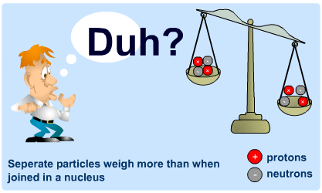
Potential students’ conceptions & challenges
Relativistic physics - time dilation.
Nuclear physics - mass defect
Particle physics - annihilation, creation oscillation
Notes:
In relativistic physics, suddenly time does not flow equally for every observer.
--- CLICK
- In nuclear physics mass is suddenly not conserved and can be energy.
--- CLICK
- In particle physics particles can suddenly change from one to another, appear and disappear,

Slide 20
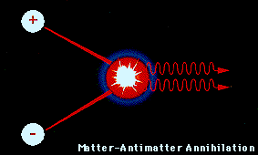
Potential students’ conceptions & challenges
Relativistic physics - time dilation.
Nuclear physics - mass defect
Particle physics - annihilation, creation oscillation
Notes:
In relativistic physics, suddenly time does not flow equally for every observer.
--- CLICK
- In nuclear physics mass is suddenly not conserved and can be energy.
--- CLICK
- In particle physics particles can suddenly change from one to another, appear and disappear,

Slide 21
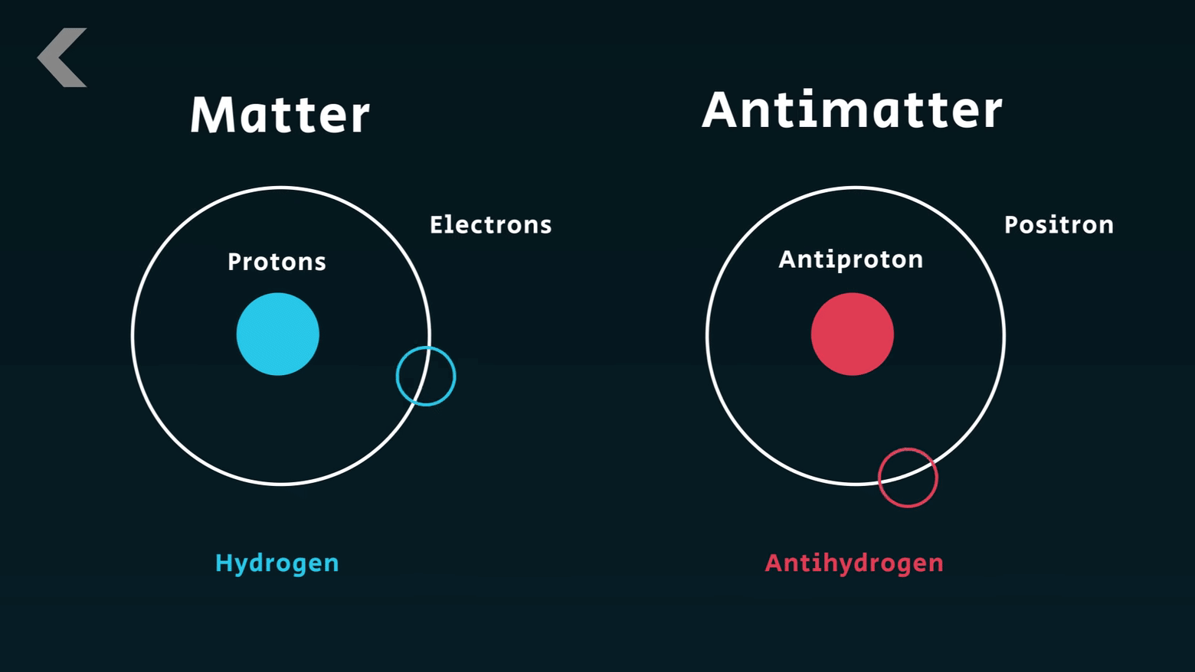
Potential students’ conceptions & challenges
Antimatter
Opposite of timeflow direction of antimatter
Notes:
Maybe physicists made a huge mistake when they decided label something as “antimatter”, because it is just a type of matter actually.
--- CLICK
And what about the “opposite of time” direction for antiparticles…
--- CLICK
that is just very a weird way to explain things..Well it is strangely explained in books

Slide 22
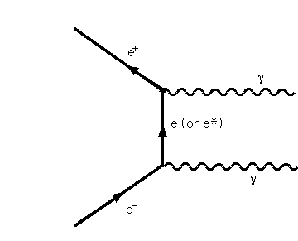
Potential students’ conceptions & challenges
Antimatter
Opposite of timeflow direction of antimatter
Notes:
Maybe physicists made a huge mistake when they decided label something as “antimatter”, because it is just a type of matter actually.
--- CLICK
And what about the “opposite of time” direction for antiparticles…
--- CLICK
that is just very a weird way to explain things..Well it is strangely explained in books

Slide 23

Potential students’ conceptions & challenges
Antimatter
Opposite of timeflow direction of antimatter
Notes:
Maybe physicists made a huge mistake when they decided label something as “antimatter”, because it is just a type of matter actually.
--- CLICK
And what about the “opposite of time” direction for antiparticles…
--- CLICK
that is just very a weird way to explain things..Well it is strangely explained in books

Slide 24
Potential students’ conceptions & challenges
Notes:
- This all becomes confusing to students’ young minds,
—CLICK
and different approach to teaching this field is needed.

Slide 25
Potential students’ conceptions & challenges
Notes:
- This all becomes confusing to students’ young minds,
—CLICK
and different approach to teaching this field is needed.

Slide 26

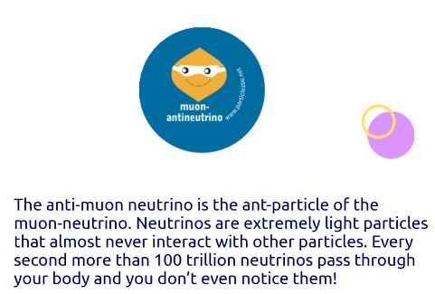
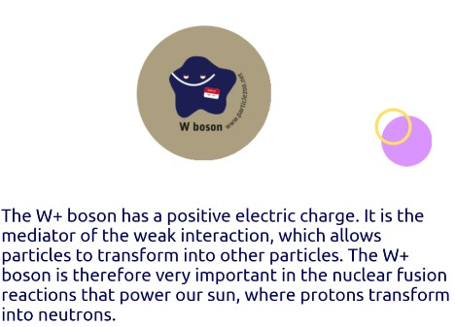
Helpful resources
https://scoollab.web.cern.ch/sites/default/files/Particle_v2/index.html

Slide 27
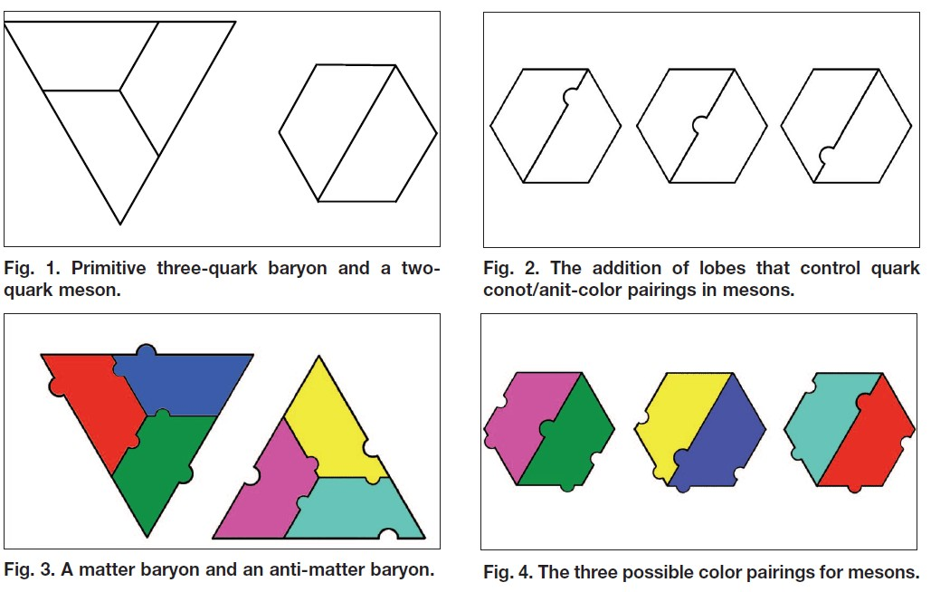
Helpful resources The Quark Puzzle
https://aapt.scitation.org/doi/10.1119/1.3393062

Slide 28
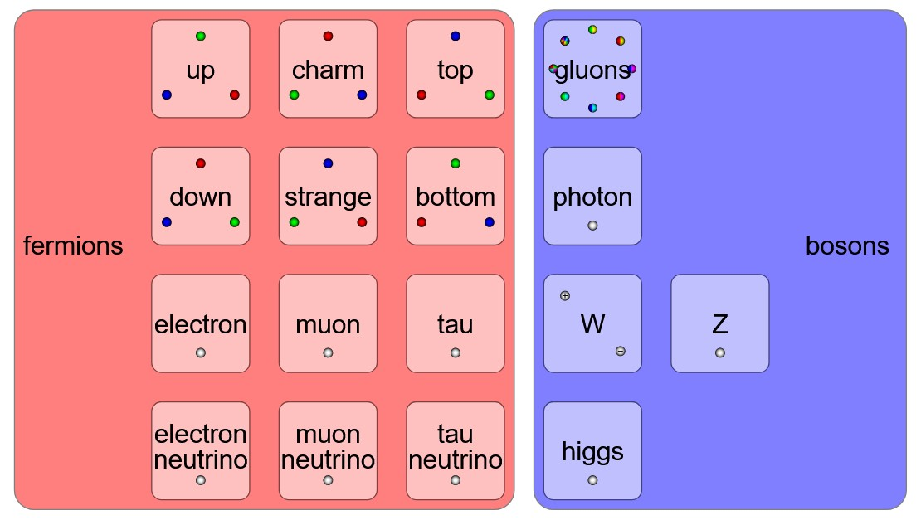
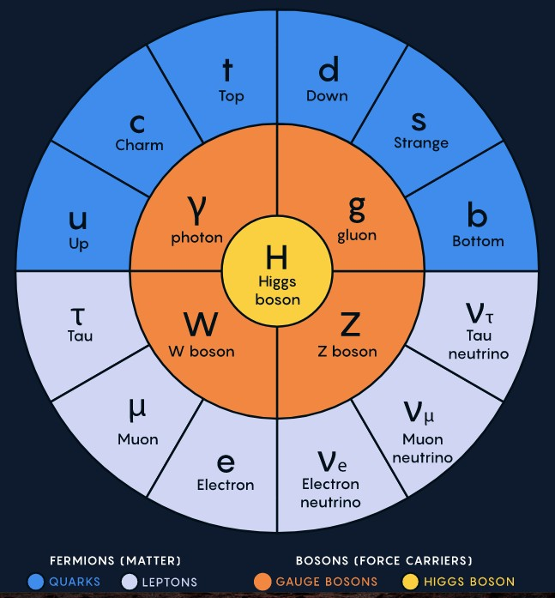
Helpful resources The Table of Particles
https://physics.info/standard/
https://www.quantamagazine.org/a-new-map-of-the-standard-model-of-particle-physics-20201022/

Slide 29
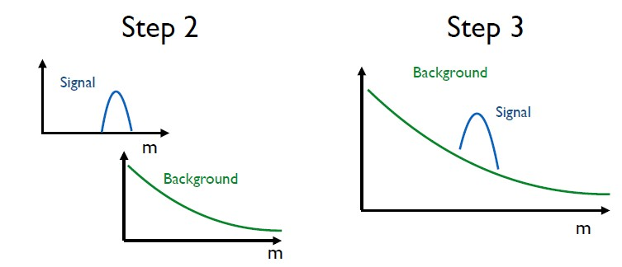
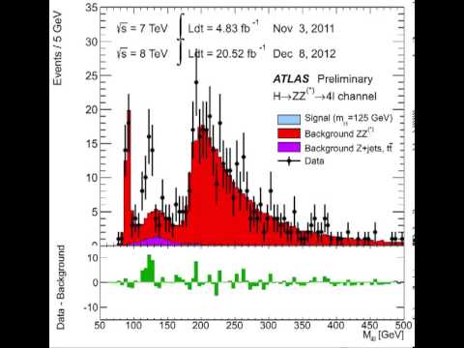
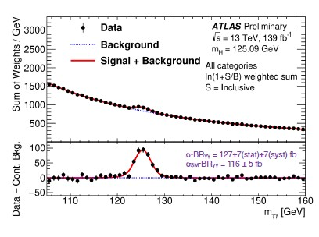
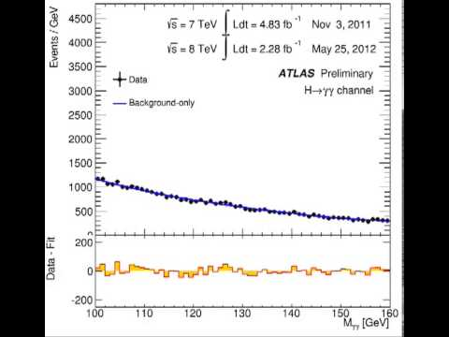
Helpful resources
Finding the Higgs Boson
The animation of signal accumulation in the Higgs boson decaying to four leptons channel
The animation of signal accumulation in the Higgs boson decaying to two-photon channel

Slide 30
Best Practice - an Idea - Higgs Day
Higgs Day - How could it look - Or could be a sequence of lessons
Approx 2 hours that would be ‘off timetable’ for around 14 years old students
20 mins Discussion - what is mass, what are we made of?
10 mins - measure the mass of different tins as they would feel on the different planets?
10 mins demo the magnetic fields with ironing filings - link to Higgs field
How scientists work - discovery process
40 mins Modelling the discovery of the Higgs field using dice and plotting graph

Slide 31
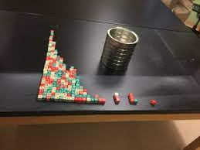
Modelling the Discovery of the Higgs boson
Do the ‘half life’ experiment to get an exponential decay curve first of all
Then explain that one student will steal and add to different groups - students make prediction
One/two student is the ‘naughty one’ who you release part way through the exercise to steal and add cubes to the different groups.
Should see a different graph

