Slide 1


wallpaperaccess.com

Slide 2
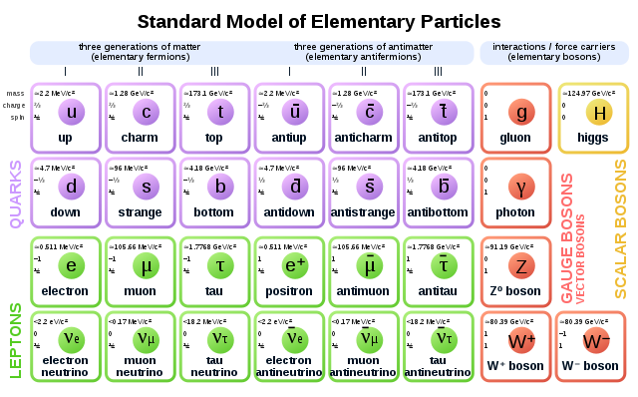
Curriculum & Classroom Connections
Standard model: particle “twins”
commons.wikimedia.org/wiki/File:Standard_Model_of_Elementary_Particles_Anti.svg

Slide 3
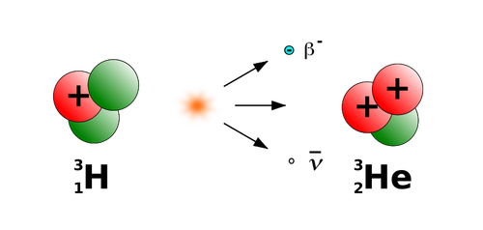
Curriculum & Classroom Connections
Nuclear physics: β decay
publicdomainvectors.org/en/free-clipart/Drawing-of-beta-minus-decay-of-tritium/35298.html

Slide 4
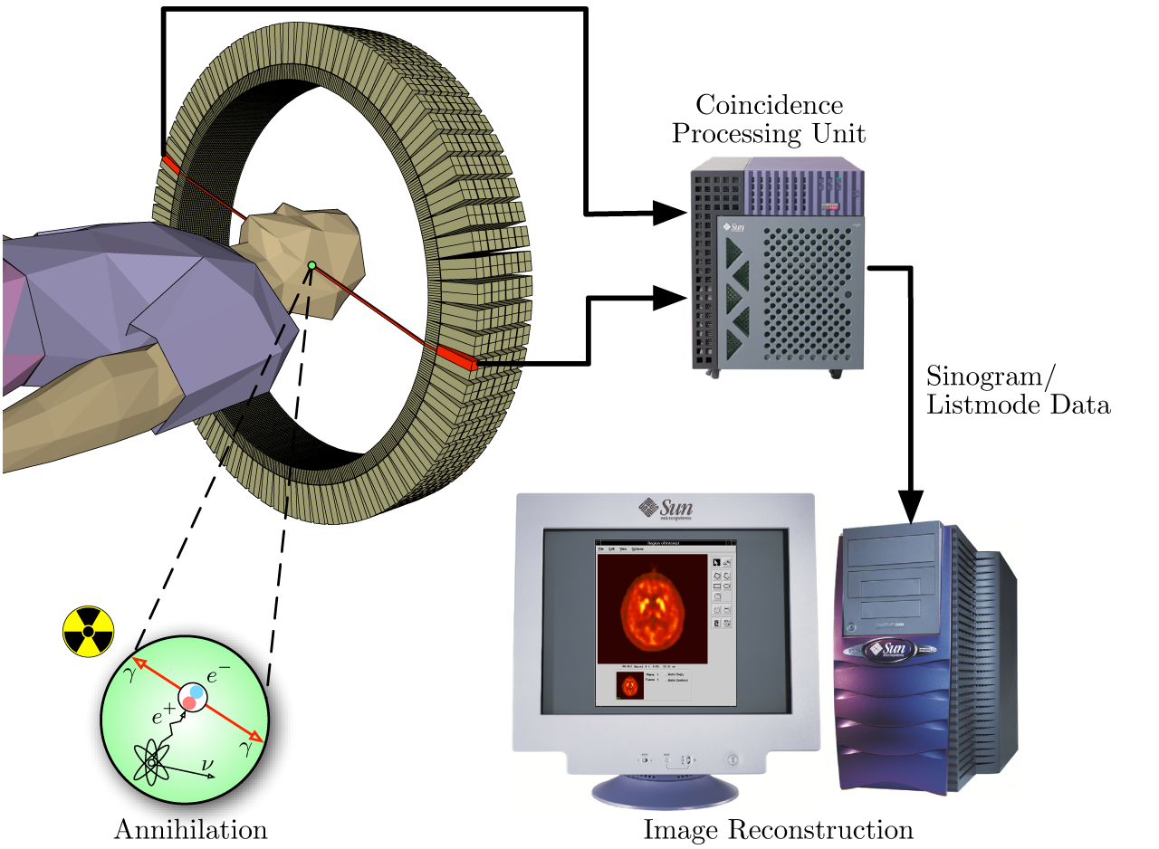
Curriculum & Classroom Connections
Medical applications: PET scan
de.m.wikipedia.org/wiki/Datei:PET-schema.png

Slide 5

Curriculum & Classroom Connections
Big Bang Theory: asymmetry between matter and antimatter - still an open question!
www.needpix.com/photo/8202/universe-space-expansion-big-bang-big-bang-theory-theory

Slide 6
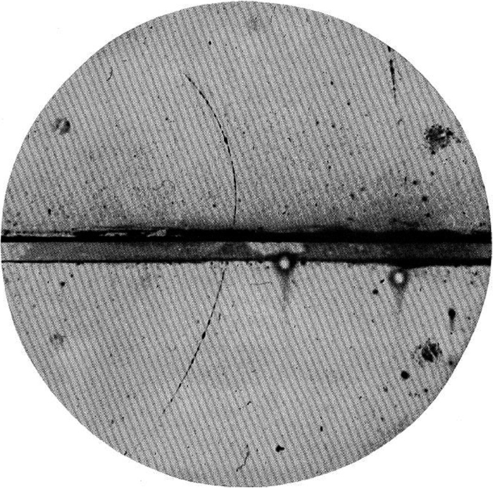
Key Ideas
Carl Anderson detected a positron in a cloud chamber, proving the existence of antimatter.
link.springer.com

Slide 7
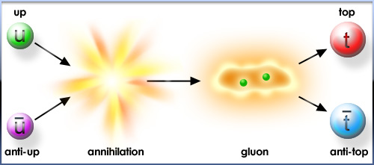
Key Ideas
Annihilation (canceling out) and pair production
particleadventure.org

Slide 8
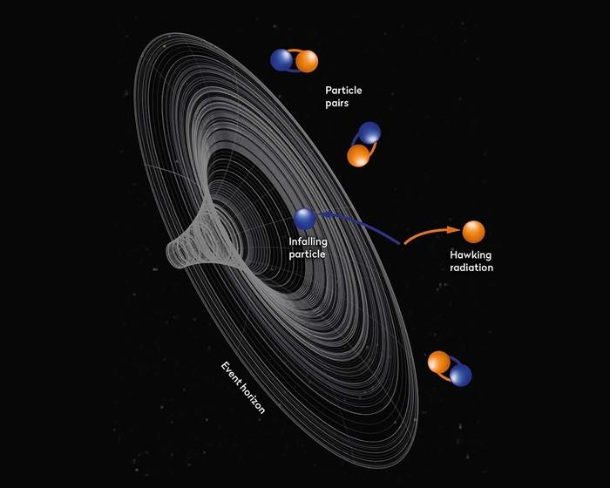
Key Ideas
Hawking Radiation
skyatnightmagazine.com

Slide 9
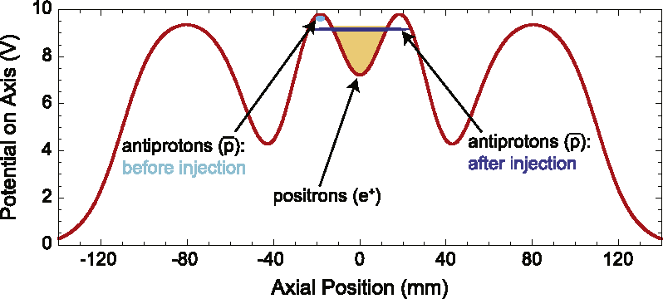
Key Ideas
Trapping antimatter
Potential wells
semanticscholar.org

Slide 10
Key Ideas
We don’t know!
Be mindful of language used - models

Slide 11
What are some conceptions students may have?
Anyone want to share an idea you think a student of yours might have about antimatter? Or what question(s) will the word antimatter bring up?

Slide 12

Potential students’ conceptions & challenges
Is the particle and antiparticle the same?? Mass?? Charge? Spin?
Aren’t they in 50/50? If so how can I be sitting here? Is there an antimatter version of me sitting in another dimension?
Is it like in the movie angels and demons? Can you carry it in a suitcase around town?
rudoz012.tumblr.com/post/183141910905/embed

Slide 13
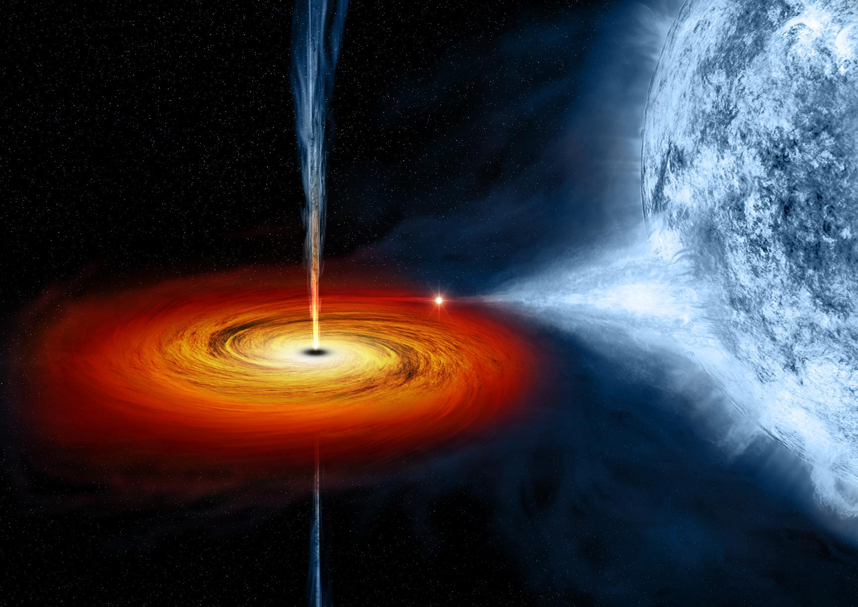
Potential students’ conceptions & challenges
encrypted-tbn0.gstatic.com/images?q=tbn:ANd9GcQ-J0_YMPr1srV6XdqPWPcjBkTltRPAgENeek-2fnnZULK-wVmB&s
What's the difference between dark matter and antimatter… aren’t they the same thing?
Do black holes eat antimatter?
What happens if antimatter touches dark matter?
Are there certain conditions required for annihilation?

Slide 14

Potential students’ conceptions & challenges
What about wave functions of particles? Do antiparticles have the opposite wave function?
Why are we so sure antimatter has to exist?
If I time travel back in time how does that link to matter? Antimatter? Is antimatter from the future? Isn’t that what Feynman diagrams show us?
giphy.com/gifs/BTTF-back-to-the-future-bttf-one-ZhESFK96NxbuO1yDgy

Slide 15


Helpful Material and Resources
Antimatter factory 360º view
Hands on antihydrogen simulation
Antimatter Rap
Angels and Demons Q&A

Slide 16
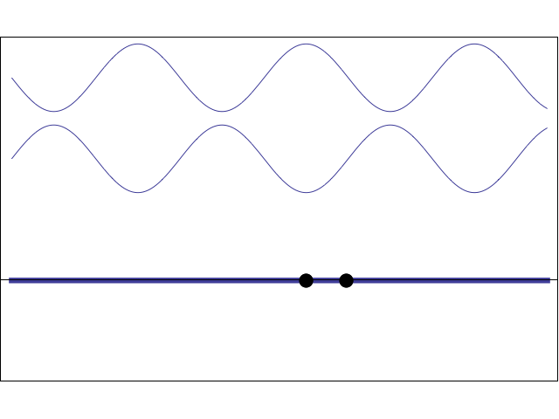
Best Practice Examples
Annihilation Models
  Opposite numbers
  Forces with action/reaction
  Viruses and antidotes
  Neutralization reactions
  Conservation Laws
  Noise canceling headphones
http://www.acs.psu.edu/drussell/Demos/superposition/standing.gif

Slide 17
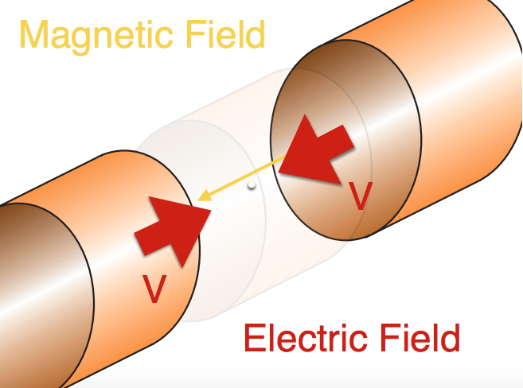
Best Practice Examples
Lesson Ideas
  Acting out reactions
  Unit Conversion Calculations
    Banana Calculations
  Storage
    Magnetic Fields
    Charged Plates
https://indico.cern.ch/event/932906/contributions/4890303/attachments/2479886/4256862/20220713_What%27s%20the%20Matter%20with%20Antimatter.pdf

Slide 18

Thank you and questions?
Ari
Ashley
Slobodan
Erin
Antònia
https://i.pinimg.com/originals/1b/a4/82/1ba482431937d80524715439dfb88ef9.gif

