Slide 1
CERN Basketball Club
Accounting report season 2019/2020
Jeronimo ORTOLA
General Assembly 2nd July 2020

Slide 2
https://espace.cern.ch/CERN-Basketball-club/

Slide 3
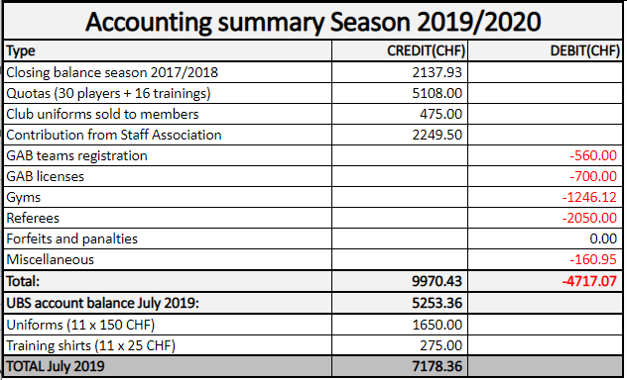

Slide 4
Conclusions
The club is in good health
  Balance UBS account: 5253.36 CHF
  Uniforms on stock: 11 x 150 CHF = 1650 CHF
  Training shirts on stock: 11 x 25 CHF: 275 CHF
  TOTAL POSITIVE BALANCE: 7178.36 CHF (4837.93 CHF last year)
We have a surplus of 2340 CHF regarding last season.
UBS account maintenance fees : 77.60 CHF.

Slide 5
Budget 2020/2021
Similar amount of club members (46 to 40 in 20/21)
Basketball backboard: ~ 2000 CHF
COVID: Refund of 40% of club membership for renewed memberships only: ~2000 CHF.
Foreseen end next season:
  TOTAL POSITIVE BALANCE: 3566.74 CHF (back to normal)

Slide 6
