Slide 1




Wakefield kick measurements
in
Antonio Gilardi
RF development meeting, 21/10/2020
Acknowledgment: Kyrre Sjobak– Roberto Corsini – Wilfrid Farabolini – Andrea Latina – Pasquale Arpaia

Slide 2
Outline:
    Experimental setup
    Measurement method
    Early results
    New experimental results
                I. #bunches/charge/bunch -length
                II. charge
                III. charge/bunch-length
                IV. #bunches/charge/bunch -length
    Consideration «TODO list»
    Future development

Slide 3
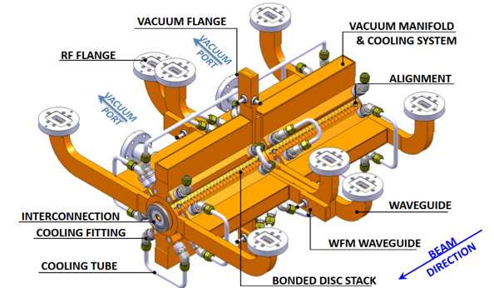
Experimental setup

Slide 4
Experimental setup
H/V correctors
Radiation monitors
iBPM
WFM
YAG screen
GIRDER
TD26CC
OTR screen
Chromox screen

Slide 5
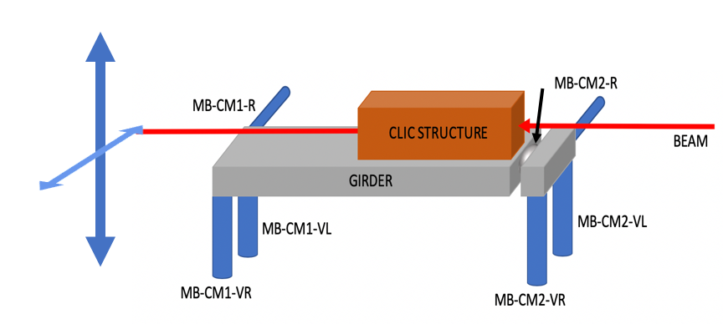
Experimental setup
Move the accelerating structure

Slide 6
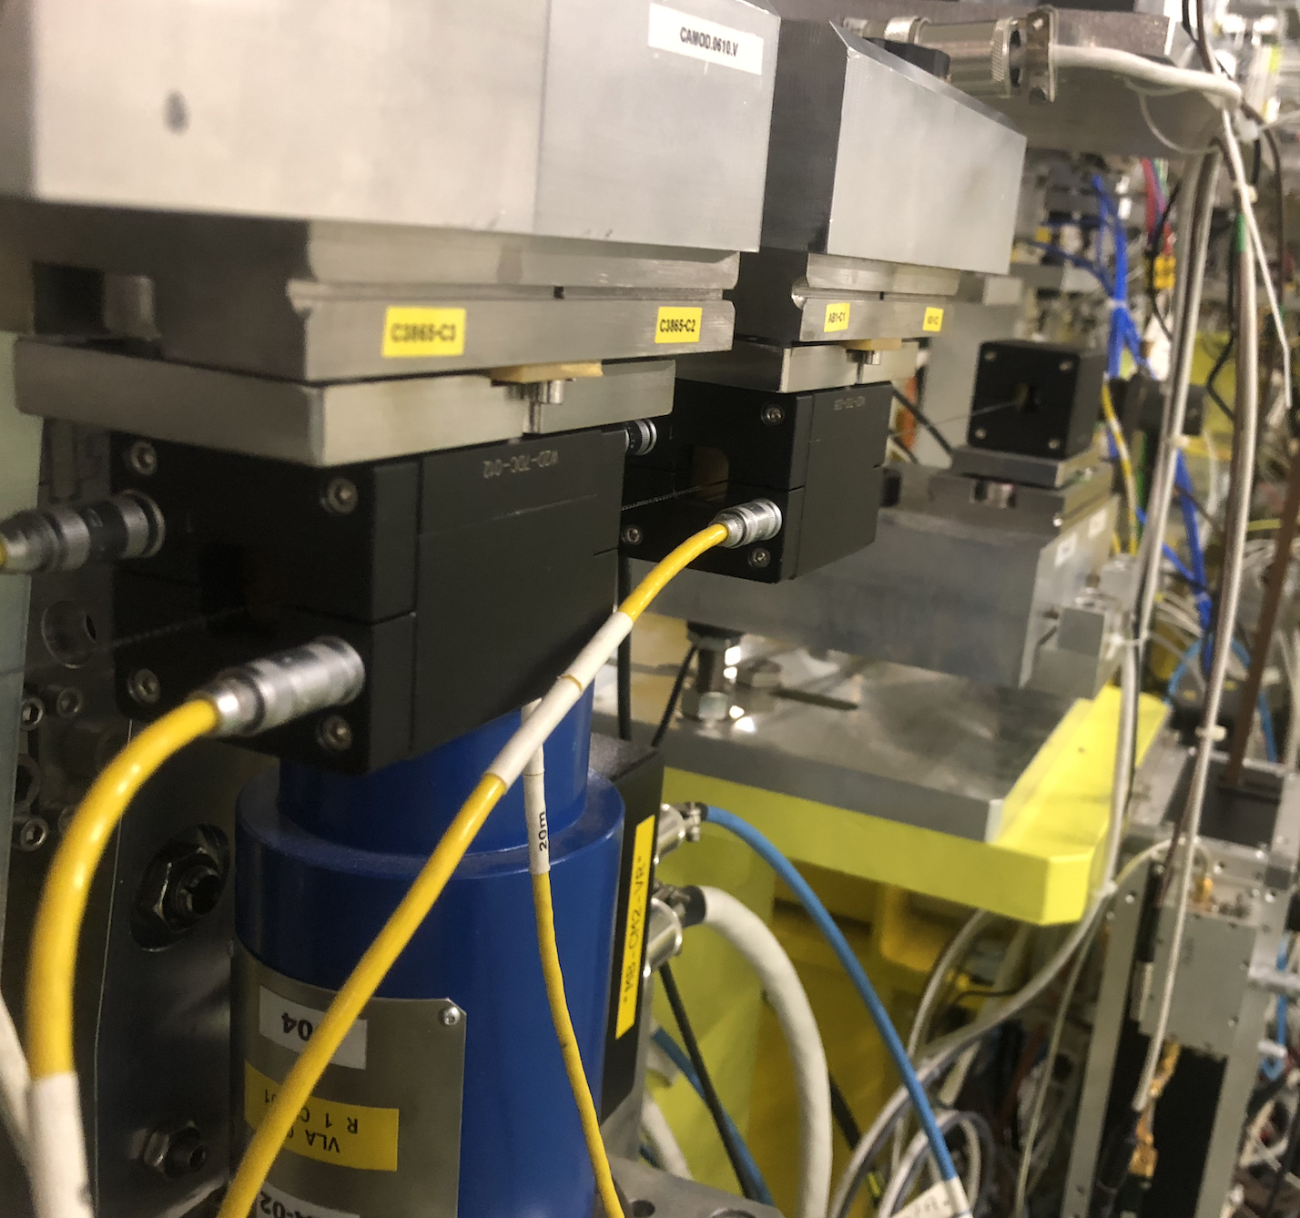
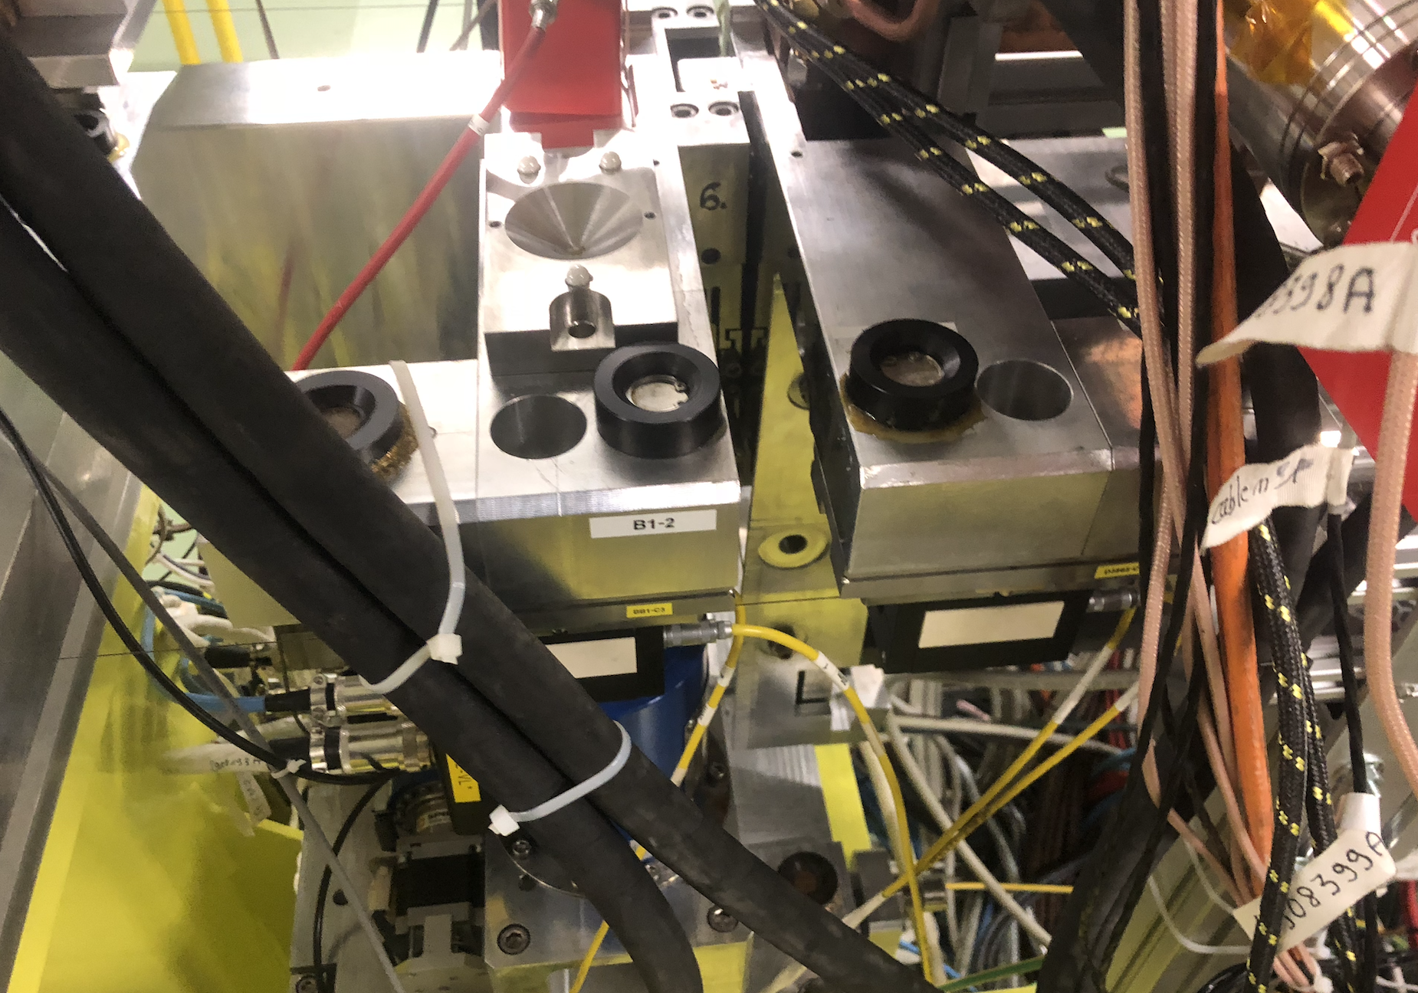
Experimental setup
Move the accelerating structure

Slide 7
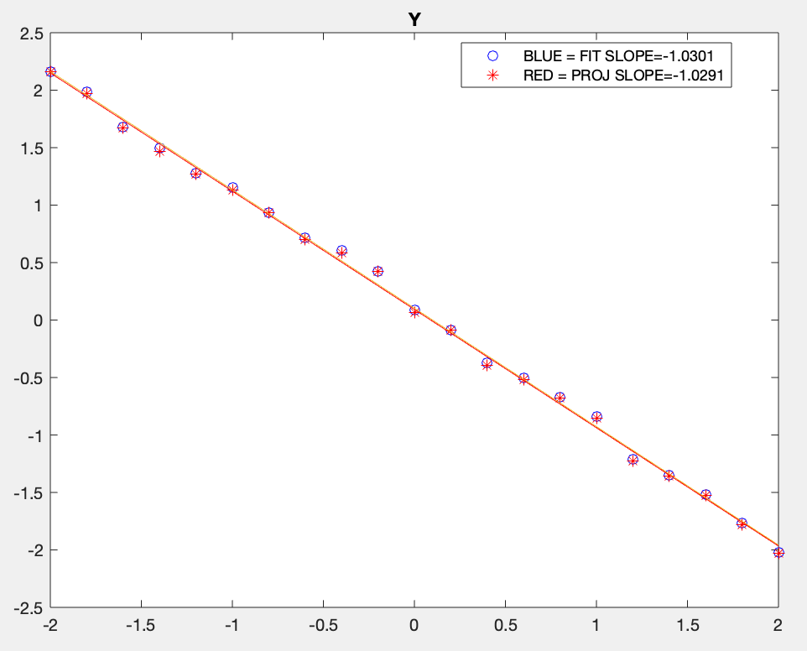
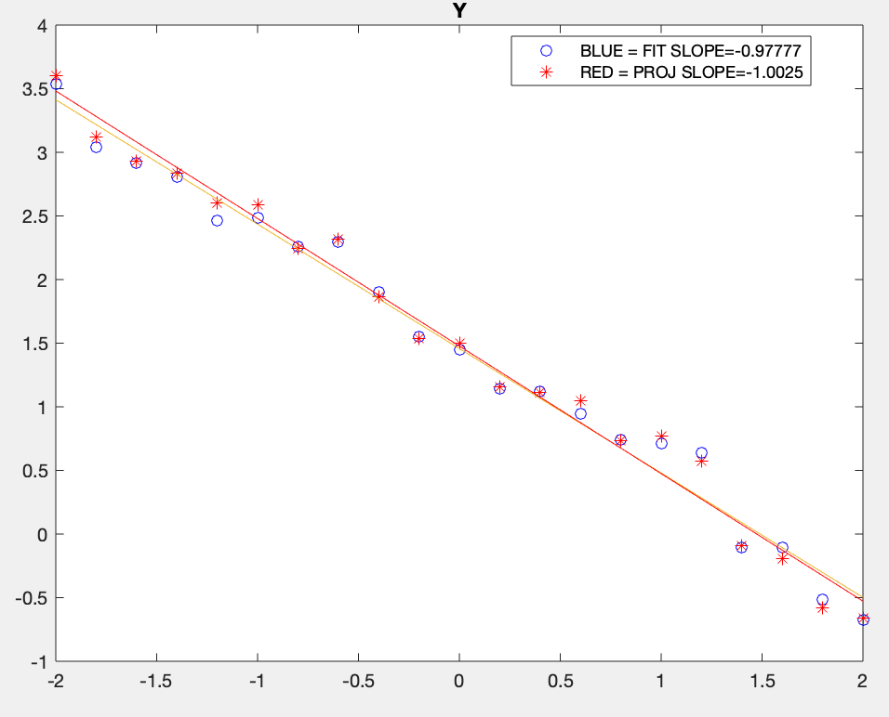
Scanning the
beam position
using a
magnetic bump
V position on screen [mm]
2020-05-28_14-25-52_V620-30pC-1.6ps-1bunch-205MeV
V position on screen [mm]
2020-05-28_14-32-33_V730-30pC-1.6ps-1bunch-205MeV
205 MeV, 1 bunch, 16 pC
205 MeV, 1 bunch, 16 pC
Imposed V position [mm]
Imposed V position [mm]
H/V correctors
Radiation monitors
iBPM
WFM
YAG screen
GIRDER
TD26CC
OTR screen
Chromox screen
Calibration of bump accuracy about 1% (as long as energy is correctly measured)

Slide 8
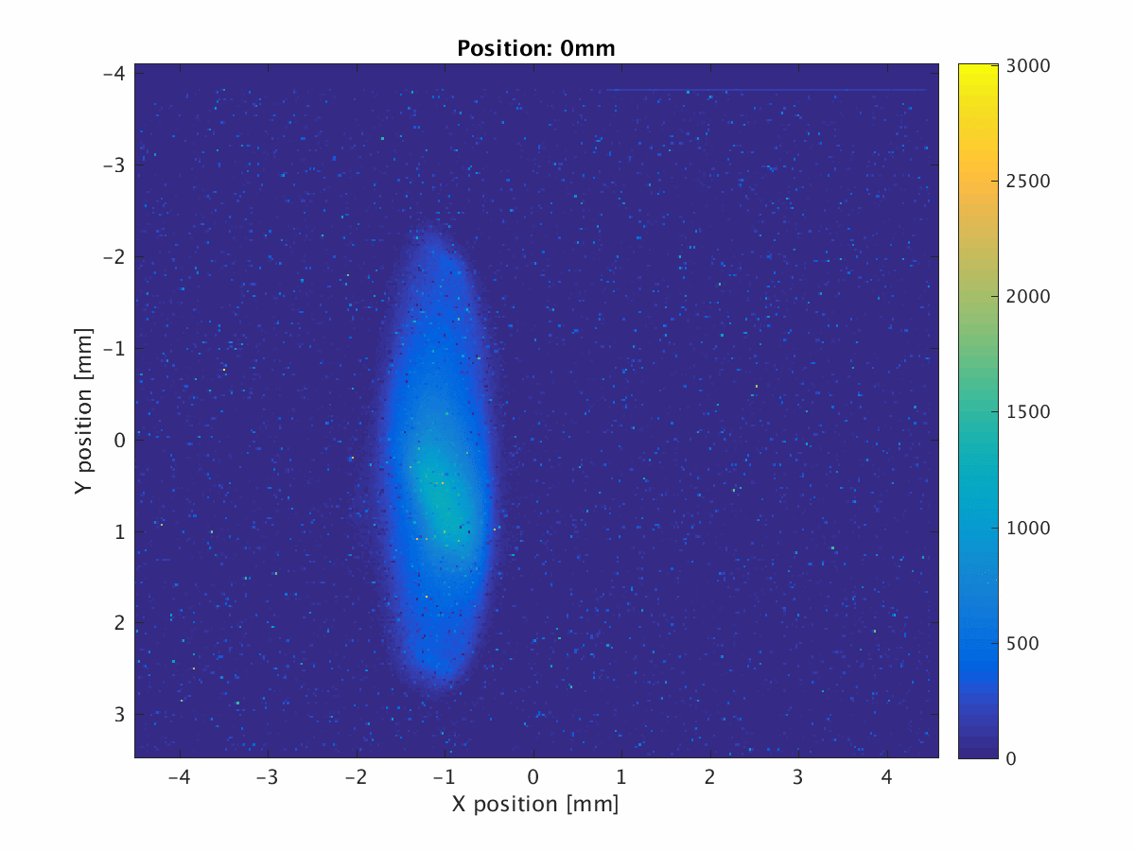
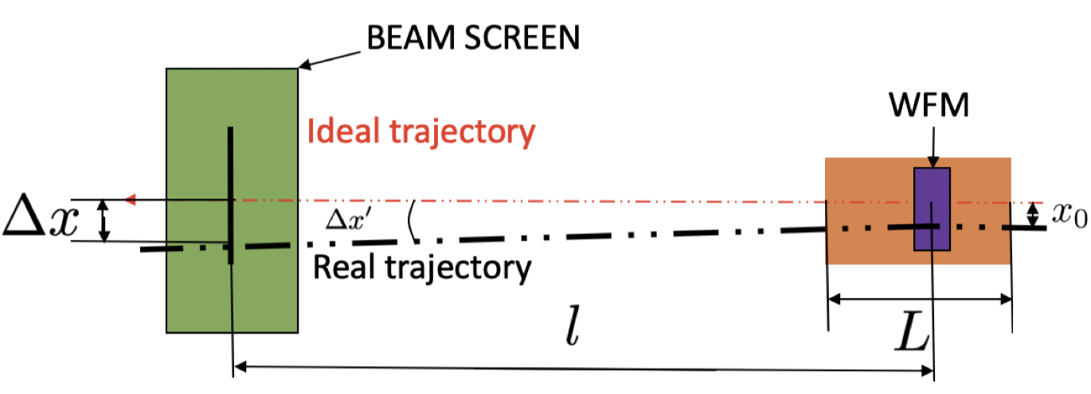
Measurement method

Slide 9
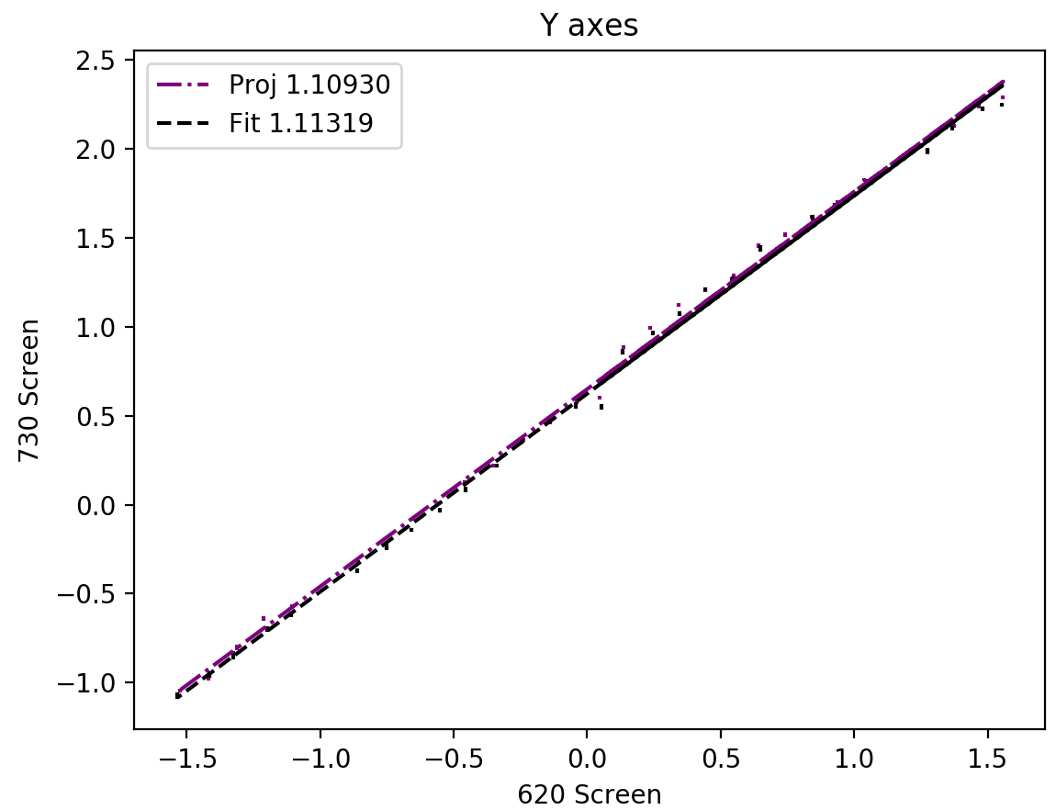
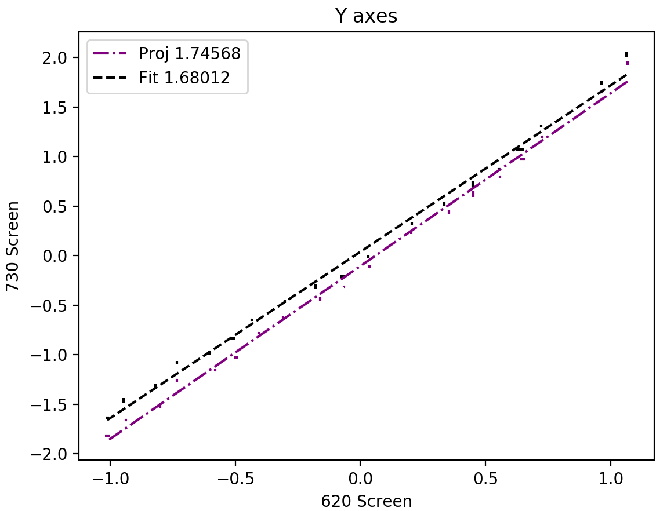
Measurement method
Low Charge: 50pC
2nd screen position [mm]
2nd screen position [mm]
High Charge: 500pC
1st screen position [mm]
1st screen position [mm]

Slide 10
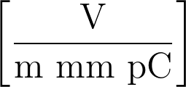
Measurement method
Low Charge: 50pC
2nd screen position [mm]
2nd screen position [mm]
High Charge: 500pC
1st screen position [mm]
1st screen position [mm]

Slide 11
Measurement method
Slope on the 2nd screen
Beam energy (measured in VESPER)
Beam charge (measured in THz)
Form factor (from simulation)
Low Charge: 50pC
2nd screen position [mm]
2nd screen position [mm]
High Charge: 500pC
1st screen position [mm]
1st screen position [mm]

Slide 12
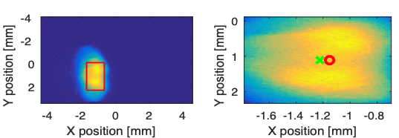
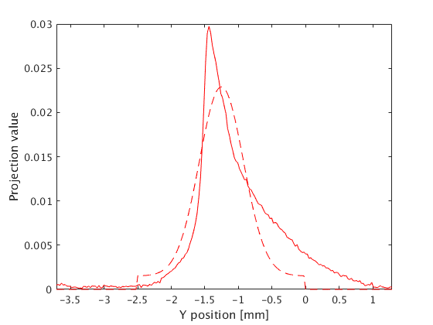
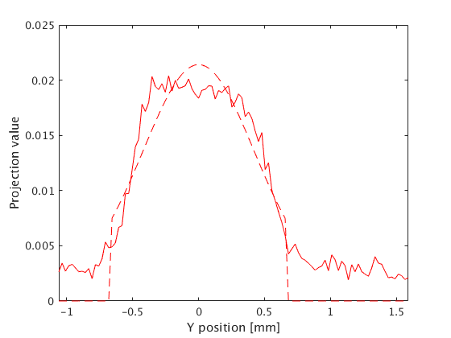
Measurement method
10 acquisitions
N-points
1 Scan
Non-gaussian beam
Gaussian beam

Slide 13
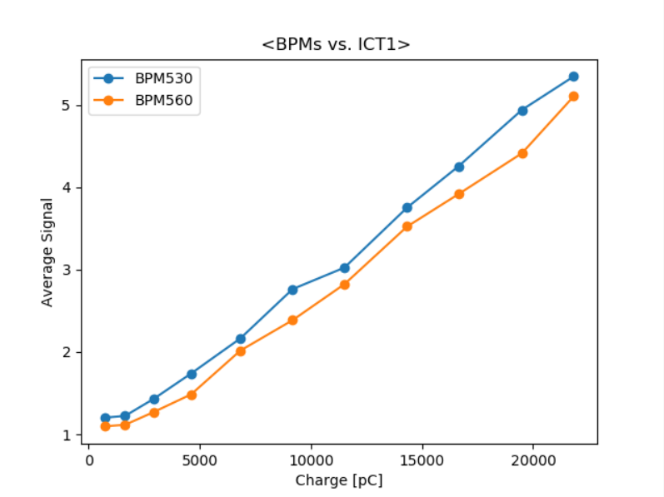
Early results
From the Wakefield simulations we expect: 115 V/(pC m mm).
From the data we got a value of: 1200 V /(pC m mm).
Thanks to a first comparison with simulation a wrong calibration of the ICT in the CLEAR beam line was discovered.
This was corrected in spring 2019
BPM
After correction
16 bunches
ICT
1 bunch
Kick independent of #bunches, scaling with bunch charge.
Indication to be Dominated from short range wake
10 bunches

Slide 14
New experimental results
Some new measurements were performed, following the results for the later run performed

Slide 15
New experimental results – I (#bunches/charge/bunch-length)
RUN in 2020-07
# Bunches → 1 1 1 1 1 51 51 37 17 1 6
Charge per pulse → 23 68 122 171 253 14538 14500 9703 3597 189 1566 [pC]
Bunch length →1.57 3.92 4.05 3.88 3.48 5.26 5.26 5.16 4.50 5.04 4.53 [ps]

Slide 16
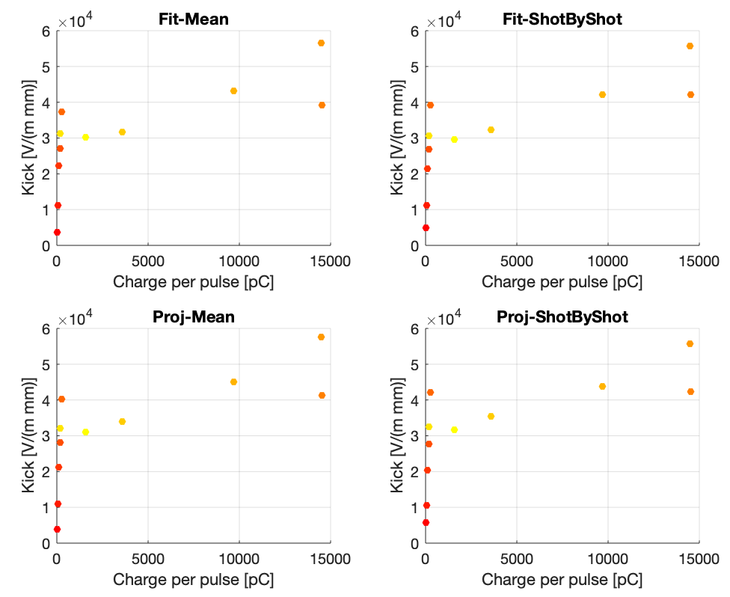
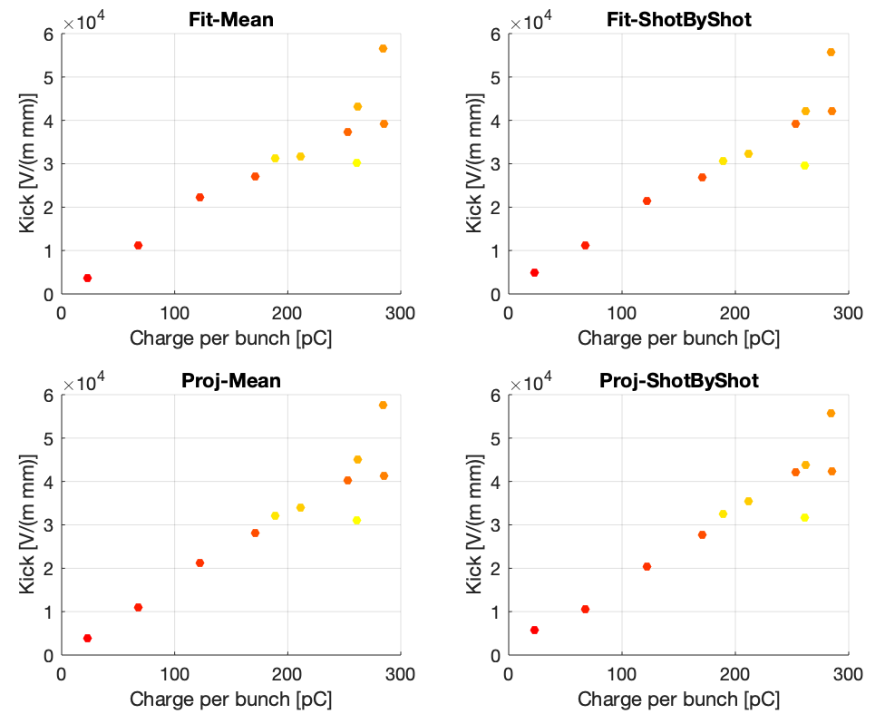
New experimental results – I (#bunches/charge/bunch-length)
RUN in 2020-07
# Bunches → 1 1 1 1 1 51 51 37 17 1 6
Charge per pulse → 23 68 122 171 253 14538 14500 9703 3597 189 1566 [pC]
Bunch length →1.57 3.92 4.05 3.88 3.48 5.26 5.26 5.16 4.50 5.04 4.53 [ps]

Slide 17
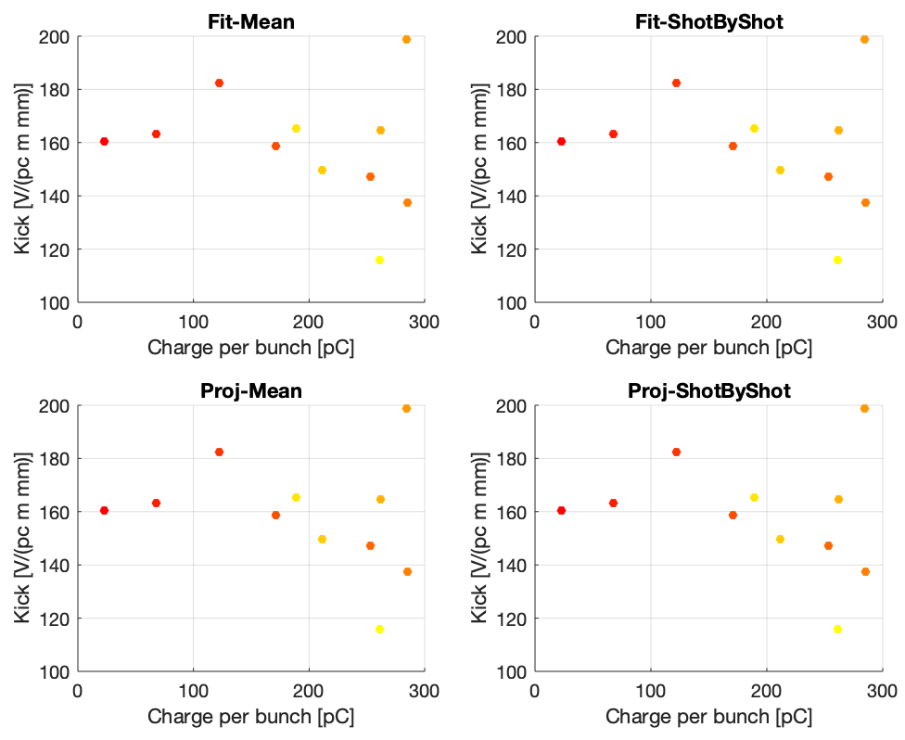
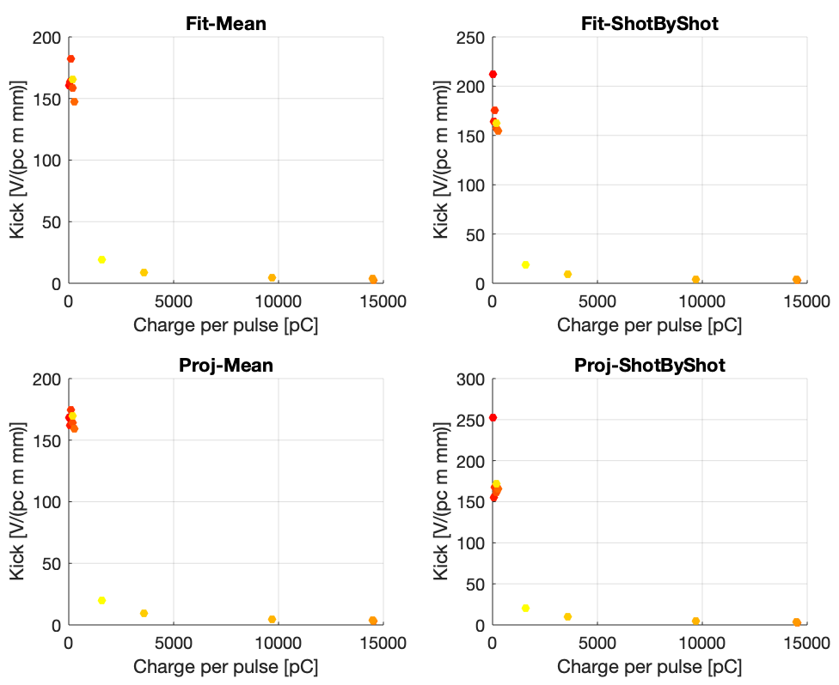
New experimental results – I (#bunches/charge/bunch-length)
RUN in 2020-07
Normalized on the charge per pulse
Normalized on the charge per bunch
# Bunches → 1 1 1 1 1 51 51 37 17 1 6
Charge per pulse → 23 68 122 171 253 14538 14500 9703 3597 189 1566 [pC]
Bunch length →1.57 3.92 4.05 3.88 3.48 5.26 5.26 5.16 4.50 5.04 4.53 [ps]

Slide 18
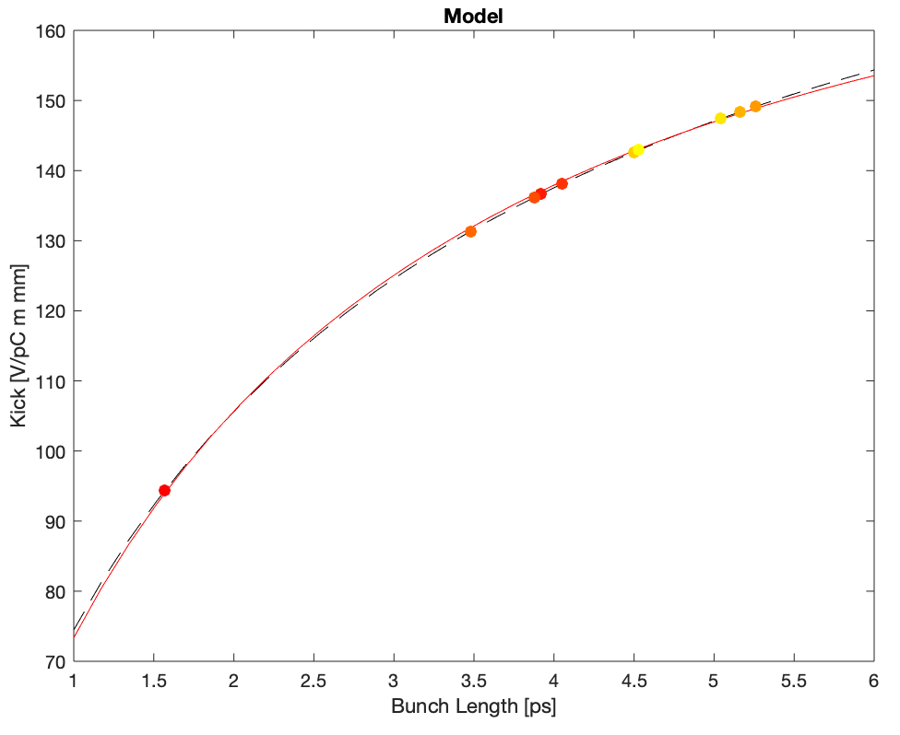
New experimental results – I (#bunches/charge/bunch-length)
Normalizing the result using the model evaluated in simulations
RUN in 2020-07
# Bunches → 1 1 1 1 1 51 51 37 17 1 6
Charge per pulse → 23 68 122 171 253 14538 14500 9703 3597 189 1566 [pC]
Bunch length →1.57 3.92 4.05 3.88 3.48 5.26 5.26 5.16 4.50 5.04 4.53 [ps]

Slide 19
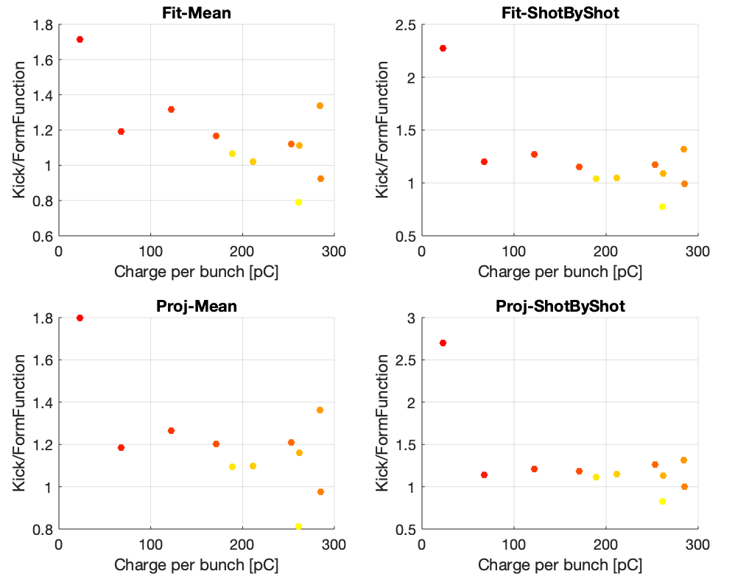
New experimental results – I (#bunches/charge/bunch-length)
Normalizing the result using the model evaluated in simulations
RUN in 2020-07
Kick/Model
# Bunches → 1 1 1 1 1 51 51 37 17 1 6
Charge per pulse → 23 68 122 171 253 14538 14500 9703 3597 189 1566 [pC]
Bunch length →1.57 3.92 4.05 3.88 3.48 5.26 5.26 5.16 4.50 5.04 4.53 [ps]

Slide 20
New experimental results – II (charge)
RUN in 2020-05
Single bunch
Charge per bunch → 254 167 123 69 10 [pC]
Bunch length → 4.04 4.09 3.98 4.05 3.90 [ps]
Almost with a constant bunch length

Slide 21
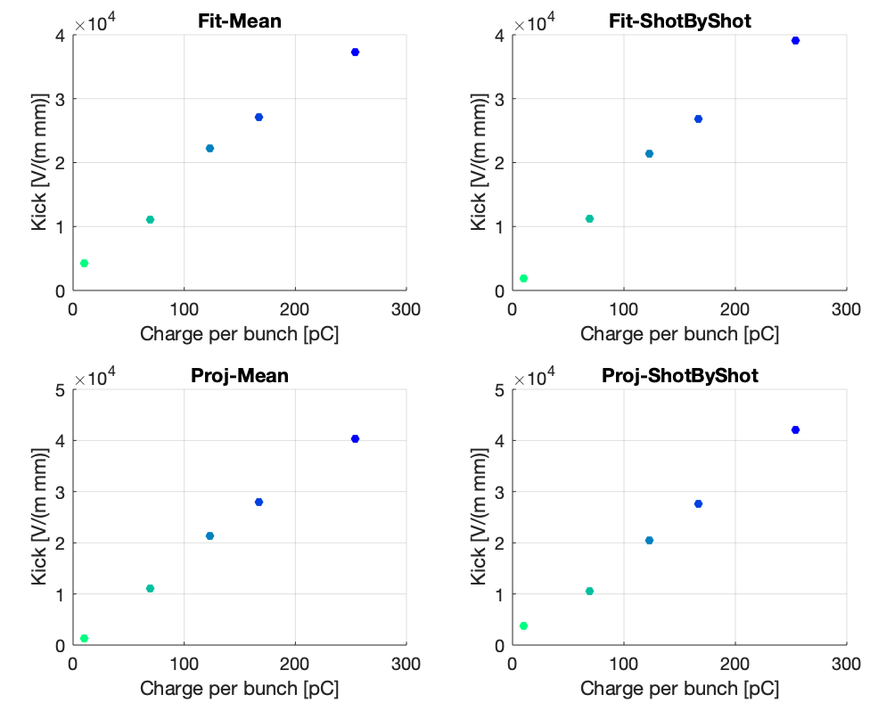
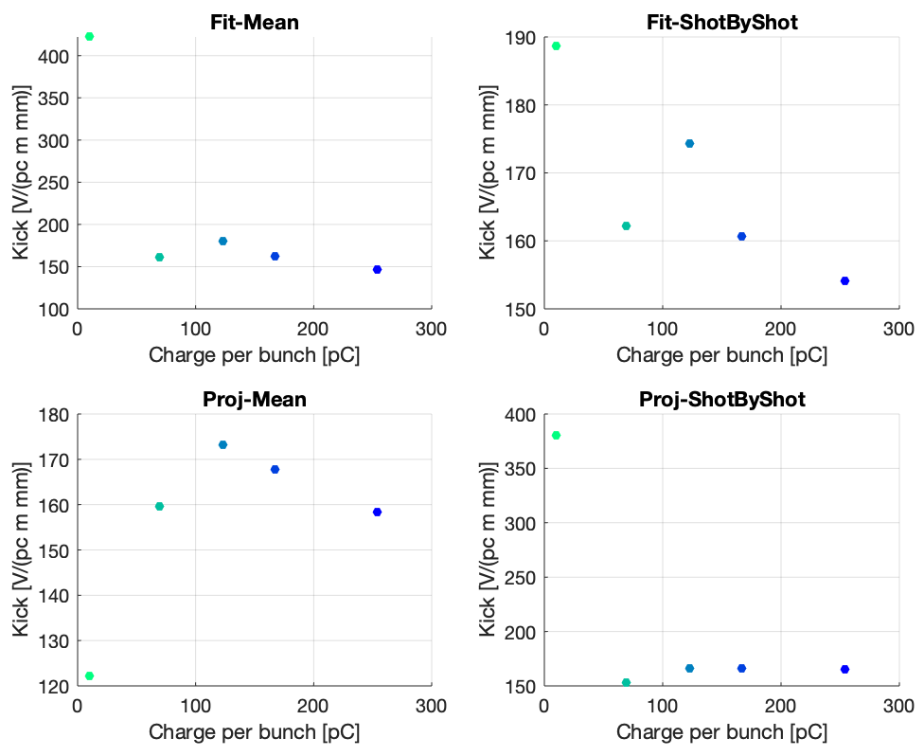
New experimental results – II (charge)
RUN in 2020-05
Normalized on the charge per bunch
Single bunch
Charge per bunch → 254 167 123 69 10 [pC]
Bunch length → 4.04 4.09 3.98 4.05 3.90 [ps]
Almost with a constant bunch length

Slide 22
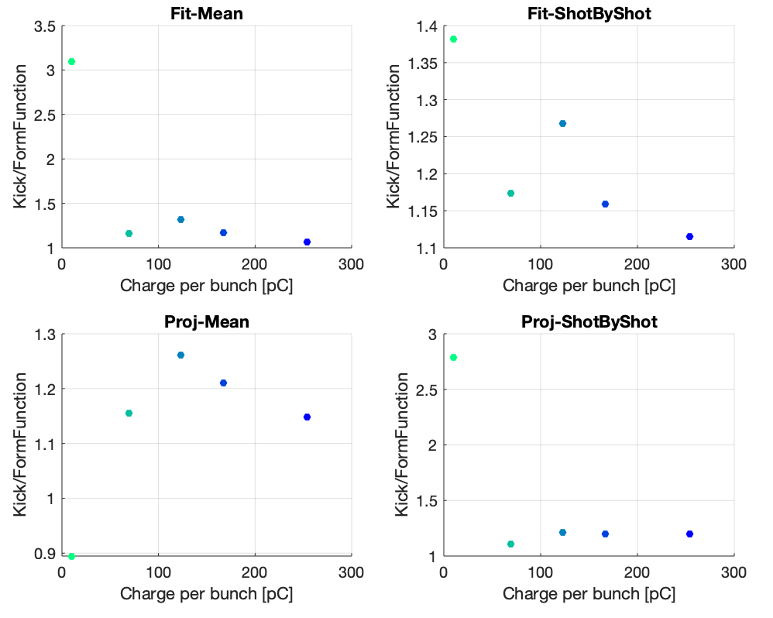
New experimental results – II (charge)
RUN in 2020-05
Kick/Model
Single bunch
Charge per bunch → 254 167 123 69 10 [pC]
Bunch length → 4.04 4.09 3.98 4.05 3.90 [ps]

Slide 23
New experimental results – III (charge/bunch-length)
RUN in 2020-09
9x 4x 4x 4x 3x 3x
20 bunches
Charge per bunch → 511 221 122 41 369 229 [pC]
Bunch length → 3.9 3.33 3.01 2.91 3.28 3.03 [ps]

Slide 24
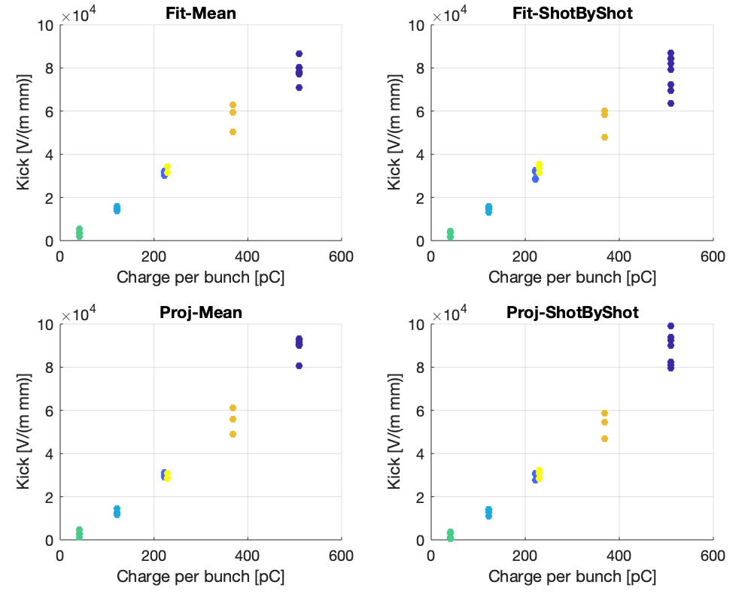
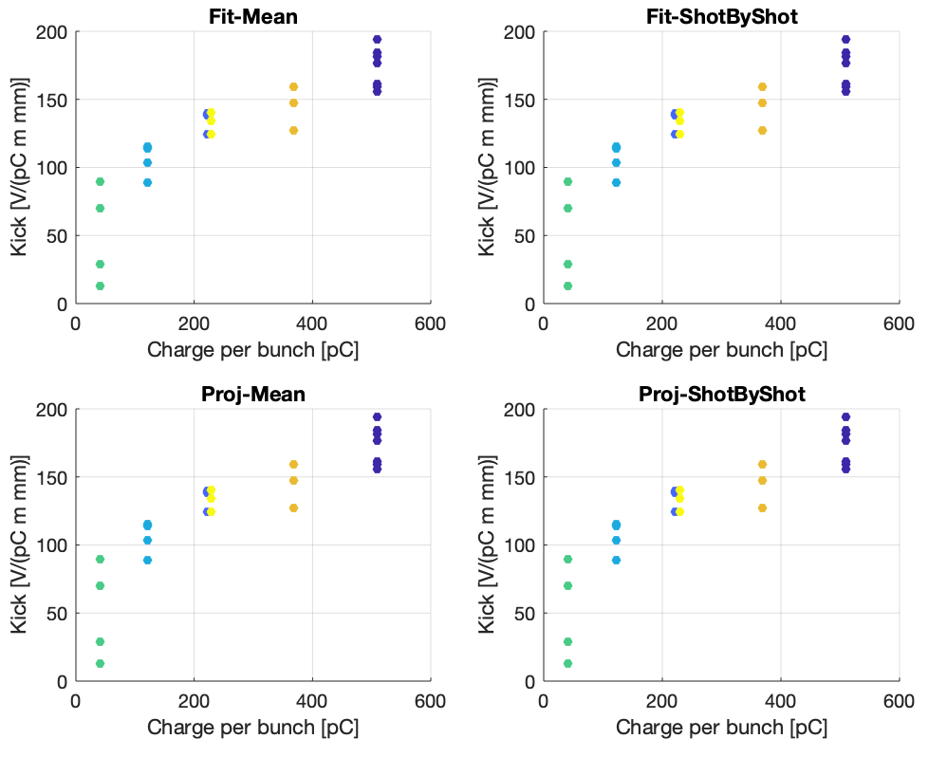
New experimental results – III (charge/bunch-length)
RUN in 2020-09
Normalized on the charge per bunch
9x 4x 4x 4x 3x 3x
20 bunches
Charge per bunch → 511 221 122 41 369 229 [pC]
Bunch length → 3.9 3.33 3.01 2.91 3.28 3.03 [ps]

Slide 25
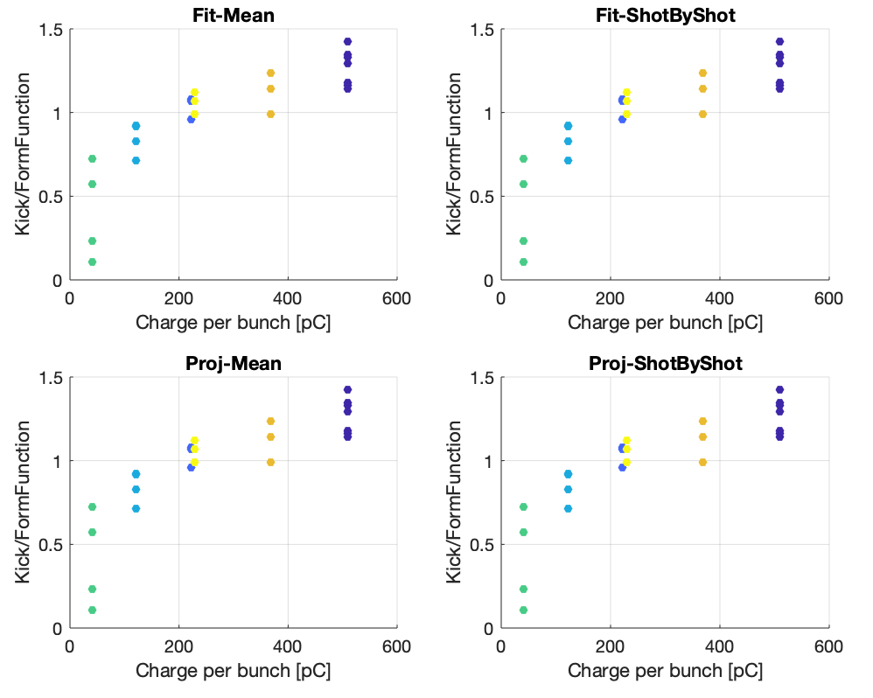
New experimental results – III (charge/bunch-length)
RUN in 2020-09
Kick/Model
9x 4x 4x 4x 3x 3x
20 bunches
Charge per bunch → 511 221 122 41 369 229 [pC]
Bunch length → 3.9 3.33 3.01 2.91 3.28 3.03 [ps]

Slide 26
New experimental results – IV (#bunches/charge/bunch-length)
RUN in 2020-09
3x 3x 3x 3x 3x
#Bunches → 20 10 5 1 40
Charge per bunch → 379 397 394 380 269 [pC]
Bunch length → 4.38 4.24 3.91 3.30 3.48 [ps]

Slide 27
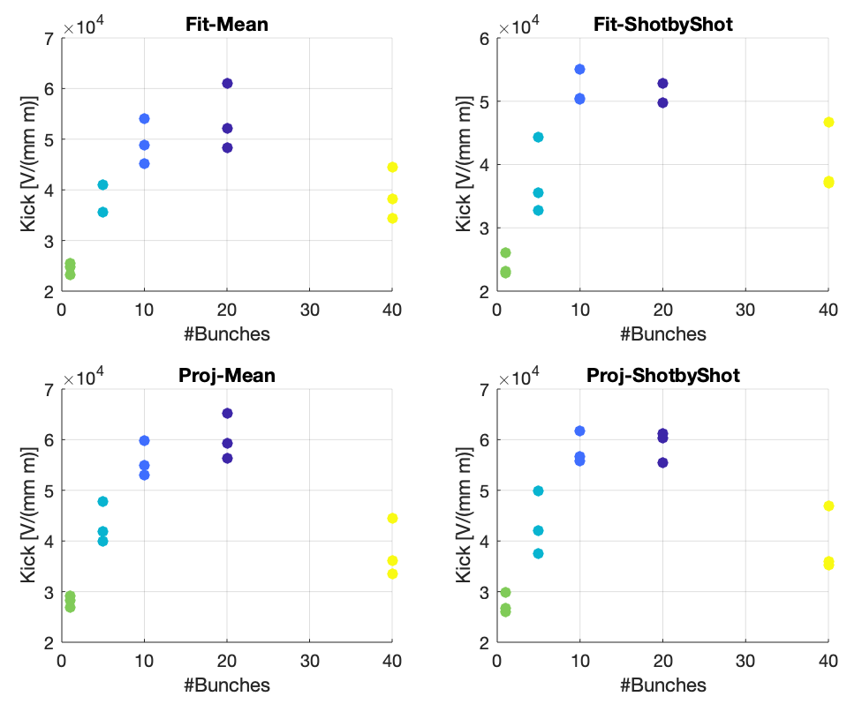
New experimental results – IV (#bunches/charge/bunch-length)
RUN in 2020-09
3x 3x 3x 3x 3x
#Bunches → 20 10 5 1 40
Charge per bunch → 379 397 394 380 269 [pC]
Bunch length → 4.38 4.24 3.91 3.30 3.48 [ps]

Slide 28
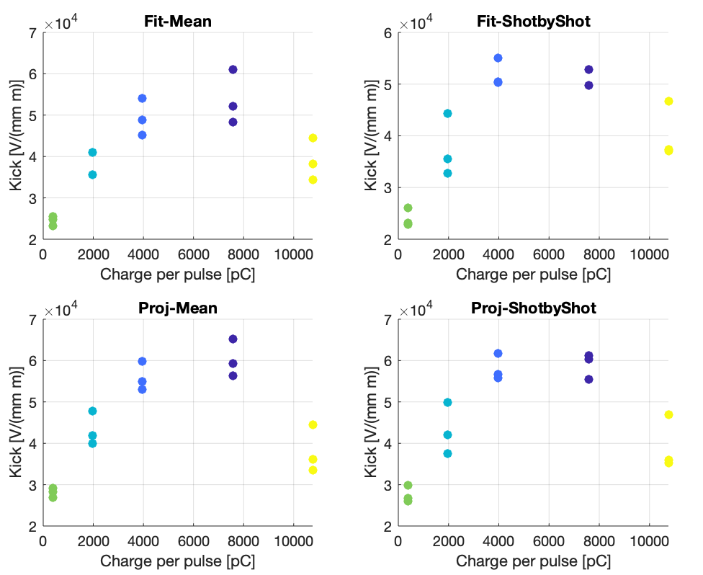
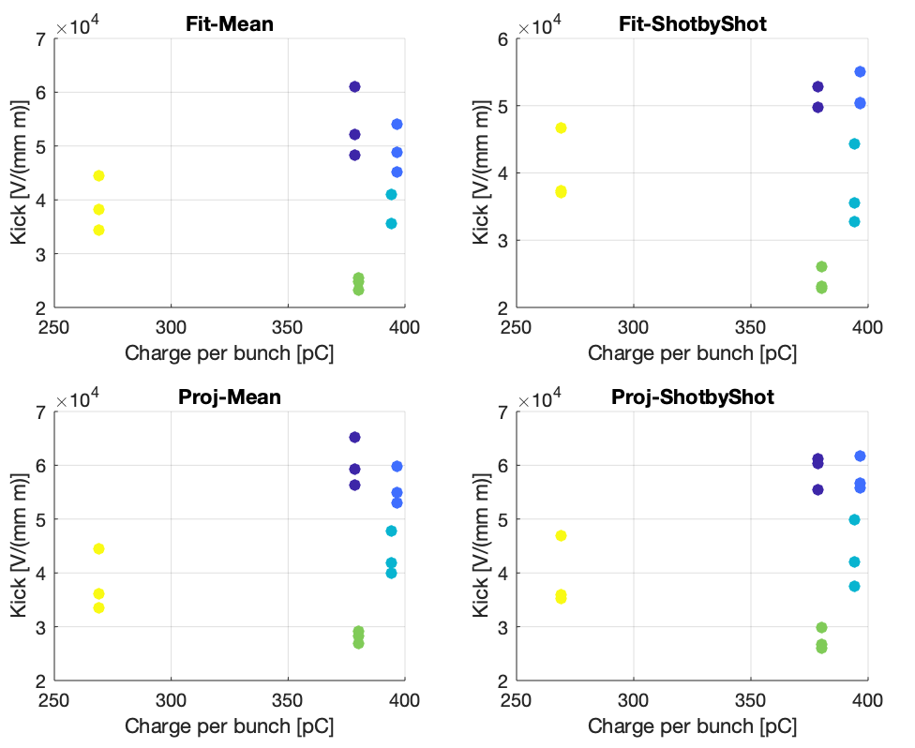
New experimental results – IV (#bunches/charge/bunch-length)
RUN in 2020-09
3x 3x 3x 3x 3x
#Bunches → 20 10 5 1 40
Charge per bunch → 379 397 394 380 269 [pC]
Bunch length → 4.38 4.24 3.91 3.30 3.48 [ps]

Slide 29
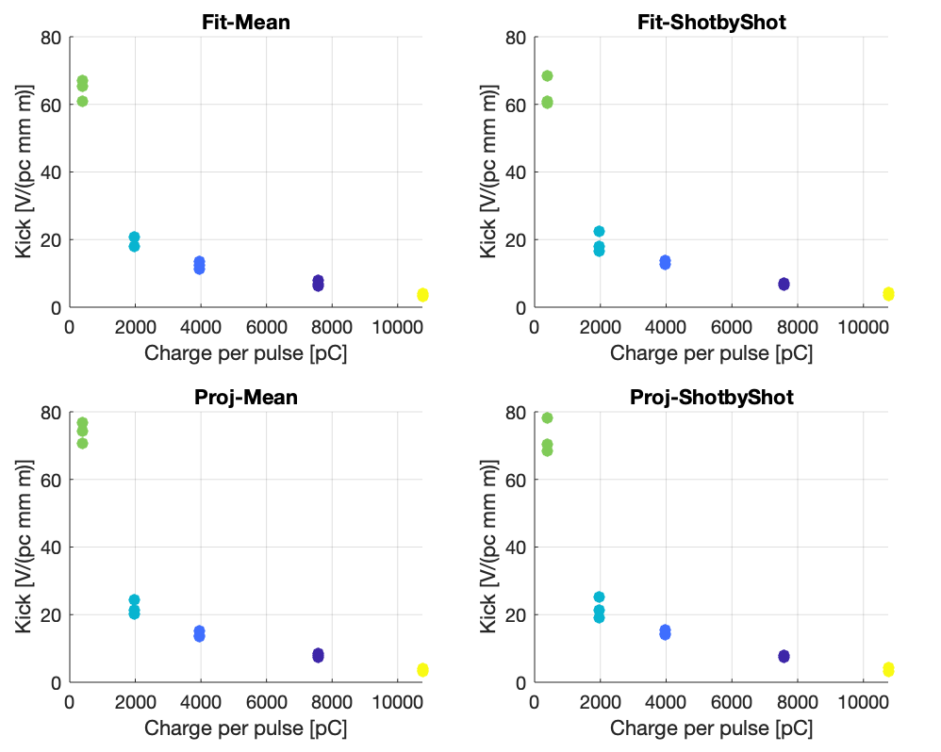
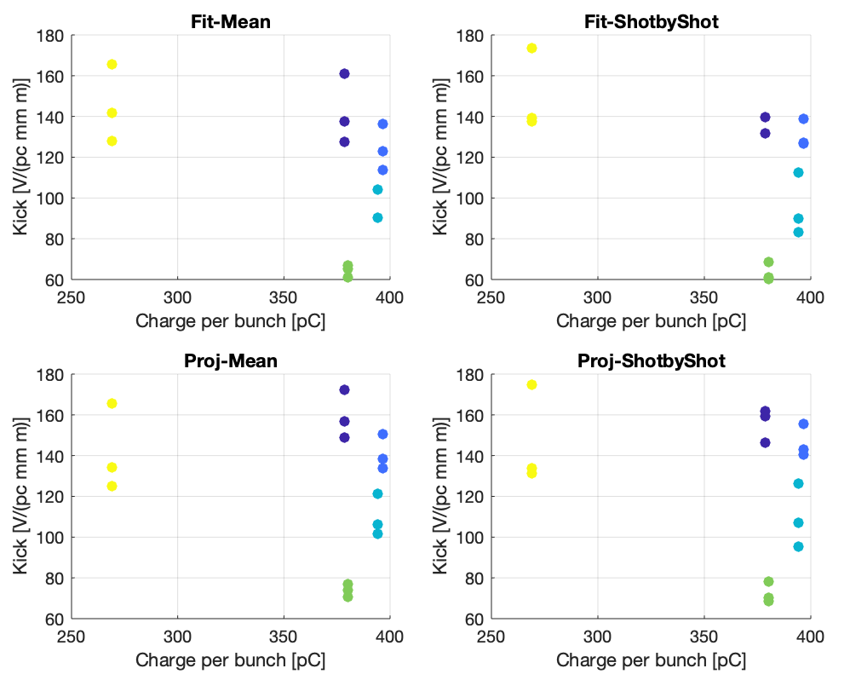
New experimental results – IV (#bunches/charge/bunch-length)
RUN in 2020-09
Normalized on the charge per pulse
Normalized on the charge per bunch
3x 3x 3x 3x 3x
#Bunches → 20 10 5 1 40
Charge per bunch → 379 397 394 380 269 [pC]
Bunch length → 4.38 4.24 3.91 3.30 3.48 [ps]

Slide 30
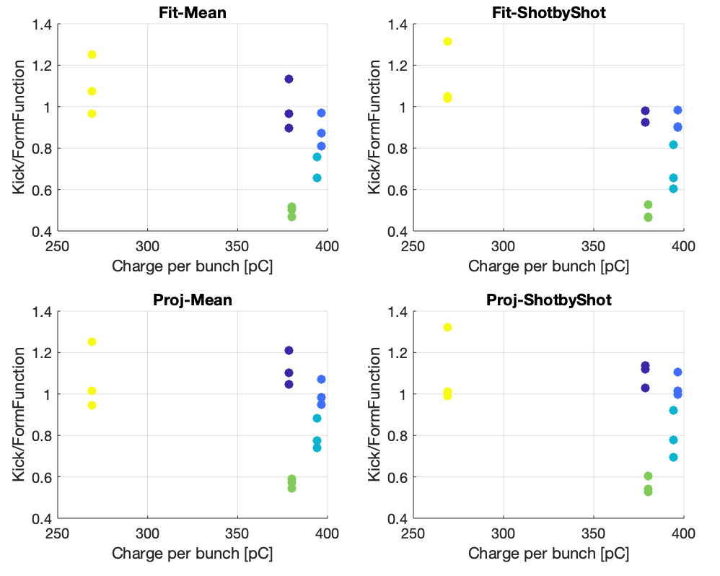
New experimental results – IV (#bunches/charge/bunch-length)
RUN in 2020-09
Kick/Model
3x 3x 3x 3x 3x
#Bunches → 20 10 5 1 40
Charge per bunch → 379 397 394 380 269 [pC]
Bunch length → 4.38 4.24 3.91 3.30 3.48 [ps]

Slide 31
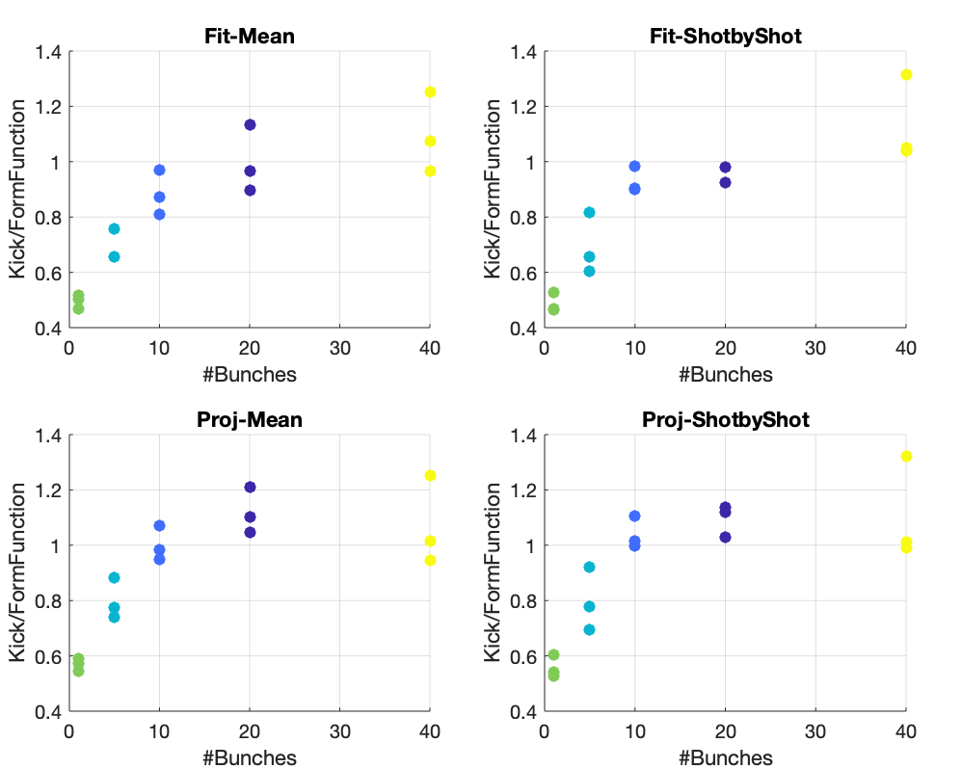
New experimental results – IV (#bunches/charge/bunch-length)
RUN in 2020-09
Kick/Model
Kick/Model
3x 3x 3x 3x 3x
#Bunches → 20 10 5 1 40
Charge per bunch → 379 397 394 380 269 [pC]
Bunch length → 4.38 4.24 3.91 3.30 3.48 [ps]

Slide 32
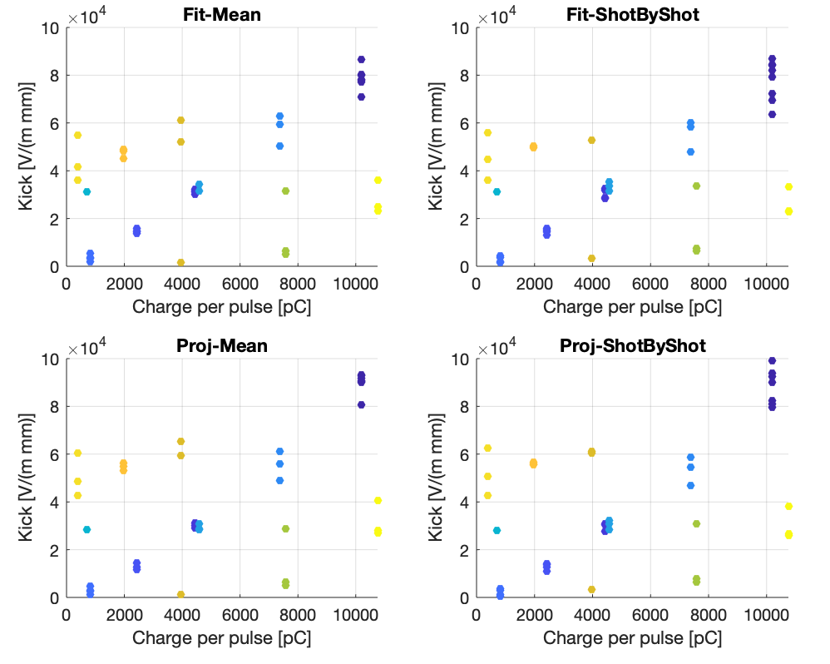
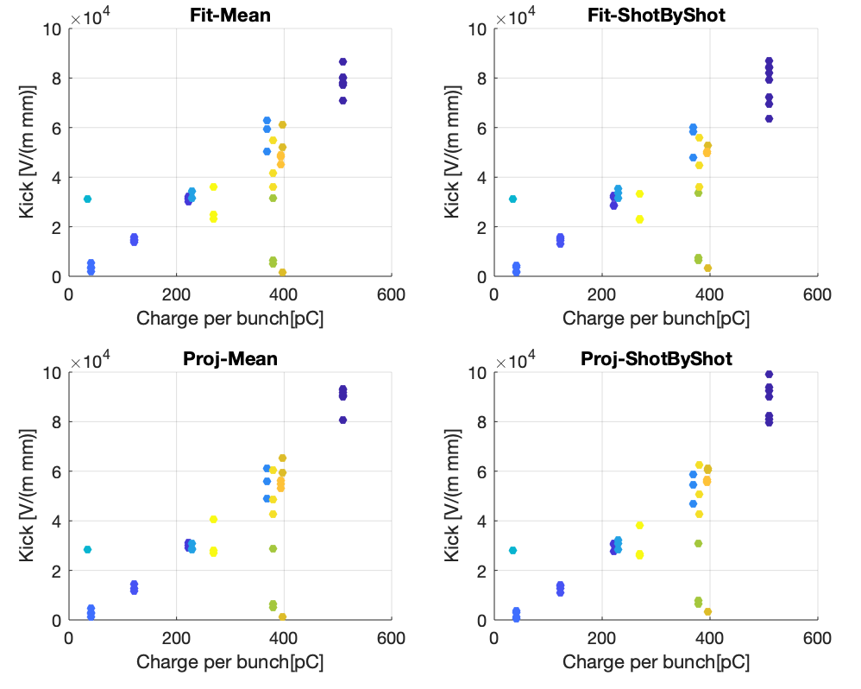
New experimental results – III & IV
(20 bunches) – 2 bunches – 5 bunches – 10 bunches – 20 bunches -- 40 bunches

Slide 33
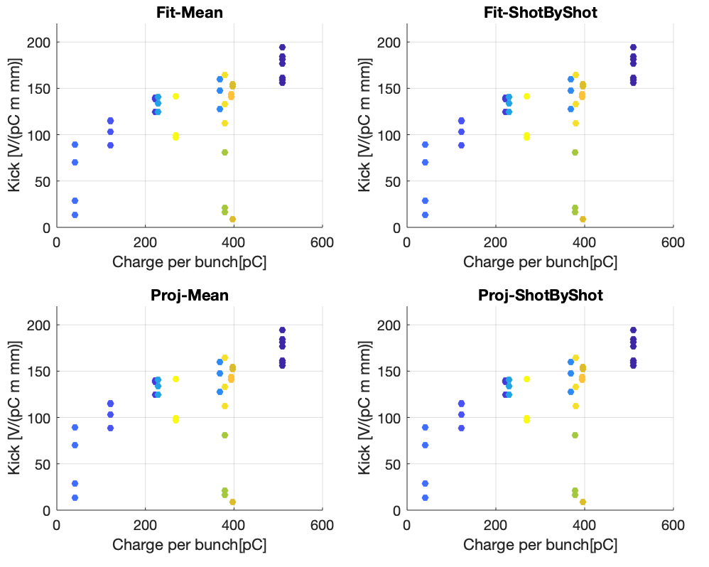
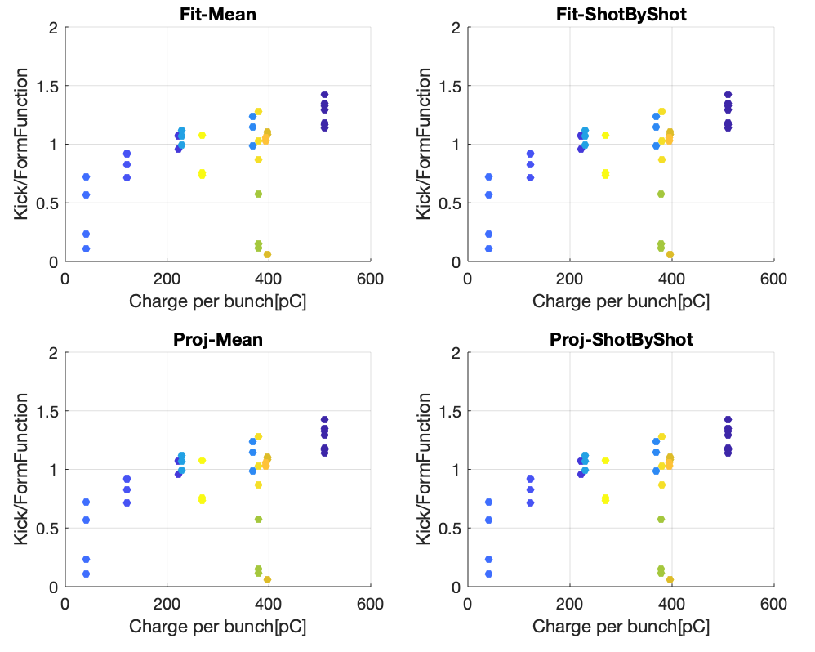
New experimental results – III & IV
Kick/Model
(20 bunches) – 2 bunches – 5 bunches – 10 bunches – 20 bunches -- 40 bunches

Slide 34
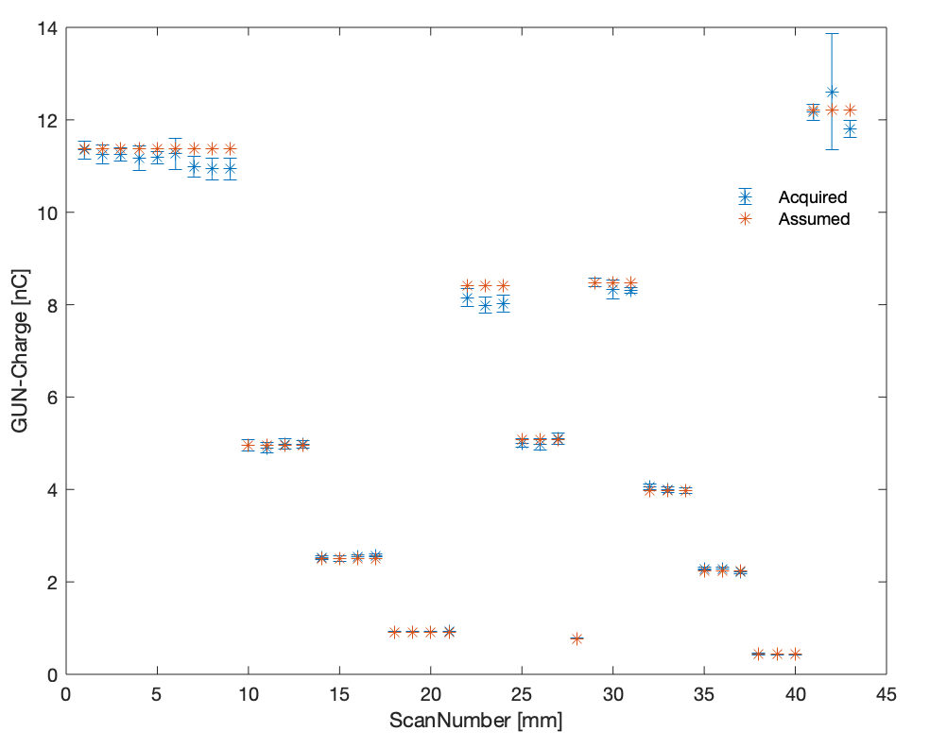
New experimental results – III & IV
(20 bunches) – 2 bunches – 5 bunches – 10 bunches – 20 bunches -- 40 bunches

Slide 35
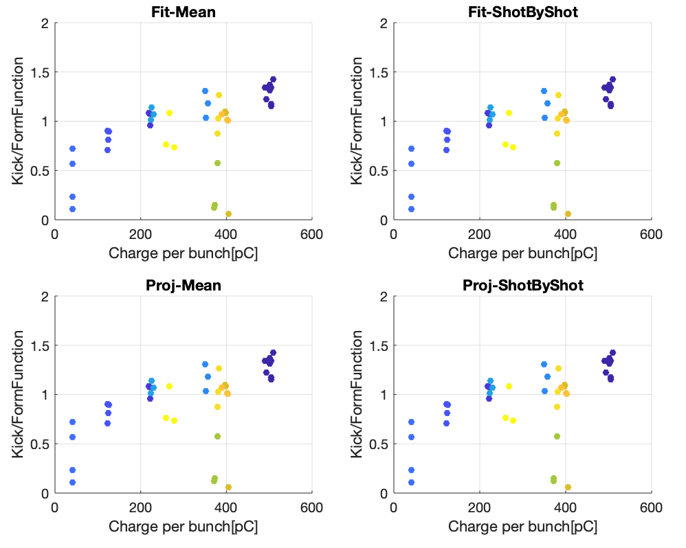
New experimental results – III & IV
Kick/Model
(20 bunches) – 2 bunches – 5 bunches – 10 bunches – 20 bunches -- 40 bunches

Slide 36
Consideration «TODO list»
Add some error bars (charge/bunch length) to understand if the span can be driven from the charge.
Some bad scans to be understood!
Improve the screen resolution: I- for the screen before the structure to improve the bump calibration (done!), and II- for the screen after the structure to improve the resolution of the scan
Use during the scan a closer charge (and position) monitoring (i.e., iBPM) would be needed.
Work on the beam condition – try to have only one parameter changing at the time
We have the confirmation that the short range are dominant…. But we see that after all the normalization there is still a trend related with the charge. We are currently investigating this trend.

Slide 37
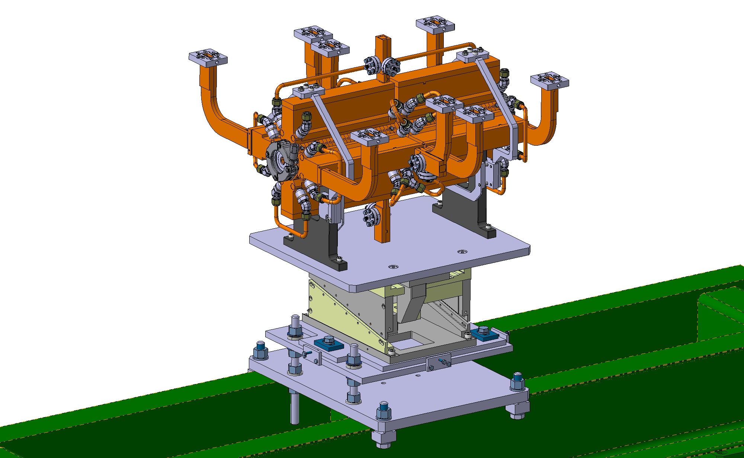
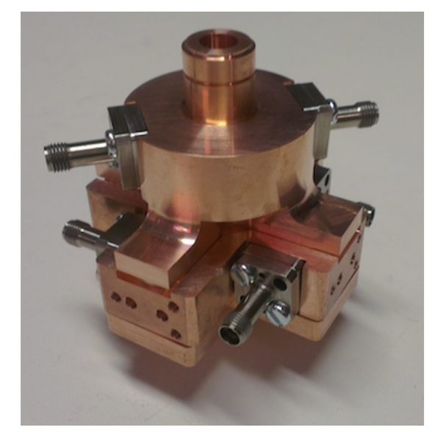
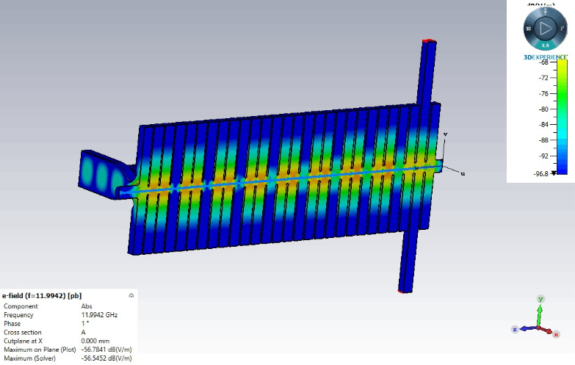
Future development
Design of a new mover (SAS-like) is already done to allow scans moving the structure.
Take action on the CLIC cavity BPM
Collaboration with the X-Box team for performing CST simulation
E-Field in Frequency Domain (@ 11.9942 GHz)

Slide 38
Thanks for your attention

Slide 39
Backup slides

Slide 40
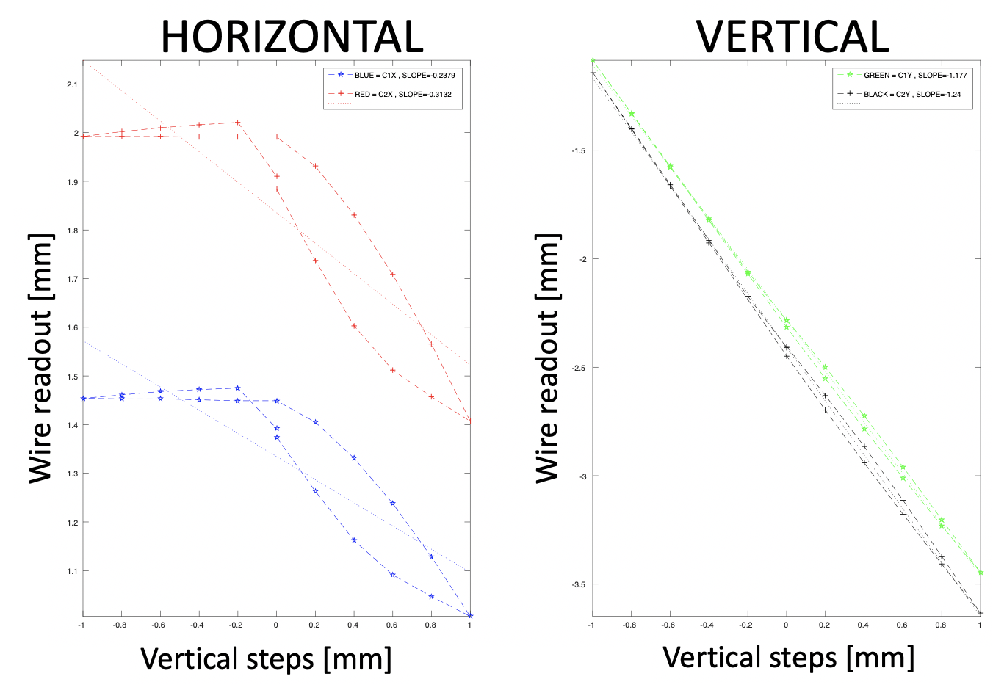
•All the preliminary scans were done to understand the limitation of the method
•The main limitation comes from a mechanical constraint while limiting the aperture.

Slide 41
