Slide 1
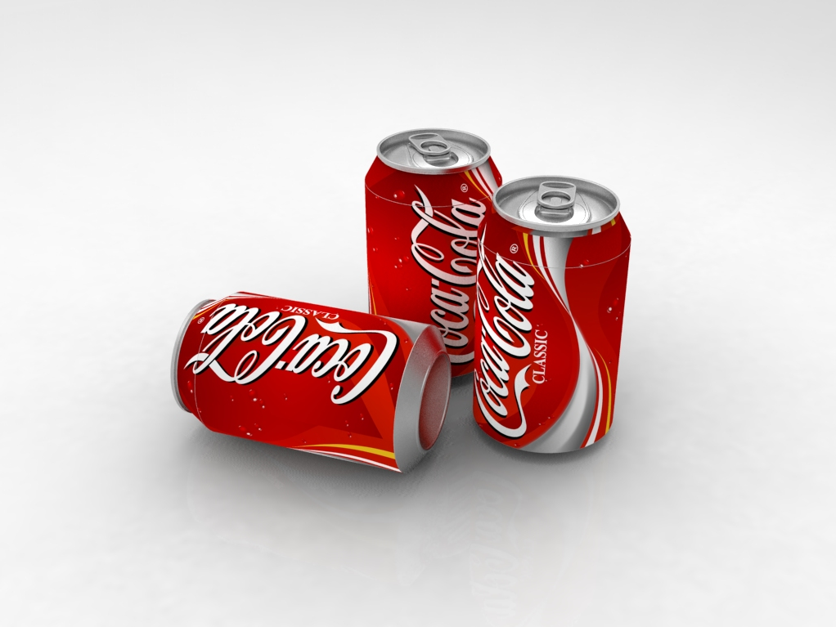


Slide 2
A simple coke can…
A typical 330 ml coke can, resembles a cylindrical cavity.
Field solutions can be found analytically with the correct boundary conditions.
  TM and TE modes (see lecture notes)
TM010 – accelerating mode.
  Resonant frequency given by:
  c – speed of light
  D – diameter
  x1 – 2.40483
~65.6 mm
~115.2 mm
f=~3.5 GHz

Slide 3
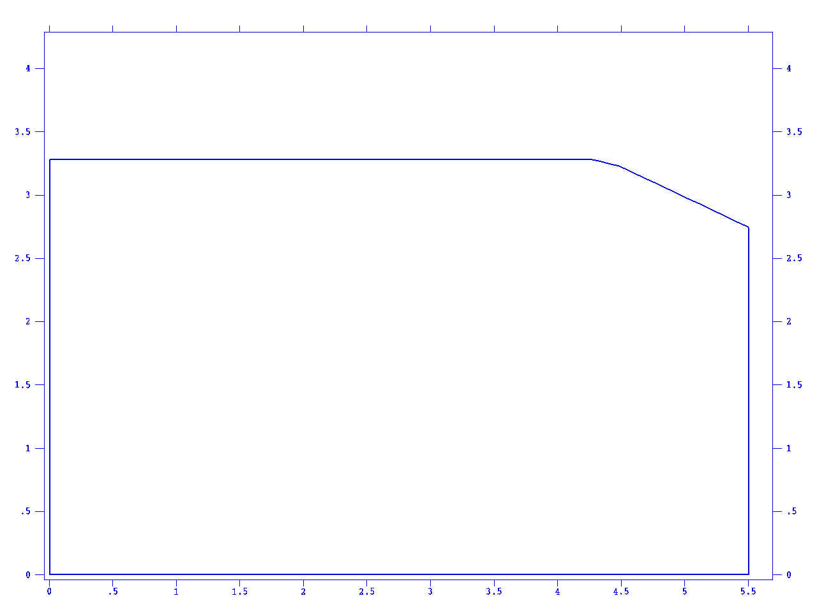
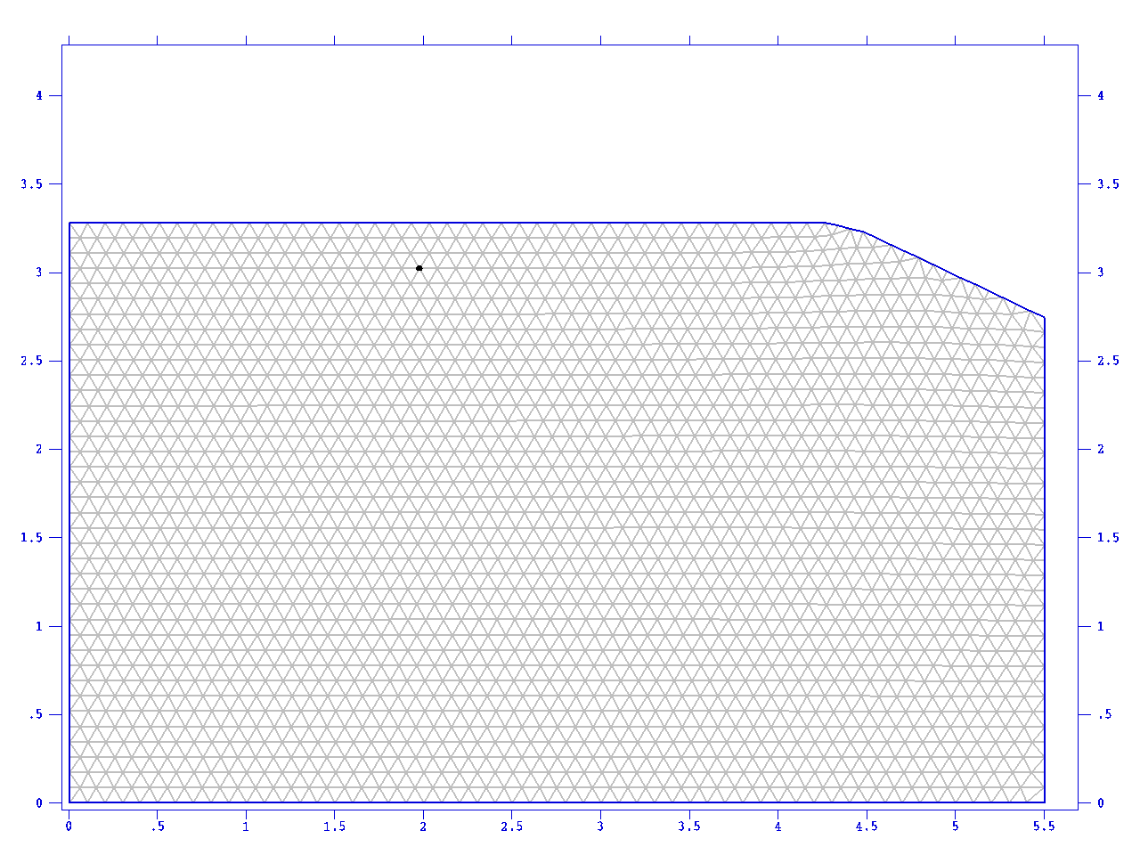
2D Model
Model A
Superfish
  2D cylindrical symmetry assumed.
Geometry
Mesh

Slide 4
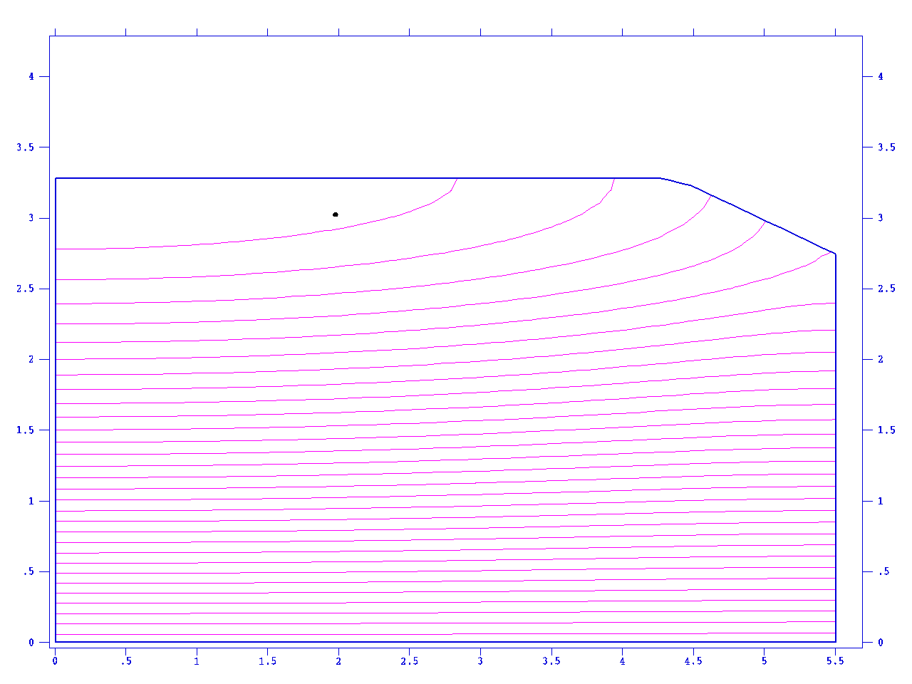
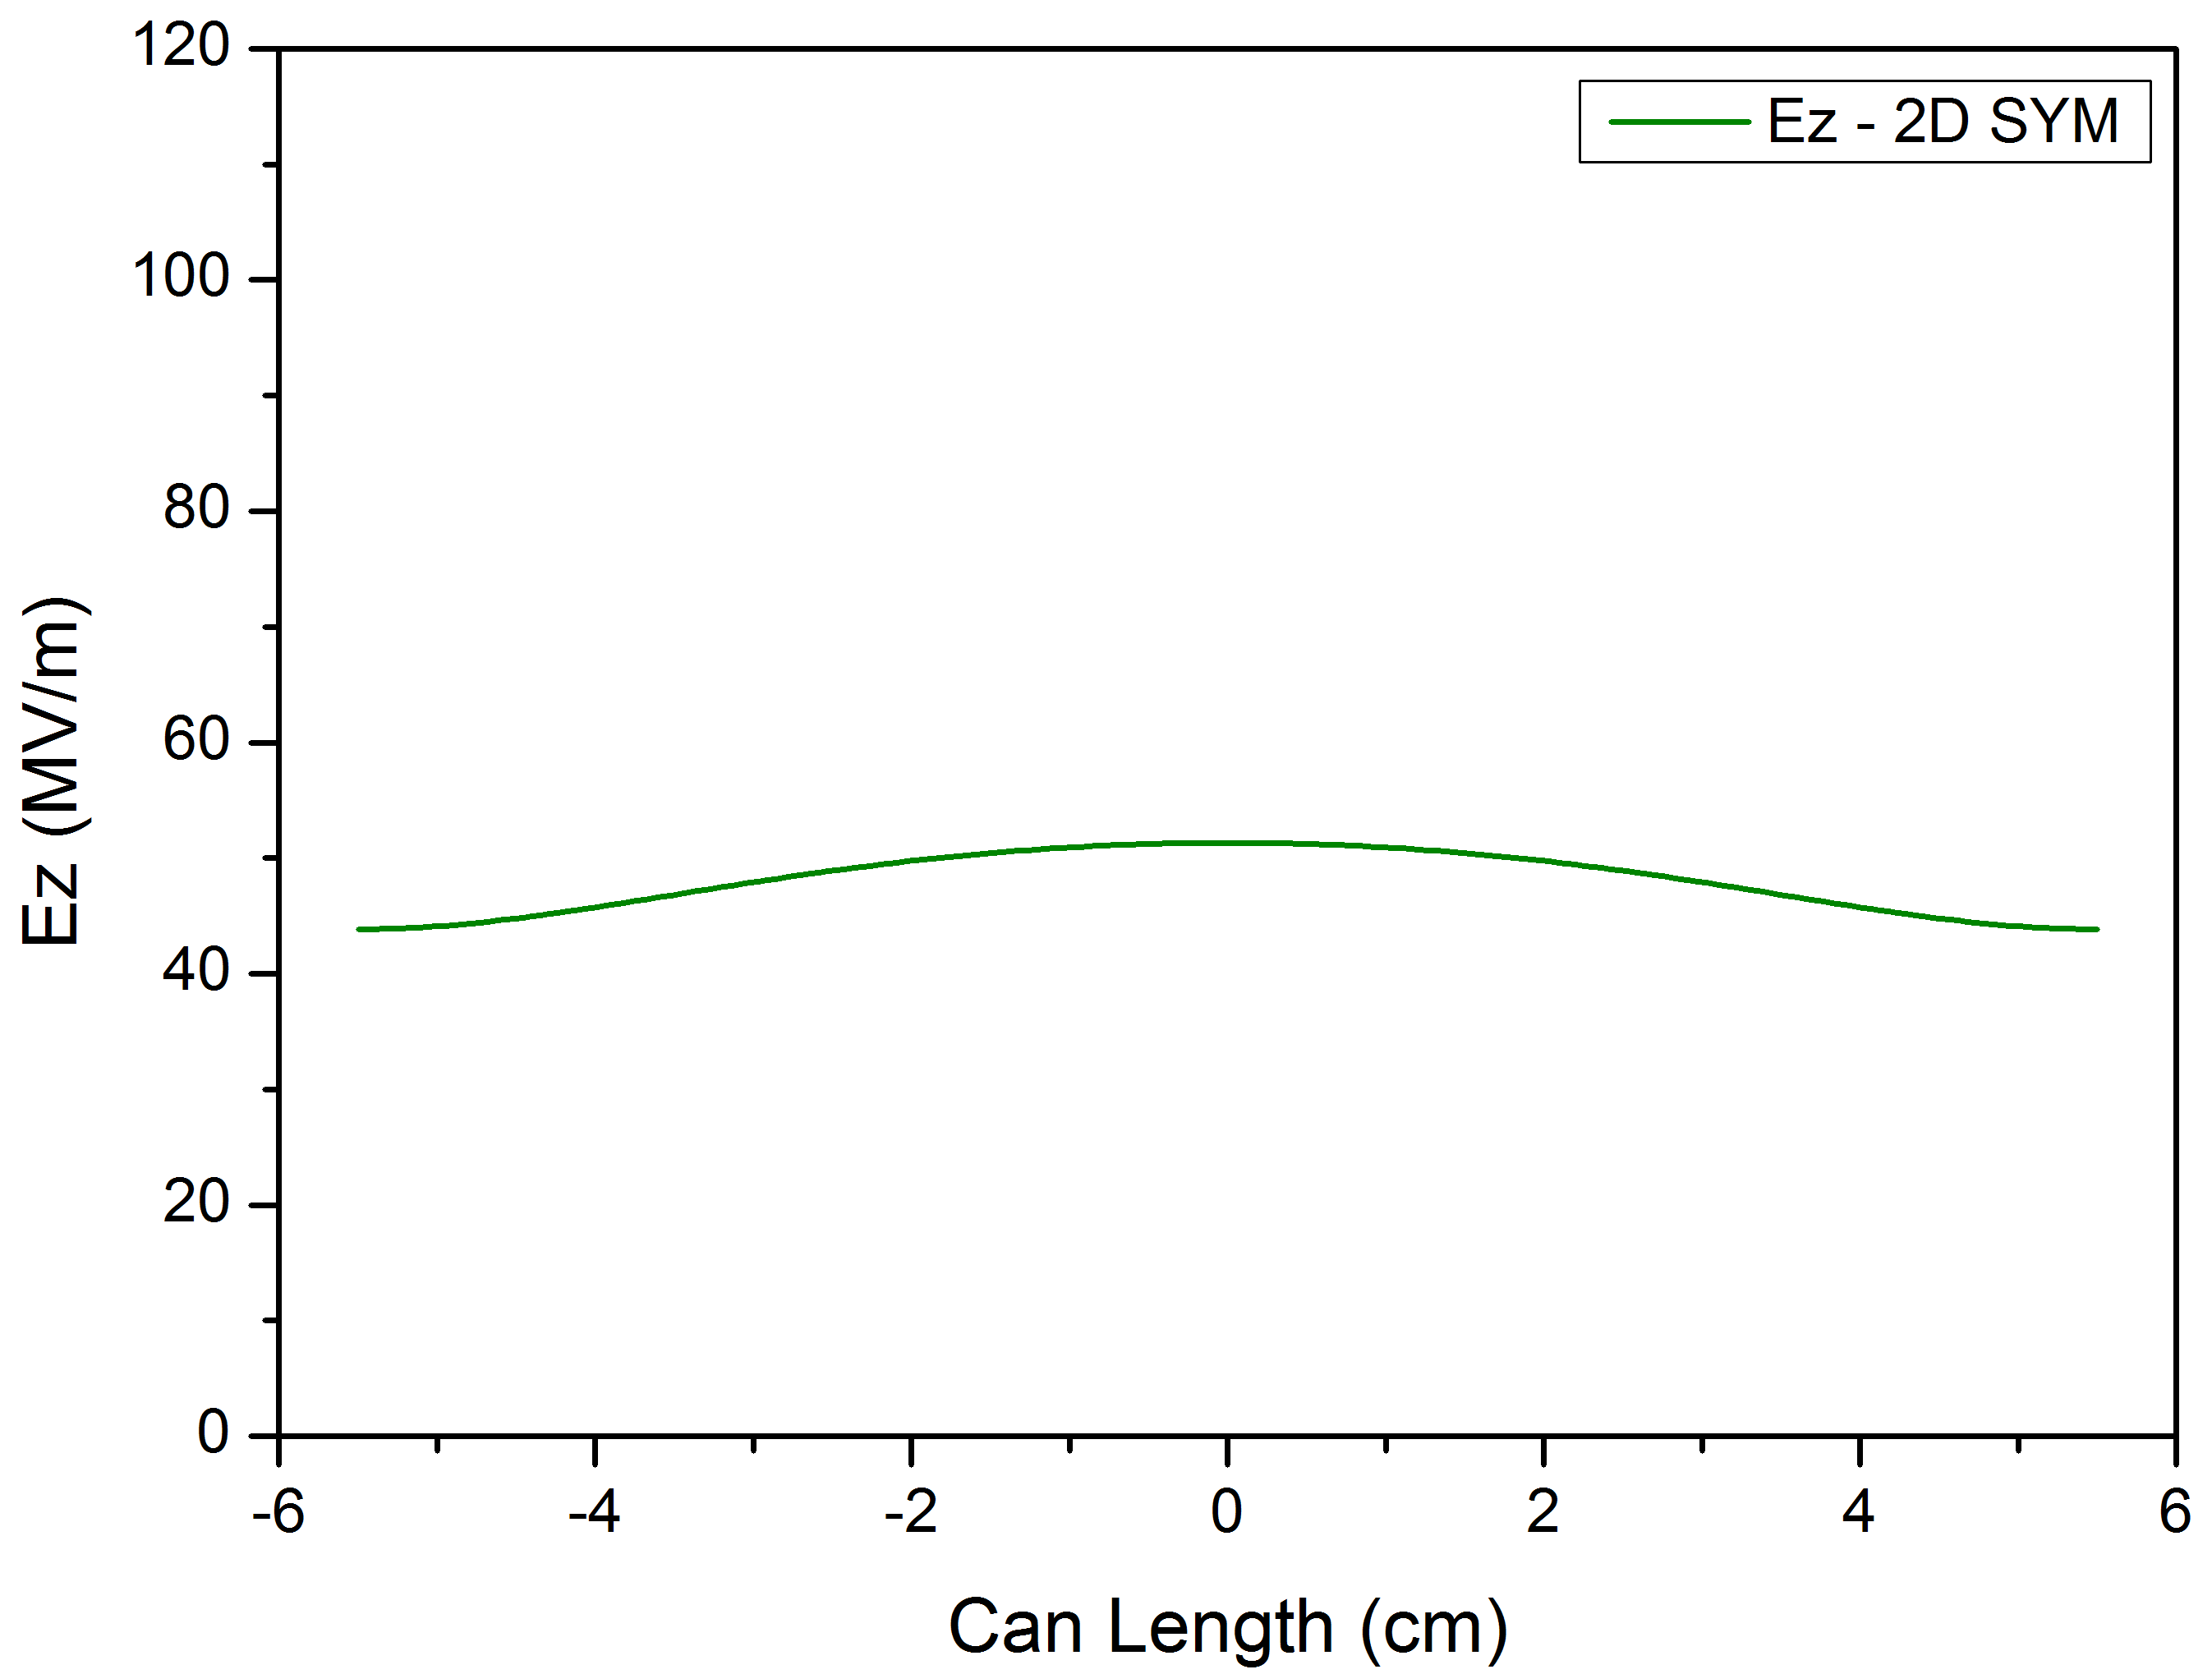
2D Model
Model A
Superfish
Field normalisation: 1J stored energy/cavity
f=~3.548 GHz
Field Lines
1D Field Line (Ez on axis – full can)

Slide 5
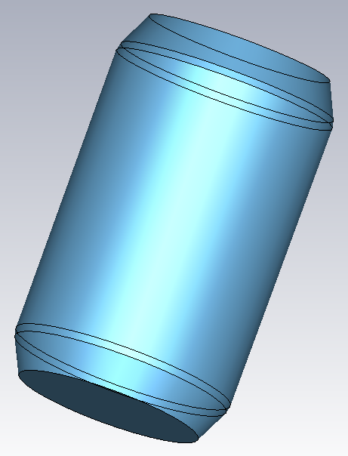
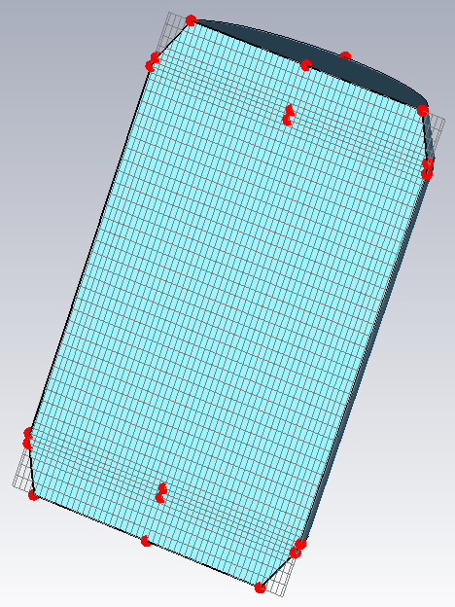
3D Model
Model B
CST MicroWave Studio
Symmetric (like the 2D model)
Geometry
Mesh

Slide 6
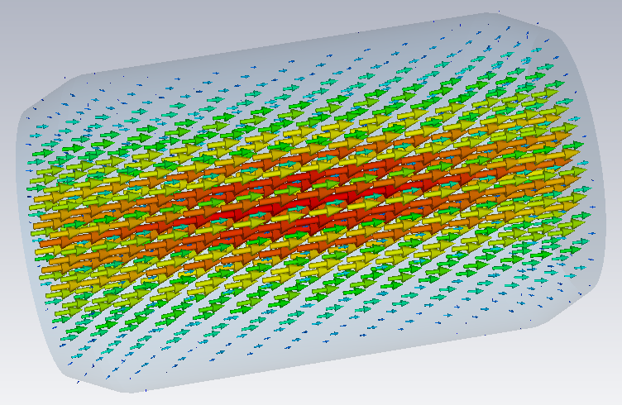
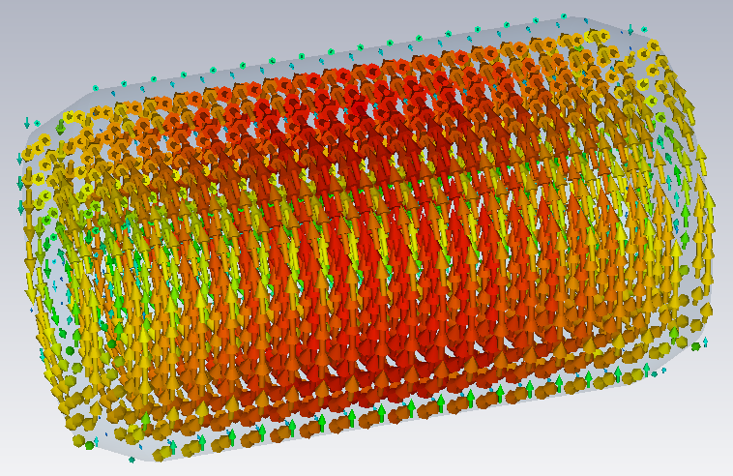
3D Model
Model B
CST MicroWave Studio
f=~3.549 GHz
Electric Field
Magnetic Field

Slide 7
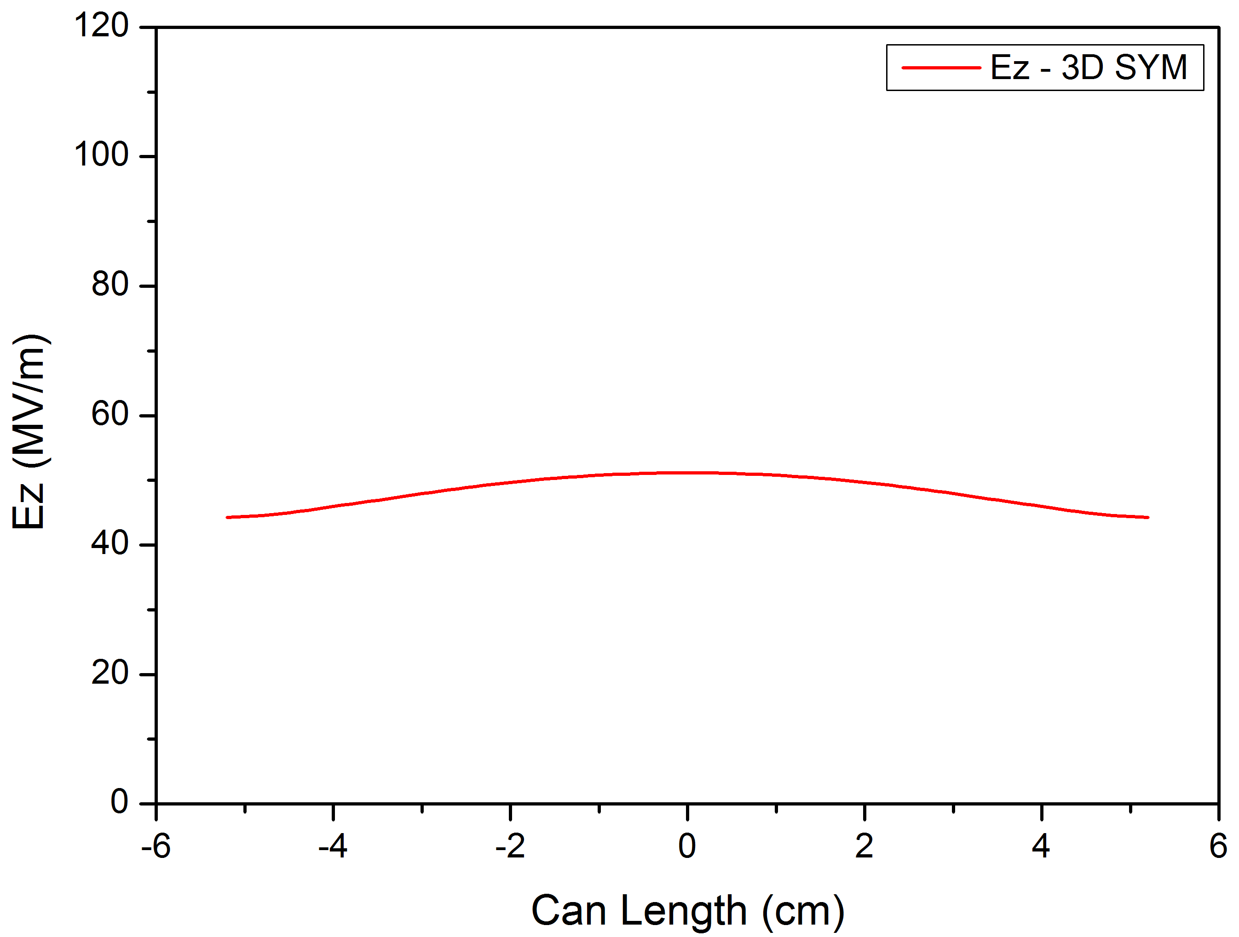
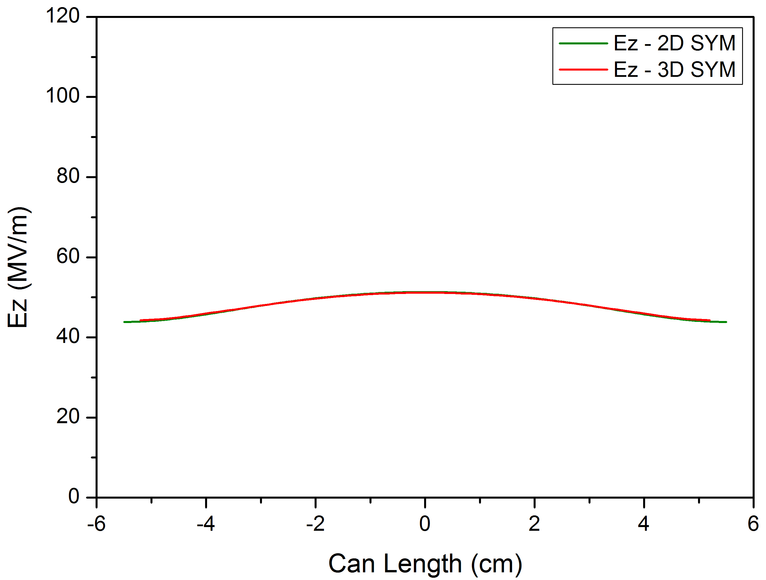
3D Model
Model B
CST MicroWave Studio
  Field Normalisation: 1J stored energy/cavity
1D Field Map (Ez on axis)
Comparison with the 2D Superfish result

Slide 8
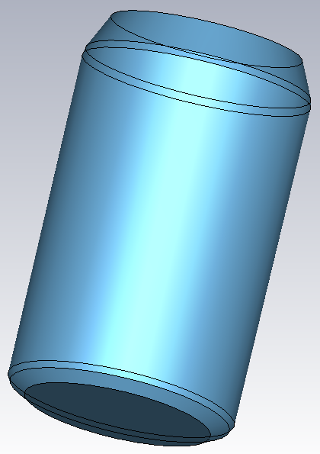
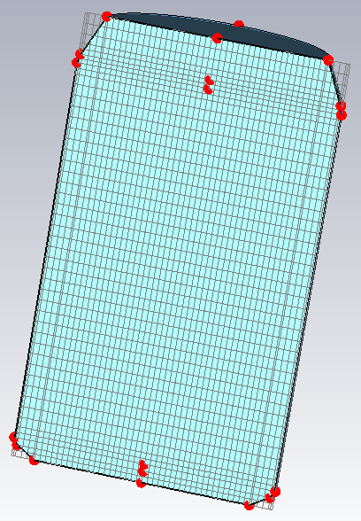
3D Model
Model C
CST MicroWave Studio
Asymmetric (closer to an actual coke can geometry)
Geometry
Mesh

Slide 9
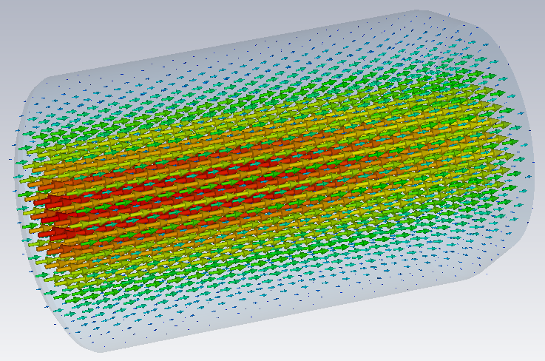
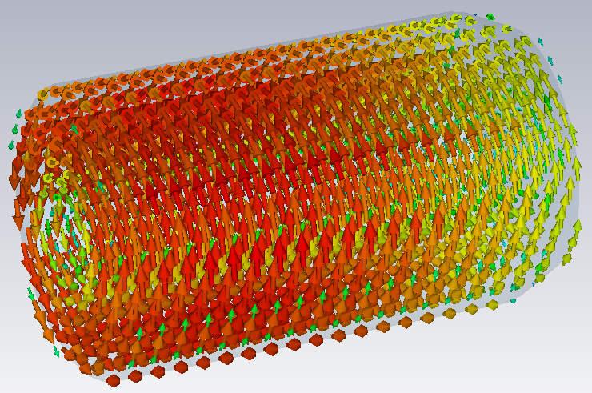
3D Model
Model C
CST MicroWave Studio
  Different scaling
f=~3.531 GHz
Electric Field
Magnetic Field

Slide 10
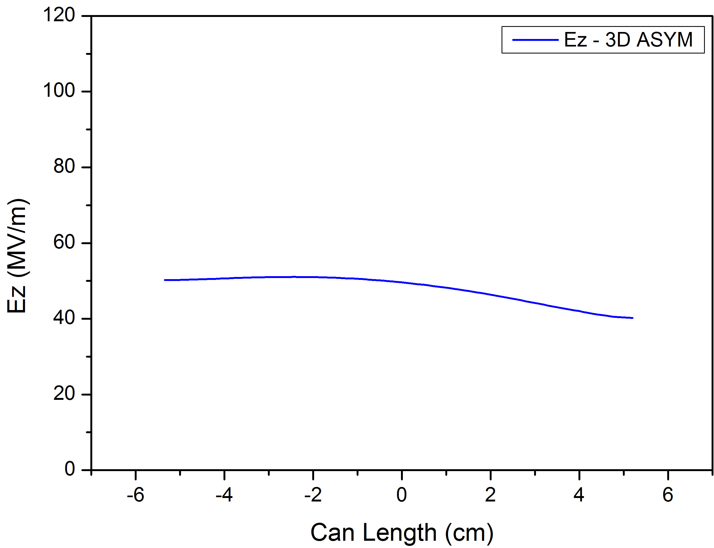
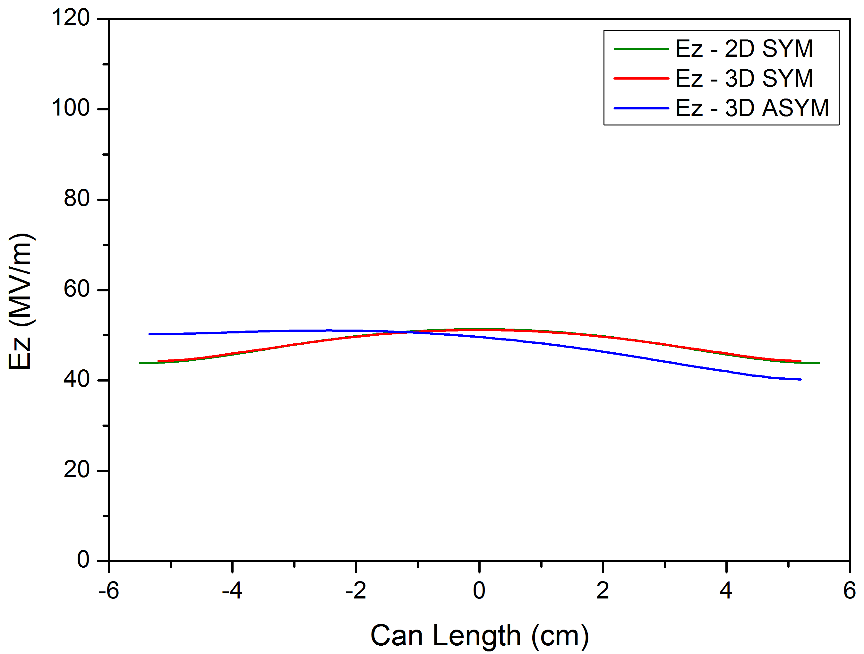
3D Model
Model C
CST MicroWave Studio
  Field Normalisation: 1J stored energy/cavity
1D Field Map (Ez on axis)
Comparisons…

Slide 11
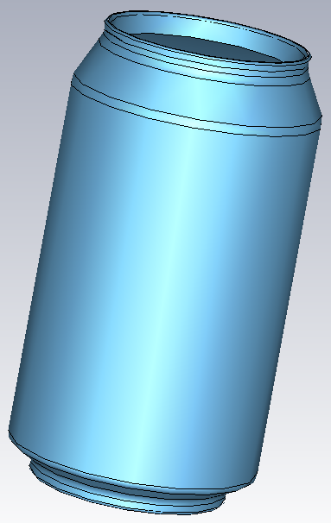
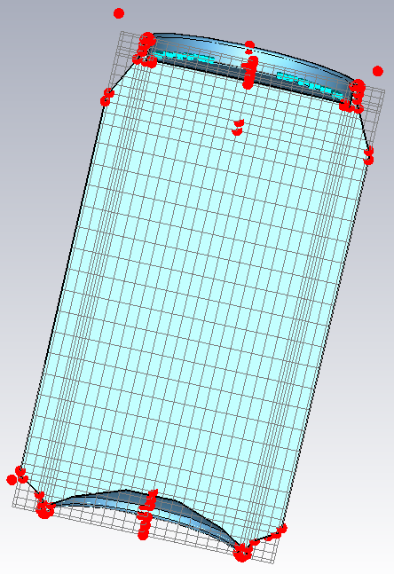
3D Model
Model D
CST MicroWave Studio
Most Details (curves, corners, etc)
Geometry
Mesh

Slide 12
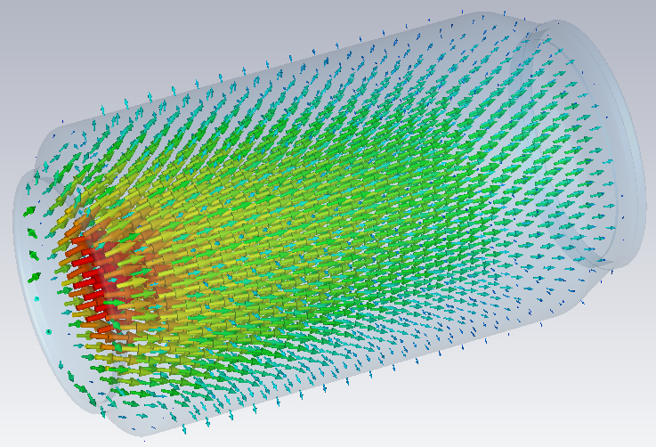
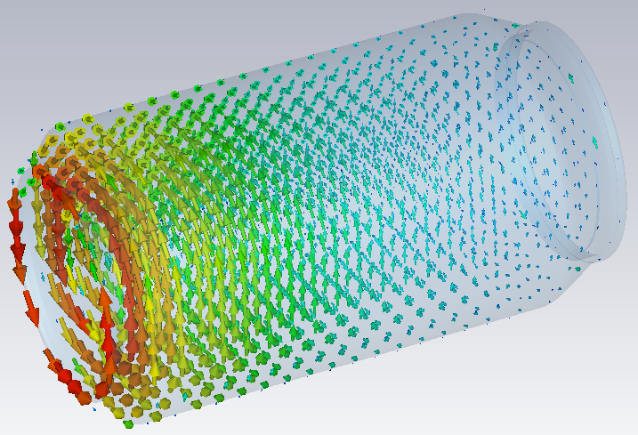
3D Model
Model D
CST MicroWave Studio
  Different scaling
f=~3.398 GHz
Electric Field
Magnetic Field

Slide 13
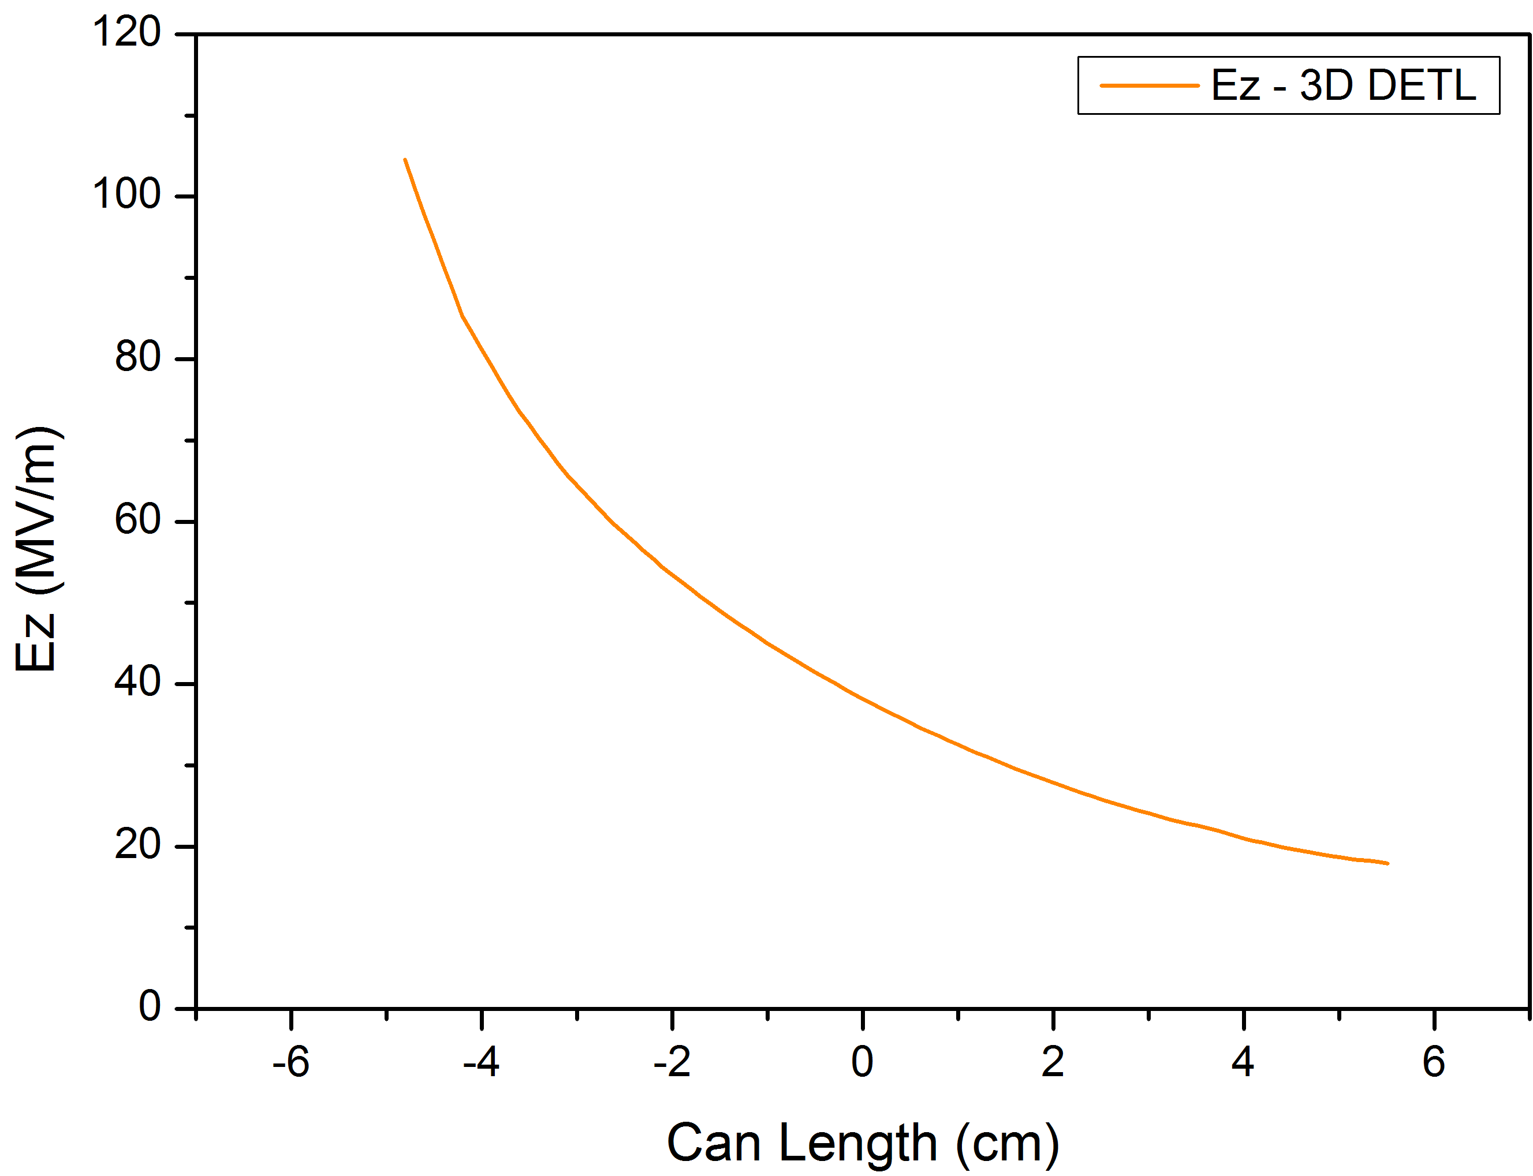
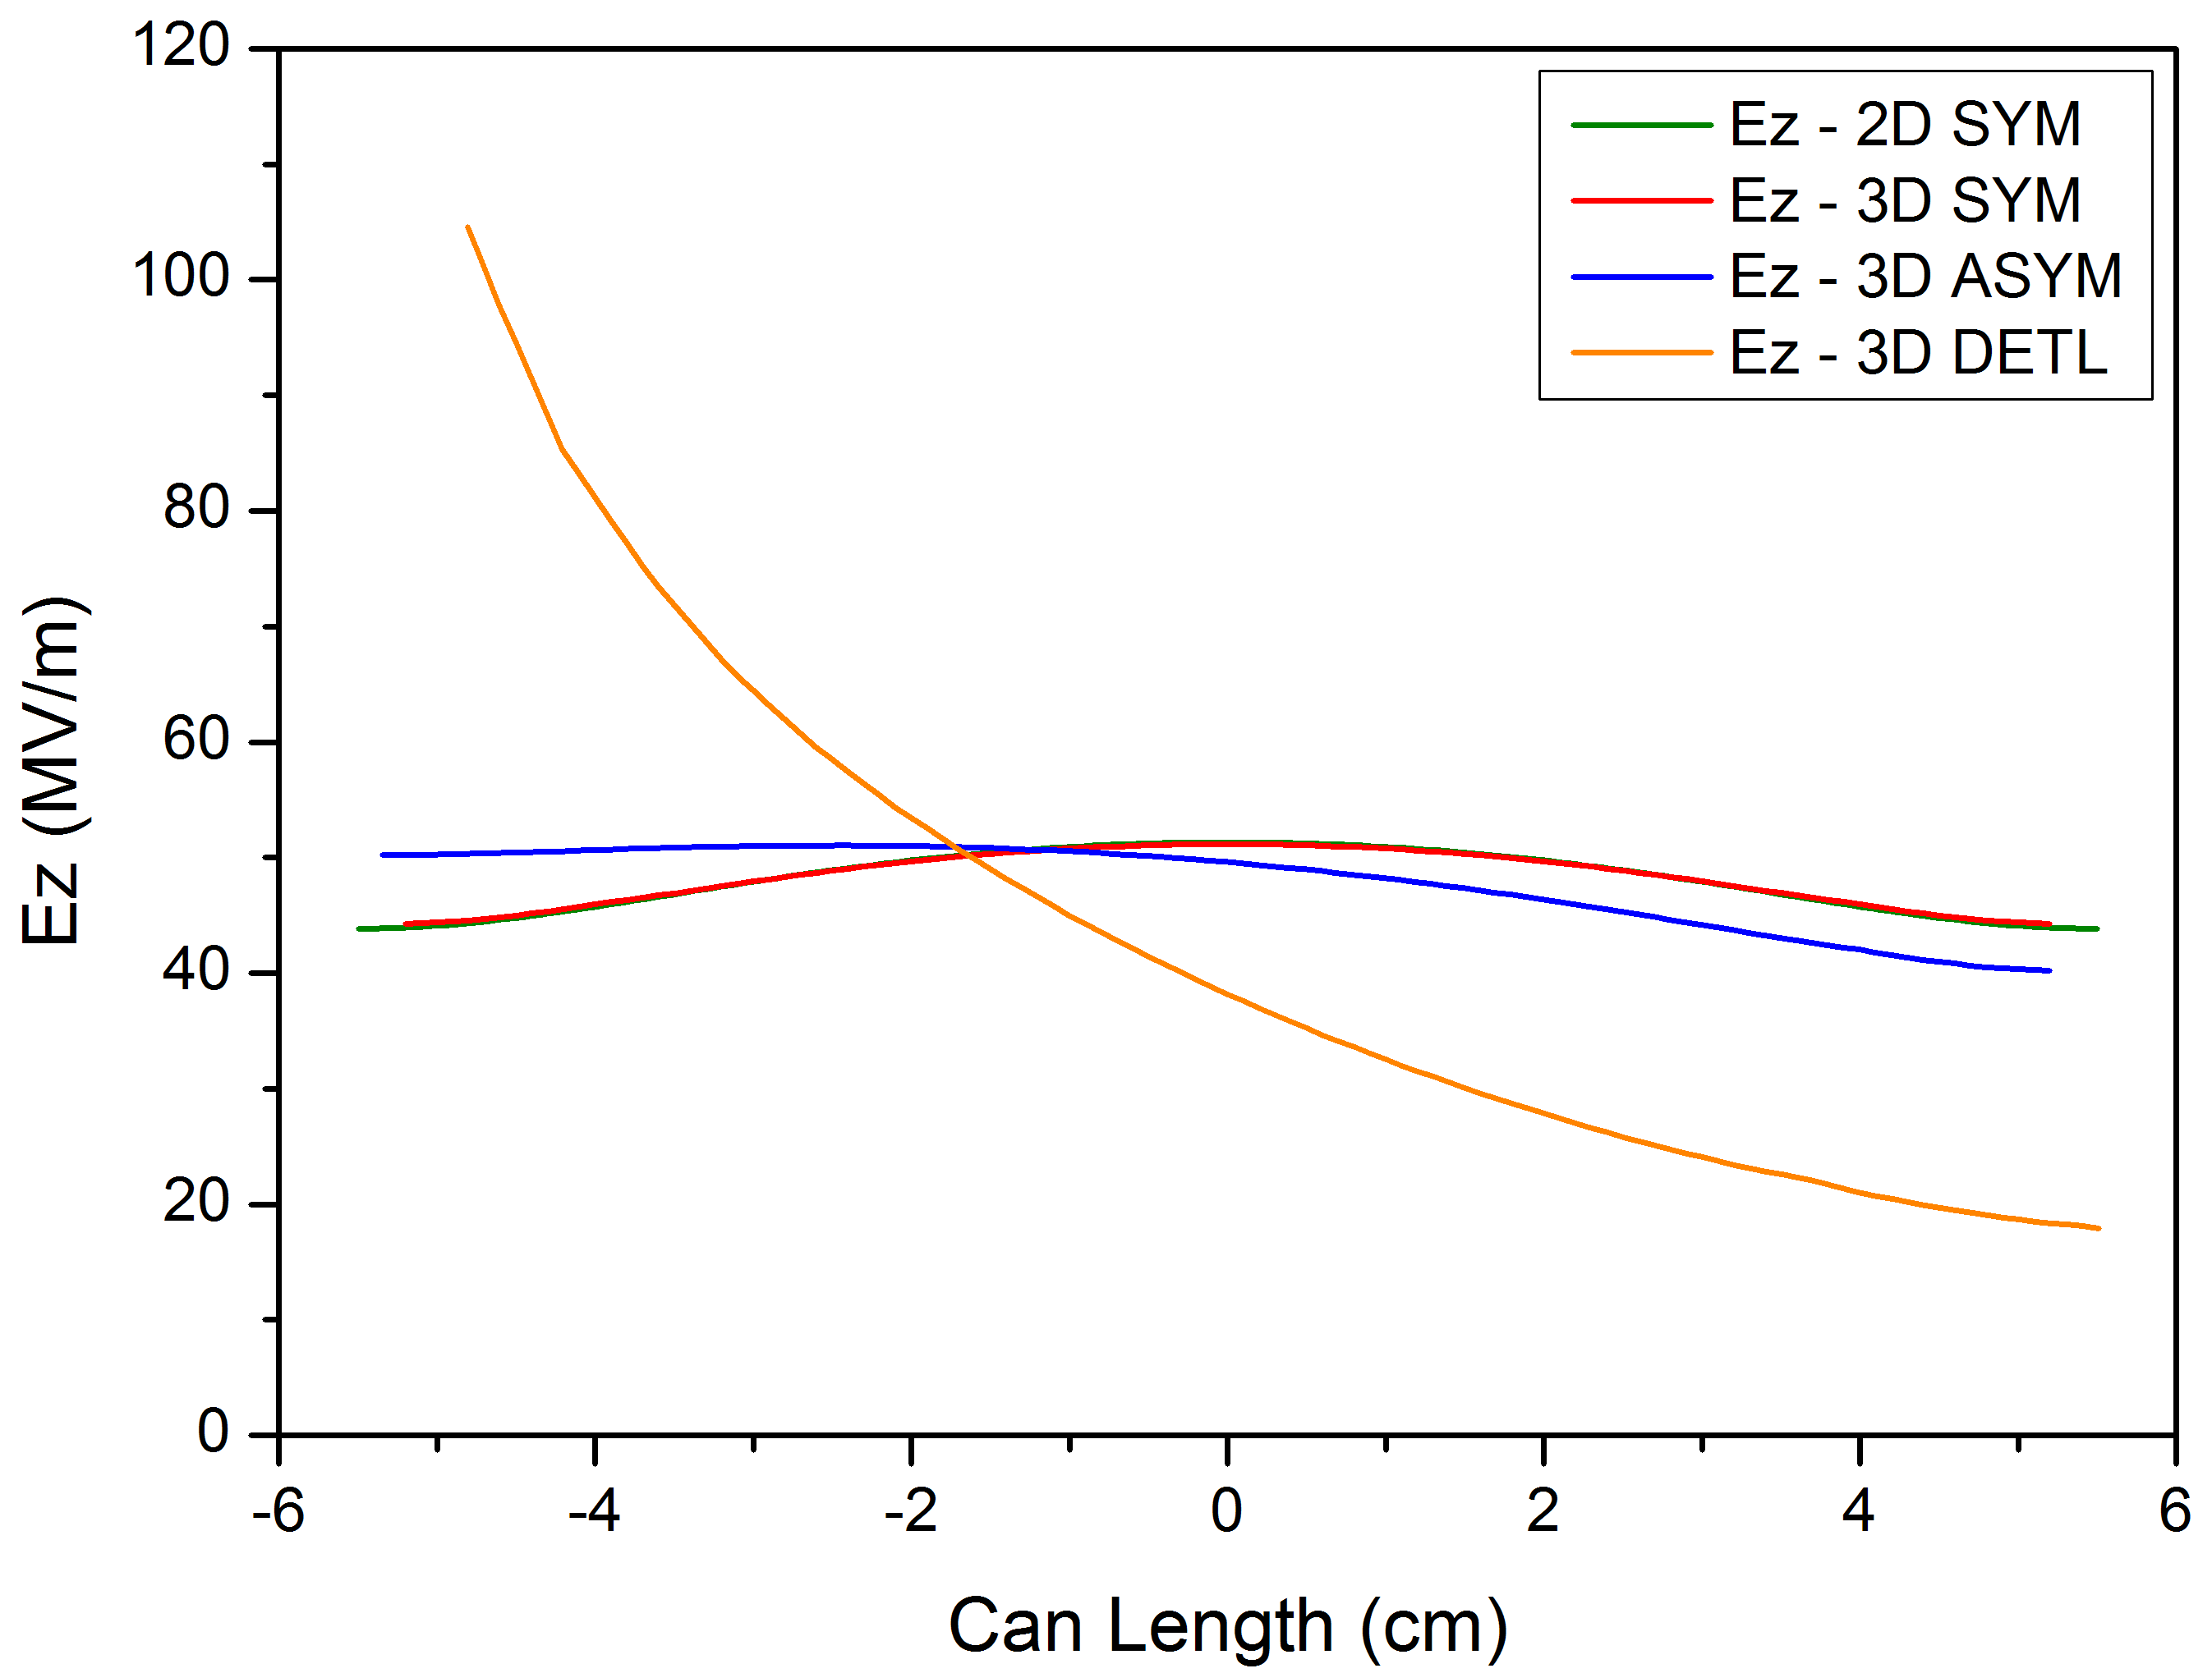
3D Model
Model D
CST MicroWave Studio
  Field Normalisation: 1J stored energy/cavity
1D Field Map (Ez on axis)
Comparisons…

Slide 14
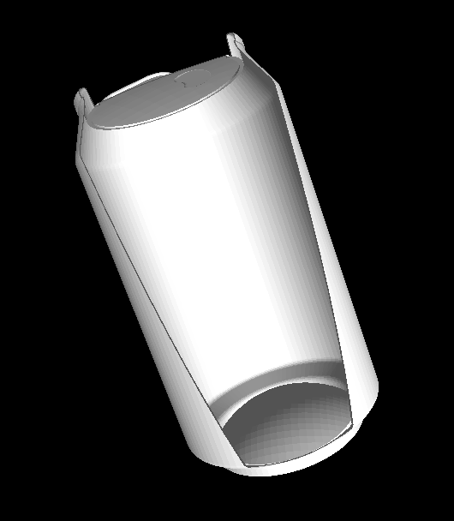
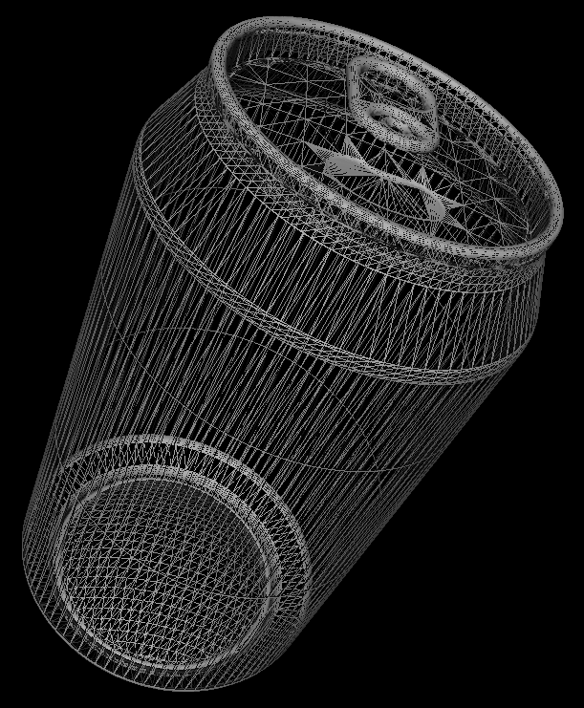
3D Model
Model E
CST MicroWave Studio
Full Details Imported CAD Model (www.grabcad.com)

Slide 15
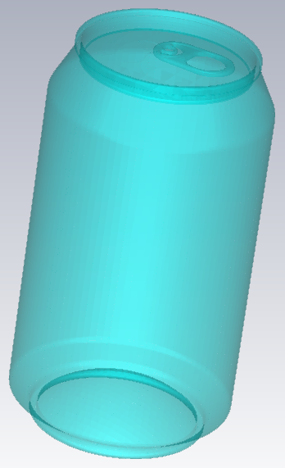
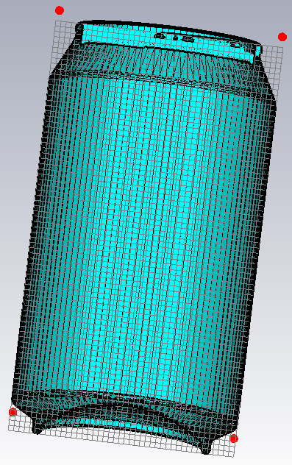
3D Model
Model E
CST MicroWave Studio
Geometry
Mesh

Slide 16
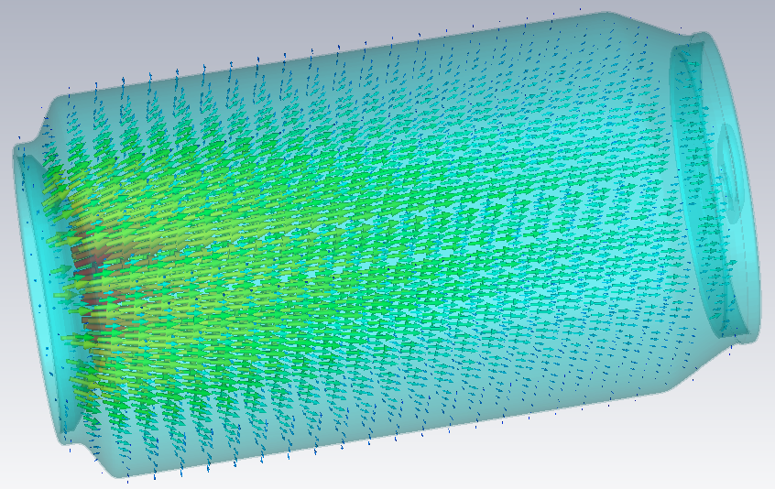
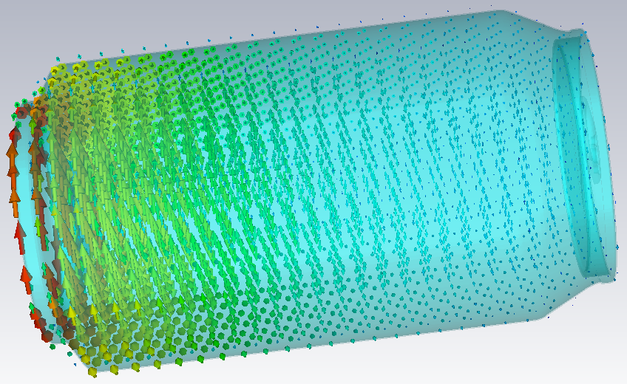
3D Model
Model E
CST MicroWave Studio
  Different scaling
f=~3.371 GHz
Electric Field
Magnetic Field

Slide 17
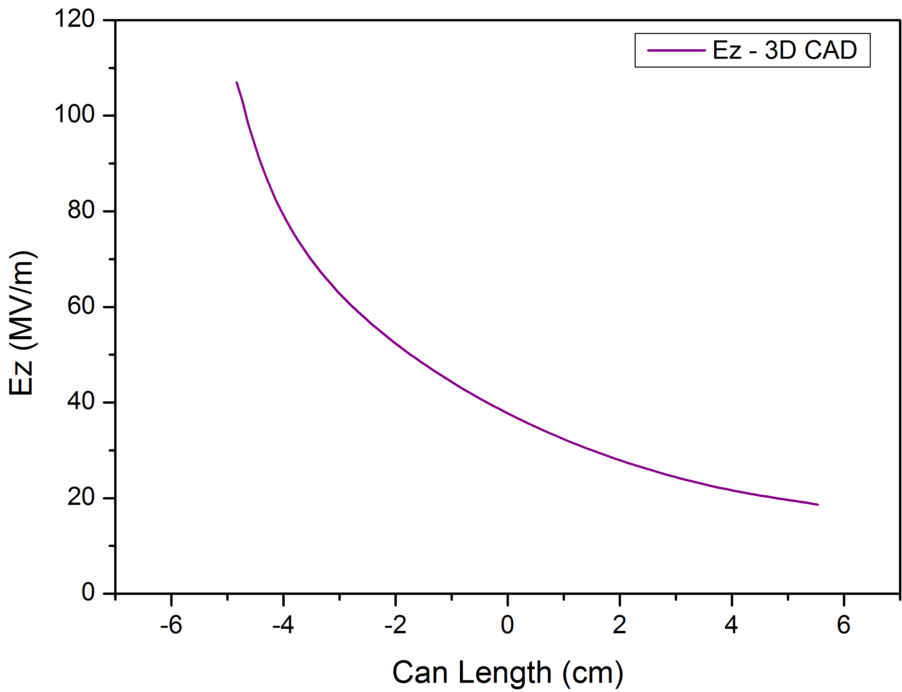
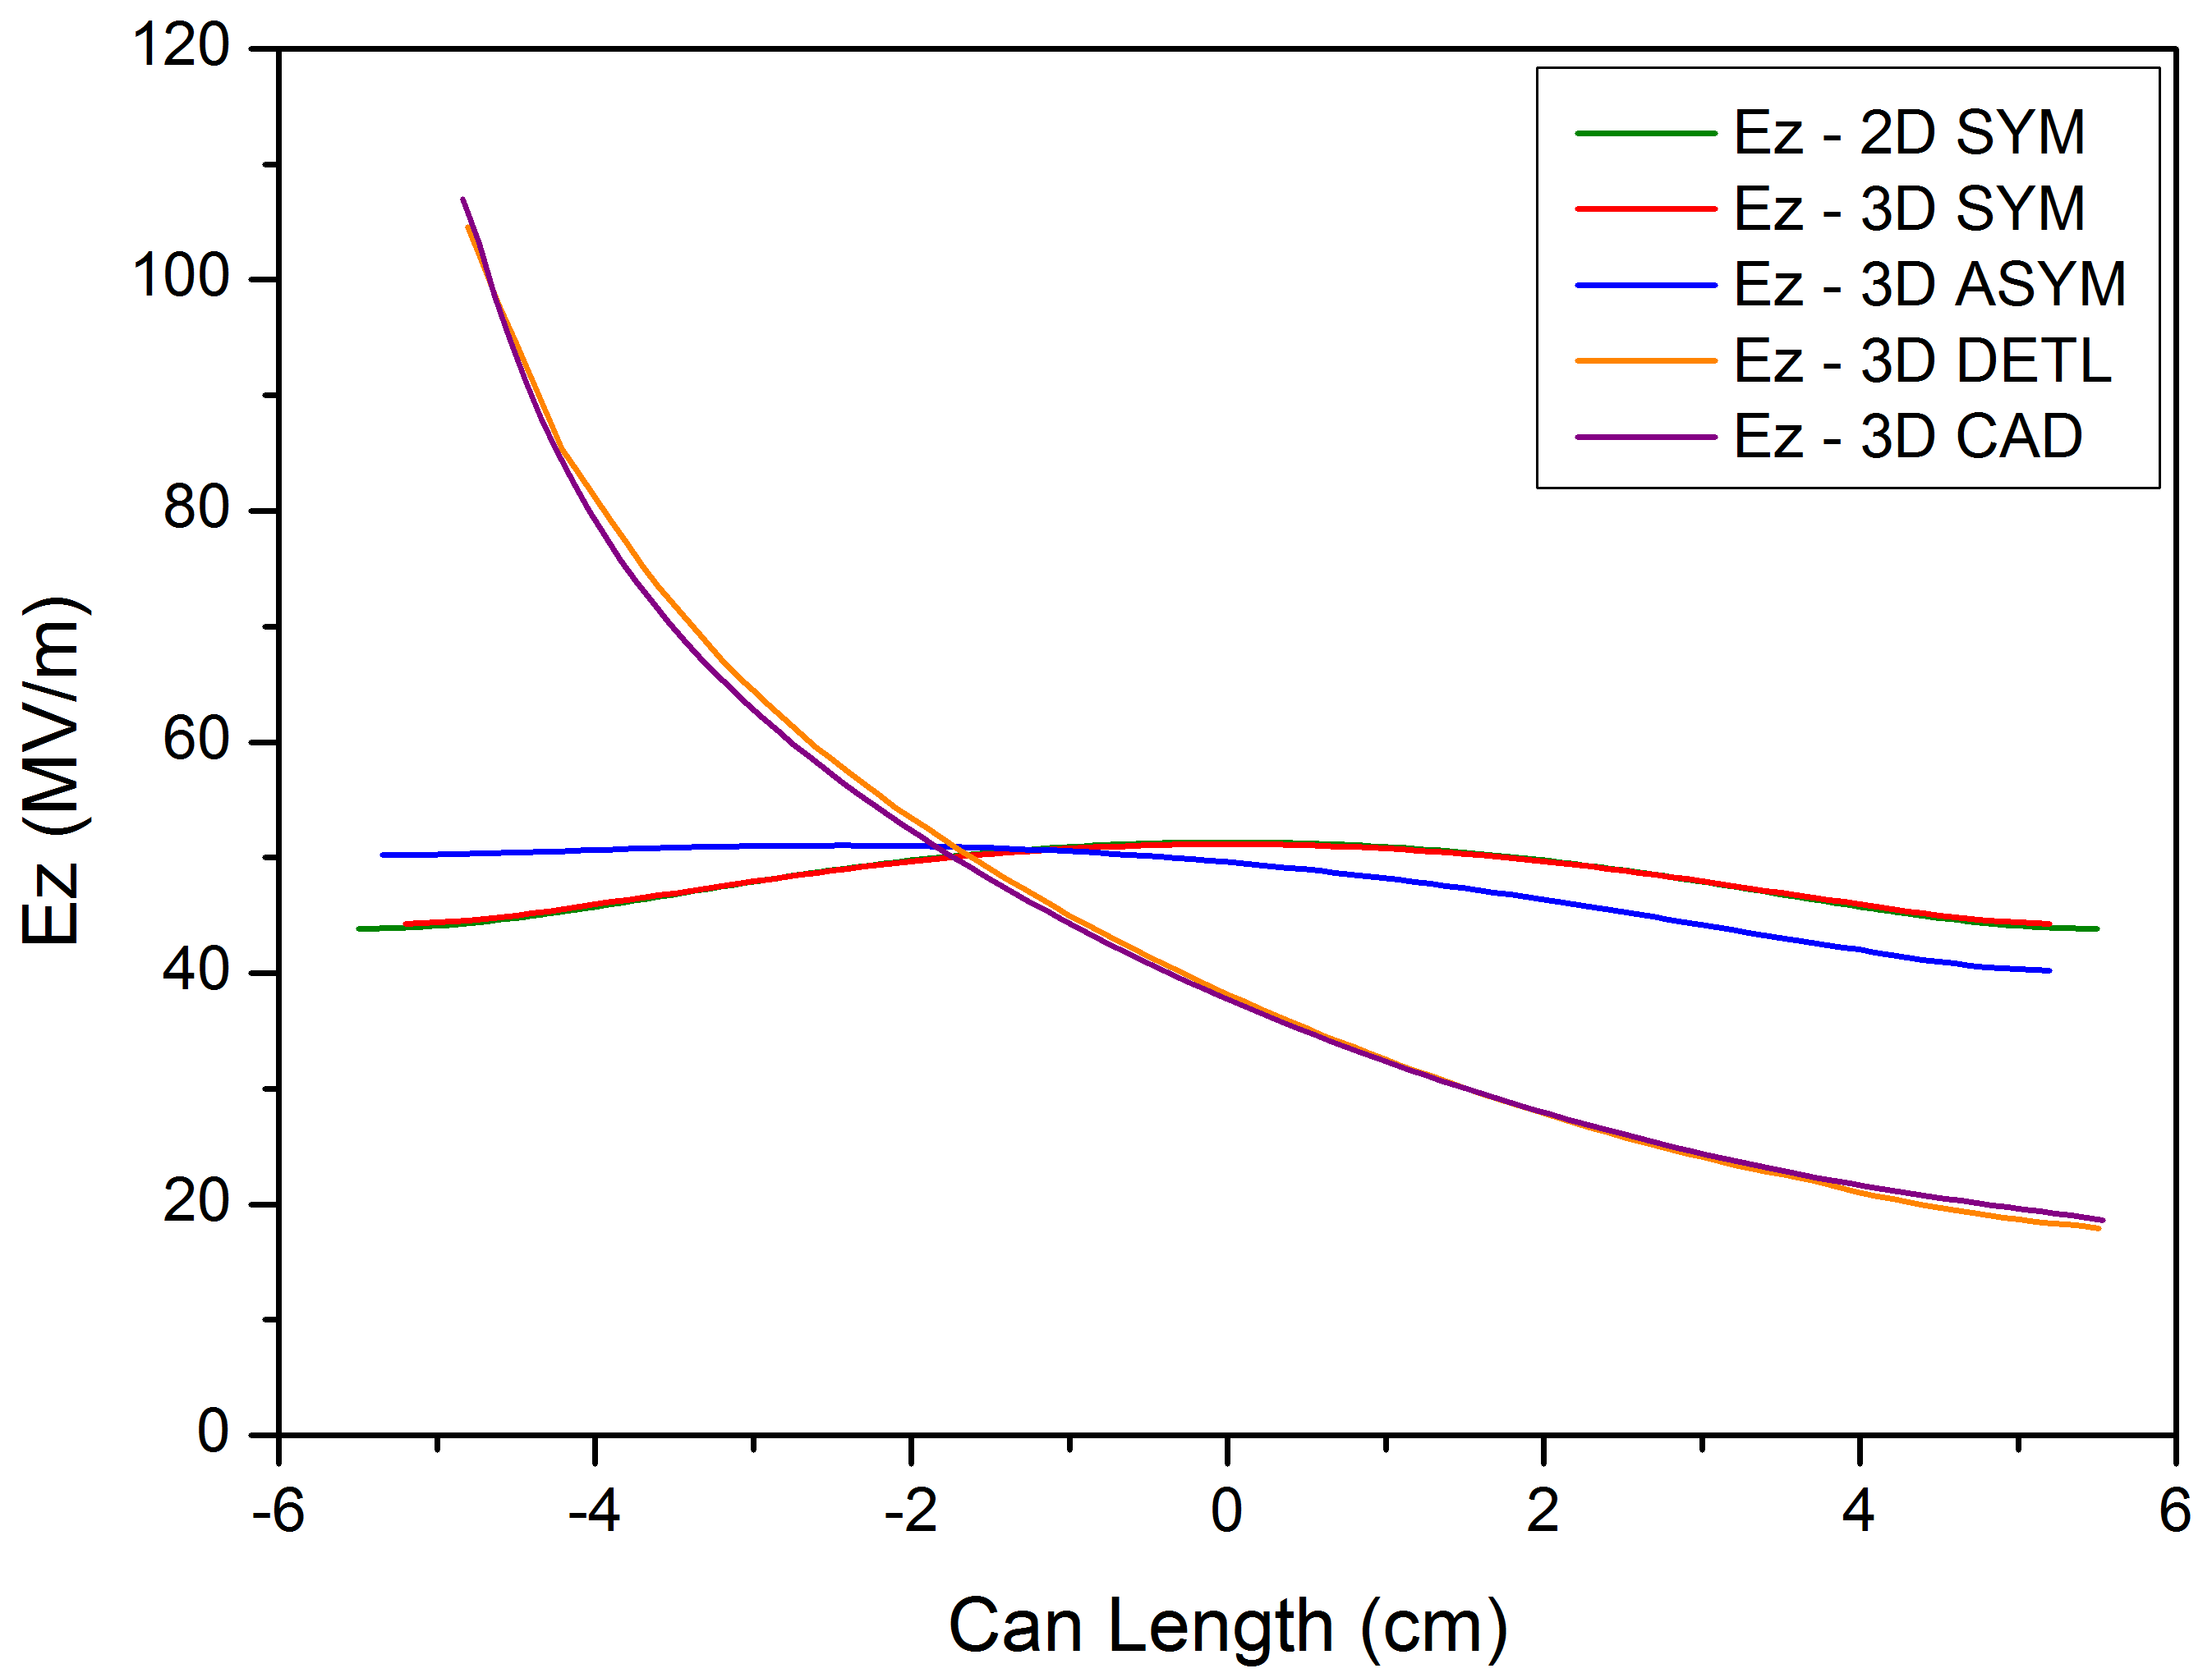
3D Model
Model E
CST MicroWave Studio
  Field Normalisation: 1J stored energy/cavity
1D Field Map (Ez on axis)
Comparisons…

Slide 18
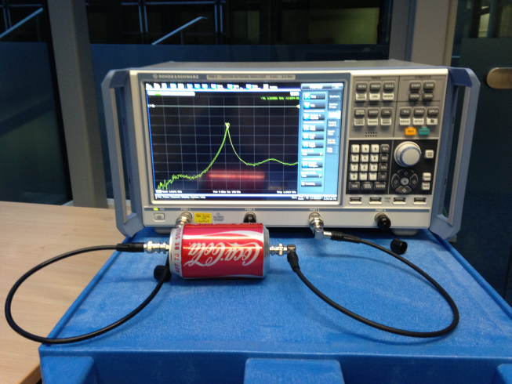
Experimental Measurement
Network Analyser: Rohde & Schwarz ZNB8
  Frequency
  Q-factor

