Slide 1


L4 Test Bench Dump Design
Cesare Maglioni ‹
EN/STI-TCD b
May 4, 2010

Slide 2

Parameters
Dump and beam
    Dumping system : fixed, in vacuum
    beam : 65mA, 100μs pulse, 1Hz rep rate both @ 3MeV and 12MeV
Considerations
    Layout : dimension limitations, integration (SEM-GRID interface)
    Energy (density) deposition and Power evacuation
    Mechanical stability: stress and deformation minimization
    Vacuum tightness and effectiveness, minimization of vacuum degradation risks
    Handling : weight, maintenance
    Water cooling only if necessary (operation rate, ..)
C. Maglioni L4 Test Bench Dump - May 4, 2010 2

Slide 3
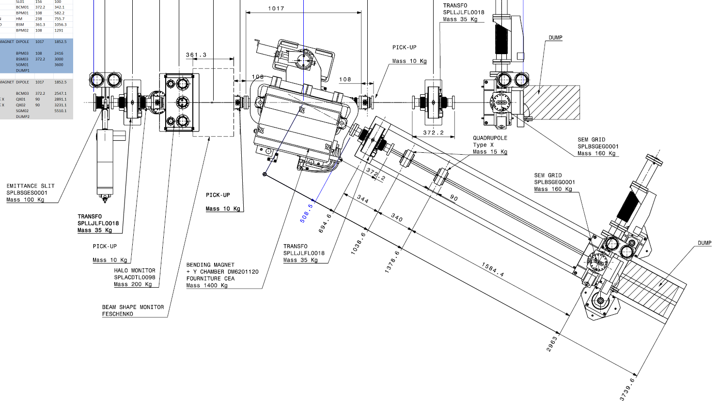
Test Bench Layout
Main beam
Diagnostic beam
    2 dumps, 2 energy levels → 1 design
C. Maglioni L4 Test Bench Dump - May 5, 2010 3

Slide 4
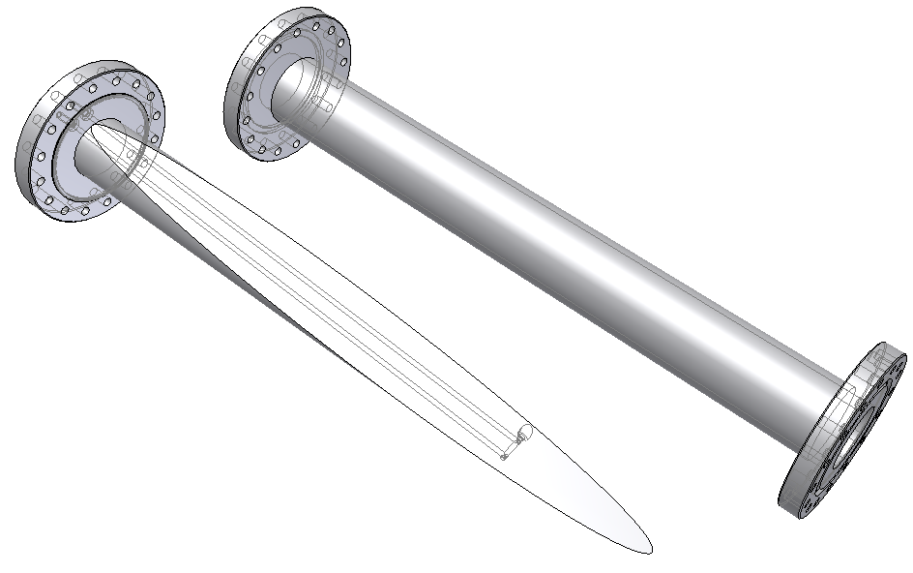
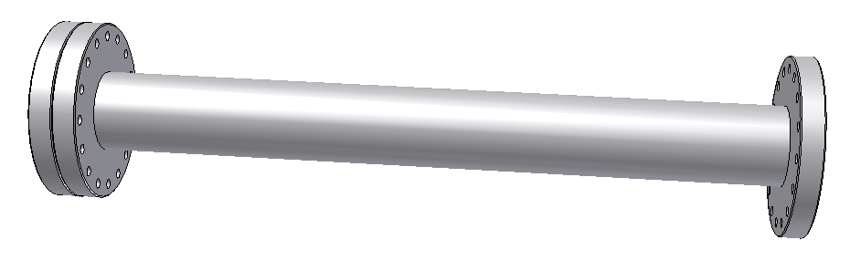
Actual Dump design
Water Cooling
Seal
Stainless Steel Vacuum vessel
Core:
solid Aluminum (6063) sectioned cylinder (absorber core)
640mm
Beam
5.5
Flange - interface with SEM-GRID
C. Maglioni L4 Test Bench Dump - May 5, 2010 4

Slide 5
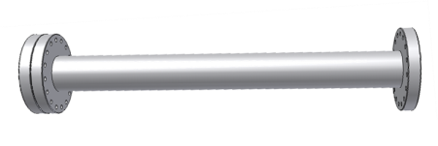
Actual Dump on Layout
C. Maglioni L4 Test Bench Dump - May 5, 2010 5

Slide 6
Actual Dump design
Water Cooling
?
Needs
RP
Seal
Stainless Steel Vacuum vessel
Core:
solid Aluminum (6063) sectioned cylinder (absorber core)
Beam
5.5
May be increased
-> shorter dump
?
Flange - interface with SEM-GRID
C. Maglioni L4 Test Bench Dump - May 5, 2010 6

Slide 7
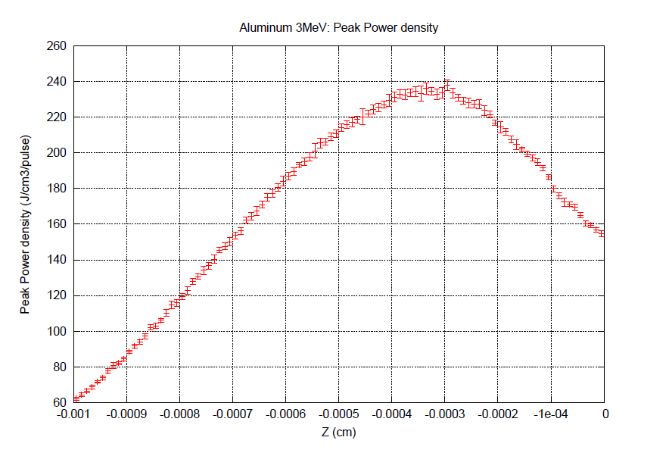
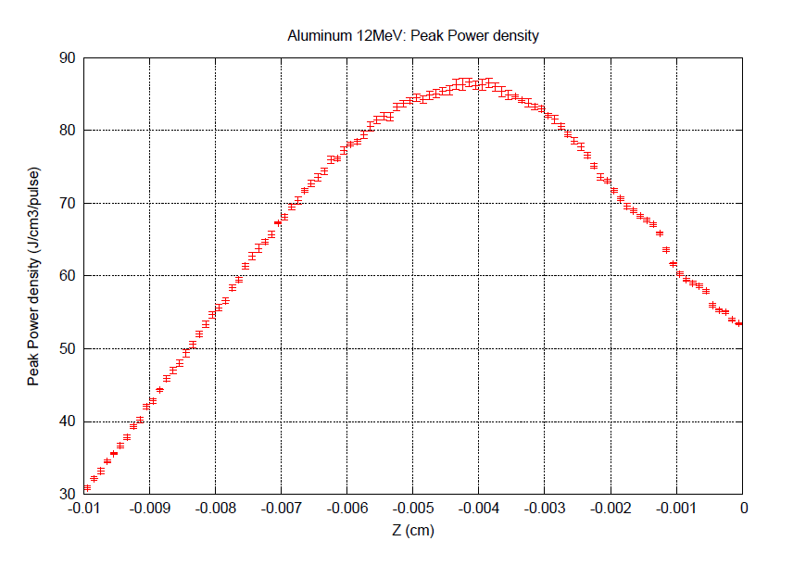
Dump design
3MeV NON-DIFFUSIVE ADIABATIC MODEL:
235 J/cm³/pulse peak
@ ~ 3.5 μm depth
DTpeak ~ 108 K (Fluka)
DTpeak ~ 98 K (Ansys)
r (τ) = 42.1 μm
12MeV NON-DIFFUSIVE ADIABATIC MODEL:
87 J/cm³/pulse peak
@ ~ 40 μm depth
DTpeak ~ 51 K (Fluka)
DTpeak ~ 37 K (Ansys)
r (τ) ~ 41.7 μm
Thermal diffusivity :
α = k/ρCp [m²/s]
Hold the relation :
⋅ r² = α ⋅ τ
τ = pulse length
r = characteristic diffusivity length
3MeV DIFFUSIVE (ADIABATIC) MODEL:
DTpeak ~ 50 K (Ansys)
12MeV DIFFUSIVE (ADIABATIC) MODEL:
DTpeak ~ 20 K (Ansys)
C. Maglioni L4 Test Bench Dump - May 4, 2010 6

Slide 8
Energy deposition
mesh size
C. Maglioni L4 Test Bench Dump - May 4, 2010 8

Slide 9
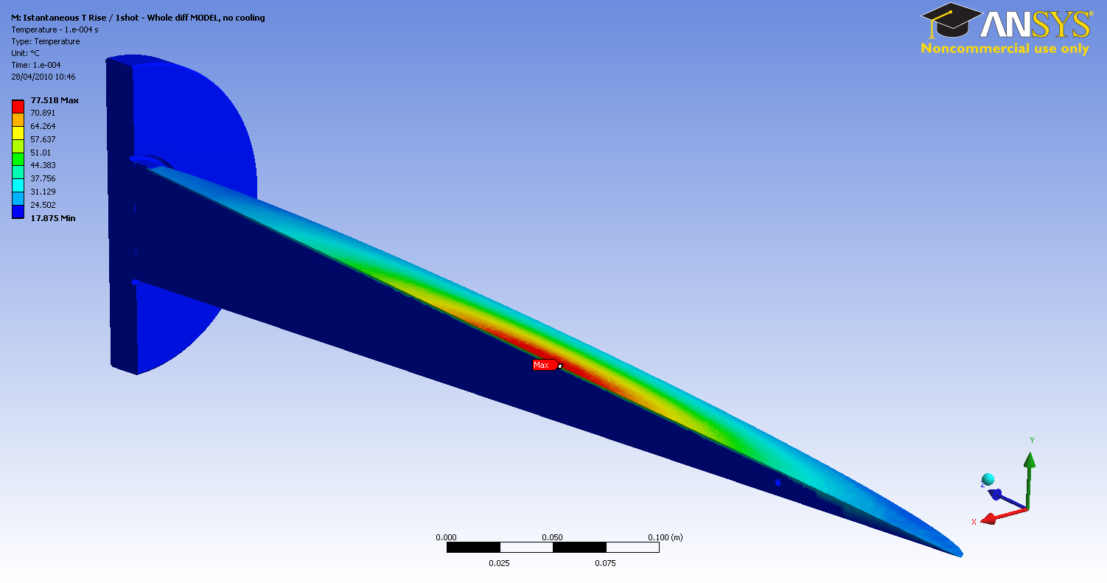
Temperature distribution
C. Maglioni L4 Test Bench Dump - May 4, 2010 7

Slide 10
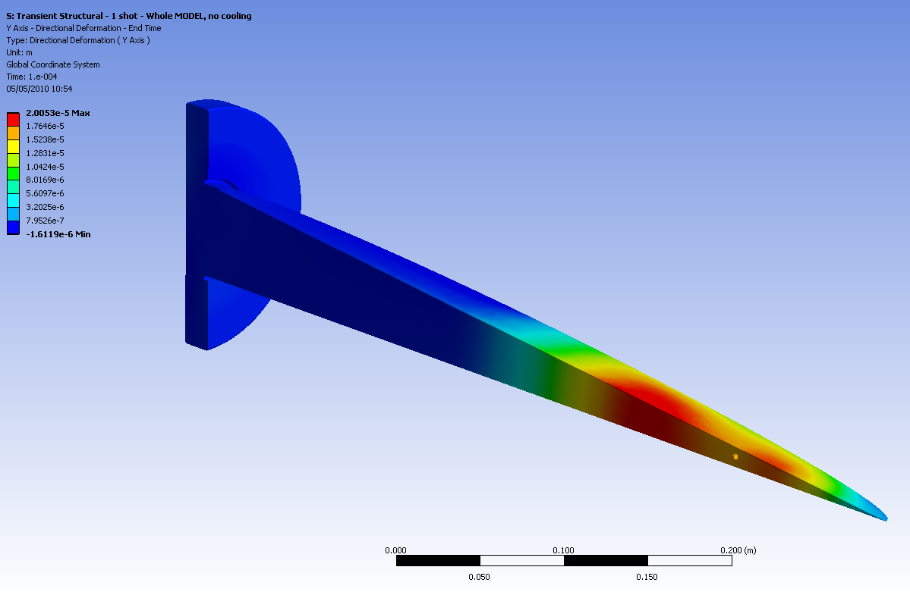
Deformations
Maximum)
C. Maglioni L4 Test Bench Dump - May 4, 2010 9

Slide 11
What next
Some improvements (if needed) …[ongoing]
Final design guidelines to Design office …[ongoing]
Technical/Engineering Spec Definition …[ongoing/end May]
Production of Technical Drawings …end June/July
Manufacturing
    Dump Core (Main workshop) …end September/October
    Steel vessel (EN\STI-TCD workshop) …end September
Dump Assembly (EN\STI-TCD workshop) …end November
Cooling, vacuum testing (EN\STI-TCD workshop) …mid December
Installation …end December
C. Maglioni L4 Test Bench Dump - May 5, 2010 11

Slide 12
Thank You ☺
Cesare Maglioni ‹
EN/STI-TCD b

