Slide 1
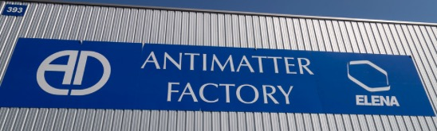
Antimatter @ CERN
Adriaan Rijllart
Retired electronics and software engineer
CERN guide
Many thanks to Tommy Eriksson, AD expert, for a lot of the slides

Slide 2

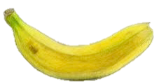

Source of antimatter
Releases a positron every 75 minutes on average
0.001 % of decays

Slide 3





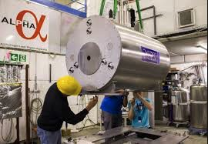

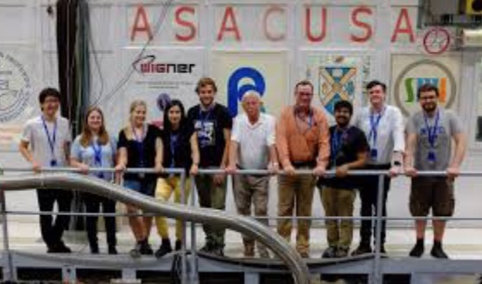
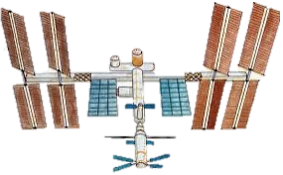


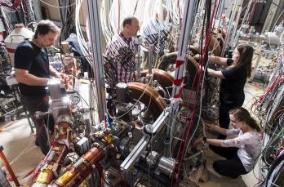


Talk overview
Talk overview
big bang
Paul Dirac
1
theory ?
2
experiments
3
Andrei Sakharov
ALPHA
4
antimatter decelerator
extra low energy antimatter
ASACUSA
AMS
Gbar
antimatter
arrival
?

Slide 4
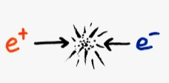
What is antimatter?
Antimatter is a material composed of antiparticles. These have the same mass as particles of ordinary matter, but have opposite charge and properties, such as lepton and baryon number.
Encounters between a particle and an antiparticle lead to both of them being destroyed (transformed into energetic photons).
positron
electron

Slide 5
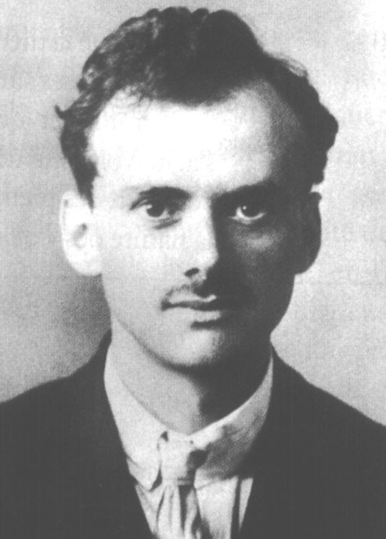

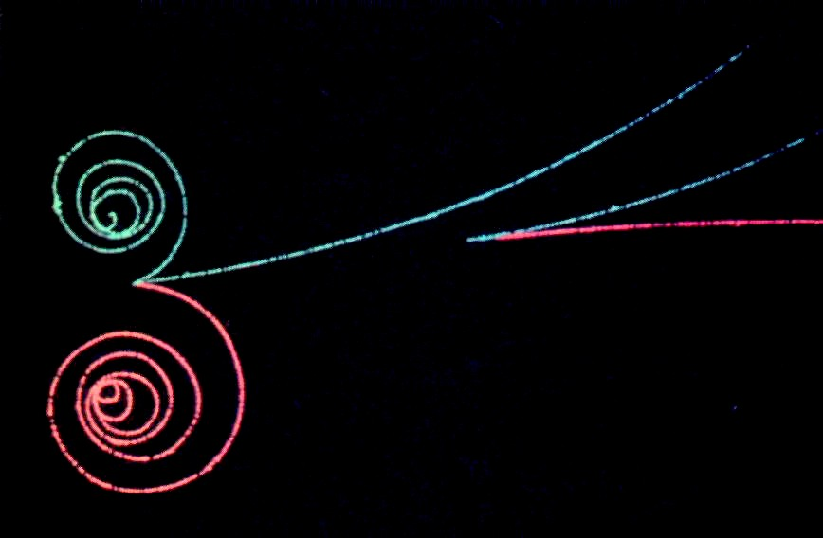
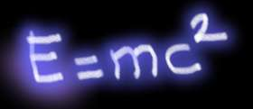

Paul Dirac: key discovery
Nobel prize 1933
Relativity + Quantum Theory
⇒ ‘Antiparticles’
Paul A. M. Dirac
particle
Energy*
* gamma rays
antiparticle

Slide 6
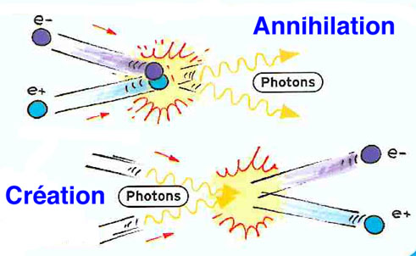
Properties of antimatter
Every particle has an antiparticle
Example:
Electron: Mass = 0.511 (MeV) Charge = -1
Positron: Mass = 0.511 (MeV) Charge = +1

Slide 7
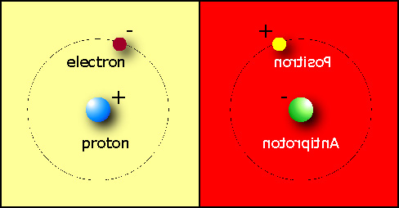
Is the universe symmetric?
1933 Dirac (from his Nobel lecture)
“If we accept the view of complete symmetry between positive and negative electric charge so far as concerns the fundamental laws of Nature, we must regard it rather as an accident that the Earth (and presumably the whole solar system), contains a preponderance of negative electrons and positive protons.
It is quite possible that for some of the stars it is the other way about, these stars being built up mainly of positrons and negative protons. In fact, there may be half the stars of each kind.

Slide 8
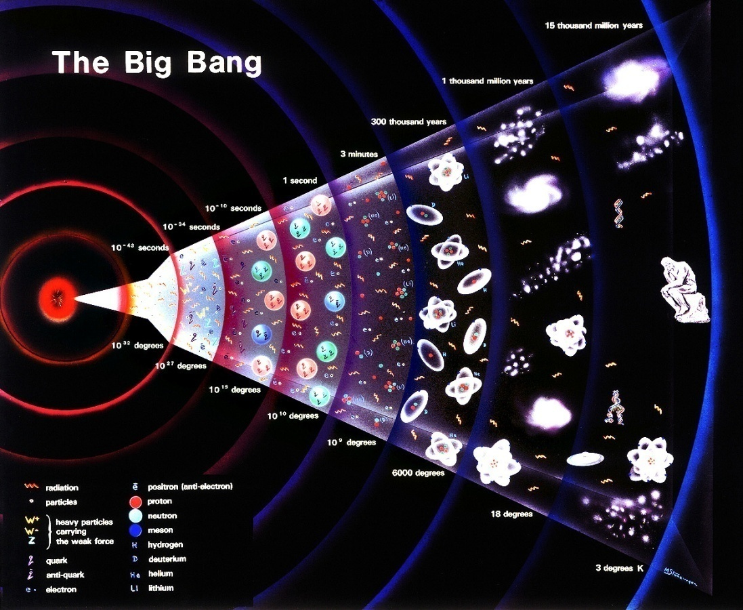
Let’s go to the origin
Big Bang
13.7 billion years ago
How did the energy transform into mass ?
(…and atoms, stars, planets)
Big Bang: ~50 % Antimatter
Now: 0 % Antimatter

Slide 9
Talk overview
Talk overview
big bang
Paul Dirac
1
theory ?
2
experiments
3
Andrei Sakharov
ALPHA
4
antimatter decelerator
extra low energy antimatter
ASACUSA
AMS
Gbar
antimatter
arrival
?

Slide 10
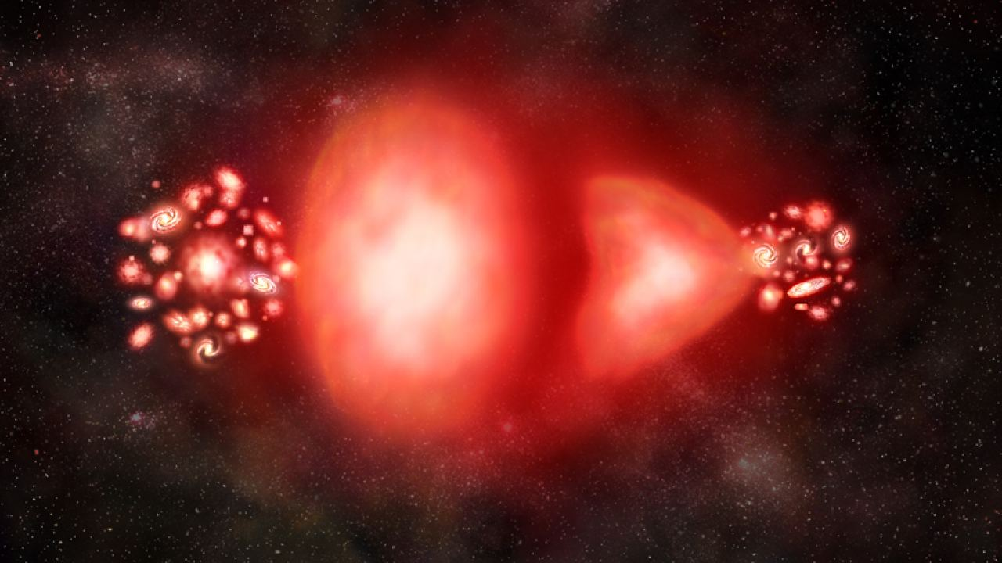
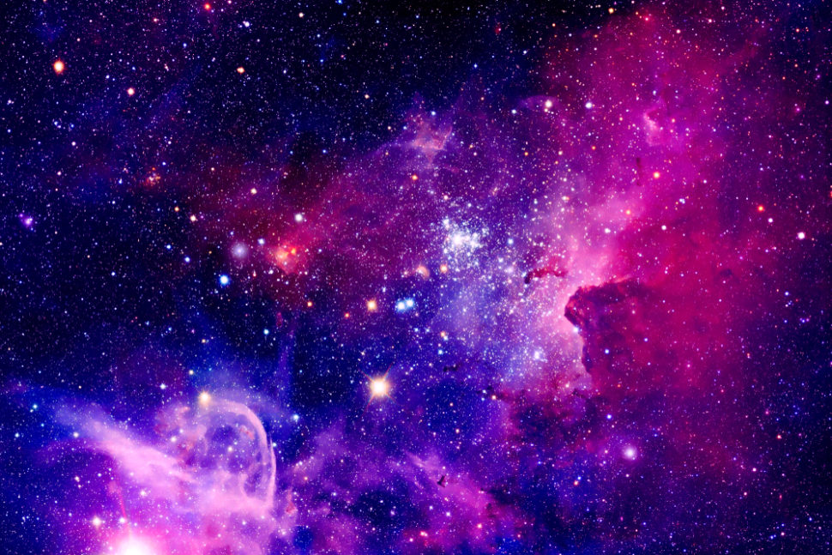
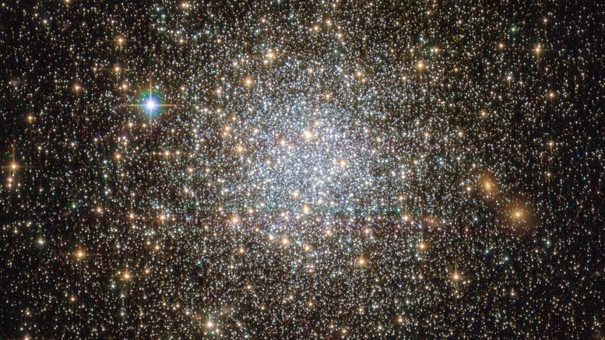
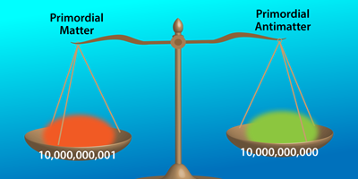
How to explain?
Four theories:
    Antigravity
    Antimatter galaxies
    Heavy neutrinos
    Particle asymmetry

Slide 11
1. Antigravity
After the big bang there was equal quantity of matter and antimatter
If matter and antimatter repel each other (antigravity) then they separated and occupy different parts of the universe
How to detect?

Slide 12
2. Antimatter galaxies
After the big bang there was equal quantity of matter and antimatter
Half of the galaxies are matter, the other half antimatter
This would make intergalactic gamma rays emerging from collisions between matter and antimatter (which we don’t see)
Perhaps the Leidenfrost effect at the boundaries, where matter and antimatter collide, could reduce the gamma rays (so we don’t see them)
Detect weak gamma rays in between galaxies!

Slide 13
3. Heavy neutrinos
Heavy neutrinos and antineutrinos may have existed in the early universe
CP symmetry breaking, which could happen in light neutrinos (and therefore in heavy neutrinos) could have tipped the balance in favour of matter by asymmetric decay
How to determine this?
Measure CP symmetry breaking in neutrinos!

Slide 14
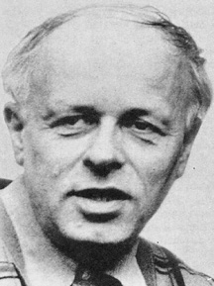
4. Particle asymmetry
Particles and antiparticles have (slightly) different decay rates*
(*this would break the CPT theorem)
Small imbalance (1,000,000,001 : 1,000,000,000)
Occurs during cool-down of Universe
Most particle-antiparticle pairs annihilate to radiation
Andrei D. Sakharov
Nobel peace prize 1975
Galaxies, stars, planets, us = ‘left-over’
Could matter and antimatter be different?
What kind of asymmetry ?
CPT theorem of physics wrong? : “NO” !!
Experimental physicists : “Let’s see … “
  Compare: Mass - charge - magnetic moment - lifetime - gravitation …..

Slide 15
Talk overview
Talk overview
big bang
Paul Dirac
1
theory ?
2
experiments
3
Andrei Sakharov
ALPHA
4
antimatter decelerator
extra low energy antimatter
ASACUSA
AMS
Gbar
antimatter
arrival
?

Slide 16
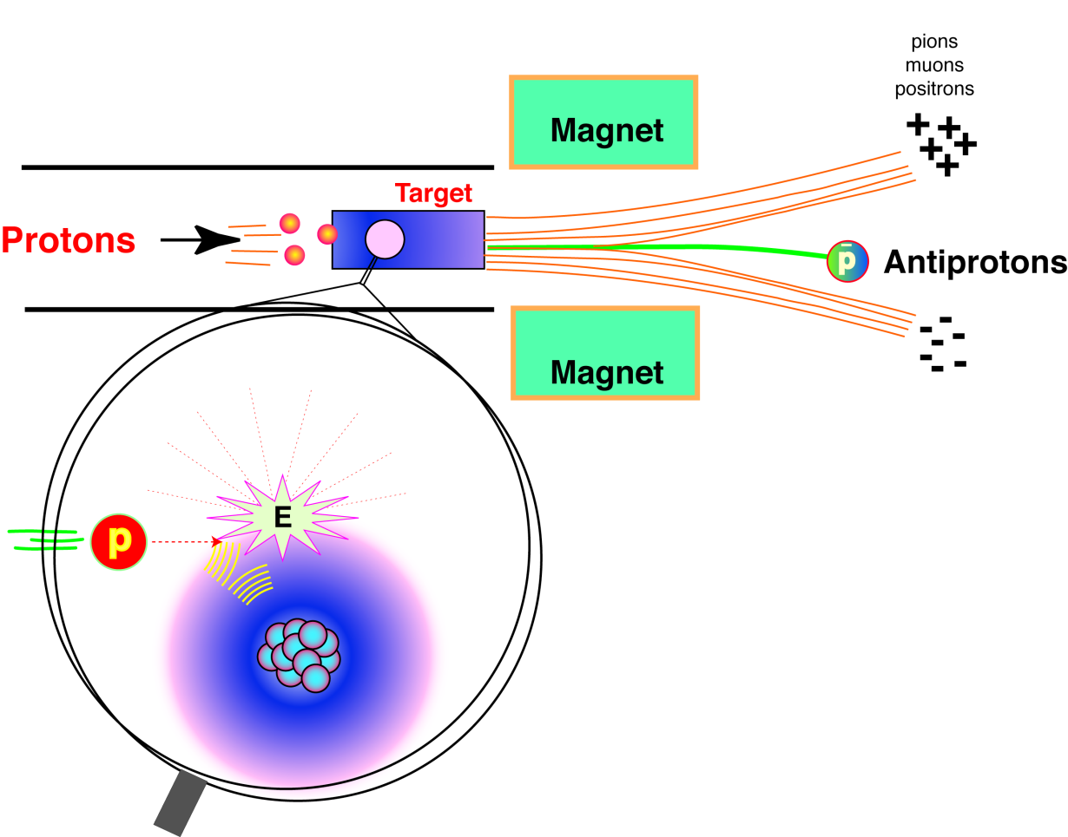
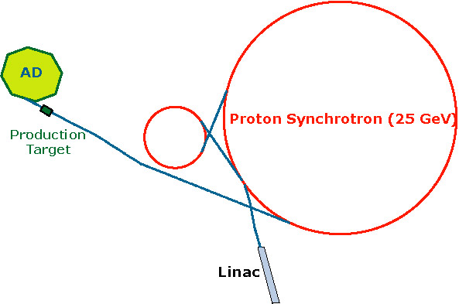
Experimentalists: Let’s make antimatter
Circ. 628 m
Circ. 182 m
Needs (at least) 6.2 GeV of (proton) energy to produce antiprotons
Use the kinetic energy of 25 GeV protons readily available at the PS
Magnetic fields used to filter particles with correct polarity/energy
50,000,000 antiprotons (per 100 s) available at 5.3 MeV for the AD experiments

Slide 17
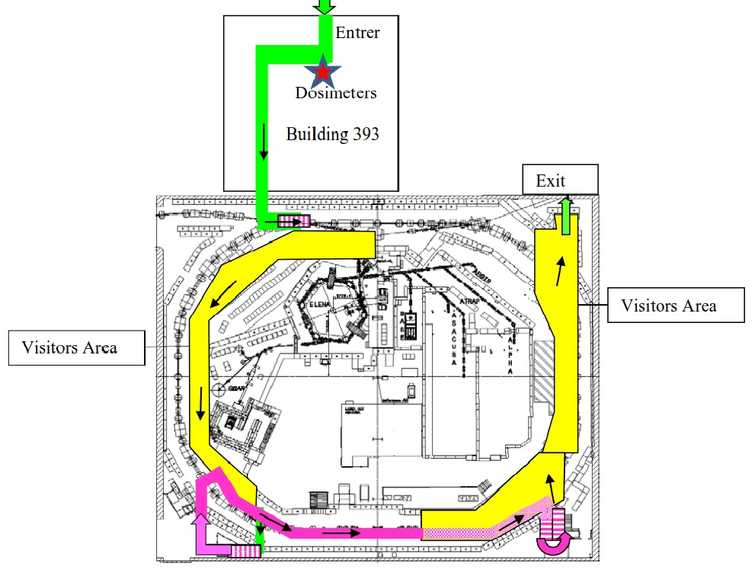
Places you will see
Front of the building
target area

Slide 18
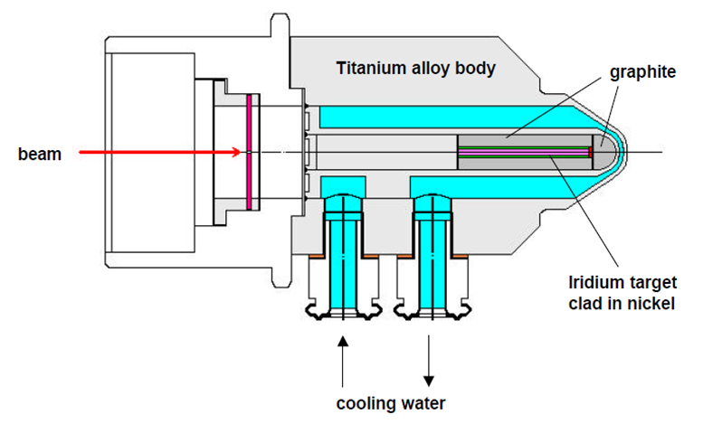
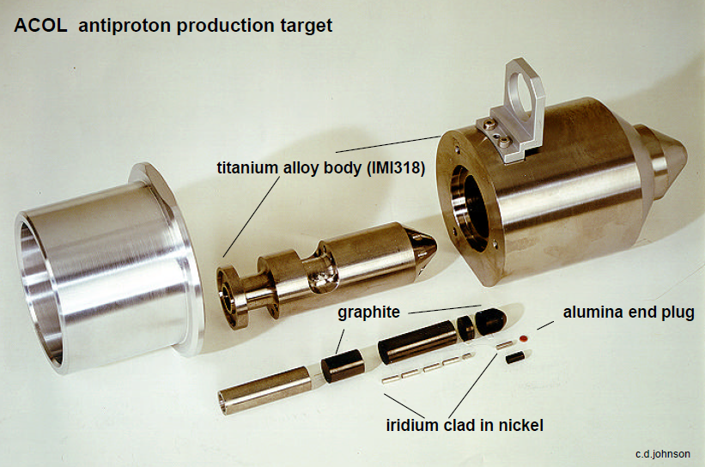
Experimentalists: Let’s make antimatter
Shoot protons on a metal: 1.5 x 10¹³ protons yields 5 x 10⁷ antiprotons in the AD
  Production target:
  Iridium production material
  3*55mm rod
  Graphite cladding
  Water-cooled Ti alloy body

Slide 19
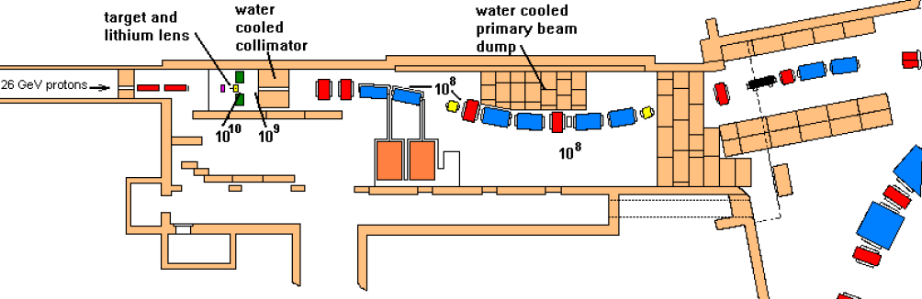
Antiproton production target area
Double spectrometers (reduce the momentum spread of antiprotons and associated particles)
PS
AD

Slide 20
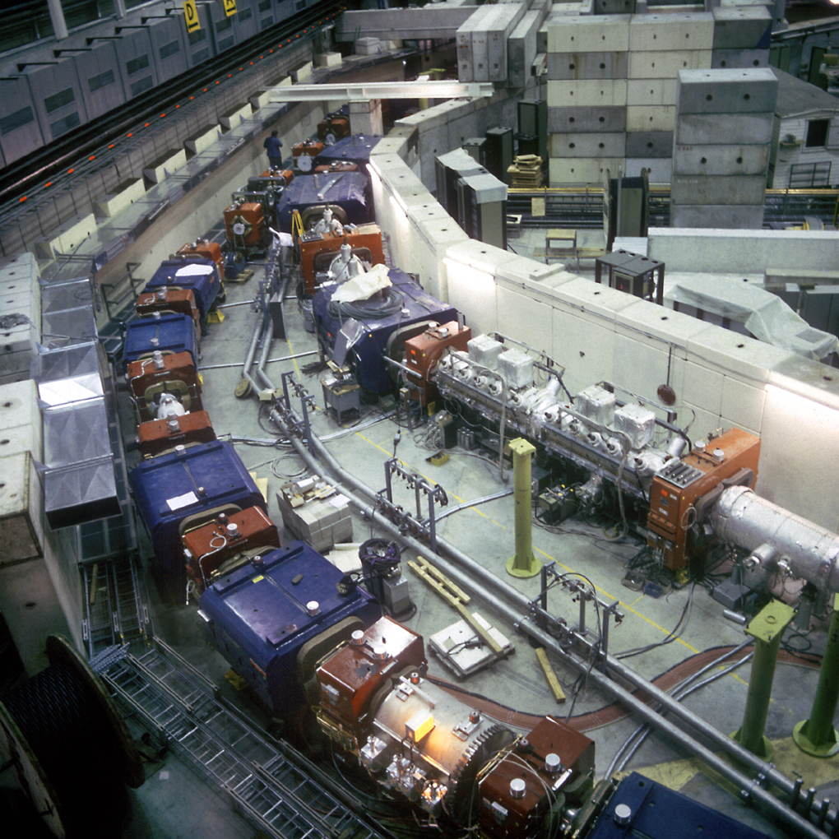
Antiproton Decelerator
AC
AA
Picture of the Antiproton Accumulator (AA) and Antiproton Collector (AC) rings (roof removed)
The outer ring (AC) was retained and converted into AD in 1998
The AA was removed

Slide 21
Talk overview
Talk overview
big bang
Paul Dirac
1
theory ?
2
experiments
3
Andrei Sakharov
ALPHA
4
antimatter decelerator
extra low energy antimatter
ASACUSA
AMS
Gbar
antimatter
arrival
?

Slide 22
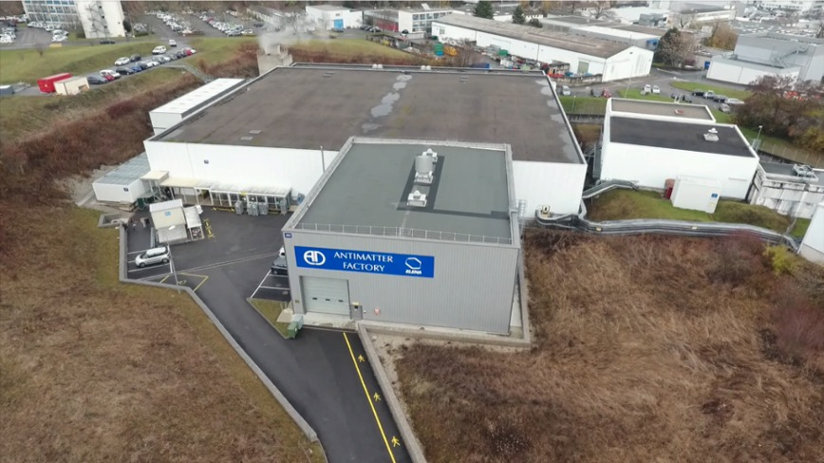
Antimatter factory

Slide 23
Places you will see
Front of the building
experimental area

Slide 24
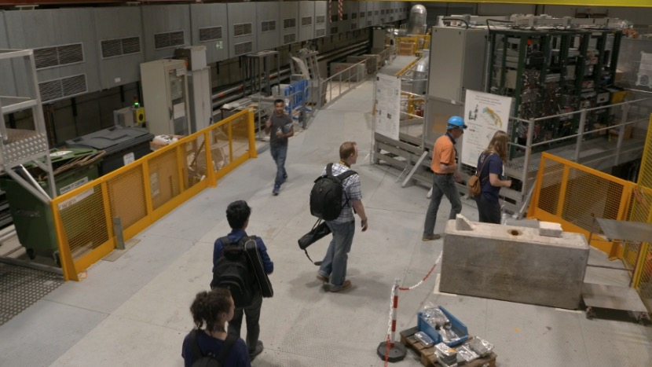
Antiproton experiments walkthrough

Slide 25
Places you will see
Front of the building
ELENA
A
S
A
C
U
S
A
A
L
P
H
A
Gbar
the door
stochastic cooler
RF cavities
electron cooler

Slide 26
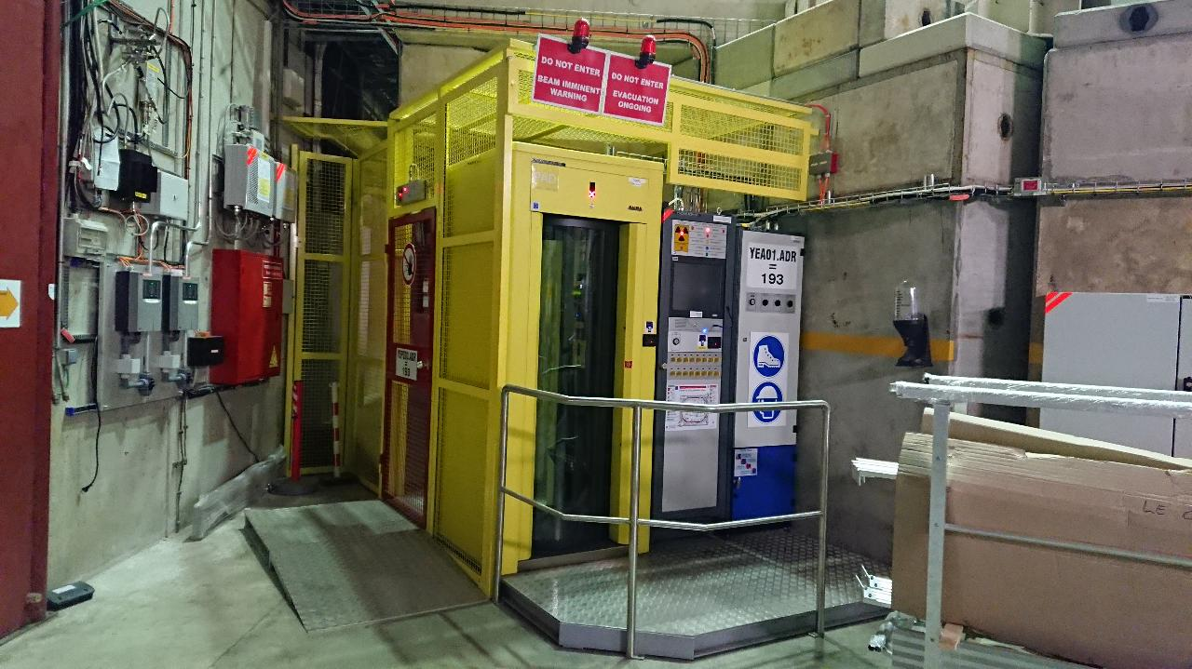
The door
AD ring access point with:
badge reader
retina scanner
interlock key
1 person at the time check
also used in Angels&Demons movie !

Slide 27
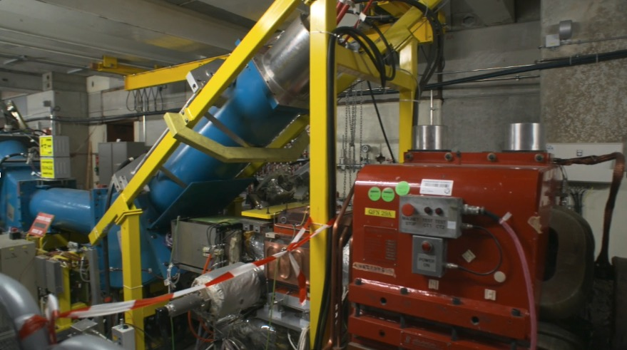
Inside the decelerator

Slide 28
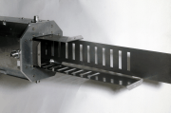
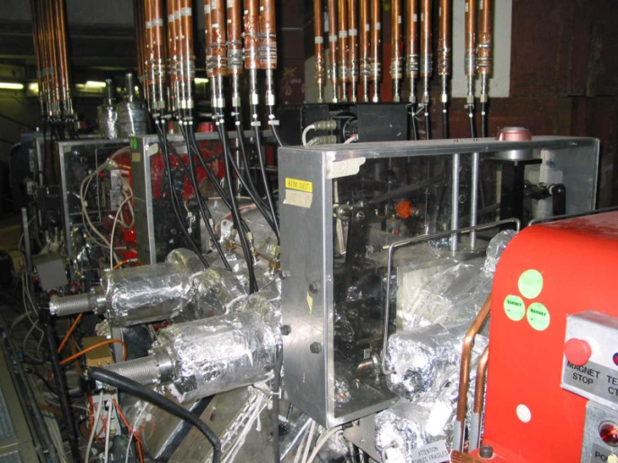
Stochastic cooling of antiprotons
pick up
Invented by Simon Van der Meer (Nobel Prize -84)
Aim of cooling:
  reduction of transverse and longitudinal emittances
  Increase of phase space density
Pickup and kicker must be correctly placed
Moving p/u and kicker follow beam size for optimum gain and signal to noise
Large system bandwidth: 1–1.6 GHz
Cryogenic cooling of certain components to reduce thermal noise
kicker

Slide 29
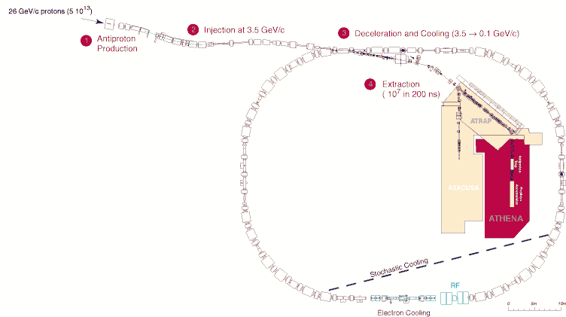
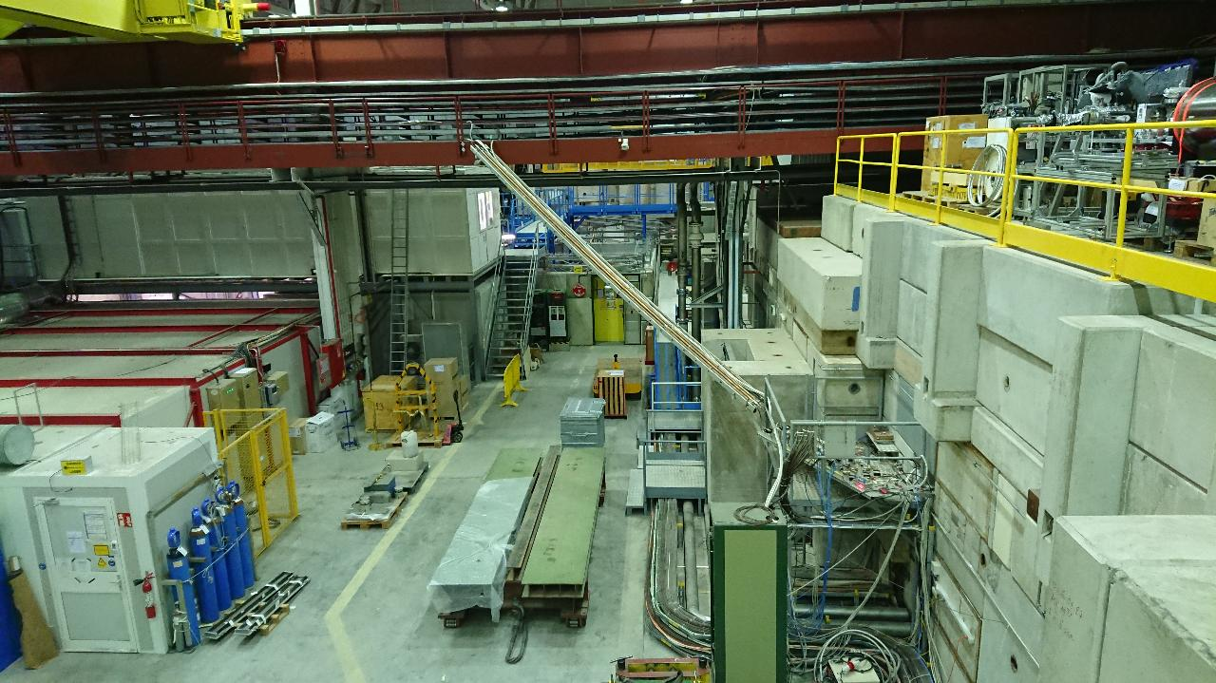
Stochastic cooling of antiprotons
Stochastic cooling transfer line (pick-ups to kickers) routed shortest possible way

Slide 30
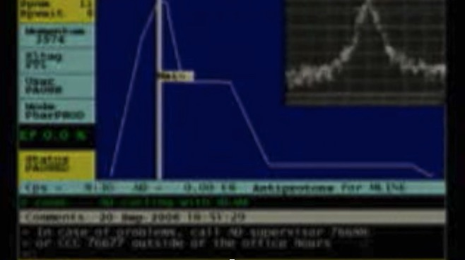
Stochastic cooling of antiprotons

Slide 31
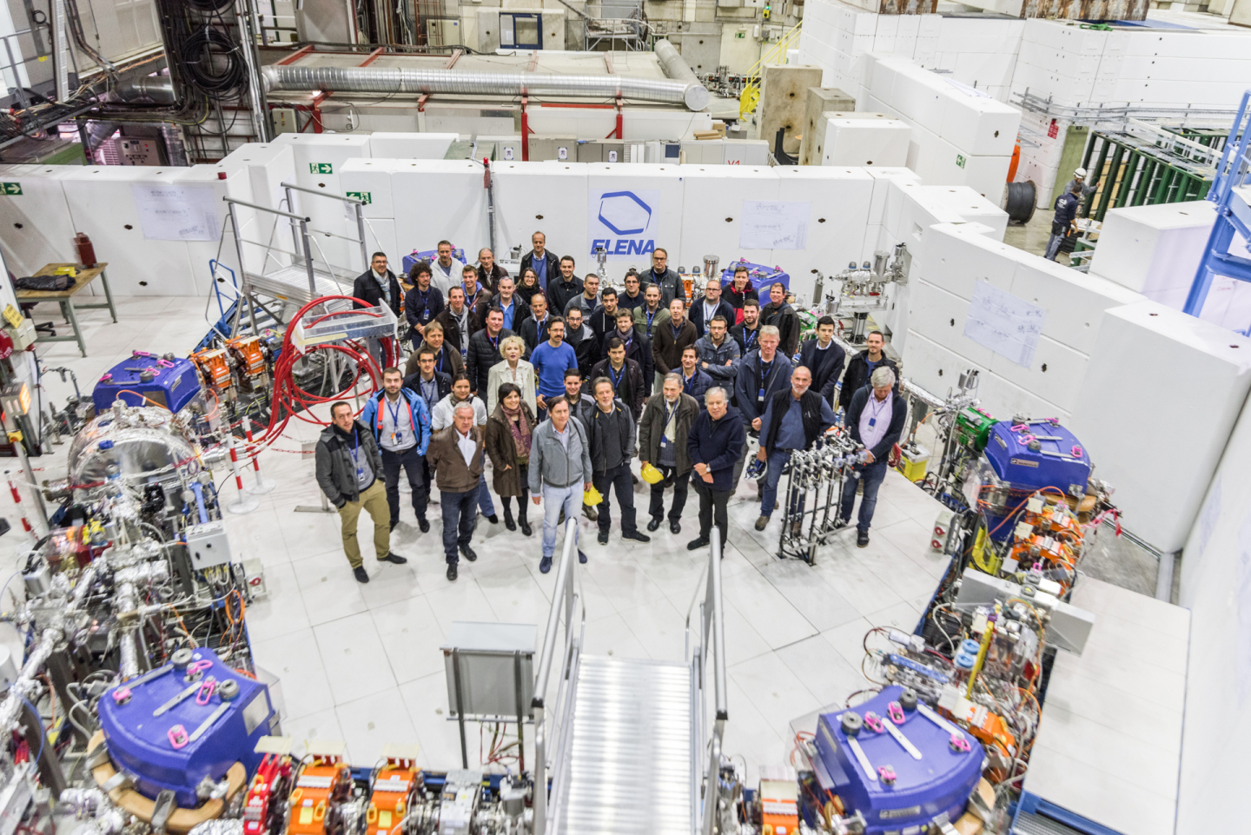
How did the antiproton facility evolve?
Antiprotons have been used since ~1980, in the beginning mainly for high energy proton-antiproton experiments in the SPS
1980-1986 AA (Antiproton Accumulator)
  3.57 GeV/c Antiproton Accumulator ring
  p/pbar collisions in SPS and in 1983 the discovery of the W and Z bosons !!!
  1984 Nobel prize for Carlo Rubbia and Simon van der Meer !!!
1986-1996 AAC (AA+AC) (AC: Antiproton Collector)
  Large acceptance Antiproton Collector ring added to increase capture
  Production rate increased 10-fold to 6*10¹⁰ pbars/h
  10¹² pbars stored (peak). p/pbar collisions in SPS
  + low energy experiments in LEAR
1998 - 2017 AD (Antiproton Decelerator)
  AC converted from fixed energy storage ring to Decelerator.
  5*10⁷ pbars slowed down to 100 MeV/c (5.3MeV kinetic). Local experimental area.
2018 - AD + ELENA (Extra Low ENergy Antiproton ring)
  Addition of a smaller ring for further deceleration with beam cooling. Many more antiprotons can be captured with cool 100 keV pbars.

Slide 32
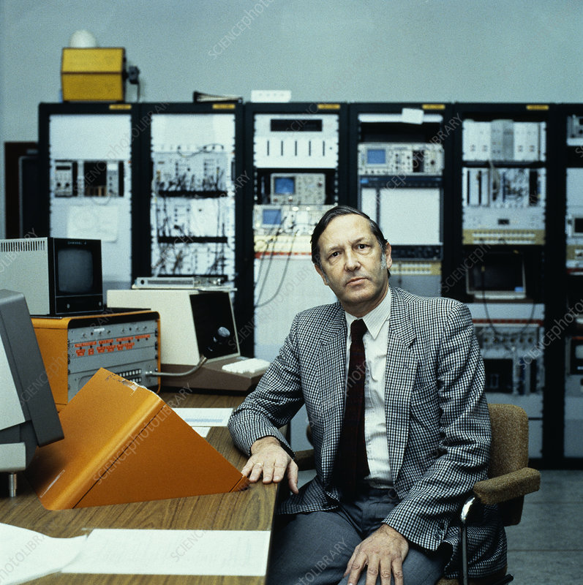
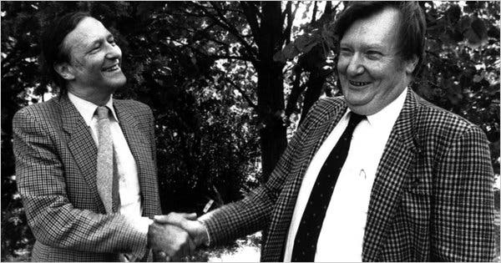
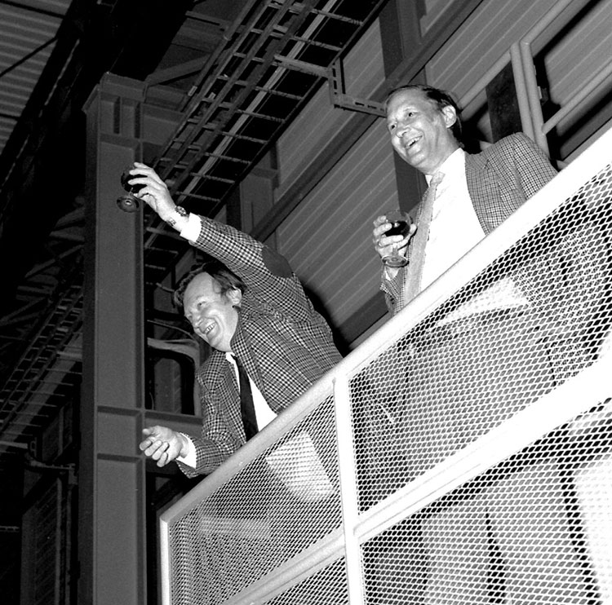
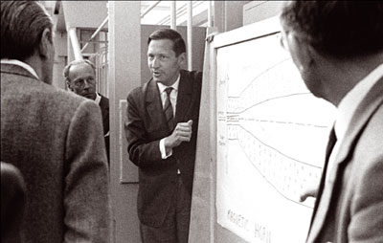
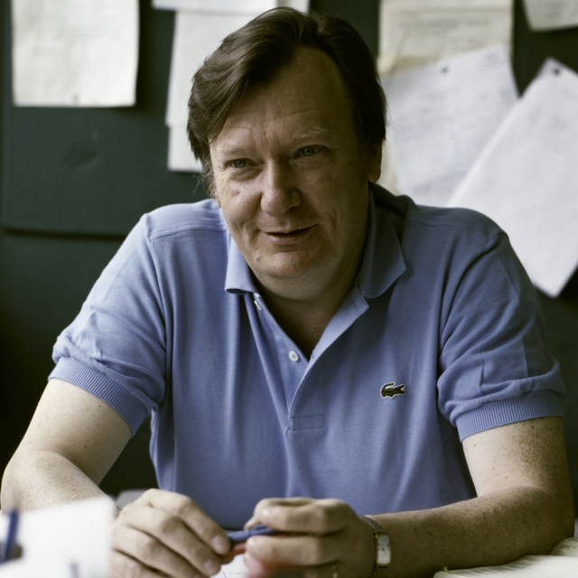
A break-through moment
Simon and Carlo
1983 Discovery of the W and Z bosons
1984 Nobel prize for Carlo Rubbia and Simon van der Meer

Slide 33
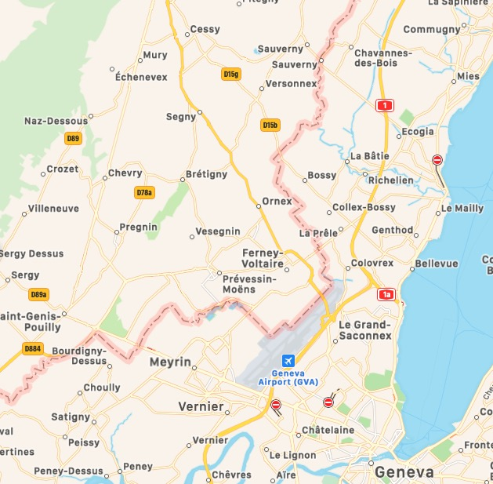

Accelerating science
To go quickly to higher energy collisions to do a discovery (and beat the competition!):
Construct a big ring (takes time)
  Better start soon
Turn the existing SPS into a collider (double the energy!)
  Using antiprotons (they can circulate in opposite direction in the same magnetic field!)
  But antiprotons are hard to get by and you need many to have good statistics
  There is a way: construct a small Antiproton Accumulator
  Critical problem: how to cool the very large momentum spread so they can be accumulated
  The solution: stochastic cooling! (new invention)
LEP/LHC
AA
SPS
PS

Slide 34
Talk overview
Talk overview
big bang
Paul Dirac
1
theory ?
2
experiments
3
Andrei Sakharov
ALPHA
4
antimatter decelerator
extra low energy antimatter
ASACUSA
AMS
Gbar
antimatter
arrival
?

Slide 35
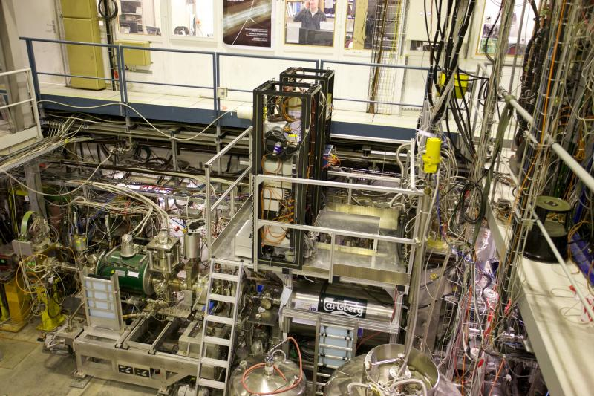
Beer
Sponsor of the ALPHA experiment

Slide 36
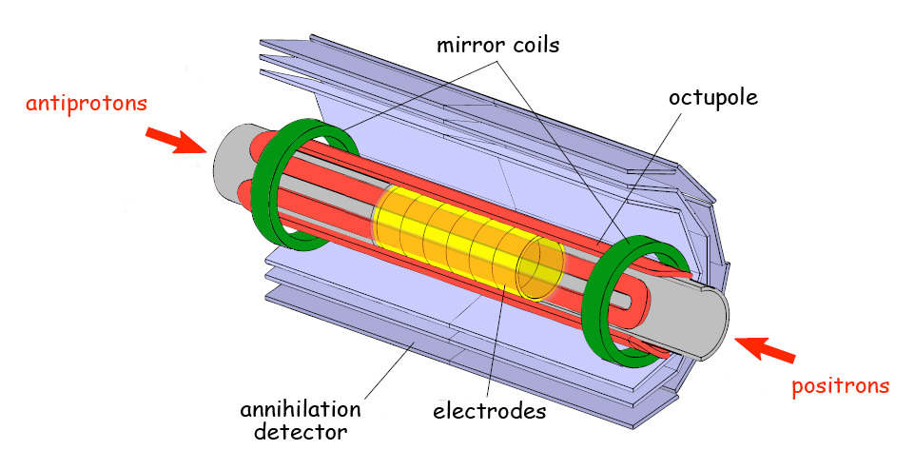
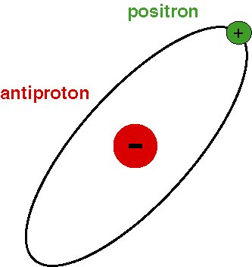
Antihydrogen
Penning trap

Slide 37
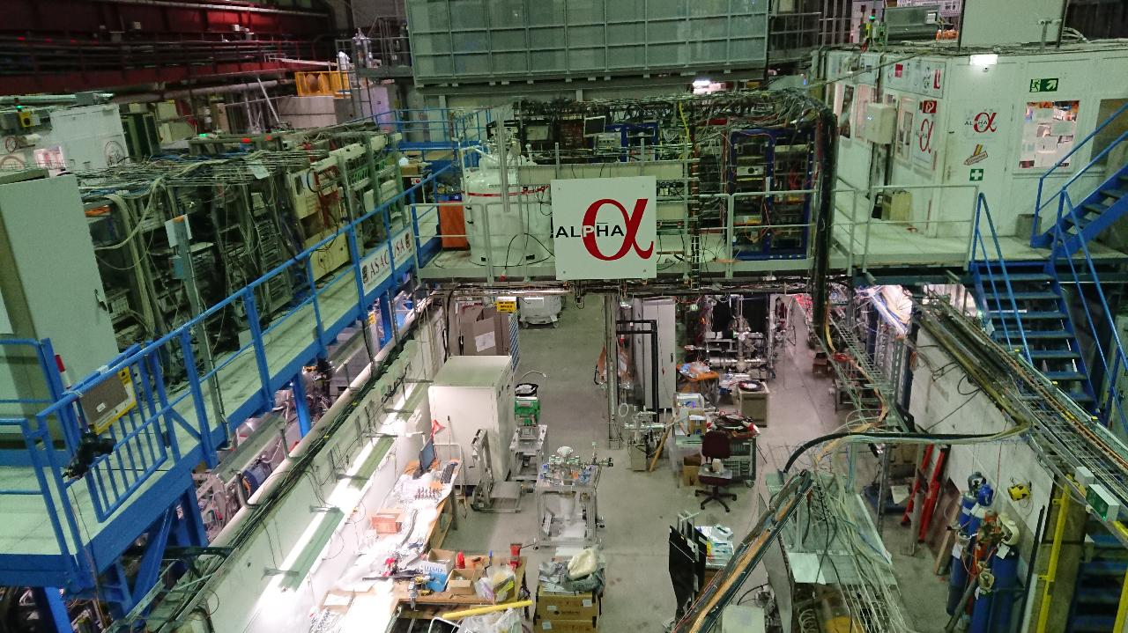
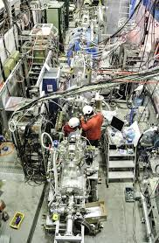
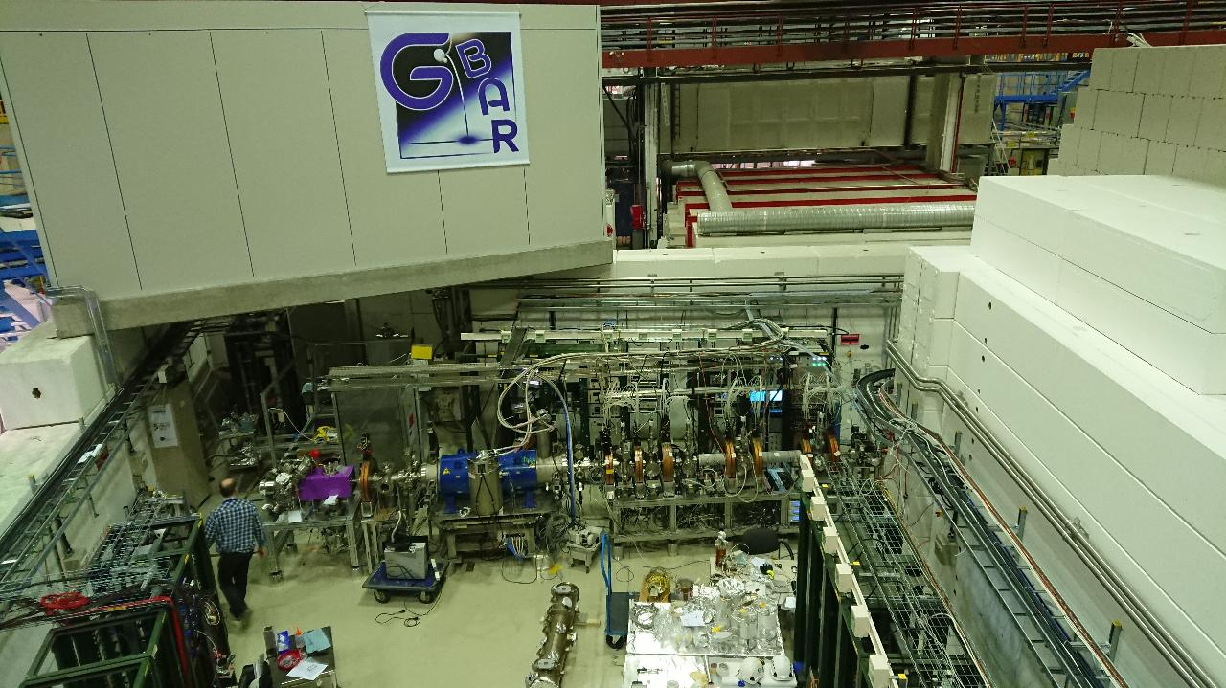
Passing by 3 experiments
ALPHA
ASACUSA
Gbar

Slide 38
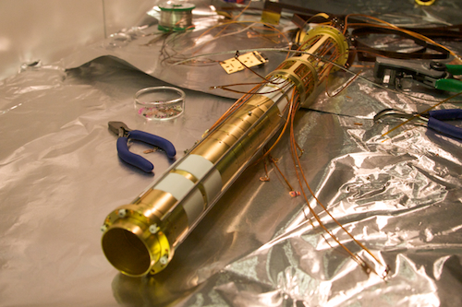
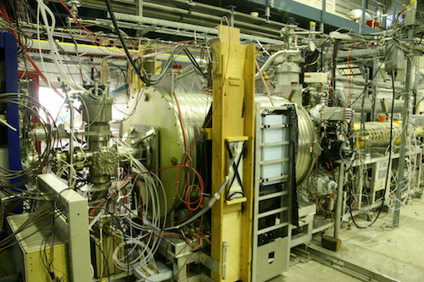
ALPHA experiment
Penning trap inside….
….fully assembled ALPHA experiment

Slide 39
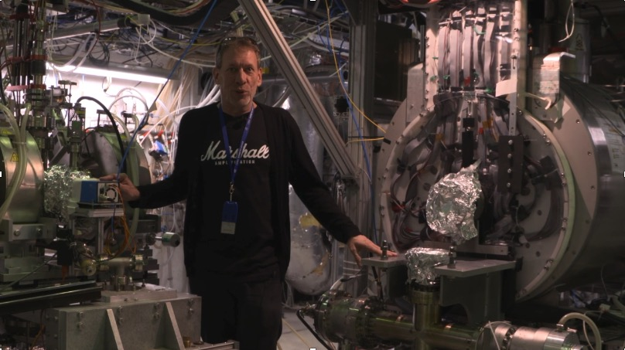
ALPHA experiment

Slide 40

ALPHA experiment

Slide 41


ASACUSA: compare mass proton-antiproton
Atomic Spectroscopy And Collisions Using Slow Antiprotons
antiprotonic helium

Slide 42

ASACUSA: Antiprotonic helium

Slide 43

Gbar: antigravity
Drop antihydrogen in the gravitational field of the earth
Ongoing installation
Positron beam line and trapping equipment
Pbar line from ELENA under hut
Free fall vessel to be installed

Slide 44

ALPHA-g
Drop antihydrogen in the gravitational field of the earth

Slide 45

From antiprotons to antihydrogen
Cool Antiprotons …
Antiprotons produced at almost the speed of light
Slow antiprotons down to (almost) rest
Accumulate positrons
Mixing for antihydrogen formation
… Cold Antihydrogen

Slide 46
Talk overview
Talk overview
big bang
Paul Dirac
1
theory ?
2
experiments
3
Andrei Sakharov
ALPHA
4
antimatter decelerator
extra low energy antimatter
ASACUSA
AMS
Gbar
antimatter
arrival
?

Slide 47



Antimatter in space
Charged particles from space collide with the atmosphere
To study them, you need to be in space
The Alpha Magnetic Spectrometer (AMS-02) was mounted on the International Space Station (ISS) in 2011

Slide 48


AMS-02

Slide 49

Proton flux

Slide 50

Helium flux

Slide 51

AMS-02

Slide 52


Ratio of C/O and N/O
Light stars: hydrogen fusion
Massive stars: CNO cycle catalysed fusion
half life ~10 min
half life ~2 min
In the Solar System: C/O = 0.54 N/O = 0.17
In Galactic Cosmic Rays: C/O = 0.90 N/O = 0.09

Slide 53

Heavier nuclei

Slide 54
Anti-alpha
matter particles
antimatter particles
helium-4
antihelium-4
helium-3
antihelium-3
1.38 ppm

Slide 55
Talk overview
Talk overview
big bang
Paul Dirac
1
theory ?
2
experiments
3
Andrei Sakharov
ALPHA
4
antimatter decelerator
extra low energy antimatter
ASACUSA
AMS
Gbar
antimatter
arrival
?

Slide 56



Energy release
1 g antimatter + 1 g matter = 43 kilotons TNT explosion (10¹⁴ J)
1000 times more than nuclear fission per gram
100 times more than nuclear fusion per gram
US project in 2004: to investigate the use of positrons as rocket fuel or explosive
For CERN antimatter factory to accumulate 1 g of antiprotons will take at 30 million years (taking 100% efficiency)
In 20 years the amount of energy produced in the form of antimatter at CERN would barely heat a cup of tea

Slide 57
Talk overview
Talk overview
big bang
Paul Dirac
1
theory ?
2
experiments
3
Andrei Sakharov
ALPHA
4
antimatter decelerator
extra low energy antimatter
ASACUSA
AMS
Gbar
antimatter
arrival
?

Slide 58

Maybe one day …
from Star Trek

Slide 59
Thank you for your participation !!

