Slide 1
IPPOG Resource Database
Making Particle Physics outreach & education available worldwide
Barbora Bruant Gulejova
Strategic Development and Communications Lead, IPPOG

Slide 2
Outline
Why outreach in particle physics and related sciences matters?
IPPOG - strategic pillar for worldwide outreach – EPPSU context
IPPOG Resource Database (RDB)
- What? Who for?
- Development of new RDB
- Curation
Invitation for audience to take part!

Slide 3
Challenges of HEP / science community
Main challenges of scientific community
Challenged financial support of large experimental endeavours
Falling interest of young people to study physics and STEM
Mistrust in science
Reasons
Misperception of physics / science in society – complicated, abstract, disconnected from real life
Lack of awareness and understanding

Slide 4
Why is physics & basic research misperceived?
Scarce exposure of society to modern physics
School curricula – mostly no modern physics
Media – misinformation and disinformation
Cell phones and computers were sewn into reality thanks to fundamental science.
Despite this:
Most students finish high school believing that there are only:
3 elementary(?) particles (electron, proton, neutron)
2 types of forces (gravitational and electromagnetic)

Slide 5
Why exposure of society to HEP matters?
Exposure to modern physics, like HEP and its technological applications increases the interest of students in physics and their perception of its role in society and sustainable development.
Study in Germany and UK:
General interest in physics at schools has increased strongly thanks to inclusion of
extra-curriculum activities in HEP (exhibitions, Physics Masterclasses, teaching)!
IPPOG Resource Database
Teaching contemporary natural science/ physics leads to understanding of:
scientific method
high financial and personal investments to large experiments, as LHC
media misinformation

Slide 6


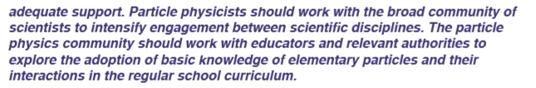

European Particle Physics Strategy Update
CERN-ESU-014
Importance to update physics curricula is now officially recognised by full HEP community
6

Slide 7
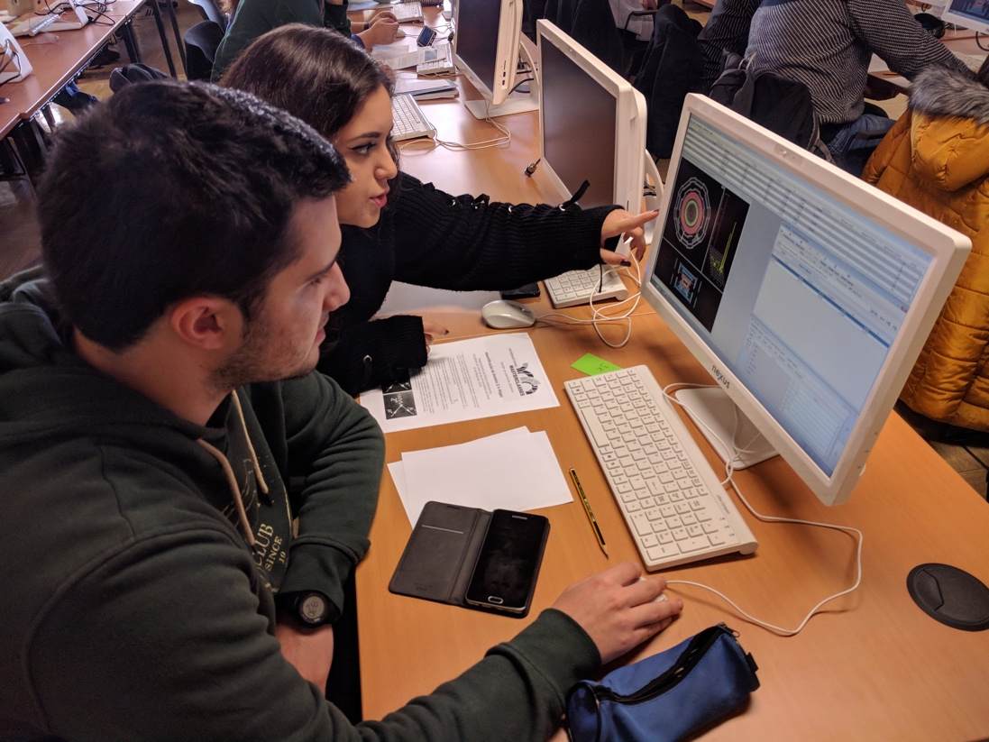
International Particle Physics Outreach Group
Before the update of physics school curricula is achieved (long-term process)…..
Outreach
Informal education
Extra-curricula activities
The way to bridge the gap
between contemporary
science and school education
and increase appreciation of
science by society
The International Particle Physics Outreach Group (IPPOG) has been making concerted and systematic efforts to present and popularise particle physics and related sciences across all audiences and age groups since almost 25 years.
Today, HEP and scientific community has in IPPOG a strategic pillar in fostering long-term, sustainable support for fundamental scientific research around the world.

Slide 8
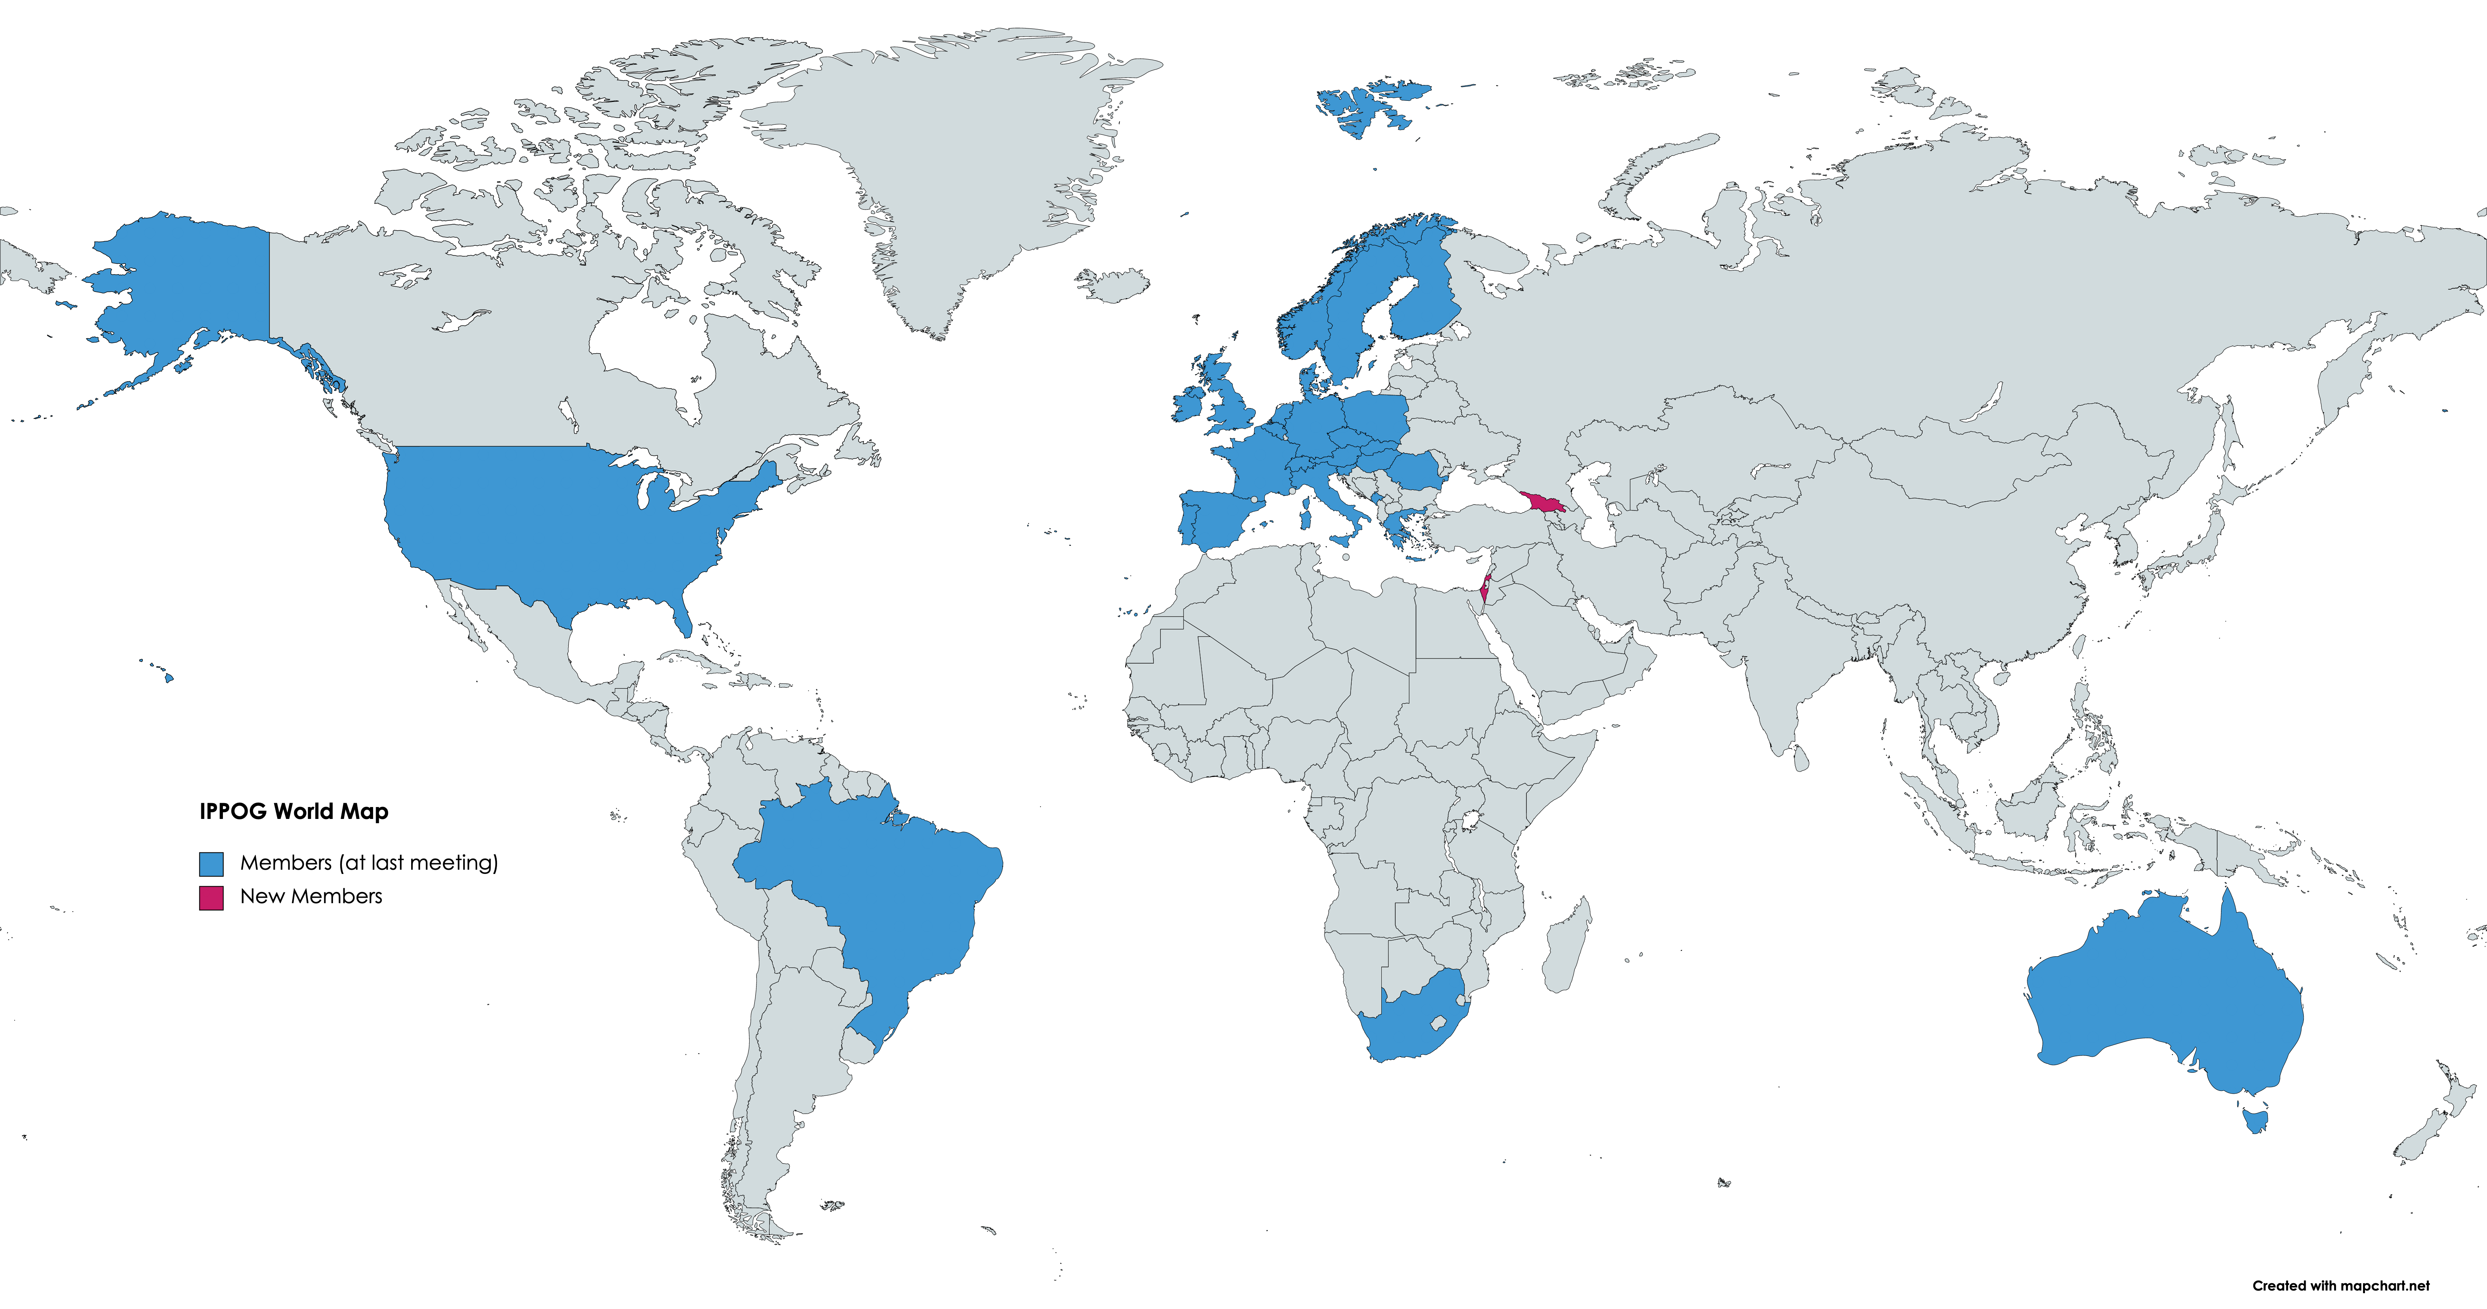
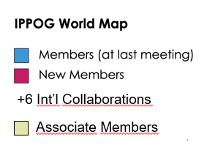
IPPOG: Global Network
• Asia
• Africa
• Australia
• Europe
• The Americas
• International Labs
and Collaborations
(Feb 2021)
37 Members:
30 Countries
6 Collaborations / Experiments (ATLAS, ALICE, Belle II, CMS, HAWK, LHCb)
1 International Lab (CERN)
2 Associate Members:
2 National Labs (DESY, GSI)
+6 Int’l Collaborations
Associate Members

Slide 9
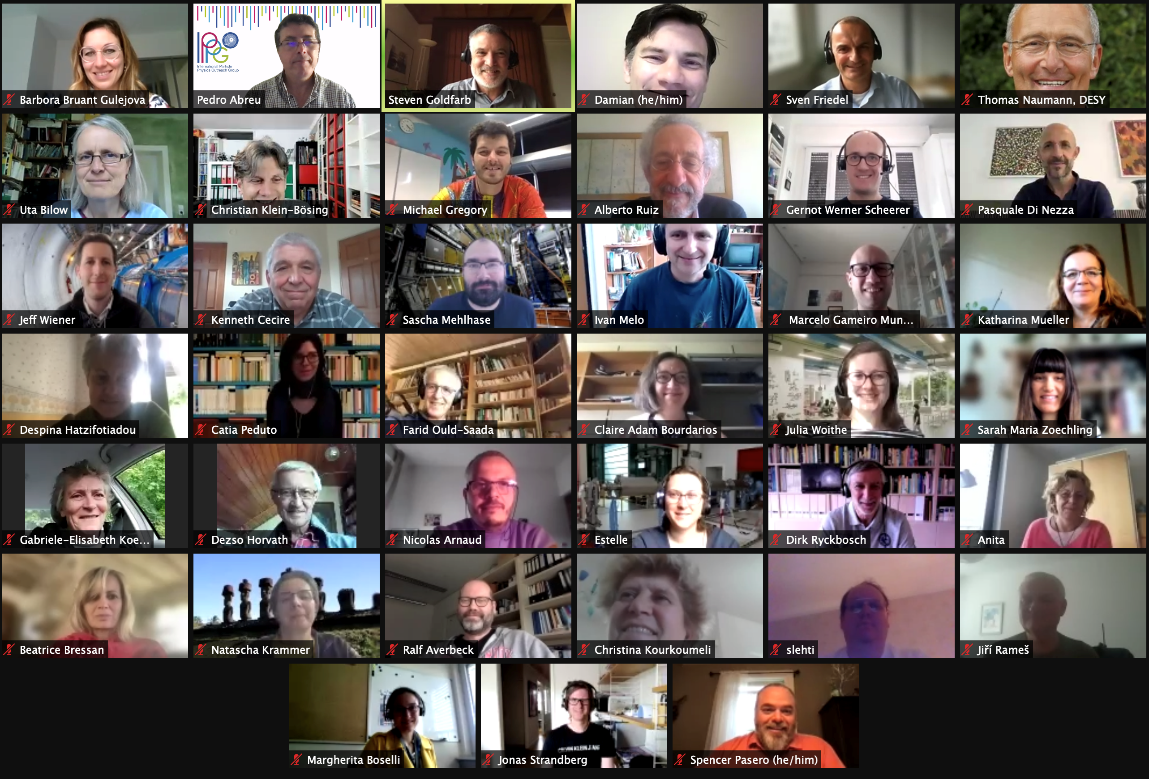
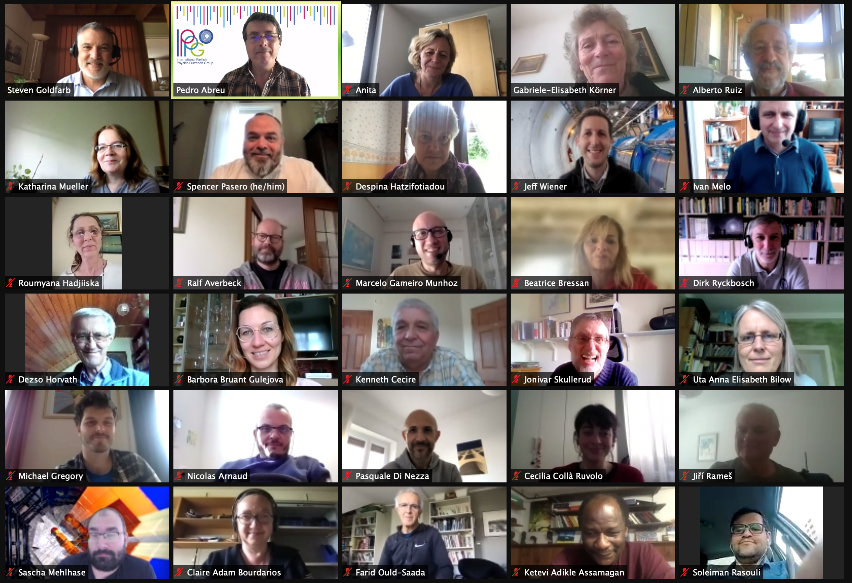
IPPOG Collaboration
International Scientific Collaboration
  Active Researchers with Experience in Education & Outreach
  Experts in Communication & Education
Mission
Establish Understanding of scientific process
Instil Appreciation of fundamental research and importance
of evidence-based reasoning
Build Trust with communities
Inspire Next Generation of scientists
19 May 2021

Slide 10
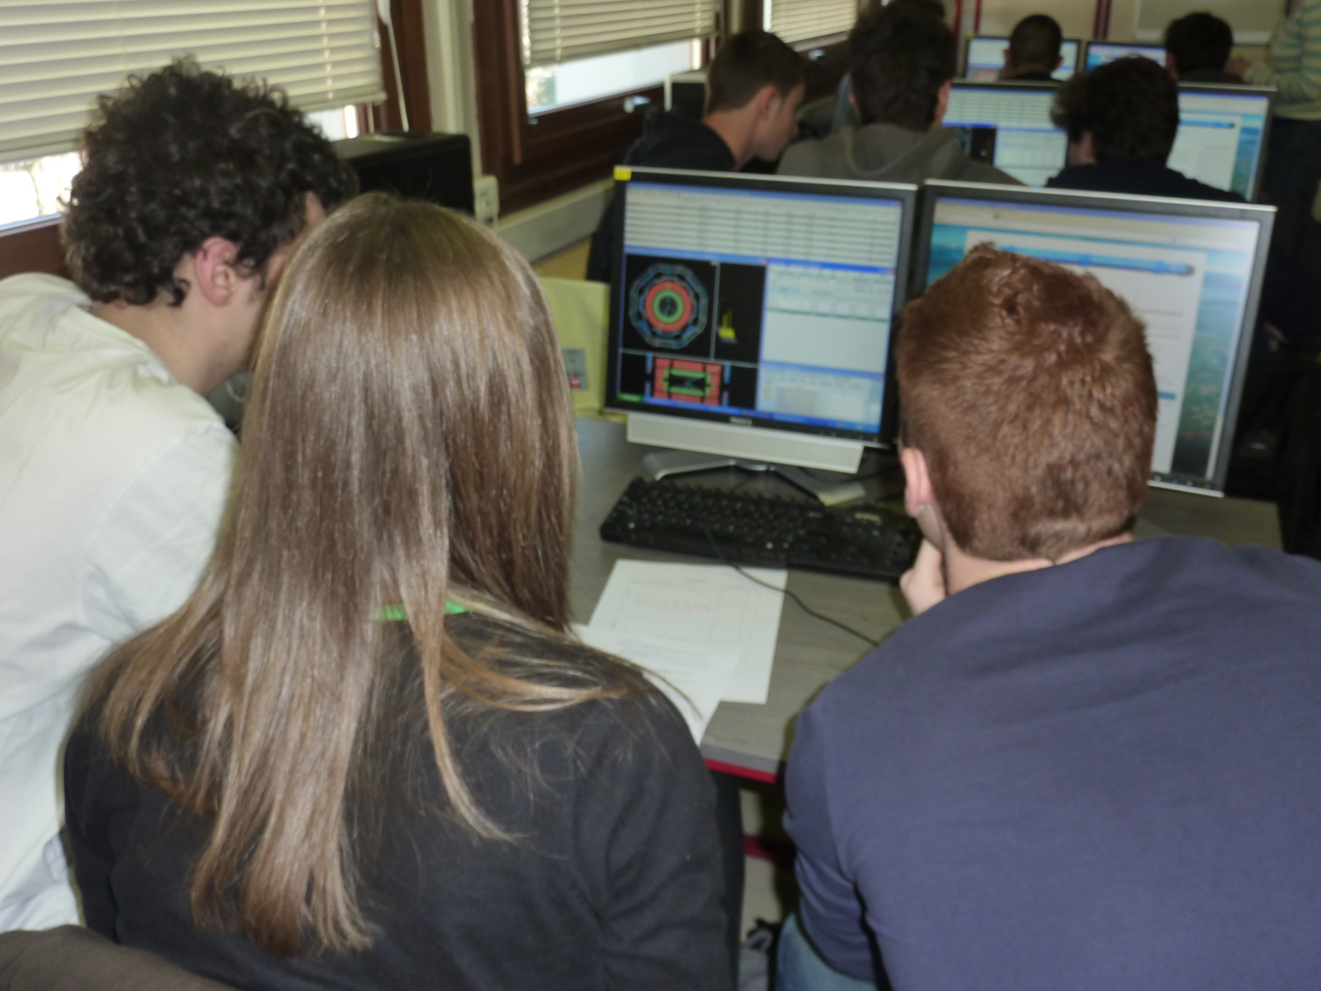
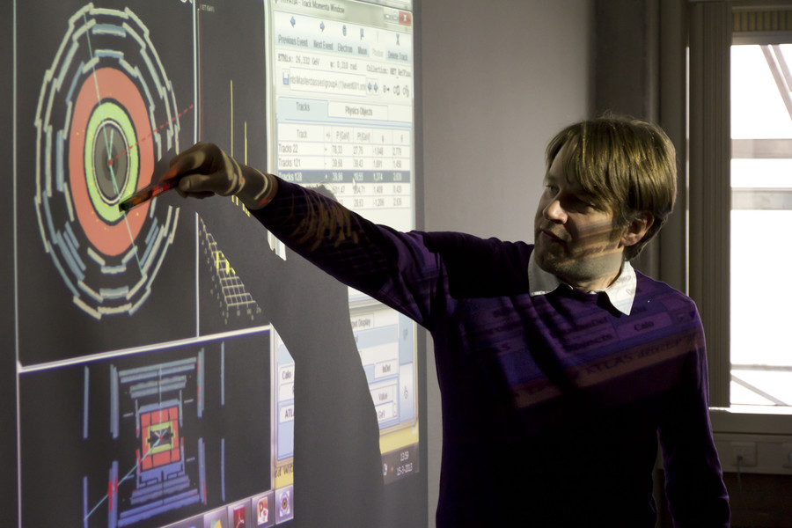
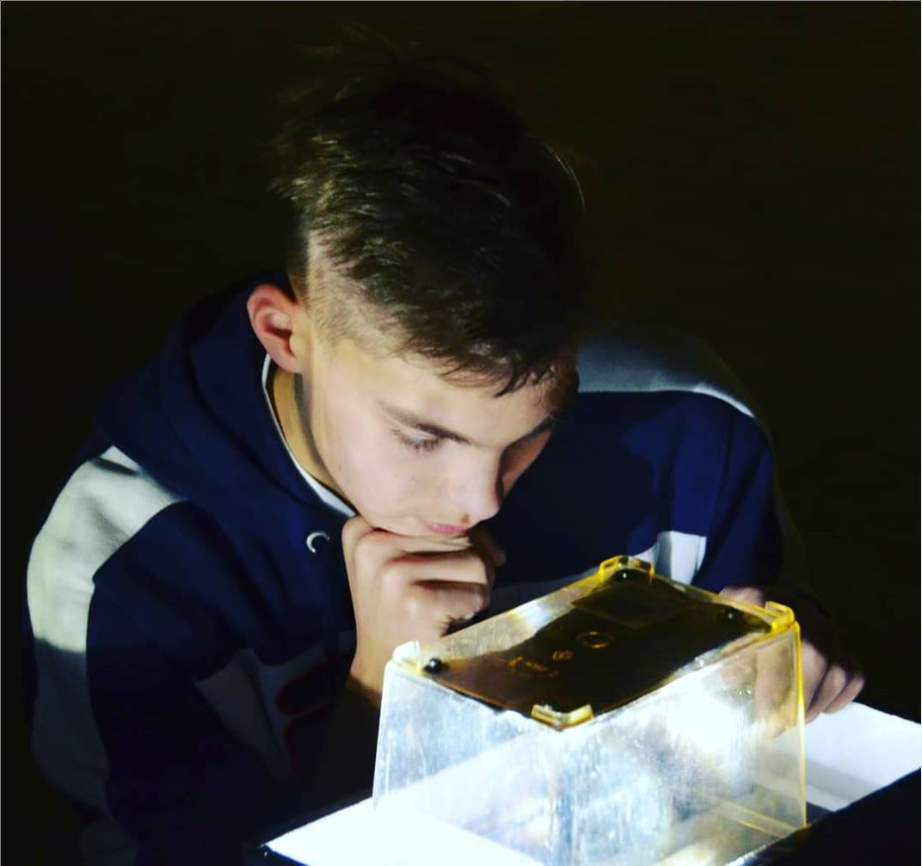
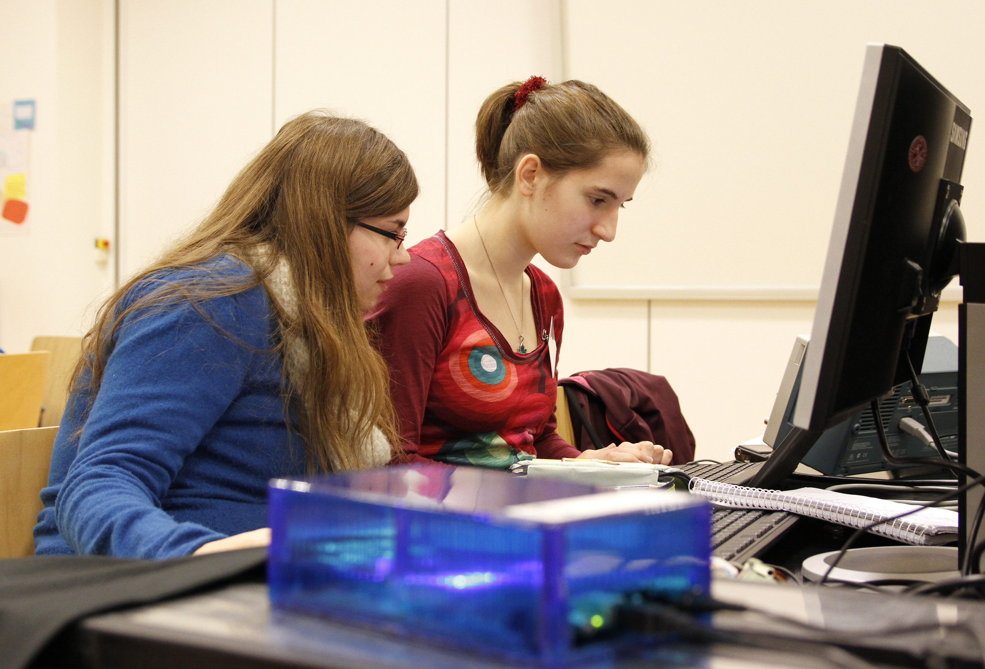

Activities with global reach
International Masterclasses in Particle Physics
• Flagship activity for high schools students (15–18 y.)
• Real Data from ATLAS, CMS, ALICE, LHC-b, Belle-II,
MINERvA, Hadron therapy
Worldwide data Day
Global Cosmics
• Network of Cosmic Rays Projects for Schools
• International Cosmic Day and International Muon Week
EPS HEPP Outreach Prize 2021 awarded to Uta Bilow and Ken Cecire, coordinators of the International Masterclasses,
and Sascha Mehlhase, IPPOG representative from the ATLAS Experiment
Resource Database
• Primary source of particle physics outreach material in the world
… and many other projects, competitions, campaigns and activities…
Support Local Activities
• Sharing of expertise, best practices, resources to support events, kick-start activities

Slide 11
IPPOG Website & Resource Database
IPPOG is an ideal platform for:
sharing, developing and improving
explanatory and teaching materials, strategies, methods, activities and tools
to reach broader audiences
based on the world best practices in E&O of HEP and related sciences
“IPPOG wants the new website to become more open to students, teachers and the general public, and for the RDB to become the primary source of particle physics outreach material in the world.”
IPPOG is upgrading its website:
improve the user experience across the IPPOG digital portfolio
strengthen IPPOG online presence by creating a new website including a new RDB
greatly broaden the audience type and use of the webpages & available resources

Slide 12
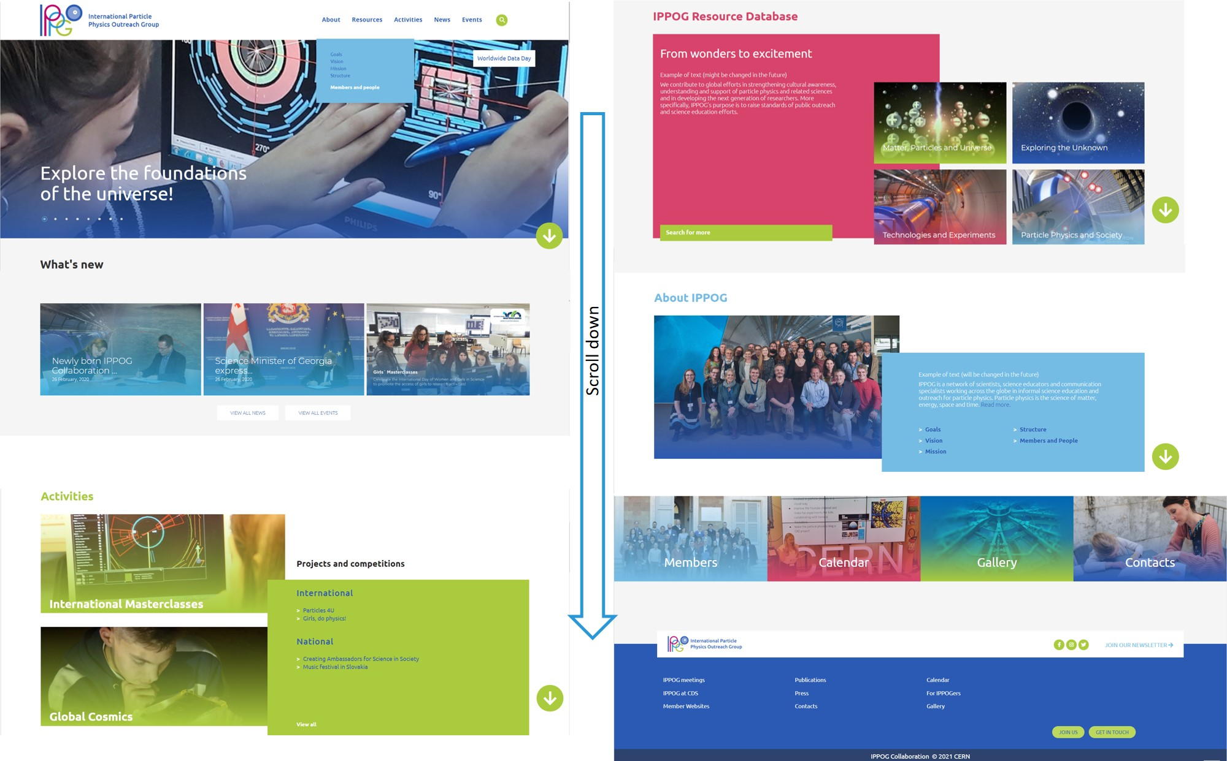
IPPOG New Websites
New IPPOG website under development
Coming soon!

Slide 13
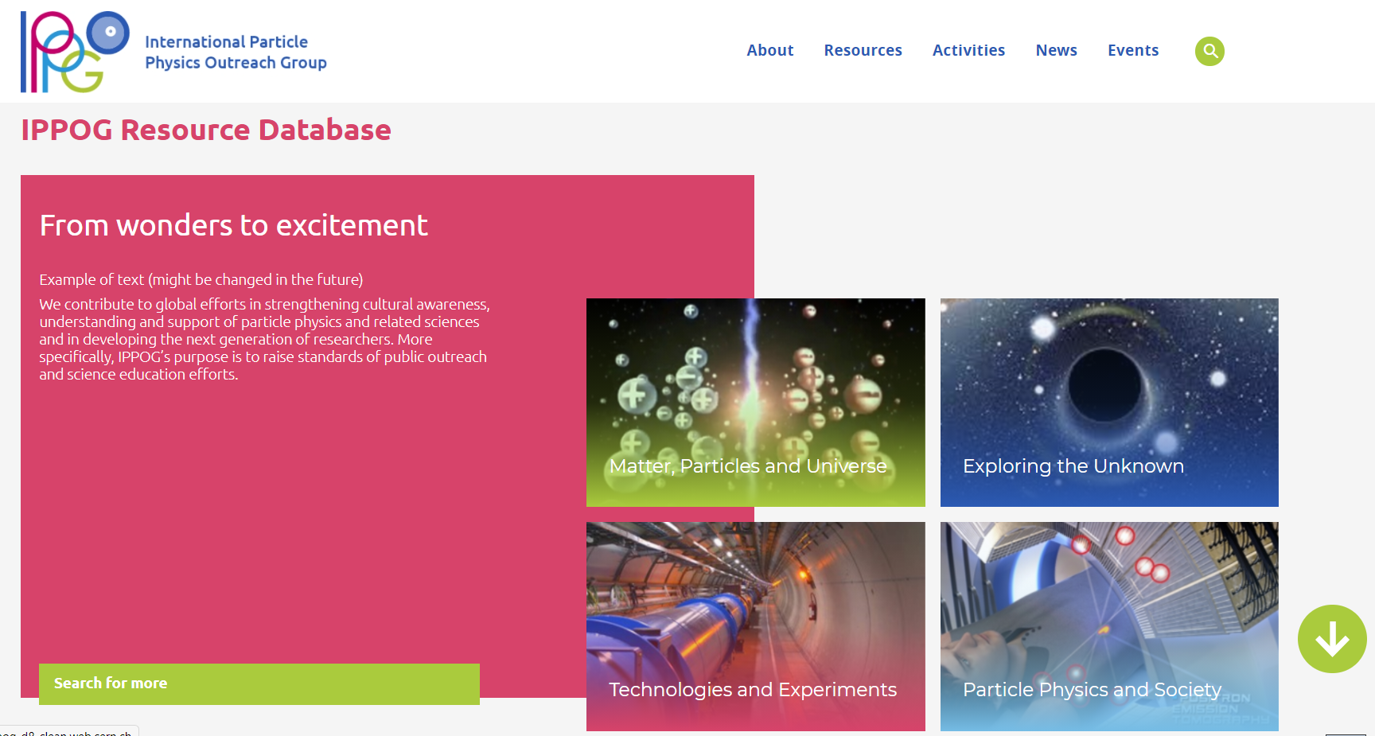
IPPOG Resource Database

Slide 14
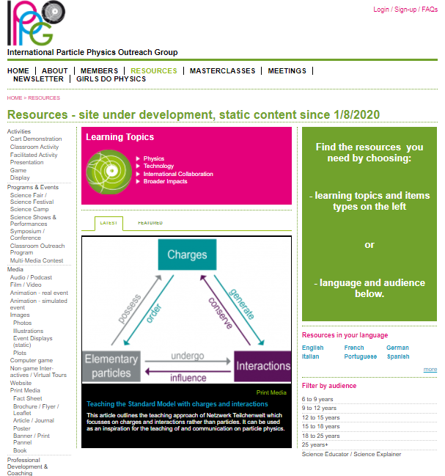
IPPOG Resource Database History
Idea born in 2009: transformation of EPPOG (former IPPOG) from a “discussion forum” to a possible world leader in informal scientific E&O activities for HEP and related fields: IPPOG.
Initially “EPPOG Best Practice Database” meant to be used by science institutions and laboratories for outreach and informal science education purposes
self-sustaining, users vote on highest quality & most useful items to be best practice
First version released in 2011
Today about 370 items collected over last 10 years
Current RDB static, no submissions.
New RDB to be published end 2021

Slide 15
New IPPOG Resource Database is / will be…
online platform to facilitate the exchange of HEP E&O resources across the globe
collection of high-quality engaging materials (e.g. videos, posters, talks, hands-on activities, tools, brochures and more)
content recommended by experts
to share wonders and excitement of HEP with teachers, students and general public
readily understandable and regularly updated to reflect the latest discoveries in HEP
primary source of HEP outreach material in the world

Slide 16

New IPPOG Resource Database
REVIEW and REDESIGN of Resource Database
Several years of discussions, efforts and feedback
New improved Resource Database proposal in 2017
Intense collaboration with high school teachers (“IPPOG Friends” group)
Broaden audiences
Improve functionality and user-friendliness
for both users and contributors
Simplify categories
Full coverage of relevant topics
Keep the content up-to-date
Continuous feedback and improvements
GOALS

Slide 17
IPPOG Resource Database Challenges
TECHNICAL
Dedicated submission form at CDS
Interface between CDS and Drupal (external company)
In-kind contribution from CERN
CONTENT
Curation of existing / “old” items
Collection of new / up-to-date best items
New content development

Slide 18
IPPOG RDB Curation
RDB CURATION group (since summer 2020)
~ 40 experts from around the world: - physics teachers, scientists and science communicators
Alberto Ruiz Jimeno
Andreas Delannoy
Ani Torres
Anna Marie Wolf
Carlos Cunha
Cassondra McHugh-Lowther
Cédric Vanden Driessche
Claire Adam-Bourdarios
Claire Bonnoit-Chevalier
Daniela Ambar Gayoso Miranda
Dario Menasce
Despina Hatzifotiadou
Enrique Arce-Larreta
Harry Stuckey
Ian Bearden
Ivan Melo
Jean-Christophe Pelhate
Joel Klammer
José María Díaz Fuentes
Julia Woithe
Kevin Martz
Kevin Mosedale
Lucia Battistella
Luís Afonso
Maria Niland
Marla Glover
Michael R. Fetsko
Michael Wadness
Miki Otsuka
Moritz Springer
Patricia Teles
Pierluigi Paolucci
Ram Krishna Sharma
Richard Dower
Robert Nickson
Soleiman Rasouli
Spencer Pasero
Stefania Della Sciucca
Yury Ivanov
CRITERIA
Is the physics right?
Is it a topic of interest?
Is it related to particle physics or associated fields?
Is it up-to-date or has it been superseded?
Are you aware of a similar resource in the same language?
Do you consider this resource as really outstanding?
Special Curation tool developed – launched Dec ‘20
366 resources: each evaluated by 2-3 experts =>
> 800 items to curate by end of summer 2021!

Slide 19
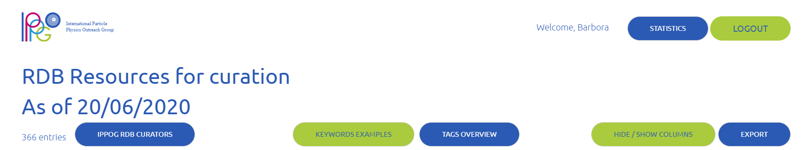
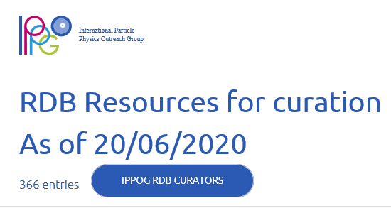

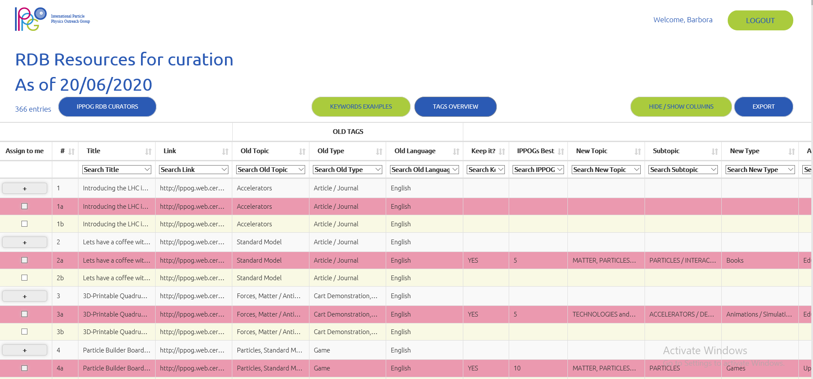

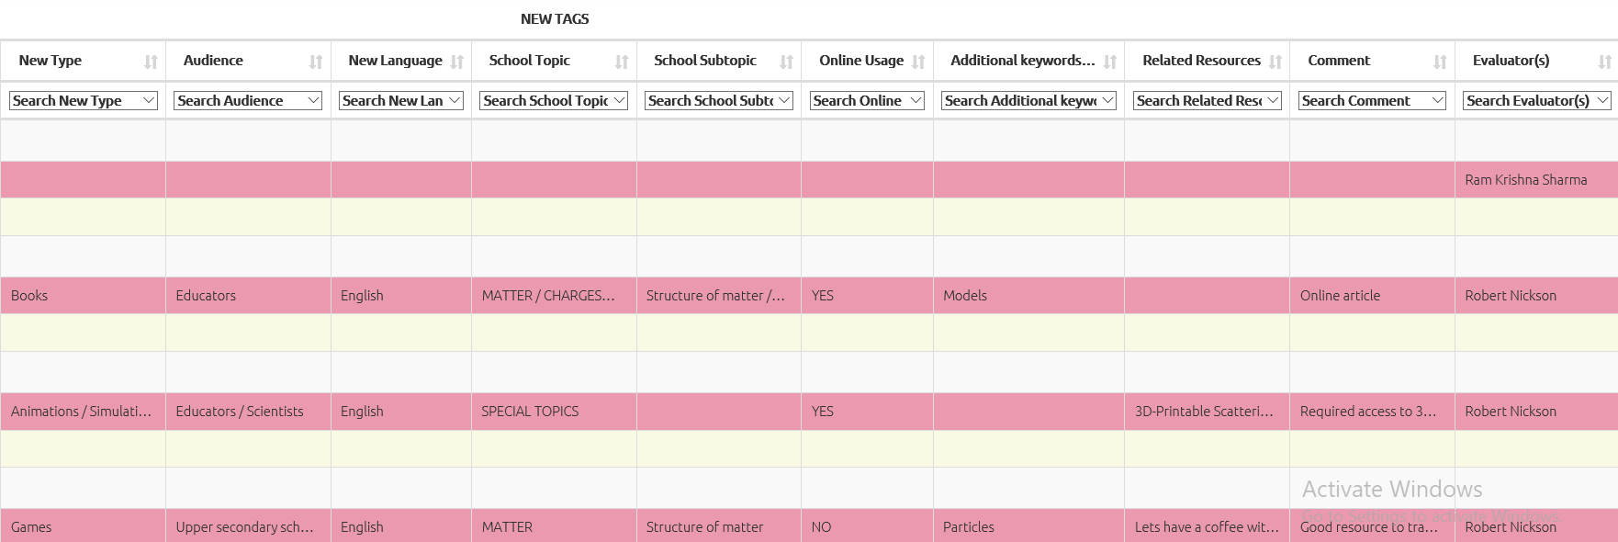
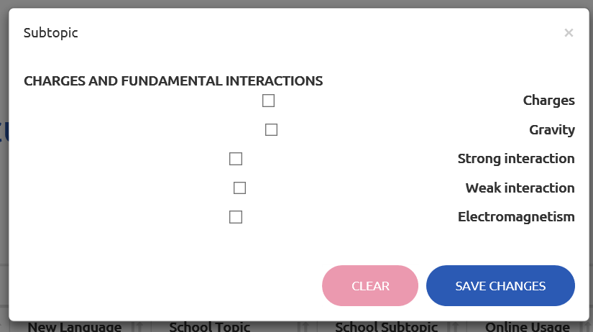
IPPOG RDB Curation tool
GREAT FUNCTIONALITIES
(impossible with google docs)
SECURITY: users sign in with their account and can edit only their entries
SECURITY: editable (only new tags) and non-editable fields
SEARCH & FILTERING : each tag / column can be filtered with chosen values
DROPDOWN MENUS with predefined lists
MULTIPLE CHOICE when entering values
CLEAR: red line - taken by somebody else; blue line - mine
UNDO / CLEAR OPTION
VIEW and EXPORT options
PLAN: TO BE USED (at least partly) to help populating new RDB…

Slide 20
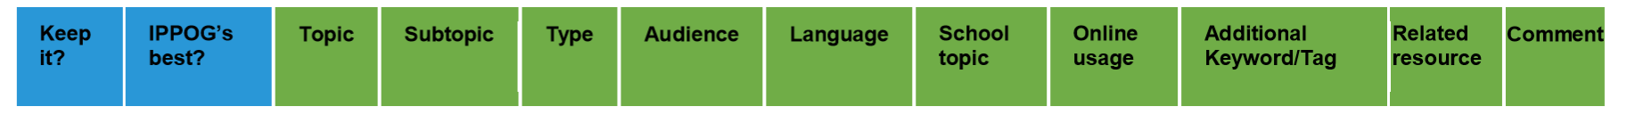
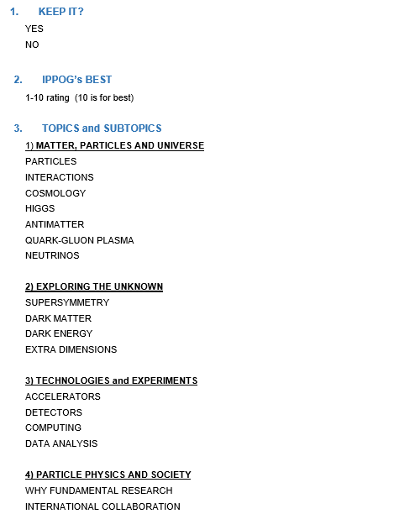
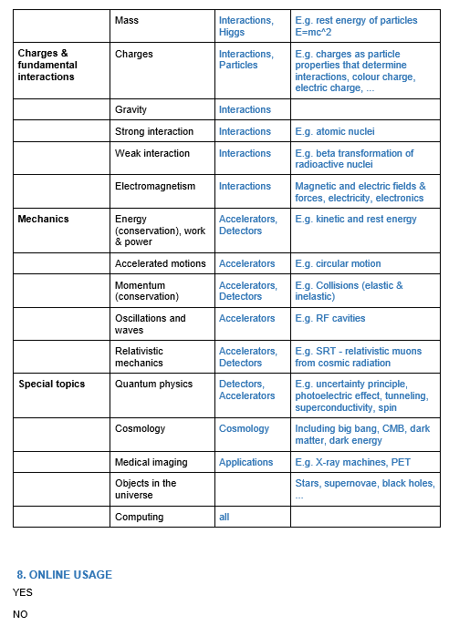
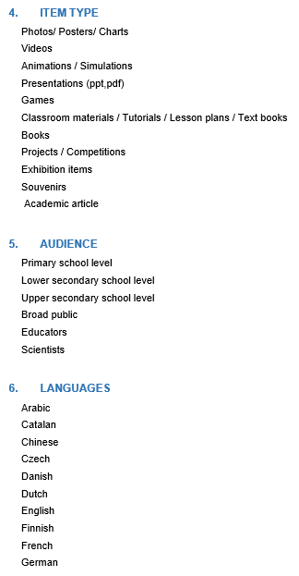
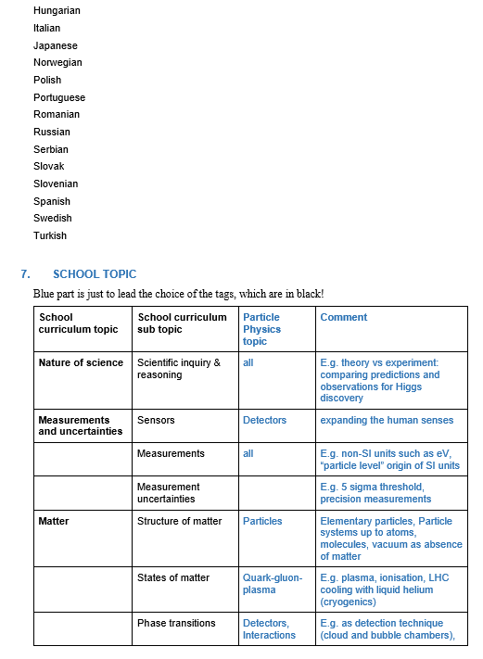
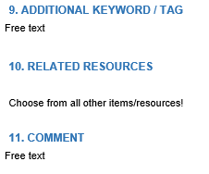
IPPOG Resource Database Curation
NEW
Link to school
physics curiculum

Slide 21
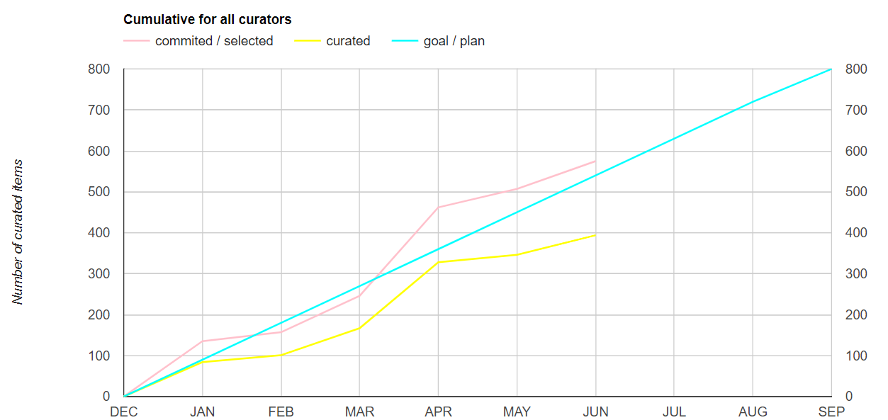
IPPOG RDB curation time evolution
575
394
Please, help and join the effort!

Slide 22

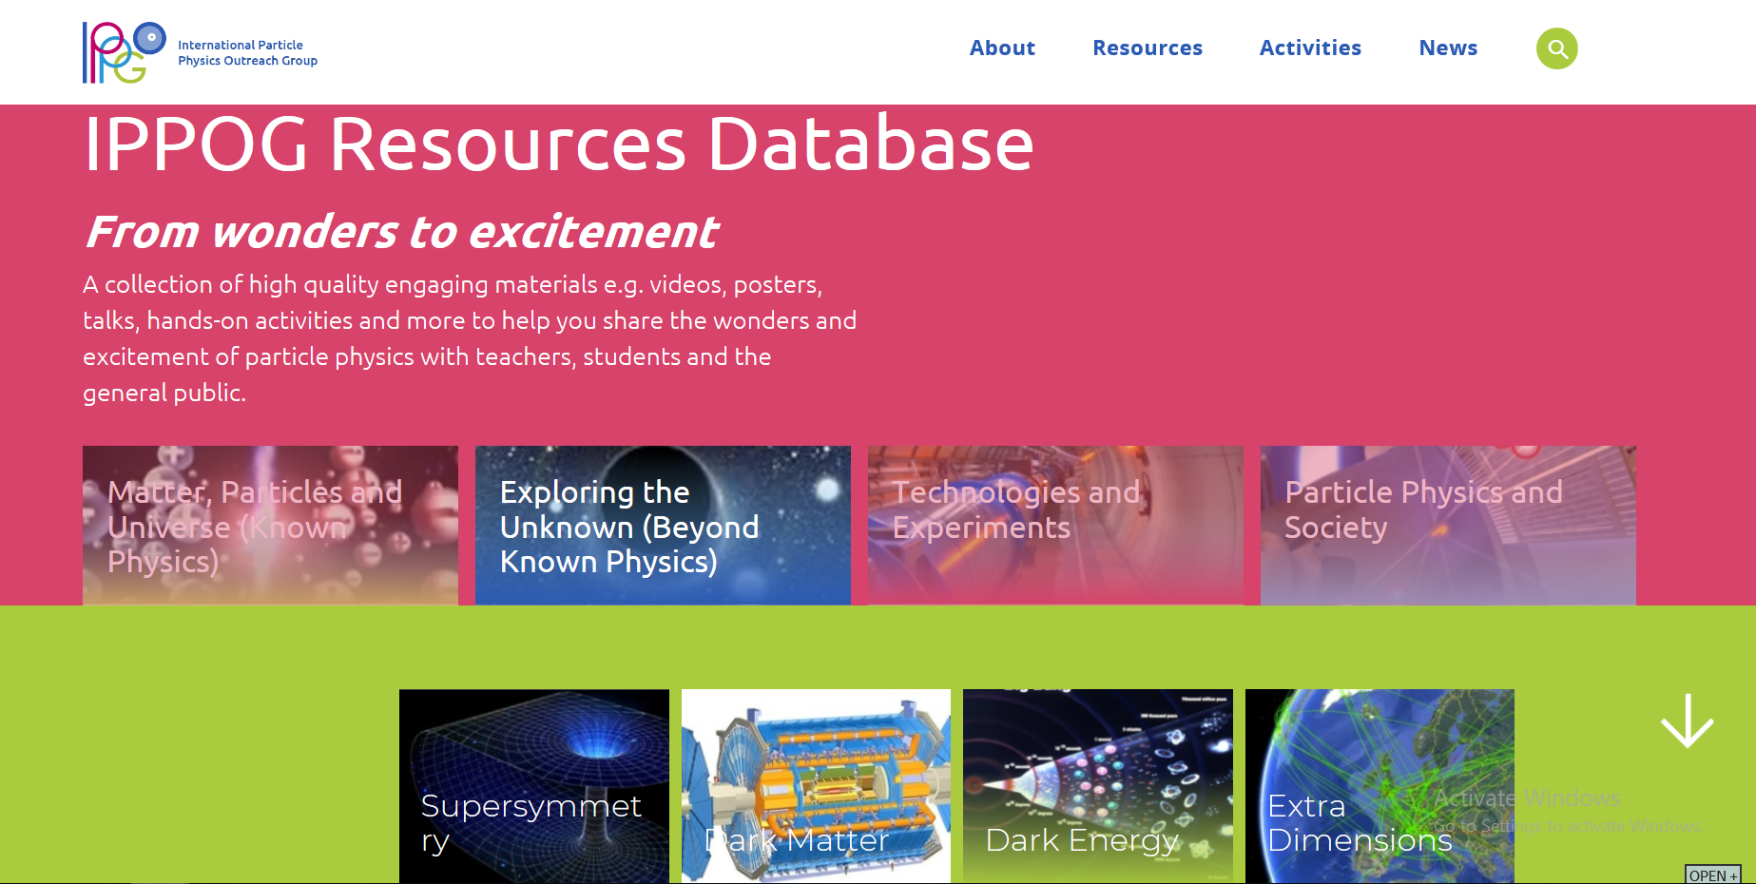
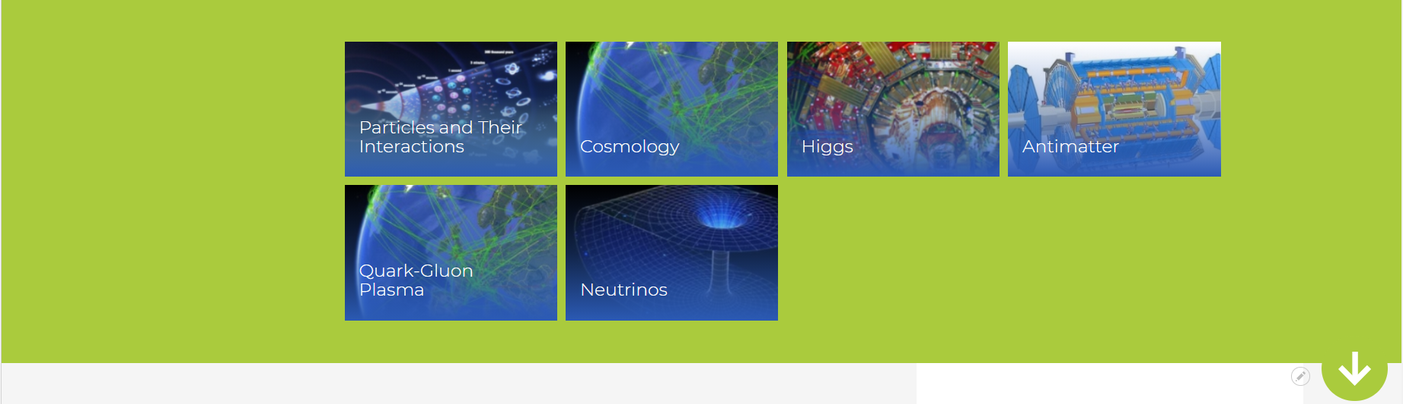
New IPPOG RDB website preview
https://test-ippog-d8-clean.web.cern.ch/
SEARCH:
1) Choose physics topic
(from picture)
2) Filter in search
engine
Hover on 1 from
4 main topics:
- Subtopics shown
- Random selection
changing at each refresh
shown below

Slide 23
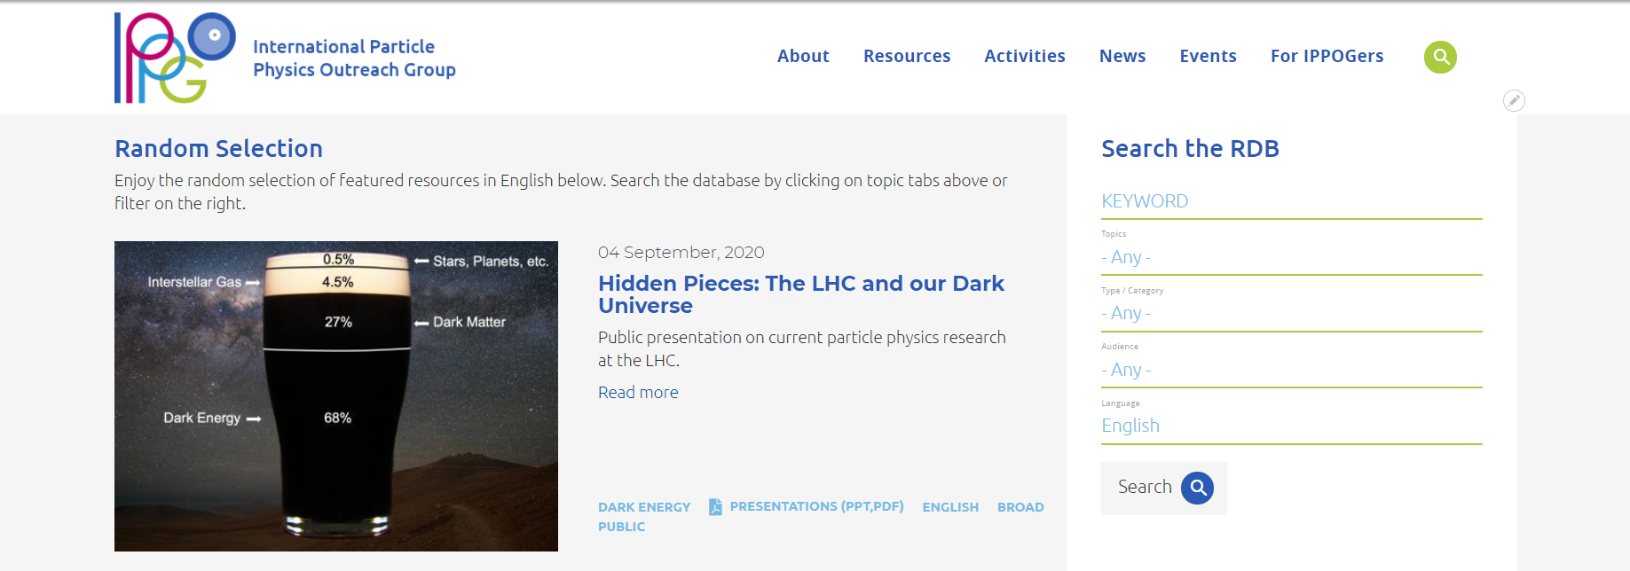
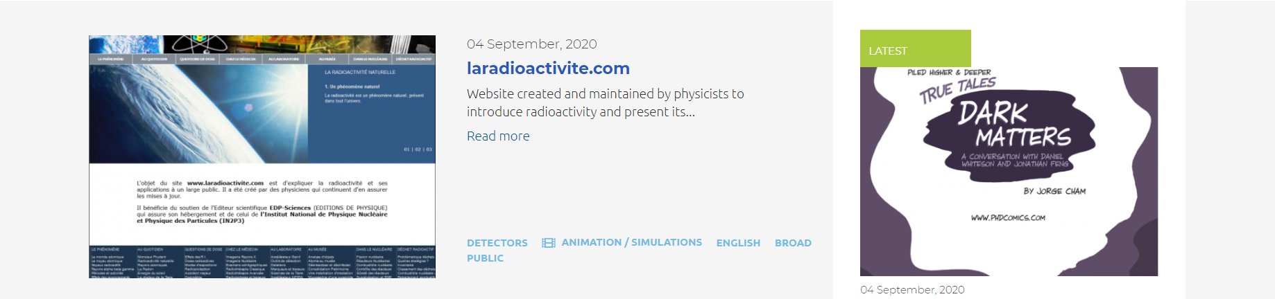
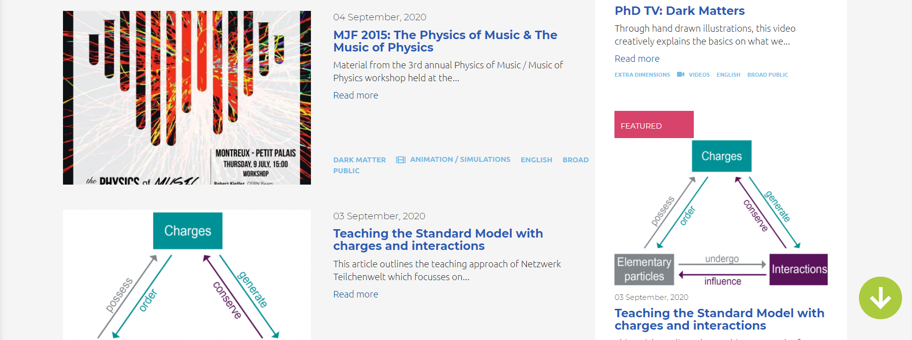
https://test-ippog-d8-clean.web.cern.ch/
SEARCH:
1) Choose physics topic
(from picture)
2) Filter in search
engine
Order of items according to rating
20th IPPOG meeting, 3 December 2020, online
23

Slide 24
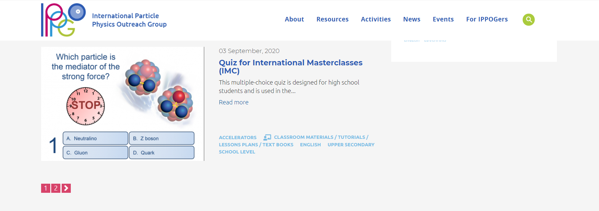
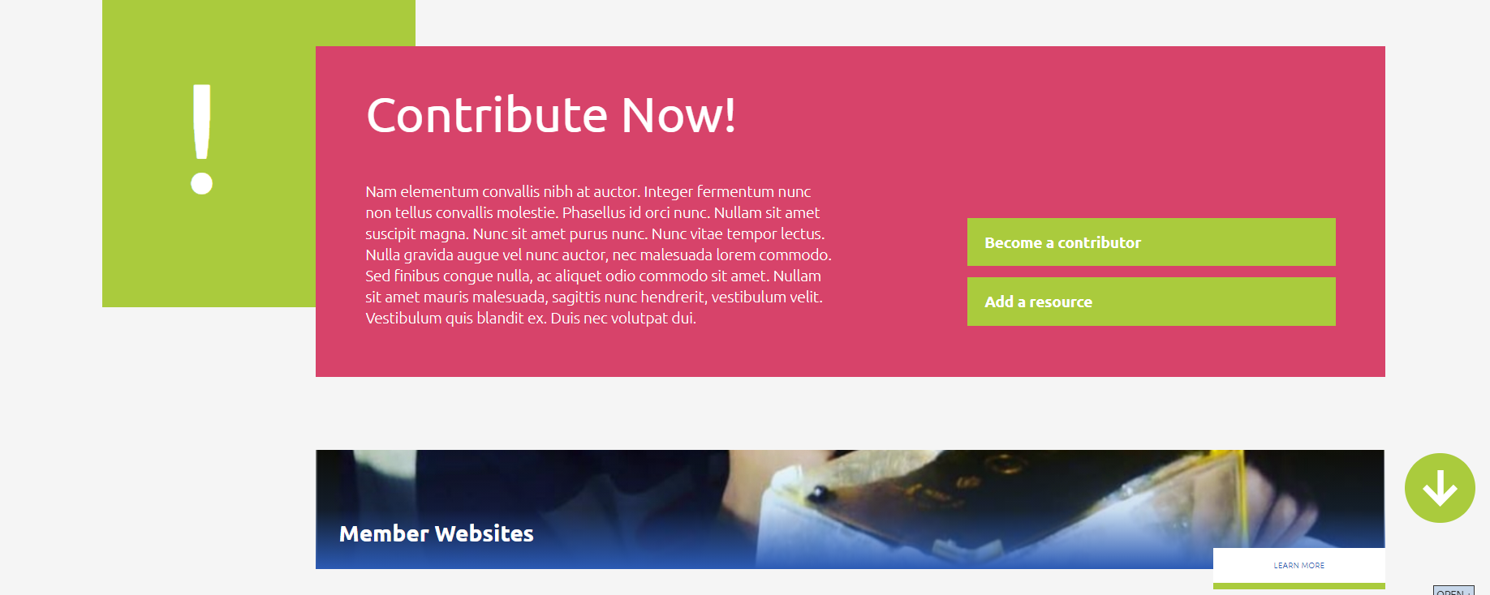
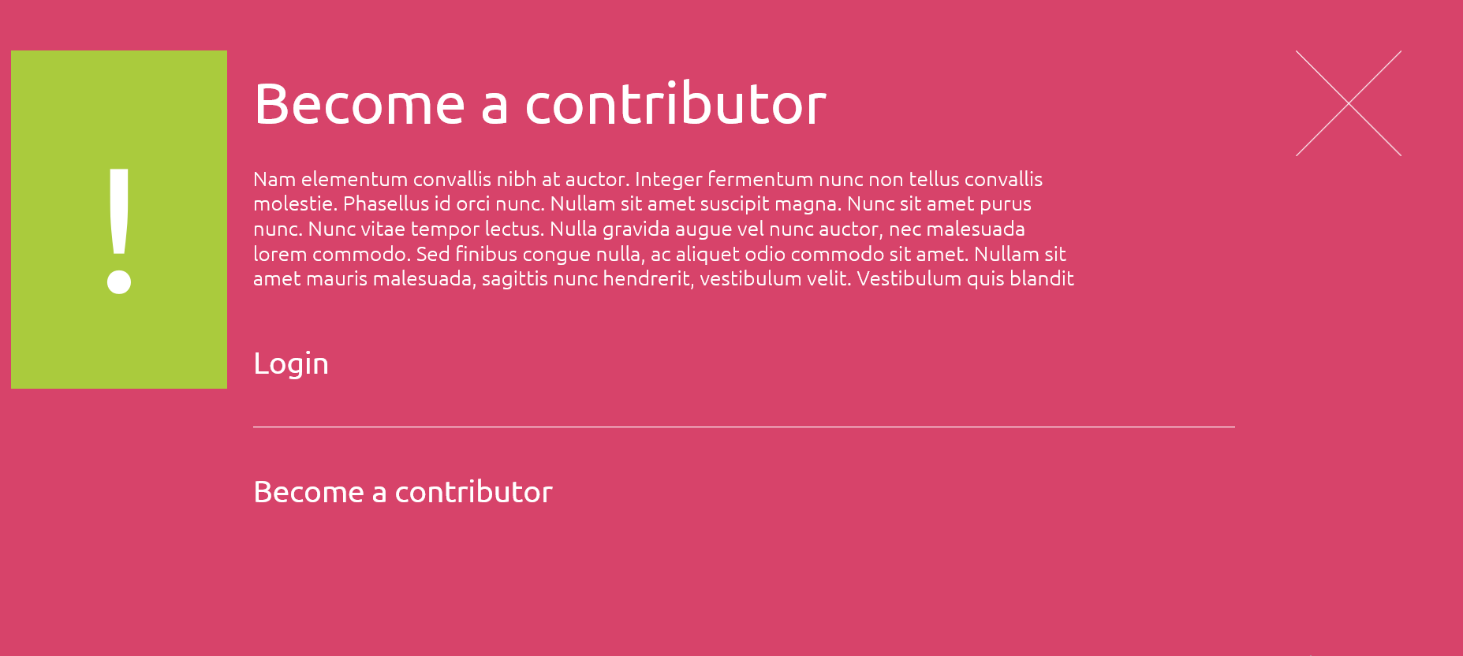
USER FRIENDLY
SUBMISSIONS:
- Clear instruction
- Form for contributors

Slide 25
IPPOG Resource Database Challenges
TECHNICAL
Dedicated submission form at CDS
Interface between CDS and Drupal (external company)
In-kind contribution from CERN
CONTENT
Curation of existing / “old” items
Collection of new / up-to-date best items
New content development

Slide 26
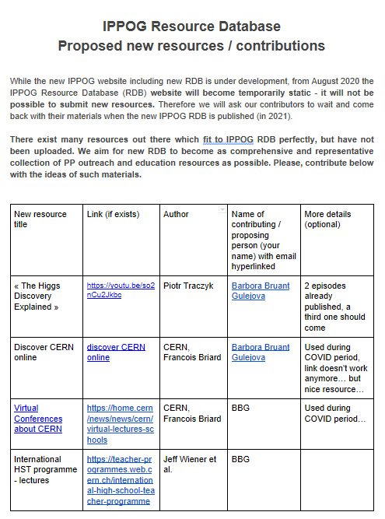
Collecting new resources for RDB
Collecting efforts since December 2020 (google doc )
New RDB Working Group (May 2021):
Complete
Wrap up
Evaluate
Assign new tags
- with help of dedicated
curation tool
RUIZ JIMENO, Alberto
SHARMAZANASHVILI, Alexander
STRANDBERG, Jonas
WOZNIAK, Krzysztof Wieslaw
WETZLER, Susan
WEGNER, Jeremy
KLAMMER, Joel
GLOVER, Marla
COYLE, Helen
PAOLUCCI, Pierluigi
KIRILOVA, Galina
KLEIN BOESING, Christian
BEARDEN, Ian Gardner
GAMEIRO MUNHOZ, Marcelo
GORISEK, Andrej
HADJIISKA, Roumyana Mileva
HATZIFOTIADOU, Despina
MELO, Ivan
PRICE, Darren
BARDEEN, Marge
ADAM BOURDARIOS, Claire
Open to join!
7 members also in
RDB curation group
Later we will create RDB standing committee

Slide 27
IPPOG Resource Database Challenges
TECHNICAL
Dedicated submission form at CDS
Interface between CDS and Drupal (external company)
In-Kind contribution from CERN
CONTENT
Curation of existing / “old” items
Collection of new / up-to-date best items
New content development

Slide 28

IPPOG New content under development
IPPOG Working Groups
Explaining PP to Lay audience
Outreach of Applications for Society
Analogies, images, examples, stories…
Stories with human touch
RDB main topic No 4
Tool for community to shape attitude and perception
of physics and fundamental research by decision makers,
funding bodies, media and public and even motivate young people to undertake physics studies.

Slide 29
TAKE PART!
STAY TUNED!!! New IPPOG websites coming up end 2021
BECOME RDB CONTRIBUTER! Submit resources (2022)
PROPOSE RDB ITEMS
JOIN CURATION GROUP and/or RDB WG!
Contact barbora.gulejova@cern.ch
NOW!

Slide 30
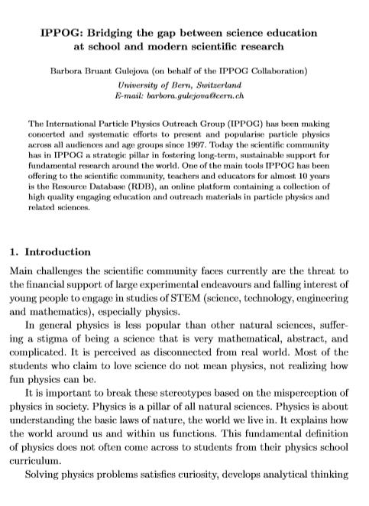
Learn more ….
IPPOG - Bridging the gap between science education at school and modern scientific research
Article submitted to World Scientific WSPC Gribov 90 (Pre-print available)
https://cds.cern.ch/record/2746338 and http://arxiv.org/abs/2011.14743
THANK YOU

