Slide 1




Current status of Pakistan’s Collaboration with CERN and opportunities
Zafar Yasin
Head ALICE-CERN Group, PINSTECH

Slide 2
OUTLINE
Introduction to CERN and Large Hadron Collider (LHC)
Pakistan ‘s Collaboration with CERN
PINSTECH ‘s Collaboration with CERN
Heavy Ion Collisions and ALICE (A Large Ion Collider Experiment ) Detector
Signatures of QGP
Particle yields and statistical model
TPC upgrade of ALICE
Contribution of PINSTECH for ALICE
Summary and Conclusions

Slide 3
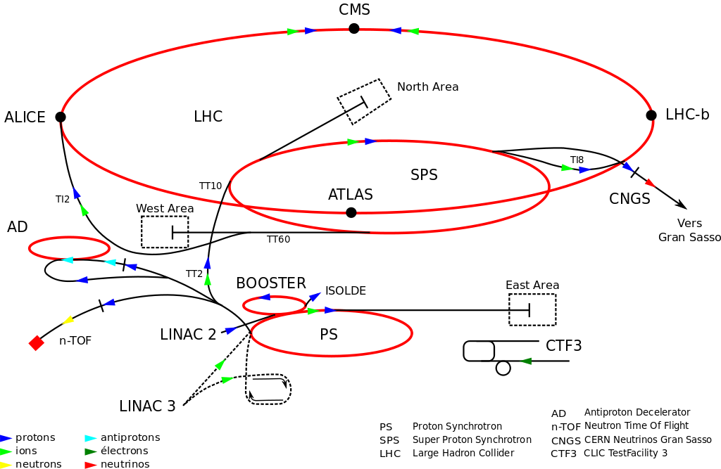
Brief Introduction to CERN
CERN houses the largest Accelerator Complex in the world
Location: suburbs of Geneva on the Franco-Swiss border
Established in 1954
Current Largest program: LHC (Large Hadron Collider)
Housed in a tunnel of 27 Km circumference, 100 m deep underground. Planning for 100 km
Two oppositely moving proton/lead beams collide
France
Four detectors CMS, ALICE, ATLAS and LHCb are located at different locations of the LHC

Slide 4
Brief Introduction to CERN (CERN Members)
France

Slide 5

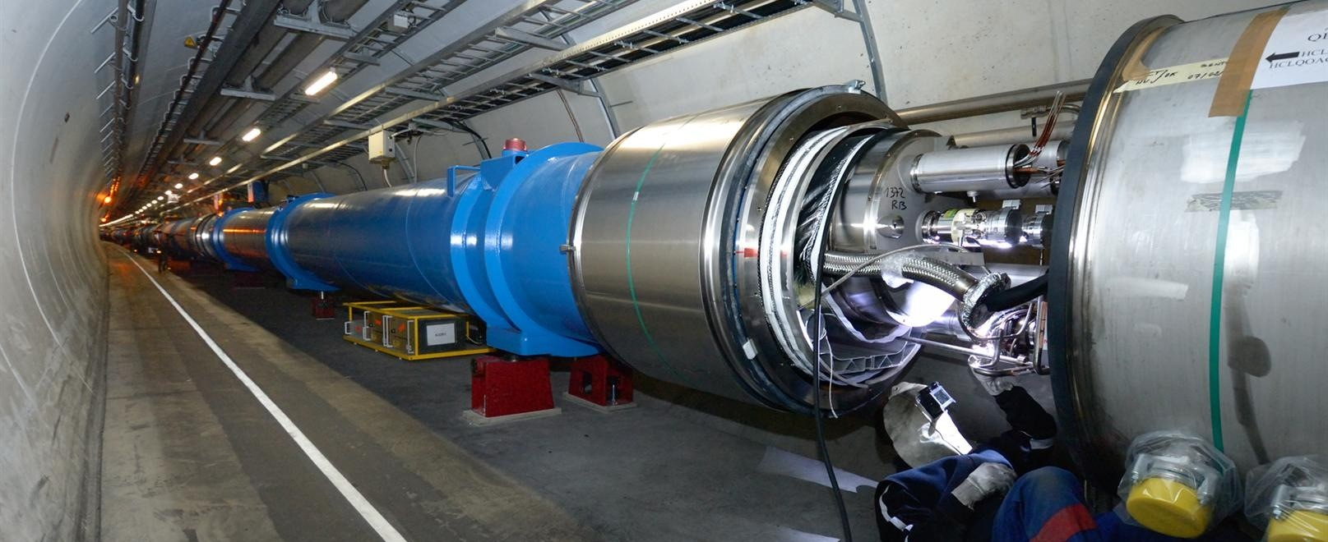
LHC is a very powerful machine: it produces pp, p-Pb and Pb-Pb but also γγ, γp and γPb collisions
Brief Introduction to CERN (LHC)

Slide 6


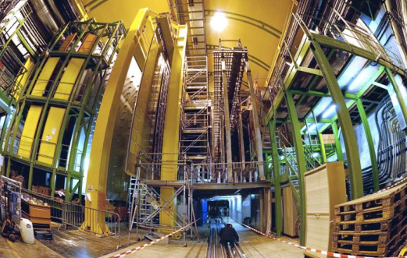
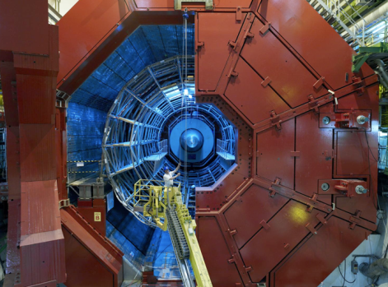


Enter a New Era in Fundamental Science
The Large Hadron Collider (LHC), one of the largest and truly global scientific projects ever, is the most exciting turning point in particle physics.
CMS
LHCb
Will address some of the most fundamental questions in modern physics
ALICE
LHC ring:
27 km circumference
ATLAS

Slide 7
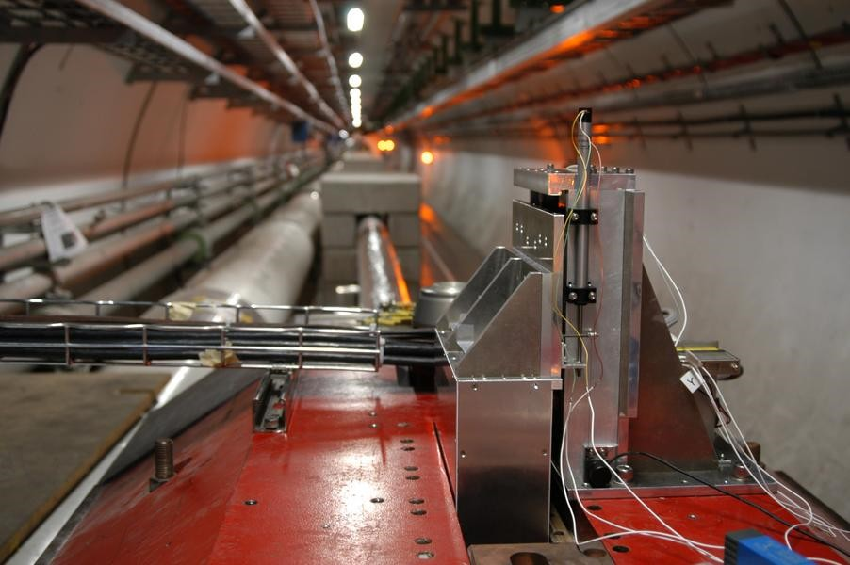
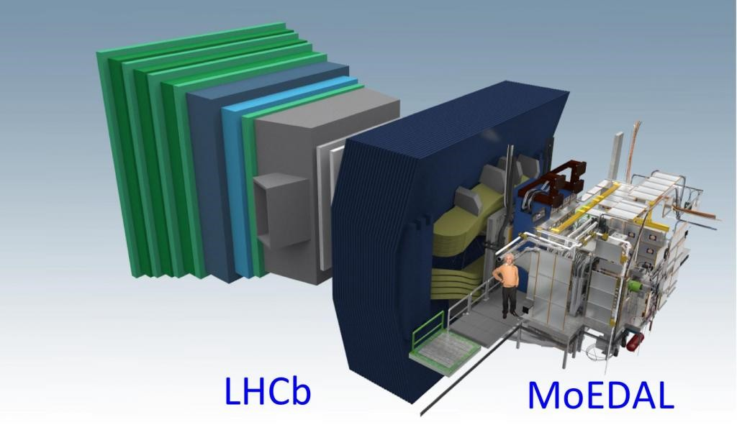
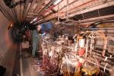
But also 3 smaller at LHC, more specialized ones:
LHCf
measurement of forward neutral particle production for cosmic ray research
MoEDAL
Monopole and Exotics Detector at the LHC
France
TOTEM
Total Cross Section, Elastic Scattering and
Diffraction Dissociation at the LHC

Slide 8
Proton Synchrotron (PS) and Super Proton Synchrotron (SPS) Experiments
Super Proton Synchrotron Experiments:
COMPASS: Common Muon and Proton Apparatus for Structure and Spectroscopy. For quark gluon interaction studies
NA61/SHINE: SPS heavy ion and neutrino Experiment. Studies of hadron collisions with fixed targets.
NA62: SPS based Kaon decay studies. Test for Standard Model.
UA9: Study of High energy beam control using crystals.
Proton Synchrotron Experiments:
CLOUD: Cosmic rays Leaving Outdoor Droplets. Cosmic rays assisted cloud formation.
DIRAC: The Dimeson Relativistic Atom Complex. Study of pionium atom decay for strong interactions
ISOLDE: Isotope Separator on line Detector. Radio active Nuclei beams. PS Booster. Atomic and Nuclear Physics, Life sciences, Astro-physics. About 90 experiments underway.
nTOF: neutron time of flight experiments. Beam from few MeV to GeV.
France

Slide 9



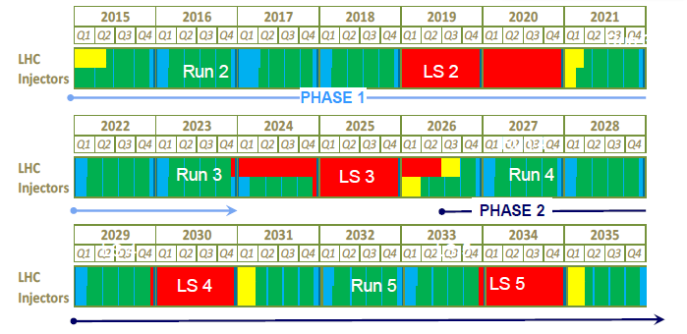






LHC Schedule
PHASE I Upgrade
ALICE (51 + 8 M€), LHCb major upgrade ATLAS, CMS‚ “minor“ upgrade
LHC “minor“ upgrade
Heavy Ion Luminosity from 10²⁷ to 7 x10²⁷
PHASE II Upgrade
A¹T^{/1}L¹A^{/2}S⁰¹,⁶CMS major upgrade
HL-­‐LHC, pp from 10³⁴ (peak) to 5x10³⁴ (levelled)

Slide 10
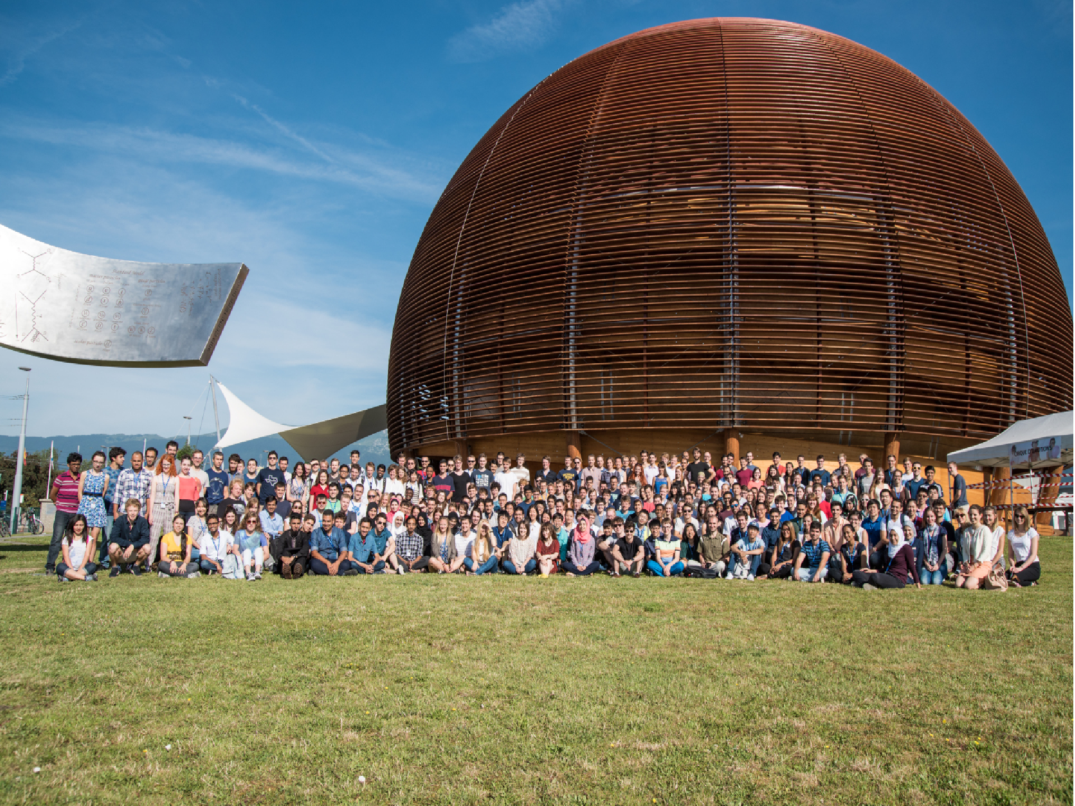
OPPORTUNITIES FOR STUDENTS AND RESEARCHERS
SUMMER STUDENTS PROGRAMME
TECHNICAL STUDENTS PROGRAMME
DOCTORAL STUDENTS PROGRAMME
PROJECT ASSOCIATES PROGRAMME
TEACHERS TRAINING
FELLOWSHIP PROGRAMME (JUNIOR/SENIOR)
(2 – 3 MONTHS)
(4 – 12 MONTHS)
(6 – 36 MONTHS)
(12 – 36 MONTHS)
(2 – 3 WEEKS)
(6 – 36 MONTHS)
FELLOWSHIP PROGRAMME (POST-DOC)
STAFF POSITIONS PROGRAMME
(6 – 36 MONTHS)
(5 YEARS)
CERN does not grant academic titles, agreement with Universities mandatory: 1 University supervisor + 1 CERN supervisor Excellent opportunity to start/develop collaboration

Slide 11
Summary of various HRD programs offered by CERN
Description | Remarks
Students programs i. Doctoral, Technical, Administrative (PhD thesis work, Bachelor or Master project) ii. Summer (undergraduates) iii. Short Term Internship (undergraduates) iv. Accelerator Schools (Introductory & Adv) | i. 6 months to 03 years (~ 290 positions/ year) ii. 8 to 13 weeks (~200 positions/year) iii. 1 to 6 months iv. 02 weeks
Fellowships (Junior, Senior) For graduates of applied sciences, computing and engineering. Senior is awarded to PhD or equivalent. Junior is BSc or MSc graduates. | 1/2 to 3 years (for job experience) ~200 positions/year Junior: Less than 4 yrs experience Senior: Less than 10 yrs experience
Associates/Users (for employees) i. Scientific ii. Corresponding iii. Project | i. upto 01 year, senior scientists ii. upto 06 months, Senior scientists / teachers iii. upto 03 yrs
Teachers Training National, High School, Intn’l Teacher Weeks | For School/college teachers 2 to 3 weeks
Technician Training | 1 to 3 years (~30-50 positions/year)
Staff Positions | 5 years (~ 150 positions/year)

Slide 12
Pre-Selection of Students for CERN
CERN advertises student programs on its website
The site can be accessed by typing careers at CERN on web
Students apply for a particular program online to CERN
CERN sends data of all applicants from Pakistan to CERN Sectt.
CERN Sectt. pre-select/shortlist (normally 10%)
CERN sends the pre-selected students to relevant department at CERN for final selection.
Funding is provided to the selected students by CERN out of annual contribution of Pakistan (CHF 1.5-1.8 M; arranged by PAEC)

Slide 13
Pak-CERN Collaboration

Slide 14
Pak-CERN Collaboration
1994 - cooperation agreement signed
2003 - Pakistan became member of CMS through NCP
2006 - President of Pakistan pledged 5 M CHF
2012 - LHC consolidation Protocol signed
2012 - Pakistan joined ALICE collaboration through COMSATS
2013 - Pakistan Applied for CERN Associate Membership (AM)
2014 - CERN Task Force visited Pakistan to assess and evaluate the AM
2014 - On Dec. 19 DG CERN and Chairman PAEC signed agreement for AM in the presence of the Prime Minister of Pakistan
2015 - On July 31, 2015 Pakistan was granted the Associate Membership of CERN
2016 - Framework Collaboration agreement signed for integration of any future activities in a new legal structure
2017- PINSTECH became associate member of ALICE experiment
2020 - PINSTECH became full member of MEDICIS Experiment

Slide 15
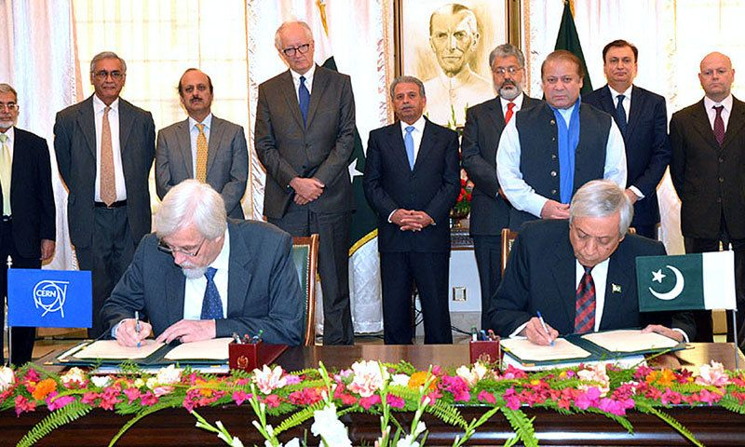
Associate membership of CERN
Ex-DG CERN
(Rolf-Dieter Heuer)
Ex-Chairman PAEC (Dr. Ansar Prevaiz)
Signing on associate membership

Slide 16
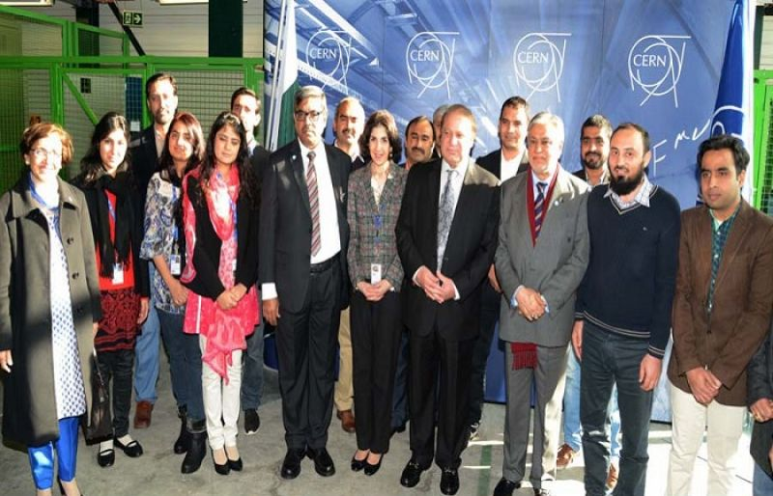
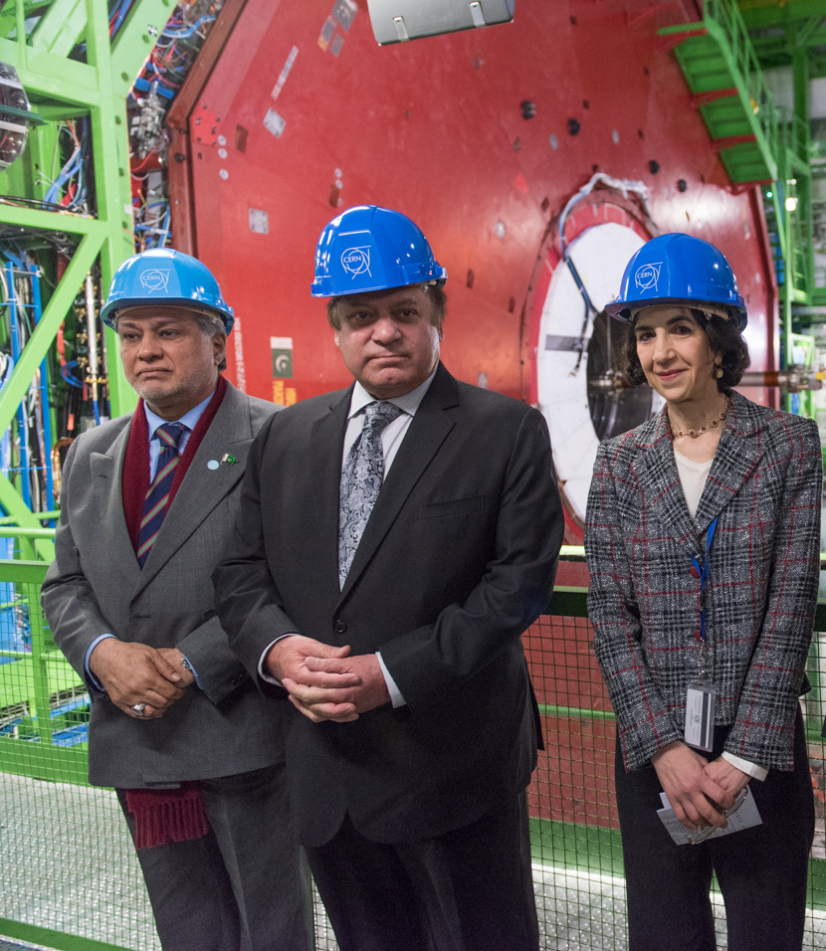
Visit of Prime Minister of Pakistan at CERN

Slide 17
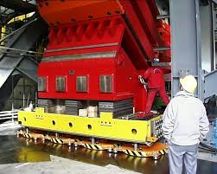
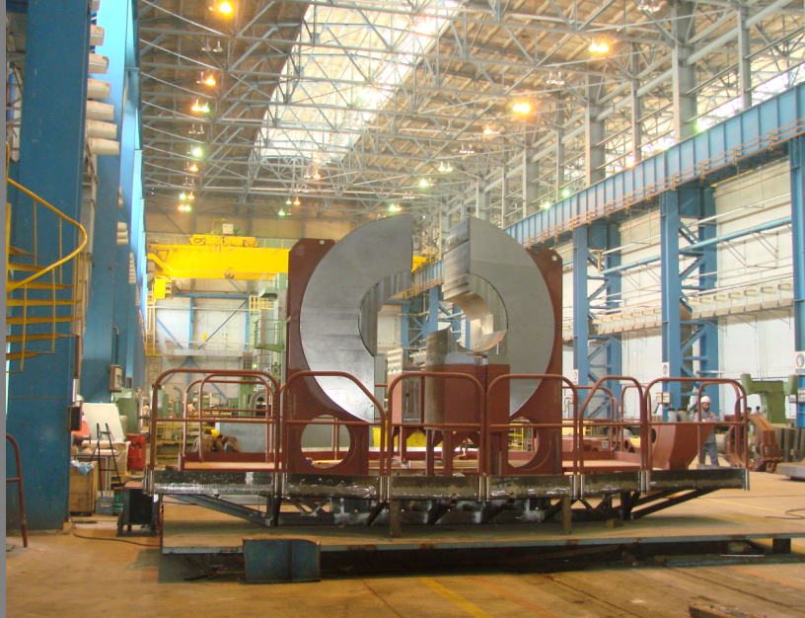
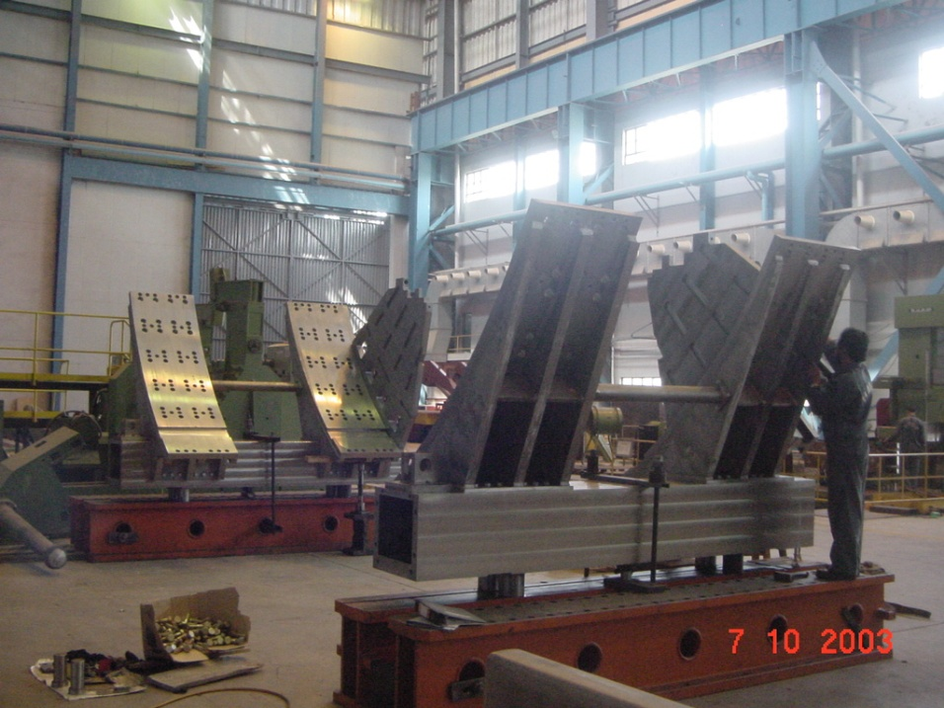
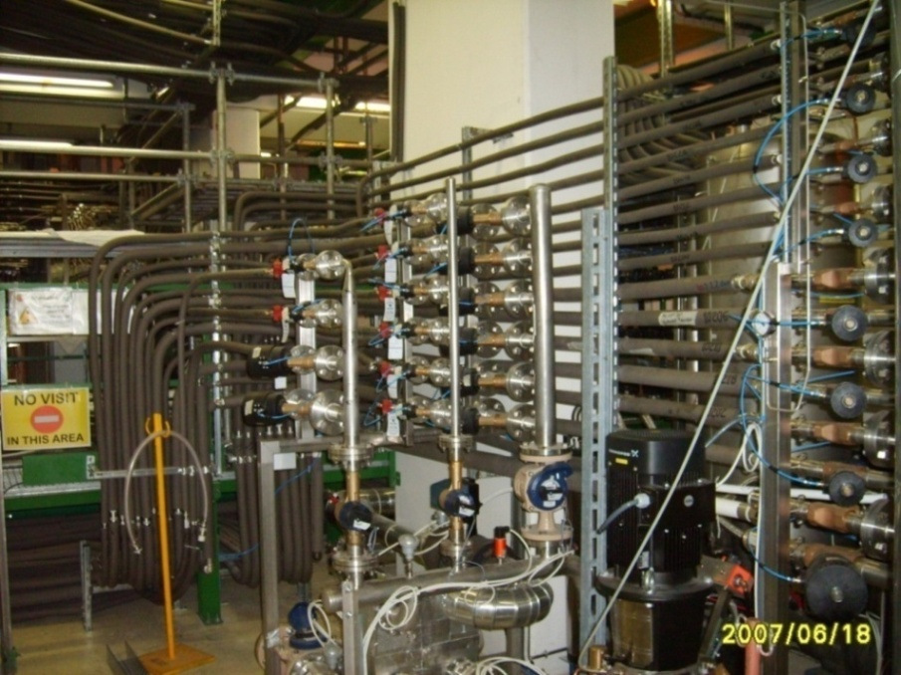
Projects for CERN - Mechanical
CMS Magnet Feet
Shielding for CMS Detector
Barrel Saddle Support for ATLAS
Piping work for ALICE

Slide 18
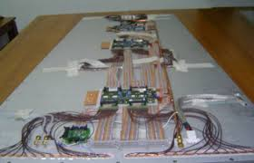
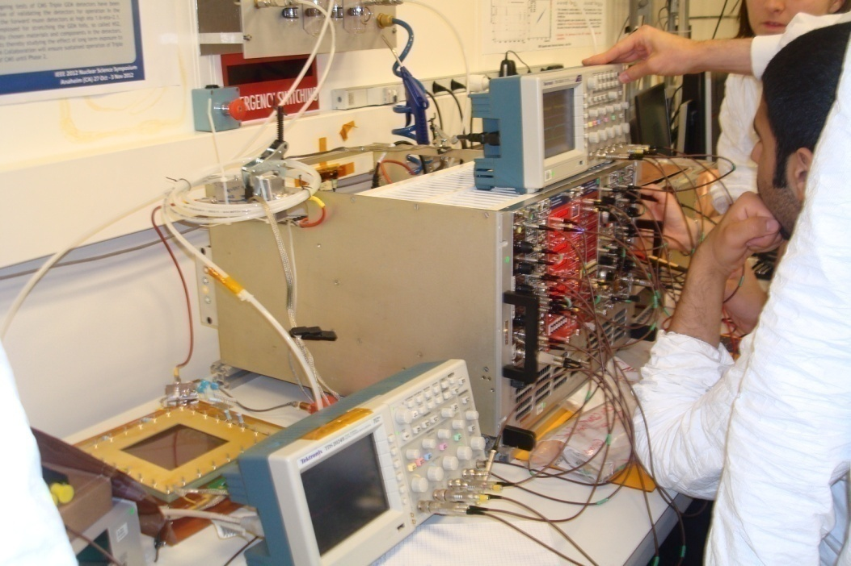
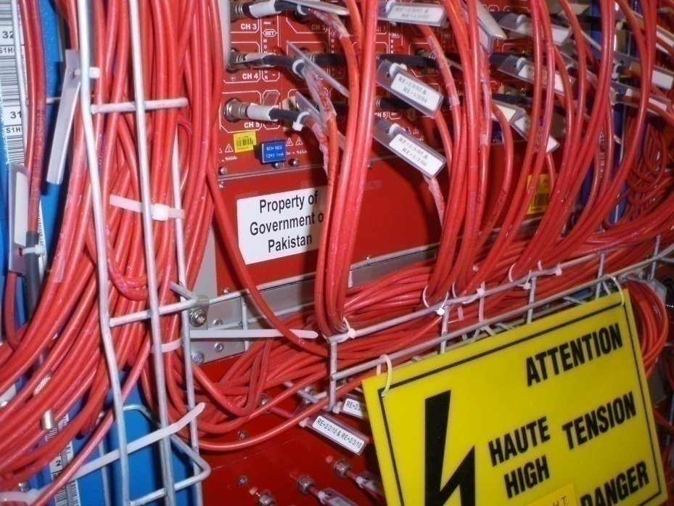
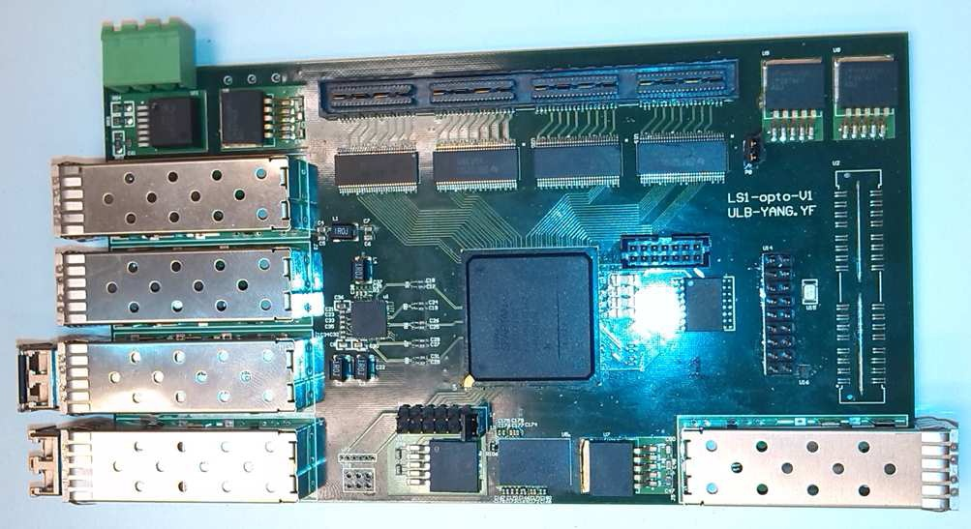
Projects for CERN – Radiation Detection
Resistive Plate Chamber(RPC)
Gas Electron Multiplier (GEM)
opto-hybrid Board for GEM
Front End Electronics for RPC
18

Slide 19
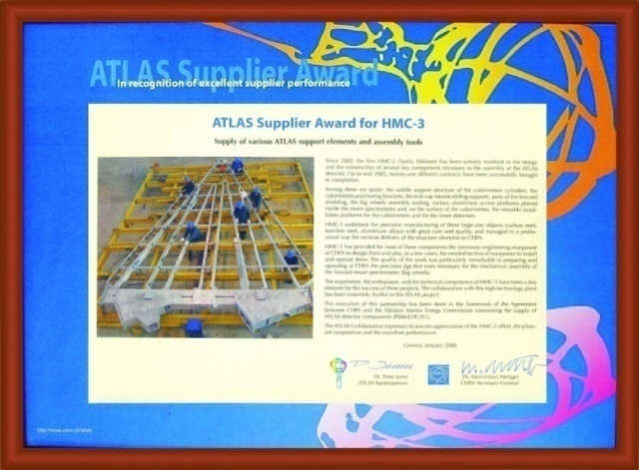
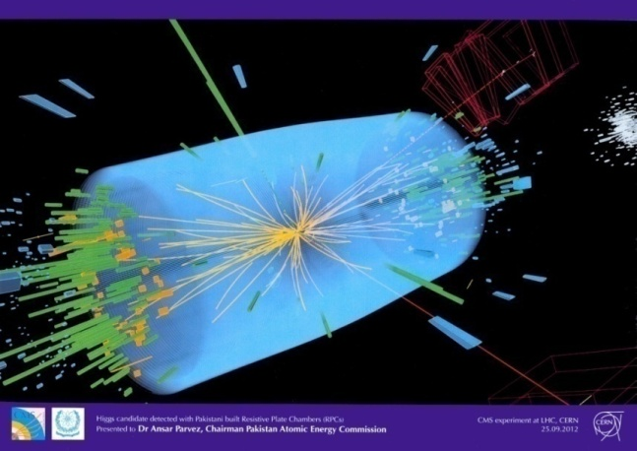
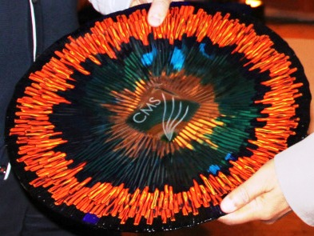
Awards Conferred to PAEC
ATLAS Award :
Best Industrial Partner-2006
CMS Shield for Higgs Boson - 2012
CMS Crystal Award - 2014

Slide 20
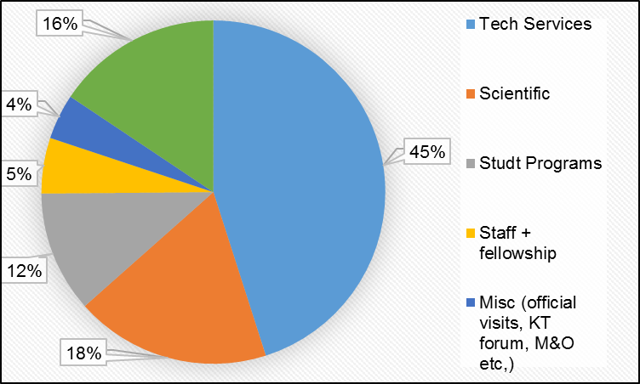
  Education, Training and Outreach
Based on 05 years averaged data, various activities have been organized and are as follows.
Following is observed:
Major share goes to technical services i.e. 45%
Scientific activities are only 18%
Share of commercial contracts is 16%

Slide 21
Management Structure for PAK-CERN Collaboration
GoP has assigned the responsibility of dealing with CERN to PAEC after Pakistan attained Associate Membership and Chairman PAEC is the designated authority to oversee all CERN related matters in Pakistan.
Member (Science), PAEC is the focal person on all CERN related matters. CERN Secretariat has been working under Member (Science) - Jan. 2013.
Member (Science) is supported by Director CERN SESAME Collaborations (CSC).
Director CSC is the contact person for all to and fro communications with CERN as well as within the country.
Director CSC circulates / advertises the vacancy/post generated at CERN and seeks applications from across the country.
CERN sends all applications received directly from Pakistan for Staff positions/training/ association ship etc. to Director CSC who conveys the recommendation to CERN after approval of the Chairman PAEC.
ILO (CERN) appointed; actively pursuing commercial contracts.

Slide 22
CERN-SECTERIAT for PAK-CERN collaboration
Dr. Sohail Ahmad Janjua (sajanjua61@gmail.com), Director CERN Collaboration
Dr. Zafar Yasin (zyasin@cern.ch)
CERN Secretariat Address:
HQrs Pakistan Atomic Energy Commission (PAEC)
P. O. Box 1114
Islamabad
Tel #:+92-51-9246154, Mobile #: +92-333-5184472
Fax : 051-9246150

Slide 23
PINSTECH-CERN Collaboration

Slide 24
PINSTECH-Collaboration with CERN
PINSTECH is collaborating with CERN in three main areas:
ALICE (A Large Ion Collider Experiment), PINSTECH is an Associate Member of ALICE
MEDICIS (Medical Isotopes Collected from ISOLDE), PINSTECH is member of ISOLDE
Accelerator Technology, many scientists and engineers got training from CERN

Slide 25
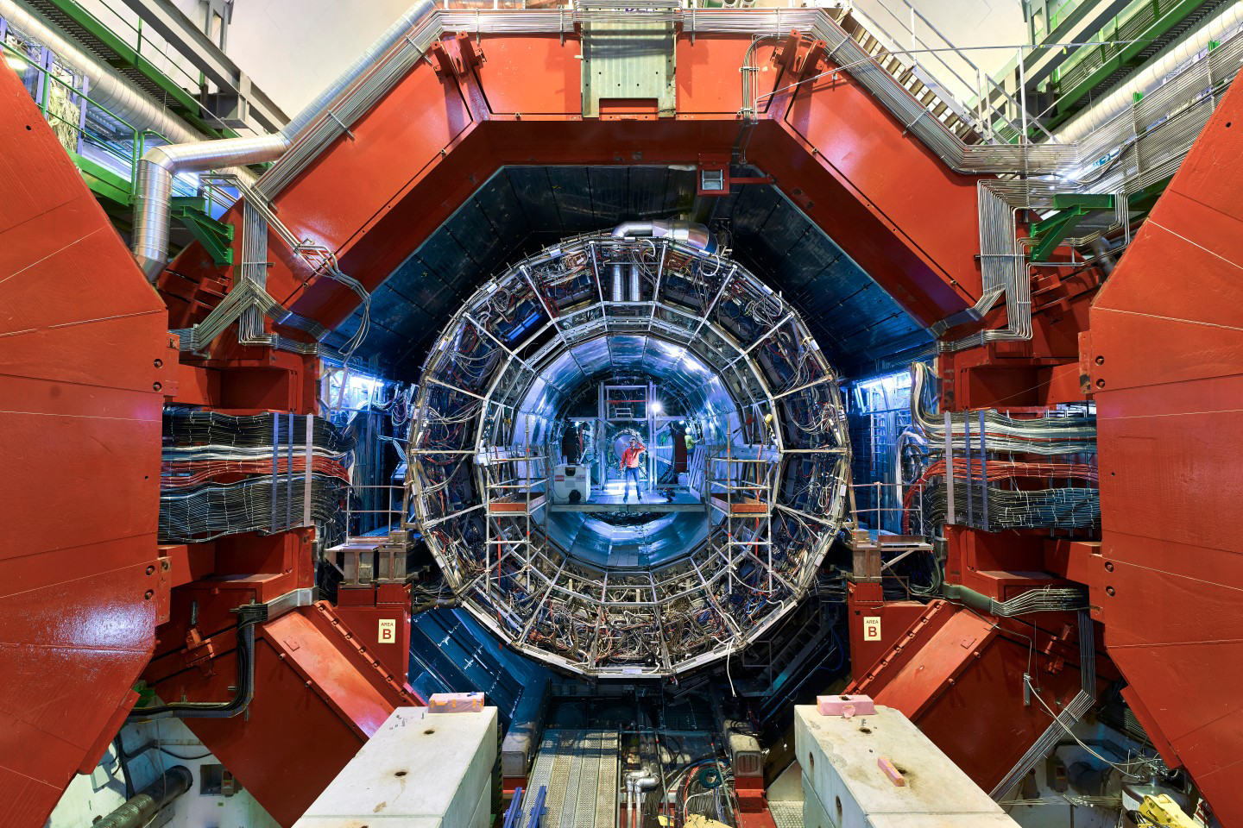
A Large Ion Collider Experiment (ALICE)
The ALICE collaboration uses the 10,000-tonne ALICE detector – 26 m long, 16 m high, and 16 m wide.
A heavy ion detector (Pb-Pb, p-Pb, A-A)
It is designed to recreate conditions similar to those some 10⁻⁶ seconds after the big bang
Enabling us to learn about the evolution of the very early universe
ALICE (A Large Ion Collider Experiment) is a dedicated experiment to study the Quarak Gluon Plasma (QGP) prodcued as a result of Pb-Pb collisions at the LHC

Slide 26
History of the Universe

Slide 27
History of the Universe

Slide 28
What is Quark-Gluon Plasma

Slide 29
Evolution of the Heavy ion collision
Cross over=mixed phase

Slide 30
Evolution of the Heavy ion collision
From Lokesh Kumar
At the end we will calculate these tepms.

Slide 31
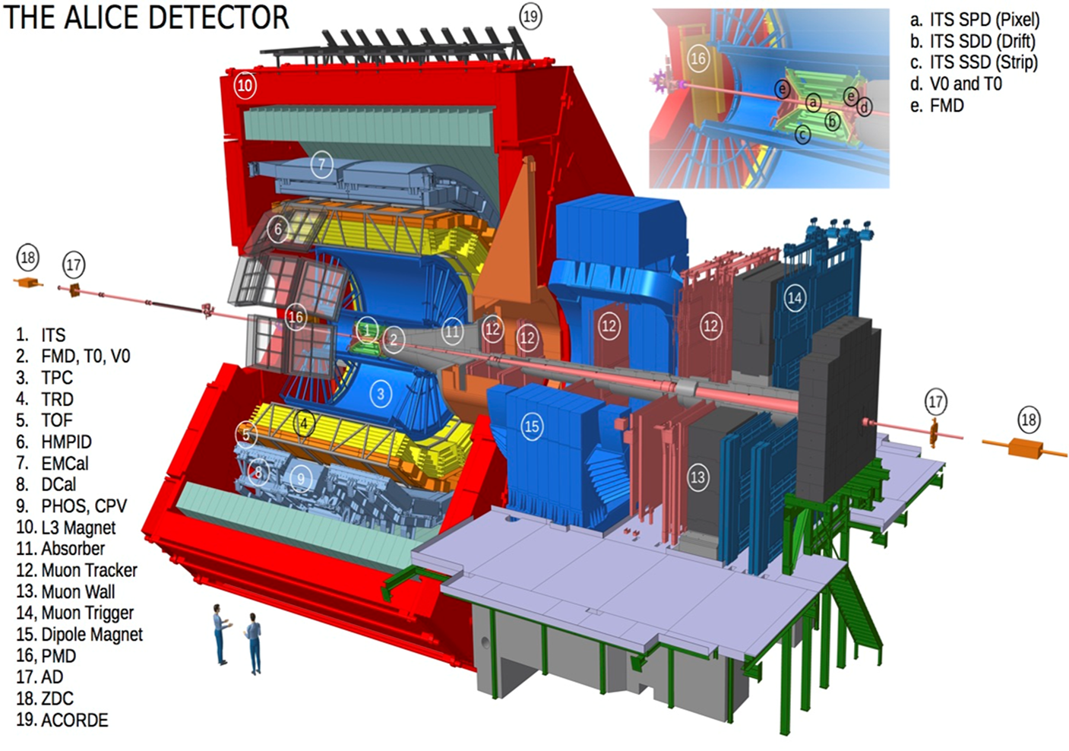
ALICE DETECTOR
How to achieve state of matter after the Big Bang in laboratory, via colliding heavy ions in accelerators and using a dedicated detector for heavy ions
Purpose of ALICE detector is to study the QGP (considered to be a state of matter after the big bang) and nature of strong force.
ALICE is a collaboration of around 2000 people from around 172 institues of 45 countires.
PINSTECH became associate member of ALICE in September, 2017
PAEC was playing a major role in engineering but not much in physics
ALICE (A Large Ion Collider Experiment) is a dedicated experiment to study the Quarak Gluon Plasma (QGP) prodcued as a result of Pb-Pb collisions at the LHC

Slide 32
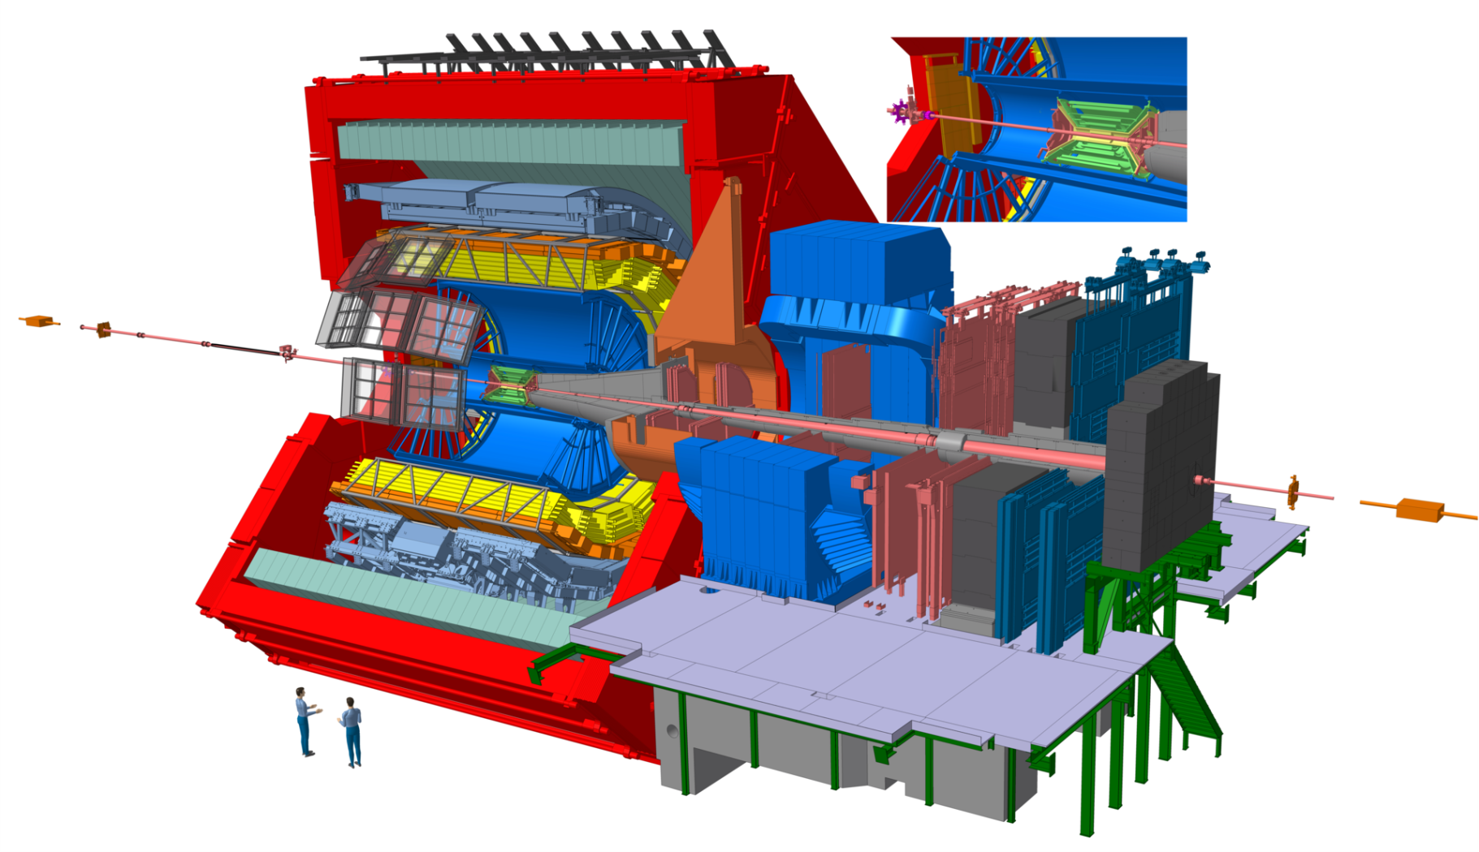
ALICE detector setup
Inner Tracking System (ITS)
  Vertexing
  Tracking
Time-of-Flight (TOF)
  Particle identification
Time Projection Chamber (TPC)
  Tracking
  Vertexing
  Particle identification via dE/dx
V0
  Centrality determination
  Minimum-bias trigger
Transition Radiation Detector (TRD)
  Tracking
Transition radiation (TR) is a form of electromagnetic radiation emitted when a charged particle passes through inhomogeneous media.

Slide 33
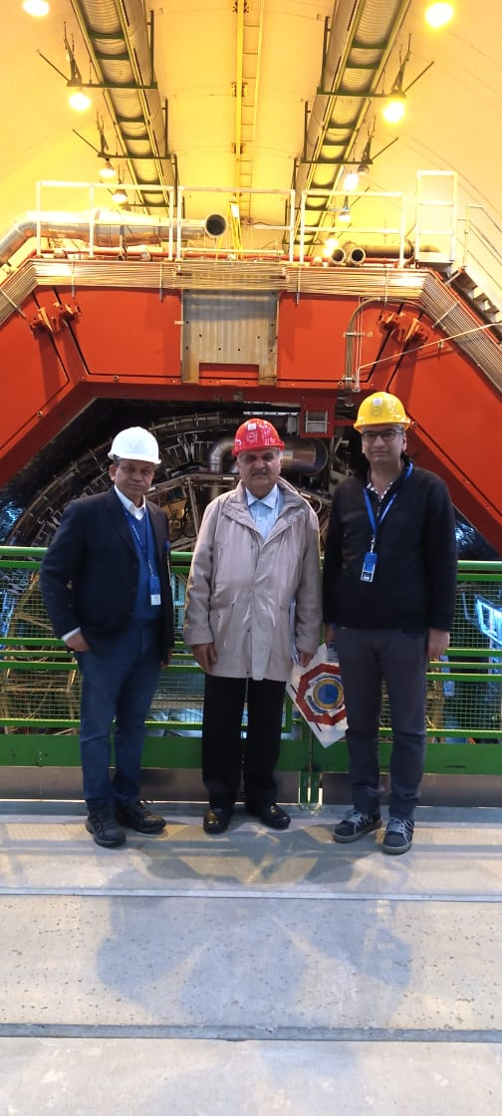
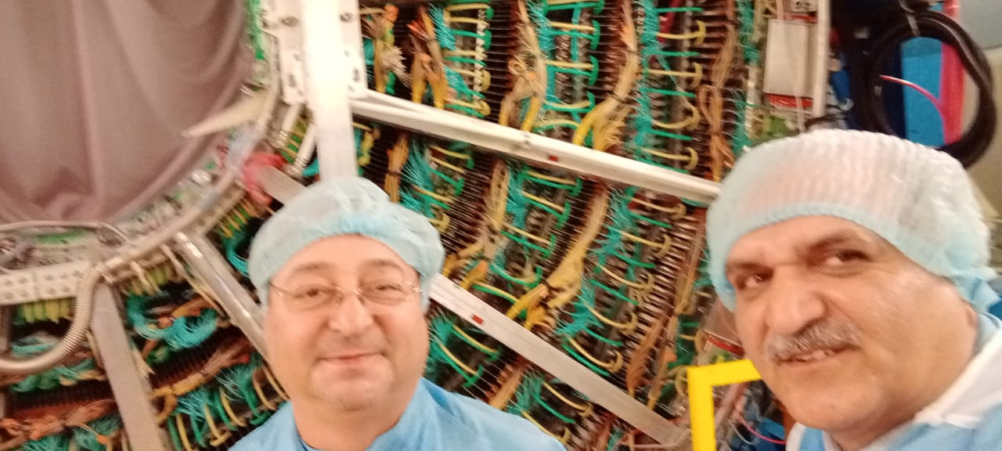
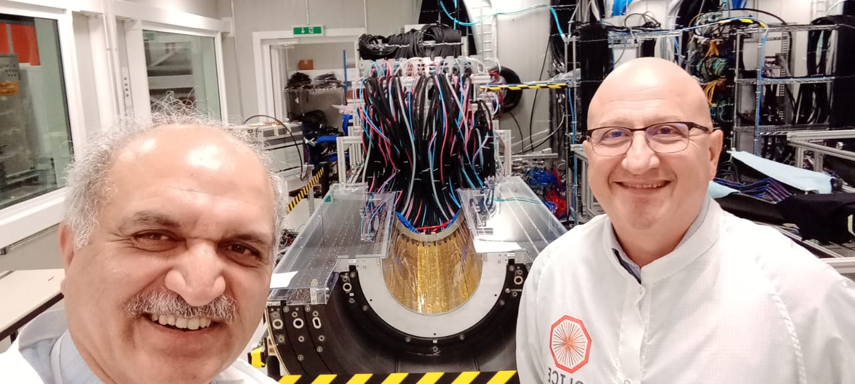
DG PINSTECH visit ALICE detector, GEM and Si detector labs

Slide 34
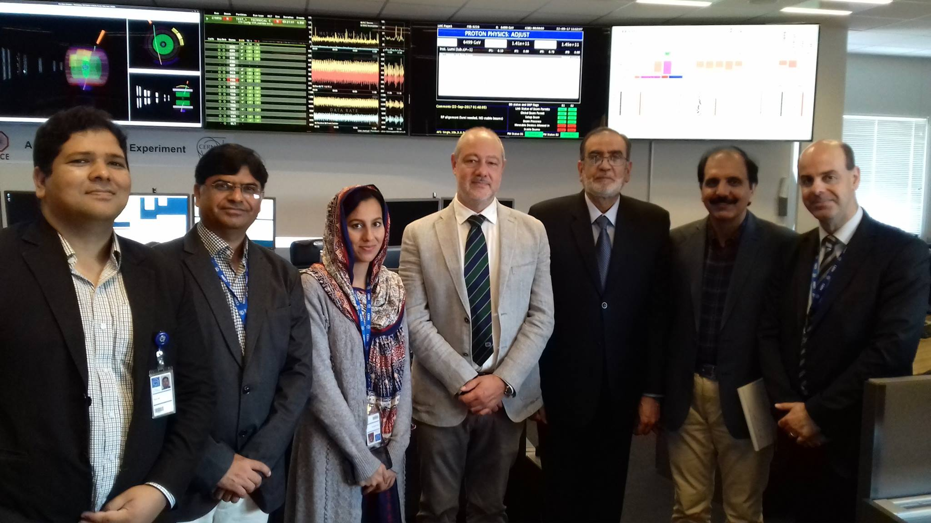
ALICE control room, Chairman PAEC visit

Slide 35
PINSTECH Involvement in ALICE
PINSTECH is involved in physics analysis with data from the ALICE experiment, in the TPC upgrade of the ALICE for run3 and also in O2 (Offline-Online) software for TPC upgrade.
In Physics analysis:
1. Absorption study of (anti-)deuteron and (anti-)helium in detector material of ALICE
Alexander P. Kalweit, M. Puccico, Zafar Yasin
2. Pi, K, p production in Xe-Xe collision at 5.44TeV
Sadia Marium, Nicolo Jacazio, Ivan Rawasenga
3. Study of (anti-)triton in p-p, p-Pb and Pb-Pb collisions at 5.02 TeV.
Zafar Yasin, Sohaib Hassan, Maria Gul, A.P. Kalweit
4. To study the behavior of (anti-)deuteron production vs Rt with ALICE data
Uzair Aslam, Zafar Yasin
5. Study of (anti-)deuteron production in pp collisions at 13 TeV with HM trigger using ALICE data
Bilal Javed, Zafar Yasin
In detector upgrade:
4. Assembly, testing and installation of gem detectors for TPC upgrade
Sohaib Hassan, Maria Gul, Chilo Garabatos Cuadrado, Anastasia Berdnikova
5. Simulation studies for secondary discharges in GEM detectors
Sohaib Hassan, Chilo Garabatos Cuadrado, Anastasia Berdnikova

Slide 36
Signatures of QGP
It is not possible to measure directly QGP (too small and short lived), only final state hadrons produced after the QGP has cooled down and the particles produced at the early stages of the collisions that escape the system are measured to deduce the initial information of QGP.
The investigation of the creation of the QGP and the study of its properties is thus relying on appropriate experimental observables (so-called “signatures”) and their comparison to models.
Signatures of QGP
Nuclear modification factor
Particle yields and statistical model
Collective flow and hydrodynamics (Will only touch radial flow not elliptic and others)
Strnageness Enhancement
Elliptic and radical flow
Charged particle multiplicity
J/ᴪ suppression
Direct photon production
I will discuss only first three here.

Slide 37
Nuclear modification factor, R_{AA}
A jet is a narrow cone of hadrons and other particles produced by the hadronization of a quark or gluon in a particle physics or heavy ion experiment.
Jets are produced in QCD hard scattering processes, creating high transverse momentum quarks or gluons
How does QGP effects particles going through it.
In the detector we have back to back jets.
Two peaks in pp and one peak disapperas in Pb-Pb due to Energy loss in medium (QGP). In Pb-Pb lot of little towers., tremendious number of particles as compared to p-p. one of the jets is completely dissolved in the medium and this is called jet quenching.
No evidence of jet quenching in small systems
until now.

Slide 38
Nuclear modification factor, R_{AA}
If no QGP, R_{AA} = 1
More suppression in central collisions as compared to peripheral.

Slide 39
PID from TPC
Zafar
Specific Energy Loss
Paticles passing through matter loose energy mainly by ionosation
Average energy loss calculated with Bethe-Bloch formula
Identify particle by measuring energy deposition and momentum
First step is to identify (anti-)deuterons and separate them from other particles. From the performance plots we are fully satisified with our approach.

Slide 40
PID from TOF
Zafar
Time of Flight
Particles with the same momentum have slightly different speed due to their mass
Needed flight time precision e.g for a particle with p = 3 GeV/c,
Flight time can be calculated
Methods can be combined
First step is to identify (anti-)deuterons and separate them from other particles. From the performance plots we are fully satisified with our approach.

Slide 41
Extraction of (anti-)tritons
Sohaib Hassan
Maria Gul
From TPC and TOF
Red dotted lines show the windows to select (anti-)tritons

Slide 42
Ratio of anti-triton to triton spectra
Sohaib Hassan
Maria Gul
After secondary correction, good improvement in ratio at low Pt.
For 1.5 < Pt < 1.95, the ratio is greater than one and it seems due to fit range or so and we will look into this again.
After correction with systematics uncertanities, ratio is expected close to one.
42

Slide 43
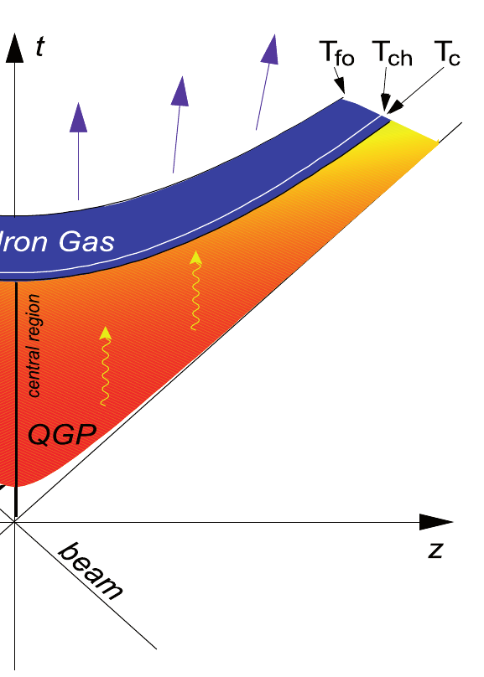
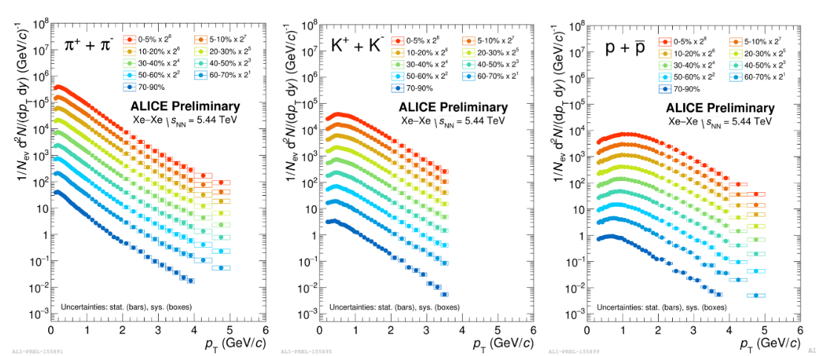
Particle yields at kinetic freeze-out
Sadia Marium
Kinetic Freezout

Slide 44
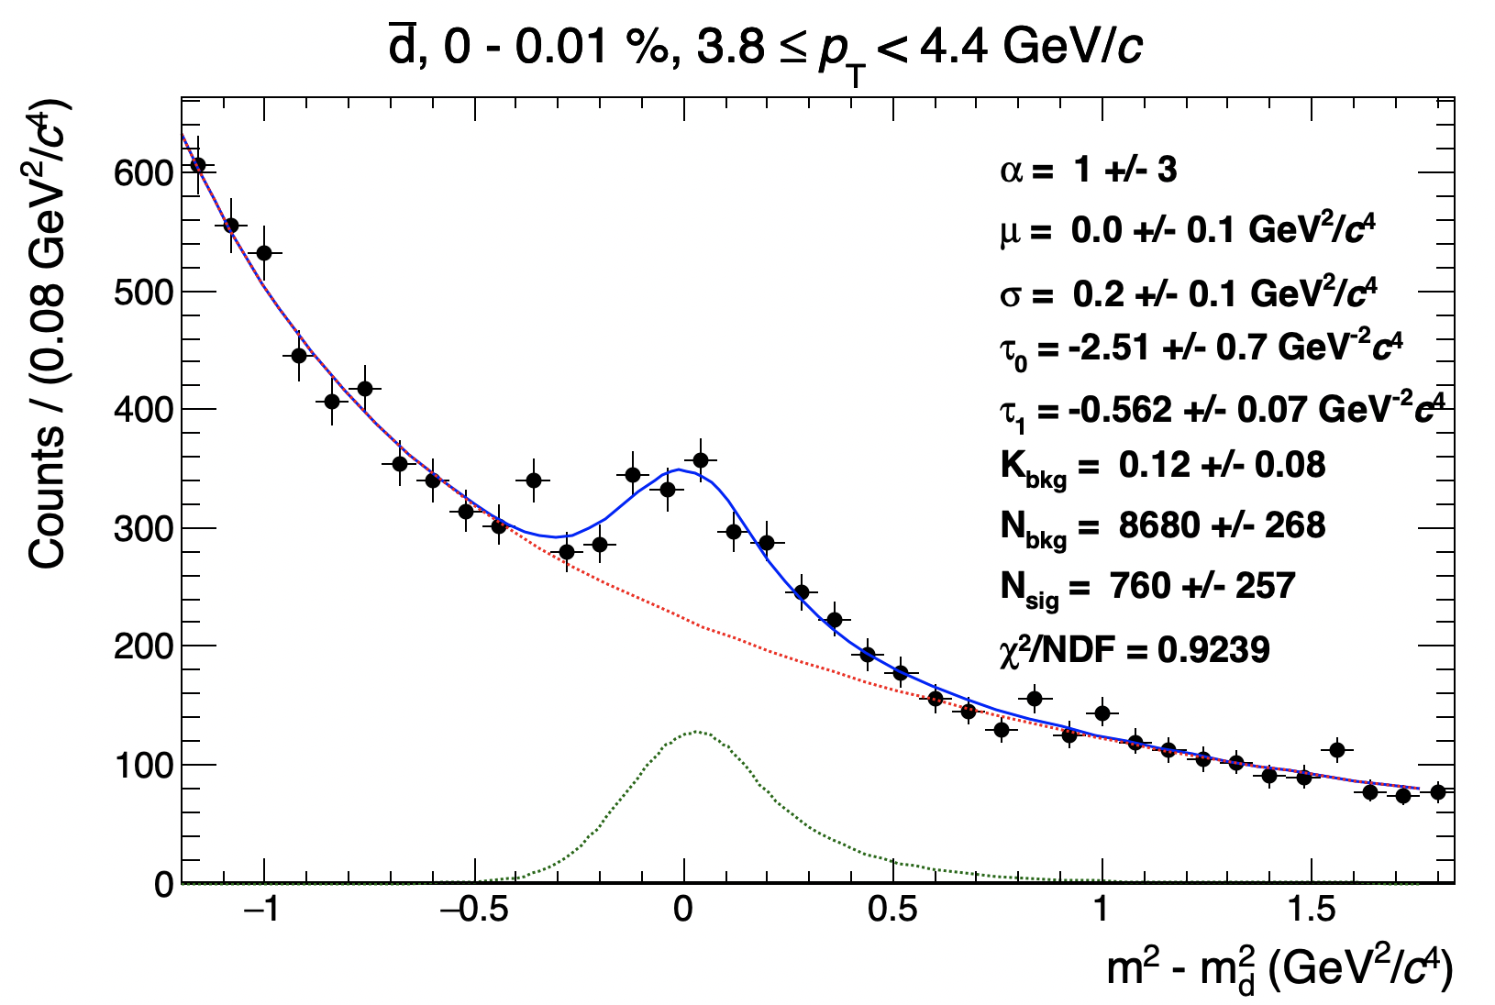
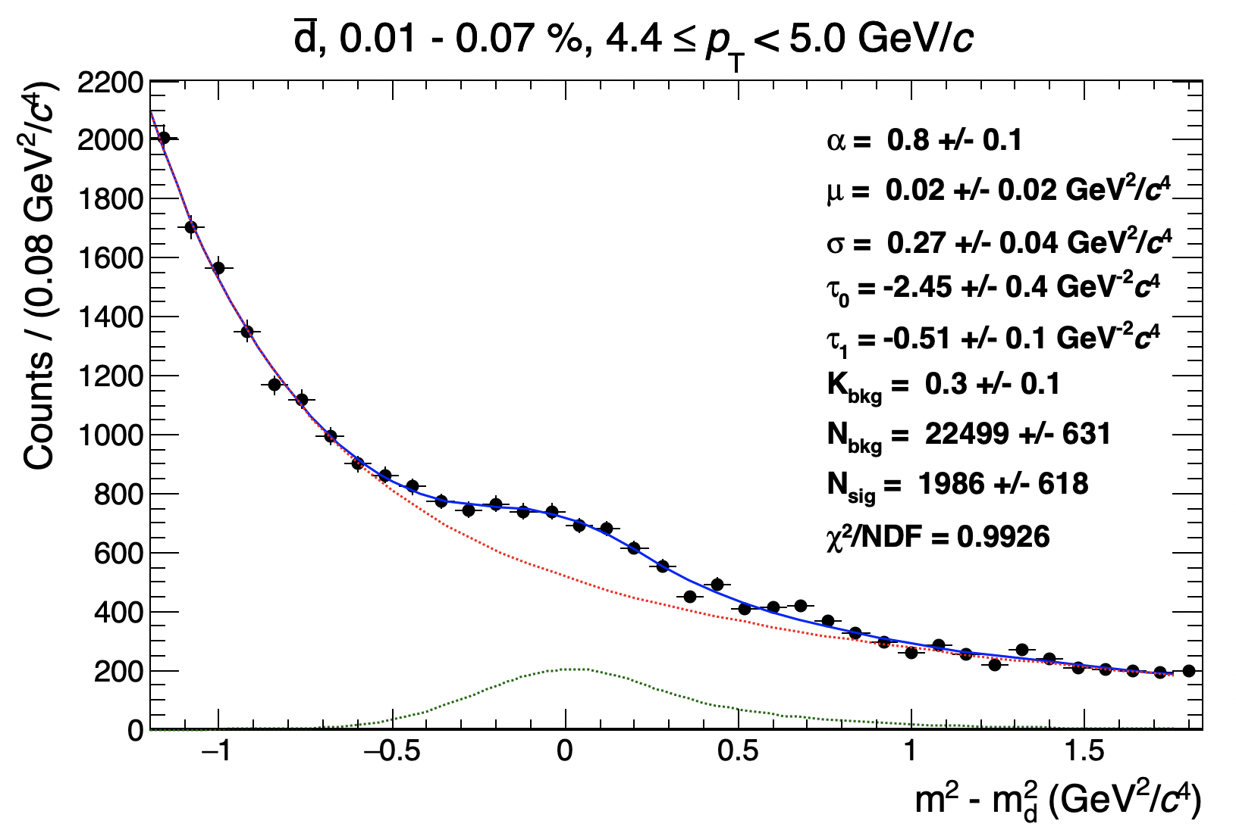
(Anti-)deuteron production in pp 13 TeV with HM
Due to the high number of (anti-)deuterons produced at high multiplicity and to the large data sample, it is possible to extend the pT range
Some check in the highest pT bin are ongoing
All the fits are included in the backup
TPC + TOF signal extraction at high pT

Slide 45
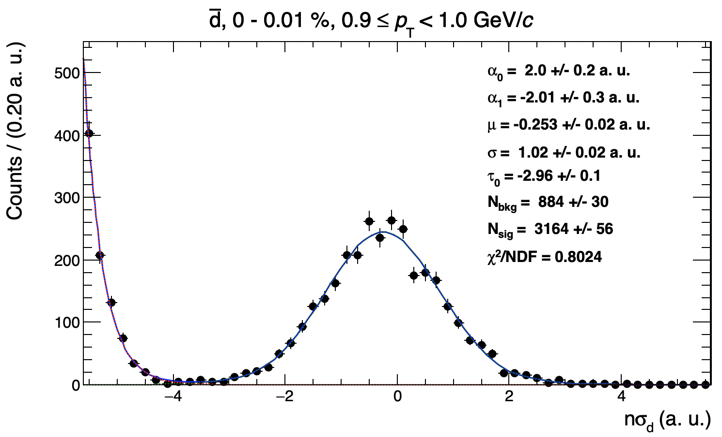
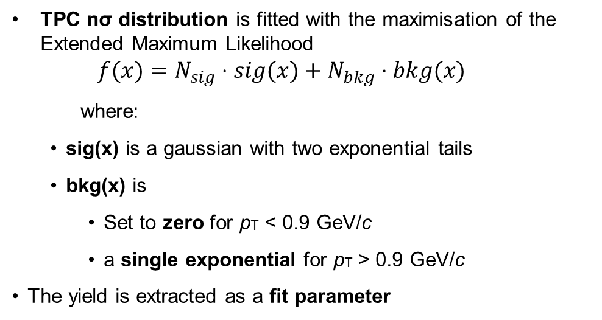
(Anti-)deuteron production in pp 13 TeV with HM
TPC signal extraction ( pT < 1 GeV/c )
TPC nσ distribution is fitted with the maximisation of the Extended Maximum Likelihood
  $$f(x)=N_{sig}⋅sig(x)+N_{bkg}⋅bkg(x)$$
  where:
  sig(x) is a gaussian with two exponential tails
  bkg(x) is
    Set to zero for pT < 0.9 GeV/c
    a single exponential for pT > 0.9 GeV/c
The yield is extracted as a fit parameter

Slide 46
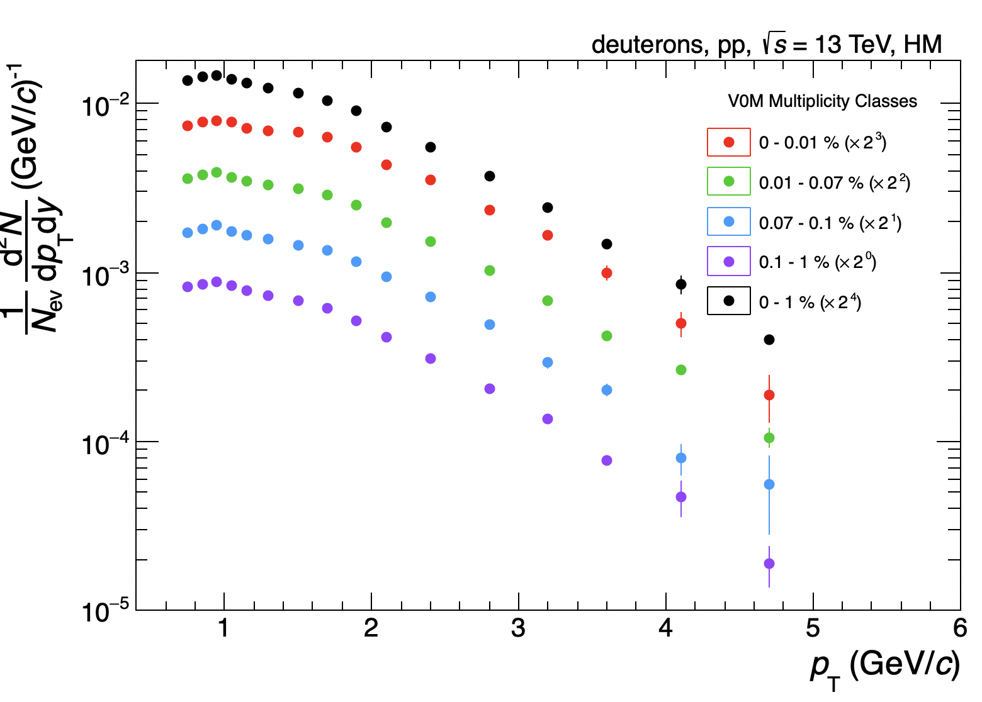
(Anti-)deuteron production in pp 13 TeV with HM
There is a bit of mismatch between TPC and TOF
  Only for deuterons -> it must be related to secondaries
Checks ongoing

Slide 47
(Anti-)deuteron production in pp 13 TeV with HM
There is a bit of mismatch between TPC and TOF
  Only for deuterons -> it must be related to secondaries
Checks ongoing

Slide 48
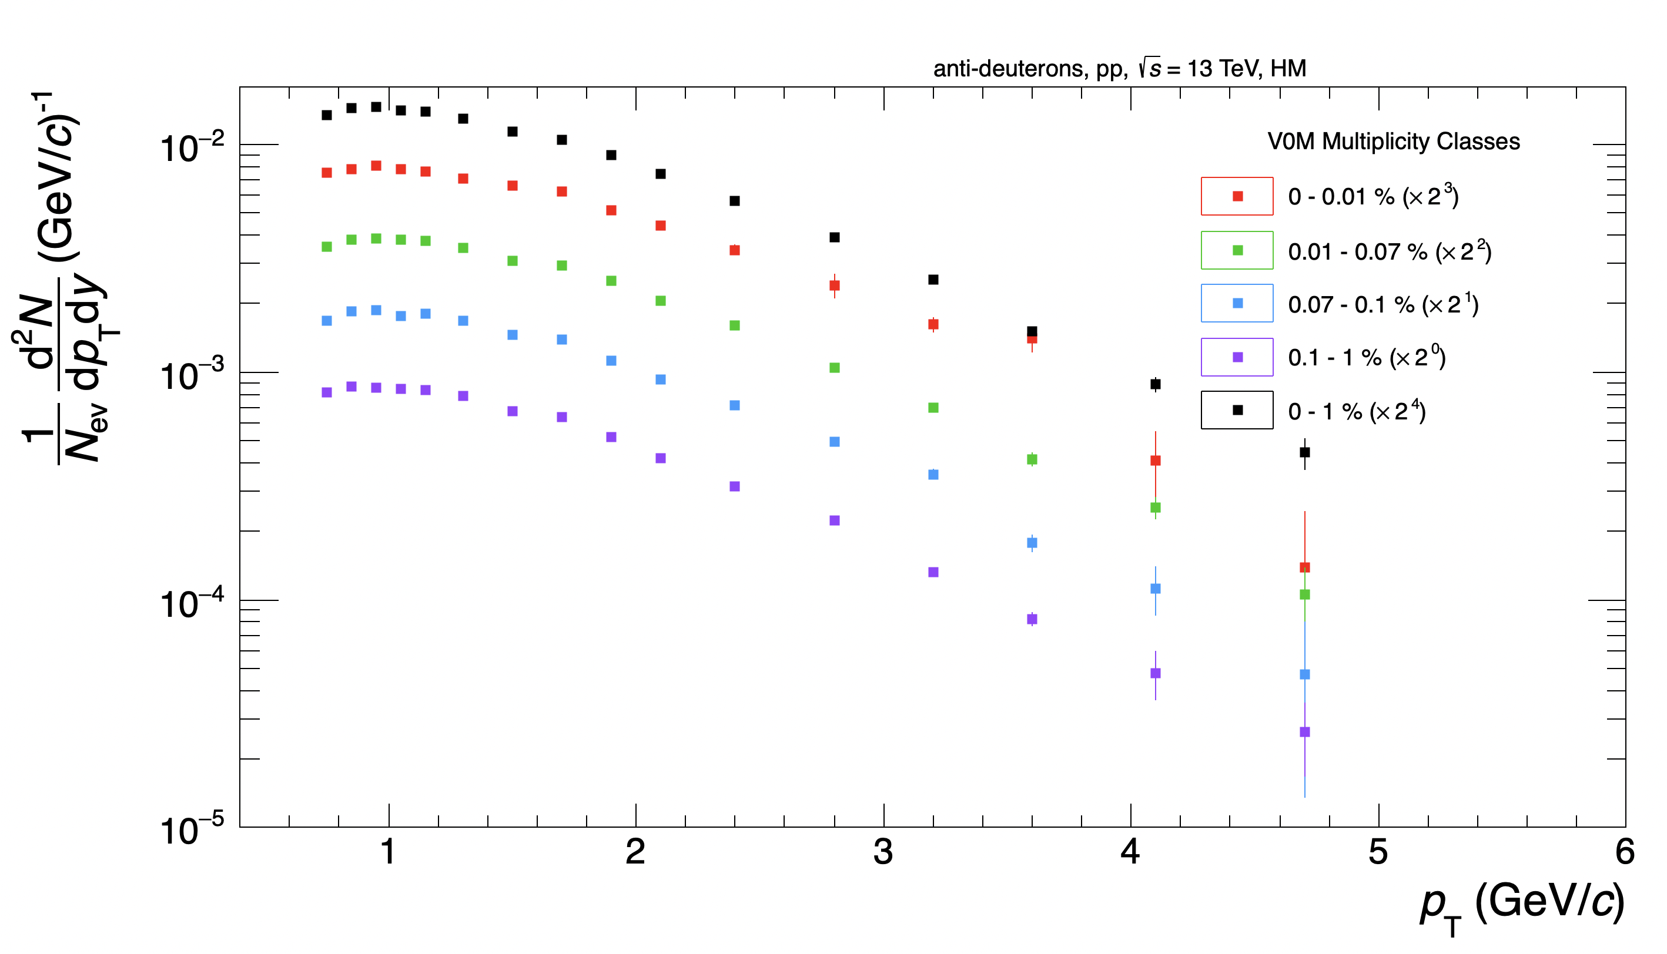
(Anti-)deuteron production in pp 13 TeV with HM

Slide 49
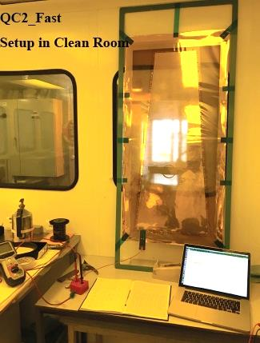
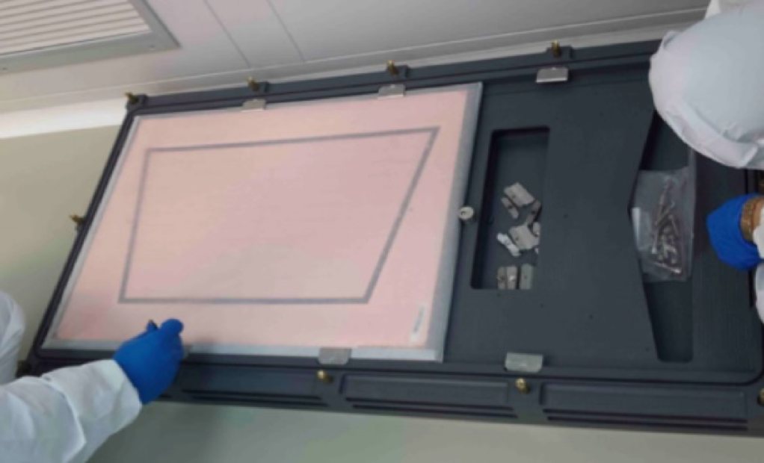
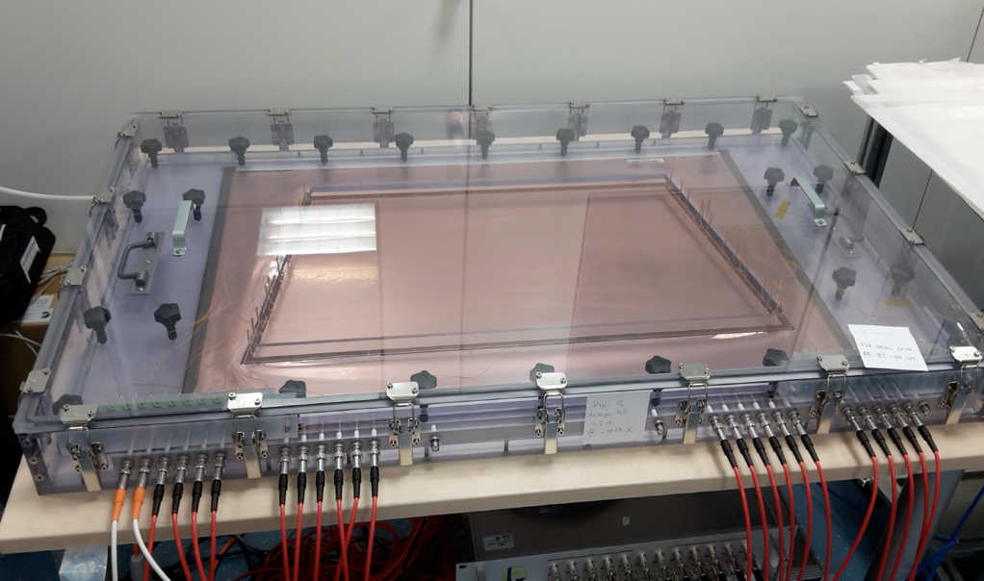
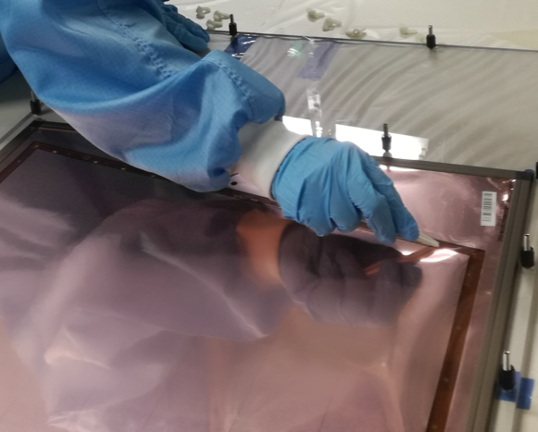
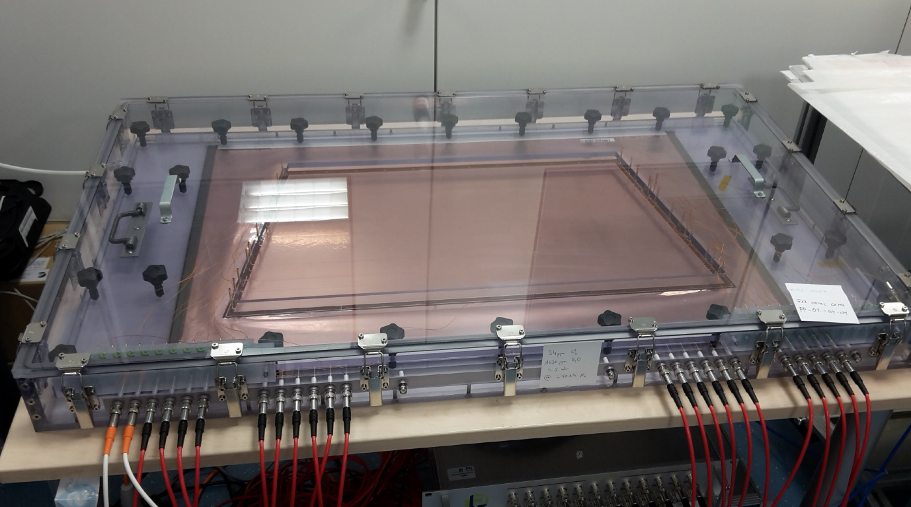
QA of GEM Foils for ALICE TPC
PINSTECH contributed in ALICE GEM QA for the characterization of GEM foils.
A QA scheme consisting of various tests was followed to determine quality of foils.
“Passed” GEM foils were transported to collaborating sites for advanced testing and assembly.

Slide 50
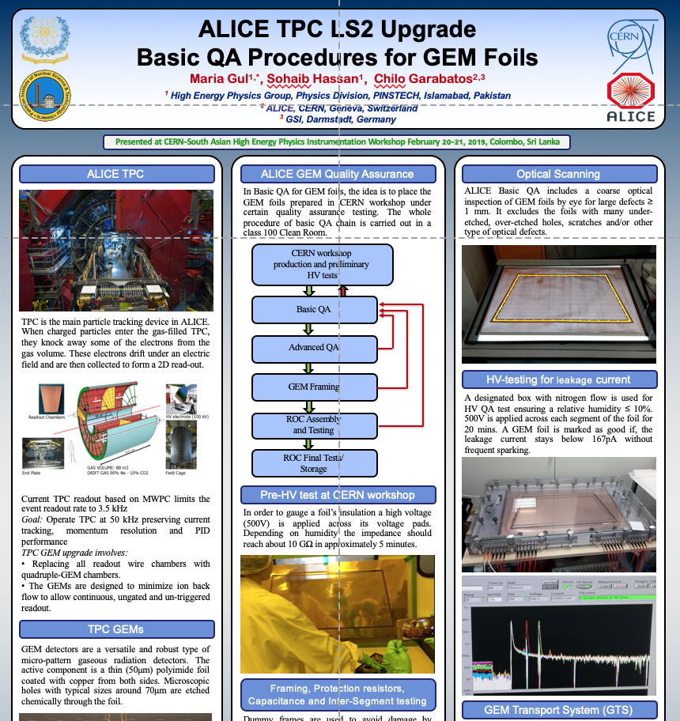
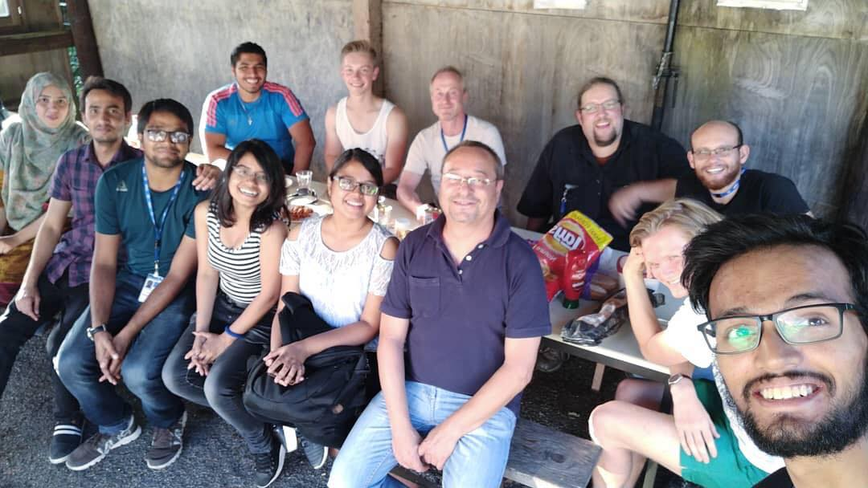
Time Projection Chamber (TPC) of ALICE detector upgrade
Increased Pb-Pb interaction rate after LS2
  @ 50KHz
Current ROCs are not capable of working beyond a few KHz
New GEM based ROCs

Slide 51
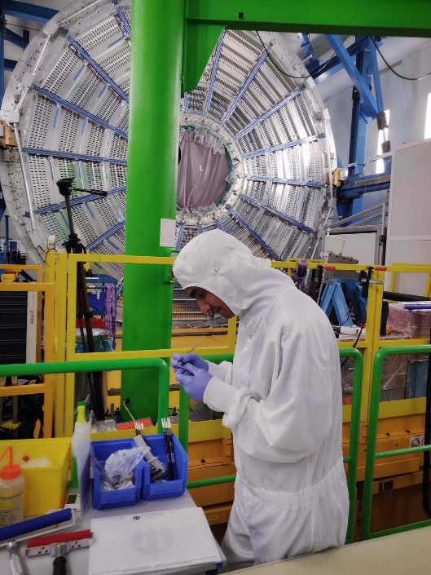
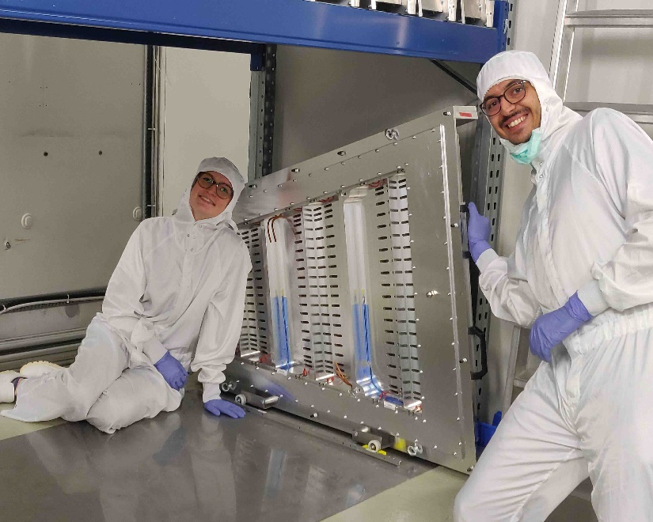
TPC of ALICE detector upgrade- GEM Installation
Sohaib was invited by TPCU management for the installation of chambers (18 Aug-15Sep 2019)
18 chambers (0n each side)
  18 IROCs
  18OROCs
Chamber Preparation
  4~5 hours per day
Chamber Installation
  5~6 hours per day
Many step procedure
  Cleaning of tools
  Record upgrade
  Removal of cover protection
  Installation of alignment pins
  And cylinders
  Glue-ing
  …….

Slide 52
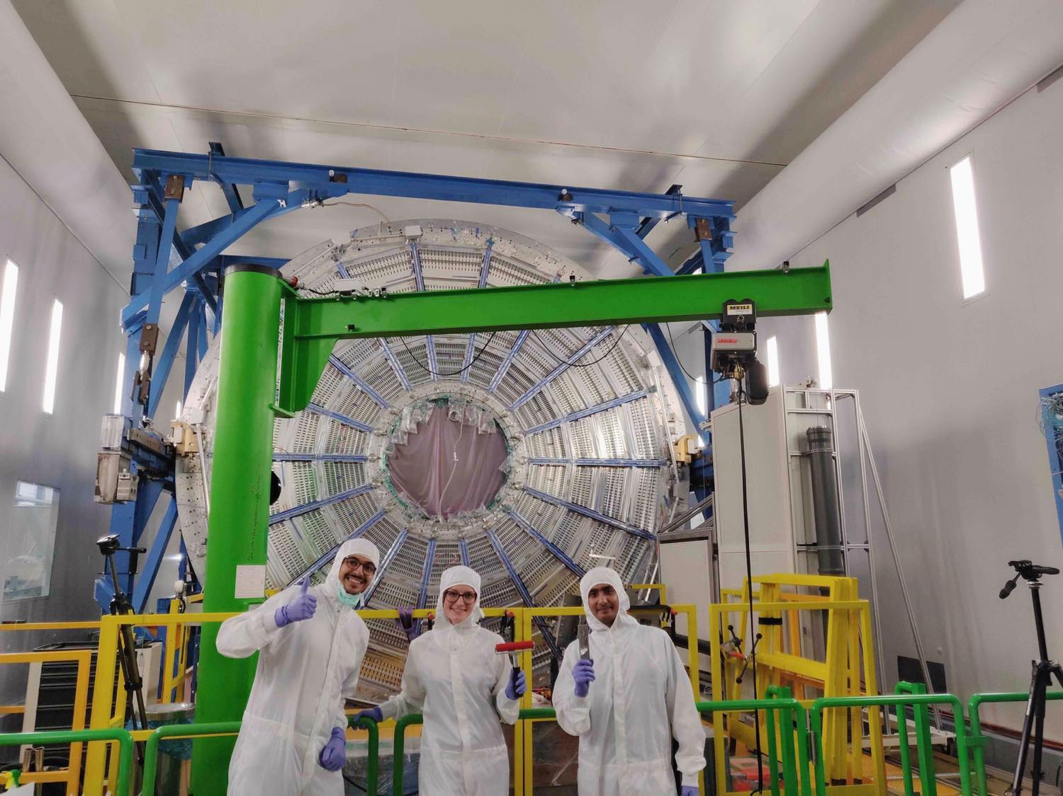
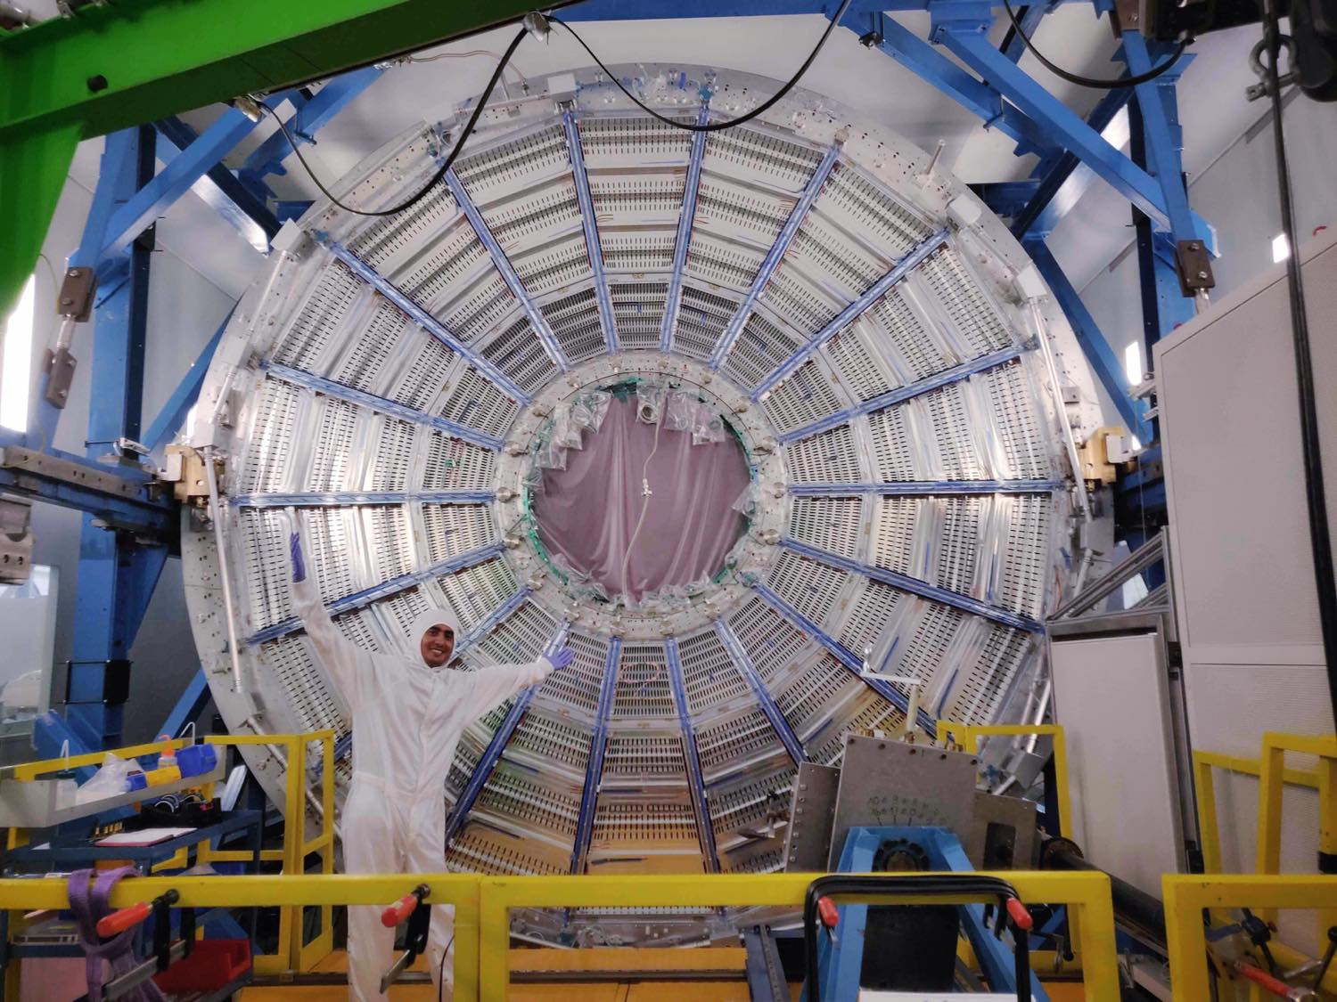

TPC of ALICE detector upgrade- GEM Installation

Slide 53
Contribution of PINSTECH for ALICE
PINSTECH scientists contributed in the form of publications, analysis notes, conference presentations/ posters and in different PAG meetings as below.
Zafar Yasin, ALICE Collaboration."Multiplicity dependence of light (anti-)nuclei production in p-Pb collisions at √sNN = 5.02 TeV", Phy. Letters B (2019)135043.
Sohaib Hassan, et al, Secondary discharge studies in single and multi-GEM structures, NIM A 937 (2019)168.
Zafar Yasin, Preliminary study of the (anti-)deuteron absorption in the detector material of ALICE at the LHC. Presented at Quark Matter, 13-17 May, 2018, Venice Italy. https://qm2018.infn.it/.
Sadia Marium, Production of pi/K/p in Xe-Xe collisions a sqrt(s) = 5.44TeV. Presented at Quark Matter, 13-17 May, 2018, Venice Italy. https://qm2018.infn.it/.
Maria Gul, Sohaib Hassan, et al, ALICE TPC LS2 upgrade basic QA procedures for GEM foils: presented at CERN-South Asian HEP Instrumentation Workshop, February 20-21, 2019, Colombo, Sri Lanka.
Zafar Yasin, Analysis Note ALICE: Preliminary study of the (anti-)deuteron absorption in the detector material of ALICE at the LHC . https://alice-notes.web.cern.ch/node/758.
Sadia Marium et al, Analysis Note ALICE: Production of pi/K/p in Xe-Xe collisions a sqrt(s) = 5.44TeV https://alice-notes.web.cern.ch/node/771
Sadia Marium, et al. Our work on pi/k/p spectra study was presented at ALICE Physics Week at Amsterdam (4-8 Dec 2017) https://indico.cern.ch/event/642717/
Sadia Marium, et al. Our work on pi/k/p spectra study was presented at ALICE Physics Week in Frascati (5-9 Feb 2018) https://indico.cern.ch/event/687851/timetable
S.Hassan, C.Garabatos , A.Berdnikova Gaseous Detector Development (GDD) RD51 meeting, CERN (July 05, 2018)“Secondary discharges for different gas mixtures”.
https://indico.cern.ch/event/740611/
Z. Yasin, S. Hassan, M. Gul. First look into spectra study of (anti-)triton in pp collisions at √sNN 5.02 TeV.Presented online at Nuclei and Exotica PAG meeting on 2 October, 2019. https://indico.cern.ch/event/852320/

Slide 62
Summary and Conclusions
Pakistan has contributed in major experiments at CERN.
More opportunities for students and young researches after attaining the associate membership.
PAEC has been contributing in engineering projects at CERN but not in physics analysis.
Contribution of ALICE-CERN group are appreciated by ALICE management.
PINSTECH and PAEC can get lot of benefits from ALICE after attaining full membership.

Slide 63
Thank you for your attention

