Slide 1
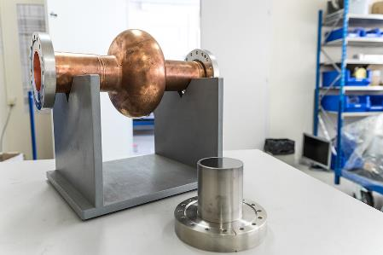
From QPR to 1.3 GHz cavities
Lorena VEGA CID on behalf of all the CERN colleagues from BE-RF, TE-VSC and TE-CRG contributing to these studies.
Special thanks to A. Bianchi, G. Rosaz, G. Vandoni, P. Vidal and W. Venturini

Slide 2

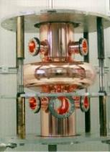
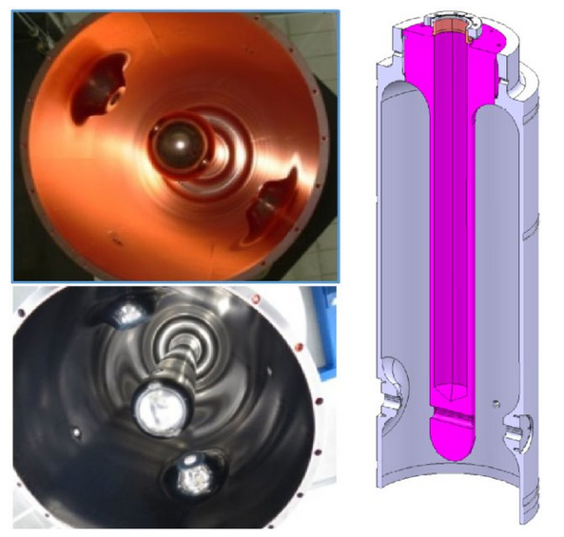
CERN R&D on thin films
  Niobium on copper
  Technology used historically at CERN.
  Interest in developing the RF performance
  A15 on copper
Investigate new materials with potential SRF applications.
HIE-ISOLDE
LHC

Slide 3
RF characterization of thin films
Colleagues from different groups and fields are involved in the R&D activities
RF characterization
Samples preparation
Cryogenics operation

Slide 4


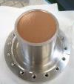

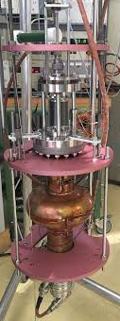



Path from QPR to coated cavities
QPR sample
1.3 GHz cavity
-Bias
-Temperature
-Pressure
-Pulse parameters
-Peak power
-Bias
-Temperature
-Pressure
-Pulse parameters
-Peak power
Identify parameters that influence the RF performance
Measure RF performance
Measure RF performance

Slide 5
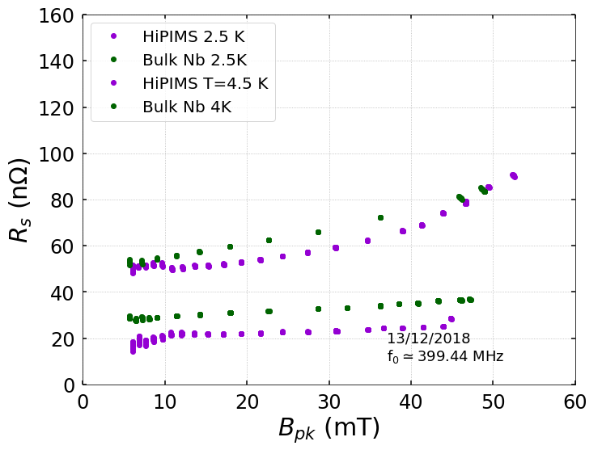
Finding a recipe for a good QPR sample
QPR sample
-Bias
-Temperature
-Pressure
-Pulse parameters
-Peak power
Identify parameters that influence the RF performance
Measure RF performance
HiPIMS sample showing comparable performance to bulk niobium in terms of Q-slope

Slide 6
Coating two 1.3 GHz cavities with the QPR recipe
N2: Fully coated with the same QPR recipe (HiPIMS)
N3: Cut-off tubes coated with positive bias HiPIMS. The same QPR recipe for the cell.
1.3 GHz cavity
-Bias
-Temperature
-Pressure
-Pulse parameters
-Peak power
Measure RF performance

Slide 7
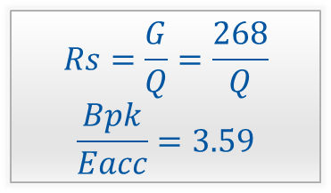
Comparing QPR and cavity results
$$Rs=\frac{G}{Q}=\frac{268}{Q}$$
$$\frac{Bpk}{Eacc}=3.59$$

Slide 8
Can we predict a cavity performance from QPR measurements?
QPR sample
1.3 GHz cavity
-Bias
-Temperature
-Pressure
-Pulse parameters
-Peak power
-Bias
-Temperature
-Pressure
-Pulse parameters
-Peak power
Identify parameters that influence the RF performance
Measure RF performance
Is the coating fully reproducible in a cavity by scaling the parameters?
Measure RF performance

Slide 9
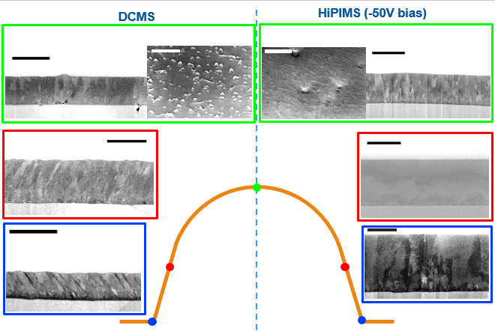
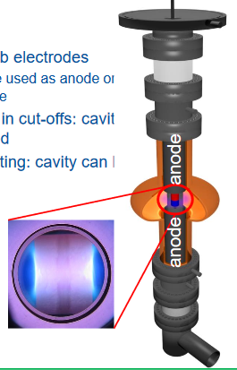
Influence of impinging angles on coating morphology
HiPIMS technique allows to achieve denser layer in all the orientations.
This technique may still need specific optimization for the cavity geometry.
Notes:
With DCMS magnetron sputtering the influence of the impinging angles is evident> see the columnar structure that reflects the angle of incidence. HiPIMSBiased HiPIMS shows densification of the layer no matter the orientation

Slide 10
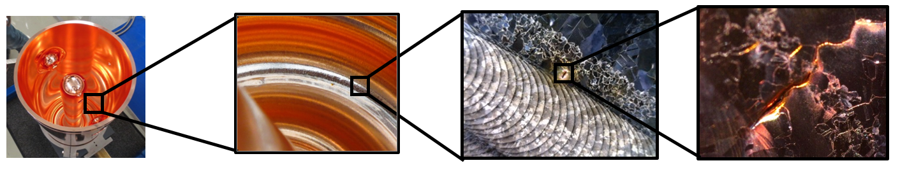
Influence of the quality of the substrate
Welds are potential sources of defects, holes may trap chemicals and contaminate the SC layer.
Use seamless substrates: this solved the problem for HIE ISOLDE cavities (100 MHz and 4.5 K)→ not a Nb/Cu thin film specific issue
To be done
Use electroformed substrate
Machine from bulk a 1.3 GHz cell to get a high quality substrate
Notes:
Example HIE ISOLDE Cavites

Slide 11
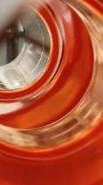
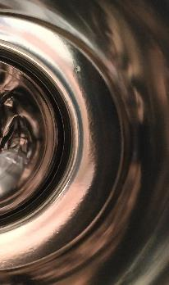
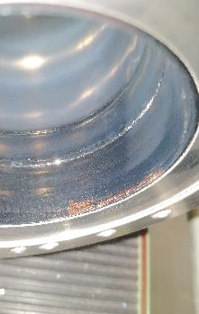
Influence of the quality of the substrate
Defects in substrate are propagated to the coating.
Last 2 cavities were spun and then treated at JLab (tumbled), nonetheless some defects were still present
To be done
Install thermal mapping system to localize defects.
Notes:
>20 years ago spun cavities were used as substrate. After several usages they cannot be used anymore. No substrates for some time and the last series of substrates are no good in terms of surface quality. Two of them have been treated at Jlab and are the ones that we are currently using. However, there are still defects. Reference to previous slide> to be improved with electroformed or machined from the bulk.

Slide 12
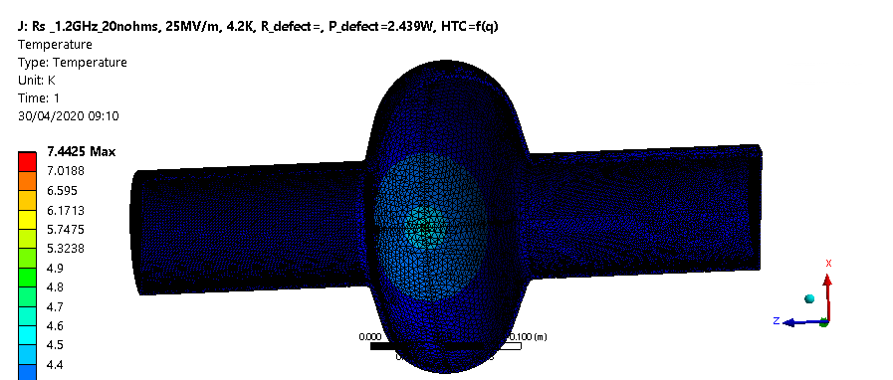

Understanding Q drop with simulations
Thermal quenches are not observed in niobium on copper cavities.
The temperature increases locally in presence of defects, but thanks to the high thermal diffusivity of copper, heat quickly spreads and the temperature of Nb film is maintained below Tc in steady-state conditions.
As a result, an area of increased temperature (thus, increased Rs) surrounds the defect: This contributes to the global surface resistance, leading to Q drop.
Niobium thin film
Copper
High thermal diffusivity in copper: High spread of temperature!

Slide 13
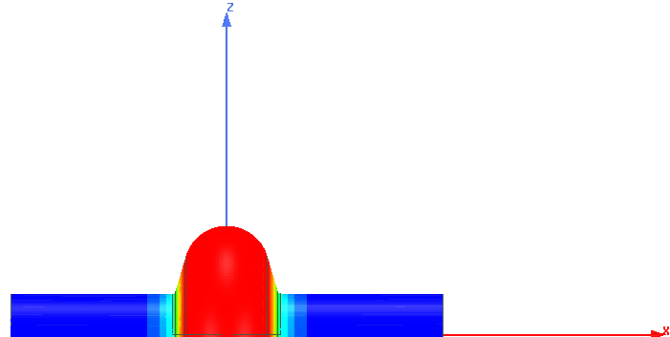
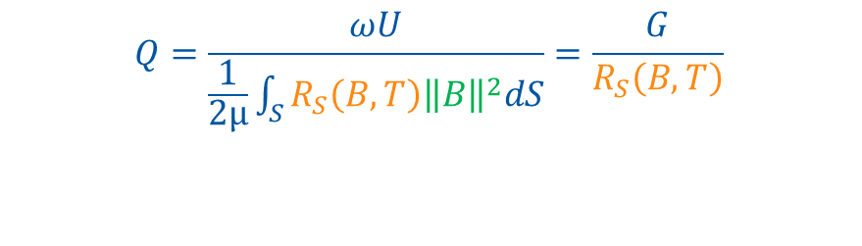
Q drop in presence of defects
$$Q=\frac{ωU}{\frac{1}{2μ}\int_{S}{R_{S}\left(B,T\right){\left\|B\right\|}^{2}dS}}=\frac{G}{R_{S}\left(B,T\right)}$$
Higher temperature area
Data calculated for 16 MV/m

Slide 14

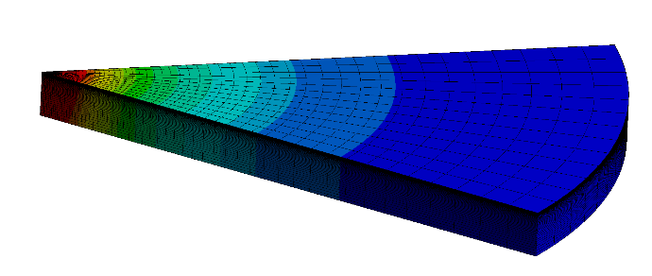
Building the model
Dimension of defect causing hot spot ?
Nb/Cu interface:
Thermal resistance?
Definition of material properties
Definition of RF loads
Definition of boundary conditions
Cu/He interface: Heat transfer regime?

Slide 15
Definition of material properties
Definition of RF loads
Definition of boundary conditions:
Correct definition of thermal properties are key to obtain realistic results.
Parametrize the properties in function of RRR and temperature!

Slide 16
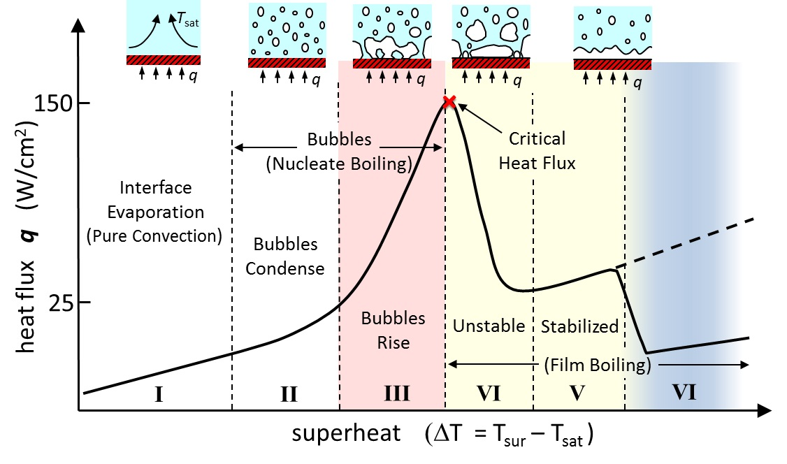
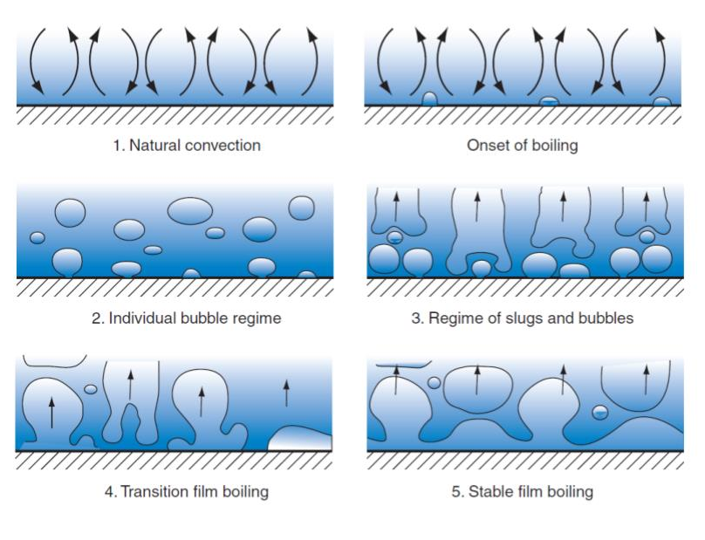
Definition of material properties
Definition of boundary conditions
Definition of RF loads
Interface between helium and copper
Natural convection
Nucleate boiling
Film boiling
He I has a rather small thermal conductivity and large speciﬁc heat:
Conduction heat transport is of little signiﬁcance to the overall heat transfer
Heat transport is dominated by convection mechanisms.

Slide 17



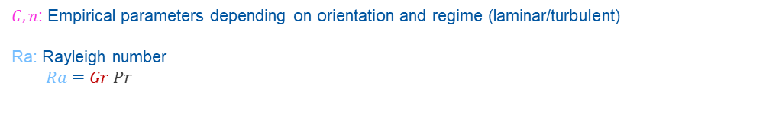
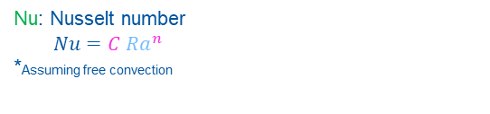
Definition of material properties
Definition of boundary conditions
Definition of RF loads
Natural convection
Nucleate boiling
Film boiling
At low fluxes, up to a few W/m2, heat is transfer via density-driven convection currents near the heated surface
 | Q (W/m²) | Regime | h | Equation
He I | <10 | Natural convection | 500 W/m²K | Q=h(T_{s} –T_{He})
The convection coefficient is obtained from empirical correlations based on dimensionless parameters dependent on the properties of the system. There is sufﬁcient quantity of experimental data for normal liquid helium (He I).
$k_{f}$: Thermal conductivity of the fluid
$$h=\frac{Nu k_{f}}{L}$$
L: Characteristic length
Nu: Nusselt number
$Nu=C {Ra}^{n}$
*Assuming free convection
$C, n$: Empirical parameters depending on orientation and regime (laminar/turbulent)
Ra: Rayleigh number
$$Ra=Gr Pr$$
$Pr$: Prandlt number
$$Pr=\frac{μc_{p}}{k}$$
$Gr:$ Grashof number
$Gr=\frac{gβ\left(T_{s}−T_{b}\right)L^{3}}{k}$

Slide 18
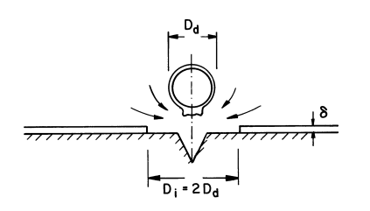
Definition of material properties
Definition of boundary conditions
Definition of RF loads
Natural convection
Nucleate boiling
Film boiling
As heat flux increases, bubbles start forming at preferred sites: activation of nucleation sites.
Layer of superheated liquid (T_{s})
Cold liquid rushes down as bubble detaches (T_{b})
Improved cooling of the surface:
  A layer of superheated liquid is formed near the heated surface (Ts>Tbath)
  As a bubble is detached from the surface, cold liquid from above rushes down and cool down the surface.
Nucleation site

Slide 19

Definition of material properties
Definition of boundary conditions
Definition of RF loads
Natural convection
Nucleate boiling
Film boiling
 | Q (W/m²) | Regime | h | Equation
He I |  | Nucleate boiling
Calculate separately contribution from natural convection of bulk and bubble hydrodynamics:
  q_{NB}=q_{b}+q_{NC}
Highly experimental: very difficult to estimate!
q_{NC}=>Adimensional numbers (Nu, Ra)
q_{b}=> Hsu and Graham correlation
f-frequency rate of detachment
n-number of nucleation sites per area
rc-critical size of a departing bubble.
…
Latent heat of He in the bubble
Heat needed to superheat the part of the layer of liquid that has been detached with the bubble

Slide 20
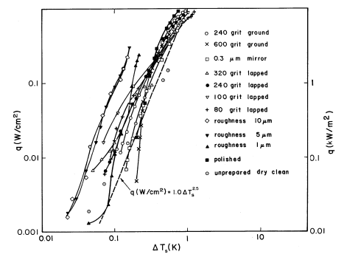

Van Sciver, Steven W
Helium cryogenics
Definition of material properties
Definition of boundary conditions
Definition of RF loads
Natural convection
Nucleate boiling
Film boiling
 | q (W/m²) | Regime | h | Equation
He I | 10<q<? | Nucleate boiling | 10000 W/m²K^{2.5} | Q=h(T_{s} –T_{He})^{2.5}
Use empirical fit (C. Schmidt, “Review of steady state and transient heat transfer in pool boiling He–I”, Proceedings of the SaclayWorkshop on Stability of Superconductors in He-I and He-II, International Institute of Refrigeration, Paris, 1982, pp. 17-31) :
$$q \left(\frac{W}{m^{2}}\right)=10000{(T_{S}−T_{b}) }^{2.5}$$
Graph for flat Cu samples facing upward, different roughness: The rougher, the more efficient the cooling. In yellow, Van Sciver, S. W. (2012). Helium cryogenics. Springer Science & Business Media.

Slide 21
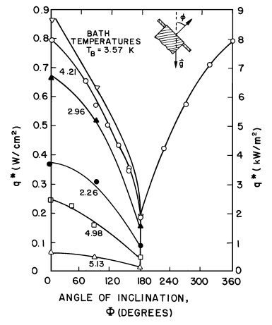
Definition of material properties
Definition of boundary conditions
Definition of RF loads
Natural convection
Nucleate boiling
Film boiling
 | q (W/m²) | Regime | h | Equation
He I | 10<Q<10000 | Nucleate boiling | 10000 W/m²K^{2.5} | Q=h(T_{s} –T_{He})^{2.5}
According to experimental data: 5000-15000 W/m²
Orientation needs to be accounted! Note that having a defect in the cell below the equator can lead to a considerable decrease in the heat transfer efficiency.
At 90 (equator), q*~6000W/m²
Lyon, D. N. (1965). Boiling heat transfer and peak nucleate boiling fluxes in saturated liquid helium between the lambda and critical temperatures. Adv. Cryog. Eng., 10, 371.

Slide 22

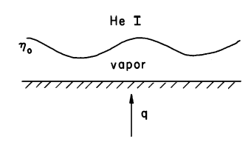
author = "Paudel, Deepak", title = "{Quench Simulation of Superconducting Magnets with Commercial Multiphysics Software}", month = "Jun", year = "2015", reportNumber = "CERN-THESIS-2015-090", url = "http://cds.cern.ch/record/2031145", note = "Presented 30 Jun 2015", }
Definition of material properties
Definition of boundary conditions
Definition of RF loads
Natural convection
Nucleate boiling
Film boiling
Convection coefficient: Film boiling
At higher heat flux rates, bubbles get larger and detachment rate increases, becoming unstable and forming a continuous vapor film preferred sites: activation of nucleation sites.
 | Q (W/m²) | Regime | h | Equation
He I | >10000 | Film boiling | 250 W/m²K | Q=h(T_{s} –T_{He})
Film boiling stabilization:
  Liquid He is heavier than vapour so the tendency is to rewet the surface.
  The waves at the interface liquid-vapor oscillate with amplitude η: They must be damped for the interface to be stable, otherwise the amplitude would grow beyond the vapor ﬁlm thickness and rewet the surface.
  Typical values of heat transfer coefficient are 100 to 2000 W/m²K (C. Schmidt, International Institute of Refrigeration, Paris, pp. 17-31, 1982)
  A value of 250 W/m²K is selected based on Paudel, D, Quench Simulation of Superconducting Magnets with Commercial Multiphysics Software, CERN-THESIS-2015-090, 2015.

Slide 23
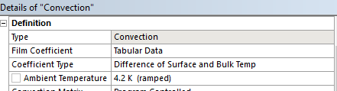
Definition of material properties
Definition of boundary conditions
Definition of RF loads
 | Q (W/m²) | Regime | h | Equation
He I | <10 | Natural convection | 500 W/m²K | Q=h(T_{s} –T_{He})
 | 10<Q<10000 | Nucleate boiling | 10000 W/m²K^{1.5} | Q=h(T_{s} –T_{He})^{2.5}
 | >10000 | Film boiling | 250 W/m²K | Q=h(T_{s} –T_{He})
ANSYS Convection coefficient:

Slide 24
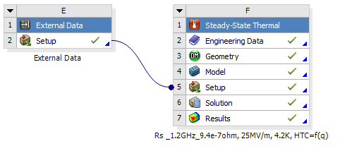
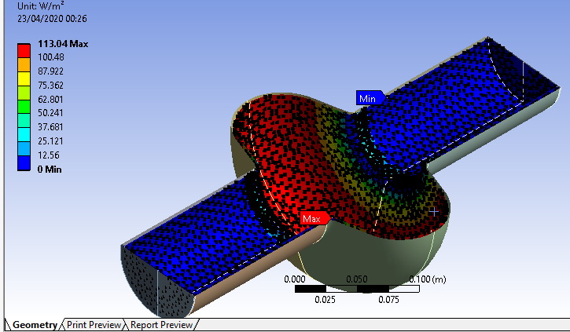
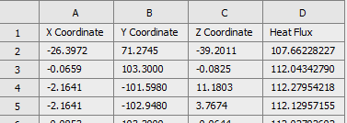
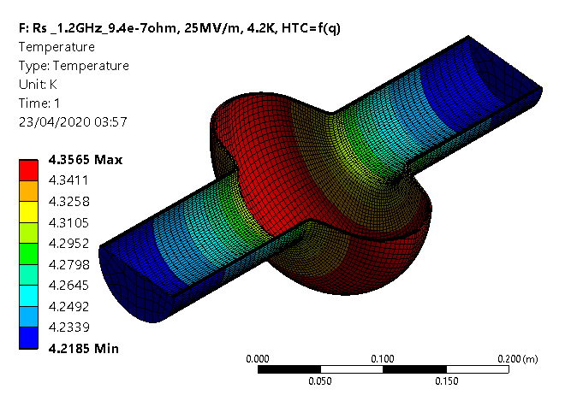
Definition of material properties
Definition of boundary conditions
Definition of RF loads
Heat flux mapping: The RF loads are imported from CST to ANSYS Mechanical
To do this across the dissimilar mesh interface used in each of these softwares, the nodes of the CST mesh are mapped to the local coordinates of a node/element in the ANSYS mesh.
RF power density imported from CST to ANSYS
Temperature profile calculated for 25MV/m, 4.2 K bath
From CST, a .txt file is generated with 4 columns: X, Y, Z and heat flux.

Slide 25
Example of temperature distribution in presence of a defect
Temperature profile calculated for 25MV/m, 4.2 K bath, with a defect of 0.01 cm, assuming a tool-steel particle

Slide 26
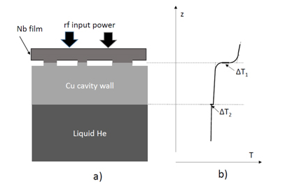
Future studies: Including effect of blisters in the coating
A bad adhesion of the film to the substrate can lead to thermal contact resistance of 110 cm²K/W (Bonded contact would be 0.3 cm²K/W)
The interface Nb/Cu could be included in the simulations with the corresponding thermal resistance.
V Palmieri, and R Vaglio, Thermal contact resistance at the Nb/Cu interface as a limiting factor for sputtered thin film RF superconducting cavities,, 2015, Superconductor Science and Technology, Volume 29, Number 1:

Slide 27
Wrap-up
At CERN, RF characterization of thin films is carried out to find potential applications to SRF cavities.
HiPIMS coatings applied to QPR samples have shown Q-slopes comparable to bulk Nb.
When applying the same coating technique to 1.3 GHz cavities the RF performance is not as good as expected.
Efforts should be put on:
  Specific optimization of the coating technique for the cavity geometry.
  Have good substrates (seamless cavities with thermal mapping system).
Simulations are powerful tools that can help us to keep investigating the mechanisms behind the Q drop .

Slide 28
Thanks for your attention.

