Slide 1




Research and development on SRF 6 GHZ cavities
Vanessa Garcia Diaz, E. Chyhyrynets, F. Stivanello, M. Zanierato, C. Pira
EASITrain – European Advanced Superconductivity Innovation and Training. This Marie Sklodowska-Curie Action (MSCA) Innovative Training Networks (ITN) has received funding from the European Union’s H2020 Framework Programme under Grant Agreement no. 764879

Slide 2
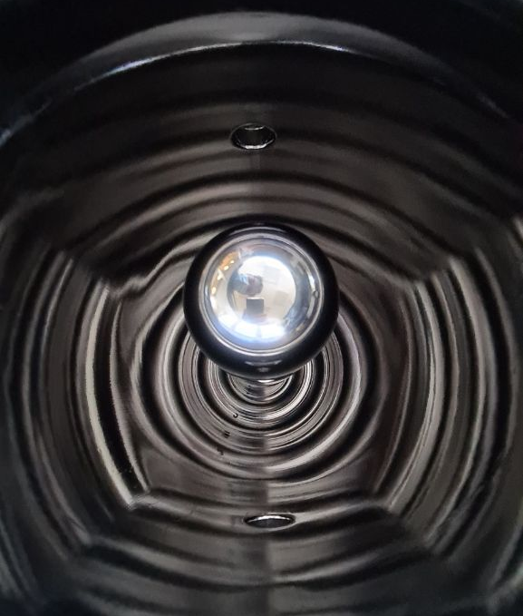
Outline
Why 6 GHz?
State of art on 6 GHz cavities
Seamless motivation
Manufacturing process
Surface treatments
Coating process
RF Characterization
Magnetic flux trapped study
Nb on Cu coated QWR (LNL)

Slide 3
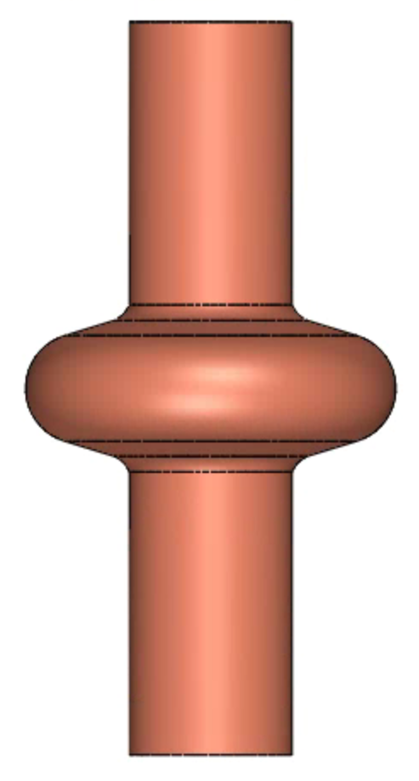
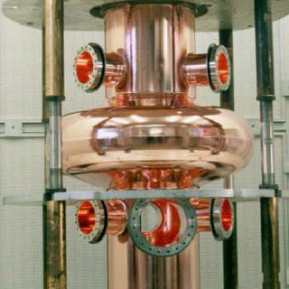
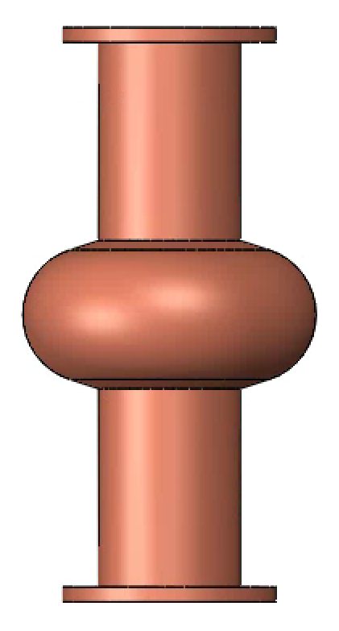
Why 6 GHz cavities?
1,3 GHz
400 MHz
6 GHz
~40 cm
~ 100 cm
10 cm
S. Bauer et al., TEST RESULTS OF SUPERCONDUCTING CAVITIES PRODUCED AND PREPARED COMPLETELY IN INDUSTRY, Proceedings of EPAC 2004, Lucerne, Switzerland.

Slide 4
Why 6 GHz cavities?
Low cost
Statistic
Easy to handle
Smaller equipments
6 GHz
10 cm

Slide 5
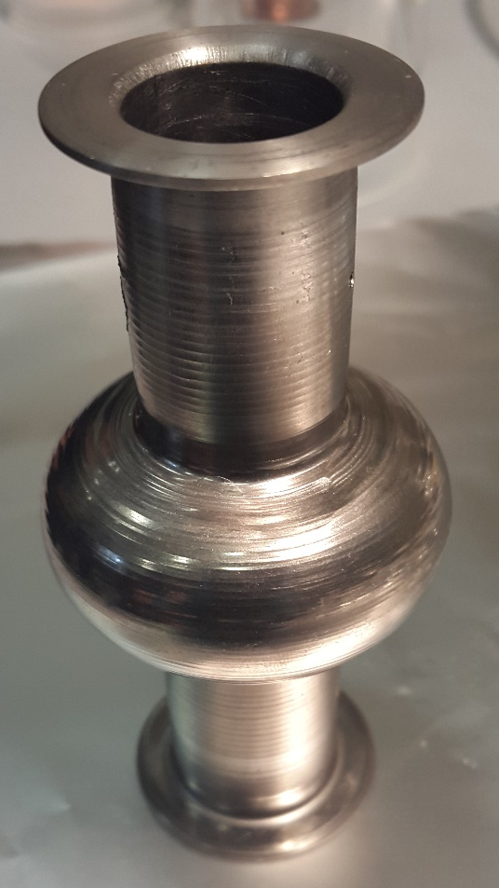
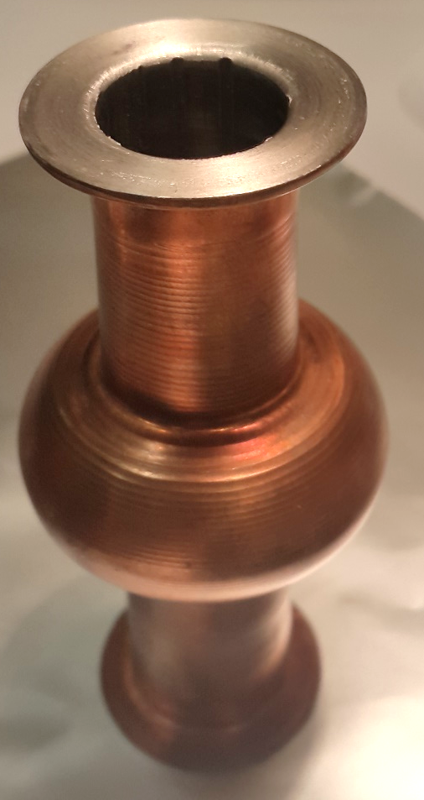
State of Art Nb on Cu
High Q₀
Thermal stability
Cost reduction
ALPI (LNL-INFN)
ISOLDE (CERN)
LHC (CERN)
LEP2 (CERN)
6GHz
6GHz
Bulk Nb
Nb on Cu

Slide 6
6GHz State of Art
Best 6GHz Nb bulk
Increase performances!
Nb on Cu thin film

Slide 7
Manufacturing
Surface preparation
Chemical preparation
PVD process
Cleanroom assembly
RF characterization

Slide 8
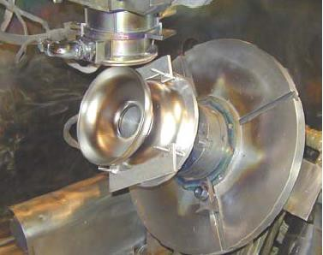
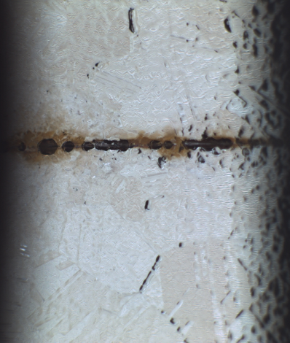
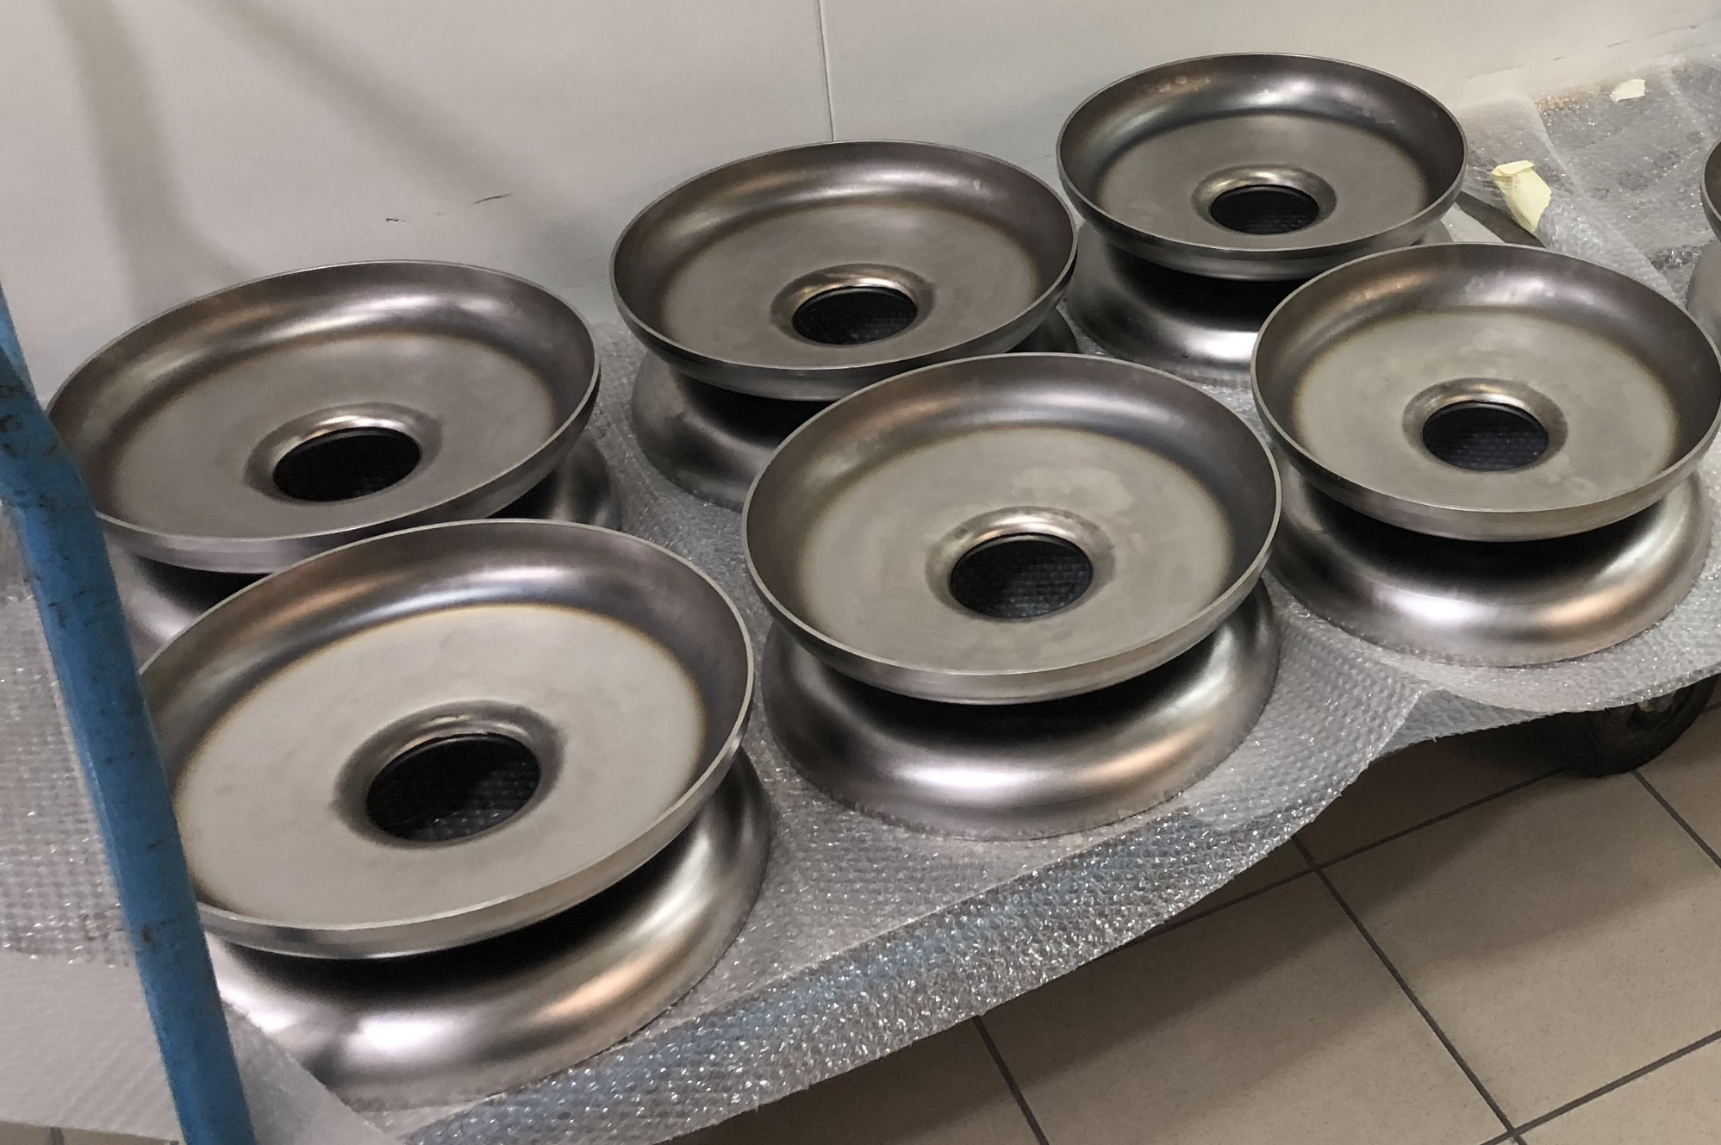
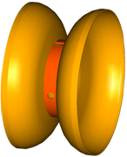
Seamless motivation
See Sertore’s and Pira’s lecture (30/09)
JLAB
Lower RF performances
Imperfections
+
Roughness effect
Defects in the equator!

Slide 9
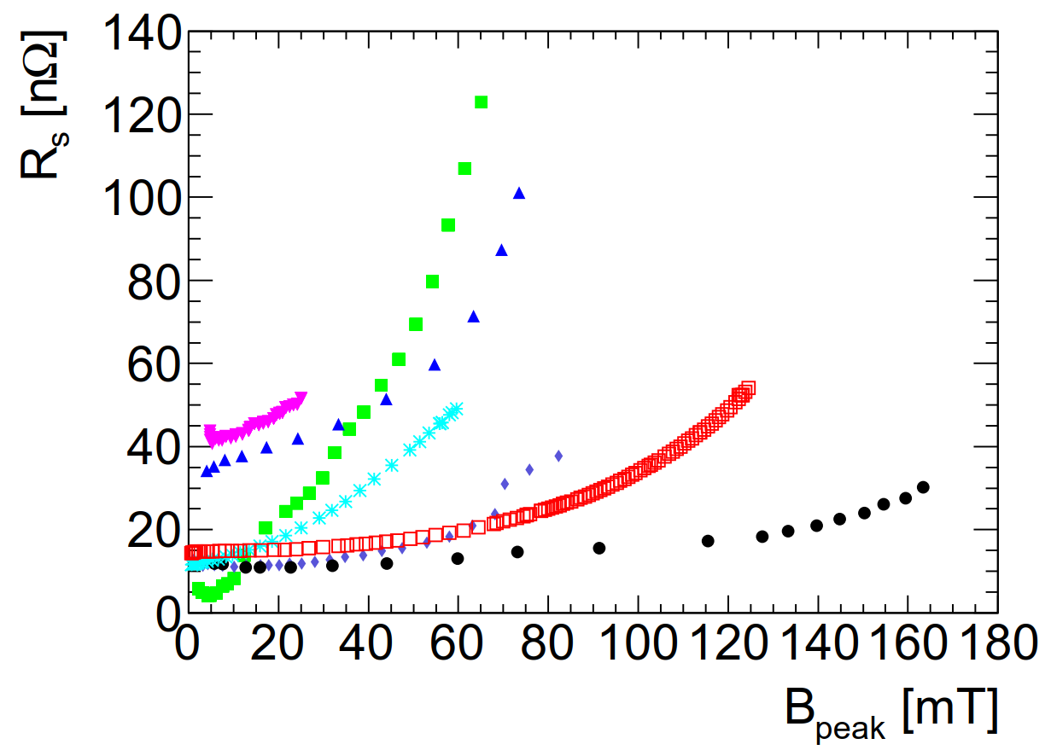
Seamless motivation
1-cell HIPIMS
1.3GHz
LHC DCMS 400MHz
QPR ECR
400MHz
HIE-ISOLDE QS16
100MHz
HIE-ISOLDE QSS2
100MHz
1-cell DCMS
1.5GHz
TESLA bulk Nb
1.3GHz (*)
W. Venturini “Thin film research: CERN experience and possible future applications” TTC meeting Milano 2018
L. Lilje “State of the art SRF cavity performance” Proceedings of LINAC 2004, Lübeck, Germany

Slide 10
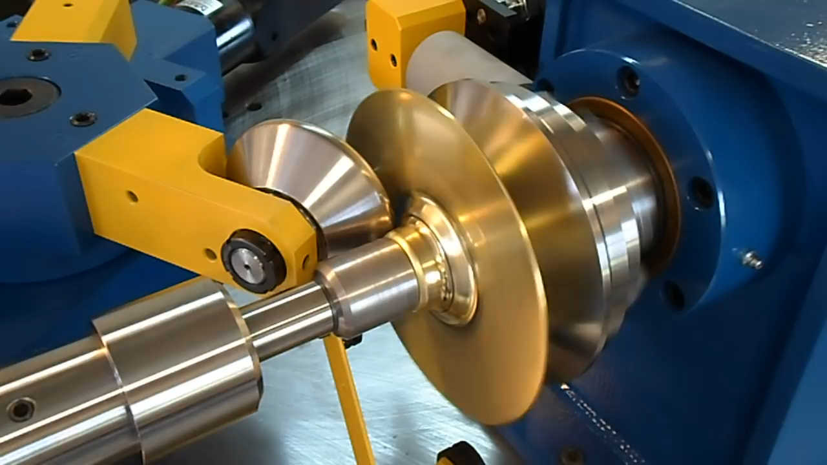
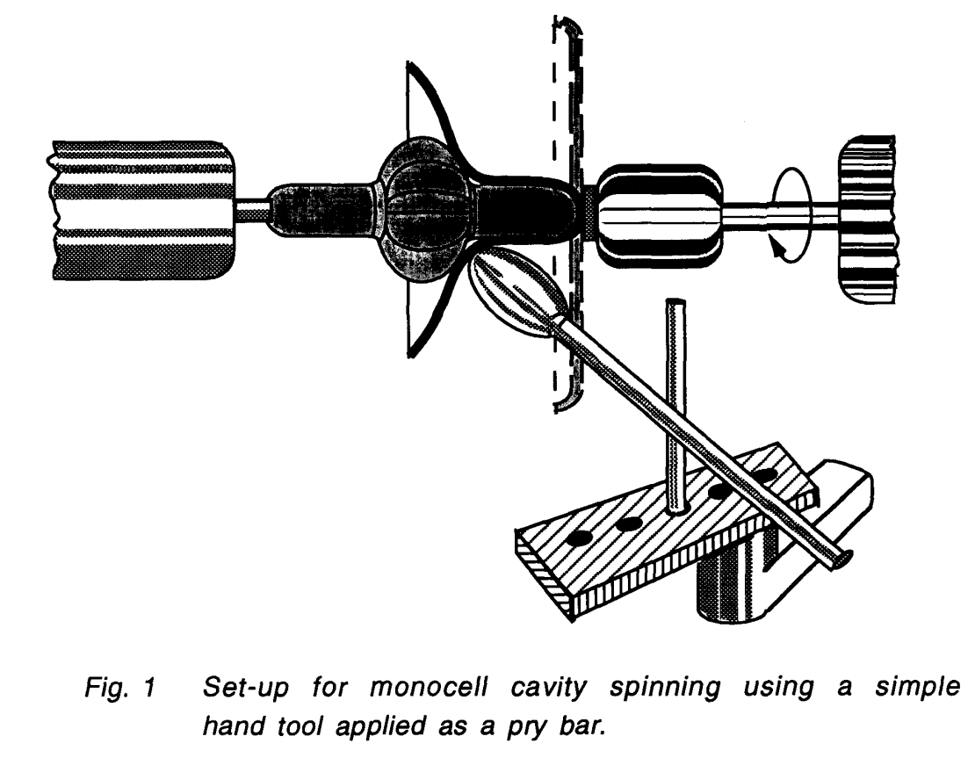
Manufacturing process @LNL
https://www.manufacturingguide.com/en/spin-forming-discs
V. Palmieri «Seamless 1,5GHz cavities obtained by spinning a circular blank of Copper or Niobium» Proceedings of SRF 1993, Virginia, USA.
Spinning of a Brass Disc

Slide 11
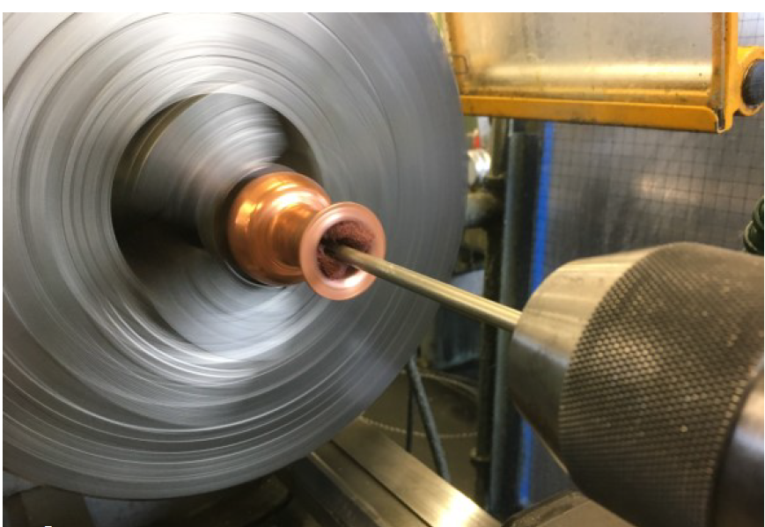
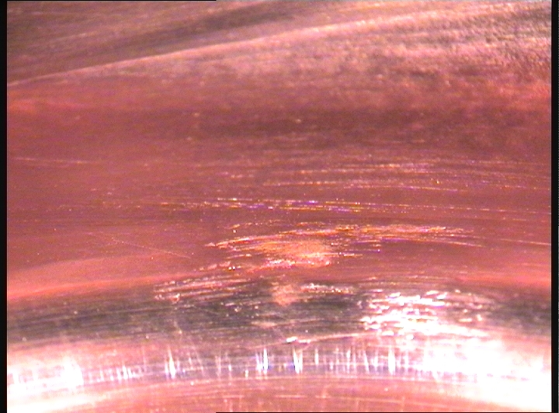
Surface preparation
Cavity inner surface after grinding

Slide 12
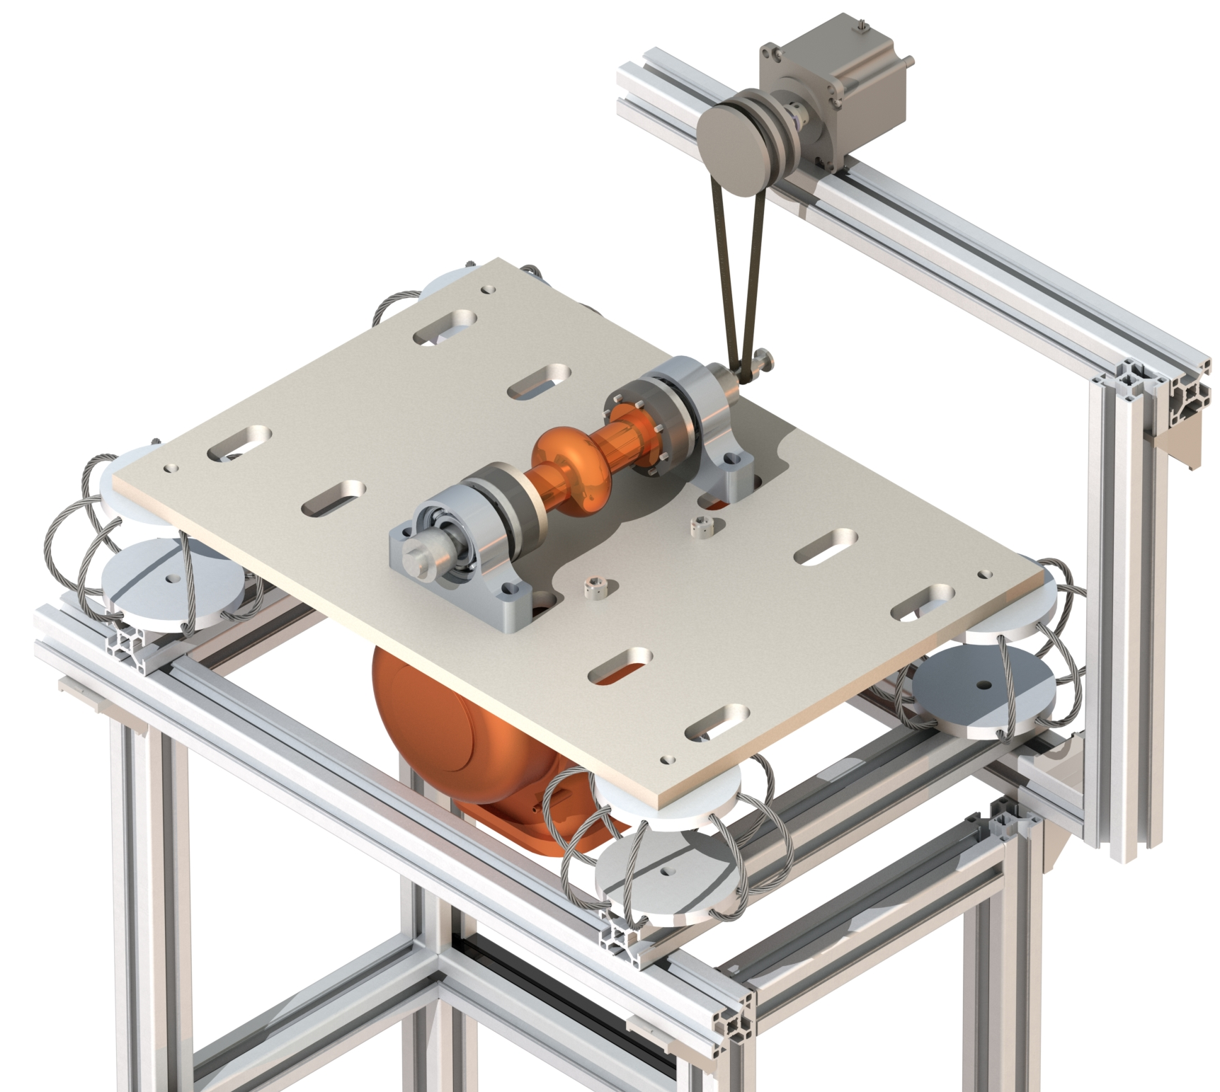
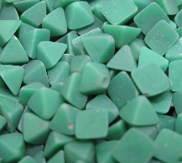
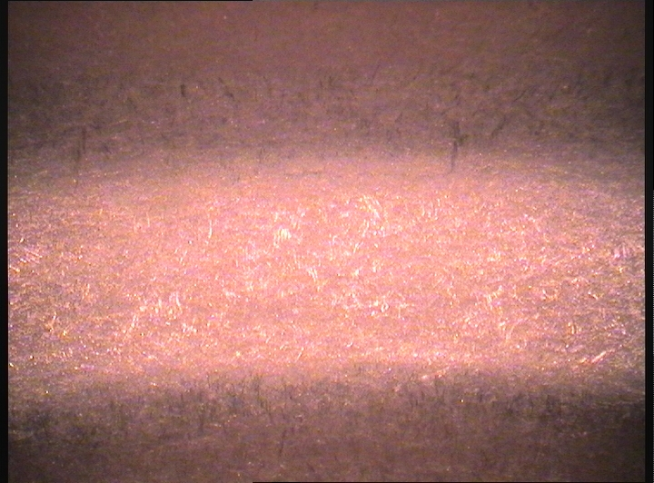

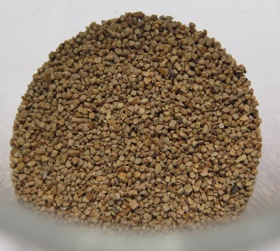
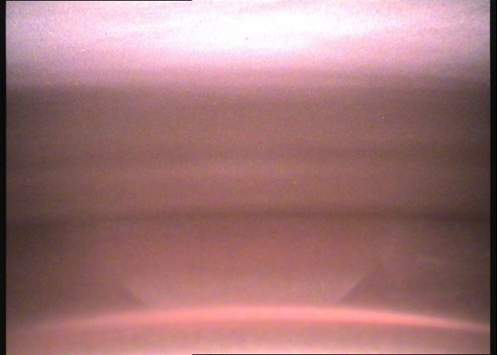
Surface preparation
Al₂O₃
Step 1
Initial surface
8h
0,3 g/h
3,6 µm/h
Courtesy of Eduard Chyhyrynets
Coconut
4h
Vibrotumbling
0,01 g/h
0,1 µm/h
Step 2

Slide 13
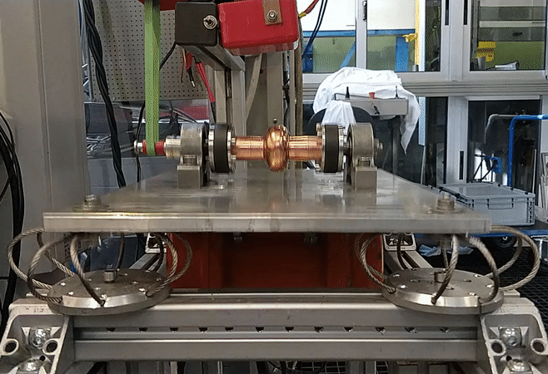
Surface preparation
Rotation
Courtesy of Eduard Chyhyrynets
Vibration
Vibrotumbling

Slide 14
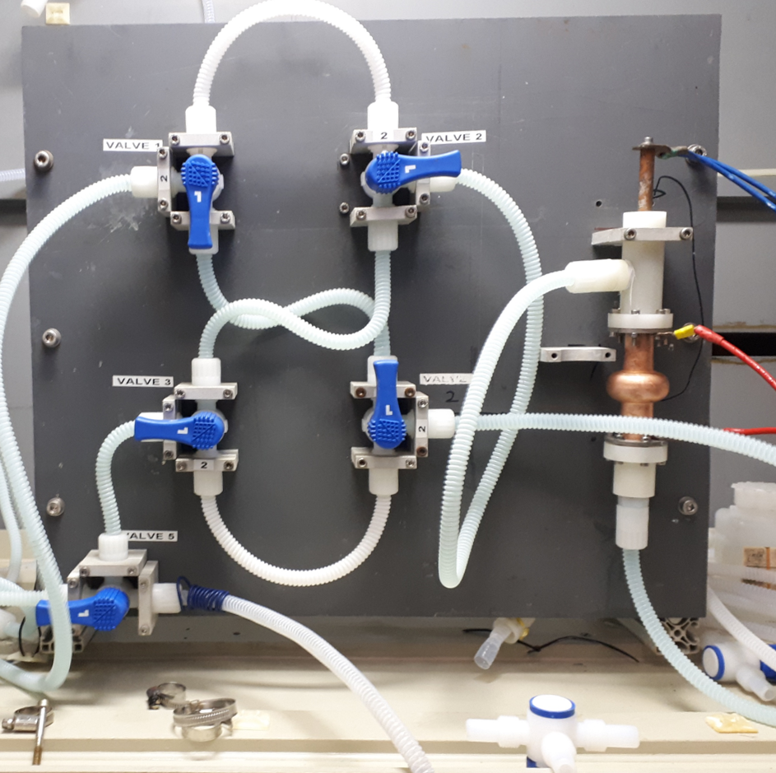
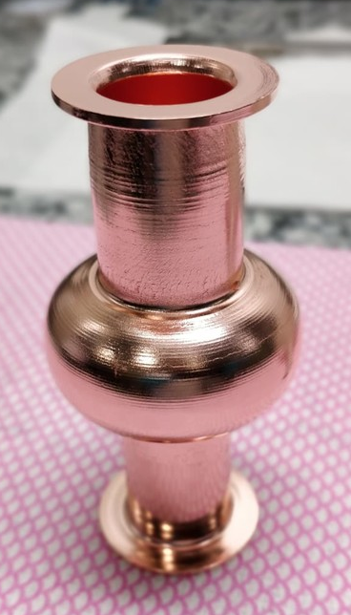
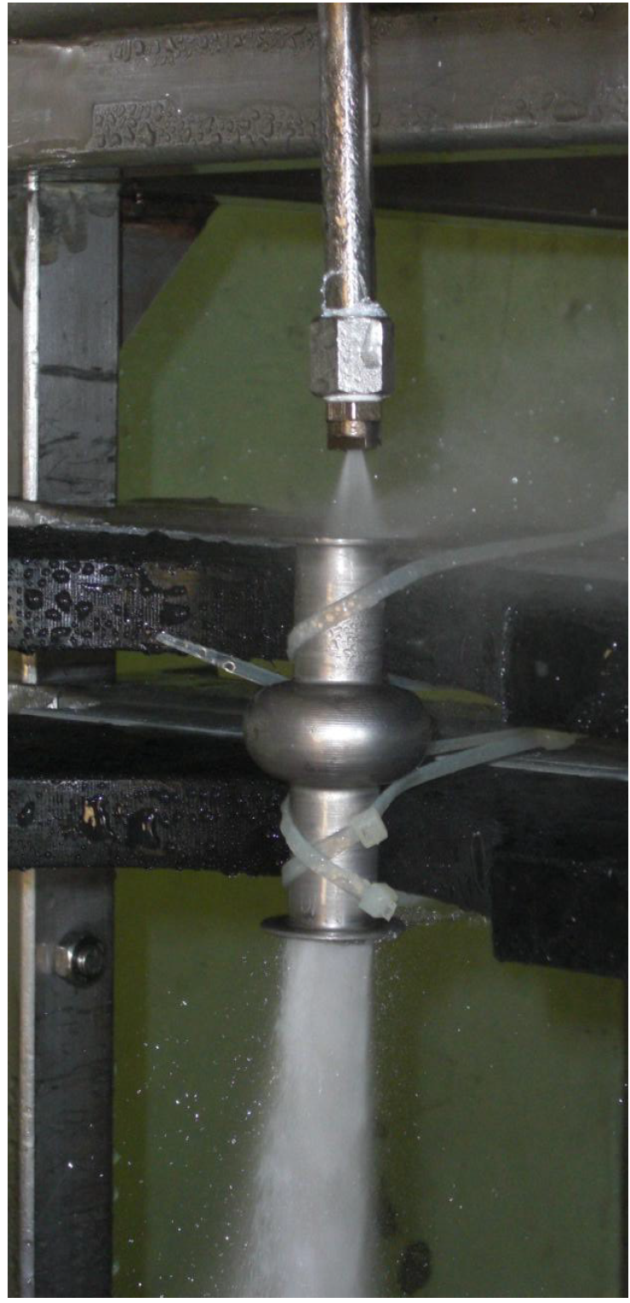
Chemical preparation
Deoxidation
Electropolishing
Chemical polishing SUBU
HPR
HPR set up
Vertical electropolishing set up

Slide 15
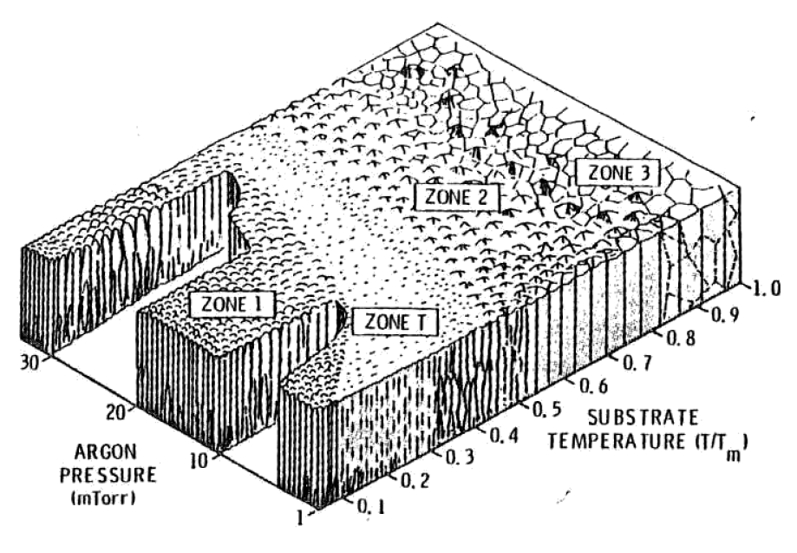
PVD process by DC Magnetron Sputtering
See Pira’s lecture (30/09)
High substrate temperature
Niobium
Copper @550°C
J. A. Thornton and D. W. Hoffman, “Stress-related effects in thin films,” Thin Solid Films, vol. 171, no. 1, pp. 5–31, 1989.

Slide 16
PVD process by DC Magnetron Sputtering
High substrate temperature
Thick film ~70 µm
Thin film ~2-3 µm
Niobium
Thick film
Nb bulk like properties
Decrease thermal boundary resistance
Copper

Slide 17
PVD process: thick films by long pulsed DCMS
Single Layer thickness
100 - 500 nm
DC ON
Thick film ~70 µm
Niobium
DC OFF
Copper
Total time of process ~ 5 hours

Slide 18
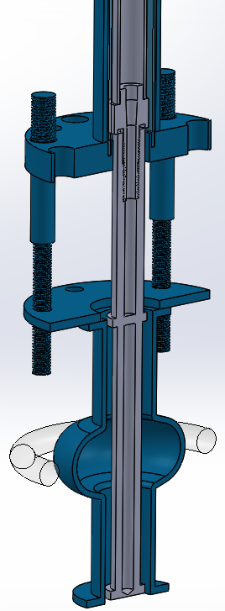
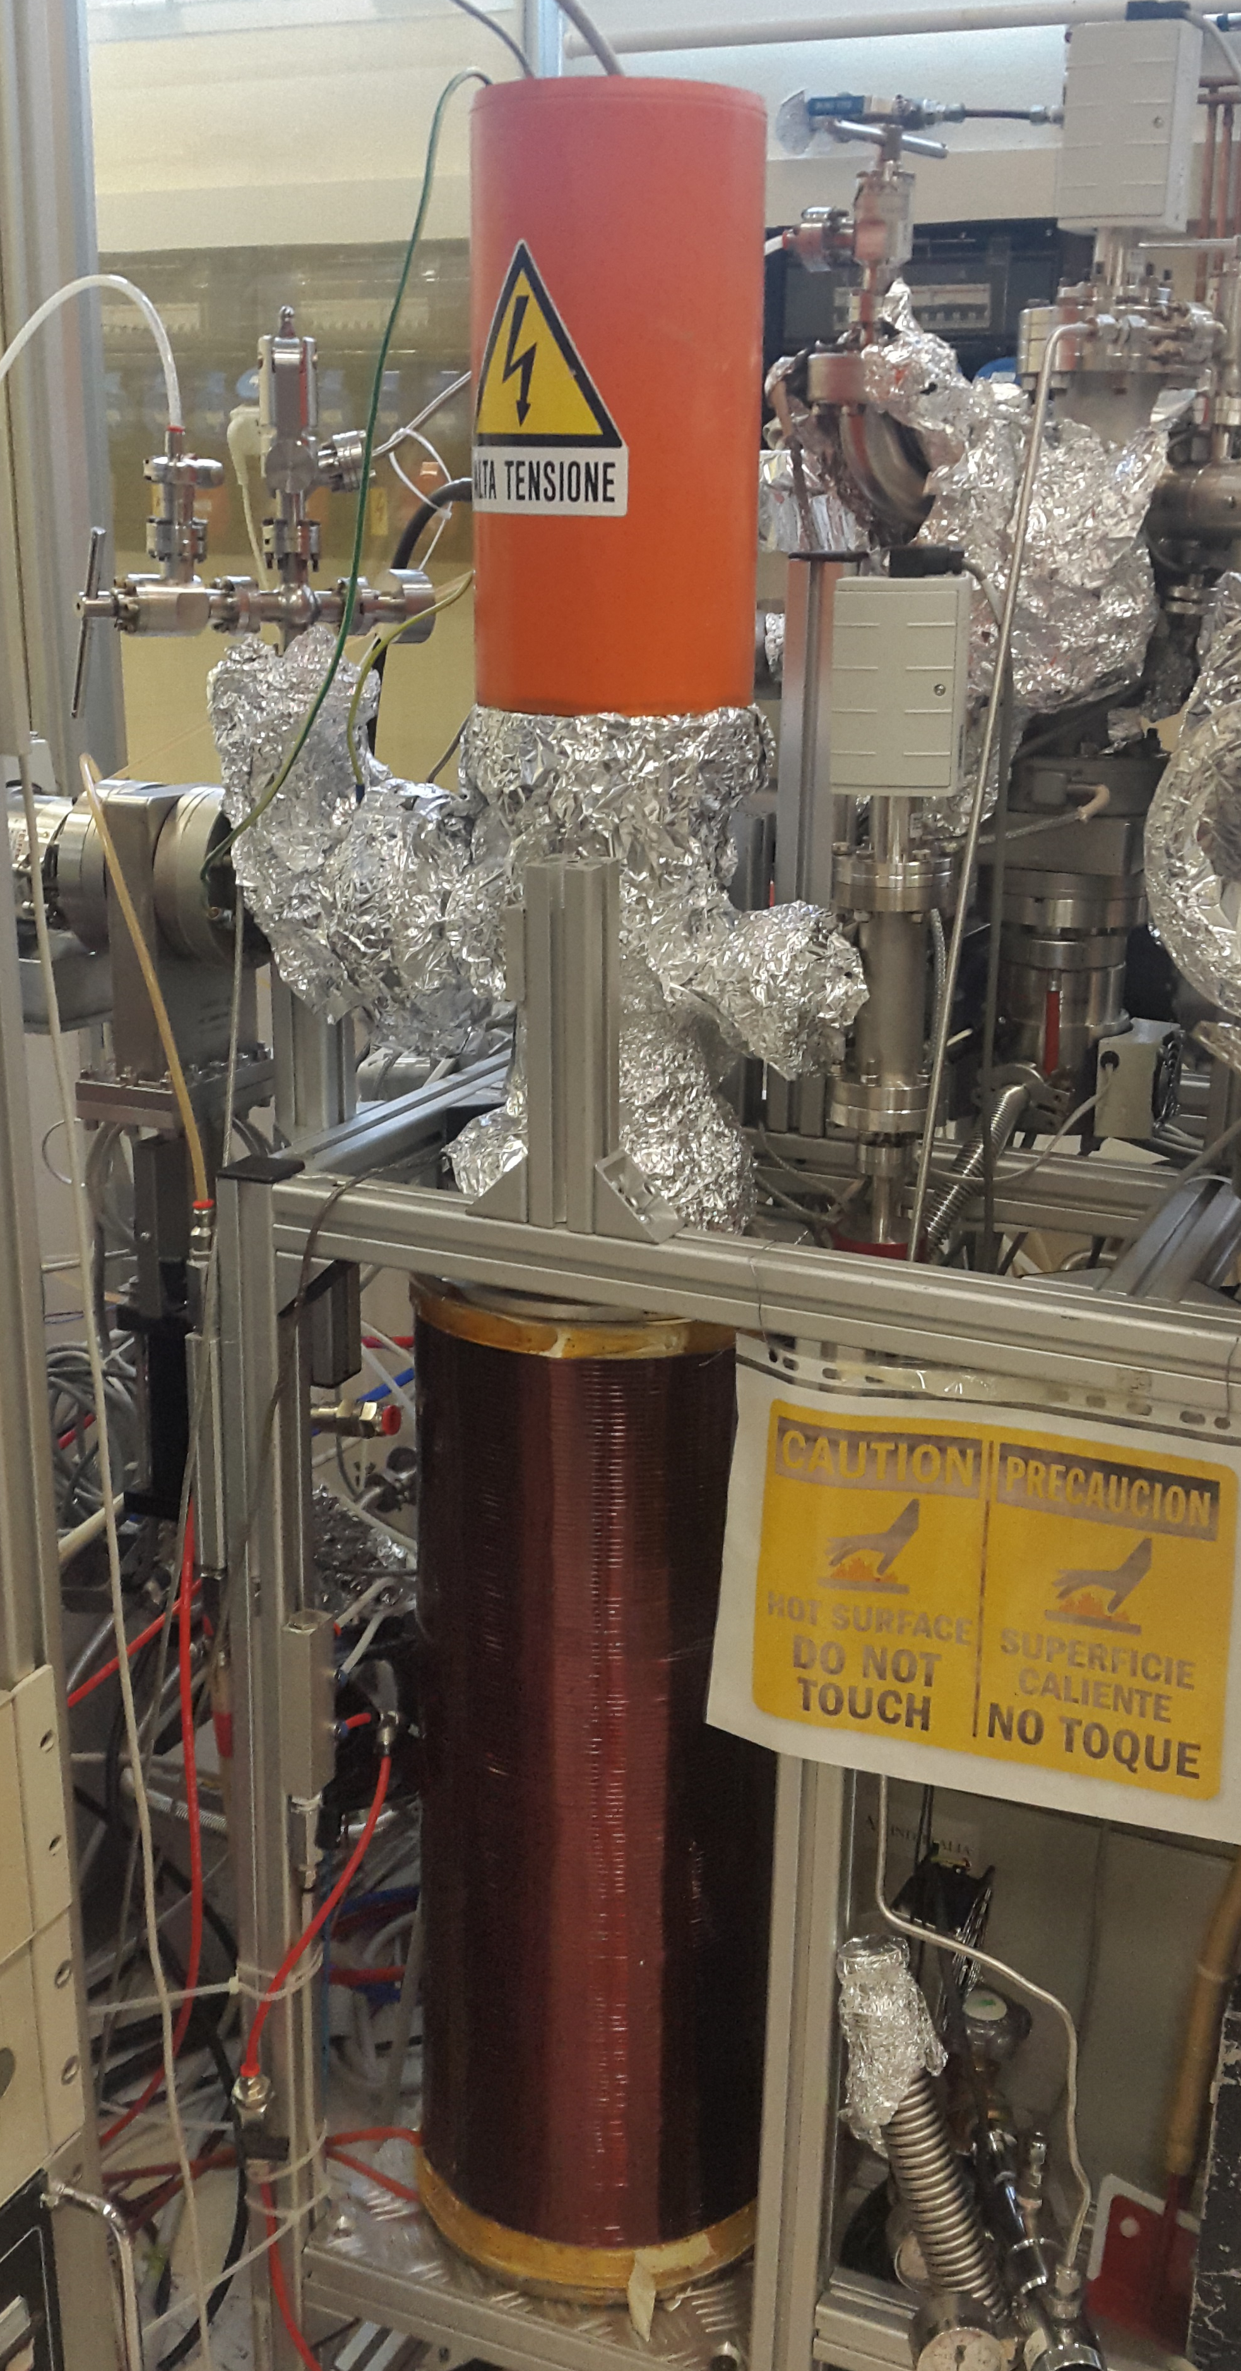
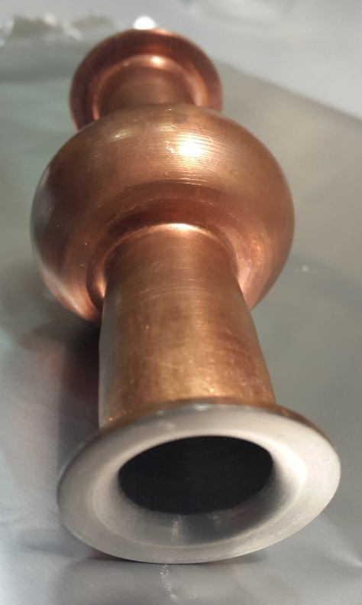
PVD process: thick films by long pulsed DCMS
Grounded
Potential
Baking = 600°C for 48 hours
Temperature = 550 °C
Base pressure < 1 x 10⁻⁹ mbar
Magnetic Field = 830 Gauss
Current = 1 A
Sputtering system for 6GHz cavities
IR lamp
Cu cavity
Nb on Cu 6GHz cavity
Nb cathode

Slide 19
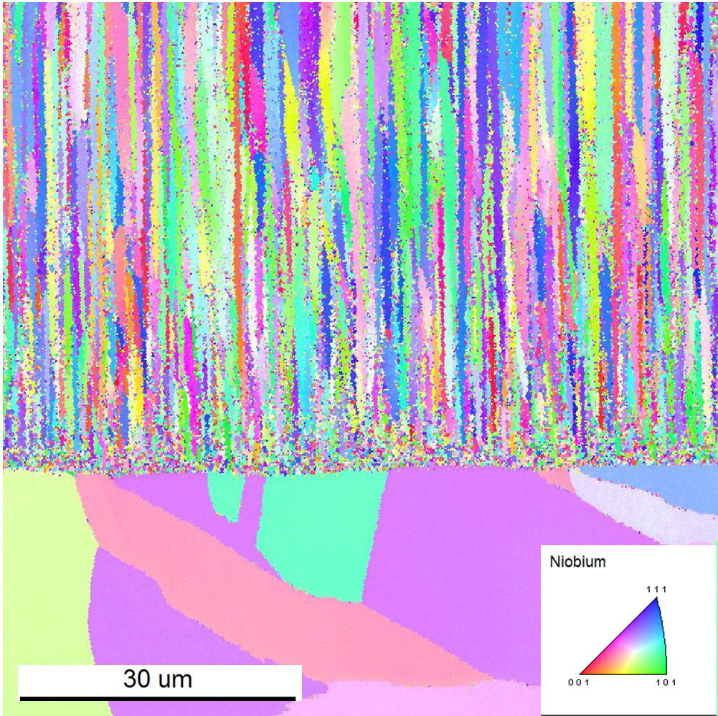
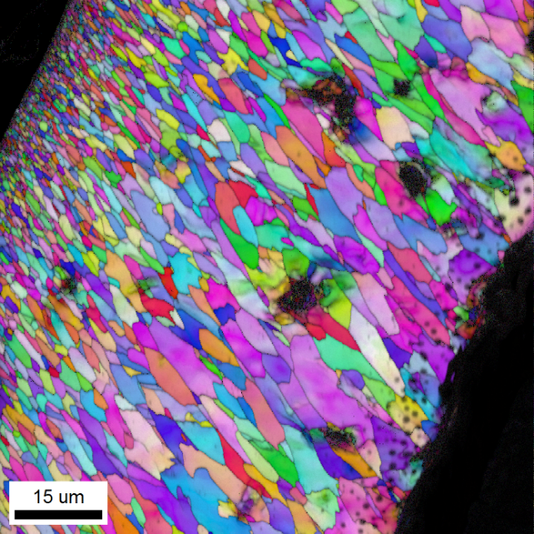
Thick Film morphology by EBSD
Cu
Columnar growth
Larger grains
Courtesy of STFC (Reza Valizadeh)
Cu
Cav 21: 75 µm
500nm single layer thickness
Cav 16: 75 µm
500nm single layer thickness

Slide 20
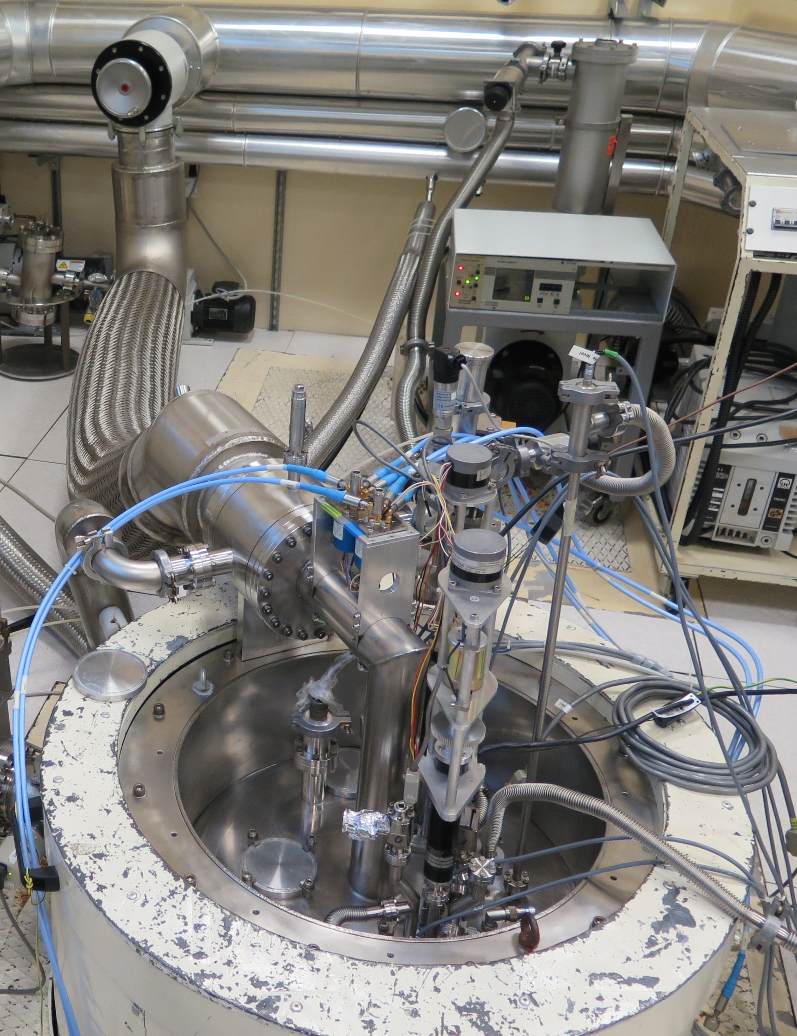
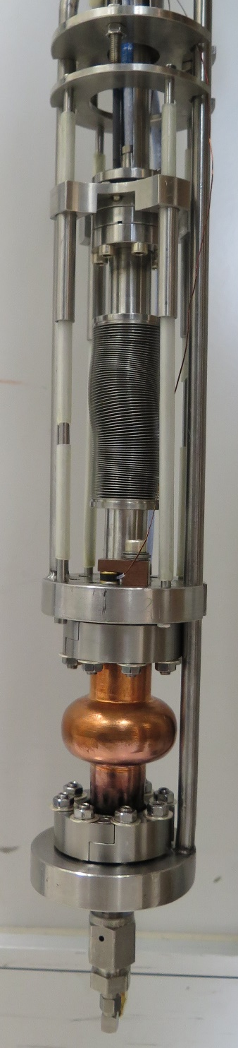
RF characterization
Cavity inserted in cryostat in order to cool down
After cool down, Q vs Eacc is measured 4,2K and 1,8K.

Slide 21
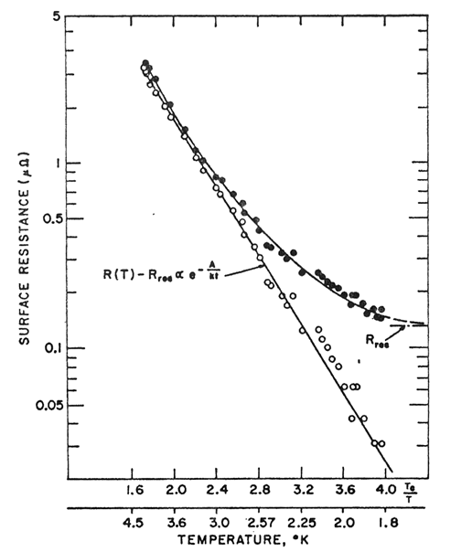
RF characterization
Nb Bulk @1,8K
R_{res}
Predominant @1,8K
Nb on Cu Thick film @1,8K
R_{bcs}
Predominant @4,2K
See Vaglio’s lecture
Nb on Cu Thick film @4,2K

Slide 22
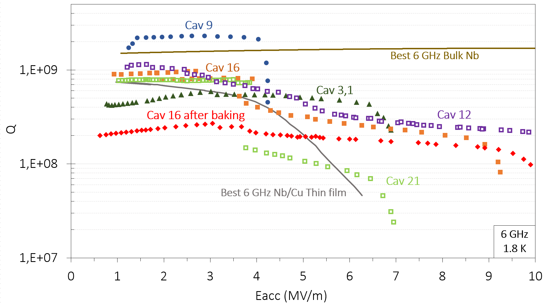
RF characterization @1,8K 6GHz
One shot mode:
Cav 9
Cav 3,1
Multilayer mode:
Cav 12
Cav 16
Cav 21

Slide 23
RF characterization @1,8K 6GHz dependence of single pulse thickness
Nb Bulk

Slide 24
RF characterization @1,8K 6GHz dependence of single pulse thickness
Nb Bulk
Systematically higher Q
and higher Eacc
Single pulse thickness 500nm

Slide 25
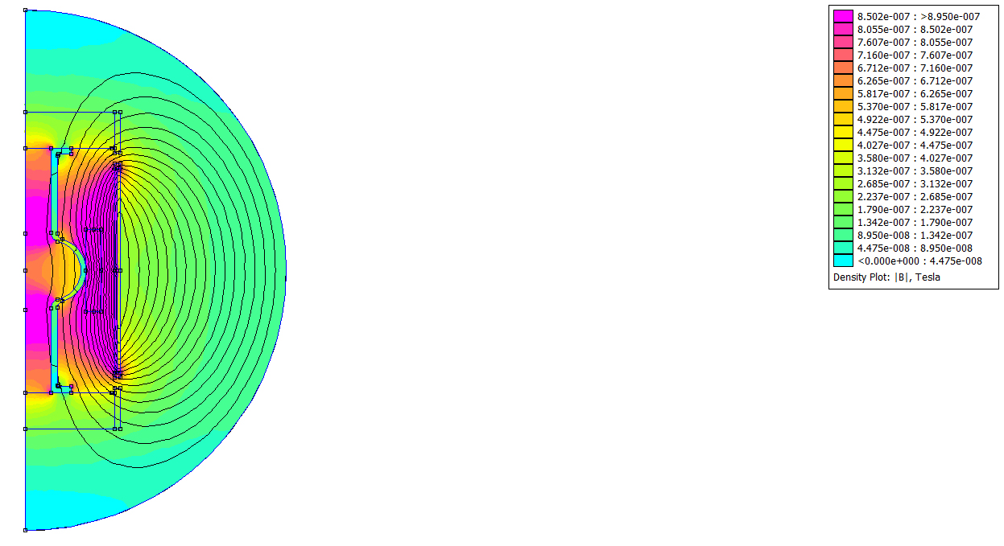
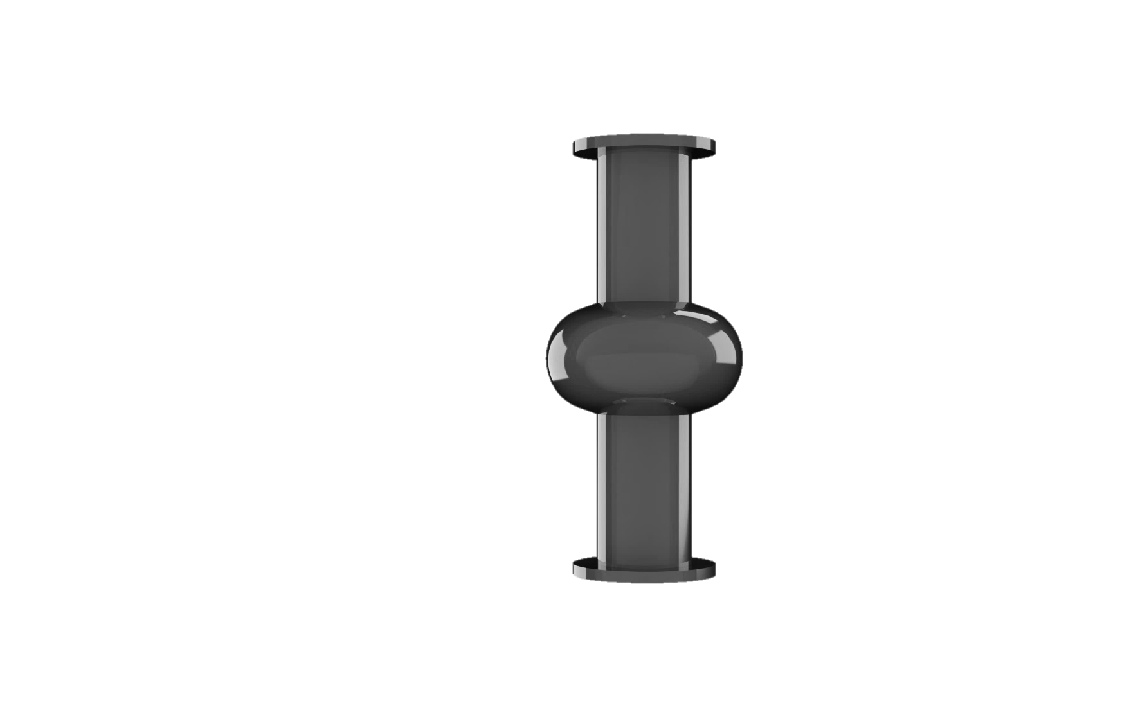
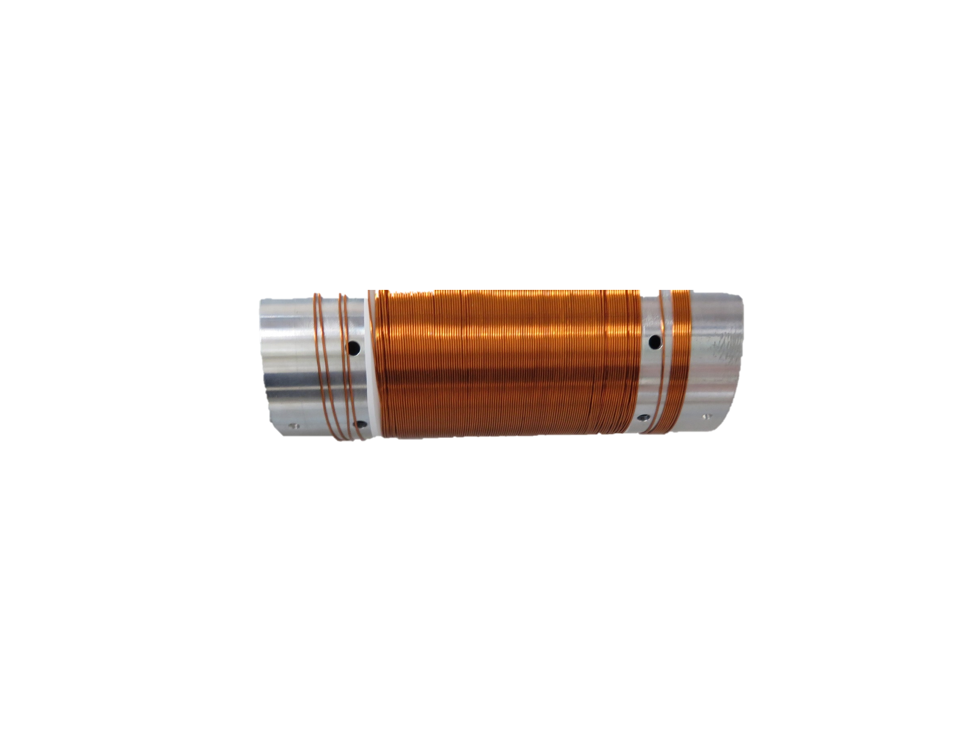
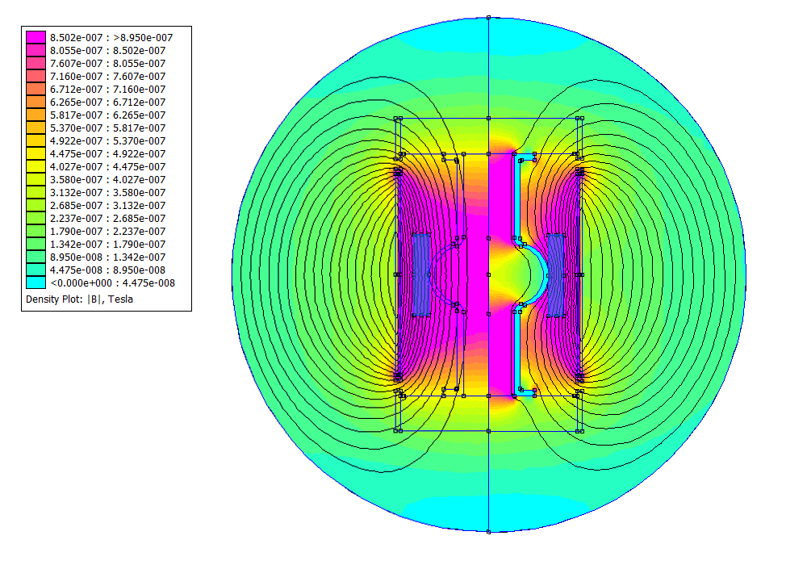

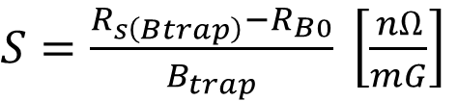

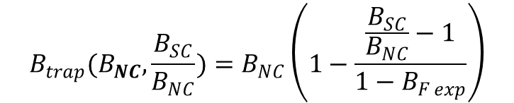
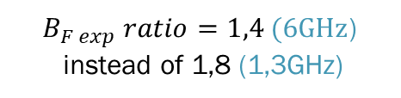
Magnetic flux trapped study
$$R_{s}= R_{BCS}+ R_{res}$$
$$B_{trap}(B_{NC},\frac{B_{SC}}{B_{NC}})=B_{NC}\left(1−\frac{\frac{B_{SC}}{B_{NC}}−1}{1−B_{F exp}}\right)$$
$$R_{res}= R_{s(Btrap)}+ R_{0}$$
Trapped magnetic flux
$S=\frac{R_{s\left(Btrap\right)}−R_{B0}}{B_{trap}} \left[\frac{nΩ}{mG}\right]$
Increase R_{res} !!
$B_{F exp} ratio=1,4 (6GHz$)
instead of 1,8 (1,3GHz)
Martinello 2015, «Trapped flux surface resistance analysis for different surface treatments», Proceedings SRF2015, Whistler, Canada

Slide 26
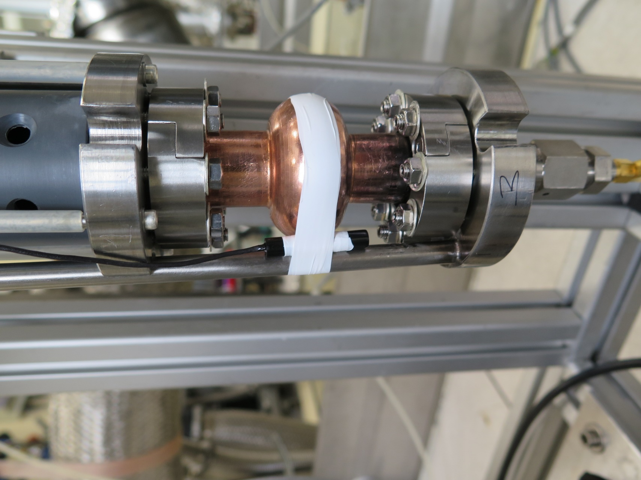
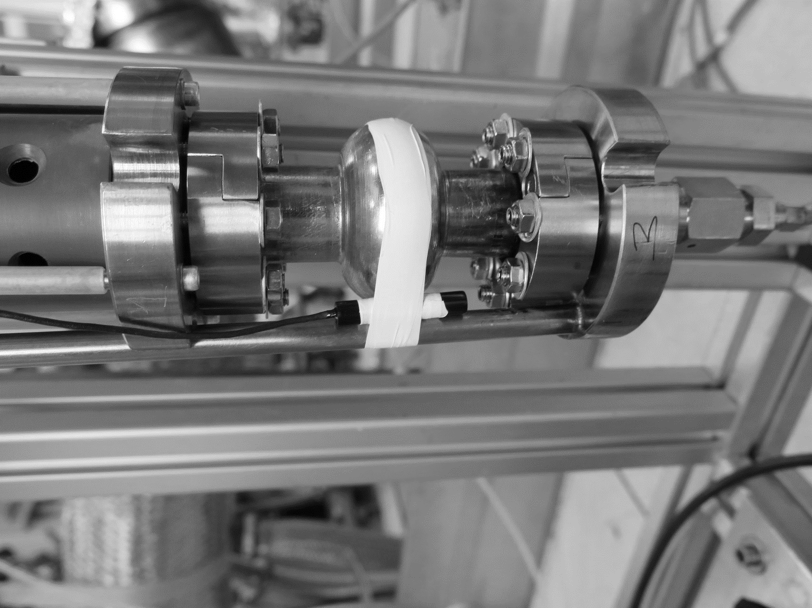
Magnetic flux trapped study
0mG (Compensation)
No B applied
Nb04
50mG
180mG
100mG
1.8K
6GHz
Niobium Bulk

Slide 27
Magnetic flux trapped study
1.8K
6GHz
Cu39
0mG (Compensation)
No B applied
180mG
50mG
Nb on Cu
thin film

Slide 28
Magnetic flux trapped study
It is needed more statistic to confirm but this data indicates that Nb bulk cavities are more sensitive to magnetic field respect to thin film cavities, as expected
Effect higher in Bulk Nb
Thick films effect?…

Slide 29
Conclusions
Thick film is a promising approach in order to push the limits of the Nb on Cu cavities technology.
The effect of the surface preparation and single pulse thickness is fundamental for the cavity performance.
Magnetic flux trapped in 6GHz cavities study will include a thick film RF characterization.

Slide 30
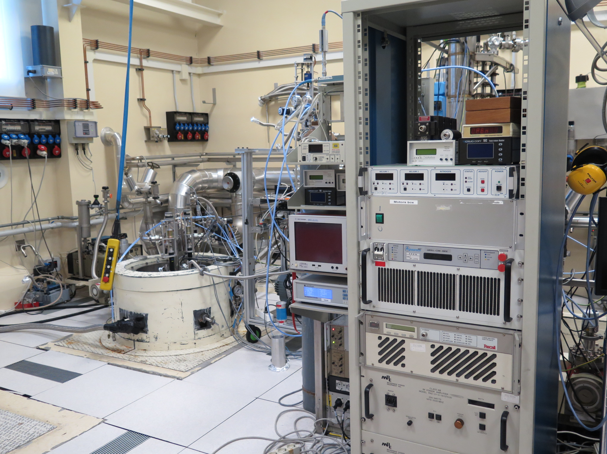
Thank you!

