Slide 1



Student Workshop on Superconductivity and Applications
Development of Superconducting MgB2 Wires
Paola Mauceri
ASG Superconductors
EASITrain – European Advanced Superconductivity Innovation and Training. This Marie Sklodowska-Curie Action (MSCA) Innovative Training Networks (ITN) has received funding from the European Union’s H2020 Framework Programme under Grant Agreement no. 764879

Slide 2
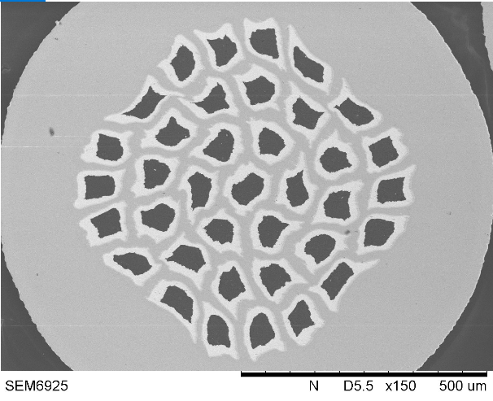
Outline
Why MgB2?
MgB2 application matrix
ASG Superconductors company
Columbus MgB2 Unit
MgB2 production process
MgB2 wires production process
MgB2 wires quality control
MgB2 wire configurations
Conclusion

Slide 3
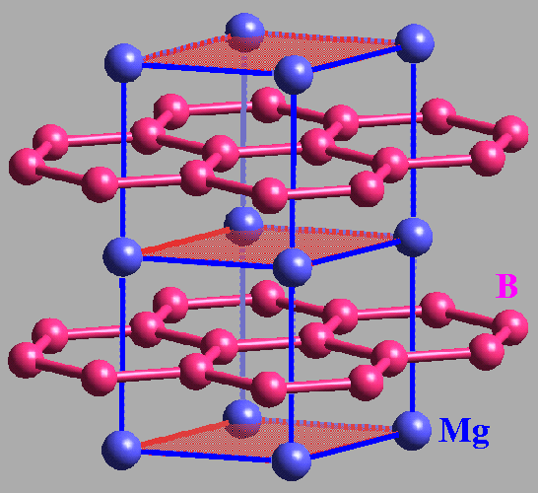
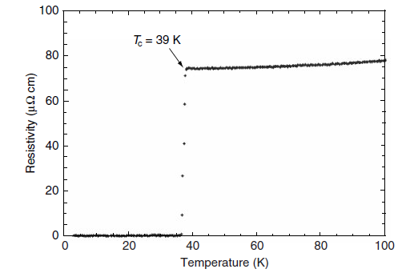
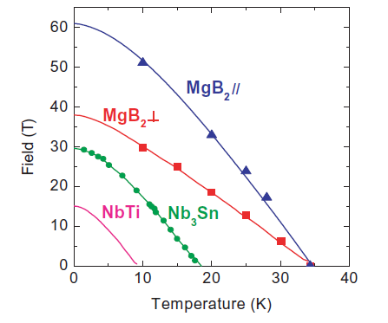
Why MgB2?
Simple composition and structure:
2 elements
Hexagonal crystal structure
Graphite type structure
Relatively high Tc
High critical field
Iwasa Y et al. 2006
A round table discussion on MgB₂:
towards a wide market or a niche production?
IEEE Trans. Appl. Supercond 16 1457-64
Nagamatsu et al. 2001
Superconductivity at 39K in magnesium diboride
Nature 410 63-4

Slide 4
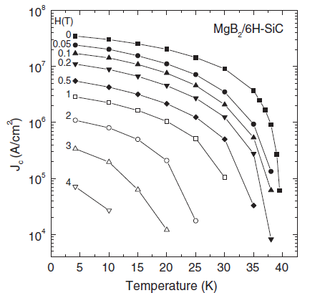
Why MgB2?
Compound | Mass density
Copper | 8,96 g/cm³
NbTi | 6 g/cm³
Nb3Sn | 5,4 g/cm³
YBCO | 6,35 g/cm³
BSCCO-2223 | 6,5 g/cm³
MgB₂ | 2,6 g/cm³
Low material cost
PIT process for wire fabrication
MgB2-based systems could be cooled by modern cryocooling devices
Large critical current density
Low density
Zeng et al. 2003
Superconducting MgB₂ thin film on silicon carbide substrate by HPCVD
APL 82 2097-9

Slide 5
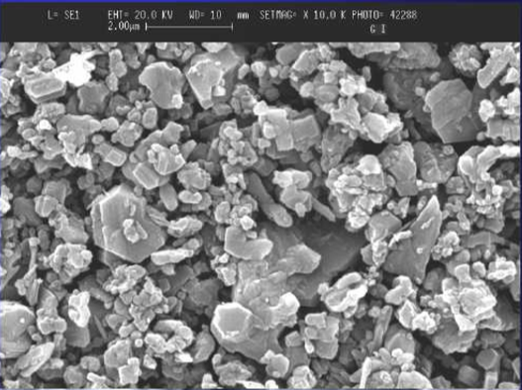
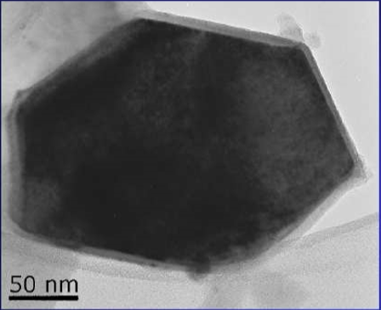
MgB2 Powder SEM Image
Hexagonal structure

Slide 6

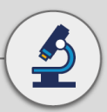

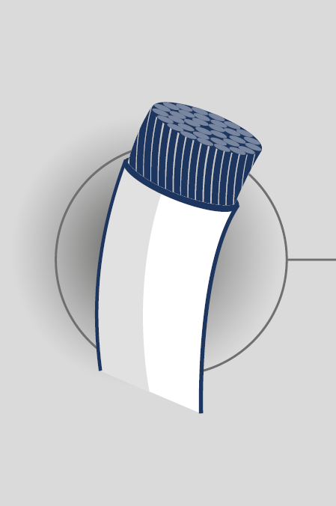





MgB2 application matrix
 | cables | Rotating machines (motors/ generators) | magnets | Fault current limiters | Energy storage devices
Medical
Electricity/ grid
Industrial
Aircraft/ aerospace
Energy generation
Naval
Notes:
2005
MRO - First MRI open space system , cryogen free , with MgB2conductor
2010 to date
The development of the second leg
IBA - one of two commercial systems for proton therapy utilizing a high field cryogen free system
MRO Rotating - first prototypes for Image Guided Therapy, SC magnets cryogen free that can be moved during operation
UHF MRI
We are also trying hard to introduce SC solutions in a very conservative industry :Energy transportation
SMES
FCL – we are close to install in UK the first induction system at 33 KV with MgB2 conductor

Slide 7




Slide 8
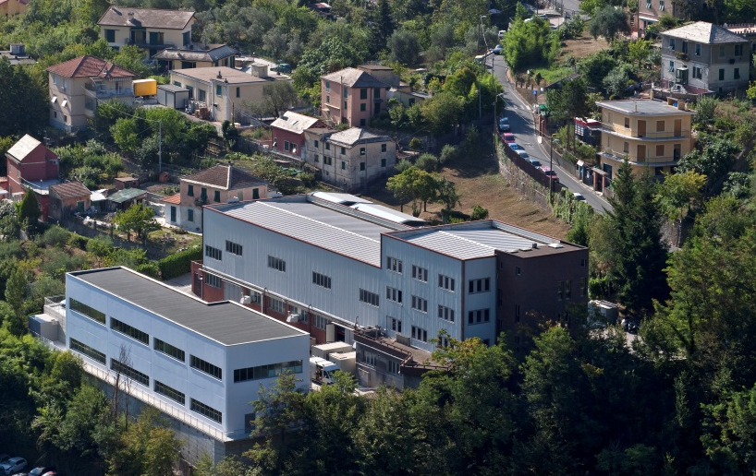
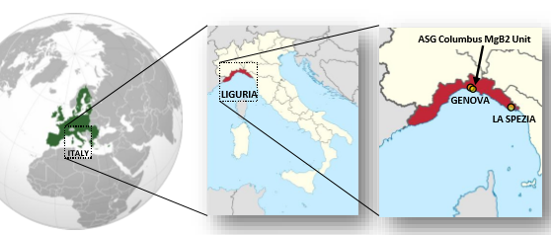
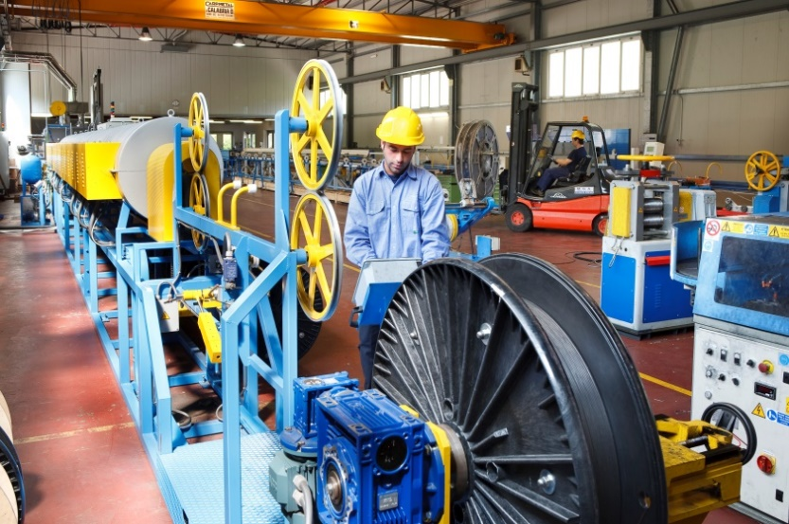
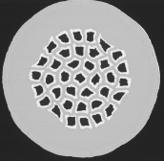

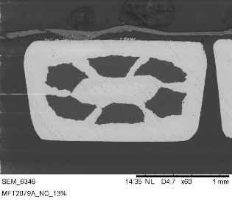
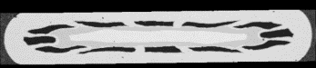
Columbus MgB2 Unit
Round wires
MRO
MRI

Slide 9
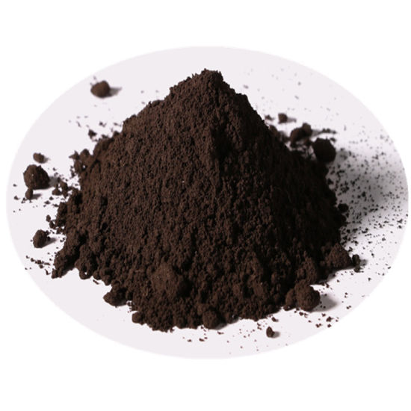
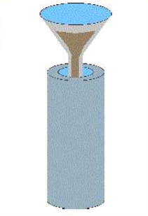
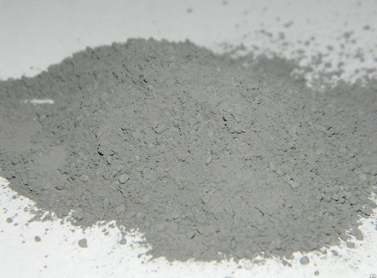
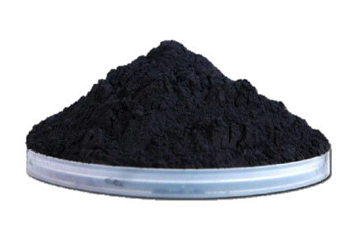
MgB2 Production Processes
B
Mg
IN-SITU
B
Mg
MgB2
EX-SITU

Slide 10
MgB2 Production Processes
In-situ
Low cost
High speed process
Ex-situ
Easier process
Homogeneity over long length
Control of the powder granulometry and purity
Easier insertion of doping
Advantages

Slide 11
MgB2 Production Processes
In-situ
Inhomogeneity over long length
Need of inert sheaths
Ex-situ
Need of hard sheath materials
Disadvantages
More flexible and reliable method!!!

Slide 12
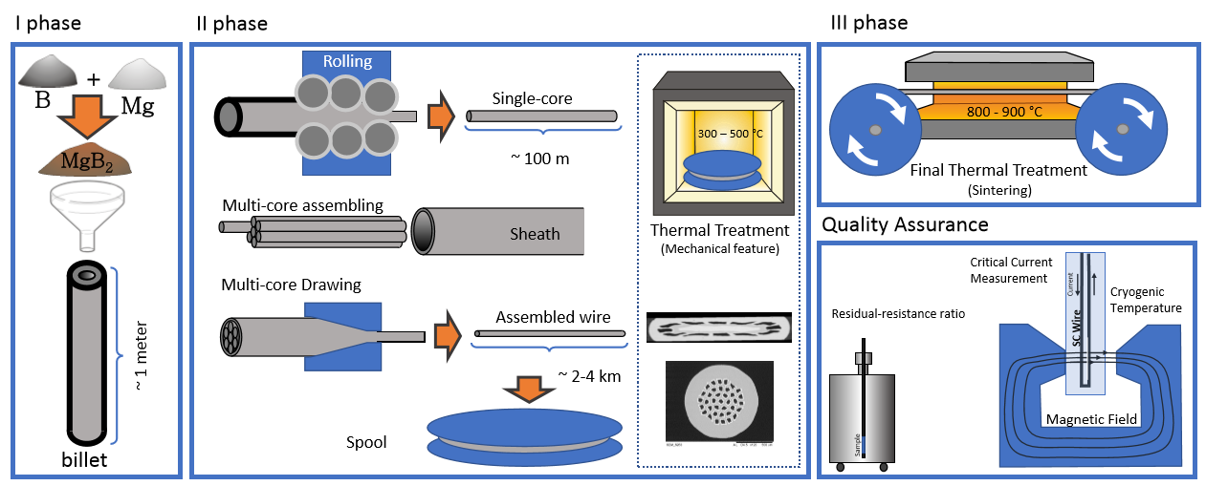
MgB2 Wires Production Process

Slide 13
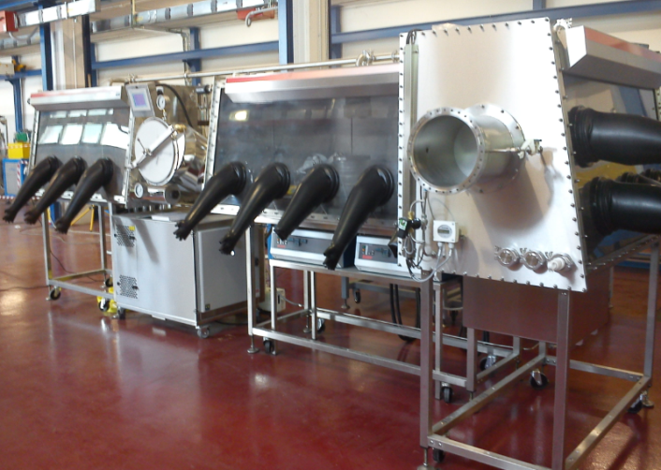
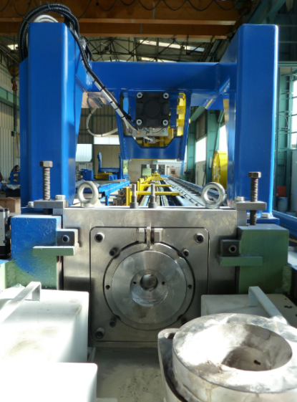
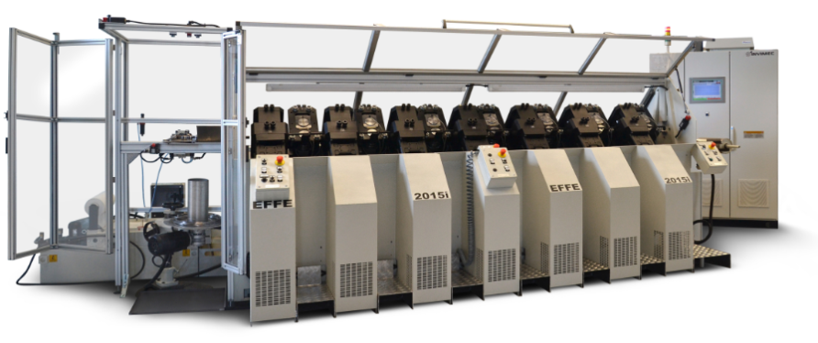
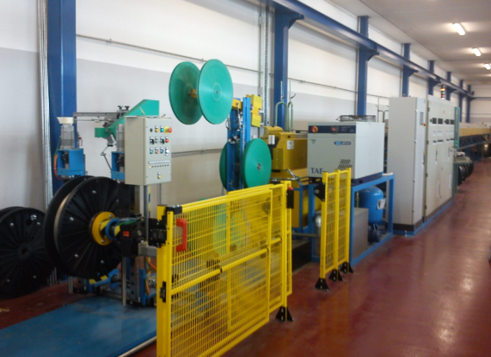
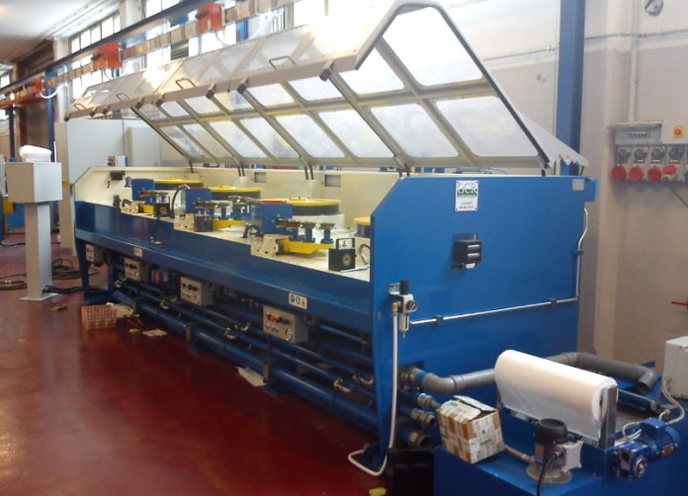
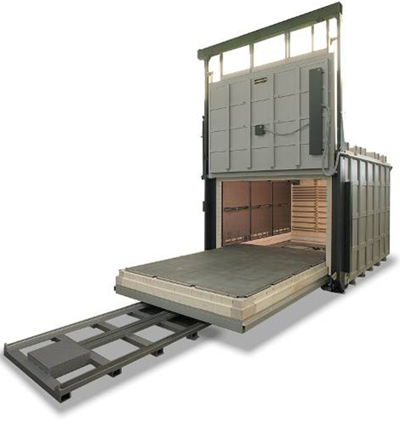
MgB2 Wires Production Process
Powders clean synthesis
Multistep rolling machine
High power straigth drawing machine
20 m long in-line furnace
Multistep drawing machine
4 meter furnace for annealing HT

Slide 14
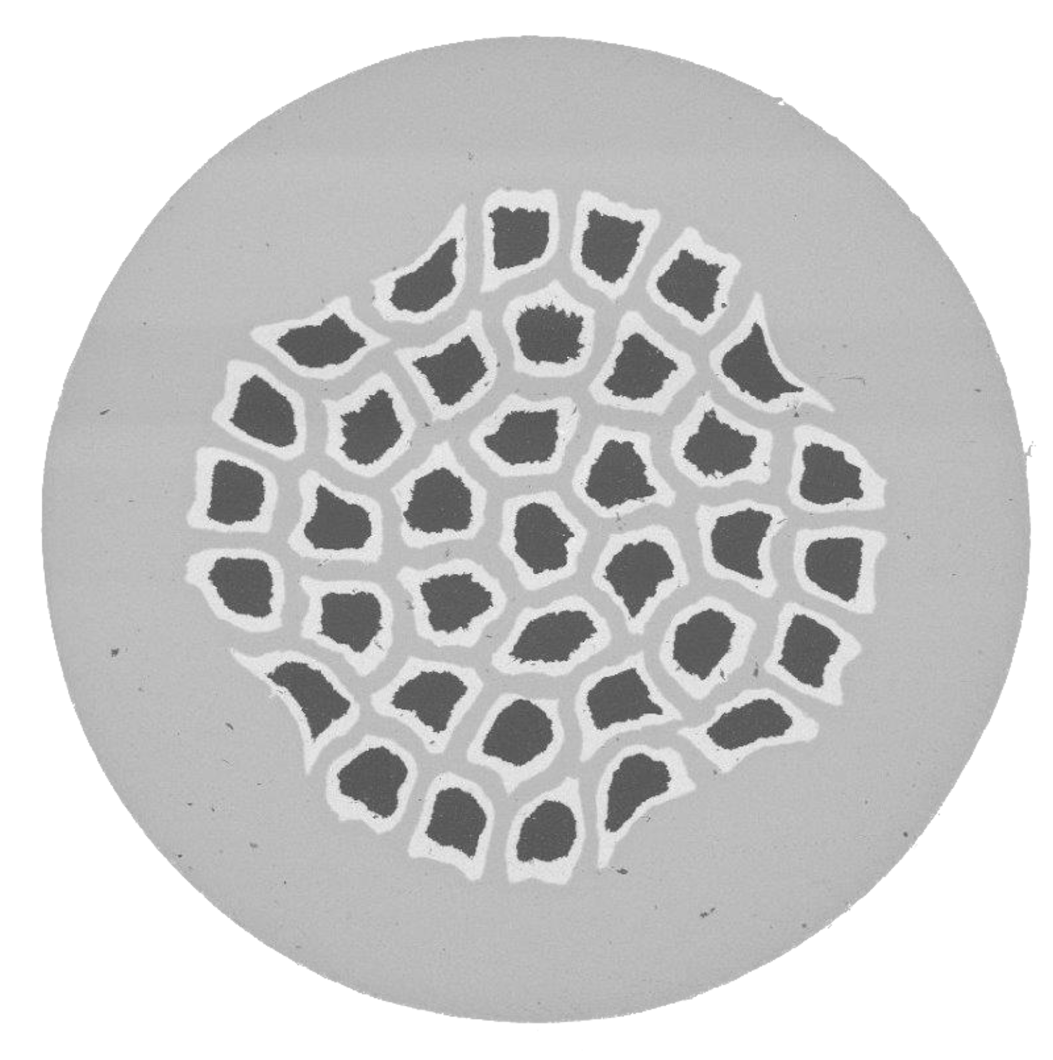
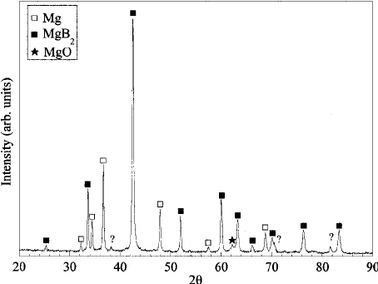
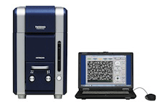
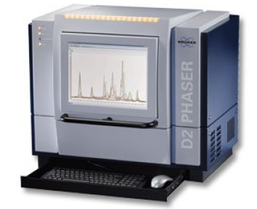
MgB2 Wires Quality Control (ISO 9001:2008)
Structure characterization
SEM and EDS
XRD

Slide 15
MgB2 Wires Quality Control (ISO 9001:2008)
Current transport measurement
Tests parameters range
Field: 0 – 1.8 T
Temperature: 20 – 30 K
Current: 0 – 1000 A

Slide 16
MgB2 Wires Quality Control (ISO 9001:2008)
Residual-resistance ratio (RRR) and Tc Test
Sample

Slide 17
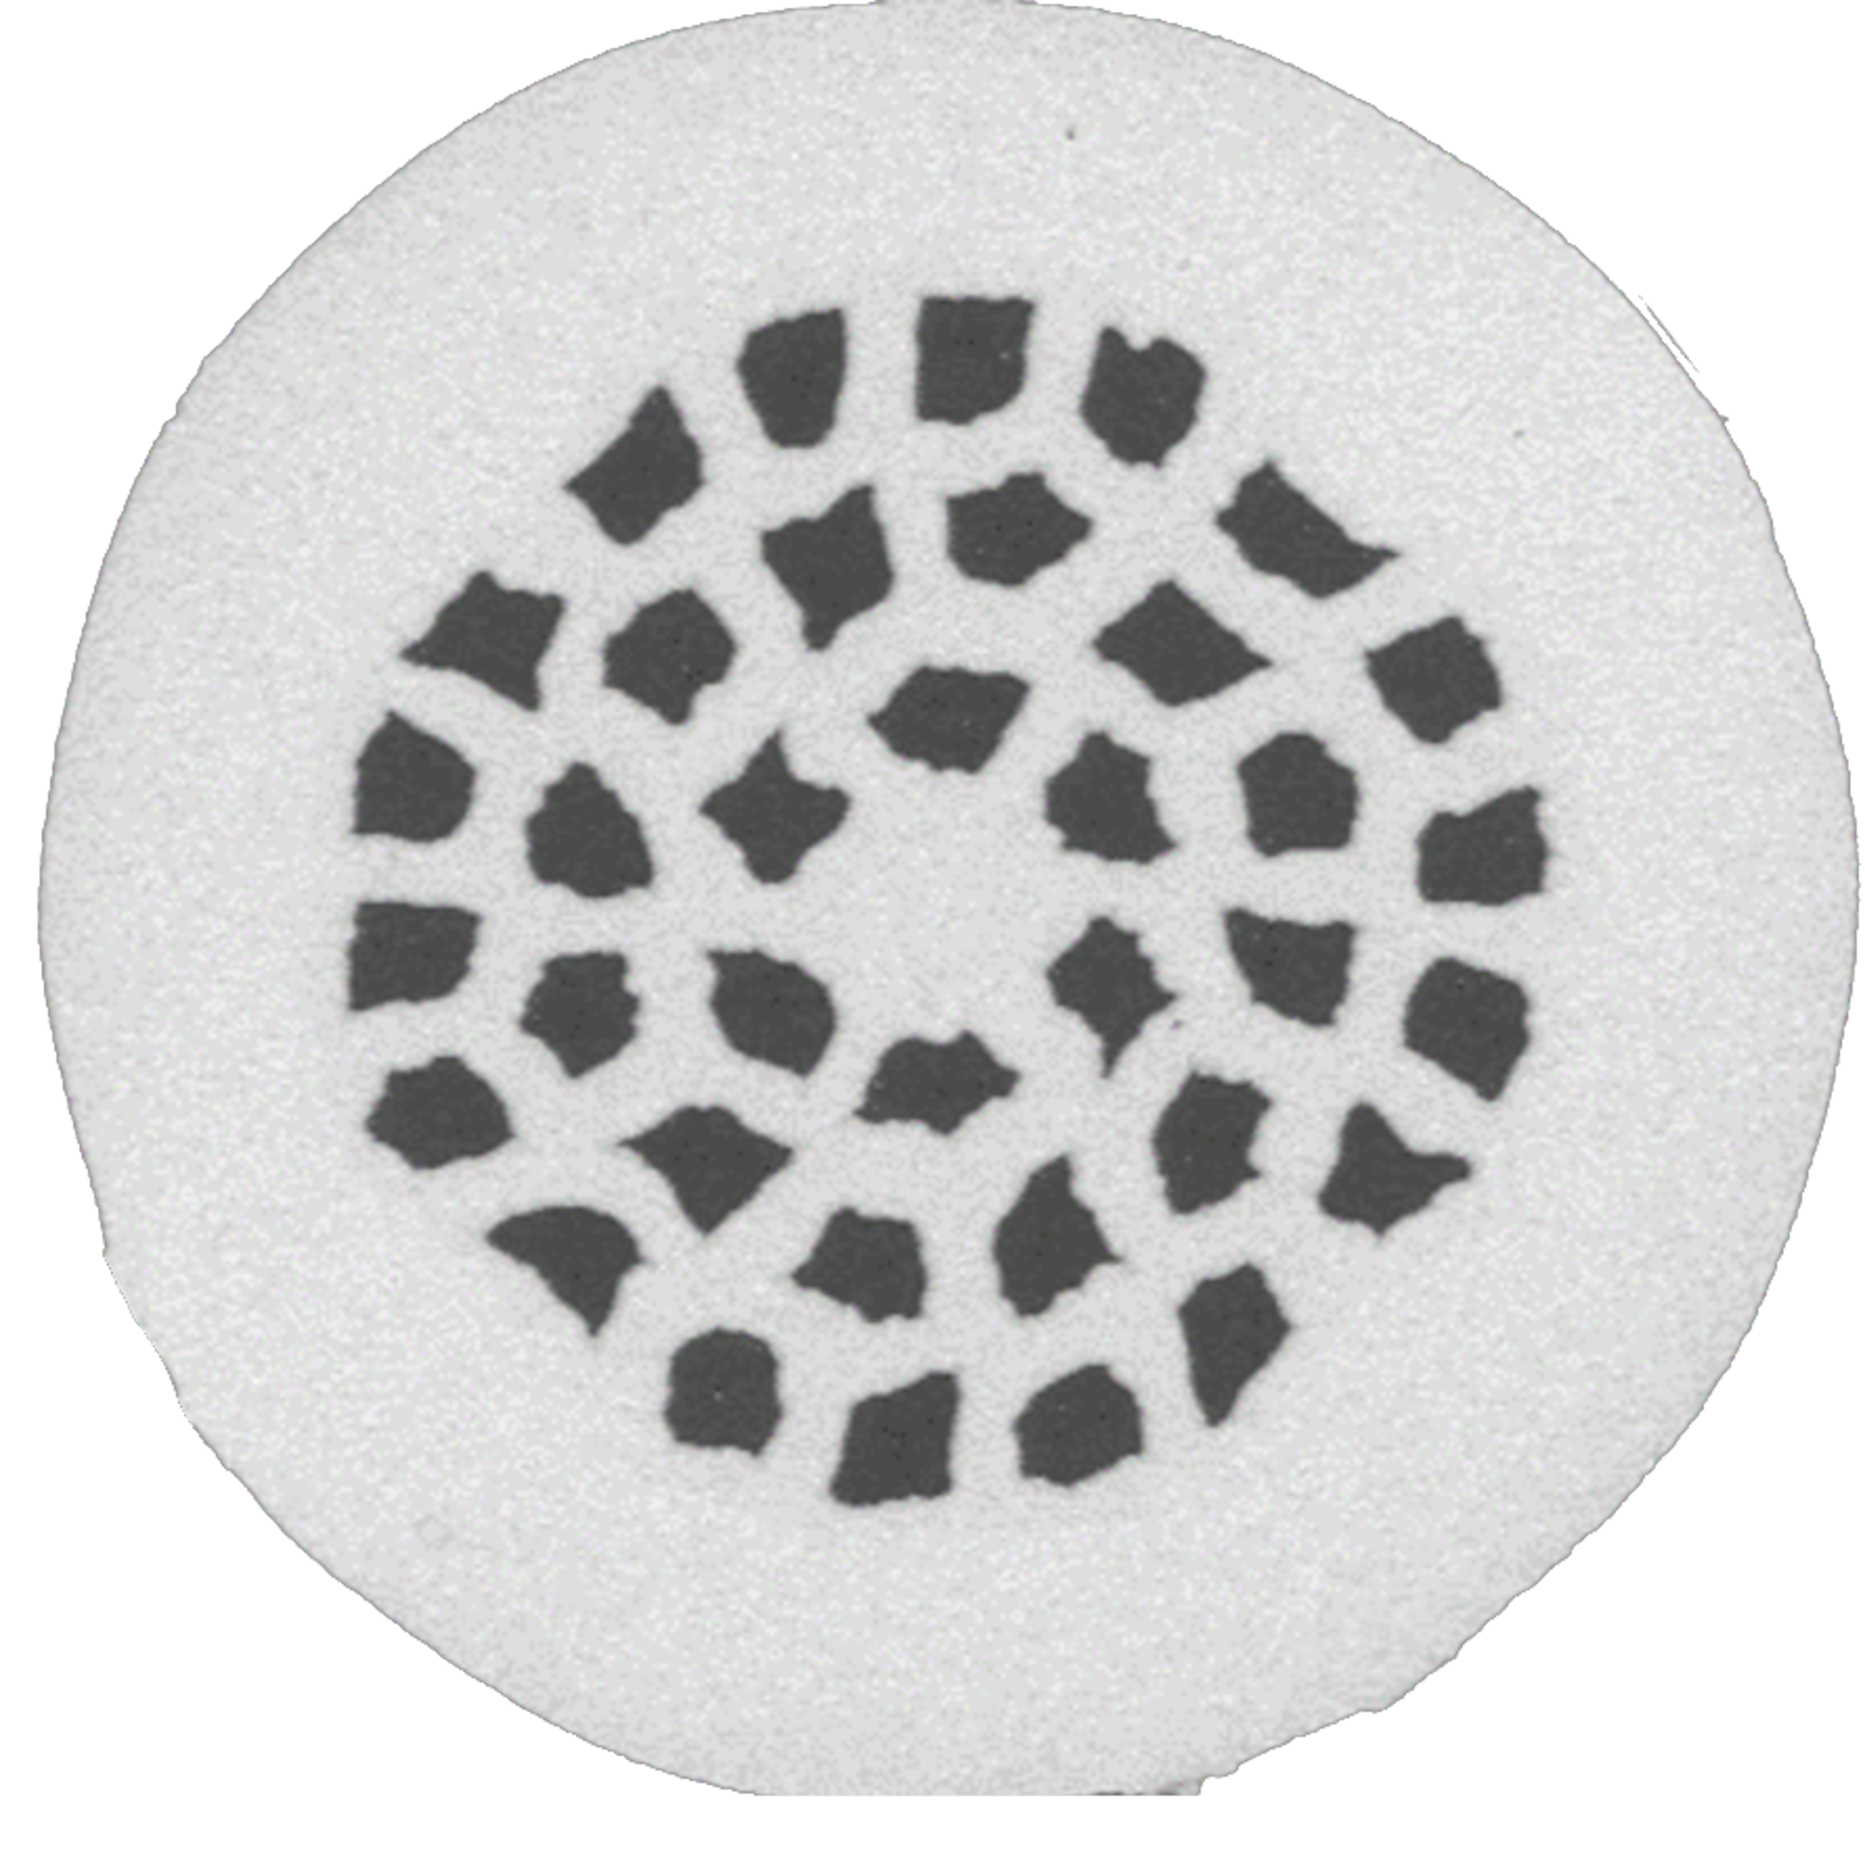
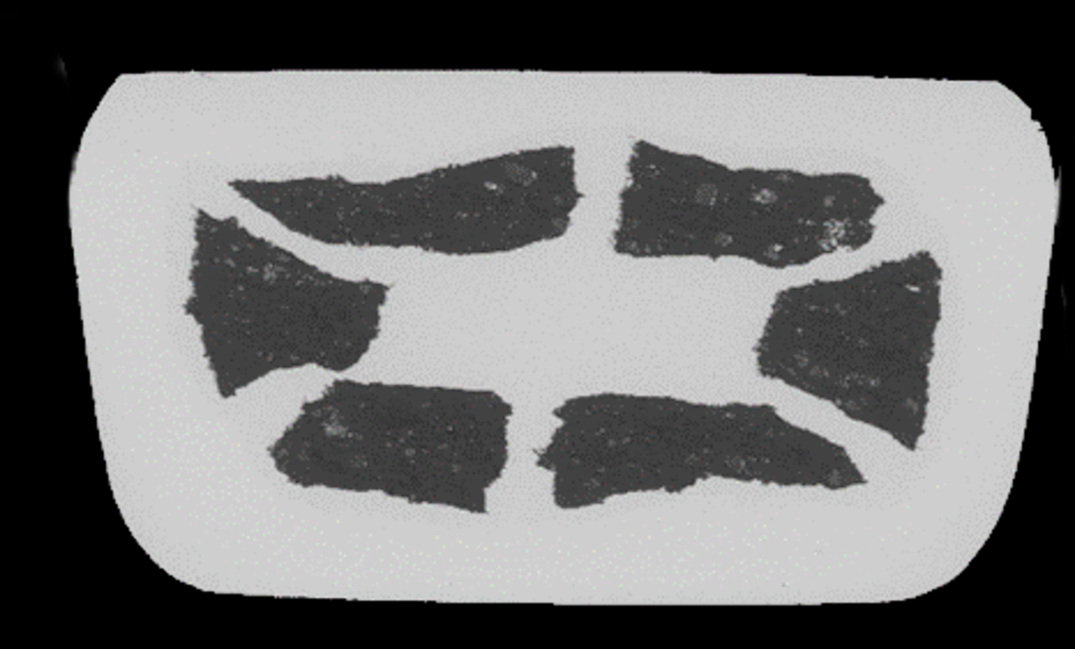
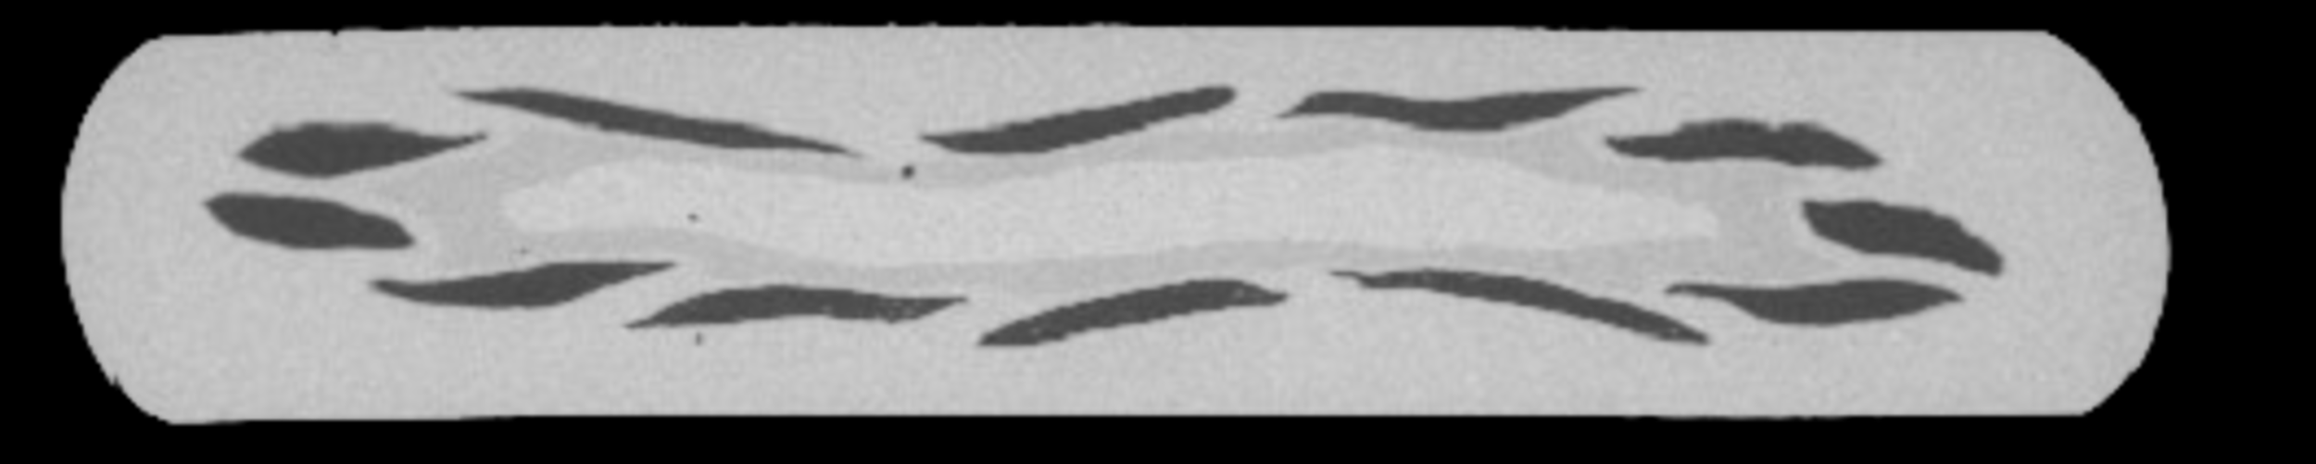
MgB2 Wire Configurations
Round Wires
Diameter: d = 1.33mm
36 filaments
Materials: Monel, Ni
FF: 17%
Diameter: d = 1mm
37 filaments
Materials: Monel, Ni
FF: 14%
Tapes
Dimension: 2mm x 1mm
6 filaments
Materials: Monel, Ni
FF: 29%
Dimension: 3,67 mm x 0,65 mm
12 filaments
Materials: Ni, Iron, Copper
FF: 11%

Slide 18
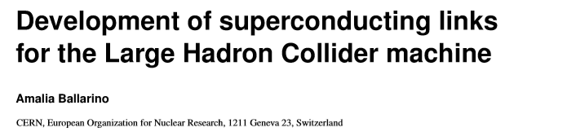
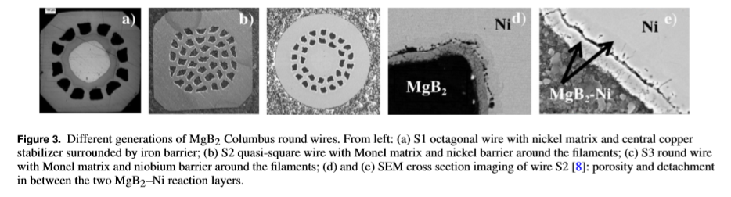
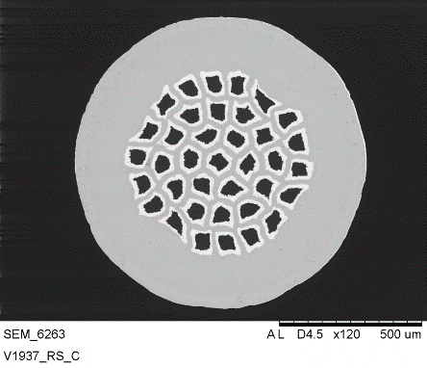
MgB2 Round Wires
Final configuration
Diameter: 0.93mm
37 filaments
Materials: Monel, Ni, Nb
FF: 11.5%
Copper-Tin electrodeposition

Slide 19
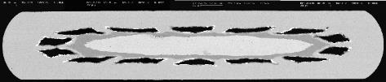
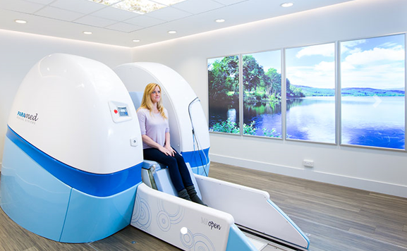

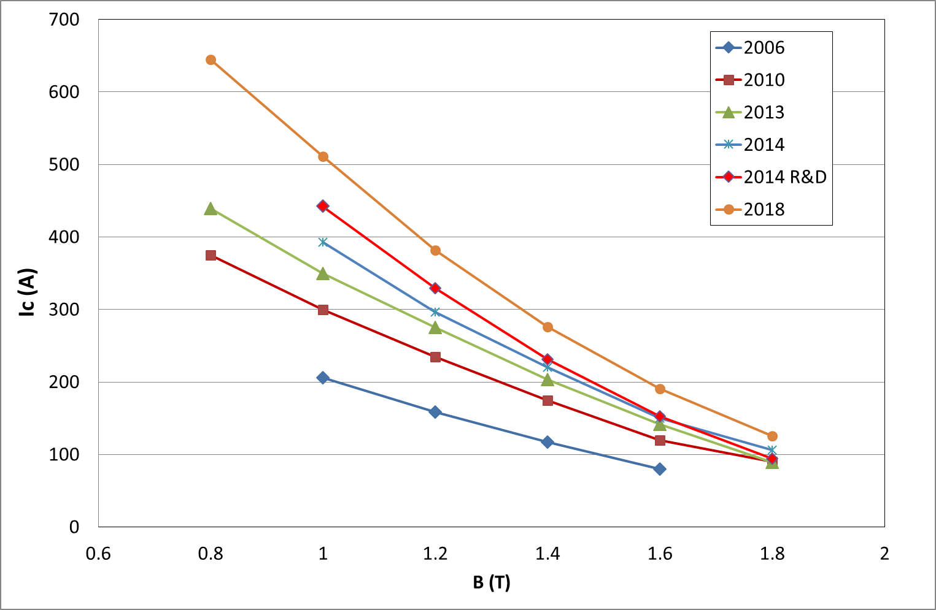
MgB2 Tapes for MRI
Wire layout in 2006:
14 filaments
Unit piece length 1.6 Km
Updated wire layout:
12 filaments
Improved fabrication process
Unit piece length 4.0 Km
Synthesis in controlled atmosphere
MROpen

Slide 20
Conclusion
MgB2 as a SC material, allow to produce high quality superconducting wires for the LHC.
Ex-situ PIT technique has been industrially implement in the new Columbus plant
Several wire configurations have been developed in the last years
MgB2 tapes are an optimal solution for the magnets development of MRI machines.
ASG Superconductors is working in innovative projects that are exploring the opportunity to implement MgB₂ SC technology in many applications such as energy transmission, generation and storage

Slide 21


