Slide 1
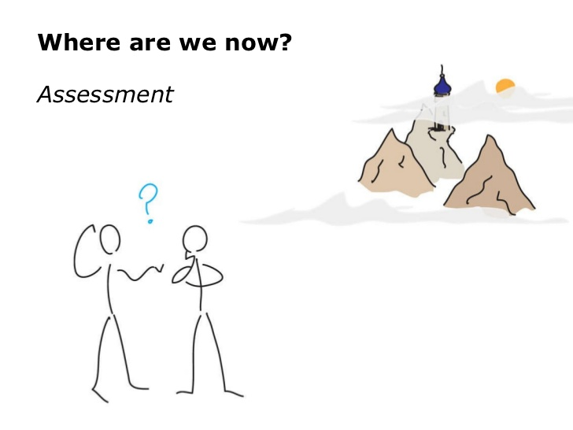
FCC-ee Injector Design and Test Stand at PSI Coordination meeting 03
AGENDA
Organizational aspects
Update on WPs and Tasks
Next steps
P. Craievich – 17.12.2020

Slide 2
Organizational Aspects – Status of the collaboration
CHART proposal approved on 23th of June 2020
The project officially started on 1st of September 2020 – it lasts 4 years
The FCC addendum between CERN and PSI is still pending
PSI cannot start the recruitment process to get additional manpower (still under administrative setup)
    New person at PSI not before April/May
WP3: Addendum between CERN and JICLAB expires in April 2021
WP4/Damping ring parameters: Addendum between CERN and INFN is signed (?). Contact person at LNF is Catia Milardi.
  Selection starts for 3 candidates
  Some information is missing to complete the overall parameters table in WP0.2

Slide 3
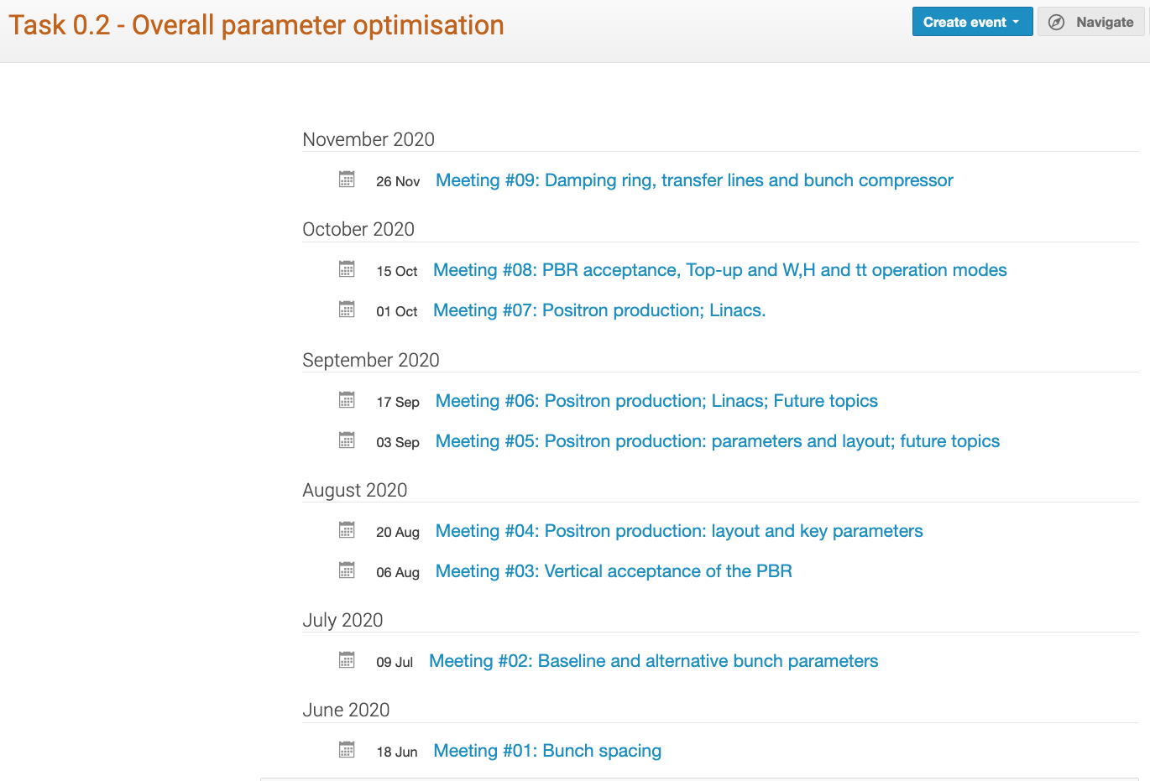
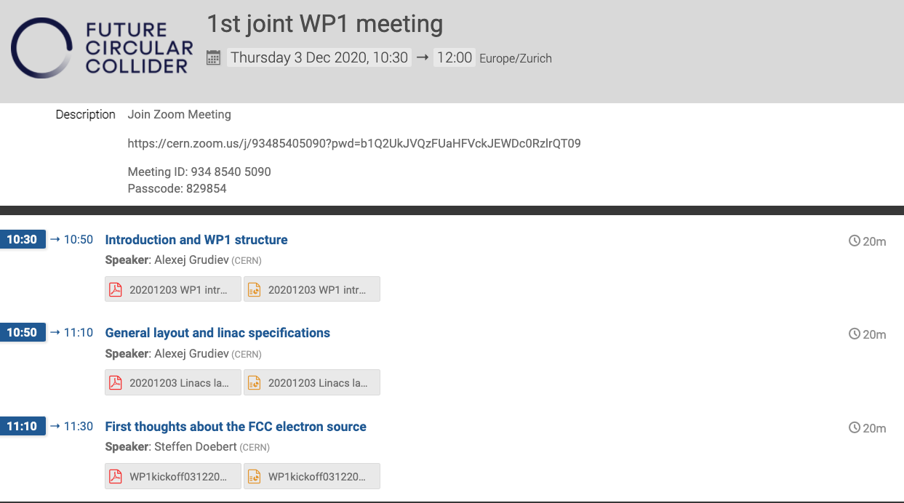
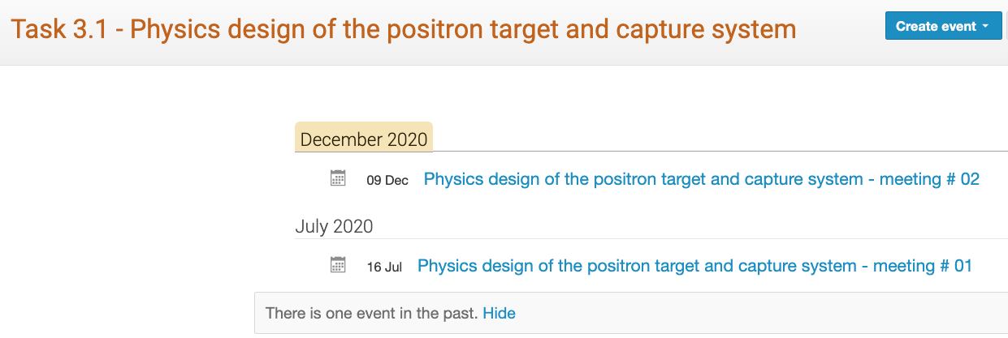
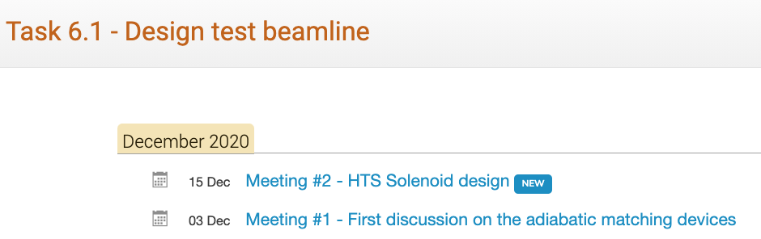
Organizational Aspects – Activates on going
WP0.2: Overall parameter optimization – every two weeks
WP1: kick-off meeting on 3/12/2021
WP3 and WP6: join meeting for the physics design of the positron source

Slide 4
Update on WPs and Tasks

Slide 5

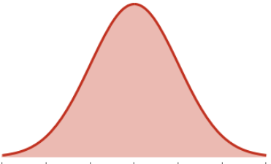
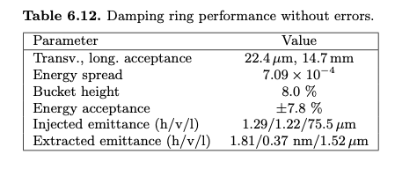
FCCee Injector in CDR0
True relative dimensions
PBR C=2280 m
S-band Injector 80 m (up to 1.54 GeV)
S-band Linac 220 m (1.54 GeV to 6 GeV)
Baseline
Booster ring
20 GeV to 45.6 GeV (min)
Positron source at 4.46 GeV
DR
C=240 m
Alternative: C-band Linac 660 m (6 GeV to 20 GeV)
100ns
Beam parameters at the booster ring injection:
Bunch charge (both species): 3.4 nC (relative jitter 1%)
Norm. emittance (h/v): 48 μm/ 8 μm
Bunch length: 10 mm
5-10 ms (200-100Hz)
Intial filling time (both species): 1034.8s
Top up (both species): 103.5s
Normalized emittance at 1.54GeV:
~4000 /~3700
~5600/~1100
?

Slide 6
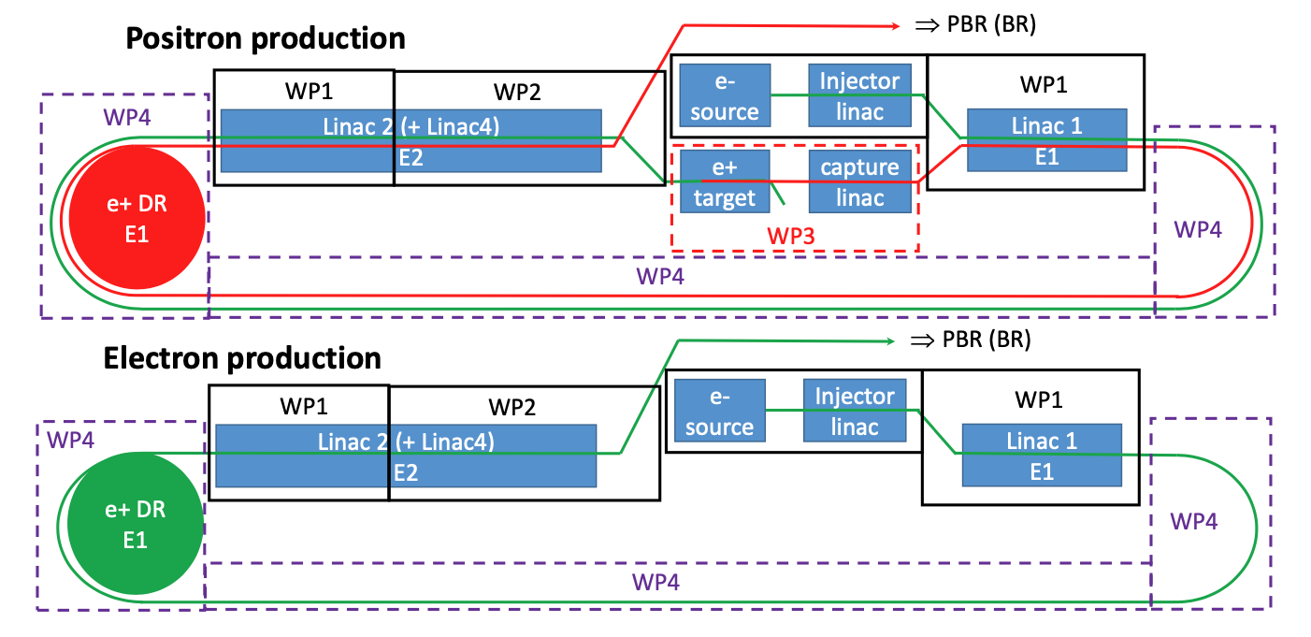
WP0.2: Overall parameters optimization
15ns (17.5 or 20 ns)
Nb = 25-30 (under discusion)
To be considered:
the impact on the damping ring (size, operation mode – damping time/ number of bunch trains, SR power)
the question how and where we adjust the bunch by bunch intensity prior to injection into the collider.
beam loading
longer RF pulses are more complicated with RF pulse compressor
wakefields effects (longitudinal and transverse
What can we gain in term of filling time?
…
10 ms (100Hz)

Slide 7
Update on WP3 (Positron Source: Target and Capture System)
WP3 general meeting on 09/12/2020: https://indico.cern.ch/event/981704/
First description of the WP tasks and update on the participant list => see WP3_program_draft_10122020.doc
Next steps (for the FCC-ee positron source nominal parameters):
  Table produced in autumn as input for the WP0.2: start working with CERN/STI group (S. Gilardoni) to justify/correct the assumptions => max. allowable rep. rate and number of bunches
  Perform the same parametric studies for the hybrid source (with recent progress in crystal simulations)
PoP experiment @PSI: should set-up the interface with the WP6 “Proof of principle Positron capture in SwissFEL” => common meetings between WP3 and WP6 from January 2021
Topics for the next meetings:
    First simulations of the positron capture with the simulated field profile of SC-solenoid (HTS) with 7 and 10 T on the target provided by PSI
    Simulation of the radiation environment (quasi-DC power distribution in target vicinity and distribution of expected integrated dose over life time) and energy deposition (average and PEDD) in target, matching device, acc. structures => high priority (input to SC solenoid design, target reliability studies and target design
    PoP experiment: main goals and roadmap => layout of the experiment, choice of the technology, etc..
    …
I. Chaikovska – 17.12.2020

Slide 8
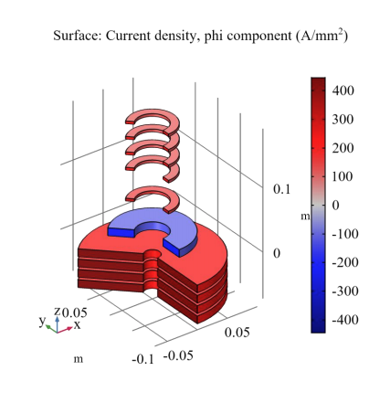
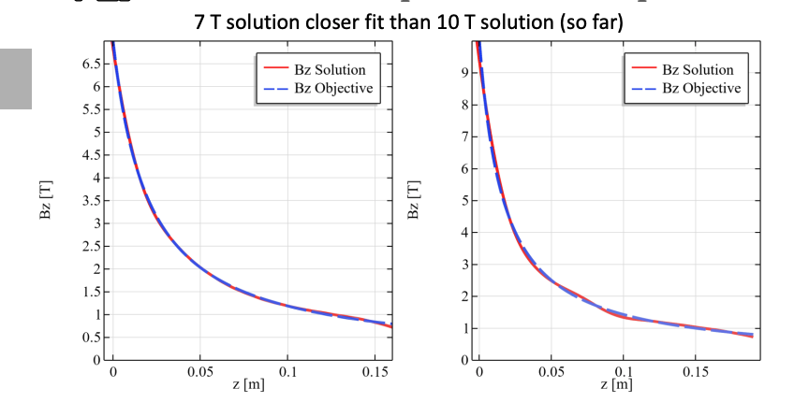
WP6: Activities at PSI
Transfer line at the linac end: BD suggests to use a 2 degree dipole in S30CB16 (linac end) to have a simple outcoupling and a double bend achromat layout to close the dispersion in the straight line. Beam dump into outcoupling direction with the idea to keep it for the tune-up of the Porthos beamline (work in progress).
Accelerating structures for positron capture system: Riccardo is studying a RF structure at S-band frequency with large aperture constant along the structure (30-40 mm)
AMD: a solenoid with HTS technology
Jaap Kosse & Bernhard Auchmann (PSI)

Slide 9
~ 2 m
~ 5 m
~ 30 m

Slide 10
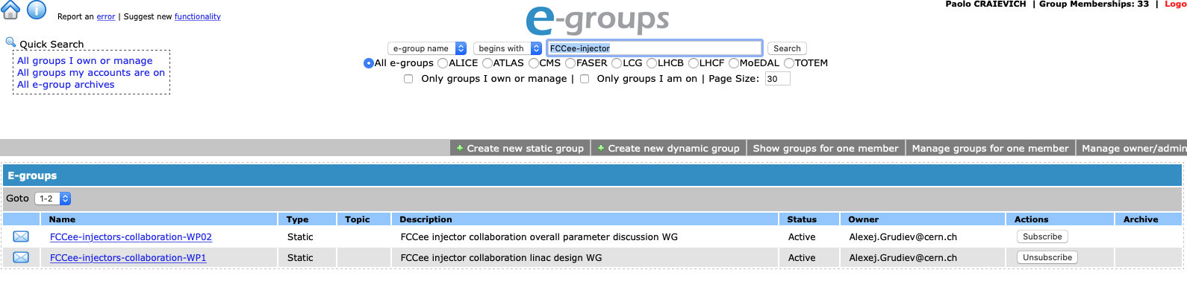
Next meetings
I would like to book Thursdays from 10am to 12pm for a meeting related to the CHART/FCC-ee Injector collaboration, specific invitation with topic and agenda will be sent before the meeting
Meetings on going:
  WP0.2: Overall parameters optimization (Damping ring and time structure)
  WP1: e+/e- 6 GeV Injector Linac
  WP3/WP6: Physics design of the positron target and capture system (CDR and SF exp.)
Mailing lists on http://e-groups.cern.ch/, please subscribe or unsubscribe by yourself
+ FCCee-injector-collaboration-WP0 (to be changed)
+ FCCee-injector-collaboration-WP3_6 (new)

Slide 11

Any questions? Open points?

Slide 12

Merry Christmas
and
best wishes for 2021!
I look forward to continuing a fruitful collaboration

