Slide 1
Material budget and power dissipation in Alice SPD and
NA62 Gigatracker.
presented by A. Kluge
CLIC CDR WG4
CERN/PH-ESE
May 6, 2010

Slide 2
Outline
ALICE SPD
  material
  power consumption
GigaTracker
  material
  power consumption
Summary

Slide 3
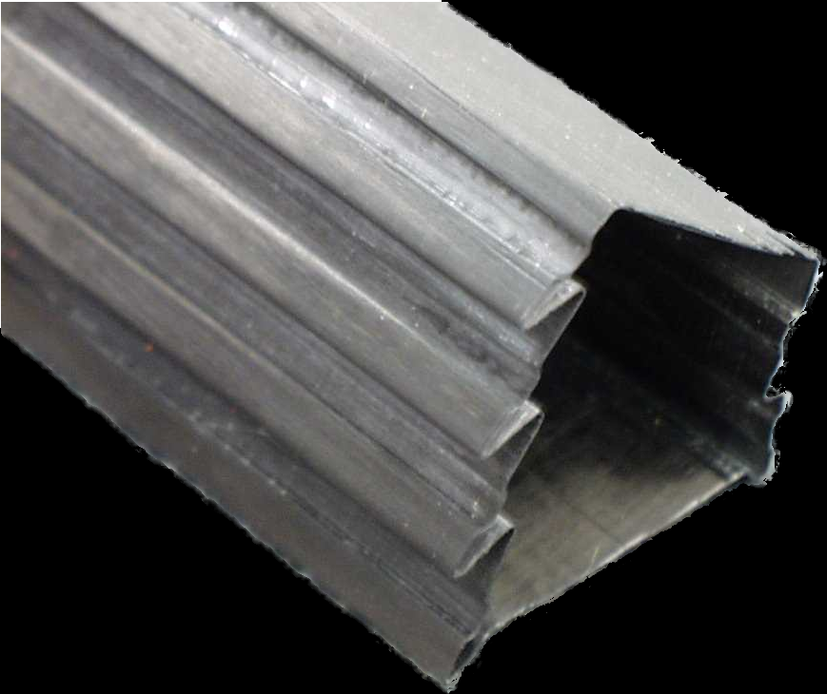
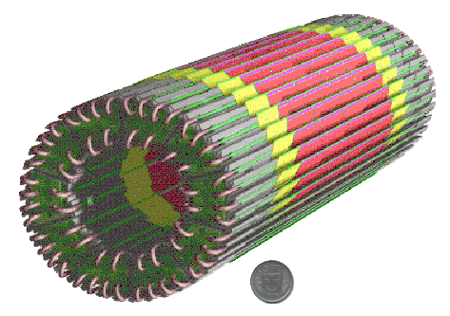
Integration

Slide 4
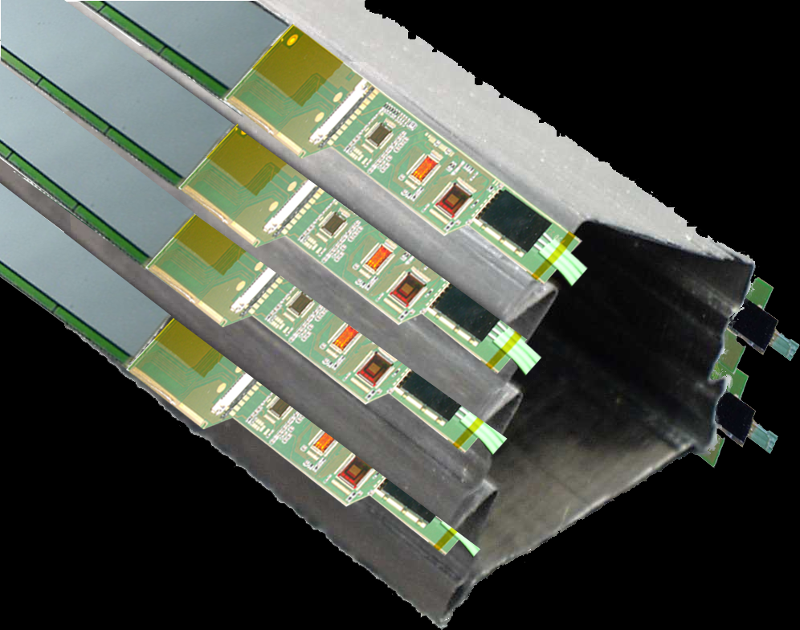
Integration

Slide 5
Electronics integration
Bus
Bonds
SMD
Components
MCM Lid
Readout Chip
Sensor
Optical Fibers
GND foil
Bus extender
Carbon
Support
Pilot MCM
MCM Extender

Slide 6
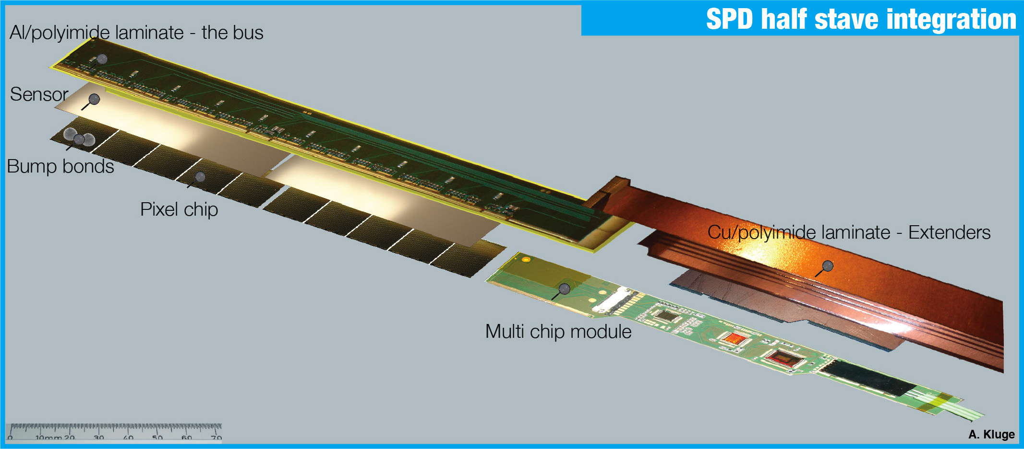
Electronics integration

Slide 7
Material budget of one ALICE SPD layer

Slide 8
Material budget of one ALICE SPD layer
Star Low Mass Carrier (Mimosa5)
illustration from Marco

Slide 9
Power consumption
Analog: 1.6 V * 560 mA = 0.9 W
Digital: 1.6 V * 400 mA = 0.64W
ASIC size = 15 * 14 mm² = 210 mm²
Active pixel area = 13.6 x 12.8 mm² = 174 mm²
Power consumption (ASIC/Active) = 0.7 W / cm² / 0.9 W / cm²

Slide 10
Experimental setup- NA62
hit correlation via matching of arrival times – 100 ps
selects particles
with 75 GeV/c
GTK sees
all particles
straw chambers
measure position
RICH
identifies pions
sees
kaons only
Mag2
Mag3
straw chambers
RICH
A. Kluge
GTK1
GTK3
Cedar
GTK2
Achromat
Mag1
Mag4
250 m
Vacuum tank
beam: hadrons, only 6% kaons-> only 20% decay in the vacuum tank into a pion and 2 neutrinos -> out of which only 10⁻¹¹ decays are of interest

Slide 11
Experimental setup:
GTK specifications
300 µm
100 ps
time resolution arrival time
300 µm
800 MHz particle rate

Slide 12
Experimental setup:
GTK specifications
300 µm
thin, 200µm sensor + 100 µm chip
(<0.5% of X₀)
100 ps
time resolution arrival time
300 µm

Slide 13
Beam & detector configuration

Slide 14
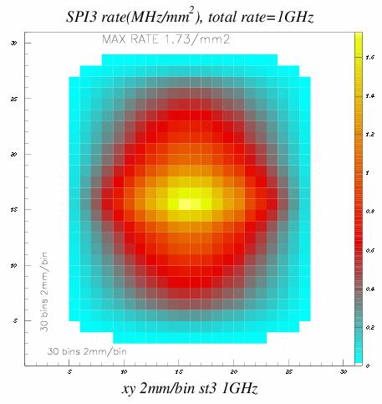
Beam profile
60 mm
27 mm

Slide 15
ASIC covering beam
60 mm
12 mm
4.5-6 mm
13.5 mm
27 mm
45 rows times 40 columns per chip = 1800 pixels per chip

Slide 16
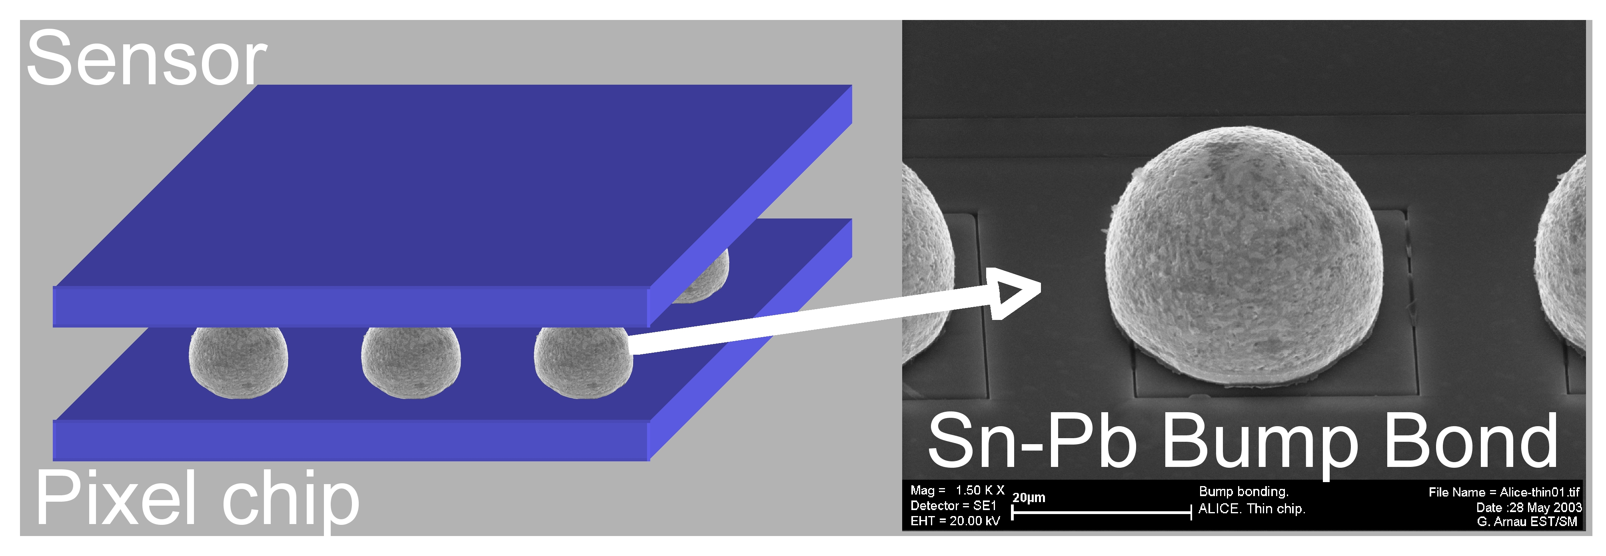
Hybrid pixel detector

Slide 17
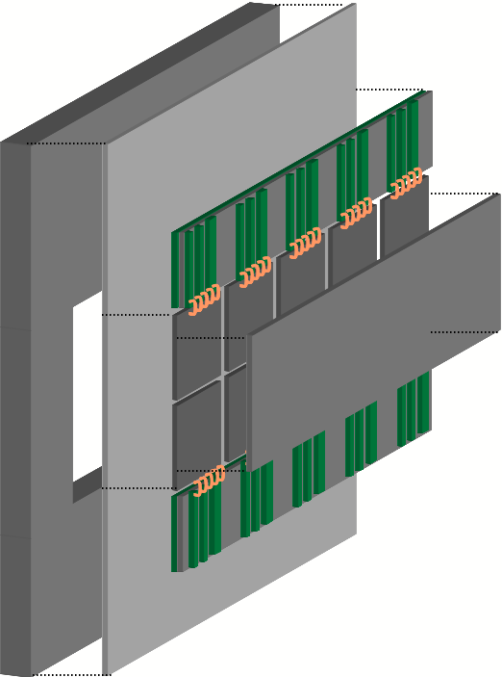
Giga Tracker setup
Component | Material | Thickness [μm] | X0 [%]
Sensor | Si | 200 | 0.21
Bump Bonds | Pb-Sn | ~25 | 0.001
Readout Chip | Si | 100 | 0.11
Cooling Plate | Si | ~150 | ~0.15
Sum |  |  | ~0.47

Slide 18
The electronics specification

Slide 19
General: System Specifications
Number of pixels per chip | 1800 = 45 x 40
Size of pixels | 300 µm x 300 µm
Active area per chip | 12 mm x 13.5 mm = 162 mm²
Chip design time resolution | 100 ps (rms)
Thickness of sensor | 200 µm
Type of sensor | p in n
Thickness of read-out chip | 100 µm
Dynamic input range | 5000 – 60000 electrons

Slide 20
General: System Specifications
Design particle rate per chip | 130 MHz
Rate of center pixel | 140 kHz
Rate of center column | ~ 3.3 MHz or 0.82 MHz/mm²
Average rate per pixel | 73 kHz
Maximum dead time | 1 % (2 % in beam center)
Data transfer rate per chip | 6 Gbit/s
Total dose in 1 year | ~ 10⁵ Gy
Neutron flux in 100 days | 2 x 10¹⁴ 1 MeV neutron equivalent cm⁻²
Material budget/power | 0.5 % X₀ per station / <2W/cm⁻²

Slide 21
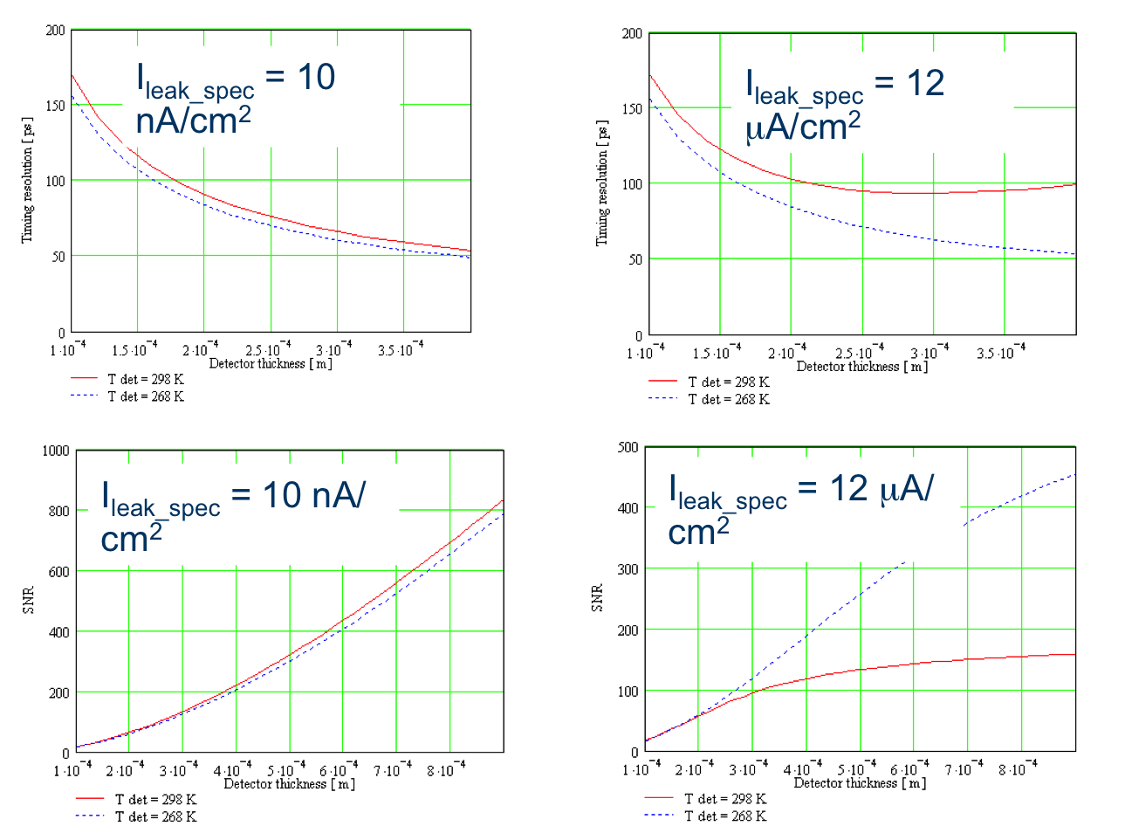
Sensor thickness optimisation
Max power dissipation:
1.2 W/cm²
Only 30% of the power per pixel goes into the input transistor
Giovanni Anelli - CERN

Slide 22
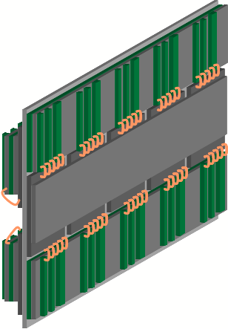
Read out
3 planes x 10 chips:
>60 high speed links +
>30 low speed links+
>30 clock links
On-detector is trigger-less
Pitch adapter & multi gigabit serial links

Slide 23
Data rate
Rate of center column = chip design rate:
3.3 MHz/column
~ 82 MHz/cm²
  => avg rate 73 kHz/pixel
  => 132 MHz/chip
=> 132 MHz/chip * ~ 32 bit = ~4.2 Gbit/s
  => max rate in beam center 140 kHz/pixel
  Example data word (11 bit address, 5 bit fine time, (5 bit fine time trailing), 11 bit coarse time
12 mm
13.5 mm

Slide 24
Data rate & buffering
4.2 Gbit/s: Can we store the data on chip & send only data selected from NA62 trigger processor?
Trigger latency: < 1ms, trigger window 10 ns
4.2 Gbit/s * 1 ms = 4.2 Mbit
  1 Flip-flop: 3.6 x 7.2 µm² = 26 µm2 =>
  10⁸ µm² = 10 x 10 mm²
As a result we cannot store the data
We must ship it out without trigger
Triggerless architecture
Data selection off-detector in FPGA

Slide 25
The ASIC architecture

Slide 26
Jitter-free pixel signal to TDC in EOC
amplifier
& discriminator/time-walk-compensator
reference clock
time-to-digital converter TDC
buffering & read-out processor

Slide 27
Precise clock signal to all pixels
amplifier
& discriminator/
time-walk-compensator&
buffering
&
TDC
reference clock
buffering & read-out processor

Slide 28
GTK cooling & electro-mechanical integration
Vito Carassiti, Alessandro Mapelli, Michel Morel,Georg Nüssle

Slide 29
Giga Tracker setup
Component | Material | Thickness [μm] | X0 [%]
Sensor | Si | 200 | 0.21
Bump Bonds | Pb-Sn | ~25 | 0.001
Readout Chip | Si | 100 | 0.11
Cooling Plate | Si | ~150 | ~0.15
Sum |  |  | ~0.47

Slide 30
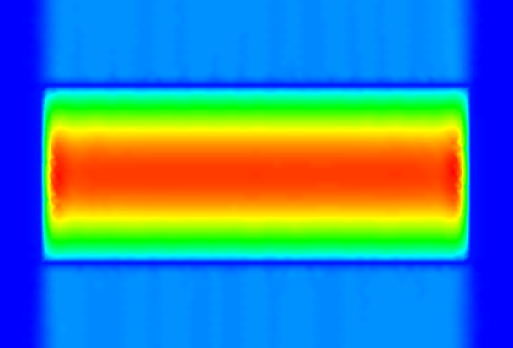
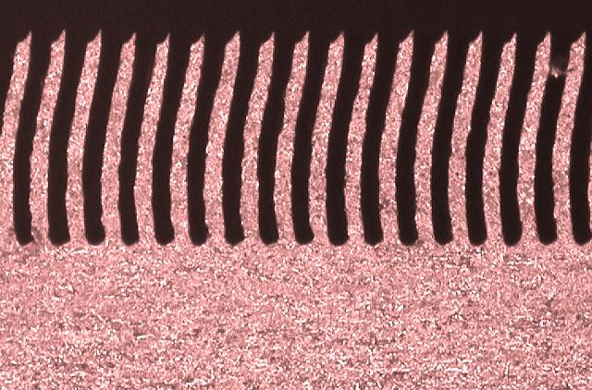
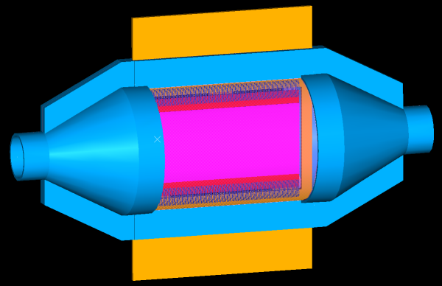
Cooling systems under investigation
carbon plate, conductive cooling
micro channels
convective cooling in a vessel

Slide 31
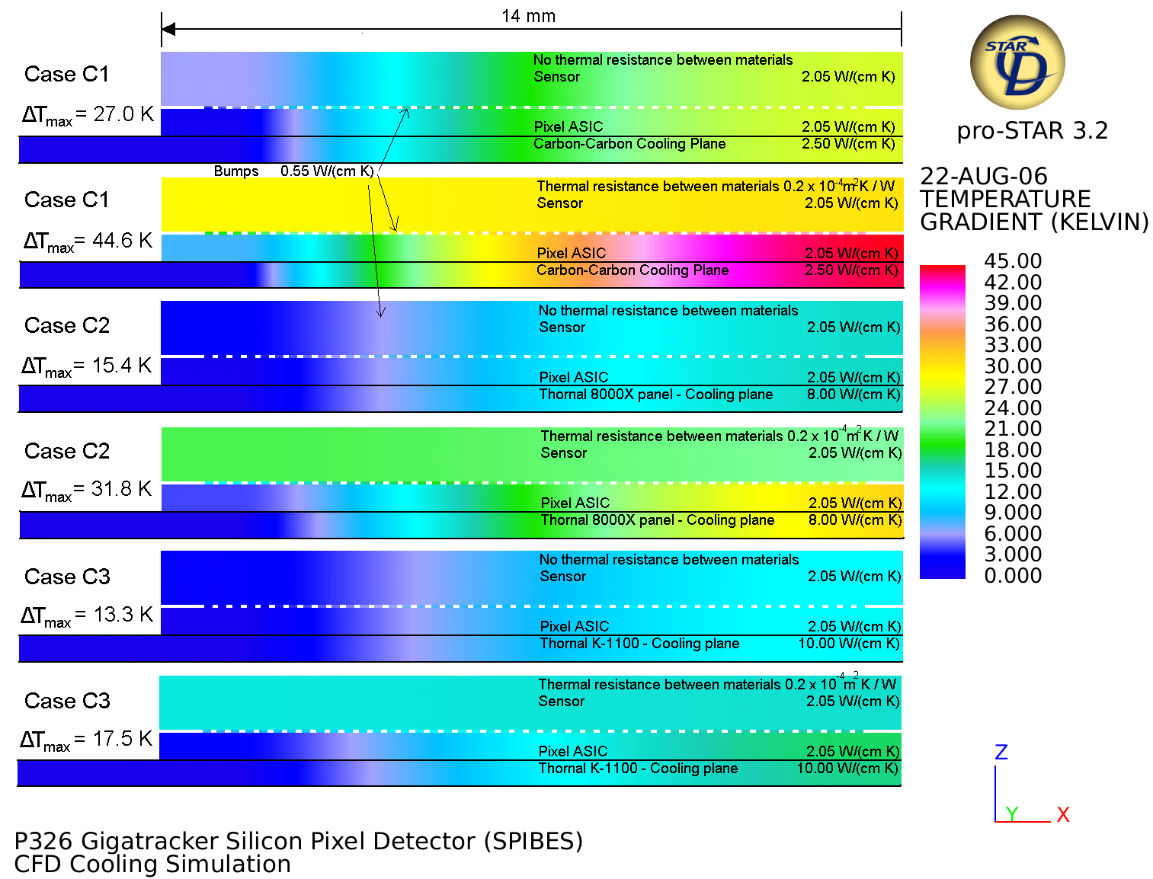
Thermal drop: ideal contact between materials (Thomas Kuhn)
https://edms.cern.ch/document/761753/1

Slide 32
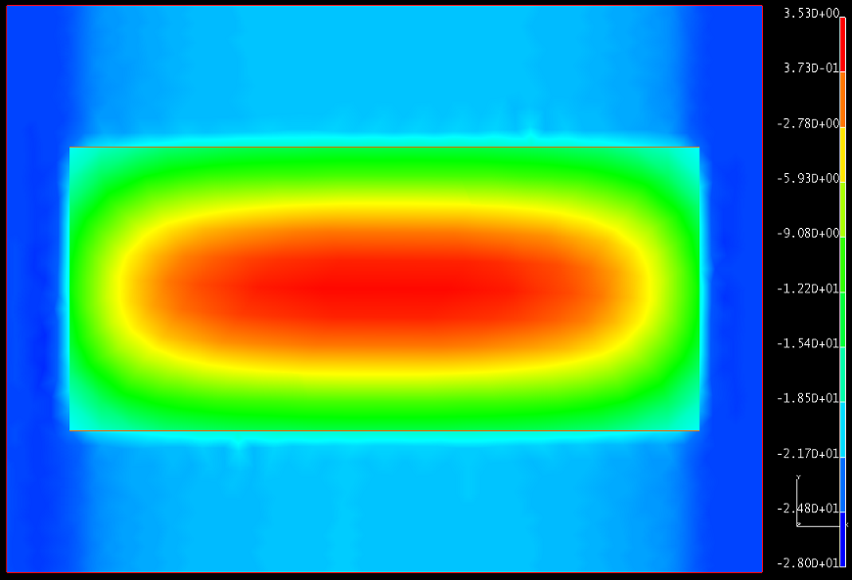
Temperature distribution
Vittore Carassiti - INFN FE

Slide 33
Microchannel cooling

Slide 34
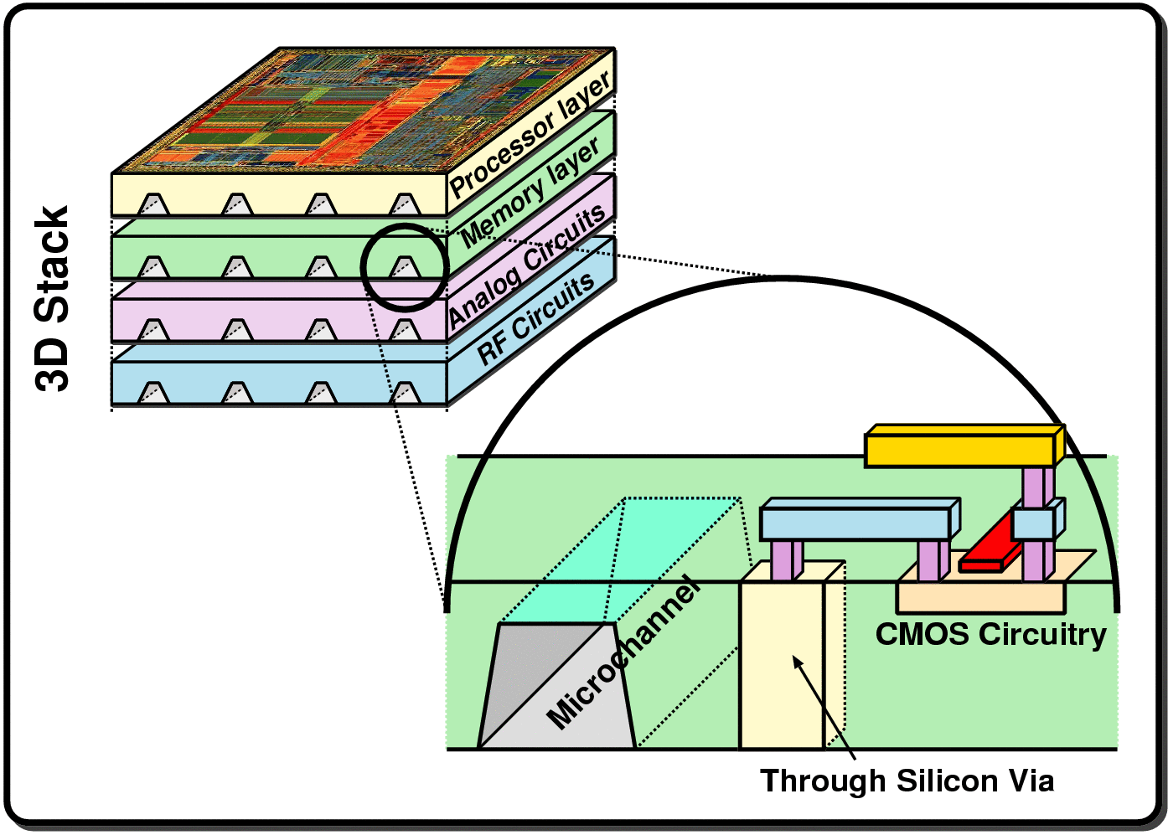
3D integrated ASIC cooling
EFPL Lausanne, Prof. Thome

Slide 35
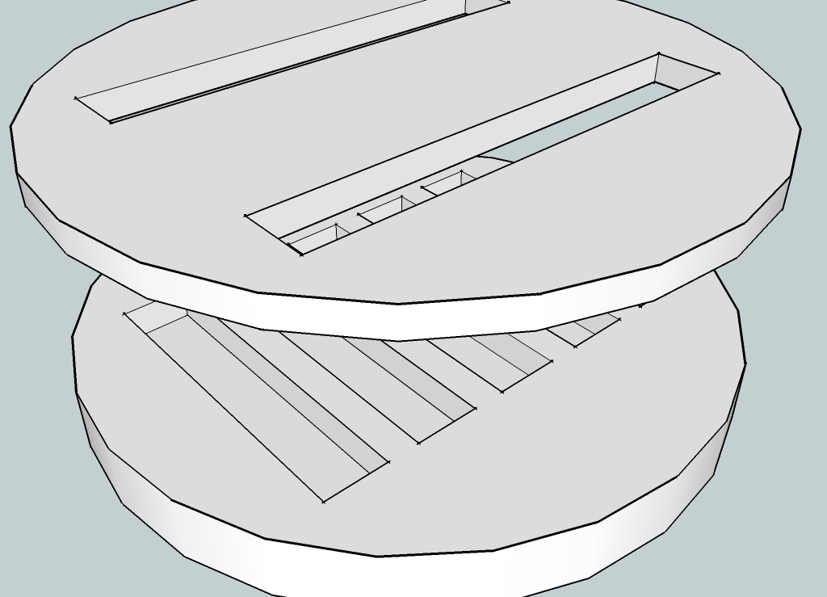
Production principle
Micro channels etched in thin wafer
Cover wafer is bonded to channels
Cover contains holes for inlet and outlet
Mapelli, Nüssle

Slide 36
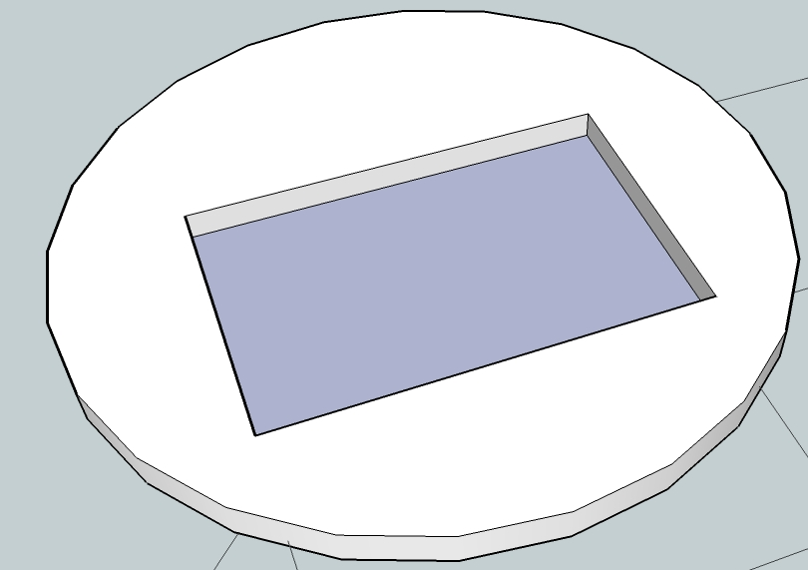
Production principle
Cover layer thinned active beam area
Micro channels etched in thin wafer
Cover wafer is bonded to channels
Cover contains holes for inlet and outlet
Mapelli, Nüssle

Slide 37
Tentative layout of micro channels for the Gigatracker
Mapelli, Nüssle

Slide 38
C₆F₁₄ cooling liquid of choice
radiation hard
thermally and chemically stable
nonflammable, nontoxic, nonconducting
known and used at CERN (CMS and Atlas Tracker)
used in liquid phase
C₃F₈ is an option in case of to high pressure in the cooling plate for C₆F₁₄
 | C₆F₁₄ @ -20°C | H₂O @ +20°C
Density ρ [kg/m³] | 1785 | 998
Viscosity ν [10⁻⁷ m²/s] | 8.2 | 10
Heat capacity c_{p} [J/(kg K)] | 976 | 4183
Thermal conductivity λ [10⁻² W/(m K)] | 6.2 | 60

Slide 39
Fluid temperature difference
12bar pressure drop
2bar pressure drop
Temperature difference between inlet and outlet for channels of
50μm x 50μm
Nüssle

Slide 40
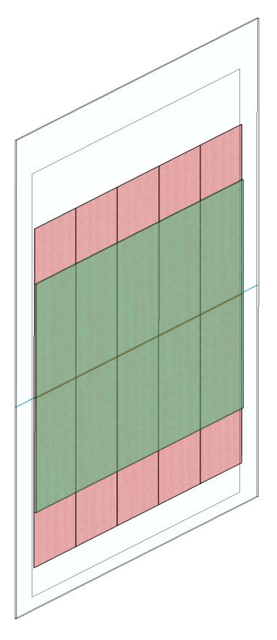
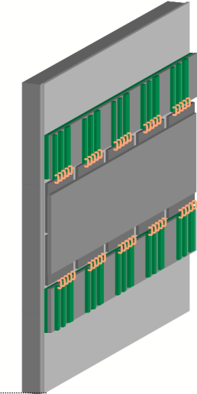
CFD model – boundary conditions
Cooling plate
fixed temperature at the backside
Readout chip
2 W/cm², 12 x 20 mm
Sensor, silicon pixels
30 x 60 mm
all remaining walls are considered adiabatic, since the GTK will operate in vacuum
heat source is the volume of the readout chip

Slide 41
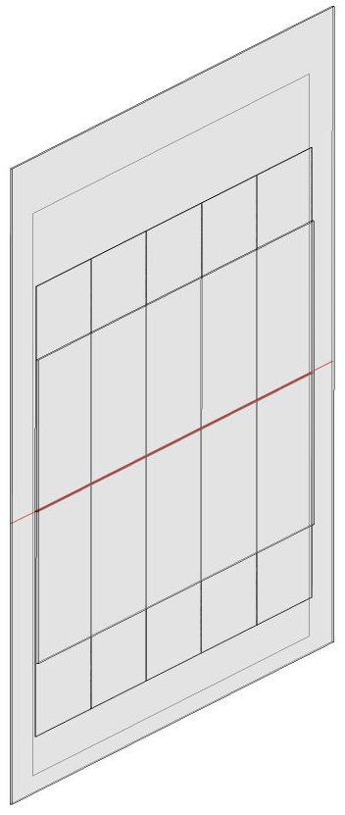
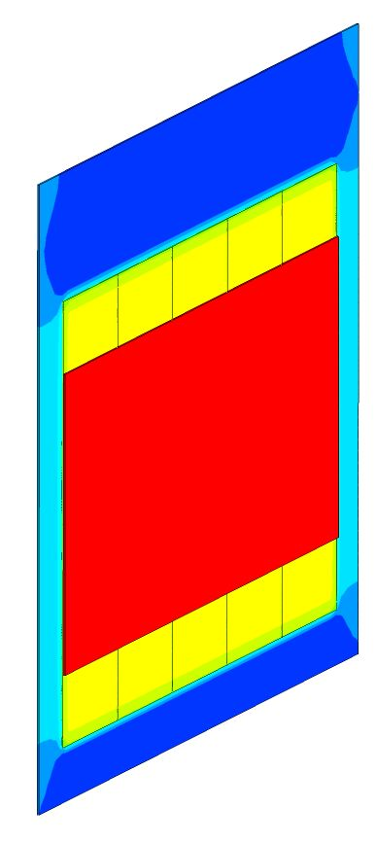
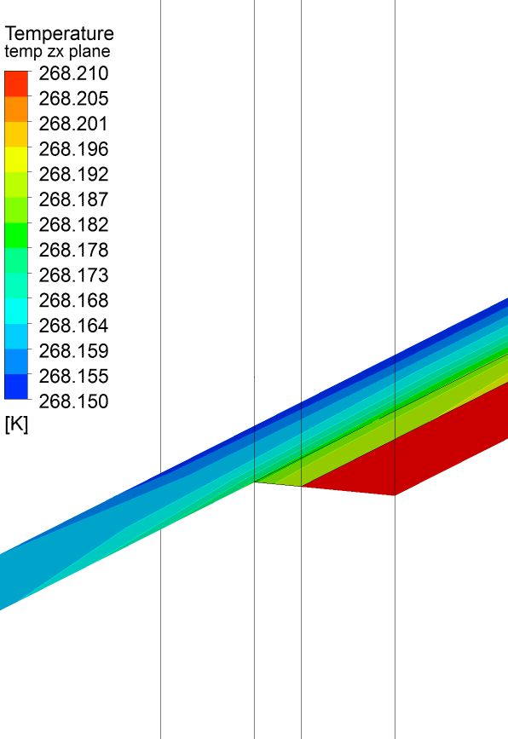
Temperature distribution λ=70W/mK
Heat transfer coefficient between chips and cooling plate of λ=70W/mK, for a material thickness of 25 μm

Slide 42
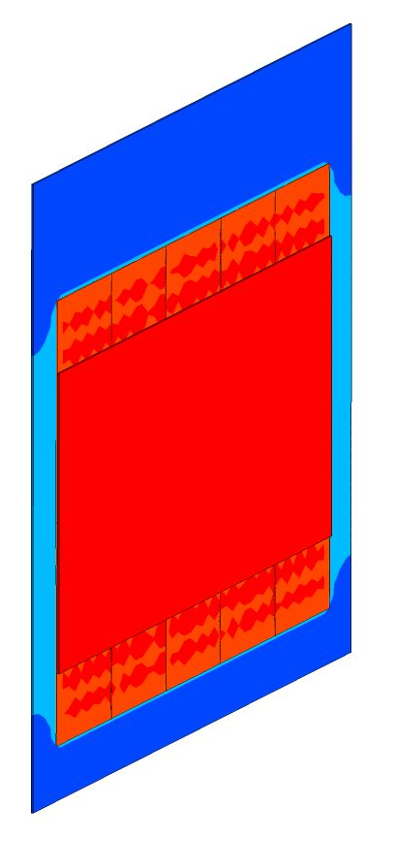
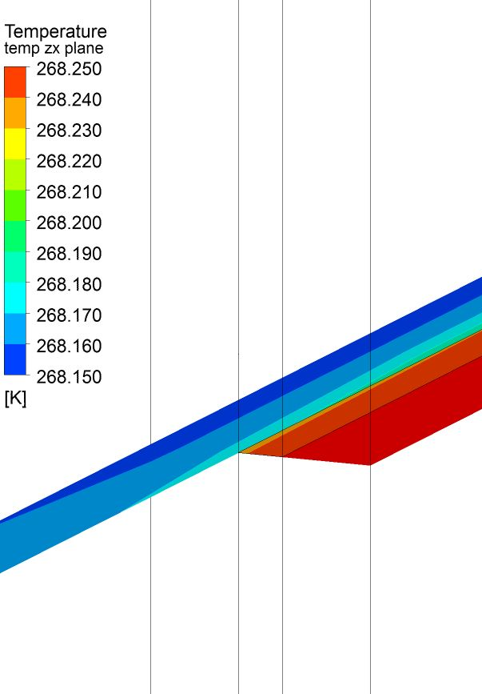
Temperature distribution λ=7W/mK
Heat transfer coefficient between chips and cooling plate of λ=7W/mK, for a material thickness of 25 μm

Slide 43
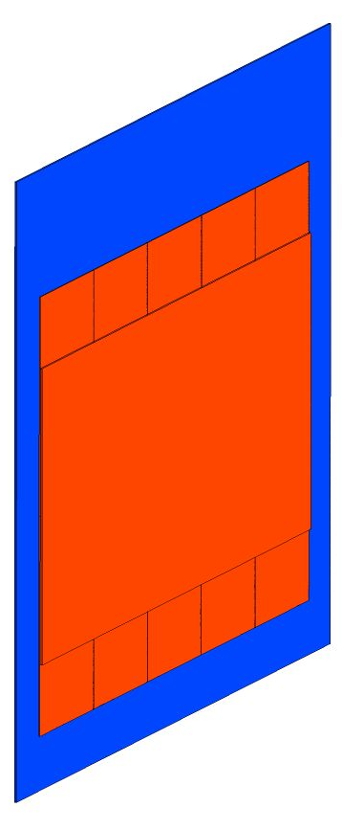
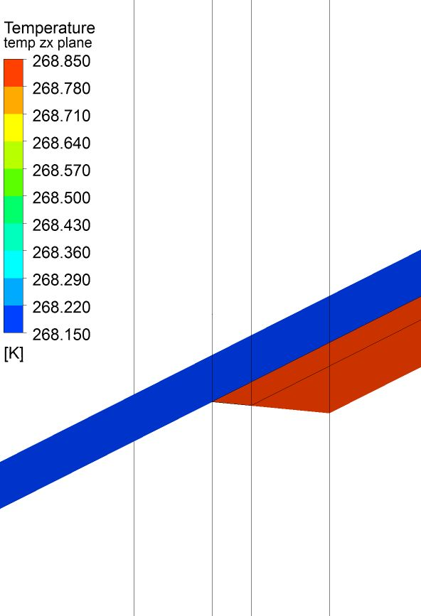
Temperature distribution λ=0.7W/mK
Heat transfer coefficient between chips and cooling plate of λ=0.7W/mK, for a material thickness of 25 μm

Slide 44
Mapelli

Slide 45
Mapelli

Slide 46
Mapelli

Slide 47
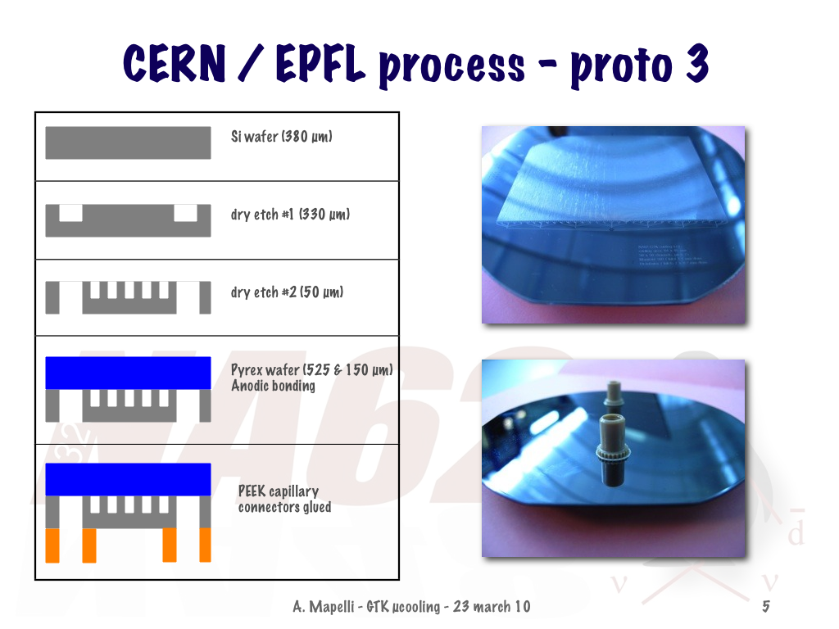

Slide 48
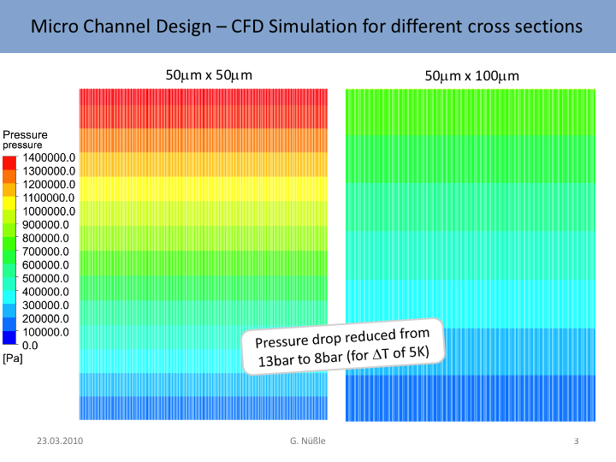

Slide 49
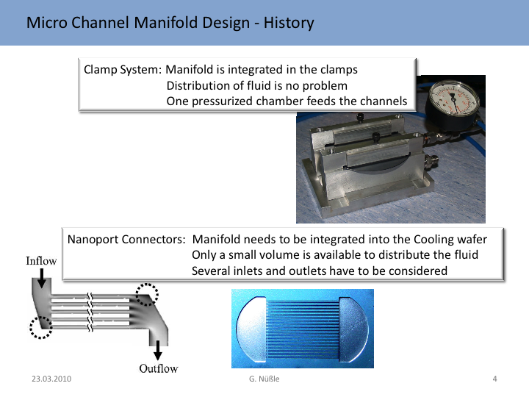

Slide 50
Cooling vessel

Slide 51

Cooling vessel
PCB
VESSEL WALL
VESSEL FRAME
COOLING PLATE
HEAT FLUX
DETECTOR
ELECTRICAL
CONNECTIONS

Slide 52
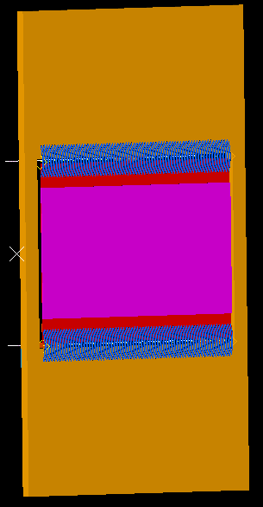
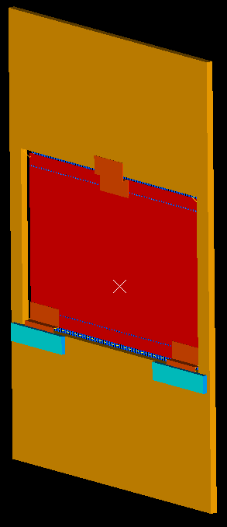
DETECTOR – PCB ASSEMBLY
FRONT VIEW
BACK VIEW
SUPPORTS
SLIDERS
ELECTRICAL CONNECTIONS

Slide 53
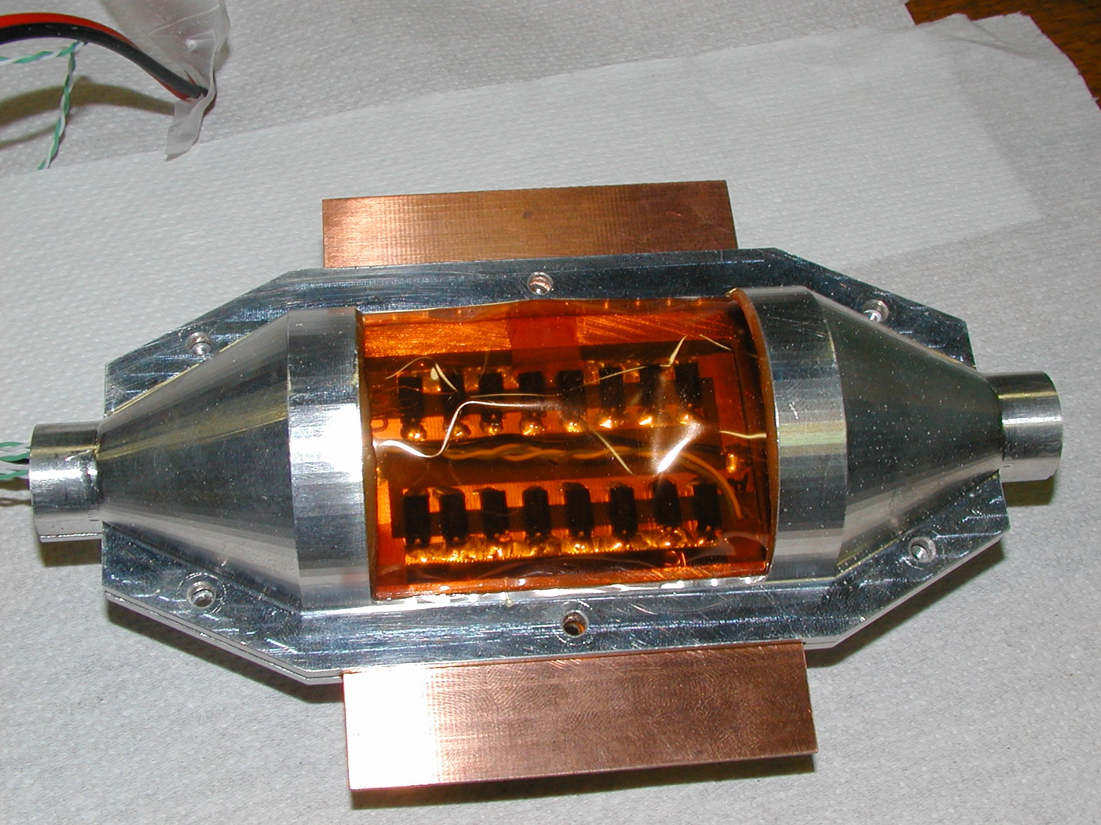

Slide 54
Summary
ALICE SPD & NA62 GTK are LHC-type hybrid pixel detectors
Analog consumes significant power because of timing response (25ns / 3 ns)
Material budget: 1% -> 0.45 %
Micro-channel cooling: GTK first application in HEP

Slide 55
data rate & can pulsing be done
can power pulsing be done or is the read-out rate too high?
occupancy: 10 (-50) hits /mm²/312 bx
assume chip of: 10 mm x 10 mm and pixel size of 50 µm x 50 µm =>
200 x 200 pixel = 40000 pixels = 16 bit address
time stamping 1 bx out of 312 = 9 bit
occupancy => 10 hits/mm² * 100 mm² / 40000= 1000 / 40000= 2.5%
No trigger: Chip Data rate/ 312 bx => 1000 hits * 32 bit = 32000 bit
32 kbit/20ms = 1.6 Mbit/s
32 kbit/312 bx= 200 Gbit/s
No trigger: Data rate /cm² = 1.6 Mbit/s continous

