Slide 1


New Spiral Load RF Design
09.09.2020
Hikmet Bursali, Alexej Grudiev

Slide 2
Outline
Motivation
Straight Load Model
Design Process
  Straight to Spiral Model
  Spiral Model with WR90 Transition
  Spiral Model with Vacuum Holes
  Spiral Model with Pumping Port
Reflection Optimisation
Final RF Model
Conclusion & Future Work

Slide 3
Reminder
Why do we use RF loads?
In order to absorb remaining RF power passing through the RF system. (Not used for beam acceleration or dissipated on resistive walls.)
(Ex: TD26CC P_{in}= 43.3MW – unloaded for 100MV/m)*
Where do we use RF loads?
At the RF output of traveling wave type structures.
RF Load
Power Source
Beam Direction
*https://edms.cern.ch/document/1078698/1
Traveling Wave Linac

Slide 4
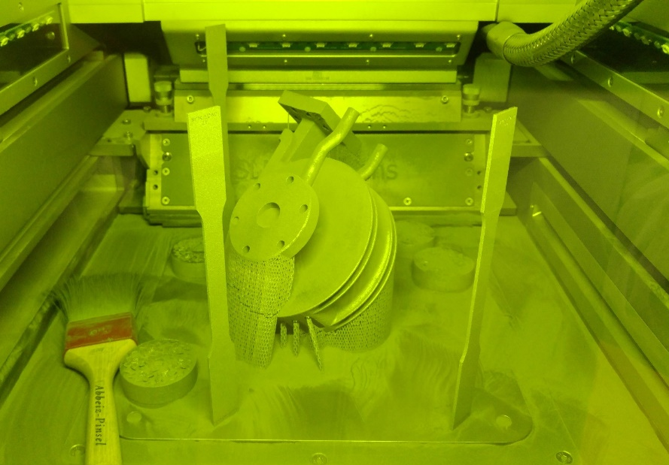
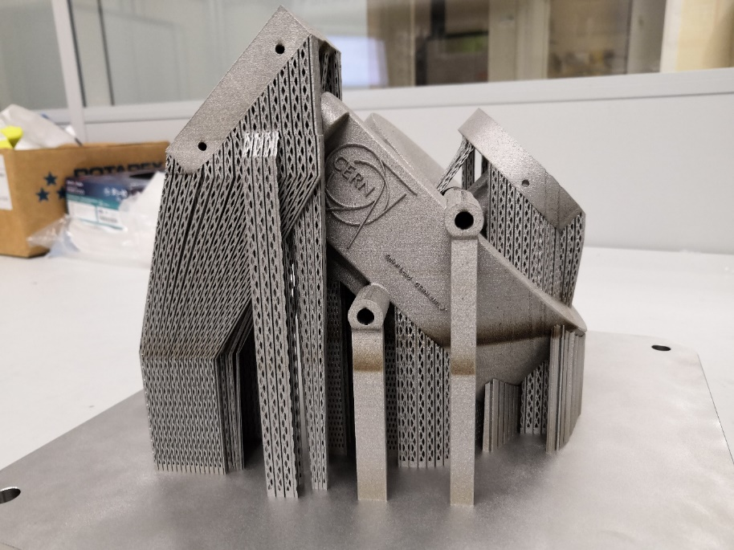
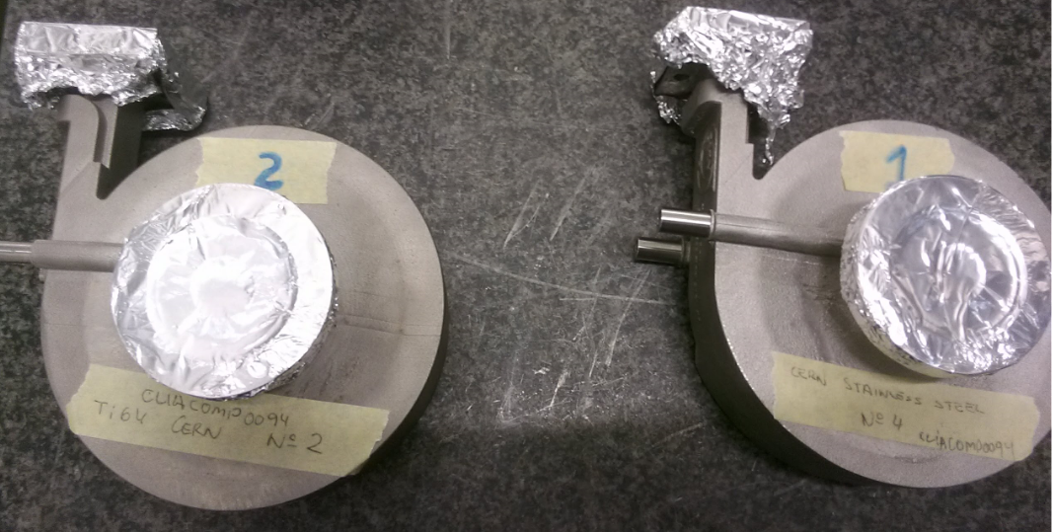
X-Band RF Loads (produced by Additive Manufacturing)
We have several RF spiral loads which were designed (CLIACOMP0071
, CLIACOMP0094), fabricated (at CERN or Vendor companies) and tested successfully. (Materials; Stainless-Steel “316L”, Titanium alloy “Ti6A14V”)
For more info, please see the document;
https://edms.cern.ch/document/2323664/1
The current designs allow to produce only one load during an additive manufacturing cycle because of 45° oblique placing and 3D printing machine dimensions.
Spiral Load in 3D printing machine
*
Support parts
(removing after production)
*Photos from Romain Gerard
*

Slide 5
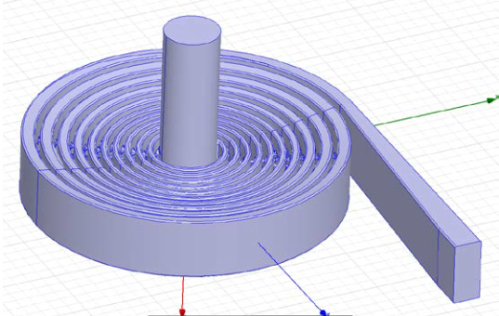
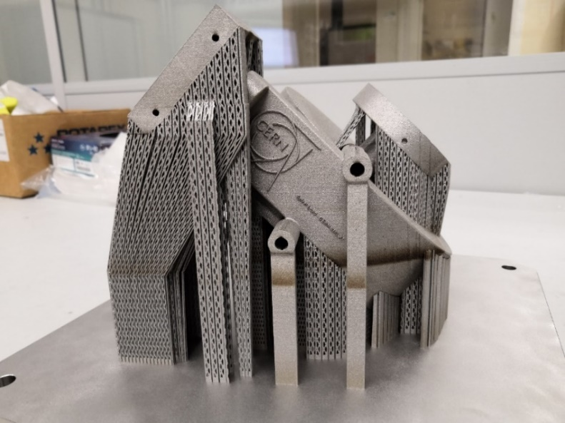
Motivation
The aim of this study is to optimise the internal cross-section of RF loads in order to create a stackable design to increase number of products per additive manufacturing cycle and so decreasing the unit price.
with 45° oblique placing to allow additive manufacturing
Current cross-section
45°
45°
*
New cross-section
Placing directly (without 45°)
Less space allowing stackable design (allows producing more than one load during one manufacturing cycle)
Material saving with reducing material for support parts (cost reducing)
Previous RF Design with rectangular internal cross section
*Development of X Band High Power RF Load for CLIC Applications Using Additive Manufacturing Techniques; D’Alessandro, Gian Luigi (https://cds.cern.ch/record/2139981?ln=en)
90°
45°
45°

Slide 6
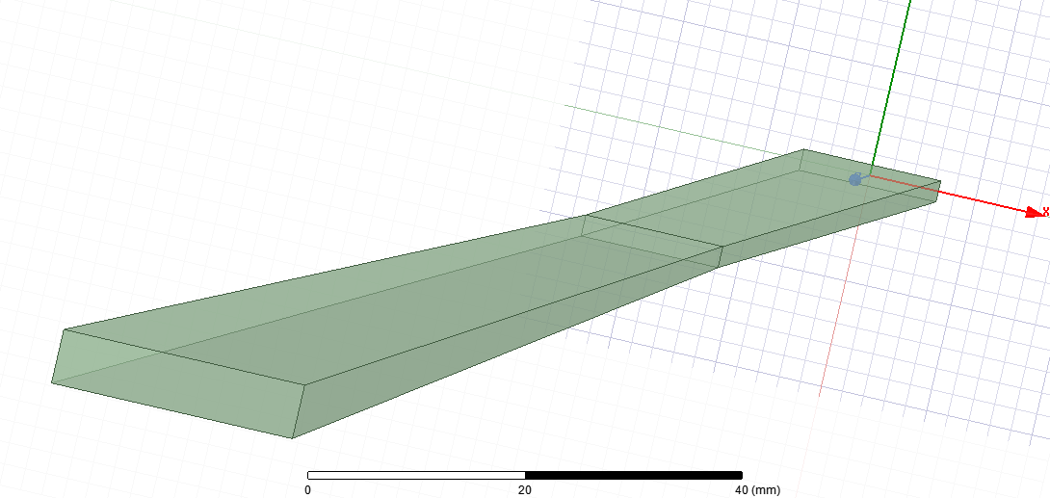
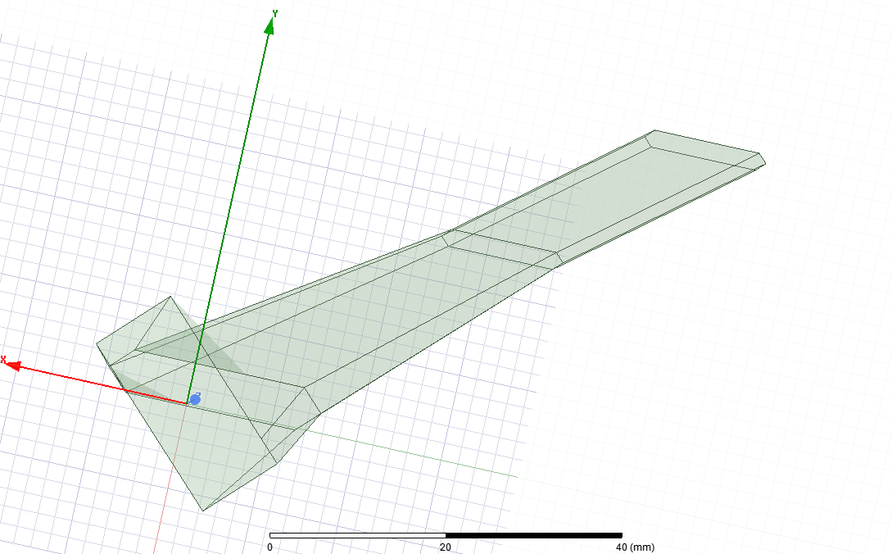
Straight Model Reference Design
Parametric Design
Previous model with rectangular cross-section
Model with new cross-section
Straight Part
Tapered part
The dimensions of previous design were used directly and optimised with the new cross-section.
Ti6A14V
Conductivity: 6.10⁵ S/m
*Development of X Band High Power RF Load for CLIC Applications Using Additive Manufacturing Techniques; D’Alessandro, Gian Luigi (https://cds.cern.ch/record/2139981?ln=en)

Slide 7
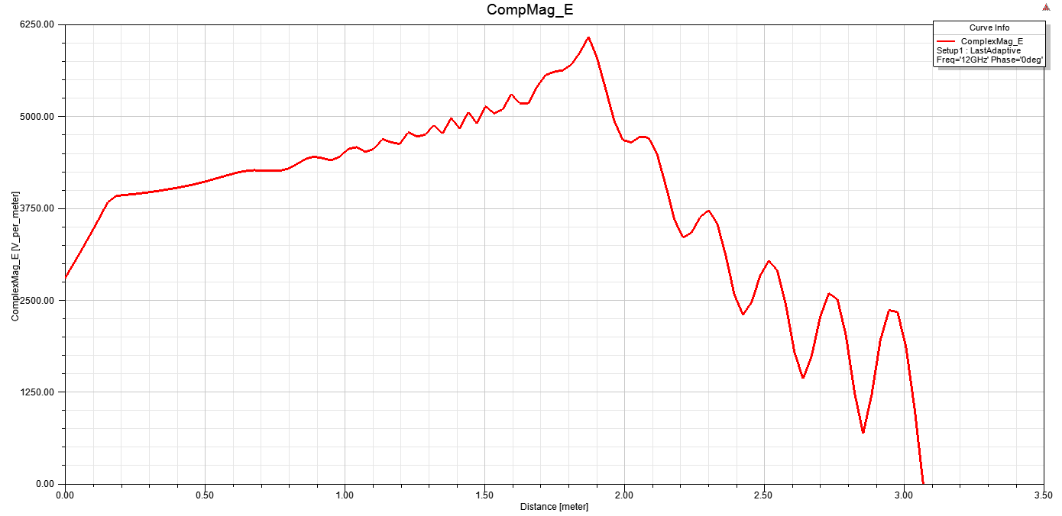
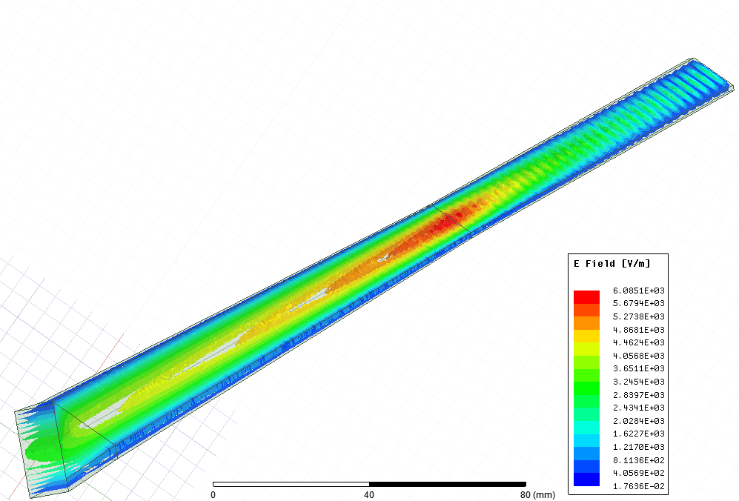
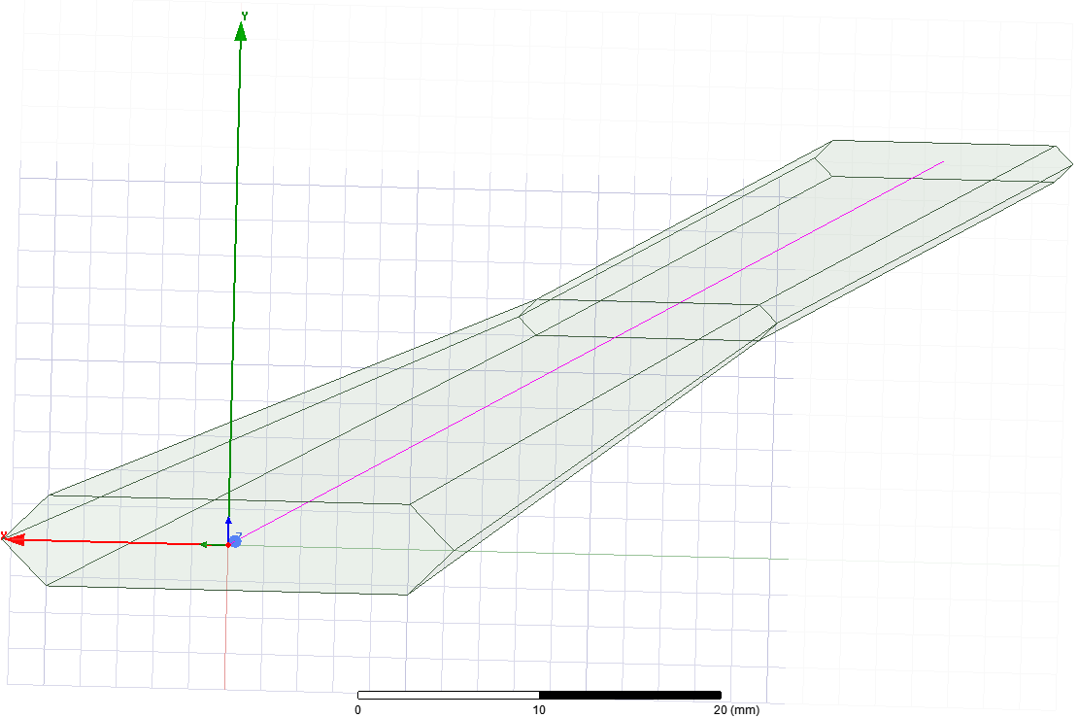
Electric Field (Complex Magnitude)
Line for E-field & Poynting Vector Calculation

Slide 8
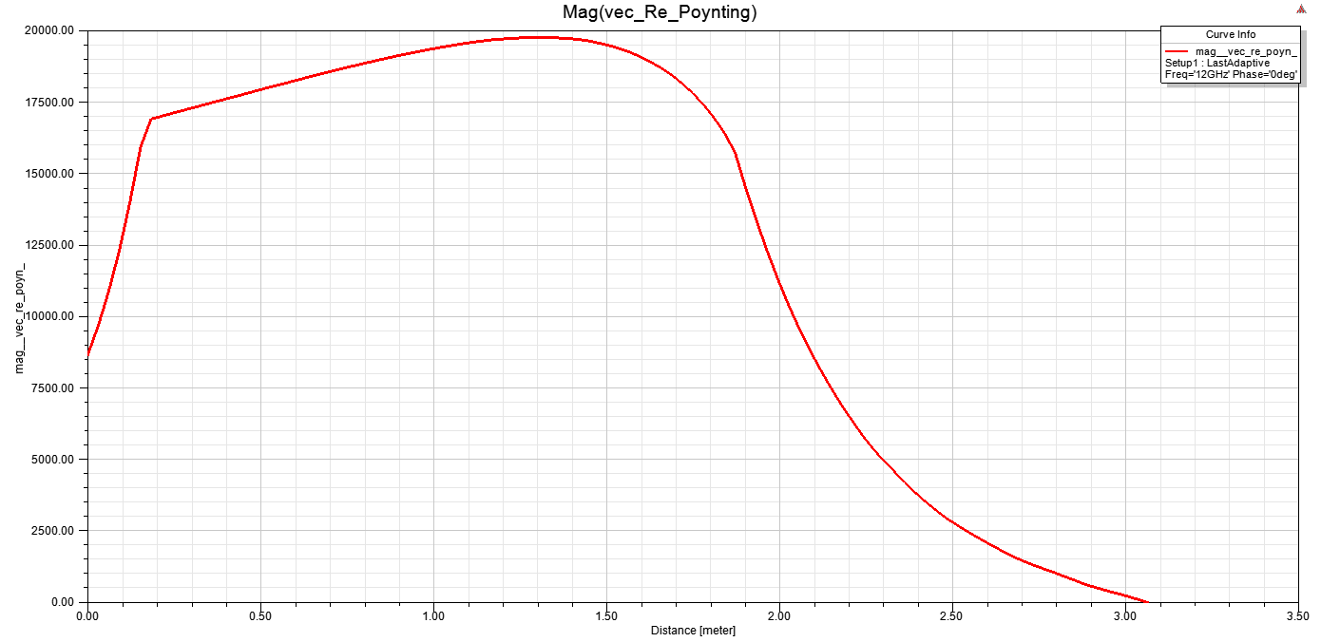
Poynting Vector
Line for E-field & Poynting Vector Calculation
BE-RF-MK

Slide 9
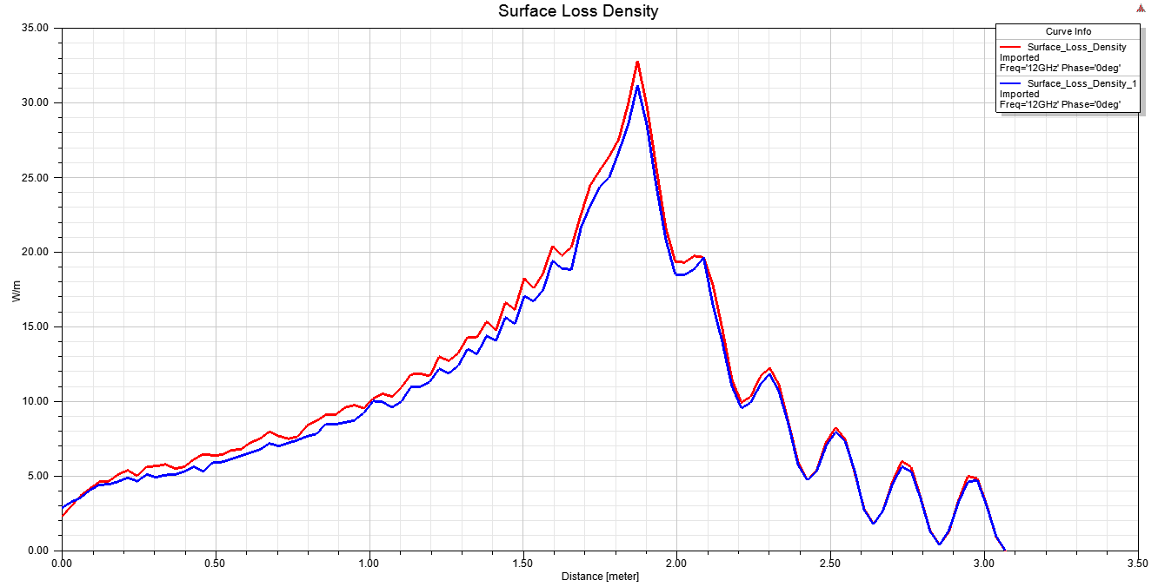
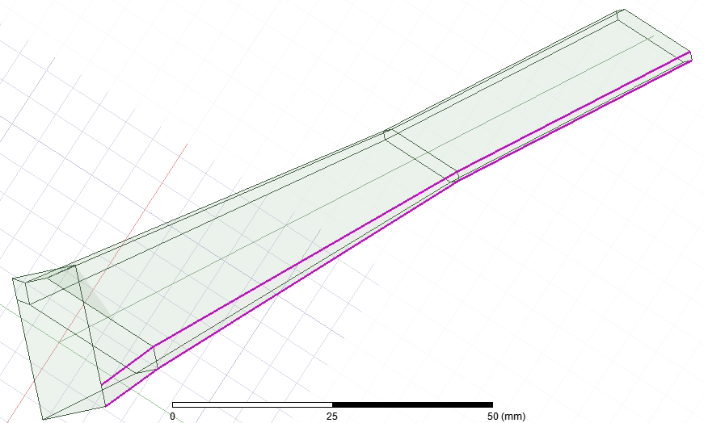
Line 2
Line 1
The peaks are at the junction place of tapered and straight parts.
BE-RF-MK

Slide 10
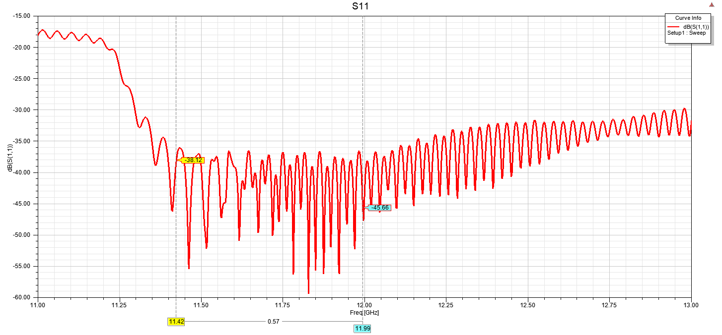
Reflection
BE-RF-MK

Slide 11
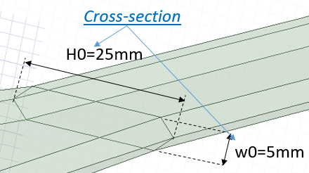
Straight Model on HFSS-Parameters
H2=14.3mm
w2=2mm
H1=14.3mm
w1=2mm
L2=1.2m
b=10.16mm
WR90 Waveguide Dimensions
L1=1.7m
Total Length=3.067m
a=22.86mm

Slide 12
Design Process
Meetings
&
Feedbacks
&
Updates
RF Simulations
(HFSS)
Mechanical Model by Design Team*
(CATIA)
Parametric Model from Design Team
*Oleg Gumenyuk, Benoit Riffaud, Romain Gerard
12

Slide 13
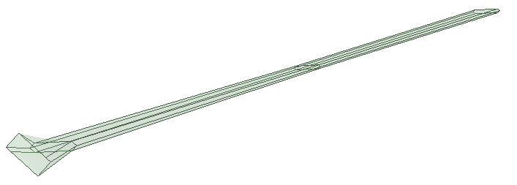
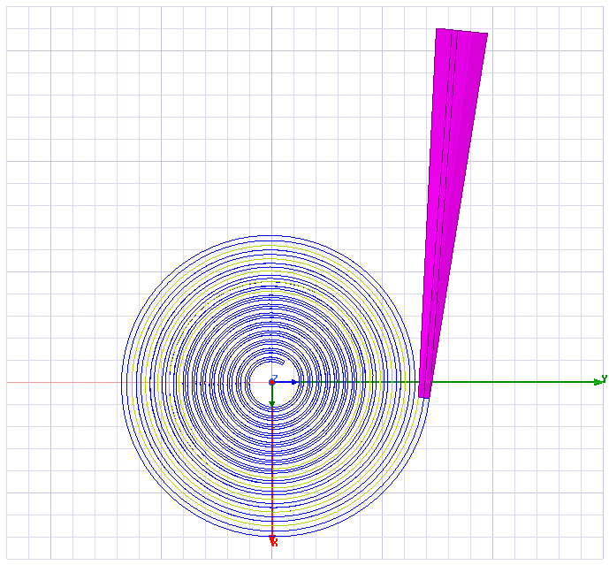
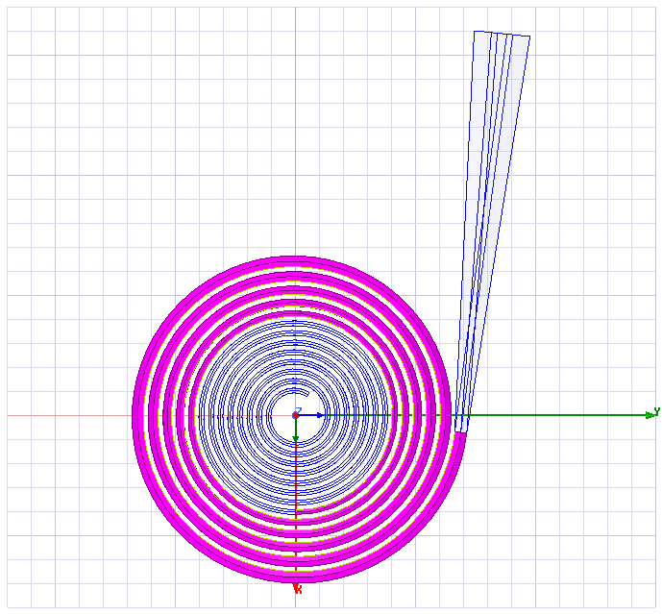
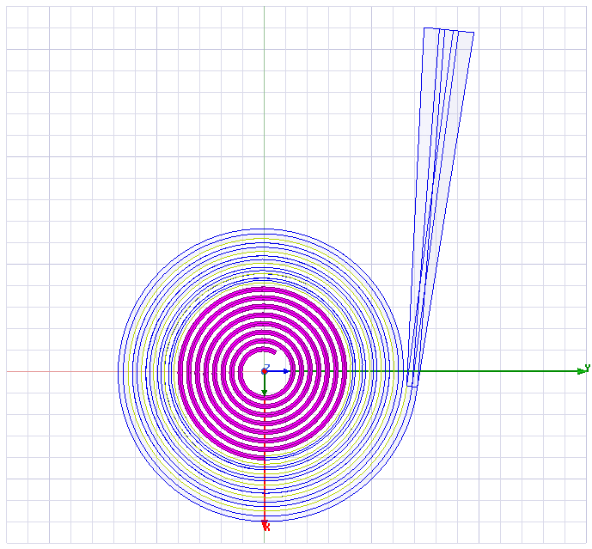
Straight to Spiral Model
Starting section to make spiral
Transition part
Tapered part
Straight part

Slide 14
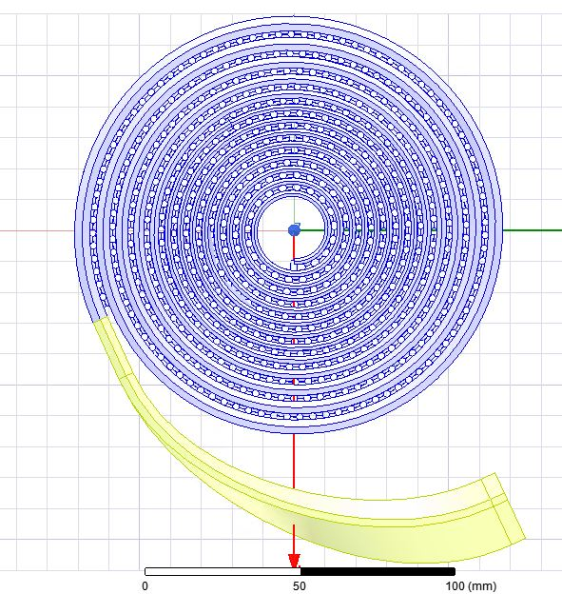
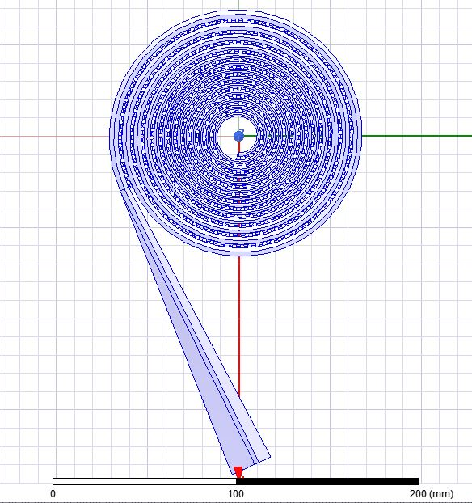
Straight Model with WR90 Transition
Model with Bent Transition
Model with Straight Transition
RF simulations for transition parts to select the model.
Oleg Gumenyuk

Slide 15
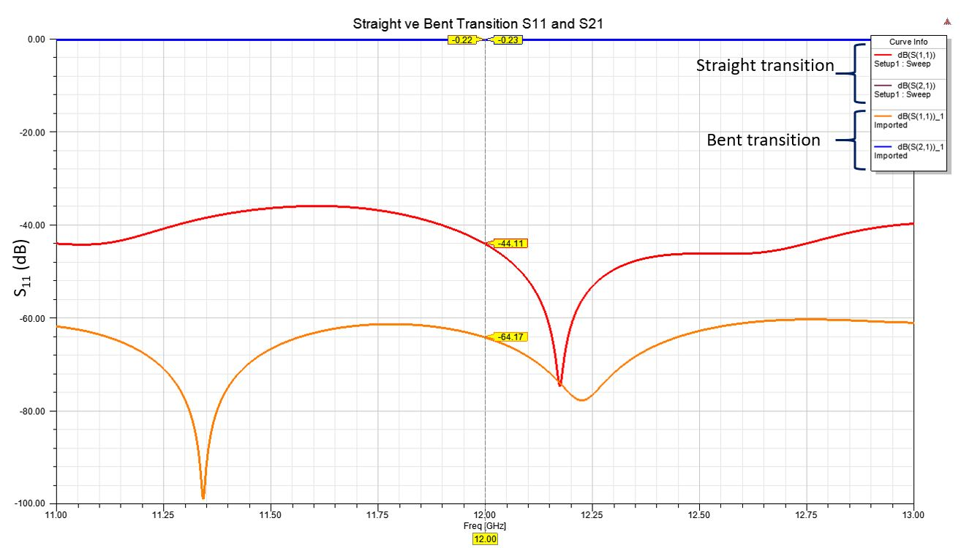
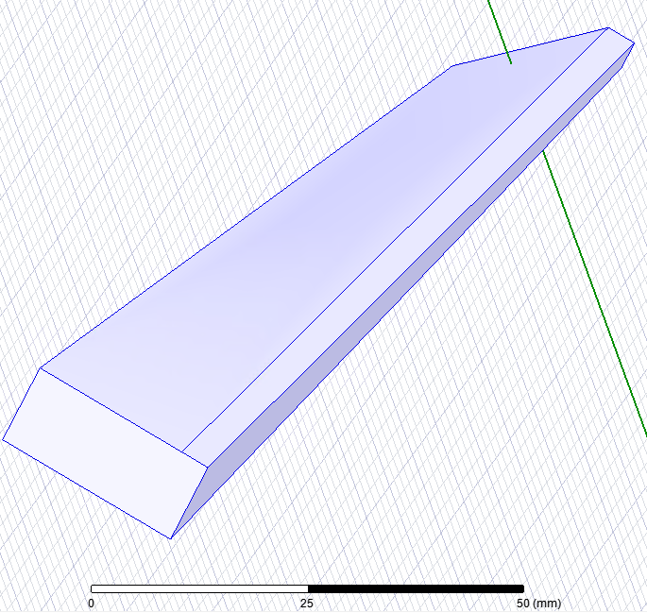
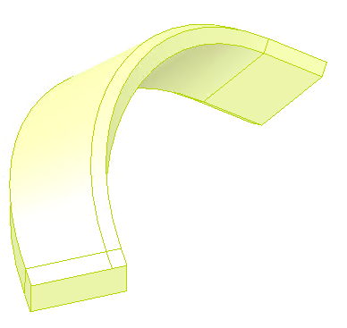
S-parameters (dB)
Better reflection!✓

Slide 16
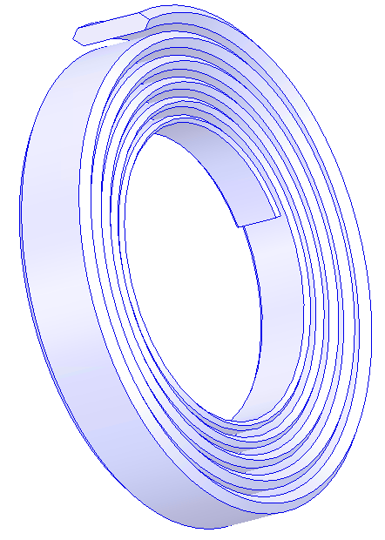
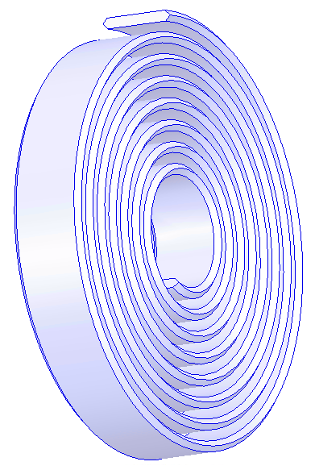
Spiral Model Dimension Parameters
H0
(25mm)
Connection
2mm (gap)
H1=H2
(14.3mm)
w0
(5mm)
w1=w2
2mm (gap)
(2mm)
Connection
b
(10.16mm)
End of the load
(Same cross-section)
a
(22.86mm)
Same straight design parameter dimensions were used on spiral model.

Slide 17
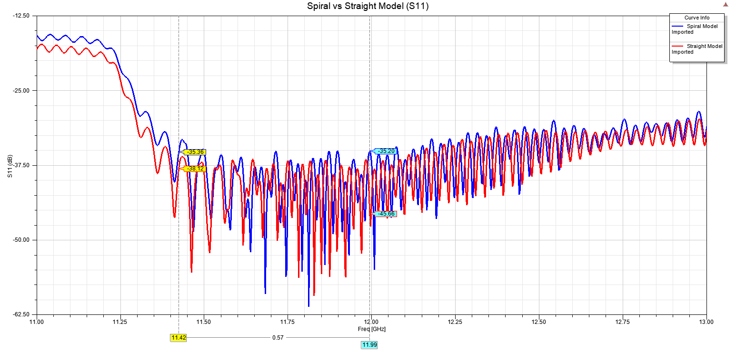
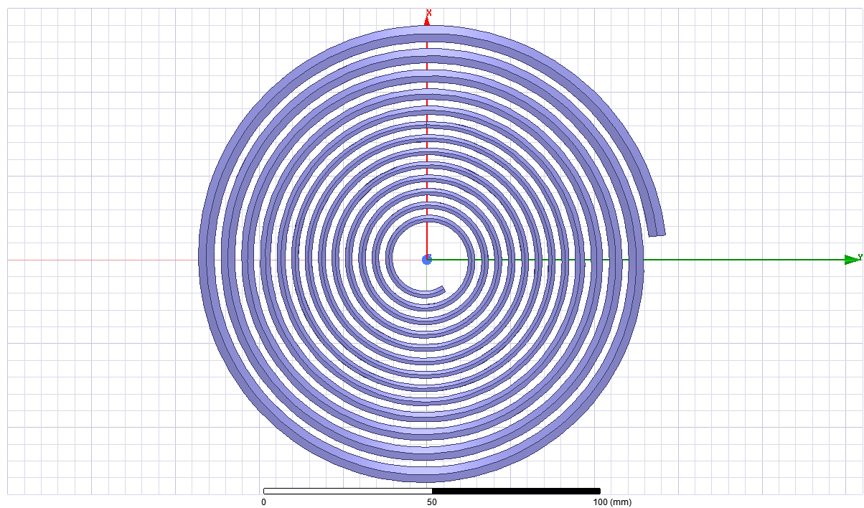

Slide 18
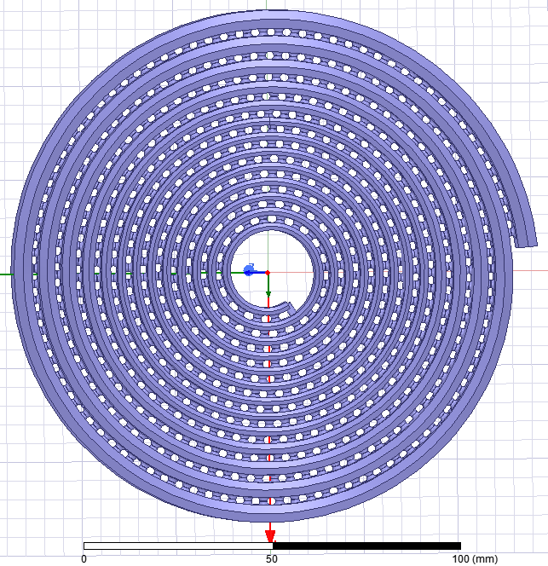
Spiral Model with Vacuum Holes
vacuum holes with 2mm diameter

Slide 19
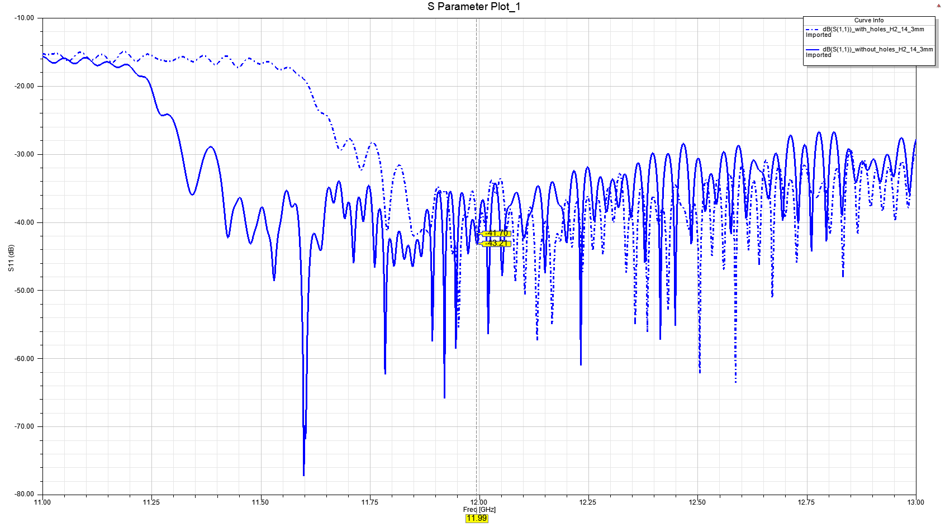
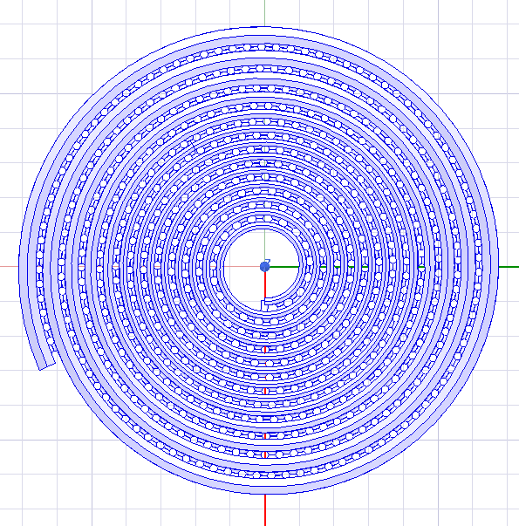
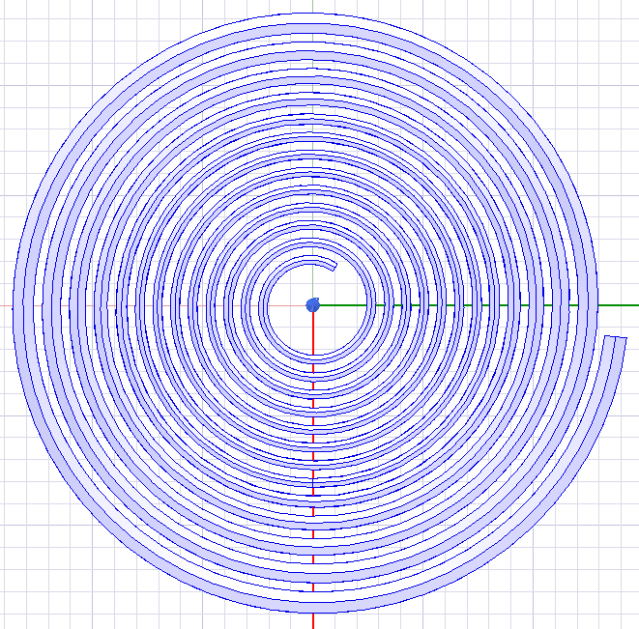
Frequency shift due to vacuum holes
Model with holes
Frequency shift
due to holes
~350 MHz
To compensate frequency shift→Changing H2 from 14.3 to 14.6mm
Model without holes
11.9942 GHz

Slide 20
Spiral Model Dimensions (Updated)
25mm
H2
14.6mm
Connection
2mm (gap)
5mm
2mm
2mm (gap)
Connection
10.16mm
End of the load
(Same cross-section)
22.86mm

Slide 21
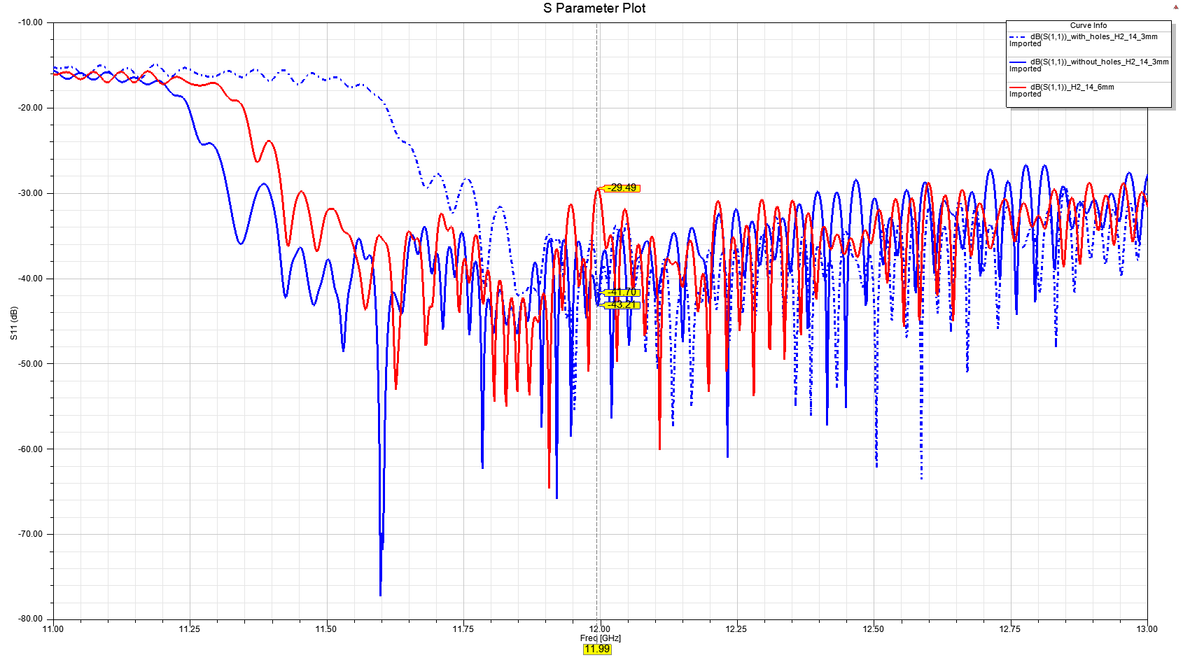
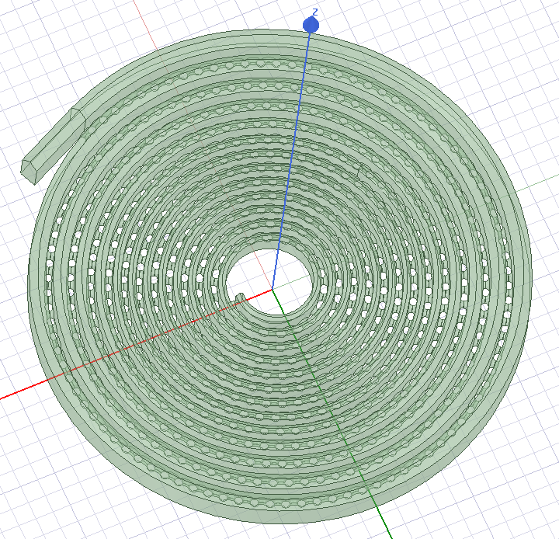
Frequency shift due to vacuum holes
Model with holes
(H2=14.3mm)
H2 determines cut-off frequency
Model with holes
(H2=14.6mm)
There is a peak at our target frequency!
Model without holes
(H2=14.3mm)
11.9942 GHz

Slide 22
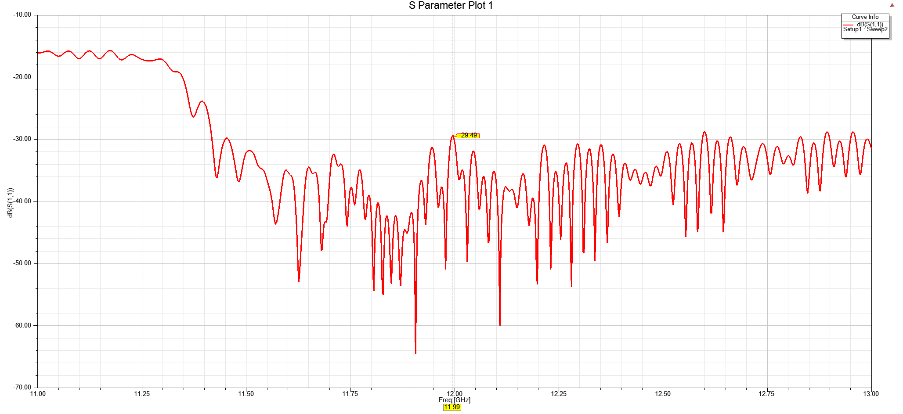
Reflection Improvement on HFSS
There is a peak @ 11.9942 GHz
Model with holes
H2=14.6mm

Slide 23
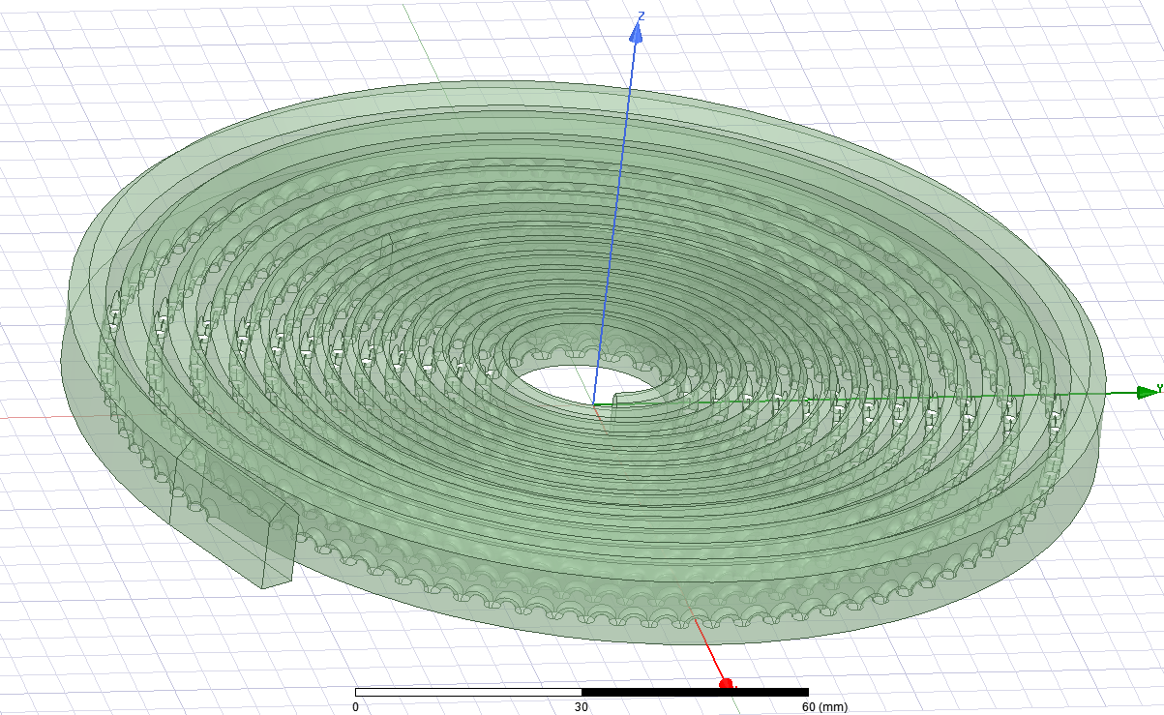
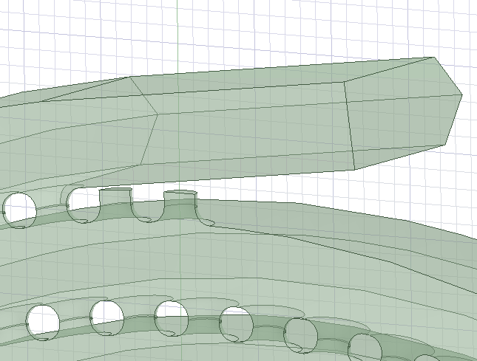
Inner waveguide of model has vacuum holes both sides.
Outer face of model has vacuum holes only one side, this causes reflection cumulation at the last hole (under transition part).
To overcome this; we have added different number of tuning holes to see how reflection changes.
Tuning holes

Slide 24
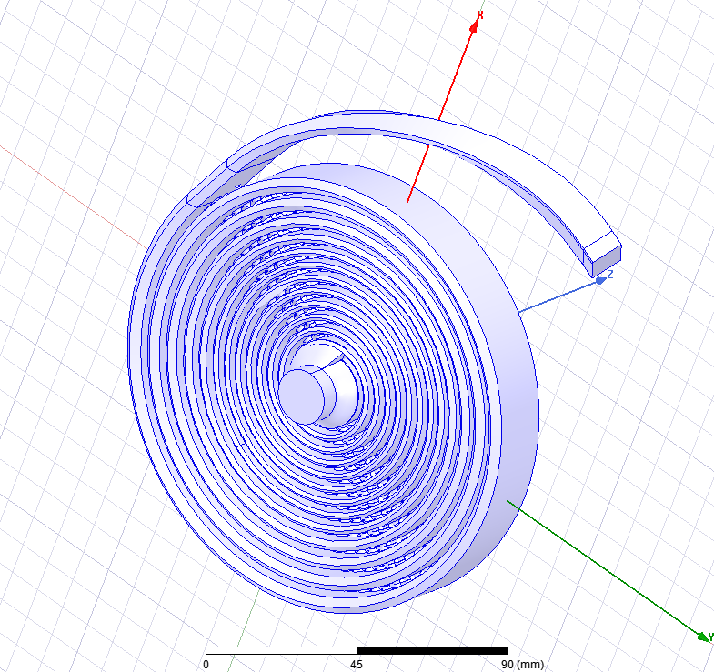
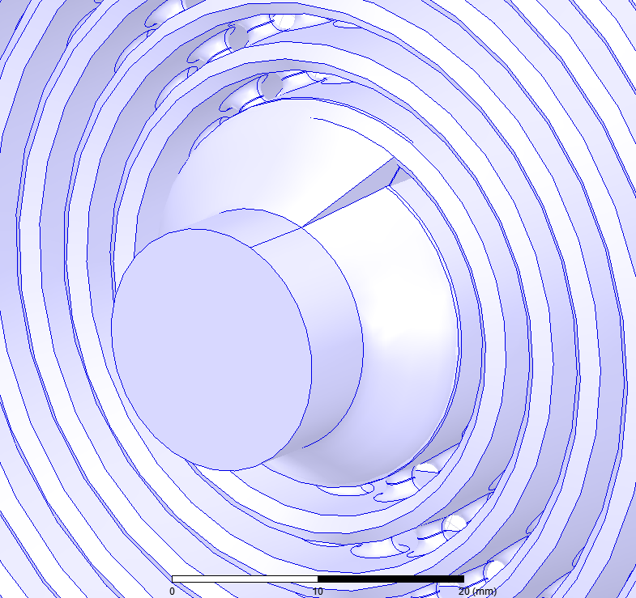
Spiral Model with Pumping Port
CF16 Vacuum Flange
Oleg Gumenyuk

Slide 25
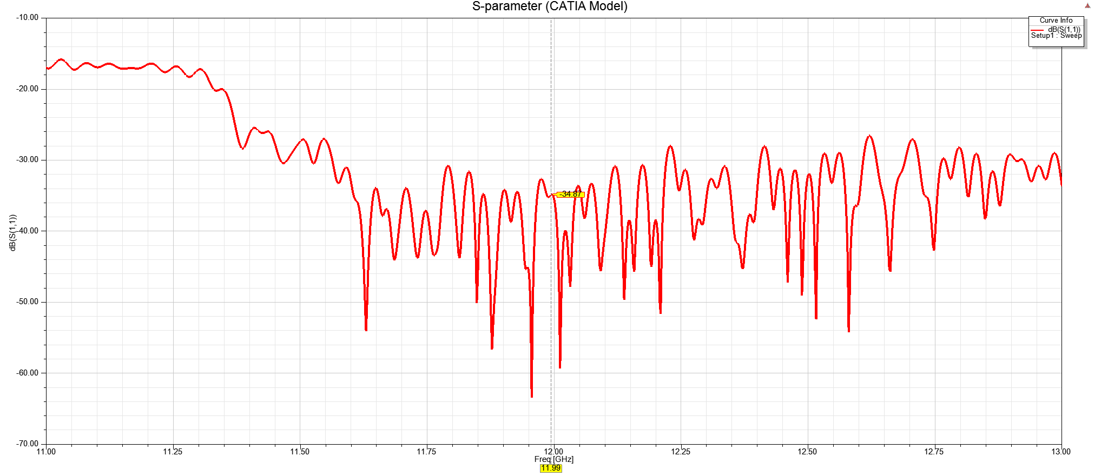
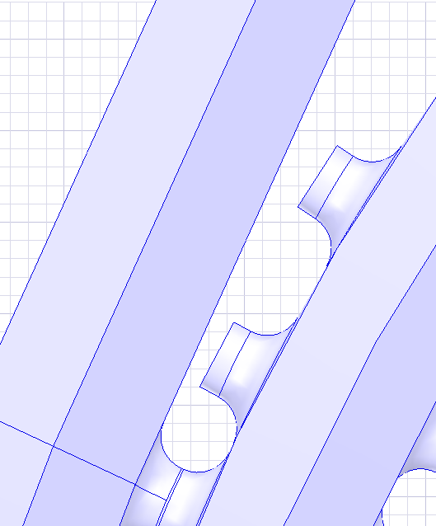
Reflection (model with vacuum port)
2 tuning holes with 2mm diameter
11.9942 GHz

Slide 26
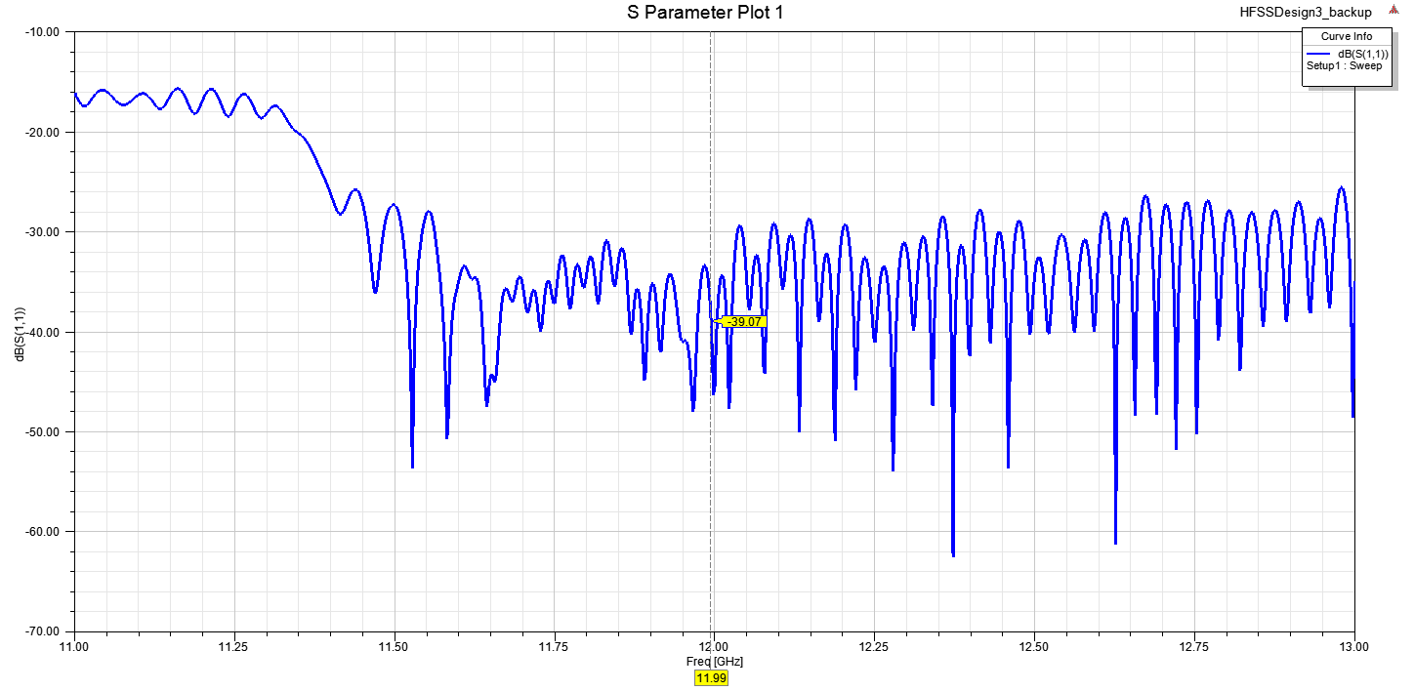
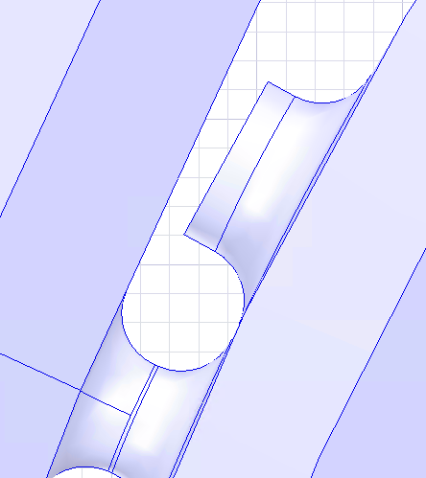
Reflection Optimisation
Material: Ti6A14V
(σ= 6.10⁵ S/m)
3mm
1 tuning hole with 3mm diameter
11.9942 GHz

Slide 27
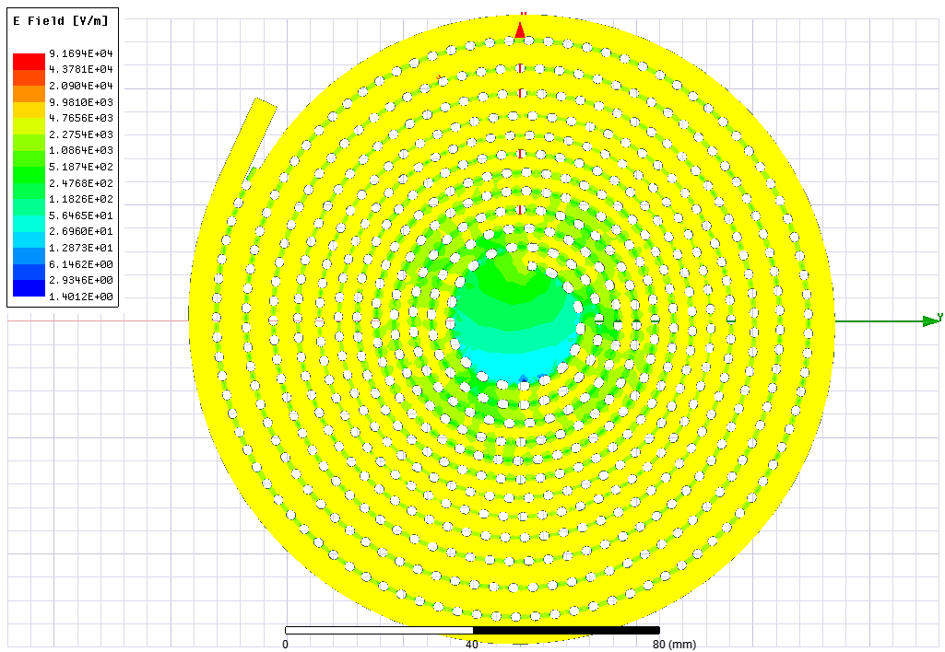
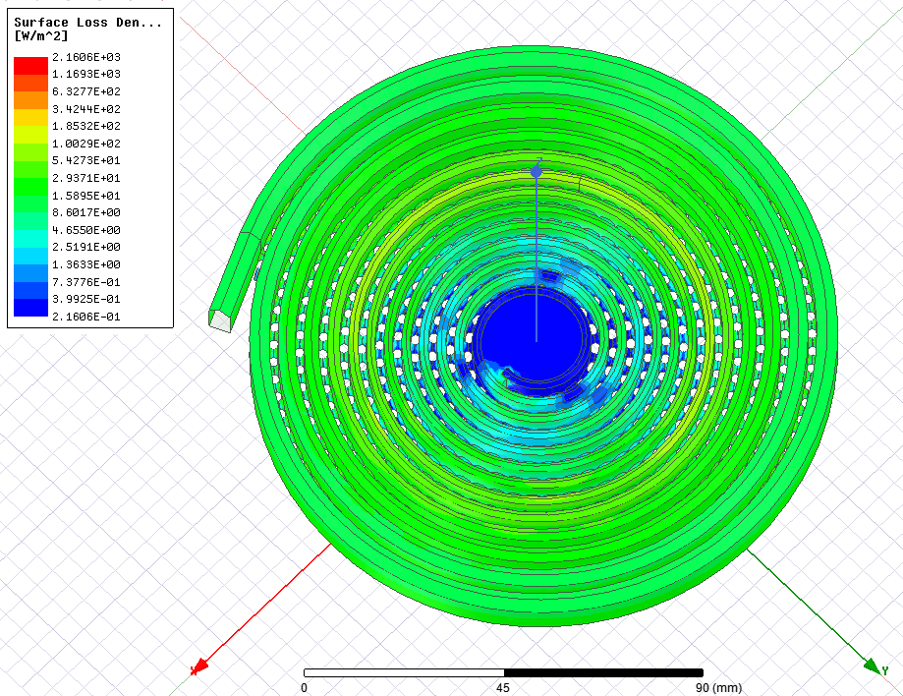
Electric Field & Surface Loss Density @12GHz
Input Power=1W

Slide 28
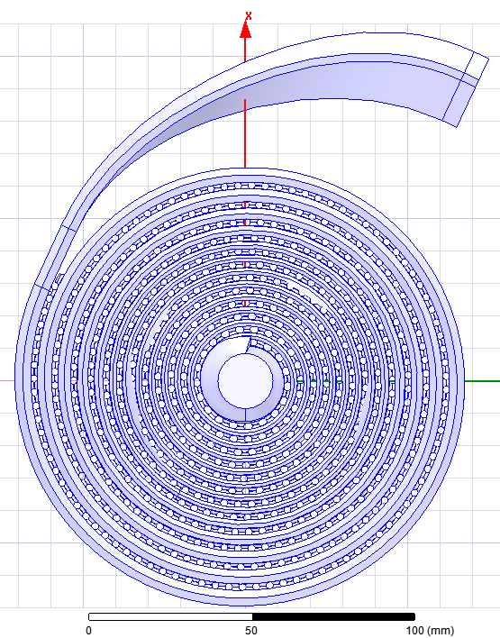
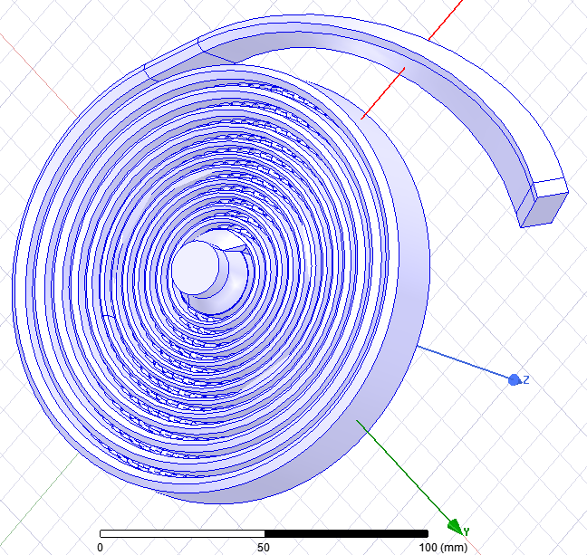
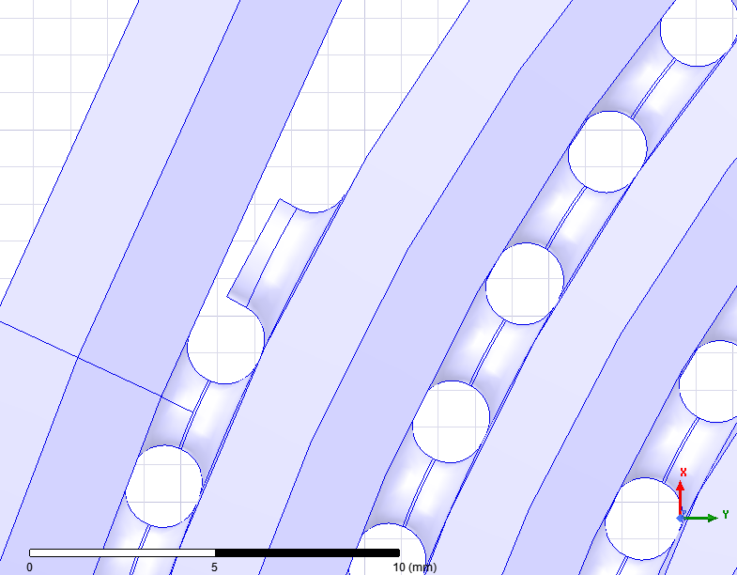
Final Model (in HFSS)
Side View
Upper View
Tuning hole
Mechanical Design by Oleg Gumenyuk

Slide 29
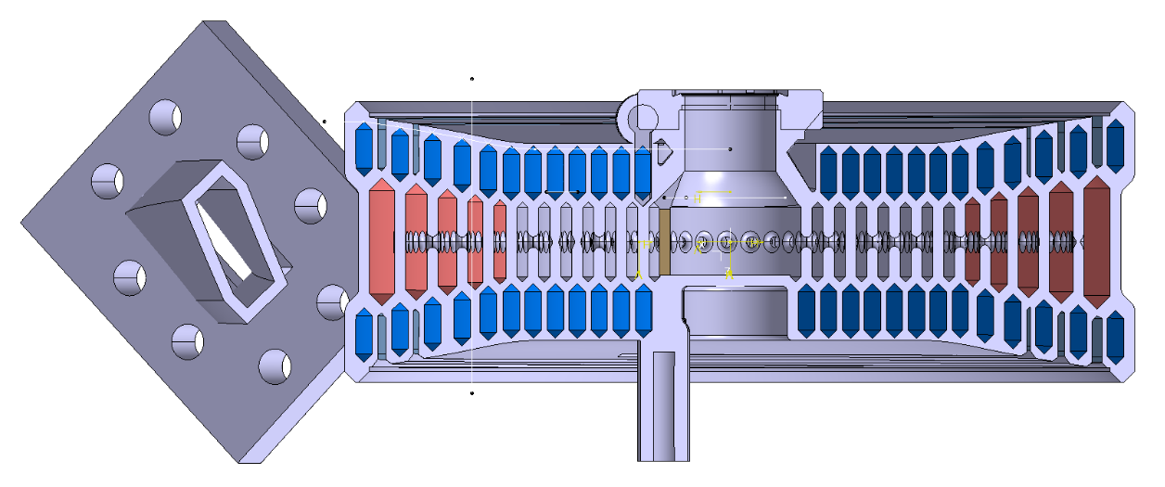
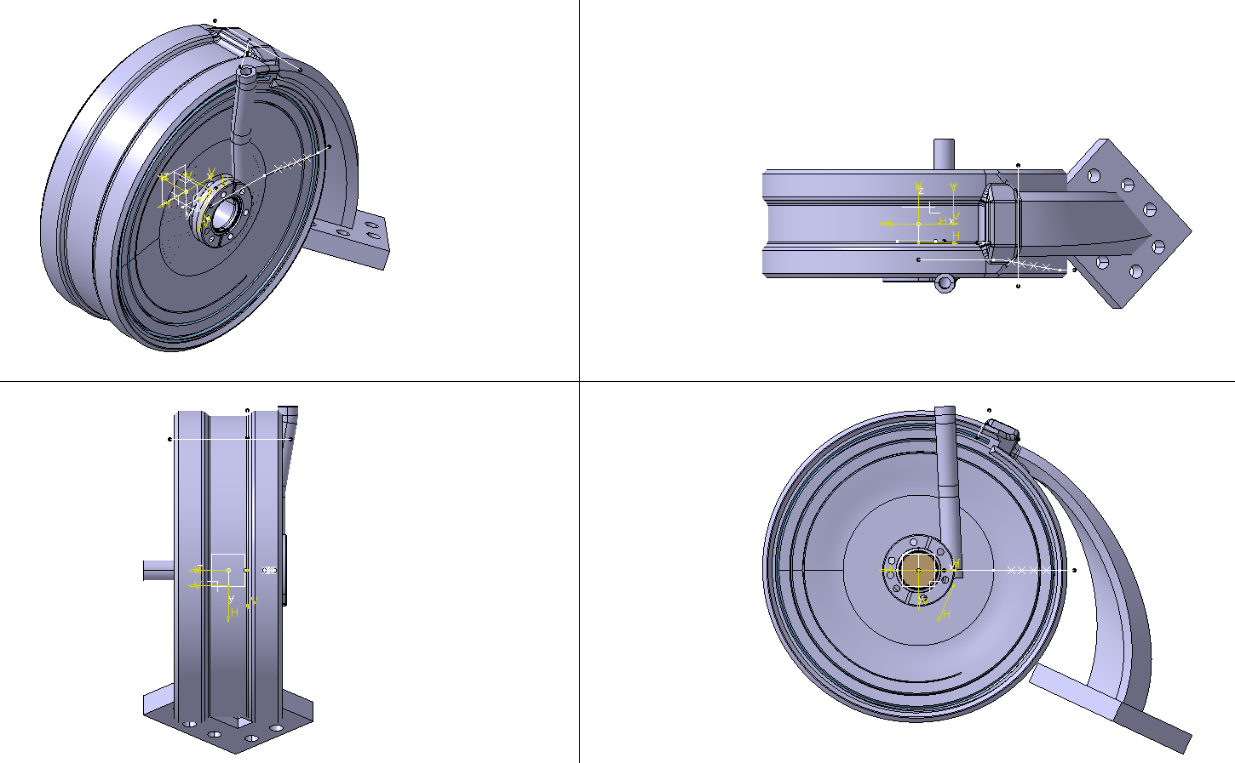

Final Model (in CATIA)
Internal Views
Side Views
Pedro Morales Sanchez

Slide 30
Conclusion & Future Work
RF Design of spiral load with new cross-section is ready!
(https://edms.cern.ch/document/2404437/1)
Cooling Circuit Integration
Mechanical Design (Ongoing by Pedro Morales Sanchez)
Thermal Simulations
Production by Additive Manufacturing
RF Test

Slide 31
Thank you for your attention!
Special thanks to;
Nuria Catalan Lasheras, Benoit Riffaud, Oleg Gumenyuk, Romain Gerard, Joel Sauza Bedolla, Pedro Morales Sanchez

Slide 32
Backup Slides

Slide 33
Spiral Model Dimensions-Final Version
Connection
25mm
(H0)
(H1)
2mm (gap)
14.6mm
(w0)
5mm
(w1)
2mm
2mm (gap)
Connection
10.16mm
(b)
End of the load
(Same cross-section)
(H2,w2)
22.86mm
(a)

Slide 34

S11 without roughness
S11 with *50 um roughness
* Average roughness for Ti alloy
11.9942 GHz
Spiral Model without vacuum port
M.Heretis, P.Spanoudakis, N.Tsourveloudis, ‘’Surface Roughness characteristics of Ti6Al4V alloy in conventional lathe and mill machining’’, Technical University of Crete, p.5 2009

