Slide 1
LHC Machine
Experimental Beam Vacuum Project
VSC Follow-up meeting 31th of August 2020
On behalf of the experimental team
Josef Sestak, Jerome Chaure

Slide 2
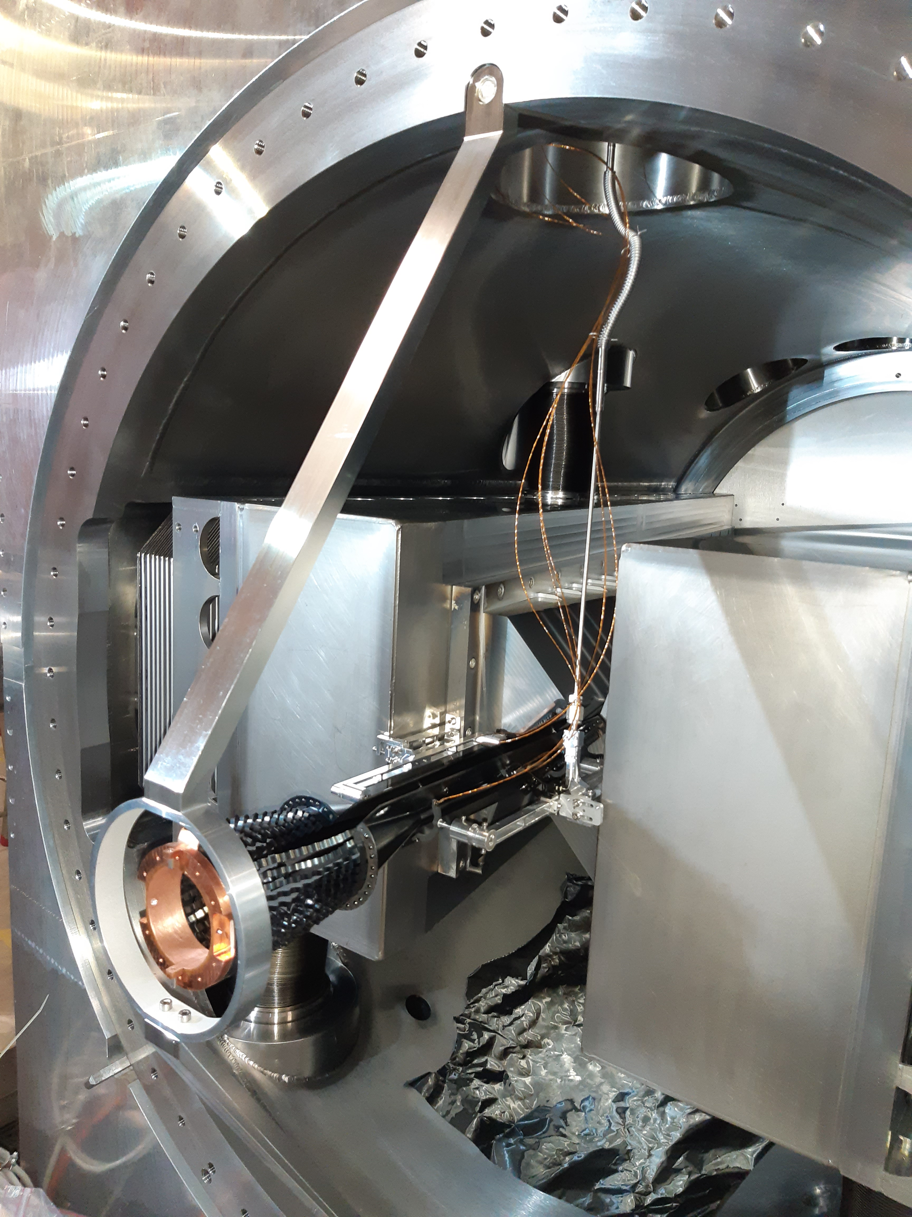
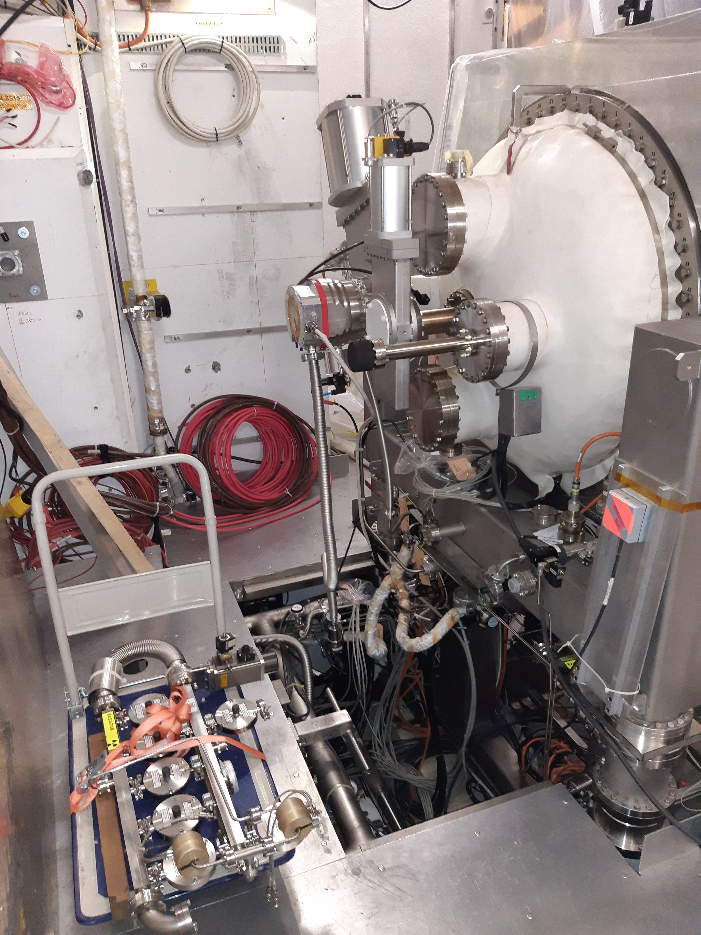
Progress on UX activities
LHCb
VELO & SMOG2
SMOG2 storage cell installed
VELO vacuum HW installed

Slide 3
Progress on the UX activities
LHCb experiment
  VELO RF boxes upgrade – complete;
  VELO SMOG2 installation – complete;
  GIS modifications & GFS line – complete;
  New upstream vacuum layout – complete;
  Some small mechanical activities ongoing;
  VELO ready for the control interface tests by this week.

Slide 4
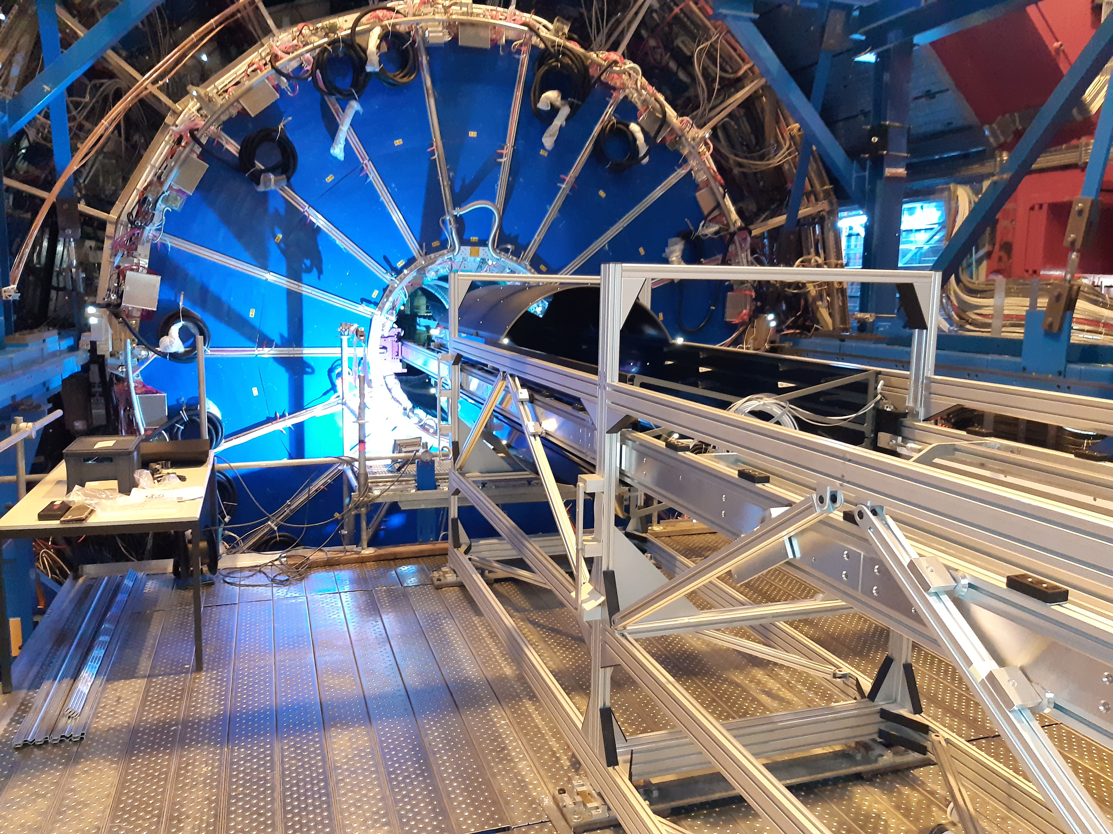
Progress on the UX activities
ALICE experiment
Preparations for IP2.X installation
Equipment and procedures ready.
By this week we have installation readiness audit + visit of the UX.
Waiting for the confirmation of the start date from ALICE.
Expected start by week 38 (bake-out w.40-41).
ALICE ITS cage (will house the central chamber)
Before the insertion test into the TPC (last week)

Slide 5
Progress on the UX activities
ATLAS experiment
  Special Pilot Run layout – discussion ongoing.
  GIS TMP reinstalled – leak detection of the table today (ICM co-activities ongoing).
CMS experiment
  Inspections of the IP5.X cabling traversing the UX to US (via the triplet zone).
  More detailed update after LHCC this week.

Slide 6
Installation schedule – main activities
Schedule for 2020 activities is still drifting.
LHCb UX85 activities
ALICE UX25 activities
Week 32 – SMOG2 installation - DONE;
Week 33 – 35 – Reinstallation of the VELO vacuum hardware - DONE
Week 38 – 40 – ALICE IP2. X MECA;
Week 40 – 41 – Bake-out of the IP2.X; A1R2.X; Neon venting after BO;
Week 43 – ALICE post-mechanical activities;
Week 43 – 44 – VELO exit-foil window (TBC).

Slide 7
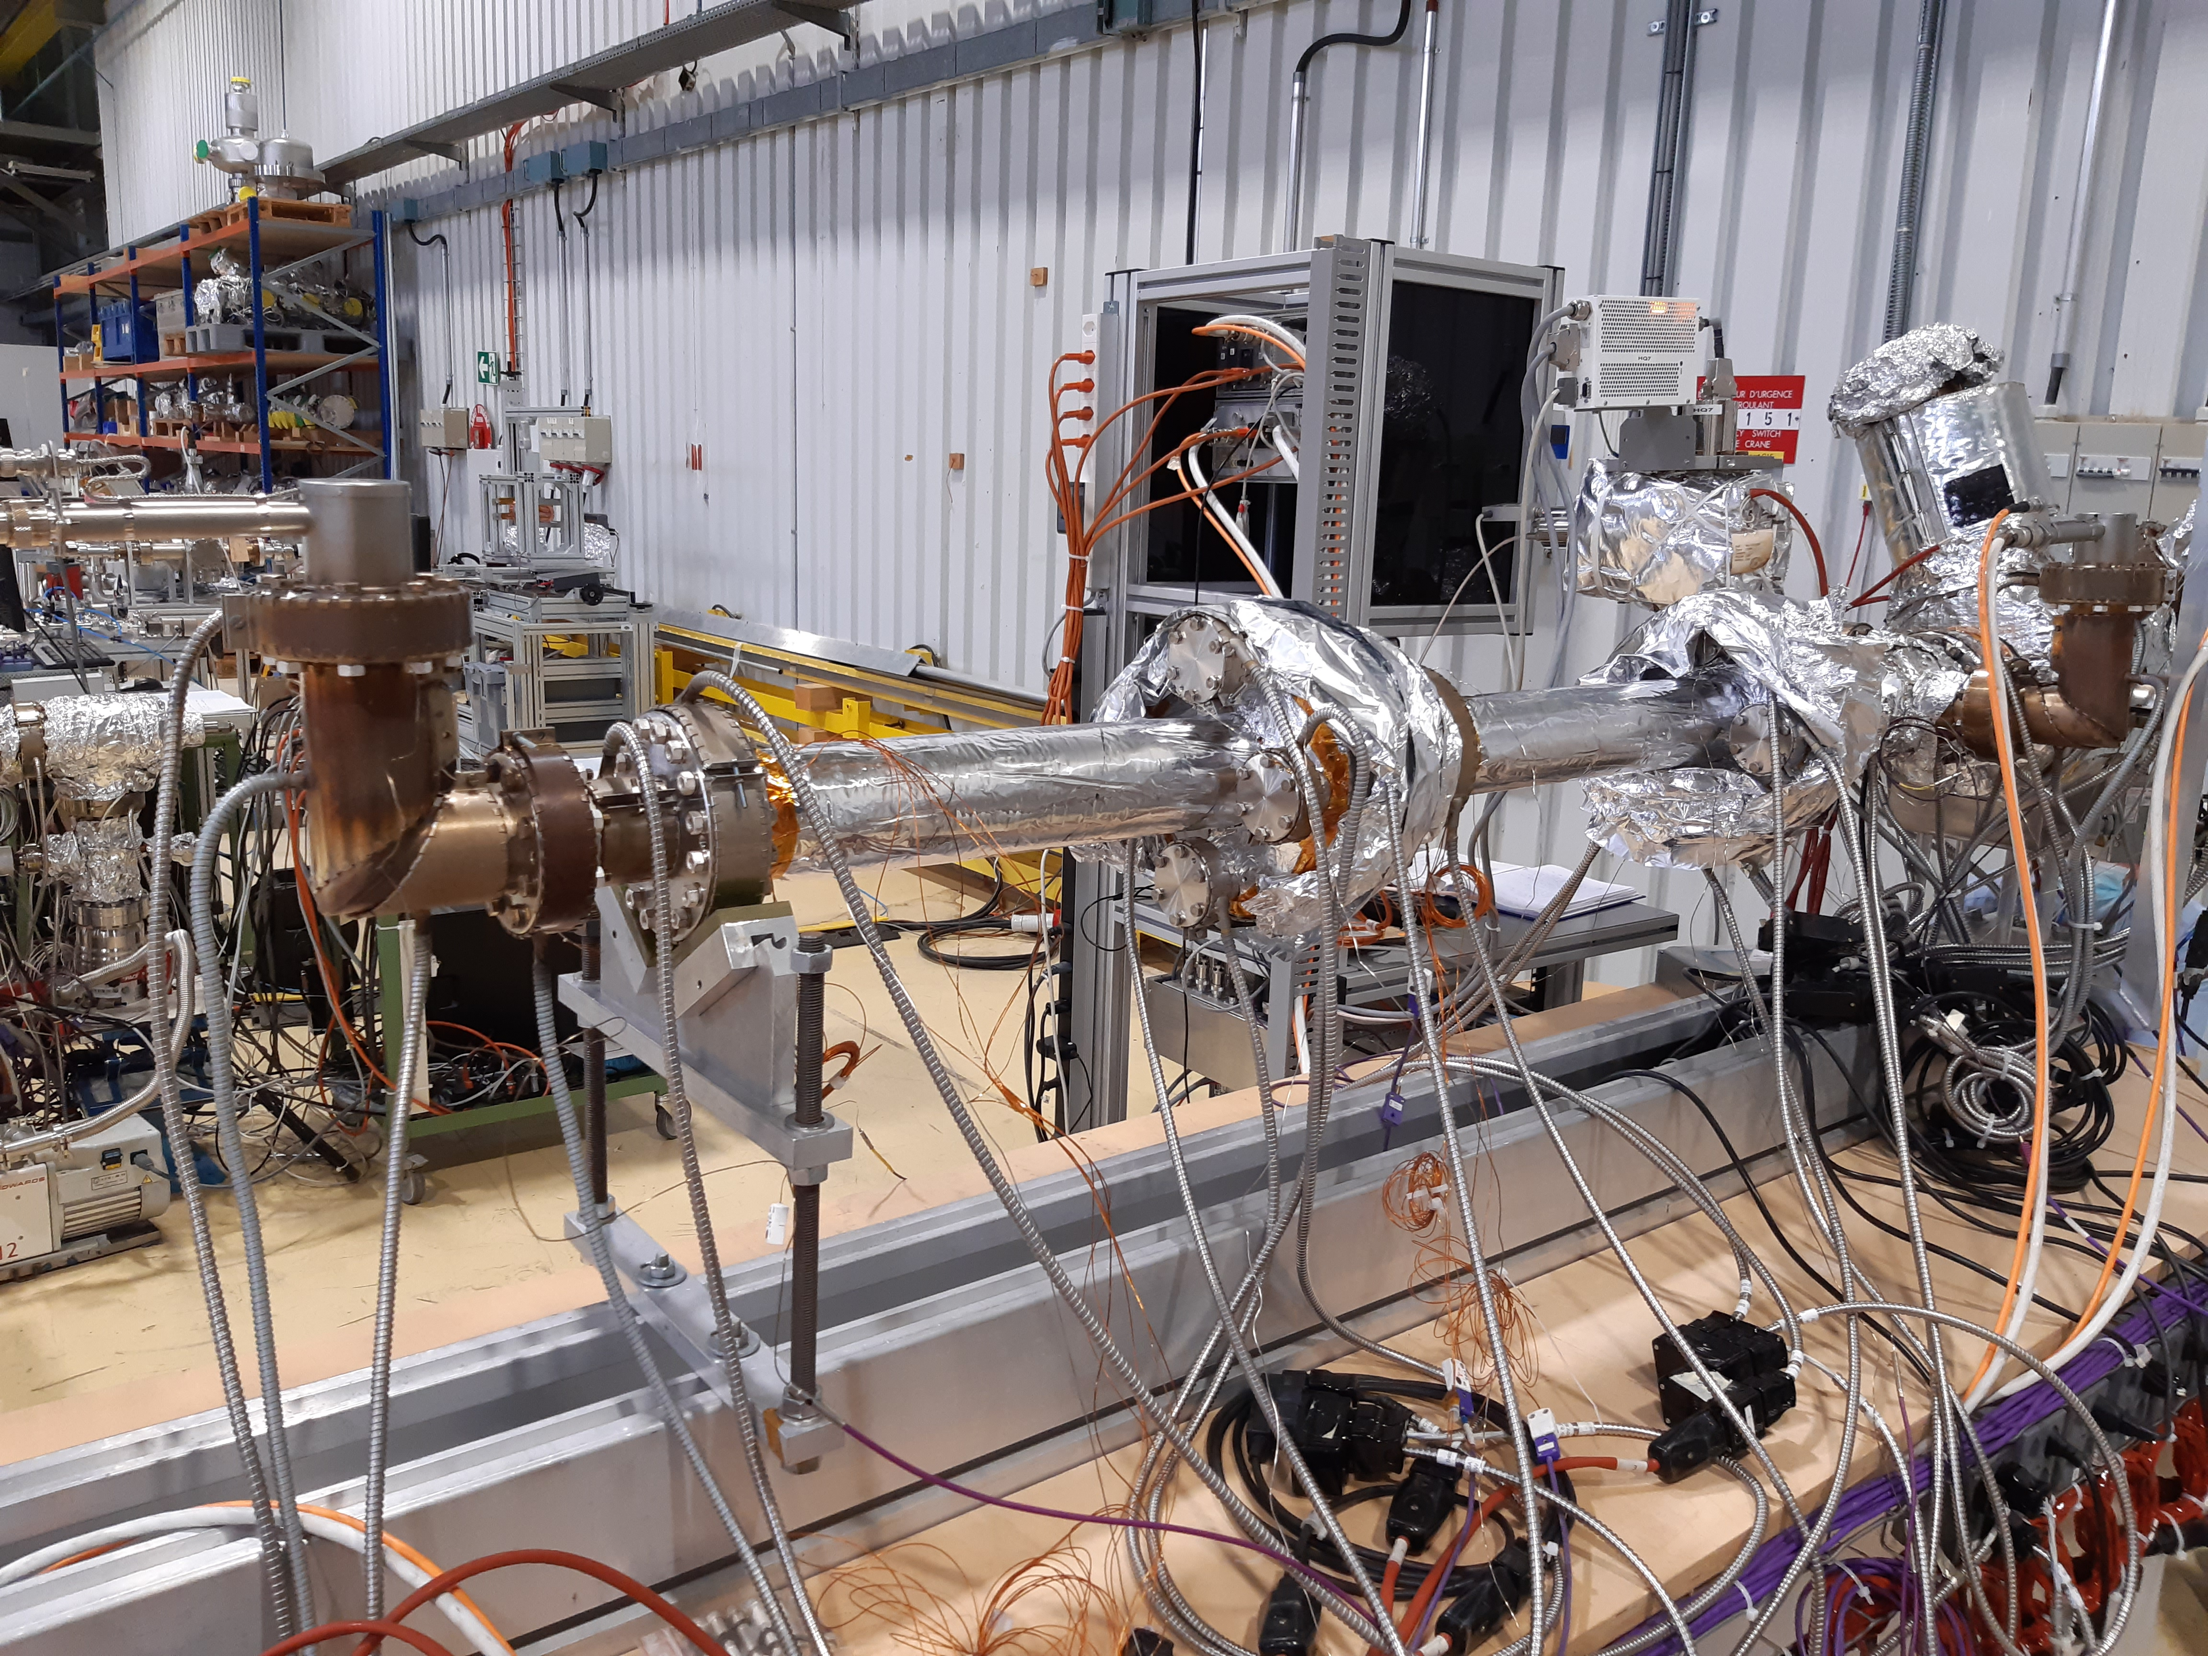
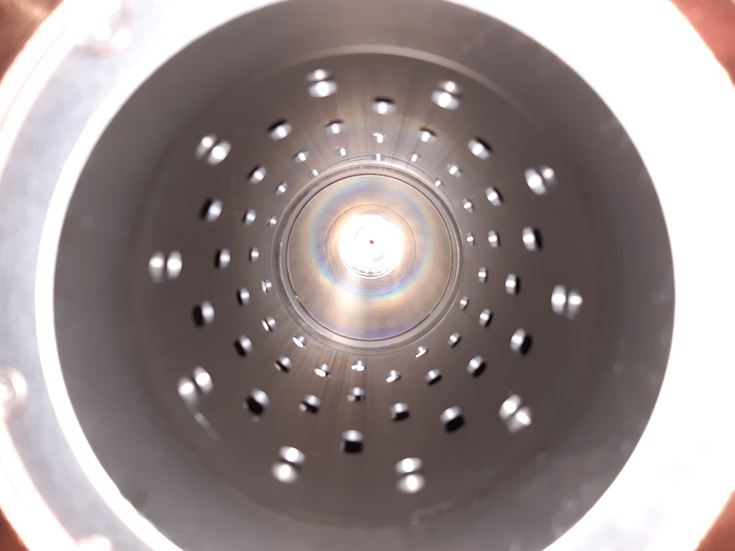
Surface activities update – CMS chambers
NEG coating of 2x VC5FP forward pumping chamber complete.
2 Forward pumping chambers on NEG TB#3 (b.113)
NEG coated RF screen with slots within the conical part
No visible surface imperfections after the coating.
NEG performance tests ongoing (b.113).
Spare chamber with AP (leak on the feedthrough).

Slide 8
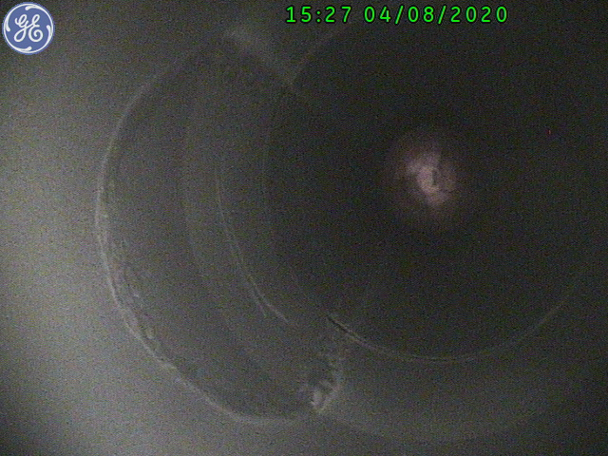
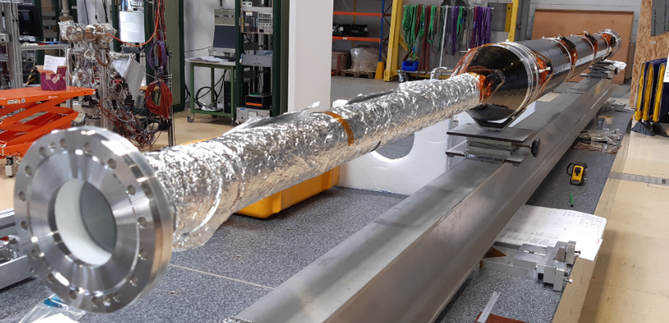
Surface activities update – CMS chambers
Additional circulation etching of HF-CT2 #3.
  Circulation etching process delivers visible variation in surface texture. Visible areas represents zones with where the etching solution stays for increased period of time.
  Difficulty presents the reduction cone of the chamber.
Marks on the reduction cone
HF-CT2 on the endoscopy setup
Diameter reduction
from 195mm to 74mm
on 225mm of length
Result discussed with Pedro and should be OK for coating – by the next week

Slide 9
Activities for next two weeks
UX activities
  LHCb VELO – HW preparations for controls tests;
  Installation of the sector valve in RB26 (ALICE);
Lab activities
  NEG acceptance of CMS forward pumping (2x);
  VAC acceptance of the CMS HF-CT #3;
  NEG coating of the CMS HF-CT #3;
  Circulation etching of the CMS HF-CT #1-2;
  Installation of the permanent heaters on CMS HF-CT #1-2;
NEG coating of HF-CT2 (2x) by end of September beginning of October
NEG coating of End-Cap (2x) by end of October beginning of November
Once OP chambers are complete we do 1+1 spares.
Installation foreseen by mid-February (TBC)

Slide 10
Thank you for your attention and help

