Slide 1
ICM activities: LHC, SPS, CPS
G. Pigny
31st of August 2020

Slide 2
LHC

Slide 3
Performed activities
W32-35 (Pablo, Sebastien, Andre, Abel N. & FSU)
LHC DB modification (more info: VACCO-3847) & SCADA/PLC update
Migration of WinCC-OA to 3.16
LSS1:
  Connection of mobile pumping groups (B5L1+C4L1)
LSS2:
  Connection TCLD + Tests (11R2) – Reparation VRJIA boxes
  Reconnection Point 2 Left side (Power cable of PLC badly connected)
LSS3:
  Connection of mobile pumping groups (B5L1+C4L1)
  Reconnection of power outlets and DP cards reset after Power cut
ARC34, LSS4:
  Reconnection of mobile pumping groups ARC 34
  Connection of mobile pumping group (D5L4+C5L4)

Slide 4
Performed activities
W32-35 (Pablo, Abel N. & FSU, Rodrigo)
LSS7:
  Instrumentation checking and connection of new VPI-NEG in IP7.R-B, incl. manufacturing of new feedthrough for SVA3 local cable (w/FSU).
  Functional tests of VGI and VPI chain in LSS7 following BVO requests. NEG consolidation and tests.
  Reparation of VPI communication (VRPIT.TZ76.R08) – Problem with connector in the patch panel.
  Change of TPG in Point 7 + solved some problems with the bakeout wireless pumping groups.
LSS8, TI8:
  Connection of mobile pumping groups (A5L8+A6L8)
S7-200 based VPGM controllers (Rodrigo)
  Correction and test of the PLC SW
  Update of some VPGM in B113

Slide 5
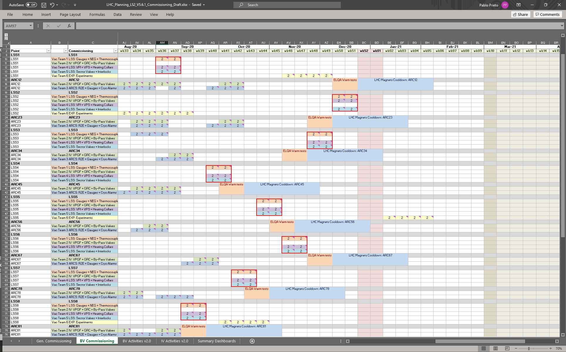
BV Commissioning Plan (draft)

Slide 6
Performed activities
W32-35 (Lampros, Nikos, Pepe, Alexandre and FSU)
Insulation Vacuum, LS2 slave PLC replacement and R2E electronics:
Commissioning Sector 12: 100% completed.
  Calibrations of Piezo/Pirani in LSS.
  Control chain tests of all gauges, valves. Replace HV cable in sector 11R1.M/
  VPGF functional tests.
  CRYO alarms.
Commissioning Sector 45: 100% completed. (activity resumed from 80% from week 26).
  Finish calibrations of Piezo/Pirani in RF and LSS4R.
  Consolidation of TPG300 controllers in RF and LSS4R.
  Reparation and calibration of legacy pirani electronics for C45.Q.
  CRYO alarms commissioned. Official validation planned for the 15th of September.
Commissioning Sector 78 (Pepe, Rodrigo & FSU): 65% completed.
  Calibrations of Piezo/Pirani in LSS8L and LSS7R.
  Control chain tests of all gauges, valves from LSS8L to 34L8 and in LSS7R. Replace HV cable in sector 11L8.M.
  VPGF PLC software update of all sector; functional tests from LSS8L to 34L8 and in LSS7R.
LHC
6
6
Notes:
6

Slide 7
Performed activities
W32-35 (Lampros, Nikos, Pepe, Alexandre and FSU)
Insulation Vacuum, LS2 slave PLC replacement and R2E electronics:
Sector 81 official validation of CRYO alarms successful.
PLC and R2E consolidation of Sector 23:
  Material transport in UA27 and RE28.
  RE28 mechanical modifications and installation of new VPGF.
  Local crates modifications from 8R2 to 32R2.
Sector 34 preparation for the commissioning (w/ Rodrigo):
  VPGF PLC software update.
DLM support:
  ARC45: Repair the VRR1 open status of the VPGFA.502.24R4.Q.
  LSS2R: Solve issue with crossed cables between piezo and pirani in 5R2.M.
LHC
7
7
Notes:
7

Slide 8
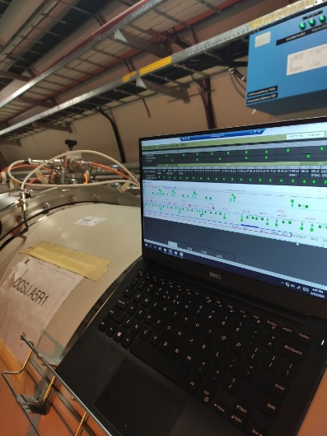
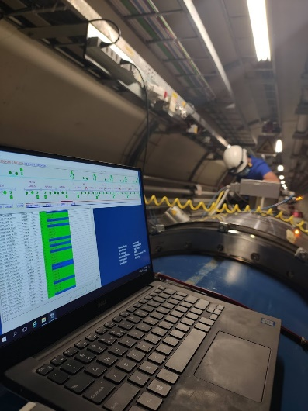
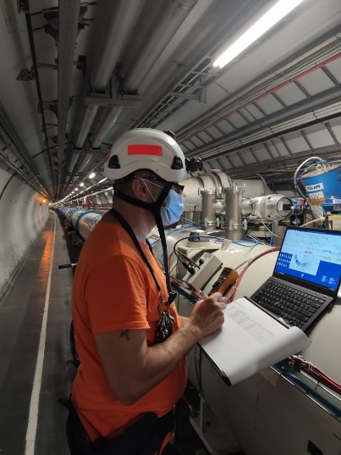
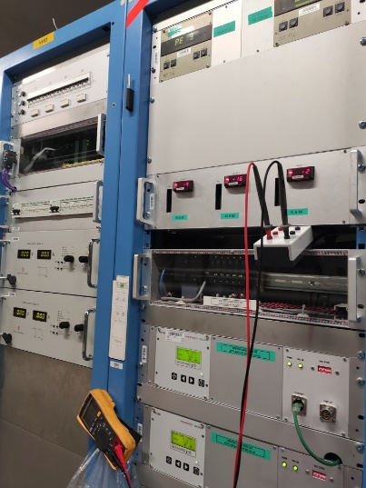
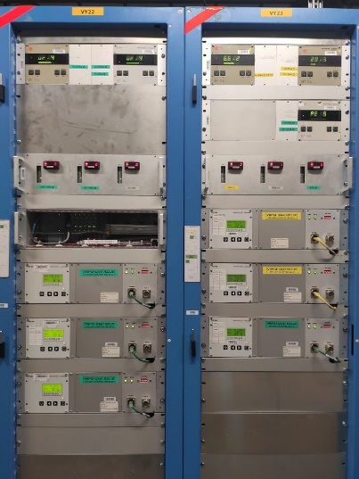
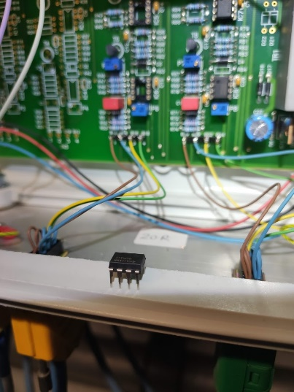
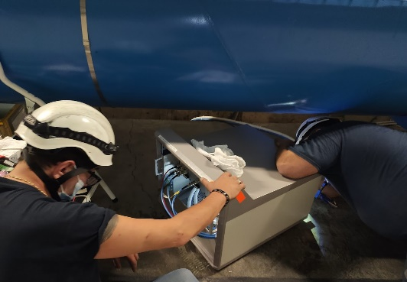
Performed activities
W32-35 (Lampros, Nikos, Pepe, Alexandre and FSU)
Insulation Vacuum, LS2 slave PLC replacement and R2E electronics:
CRYO alarms test S12
CRYO Validation S81
Commissioning S78
HV Cable replacement
Commissioning S45
LHC
8
8
Notes:
8

Slide 9
Planned activities
W36/W37 (Pablo, Abel N. & FSU)
LHC BV Commissioning Phase:
  LSS1, Pilot Tests:
    First contact with field commissioning, teach and review existing procedures, prepare files.
    Perform full commissioning of LSS1 (Gauges, Pumps, Valves, Interlocks, NEG, Solenoids, …)
LSS1:
    ATLAS-GIS PLC intervention (PLC not reachable)
LSS2, TI2:
  TI2.1204: Connection pumping group TI2 (Cable 60m)
LSS4:
  BGC: Mobile pumping group + BO-NEG support (C5L4+B5L4)
LSS7:
    TCPPM/-SPM: Mobile pumping group + BO-NEG support (IP7+A4L7)
AOB:
  Critical Gauges, TE Elec. Safety and QA actions (Simulators, IP2x, Racks Cleaning, etc.)

Slide 10
Planned activities
W36/37 (Lampros, Nikos, Pepe, Alexander & FSU)
Insulation Vacuum, LS2 slave PLC replacement and R2E electronics:
Finish Commissioning Sector 78
  Piezo calibrations in LSS7R.
  Gauges, valves and VPGF from LSS7R to 33R7.
  CRYO alarms tests.
Finish PLC-R2E installation UA27 and RE28
  RE28 cabling (bornier, Ethernet, etc..)
  VRJGE modifications.
  R2E installation.
  UA27 PLC installation and cabling.
  LSS local crates replacement.
Start Commissioning sector 34
CRYO alarm official validation sector 45
LHC
10

Slide 11
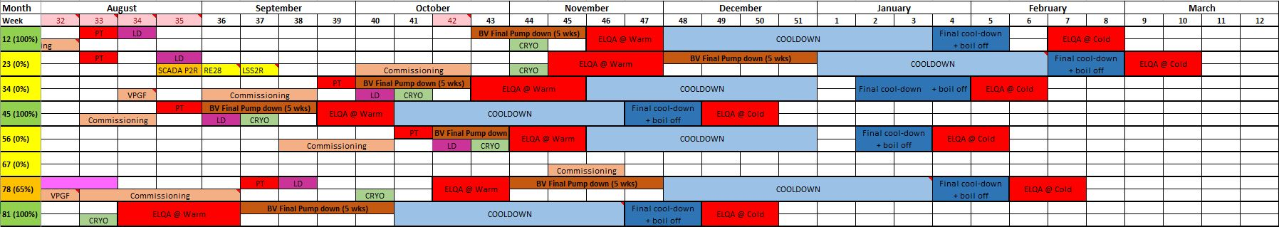
IV Commissioning planning (V3.1)
% of Commissioning status
Start Commissioning S34
RE28, UA27 PLC-R2E installation
Commissioning S78
Commissioning S45
Cool-down delays:
S23 delayed to week 1 from week 48
S78 delayed to week 48 from week 44
S81 delayed to week 41 from week 38
LHC
11

Slide 12
LHC Burndown Chart
W33-W35 (Pablo, Lampros, Nikos)
Beam Vacuum, Experiments, Insulation Vacuum, R2E:
\\cern.ch\dfs\Departments\TE\Groups\VSC\ICM\LS2\LHC\-. General Documentation\0. Planning

Slide 13
SPS

Slide 14
Performed activities
W32-35 (Abel G.)
SPS – BA1:
  Troubleshooting for VPIB_11958 in sparking (MKP). Power supply damaged.
  Labelling of all the obsolete cables in LSS1 in view to the LS3 de-cabling campaign. De-cabling list finished for BA1 (just missing to put them in the DEC template).
SPS – BA2:
  Installation of NEG pumps mini-rack and connections into the patch panel.
  Troubleshooting for VPIA_21560 with high current. Pumps damaged.
  Troubleshooting for VPIA_22240 without communication. Power supply damaged.
  Troubleshooting for VPIA_22520 in sparking. Fischer at rack side and local cable damaged.
  De-cabling list finished (just missing to put them in the DEC template).
SPS – BA3:
  Troubleshooting for VPIA_31455 in sparking. Local cable and power supply damaged.
  Troubleshooting for VPIA_31580 in sparking. Local cable and power supply damaged.
  Troubleshooting for VPIB_31633 & VPIB_31636 in sparking. Local cables and local boxes wet after water leak.
SPS – BA4:
  Troubleshooting for VPIA_41580 in sparking. Local cable blocked by magnet cannot be removed.
  Troubleshooting for VPIA_410048 in over-current. Pump damaged.

Slide 15
Performed activities
W32-35 (Abel G.)
SPS – BA5:
  Connection of all the second campaign cables on the rack side.
  Connection and commissioning of all the instruments in sectors 530 & 531 (Kickers – LSS5).
  Troubleshooting for VPIA_53520 with sparking appearing randomly. HV channel of Agilent damaged.
SPS – BA6:
  Troubleshooting for VPIA_61455 in sparking. Socket at patch panel level damaged.
ISOLDE:
  Connection and commissioning of all the instruments in the GPS10 Front-End.
  Arrangement of the extra-length cables pulled them back to the GPS20 separator.

Slide 16
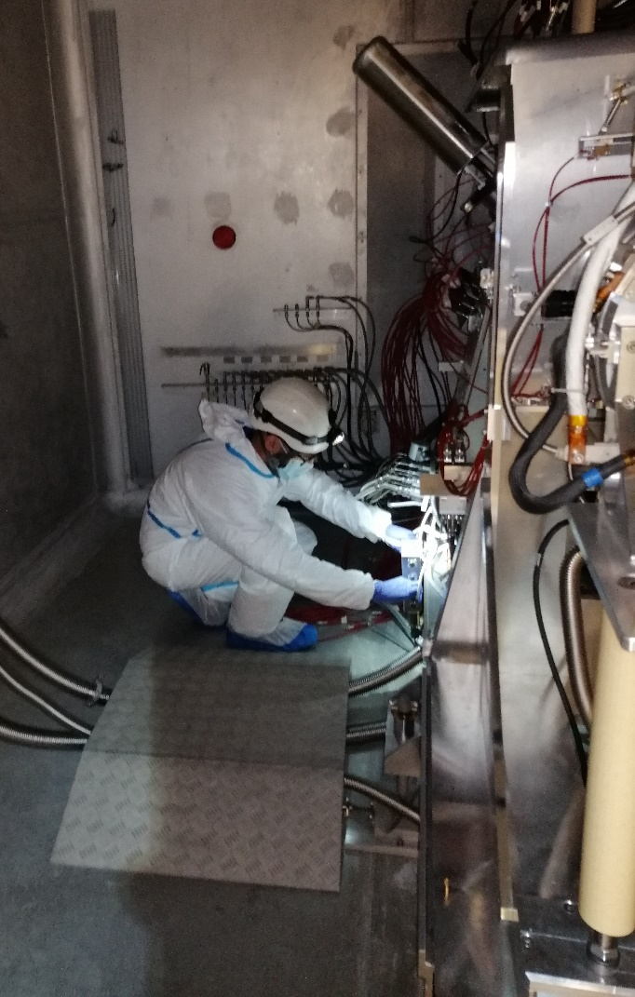
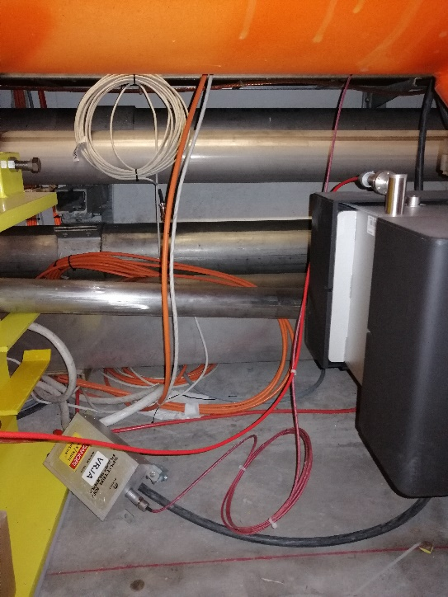
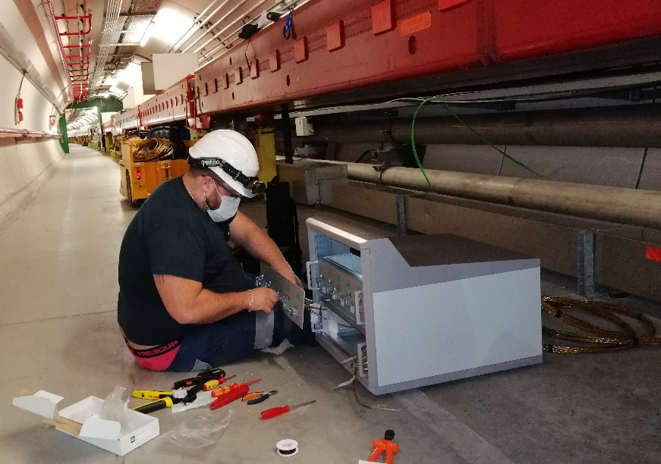
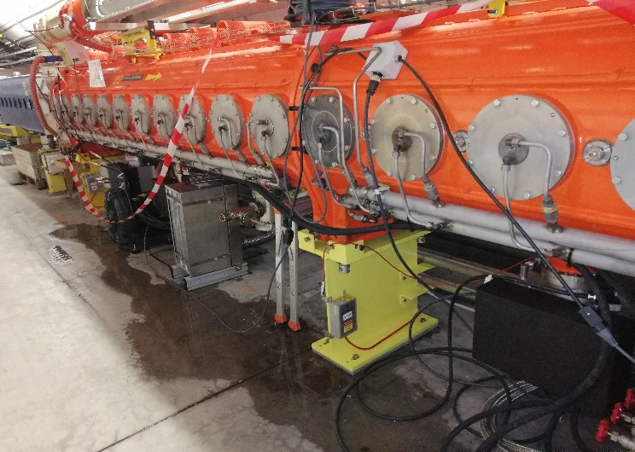
Performed activities
W32/33/34/35 (Abel G.)
ISOLDE: GPS FE Connections
SPS: Patch panel connections for NEG
SPS: Local boxes under HV removed by subcontractors!
SPS: Water leak over RF cavities

Slide 17
Planned activities
W36/37 (Abel G.)
SPS – BA2:
  Connection and commissioning of all the instruments in LSS2 (waiting for EN-EL to finish the cabling campaign).
SPS – BA5:
  Continuing the connection and commissioning of instruments in LSS5.
ISOLDE:
  Support to BVO during pump-down activities.
Test of TPG500 compatibility

Slide 18
CPS

Slide 19
Performed activities
W32+33+34+35 (J. de la Gama.)
PSR:
  Grounding for Vacuum chambers
  The PSR has been closed and we have finished the connection and commissioning of all sectors
  Alarms for cavities 11, 36, 46, 51, 56, 66, 76, 81, 86, 91, 96 tested
  Several VPI controllers repairs
  VIC to remove the cables from YETS 2018
  Repairing VPS controllers after first sublimation
PS Booster (in IST):
  New connectors for BI valves
LEIR
  Isolation test for EE.QFN10-S5.VPI1
  Replacement of 2 VGI controllers

Slide 20
Performed activities
W32+33+34+35 (J. de la Gama.)
ELENA:
  Repair of ring valves troubleshooting
  Repair VRJIA boxes
  New rack documentation with names and numbers
  Modification and test cables for door interlocks
  Finished the Profibus network
  Tested full interlock loop for LNE05,06 and 07
  VPIs, Penning/Piranis and fast penning connection
  Corrected the pinout on valves
Deadlines
  Mid July – Ring HW commissioning. – Our equipment for the ring is ready.
  Early August – Circulate H-.
  Mid September – Transfer line HW commissioning.

Slide 21
Thank you !

