Slide 1
Analysis and Modelling of Geometry and Field Quality Along the Series Production of the 11T Dipole
Dariusz Pulikowski,
Susana Izquierdo Bermudez,
Arnaud Devred,
José Luis Rudeiros Fernandez,
Acknowledgements:
Lucio Fiscarelli, Frédéric Savary, Giovanni Succi
2020.07.14

Slide 2
Outline
Motivation
11T Production and data
Geometry and Field Quality Control
Magneto-static 11T model
Modelling field errors
Summary

Slide 3
Motivation
Production of 11T coils and Collared Coils (CC) consist of geometrical, electrical, and magnetic Quality Control (QC) performed in various stages.
This presentation shows current status of a study coupling different QC types, aiming to:
Investigate correlation between selected production features, geometry measurements, and high order field harmonics,
Identify, model and estimate phenomena driving field error variability.

Slide 4
11T Production and data
Manufacturing steps and selected QC

Slide 5
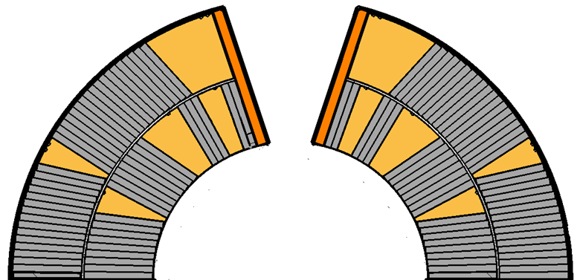
Impregnated 11T coil main features
Impregnated 11T coil
Winding & curing of IL
Winding & curing of OL
Reaction
Splicing and Impregnation
Coil branch
Loading Plate
Wedge
Cable block
Outer Radius
Outer layer
Midplane
Inner layer

Slide 6
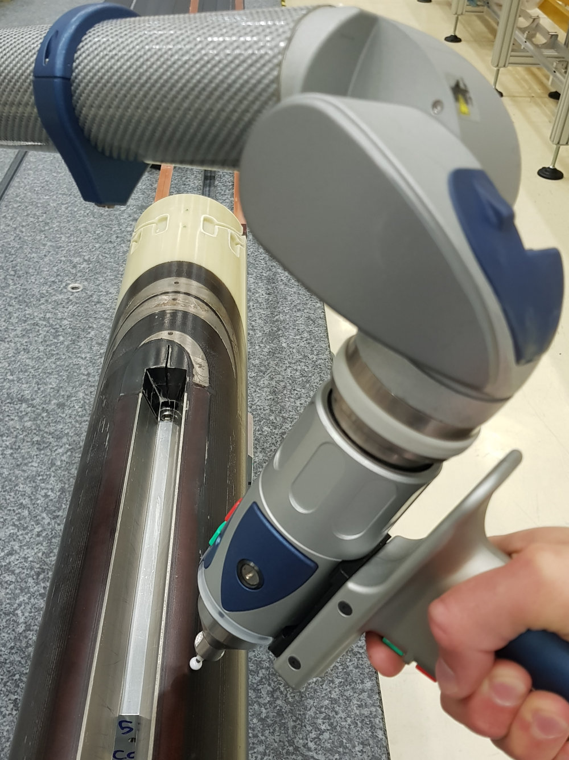
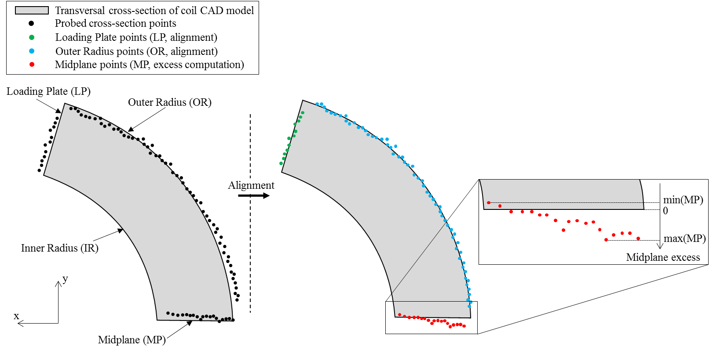
Geometry measurement of impregnated coil
Throughout the 11T production impregnated coil metrology is performed with Faro Arm Edge 2.7, featuring:
Volumetric maximum deviation: 41μm
Repeatability: 29 μm
The inspecion consists of two full coil measurements. The results are afterwards used for ensuring measurement qualification (spread threshold) and in order to increase precision by averaging cross-section output.

Slide 7
Total midplane excess of 11T coils
Summary of prototype and series coils collared in 10 CC
Total midplane excess (Left branch + Right branch midplane excess)
Geometry analysis radius indicated in brackets

Slide 8
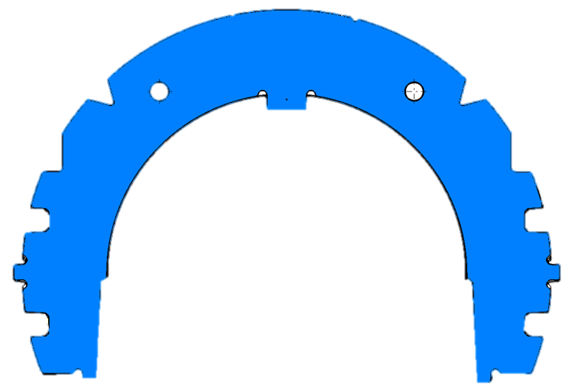
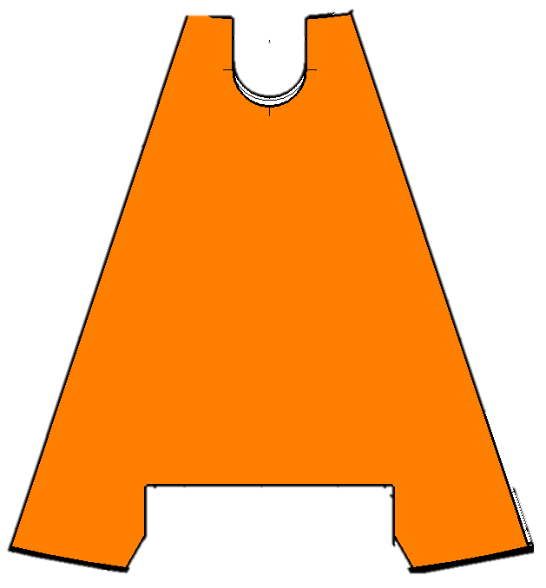
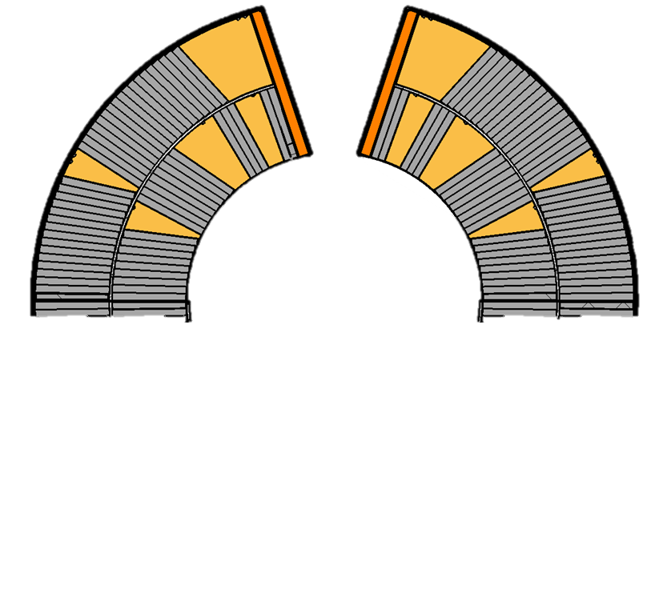
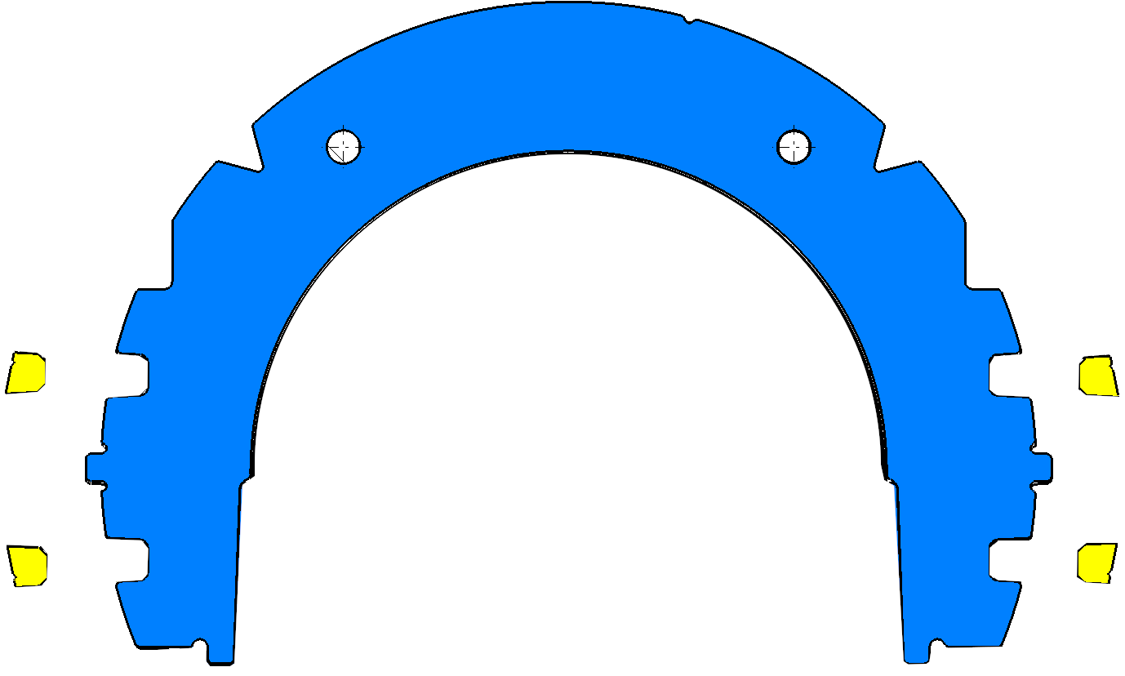
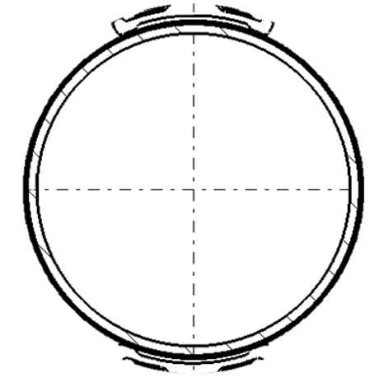
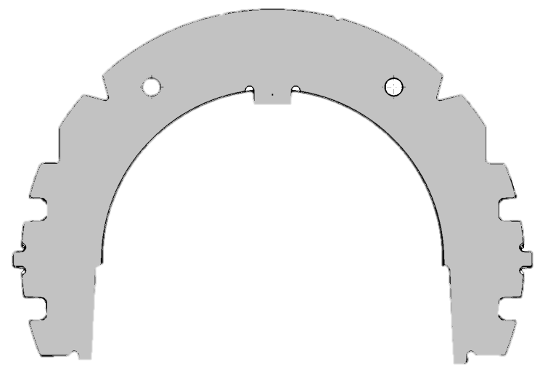
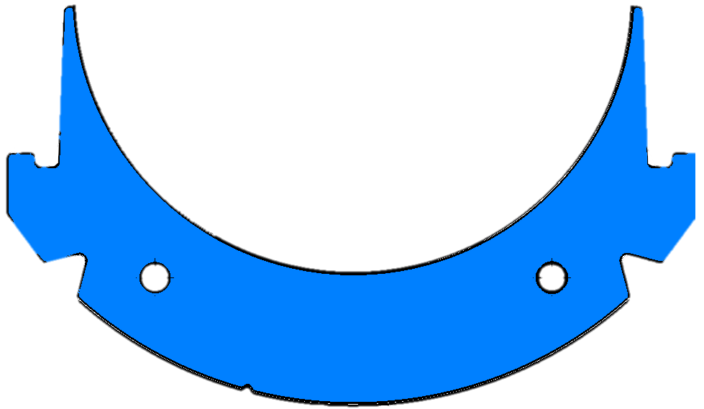
Simplified 11T Collaring scheme
The collaring process aims to provide structurally rigid assembly and join two 11T coils in dipole configuration.
Depicted here is a simplified scheme without insulation layers, collaring shoe etc. (excluded for clarity).
The force applied vertically with collaring press aligns key features of long collars positioned on top and bottom of the assembly. The longitudinal tapered keys are then inserted, preventing opening of the collar structure after release of the pressure.
‘Long’ collar
Removable pole
Graded collaring shim
Upper coil
Collaring key
Cold bore tube
Lower coil
‘Short’ collar
‘Long’ collar

Slide 9
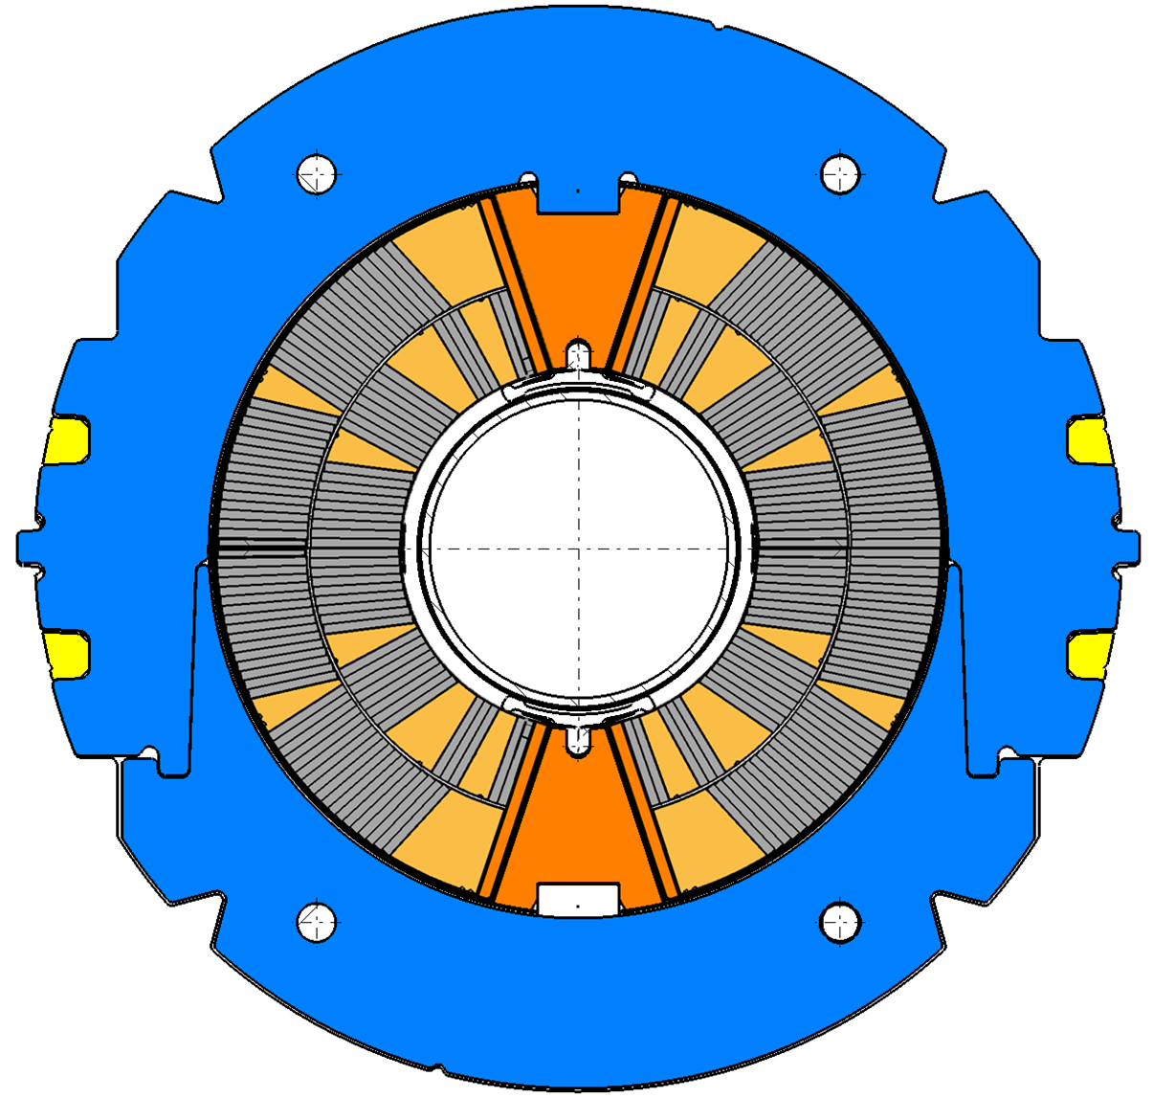




11T Collared Coil main features
The stainless-steel shim located between removable pole and loading plate serves two purposes:
compensate the branch midplane excess longitudinal variability,
provide azimuthal pre-stress.
The branch azimuthal excess compensation is provided by longitudinal shim thickness gradation (in step of 25um).
The azimuthal pre-stress is applied by shim thickness excess of 0.3 mm.
The shim thickness is top-bottom symmetric, e.g. the thickness in quadrants Q1 and Q4 is equal.
Collar structure
Removable pole
Graded collaring shim
$$Q2$$
$$Q1$$
Upper coil
Collaring key
Lower coil
$$Q3$$
$$Q4$$

Slide 10
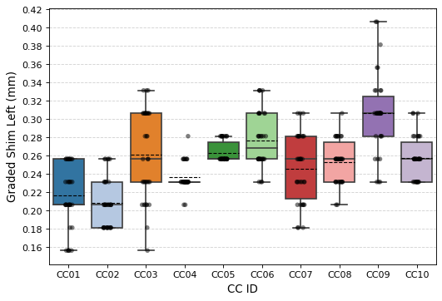
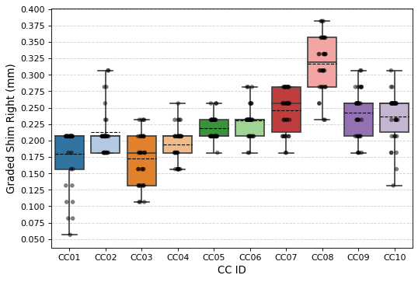
Graded shim thickness of 11T CC
Summary of 11T CC assembly shim thickness
Courtesy of José Luis Rudeiros Fernandez
CC Left (Q2, Q3)
CC Right (Q1, Q4)

Slide 11
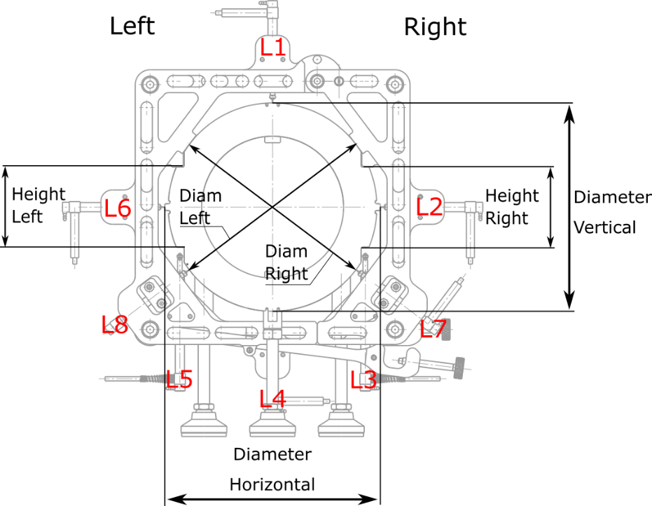
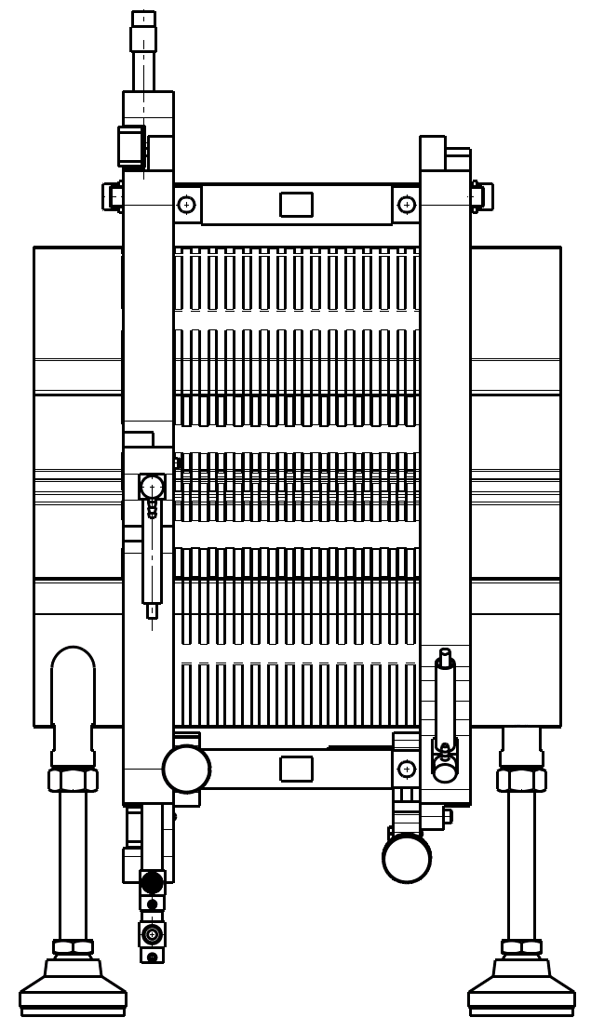
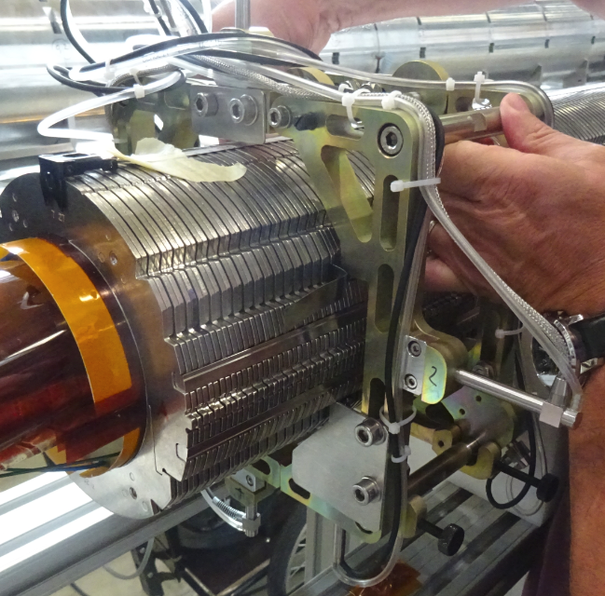
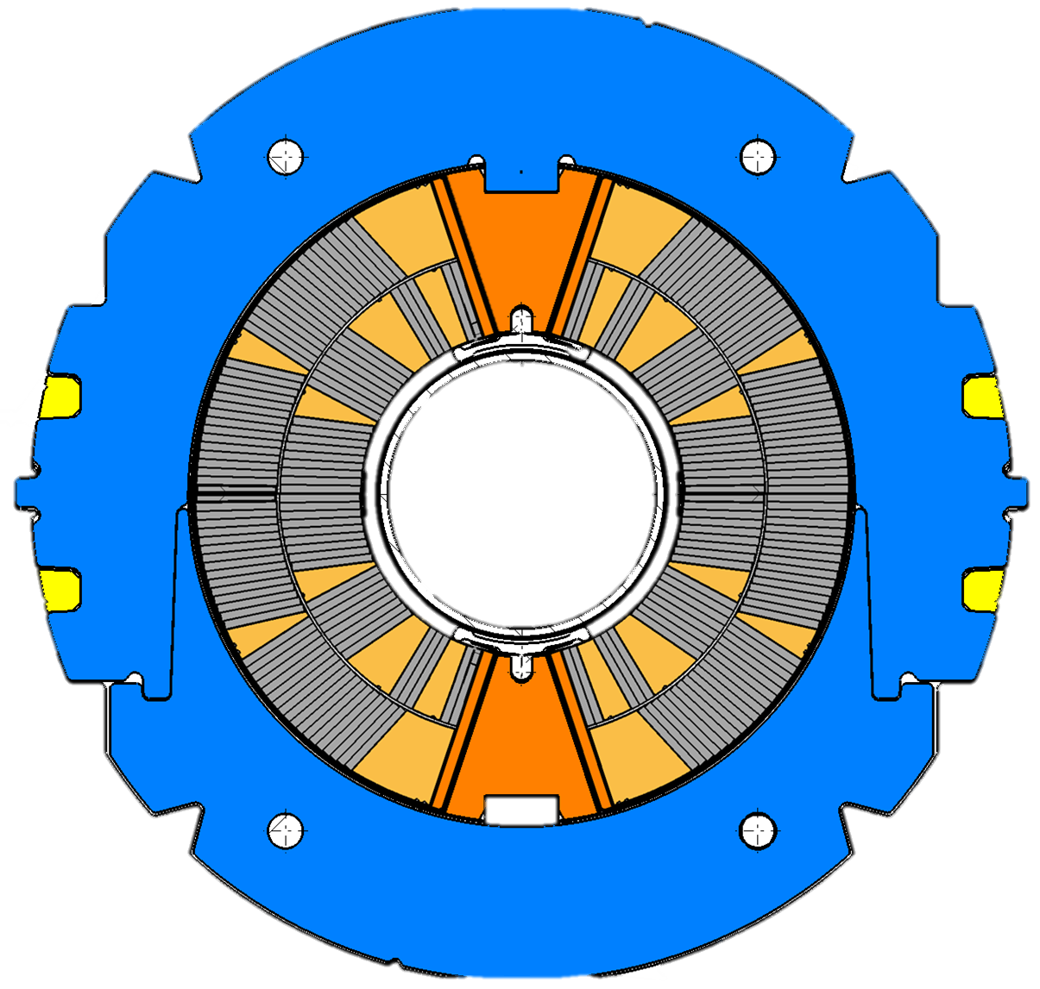
Geometry measurement of Collared Coil
The tool is assembled around the collared coil (using hinge and screws);
There are 8 LVDT distance sensors (L1 to L8) that measure 6 dimensions:
  Diameter: Horizontal, Vertical, Left 37deg, Right 37deg;
  Height: Left, Right
  Sensor head features flat round cross-section of 4.75 mm diameter;
  Each measurement starts (and finishes) with the calibration

Slide 12
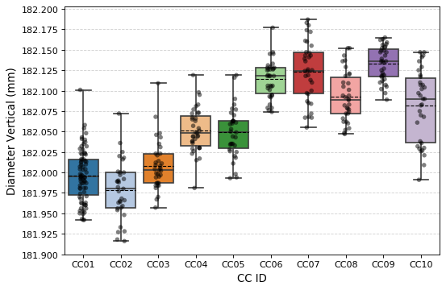
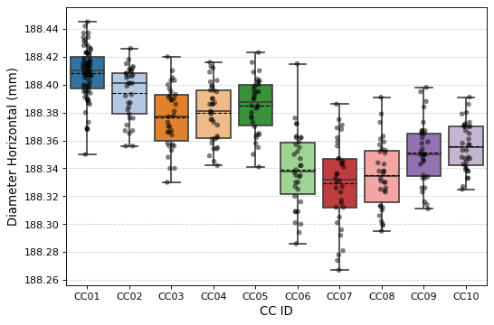
Diameters of 11T CC
Summary of measured vertical and horizontal diameter of 11T CC

Slide 13
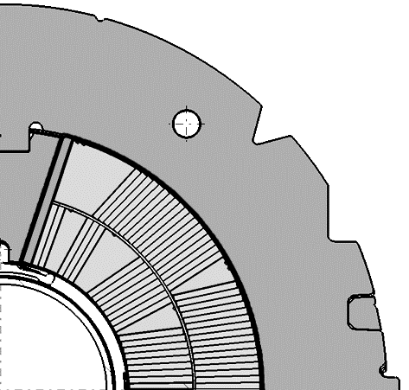
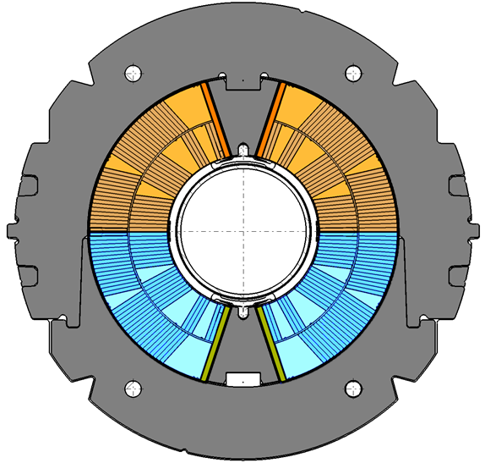









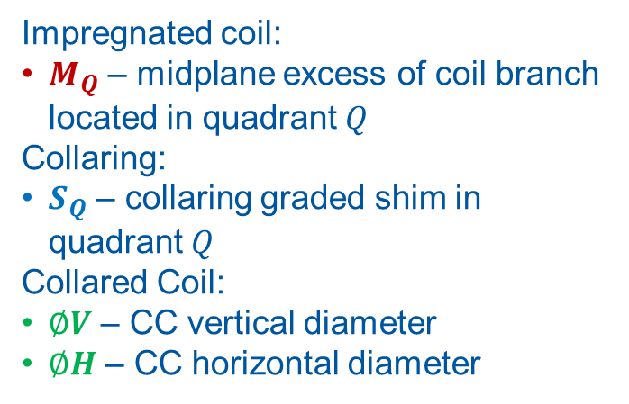
Selected geometry QC
Impregnated coil:
$M_{Q}$ – midplane excess of coil branch located in quadrant $Q$
Collaring:
$S_{Q}$ – collaring graded shim in quadrant $Q$
Collared Coil:
$∅V$ – CC vertical diameter
$∅H$ – CC horizontal diameter
$$S_{1}$$
$$∅V$$
$$Q2$$
$$Q1$$
$$M_{1}$$
$$\vec{B}$$
$$Q3$$
$$Q4$$
$$∅H$$
CC Left
CC Right

Slide 14

Selected field QC
Magnetic Measurement:
Expression of magnetic field shape and uniformity with finite number of coefficients:
$$\vec{B}=10^{−4}\sum_{n=1}^{∞}{\left(b_{n}+ia_{n}\right){\left(\frac{x+iy}{R_{ref}}\right)}^{n−1}}$$
$\vec{B}→b_{2,3},a_{2,3}$ – measured field quality expressed in normal and skew field harmonics
$$S_{1}$$
$$∅V$$
$$Q2$$
$$Q1$$
$$M_{1}$$
$$\vec{B}$$
$$Q3$$
$$Q4$$
$$∅H$$
CC Left
CC Right

Slide 15
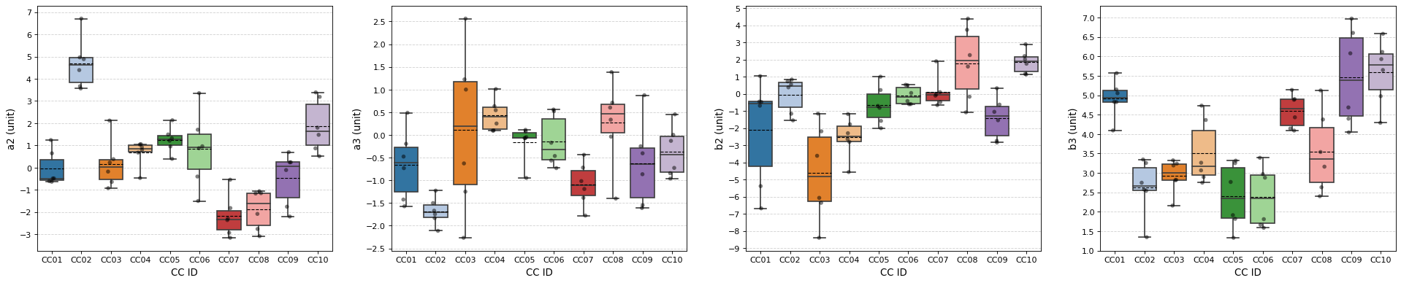
Magnetic measurement
Summary of high order harmonics (a2, a3, b2, b3) measured in straight part of CC assembly
Courtesy of Lucio Fiscarelli

Slide 16
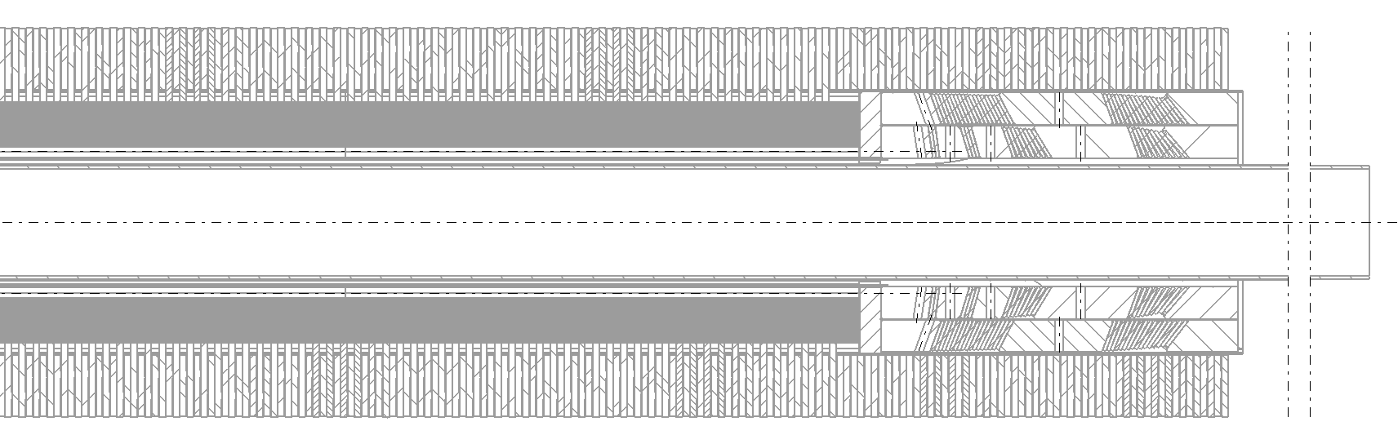


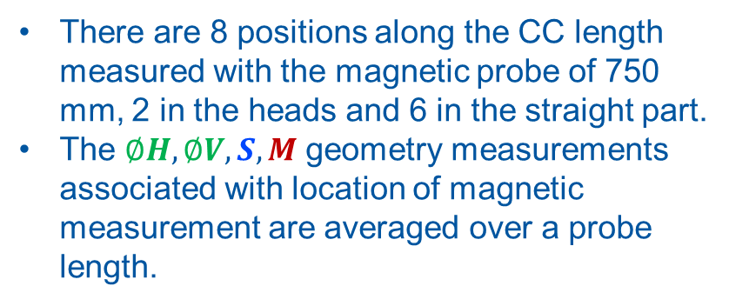



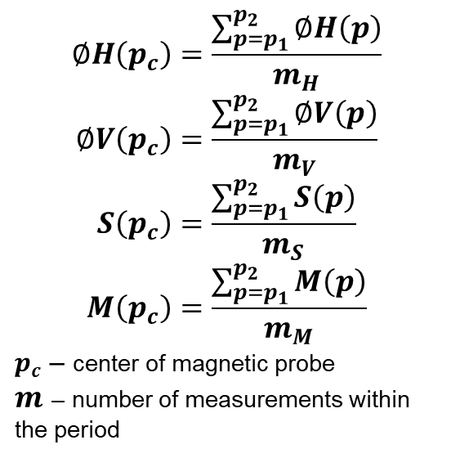


Longitudinal normalization of data
$$∅H\left(p_{c}\right)=\frac{\sum_{{p=p}_{1}}^{p_{2}}{∅H\left(p\right)}}{m_{H}}$$
$$∅V\left(p_{c}\right)=\frac{\sum_{{p=p}_{1}}^{p_{2}}{∅V\left(p\right)}}{m_{V}}$$
$$S\left(p_{c}\right)=\frac{\sum_{{p=p}_{1}}^{p_{2}}{S\left(p\right)}}{m_{S}}$$
$$M\left(p_{c}\right)=\frac{\sum_{{p=p}_{1}}^{p_{2}}{M\left(p\right)}}{m_{M}}$$
$p_{c}$ – center of magnetic probe
$m$ – number of measurements within the period
There are 8 positions along the CC length measured with the magnetic probe of 750 mm, 2 in the heads and 6 in the straight part.
The $∅H,∅V,S,M$ geometry measurements associated with location of magnetic measurement are averaged over a probe length.
$$∅H,∅V$$
$$S,M$$
$$\vec{B}$$
$$p_{c}$$
$$p$$
$$p_{1}$$
Magnetic probe length
$$p_{2}$$

Slide 17
Magnetic modelling
11T baseline and transformations

Slide 18
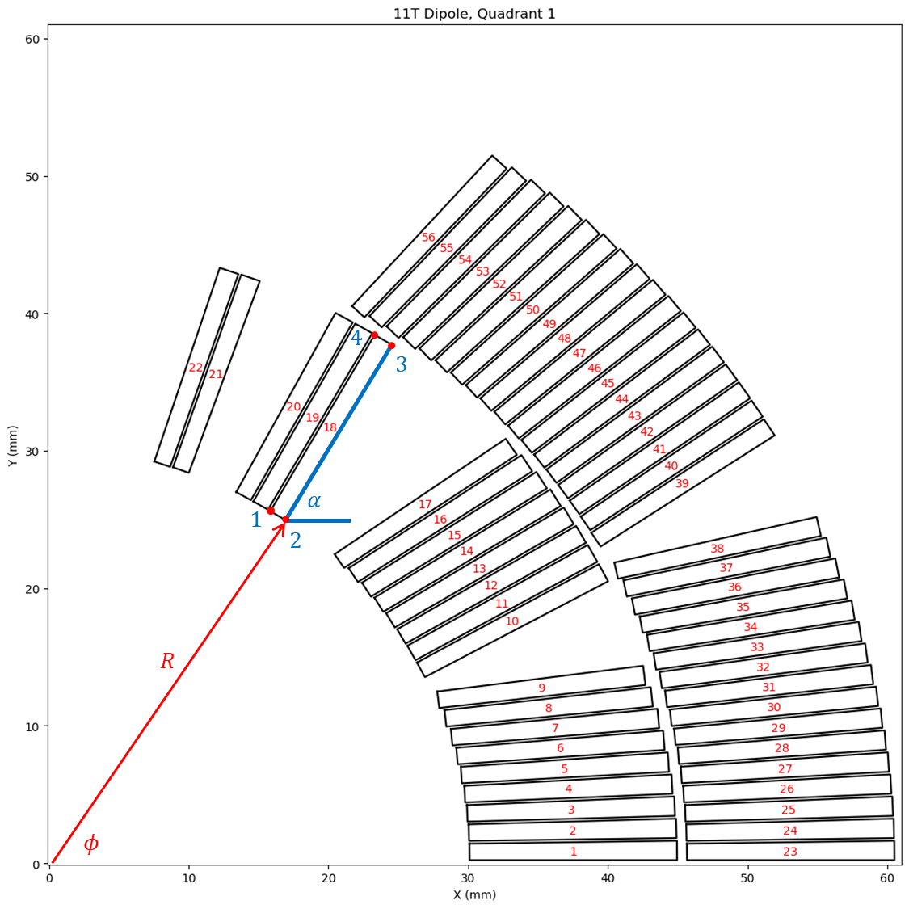
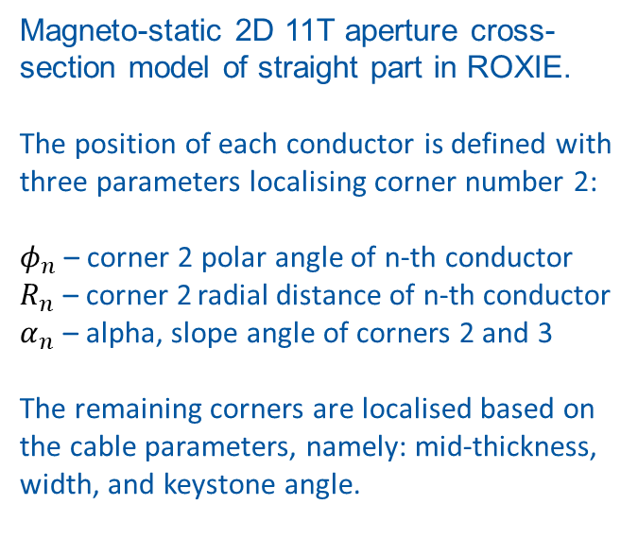
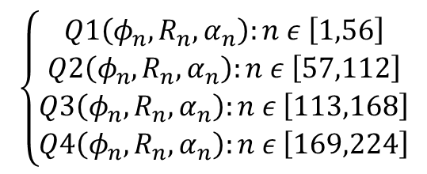
Magneto-static 11T model
Magneto-static 2D 11T aperture cross-section model of straight part in ROXIE.
The position of each conductor is defined with three parameters localising corner number 2:
$φ_{n}$ – corner 2 polar angle of n-th conductor
$R_{n}$ – corner 2 radial distance of n-th conductor
$α_{n}$ – alpha, slope angle of corners 2 and 3
The remaining corners are localised based on the cable parameters, namely: mid-thickness, width, and keystone angle.
34 turns
2 blocks
22 turns
4 blocks
$$\left\{\begin{aligned}Q1\left(φ_{n},R_{n},α_{n}\right):n ε \left[1,56\right] \\ Q2\left(φ_{n},R_{n},α_{n}\right):n ε \left[57,112\right] \\ Q3\left(φ_{n},R_{n},α_{n}\right):n ε \left[113,168\right] \\ Q4\left(φ_{n},R_{n},α_{n}\right):n ε \left[169,224\right]\end{aligned}\right.$$

Slide 19
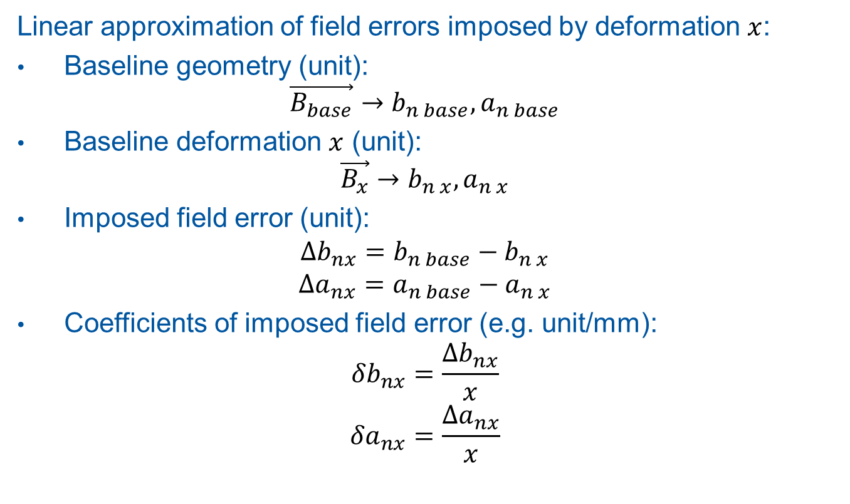
Coefficients of field error
Linear approximation of field errors imposed by deformation $x$:
Baseline geometry (unit):
$$\vec{B_{base}}→b_{n base},a_{n base}$$
Baseline deformation $x$ (unit):
$$\vec{B_{x}}→b_{n x},a_{n x}$$
Imposed field error (unit):
$${Δb}_{nx}=b_{n base}−b_{n x}$$
$${Δa}_{nx}=a_{n base}−a_{n x}$$
Coefficients of imposed field error (e.g. unit/mm):
$${δb}_{nx}=\frac{{Δb}_{nx}}{x}$$
$${δa}_{nx}=\frac{{Δa}_{nx}}{x}$$

Slide 20
11T deformation models
Rigid conductor transformations investigating field quality influence of three phenomena:
Graded collaring shim
Midplane pairing
Aperture ovalization
Presented models assume no change in dimension of the conductor, but its placement in the aperture. The applied transformation modifies turn-to-turn distance, which can be understood as the insulation thickness.

Slide 21
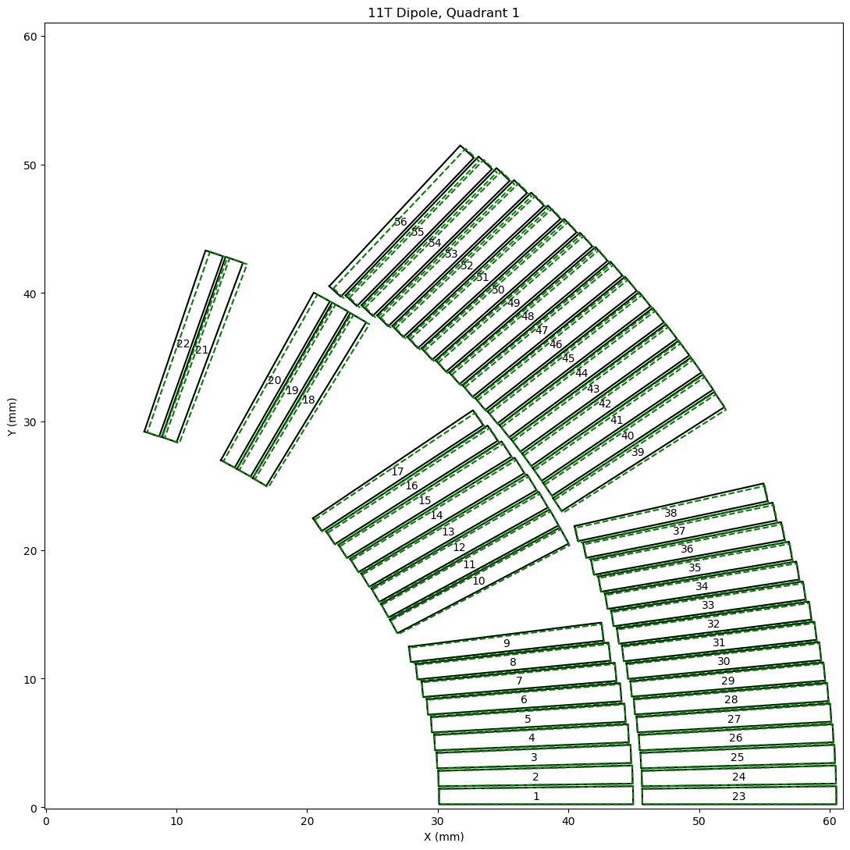
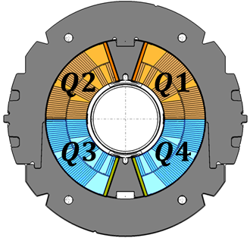
11T graded collaring shim
The effect of graded shim added in the aperture assembly process in order to apply uniform azimuthal pre-stress of paired coil branches.
Rigid conductor rotation about origin. The largest azimuthal deviation applied to conductor closest to pole.
Transformed conductor geometry shown in green, with baseline in black.

Slide 22
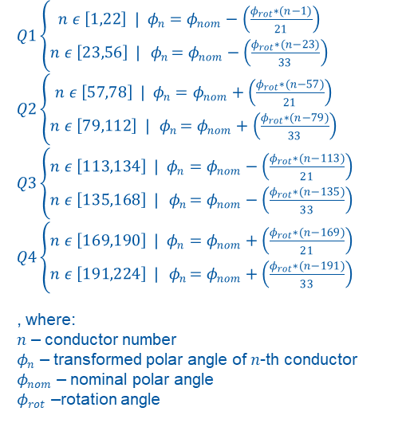
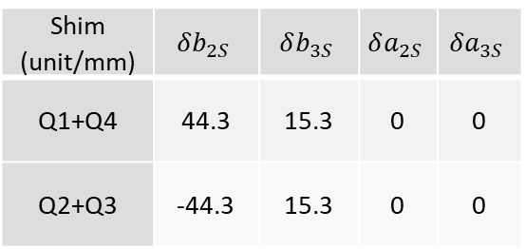
11T graded collaring shim
$Q1\left\{\begin{aligned}n ε \left[1,22\right] | φ_{n}=φ_{nom}−\left(\frac{φ_{rot}∗(n−1)}{21}\right) \\ n ε \left[23,56\right] | { φ}_{n}=φ_{nom}−\left(\frac{φ_{rot}∗(n−23)}{33}\right)\end{aligned}\right.$
$Q2\left\{\begin{aligned}n ε \left[57,78\right] | φ_{n}=φ_{nom}+\left(\frac{φ_{rot}∗(n−57)}{21}\right) \\ n ε \left[79,112\right] | { φ}_{n}=φ_{nom}+\left(\frac{φ_{rot}∗(n−79)}{33}\right)\end{aligned}\right.$
$Q3\left\{\begin{aligned}n ε \left[113,134\right] | φ_{n}=φ_{nom}−\left(\frac{φ_{rot}∗(n−113)}{21}\right) \\ n ε \left[135,168\right] | { φ}_{n}=φ_{nom}−\left(\frac{φ_{rot}∗(n−135)}{33}\right)\end{aligned}\right.$
$Q4\left\{\begin{aligned}n ε \left[169,190\right] | φ_{n}=φ_{nom}+\left(\frac{φ_{rot}∗(n−169)}{21}\right) \\ n ε \left[191,224\right] | { φ}_{n}=φ_{nom}+\left(\frac{φ_{rot}∗(n−191)}{33}\right)\end{aligned}\right.$
, where:
$n$ – conductor number
$φ_{n}$ – transformed polar angle of $n$-th conductor
$φ_{nom}$ – nominal polar angle
$φ_{rot}$ –rotation angle
Shim (unit/mm) | $$δb_{2S}$$ | $$δb_{3S}$$ | $$δa_{2S}$$ | $$δa_{3S}$$
Q1+Q4 | 44.3 | 15.3 | 0 | 0
Q2+Q3 | -44.3 | 15.3 | 0 | 0

Slide 23
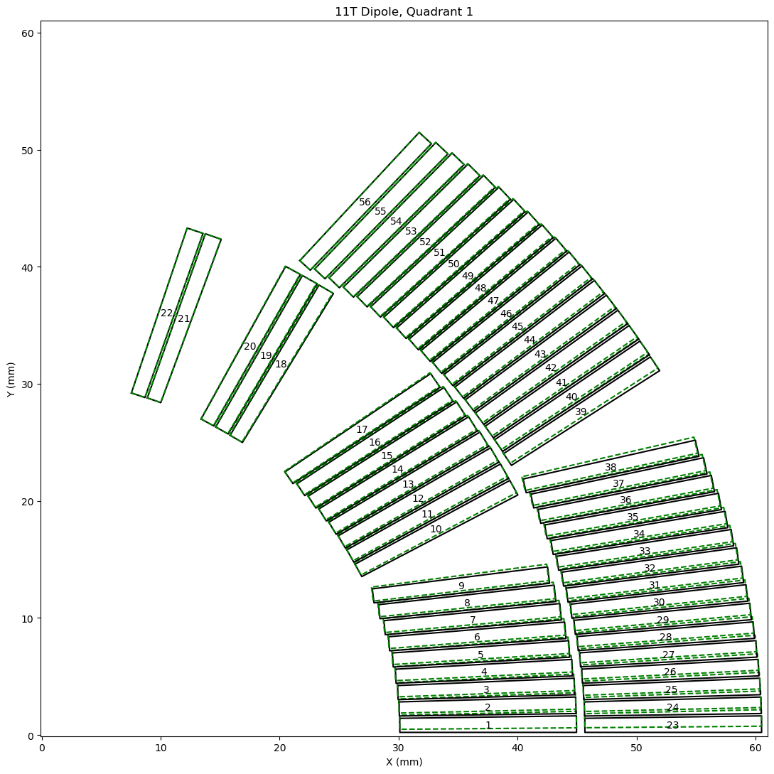
11T Midplane pairing
The effect of midplane shift due to pairing of two branches of opposing coils in the aperture assembly.
Rigid conductor rotation about origin. The largest azimuthal deviation applied to conductor closest to midplane.
Transformed conductor geometry shown in green, with baseline in black.

Slide 24
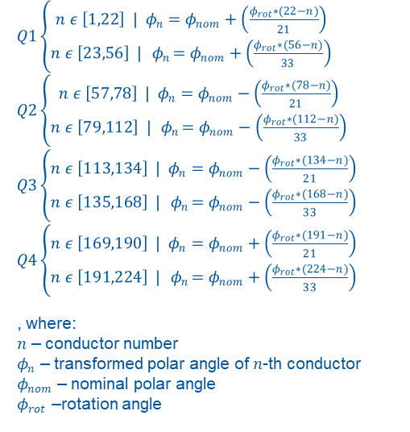
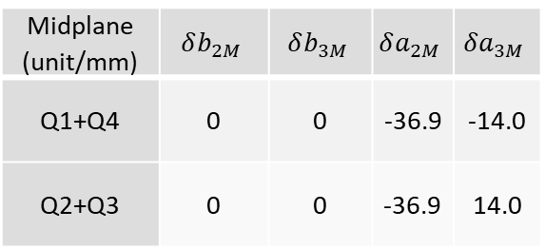
11T Midplane pairing
$Q1\left\{\begin{aligned}n ε \left[1,22\right] | φ_{n}=φ_{nom}+\left(\frac{φ_{rot}∗(22−n)}{21}\right) \\ n ε \left[23,56\right] | { φ}_{n}=φ_{nom}+\left(\frac{φ_{rot}∗(56−n)}{33}\right)\end{aligned}\right.$
$Q2\left\{\begin{aligned}n ε \left[57,78\right] | φ_{n}=φ_{nom}−\left(\frac{φ_{rot}∗(78−n)}{21}\right) \\ n ε \left[79,112\right] | { φ}_{n}=φ_{nom}−\left(\frac{φ_{rot}∗(112−n)}{33}\right)\end{aligned}\right.$
$Q3\left\{\begin{aligned}n ε \left[113,134\right] | φ_{n}=φ_{nom}−\left(\frac{φ_{rot}∗(134−n)}{21}\right) \\ n ε \left[135,168\right] | { φ}_{n}=φ_{nom}−\left(\frac{φ_{rot}∗(168−n)}{33}\right)\end{aligned}\right.$
$Q4\left\{\begin{aligned}n ε \left[169,190\right] | φ_{n}=φ_{nom}+\left(\frac{φ_{rot}∗(191−n)}{21}\right) \\ n ε \left[191,224\right] | { φ}_{n}=φ_{nom}+\left(\frac{φ_{rot}∗(224−n)}{33}\right)\end{aligned}\right.$
, where:
$n$ – conductor number
$φ_{n}$ – transformed polar angle of $n$-th conductor
$φ_{nom}$ – nominal polar angle
$φ_{rot}$ –rotation angle
Midplane (unit/mm) | $$δb_{2M}$$ | $$δb_{3M}$$ | $$δa_{2M}$$ | $$δa_{3M}$$
Q1+Q4 | 0 | 0 | -36.9 | -14.0
Q2+Q3 | 0 | 0 | -36.9 | 14.0

Slide 25
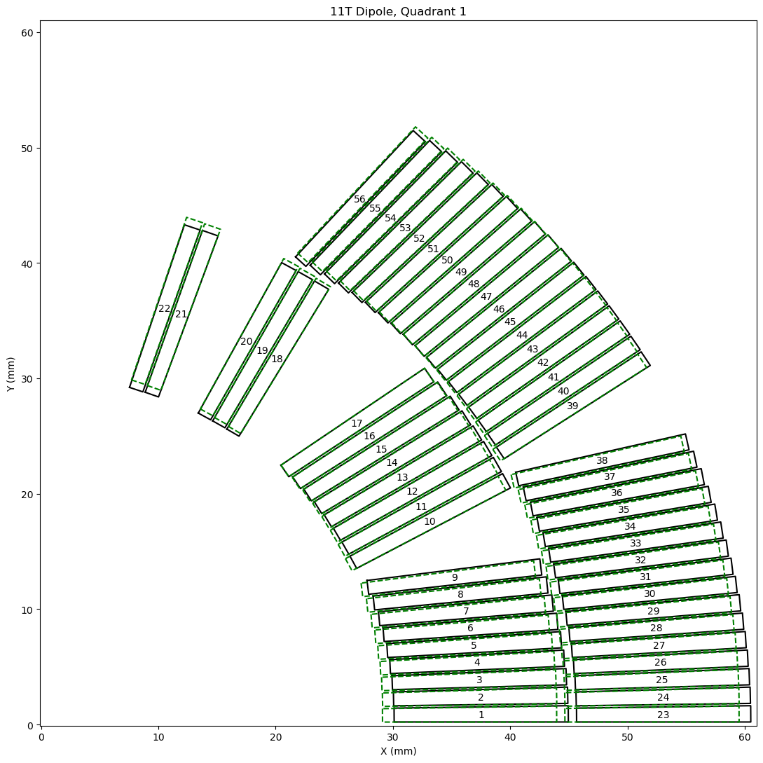
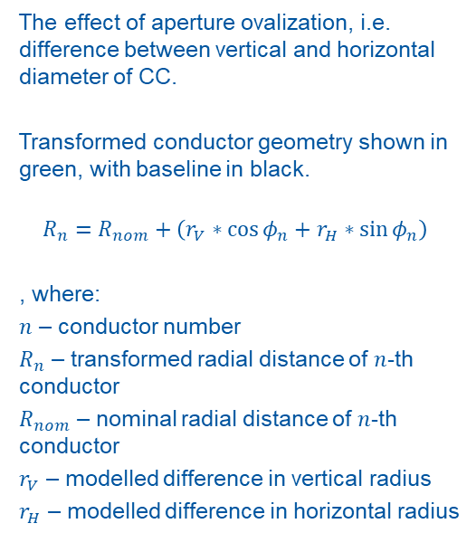
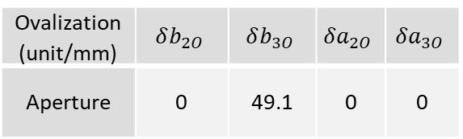
11T Aperture ovalization
The effect of aperture ovalization, i.e. difference between vertical and horizontal diameter of CC.
Transformed conductor geometry shown in green, with baseline in black.
$$R_{n}=R_{nom}+\left(r_{V}∗\cos{φ_{n}}+r_{H}∗\sin{φ_{n}}\right)$$
, where:
$n$ – conductor number
$R_{n}$ – transformed radial distance of $n$-th conductor
$R_{nom}$ – nominal radial distance of $n$-th conductor
$r_{V}$ – modelled difference in vertical radius
$r_{H}$ – modelled difference in horizontal radius
Ovalization (unit/mm) | $$δb_{2O}$$ | $$δb_{3O}$$ | $$δa_{2O}$$ | $$δa_{3O}$$
Aperture | 0 | 49.1 | 0 | 0

Slide 26
Modelling examples
Field error estimation of selected CC

Slide 27
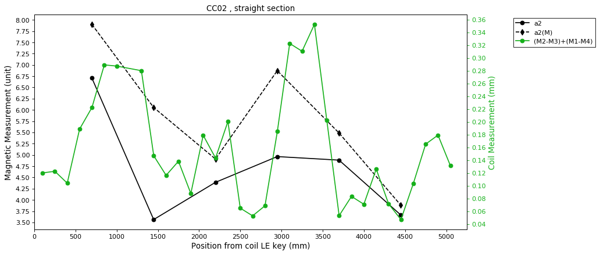

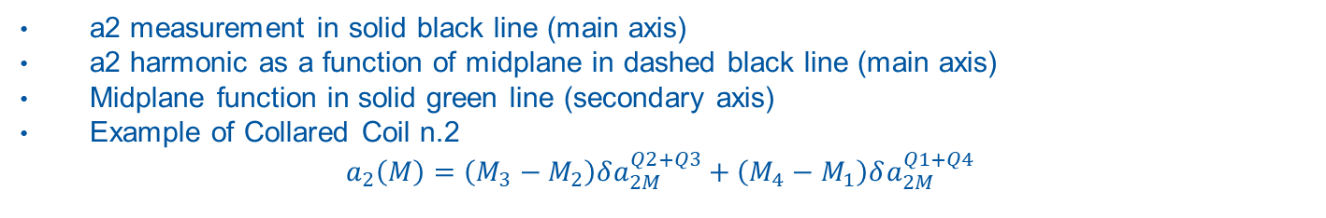



Modelling field errors a2
a2 measurement in solid black line (main axis)
a2 harmonic as a function of midplane in dashed black line (main axis)
Midplane function in solid green line (secondary axis)
Example of Collared Coil n.2
$$a_{2}\left(M\right)=\left(M_{3}−M_{2}\right)δa_{2M}^{Q2+Q3}+\left(M_{4}−M_{1}\right)δa_{2M}^{Q1+Q4}$$
$$M2$$
$$M1$$
$$M3$$
$$M4$$

Slide 28
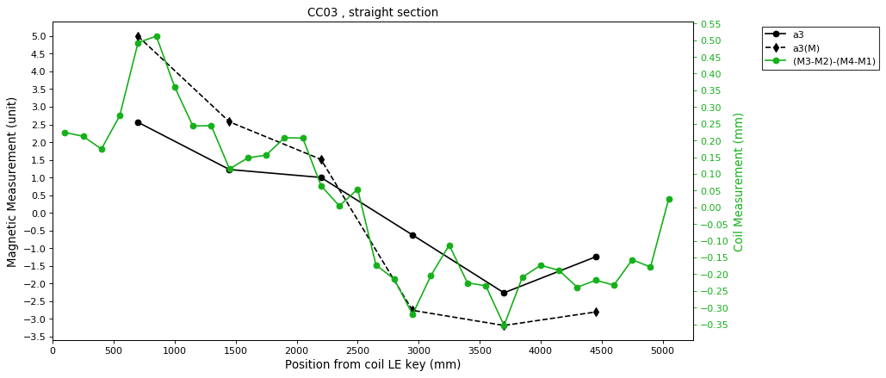





Modelling field errors a3
a3 measurement in solid black line (main axis)
a3 harmonic as a function of midplane in dashed black line (main axis)
Midplane function in solid green line (secondary axis)
Example of Collared Coil n.3
$$a_{3}\left(M\right)=\left(M_{3}−M_{2}\right)δa_{3M}^{Q2+Q3}+\left(M_{4}−M_{1}\right)δa_{3M}^{Q1+Q4}$$
$$M2$$
$$M1$$
$$M3$$
$$M4$$

Slide 29
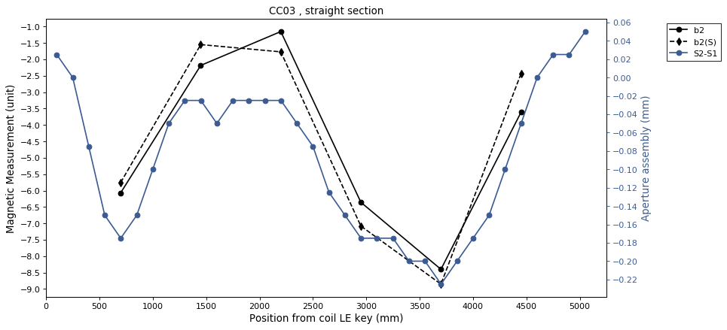

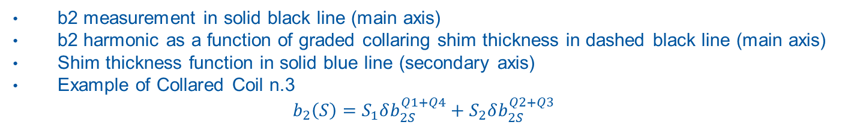



Modelling field errors b2
b2 measurement in solid black line (main axis)
b2 harmonic as a function of graded collaring shim thickness in dashed black line (main axis)
Shim thickness function in solid blue line (secondary axis)
Example of Collared Coil n.3
$$b_{2}\left(S\right)=S_{1}δb_{2S}^{Q1+Q4}+S_{2}δb_{2S}^{Q2+Q3}$$
$$S2$$
$$S1$$
$$S3$$
$$S4$$

Slide 30
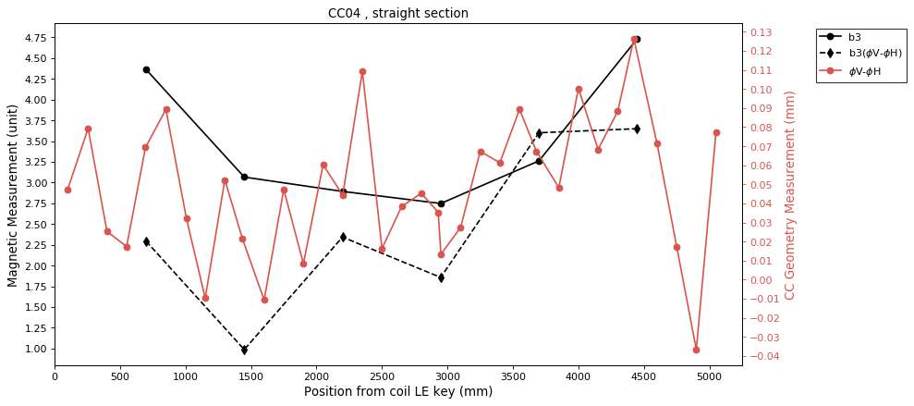
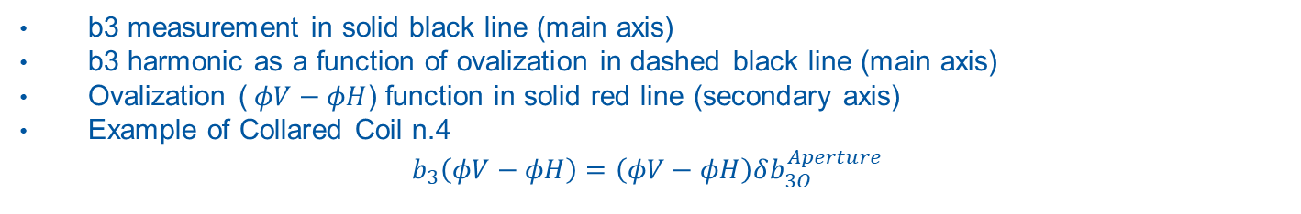
Modelling field errors b3
b3 measurement in solid black line (main axis)
b3 harmonic as a function of ovalization in dashed black line (main axis)
Ovalization ($φV−φH$) function in solid red line (secondary axis)
Example of Collared Coil n.4
$$b_{3}\left(φV−φH\right)=\left(φV−φH\right)δb_{3O}^{Aperture}$$

Slide 31
Modelling field errors
Based on data of 10 CC

Slide 32
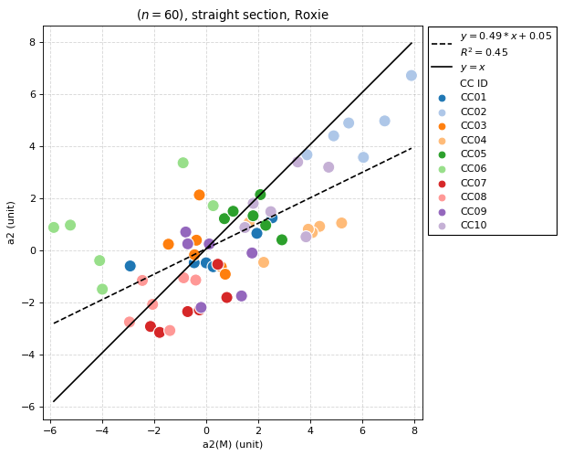

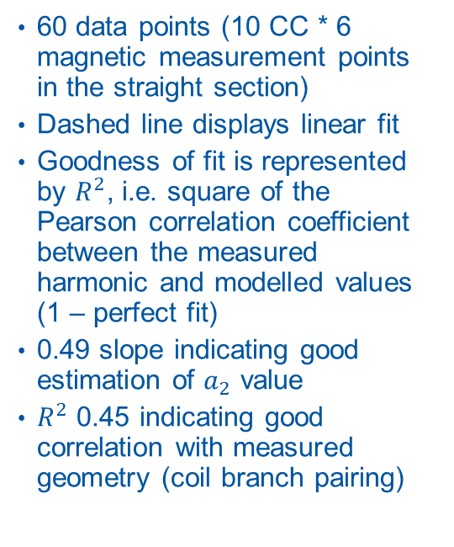
Modelling a2 of 10 CC: $a_{2}\left(a_{2}\left(M\right)\right)$
60 data points (10 CC * 6 magnetic measurement points in the straight section)
Dashed line displays linear fit
Goodness of fit is represented by $R^{2}$, i.e. square of the Pearson correlation coefficient between the measured harmonic and modelled values (1 – perfect fit)
0.49 slope indicating good estimation of $a_{2}$ value
$R^{2}$ 0.45 indicating good correlation with measured geometry (coil branch pairing)

Slide 33



Modelling a3 of 10 CC: $a_{3}\left(a_{3}\left(M\right)\right)$
60 data points (10 CC * 6 magnetic measurement points in the straight section)
0.29 slope indicating fair harmonic estimation
$R^{2}$ 0.35 indicating fair correlation with measured geometry (coil branch pairing)

Slide 34



Modelling b2 of 10 CC: $b_{2}\left(b_{2}\left(S\right)\right)$
60 data points (10 CC * 6 magnetic measurement points in the straight section)
0.8 slope indicating that majority of $b_{2}$ variability is related to shim geometry
$R^{2}$ 0.65 indicating good correlation of $b_{2}$ and collaring shim thickness

Slide 35



Modelling b3 of 10 CC: $b_{3}\left(b_{3}\left(φV−φH\right)\right)$
60 data points (10 CC * 6 magnetic measurement points in the straight section)
$R^{2}$ 0.08 indicating no linear correlation of $b_{3}$ and measured CC vertical and horizontal diameters
Allowed harmonic, not compensated by conductor design symmetry

Slide 36

Summary, results
Production of 11T impregnated coil is finalized with geometry QC. The resulting branch midplane excess ($M$) is afterwards used in preparation of the collaring graded shim ($S$) for each CC assembly
Collaring joins two 11T coils in dipole configuration. QC of CC consists of geometry (vertical and horizontal diameter) and magnetic measurements (field components)
The shim and midplane magnetic models can predict the majority of $a_{2}, a_{3}$ and $b_{2}$ field harmonics
The quadrant midplane excess ($M$) of CC assembly is correlated with $a_{2}$ and $a_{3}$ skew component and can be well estimated with $δa_{2M}$ and $δa_{3M}$ coefficients
The asymmetry of collaring shim ($S$) causes the majority of $b_{2}$ component variability and can be well estimated with $δb_{2O}$ coefficient
Measured $φV−φH$ ovalization of CC is not in linear correlation with $b_{3}$ normal component

Slide 37


Summary, geometry measurement precision
With the current understanding of geometry measurements and presented models, one can estimate the level of precision of modelled harmonics:
The midplane excess measurement repeatability of $±29μm$ provides:
  $±1.0unit$ of $a_{2}$, i.e. $±17\%$ of measured harmonic range
  $±0.4unit$ of $a_{3}$, i.e. $±13\%$ of measured harmonic range
The collaring shim caliper measurement accuracy of $±20μm$ provides $±0.9unit$ of $b_{2}$, i.e. $±8\%$ of measured harmonic range (conservative).

Slide 38

Summary, next steps
Presently the study was focused on investigating linear dependency between measured geometrical and magnetic parameters.
One can see that ‘simple’ feature, i.e. collaring shim thickness that is relatively easy to control and has straightforward impact on conductor position, fits very well the linear assumption.
The measure of midplane azimuthal excess, a result of ‘complex’ post-processing, is less predictable with linear model, however still acceptable.
The measurement of CC vertical-horizontal diameters shows no linear dependency with $b_{3}$ harmonic that, as proven with magnetic model, is very sensitive to the ovalization of the conductor.
The focus of future work is to model the $b_{3}$ dependency with mechanical model, considering 11T CC topology and interfaces. Currently, we have a strong evidence that the majority of $b_{3}$ can be estimated with intermediate model considering ‘new take’ on coil and CC geometry, which will be a focus of a follow-up seminar.
The study aims to develop a comprehensive framework based on 11T production at CERN, adaptable to various magnet designs and production techniques, bringing magnetic (and electric) measurements as production fleeb-back tools.

Slide 39
Thank you!

