Slide 1
Longitudinal pre-load of Nb₃Sn magnets
Susana Izquierdo Bermudez
with feedback and material (mainly) from Paolo Ferracin, Eelis Takala, Emma Gautheron, Manuel Garcia Perez, Giorgio Vallone, Etienne Rochepault.

Slide 2
Outline
Introduction
MQXF experience
11 T experience
eRMC/RMM experience
Few other important 3D features
  Pole (Titanium vs Bronze)
  Aluminum shell (Full length vs Segmented)

Slide 3
General Statements
Understanding the 3D mechanical state of SC magnets is complex and requires a dedicate effort.
Modeling and measuring the reaction process is not a simple task.
‘Two schools’ in terms of longitudinal support, with no consensus on the magnet community:
  Pre-load coil ends to compensate the axial forces and keep coil end turns under compression (MQXF concept, axial plate and pre-loaded rods)
  Limit the coil displacements due to electromagnetic forces by having a rigid structure in the longitudinal direction (11 T concept, end-plate welded to the shell)
My aim is not to judge what is the correct approach, but to show our current understanding.

Slide 4
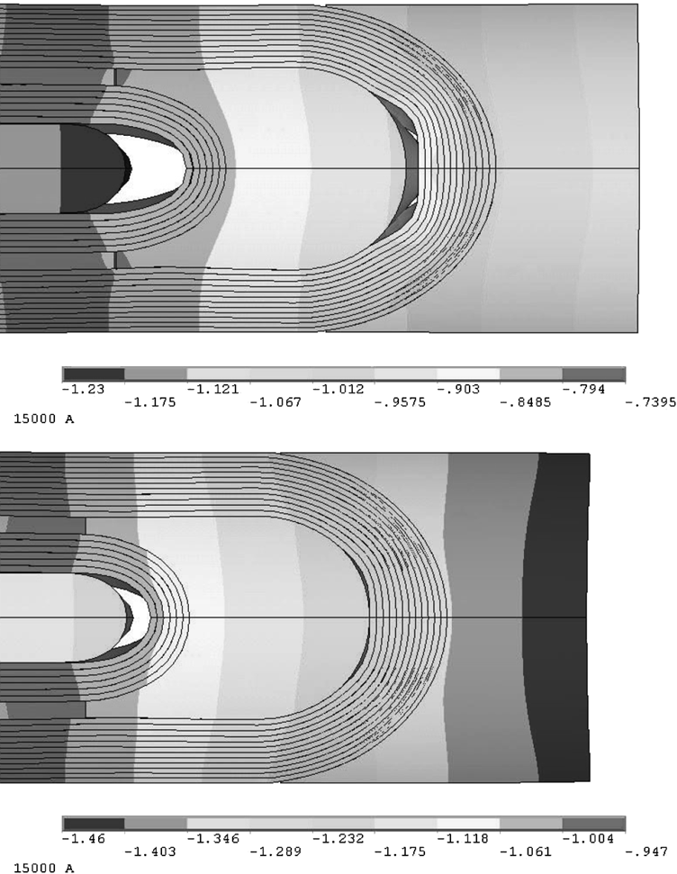
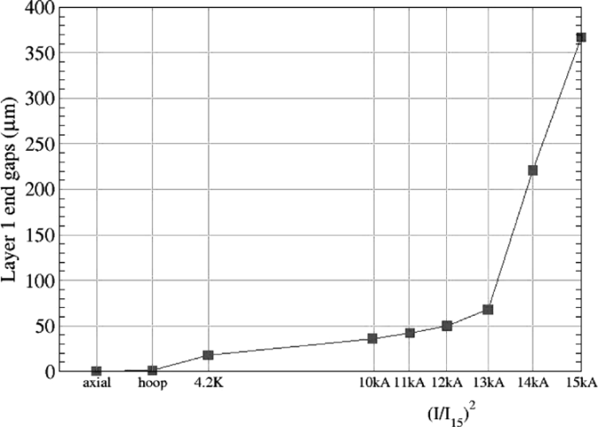
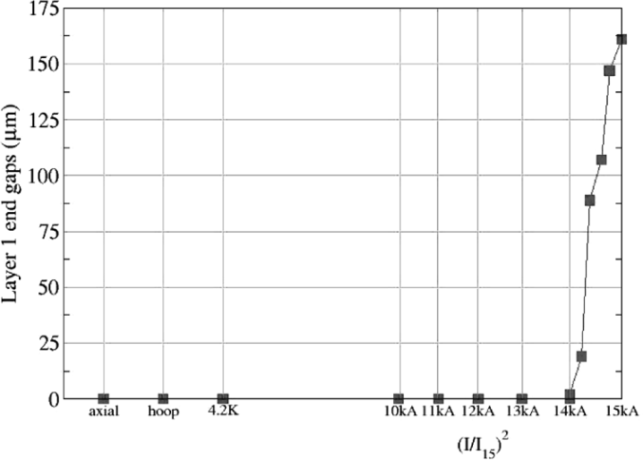
Force or not force?
Two type of axial displacements:
  Relative movement of the coil with respect to the structure. It depends on the overall stiffness of the structure, i.e., independent of the level of pre-load in the ends.
  Relative movement of the coil ends with respect to the pole. It depends of the level of pre-load.
This was extensively studied in LBNL, developing the rods - plate axial pre-load system we are currently using for MQXF
S. Caspi, P. Ferracin., “Towards integrated design and modeling of high field accelerator magnets,” IEEE Trans. Appl. Supercond., vol. 16, no. 2, pp. 1298–1303, June 2006.
Axial displacements of inner layer’s (0.2 friction factor assumed).
Limited axial support (top) and full axial support (bottom).

Slide 5
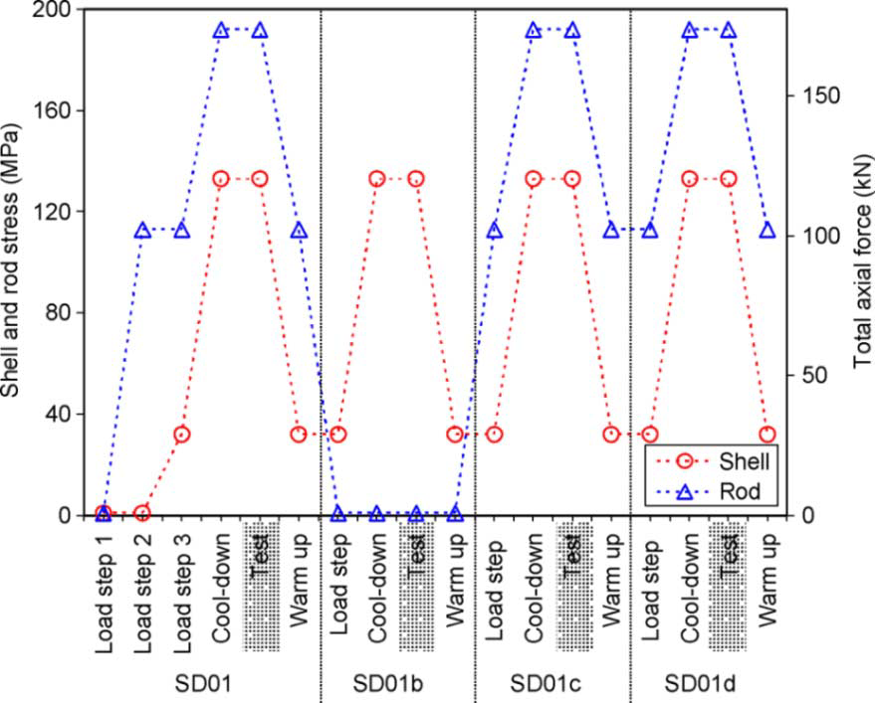
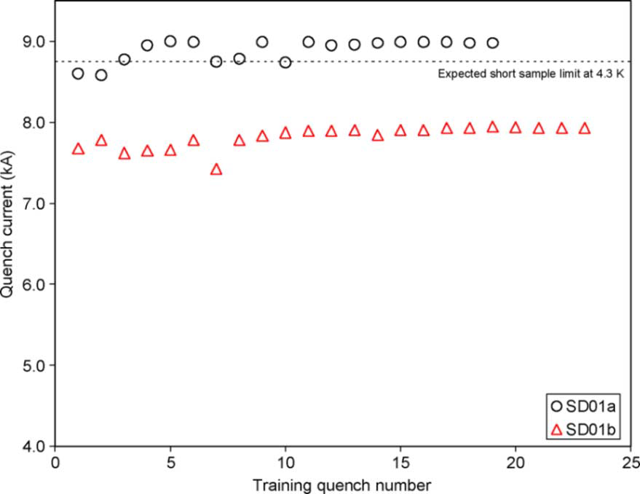
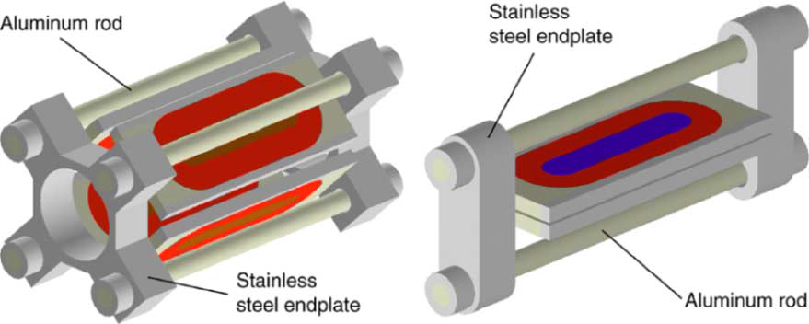
SQ/SD Experience (LBNL)
LBNL/LARP intensively studied this problem (FE and experience in sub-scales) .
SQ02 and SD01 show a clear degradation in training performance with no axial support
  This is an extreme condition, since both the relative movement coil to structure and relative movement coil to pole were relaxed.
Fz @ Iss = 0.17 MN/end
S. Caspi, P. Ferracin., “Towards integrated design and modeling of high field accelerator magnets,” IEEE Trans. Appl. Supercond., vol. 16, no. 2, pp. 1298–1303, June 2006.

Slide 6
eRMC/RMM
Within the FCC effort, eRMC/RMM was designed in order to be able to explore the parameter space:
  Aluminum and SS rods procured
  Big rods, thick end plate, in order to have a very rigid structure in the longitudinal direction.
More details later…

Slide 7
Overview on different magnet parameters
Magnet | Longitudinal pre-load system | # of ap. | Field [T] or gradient [T/m] | Fz/ap. [MN]
LHC-MB | ? mm thick end-plate, ? mm thick SS shell | 2 | 8.3 | 0.24
11 T MBHS | 43 mm thick end-plate, 12 mm thick SS shell | 1 | 11.2 | 0.44
11 T MBHD | 75 mm thick end-plate, 15 mm SS shell. | 2 | 11.2 | 0.45
MQXFS | 4 x D = 36 mm Al rod, 75 mm thick nitronic50 plates | 1 | 132.6 | 1.2
MQXFB | 4 x D = 35 mm SS rod, 75 mm thick nitronic50 plates | 1 | 132.6 | 1.2
FRESCA2 | 4 x D = 60 mm Al rod, 150 mm thick nitronic50 plates | 1 | 13 | 2.8
eRMC | 4 x D = 64 mm Al/SS rod, 100 mm thick nitronic50 plates | 1 | 16 | 1.5
RMM | 4 x D = 64 mm Al/SS rod, 100 mm thick nitronic50 plates | 1 | 16 | 2.4
HD2 |  | 1 | 13 | 0.7
HQ |  | 1 | 219 | 1.3
LQ | 4 x D = 25.4 mm SS rod, 50 mm thick SS plates | 1

Slide 8
Outline
Introduction
MQXF experience
  Longitudinal assembly concept
  Experience from short models
  Experience from long magnets
11 T experience
eRMC/RMM experience
Few other 3D features in MQXF
  Pole (Titanium vs Bronze)
  Aluminum shell (Full length vs Segmented)

Slide 9
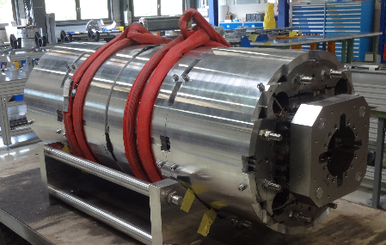
MQXF Longitudinal Assembly
Direct connection between the motion of the rod and the one of the coil ends
Goal: keep the pole turn under compression during powering.
Short models (1.2 m):
  Aluminum rods, 36 mm diameter
  Nitronic 50 end plate, 75 mm thick
MQXFA (4.2 m):
  Stainless steel rods, 32 mm diameter
  Nitronic 50 end plate, 75 mm thick
MQXFB (7.15 m):
  Stainless steel rods, 35 mm diameter
  Nitronic 50 end plate, 75 mm thick

Slide 10
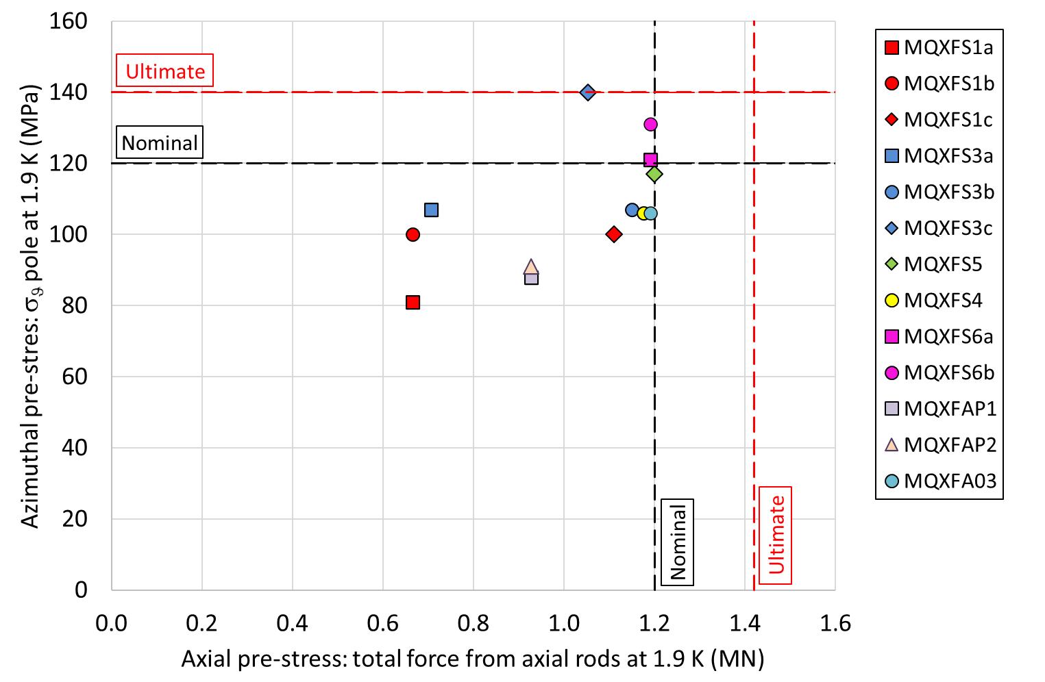
MQXF – Preload a target
Started with moderate pre-load 0.6 MN after cool down (50 % F_{em_z})
Target for series: 1.2 MN after cool down (100 % F_{em_z})
 |  | Rod Strain [µɛ] |  | Rod Stress [MPa] |  | Rod Elongation [mm] |  | Total Force [MN]
 |  | RT | 1.9 K | RT | 1.9 K | RT | 1.9 K | RT | 1.9 K
Target | MQXFS | 2450 | 3800 | 172 | 300 | 3.99 | 6.19 | 0.70 | 1.22
 | MQXFA | 950 | 1700 | 183 | 357 | 4.37 | 7.83 | 0.59 | 1.15
 | MQXFB | 900 | 1500 | 174 | 315 | 6.80 | 11.33 | 0.67 | 1.21

Slide 11
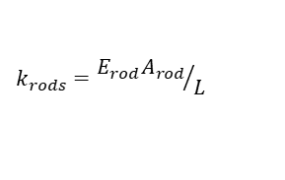
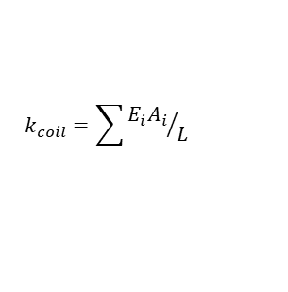
MQXF – From short to long
Main Parameters Governing the Longitudinal Motions
$$k_{rods}={E_{rod}A_{rod}}/L$$
Parameter | Unit | MQXFS | MQXFB
e.m. Force Nominal Current | MN | 1.2 | 1.2
Coil Stiffness | MN/mm | 0.10 | 0.17
Al. Rod Stiffness | MN/mm | 0.21 | 0.04
SS. Rod Stiffness | MN/mm | 0.53 | 0.14
Coil Length | m | 1.08 | 7.00
Magnet Length | m | 1.55 | 7.51
Coil Elongation
No friction, no rods | mm | 1.09 | 7.04
No friction, Al. rods | mm | 0.91 | 5.63
No friction, SS. rods | mm | 0.73 | 4.22
Friction, Al. rods | mm | 0.10 | 0.28
Friction, SS. rods | mm | 0.06 | 0.28
Force Repartition, Coil/Rods/Structure
Friction, Al. rods | % | 10/2/88 | 4/1/95
Friction, SS. Rods | % | 9/5/86 | 4/3/93
$$k_{coil}=\sum{{E_{i}A_{i}}/L}$$
Coil elongation during powering for the 7.2 m magnets:
  If not supported by the rods: 7.04 mm (0.098 %)
  With stainless steel rods, no friction: 4.22 mm (0.098 %)
  With stainless steel rods, friction: 0.28 mm (0.004 %)
G. Vallone, et. al., Mechanical Design Analysis of MQXFB, the 7.2 m long-β quadrupole for the High-Luminosity LHC Upgrade, IEEE Trans. Appl. Supercond., vol. 26, no. 4, 2016.

Slide 12
MQXFS – Experience from short magnets
The model accurately predicts the impact of cool down
All the four rods are well balanced (+- 30 µstrain to +-100 µstrain for all the tested magnets, both at warm and cold).
Very consistent behavior in all magnets.
 | Rod Strain |  |  | Rod Stress |  |  | Rod Elongation |  |  | Total Force
 | [µɛ] |  |  | [MPa] |  |  | [mm] |  |  | [MN]
 | RT | 1.9 K | ∆ | RT | 1.9 K | ∆ | RT | 1.9 K | ∆ | RT | 1.9 K | ∆
MQXFS3 | 823 | 2120 | 1297 | 58 | 167 | 110 | 1.28 | 3.29 | 2.01 | 0.23 | 0.68 | 0.45
MQXFS3b | 2492 | 3576 | 1084 | 174 | 283 | 108 | 3.86 | 5.54 | 1.68 | 0.71 | 1.15 | 0.44
MQXFS3c | 2028 | 3265 | 1237 | 142 | 258 | 116 | 3.14 | 5.06 | 1.92 | 0.58 | 1.05 | 0.47
MQXFS4 | 2427 | 3818 | 1391 | 170 | 302 | 132 | 3.76 | 5.92 | 2.16 | 0.69 | 1.23 | 0.54
MQXFS5 | 2354 | 3696 | 1342 | 165 | 292 | 127 | 3.65 | 5.73 | 2.08 | 0.67 | 1.19 | 0.52
MQXFS6 | 2443 | 3728 | 1285 | 171 | 295 | 124 | 3.79 | 5.78 | 1.99 | 0.70 | 1.20 | 0.50
Average ∆ Cool Down | 1273 |  |  | 119 |  |  | 1.97 |  |  | 0.49
STD ∆ Cool Down | 97 |  |  | 9 |  |  | 0.15 |  |  | 0.04
Max-Min ∆ Cool Down | 307 |  |  | 24 |  |  | 0.48 |  |  | 0.10

Slide 13
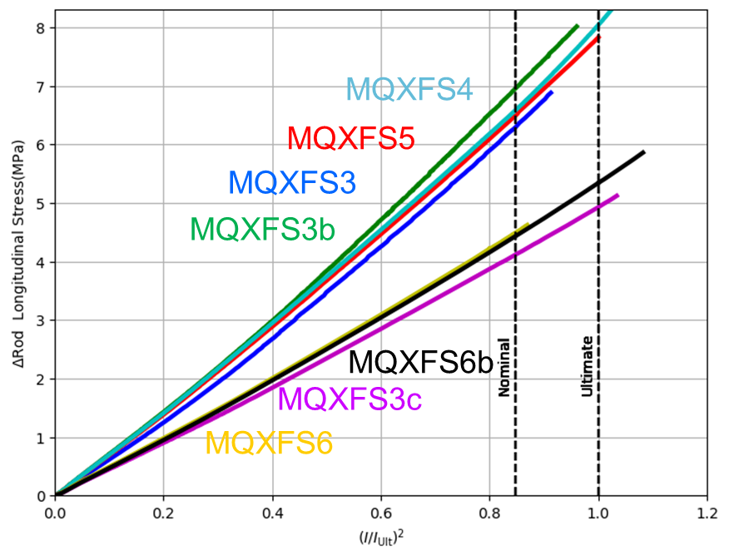
MQXFS – Experience from short magnets
As expected from the model, the rods only see 2 % for the electromagnetic forces during powering
Small differences observed in between the two types of structures:
  Structure 1&2 (thick laminations, large gap coil to collar): 1.4 % of F_{emz} in the rods, 0.16 friction coefficient needed to match the measurements
  Structure 3 (thin laminations, small gap coil to collar): 2.2 % of F_{emz} in the rods, 0.13 friction coefficient needed to match the measurements
Measurements confirm that coil elongation is independent of the pre-load level, since it depends on the system stiffness. The effect of the pre-load is to increase the contact pressure coil to pole in the end region.
Thin laminations, 5*0.125 mm gap between coil and collar, filled with polyimide
5 MPa ≈ 0.1 mm of coil elongation
Thick laminations, 13*0.125 mm gap between coil and collar, filled with polyimide or G10
Eelis Takala
G. Vallone, et. al., Mechanical analysis of the short model magnets for the Nb₃Sn low-beta quadrupole MQXF, IEEE Trans. Appl. Supercond., vol. 26, no. 4, 2016.

Slide 14
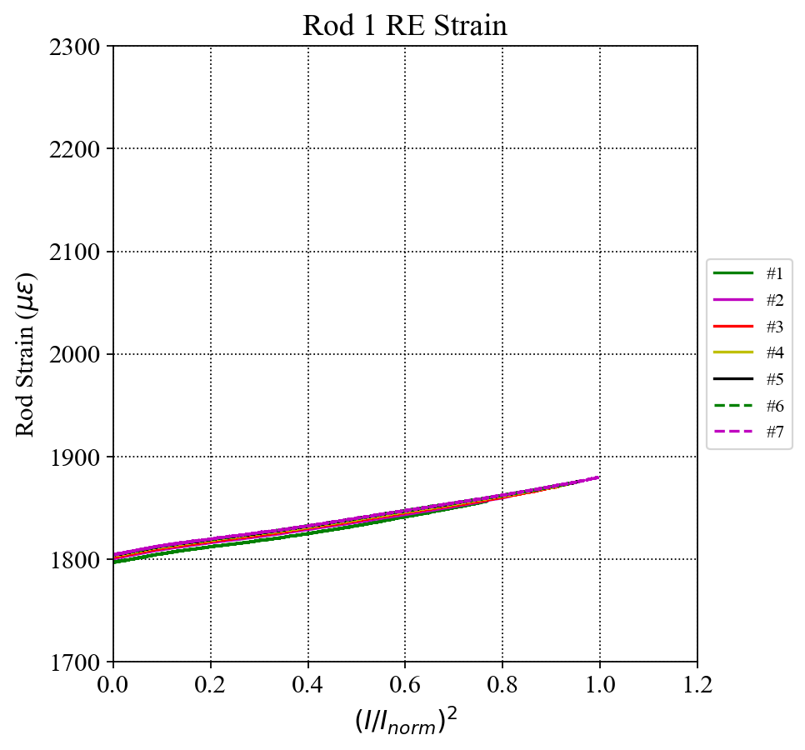
MQXFA Experience
In the first MQXFA magnets (MQXFAP01/01b and MQXAP02), issues with the readings of the SG rods.
MQXFA03 is the first magnet with reliable measurements:
  The change of the rod strain during powering to nominal is less than 100 µɛ
  The four rods have the same behavior → good balance among the rods.
Heng Pang
Delta in the rods during powering from 0 to I_{nom}
 | Rod Strain [µɛ] | Rod Stress [MPa] | Force [MN] | % of F_{em} at I_{nom} | Rod elongation [mm]
MQXFS | 75 | 6 | 0.02 | 2 | 0.12
MQXFA | 80 | 17 | 0.05 | 4 | 0.37

Slide 15
Outline
Introduction
MQXF experience
11 T experience
  Longitudinal assembly concept
  Experience from short models
  Experience from long magnets
eRMC/RMM experience
Few other 3D features in MQXF
  Pole (Titanium vs Bronze)
  Aluminum shell (Full length vs Segmented)

Slide 16
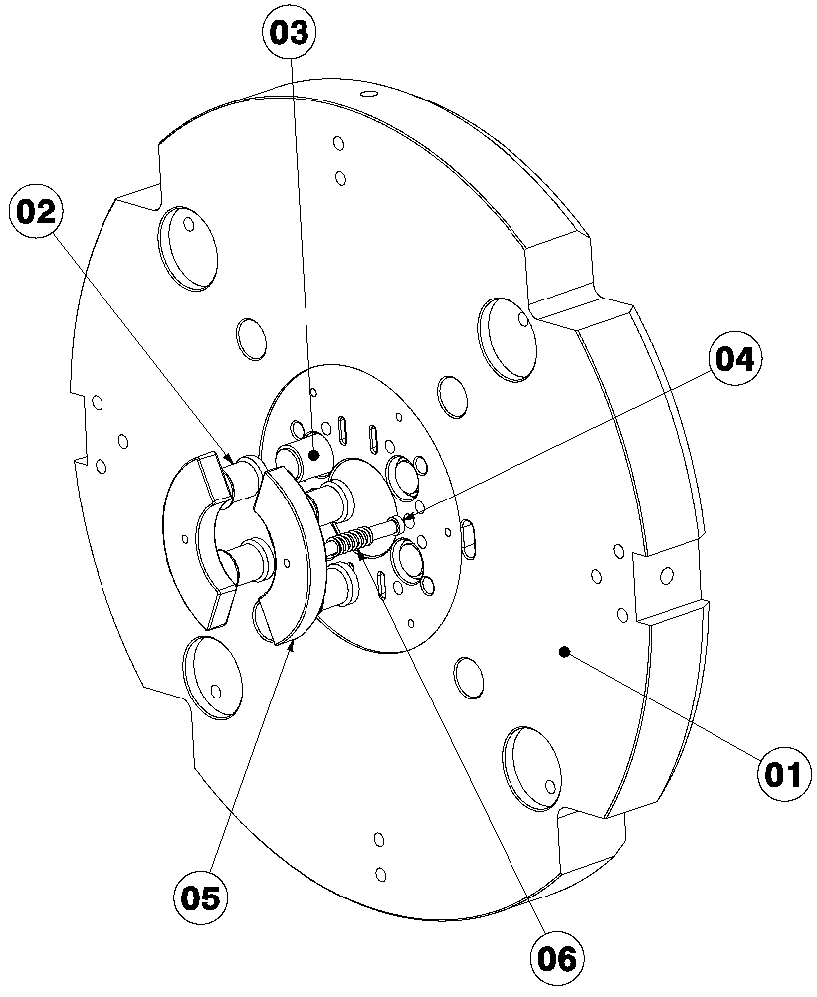
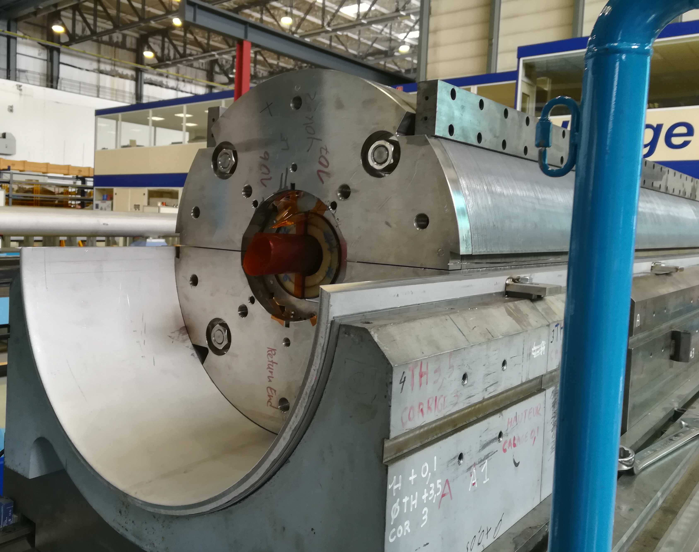
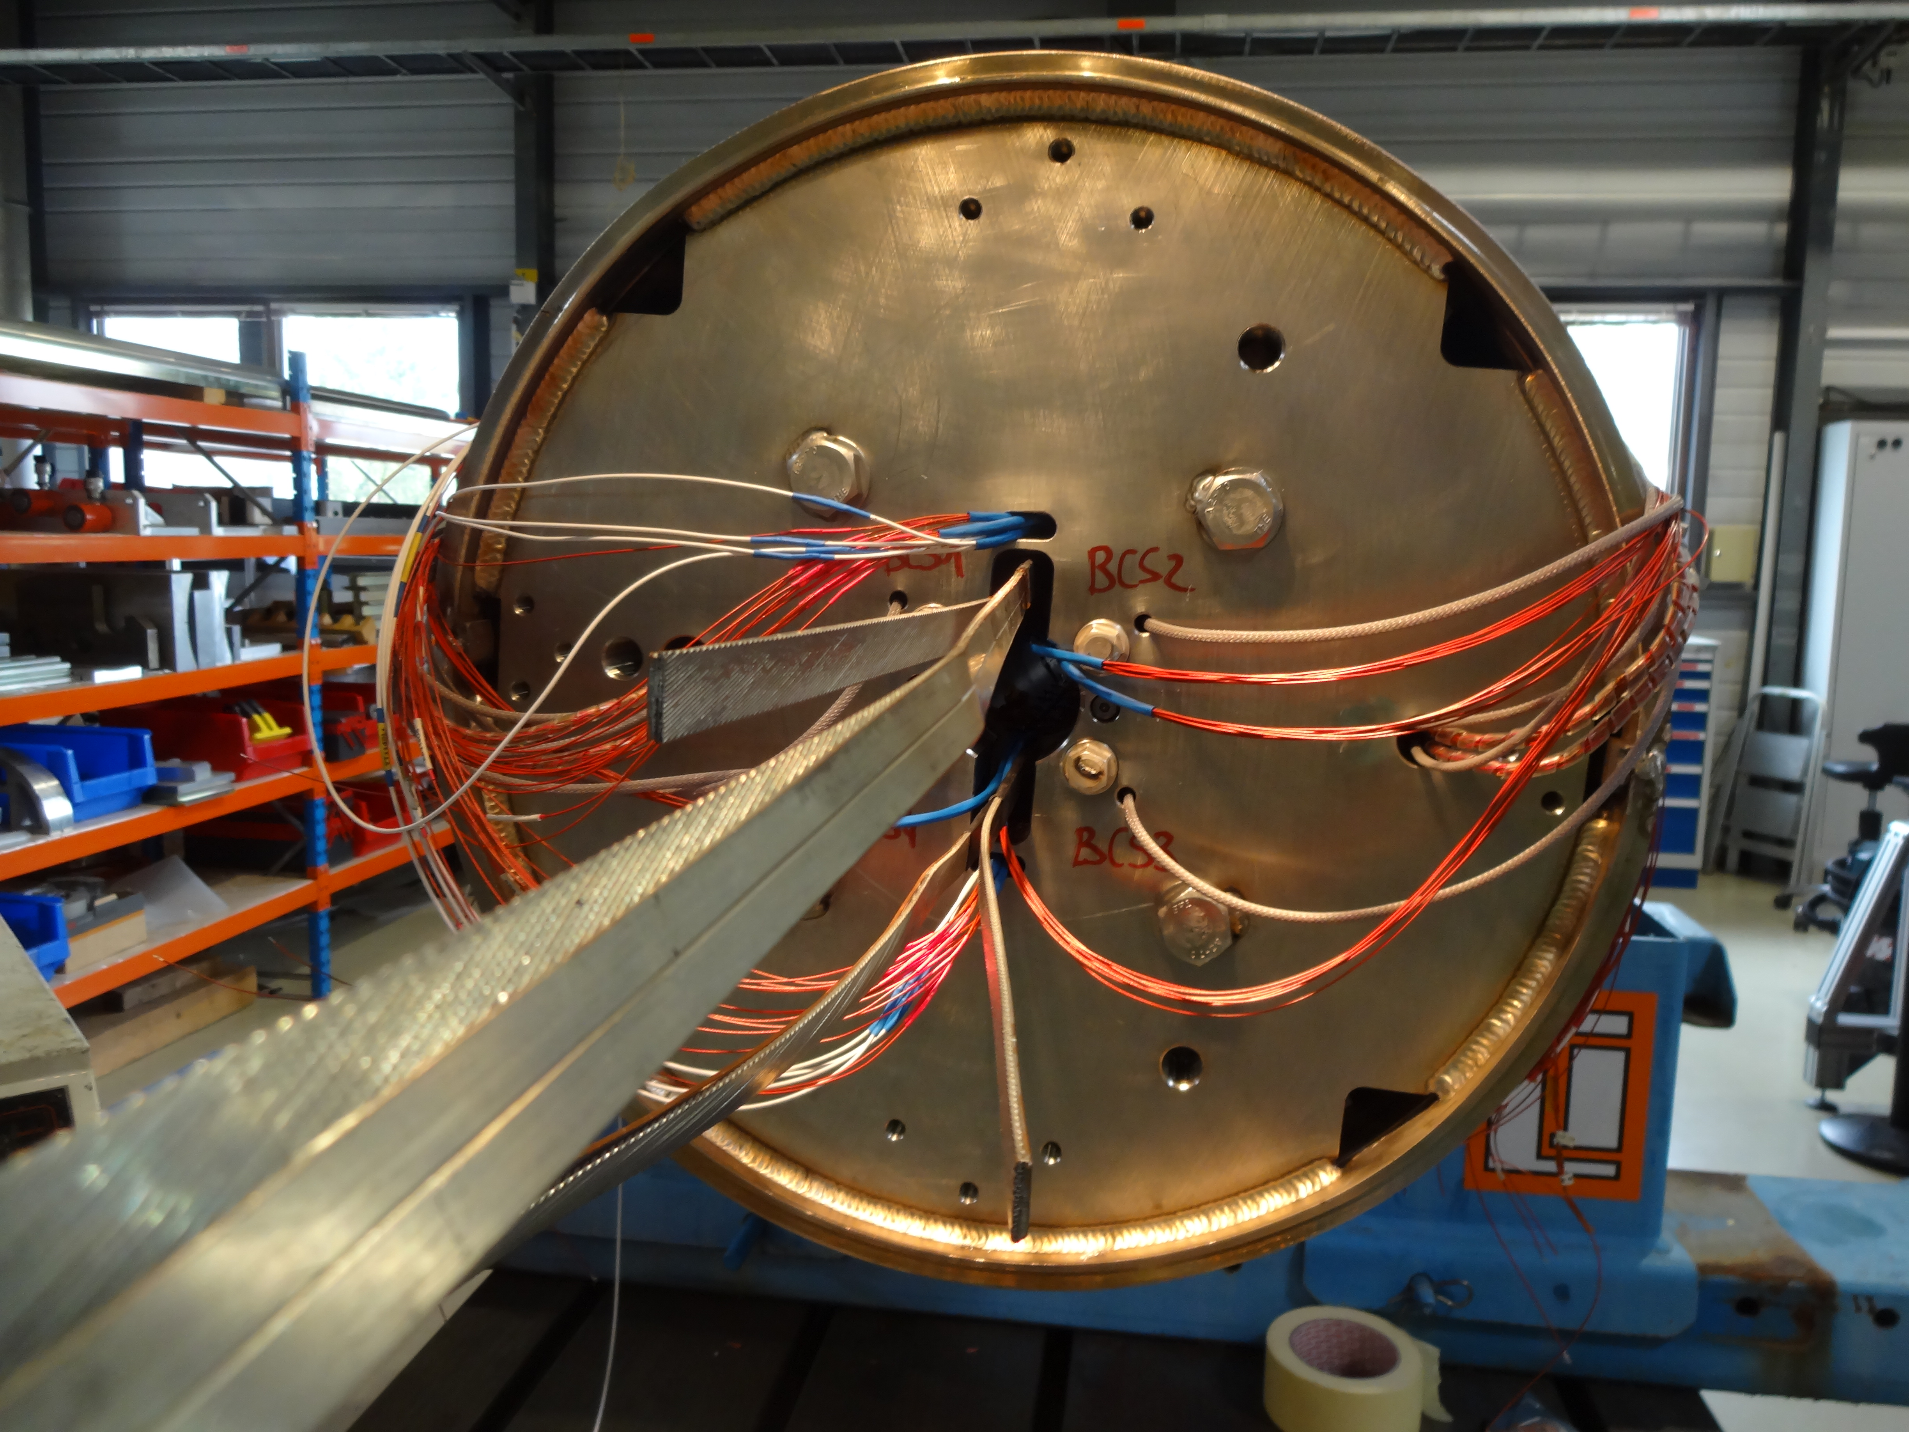
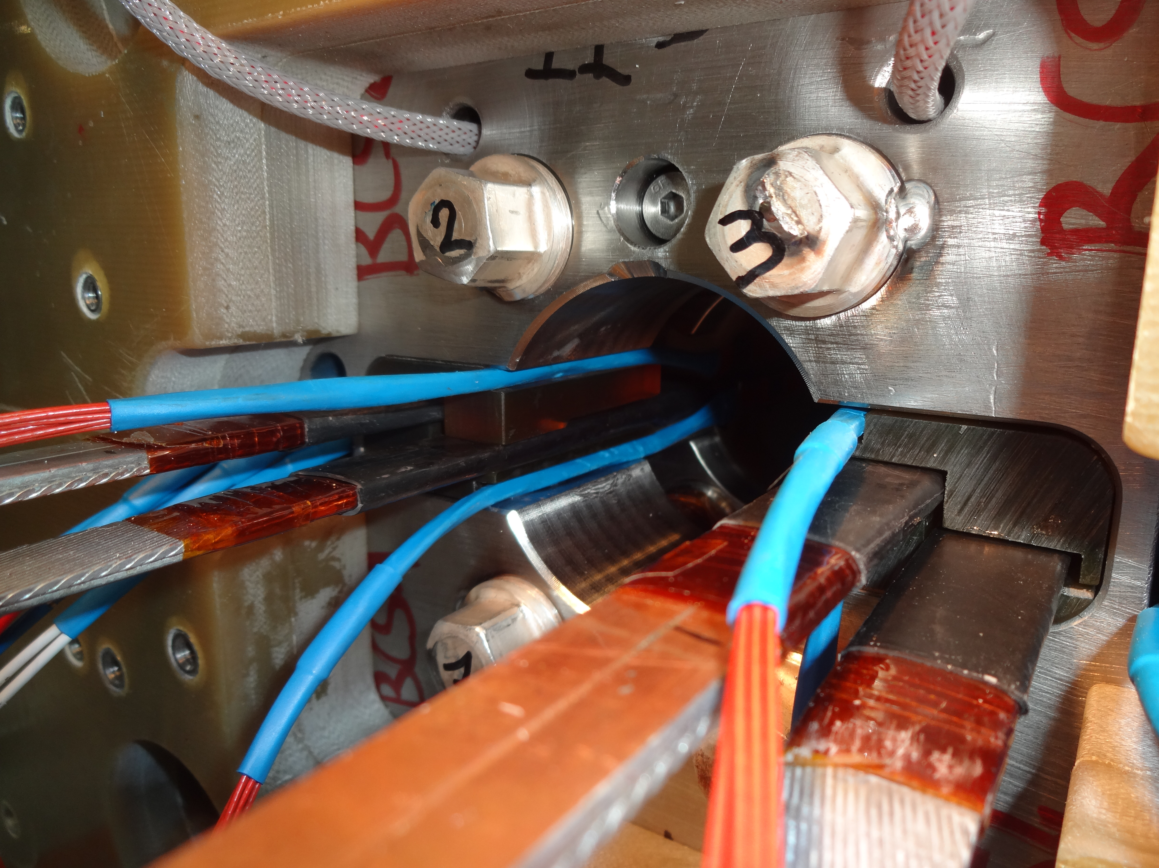
11 T Longitudinal Assembly
Slight pre-load at room temperature, to guarantee that there is still contact coil to end plate at 1.9 K.
Goal: limit the coil displacements providing a rigid lateral support
1in1 models:
  43 mm thick end-plate, 12 mm stainless steel shell.
2in1 models:
  75 mm thick end-plate, 15 mm stainless steel shell.

Slide 17
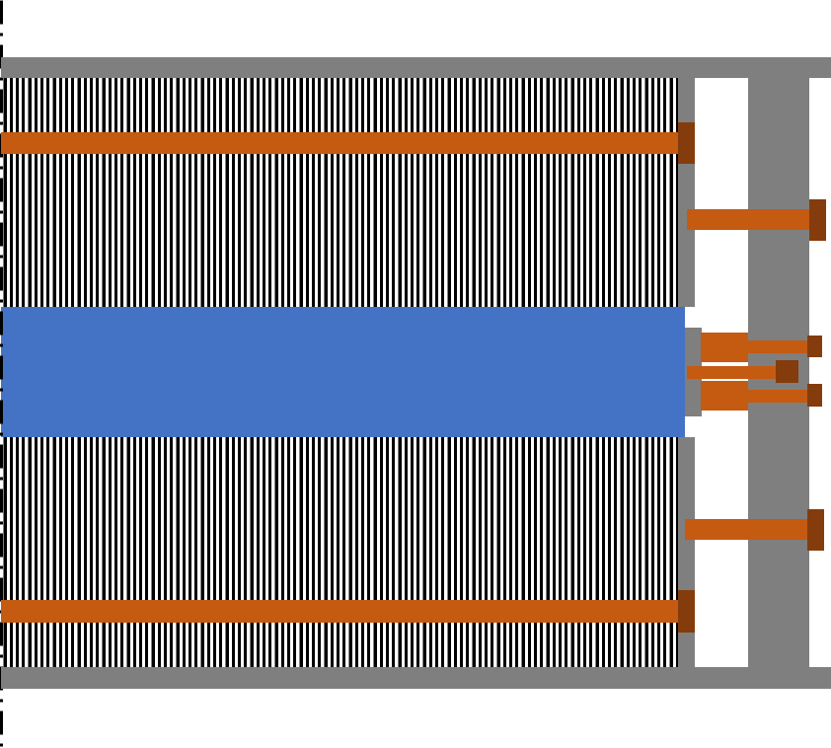
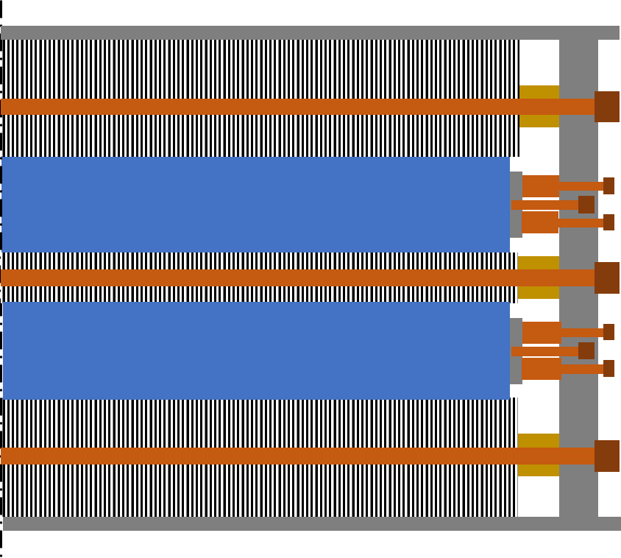
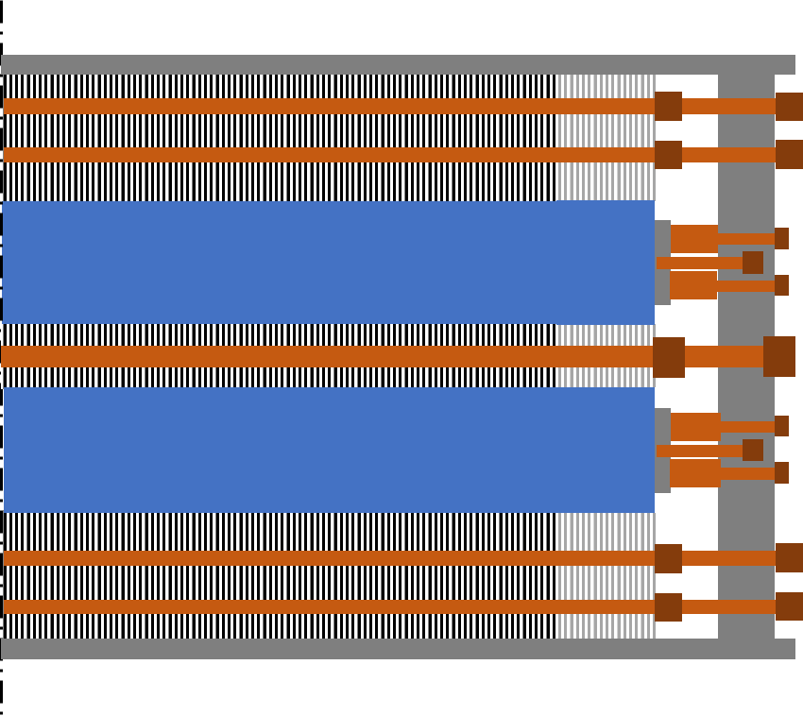
11 T Longitudinal Assembly – Short models
Details on the longitudinal assembly of 11 T short model are different.
  The thinking is that these rods have a negligible impact on the longitudinal stiffness of the assembly, but it would be good to verify through FE.
Single aperture
(SP10X)
1st Double Aperture
(DP101)
2nd&3th Double Aperture
(DP102&DP201)
  100 % packing factor of the yokes
  43 mm thick SS end-plate
  12 mm SS shell.
  4x 35/M24 mm rods end yoke through yoke
  4x M20 mm screws end plate to end yoke
  Yoke OD = 510 mm
  98 % packing factor (washers between laminations)
  75 mm thick SS end-plate
  15 mm SS shell.
  4x 32/M24 mm rods end plate through the external yoke
  2x 25/M24 mm rods end plate through the yoke between apertures
  Yoke OD = 550 mm
  98 % packing factor (laminations bended)
  75 mm thick SS end-plate
  15 mm SS shell.
  8x 12/M12 mm rods end plate through the external yoke
  2x 25/M24 mm rods end plate through the yoke between apertures
  Yoke OD = 540 mm
  Non-magnetic laminations in the ends.

Slide 18
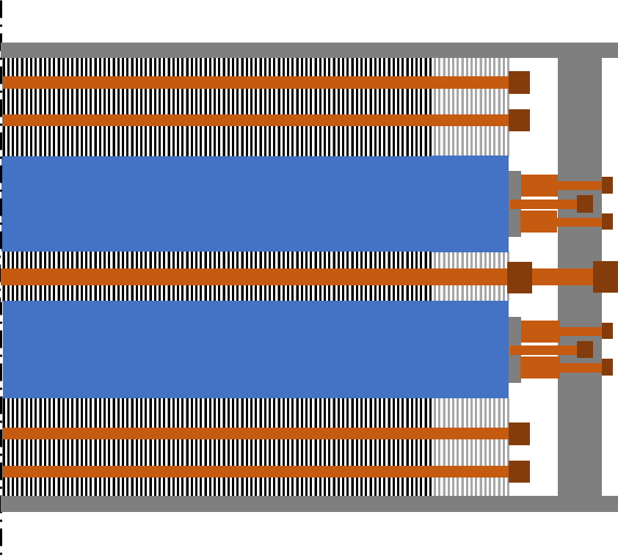
11 T longitudinal assembly –
From short to long magnets
2nd&3th Double Aperture Short Models
(DP102&DP201)
Series magnets
  98 % packing factor (laminations bended)
  75 mm thick SS end-plate
  15 mm SS shell.
  8x 12/M12 mm rods end plate through the external yoke
  2x 25/M24 mm rods end plate through the yoke between apertures
  Yoke OD = 540 mm
  Non-magnetic laminations in the ends.
  98 % packing factor (laminations bended)
  75 mm thick SS end-plate
  15 mm SS shell.
  8x 12/M12 mm rods through the external yoke
  2x 25/M24 mm rods end plate through the yoke between apertures
  Yoke OD = 540 mm
  Non-magnetic laminations in the ends.

Slide 19
11 T : Experience from short models
Bullets are loaded at RT with 20-60 kN/aperture, which corresponds to less than 10 % of the Lorentz forces at nominal current (440 kN/aperture).
During cool down, very different behavior in single and double aperture magnets.
  In the single aperture, we loose most of the applied pre-load
  In the first double aperture design, ≈ same after cool down
  In the final double aperture design, significant increase of the load in the bullets during cool down (+ 80-140 kN/aperture, i.e., 25 % of the Lorentz forces at nominal).
The reason for the different behaviour is not understood yet.
  SP
  DP101
  DP102&201

Slide 20
11 T : Experience from short models
During powering, similar behavior in all magnets → 30-60 % of the electromagnetic forces are transferred to the bullets
  One order of magnitude larger than MQXF case (2 % in MQXFS, 4 % in MQXFA)
Force transferred to the bullets during powering
Emma Lucie Gautheron

Slide 21
11 T : Extrapolation to long magnets
How much we put in the bullets?
Hard to say anything without a model and without measurements.

Slide 22
Outline
Introduction
MQXF experience
11 T experience
eRMC/RMM experience
Few other 3D features in MQXF
  Pole (Titanium vs Bronze)
  Aluminum shell (Full length vs Segmented)

Slide 23
RMM: Longitudinal stiffness
The optimization was guided by designing a system as rigid as possible:
  Rods for longitudinal loading shall be as close as possible to the coil to minimize bending of the end plate (becomes hard in blocks coil if when one needs to leave the space for the flared ends).
 | 11 T | MQXFS – Al rods | RMM- Al rods | RMM- SS rods
e.m. force per aperture at nominal field [MN] | 0.44 | 1.2 | 2.4
Coil length [mm] | 1.6 | 1.1 | 0.97
Magnet length [mm] | 2 | 1.55 | 1.5
Rod diameter [mm] | n.a. | 36 | 64
End-plate thickness [mm] | 43 | 75 | 100
Coil Stiffness [MN/mm] | 1.40 | 1.10 | 4.06 | 4.06
Rod Stiffness [MN/mm] | n.a. | 0.21 | 0.78 | 2.08
Coil elongation
No friction, no rods [mm] | 0.31 | 1.09 | 0.59
No friction, rods* [mm] | n.a. | 0.92 | 0.51 | 0.41
*Assuming infinitely rigid end-plate

Slide 24
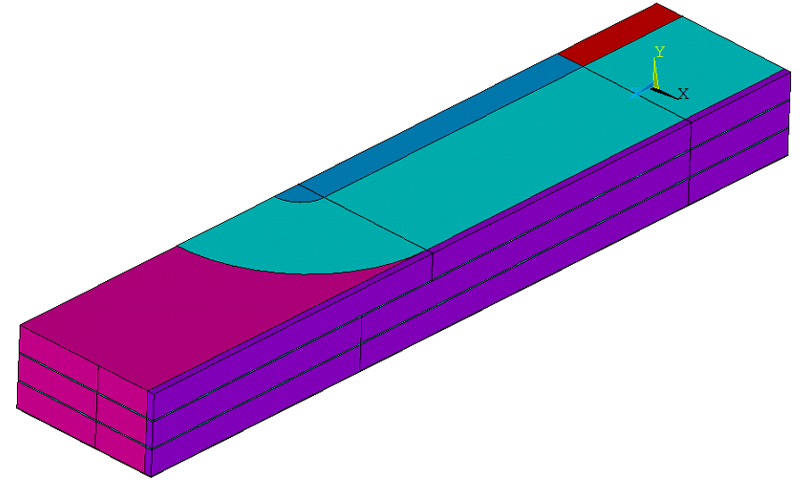
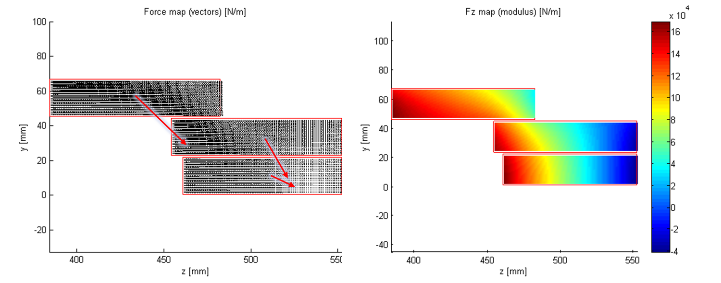
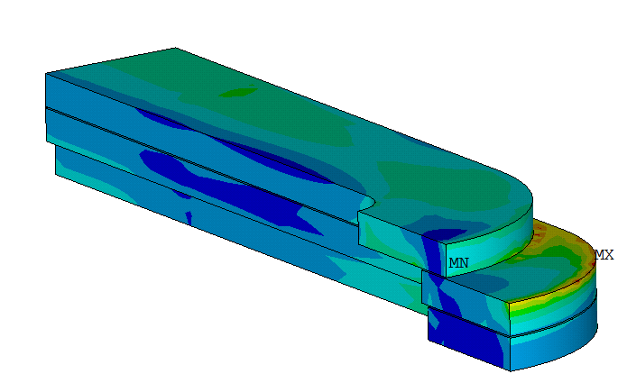
RMM – Coil end design
First coil design:
  G11 end saddles
  Shifted layers without end spacer, since you can decrease the field without the complexity of adding end parts
  Drawback: large unbalance of the forces in the coil ends.
 | Fy |  | Fz
layer | [kN] | [MN/m] | [kN] | [MN/m]
3 | -350 | -55.5 | 362 | 204
2 | -280 | -69.6 | 158 | 96.5
1 | -80 | -20.1 | 168 | 96.8

Slide 25
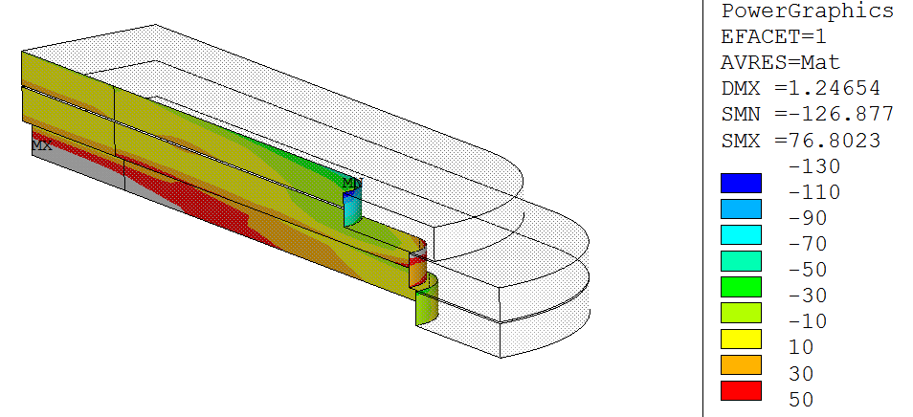
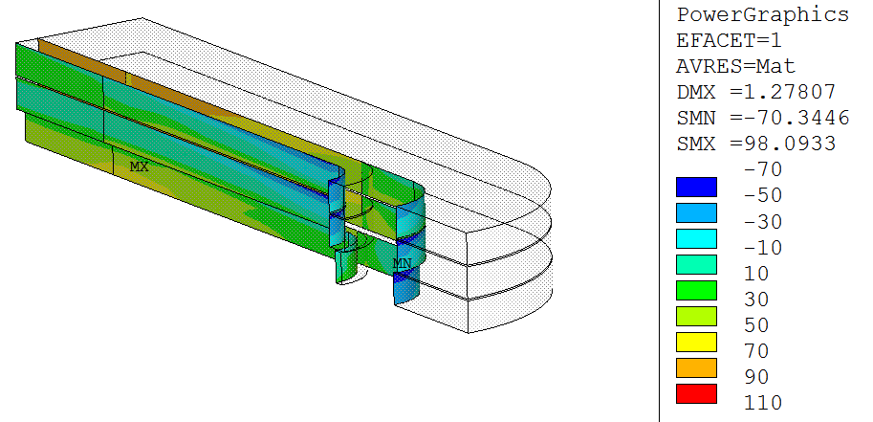
RMM – Coil end design
Final design:
  The handling of the longitudinal forces was found as a showstopper for the shifted layers solutions → moved to the traditional solution of aligned blocks with end spacers.
  Stainless steel end saddles instead of G11 to limit the coil displacement in the coil ends during powering.
  Shifted layers
  Aligned layers
https://indico.cern.ch/event/610114/

Slide 26
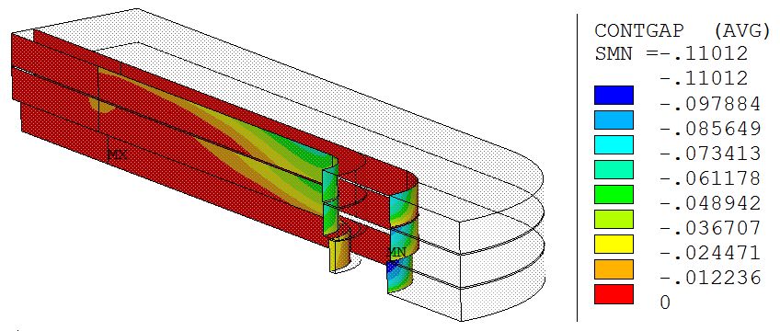
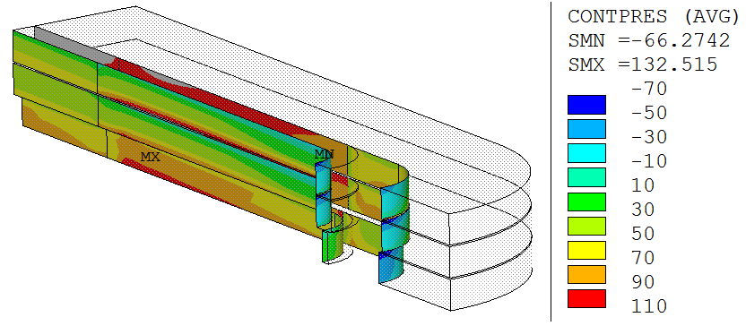
RMM: coil-pole contact
Main difficulty on the end design: keep the pole turn under compression during powering.
  Only 20% of the pre-load force applied in the rod reaches the coil-pole contact (assuming a friction coefficient of 0.2)
 | Rod Pre-load F_{z} | Rod Cool-Down F_{z} | Energization
 | [% L. F.]* | [% L. F.]* | Max. Tension [MPa] | Max. Gap [μm]
16 T | 14 | 76 | 64 | 106
18 T | 11 | 56 | 90 | 135
16 T | 32 | 100 | 56 | 94
18 T | 24 | 75 | 80 | 133
16 T | 72 | 139 | 46 | 76
18 T | 53 | 104 | 77 | 110
16 T | 97 | 167 | 40 | 62
18 T | 72 | 125 | 72 | 99
16 T | 135 | 208 | 30 | 44
18 T | 100 | 155 | 66 | 85
E. Rochepault, 3D Magnetic and Mechanical Design of Coil Ends for the Racetrack Model Magnet RMM, IEEE Appl. Supercond.

Slide 27
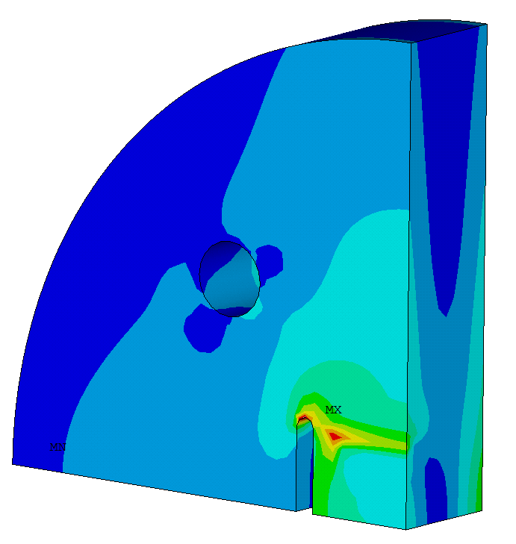
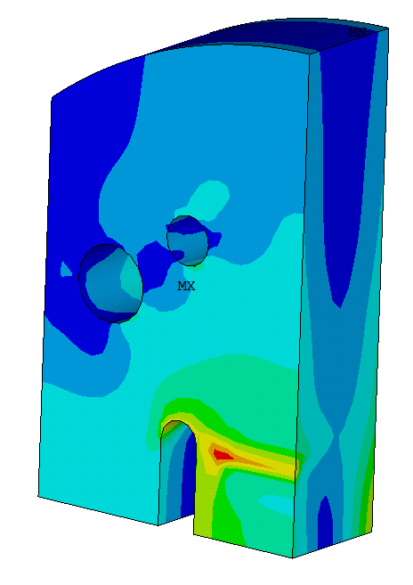
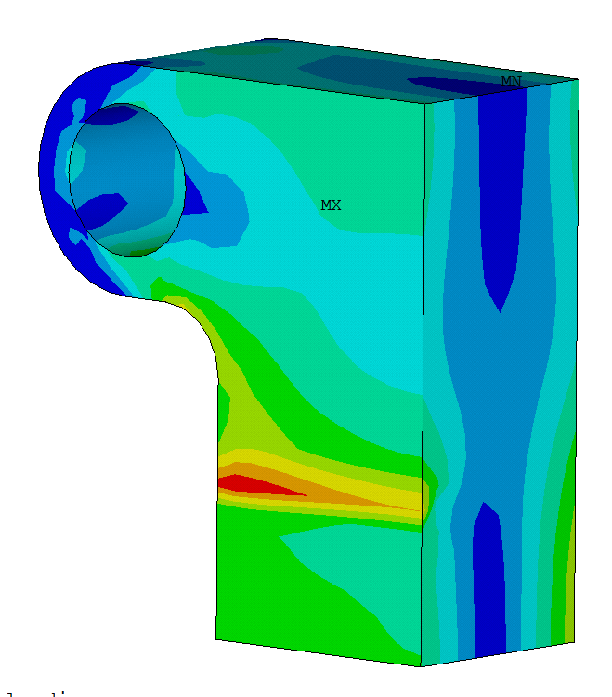
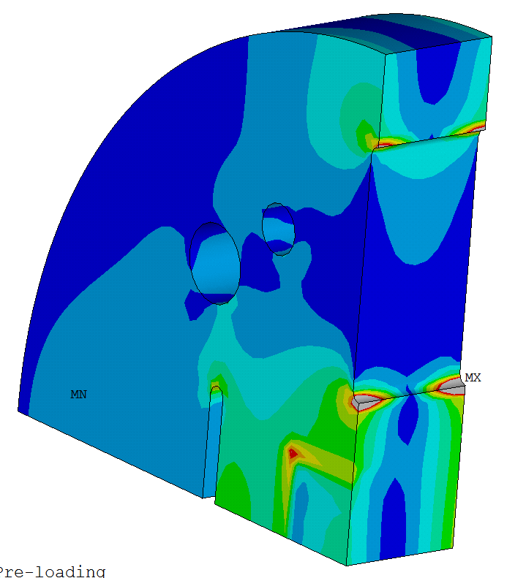
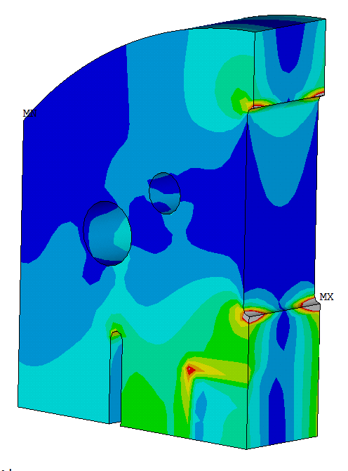
RMM: End-plate design
Goals:
Provide enough rigidity to the system, limiting coil displacements
Be able to apply up to 3 MN of pre-load
Keep stress below yield limit
Allow extraction of the leads on the Lead End
Allow bladders loading on the Return End
d. Removing un-necessary material
b. Adding material for higher rigidity
a. Increasing thickness and width for higher rigidity
Lead End
Return End
c. Different designs Lead End/Return End

Slide 28
eRMC – Feedback from experience
eRMC1a was assembled with stainless steel rods.
Target pre-load level: 60 MPa in the rods at RT (50 % F_{em} @ 16 T),80 MPa at 1.9 K (70 % F_{em} @ 16 T),
As in all the rest of magnets loaded longitudinally with this concept, good fitting between measured and FEA (specially in the second thermal cycle)
Assembly report EDMS 2333771

Slide 29
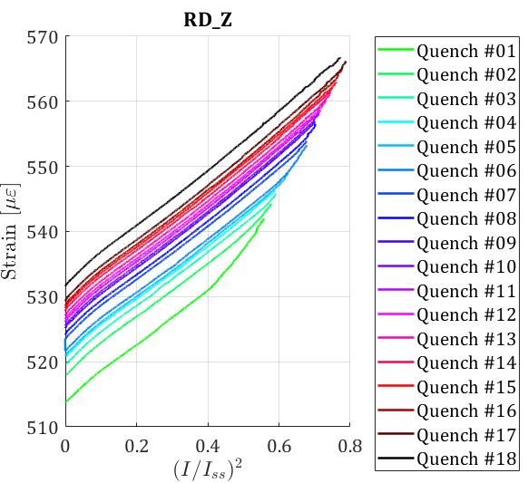
eRMC – Feedback from experience
The model (including friction) predicts 10 % of electromagnetic forces going to the rods, very consistent with measurements.
Small ratcheting effect observed during training, also very common in all the magnets with this kind of structure, studied in the past [1].
< 20με; 4 MPa
Delta in the rods during powering from 0 to 16 T
 | Rod Strain [µɛ] | Rod Stress [MPa] | Force [MN] | % of F_{em} at I_{nom} | Rod elongation [mm]
eRMC | 35 | 6 | 0.02 | 10 | 0.12
[1] P. Ferracin, S. Caspi, and A. F. Lietzke “Towards Computing Ratcheting and Training in Superconducting Magnets” IEEE TRANSACTIONS ON APPLIED SUPERCONDUCTIVITY, VOL. 17, NO. 2, JUNE 2007

Slide 30
Outline
Introduction
MQXF experience
11 T experience
eRMC/RMM experience
Few other 3D features
  Pole (Titanium vs Bronze)
  Aluminum shell (Full length vs Segmented)

Slide 31
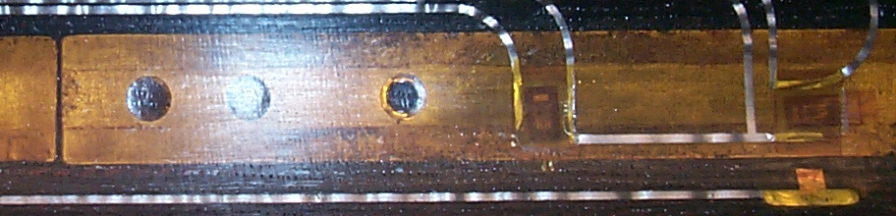
Conductor axial strain
Thermal contraction from RT/1.9 K among coil and pole/wedges play a role on the axial strain. The coil contracts ≈ 3-4 mm/m longitudinally.
Typical materials we use:
  Pole:
    Bronze (HD1/TQ times): 3.2 mm/m --> magnet performance limited in the pole transitions.
    Titanium (HQ, MQXF, 11 T…): 1.7 mm/m
    Iron (FRESCA2): 2 mm/m
  Wedges:
    Bronze (MQXF AUP): 3.2 mm/m
    ODS Copper (11T, MQXF CERN): 3.5 mm/m
    Stainless steel (FNAL): 2.8 mm/m
Gap
Island Gaps
SG-Z
SG-Theta
Slomo Caspi, Paolo Ferracin, et al

Slide 32
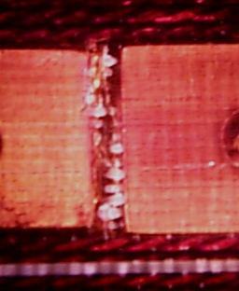
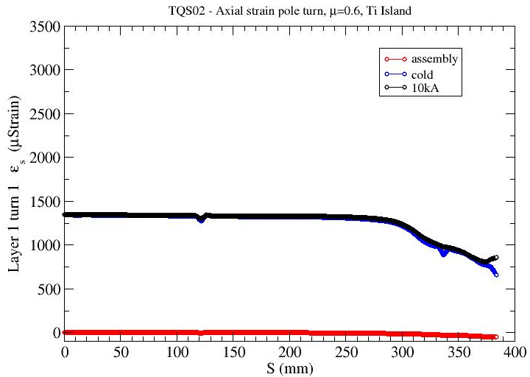
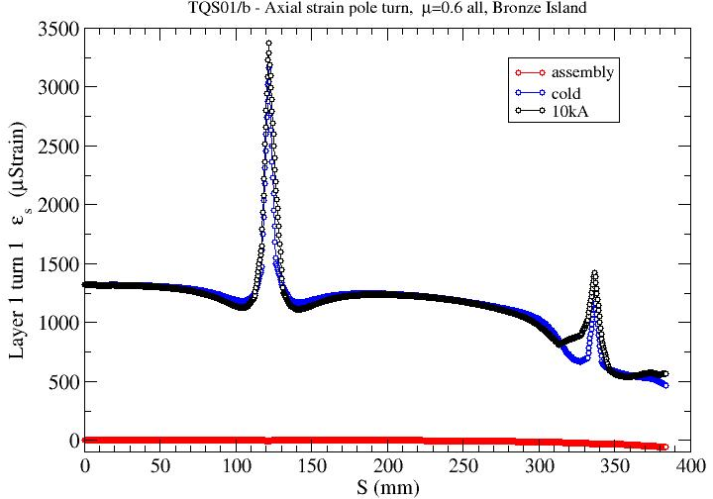
Conductor axial strain
Axial tension in bronze islands, a source of localize strain near gaps (after cold tests, sign of delamination in that region)
Based on simulations, this effect disappears when using titanium pole.
Island Gaps
TQ after test
Axial tension in
bronze-islands is a source of localized strain in the coil near gaps.
Slomo Caspi, Paolo Ferracin, et al
TQS02 , Ti island, friction=0.6
TQS01/b, Bronze island, friction=0.6

Slide 33
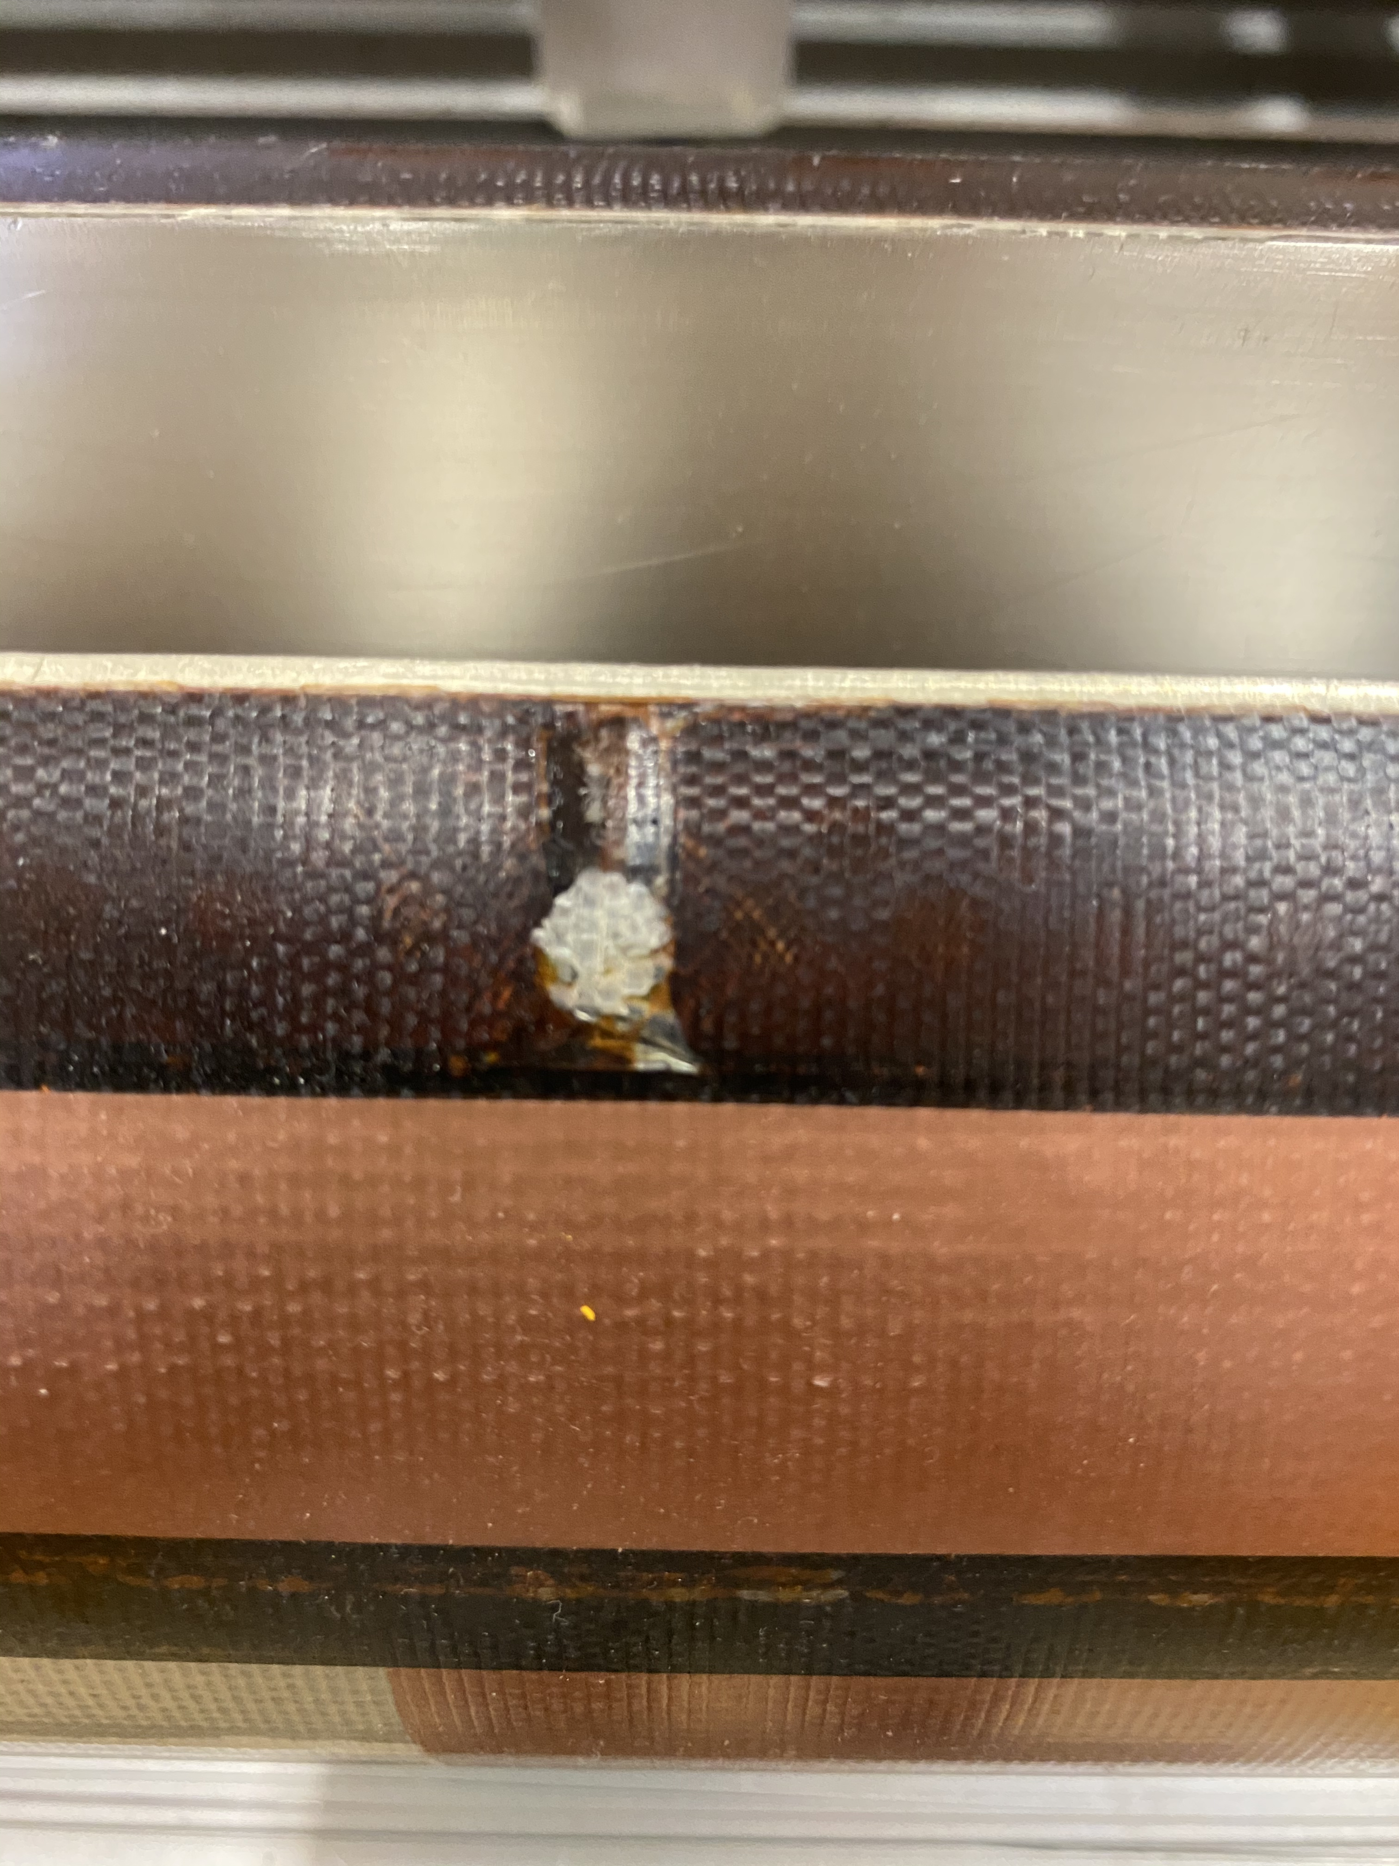
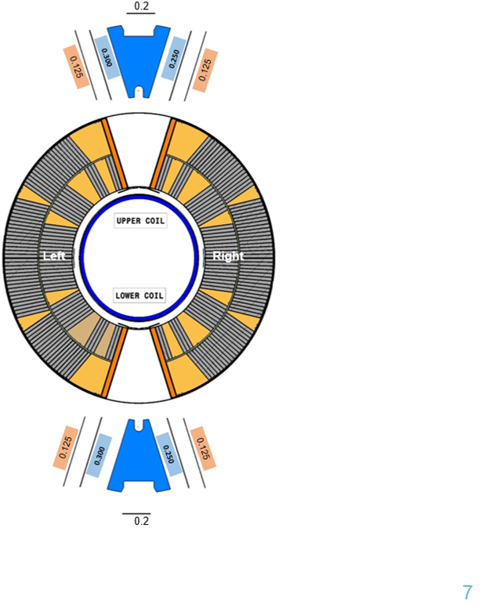
Conductor axial strain
Coil GE03 after cold test
We got rid of the issue on the pole…but we still have this feature on the wedges, put also a picture of MQXF
ODS copper wedge

Slide 34
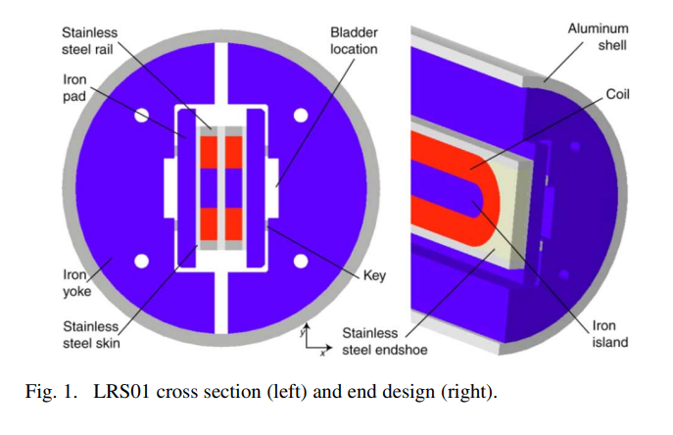
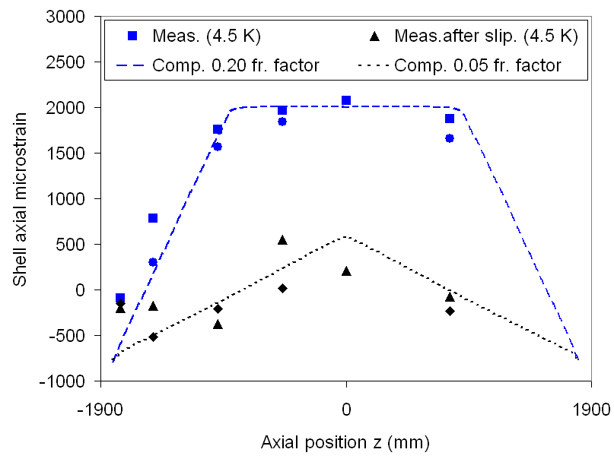
Aluminum Shell Segmentation
LRS01 Axial strain
Shell shrinks more than the yoke, friction limits the shell contractions
Strain at 4.5 K consistent with 0.2 friction model results
During excitation e.m. forces induced slippage.
This was studied in LRS (long racetrack quadrupole).
  In LRS01 High axial tension, with sudden slippages over the course of the test, and variations in azimuthal strain were recorded by gauges mounted on the shell
P. Ferracin , Assembly and Test of a Support Structure for 3.6 m Long Nb3Sn Racetrack Coils IEEE Transactions on Applied Superconductivity Year: 2008 | Volume: 18, Issue: 2

Slide 35
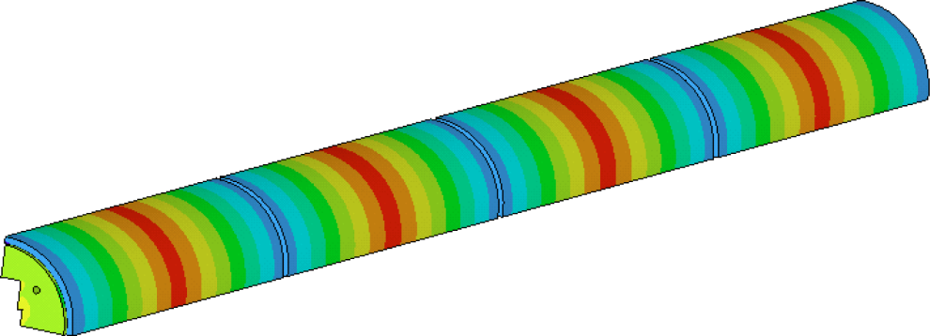
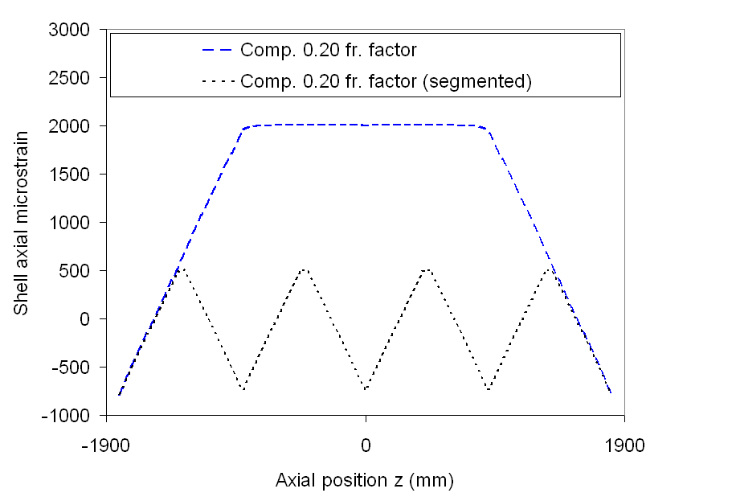
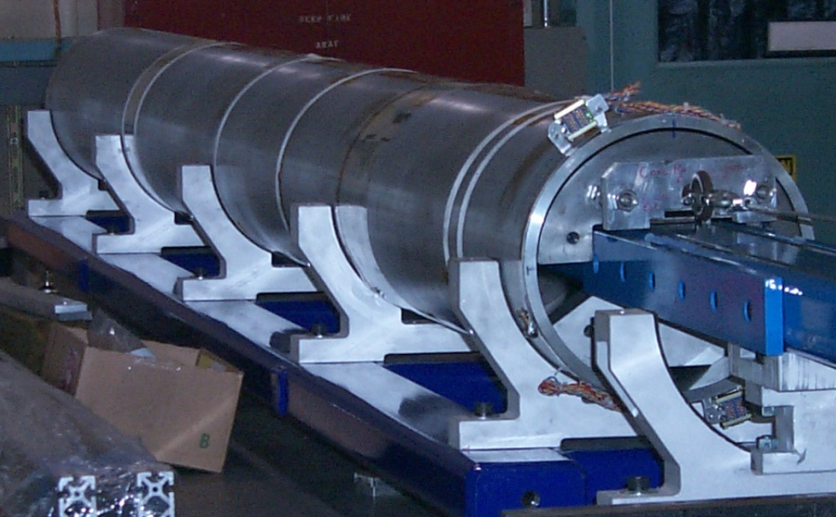
Aluminum Shell Segmentation
Shell was divided in 4 segments
No axial strain accumulation
Required for very long shells
Factor of 2 improved homogeneity
Increased field and no slippage
96% SSL with minimal training
  LRS01 reached 91 % of SSL
S4
S3
S2
S1
LRS01
LRS02
Structure re-assembly with segmented shell
Joseph F. Muratore , Test Results of LARP 3.6 m Nb3Sn Racetrack Coils Supported by Full-Length and Segmented Shell Structures, IEEE Transactions on Applied Superconductivity, 2009 | Volume: 19, Issue: 3

Slide 36
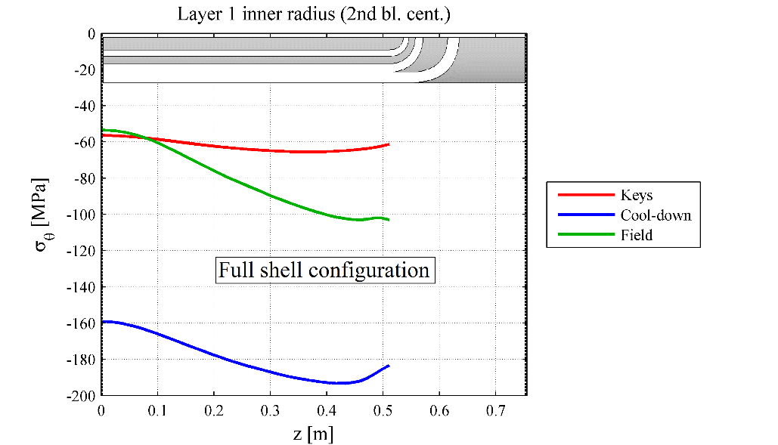
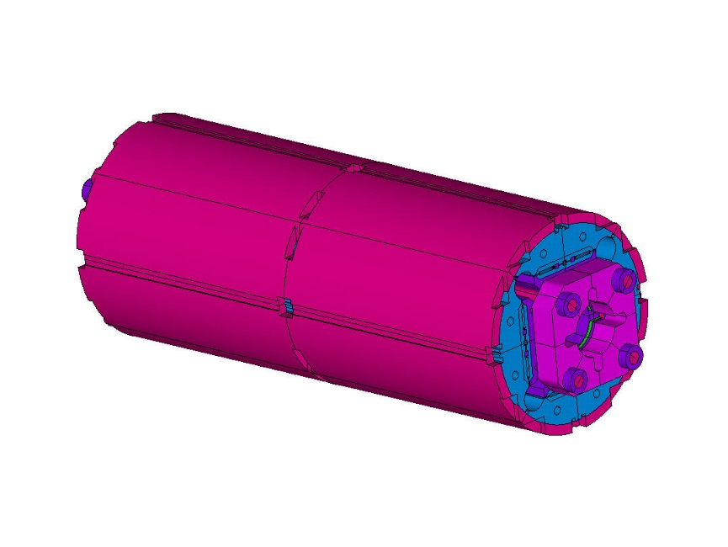

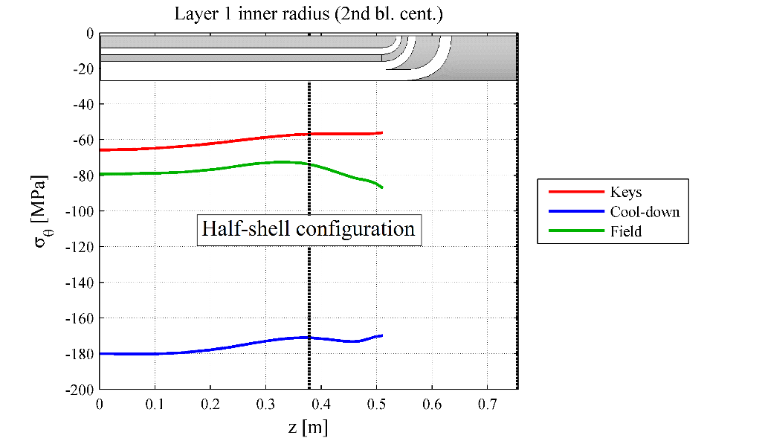
Aluminum Shell in MQXF
In order to smooth the stress in the coil ends, the aluminum shell is half length in the extremities.

Slide 43
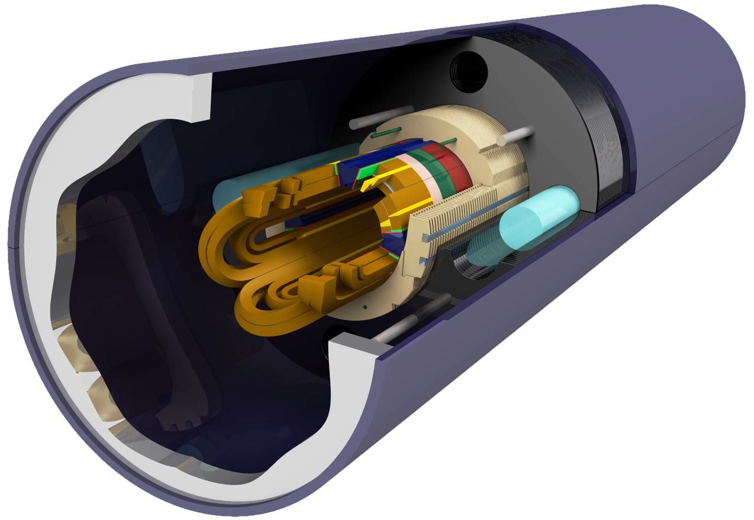
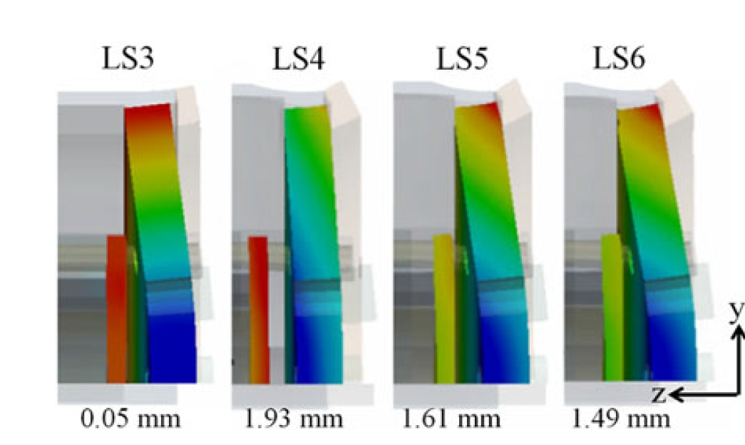
MKQXF (FEAC)
FEAC performed a design study on MKQXF, a pole loading concept magnet, using MQXF coils.
End design converged to a model with 4 bullets, a 50-mm-thick endplate, 4 rods of 30 mm diameter and pre-tension on the bullets that corresponds to an induced gap at the bullets – coil end plate interface of 0.5 mm.
Computed coil elongation during powering, for the 7.2 m magnet is 0.32 mm, due to the bending of the end-plate.
  Remark: Not so clear in [1] how the FEA model is scaled to the full length magnet: “The E-modulus of the stainless steel rods that connect the two end plates of the magnet was scaled down to the length of 1.55 m, to accurately model the behaviour of the assembly over the total length of the magnet.”
Assembly
4.2 K
140 T/m
155 T/m
[1] Charilaos Kokkinos; Mikko Karppinen, High Gradient Nb3Sn Quadrupole Demonstrator MKQXF Engineering Design IEEE Transactions on Applied Superconductivity Year: 2018, Volume: 28, Issue: 3

Slide 44

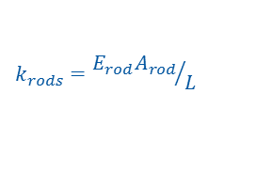

MQXF vs MKQXF
$$k_{rods}={E_{rod}A_{rod}}/L$$
$$k_{shell−yoke}≫k_{rods}$$
According to FEA, similar coil elongation in the two configurations. Possible origin:
  MKQXF larger bending of the end plate.
Further analysis on MKQXF FEA model might provide further clarifications.
$$k_{coil}=\sum{{E_{i}A_{i}}/L}$$
$$k_{coil}=\sum{{E_{i}A_{i}}/L}$$
 | MQXF | MKQXF
End plate thickness, mm | 75 (Nitronic 50) | 50 (stainless steel)
Rods diameter, mm | 36 (aluminium/stainless steel) | 30 (stainless steel)
Coil elongation for the 7.2 m magnet, including friction | 0.28 mm | 0.32 mm

Slide 45


MQXFSD1
Instrumentation
  4 CERN + 4 LARP strain gauge stations (ϑ and z) in shell
  4 CERN + 12 LARP strain gauges stations (ϑ and z) in dummy coils
  4 strain gauges z on rods
  Total: 52 gauges
1 loading at LBNL
1 cool-down at LBNL
  No thermal cycles

Slide 46


MQXFS1 (or AT1)
Structure 1 used for first short model
  ½ + 1 + ½ shell segments
  Thick laminations
  LE axial pre-load
Assembled/loaded in summer 15, cooldown in winter
Coil 3, 5, 103, 104

Slide 47


MQXFS1 (or AT1)
Instrumentation
  4 CERN + 4 LARP strain gauge stations (ϑ and z) in shell
  4 CERN + 4 LARP strain gauges stations (ϑ and z) in dummy coils
  4 strain gauges z on rods
  Total: 36 gauges
1 loading at LBNL
1 cool-down + warm-up at FNAL
Next cool-down soon at FNAL

Slide 48
MQXFS Support Structure # 2
½ + 1 + ½ shell segments
  Fabricated with final lengths and new smaller cut-outs
All other components from structure 0
LE axial pre-load
To be qualified in first half 2016 with dummy coils
  MQXFSD2

Slide 49
MQXFSD2
Instrumentation
  4 CERN strain gauge stations (ϑ and z) in shell
  12 CERN strain gauges stations (ϑ and z) in dummy coils
  4 strain gauges z on rods
  Total: 36 gauges
1 loading + cool-down performed at CERN
To be done (Feb. 16)
  Thermal cycle, II loading, II cool-down and thermal cycle at CERN

Slide 50


MQXFS Support Structure 3 and 4
½ + 1 + ½ shell segments
Thin lamination for pad and yoke
RE axial pre-load
2 sets of components delivered at CERN
  Except 1 set of shells and 1 set of collars
To be qualified at CERN in first half Mar./Apr. 2016 with dummy coils
  MQXFSD3

Slide 51


From structure 1-2 to structure 3-4
Nuts and pre-loading system moved from LE to RE
  Reduced lengths of the leads → field quality
  Easier pre-loading operation
  Increased distance between Q1 magnets

Slide 52




Short model support structures overview
Structure 1
Used in
  MQXFSD1
  MQXFS1
Structure 2
Used in
  MQXFSD0
  MQXFSD2
  MQXFS2
Structure 3
Not assembled
To be used in
  MQXFSD3
  MQXFS3
  MQXFS5
Structure 4
Not assembled
  Missing shell and collars
To be used
  MQXFSD4(?)
  MQXFS4

Slide 53
Short model support structures overview
Structure 1
Used in
  MQXFS1/1b/1c/1d/1e
Structure 2
Used in
  MQXFS3c
  MQXFS6/6b/6c
Structure 3
Used in
  MQXFS3/3b
  MQXFS5
  MQXFS4/4b/4c

Slide 55


Slide 56








The road to shell structures at LBNL
SQ01 short quad
RD2 - 6 Tesla
RT1 - 12 Tesla
SM-01 - 12 Tesla
TQS, quad
RD3-b - 14.5 Tesla
HD1 - 16 Tesla
LR01 3.6 m long cc, 11.5 T, (2007)
S. Caspi
56
Notes:
Added two more to list since November DOE review. Much simpler than D20.

Slide 57

LQ – 3.7 m long quad for LARP
A 3.4 mm bowed reaction fixture (using ONE top plate) after heat treatment
Coil is unrestrained axially.
“Development and coil fabrication for the LARP 3.7-m Long Nb3Sn Quadrupole” 19 August 2008
S. Caspi
57

Slide 58


Slide 59




Axial displacements and quench location (HD1, TQ)
Epoxy discoloration
11
17
15
9
25
14,19
18
~20
32
6
~24
27
Gap: 80 μm
Coil 7
S. Caspi
Broken fibers
59

Slide 60


SQ02 axial support system
Fz @ Iss = 0.37 MN/end
P. Ferracin et al “Effect of Axial Loading on Quench Performance in Nb3Sn Magnets”
IEEE TRANSACTIONS ON APPLIED SUPERCONDUCTIVITY, VOL. 18, NO. 2, JUNE 2008
S. Caspi
60

Slide 61


SQ02 - Ratcheting Model
frictional stress and sliding between coil and island result in an energy dissipation that quench the magnet
SQ02 geometry with contact region between coil and island
Measured rod strain as a function of the Lorentz force.
P. Ferracin, S. Caspi, and A. F. Lietzke “Towards Computing Ratcheting and Training in Superconducting Magnets” IEEE TRANSACTIONS ON APPLIED SUPERCONDUCTIVITY, VOL. 17, NO. 2, JUNE 2007
S. Caspi
61

Slide 62

Ratcheting Model
SQ02 geometry with contact region between coil and island
Computed variation of rod strain as a function of the Lorentz force.
S. Caspi
62

Slide 63

Ratcheting Model
SQ02 geometry with contact region between coil and island
Frictional energy (J/m2 ) dissipated during excitation from 3 kA to
9 kA in steps of 1 kA. Emax is the peak frictional energy dissipated in one step.
S. Caspi
63

Slide 64

Coil Estimates
Plane-Stress Sigma_z=0
(free-axial, sliding)
Plane-Strain Epsilon_z=0
(fixed-axial)
Sigma_t = -150 MPa (solid cylinder)
Epsilon_t = -3750 Mic-strain
Epsilon_z = +1250 Mic-strain
Sigma_z= 0 MPa
Magnet length L=1m
Coil change in length = +1.25 mm
Sigma_t = -150 MPa (solid cylinder)
Epsilon_t = -3333 Mic-strain
Epsilon_z = 0 Mic-strain
Sigma_z = -50 MPa coil
  Sigma_rods=-F_z/A_rods = +195 MPa (r-17mm)
  Aluminum rods E=80 GPa, 1 m long
  Rods_strain_z=195/80 = +2437 Mic-strain
  1m rods change in length = +2.4 mm

