Slide 1

QCD Results from ATLAS
Jon Butterworth (UCL) for the ATLAS collaboration
First look with a new detector
First look in a new kinematic regime
Soft (-ish) physics and tuning
Hard physics and cross sections
QCD plus…

Slide 2

Muon Spectrometer (|η|<2.7) : air-core toroids with gas-based muon chambers
Muon trigger and measurement with momentum resolution < 10% up to E_{μ} ~ 1 TeV
Length : ~ 46 m
Radius : ~ 12 m
Weight : ~ 7000 tons
~10⁸ electronic channels
3000 km of cables
3-level trigger
reducing the rate
from 40 MHz to
~200 Hz
Inner Detector (|η|<2.5, B=2T):
Si Pixels, Si strips, Transition Radiation detector (straws)
Precise tracking and vertexing,
e/π separation
Momentum resolution:
σ/p_{T} ~ 3.8x10⁻⁴ p_{T} (GeV) ⊕ 0.015
EM calorimeter: Pb-LAr Accordion
e/γ trigger, identification and measurement
E-resolution: σ/E ~ 10%/√E
HAD calorimetry (|η|<5): segmentation, hermeticity
Fe/scintillator Tiles (central), Cu/W-LAr (fwd)
Trigger and measurement of jets and missing E_{T}
E-resolution: σ/E ~ 50%/√E ⊕ 0.03
Notes:
2

Slide 3
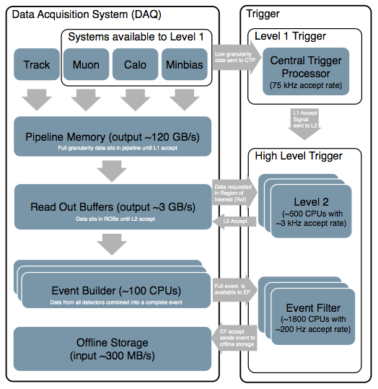

Slide 4
ATLAS Operation

Slide 5
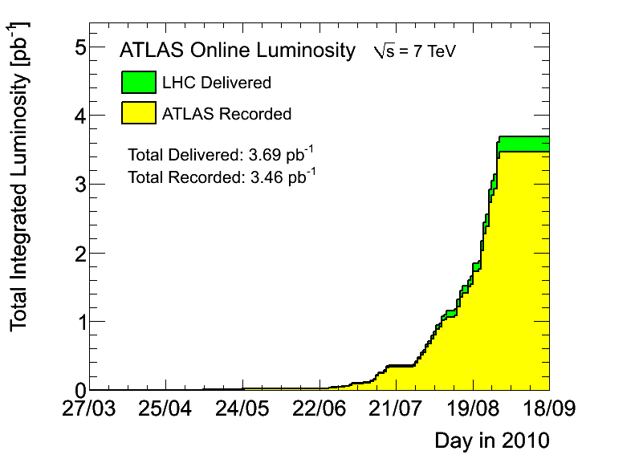
ATLAS Operation
~95% data taking efficiency

Slide 6
Luminosity
Monitored by using rates in low-angle detectors & endcaps
Absolute calibration from van der Meer scans
Uncertainty ~11%
  dominant error from knowledge of beam current

Slide 7
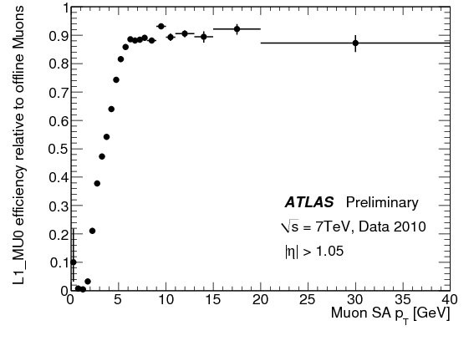
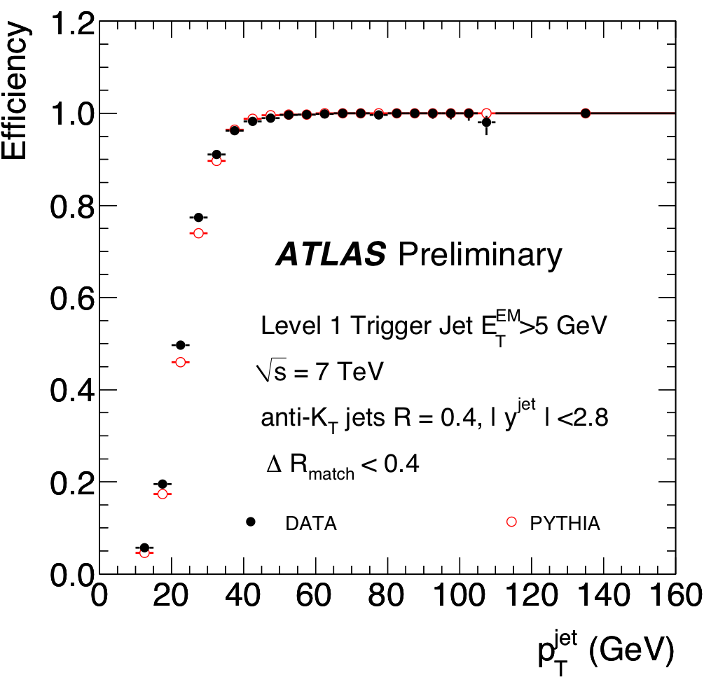
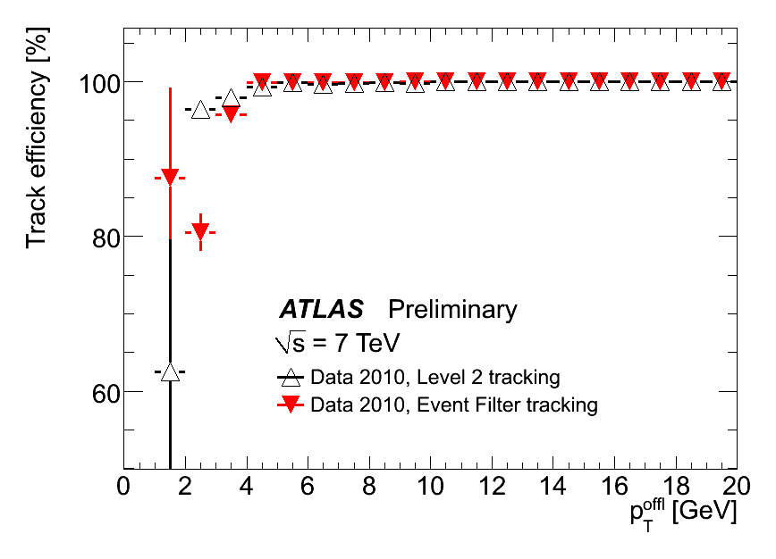
Trigger Performance Examples
Muon efficiency
Electron efficiency
Jet efficiency

Slide 8
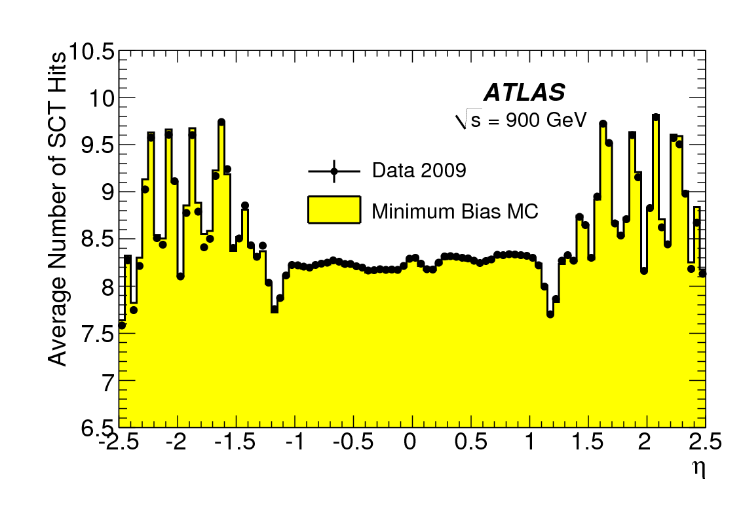
First collision results
Particle multiplicities in 900 GeV collisions Phys Lett B 688, 1 (2010) pp.21-4
Demonstrate excellent modeling of the detector

Slide 9
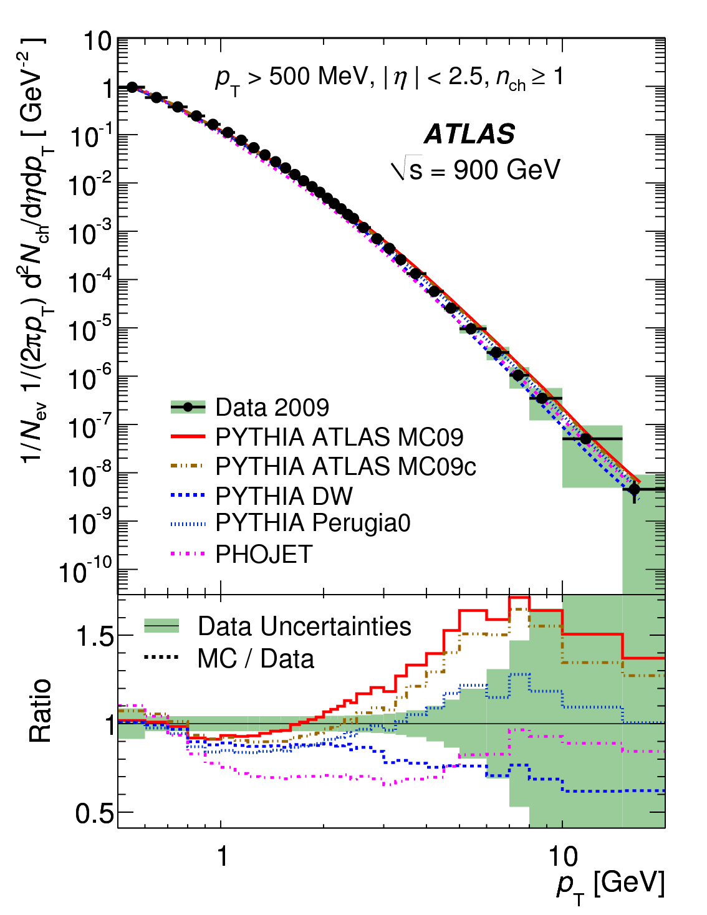
First collision results
Particle multiplicities in 900 GeV collisions Phys Lett B 688, 1 (2010) pp.21-4
Demonstrate excellent modeling of the detector
and reasonable modeling of the soft QCD physics (of which more later)

Slide 10
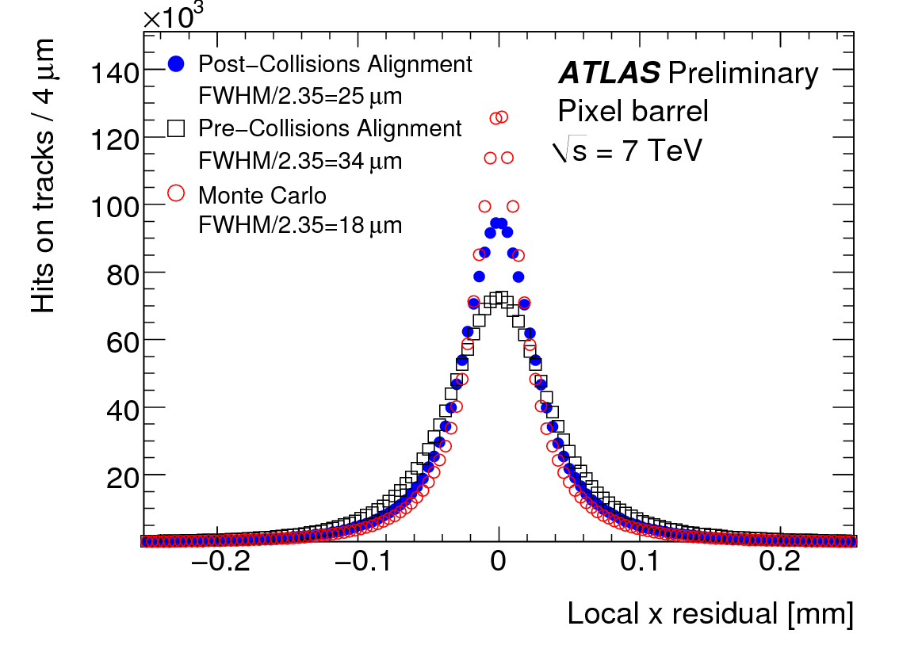
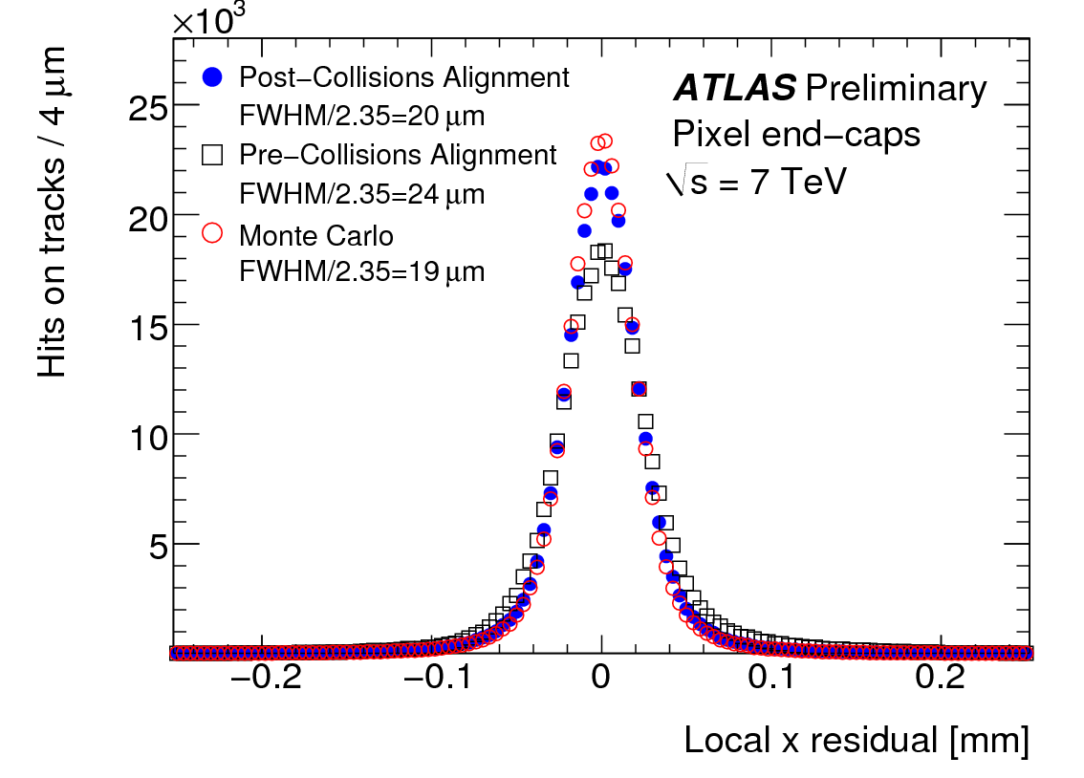
Tracker alignment (Pixel)
ATLAS-CONF-2010-067

Slide 11
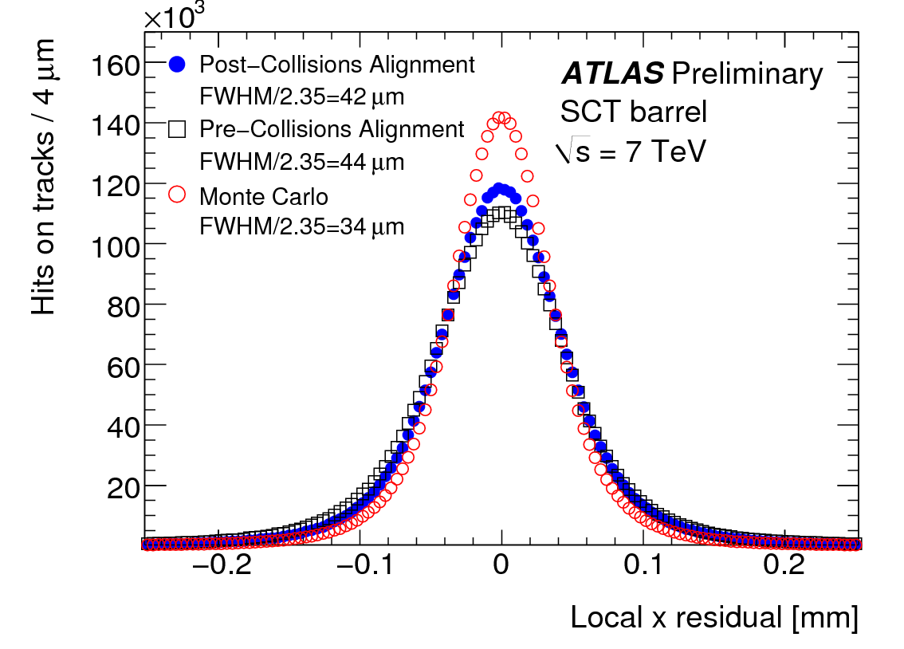
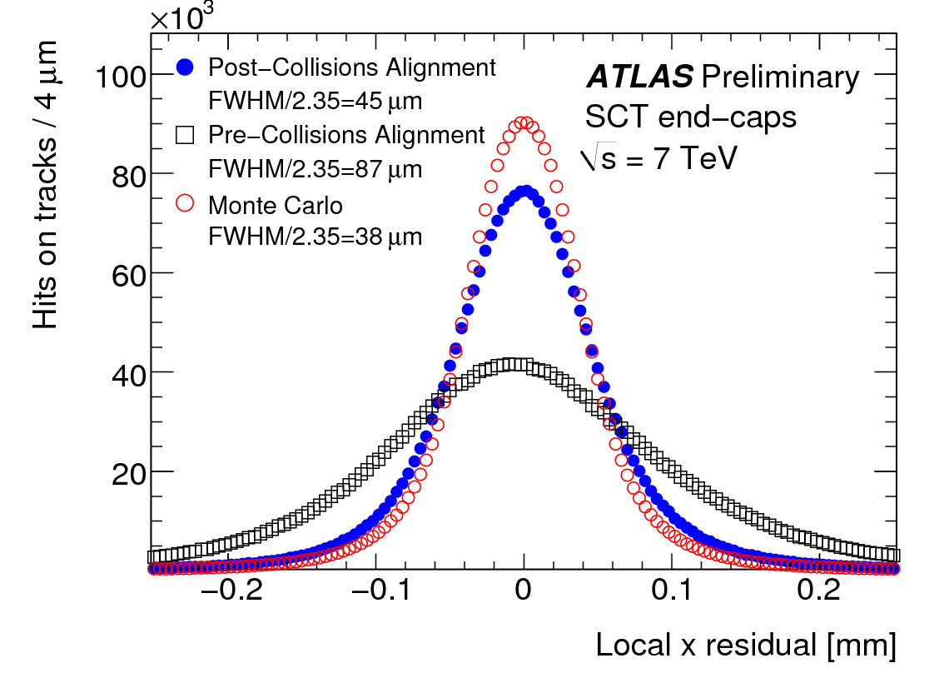
Tracker alignment (SCT)
ATLAS-CONF-2010-067

Slide 12
Tracker alignment (TRT)
ATLAS-CONF-2010-067

Slide 13
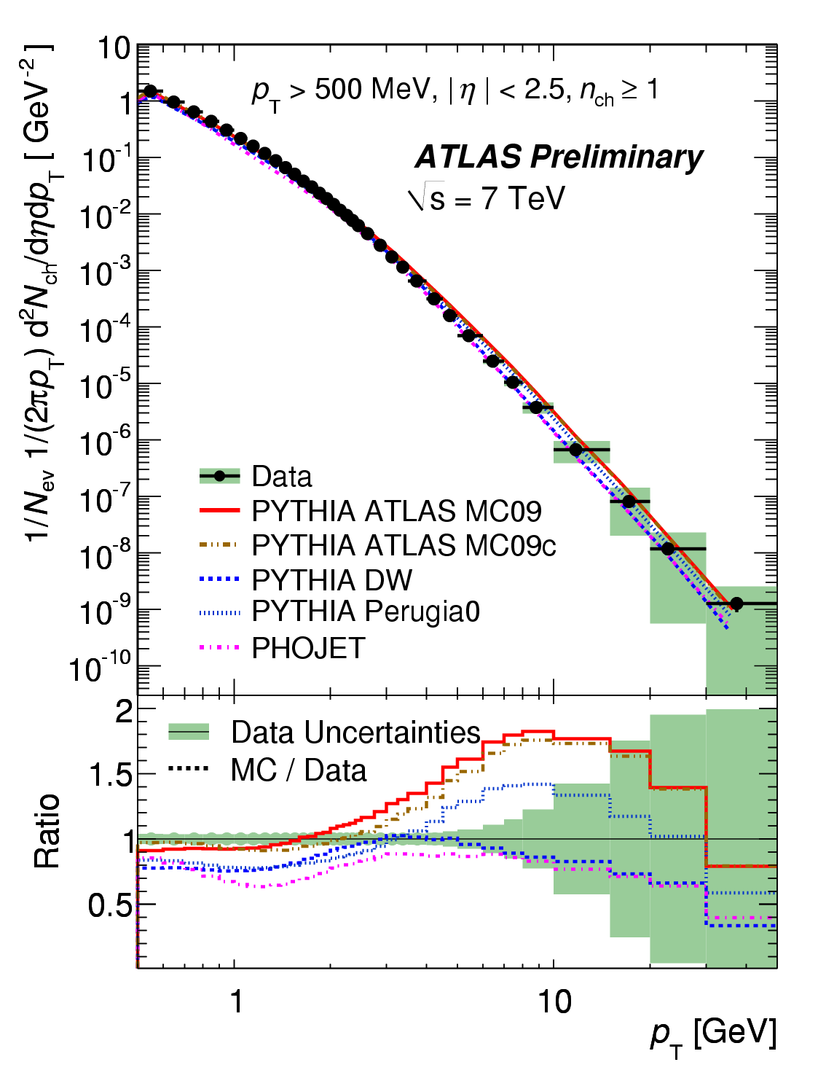
First 7 TeV Results

Slide 14
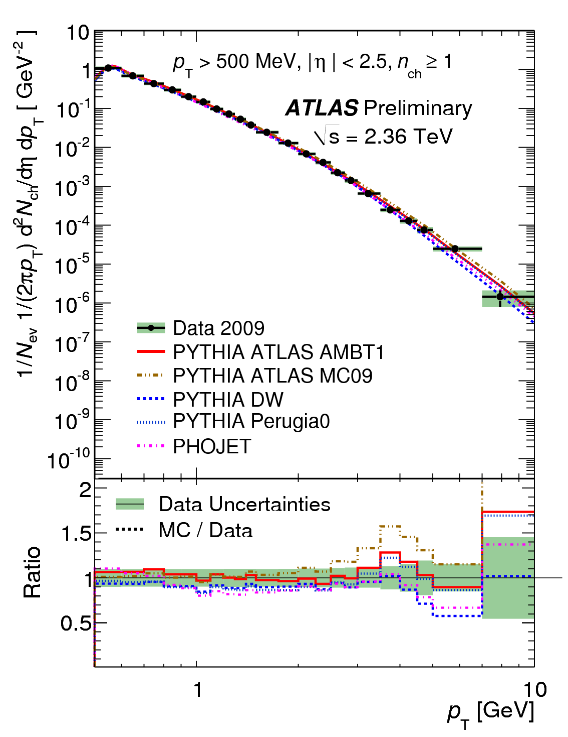
…and also 2.36 TeV
NB Change of default (red) MC
ATLAS-CONF-2010-024, ATLAS-CONF-2010-047

Slide 15
Understanding the environment
Previous results in well-defined but limited phase space
  all events with > 0 stable charged particles with p_{T} > 500 MeV, |η|<2.5.
  Extending this would be good
Sensitive to unknown diffractive component
  Disrupts tuning, and less relevant for underlying event

Slide 16
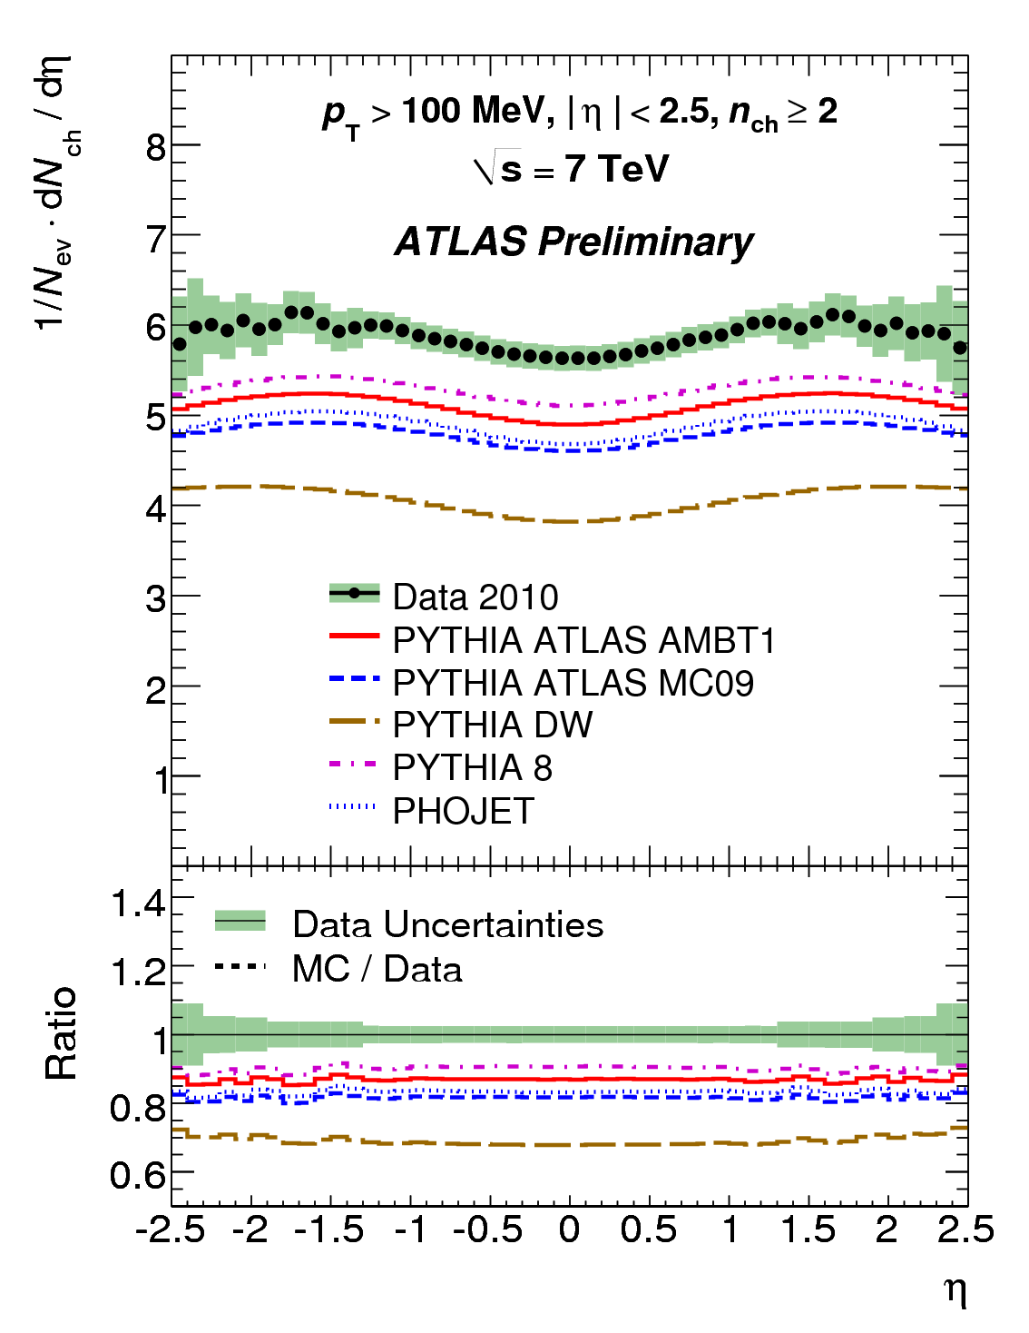
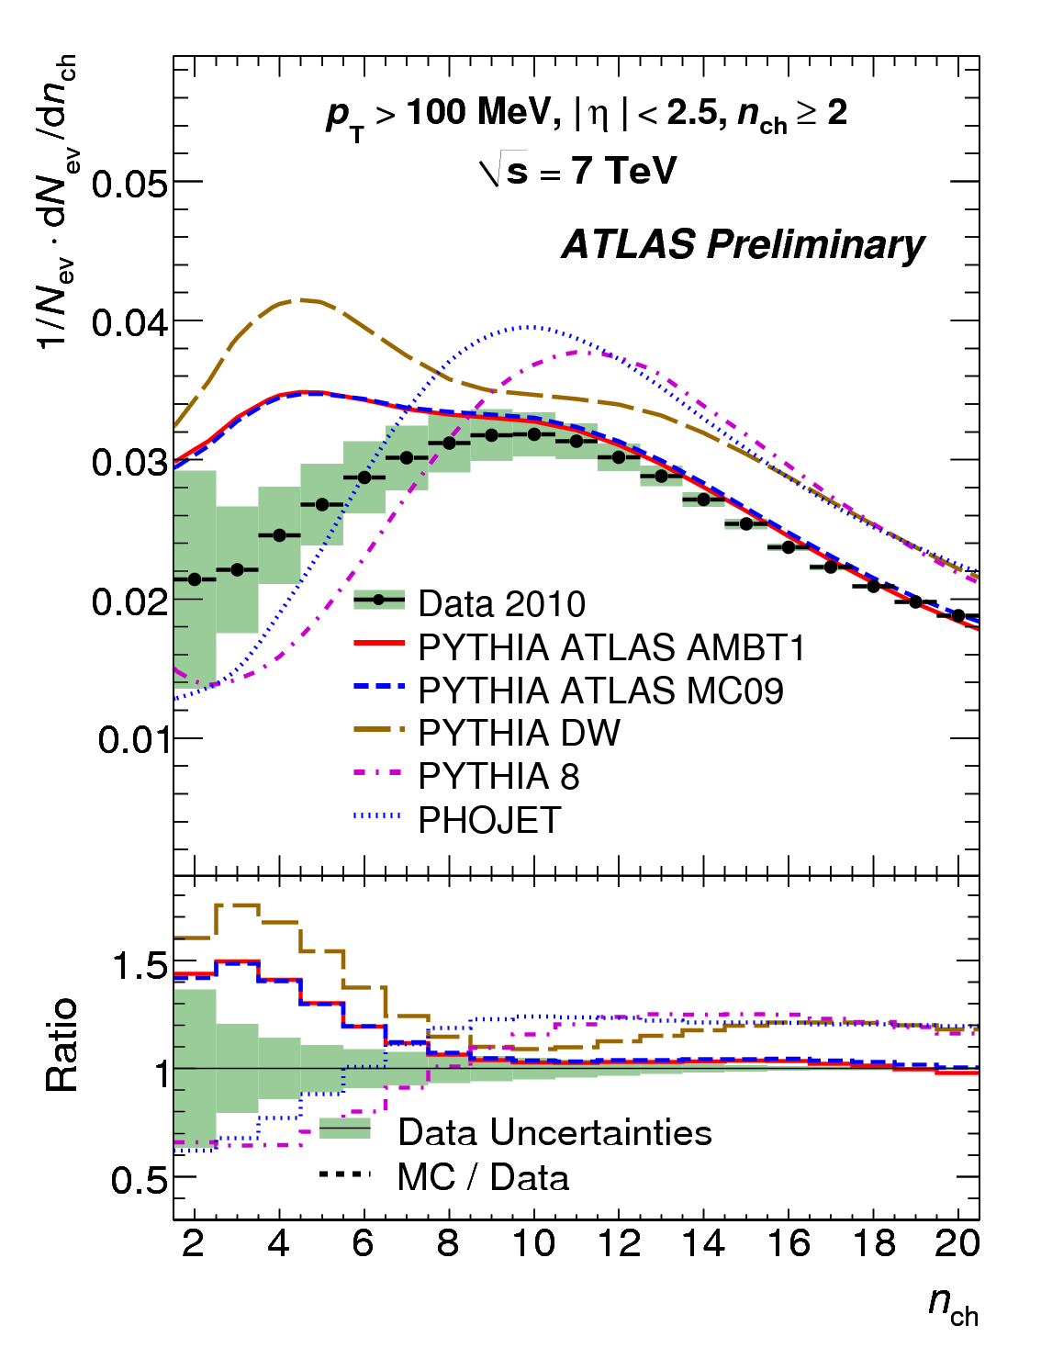
Extend to lower p_{T}
ATLAS-CONF-2010-046

Slide 17
Diffraction and the underlying event
Diffraction contributes strongly to “minimum bias” (and so to pile up) but not much the “underlying event”
Diffraction in pp is poorly understood even at lower energies.
  However, lower multiplicity is general property
Measure “next-to-minimum” bias
  Apply a higher multiplicity cut to reduce diffraction
  Tune to this (AMBT1)

Slide 18
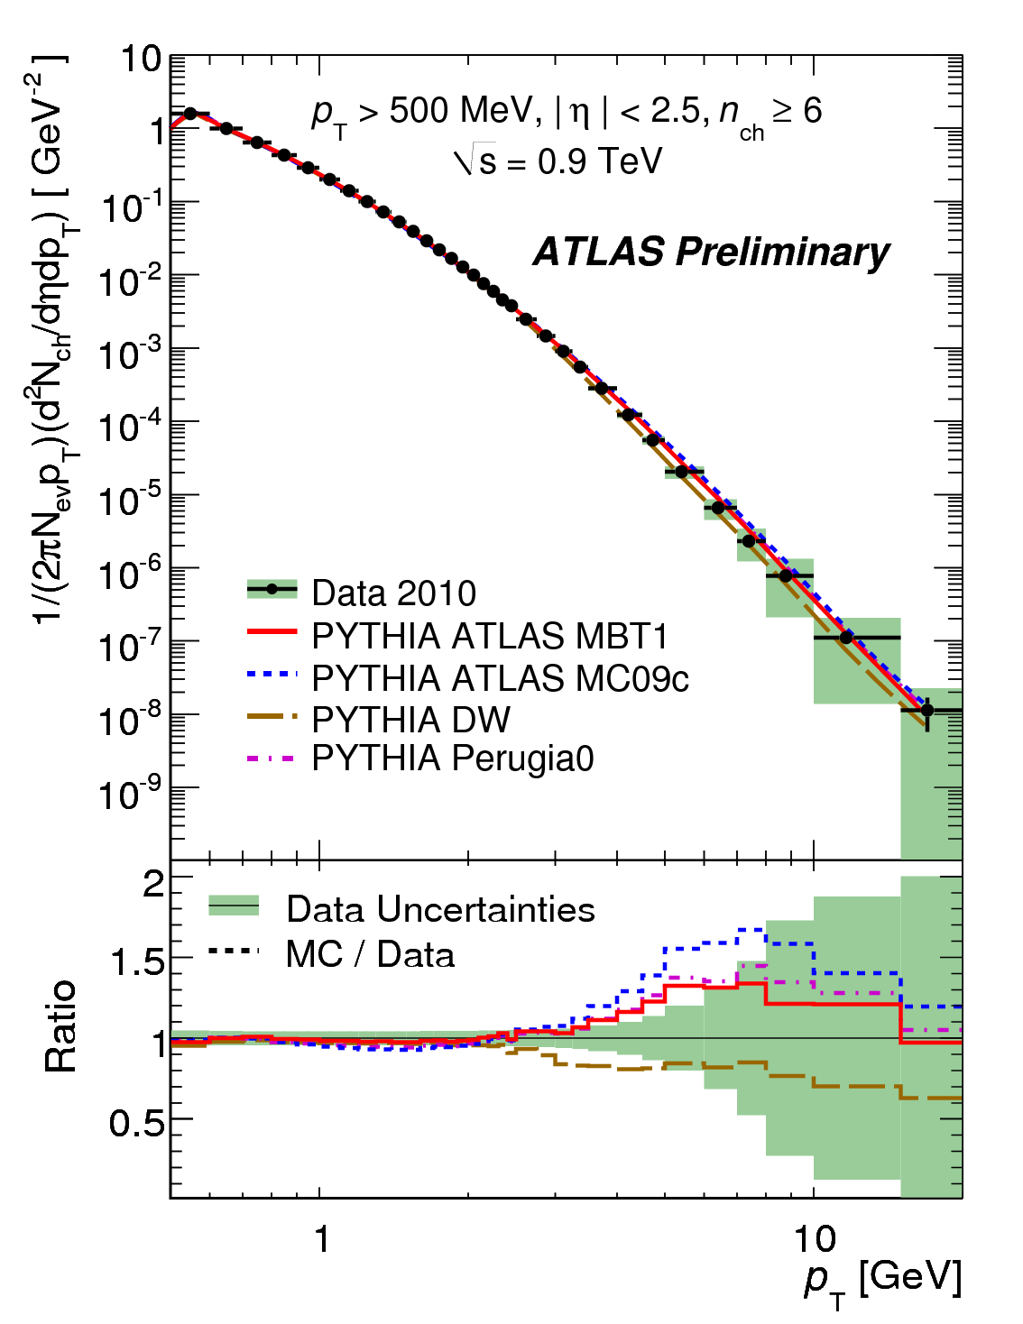
Diffraction and the underlying event
ATLAS-CONF-2010-031

Slide 19
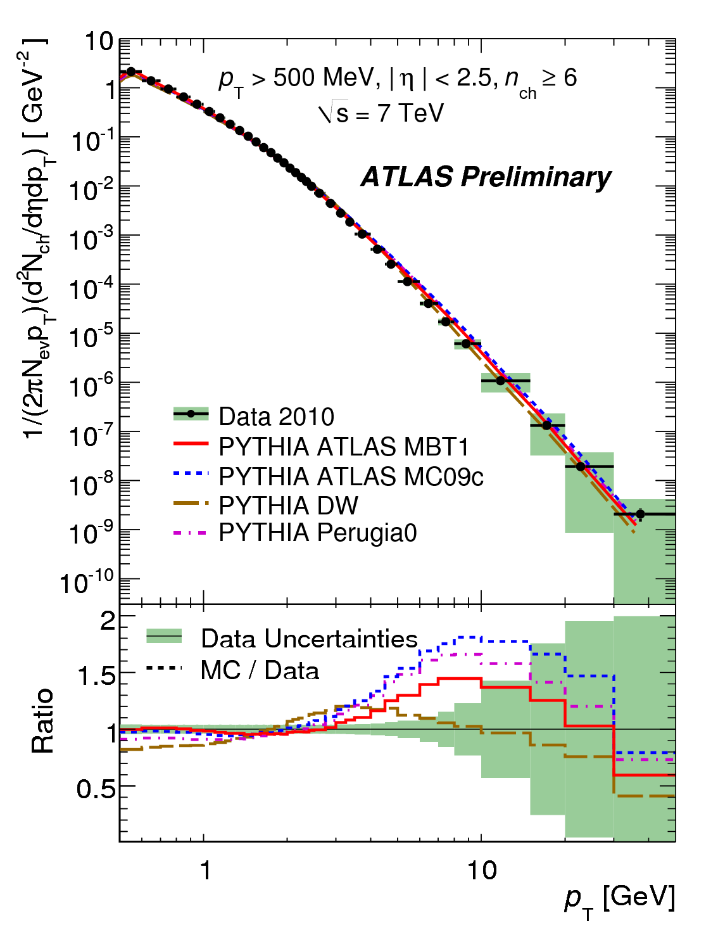
Diffraction and the underlying event
ATLAS-CONF-2010-031

Slide 20
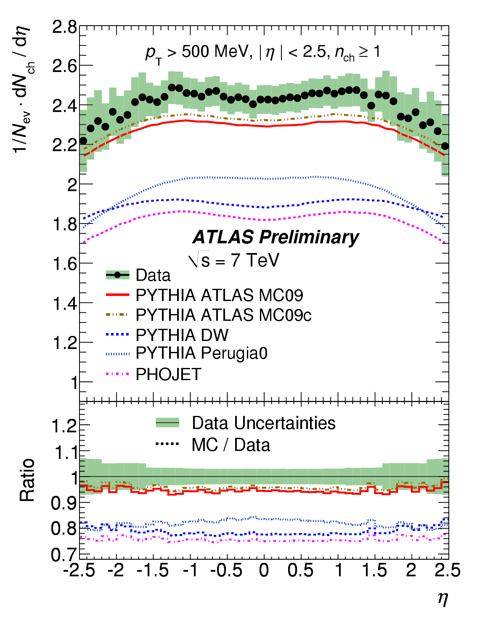
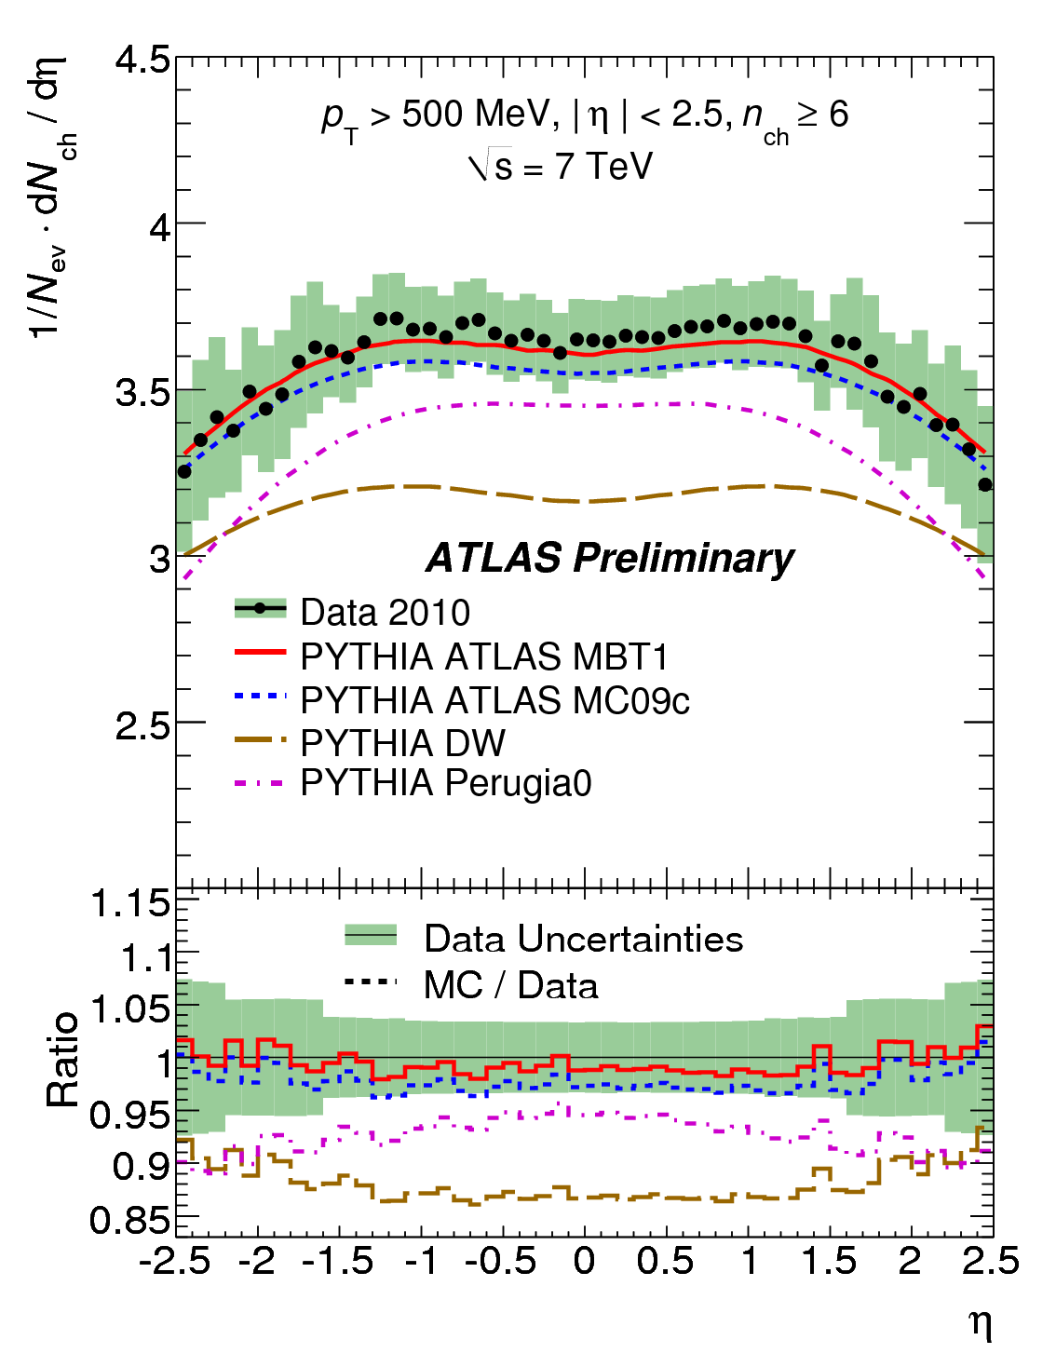
Diffraction and the underlying event
Not only is the new tune an improvement, but the older tunes seem to do better at the “reduced diffractive” sample.

Slide 21
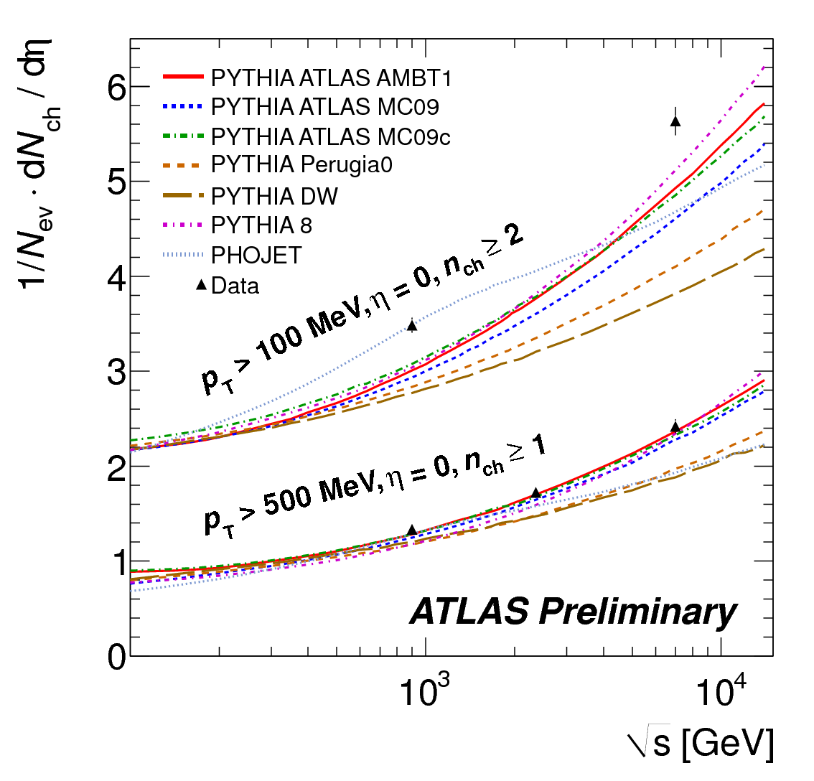
…and also 2.36 TeV
ATLAS-CONF-2010-024, ATLAS-CONF-2010-047

Slide 22
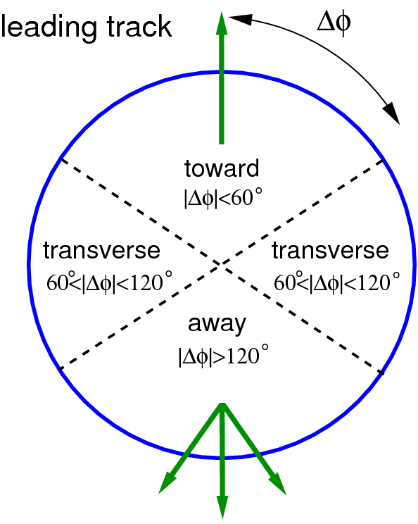
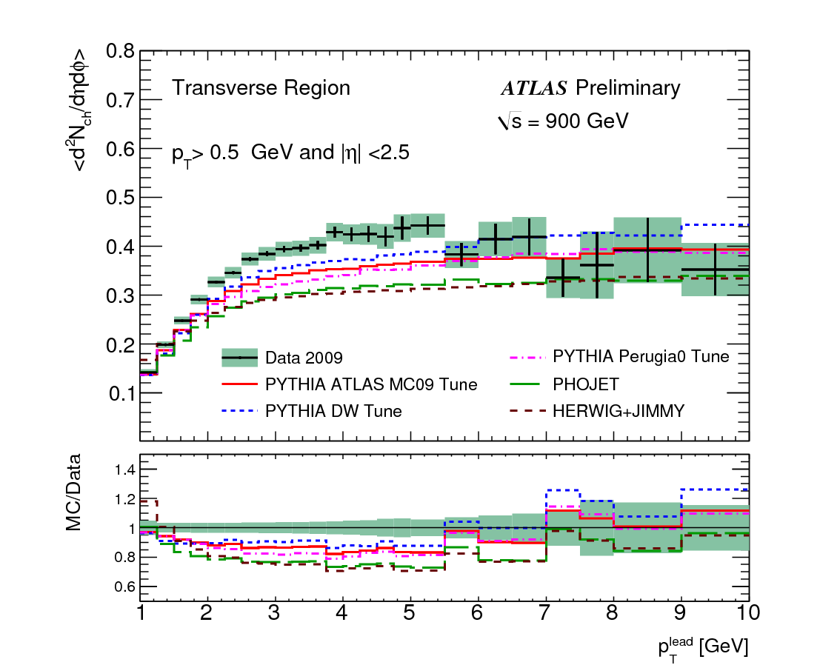
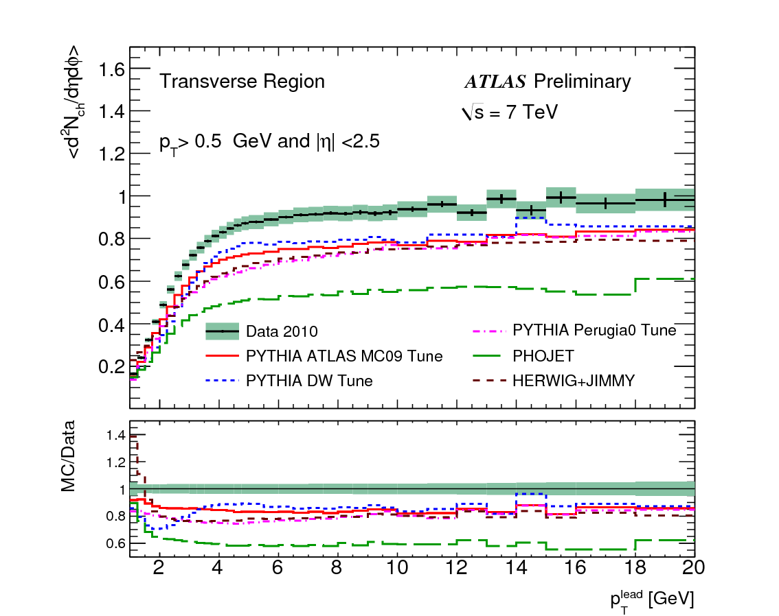
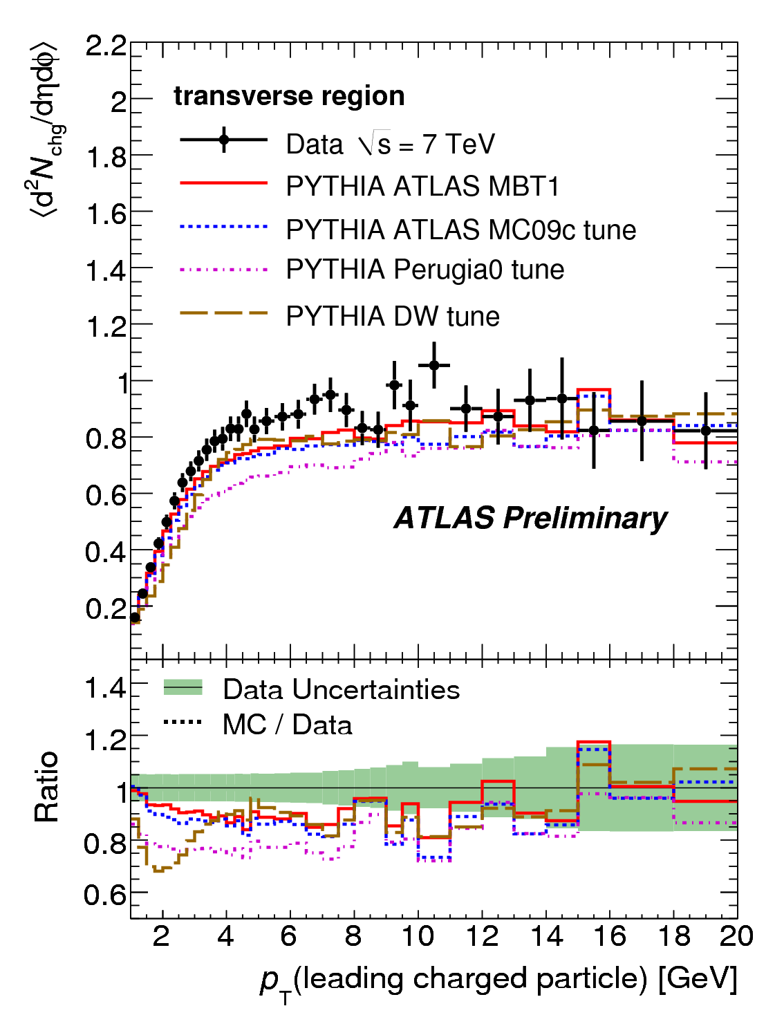
Underlying event
Comparison to underlying event measurement
ATLAS-CONF-2010-081

Slide 23
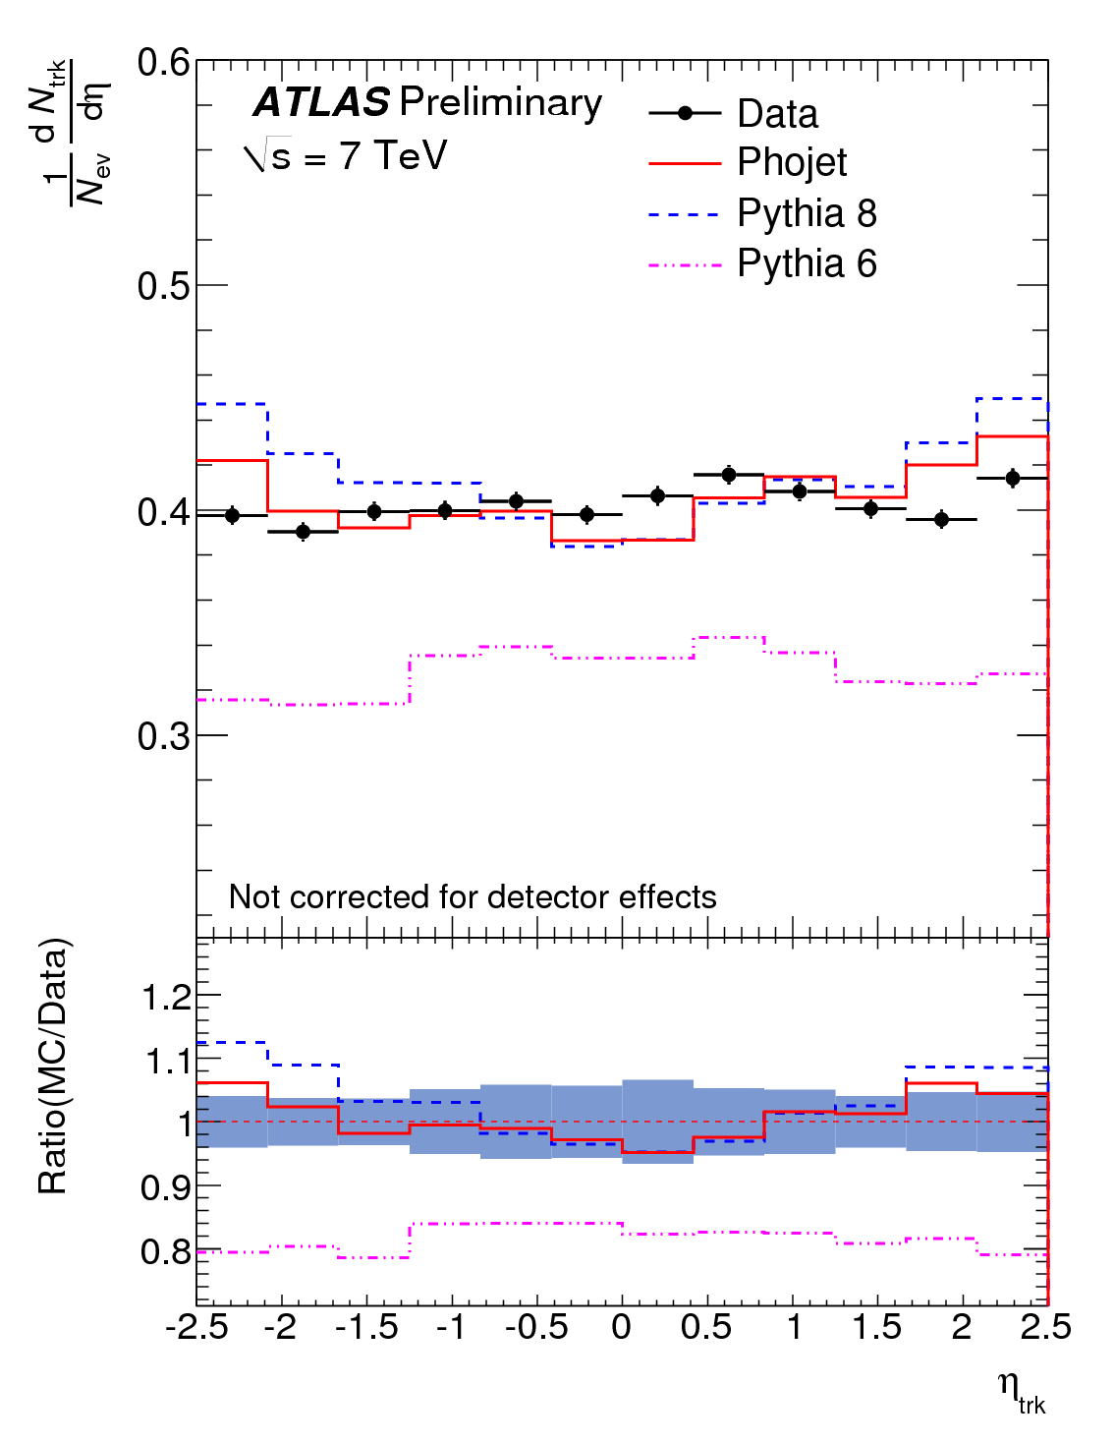
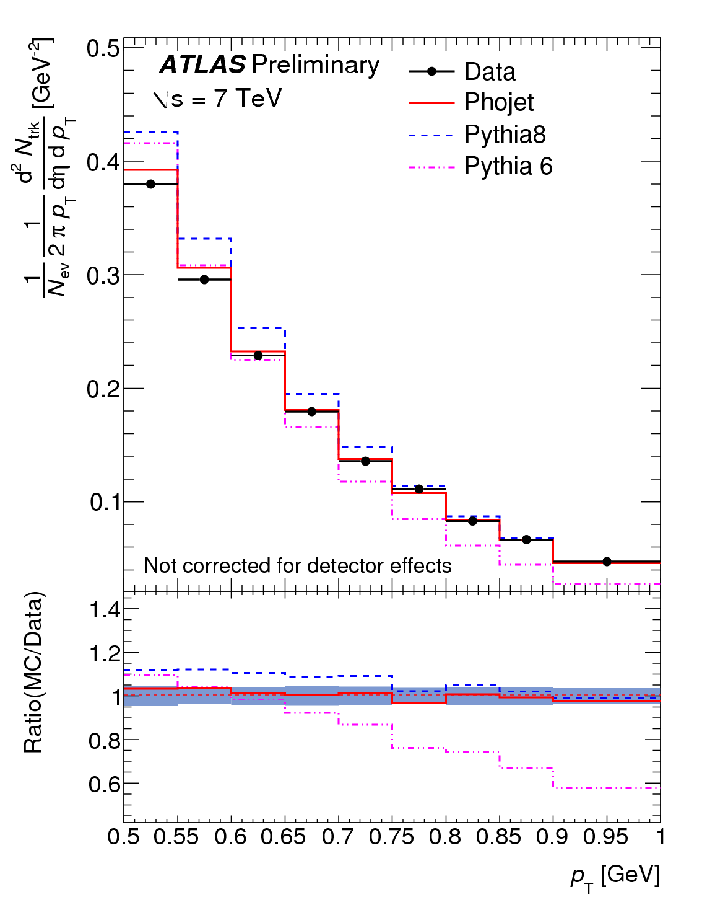
Focus on diffraction
Compare sample with exactly one side hit in the MBTS against those with any/both hit
  Enhances single diffractive in the one-side sample
Proportional of single-sided events in data =
ATLAS-CONF-2010-048

Slide 24
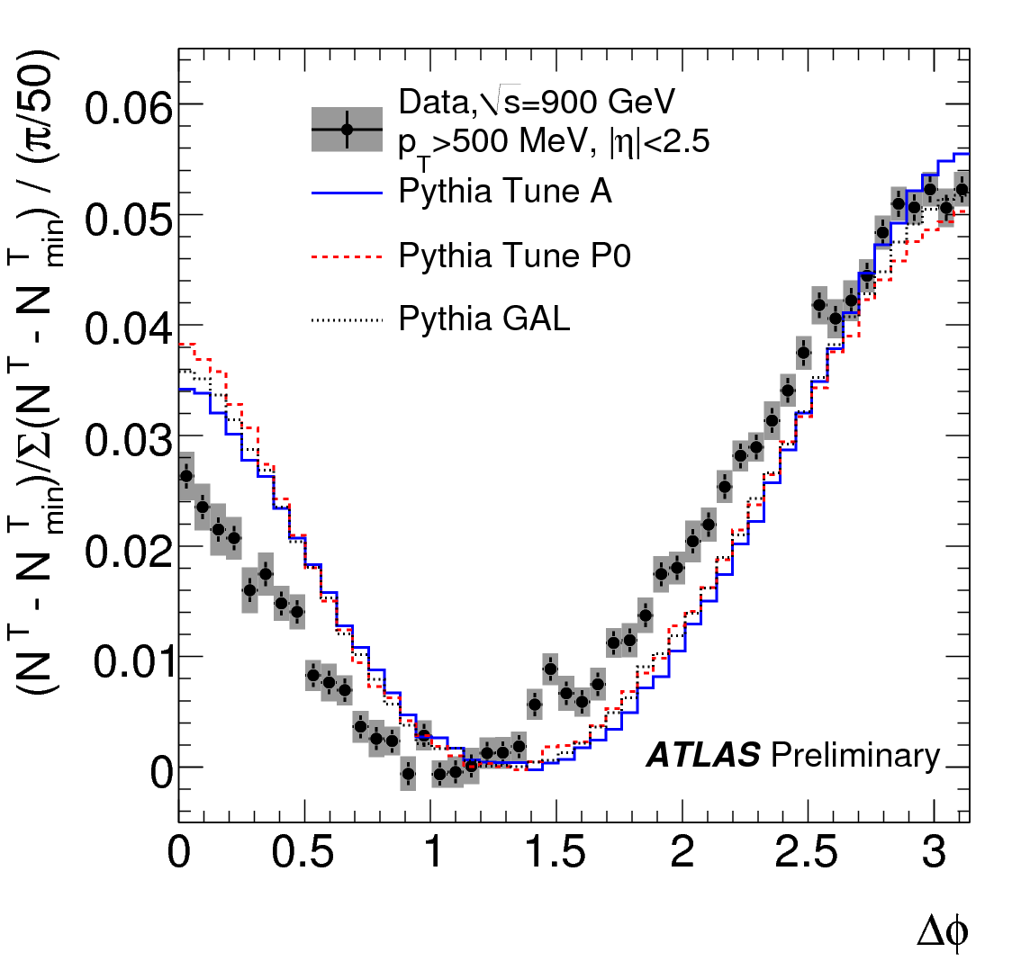
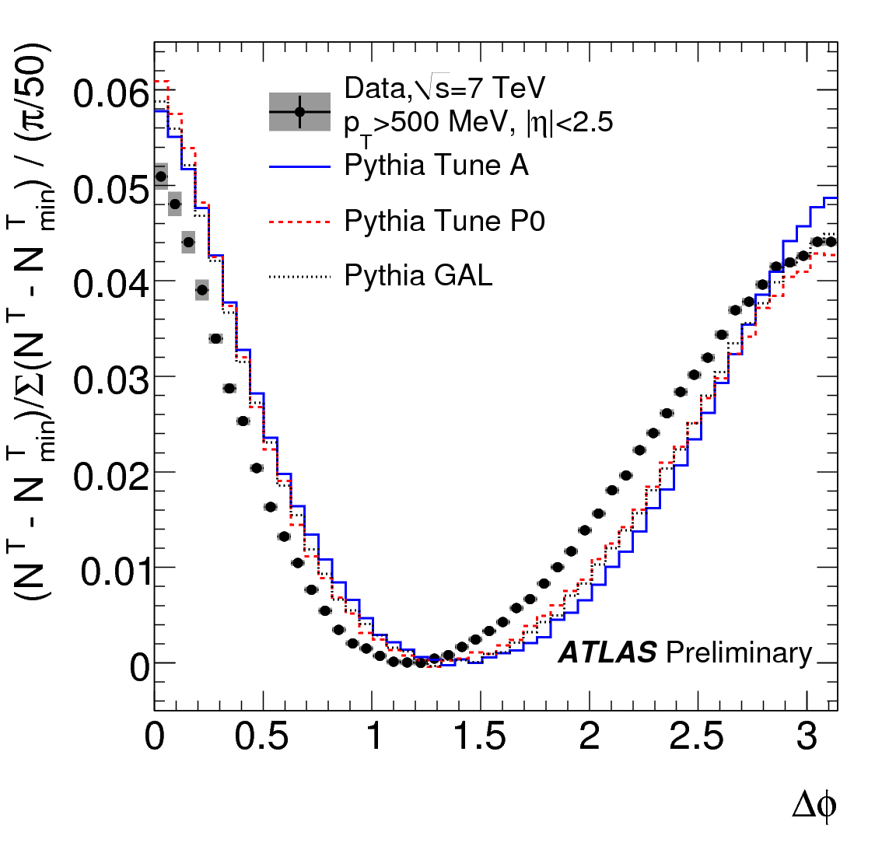
Particle correlations
Plot the φ distribution of all tracks relative to the highest p_{T} track.
ATLAS-CONF-2010-082

Slide 25
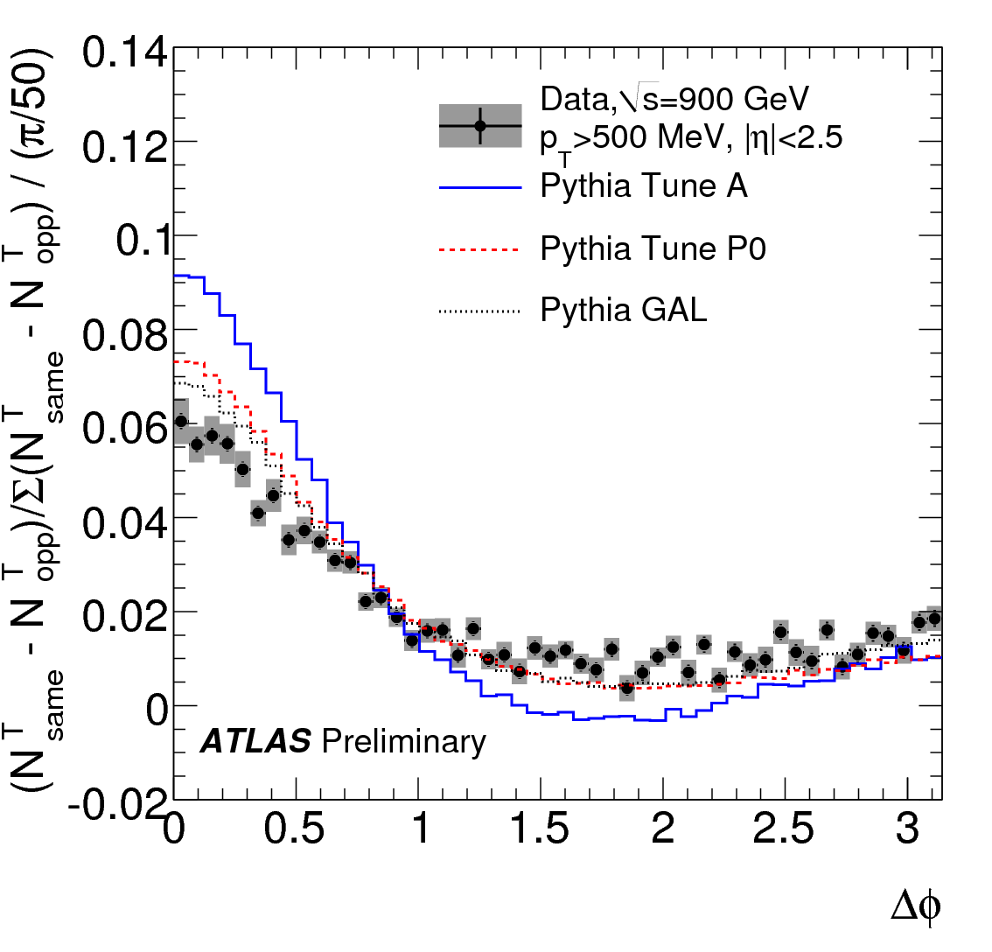
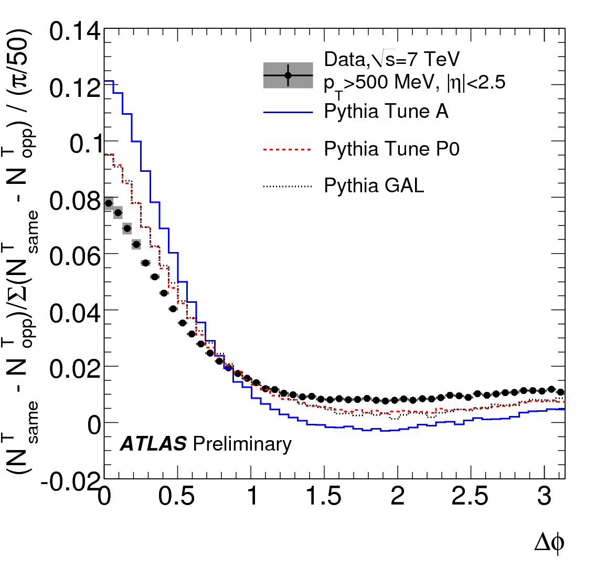
Particle correlations
Plot the φ distribution of tracks relative to the highest p_{T} track separately with same sign and opposite sign η, and substract.
ATLAS-CONF-2010-082
ATLAS-CONF-2010-082

Slide 26
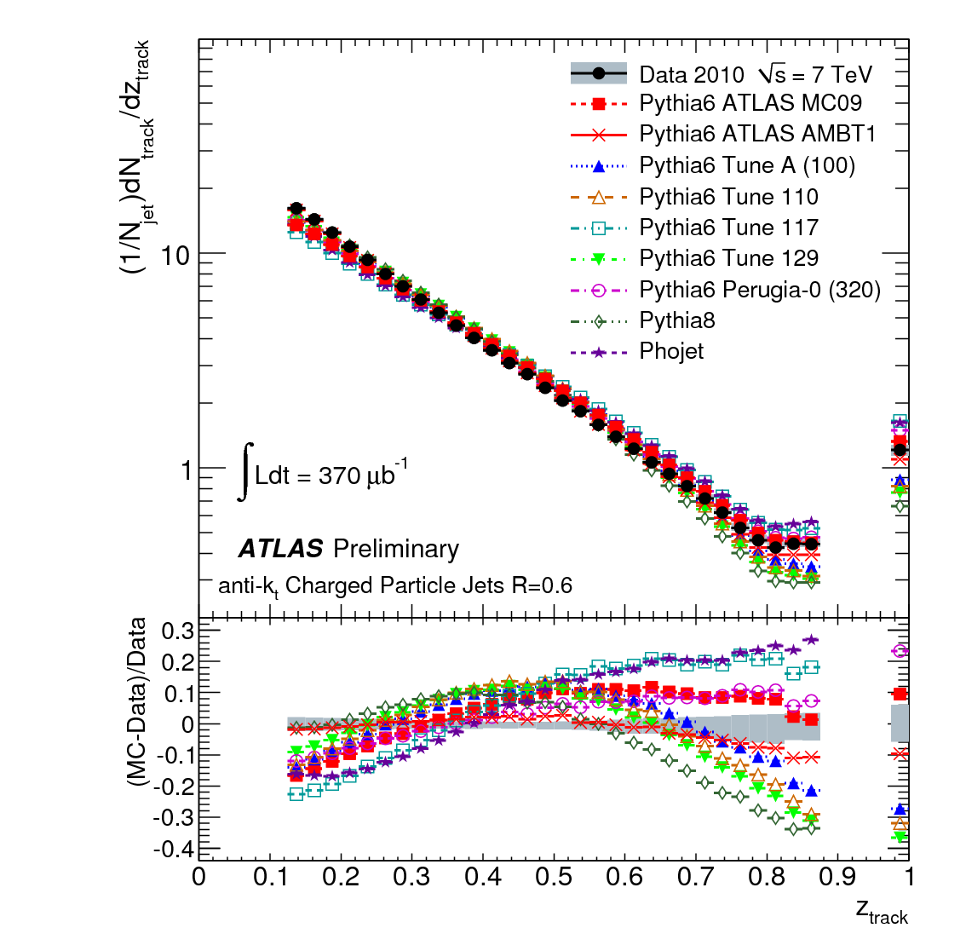
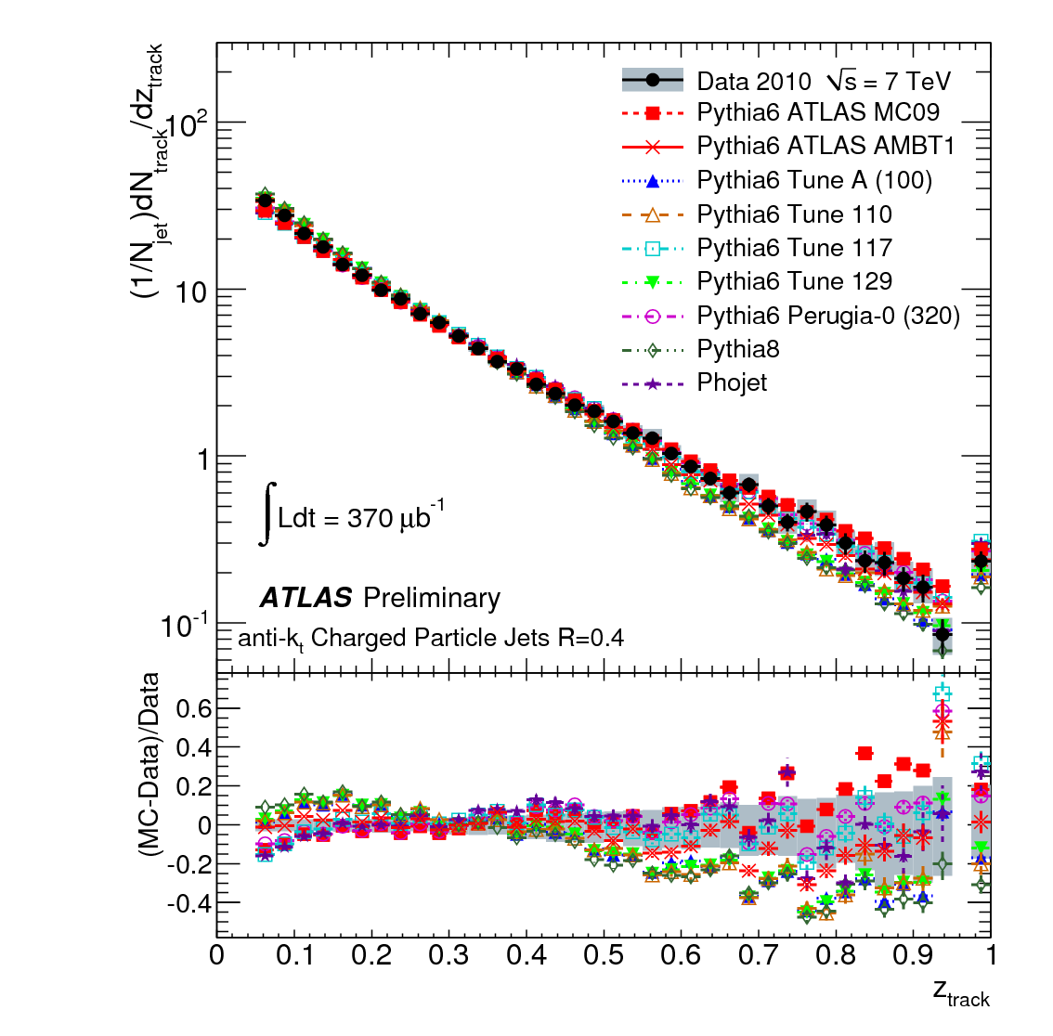
Hard QCD : Jet Shapes
4 GeV < Track jet p_{T} < 6 GeV
15 GeV < Track jet p_{T} < 24 GeV
ATLAS-CONF-2010-049

Slide 27
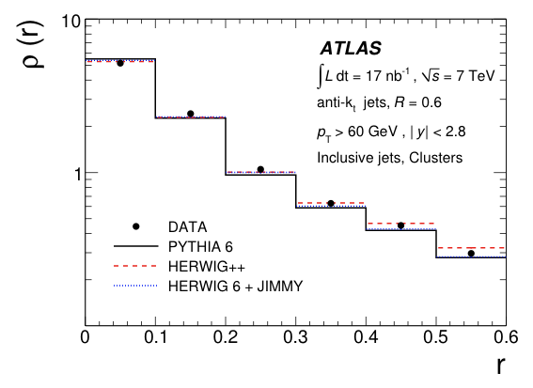
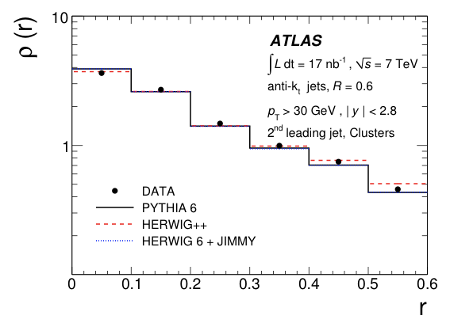
Hard QCD : Jet Shapes
CERN-PH-EP-2010-034
To be submitted to EPJC

Slide 28
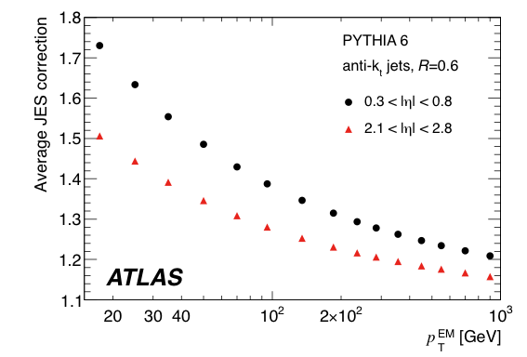
Jet Energy Scale
Current strategy
  Electromagnetic scale from test beam measurements (electrons & muons)
  Correction for
    Difference in hadronic/electromagnetic response
    Losses in material in front of Calorimeter
    Leakage from back of the calorimeter
    Magnetic field
    Cluster and jet algorithmic inefficiency
  are all dealt with by simulation
CERN-PH-EP-2010-034
To be submitted to EPJC

Slide 29
Jet Energy Scale Uncertainty
Dominant systematic in ~all measurements involving jets or missing energy.
Uncertainties from
  Translating test beam EM scale to in situ (3-4%)
  Material knowledge/simulation ~2%
  Noise <3%
  Beamspot position <1%
  “closure test” <2%
  Hadronic (GEANT) shower model ~4%
  Hadronic (generator) show model <4%
  Pile up: variable. (<1% for cross section measurement)
  Intercalibration in y (from in situ dijet balance) <3%
  For dijet measurements, decorrelated error ~3%

Slide 30
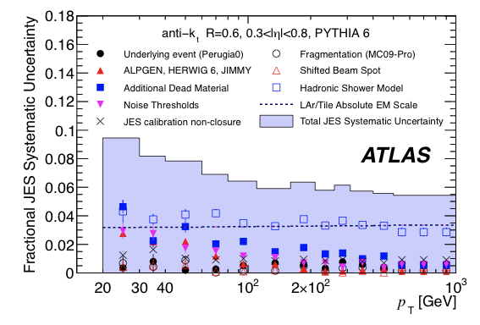
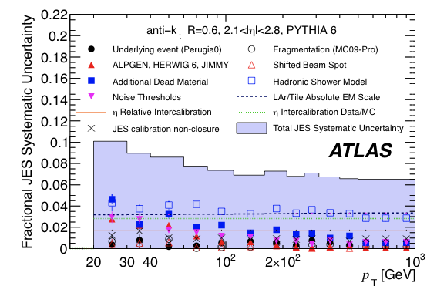
Jet Energy Scale Uncertainty
< 9% everywhere. ~6% for high p_{T}
~40% error on jet cross section
Checked with extensive single-particle studies in collision data and soon by photon-jet balance
CERN-PH-EP-2010-034
To be submitted to EPJC

Slide 31
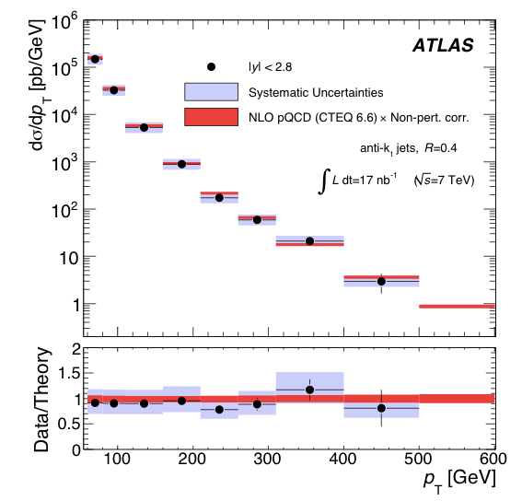
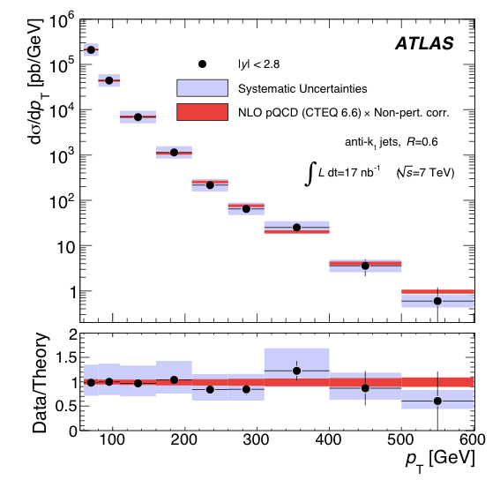
Hard QCD : Jet Cross Sections
CERN-PH-EP-2010-034
To be submitted to EPJC

Slide 32
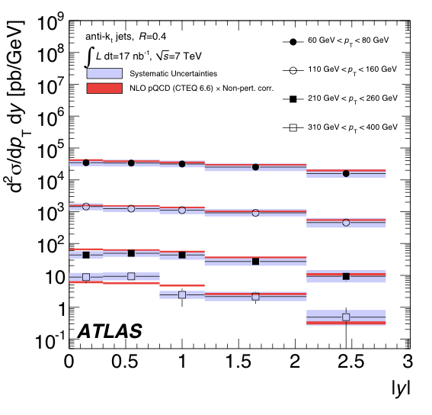
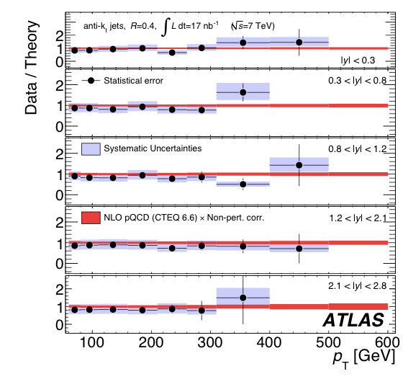
Inclusive Jet cross sections
CERN-PH-EP-2010-034
To be submitted to EPJC

Slide 33
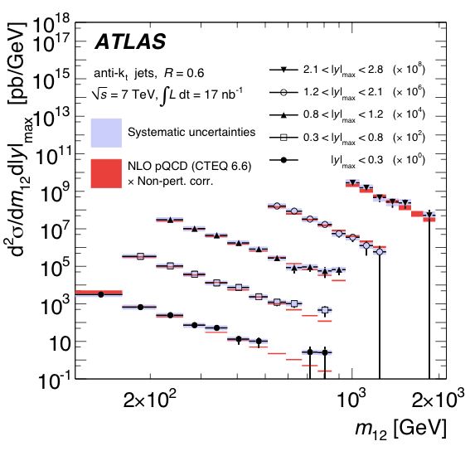
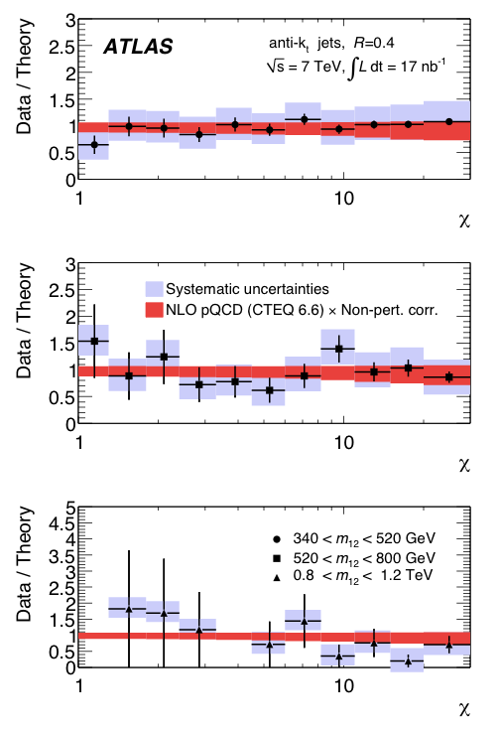
Dijet cross sections
χ = (1+cos θ*)/(1-cos θ*)
CERN-PH-EP-2010-034
To be submitted to EPJC

Slide 34
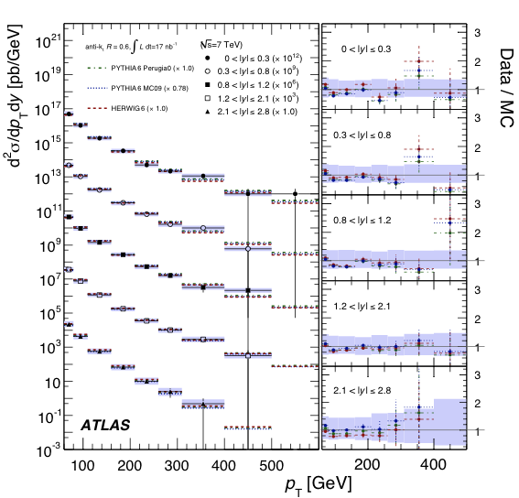
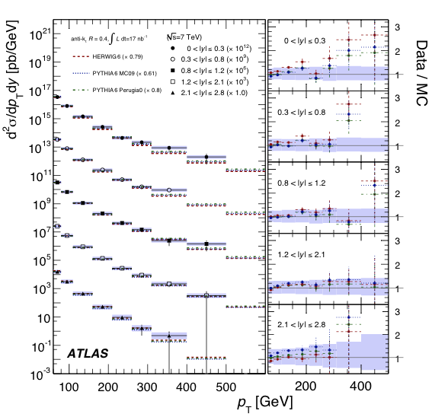
Jet cross sections vs MC
CERN-PH-EP-2010-034
To be submitted to EPJC

Slide 35
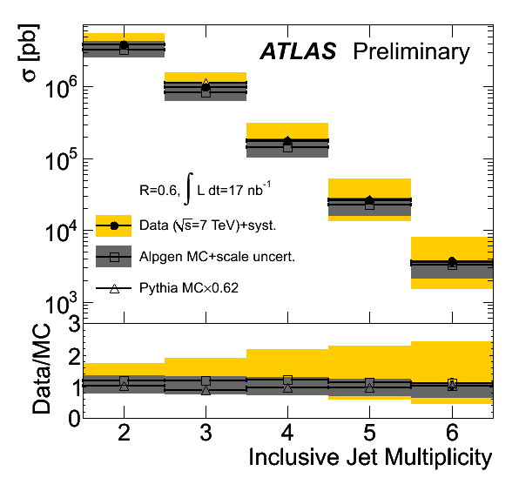
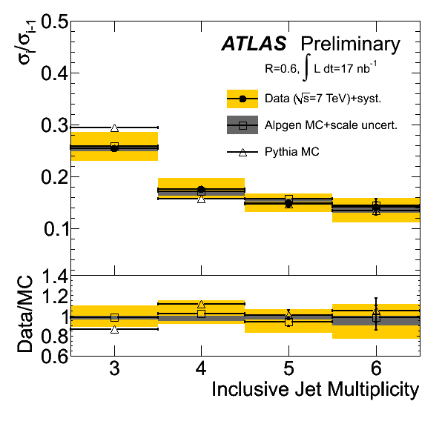
Multijets
p_{T} > 30 GeV |y| < 2.8 Ratio of Njet to (N-1)jet
cross section vs N
ATLAS-CONF-2010-084

Slide 36
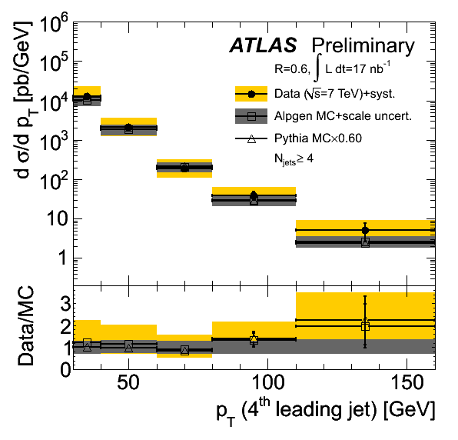
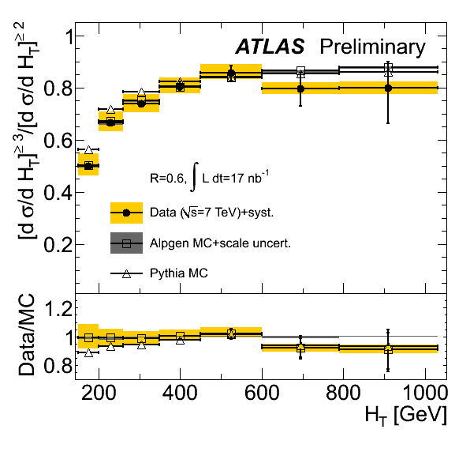
Multijets
p_{T} > 30 GeV |y| < 2.8 H_{T} is the sum of the transverse energy
in the jets
ATLAS-CONF-2010-084

Slide 37
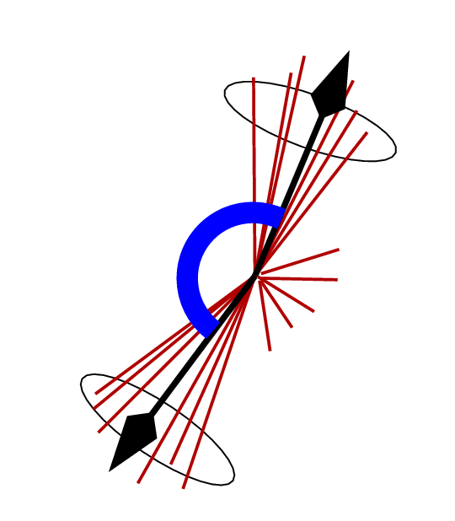


Azimuthal Jet Decorrelations
ATLAS-CONF-2010-084

Slide 38


Azimuthal Jet Decorrelations
ATLAS-CONF-2010-084

Slide 39


Minijet Veto
Select dijet events; jet p_{T} > 30 GeV, average jet pT > 60 GeV. Two selections:
  A:boundary jets are the highest pT jets
  B:boundary jets are the most forward/backward satisfying the above
Veto on any extra jets between the boundary jets with p_{T}>30 GeV
ATLAS-CONF-2010-085

Slide 40



QCD plus: Vector bosons
Cross sections and charged lepton asymmetry (W)
ATLAS-CONF-2010-051

Slide 41


QCD plus: Vector bosons
Cross sections (Z)
ATLAS-CONF-2010-076

Slide 42


QCD plus: Vector bosons

Slide 43


QCD plus: Vector bosons

Slide 44


QCD plus: Top
Jet p_{T} > 20 GeV (anti-k_{t})
At least one b-tagged jet
ATLAS-CONF-2010-087

Slide 45


QCD plus: Searches
Seach for resonances in dijet mass distribution.
  q* mass limit ~ 1.26 TeV
arXiv:1008.2461 (accepted by PRL)

Slide 46
Summary
ATLAS and the LHC are performing very well
Detailed studies of the soft QCD environment, and MC tuning, well underway
Jet cross sections measured, agree with NLO QCD
W & Z cross sections and asymmetries measured
Studies of jet+W,Z well advanced, t+jets underway
New physics searches exploiting the understanding of QCD and of the detectors.

Slide 47


Minijet Veto
Select dijet events; jet p_{T} > 30 GeV, average jet pT > 60 GeV. Two selections:
  A:boundary jets are the highest pT jets
  B:boundary jets are the most forward/backward satisfying the above
Veto on any extra jets between the boundary jets with p_{T}>30 GeV

