Slide 1
Status of Task 17.2
ARIES WP17 2nd Annual Meeting,
14 July 2020 – Video meeting
Alessandro Bertarelli (CERN)

Slide 2
Task 17.2: Overview
Materials development and characterization
  Research, investigation, development and characterization of novel CMC and MMC based on graphitic, carbide or diamond reinforcements and dopants (in collaboration with Task 14.4).
  Study and development of electrically conductive coatings, resisting the impact of high intensity particle beams.
  Characterization of thermophysical and outgassing properties, microstructural analyses, study of phases and of their change under various environments …
  Participants: CERN, GSI, NIMP, POLIMI, POLITO, UM (plus Brevetti Bizz, RHP-Technology through WP14)

Slide 3
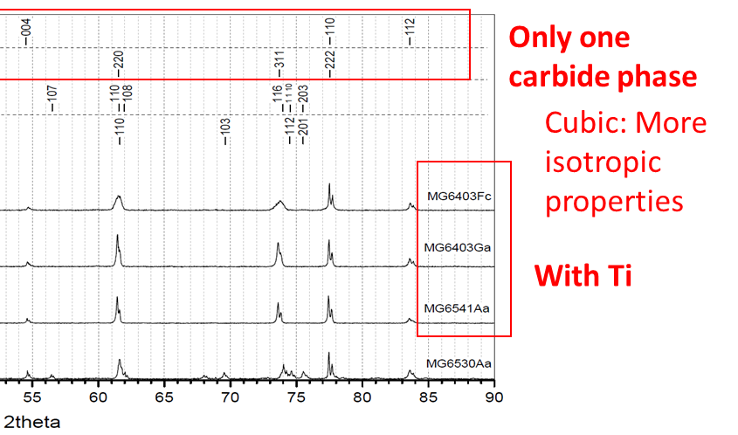
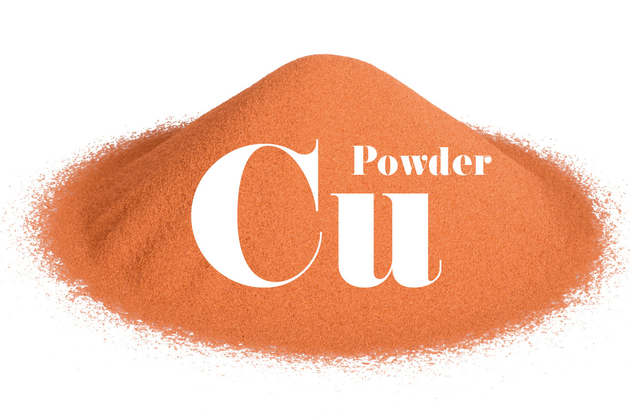
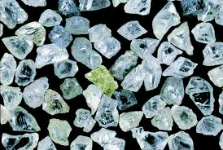
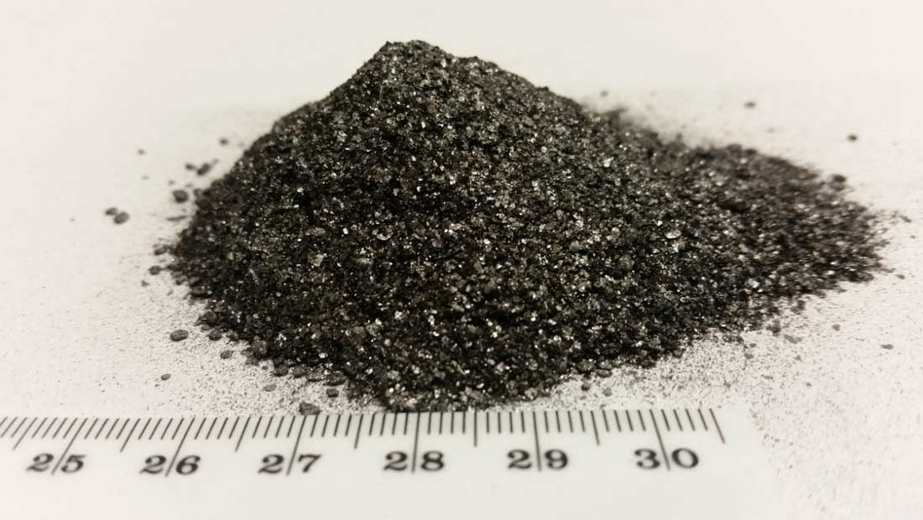
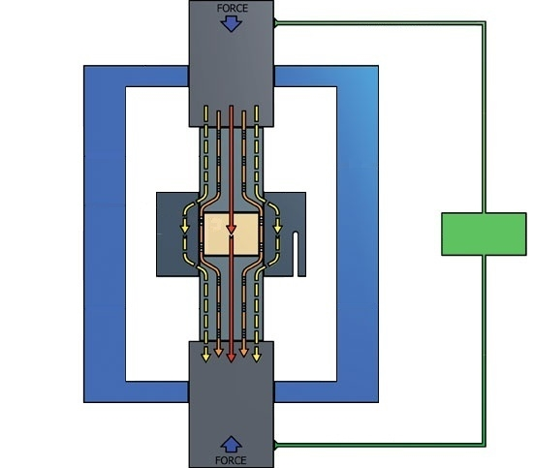
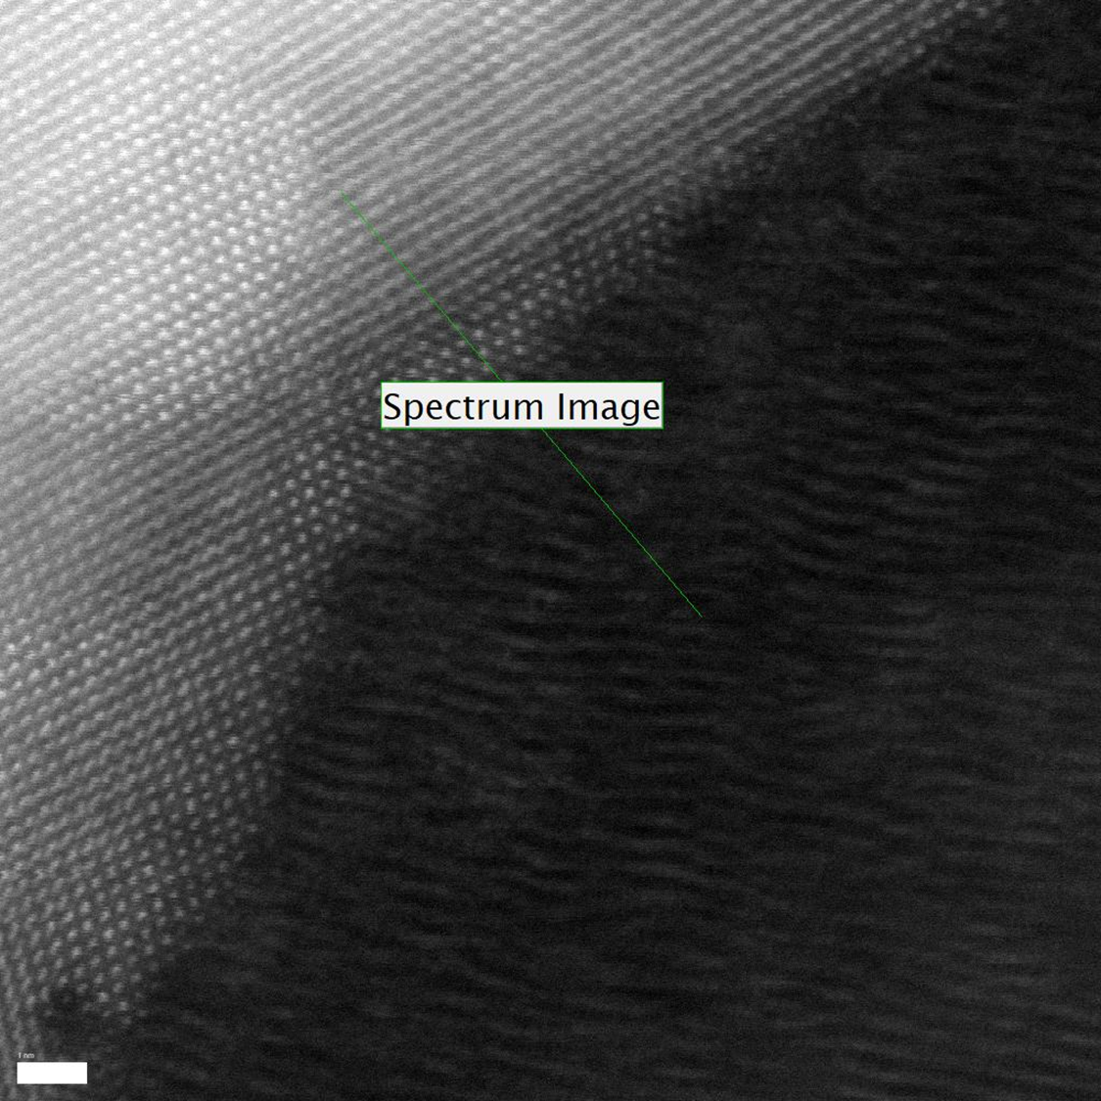
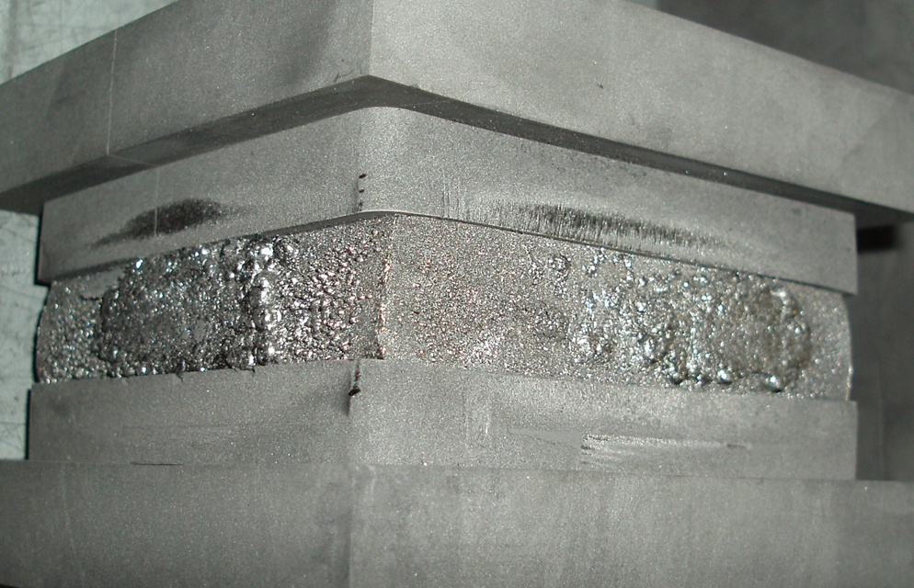
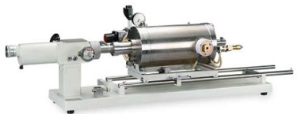
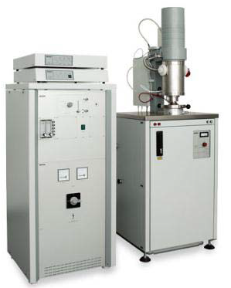
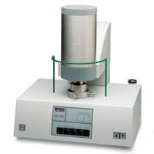
Task 17.2: Overview
Choice of components (materials, topology, dopants …)
High-temperature manufacturing (SPS, RHP …)
Thermophysical characterization (DIL, LFA, DSC …)
Microstructural characterization (SEM, FIB, XRD, EDS, TEM …)
Data analysis, investigation, new proposal …
Pressure
Graphite Die
Powders
DC Current
(continuous or pulsed)
Graphite Punch
Vacuum Chamber
Pressure
Task 14.4
in collaboration with University of Zaragoza (SP)

Slide 4

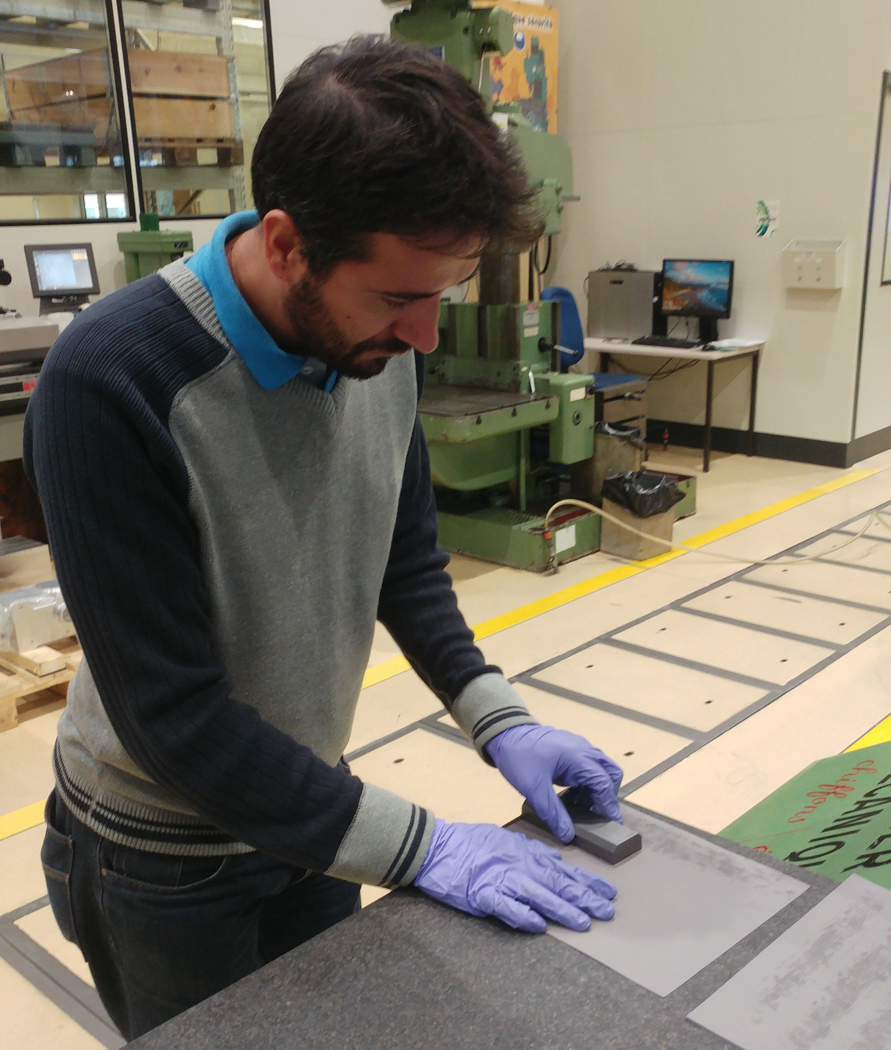
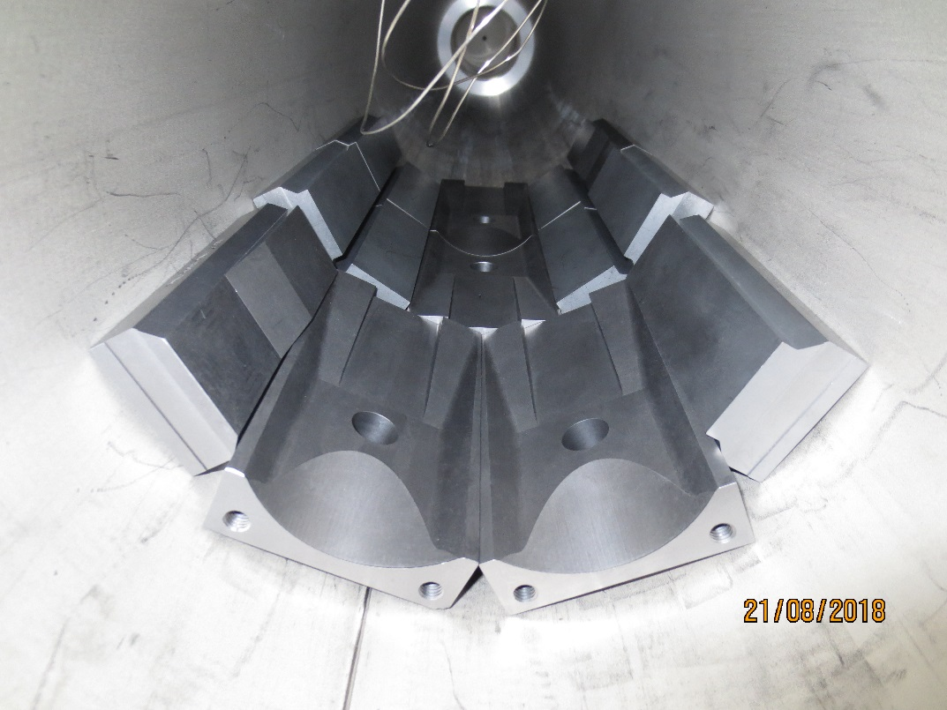
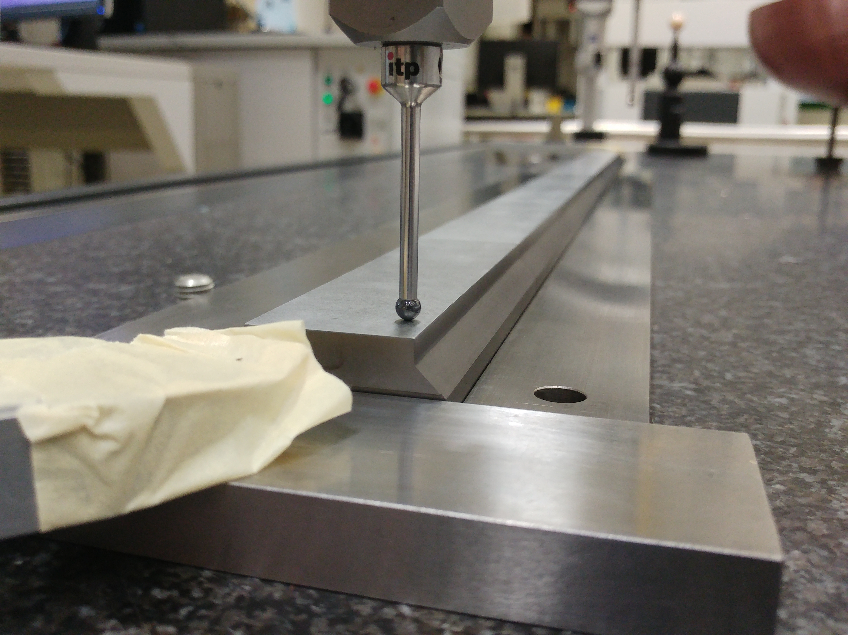
Task 17.2 – Material Development
Molybdenum Carbide – Graphite (MoGr) from R&D to industrialization …
After extensive R&D (CERN, Brevetti Bizz), MoGr was successfully industrialized
Large contract for the production of MoGr blocks for 5 primary and 10 secondary HL-LHC collimators. Total of 380 blocks
Main challenges highlighted by the industrial phase: tight tolerances (require a multi-stage machining process) and UHV (high-precision control of the cycle parameters)
Material production completed in April 2020, first collimators already installed in the machine!
Blocks for secondary collimators coated with molybdenum layer to further increase electrical conductivity
Thanks ARIES, EuCARD2, EuCARD!!

Slide 5
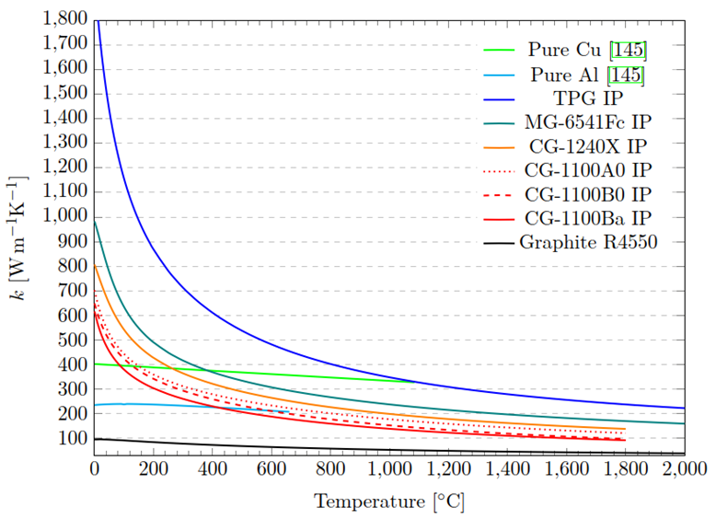
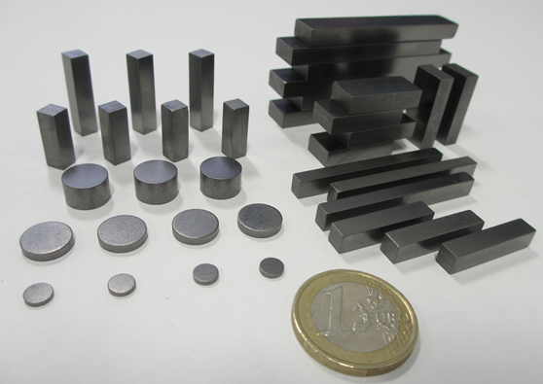
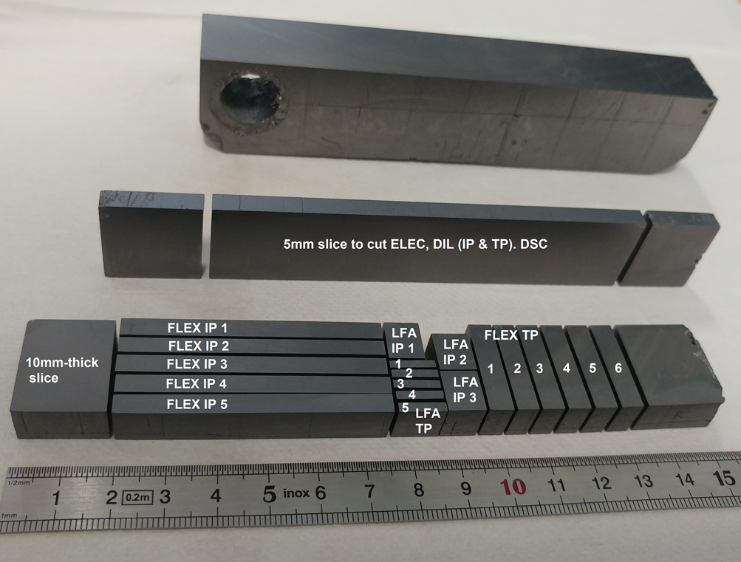
Task 17.2 – Material Development
Novel Chromium – Graphite (CrGr) composite under development as lower cost alternative to MoGr
4 different CrGr grades, produced by
Brevetti Bizz, investigated
Thermo-physical analyses performed
Microstructural characterization
XRD in-situ up to 600 °C: phase
stability and CTE
Record high thermal conductivity
measured in grade CG-1240X:
739 Wm⁻¹K⁻¹ at 20°C. Almost as
high as best MoGr grade.
Plot reference: Optimisation Of
Graphite-matrix Composites
For Collimators In The
LHC Upgrade, PhD Thesis, J.Guardia, 2019
[1]
[1]
CG-1240X (TP)

Slide 6
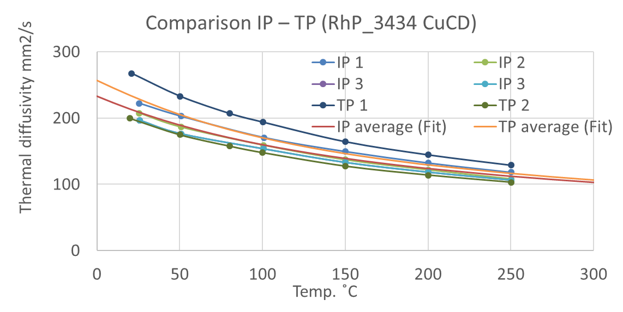
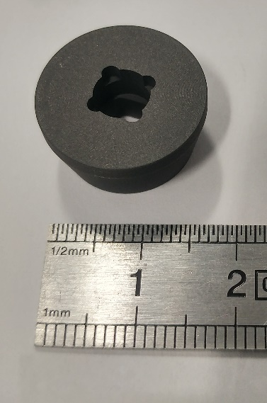
WP14.4 contributions to WP17 – recent highlights
Copper – diamond (CuCD) anisotropy test
  3 new samples measured with tailor-made sample holder (non-standard dimensions). Samples with in-plane (IP) orientation, opposite to usual through-plane (TP) samples.
  No relevant differences observed between IP and TP directions. The material can be considered isotropic despite being produced under uniaxial pressing load.
Custom-made graphite sample holder for square samples with 5 mm-long sides

Slide 7
Task 17.2: What’s next (excerpts) …
  Prepare MS61 (Compendium of Materials Developed), due in August 2020!!!!
  Complete optimization of carbide – graphite materials (MoGr and CrGr) and their characterization (thermophysical, UHV, radiation resistance, microstructure …)
  Integrate results from experimental tests at POLITO, GSI and ELI-NP
  Prepare for final report …

Slide 8

Thank you and enjoy the (short) session!

