Slide 1
Status of task 17.3 and publications on Shocks and Vibrations
2nd Annual Meeting of Aries WP17
Lorenzo Peroni (POLITO)

Slide 2
Task 3 description
Task 3: Dynamic testing and online monitoring
  Testing of material samples in a broad range of environments:
  Mechanical testing in quasi-static and dynamic conditions, at various temperatures
  Tests under very high power laser and particle beams
  Irradiation tests with online monitoring of properties evolution
  Hydrodynamic simulations of experiments - constitutive models, spall strengths for new materials
  Participants: CERN, ELI-NP, GSI, POLIMI, POLITO

Slide 3
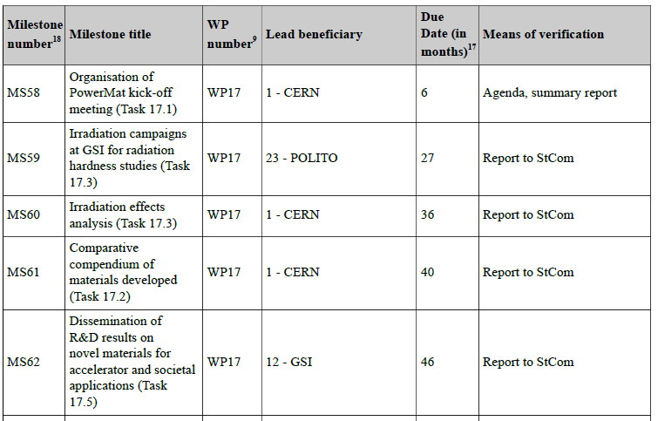
Milestones
✓
✓

Slide 4
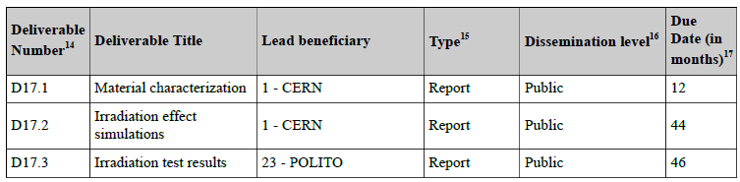
Deliverables

Slide 5
Task 17.3 – Material Testing: Irradiation at GSI UNILAC
Assessment of radiation damage to graphitic materials induced by 4.8 MeV/u Ca ions: electrical resistivity and coating microscopy analysis
Irradiation test (TNA) in March/April 2019 on coated and bare samples at DPA levels comparable to end-of-life HL-LHC. Examination started already ~2 months later thanks to low residual dose
Electrical Resistivity
  DC measurements with the 4-probe
  method and multi-layer model
  Bulk resistivity increasing faster in more ordered
  materials; MoGr with fibres more radiation resistant
  Coatings resistivity worsening significantly less in pulsed-
  mode (HIPIMS) compared to DC-mode (DCSM)
FIB-SEM investigation of Mo coating/bulk interface
  Columnar and dense structure kept after irradiation
  The coating-bulk interface is continuous, no evidence
  of coating detachment;
  no cracks
Pristine
Irradiated at max DPA

Slide 6

Task 17.3 – Material Testing: Irradiation at GSI UNILAC
Assessment of hardening of graphitic materials (3 Graphites grades, 2 suppliers) induced by 4.8 MeV/u Au ions (early 2020) by quasi-static and dynamic techniques
Microindentation
  Young‘s modulus rises up to 300 %
Dynamic hardness test
  indenter accelerated towards sample
  surface with a constant force
  strain rates at the surface ~ 10⁴ s⁻¹
  observation of velocity and penetration on
  the surface; differences between grades detected
  calculation of dynamic hardness $H_{dyn}=\frac{ (E_{kin,in}−E_{kin,out})}{Indent volume}$

Slide 7
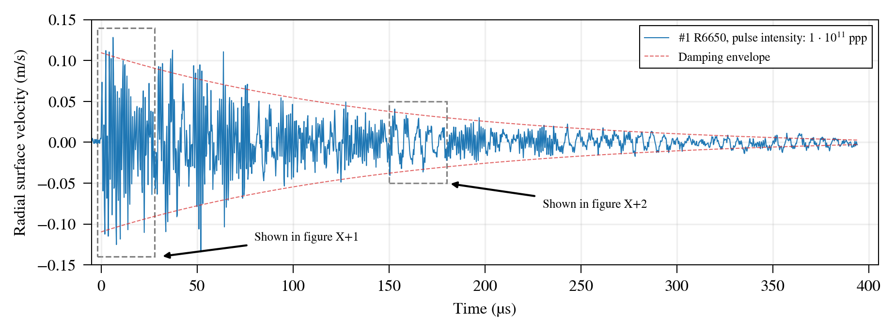
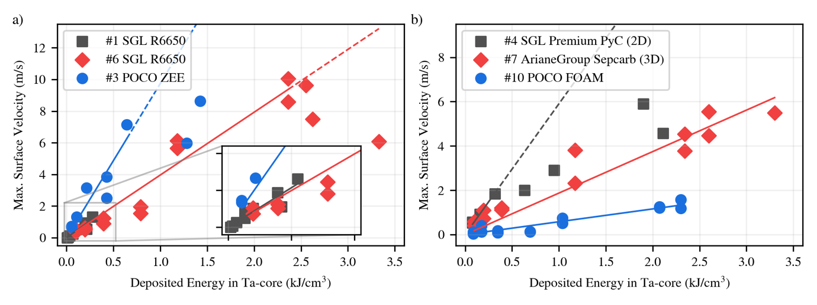
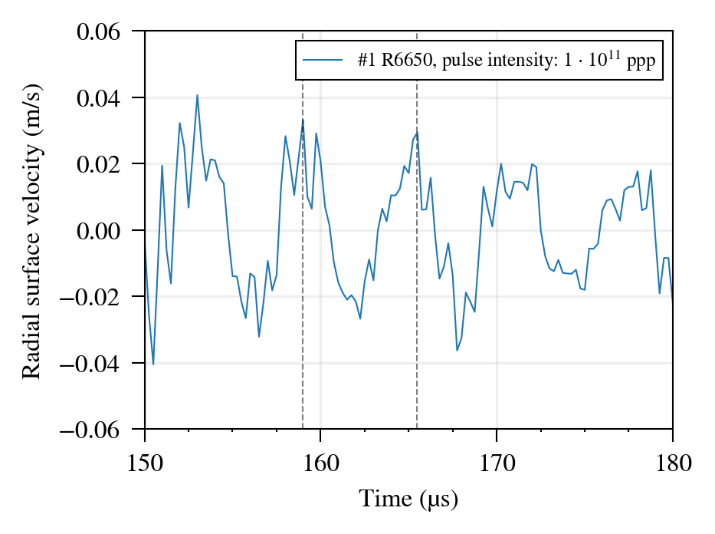
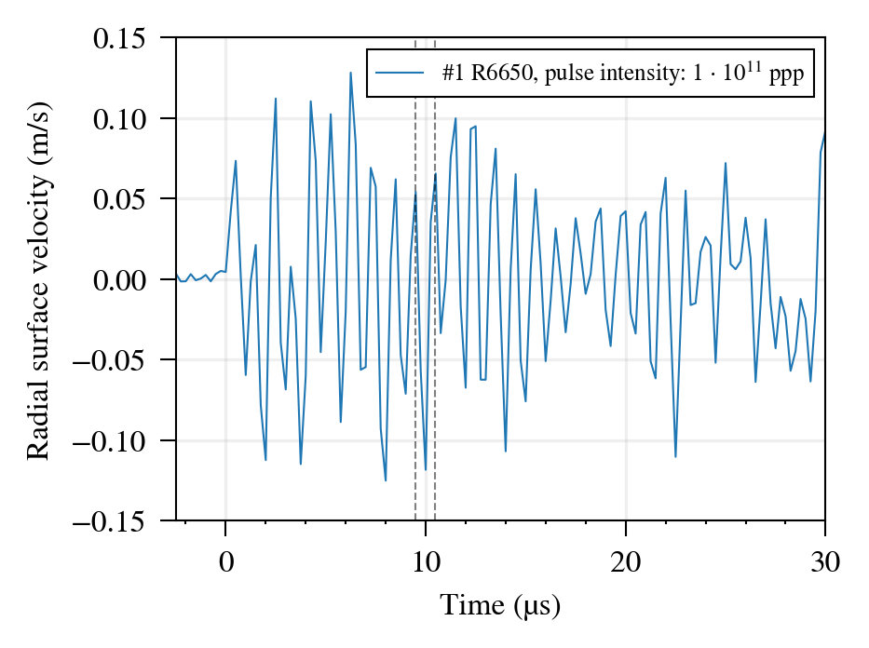
Task 17.3. Material Testing: FlexMat @ HiRadMat
Aim: Testing of dynamic response of target and beam dump materials to proton beam impact
Since last reporting: detailed analysis of response of different graphitic materials at high strain rates-using Ta core drivers
Axial wave
Radial wave
Short-pulse 440 GeV proton beam impact on Tantalum cores
embedded in different graphitic shells
Identification of beam-induced radial & axial pressure waves
Extraction of material parameters in dynamic loading conditions with FE simulations
Identified load limits for failure of the graphitic shells by deviation from monotonic increase with increasing energy deposition density

Slide 8
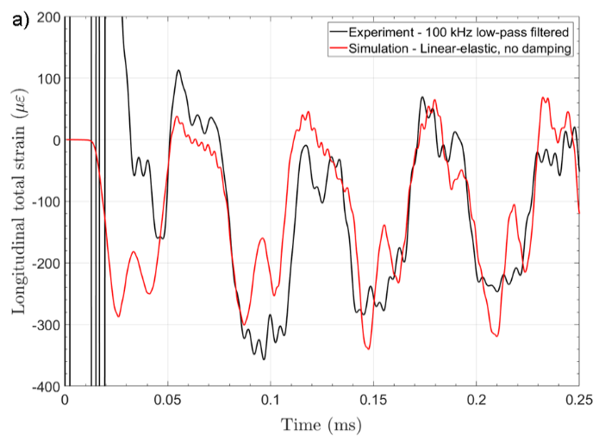
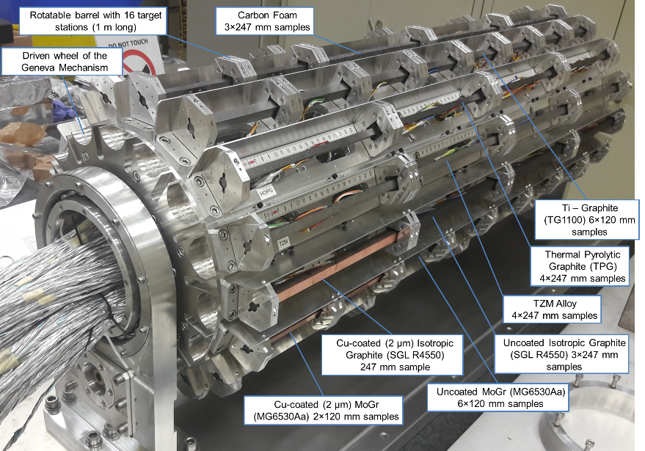
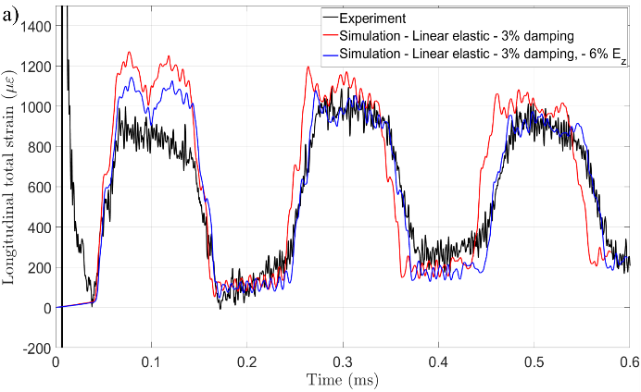
Task 17.3 – Material Testing: MultiMat @ HiRadMat
Post-processing of MultiMat acquired data and comparison to advanced simulations ongoing (CERN, POLITO, UOM):
In general good agreement, particularly for isotropic materials
Elastic constants of several materials updated
(e.g. CFC, CuCD)
Role and extent of internal damping assessed
Some unexpected failures (SiC and TZM)
analyzed and (partly) explained

Slide 9
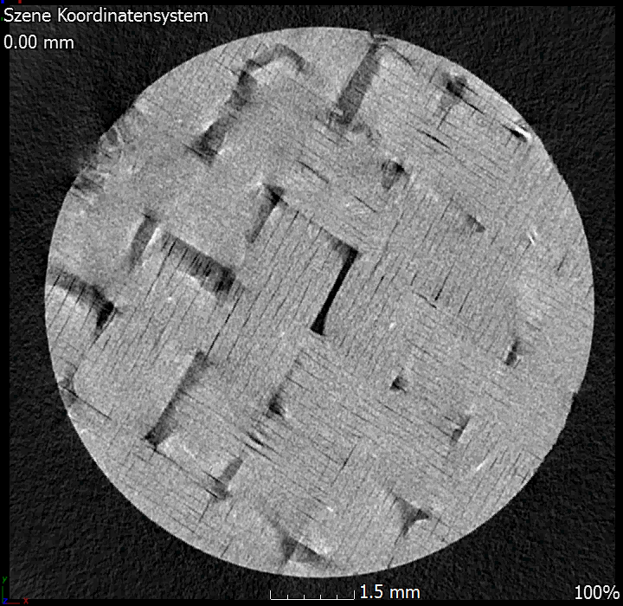
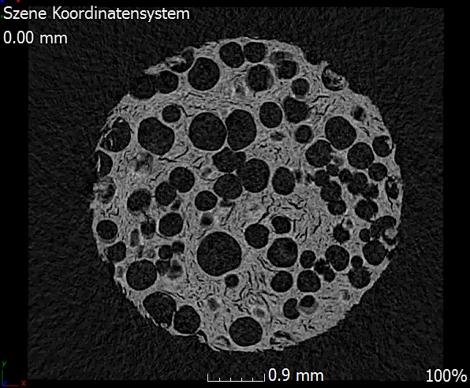
Task 17.2 and 17.3 – Highlights
X-ray tomography
GSI
2D CFC
POCO Foam
Nanoindentation, nanoimpact
Fatigue testing
Creep
Poisson ratio measurements
Laser Flash analysis
Thermomechanical analysis
X Ray Diffraction
Raman spectroscopy
Nanoimpact with varying Strain Rate depending on impact parameters
Isotropic graphite
8 µm grains -SGL
Isotropic graphite
1 µm grains-POCO

Slide 10
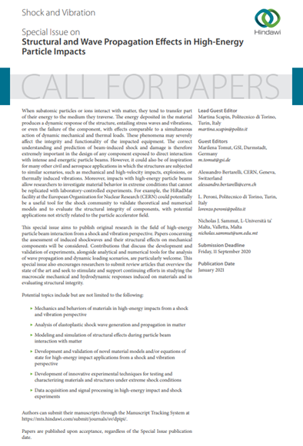
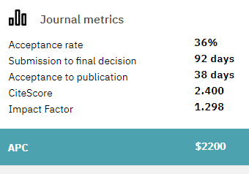
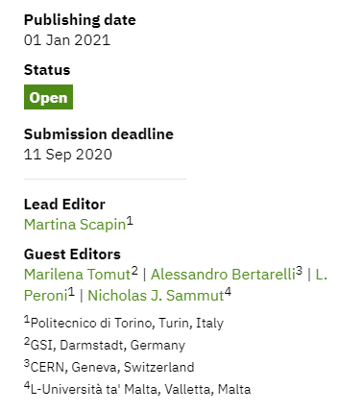
Special Issue

Slide 11
Only 3 submitted papers…
Shockwave propagation in particle accelerator scenarios
Martina Scapin
Submitted 2019/12/09
Editor assigned, reviewers invited
Dynamic Response of Graphitic Targets with Tantalum Cores Impacted by Pulsed 440-GeV Proton Beams
Pascal Simon, Philipp Drechse, Peter Katrik, Kay-Obbe Voss, Philipp Bolz, Fiona J. Harden, Michael Guinchard, Yacine Kadi, Christina Trautmann, Marilena Tomut
Submitted 2020/06/14
Editor assigned, reviewers invited
Thermomechanical Characterisation of Copper Diamond and Benchmarking with the MultiMat experiment
Nicholas J. Sammut, Pierluigi Mollicone, Michele Pasquali, Federico Carra, Alessandro Bertarelli, Jorge Guardia Valenzuela, Oscar Sacristan De Frutos, Marcus Portelli,
Submitted 2020/07/08
All the submitted papers have at least one of the authors which is also a guest editor for the SI

