Slide 1
Possible scenarios for dynamic tests (in coming months)
2nd Annual Meeting of Aries WP17
Lorenzo Peroni (POLITO)

Slide 2
Task 3 description
Task 3: Dynamic testing and online monitoring
  Testing of material samples in a broad range of environments:
  Mechanical testing in quasi-static and dynamic conditions, at various temperatures (postponed due to COVID emergency and Vacuum chamber delay)
  Tests under very high power laser and particle beams
  Irradiation tests with online monitoring of properties evolution
  Hydrodynamic simulations of experiments - constitutive models, spall strengths for new materials
  Participants: CERN, ELI-NP, GSI, POLIMI, POLITO

Slide 3
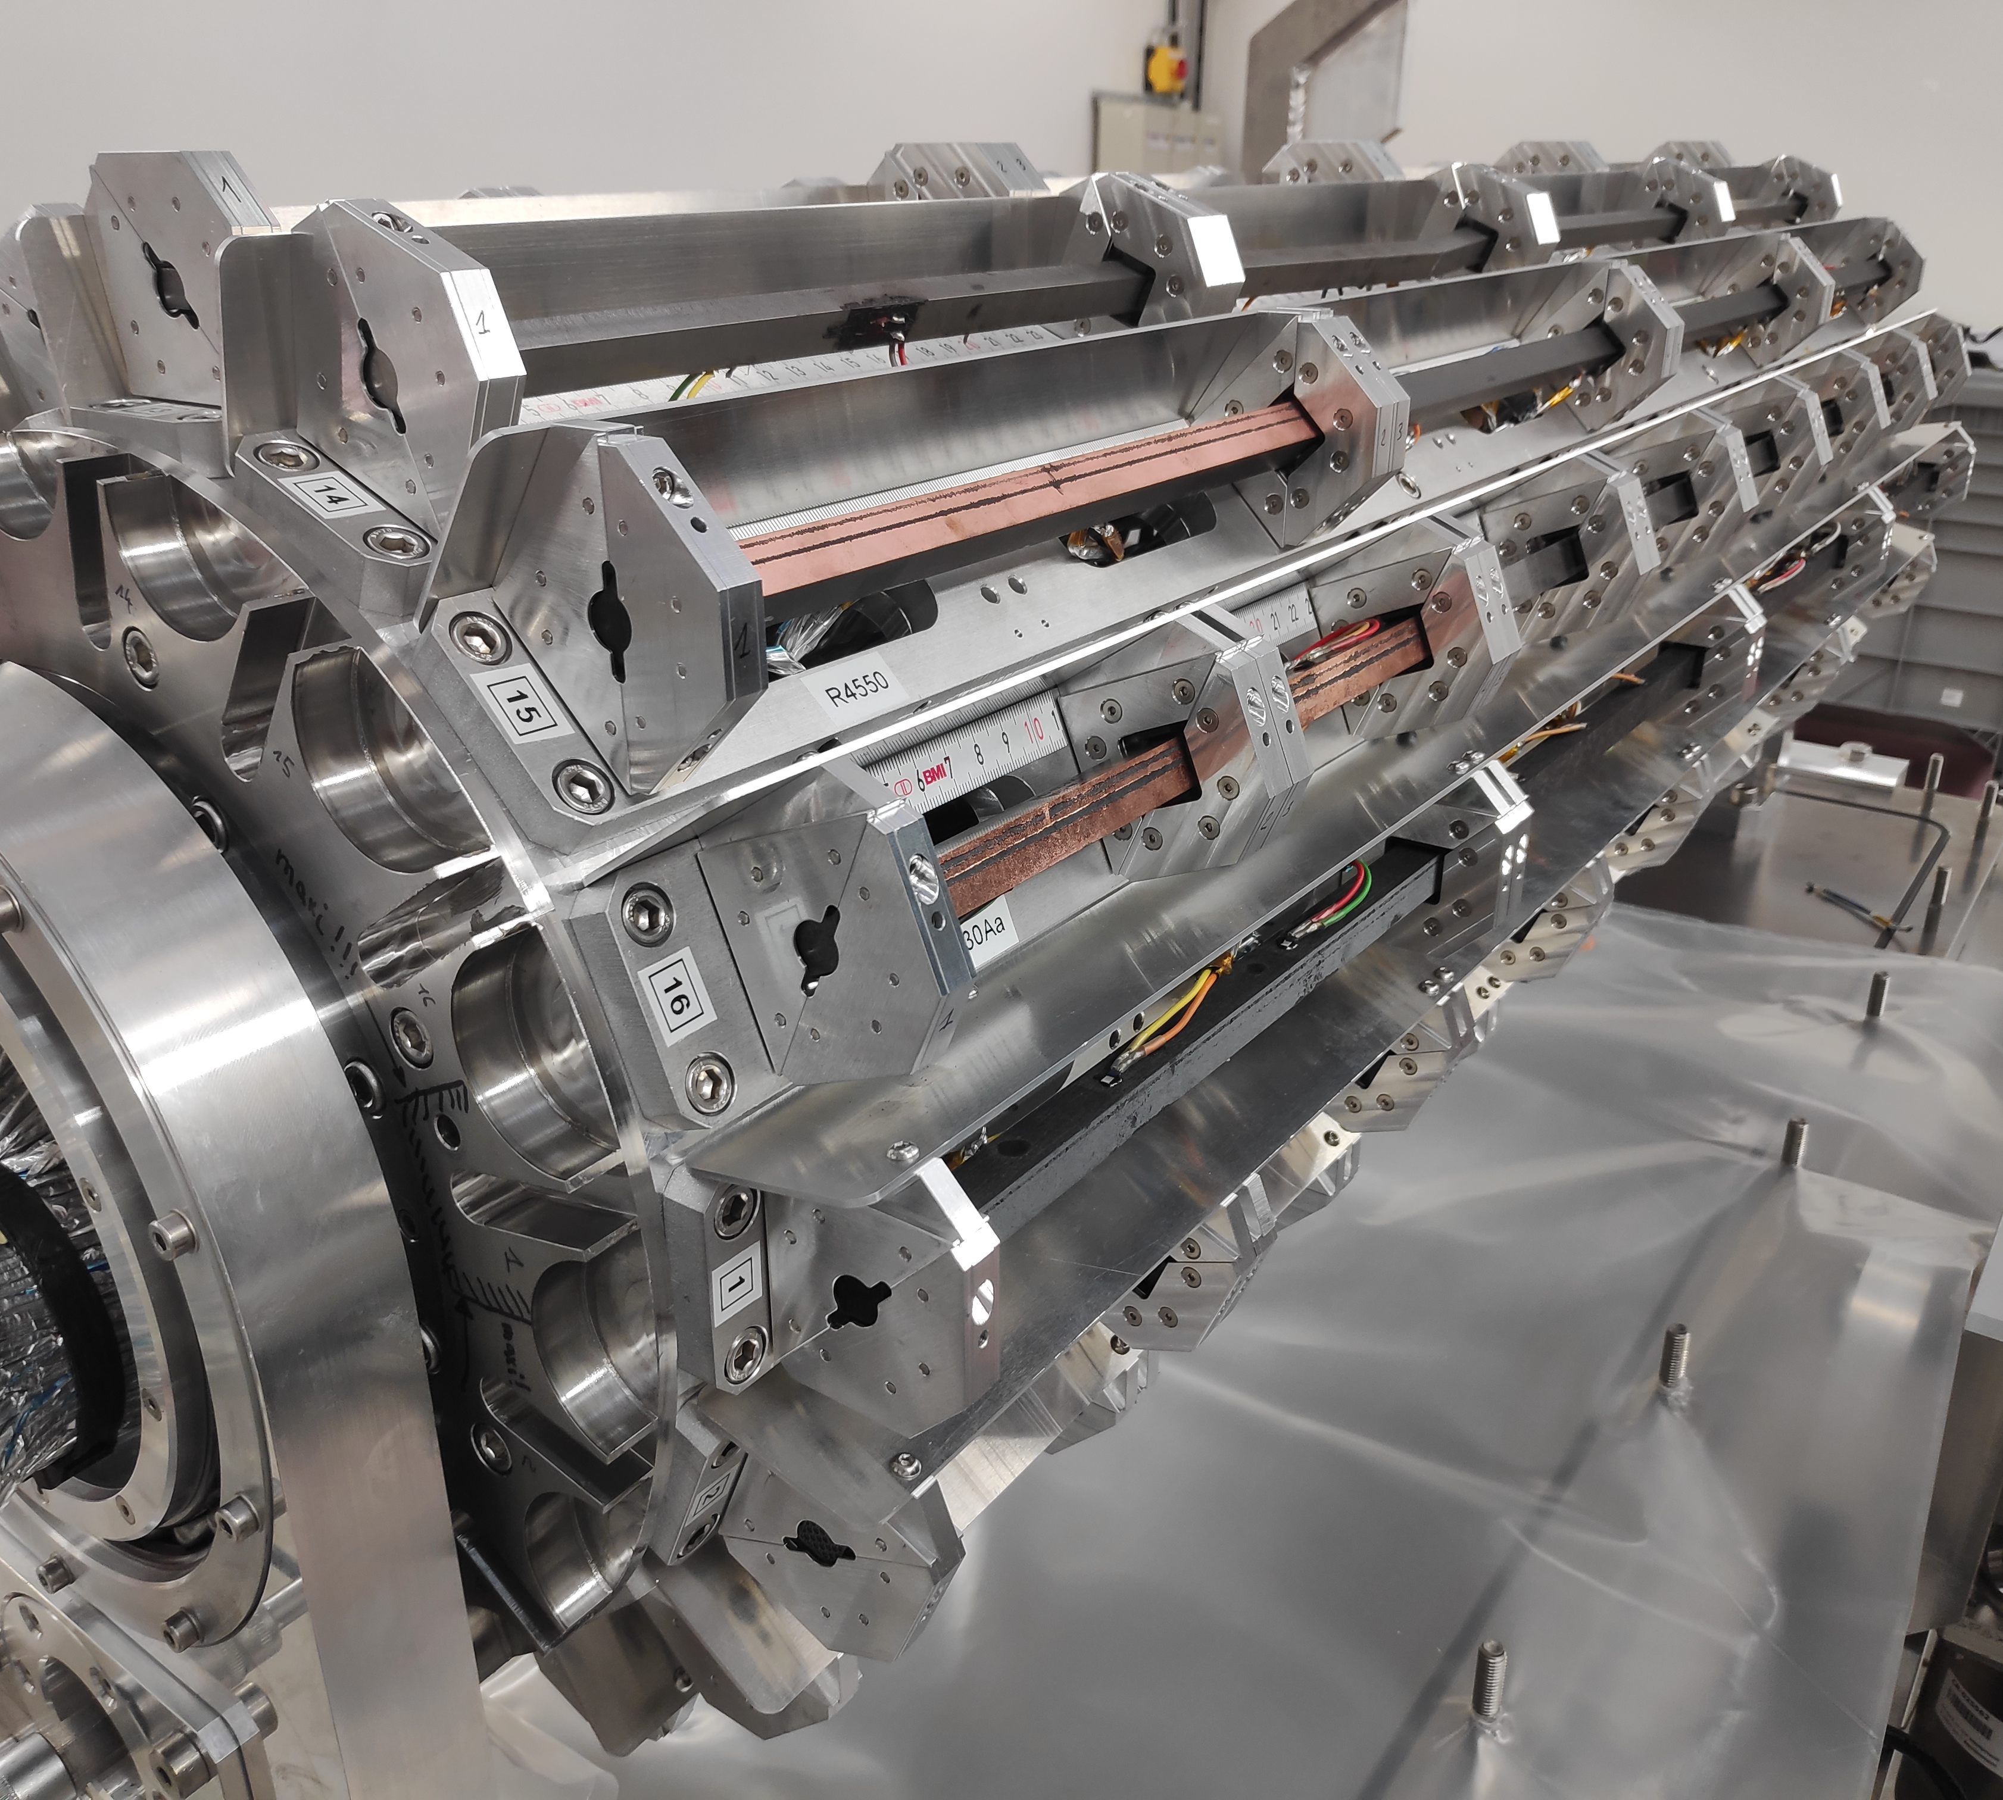
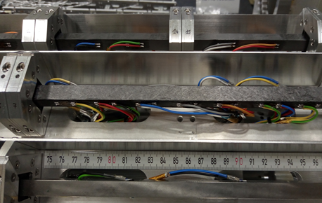
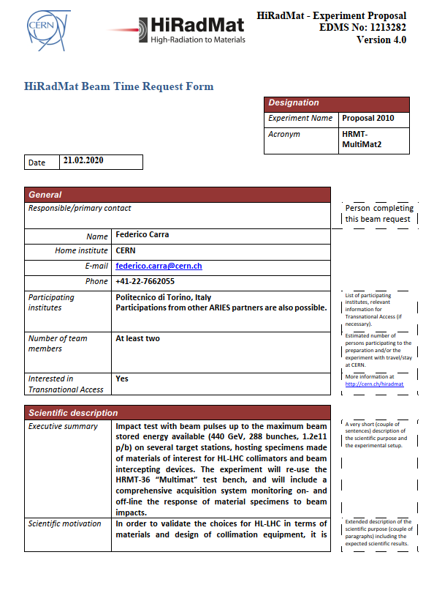
High energy particle beams: Multimat-2
Experiment on materials samples proposed for next HiRadMat run (2021/22)
Goals: validate the industrial solutions for HiLumi (MoGr NB-8404Ng with HIPIMS coating, coated graphite); improve definition of material models for graphitic materials; explore collimator threshold of damage.
Makes use of the MultiMat test bench, with new targets
Open to additional materials of interest from other projects, including ARIES!
Submitted to the HiRadMat scientific board in June and under evaluation

Slide 4
Laser Shockwaves (I)
From the beginning of their development, high-power laser facilities have always been considered as potential calibrated-shock generators. Indeed, the interaction between the laser and the front face of a solid target generates a plasma whose expansion creates a shock wave into the matter that may lead to its failure.
The shock pulses are created due to the rapid heating of the surface from the photon bombardment of the material. The surface heats and expands, forming a plasma. Because of the rapid heating and thermal expansion, the front of the material is shock compressed at times on the order of nanoseconds. This pulse then propagates through the material as a shock wave. The heat effects from the laser irradiation are limited to the first few atomic planes.

Slide 5
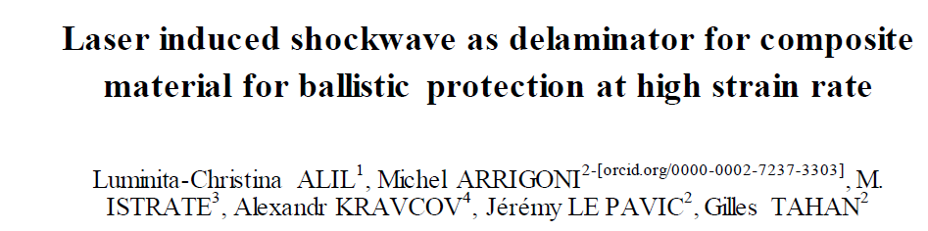
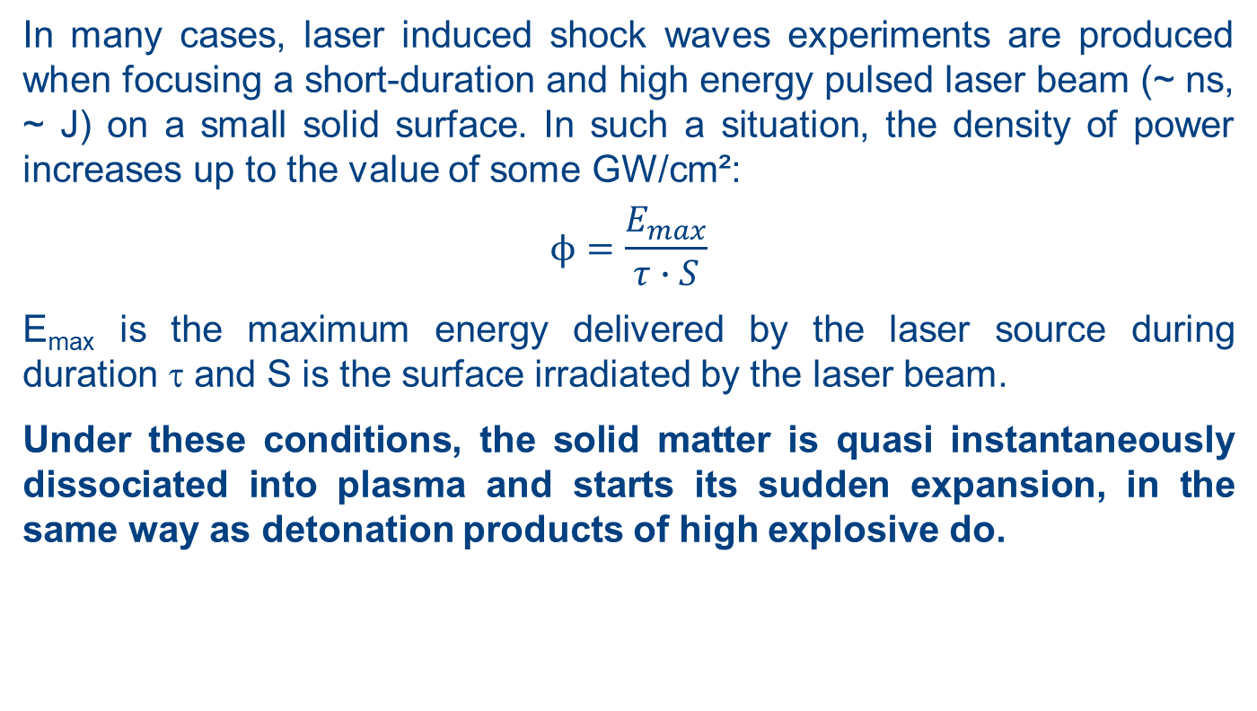
Laser Shockwaves (II)
In many cases, laser induced shock waves experiments are produced when focusing a short-duration and high energy pulsed laser beam (~ ns, ~ J) on a small solid surface. In such a situation, the density of power increases up to the value of some GW/cm²:
$$ϕ=\frac{E_{max}}{τ∙S}$$
E_{max} is the maximum energy delivered by the laser source during duration τ and S is the surface irradiated by the laser beam.
Under these conditions, the solid matter is quasi instantaneously dissociated into plasma and starts its sudden expansion, in the same way as detonation products of high explosive do.

Slide 6
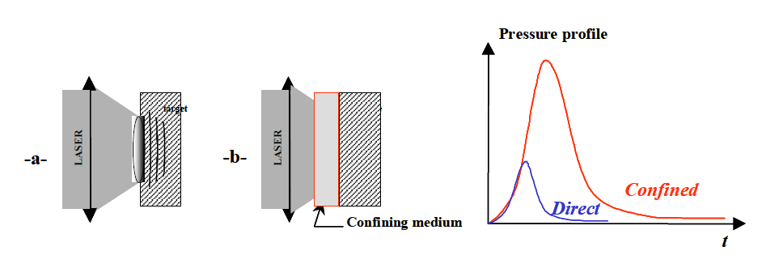
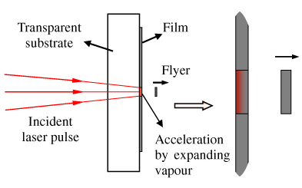
Laser Shockwaves (III)
Two modes of interaction are distinguishable according to whether the plasma expands freely (direct interaction) or is retained by a transparent medium confining the plasma
The generated shock could be used to test a specimen or to drive a flyer plate for an impact test

Slide 7
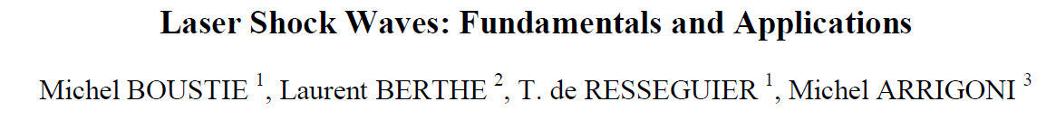
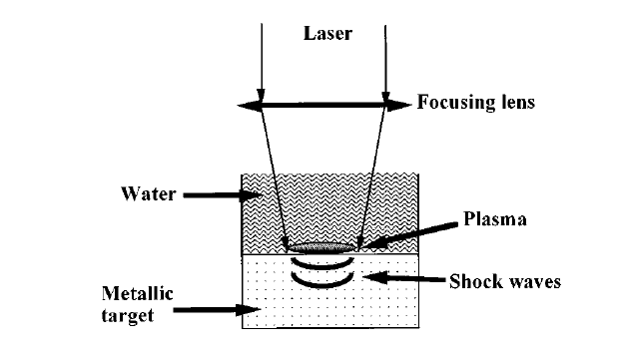
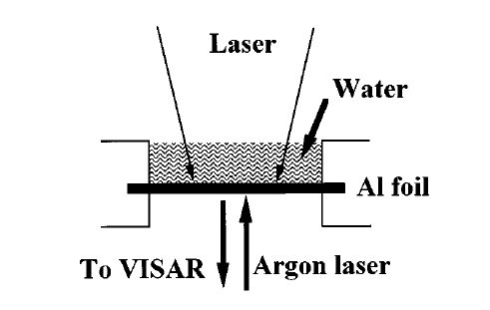
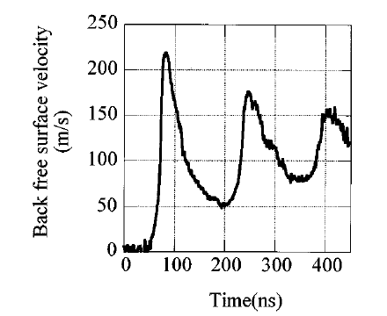
Some examples
“High power pulsed laser (above 1GW/cm²) interaction with matter yields to very high amplitude pressure loadings with very short durations, initiating into solids a strong short shock wave. Compared to the conventional generators of shock (launchers of projectiles, explosives), these particular characteristics offer the possibility to study the behavior of matter under extreme dynamic conditions, with a possible recovery of the shocked samples presenting the effects of the passage of the shock in most cases”

Slide 8
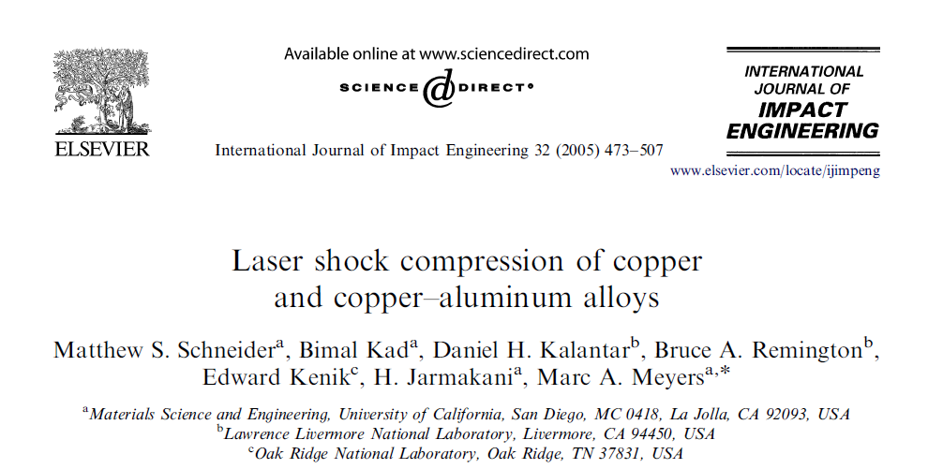
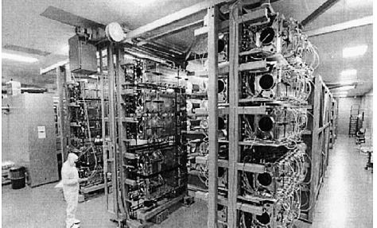
Some examples
The shock experiments were carried out at the OMEGA Laser Facility at University of Rochester’s Laboratory for Laser Energetics (LLE). The input laser energies used in the experiments were 70, 200, and 300 J with a 2.5 ns pulse duration. The laser spot size was 3 mm. This experimental setup provided energy densities on the order of 50 MJ/m².
VISAR wave profile measurements were also performed during these experiments to obtain time-resolved data on the shock wave profile as it breaks from the free surface. Samples of various thicknesses were irradiated with different laser intensities to obtain the different release profiles.

Slide 9
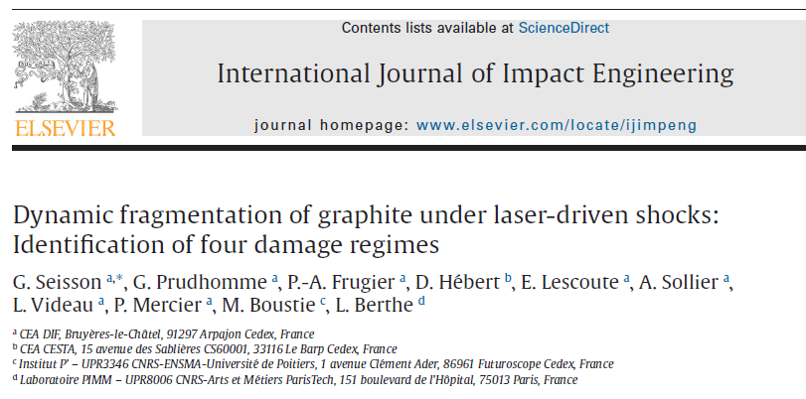
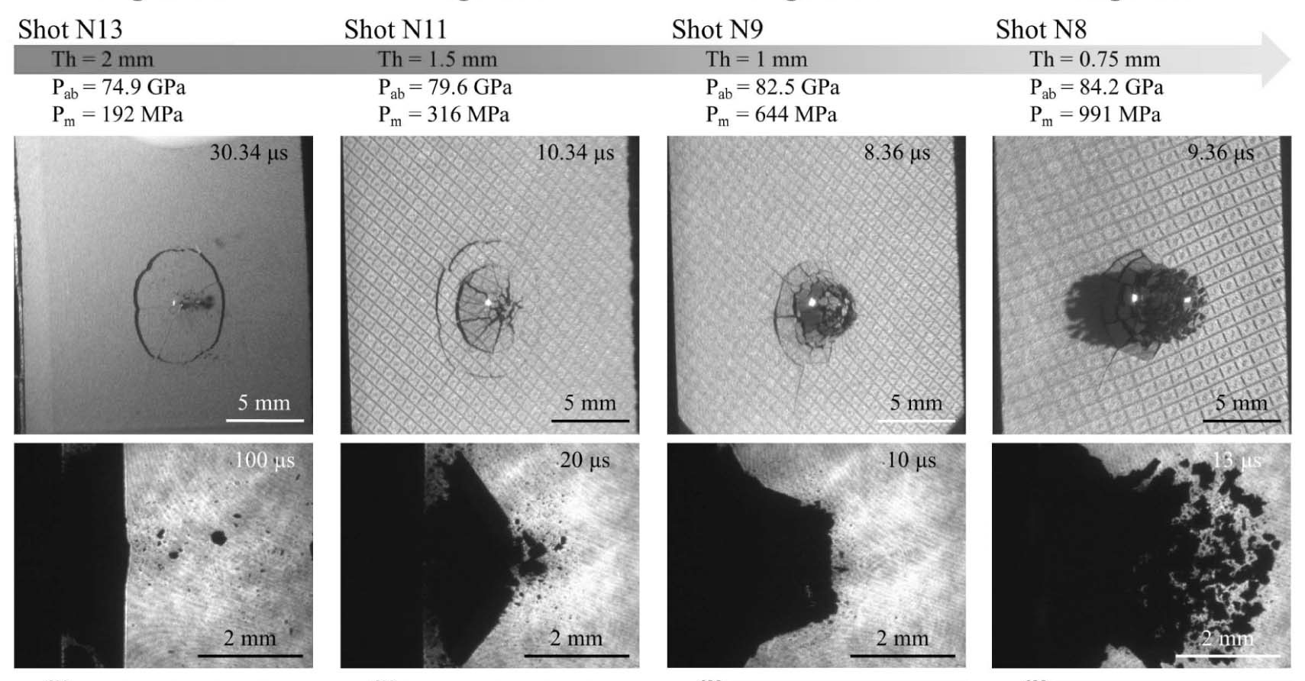
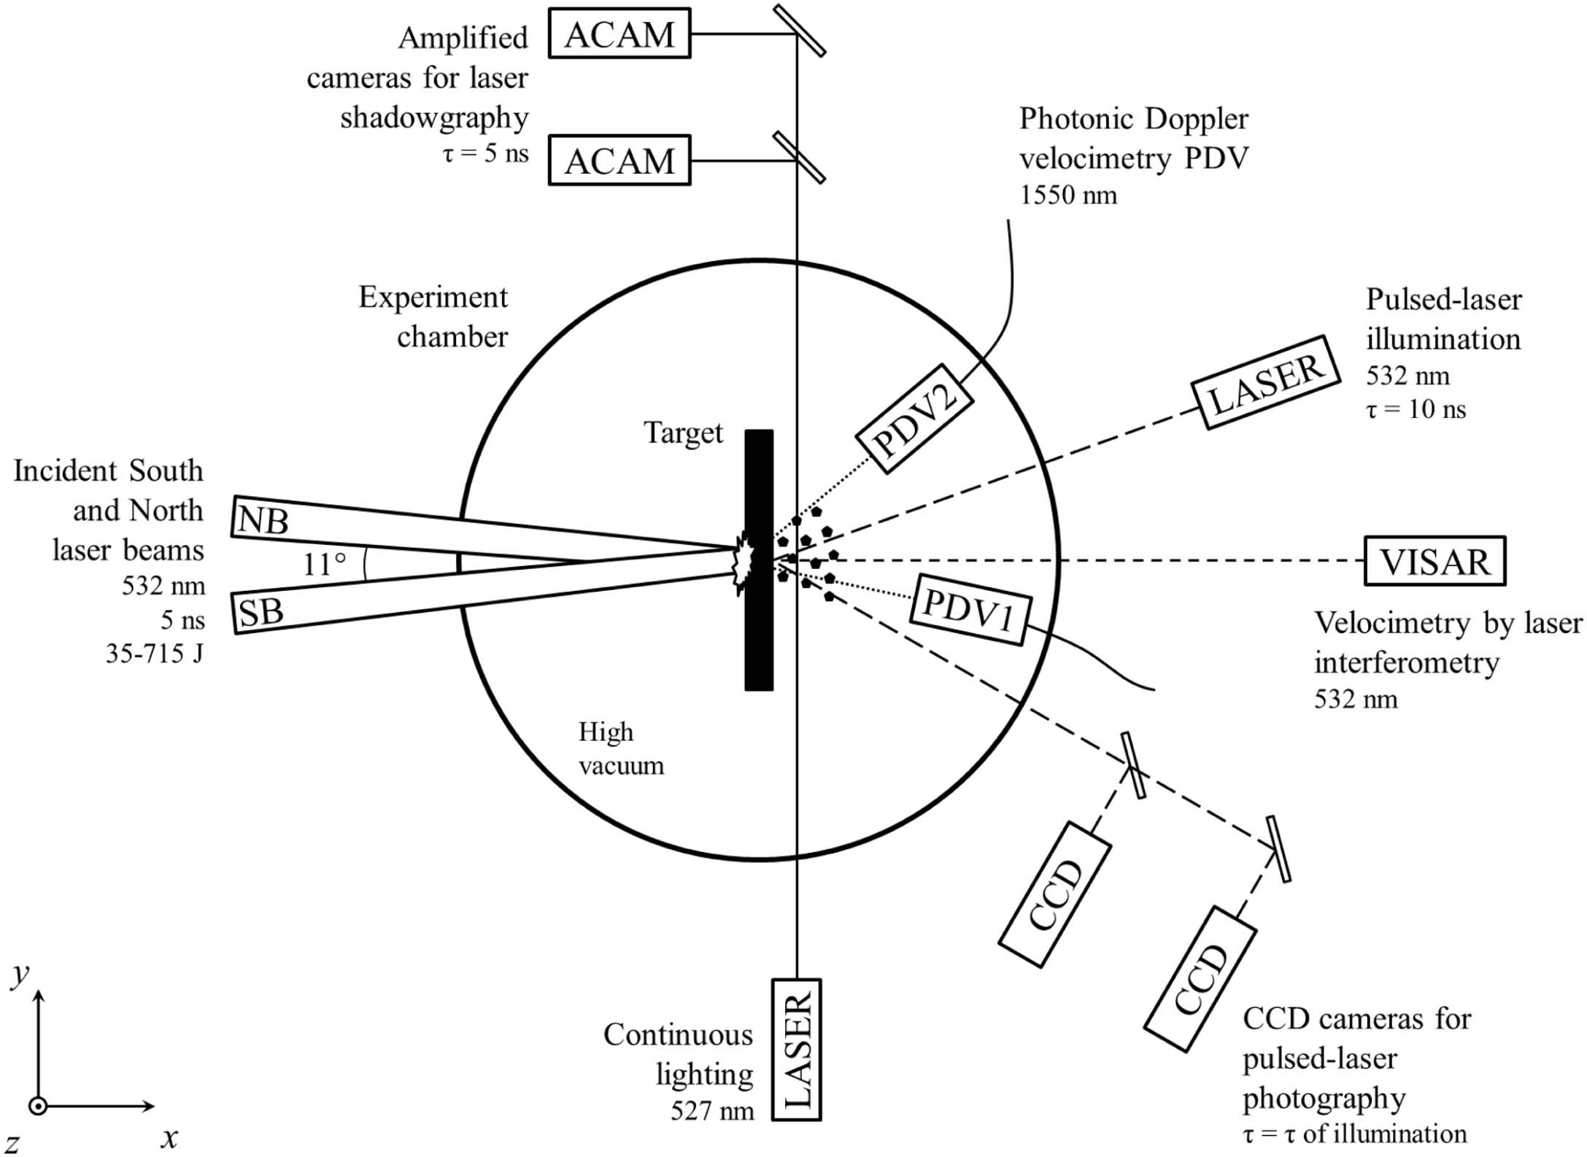
Some examples
Luli2000 is a high-power laser facility of the Laboratoire pour l'Utilisation des Lasers Intenses (LULI) based at the École Polytechnique (Palaiseau, France). This laser generates square temporal pulses tunable from 0.5 to 5 ns and can reach energies up to 1 kJ at the wavelength of 1064 ns.

Slide 10
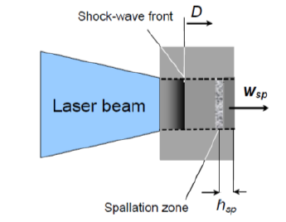
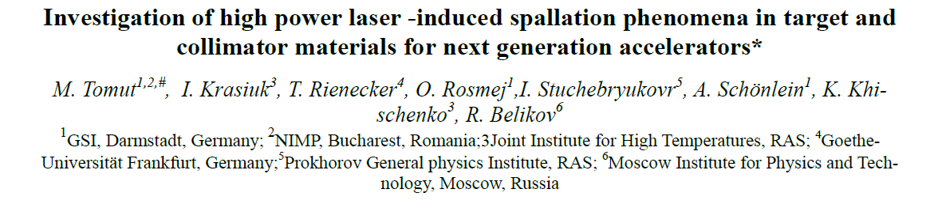
WP17 partners capabilities
Within the experiment P089, investigations of spallation phenomena in different graphite grades, copper-diamond and molybdenum-graphite composites were conducted at the Z6 experimental area, using shock waves induced by the PHELIX laser at GSI. A pulsed laser beam with a wavelength of 530 nm, 1.4 ns pulse duration and energies of 120 J was focused to a spot size of 1.3 mm on the target. Typical beam intensities were about 0.6×10¹³ W/cm².

Slide 11
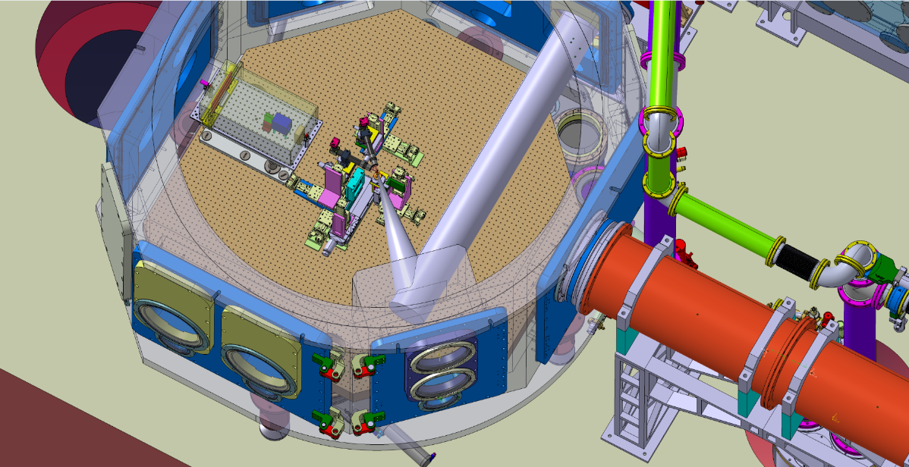
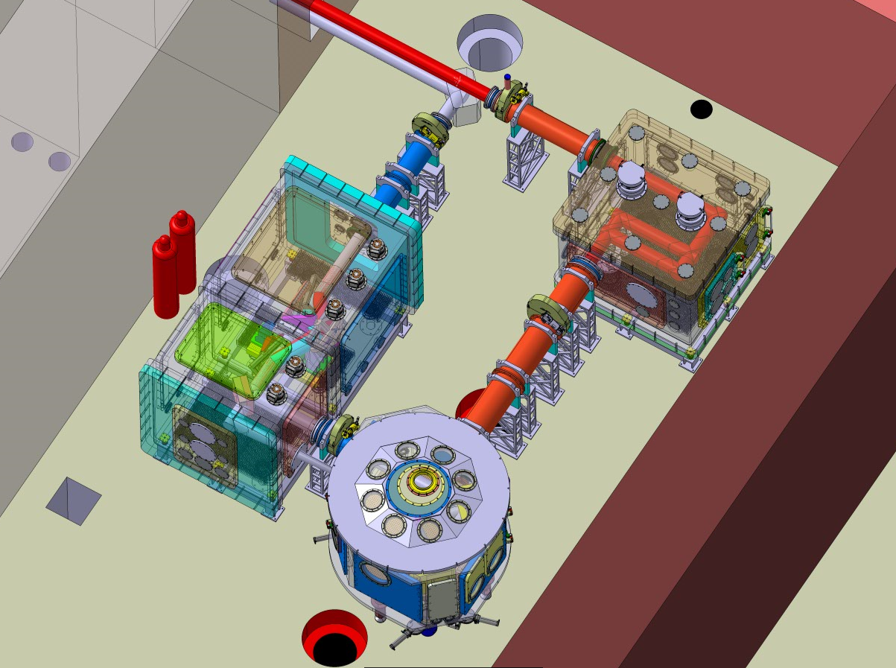
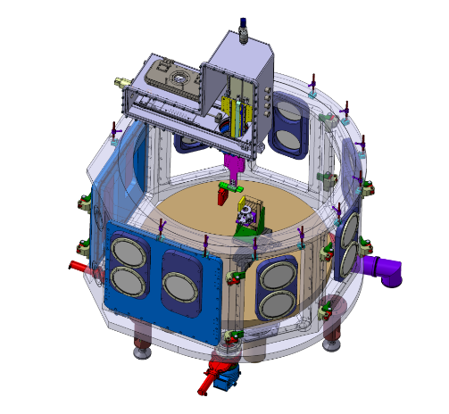
What’s next in PowerMat
Status of E5 Experimental Area for Materials Research at ELI-NP, Bucharest (2 x 1 PW Lasers )
  2018 - 2019 – finalization of 1 PW optics and interaction chambers in E5
  mid 2019 – laser beam characterization; proton acceleration; first experiments
E5 interaction chamber, F/#3.5 parabola, 5x10²¹ W/cm²
Delay line and F/#25 parabola
proton acceleration
configuration
Automatic
target feeder
Electron and Ion diagnostics

Slide 12
In the near future
Is it possible to plan laser driven shockwaves experiments in the next months?
Which Laser Source will be available for these tests (GSI, ELI-NP…)? Which energy level, pulse duration, spot size…?
Which instrumentations will be available through the Powermat partners (VISAR, Fast cameras…)
Which materials could be good candidates?
Is it the timeline compatible with the ARIES end?

Slide 13
Thank you!

