Slide 1
Dynamic Response of Graphitic Targets with Tantalum Cores Impacted by Pulsed 440-GeV Proton Beams
2nd Annual Meeting of ARIES WP17
P. Simon, P. Drechsel, P. Katrik, K.-O. Voss, P. Bolz, F. J. Harden, M. Guinchard, Y. Kadi, C. Trautmann, M. Tomut

Slide 2
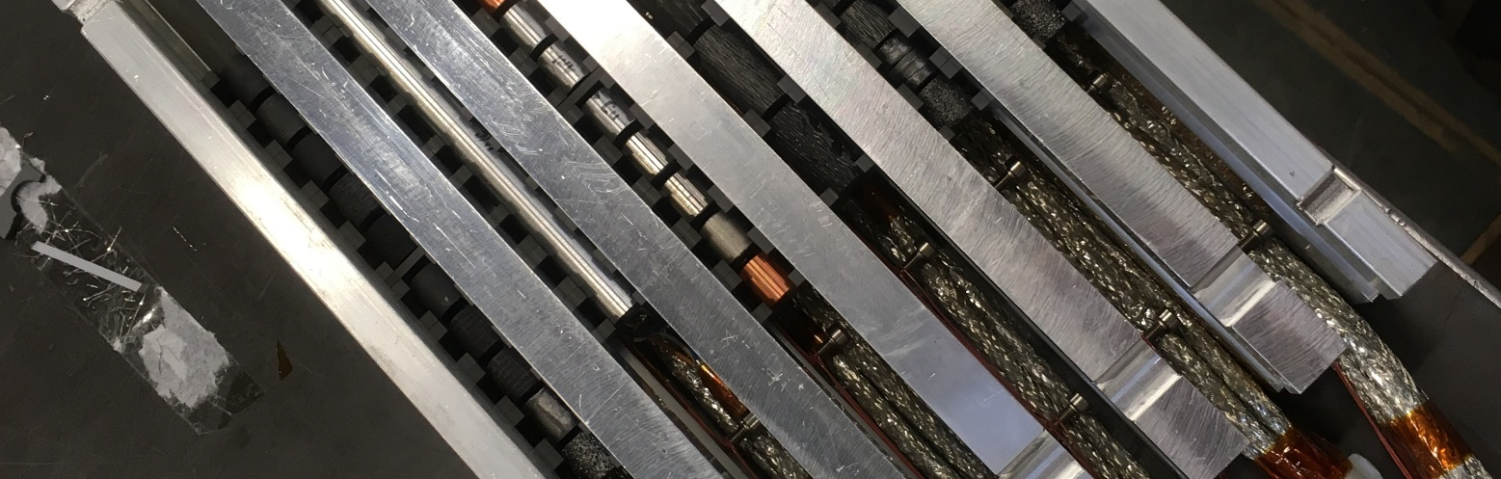
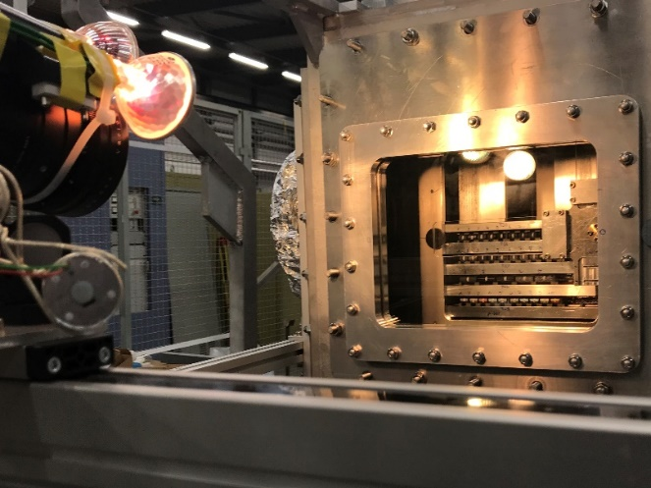
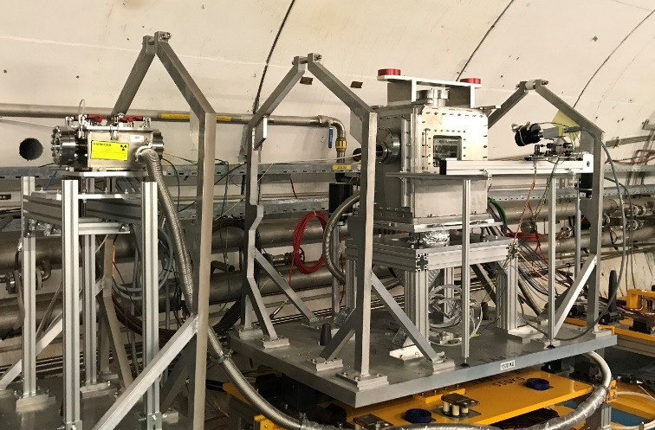
HRMT-38 “FlexMat”
HiRadMat Experiment performed in May 2018
Measured dynamic response of a wide variety of graphite grades (0.5 – 2.25 g/cm3), polycrystalline graphite, glassy carbon, CFC, foam, TPG…
  All relevant for beam intercepting devices
Overall 46 samples in 6 target stations with <=10 samples in-line
Dedicated target station of ⌀10 mm graphite samples with a press fit ⌀3 mm tantalum (Z=73, ρ=16.67 g/cm³) core
  Use higher specific energy deposition in tantalum to induce potential failure in the surrounding graphite
Overview presentation at the 1st annual meeting in Malta 2018

Slide 3
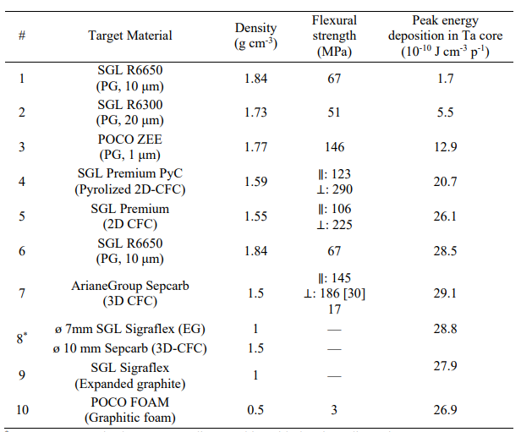
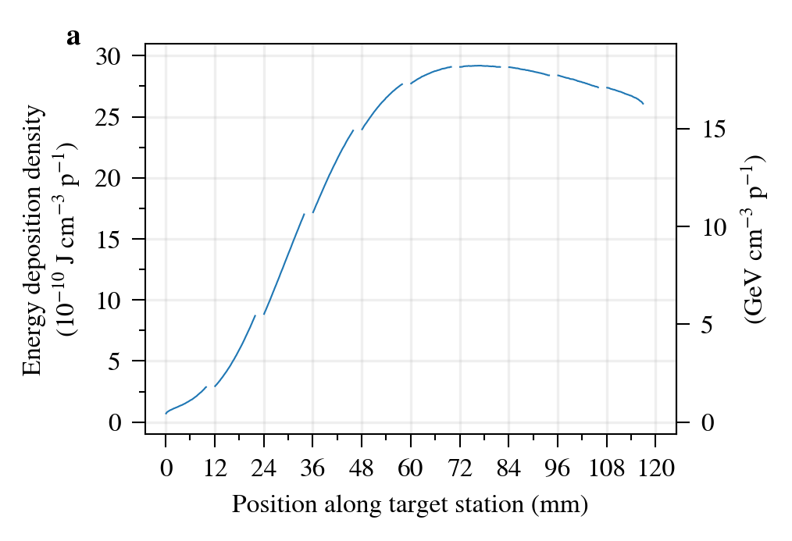
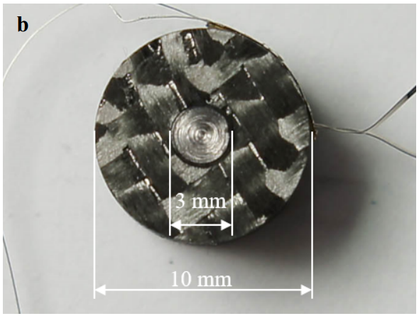
FlexMat / Target Station 6
10 Samples with embedded tantalum „core“
Tantalum has shown excellent robustness towards beam impact in comparable conditions
  Tested extensively in HRMT-27 RodTarg
Max. specific energy deposition (100 mm target):
Graphite, 1.83 g/cm³: ~1 GeV/cm³ p (σ = 0.25 mm)
Tantalum, 16.67 g/cm³: ~18 GeV/cm³ p (σ = 1.5 mm)
This induces up to ~100 MPa stress in the graphite at beam intensities of ~2-6×10¹¹ ppp

Slide 4
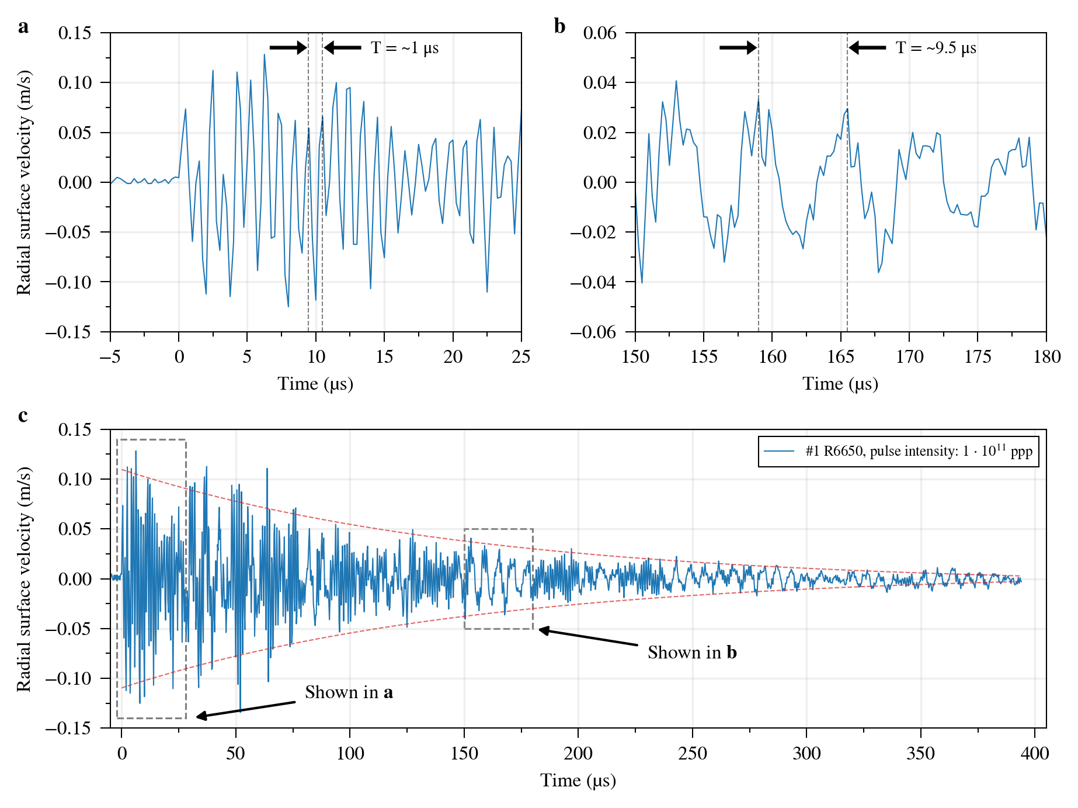
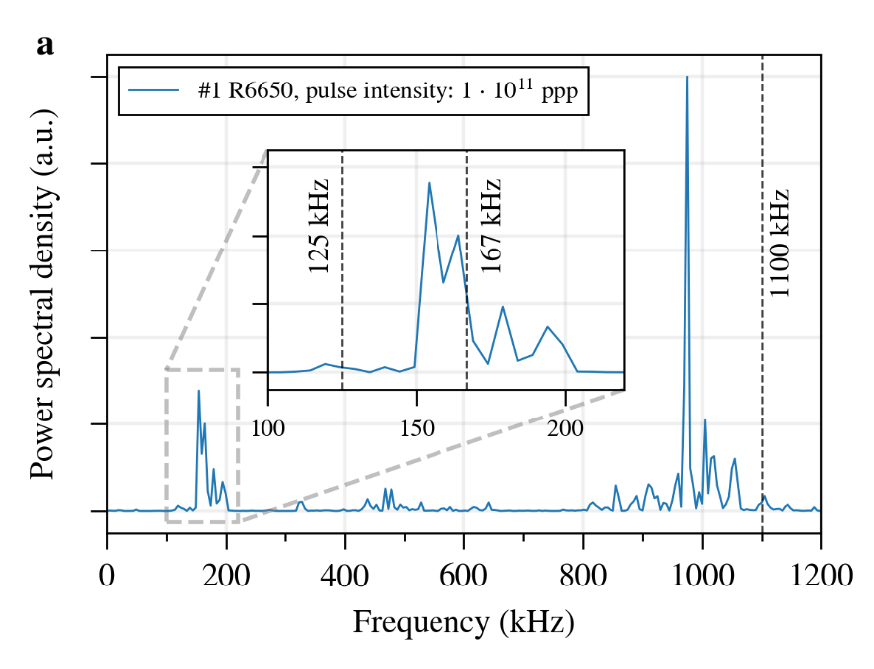
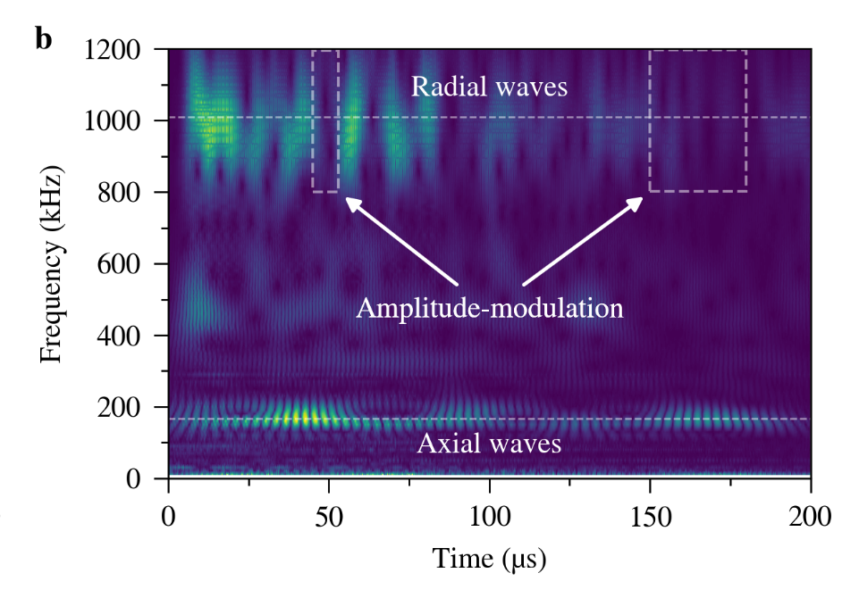
Sample #1 R6650 / 1×10¹¹ ppp
Radial waves
Axial waves
Clear identification of radial and axial waves
Signal dominated by dynamic response of tantalum core
Considerably faster damping of dynamic response in comparison to bare metal

Slide 5
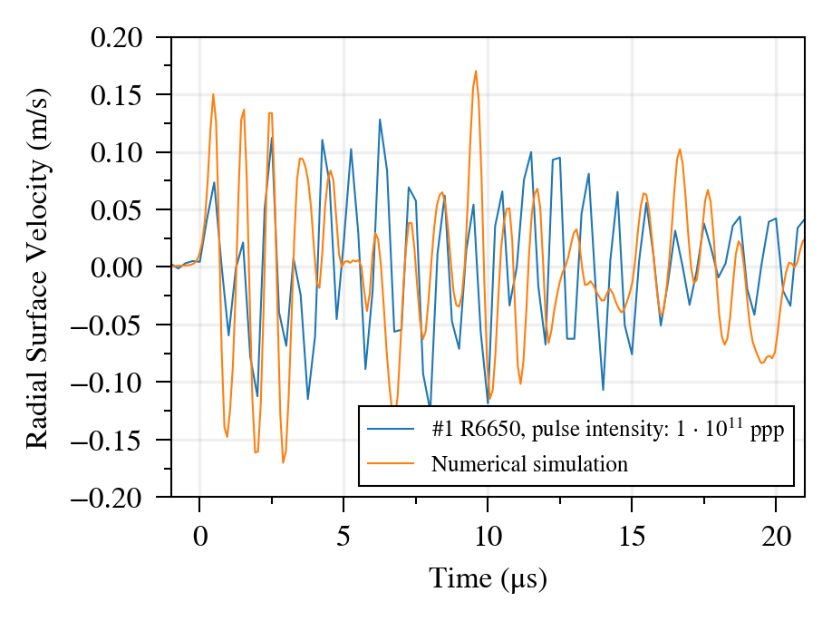
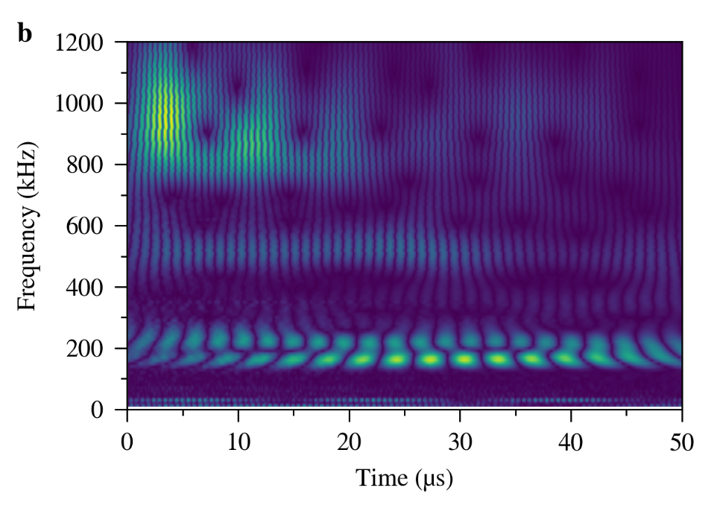
Sample #1 R6650 / 1×10¹¹ ppp
Exp.
Sim.
Simulation using ANSYS Workbench w/ FLUKA input
  Material parameters from supplier datasheets
  No plasticity, fully bonded contact

Slide 6
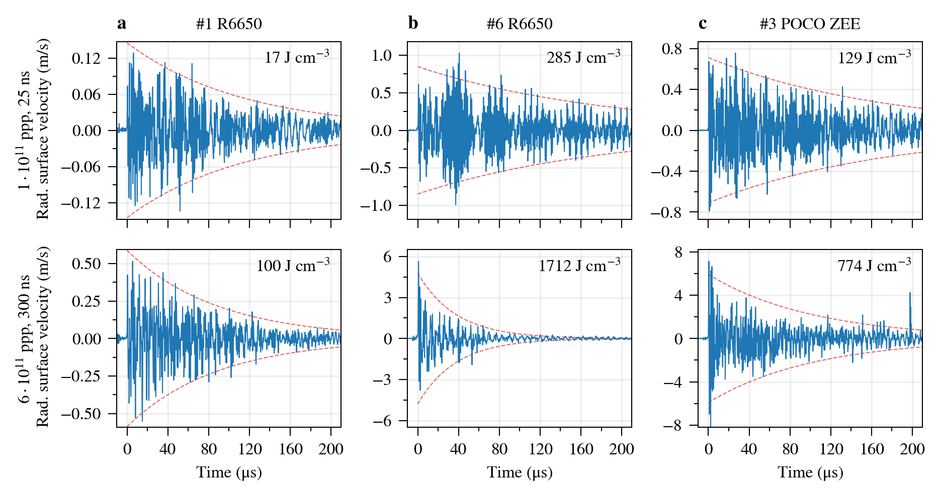
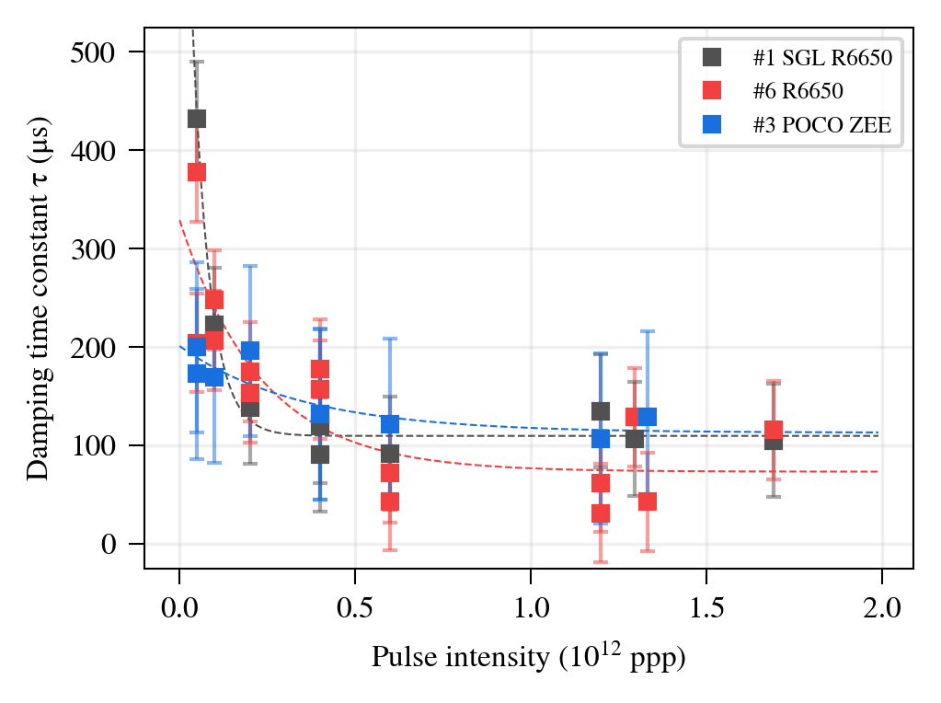
Polycrystalline Graphites
Failure?
No correlation between microstructure (grain size) and damping behaviour
  Damping time constant decreases systematically with pulse intensity
Deformed wave structure hints to first signs of failure in target #6 at 6×10¹¹ ppp

Slide 7
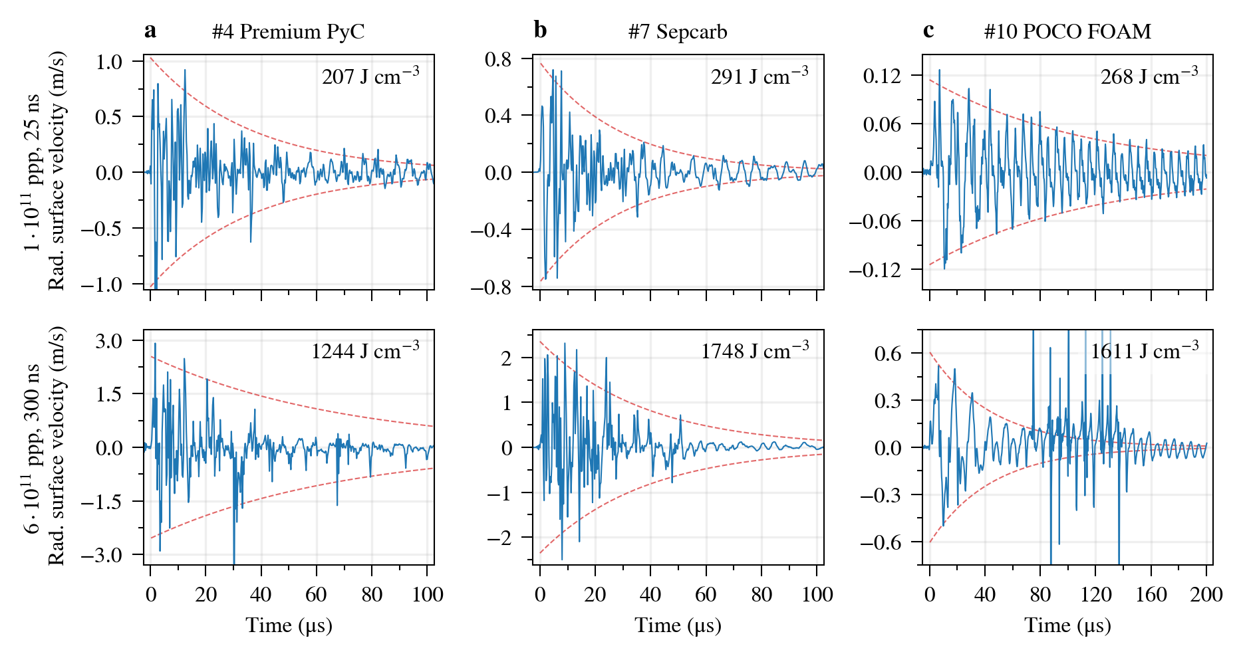
CFCs + Graphitic Foam
Possible failure in CFCs below 2 kJ/cm³ in tantalum core?
Somewhat unexpected due to large strength of the material
Foam response very clear, even at higher beam intensities

Slide 8
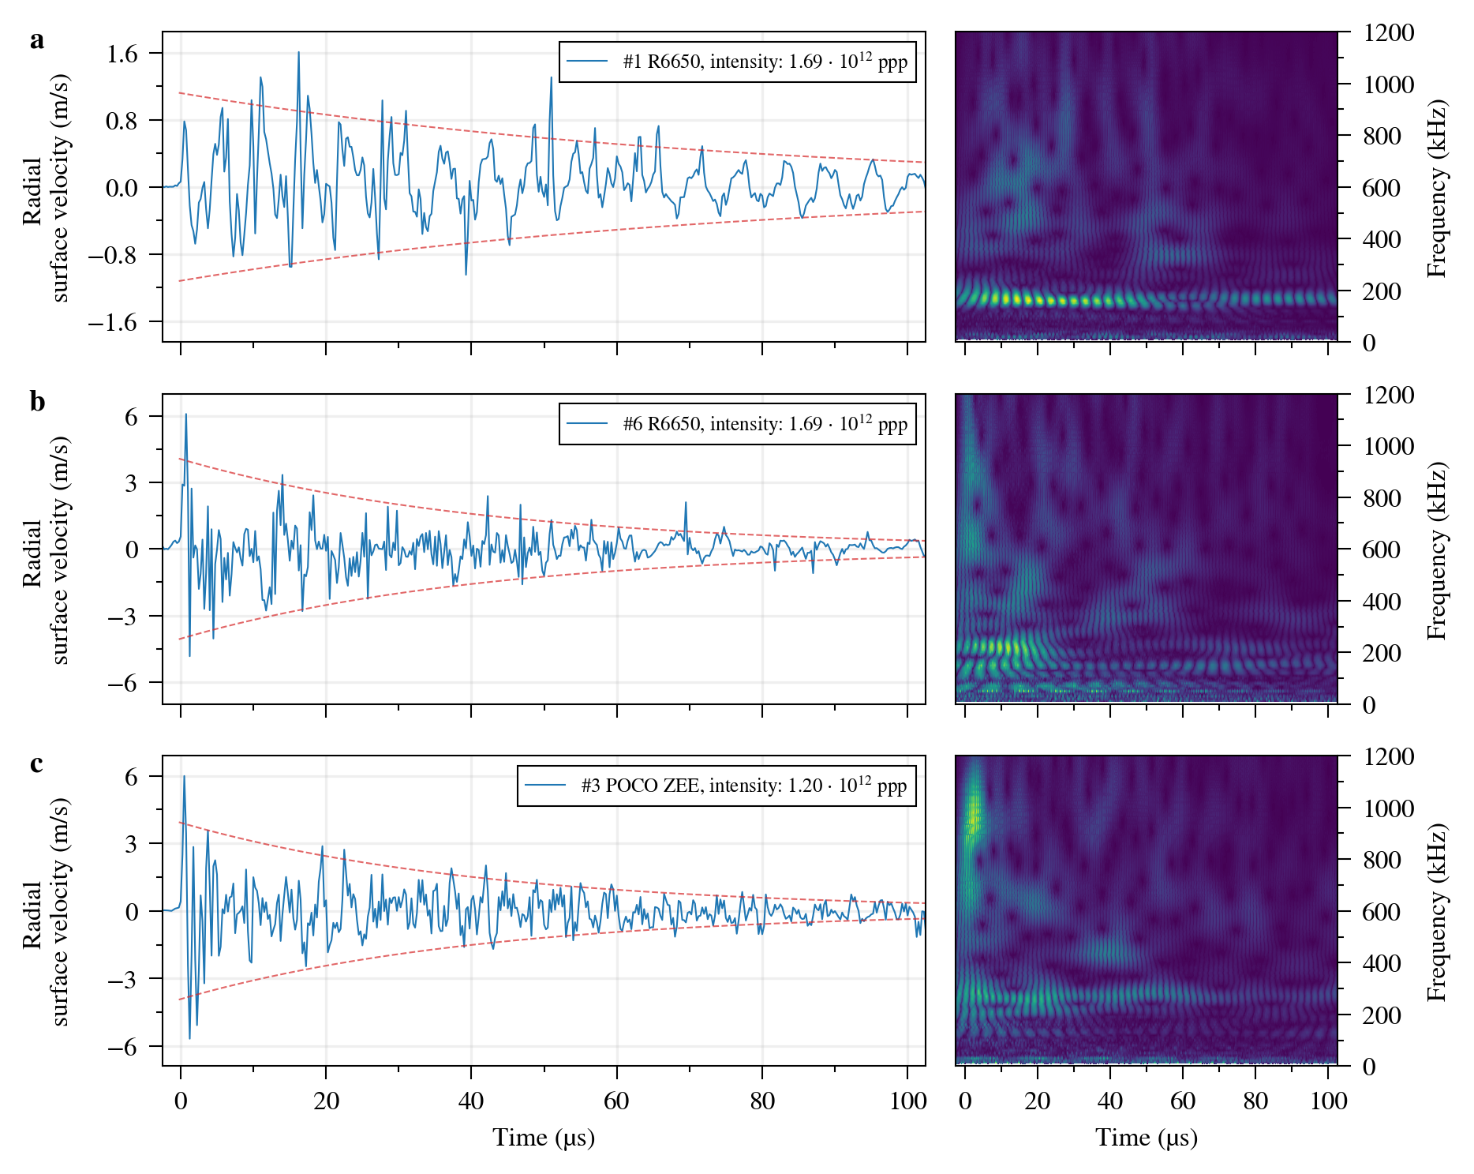
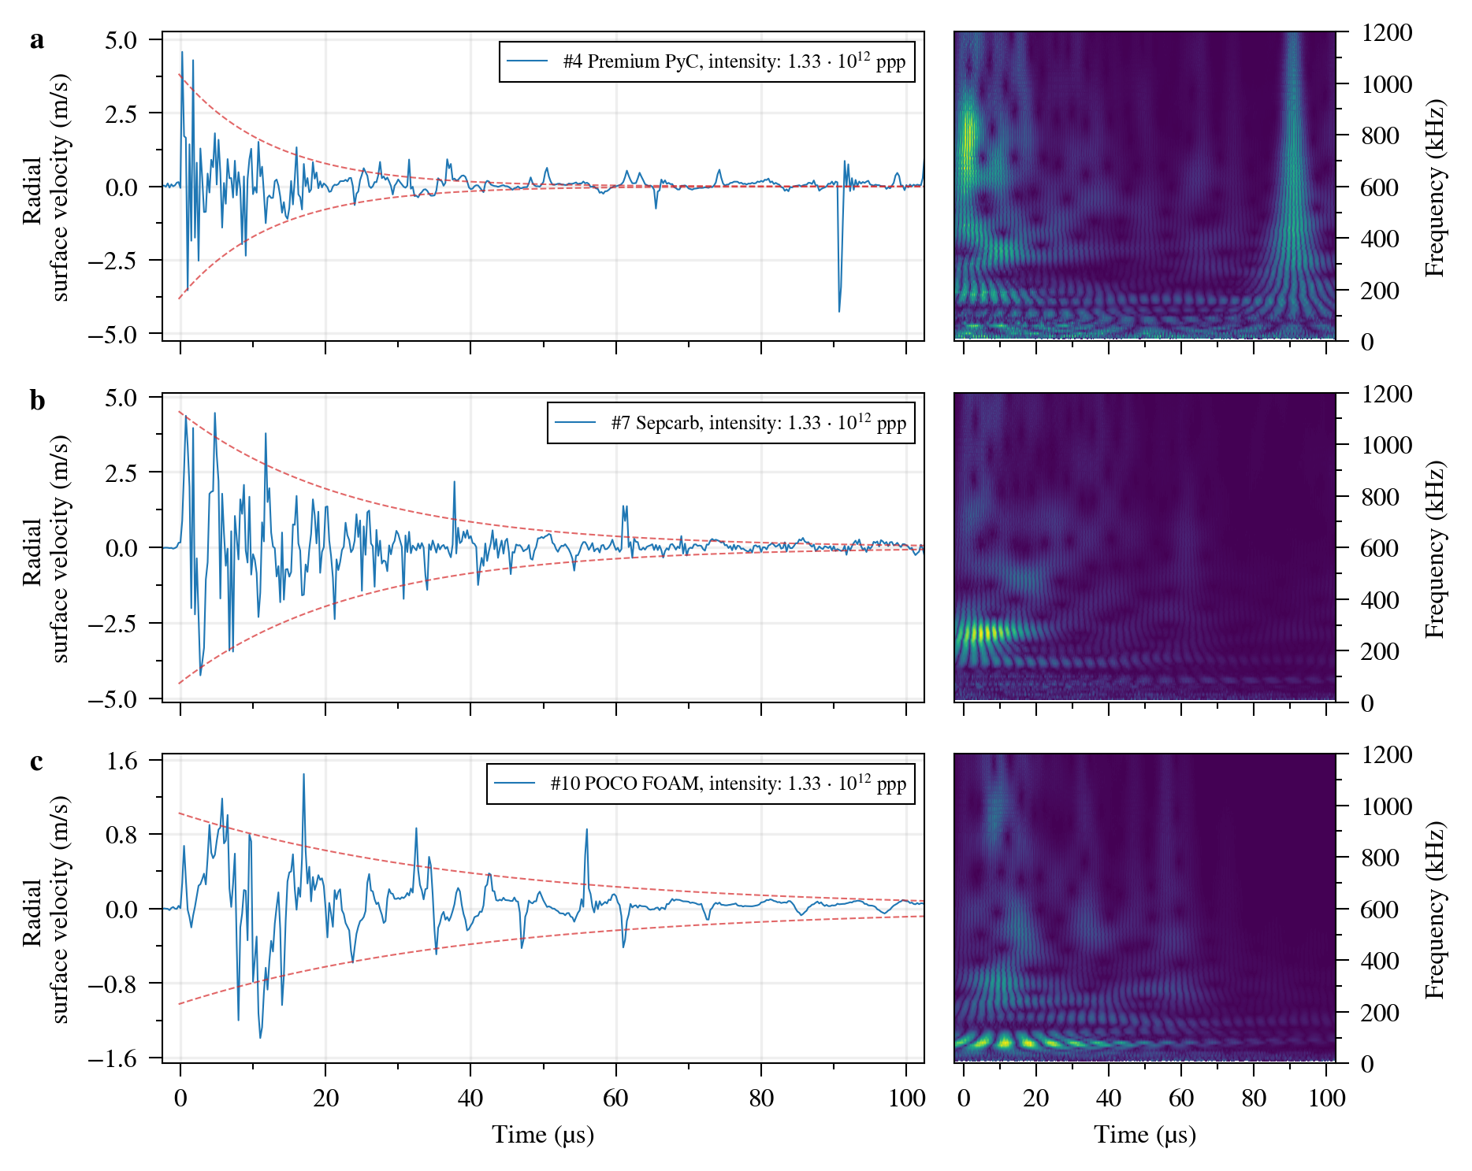
High intensity / 1.3 – 1.7×10¹² ppp
Failure in nearly all samples (graphite + tantalum core)
  Beam-induced stresses in the cores ~2x higher than during RodTarg
Out of the large energy deposition samples (starting from sample #4) Sepcarb shows the „cleanest“ response

Slide 9
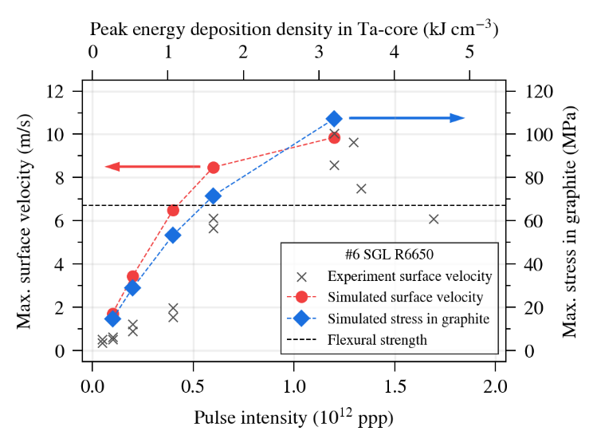
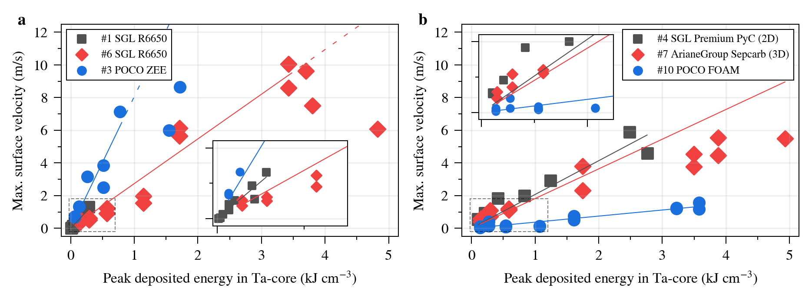
Summary
Slopes are proportional to CTE of the materials
Polycrystalline graphites show clear signs of failure:
  Velocity doesn‘t increase with beam intensity at a certain point
  #6 R6650: agrees well with stresses expected from ANSYS
CFCs have a more peculiar behaviour with apparently two regimes:
  Linear response <1 kJ/cm³
  Decreased slope >1 kJ/cm³
  Fiber delamination? Failure of the low strength matrix? (tensile strength 17 MPa in Sepcarb)
Very interesting results for POCO FOAM

Slide 10
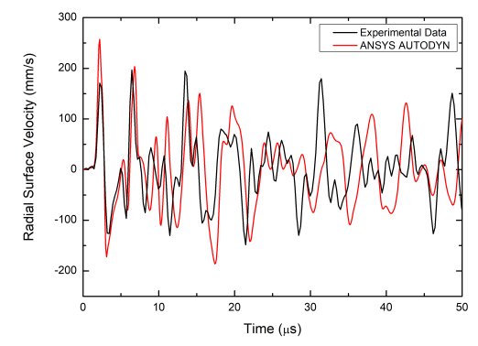
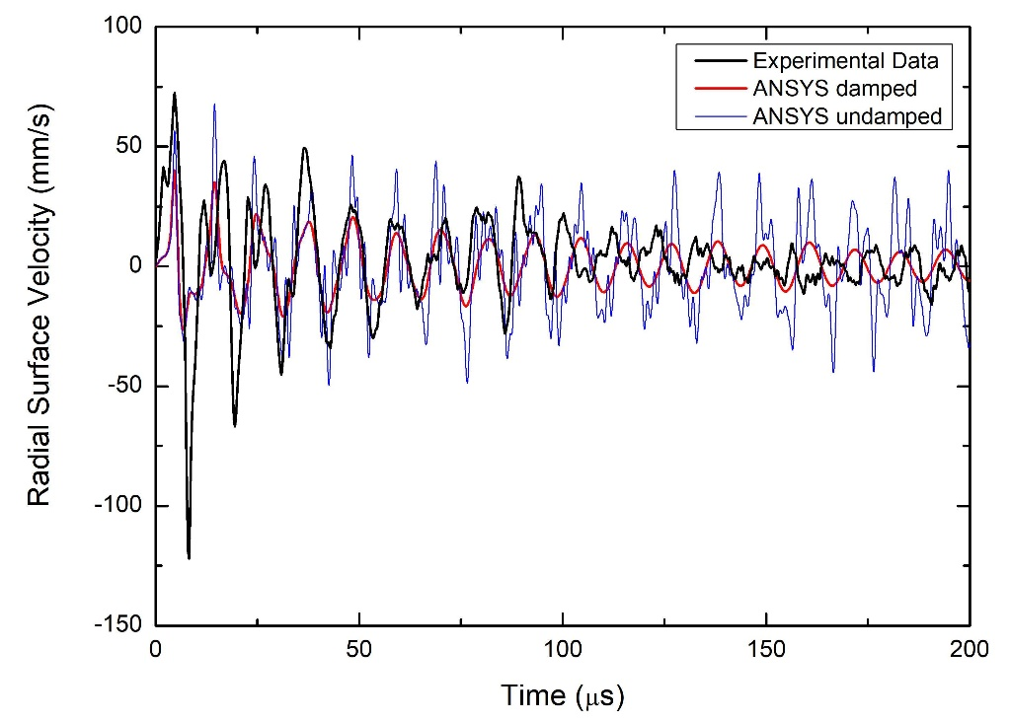
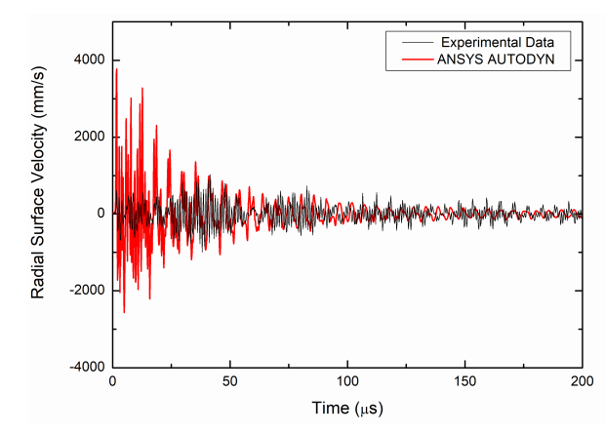
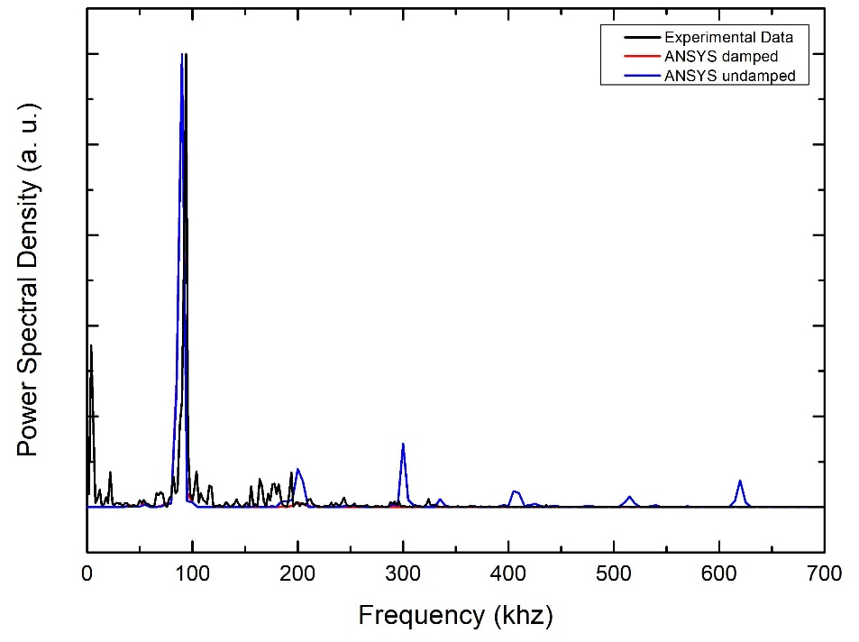
Outlook
Simulations with AUTODYN:
Foam in Workbench:
(AUTODYN produces error at 0.5 g/cm³ ☹)
Pure graphite
Graphite + Ta

