Slide 1
Ion irradiation test at GSI for collimator materials: results and future test plan
ARIES WP17 annual meeting
14/07/2020
C. Accettura (CERN and Politecnico di Milano)
With contribution of:
Baris, A. Bertarelli, P. Bolz, F. Carra, A. Lechner, A. Perez, A. Prosvetov,
S. Redaelli, P. Simon, E. Skordis, M. Tomut, A. Waets

Slide 2
Outline
GSI irradiation 2019
  Experiment overview
  Electrical resistivity
  Raman spectroscopy
Future test planning
Conclusions

Slide 3
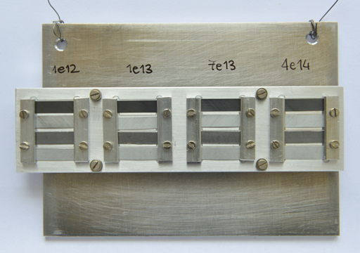
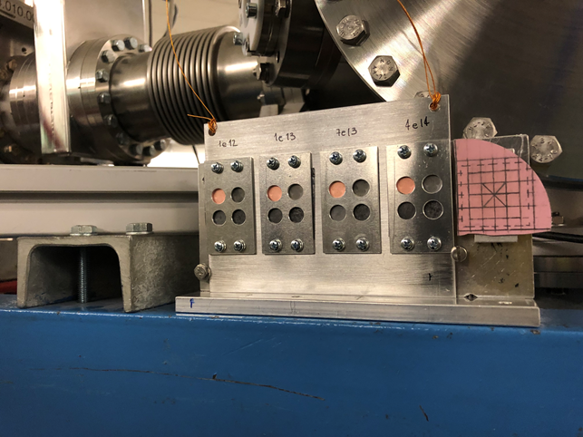
Ion irradiation campaign-GSI2019
⁴⁸Ca ions at 4.8 MeV/u
80 samples of graphitic material tested, half of them coated with thin films
  Gr R4550
  Gr R4550+Mo HIPIMS
  MoGr Nb8304Ng
  MoGr Nb8304Ng+Mo HIPIMS
  MoGr Nb8304Ng+Cu HIPIMS,
  MoGr MG6541Fc+Mo DCMS
  MoGr MG6541Fc
  CFC FS140
FLUKA simulation to compute DPA rate
Tmax~100°C (simulated)
Movable sample holder to irradiated 4 target station at different fluence (max DPA in the coating=HL-LHC)
HL-LHC primary and secondary collimators
Fluences [ions/cm²] | Peak DPA coating | Peak DPA bulk
1·10¹² | ~2.8·10⁻⁶ | ~1.1·10⁻⁴
1·10¹³ | ~2.8·10⁻⁵ | ~1.1·10⁻³
7·10¹³ | ~1.9·10⁻⁴ | ~7.8·10⁻³
4·10¹⁴ | ~1.1·10⁻³ | ~4.4·10⁻⁻²

Slide 4
Electrical resistivity studies
DC measurements with the 4-probe method and multi-layer model (~1/3 of the sample irradiated)→ important to know the irradiated layer thickness
FLUKA simulation for sample with different density: penetration depth in function of the density→ analytical correlation to know the irradiated layer for every samples
Density as important as the composition!
MoGr
Gr/CFC

Slide 5
Electrical resistivity studies
DC measurements with the 4-probe method and multi-layer model (~1/3 of the sample irradiated)→ important to know the irradiated layer thickness
UNCOATED
Electrical resistivity decrease faster in material with higher graphitization (MoGr)
MoGr with fibers more radiation resistant

Slide 6
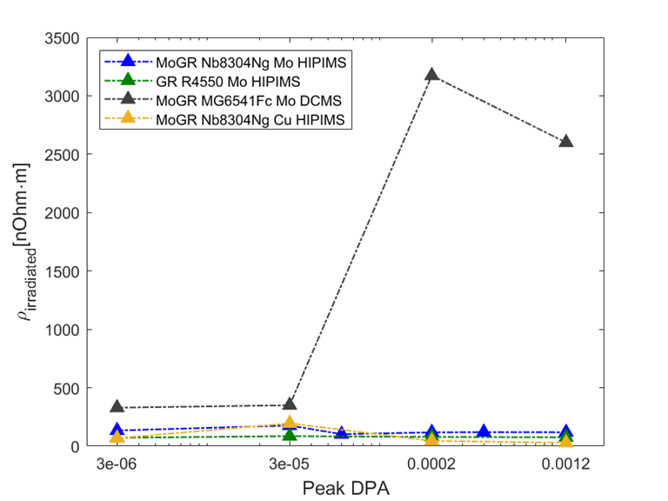
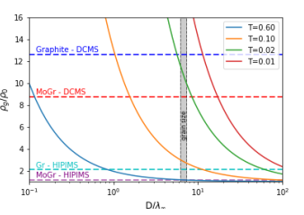
Electrical resistivity studies
DC measurements with the 4-probe method and multi-layer model (~1/3 of the sample irradiated)→ important to know the irradiated layer thickness
COATED
C. Accettura et al. "Resistivity Characterization of Molybdenum-Coated Graphite-Based Substrates for High-Luminosity LHC Collimators." Coatings 10.4 (2020): 361.
DCSM coating more resistant before the irradiation and it is loosing more then HIPIMS
DCSM has lower transmission coefficient, but similar grain size→ difference at the GBs

Slide 7
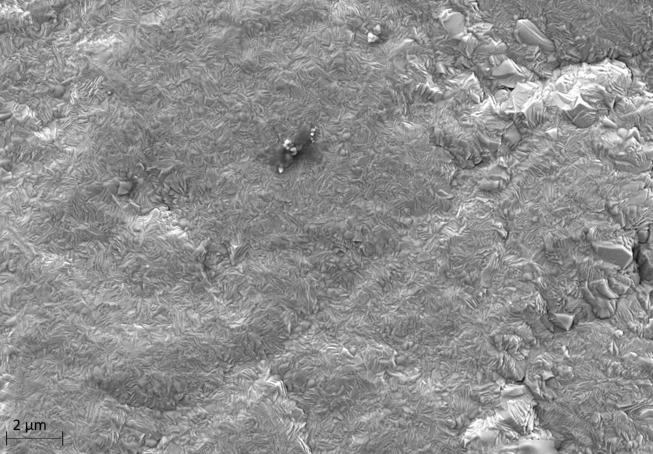
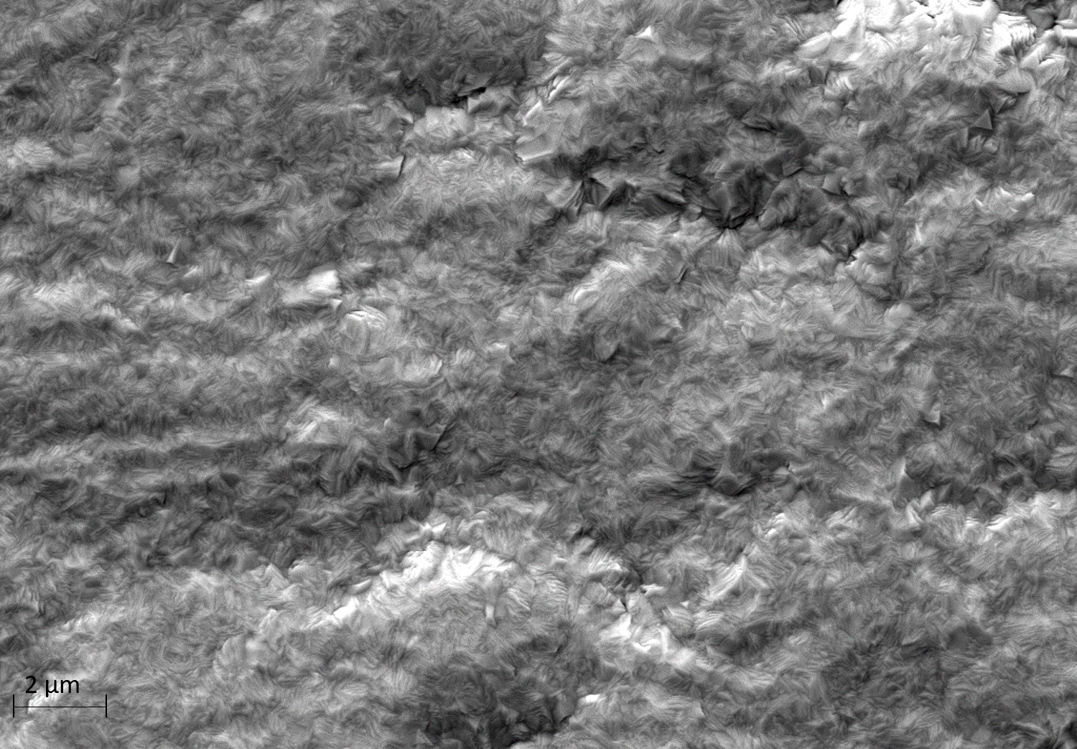
Microscopic observation of coatings
Pristine
Irradiated at 4e14 ions/cm² →max DPA
Mo coating produced with HIPIMS on MoGr (baseline for HL-LHC collimators)
  Columnar and dense structure kept after irradiation
  No cracks
  Good contact with the bulk
Important to evaluate effect of gas production

Slide 8
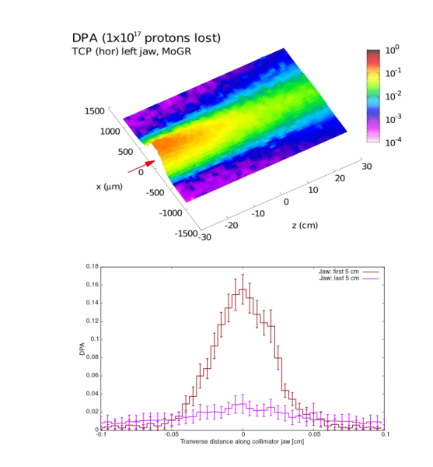
Peak vs average dpa
Peak dpa coating~average
Peak dpa 1 order of magnitude higher with respect to the average, 2 order of magnitude higher with respect to the surface
 | PEAK DPA |  | Average DPA
Fluences | Nb | Gr | Nb | Gr
1.00E+12 | 7.66E-05 | 7.25E-05 | 5.14E-06 | 4.75E-06
1.00E+13 | 7.66E-04 | 7.25E-04 | 5.14E-05 | 4.75E-05
7.00E+13 | 0.0053 | 0.0051 | 0.00036 | 0.000333
4.00E+14 | 0.0306 | 0.029 | 0.002056 | 0.001901
How to plot the properties degradation?
  Reference in the past used the peak dpa
  If I consider only the peak in the bulk→ underestimating the damage
  If I consider the average: not complete information, average dpa with higher peak can give different results, especially if threshold of more severe damage exist
  When considering the comparison with the collimators, consider a larger affected area

Slide 9
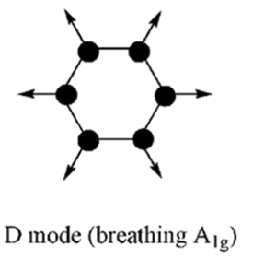
Raman spectroscopy on irradiated sample
Laser skin depth (514.5nm) for graphite~50-100nm: investigated region with a dpa << peak dpa, but flat
General findings:
  I_{D}, I_{D’}, FWHM_{G} increase→ in-plane information
  2D double peak becomes single (MoGr)→ through-plane information
In-plane defects in CFC
Stacking fault in MoGr
PRISTINE
IRRADIATED at 4E14 ions/cm²
IRRADIATED at 4E14 ions/cm²
PRISTINE

Slide 10
Microscopic vs electrical resistivity
ID increasing with fluences→ accumulation of defects
Increase of electrical resistivity coherent with in-plane defects concentration found with RS: MoGr Nb more affected and Gr less affected (relative values)
MoGr with fibers higher D peak, but less affected than CFC→ phenomenon related to higher dpa (not detected by RS)?

Slide 11
Raman spectroscopy
MoGr remains with a more order structure clearly different with respect to Gr and CFC, especially the AB stacking fault
RS useful to see difference response of materials and coherent with electrical resistivity
Test proposal: investigate RS evolution after annealing of material at different temperature
  Useful to study defects mobility
  Useful to study influence of material structure on defects recombination
  Useful to estimate properties recovery (Bake-out temperature in LHC!)

Slide 12
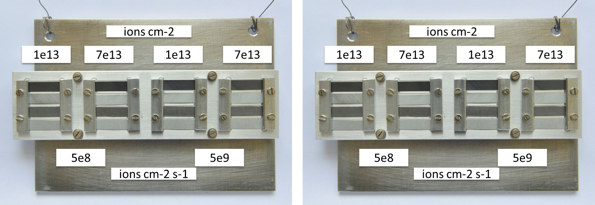
Planning for GSI2020 campaign (postponed)
Test postponed for the Covid-19 emergency→ new proposal for 2021 beamtime submitted
Aim: Investigation of flux effect→ DPA rate effect (damage evolution→ scaling to HL-LHC?)
Same materials (Gr, MoGr and coating) selected for proton irradiation @BLIP (see N. Solieri presentation)→ additional effect of gas production
Focus on MoGr (new grade) and Gr with Mo coating
Investigate 2 fluences at 2 flux
Reduce the heat exchange on the low flux to have the same temperature on the two holders
5e8
5e8
5e9
5e9
5e8 (~90h)
5e9 (~10h)
Timeline
Jan-Feb 2020
Mar-Apr 2020
Design
Sample procurement
Sample characterization
Test
done
postponed
Beginning 2021?

Slide 13
Conclusion
GSI irradiation campaign in 2019 very useful: coating and new MoGr grade irradiated for the first time and accessible 1 month after the test
Electrical resistivity degradation:
  Interesting results indicate possible positive effect of C-fibers
  Coating production process influence the results
RS gives microscopic information coherent with the macroscopic→ interesting to perform annealing studies to understand defects mobilities for different materials
Possibility to compare outcome of ion irradiation with proton irradiation (RADIATE collaboration)

Slide 14
Electrical resistivity coating
UNCOATED
COATED

Slide 15
Electrical resistivity coating
Nb
Gr

Slide 16
Uncoated and coated
Nb
Gr
UNCOATED
COATED
CFC
Mg

Slide 17
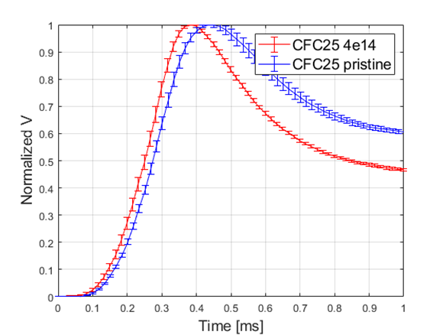
GSI 2019-Thermal conductivity
All the samples tested
Systematic (for all the samples) increase of the heating ramp→ not coherent with literature
More test planned to understand this behavior (Aluminum foil)

Slide 18
GSI 2019-Thermal conductivity
Nb12-pristine
Long acquisition time measurement indicate also a decrease in the in-plane thermal conductivity, but difficult to quantitative estimate without the fitting the first part of the curves.

Slide 19
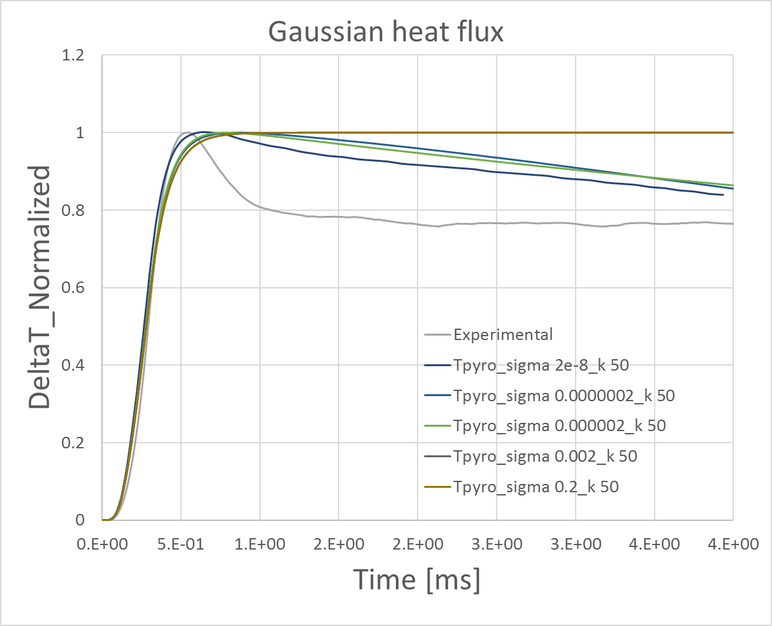
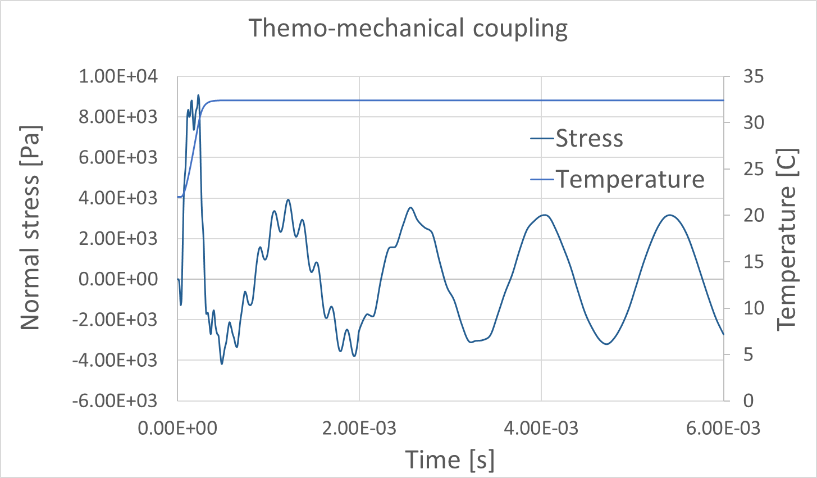
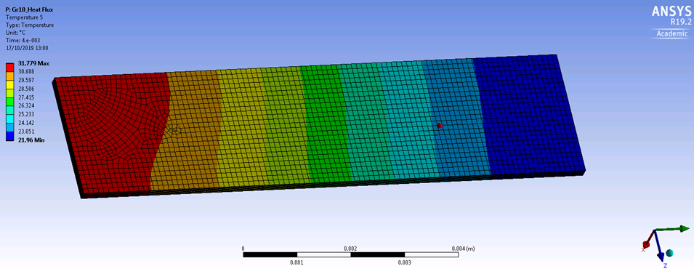
Methods
Deep investigation of possible thermal losses:
  Convection/radiation
  Gaussian flux distribution
  Laser power penetration depth
  Thermoelastic temperature oscillation

