Slide 1
Computational simulation of lattice defects in graphite

Slide 2
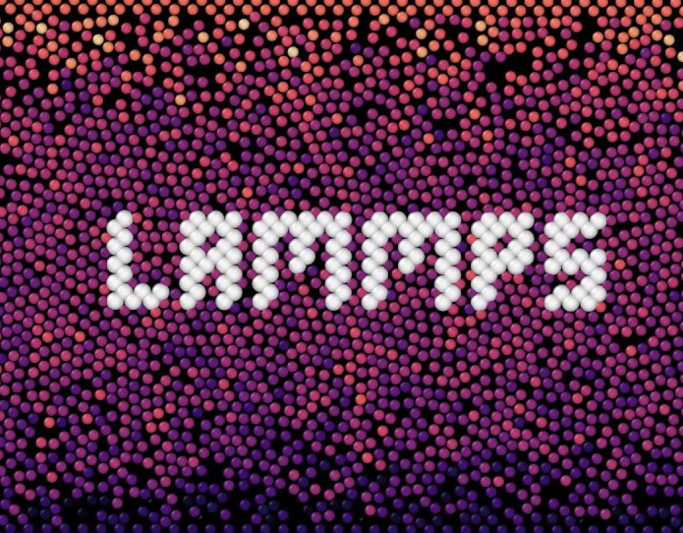
MSc thesis project: Modeling of radiation damage effects on graphitic materials
Ultimate goal: fill this (huge) gap
Single collisional events infos (FLUKA)
Macroscopic behaviour of devices
t
Engineering design
1y
Obtain mechanisms & data for higher scale models
Frenkel pair accumulation methodology
Select significant phenomena and orient investigations
1s
Continuum modeling
100ns
Mesoscale modeling
GIOIA - Graphite radiatIOn damage sImulAtion
50,000 core-hours on CINECA, HPC center
Molecular mechanics
10ps
Quantum mechanics
1-10nm
100nm
1µm
1mm
1m
d
S. Plimpton, J Comp Phys, 117, 1-19 (1995)

Slide 3

MSc thesis project: Modeling of radiation damage effects on graphitic materials
Supercell?
Defects?
bulk
data?
single grain boundary
interstitials
polycristalline
intercalated atoms
both
Computes?
conductivity coefficients
swelling
validation
failure mechanisms
simulation
validation
simulation
amorphisation
prediction
prediction

Slide 4
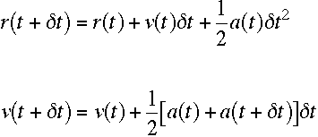
Molecular Dynamics
..is the solution of the classical equations of motion for a system of N atoms or molecules in order to obtain the time evolution of the system
Requires the definition of the potential to compute the forces
Uses algorithms to integrate
the equations of motion
of crucial importance!!
We chose the usual velocity-Verlet
We chose LCBOP for pure graphite
J. H. Los and A. Fasolino, Phys. Rev. B 68, 2003

Slide 5
Can Molecular Dynamics predict material behaviour?
simulation
validation
prediction
Notes:
Despite the high computational cost and the huge scale difference between MD “experiments” and real situations, these procedures might be the only way to try to begin to tackle the problem

Slide 6
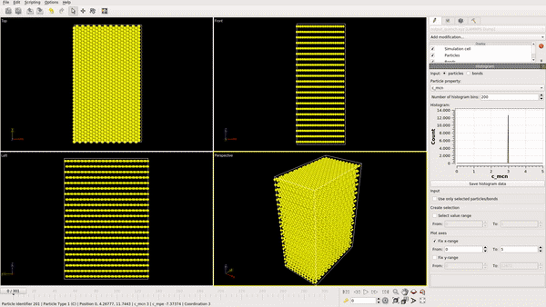
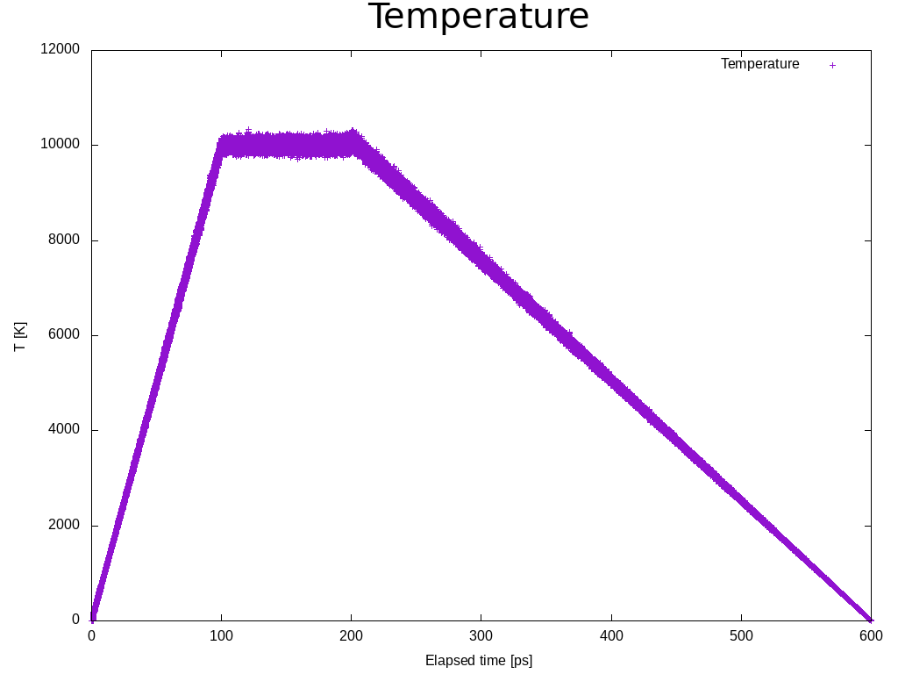
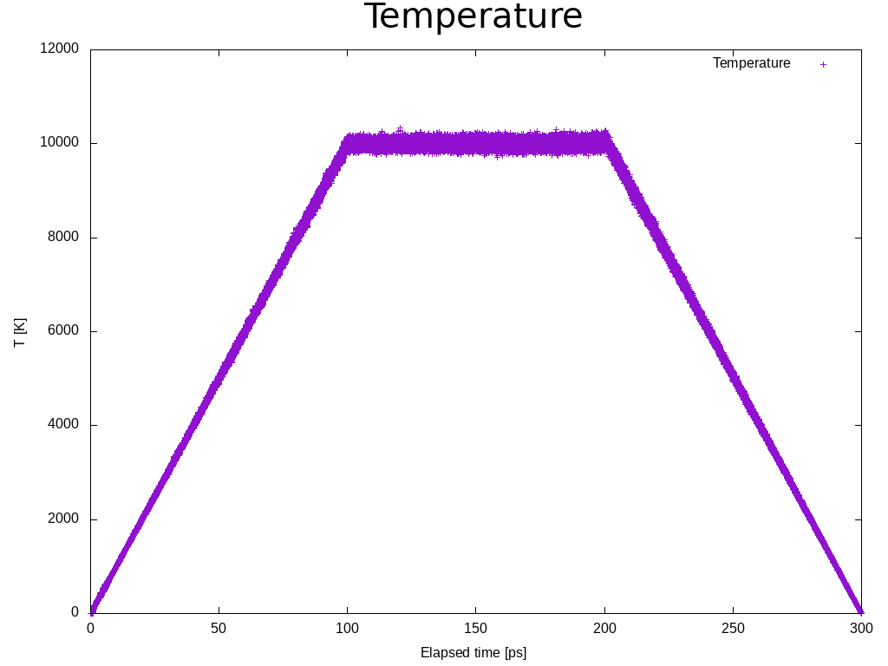
Validation
Potential validation:
Test on the amourphous state created by quenching a 12800 atom supercell from 10’000 K to 1 K, followed by relaxation by static procedure of energy minimisation
This state should be the least stable to avoid any non-physical stabilisation
quench8, 12672 atoms 29x51x73Å, 300ps
Procedure validation:
replicating preliminary results reported in literature, using a 102400 atoms cell with Frenkel pair accumulation methodology with different dpa

Slide 7
Frenkel pair accumulation
Def: creating continuously point defects (Frenkel pairs) in a graphite supercell using MD calculations
1
2
a new position for this atom is generated randomly such that the closest distance with its first neighbours > 0.5 Å
the system is relaxed under constant temperature and constant pressure
Berendsen thermostat and barostat is chosen for fast relaxation
a C-atom is randomly selected in the supercell
3
4
loop until desired dpa is reached
The dpa rate has no influence/meaning because of the low mobility below 200°
Chartier et al., Carbon 91, 2015

Slide 8
Frenkel pair accumulation
1
2
a new position for this atom is generated randomly such that the closest distance with its first neighbours > 0.5 Å
the system is relaxed under constant temperature and constant pressure
Berendsen thermostat and barostat is chosen for fast relaxation
a C-atom is randomly selected in the supercell
3
4
loop until desired dpa is reached
to compensate the increase
of temperature and strain due to the relaxation of each defect
the supercell is submitted to local stresses and the potential energy artificially increases around each defect

Slide 9
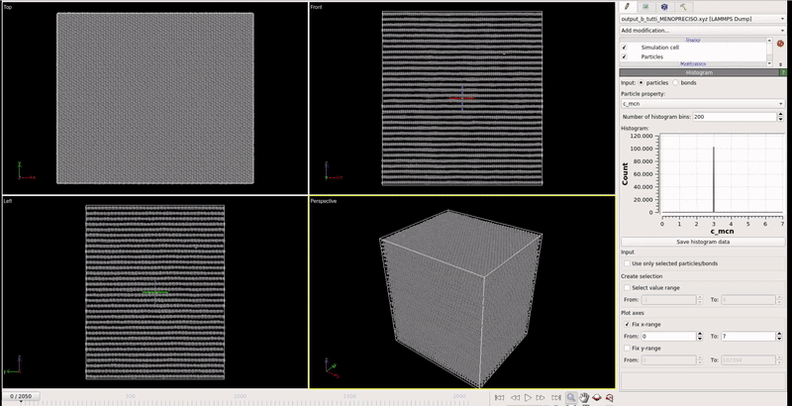
Frenkel pair accumulation: an example
102400 atoms, 98x85x107Å, 0.02dpa, 300K, 1 bar histogram: coordination number, cutoff 1.8Å

Slide 10
Inserting intercalated atoms
Def: artificially inserting intercalated atoms in the pristine structure
1
2
the system is relaxed under constant T and P with Berendsen (fast)
one atom is randomly selected in the supercell
4
3
change the type of atom (C) to the desired element
a new position for this atom is generated randomly such that the closest distance with its first neighbours > 0.5 Å
6
select only the intercalated atoms, discard the remaining supercell and superimpose it to the [step 0] perfect supercell
7
let evolve and continue analysis
0
create the normal (perfect) graphite supercell
5
loop until desired quantity is reached
Hybrid potential needed in order to describe interaction

Slide 11
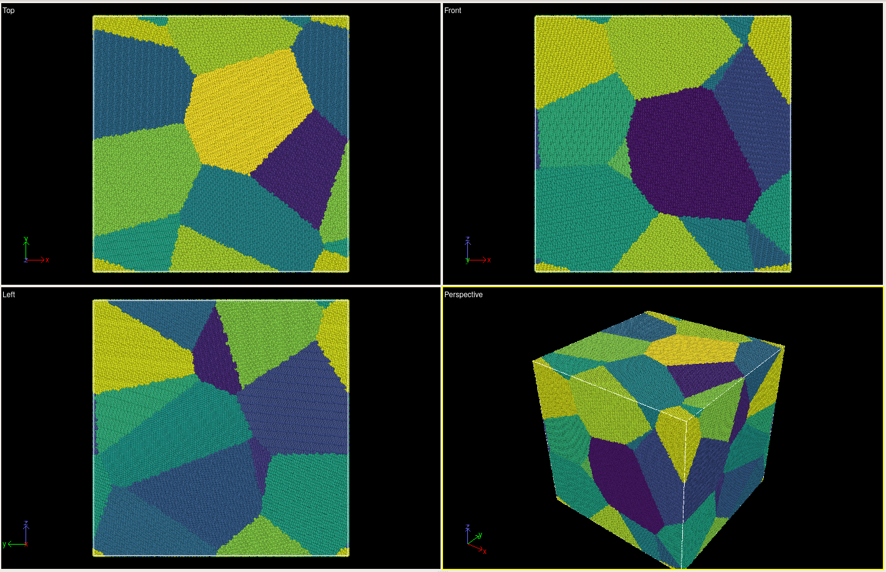
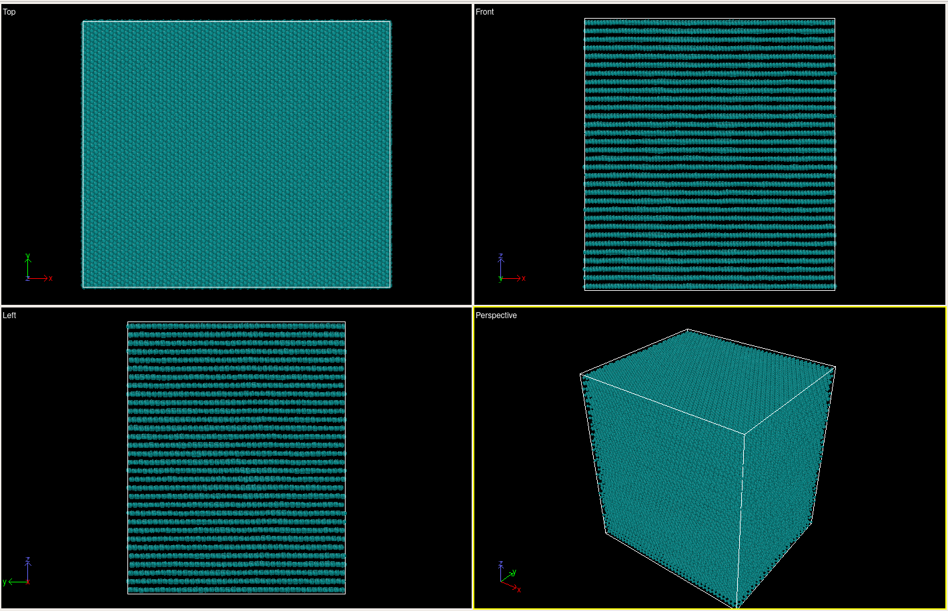
Geometries
Supercell?
Grains
bulk
single grain boundary
polycristalline
Monocrystal
18 grains, 5503642 atoms, 400x400x400Å
Only 1 grain boundary!
102400 atoms, 98x85x107Å

Slide 12

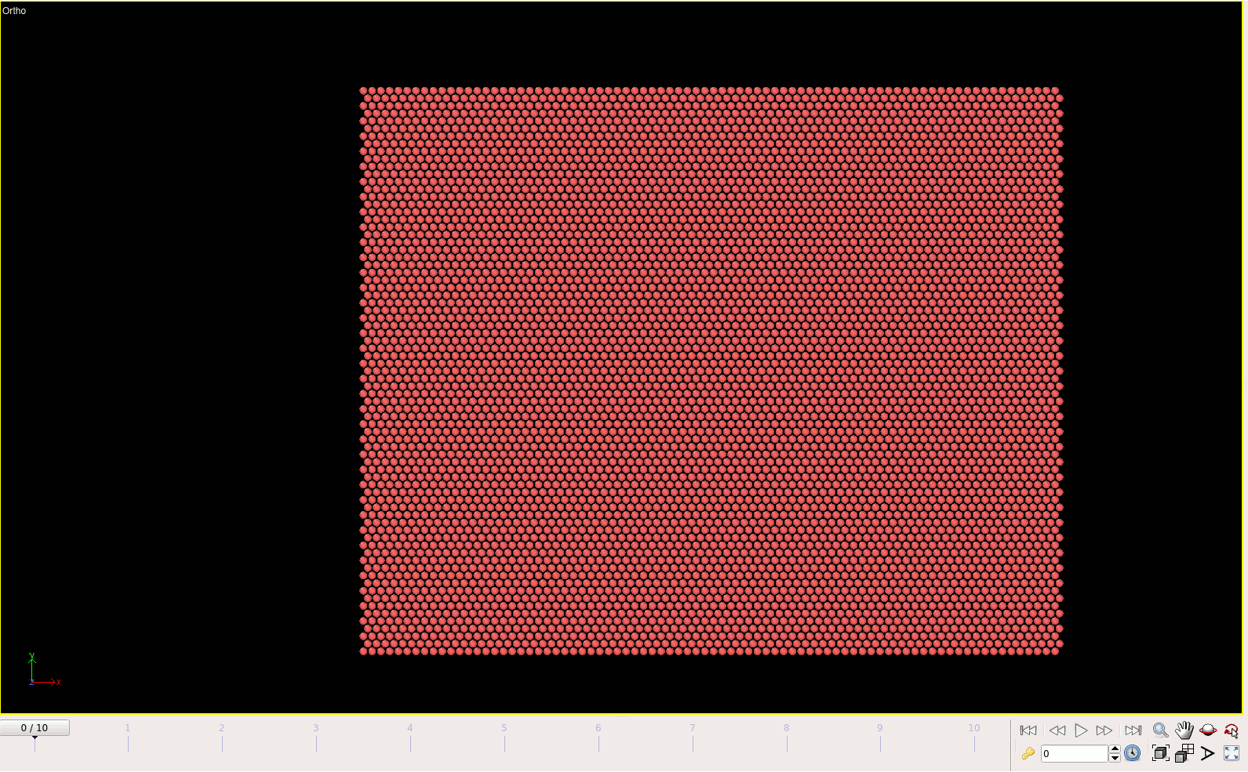
Goals
Computes?
Thermal conductivity
Volume change/swelling
conductivity coefficients
swelling
Green-Kubo relations
failure mechanisms
amorphisation
calculate the heat flux vector, then the Green-Kubo formulas relate the ensemble average of the auto-correlation of the heat flux J to the thermal conductivity k
Fracture mechanism
similarly for the
Electrical conductivity
Temperature dependence ?

Slide 13
Thank you
for your attention

