Slide 1

Updates on BLIP irradiation tests and RaDIATE activities
N. Solieri
Under the supervision of M. Calviani
On behalf of the RaDIATE collaboration

Slide 2
Outline
Radiation damage in Beam Impacted Devices (BIDs)
    Material R&D approaches for BIDs at different time-scales
    The RaDIATE collaboration
BLIP Irradiations
    BNL’s BLIP facility
    Organization of an irradiation at BLIP and subsequent PIE
    An overview of the irradiations that we have launched
    The CERN2 capsule
An overview of some of the other RaDIATE activities
    BeGrid2 (HRMT43) organization and subsequent PIE (K. Ammigan, FNAL)
    Fatigue testing of Ti alloys for FNAL beam windows (S. Bidhar, FNAL)
    Ti-base alloy tensile testing and microscopy (D. Senor, PNNL)
    Radiation damage effects in Be (S. Kuksenko, UKAEA)
    Development of ANSYS scripts for the implementation of radiation damage data (N. Solieri, CERN)

Slide 3
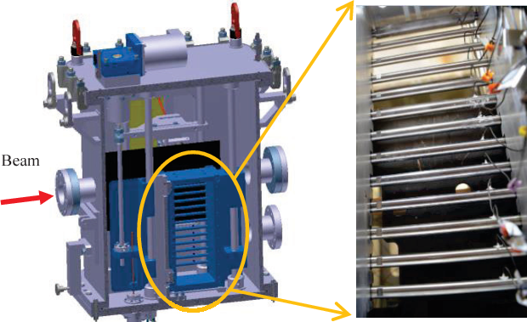
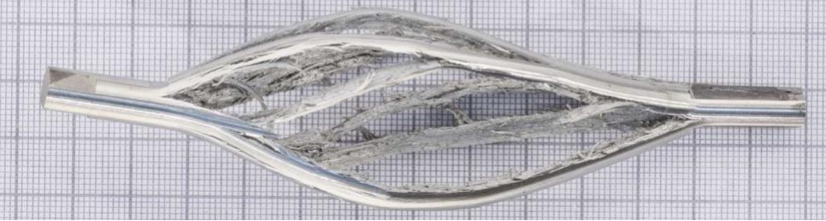
Material R&D studies for BIDs
Data from material studies for nuclear reactors poorly translate to BID scenarios → Need own material R&D
TIMESCALE
ns / µs
months / years
HiRadMat
Characterization of the dynamic response of the materials/prototypes under proton beam impact. No relevant radiation damage produced
1
¹Courtesy C. Torregrosa
² Courtesy E. Fornasiere, in collaboration with Framatome GmbH

Slide 4
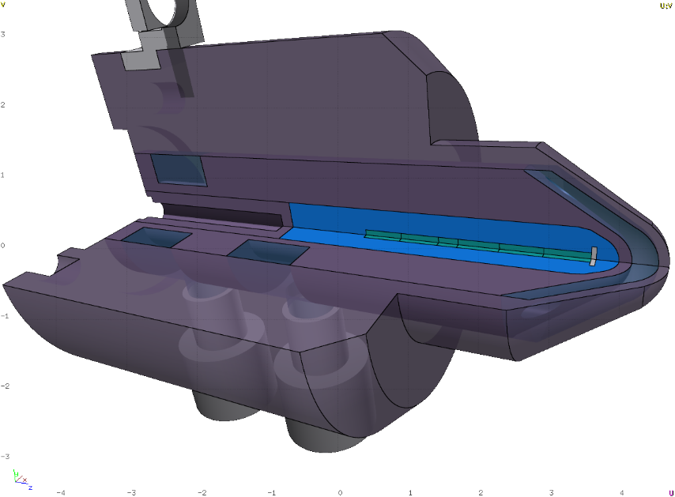
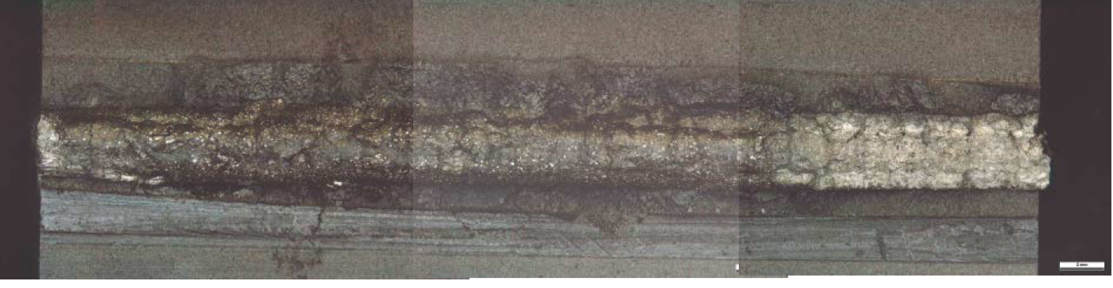
Material R&D studies for BIDs
Data from material studies for nuclear reactors poorly translate to BID scenarios → Need own material R&D
TIMESCALE
ns / µs
months / years
HiRadMat
Post-mortem irradiation examination
Characterization of the dynamic response of the materials/prototypes under proton beam impact. No relevant radiation damage produced
Opening of a spent AD-Target after 7 years of irradiation
2
BLIP Irradiations
Several small samples for material testing enclosed in welded stainless steel capsules (Ø70 mm, 5 mm thick)
1
¹Courtesy C. Torregrosa
² Courtesy E. Fornasiere, in collaboration with Framatome GmbH

Slide 5
Material R&D studies for BIDs
Data from material studies for nuclear reactors poorly translate to BID scenarios → Need own material R&D
TIMESCALE
ns / µs
months / years
HiRadMat
Post-mortem irradiation examination
Characterization of the dynamic response of the materials/prototypes under proton beam impact. No relevant radiation damage produced
Opening of a spent AD-Target after 7 years of irradiation
WE CAN ALSO COMBINE THE TWO APPROACHES (BeGrid2)
2
BLIP Irradiations
Several small samples for material testing enclosed in welded stainless steel capsules (Ø70 mm, 5 mm thick)
1
¹Courtesy C. Torregrosa
² Courtesy E. Fornasiere, in collaboration with Framatome GmbH

Slide 6
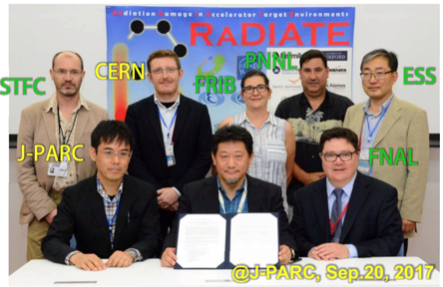
Broad aims are threefold:
to generate materials data for accelerator and fission/fusion communities
Bring together HEP and nuclear fusion/fission materials research communities
to initiate a continuing synergy between research in these communities, benefitting both proton accelerator applications in science and industry and carbon-free energy technologies
5th in-person collaboration meeting held at CERN in Dec. 2018

Slide 7
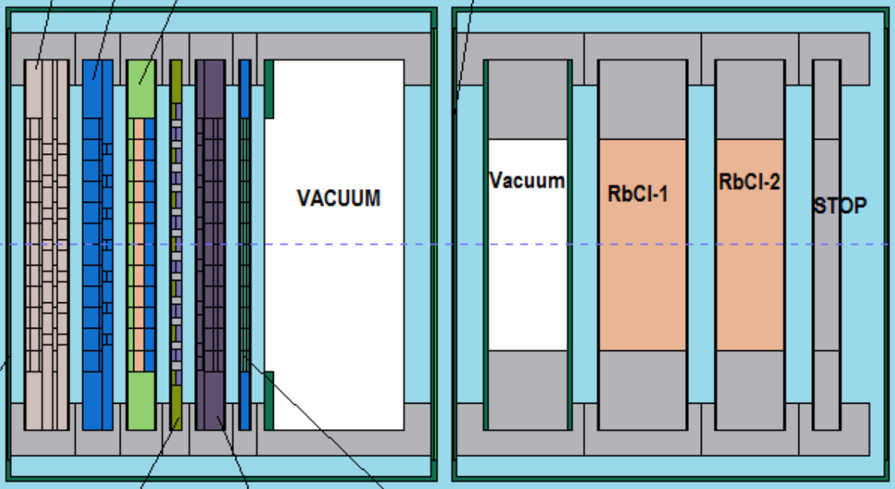
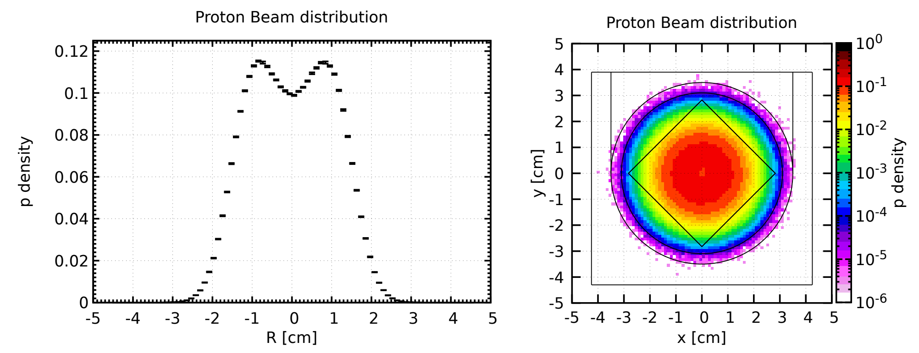
Irradiations at BLIP
Material irradiation in tandem and upstream of isotope targets:
  Primary proton energy: up to 200 MeV
  RaDIATE Target array needs to be optimized for each run to deliver a beam that is appropriate for isotope production
  POT ~ 1E21
  Peak DPA: 0.88 (Ta2.5W, CERN2 capsule), 1.2 (Ir, HighZ capsule)
  Rastered beam profile to achieve more constant irradiation profile
  Irradiation length O(months)
BLIP – Brookhaven Linear Isotope Producer at BNL
RaDIATE Targets
Isotope Targets
1
Objectives:
  Evaluate radiation damage effects from high-energy protons in various accelerator materials:
      Beam windows, Secondary particle production targets, Beam dumps
  Perform PIE activities to characterize property changes due to proton irradiation damage
      Strength (tensile, bend, fatigue)
      Thermal (CTE,conductivity)
      Annealing effects and microstructure (SEM, TEM, EBSD)
2
¹Courtesy K. Ammigan
²Courtesy J. Canhoto

Slide 8
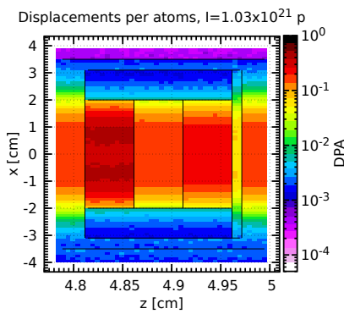
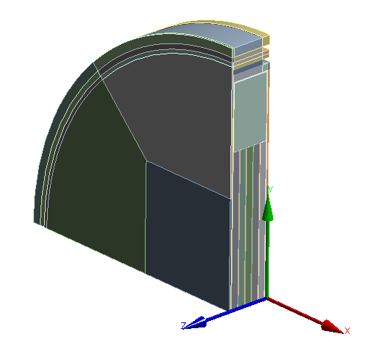
Organization of an irradiation at BLIP and subsequent PIE
Definition of irradiation run aims and target assembly
Comparison with the conditions achieved in the BID and BNL proton energy budget
FLUKA Studies
ANSYS Studies
¹Courtesy K. Ammigan

Slide 9
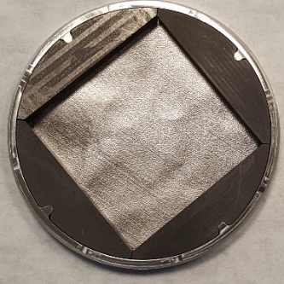
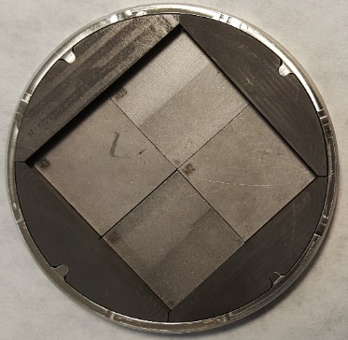
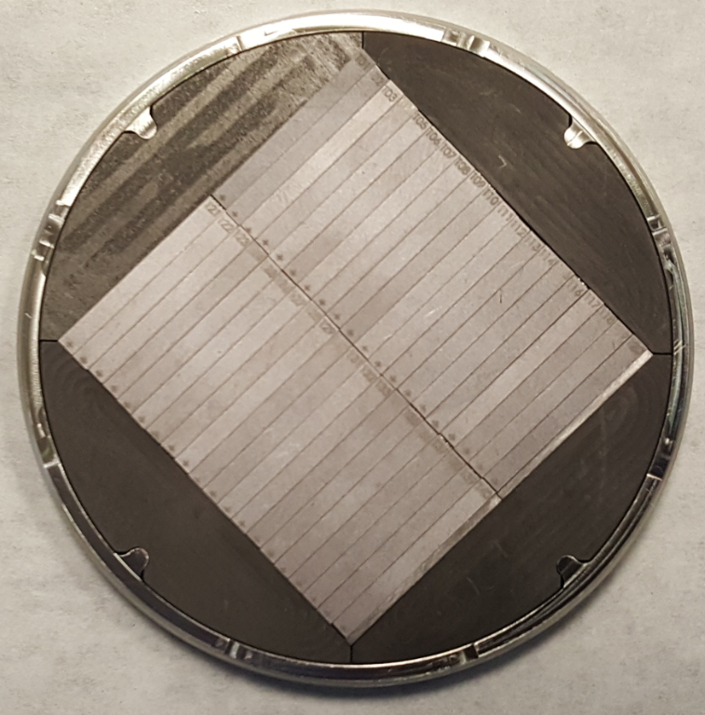
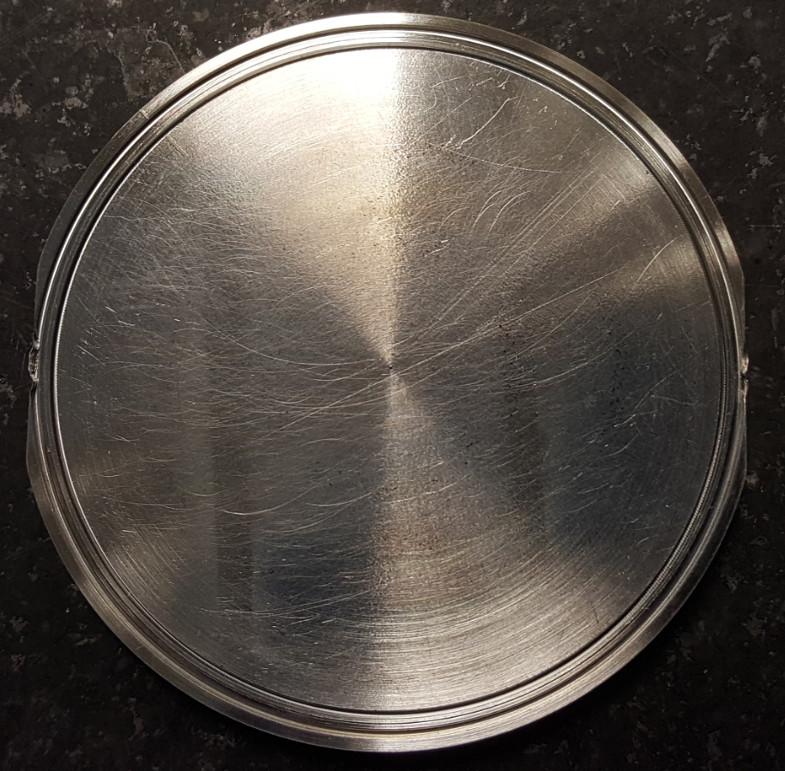
Organization of an irradiation at BLIP and subsequent PIE
Definition of irradiation run aims and target assembly
Capsule and material specimens fabrication
Comparison with the conditions achieved in the BID and BNL proton energy budget
FLUKA Studies
ANSYS Studies
Capsule Cover
Filling with specimens
EBW
¹Courtesy K. Ammigan

Slide 10
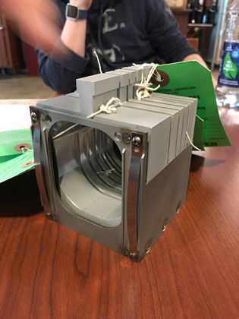
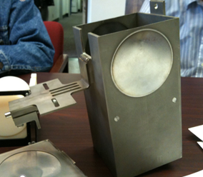
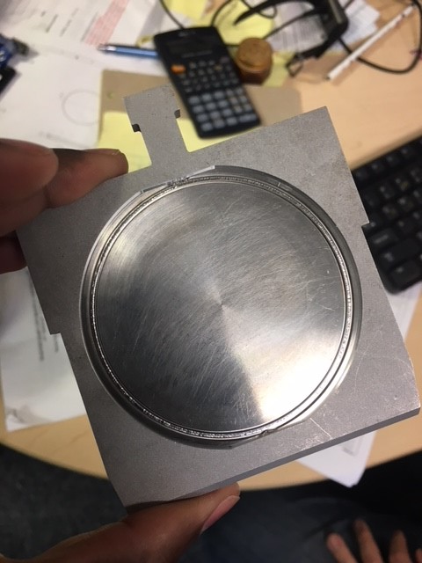
Organization of an irradiation at BLIP and subsequent PIE
Definition of irradiation run aims and target assembly
Capsule and material specimens fabrication
Shipment of capsule to BNL and installation in the beamline
Comparison with the conditions achieved in the BID and BNL proton energy budget
1
FLUKA Studies
ANSYS Studies
Capsule fitted in
capsule holder
Basket assembly
(2.5 mm water gap)
Target box assembly
Capsule Cover
Filling with specimens
EBW
¹Courtesy K. Ammigan

Slide 11
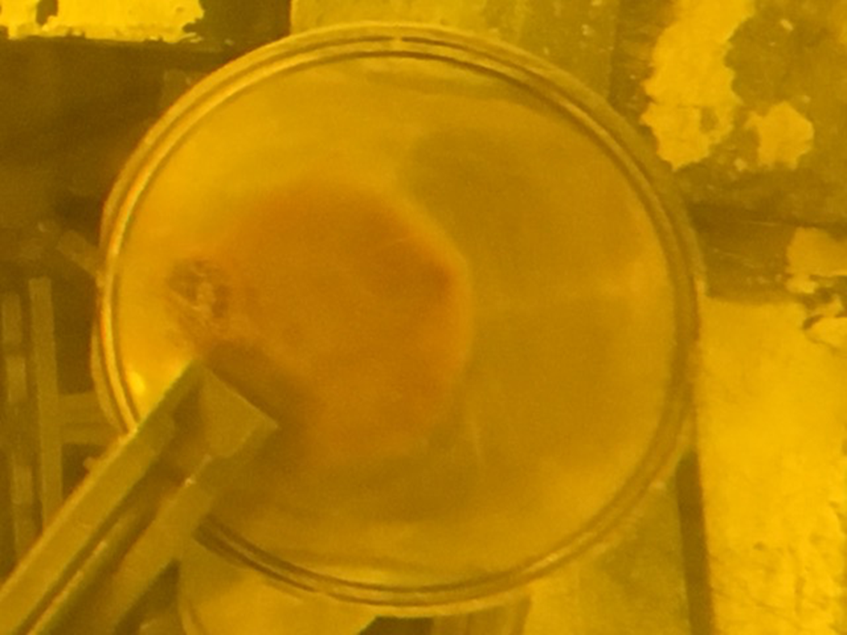
Organization of an irradiation at BLIP and subsequent PIE
Definition of irradiation run aims and target assembly
Capsule and material specimens fabrication
Shipment of capsule to BNL and installation in the beamline
Irradiation and subsequent cooldown – O(year)
Comparison with the conditions achieved in the BID and BNL proton energy budget
1
FLUKA Studies
ANSYS Studies
Capsule fitted in
capsule holder
Basket assembly
(2.5 mm water gap)
Target box assembly
Capsule Cover
Filling with specimens
EBW
CERN2 Capsule: Computed dose sum @ 1m after 18 months cooldown ~4 mSv/h
¹Courtesy K. Ammigan

Slide 12
Organization of an irradiation at BLIP and subsequent PIE
Definition of irradiation run aims and target assembly
Capsule and material specimens fabrication
Shipment of capsule to BNL and installation in the beamline
Irradiation and subsequent cooldown – O(year)
Comparison with the conditions achieved in the BID and BNL proton energy budget
1
FLUKA Studies
ANSYS Studies
Capsule fitted in
capsule holder
Basket assembly
(2.5 mm water gap)
Target box assembly
Capsule Cover
Filling with specimens
EBW
CERN2 Capsule: Computed dose sum @ 1m after 18 months cooldown ~4 mSv/h
PIE ACTIVITIES
¹Courtesy K. Ammigan

Slide 13
Organization of an irradiation at BLIP and subsequent PIE
Definition of irradiation run aims and target assembly
Capsule and material specimens fabrication
Shipment of capsule to BNL and installation in the beamline
Irradiation and subsequent cooldown – O(year)
Comparison with the conditions achieved in the BID and BNL proton energy budget
1
FLUKA Studies
ANSYS Studies
Capsule fitted in
capsule holder
Basket assembly
(2.5 mm water gap)
Target box assembly
Capsule Cover
Filling with specimens
EBW
CERN2 Capsule: Computed dose sum @ 1m after 18 months cooldown ~4 mSv/h
PIE ACTIVITIES
CERN2 Capsule → Design started in second half of 2017
PIE on some of the specimens will take place during 2020
¹Courtesy K. Ammigan

Slide 14
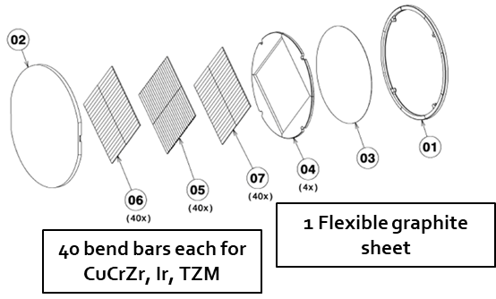
An overview of the BLIP irradiation runs we launched
High-Z Capsule
POT: 1.03E21
Peak DPA: 2.75 (Ir)
Max T_{irr}: ~850 °C
CuCrZr, TZM → SPS Int. Dump
Ir → AD-Target
Capsule currently at PNNL
Opening will take place in the coming weeks
PIE → 4-point bending test
A previous capsule suffered catastrophic damage and all the specimens were destroyed

Slide 15
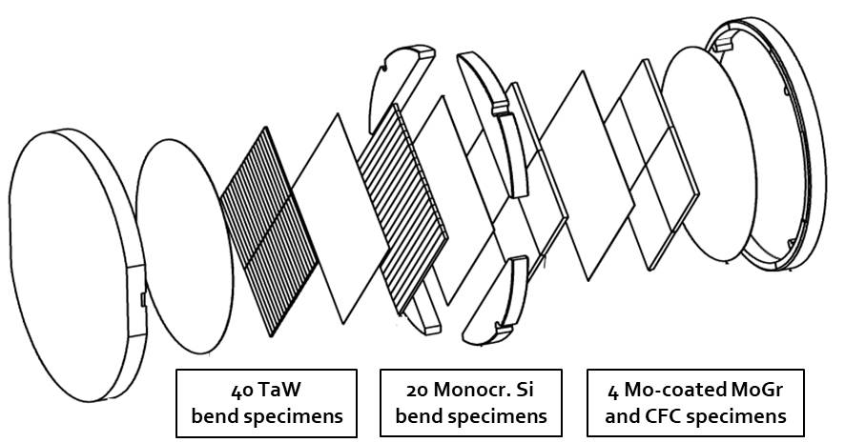
An overview of the BLIP irradiation runs we launched
High-Z Capsule
CERN2 Capsule
POT: 1.03E21
Peak DPA: 2.75 (Ir)
Max T_{irr}: ~850 °C
CuCrZr, TZM → SPS Int. Dump
Ir → AD-Target
Capsule currently at PNNL
Opening will take place in the coming weeks
PIE → 4-point bending test
A previous capsule suffered catastrophic damage and all the specimens were destroyed
POT: 2.8E21
Peak DPA: 4.77 (Ta)
Max T_{irr}: ~230 °C
Mo-Coated MoGr and CFC → HiLumi Collimators
Monocr. Si → SPS Dump
Capsule currently at BNL
Opening was scheduled for end of Mar-Apr. 2020 @ Framatome
Restart of activities being planned in collaboration with BNL
PIE → Coating visual inspection, adhesion test, 4-point bend test

Slide 16
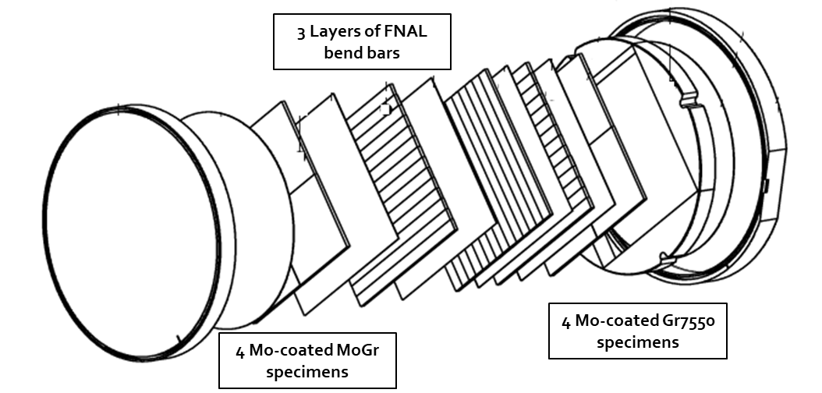
An overview of the BLIP irradiation runs we launched
High-Z Capsule
CERN3 Capsule (CERN/FNAL)
CERN2 Capsule
POT: 1.03E21
Peak DPA: 2.75 (Ir)
Max T_{irr}: ~850 °C
CuCrZr, TZM → SPS Int. Dump
Ir → AD-Target
Capsule currently at PNNL
Opening will take place in the coming weeks
PIE → 4-point bending test
A previous capsule suffered catastrophic damage and all the specimens were destroyed
POT: 2.8E21
Peak DPA: 4.77 (Ta)
Max T_{irr}: ~230 °C
POT: 7.5E21 (expected)
Max T_{irr}: ~170 °C (CERN specimens)
Mo-Coated MoGr and CFC → HiLumi Collimators
Monocr. Si → SPS Dump
Mo-coated MoGr and Gr7550 → HiLumi Collimators
Capsule construction under way at CERN
Irradiation was scheduled to take place in May 2020, now scheduled for second half of 2020
Capsule currently at BNL
Opening was scheduled for end of Mar-Apr. 2020 @ Framatome
Restart of activities being planned in collaboration with BNL
PIE → Coating visual inspection, adhesion test, 4-point bend test

Slide 17
An overview of some of the other RaDIATE activities

Slide 18
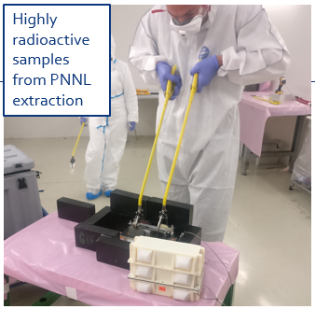
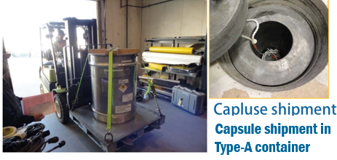
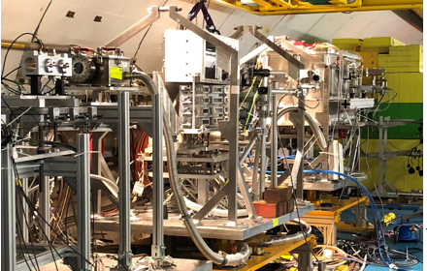
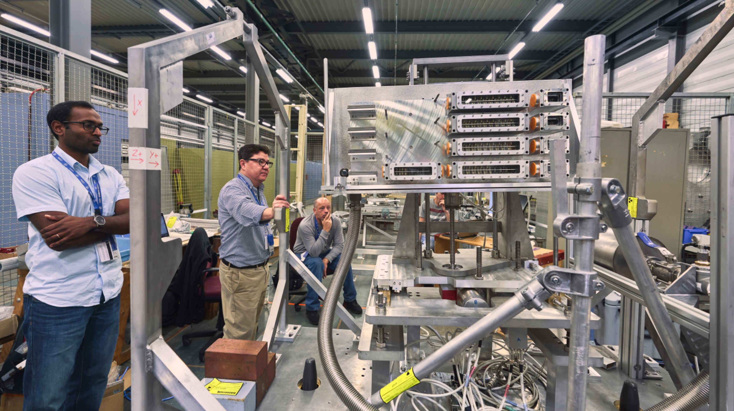
BeGrid2 (HRMt43) - Organization
K. Ammigan (FNAL)
Objectives →
Identify thermal shock response differences between non-irradiated and previously
proton-irradiated specimens from BNL BLIP:
        (Be, C, Ti-alloys, Si, SiC-coated C)
First and unique tests with
pre-activated materials at HiRadMat
Explore novel materials such as:
      Metal foams (C, SiC)
      Electrospun fiber mats (Al₂O₃, ZrO₂)
Very complex coordination between BNL, FNAL, PNNL and CERN for handling of highly radioactive samples
Real-time measurement of dynamic thermo-mechanical response of graphite specimens in an effort to benchmark numerical simulations
Completed in Oct. 2018

Slide 19
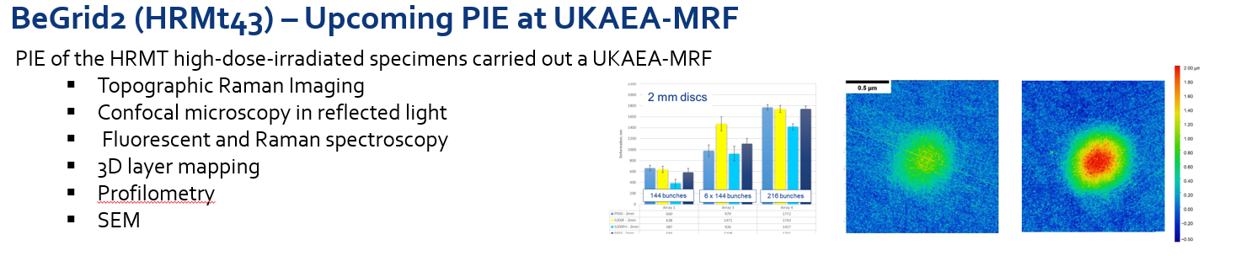
BeGrid2 (HRMt43) - Organization
K. Ammigan (FNAL)
Objectives →
Identify thermal shock response differences between non-irradiated and previously
proton-irradiated specimens from BNL BLIP:
        (Be, C, Ti-alloys, Si, SiC-coated C)
First and unique tests with
pre-activated materials at HiRadMat
Explore novel materials such as:
      Metal foams (C, SiC)
      Electrospun fiber mats (Al₂O₃, ZrO₂)
Very complex coordination between BNL, FNAL, PNNL and CERN for handling of highly radioactive samples
Real-time measurement of dynamic thermo-mechanical response of graphite specimens in an effort to benchmark numerical simulations
Completed in Oct. 2018

Slide 20
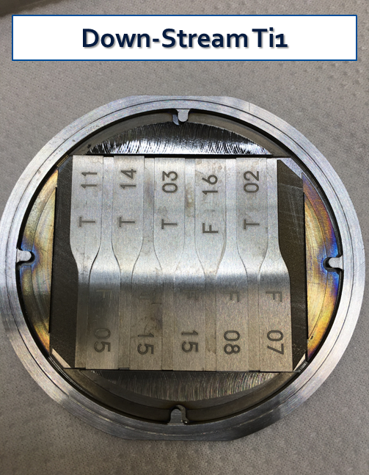
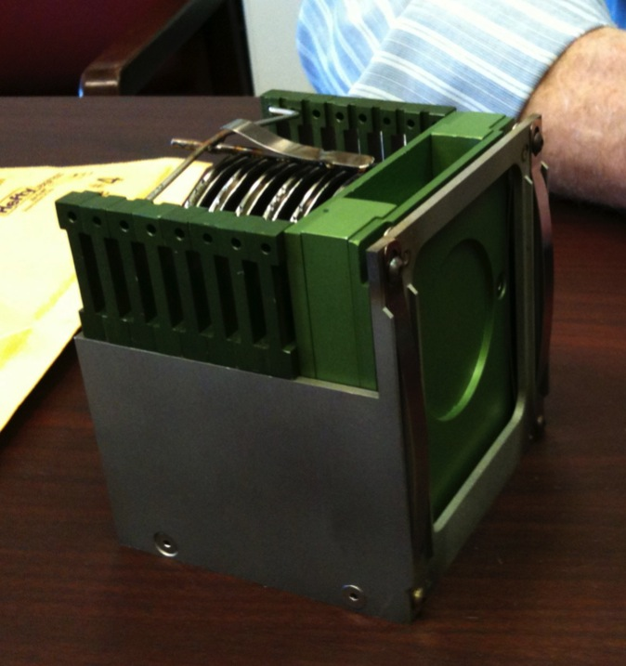
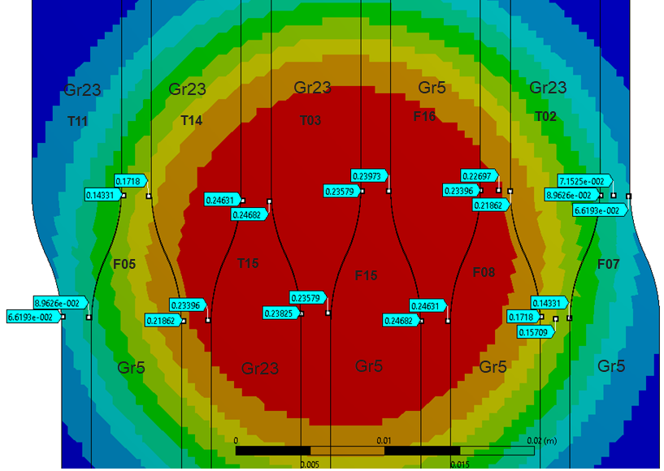
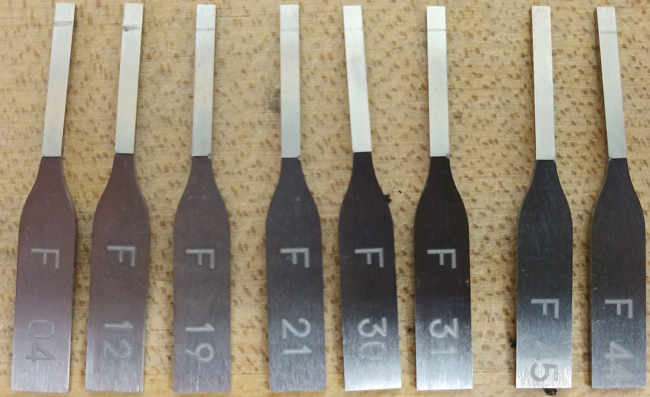

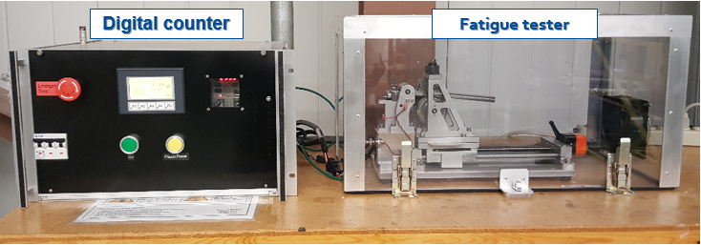
Fatigue testing of Ti alloys for FNAL T2K beam window (1/2)
S. Bidhar (FNAL)
T2K’s Ti beam window subjected to thermal shock-induced load cycles AND long-term proton beam irradiation damage
Ti bend specimens for fatigue testing
Ti specimens in BLIP capsule
BLIP capsule in capsule holder
BLIP irradiation – dose map (DPA) on Ti specimens
FNAL custom-made Bending Fatigue tester
Cyclic load frequency of 15 Hz
Stress range of 375MPa - 1250 Mpa
Automatically stops when sample cracks
Ti Grade 5 and 23 tested
Testing completed in Feb 2020

Slide 21
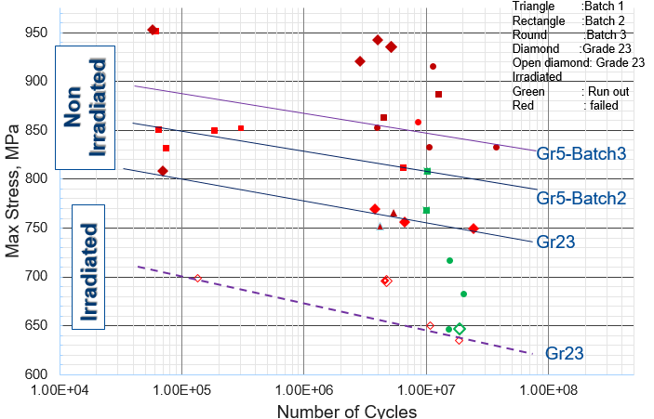
Fatigue testing of Ti alloys for FNAL T2K beam window (2/2)
Similar slope between irradiated and
un-irradiated specimens but decrease in the fatigue life for a given stress amplitude

Slide 22
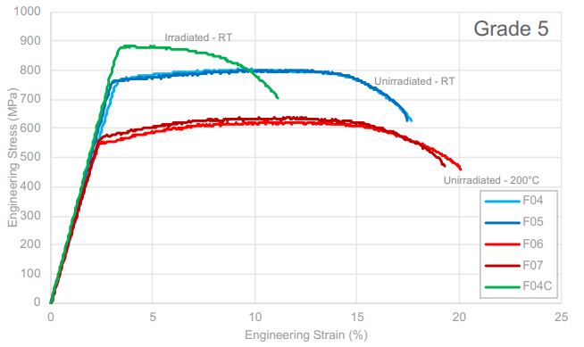
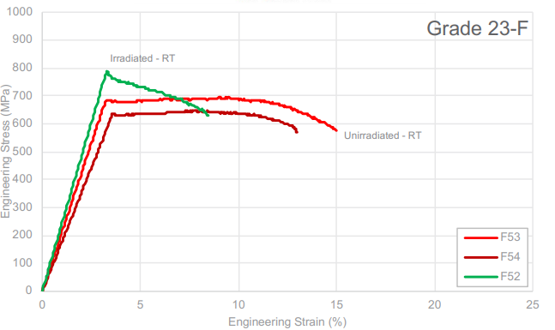
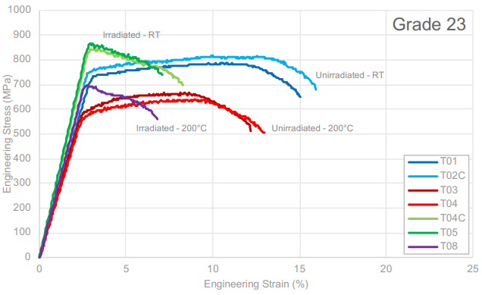
Ti-base alloys tensile testing and microscopy
D. Senor (PNNL)
Distinct radiation hardening observed for each of the analyzed Ti grades

Slide 23
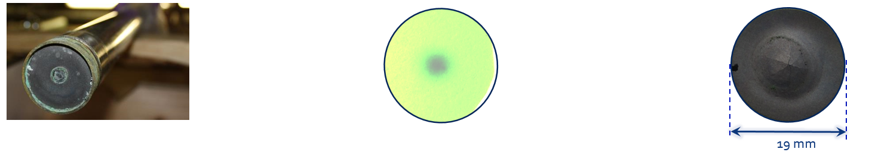
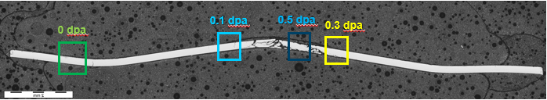
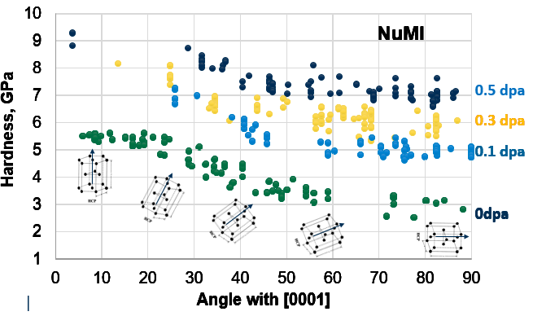
Radiation damage effects in Be
S. Kuksenko (UKAEA)
NuMI beam window:
  120 GeV proton beam
  1.57×10²¹ protons during its lifetime
  Up to 0.5 dpa
  T ≈ 50ºC
Significant hardening is observed in the p-irradiated beryllium even at 0.1 dpa
Hardening increases with irradiation to higher doses (at least up to 0.5 dpa)
Hardness of the irradiated beryllium is less anisotropic

Slide 24
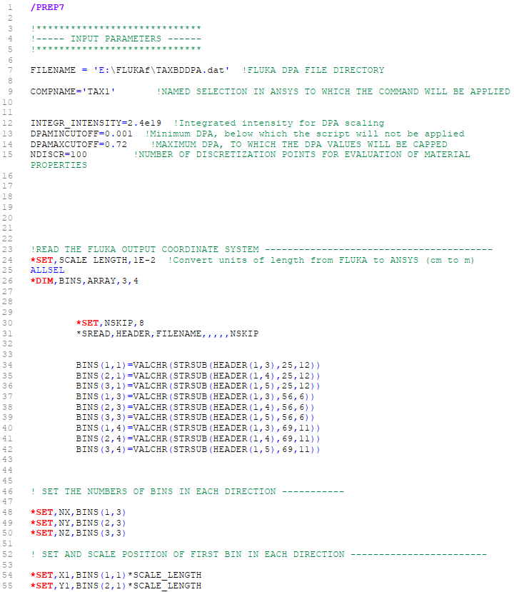
Development of ANSYS scripts for the implementation of radiation damage data
N. Solieri (CERN)
We need a way to easily implement the radiation damage to material properties data accumulated through the BLIP irradiations into ANSYS Workbench for the assessment of our devices
Importation of FLUKA-generated DPA map into ANSYS and its scaling to integrated intensity
Discretization into N DPA levels and generation of N corresponding materials
Implementation of law of degradation of material property with respect to DPA:
        Thermal conductivity/expansion
        Hardening
        …
Assignment of material to element depending on DPA value at element centroid coordinates
Only adds a couple of minutes of computation time for typical size-models
Already available for XYZ and RPZ binning

Slide 25
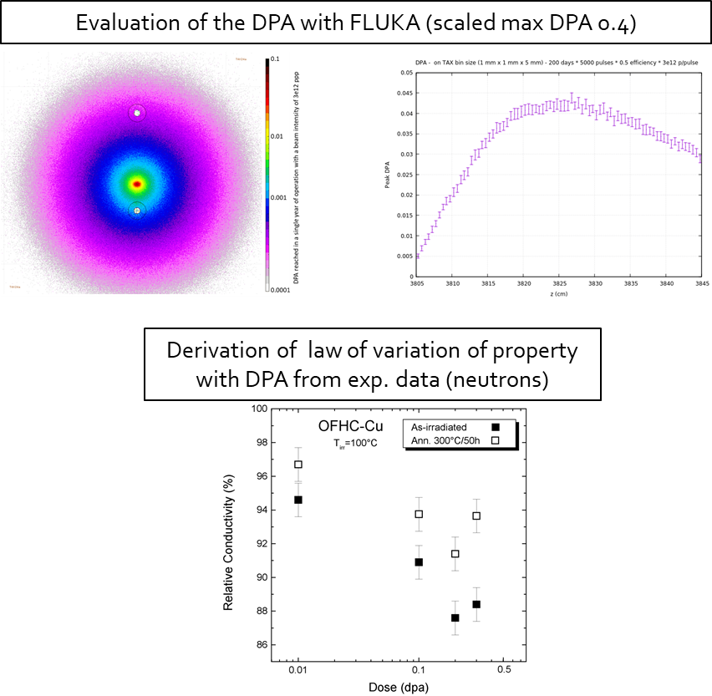
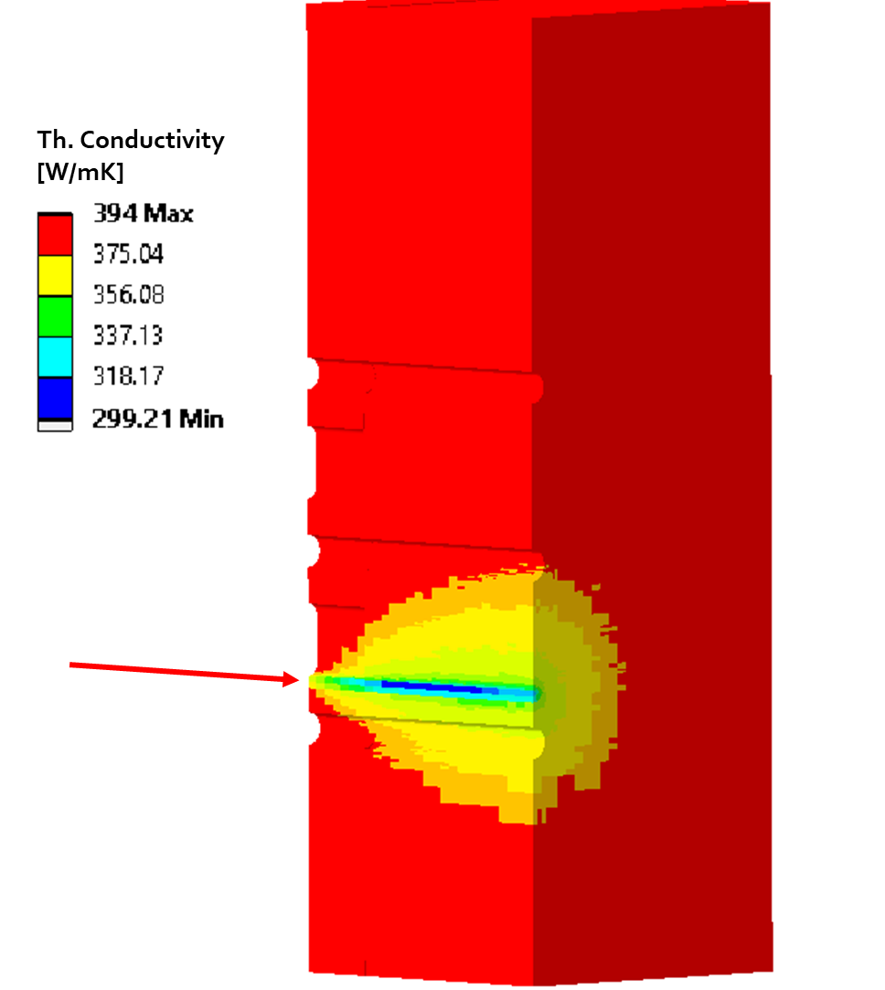
Example – Th. Conductivity Degradation in first block of K12 TAX
What would happen to the thermal conductivity of the C10300 in the first TAX block after 4 years of 4x intensity BD mode (integrated intensity 2.4E19)?
APDL Script
1
2
24% peak reduction in Th. Cond!
¹Courtesy A. Ciccotelli
²M. Eldrup, N. Singh, Influence of composition, heat treatment and neutron irradiation on the electrical conductivity of copper alloys

Slide 26
Conclusions & future outlook
Proton-beam-induced radiation damage to materials is one of the main challenges in the design, operation of current and future BIDs
BLIP Irradiations: assessing long-term radiation damage on materials that we employ in BIDs
Two capsules will be opened during 2020:
    High-Z Capsule → CuCrZr, TZM (SPS Internal Dump), Ir (AD-Target)
    CERN2 Capsule → Mo-coated MoGr and CFC (HiLumi collimators)
A new irradiation is scheduled for 2020:
    CERN3 Capsule → Mo-coated MoGr and Gr7550 (HiLumi collimators)
Plenty of results coming from RaDIATE work packages in the coming months

Slide 27
BACKUP SLIDES

Slide 28

Microscopic radiation damage effects
Three main effects of irradiation on the microstructure of structural materials:
  Structural changes from displacement and rearrangement of atoms
      Creation of vacancies and self-interstitials (and their recombination or clustering)
      Growth of cavities (swelling), climb of dislocations (creep), microvoids
      …
  Kinetic effects → Radiation Enhanced Diffusion, Segregation and Precipitation (RED, RIS, REP)
  Transmutation → Production of new atomic species. Production cross sections are highest for light transmutants (H, He)
      Displacement cross section σ_{dpa}→ Above 20 MeV (for Fe) only very slightly increases with energy
      H and Helium production cross section σ_{α} → Continuously increasing with energy
Irradiation Source | DPA rate (DPA/s) | He gas production (appm/DPA) | Irradiation Temp (˚C)
Mixed spectrum fission reactor | 3 x 10⁻⁷ | 1 x 10⁻¹ | 200-600
Fusion reactor | 1 x 10⁻⁶ | 1 x 10¹ | 400-1000
High energy proton beam | 6 x 10⁻³ | 1 x 10³ | 100-800
1
¹P. Hurh
Notes:
Radiation Enhanced Diffusion (RED) → Caused by the increased concentration of vacancies and the additional presence of self-interstitials
Radiation Induced Segregation (RIS) → Due to flux of defects to sinks
Radiation Enhanced Precipitation (REP) →

Slide 29
Microscopic radiation damage effects
Three main effects of irradiation on the microstructure of structural materials:
  Structural changes from displacement and rearrangement of atoms
      Creation of vacancies and self-interstitials (and their recombination or clustering)
      Growth of cavities (swelling), climb of dislocations (creep), microvoids
      …
  Kinetic effects → Radiation Enhanced Diffusion, Segregation and Precipitation (RED, RIS, REP)
  Transmutation → Production of new atomic species. Production cross sections are highest for light transmutants (H, He)
      Displacement cross section σ_{dpa}→ Above 20 MeV (for Fe) only very slightly increases with energy
      H and Helium production cross section σ_{α} → Continuously increasing with energy
Irradiation Source | DPA rate (DPA/s) | He gas production (appm/DPA) | Irradiation Temp (˚C)
Mixed spectrum fission reactor | 3 x 10⁻⁷ | 1 x 10⁻¹ | 200-600
Fusion reactor | 1 x 10⁻⁶ | 1 x 10¹ | 400-1000
High energy proton beam | 6 x 10⁻³ | 1 x 10³ | 100-800
Effects from low energy neutron irradiations do not equal effects from high energy proton irradiations (transmutation)
1
¹P. Hurh
Notes:
Radiation Enhanced Diffusion (RED) → Caused by the increased concentration of vacancies and the additional presence of self-interstitials
Radiation Induced Segregation (RIS) → Due to flux of defects to sinks
Radiation Enhanced Precipitation (REP) →

Slide 30
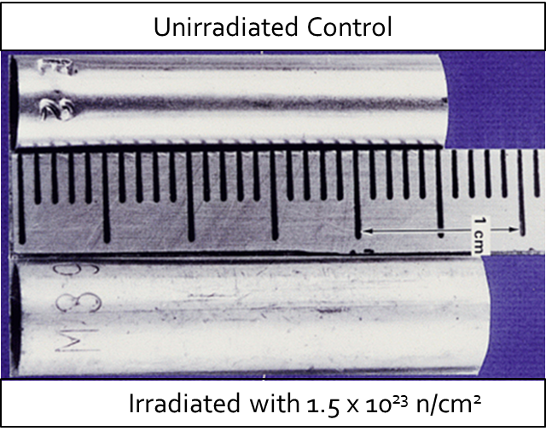
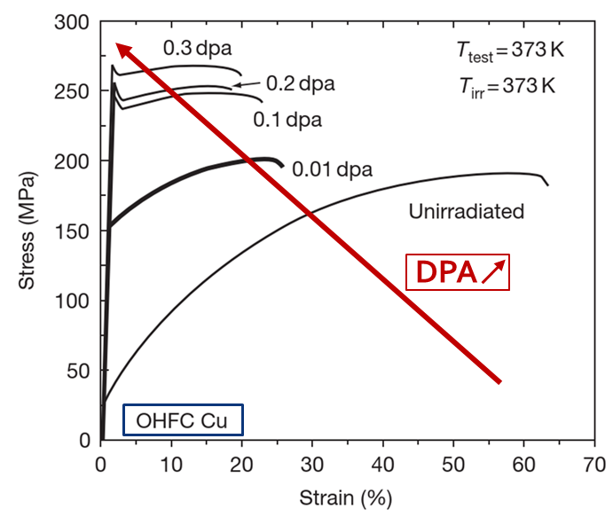
Radiation damage effects on macroscopic material properties
Dimensional Change and associated reduction of density
Reduction of thermal/electrical conductivity and thermal expansion
Hardening and embrittlement
                Loss of ductility
                Hardening
                Reduction of fracture toughness, change of fracture mode from ductile to brittle
                Irradiation embrittlement → Mostly due to pinning of dislocations by irradiation induced dislocation loops, precipitates, cavities or bubbles
                H and He embrittlement
                Accelerated corrosion
1
E.g. SS316
2
¹K. Whittle, Radiation Damage, Ch.2
²M. Li, S. J. Zinkle, Physical and Mechanical Properties of Copper and Copper Alloys, Comprehensive Nuclear Materials, vol.4 (2012)

Slide 31
Radiation damage effects on macroscopic material properties
Dimensional Change and associated reduction of density
Reduction of thermal/electrical conductivity and thermal expansion
Hardening and embrittlement
                Loss of ductility
                Hardening
                Reduction of fracture toughness, change of fracture mode from ductile to brittle
                Irradiation embrittlement → Mostly due to pinning of dislocations by irradiation induced dislocation loops, precipitates, cavities or bubbles
                H and He embrittlement
                Accelerated corrosion
1
E.g. SS316
Thermo-mechanical response of BIDs heavily depend on material properties, but material properties heavily dependent upon Radiation Damage
2
¹K. Whittle, Radiation Damage, Ch.2
²M. Li, S. J. Zinkle, Physical and Mechanical Properties of Copper and Copper Alloys, Comprehensive Nuclear Materials, vol.4 (2012)

Slide 32
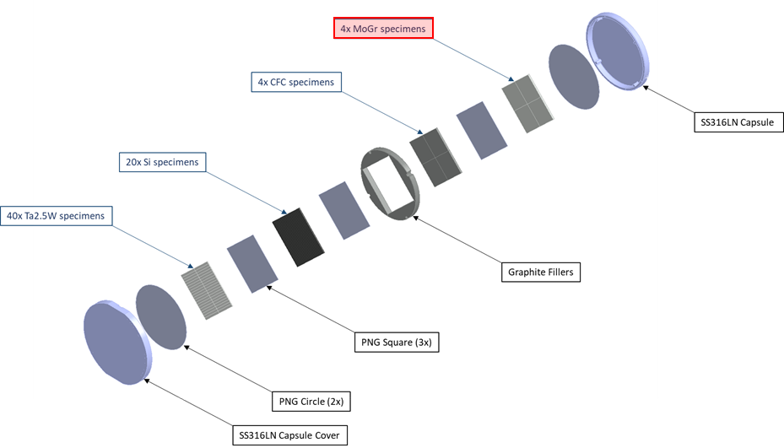
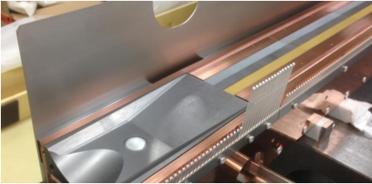
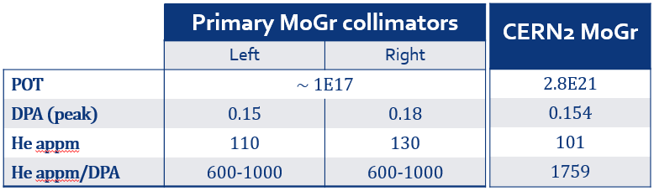
The CERN2 capsule
Capsule Ø70 mm, 5 mm thick
TCSPM Prototype
1
Stainless steel welded capsule containing:
  40x Ta2.5W specimens (BDF Target)
  20x Monocrystalline Si specimens (SPS Int. Dump)
  4x Mo-coated CFC specimens (HiLumi Collimators)
  4x Mo-coated MoGr specimens
  Panasonic graphite foils
  Graphite fillers
2
¹Courtesy I. Lamas
²A. Waets, FLUKA simulations on residual gas production in IR7 collimators, ColUSM 20/09/2019

Slide 33
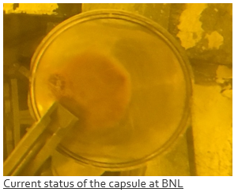
Scope of the Contract – Baseline activities
CERN rules →
Technical specification for the activities
    Tendering procedure for companies who have experience in the field
        Awarding of contract: Framatome GmbH (DE)
        Shipment of the capsule to the contractor’s facility (Capsule currently at BNL, USA)
        Opening of the capsule:
          Preparation of opening procedure. Evaluation of applicability of opening procedure when the CERN2 irradiated capsule is unloaded in the hot cell
          Validation of opening procedure on spare CERN2 capsule supplied by CERN
          Extraction of the specimens by means of vacuum tweezers
          Sorting and storage of the specimens
        PIE activities:
          Visual inspection on 4 Mo-coated MoGr and 4 Mo-coated CFC specimens
          Test adhesion of the coating on 2 Mo-coated MoGr specimens
        Transport of all the specimens from contractor’s facilities to CERN

Slide 34
Scope of the Contract – Baseline activities
CERN rules →
Technical specification for the activities
    Tendering procedure for companies who have experience in the field
        Awarding of contract: Framatome GmbH (DE)
        Shipment of the capsule to the contractor’s facility (Capsule currently at BNL, USA)
        Opening of the capsule:
          Preparation of opening procedure. Evaluation of applicability of opening procedure when the CERN2 irradiated capsule is unloaded in the hot cell
          Validation of opening procedure on spare CERN2 capsule supplied by CERN
          Extraction of the specimens by means of vacuum tweezers
          Sorting and storage of the specimens
        PIE activities:
          Visual inspection on 4 Mo-coated MoGr and 4 Mo-coated CFC specimens
          Test adhesion of the coating on 2 Mo-coated MoGr specimens
        Transport of all the specimens from contractor’s facilities to CERN
Project delayed due to COVID but now on track to completion during 2020

