Slide 1
Overview and recent developments within Task 17.5
ARIES WP17 Annual Meeting
14 July 2020, online meeting
Marilena Tomut, GSI, WWU

Slide 2
Task 17.5 description
Task 17.5. Broader accelerator and societal applications
  This task follows broader applications of new developed materials for high-power accelerators, space, society (energy, medicine, computing)
  Irradiation induced defect centers in diamond for luminescent screens, medical imaging and quantum computing.
  Application of novel materials for high power targets, beam catchers, beam windows
  Participants: GSI, CERN, RHP Technology, NIMP, WWU

Slide 3
Task 17.5 - after Malta
Task 17.5. Broader accelerator and societal applications
Reduce diamond particle sizes amd improve their surface distribution for better beam-spot reproduction – (RHP-GSI) – new Ti and Cu matrix samples were produced in WP 14
Understand the contribution of (irradiation induced) color centers in diamond to iono– and photo-luminescence, for different applications (luminescence screens, QD’s and medical imaging)
Continue radiation damage and beam induced pressure wave response studies for different carbon materials for high power targets and beam dumps - joint activities for tasks 17.2 and 17.3.

Slide 4
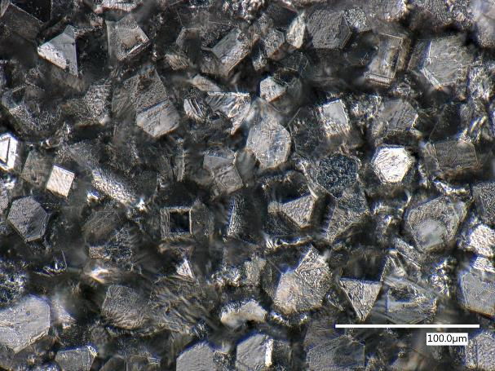
Task 17.5 – optimization of diamond-metal composites for luminescence applications
Ti-based composites consisted of diamonds with a nominal diameter of 45 μm and embedded into either Ti Gd2 or Ti Gd5 under different hot-pressing parameters. The samples had an approximate diameter of 20 mm and an overall thickness of 1 mm.

Slide 5
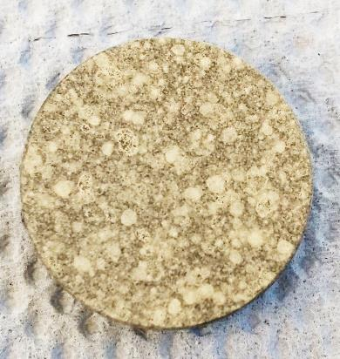
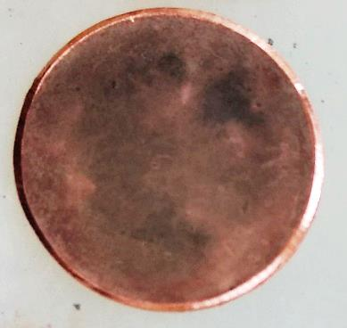
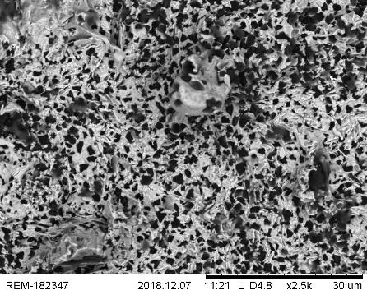
Task 17.5 – optimization of diamond-metal composites for luminescence applications
In February 2019, a third set of samples have been produced and sent for testing at GSI - Cu base and very find diamond fractions. RHP tested the use of a spray system to coat an inert substrate with a fine layer of diamonds, following which this would be transferred into a Cu surface during a hot-pressing process.

Slide 6
Task 17.5. Broader accelerator and societal applications
Irradiation of N- containing diamonds, CuDia and TiDia composites for luminescesnce applications at GSI – UNILAC
High intensity and high fluence irradiation with: 4.8 MeV/n Ca, Sn, Xe and Au
Various on-line experiments: iono-luminescence, photoluminescence and FTIR and UV/c spectroscopy

Slide 7
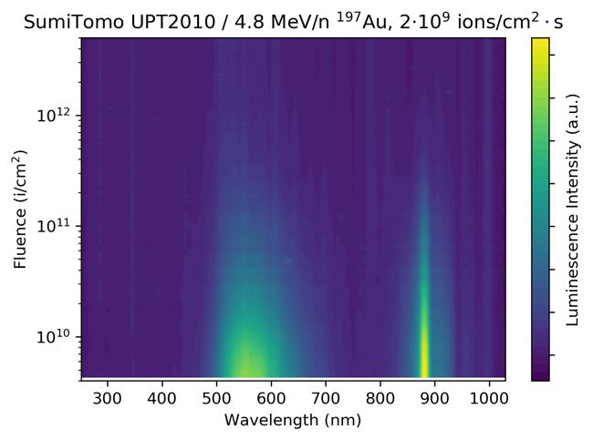
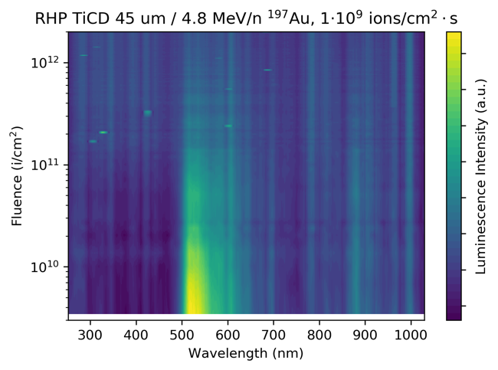
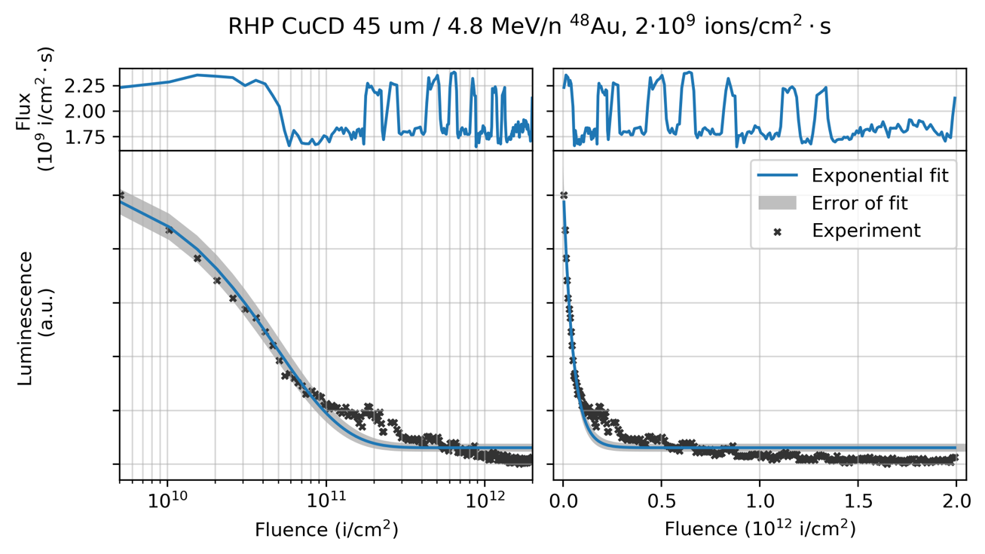
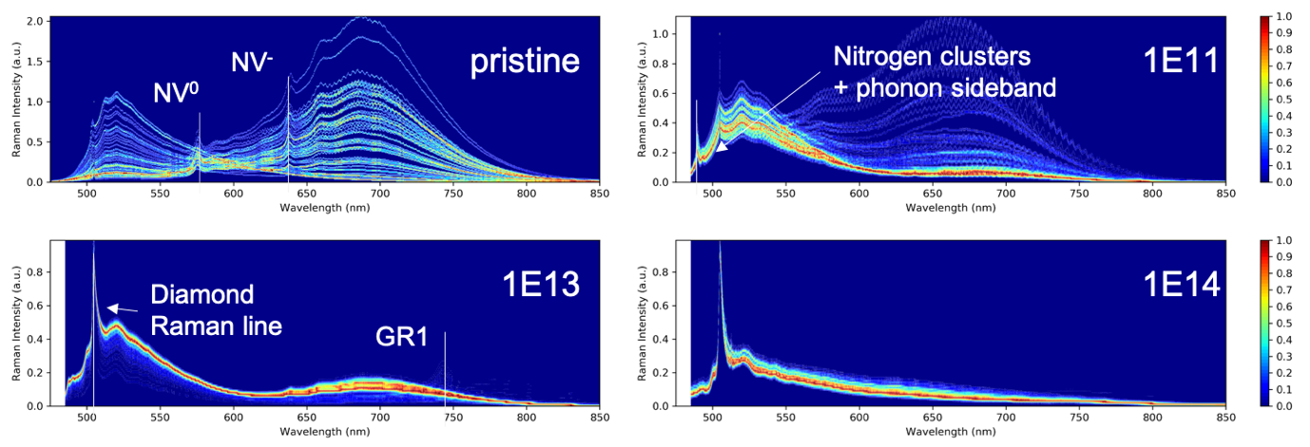
Luminescence of ion-irradiated diamond and diamond- metal composites
Online iono-luminescence measurements
Iono-luminescence decay with fluence
SumiTomo diamond
TiCD
  Decay of light yield
  Loss of transmission
3H
Ni
3H
Ni
colour centers
CuCD- photoluminescence spectroscopy
7
Updates on luminescence studies of metal-diamond composites

Slide 8
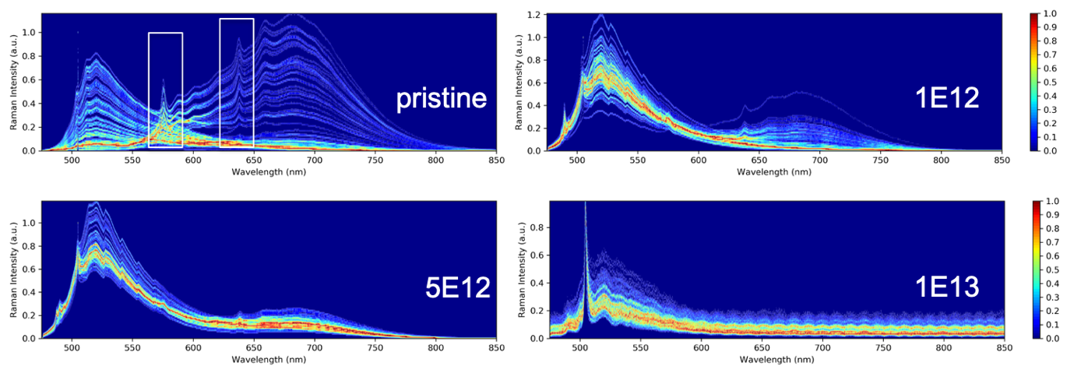
Ti-Dia / Photoluminescence spectroscopy
High statistics photoluminescence spectra on diamond/Ti-matrix composite
Nitrogen-related color centers (N-V, 2N-V, 3N-V, N-N) sensitive to ion-irradiation
Dramatic changes in spectra beyond fluence of 1⋅10¹² i/cm²
  Nitrogen-related color centers apparently do not play a major role in SHI-luminescence
8
Updates on luminescence studies of metal-diamond composites

Slide 9

Task 17.5. Pyrolytic graphite foil as heat sink for production targets in NUMEN-project
15 MeV/u ¹⁸O-ion irradiation [2]:
O-ion flux : 8.6$×$10¹⁴ $\frac{ions}{{cm}^{2}∙s}$
beam current : 50 $μ$A
Gaussian beam profile with 2 mm FWHM
power density: 0.6 $\frac{MW}{{cm}^{3}}$
Pyrolitic graphite:
low atomic number (Z=6)
(low energy loss)
high thermal conductivity
evaluation of degradation of thermal conductivity of graphite foils
Cooling system for high intensity ion beam operation in the NUMEN-project [1]

Slide 10

Irradiation of pyrolytic graphite foils
Pyrolitic graphite foils- stacked for 4.8 MeV/u ¹⁹⁷Au-irradiation on 2 sample holders
- Stack thickness covers an ion range of approx. 47 $μ$m
- probing different energy loss levels along ion path
OPTIGRAPH samples on first holder for 4.8 MeV/n ¹⁹⁷Au-irradiation

Slide 11
Deliverables & Milestones
Task 17.5. - MS 62 – Dissemination of R&D results on novel materials for accelerator and societal applications (month 46)
Planned initially as an Workshop “Extreme Beams meet Extreme Materials”
To be replaced by an online workshop or by a Special Issue in a open access journal (“Materials”- IF 3.4)
Task | Year 1 |  |  |  | Year 2 |  |  |  | Year 3 |  |  |  | Year 4
 | Q1 | Q2 | Q3 | Q4 | Q1 | Q2 | Q3 | Q4 | Q1 | Q2 | Q3 | Q4 | Q1 | Q2 | Q3 | Q4
17.1 |  | M
17.2 |  |  |  |  |  |  | M |  |  |  |  |  | D
17.3 |  |  |  |  |  |  |  |  | M |  |  |  |  |  |  | D
17.4 |  |  |  |  |  |  |  |  |  |  |  | M |  | D
17.5 |  |  |  |  |  |  |  |  |  |  |  |  |  |  |  | M
14.4 |  |  |  | M |  |  |  | D

Slide 12
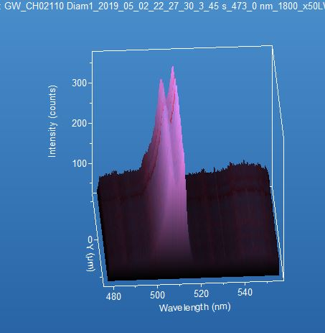
What’s next - IFAST – WP4.3
IFAST Task 4.3. - GRAPH&BEAWIN
M. Losasso and M. Tomut
Beam windows for high-power accelerator applications. Suspended graphenic membrane and novel metallic beam windows for next generation accelerators
Continuation of activities in task 17.5. on materials for broader accelerator applications
Objectives:
Production of innovative materials suitable for beam-windows applications in high power accelerators
Particle transport and thermomechanical simulations for beam windows under high intensity operation conditions
Characterisation of beam windows materials under thermomechanical load and extended radiation damage and their integration in accelerator environment
Participants: CERN, GSI, WWU Münster, RHP
EC contribution: 100 k€ / Duration: 32 months
graphenic membrane
Raman spectra of
graphenic membrane

Slide 13

Thank you for your attention!
Thank you

Slide 14
Iono-luminescence in diamonds and diamond-metal composites
Swift heavy-ion (SHI) induced luminescence in monocrystalline diamonds and diamond/titanium-matrix composite
Luminescence during SHI-excitation dominated by (intrinsic) 3H color center (~500 – 600 nm) & nickel-related color center (~883 nm)
  Incorporation of nickel during synthesis
  No evidence for additional iono-luminescenct beam-induced defects
Critical fluence of ~1⋅10¹² i/cm² (4.8 MeV/n ¹⁹⁷Au) where more than 90% of luminescence intensity vanishes
Emission from 3H also observed in nitrogen-free CVD diamonds
14
Updates on luminescence studies of metal-diamond composites

