Slide 1
New results on beam-induced color centers in nitrogen containing diamonds
2nd Annual Meeting of ARIES WP17
P. Simon, M. Tomut (GSI) D. Grech, M. Kitzmantel (RHP)

Slide 2
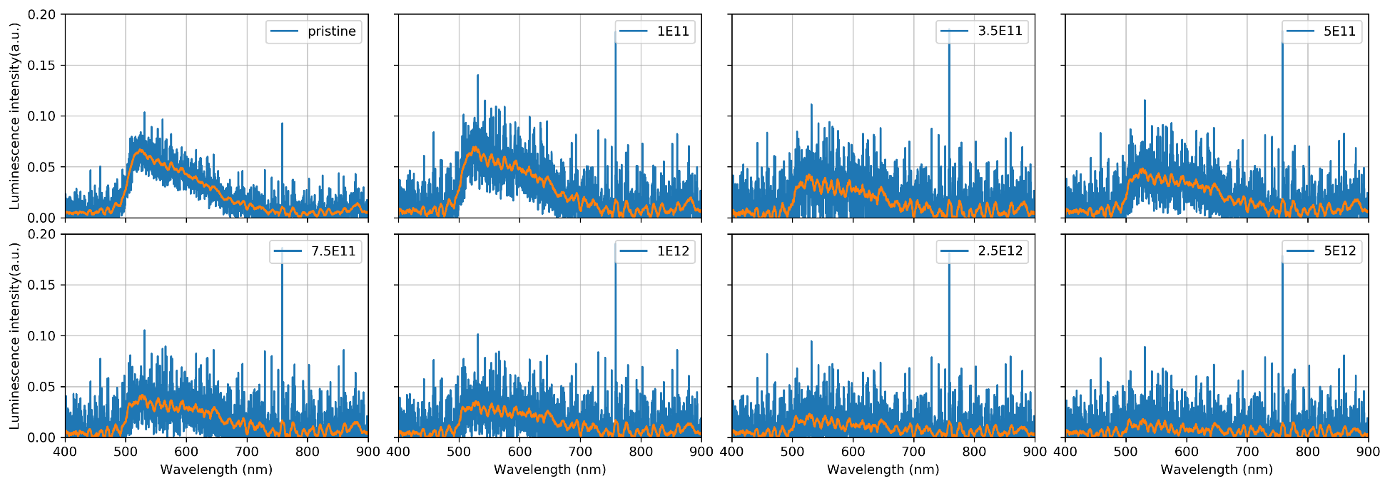
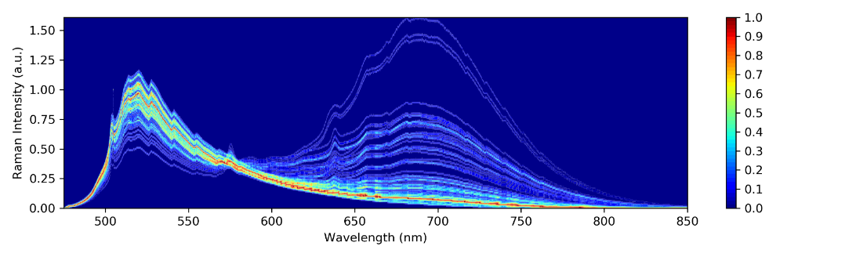
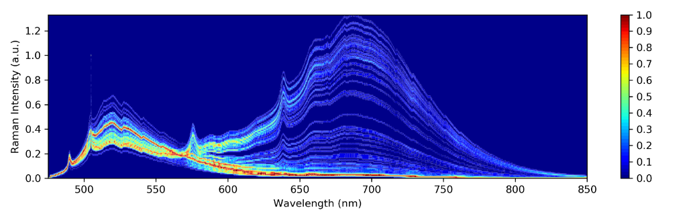
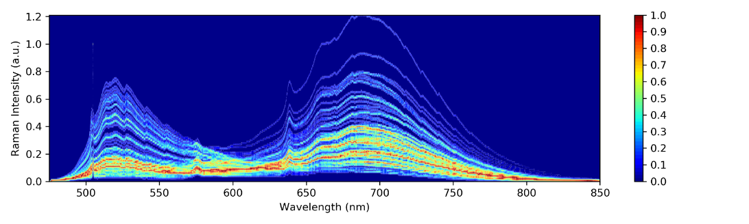
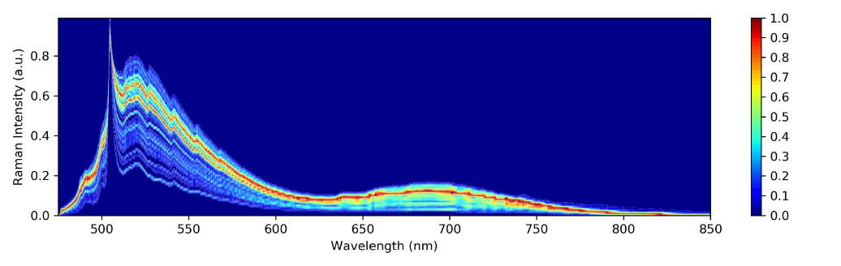
Recap of 1st Annual Meeting in Malta
Measured first iono-luminescence (IL) spectra in 2018 on Diamond/Titanium-matrix composites:
Raman/PL measurements on composites is not straight forward:
NV⁰
N-clusters
NV⁻
pristine
1E11
1E12
1E13

Slide 3
Recap of 1st Annual Meeting in Malta
Measured first iono-luminescence (IL) spectra in 2018 on Diamond/Titanium-matrix composites:
Raman/PL measurements on composites is not straight forward:
New IL measurements with improved SNR during 2019 & 2020 beamtimes
NV⁰
N-clusters
NV⁻
Measurements on irradiated monocrystals with the same characteristics
pristine
1E11
1E12
1E13

Slide 4
Irradiation campaigns 2019 & 2020
Irradiation with 4.8 MeV/n ⁴⁸Ca and ¹⁹⁷Au
Beamtime 2019 (composites & yellow diamonds):
  Improved IL measurements with peltier-cooled moving-grating CCD spectrometer (up to 5⋅10¹³ i/cm²)
    Sensitivity beyond beam diagnostic cameras
  In-situ FT-IR measurements (up to 5⋅10¹³ i/cm²)
  First irradiation of monocrystalline diamonds (irregular geometry)
Beamtime 2020 (composites, CVD diamonds & yellow diamonds):
  IL with fast CCD spectrometer and on-line flux measurement
  In-situ UV/c absorption spectroscopy at 50 K and RT
  Irradiation of monocrystalline diamonds with regular geometry

Slide 5
Irradiation campaigns 2019 & 2020
Irradiation with 4.8 MeV/n ⁴⁸Ca and ¹⁹⁷Au
Beamtime 2019 (composites & yellow diamonds):
  Improved IL measurements with peltier-cooled moving-grating CCD spectrometer (up to 5⋅10¹³ i/cm²)
    Sensitivity beyond beam diagnostic cameras
  In-situ FT-IR measurements (up to 5⋅10¹³ i/cm²)
  First irradiation of monocrystalline diamonds (irregular geometry)
Beamtime 2020 (composites, CVD diamonds & yellow diamonds):
  IL with fast CCD spectrometer and on-line flux measurement
  In-situ UV/c absorption spectroscopy at 50 K and RT
  Irradiation of monocrystalline diamonds with regular geometry

Slide 6
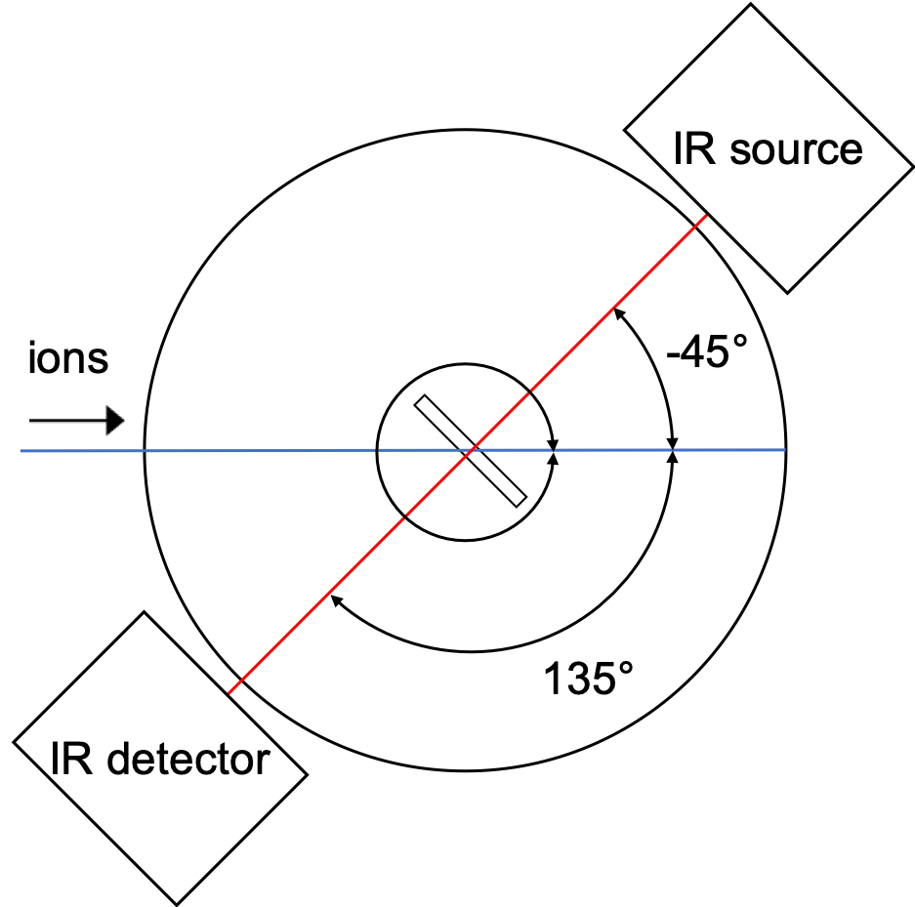
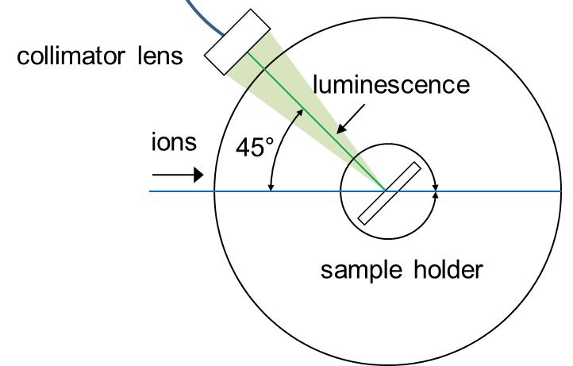
IL + FT-IR measurements 2019
On-line iono-luminescence:
  Horiba iHR320
  Integration time: 5-120 s
In-situ FT-IR:
  Thermo Fisher Nicolet 6700
  2 cm⁻¹ resolution
spectrometer
optical
camera

Slide 7
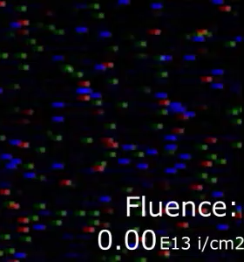
Iono-luminescence

Slide 8
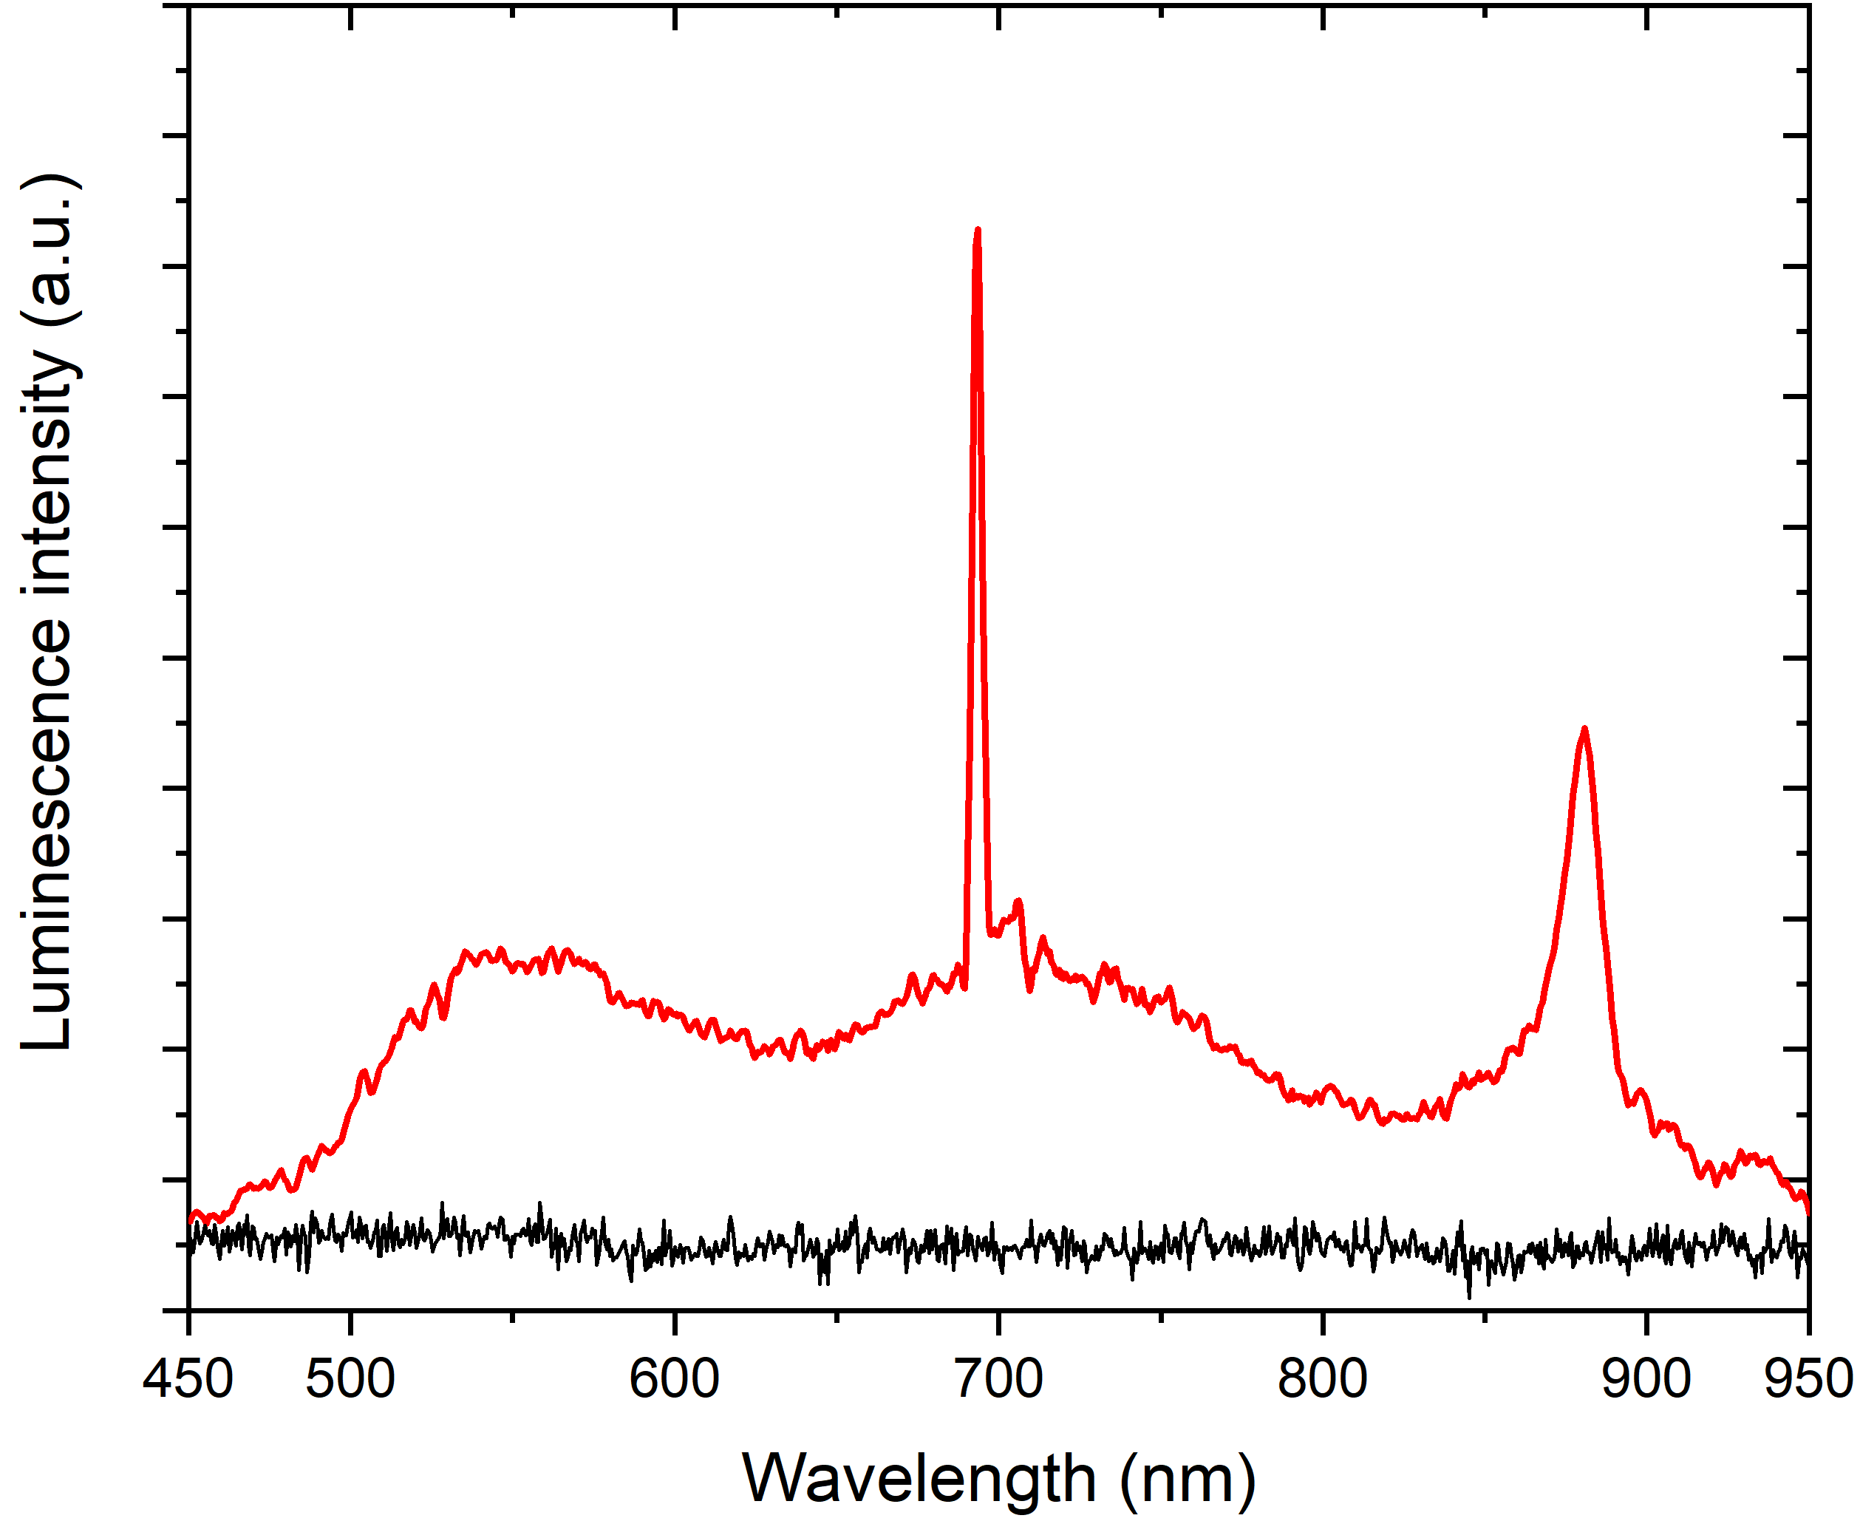
Iono-luminescence Spectrum
No nitrogen-related ZPLs!
  [N-V-N]: 502 nm
  NV0: 575 nm
  NV-: 638 nm
1×10¹¹ ions/cm²
N-V-N ZPL
NV⁰ ZPL
NV⁻ ZPL
ZPL: zero-phonon line
PSB: phonon sideband
HPHT: High pressure / high temperature

Slide 9
Iono-luminescence Spectrum
No nitrogen-related ZPLs!
Broad bands:
  500 – 650 nm
    [N-V-N] PSB?
    Intrinsic „A“ radiation band?
  650 – 800 nm
    NV⁻ PSB?
1×10¹¹ ions/cm²
NV⁻ PSB
H3 [N-V-N] PSB?
„A“ rad. Band?
NV⁰ ZPL
NV⁰ ZPL
N-V-N ZPL
NV⁻ ZPL
ZPL: zero-phonon line
PSB: phonon sideband
HPHT: High pressure / high temperature

Slide 10
Iono-luminescence Spectrum
No nitrogen-related ZPLs!
Broad bands:
  500 – 650 nm
    [N-V-N] PSB?
    Intrinsic „A“ radiation band?
  650 – 800 nm
    NV⁻ PSB?
ZPLs:
  ~690 nm
    Al₂O₃ (nat. oxide layer on sample holder)
  ~884 nm
    Nickel-related (precursor during HPHT)
1×10¹¹ ions/cm²
NV⁻ PSB
H3 [N-V-N] PSB?
„A“ rad. Band?
NV⁰ ZPL
NV⁰ ZPL
N-V-N ZPL
NV⁻ ZPL
ZPL: zero-phonon line
PSB: phonon sideband
HPHT: High pressure / high temperature

Slide 11
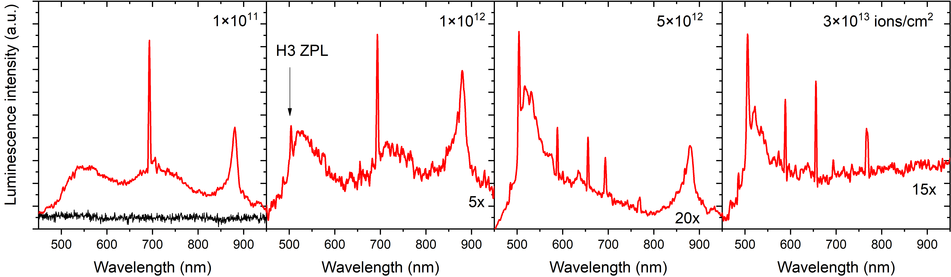
Iono-luminescence Spectra Evolution
1×10¹¹ ions/cm² 1x
1×10¹² 5x
5×10¹² 20x
3×10¹³ 15x
Al₂O₃
H3 ZPL?
NV⁻ PSB
Evolution of ZPL at ~500 nm
  H3 [N-V-N]: 503.2 nm
  3H (intrinsic): 503.4 nm
Strong decrease of integrated IL signal
Possible ZPLs at ~590, ~660 & 760 nm → No clear identification possible

Slide 12
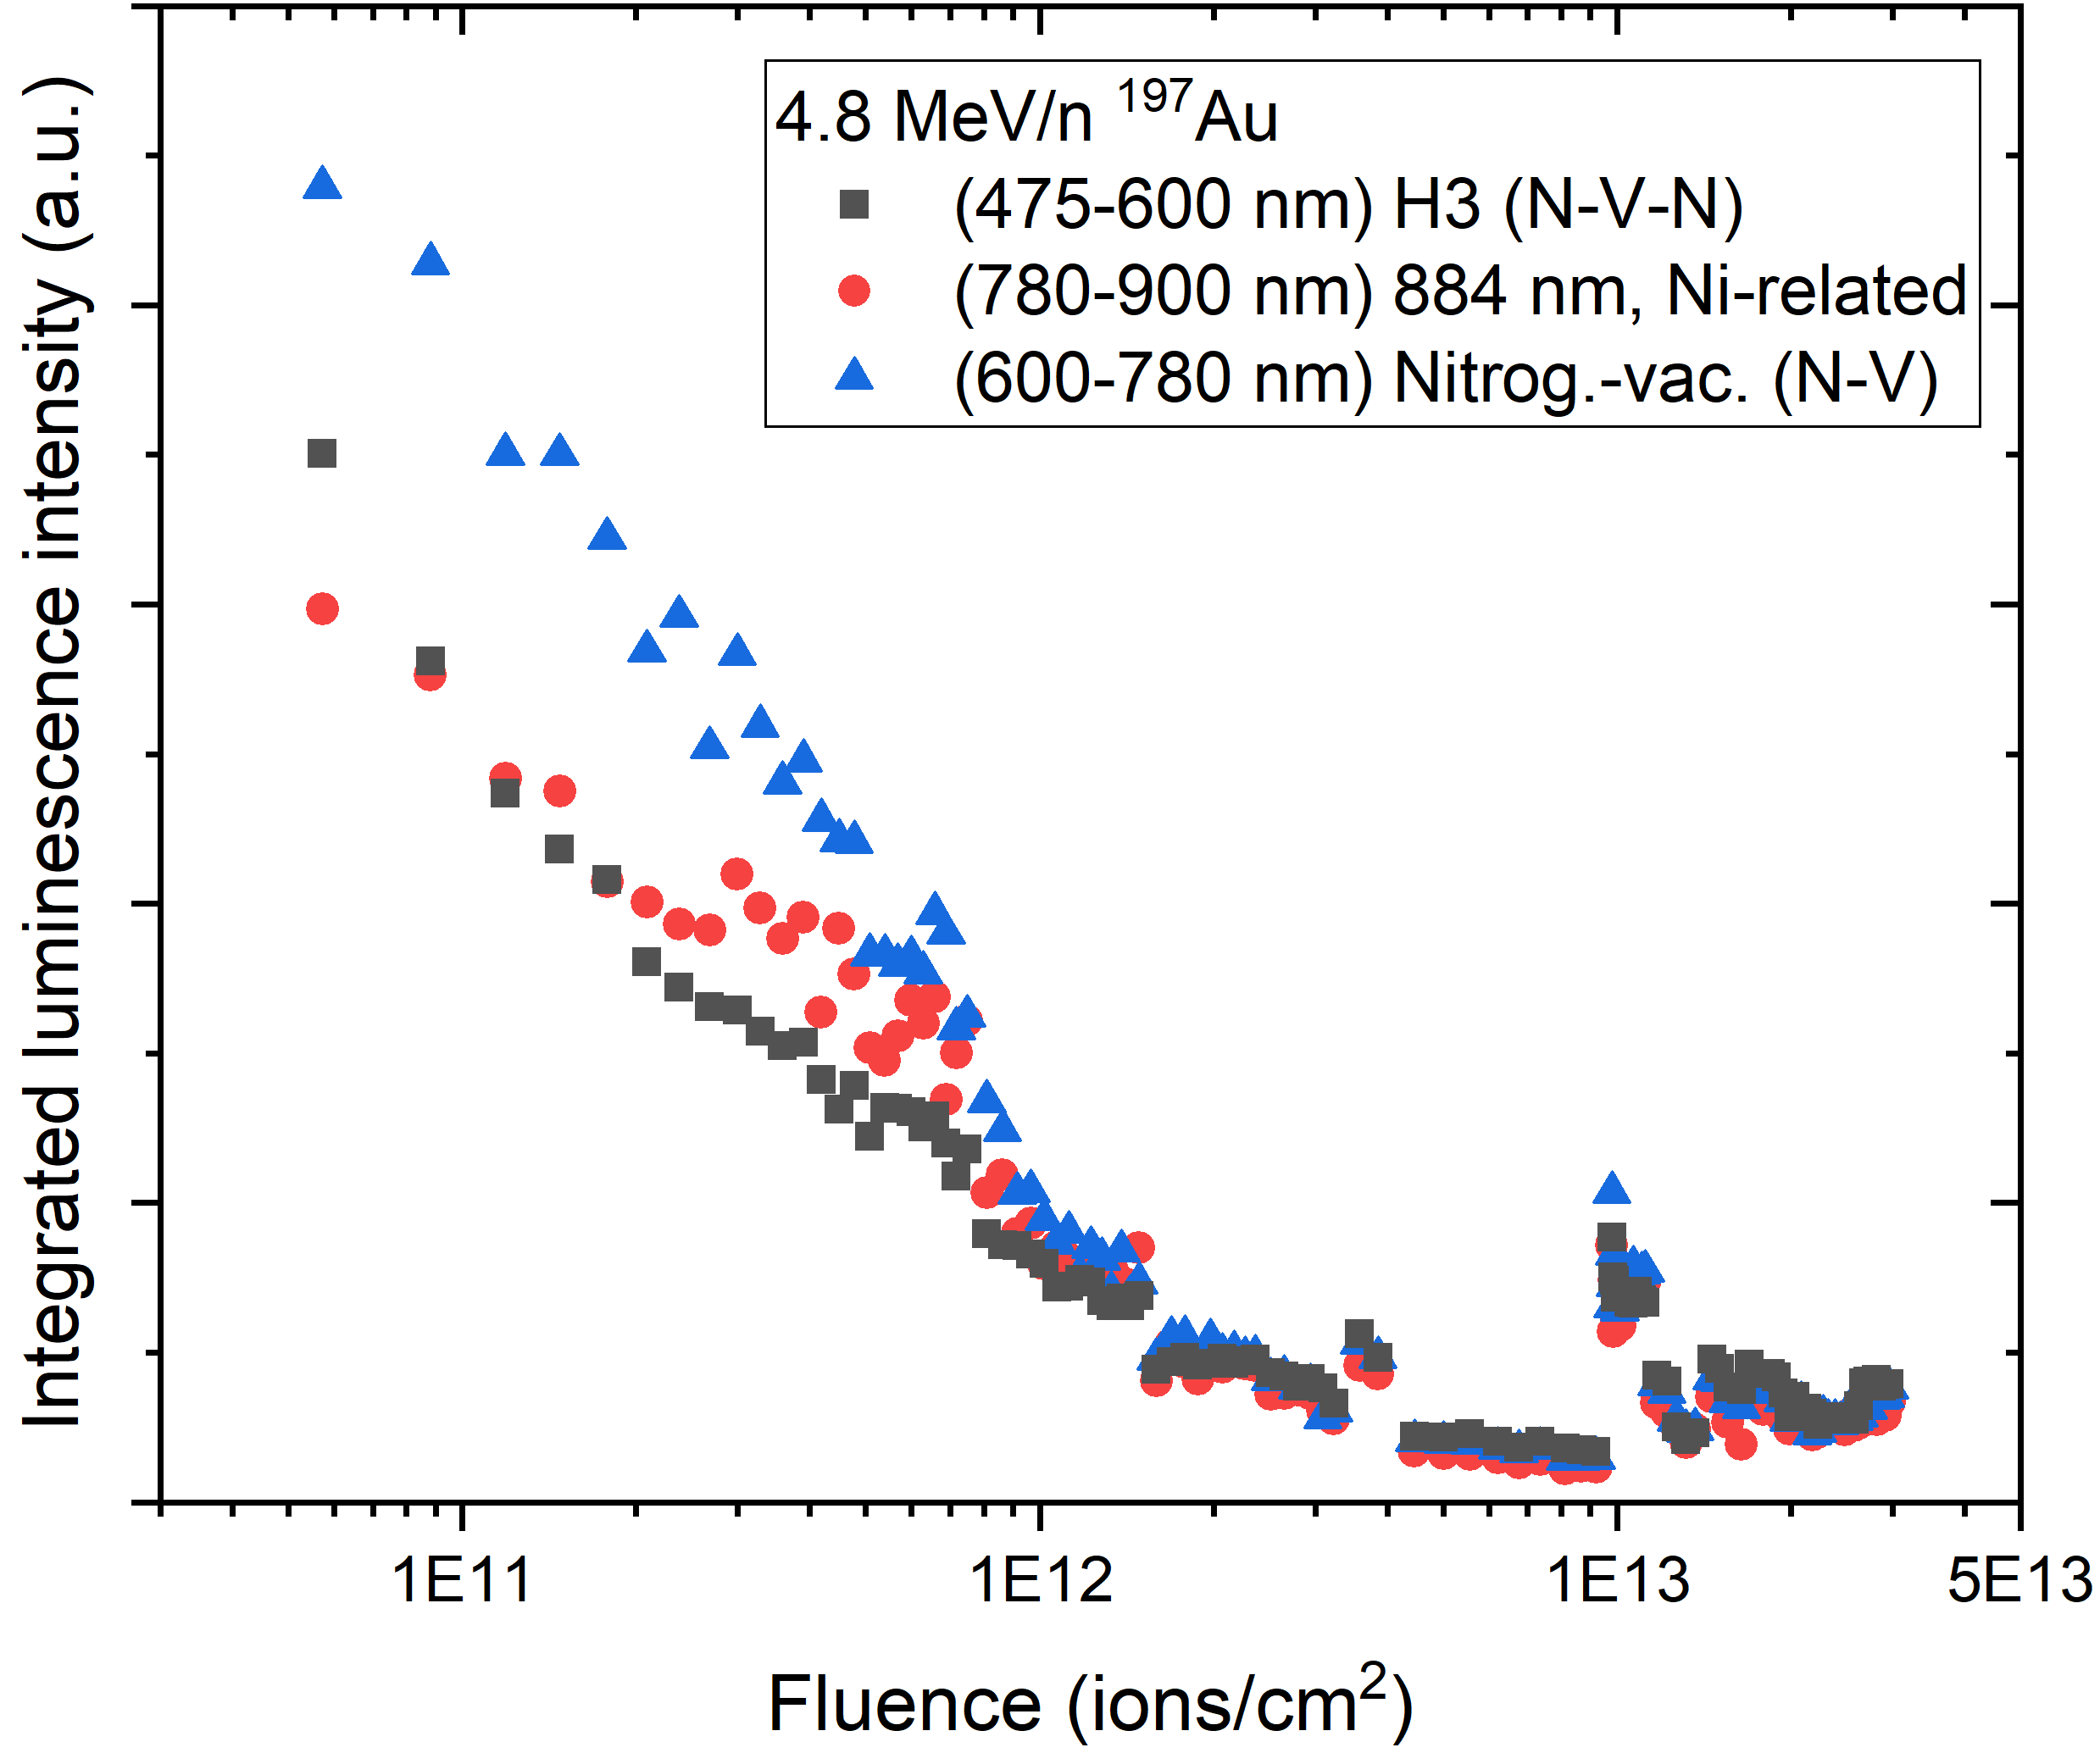
Integrated IL signal
Exponential decay of IL sigal with increasing fluence
Only 5% of initial signal preserved at final fluence
  Close to detection limit of spectrometer
No significant contribution of beam-induced defects
H3 / 3H
beam off (2 h)

Slide 13
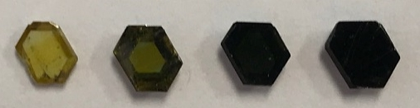
Integrated IL signal
Exponential decay of IL sigal with increasing fluence
Only 5% of initial signal preserved at final fluence
  Close to detection limit of spectrometer
No significant contribution of beam-induced defects
... And what about transmission?
H3 / 3H
beam off (2 h)
After irradiation with 4.8 MeV/n ¹⁹⁷Au:
5 mm
1×10¹¹
1×10¹²
5×10¹²
1×10¹³ ions/cm²

Slide 14
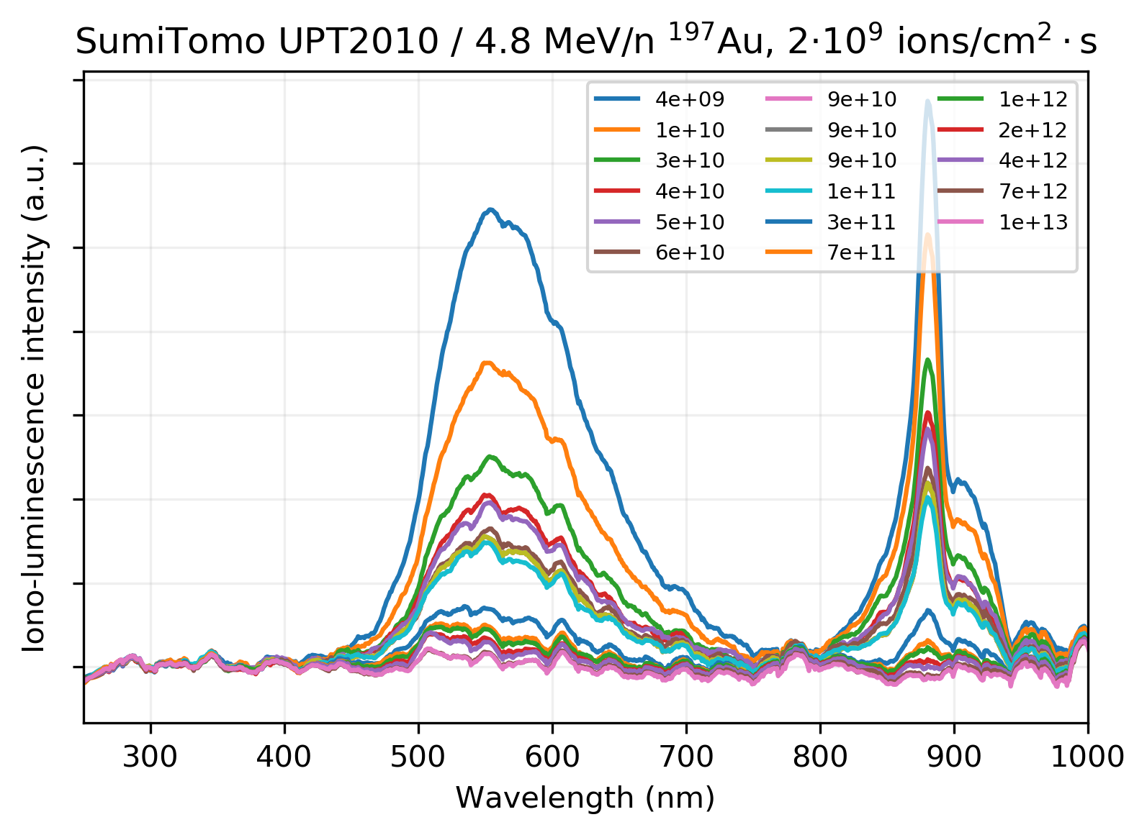
IL signal / composite vs. monocrystal
TiCD / 4.8 MeV/n 197Au
1×10¹¹ ions/cm²
Commercially available (10-100 €/pc., up to 3x3x1 mm) HPHT diamonds with ~200 ppm N_{s}
Measurements with new (fast) CCD spectrometer set-up
Good agreement between old & new IL set-up!
Monocrystals behave virtually identical to composites!

Slide 15
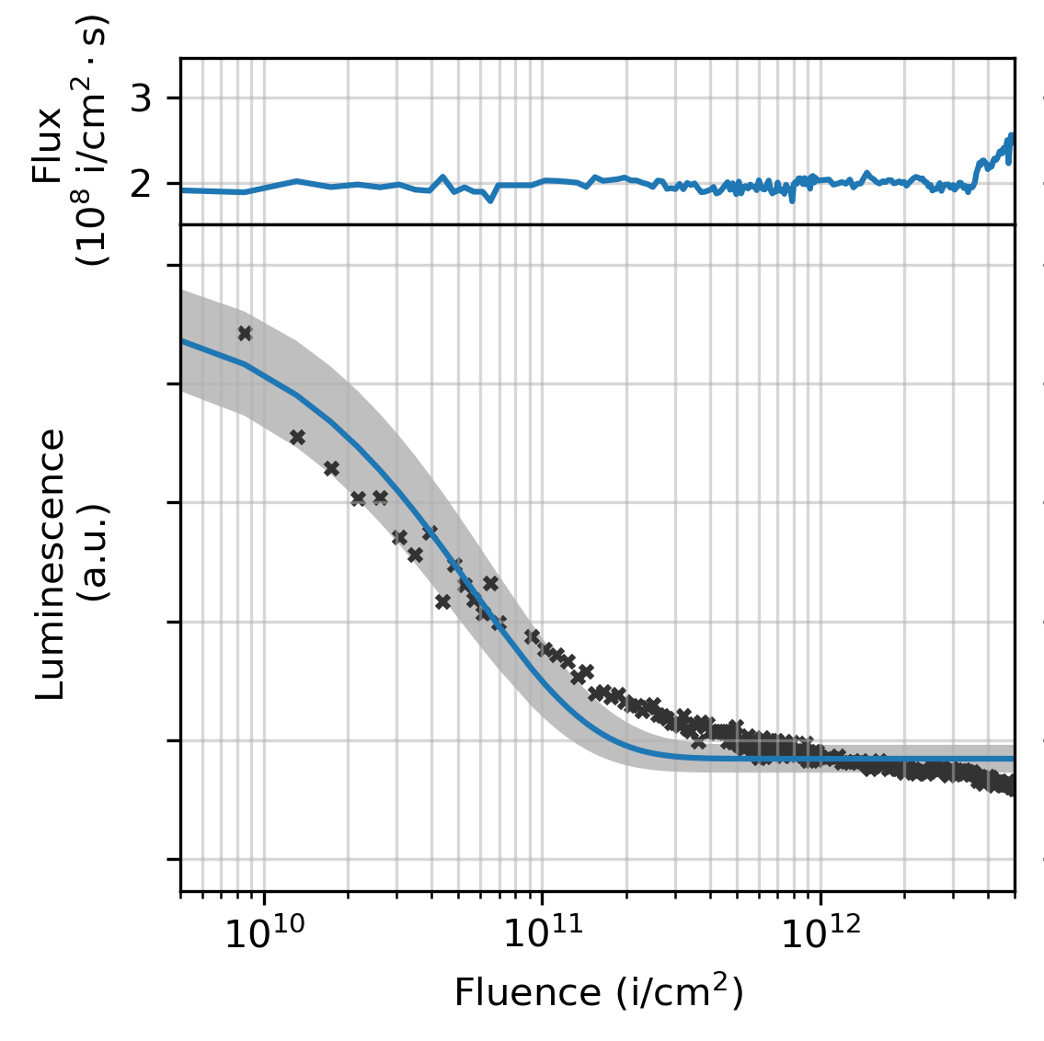
IL signal / composite vs. monocrystal
H3 / 3H
beam off (2 h)
Commercially available (10-100 €/pc., up to 3x3x1 mm) HPHT diamonds with ~200 ppm N_{s}
Measurements with new (fast) CCD spectrometer set-up
Good agreement between old & new IL set-up!
Monocrystals behave virtually identical to composites!

Slide 16
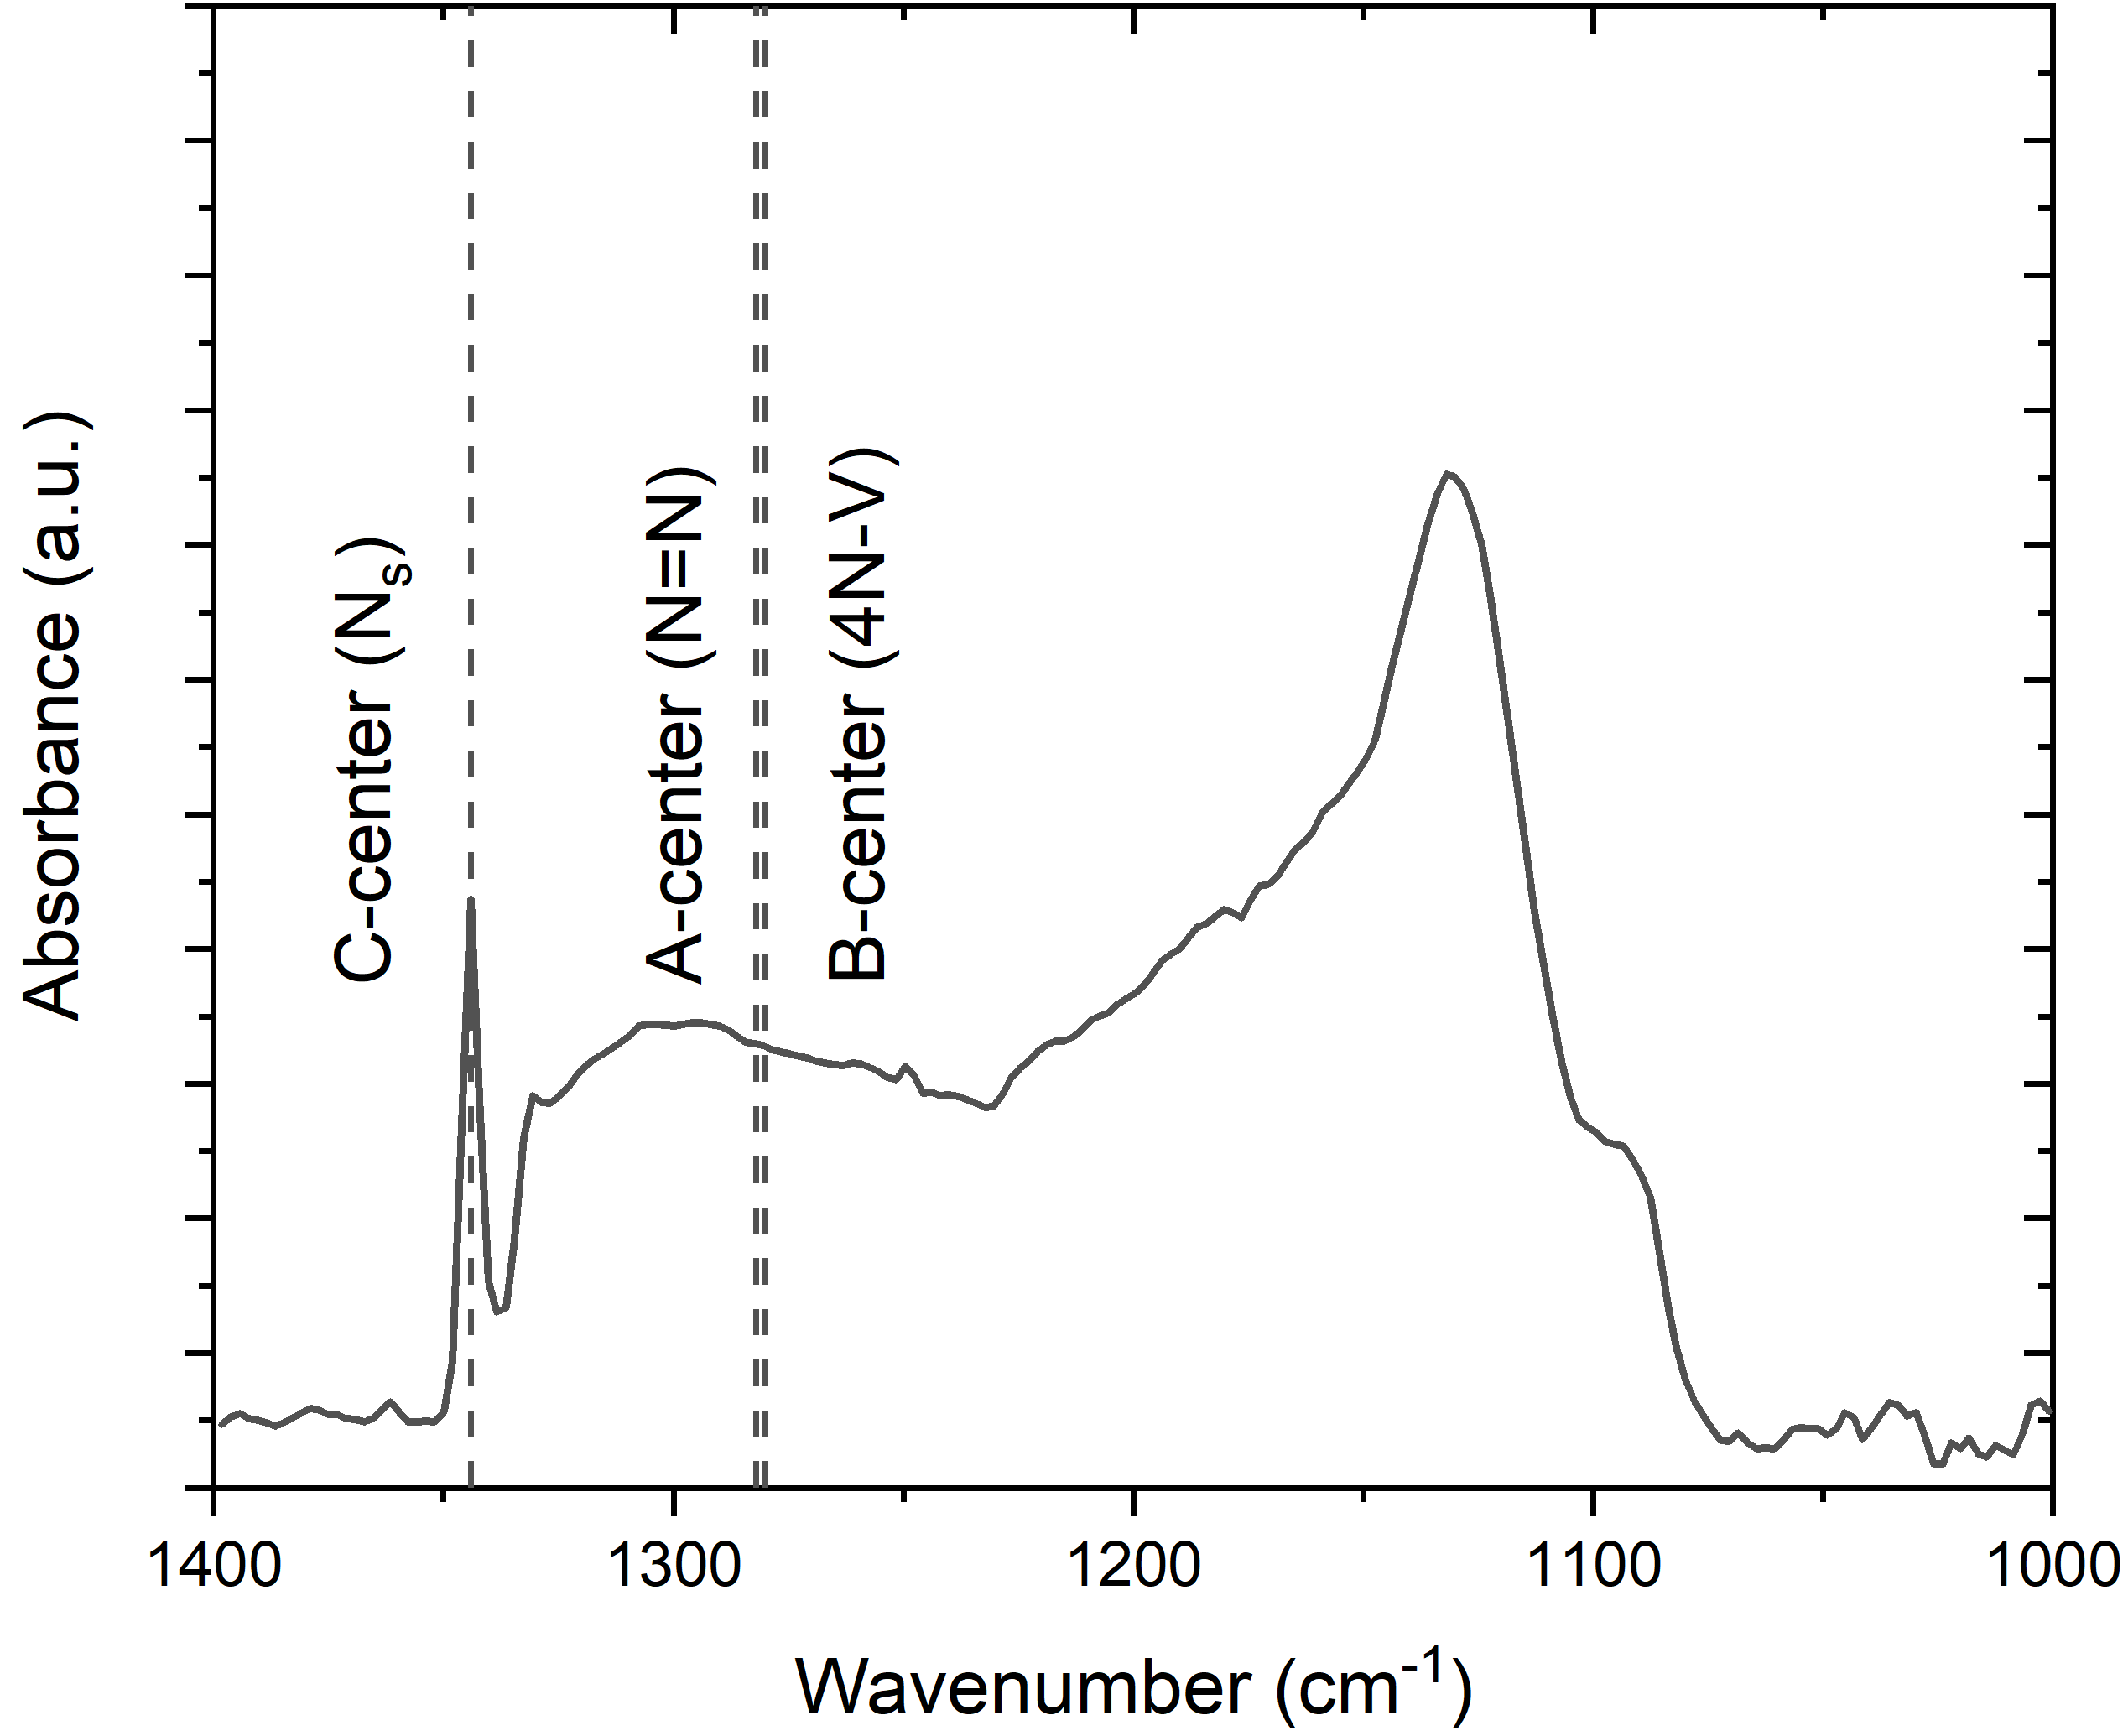
FT-IR spectroscopy of irr. diamond
1344 cm⁻¹: C-center (N_{s})
1282 cm⁻¹: A-center (N=N)
1280 cm⁻¹: B-center (4N=V)
Tracking of radiation-induced defect dynamics
pristine

Slide 17
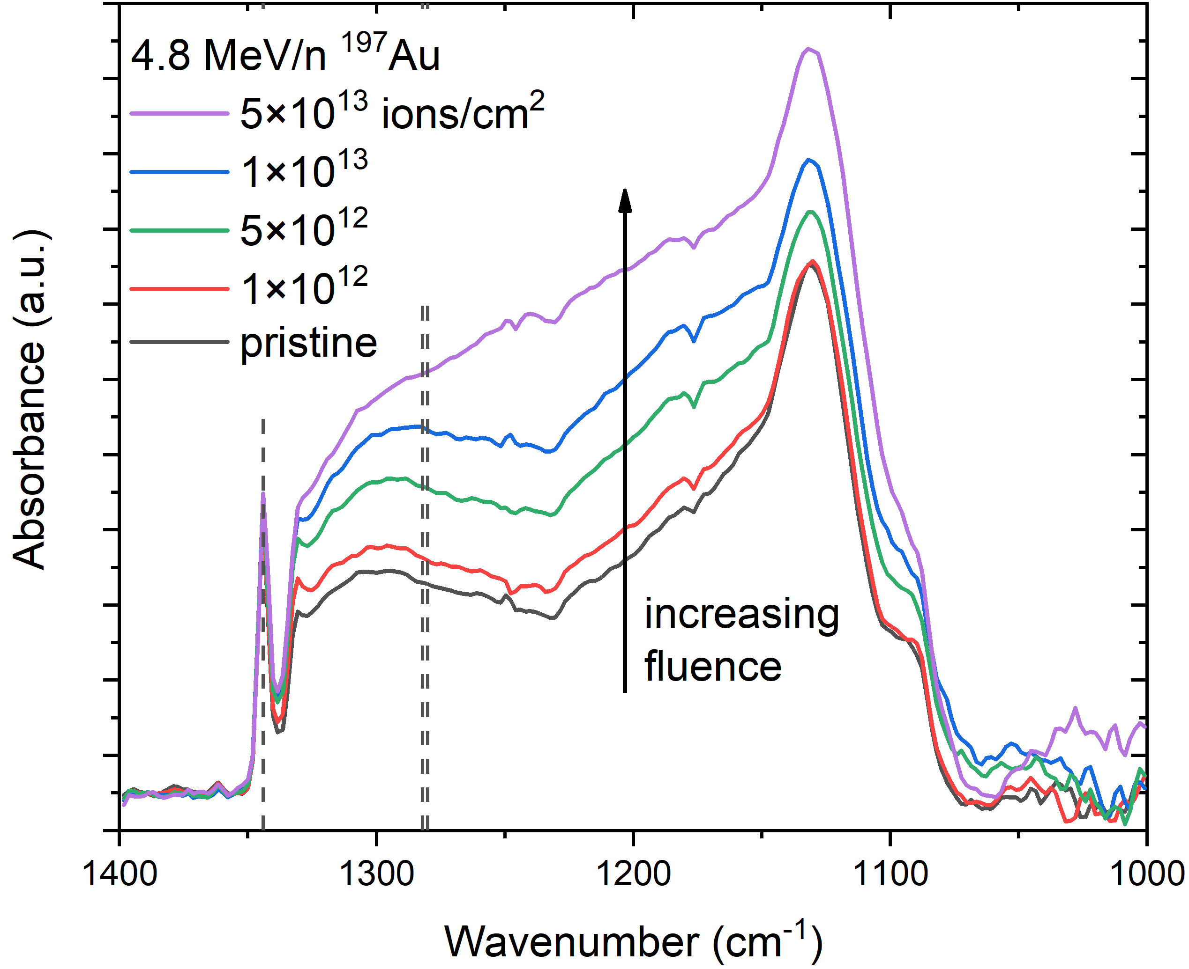
FT-IR spectroscopy of irr. diamond
1344 cm⁻¹: C-center (N_{s})
1282 cm⁻¹: A-center (N=N)
1280 cm⁻¹: B-center (4N=V)
Tracking of radiation-induced defect dynamics
Non-luminescent defects that act as sinks for nitrogen:
C
A
B
N + V → N-V + N → N-V-N → N=N + V
ΔE_{b} = 6.3 eV
ΔE_{b} = 4.5 eV
ΔE_{b} = 2.3 eV

Slide 18
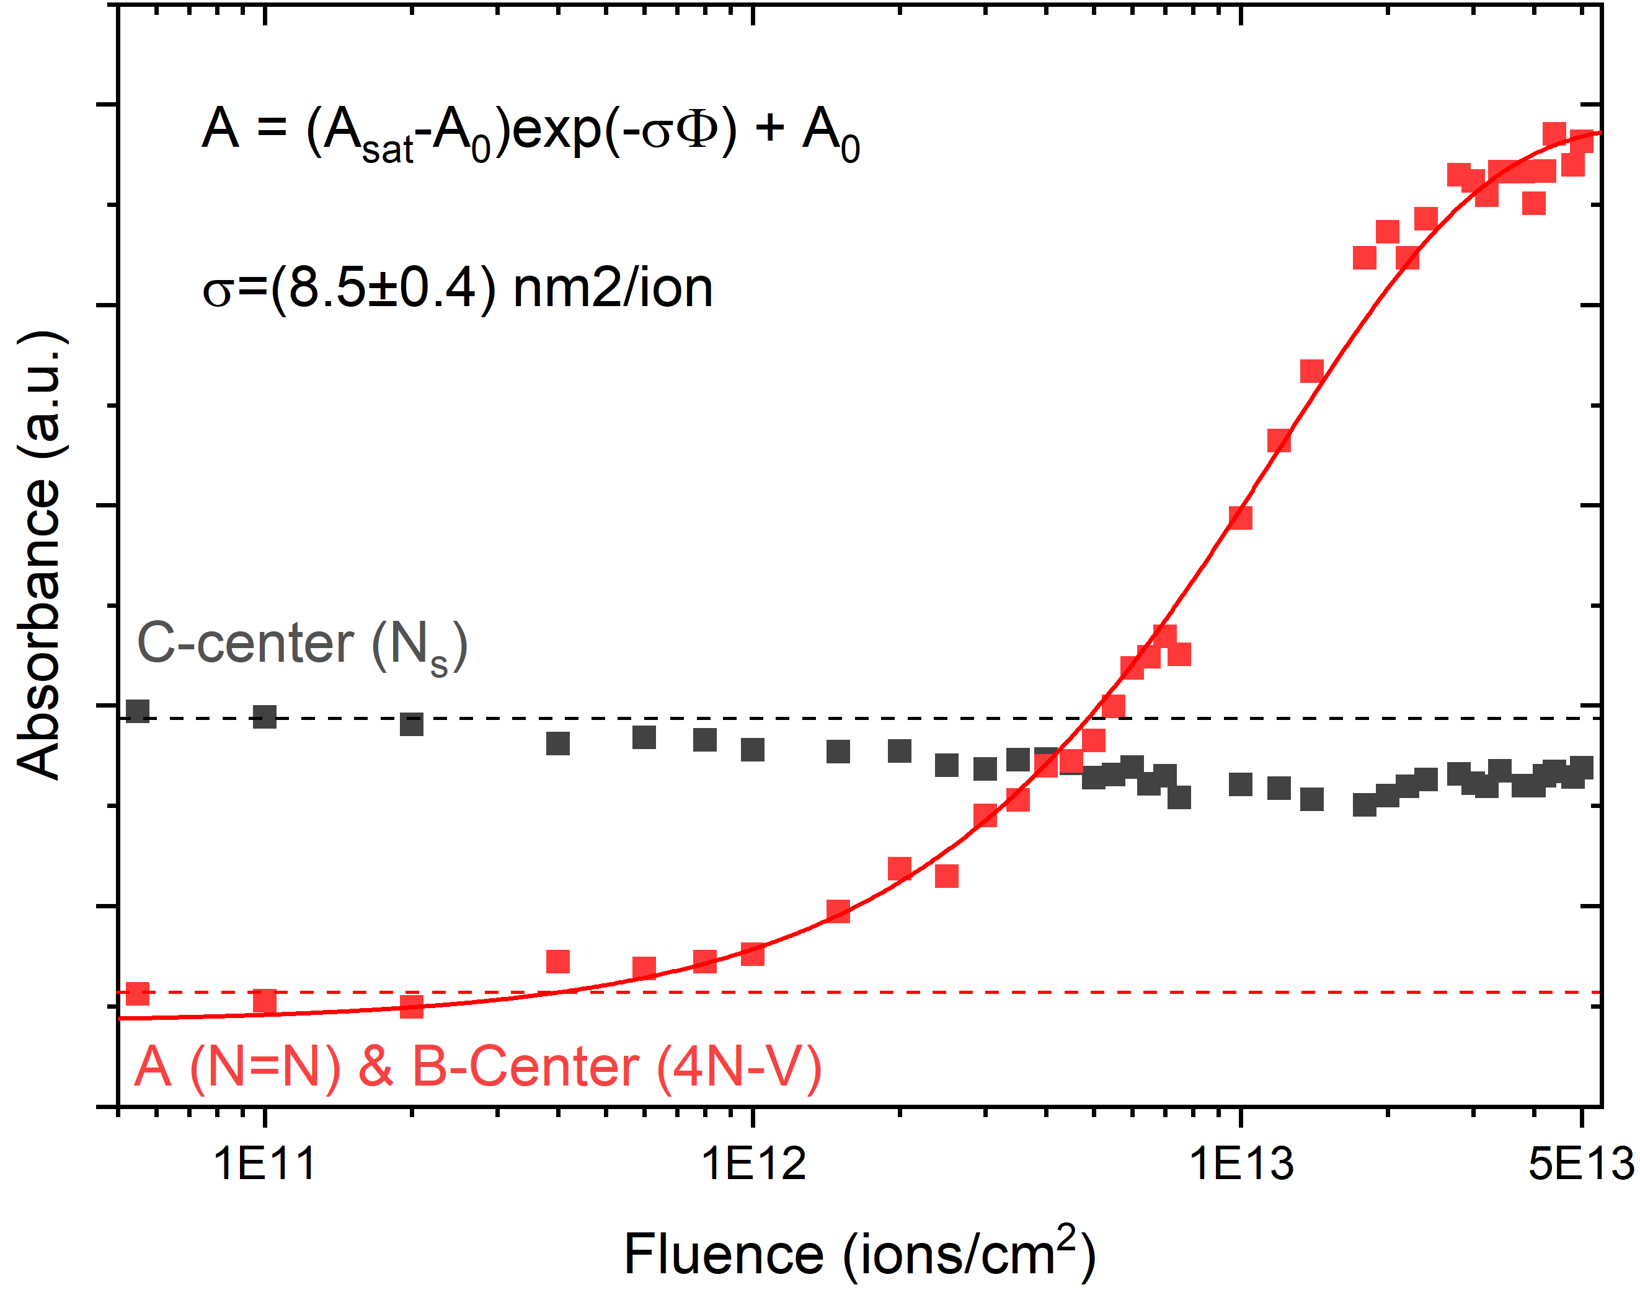
FT-IR spectroscopy of irr. diamond
1344 cm⁻¹: C-center (N_{s})
1282 cm⁻¹: A-center (N=N)
1280 cm⁻¹: B-center (4N=V)
Tracking of radiation-induced defect dynamics
C-center signal almost constant
  Dominated by non-irradiated volume
A&B center signal increases with fluence
  Damage cross-section:
  (8.5±0.4) nm²/ion

Slide 19
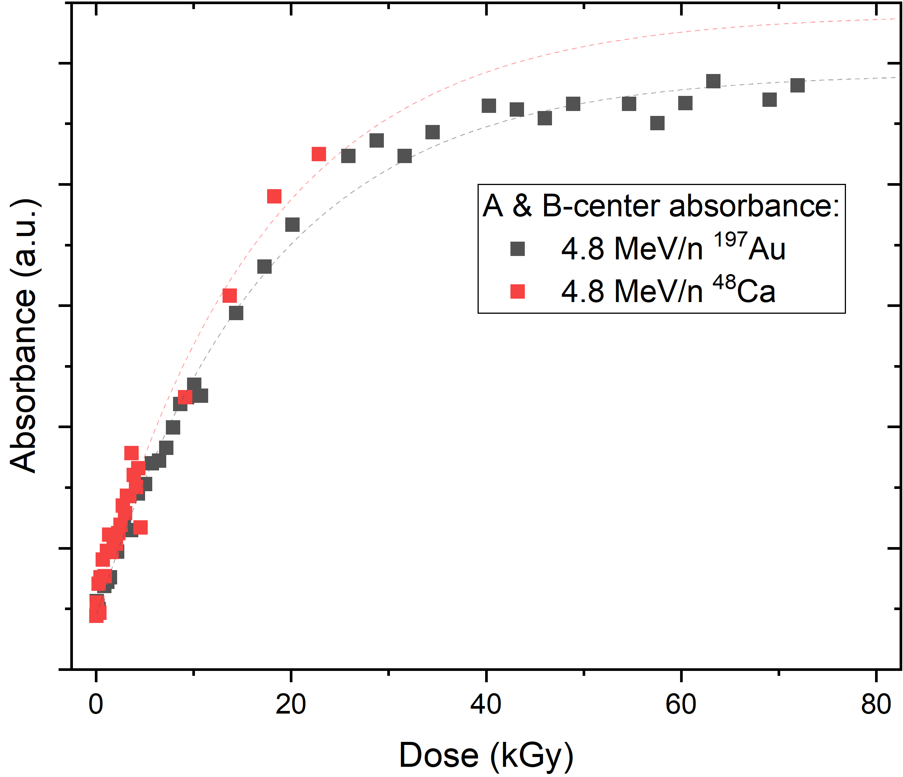
FT-IR spectroscopy of irr. diamond
1344 cm⁻¹: C-center (N_{s})
1282 cm⁻¹: A-center (N=N)
1280 cm⁻¹: B-center (4N=V)
Tracking of radiation-induced defect dynamics
C-center signal almost constant
  Dominated by non-irradiated volume
A&B center signal increases with fluence
  Damage cross-section:
  (8.5±0.4) nm²/ion
No effect of beam-induced macroscopic temperature!
Similar effect as annealing >1600°C & >5 GPa for several hours!

Slide 20
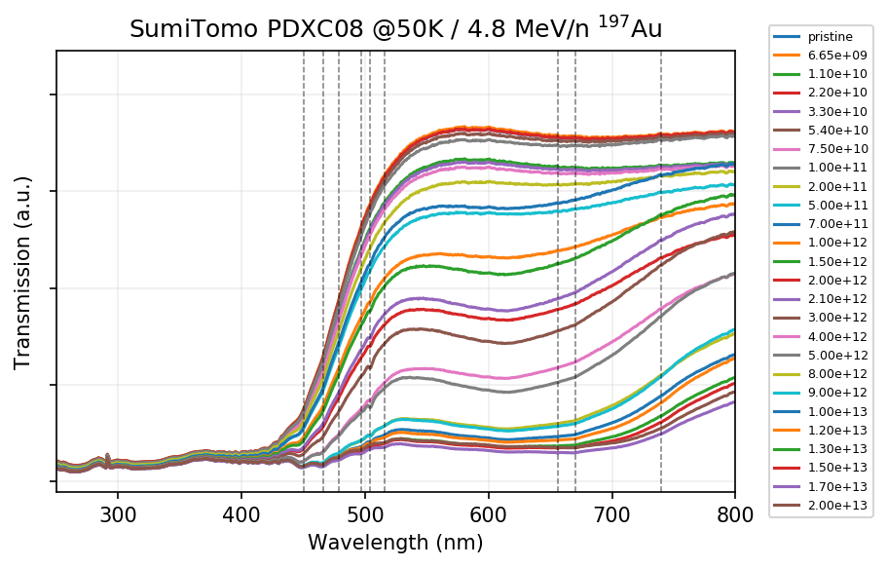
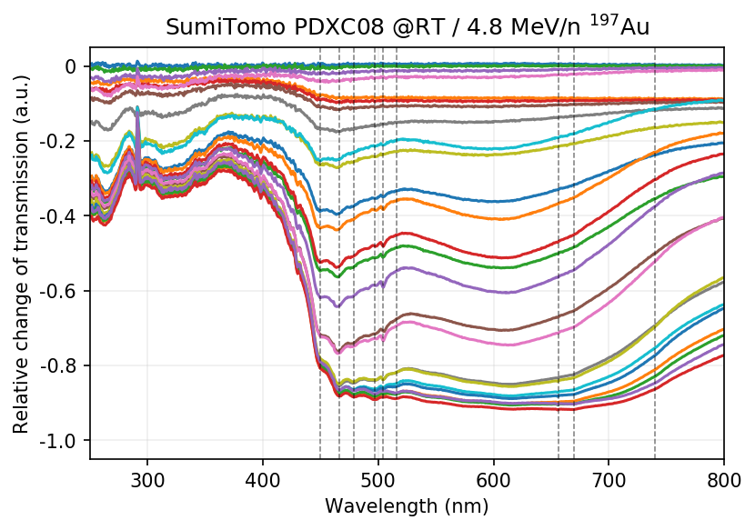
In-situ UV/c absorption spectroscopy
ND1 (V⁻)
Irradiation and measurement at both RT and 50 K
Dramatic decrease in transmission
  Already 30-40% loss of transmission at 1×10¹² (>450 nm)
Several absorption lines of color centers can be identified, mostly intrinsic
3H / H3 (N-V-N)

Slide 21
Summary
IL signal drops down to 5% of initial signal with irradiation
Optical camera shows change of main emission from „green“ to „blue“
  Beam diagnostic cameras operate with a narrow filter
FT-IR shows that complex non-luminescent nitrogen defects are forming
Intrinsic degradation of transmission by irradiation
  Additional process that degrades IL signal
IL signal of diamond excited by swift heavy-ions might be an intrinsic process
  Implications for potential optimization of the diamonds?

