Slide 1
R&D on Flux Concentrator and NC solenoid
Pavel Martyshkin
Budker Institute of Nuclear Physics,
Novosibirsk

Slide 2
Target simulation
  positron production ratio
  mean power deposition
  peak energy deposited density
FC optimization together with conversion target
  longitudinal field profile
  transverse field profile
DC solenoid simulation
  bridge coil optimization
  longitudinal field profile optimization

Slide 3
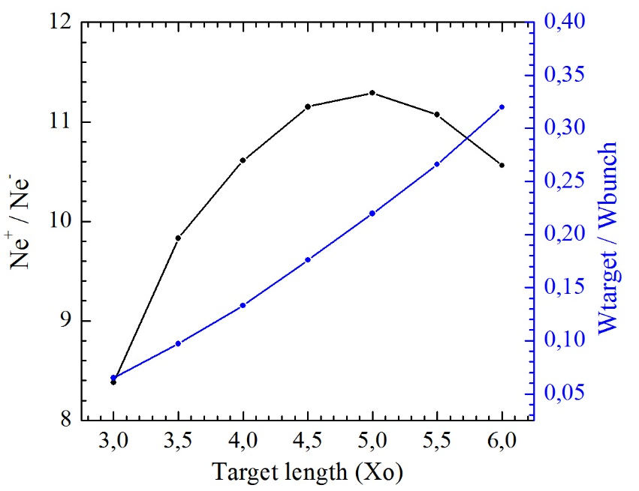
Incident electron bunch energy is 4.5 GeV
e⁻ bunch charge | e⁻ bunch population | power in e⁻ bunch | heat target power 200 pps
2x6.7 nC | 2x4.2∙10¹⁰ | 2x30 J | 2.1 kW
Total positron conversion ratio for W₇₄R₂₆ alloy target different thickness (left) and total power deposition in target material (X_{O} is a radiation length).

Slide 4
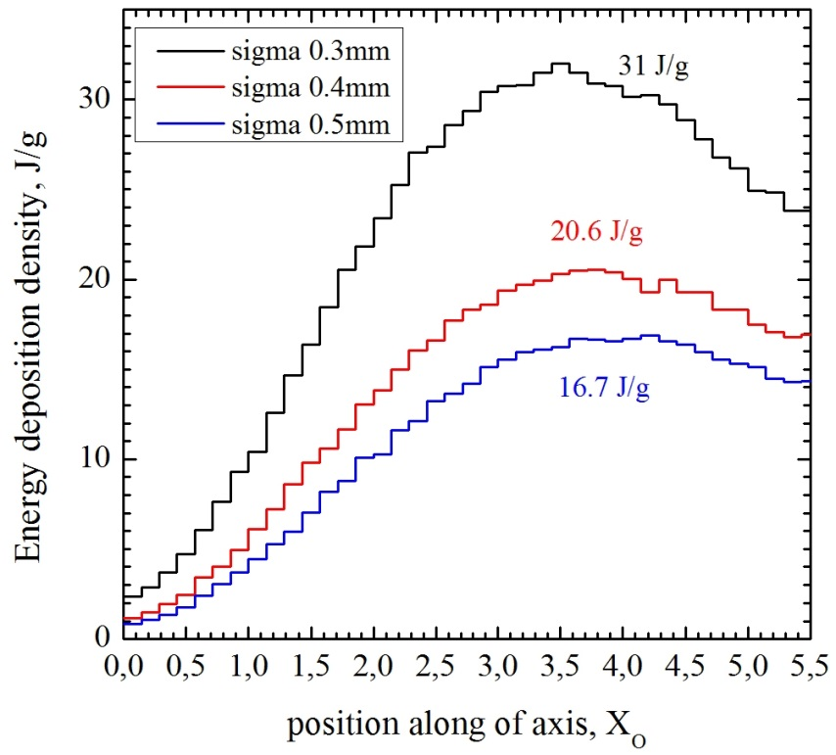
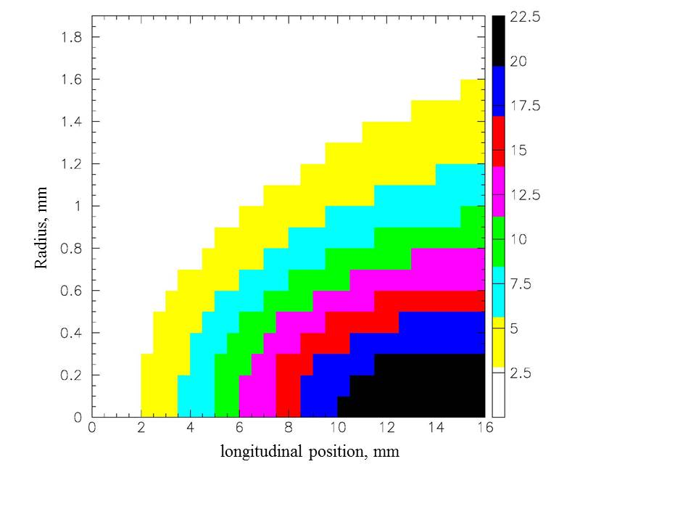
W₇₄R₂₆ alloy peak energy deposited density surviving limit is 35 J/g
2D color plot of energy deposition density (J/g) in a W₇₄R₂₆ alloy cylinder. Transverse size of incident electron beam (σ) is 0.4 mm

Slide 5
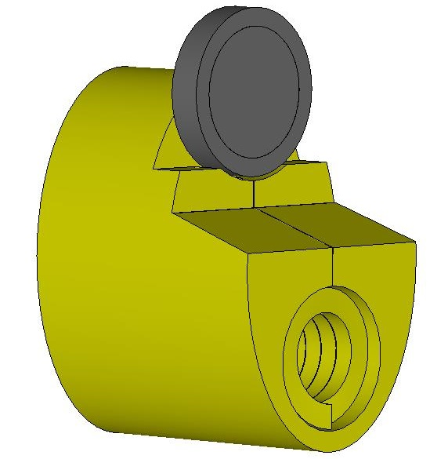
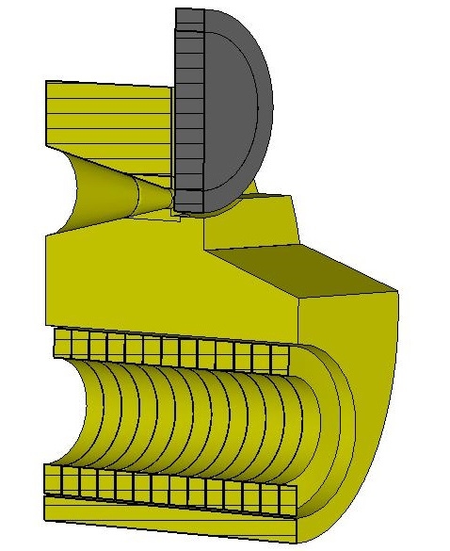
FCC-ee FC Computer model with a positron production target
Elliptical cylinder 120x180 mm
Total length is140 mm
Conical part length is 70 mm
Min cone diameter is 8 mm
Max cone diameter is 44 mm
Cone angle is ≈29 degrees
Cylindrical hole diameter is 70 mm
Coil has 13 turns
Current profile is a half of sine with a pulse length of 25 µs
Peak current is ~ 20 kA (peak field is 7 Tesla)
Gap between coil turns is 0.4 mm
Gap between coil and FC body is 1 mm
Turns size is 9.6x14 mm
Target (W74Re26) diameter is 90 mm, thickness is 15.8 mm
Gap between target and FC front face is 2mm

Slide 6
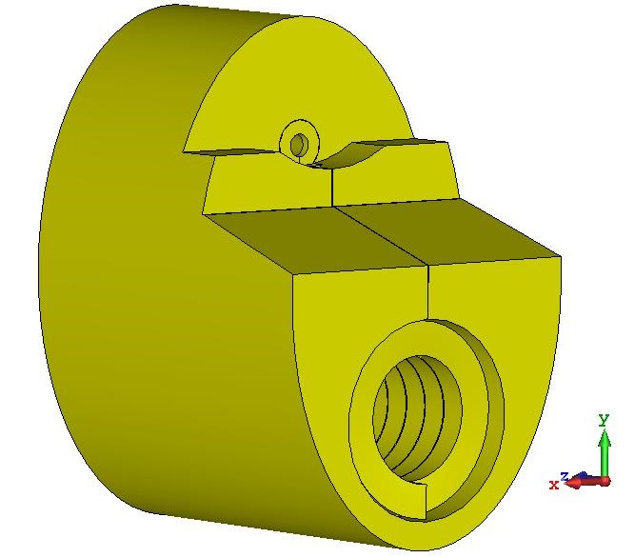
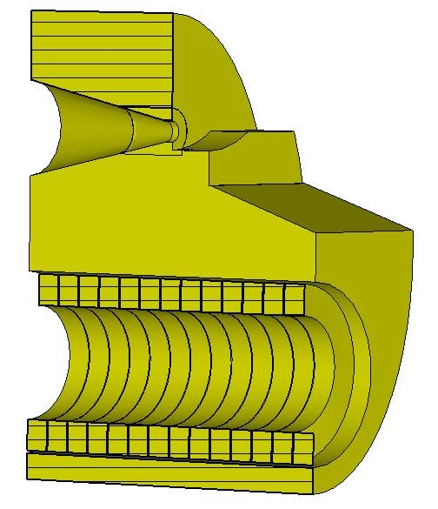
FCC-ee FC Computer model with a positron production target
Elliptical cylinder 120x180 mm
Total length is140 mm
Conical part length is 70 mm
Min cone diameter is 8 mm
Max cone diameter is 44 mm
Cone angle is ≈29 degrees
Cylindrical hole diameter is 70 mm
Coil has 13 turns
Current profile is a half of sine with a pulse length of 25 µs
Peak current is ~ 20 kA (peak field is 7 Tesla)
Gap between coil turns is 0.4 mm
Gap between coil and FC body is 1 mm
Turns size is 9.6x14 mm
Target (W74Re26) diameter is 90 mm, thickness is 15.8 mm
Gap between target and FC front face is 2mm

Slide 7
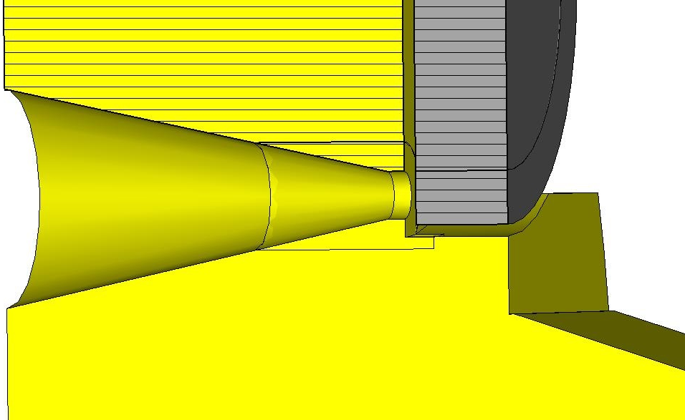
Geometry Variations of
FCC-ee FC Computer model
‘0’ position
Model #1 grooving gap is 2 mm, gap between FC front face and target is 2 mm
Model #2 grooving gap is 2 mm, gap between FC front face and target is 3 mm
Model #3 grooving gap is 2 mm, gap between FC front face and target is 4 mm
Model #4 grooving gap is 3 mm, gap between FC front face and target is 4 mm
Model #5 grooving gap is 4 mm, gap between FC front face and target is 4 mm

Slide 8
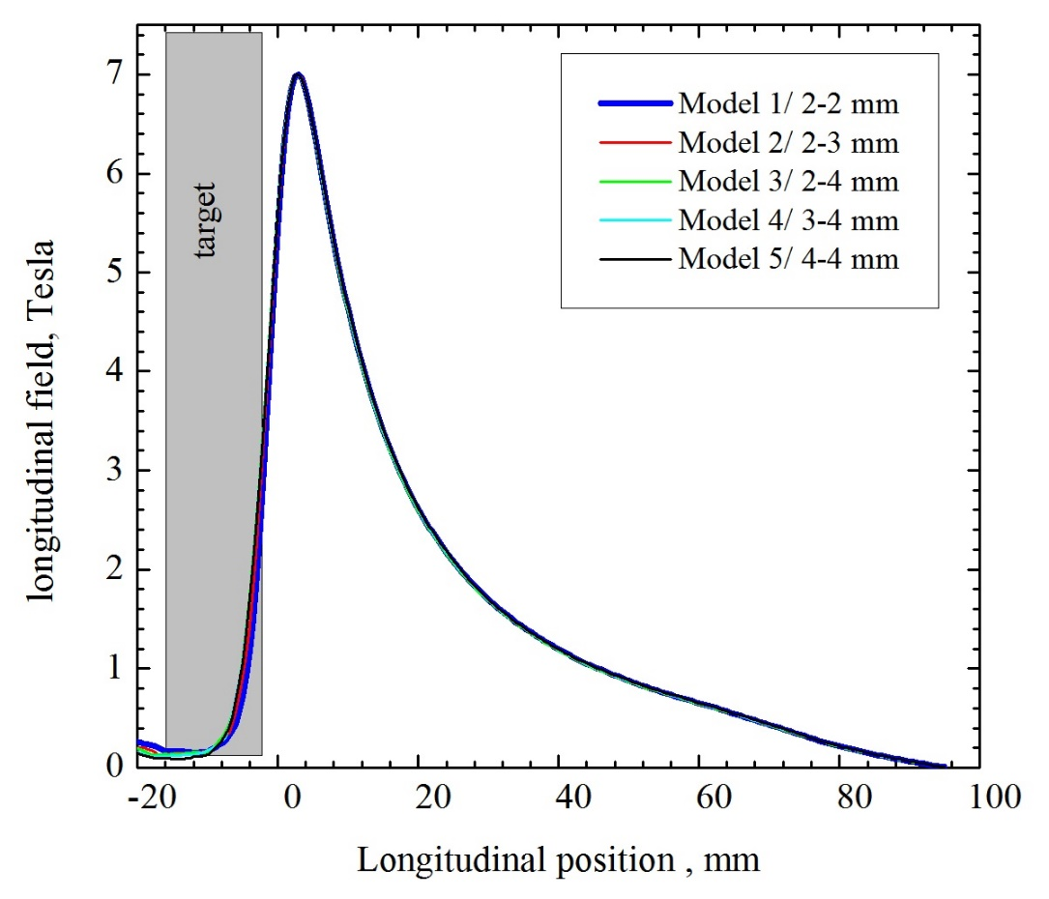
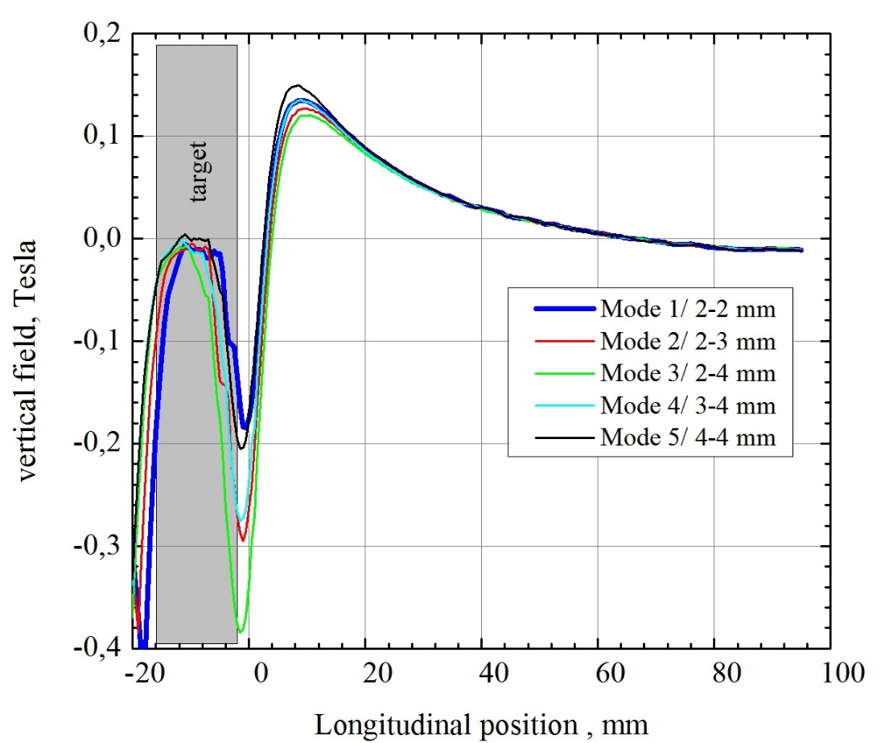
Field profiles on FC axis
Model #1 grooving gap is 2 mm, gap between FC front face and target is 2 mm
Model #2 grooving gap is 2 mm, gap between FC front face and target is 3 mm
Model #3 grooving gap is 2 mm, gap between FC front face and target is 4 mm
Model #4 grooving gap is 3 mm, gap between FC front face and target is 4 mm
Model #5 grooving gap is 4 mm, gap between FC front face and target is 4 mm

Slide 9
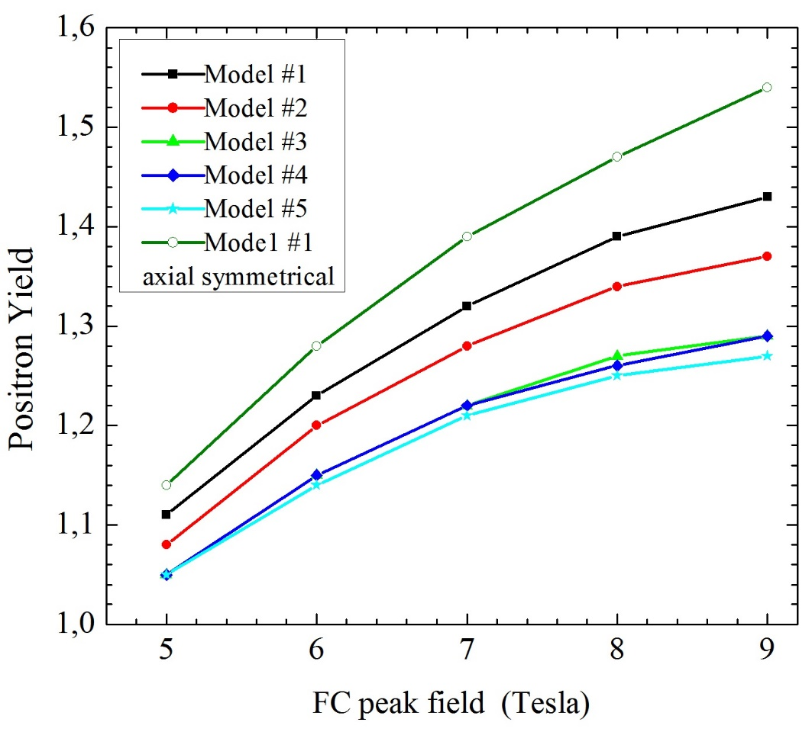
Positron yield at solenoid exit ( e+ energy ~190MeV)
Solenoid field 0.7 Tesla
Electron spot size (σ) 0.5 mm
Electron bunch length(σ) 2 mm
Acceleration structure diameter 30 mm
Acceleration gradient 20 MeV/m
RF frequency 2856 MHz
Number of accelerating structures 3
Model #1 grooving gap is 2 mm, gap between FC front face and target is 2 mm
Model #2 grooving gap is 2 mm, gap between FC front face and target is 3 mm
Model #3 grooving gap is 2 mm, gap between FC front face and target is 4 mm
Model #4 grooving gap is 3 mm, gap between FC front face and target is 4 mm
Model #5 grooving gap is 4 mm, gap between FC front face and target is 4 mm

Slide 10
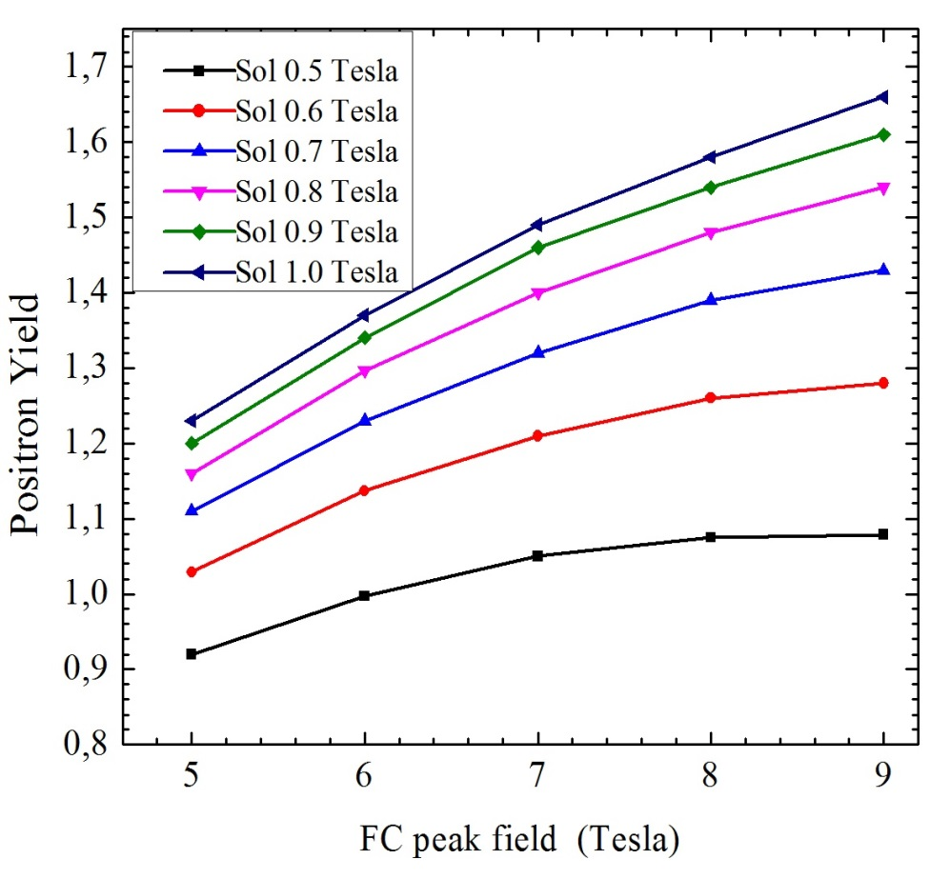
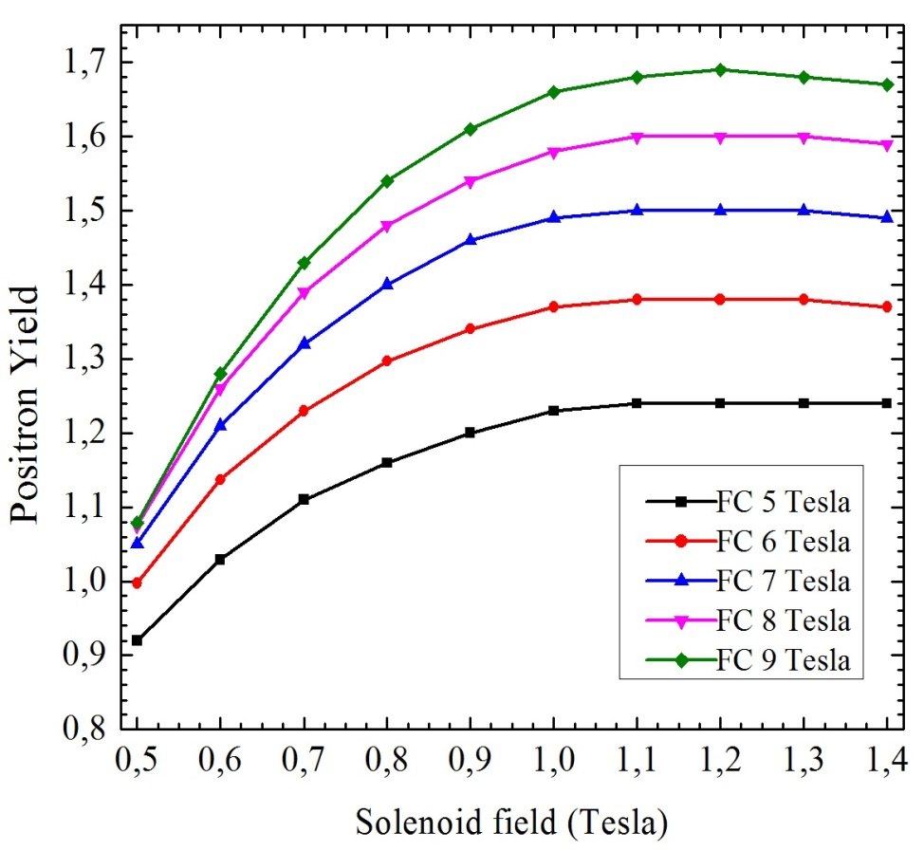
Positron yield after solenoid (e+ energy ~ 190MeV, FC Model #1)
Electron spot size (σ) is 0.5 mm
Acceleration structure diameter is 30 mm

Slide 11
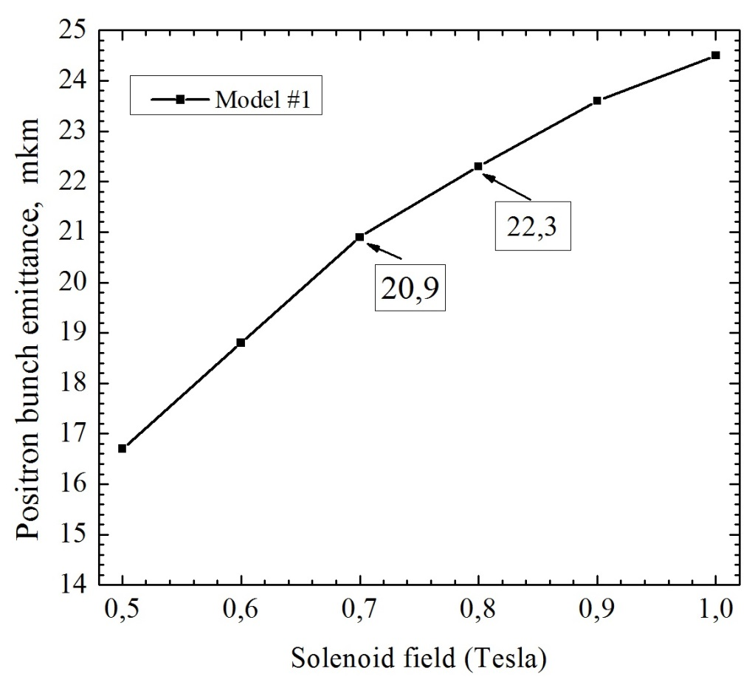
RMS positron bunch emittance at solenoid exit with solenoid field variation
(e+ energy ~ 190MeV)
Electron bunch spot size (σ) is 0.5 mm
Acceleration structure diameter is 30 mm
Emittance value doesn’t depend from FC peak field

Slide 12
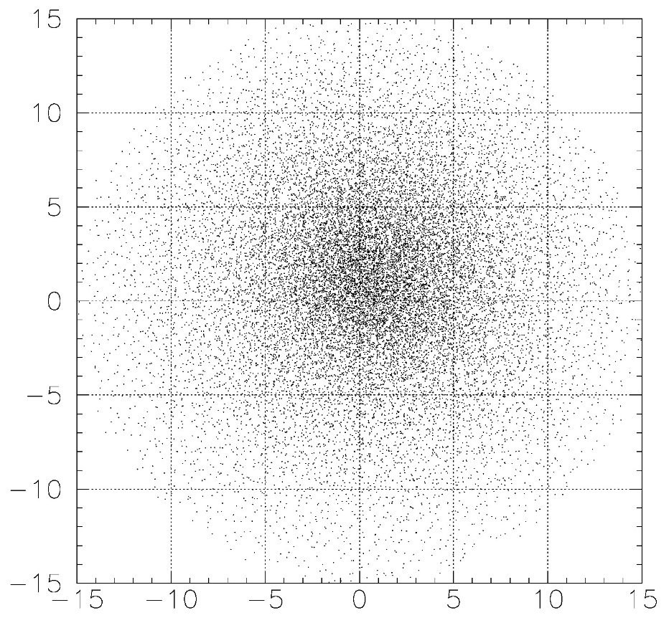
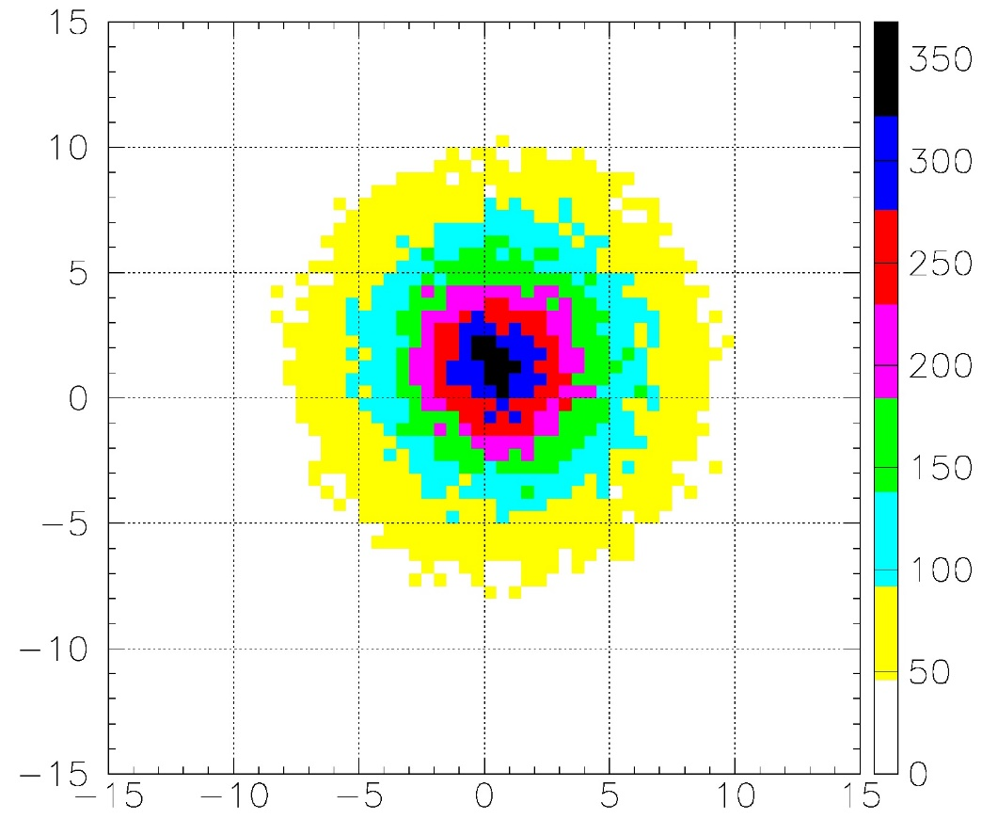
Positron bunch size at solenoid exit
(0.8 Tesla, e+ energy ~ 190MeV, FC Model #1)
FC peak field is 7 Tesla
Solenoid field is 0.8 Tesla
RMS size is ~ 4.8 mm
Horizontal offset is ~ 0.6 mm
Vertical offset is ~ 1.2 mm
Y(mm)
Y(mm)
X(mm)
X(mm)

Slide 13
Accelerating structure size parameters
308
308
63
2901
63
2901
63
2901
63
2901
3027
3027
3027
3027

Slide 14
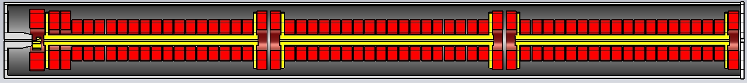
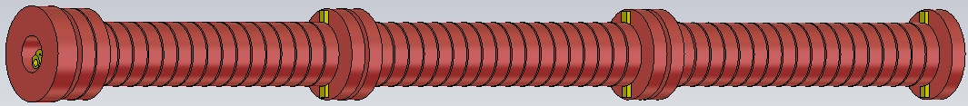
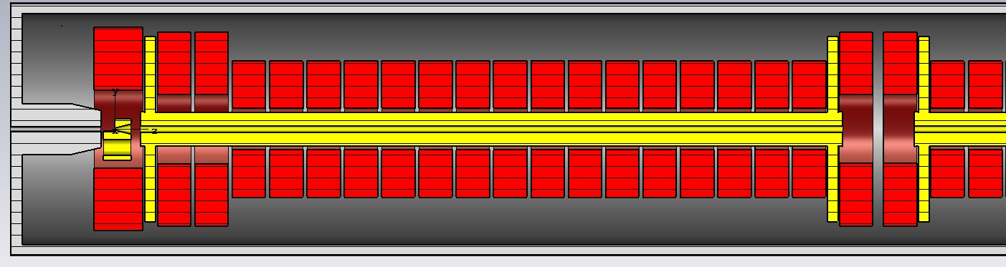
NC Solenoid and accelerating structures layout

Slide 15
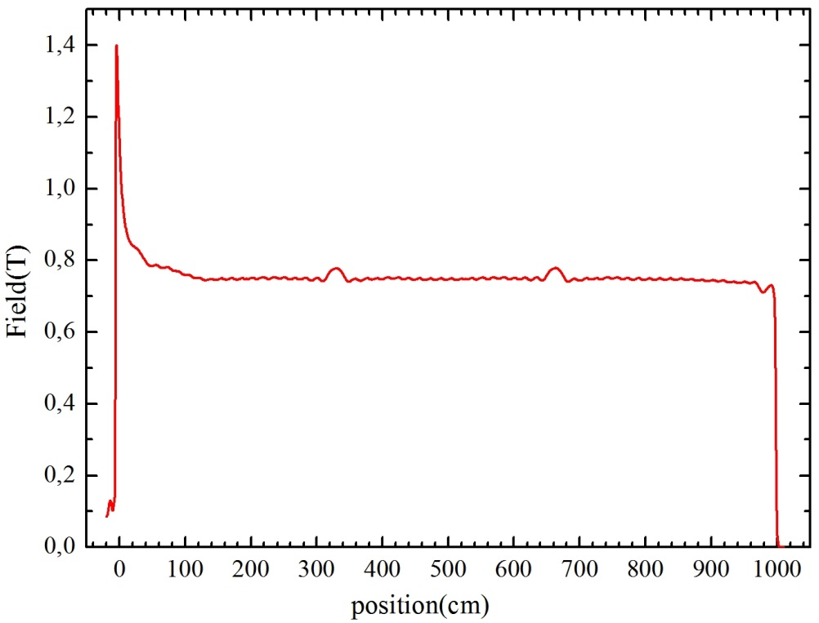

Slide 16
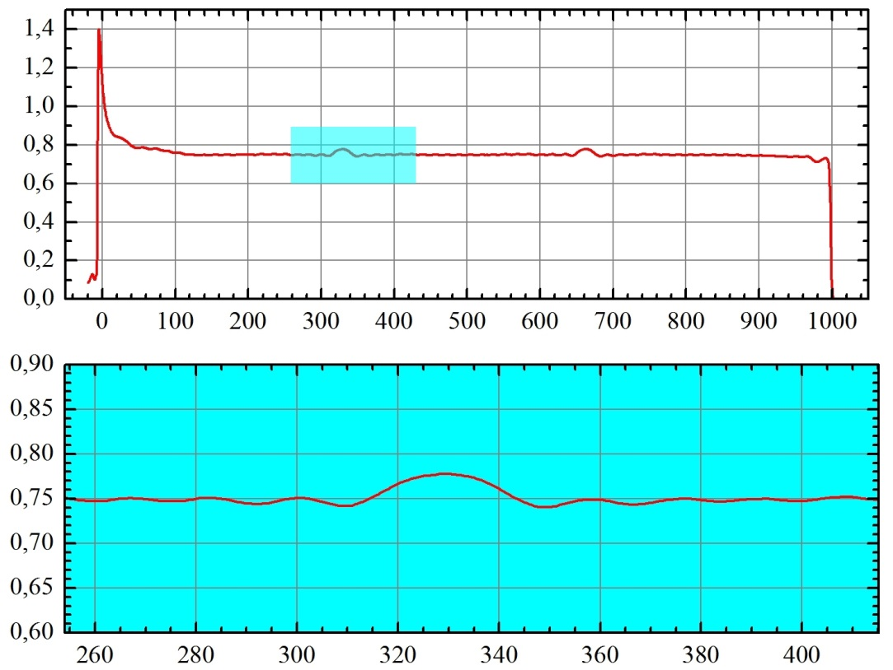

Slide 17
BC
C1-1
C1-3
C1-10
C1-18
C2-1
C2-10
C2-18
C3-1
C3-10
C3-18
C1-2
C1 C2
C3 C4
C5
Coil # | I×N, kA•turn | Turns number | Dint, mm | Dext, mm | Coil width, mm
C1-3÷C1-18, C2-1÷C2-18, C3-1÷C3-18 | 96 ~1 kA/turn | 96 (8×12 layers) (16×16 mm) | 180 | 590 | 144
C1-1,C1-2, C1,C2,C3,C4,C5 | 128 1 kA/turn | 128 (8×16 layers) (16×16 mm) | 300 | 840 | 144
BC | 192 1.15 kA/turn | 192 (12×16 layers) (16×16 mm) | 340 | 880 | 214

