Slide 1

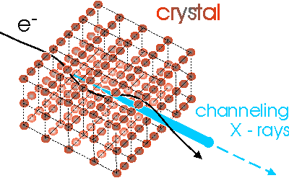
Reoptmization of the crystal for Hybrid scheme @FCC-ee.
L. Bandiera
INFN Ferrara
Physics design of the positron target and capture system - meeting
16/07/2020

Slide 2
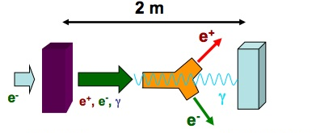
Hybrid crystal based positron source for FCC-ee
Thin crystal radiator (thickness< X₀)
(to limit the heating)
Amorphus converter target
Idea of R. Chehab, V. Strakhovenko and A. Variola, NIM B 266 (2008) 3868

Slide 3
Crystal based positron source
Main advantages
  Enhancement of photon generation in crystals in channeling conditions ➔ enhanchement of pair production in the converter target
  High rate of soft photons ➔ creation of soft positrons easily captured in matching systems.
Open questions:
  Define the best e-beam and target parameters
  Crystal radiator quality
  Target resistance

Slide 4
Crystal based positron source
Main advantages
  Enhancement of photon generation in crystals in channeling conditions ➔ enhanchement of pair production in the converter target
  High rate of soft photons ➔ creation of soft positrons easily captured in matching systems.
Open questions:
  Define the best e-beam and target parameters
  Crystal radiator quality
  Target resistance
We can contribute to these tasks:
Realistic Monte Carlo simulations:
  Collaboration with INP Minsk
  (V. Tikhomirov);
Feasibility tests;
Crystals purchase and characterization.

Slide 5
Tests on beam
We have a long experience in carring out experiments on Channeling Radiation in different laboratories worldwide (CERN SPS&PS, SLAC, MAMI, DESY..), providing the necessary equipment for possible future tests:
Setup: detectors, DAQ etc..;
High-precision goniometer for crystal orientation with the beam;
Crystals and their characterization;
Simulation and data analysis.

Slide 6

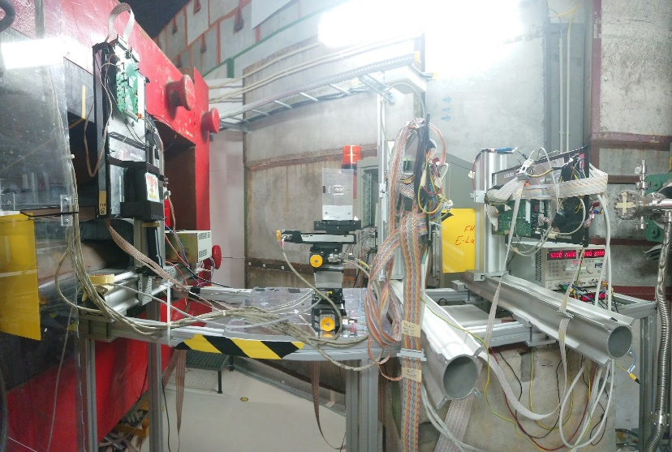
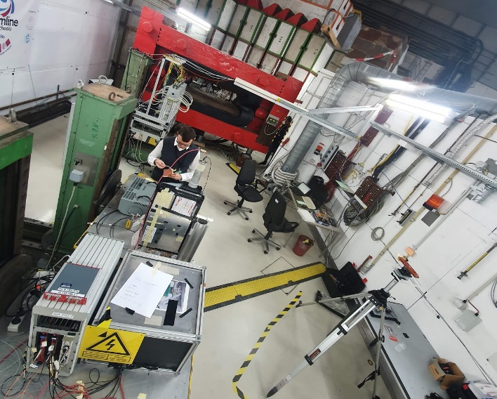
Tests on beam
To check our Monte Carlo simulation for positron source we carried out a test beam @DESY TB in 2019
Si tracking
magnet (charged/neutral separation)
em calorimeter
e⁻ beam
@5.6 GeV
W crystal on a goniometer
Axis <100>; 2.25 mm (< X₀);
Multiplicity counter
(Scintillator + Si large area)
Preshower to measure the photon enhancement

Slide 7
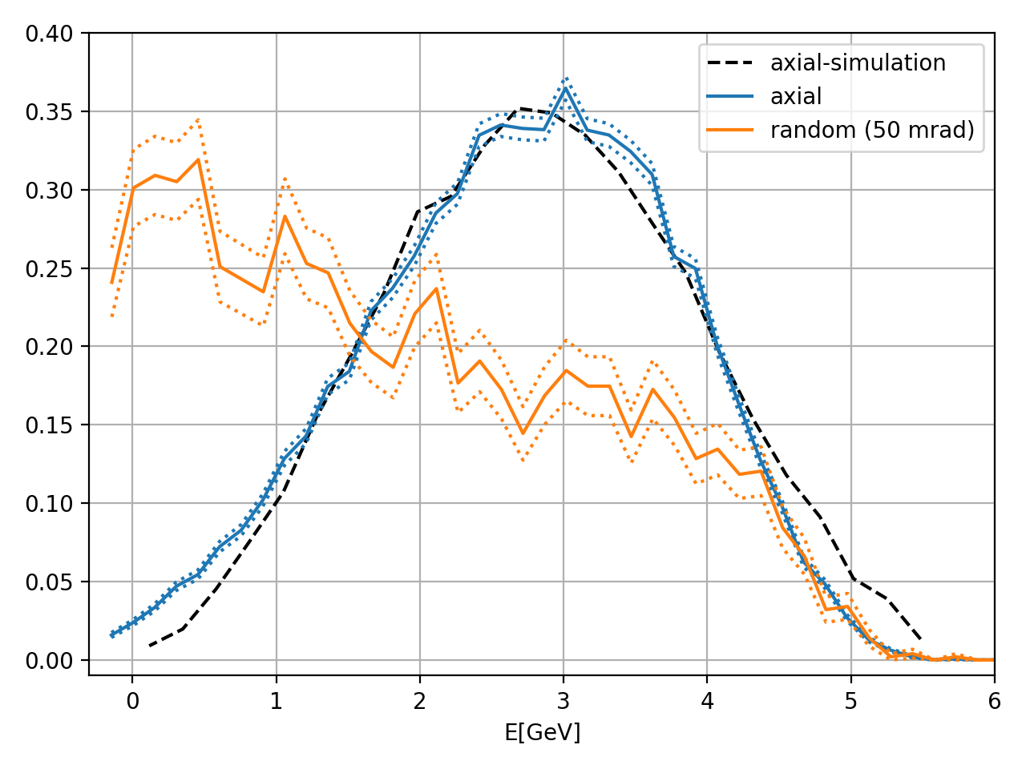
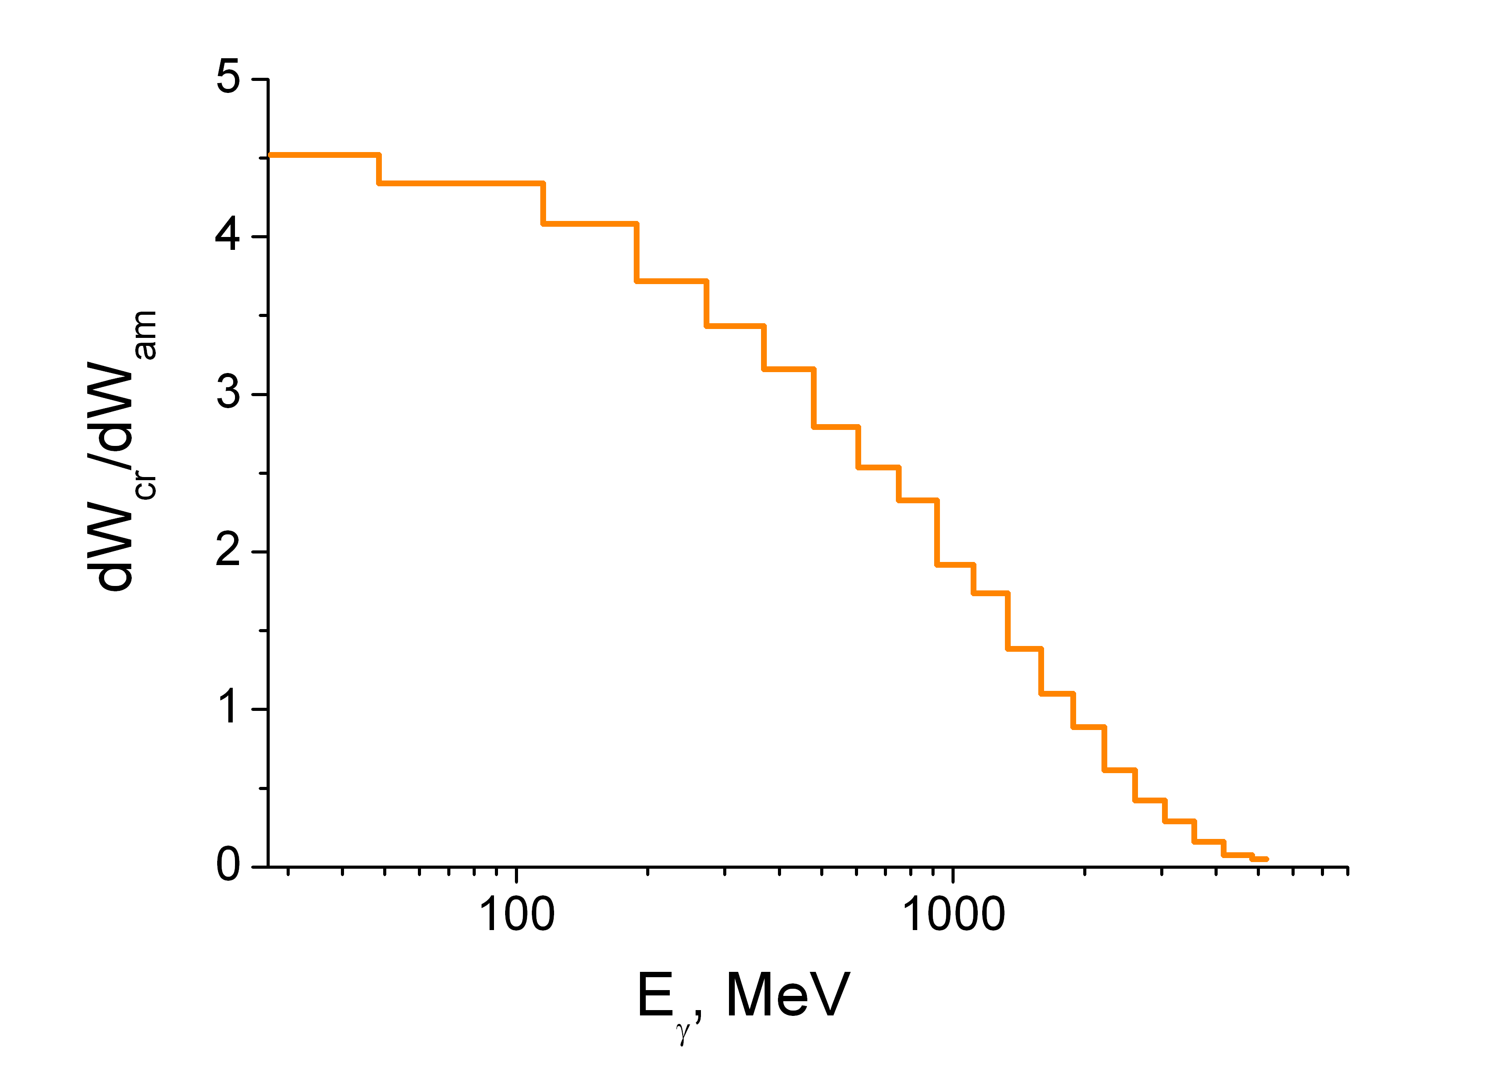
Tests on beam
Radiative energy loss in axial channeling collected at the calorimeter
Simulated
photon enhancement
The setup can be modified for future tests @CERN SPS (18.5 GeV) or @DESY TB(4.5 GeV) to validate the used model and as feasibility tests.
@18.5 GeV, harder photons emission in strong field regime may occur, but also pair production enhancement in case of exploiting the crystal as conventional target. For the hybrid scheme,one may also consider to exploit lower Z crystals-> need of MC simulations!

Slide 8
THANK YOU FOR THE ATTENTION!

